Slide 1
e-handout
To have these notes
without taking notes
Go to OrHaOlam.com
Click on downloads,
messages, 2019

Slide 2
"I don't roll a joint...
but when I do it's usually my ankle!"
Notes:
Jean Robison

Slide 3
Summary last week of warning based outline of Hebrews letter
Five Warnings
Violation / Consequences
Mercy: physical and spiritual, weaponry and husbandry

Slide 4
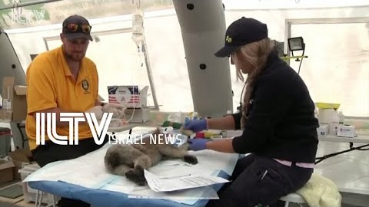
Israeli husbandry of koalas
Notes:
Israelis saving Koalas https://youtu.be/IhDc7H3T9aE
Another current topic…

Slide 5
“Deal of the Century” Flips Peace Process on Its Head
After 20 years of requiring painful concessions of Israel, it’s now the Palestinians’ turn.
Notes:
https://www.israeltoday.co.il/read/trump-deal-of-the-century-flips-peace-process-on-its-head/?utm_source=acfs&utm_medium=email&utm_campaign=newsletter-2020-01-29

Slide 6
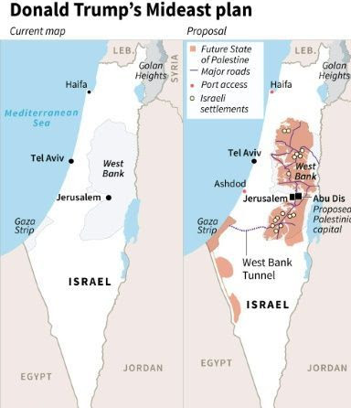

Slide 7
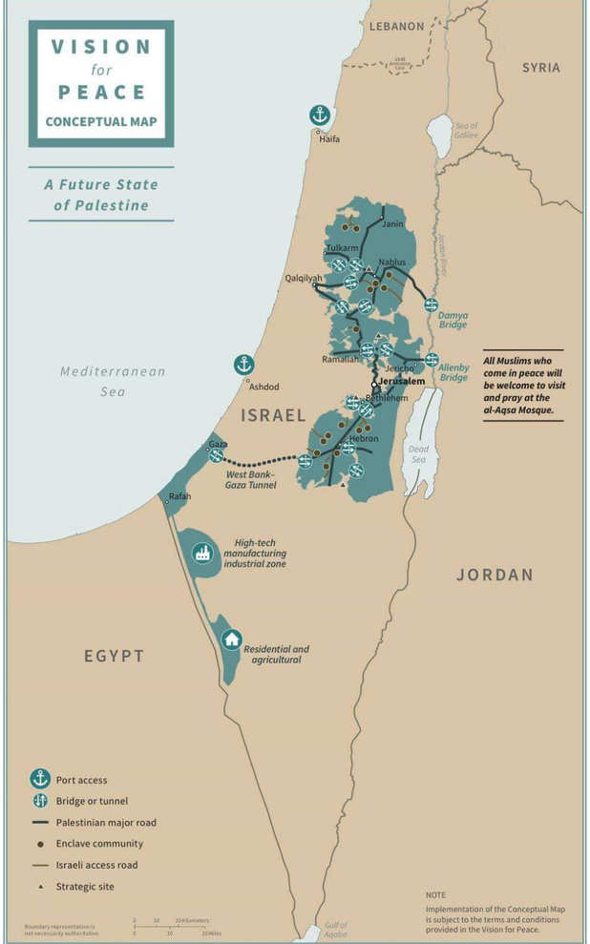
Notes:
https://www.israeltoday.co.il/read/trump-deal-of-the-century-flips-peace-process-on-its-head/?utm_source=acfs&utm_medium=email&utm_campaign=newsletter-2020-01-29

Slide 8
Israel gets:
Full security control over sea, land, air and electromagnetic space west of the Jordan River, including those areas that are part of a Palestinian state;
Full security control over all border crossings;
Hamas and all other independent Palestinian militias will be fully disarmed;
Notes:
Not going to read all, but highlight some dramatic issues. If you receive our emails, you’ll get notes.

Slide 9
Israel gets:
The Palestinian Authority will stop all payments to terrorists and their families;
The Palestinian Authority will cease incitement against Israel in its media and schools;
The Palestinians will recognize Israel as the Jewish state;
The Palestinians will waive the “right of return” for so-called Palestinian “refugees to sovereign Israel;
While the Temple Mount will remain under Muslim custodianship, people of all faiths will be permitted to pray there.

Slide 10
The Palestinians will get:
An independent Palestinian state on 70% of the West Bank and all of the Gaza Strip;
Two large parcels of land in the western Negev to compensate for the 30% of the West Bank annexed by Israel;
Dedicated highways connecting Gaza to the Negev enclaves, and a tunnel connecting the Palestinian state in the West Bank to the Gaza Strip;

Slide 11
Palestinians will get:
Some outlying neighborhoods in eastern Jerusalem enabling them to also claim the Holy City as their capital;
Access to the Israeli ports of Haifa and Ashdod;
Generous financial incentives including extensive trade agreements with Arab neighbors, Israel and the US to boost the economy of the future Palestinian state.

Slide 12

My reservations about the Trump plan concern its repeating and heightening the old, failed approach of promising the Palestinians benefits. No, they need to hear the deep truth that nothing good will happen until they give up their foul rejectionism.
Notes:
Mr. Pipes (DanielPipes.org, @DanielPipes) is president of the Middle East Forum. © 2020 by Daniel Pipes. All rights reserved.

Slide 13
Rather than hold out hope, it should paint a picture of despair. Failing this, the plan will end up as irrelevant as every prior presidential initiative.
Notes:
Mr. Pipes (DanielPipes.org, @DanielPipes) is president of the Middle East Forum. © 2020 by Daniel Pipes. All rights reserved.

Slide 14
Golda Meir said, "Peace will come when the Arabs will love their children more than they hate us."
Notes:
That’s what I think

Slide 15
Letter to the
Messianic Jews/ Hebrews
1.1 to 1.3
Messiah the Cohen [priest]

Slide 16
Outline of this message
G-d’s past revelation of Himself
G-d current revelation of Himself in the face of Messiah.
How that applies to our lives.

Slide 17
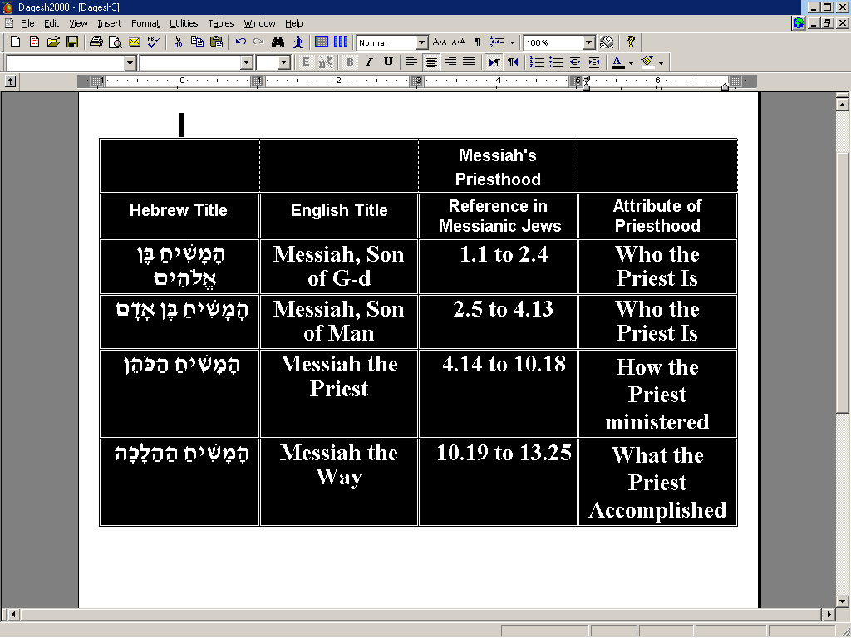
Notes:
You may wonder why Hebrew language so much here.
Feeling to it. Call it anointing.
One of our youth who made Aliyah, served well in the IDF said about coming to Israel: something strong, covenantal
Authority to it
“highly nuanced”

Slide 18
  ^{Mes. Jews/Heb. 1.1-3} At many times and in many ways, God spoke long ago to the fathers through the prophets. In these last days He has spoken to us through a Son, whom He appointed heir of all things and through whom He created the universe.

Slide 19
  ^{Mes. Jews/Heb. 1.1-3} This Son is the radiance of His glory and the imprint of His being, upholding all things by His powerful word. When He had made purification for our sins, He sat down at the right hand of the Majesty on high.
Notes:
[prayer]

Slide 20
Phrase by phrase unpacking

Slide 21
Many times and in various ways
Voice to Noah, Avraham bat kot בַּת קוֹל
Dreams
Mt. Sinai revelation: shofar, earthquake, lightning
Prophets

Slide 22
Written Torah [Ro 3 chiefly this]
Mishkan/Tabernacle: cloud and fire
Shekhinah שְׁכִינָה Presence
covenants
Notes:
Why Jews are stereotyped as rich?

Slide 23
Many times and in various ways

Slide 24
Rabbi Shaul: ^{Ro 9.4-5} Isra'el!
They were made God's children,
the Sh'khinah has been with them,
the covenants are theirs,
likewise the giving of the Torah,
The Temple service and the promises;
the Patriarchs are theirs
Notes:
many times and in various ways

Slide 25
A major purpose of this letter is to show that Yeshua and everything connected with him are better than what was available previously. He uses this word, "better," twelve times in Messianic Jews to compare the Messiah and His era with what there was before.

Slide 26
Outline of this message
G-d’s past revelation of Himself
G-d current revelation of Himself in the face of Messiah.
How that applies to our lives.

Slide 27
^{Mes. Jews/Heb. 1.1-3} But in these last days he has spoken to us by his Son,
^{Yn 17.24} Father…You loved Me before the foundation of the world.
^{Beresheet/Gen 22.2} "Take your son, your only son, whom you love,
קַח-נָא אֶת-בִּנְךָ אֶת-יְחִידְךָ אֲשֶׁר-אָהַבְתָּ
Notes:
Intensity of love descriptors
Sonship: communicates life
My dad ~1000 words, mostly anger
With each of my kids lunch/week.
Die for son or daughter
G spoke through His son.

Slide 28
  ^{Mes. Jews/Heb. 1.1-3} whom he appointed heir of all things, and through whom he made the universe.
Notes:
Owner of the universe
Designer Logos, Davar, equations.
Better than Moshe

Slide 29
^{Col 1.15-17} They have all been created through him and for him. He existed before all things, and he holds everything together.

Slide 30
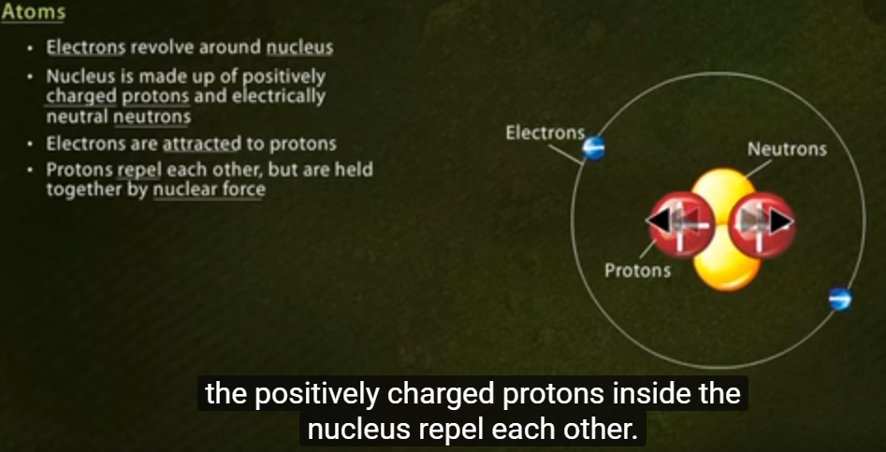
^{Mes. Jews/Heb. 1.1-3} sustaining all things by his powerful word

Slide 31
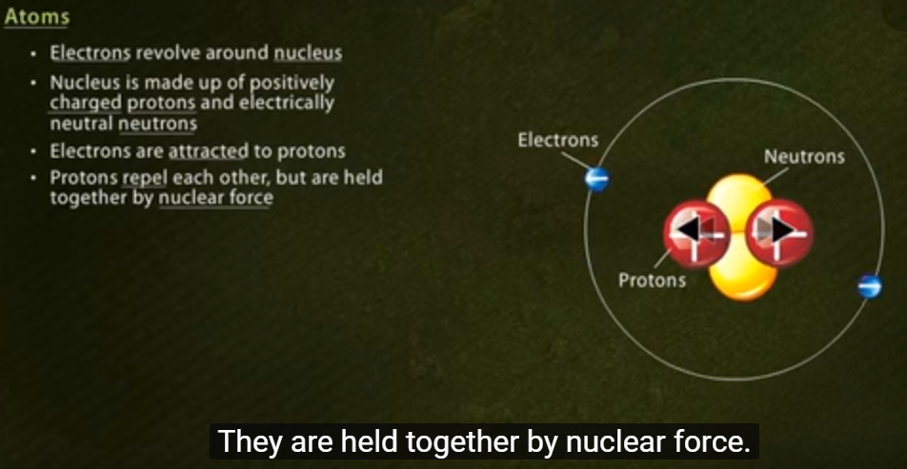
Notes:
Bit of a mystery to this force. Overcomes electromagnetic repulsion, only at close distances.

Slide 32
The nuclear strong force is about 137 times as strong as electromagnetism and 10³⁸ (100 undecillion) times as strong as gravitation.
Yeshua IS the mysterious nuclear strong force.
Notes:
https://en.wikipedia.org/wiki/Strong_interaction

Slide 33
^{Col 1.15-17} they have all been created through him and for him. He existed before all things, and he holds everything together.

Slide 34
  ^{Mes. Jews/Heb. 1.1-3} The Son is the radiance of God's glory and the exact representation of his being,
Notes:
Owner of the universe
Designer Logos, Davar, equations.
Better than Moshe

Slide 35
^{Mes. Jews/Heb. 1.1-3} being the effulgence of his glory, and the very image of his substance, ^{ASV}
Solar flares

Slide 36
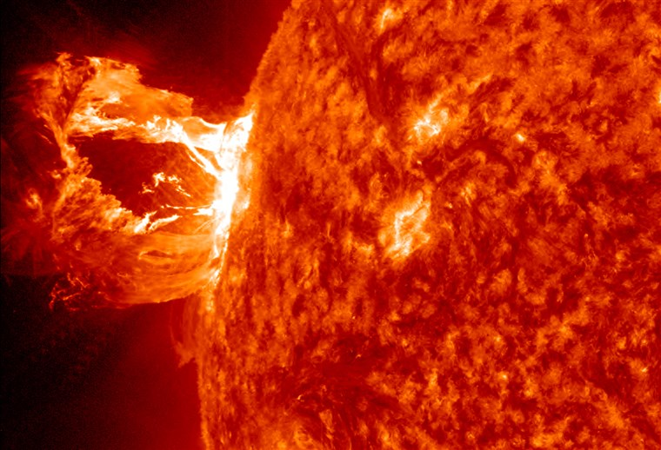
Notes:
Solar flares ARE the sun, same thermonuclear reaction happening. The texture you see on the sun’s surface are the edges of magnetic loops. Some break out in flares.

Slide 37
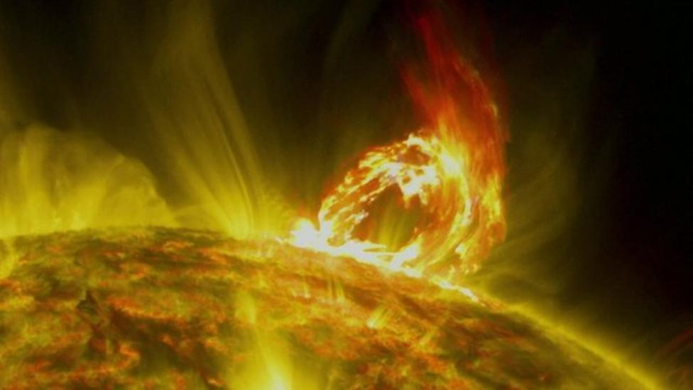
Notes:
Magnetic field and magnetic lines projecting out.
Jewish objection: a man can’t make himself G-d. Not the incarnation at all. G-d extending out.
Effulgence.

Slide 38

Aug. 21, 2017
Notes:
A bunch of us went to see the corona in the full eclipse of Aug. 2017. Prayed for clouds to dissipated, but only when blew shofars cleared up. Then torrential rain. Saw it.
Talking about seeing something MUCH more glorious.

Slide 39
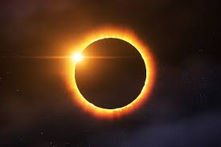

Slide 41
David Stern: This Son is the radiance of, literally, “the glory,” best rendered Jewishly as the Sh’khinah, which the Encyclopedia Judaica ^{(Volume 14, pp. 1349–1351)} defines as
“the Divine Presence, the numinous immanence of God in the world, … a revelation of the holy in the midst of the profane ….”
Notes:
Solar flare consumes all
This effulgence
Enlightens all
Convicts all of sinfulness
Redeems all

Slide 42
^{Encyclopedia Judaica} “One of the more prominent images associated with the Shekhinah is that of light. Thus on the verse, ‘ … the earth did shine with His glory’ (Ezekiel 43:2), the rabbis remark, ‘This is the face of the Shekhinah’ (Avot diRabbi Natan [18b–19a]; see also Chullin 59b–60a).

Slide 43
^{Encyclopedia Judaica} Both the angels in heaven and the righteous in olam ha-ba (‘the world to come’) are sustained by the radiance of the Shekhinah (Exodus Rabbah 32:4, B’rakhot 17a; cf. Exodus 34:29–35) ….

Slide 44
“According to Saadiah Gaon [882–942 c.e.], the Shekhinah is identical with kevod ha-Shem (‘the glory of God’), which served as an intermediary between God and man during the prophetic experience.

Slide 45
Saadia suggests that the ‘glory of God’ is the biblical term, and Shekhinah the talmudic term for the created splendor of light which acts as an intermediary between God and man, and which sometimes takes on human form.

Slide 46
Thus when Moses asked to see the glory of God, he was shown the Shekhinah, and when the prophets in their visions saw God in human likeness, what they actually saw was not God Himself but the Shekhinah.
Notes:
(see Saadiah’s interpretation of Ezekiel 1:26, 1 Kings 22:19, and Daniel 7:9 in Book of Beliefs and Opinions 2:10).”
The Jewish New Testament Commentary, (Clarksville, MD: Jewish New Testament Publications) 1996.

Slide 47
Moshe prayed: Show me your glory.
Hareni et kvodekha
הַרְאֵנִי נָא אֶת-כְּבֹדֶךָ.

Slide 48
^{Col 1.15-17} He is the visible image of the invisible God. He is supreme over all creation, because in connection with him were created all things — in heaven and on earth, visible and invisible, whether thrones, lordships, rulers or authorities —

Slide 49
Outline of this message
G-d’s past revelation of Himself
G-d current revelation of Himself in the face of Messiah.
How that applies to our lives.

Slide 50
A pillar of a believer’s life is how he / she perceives the welcoming face of Messiah.
Notes:
Key to this message

Slide 51
^{T’hillim / Ps 27.4} One thing have I asked of Adoni, that will I seek: to dwell in the House of Adoni all the days of my life, to behold the beauty of Adoni, and to meditate in His Temple.

Slide 52
^{T’hillim / Ps 90.16-17} Let Your work appear to Your servants, and Your splendor הֲדָרְךָ hadarkha [glory, splendor, majesty] on their children. Let the נֹעַם noam beauty [loveliness,kindness, pleasantness, charm] of Adoni our G-d be upon us.

Slide 53
Perceiving His face is the basis of the Aharonic blessing:

Slide 54
יָאֵר יְיָ פָּנָיו אֵלֶיךָ וִיחֻנֶּךָּ. יִשָּׂא יְיָ פָּנָיו אֵלֶיךָ וְיָשֵׂם לְךָ שָׁלוֹם.
^{Bamidbar/Nu 6.24-26} Adoni bless you and keep you! Adoni make His face to shine on you and be gracious to you! Adoni turn His face toward you and grant you shalom!’

Slide 55
^{2 Cor 4.6} For it is the God who once said, “Let light shine out of darkness,” who has made his light shine in our hearts, the light of the knowledge of God’s glory shining in the face of the Messiah Yeshua.

Slide 56
Seeing His face is the foundation of good.

Slide 57
^{Phil 3.7-8} The things that used to be advantages for me, I have, because of the Messiah, come to consider a disadvantage. Not only that, but I consider everything a disadvantage in comparison with the supreme value of knowing the Messiah Yeshua as my Lord.

Slide 58
His Face is the source of joy.

Slide 59
^{T’hillim/Ps 4.7-9} Many ask, “Who can show us some good?” Adoni, lift the light of your face over us!
You have filled my heart with more joy than all their grain and new wine. I will lie down and sleep in peace; for, Adoni, you alone make me live securely.
Notes:
Formula for overcoming sleeplessness:
Memorizing as bedtime is a powerful tool. You just take three of four words and recite them till they are embedded in memory. Then add the next three or four the next night. Cumulatively, you'll have a passage in a week!
That has three effects:
it's tiring mental labor that makes you sleepy,
it's the Word of G-d, so as your focus on it, you have insights that give shalom,
if there is any demonic influence that is affecting you, the demon sees that he's driving you to the Word, and will go away.
Psalm 3 and psalm 4 both discuss sleeping, and are GREAT for this.

Slide 60
“Without having seen him, you love him. Without seeing him now, but trusting in him, you continue to be full of joy that is glorious beyond words

Slide 61
Seeing His Face is the source motivation to conflict resolution.

Slide 62
^{Yn 17.3, 22-24} Eternal life is this: to know you, the one true God, and him whom you sent, Yeshua the Messiah… The glory which you have given to me, I have given to them; so that they may be one, just as we are one —
Notes:
Think of someone you are at odds with. How will you relate to that person if Messiah was in the room with you!

Slide 63
^{Yn 17.3, 22-24} I united with them and you with me, so that they may be completely one, and the world thus realize that you sent me, and that you have loved them just as you have loved me. “Father, I want those you have given me to be with me where I am;
Notes:
Reason we are promoting this Superbowl watch party on our sign, our website, our neighborhood forum, is that there may be people in the community who are curious, stirred by the Ruakh to come to Yeshua, but haven’t had the motivation to overcome spiritual inertia and check us out. This may be an easy “on ramp.” I’m hoping that they’ll feel the Ruakh love, joy, camaraderie among us. Be drawn. Come and look to visit with newcomers! In general, look for newcomers. No one should eat alone!

Slide 64
^{Yn 17.3, 22-24} so that they may see my glory, which you have given me because you loved me before the creation of the world.
Notes:
In the great revival of the 1700’s, John Wesley founder of Methodism [name of derision], urged that Messiah’s followers would love the children of the world with all their sensuality, and love the children of G-d with all their weaknesses.

Slide 65
His Face is the source motivation to GO, to reach out.

Slide 66
^{Yesh/Is 6} In the year of King ‘Uziyahu’s death I saw Adoni sitting on a high, lofty throne! … Seraphs [cried] “Holy, holy, holy, is Adonai-Tzva’ot! The whole earth is full of His glory…So I said, “Hineni. Send me.”

Slide 67
^{Rev. 20.11} Then I saw a great white throne and the one who is seated on it. Before his face both earth and heaven fled away, and no place was found for them.
Notes:
Knowing the terror of Adoni, we persuade men.

Slide 68
Seeing His face is the motivation to purity.

Slide 69
^{1 Yn 3.2-3} We shall be like Him, because we will see Him just as He is. Everyone who has this hope in Him purifies himself, just as He is pure.
^{Mtt 5.8} “How blessed are the pure in heart! for they will see God.

Slide 70
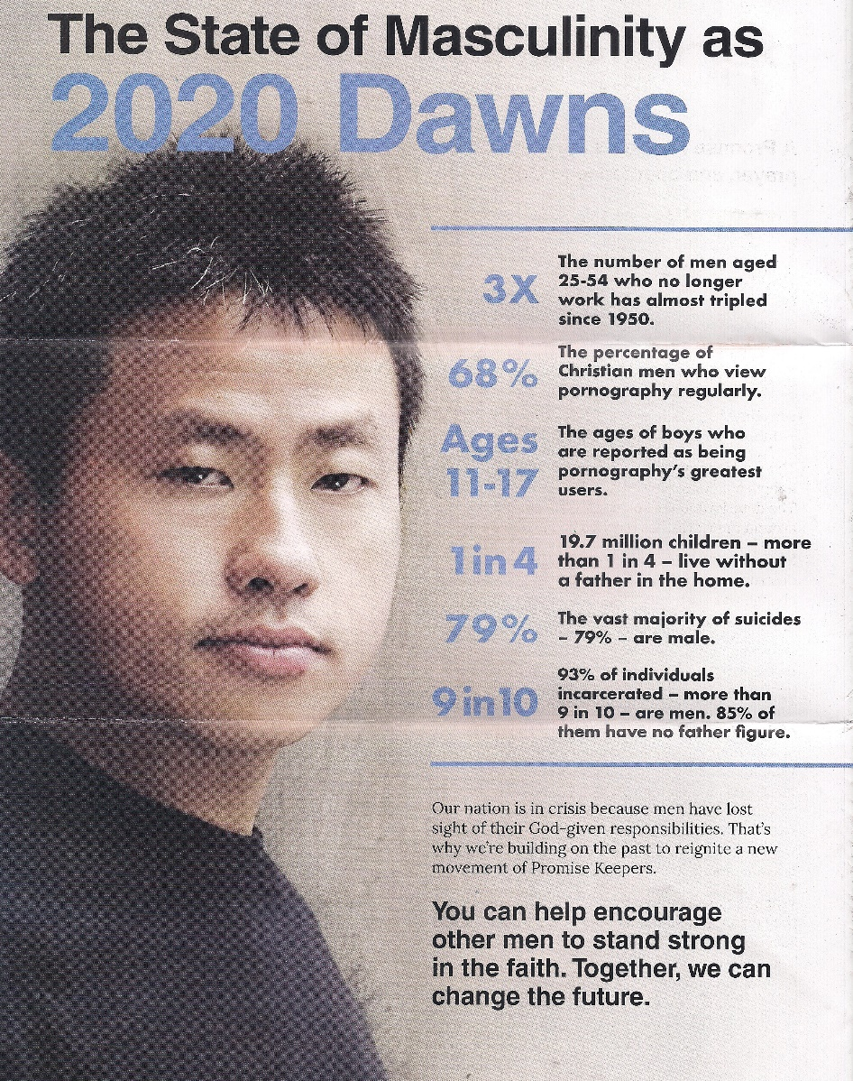

Notes:
Do you want to be seeing or imagining impurity, sensuality, when you are also seeing Messiah.

Slide 71
Edward Byrd, a former member of the LGBT community, opens up his heart in "Ran Into You," which he defines as his testimony in a song. Byrd, who previously identified as a gender-fluid or androgynous person, says he was giving himself away until he ran into God. "Nothing could make me whole," he belts in the song. "Until I ran into You.“
Notes:
https://www.charismanews.com/video/74495-androgynous-gender-fluid-person-exchanges-emptiness-for-holiness?utm_source=Charisma%20News%20Daily&utm_medium=email&utm_content=subscriber_id:5160390&utm_campaign=CNO%20daily%20-%202018-12-21

Slide 72
Byrd's mother was 15 years old when she had him. Byrd was raped, abused and then abandoned by his father. Broken, confused and devastated, Byrd turned to the LGBT community for acceptance.
Notes:
https://www.charismanews.com/video/74495-androgynous-gender-fluid-person-exchanges-emptiness-for-holiness?utm_source=Charisma%20News%20Daily&utm_medium=email&utm_content=subscriber_id:5160390&utm_campaign=CNO%20daily%20-%202018-12-21

Slide 73
Yet he knew something was missing. "God met me right in my sin and loved me into a personal relationship with him. This year actually marks my seventh year of being free!" Byrd tells Charisma.
Notes:
https://www.charismanews.com/video/74495-androgynous-gender-fluid-person-exchanges-emptiness-for-holiness?utm_source=Charisma%20News%20Daily&utm_medium=email&utm_content=subscriber_id:5160390&utm_campaign=CNO%20daily%20-%202018-12-21

Slide 74
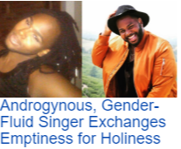
Notes:
https://www.charismanews.com/video/74495-androgynous-gender-fluid-person-exchanges-emptiness-for-holiness?utm_source=Charisma%20News%20Daily&utm_medium=email&utm_content=subscriber_id:5160390&utm_campaign=CNO%20daily%20-%202018-12-21

Slide 75
  After he had provided purification for sins, he sat down at the right hand of the Majesty in heaven.
  How long to we have to get it right?

Slide 76
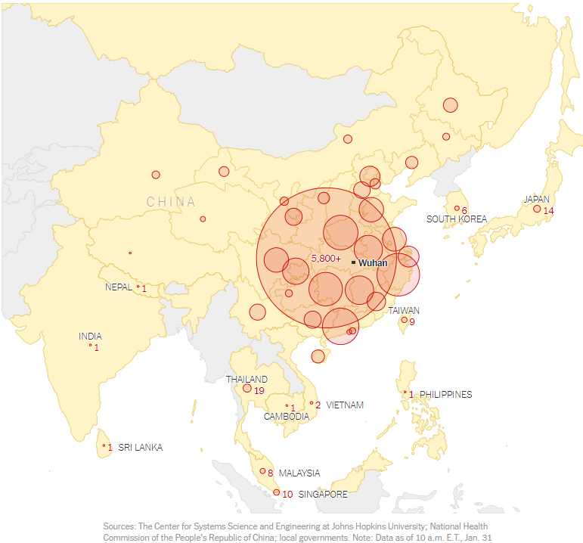
Notes:
https://www.nytimes.com/interactive/2020/world/asia/china-wuhan-coronavirus-maps.html?te=1&nl=morning-briefing&emc=edit_NN_p_20200131&section=topNews&campaign_id=9&instance_id=15628&segment_id=20853&user_id=0c340ef4a0010f69a562b70ff5e66878&regi_id=35997600tion=topNews

Slide 77
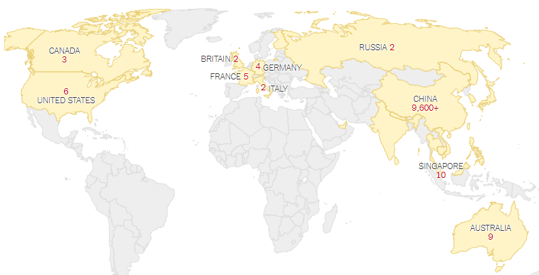
Notes:
https://www.nytimes.com/interactive/2020/world/asia/china-wuhan-coronavirus-maps.html?te=1&nl=morning-briefing&emc=edit_NN_p_20200131&section=topNews&campaign_id=9&instance_id=15628&segment_id=20853&user_id=0c340ef4a0010f69a562b70ff5e66878&regi_id=35997600tion=topNews

Slide 78
Researchers at Northeastern University and Imperial College London estimate that the number of cases may be five or ten times higher than what has been reported. On Monday, the Northeastern researchers estimated there may be around 25,000 cases.
Notes:
https://www.nytimes.com/interactive/2020/world/asia/china-wuhan-coronavirus-maps.html?te=1&nl=morning-briefing&emc=edit_NN_p_20200131&section=topNews&campaign_id=9&instance_id=15628&segment_id=20853&user_id=0c340ef4a0010f69a562b70ff5e66878&regi_id=35997600tion=topNews

Slide 79
Look within you’ll be depressed.
Look around you’ll be distressed.
Look to Yeshua and you’ll be at rest, and blessed!

Slide 80
Summary of all:
^{8.1-2} Here is the whole point of what we have been saying: we do have just such a cohen gadol as has been described. And he does sit at the right hand of HaG'dulah in heaven. There he serves in the Holy Place, that is, in the true Tent of Meeting, the one erected not by human beings but by ADONI.

Slide 82


