Slide 1
e-handout
To have these notes
without taking notes
Go to OrHaOlam.com
Click on downloads,
messages, 2020

Slide 2
Review: Rosh Hashanna greetings
Shana Tovah שָׁנָה טוֹבָה
[Have a] Good Year
שָׁנָה טוֹבָה וּמְתוּקָה
Shana Tova oo-m’tukah
[Have a] Good and sweet year

Slide 3
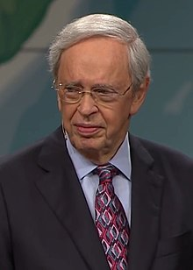
First Baptist Church in Atlanta, Georgia, senior pastor for 49 years

Slide 4
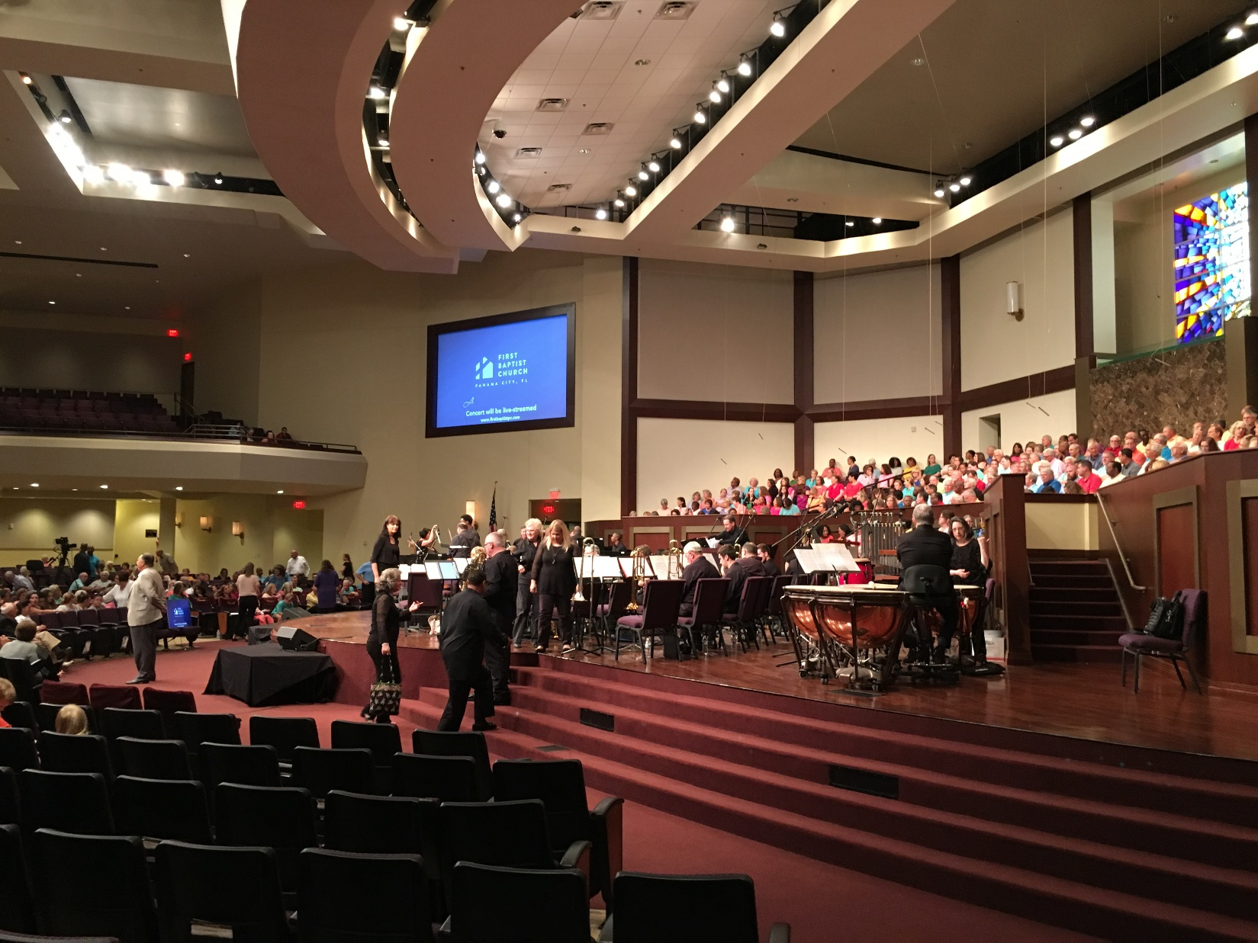

Slide 5
Dr. Charles Stanley announced his decision to step down as senior pastor of First Baptist Church Atlanta on Sunday, Sept. 13,2020 during a livestream service. With a succession plan in place, the 87-year-old passed leadership on to Dr. Anthony George, who has assisted Stanley for the past eight years.
Notes:
So, I’m retiring in 16 years. Plan on it. Joe Biden gave me a new lease on life!

Slide 7
^{Vayikra/Lev 23.24} ‘In the seventh month, the first of the month is to be for you a day of complete rest for remembering, a holy convocation announced with blasts on the shofar. ‎
זִכְרוֹן תְּרוּעָה יִהְיֶה לָכֶם שַׁבָּתוֹן
Zikaron t’ruah Yom T’ruah

Slide 8
T’ruah תְּרוּעָה shout, cry; blast (trumpet, shofar)
The shofar has a wailing, mournful, judgement sound, so a sense of judgment.
^{Shmot/Ex 19.16} Then a shofar blast sounded so loudly that all the people in the camp trembled.

Slide 9
Rabbi Kerry Baker, founding Rabbi of Congregation Kol Halev, Austin, TX writes:
The ancient instrument’s plaintive cry serves as a call to repentance and a reminder to Jews that God is their ruler.
Notes:
https://interfaithtexas.org/history-and-significance-of-rosh-hashanah/
T’kiah, t’ruah, shvarim. Not music. Sound of eternity.

Slide 10
The Mishnah refers to Rosh Hashanah as the day upon which all creatures stand in judgment before God (Rosh Hashanah 1:2)
יוֹם הַדִּיןYom HaDin
Day of Judgment
Leading up to Yom Kippur, the Day of Atonement.

Slide 11
While the blowing of the shofar is a Biblical statute, it is also a symbolic “wake-up call,” stirring Jews to mend their ways and repent. The shofar blasts call out: [Maimonides writes]: “Sleepers, wake up from your slumber! Examine your ways and repent and remember your Creator.”
Notes:
Mishneh Torah, Laws of Repentance 3:4.

Slide 12
The day, Yom T’ruah, יוֹם תְּרוּעָה
Has a connotation of judgment.
Right now, America is under judgement.
Will we respond?

Slide 14
^{Yoel 1.1-3} “Hear this, you leaders!
Listen, all who live in the land!
Has anything like this ever happened in your days, or in your ancestors’ days? Tell your children about it, and have them tell it to theirs, and have them tell the next generation.

Slide 15
^{Yoel 1.19-20} To You, Adoni, I cry! For fire has devoured the pastures of the wilderness, and flame has set ablaze all the trees of the field. Also beasts of the field pant toward You. For the water of wadis are dried up, and fire has devoured the pastures of the wilderness.

Slide 16
^{Yoel 2.1-2} “Blow the shofar in Tziyon! Sound an alarm on my holy mountain!” Let all living in the land tremble, for the Day of Adoni is coming! It’s upon us! — a day of darkness and gloom,
a day of clouds and thick fog;

Slide 17
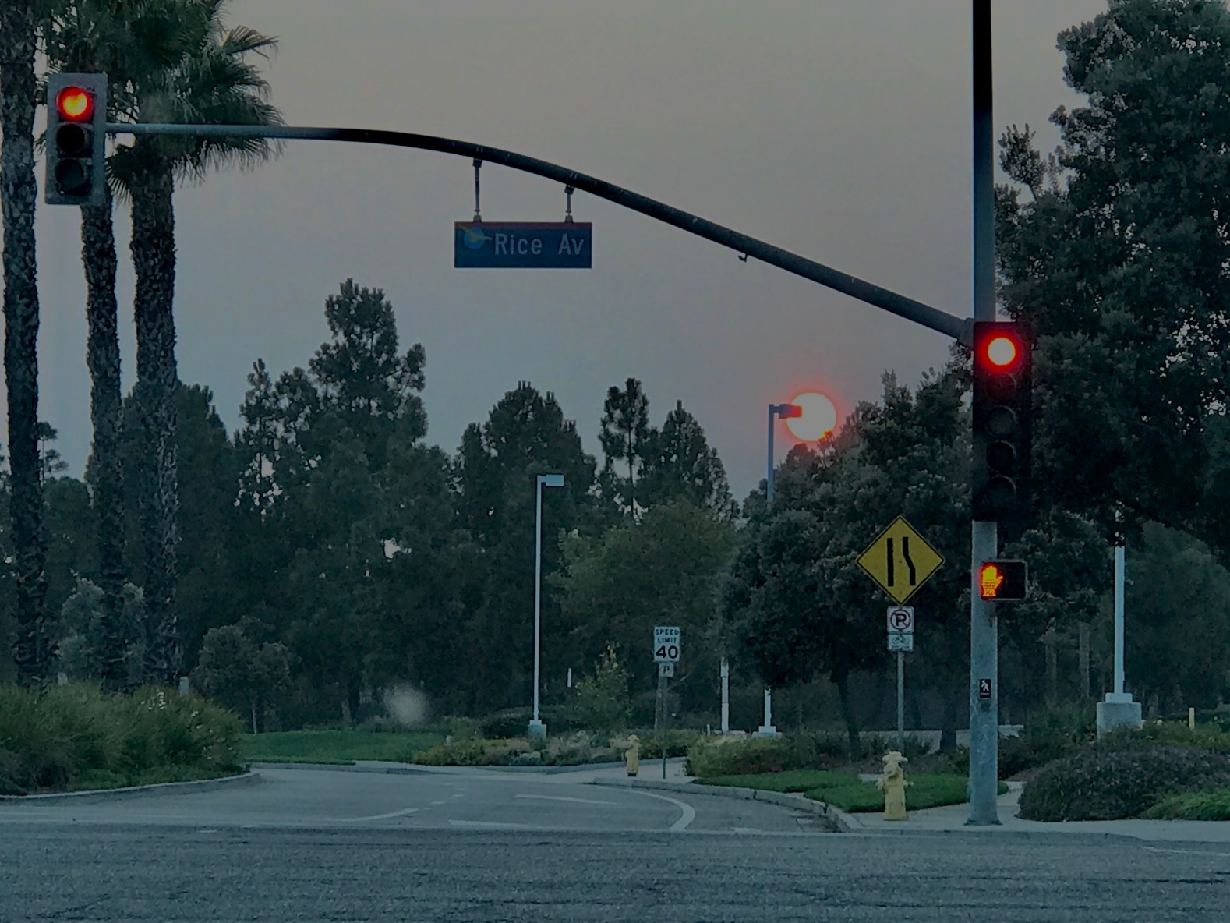
Oxnard, CA
Sept. 15, 2020
Notes:
From Daniel W. Sep 15, 2020

Slide 18
^{Yoel 2.3}Ahead of them a fire devours, behind them a flame consumes; ahead the land is like Gan-‘Eden, behind them a desert waste.

Slide 19
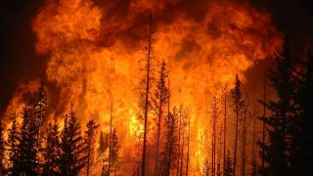
Notes:
Fire moving 50 mph some places

Slide 20
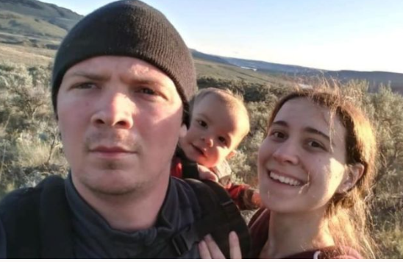
Jake & Jamie Hyland
Notes:
https://www.gofundme.com/f/hyland-family-emergency-fund

Slide 21
Seattle Messianic Rabbi Hylan Slobodkin tells of congregants: Jake, Jamie (and baby in her tummy) and their toddler son Uriel were on a short trip to their property in Okanogan, WA over the weekend. The property is deep in a rural area with no signal or communication.
Notes:
https://www.gofundme.com/f/hyland-family-emergency-fund

Slide 22
They were caught in the big Cold Spring Fire on Sunday, we think around midnight . Their abandoned truck was found burned, the fire chased them to the river where they are being rescued today (09/09/2020).
Notes:
https://www.gofundme.com/f/hyland-family-emergency-fund
Drove to Columbia River till truck stuck. Ran. Found refuge in huge rock ~10ft. He is 25% burned body, she 50%. Lost toddler and she miscarried in river.
The righteous suffer with the wicked when the culture is judged!

Slide 23
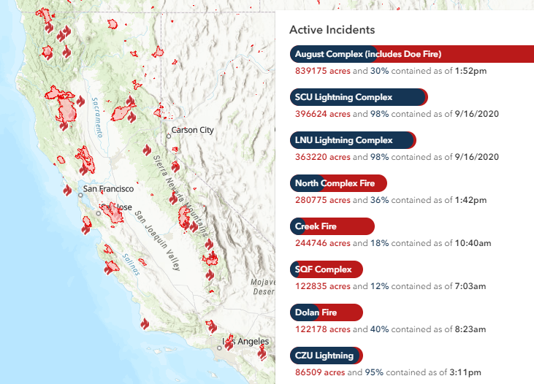
Notes:
https://www.fire.ca.gov/incidents/

Slide 24
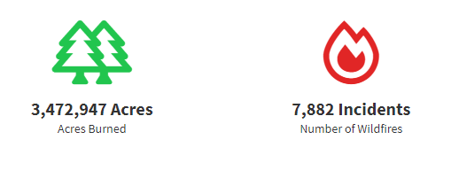
Total sq mi burned CA = Ct + RI !
Connecticut | 4,845
Rhode Island | 1,034

Slide 25
Judgment on the West Coast, California…
on America.

Slide 26
California is seen as one of the most liberal states in the U.S. in regard to lesbian, gay, bisexual, transgender (LGBT) rights, which have received nationwide recognition since the 1970s.
Compassion?
Notes:
https://en.wikipedia.org/wiki/LGBT_rights_in_California
Haight Ashbury, California Dreamin

Slide 27
California Gov. Gavin Newsom has shut down all worship in most of the state, even banning Bible studies and fellowship in private homes with anyone who does not live at that home.

Slide 28
In San Francisco, the city threatened "Abatement"—which is immediate seizure and destruction of Lighthouse Church's worship and sanctuary buildings should that church continue to meet. San Francisco allows only 12 people to assemble outside in the sweltering heat and smoke-filled air. But "protesters" and rioters can gather in the thousands.

Slide 29
In Santa Clara, North Valley Baptist Church is being fined $50,000 per week for refusing to stop worshipping together.
In Sun Valley, Grace Community Church Pastor John MacArthur will likely face contempt of court and jail time for defying a judge's injunction demanding he stop "assembling together," as the Bible commands.

Slide 30
Not just California
Is Meriting Judgment

Slide 32
(Worthy News) - A new poll has found that 22% of US Evangelicals believe in “gender fluidity” rather than that people have a God-given gender that is either male or female, the Christian Post reports. The results of the “State of Theology 2020” poll were published by LifeWay Research on September 8.
Notes:
https://www.worthynews.com/52829-survey-shows-22-of-evangelicals-believe-in-gender-fluidity

Slide 33
Sponsored by Ligonier Ministries, the poll involved over 3,000 American participants. The study found that only 73% of American Evangelicals believe that gender is God-given and not a matter of choice.
Notes:
https://www.worthynews.com/52829-survey-shows-22-of-evangelicals-believe-in-gender-fluidity
Last week 6% Americans have Biblical world view. This is not that!

Slide 34
According to a 2001 UNICEF survey, in 10 out of 12 developed nations, more than two-thirds of young people have had sexual intercourse while still in their teens. In Denmark, Finland, Germany, Iceland, Norway, the United Kingdom and the United States, the proportion is over 80%. Just normal!
Notes:
https://en.wikipedia.org/wiki/Premarital_sex#:~:text=Premarital%20sex%20is%20sexual%20activity,accepted%2C%20especially%20in%20Western%20countries.
Dawn and I switched from Netflix to Pureflix and Hallmark. Saw a Meghan Markle movie [married Prince Harry, really virtuous!]

Slide 35
The Equality Act is a bill in the United States Congress, that, if passed, would amend the Civil Rights Act to prohibit discrimination on the basis of sexual orientation and gender identity in employment, housing, public accommodations, public education, federal funding, credit, and the jury system.
Notes:
https://en.wikipedia.org/wiki/Equality_Act_(United_States)
Sounds reasonable enough!

Slide 36
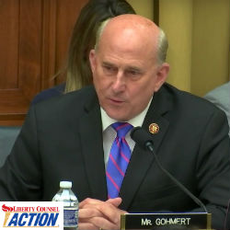
“If this bill passes… religious freedom will be in material jeopardy!” This is the testimony of U.S. House Representative Louie Gohmert (R-TX) on HR 5. This bill will strip freedom from rabbis to decline to officiate same sex ceremonies.

Slide 37
It will force synagogues and churches to host these ceremonies, or face debilitating lawsuits. Men will be able to use women’s private facilities [dorms, locker rooms, bathrooms] and compete in women’s sports.
Notes:
https://www.lcaction.org/detail/20190502-religious-freedom-rejected
Bankrupt us, or jail time

Slide 38
Total number of abortions in the U.S. 1973-2018: 61.8 million+
186 abortions per 1,000 live births (according to the Centers for Disease Control)
only surgical and medical abortions
Notes:
https://www.all.org/learn/abortion/abortion-statistics/
There was as prophetic statement on Sid Roth’s program that if Roe v Wade is reversed, the COVID plague will be lifted.

Slide 39
In addition since 1965, an average of 11 million women have used abortifacient methods of birth control in the United States at any given time. About 14 million chemical abortions occur in the United States each year, providing a projected total of well in excess of 610 million chemical abortions between 1965 and 2009.
Notes:
https://www.all.org/learn/abortion/abortion-statistics/
IUD, most forms of the pill.
^{Lev 18.21} “You are not to give any of your children in sacrifice to Molech, and defile the Name of your God. I am Adonai.

Slide 40
Recently Pastor Kevin Rowan said that there is no systemic racism in America. I take that to mean that systemic racism isn't crippling as BLM and others make it appear. A Black American can rise in the corporate, academic, industrial,

Slide 41
scientific, political world. Racism is not anymore the crippler. A Black American can even be president!
However…

Slide 42
However, it's not correct to say that “racism doesn’t exist” in any measure. For example, US Senator Tim Scott was on Dr. Dobson's Family Talk. He's an African American US Senator, described the following.

Slide 43
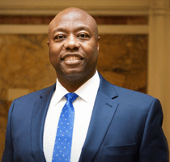
RepublicanU.S. Senator
Tim Scott, guest on Dobson’s program
Notes:
He spoke at the RNC, supportively. He’s a great guy.

Slide 44
Having the chance to talk with so many folks, and then having lived through seven [racially profiled traffic] stops, as an African-American driving a car, by law enforcement officers. As an elected official being stopped by law enforcement officers,
Notes:
https://familytalk.widen.net/s/sq8kzkvh0d

Slide 45
as a United States Senator trying to enter into the Senate buildings, wearing my Senate pin, they just didn't believe me. There is a complicated and emotional attachment to the fact that the discrimination that so many of us have felt is real.
Notes:
https://familytalk.widen.net/s/sq8kzkvh0d

Slide 46
There is a complicated and emotional attachment to the fact that the discrimination that so many of us have felt is real. The solution to it, I think it is multifaceted and layered. But the vast majority,
Notes:
https://familytalk.widen.net/s/sq8kzkvh0d

Slide 47
and I've had years and years of experience with law enforcement, the vast majority of officers have one objective: it's to do their jobs and go home. It's those apples, one bad apple spoils the whole bunch.
Notes:
https://familytalk.widen.net/s/sq8kzkvh0d

Slide 48
Baseless hatred is identified by Jewish tradition as the cause for the destruction of the Second Temple, and thus as emblematic for the substantial personal and collective harm that has ensued. In its most extreme form, this kind of hate aims to exterminate one's fellow man.
Notes:
Racial bias is totally baseless hatred. Blacks, Asians, Hispanics, Jews. Personally I love to hear accents. Like home. Hello in about 13 languages.

Slide 49
^{Vayikra/Lev 18.27-28} For the people of the land have committed all these abominations, and the land is now defiled. If you make the land unclean, it will vomit you out too, just as it is vomiting out the nation that was there before you.
America is in danger of divine judgement, already begun!

Slide 50
Where are the worst urban riots in America?
Where is the worst air pollution in America?

Slide 51
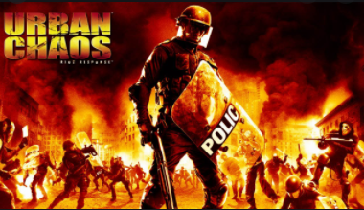

Slide 53
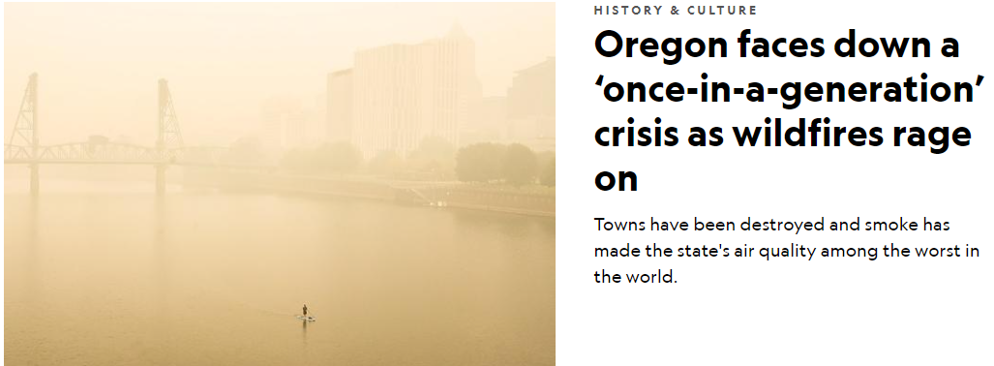

Slide 54
Worst riots…worst air pollution.
Worst immorality…worst fires.

Slide 55
America’s sins
Sexual impurity and redefinition
Racial bias, baseless hatred
Rioting from unforgiveness.
Aborting/murdering babies.
Disrespect of G-d and worship.

Slide 56
American exceptionalism
a uniquely American ideology based on liberty, equality before the law, individual responsibility, republicanism, representative democracy, and laissez-faire economics.
the idea that America has a mission to transform the world
Notes:
https://en.wikipedia.org/wiki/American_exceptionalism#:~:text=American%20exceptionalism%20is%20a%20European,called%20%22the%20first%20new%20nation%22

Slide 57
The essence of the protests is that America rather was founded on
genocide of the indigenous people
slavery
Greedy exploitative capitalism.
and should be abolished.

Slide 58
This 244 year old republic could be at its end.
Freedom to live and preach Biblically may be viewed as hateful.
Defense of our nation may be viewed as imperialism.

Slide 59
I love our country, and it’s survival is at risk. We are told
^{1 Tim 2} first of all I urge that requests, prayers, intercessions, and thanksgiving be made on behalf…kings and all who are in authority—so we may live a peaceful and quiet life in all godliness and respectfulness.

Slide 60
^{1 Tim 2} This is good and pleasing in the sight of God our Savior. He desires all men to be saved and come into the knowledge of the truth.
I think we can apply the words of Abe Lincoln in a spiritual sense:

Slide 61
It is rather for us to be here dedicated to the great task remaining before us…that we here highly resolve that…

Slide 62
this nation, under God, shall have a new birth of freedom—and that government of the people, by the people, for the people, shall not perish from the earth.

Slide 63
^{Divrei Yamin ב /2 Chron 713-14} If I shut up the sky, so that there is no rain; or if I order locusts to devour the land; or if I send an epidemic of sickness among my people; then, if my people, who bear my name, will humble themselves, pray, seek my face and turn from their evil ways, I will hear from heaven, forgive their sin and heal their land.

Slide 64
^{1K 8.38} When prayer or supplication is made by anyone or by all Your people Israel—each knowing the plague of his own heart

Slide 65
^{Yoel 2.12-14} “Yet even now,” says Adoni, “turn to me with all your heart, with fasting, weeping and lamenting.” Tear your heart, not your garments; and turn to Adoni your God. For he is merciful and compassionate, slow to anger, rich in grace,

Slide 66
^{Yoel 2.12-14} and willing to change his mind about disaster. Who knows? He may turn, change his mind and leave a blessing behind him.

Slide 67
The day, Yom T’ruah, יוֹם תְּרוּעָה
Has a connotation of judgment.
Right now, America is under judgement.
Will we respond?

Slide 68
The election will not save us. We need a culture change, only by a spiritual renewal. Such transformation has happened before in history: Wesley, Fiji Islands, Hebrides, Yeshua movement 1970’s.
By intercession… continued tomorrow. Hear the shofar call…

