Slide 1
e-handout
To have these notes
without taking notes
Go to OrHaOlam.com
Click on downloads,
messages, 2021

Slide 2
Four rules for cowboys
Notes:
https://www.focusonthefamily.com/church/balance-your-life/?utm_medium=email&utm_campaign=1143401&utm_source=E-Newsletter&seid=115185210

Slide 3
Four rules for cowboys
When you fall off, git back on.
Notes:
https://www.focusonthefamily.com/church/balance-your-life/?utm_medium=email&utm_campaign=1143401&utm_source=E-Newsletter&seid=115185210

Slide 4
Four rules for cowboys
When you fall off, git back on.
Never look straight up at a bird.
Notes:
https://www.focusonthefamily.com/church/balance-your-life/?utm_medium=email&utm_campaign=1143401&utm_source=E-Newsletter&seid=115185210

Slide 5
Four rules for cowboys
When you fall off, git back on.
Never look straight up at a bird.
Always drink upstream from the herd.
Notes:
https://www.focusonthefamily.com/church/balance-your-life/?utm_medium=email&utm_campaign=1143401&utm_source=E-Newsletter&seid=115185210

Slide 6
  Four rules for cowboys
  When you fall off, git back on.
  Never look straight up at a bird.
  Always drink upstream from the herd.
  Never squat with your spurs on.
Notes:
https://www.focusonthefamily.com/church/balance-your-life/?utm_medium=email&utm_campaign=1143401&utm_source=E-Newsletter&seid=115185210

Slide 7
Outreach review
1400 Bottles given out.
8 contact cards
Notes:
QR code stopped working for a while Sunday, then fixed.

Slide 8
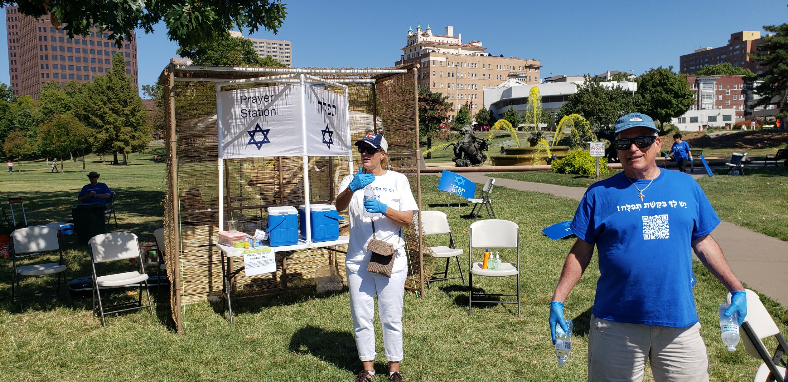

Slide 9
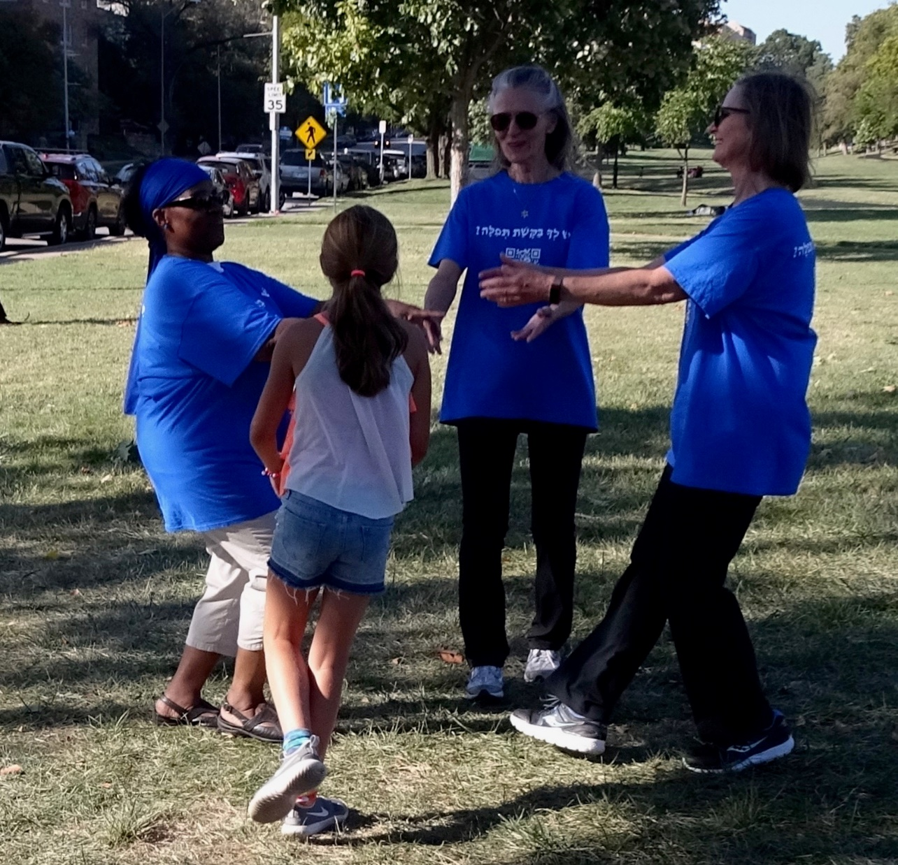

Slide 10
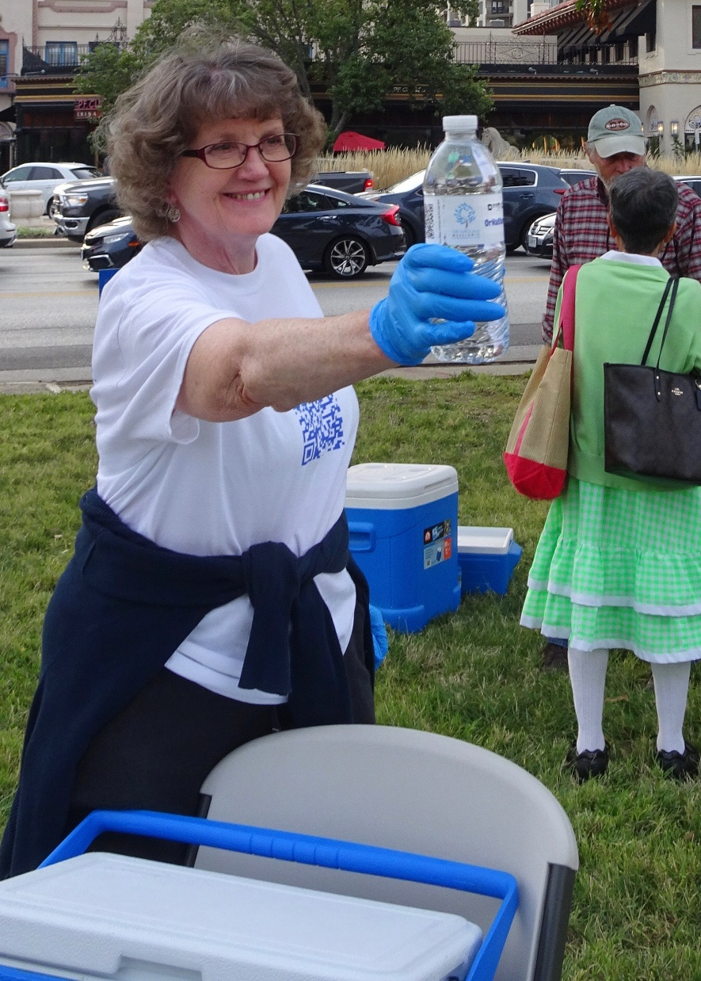

Slide 11
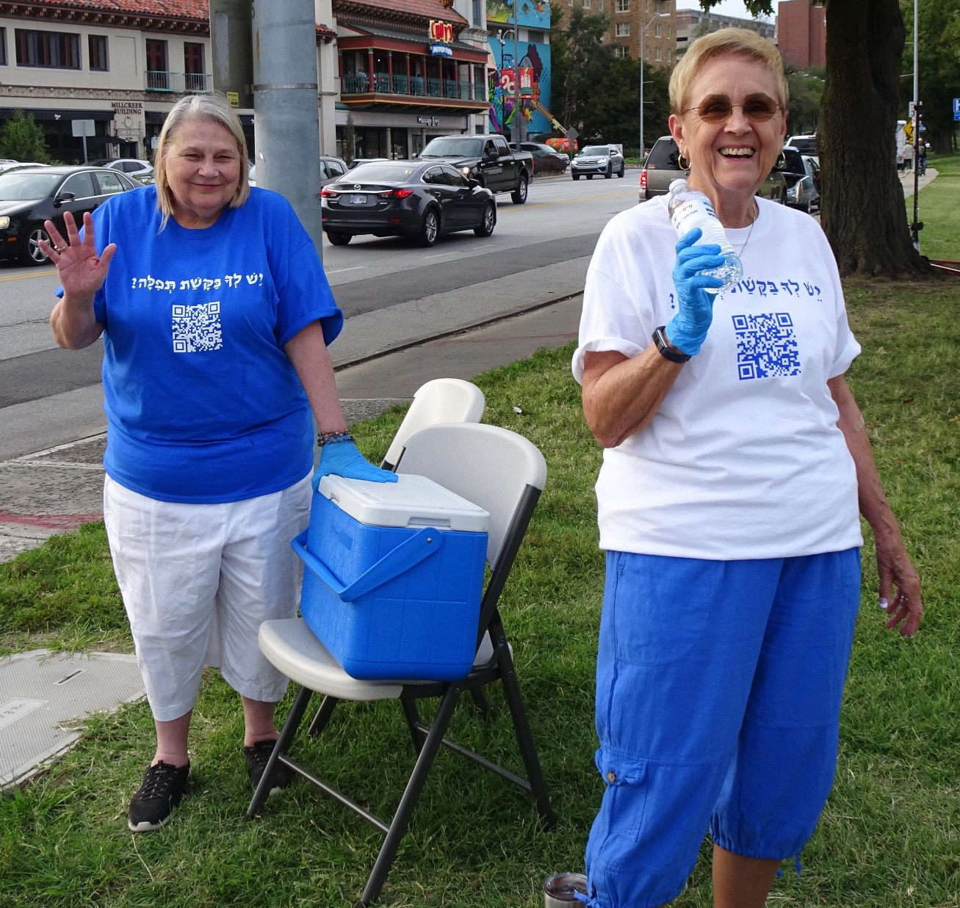

Slide 12
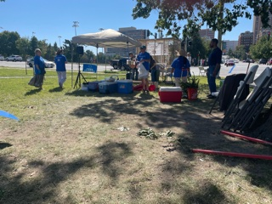

Slide 13
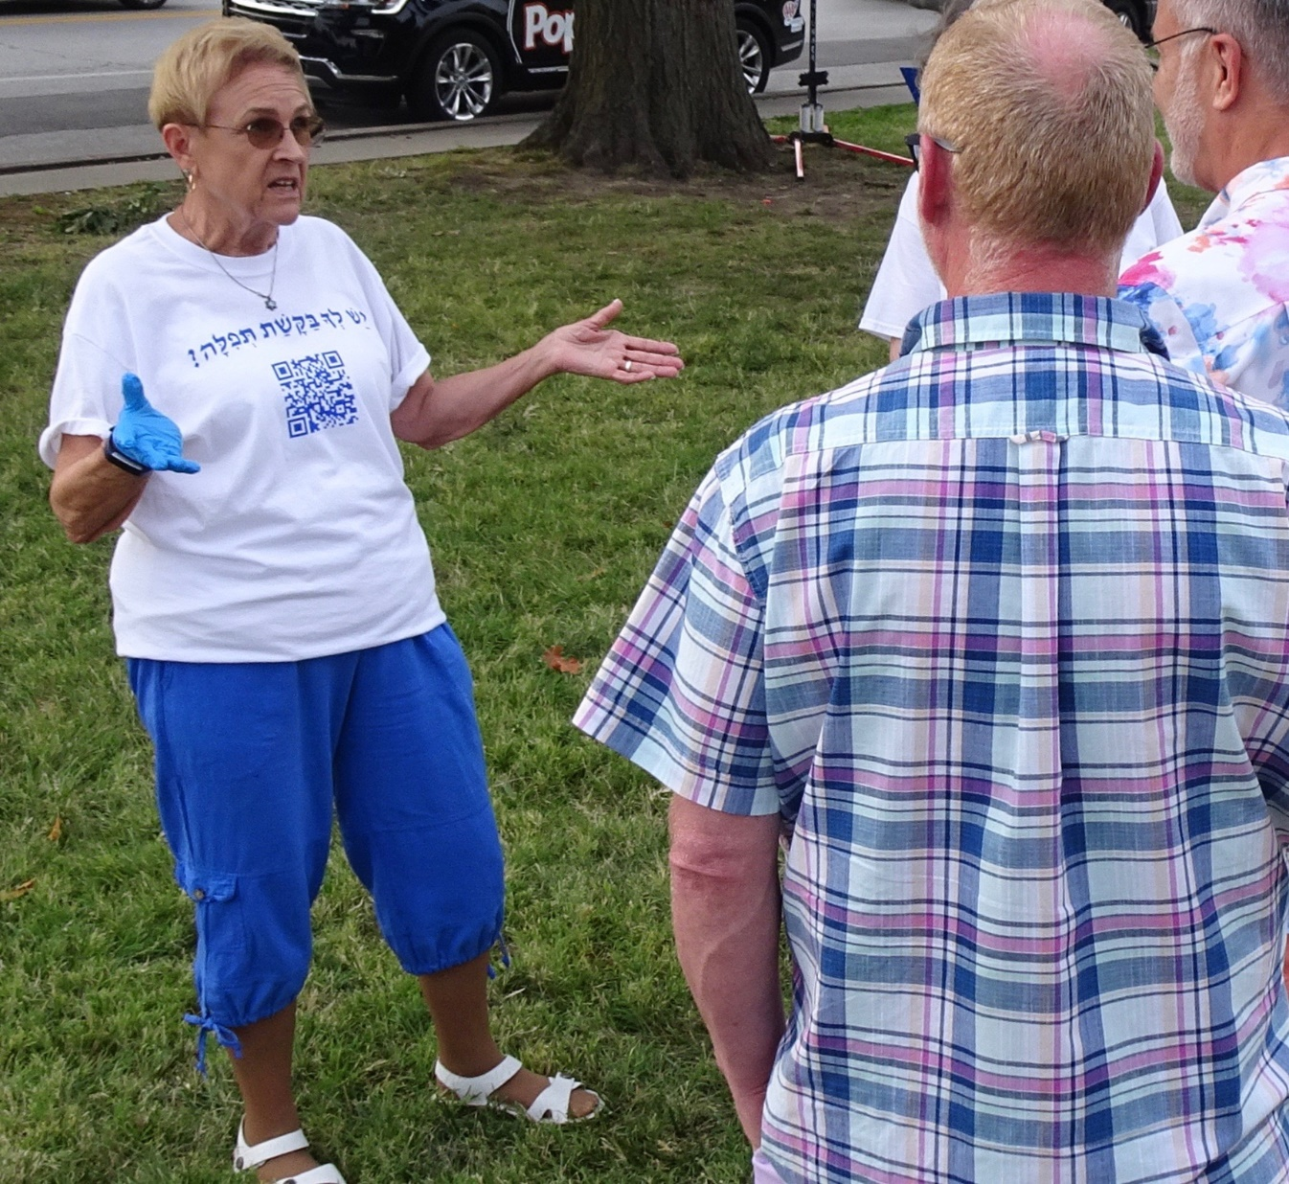
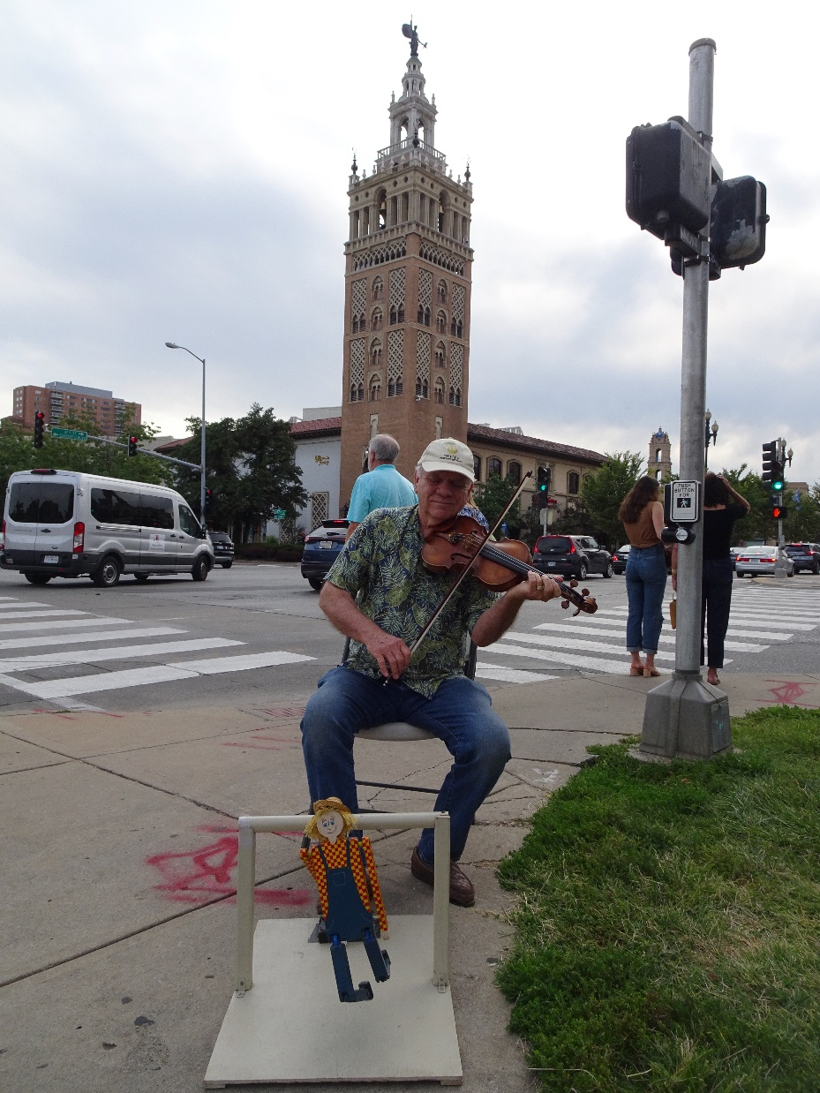

Slide 14
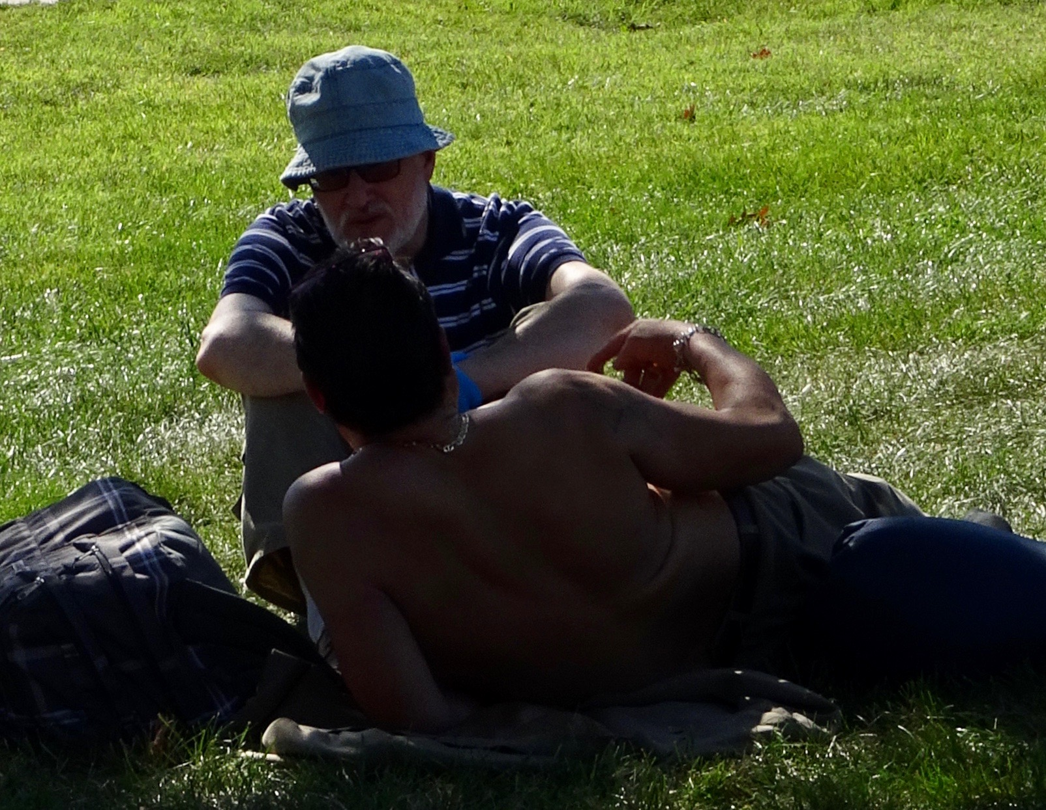
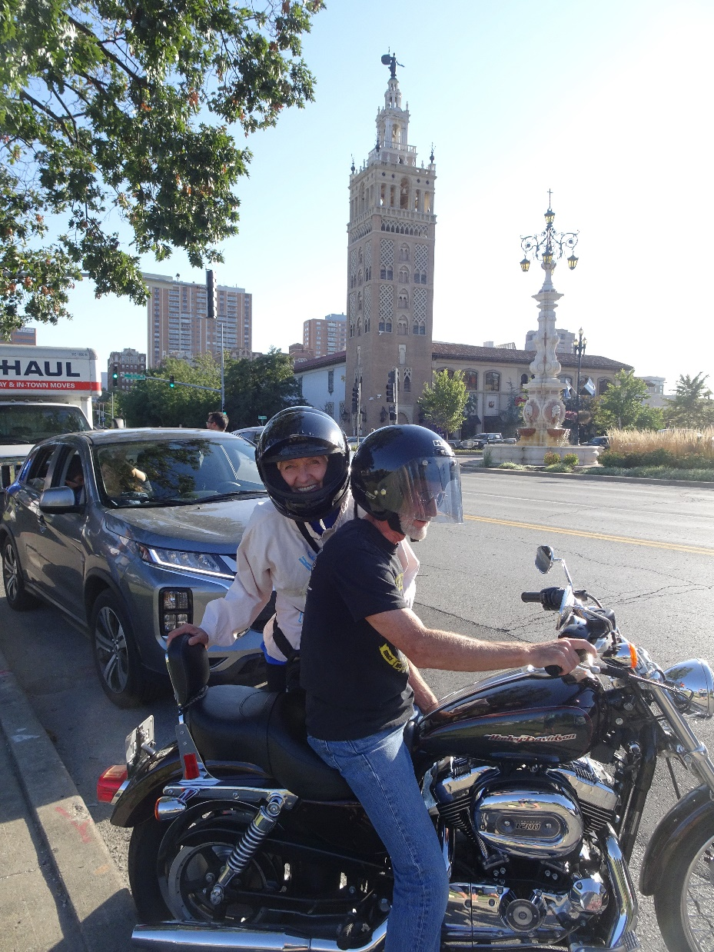
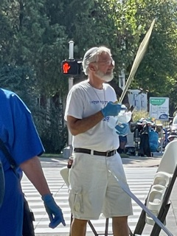

Slide 15
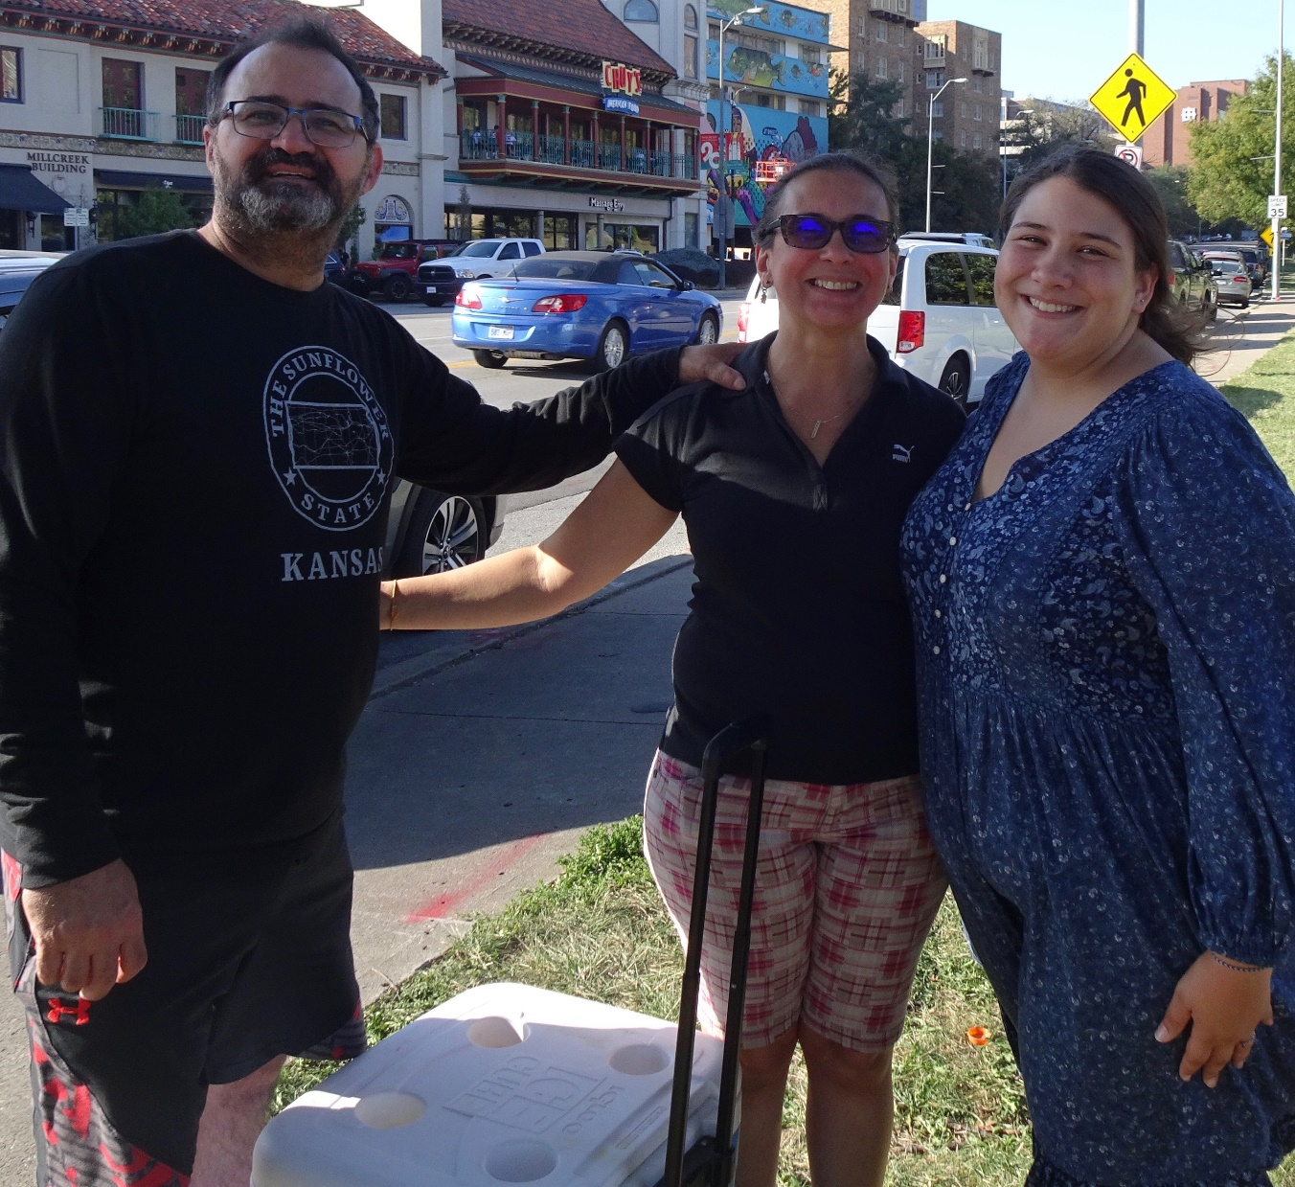

Slide 16
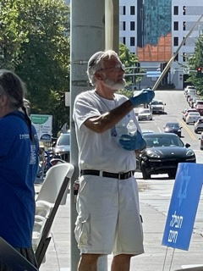

Slide 18
Next year: Plaza Art Fair during the Ten Days of Repentance.
We can’t put up the Sukkah
We can put up a Repentance Tent: a Repent-Tent
Stay Saturday night to the end.

Slide 19
A whirlwind of holidays within a single month!
Rosh Hashanah, sounding the Call for the Gathering of God’s People, leading into
the 10 Days of repentance
Culminating in Yom Kippur
Then the Joy of Sukkot- lots of community, campfires, camping

Slide 20
Sukkot Plaza outreach glorious but lots of work!
Finally Hoshana Rabba / Shmini Atzeret / Simkhat Torah where we rejoiced and danced, in the gift of G-d’s Holy Scriptures

Slide 21
Sukkot Plaza outreach glorious but lots of work!
Finally Hoshana Rabba / Shmini Atzeret / Simkhat Torah where we rejoiced and danced, in the gift of G-d’s Holy Scriptures
Revived? Exhausted?

Slide 22
Yom Kippur: 3 messages already
Temple sacrifices
Vows and Kol Nidre
Affliction
Notes:
However, as I meditated on the message for today, and looked into the returning to continuing in the Book of Messianic Jews/ Hebrews, there was a summary line that seemed to be my download.
More on this??

Slide 23
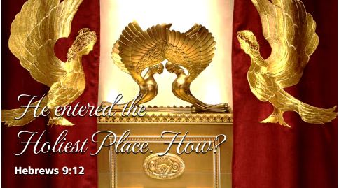

Slide 24
Messianic Jews 9.12
“He entered the Holiest Place.”
How?

Slide 25
When did He go the Holiest Place?
How did He enter that place?

Slide 26
^{MJ 9.11-14} But when the Messiah appeared as cohen gadol of the good things that are happening already, then, through the greater and more perfect Tent which is not man-made (that is, it is not of this created world),

Slide 27
^{MJ 9.11-14} he entered the Holiest Place once and for all. And he entered not by means of the blood of goats and calves, but by means of his own blood, thus setting people free forever.
Notes:
This is huge. His going into the holiest place, holy of holies, with His own atoning Blood, is our FREEDOM…from guilt, from hell, from sinful holds on us!!

Slide 28
Outline of this message
What happened in the 3 days?
What is the Temple pattern?
What are the certainties?

Slide 29
What happened in those three days?
Notes:
Looks to me like He was executed, buried, then rose from the dead. What’s this about the Holiest Place?
Consider scriptures about time from His death to resurrection.
Consider first the earliest summary doctrine of the faith: the Apostles Creed.

Slide 30
The Apostles Creed
I believe in God, the Father almighty, creator of heaven and earth. I believe in Yeshua the Messiah, his only Son, our Lord, who was conceived by the Holy Spirit and born of the virgin Miriam.
Notes:
https://www.crcna.org/welcome/beliefs/creeds/apostles-creed “Translation © 1988, Faith Alive Christian Resources, Christian Reformed Church in North America.”

Slide 31
He suffered under Pontius Pilate, was crucified, died, and was buried; he descended to hell. The third day he rose again from the dead. He ascended to heaven and is seated at the right hand of God the Father almighty. From there he will come to judge the living and the dead.
Notes:
https://www.crcna.org/welcome/beliefs/creeds/apostles-creed
Pretty plain.
Aside: Nothing about covenants and Israel. So the believers through the millennia thought that Israel was a non-issue, over, caput, out.
Back to subject: says “He descended into Hell.”
Remember, this is a creed. Useful, beautiful, poetic, liturgical.
Analogous to the Rabbi’s writings: Mishna, Talmud.
NEITHER IS AUTHORITATIVE.
Answering question: Where and how Yeshua go to Holiest place. What do scriptures say?

Slide 32
1. ^{Lk 23.42-43} And he said, “Yeshua, remember me when You come into Your kingdom.” Yeshua said to him, “Amen, I tell you, today you shall be with Me in Paradise.”
Notes:
This is straight up and simple: on the day of His death, He and his companion would be in Gan Eden = Paradise = G-d’s immediate presence and place of bliss = heaven.

Slide 33
2. ^{T’hillim/Psalm 16:10} For you will not abandon me to Sh’ol, You will not let your faithful one see the Abyss.
שָֽׁחַת (flowery) pit; grave, hell.
Notes:
Seems like He descended to Hell.
Alternatively…
Hebrew poetic parallelism means the two words are to be taken as one idea—the simple grave, a pit in the earth where flesh decays.

Slide 34
3. ^{Ephesians 4:8-10} It says, “After he went up into the heights, he led captivity captive and he gave gifts to mankind.” Now this phrase, “he went up,” what can it mean if not that he first went down into the lower parts,

Slide 35
^{Ephesians 4:8-10} that is, the earth? The one who went down is himself the one who also went up, far above all of heaven, in order to fill all things.
Notes:
The following chart is from Dispensational Truth, as I was taught in the 1970s.

Slide 36
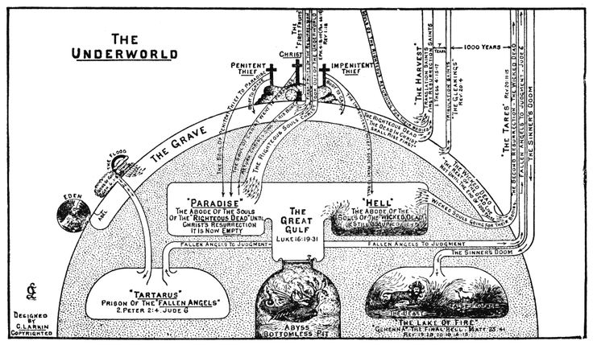
Notes:
https://duckduckgo.com/?q=clarence+larkin+maps&iar=images&iax=images&ia=images&iai=https%3A%2F%2Fs-media-cache-ak0.pinimg.com%2F736x%2F47%2Fec%2F55%2F47ec55ae24d10bc1c5661aaecd36958b.jpg
Zoom in

Slide 37
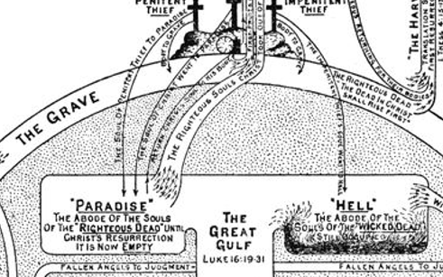
Notes:
Zoom in more…

Slide 38
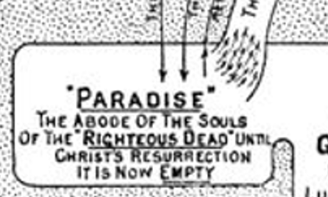
Notes:
I came to Messiah in April 1969, and about all the believers were fervent dispensationalists. Believing the rapture would come at any time, they’d be gone, and it would be up to my people. But I was a bit of an anomaly. Hadn’t really defined my identity, but knew I was still Jewish, and didn’t like being referred to as a Christian. Oppressors. I was very relieved to read that ^{Mtt 19 28} Yeshua said to them, “Yes. I tell you that in the regenerated world, when the Son of Man sits on his glorious throne, you who have followed me will also sit on twelve thrones and judge the twelve tribes of Isra’el.” So I concluded that they and I were still Jews.

Slide 39
Summing Up the Lesson (Ephesians 4:7-10)
"...descended..." — Messiah’s descent into the lower parts of the earth was his burial. His soul went not into Gehenna the eternal abode of the wicked, but into Hades the place of the dead.
Notes:
https://simplybible.com/f273-he-led-captivity-captive.htm
the simple reading of this verse is that Yeshua ascended into the heavens after first having descended into the earth below, the grave. In fact, the Greek language here can either be read “the lower region of earth” or “the lower region, earth.”
https://www.epm.org/resources/2008/Mar/22/what-happened-after-jesus-died/

Slide 40
"...captivity..." — Messiah led captivity captive in that God, through the redemption in Messiah, released sinners from the domain of darkness, Satan’s kingdom, and transferred them into Messiah’s kingdom.
Notes:
https://simplybible.com/f273-he-led-captivity-captive.htm

Slide 41
"...led..." — Messiah upon his ascension to glory, took the ownership and leadership of his slaves by the power and gifts of the Holy Spirit. He will reign as King and Shepherd-leader until he has put all enemies under his feet
Notes:
https://simplybible.com/f273-he-led-captivity-captive.htm

Slide 42
He will then return to gather in his elect who will ascend to meet him and go with him into heaven.
Notes:
https://simplybible.com/f273-he-led-captivity-captive.htm

Slide 43
4. ^{1 Peter 3:18-20} For Messiah once suffered for sins also—the righteous for the unrighteous —in order to bring you to God. He was put to death in the flesh, but made alive by the Ruakh. Through the Ruakh He also went and preached to the spirits in prison.

Slide 44
^{1Peter 3:18-20} Long ago they disobeyed while God kept waiting patiently, in the days of Noah as the ark was being built. In that ark a few (that is, eight souls) were brought safely through water
Notes:
Nowhere in the Bible is there any statement that a lost soul who has died can have a second chance.
the same Spirit who raised Yeshua as a testimony “in order that He might bring us to God” also had spoken in Noah’s day to those souls now in prison; and they are in prison because they did not listen at the time of the preaching.

Slide 45
5. ^{Yn 20.17} Yeshua says to her, “Stop clinging to Me, for I have not yet gone up to the Father. Go to My brothers and tell them, ‘I am going up to My Father and your Father, to My God and your God.’”
Notes:
Some say that He hadn’t yet presented the Blood of atonement before the Father.
Alternatively, some say He said this because he had an errand to send her on to his disciples, which required haste; nor need she stay now to show her respect to him, since she would have opportunity enough to do that, before his ascension; which though it was to be quickly, yet not directly and immediately; and this seems to be the sense of our Lord's reason:

Slide 46
Summary of information on the three days:
He was in the grave.
He may have descendent to Hell, but unlikely.
He met with G-d.

Slide 47
Outline of this message
What happened in the 3 days?
What is the Temple pattern?
What are the certainties?

Slide 48
^{MJ 9.11-14} But when the Messiah appeared as cohen gadol of the good things that are happening already, then, through the greater and more perfect Tent which is not man-made (that is, it is not of this created world),

Slide 49
^{MJ 9.11-14} he entered the Holiest Place once and for all. And he entered not by means of the blood of goats and calves, but by means of his own blood, thus setting people free forever.

Slide 50
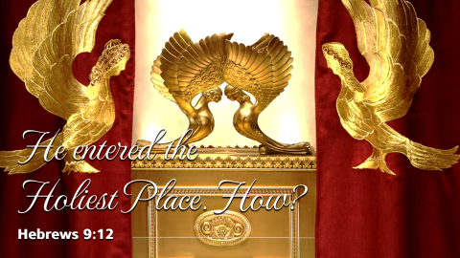

Slide 51


MJ 9.12
MJ 9.23

Slide 52
ἅγιος hágios – properly, different (unlike), other ("otherness"), holy; for the believer, means "likeness of nature with the Lord" because "different from the world."

Slide 53
Context of going into the Holiest Place, the Holy of Holies, in the Tanakhic, Bible times, the Mishkan/ Tabernacle, the Temple.

Slide 54
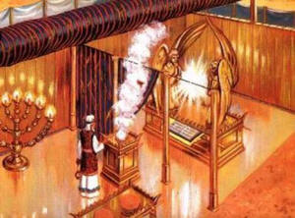
Notes:
Artist’s rendition of the Mishkan, the Tabernacle.

Slide 55
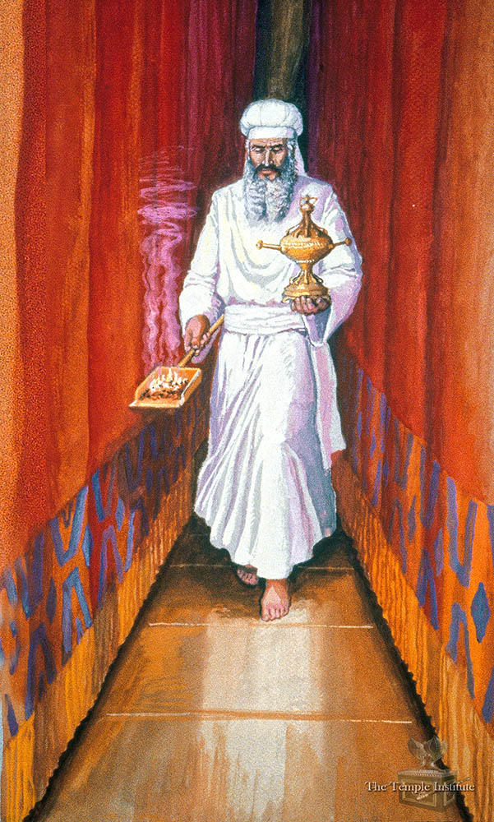
Notes:
https://templeinstitute.org/yom-kippur-part-5/
Incense first into Holy of Holies.

Slide 56
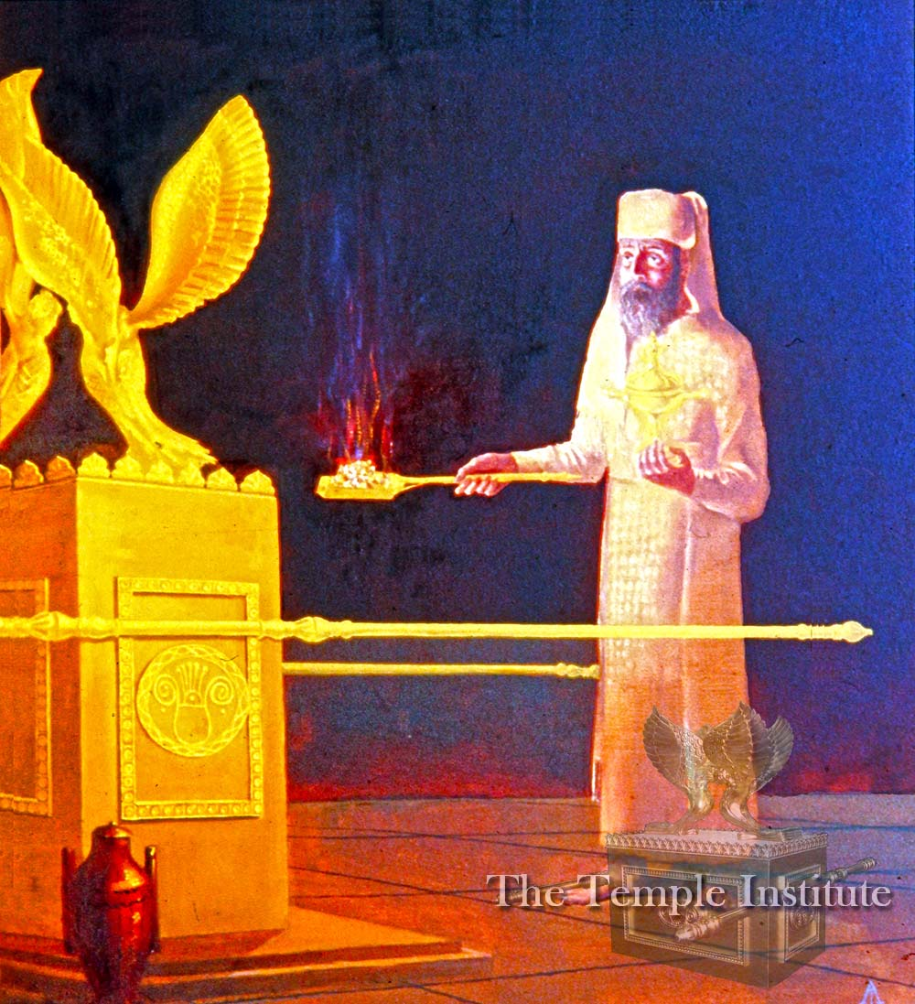
Notes:
https://templeinstitute.org/yom-kippur-part-5/

Slide 57
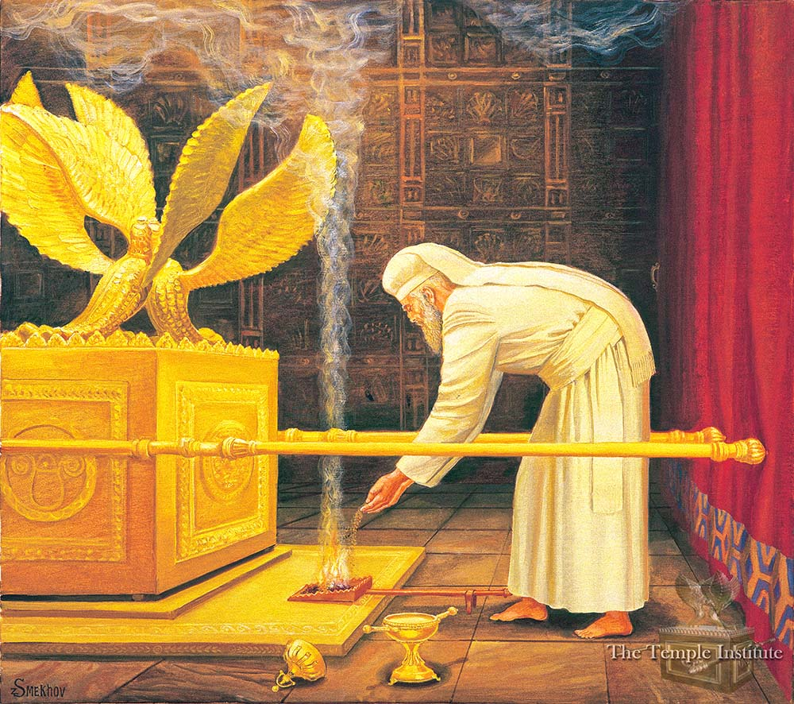
Notes:
Incences < the blood. Maybe analogous to our musical, prayerful worship, before the Word. Sets the atmosphere.

Slide 58
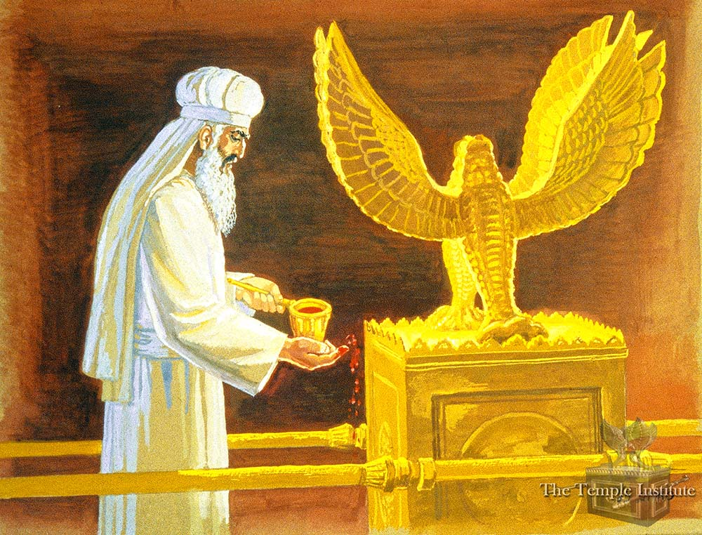
Notes:
https://templeinstitute.org/yom-kippur-part-6/

Slide 59
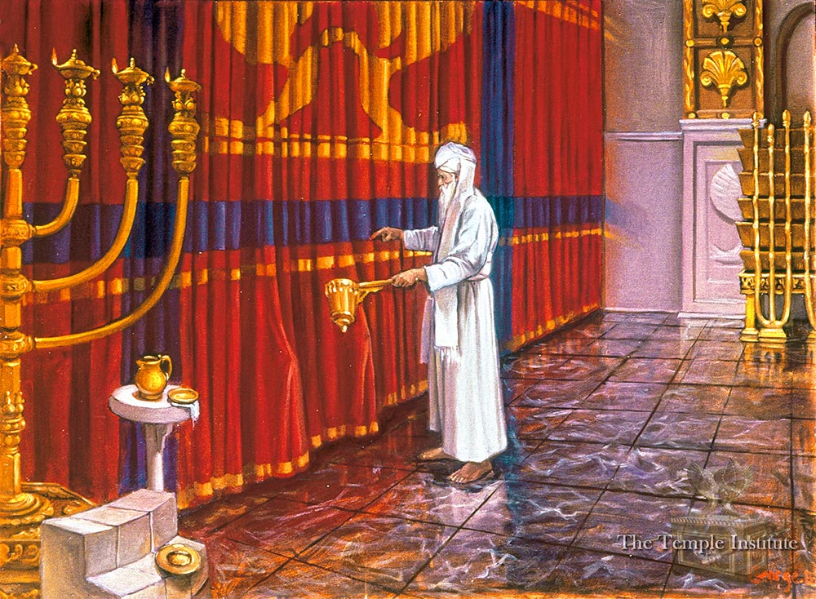
Notes:
Now the Kohen Gadol does not leave the Sanctuary, but takes up the first mizrak, containing the blood of the bullock, from the first stand where he had originally placed it. Facing the curtains that separate between the Holy (where he now stands) and the Holy of Holies, he stands opposite that same spot that he has entered unto three times - "between the poles" of the ark.
This time, he dashes from the blood of the bullock outside the curtain but towards the same spot, in the same manner we have described. Next, he places this mizrak down on its stand, once again takes up the second vessel containing the blood of the sacrificial goat, and repeats his action against the curtain.

Slide 60
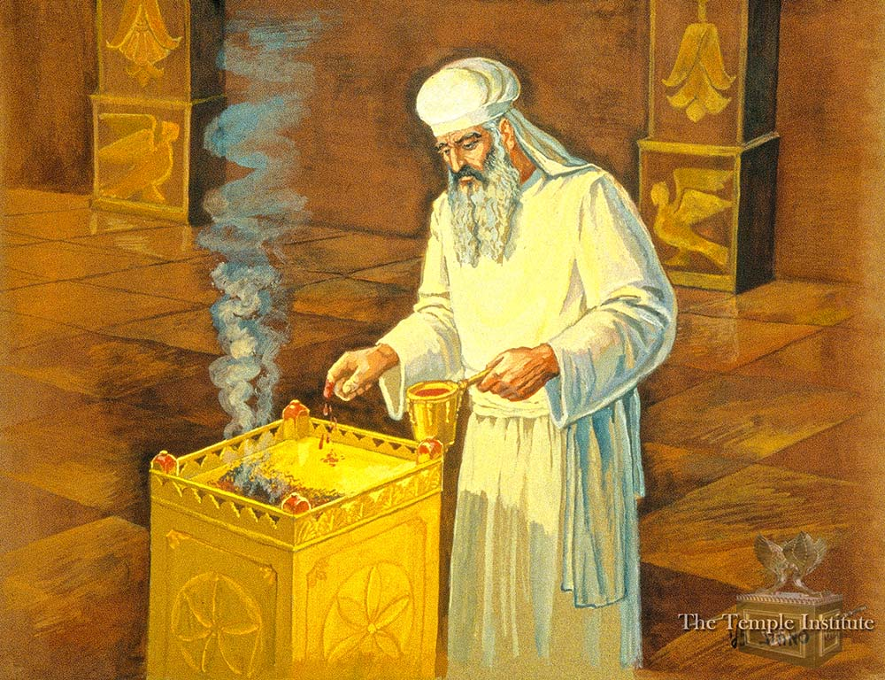
Notes:
https://templeinstitute.org/yom-kippur-part-7/
Finally, while still in the Sanctuary, the Kohen Gadol mixes the contents of both vessels together. He pours the mizrak containing the bullock's blood into that of the goat, and then pours from this full vessel back into the empty one (of the bullock) so that they will blend completely together. All this is on account of the verse (Lev. 16:18) "He shall then go out to the altar that is before G-d and make atonement on it. He shall take some of the bullock's blood and some of the goat's blood, and place the mixture on the horns of the altar all around."

Slide 61
Notes:
https://templeinstitute.org/yom-kippur-part-7/
The Kohen Gadol walks around the incense altar and sprinkles on each of its four corners. Afterwards, he clears away some of the coals on top and exposes some of the gold surface of the altar. On this area, the "floor" of the small incense altar, he sprinkles an additional seven times, as per the verse (ibid. 19): "He shall sprinkle the blood on it seven times with his forefinger." Whatever was left in the mizrak when he concluded, he poured out onto the western side of the outer altar's foundation, in keeping with the instructions (Lev. 4:7): "He shall then spill out all the rest of the bull's blood at the base of the altar, which is in front of the entrance to the Tent of Meeting."

Slide 62
^{MJ 9.24} For the Messiah has entered a Holiest Place which is not man-made and merely a copy of the true one, but into heaven itself, in order to appear now on our behalf in the very presence of God.

Slide 63
^{MJ 9.23-24} Therefore it was necessary for the replicas of these heavenly things to be purified with these sacrifices—but the heavenly things themselves with better sacrifices than these.

Slide 64
Moshe was told ^{Shmot/Ex 25.9,40} You are to make it all precisely according to everything that I show you—the pattern of the Tabernacle and the pattern of all the furnishings within—just so you must make it...See that you make them according to their pattern being shown to you on the mountain.

Slide 65
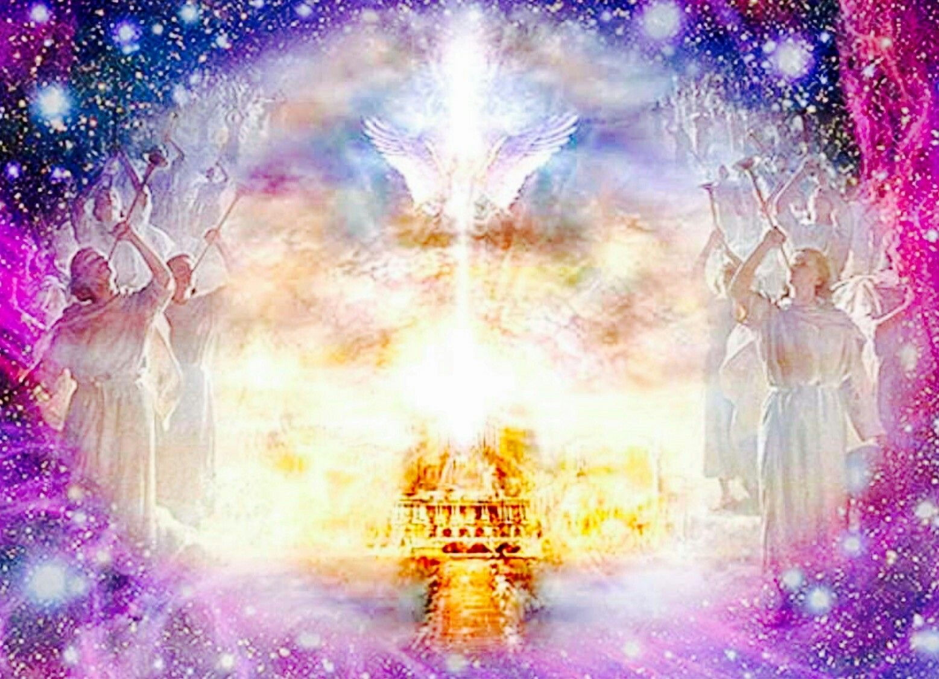
Notes:
https://duckduckgo.com/?q=christ+entered+the+holy+of+holies+in+heaven&iax=images&ia=images&iai=https%3A%2F%2Fi.pinimg.com%2Foriginals%2Fa3%2F89%2F86%2Fa389860fff5e6b793b9b6fed4be2e6d4.jpg

Slide 66
^{MJ 9.11-14} But when the Messiah appeared as cohen gadol of the good things that are happening already, then, through the greater and more perfect Tent which is not man-made (that is, it is not of this created world),

Slide 67
^{MJ 9.11-14} he entered the Holiest Place once and for all. And he entered not by means of the blood of goats and calves, but by means of his own blood, thus setting people free forever.

Slide 69
Outline of this message
What happened in the 3 days?
What is the Temple pattern?
What are the certainties?

Slide 70
How did He enter that place?

Slide 71
He had authority to enter the true holy place at any moment during His perfect life. But He would have gone alone, as He came alone.

Slide 72
He could have entered the Holiest Place = Heaven as Creator.

Slide 73
He could have entered the Holiest Place = Heaven as Creator.
He could have entered the Holiest Place as Son.

Slide 74
He could have entered the Holiest Place = Heaven as Creator.
He could have entered the Holiest Place as Son.
He could have entered the Holiest Place as perfect, pure.

Slide 75
He came with our iniquities:
^{T’hillim/Ps 38.4-7} Your indignation left no part of me intact; my [bearing humanity’s] sin made my whole body sick; for iniquities loom high over my head as a heavy burden, too heavy for me.

Slide 76
He came with our iniquities:
^{T’hillim/Ps 38.4-7} I have stinking, festering wounds because of [our] my foolishness. I am bent down, prostrate completely; I go about mourning all day long.

Slide 77
^{T’hillim/Ps 68.4-7} I am exhausted from crying, my throat is dry and sore, my eyes are worn out with looking for my God. Those who hate me for no reason outnumber the hairs on my head.

Slide 78
^{T’hillim/Ps 68.4-7} My persecutors are powerful, my enemies accuse me falsely. I am expected to return things I didn’t steal. [Humanity’s standing with G-d]

Slide 79
^{T’hillim/Ps 22.7-9} But I am a worm, not a man, scorned by everyone, despised by the people. All who see me jeer at me; they sneer and shake their heads: “He committed himself to Adoni, so let him rescue him! Let him set him free if he takes such delight in him!”

Slide 80
He entered bearing our sins in His own body and blood.
In eternity the endless love of an infinite G-d was expressed on the execution stake, quenchless affection of our great Cohen Gadol. There is nothing greater in the universe!!
Notes:
Newell p 295

Slide 81
He carried his blood not in a basin, as the high priest carried the blood of goats and calves, but in his veins; and by it, having been shed by him, he entered not into the holy place made with hands, but into heaven itself.
Notes:
https://www.biblestudytools.com/commentaries/gills-exposition-of-the-bible/hebrews-9-12.html
Some time ago I used the metaphor of a proposed space elevator…

Slide 82
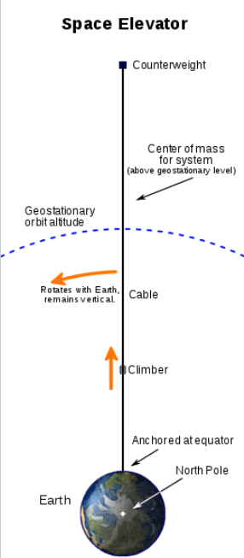
A space elevator is conceived as a cable fixed to the equator and reaching into space. Cable ~30,000 miles long!
Notes:
A counterweight at the upper end keeps the center of mass well above geostationary orbit level. This produces enough upward centrifugal force from Earth's rotation to fully counter the downward gravity, keeping the cable upright and taut. Climbers carry cargo up and down the cable.
https://en.wikipedia.org/wiki/Space_elevator#21st_century

Slide 83
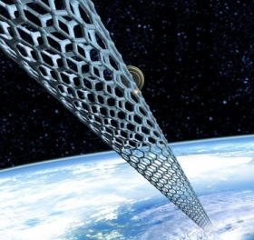
For sinners only!
Notes:
https://www.google.com/url?sa=i&url=https%3A%2F%2Fwww.outerplaces.com%2Fscience%2Fitem%2F10468-we-might-be-able-to-build-a-space-elevator-made-of-microscopic-threads-of-diamonds&psig=AOvVaw1uK8JUr3w_WFQ0nfcjIko6&ust=1610220868441000&source=images&cd=vfe&ved=0CAIQjRxqFwoTCLiA5bOKje4CFQAAAAAdAAAAABAY
No advantage in this to being Jewish, 2nd generation believer, pretty good, right political party, member. We are admitted by self renunciation and trust!

Slide 84
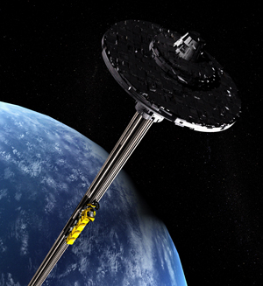

Slide 85
^{Messianic Jews 6.13 to 6.20} We have this hope as a sure and safe anchor for ourselves, a hope that goes right on through to what is inside the parokhet, where a forerunner has entered on our behalf, namely, Yeshua, who has become a cohen gadol forever, to be compared with Malki-Tzedek.

Slide 86
We need to access
to higher places!

Slide 88
^{MJ 9.11-14} he entered the Holiest Place once and for all. And he entered not by means of the blood of goats and calves, but by means of his own blood, thus setting people free forever.

Slide 89
Traditional Jews pray and repent and sing repentant songs, but don’t go away FREE!!

Slide 90
^{MJ 9.11-14} For if sprinkling ceremonially unclean persons with the blood of goats and bulls and the ashes of a heifer restores their outward purity; then how much more the blood of the Messiah,

Slide 91
^{MJ 9.11-14} who, through the eternal Spirit, offered himself to God as a sacrifice without blemish, will purify our conscience from works that lead to death, so that we can serve the living God!
Notes:
Thinking we can purify our conscience by “doing better” “doing it right”. Rather confess, trust PLUS change what you can.

Slide 93
^{MJ 9.11-14} He entered the Holiest Place once and for all. And he entered not by means of the blood of goats and calves, but by means of his own blood, thus setting people free forever.

Slide 94
Do you KNOW Yeshua and the assurance of sins forgiven?
Are you hearing daily from His Word?
How are you applying what you heard?
Are you asking this of another?
Notes:
Who are you discipling, building up?4

Slide 96
