Slide 1
e-handout
To have these notes
without taking notes
Go to OrHaOlam.com
Click on downloads,
messages, 2021

Slide 2
Danish artist Jens Haaning received $84,000 from the Kunsten Museum of Modern Art in Aalborg, Denmark, to use for a piece, but when he delivered the artwork it was not what had been promised, CBS News reported Thursday.
Notes:
https://thejewishvoice.com/2021/10/museum-gave-artist-84k-for-artwork-he-delivered-blank-canvases-called-take-the-money-and-run/

Slide 3
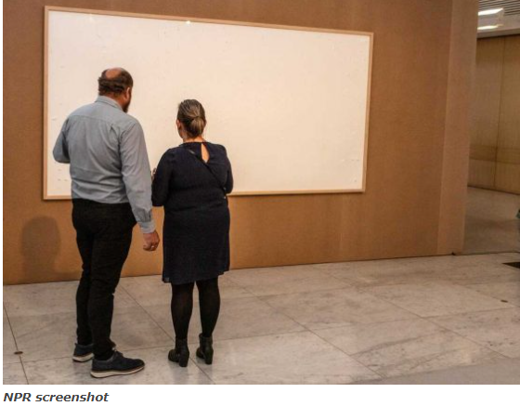
Notes:
https://thejewishvoice.com/2021/10/museum-gave-artist-84k-for-artwork-he-delivered-blank-canvases-called-take-the-money-and-run/

Slide 4
Artist Jens Haaning presented the Kunsten Museum of Modern Art in Aalborg, Denmark, with two blank canvases and explained they were called “Take the Money and Run.”
$84,000!
Notes:
https://thejewishvoice.com/2021/10/museum-gave-artist-84k-for-artwork-he-delivered-blank-canvases-called-take-the-money-and-run/

Slide 5
MJ 9.15-17
Testament or Covenant
Notes:
To many Jewish people, the New Testament is a foreign book, suspected to be full of anti-Semitic goading. The name doesn’t even sound like a religious Jewish book. Testament? We’ll find out it’s partially a true name.

Slide 6
^{MJ 9.15-17} It is because of this death that he is mediator of a new covenant [or testament]. Because a death has occurred which sets people free from the transgressions committed under the first covenant, those who have been called may receive the promised eternal inheritance.
Notes:
Meaning of “covenant or testament”
What “new covenant?”
Transgressions before?
Eternal inheritance and covenant.

Slide 7
^{MJ 9.15-17} For where there is a will, there must necessarily be produced evidence of its maker’s death, since a will goes into effect only upon death; it never has force while its maker is still alive.
Notes:
Sounds like a “last will and testament.”

Slide 8
What is the context, from last week…

Slide 9
^{MJ 9.14} The blood of Messiah [who through the eternal Spirit offered Himself without blemish to God] will cleanse our conscience from dead works to serve the living God.

Slide 10
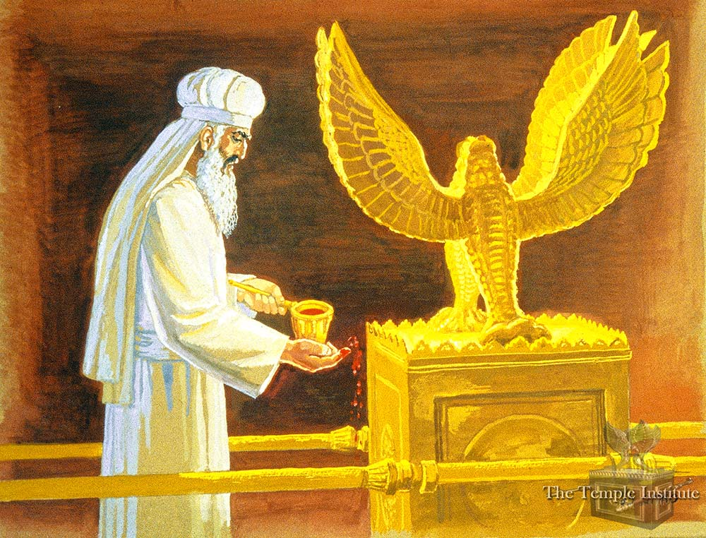
Jerusalem Temple
Notes:
https://templeinstitute.org/yom-kippur-part-6/

Slide 11
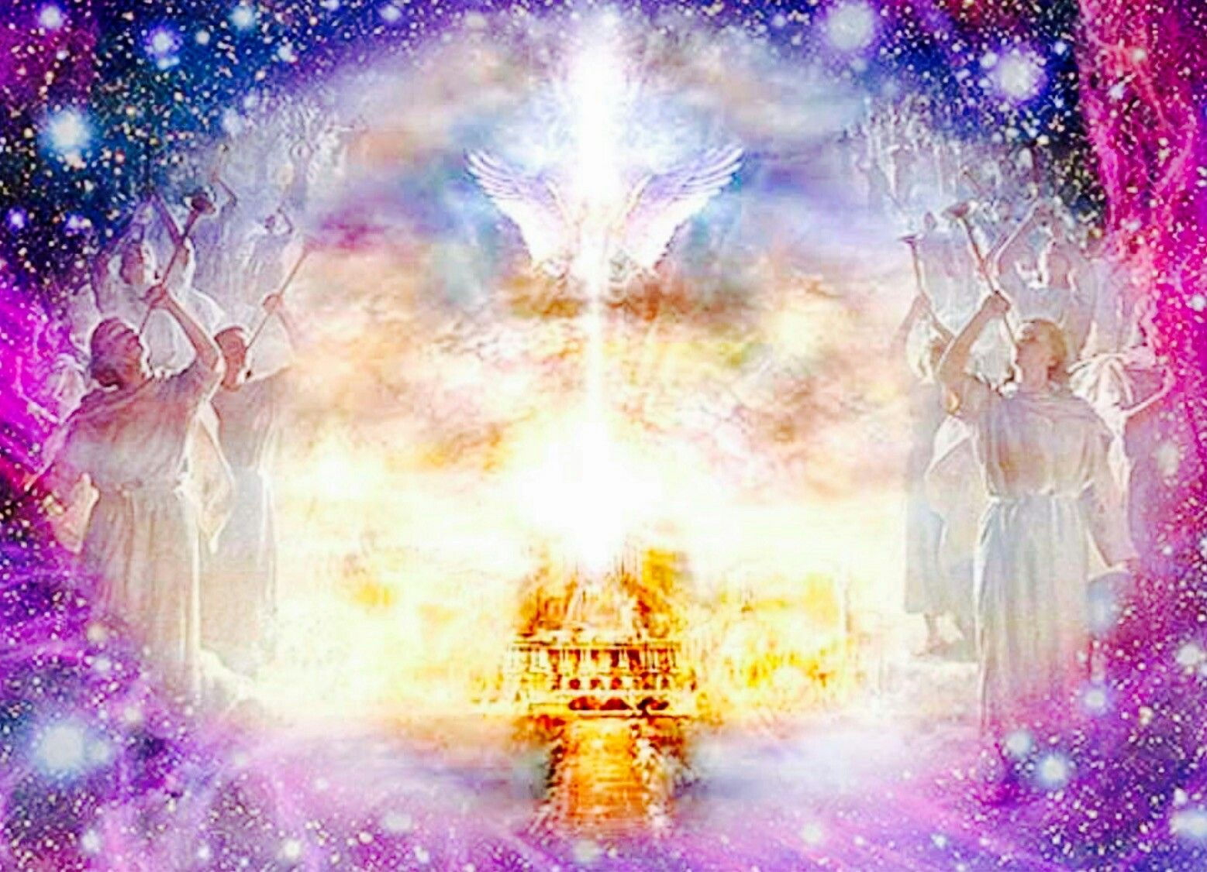
Heavenly Temple?
Notes:
https://duckduckgo.com/?q=christ+entered+the+holy+of+holies+in+heaven&iax=images&ia=images&iai=https%3A%2F%2Fi.pinimg.com%2Foriginals%2Fa3%2F89%2F86%2Fa389860fff5e6b793b9b6fed4be2e6d4.jpg

Slide 12
Meaning of “covenant”
What “new covenant?”
Transgressions before?
Eternal inheritance and covenant.

Slide 13
^{MJ 9.15-17} It is because of this death that he is mediator of a new covenant [or will, testament ^{KJV}].
This phrase has mystified Messianics:
KJV: And for this cause he is the mediator of the new testament,
Notes:
Testament 13x in the Messianic scriptures.
New Testament is the wrong term. Only half wrong.
Old Testament vs New Testament
But, WHAT does that word really mean?
Scientists explore phenomena, and draw conclusions. We explore scripture evidence…and draw conclusions!

Slide 14

MJ/ Heb 9.15…

Slide 15

diá, "thoroughly," intensifying
títhēmi, "place, set“
diathḗkē a set-agreement
Notes:
Sounds like Yoda talk.
Note components of the word, diatheke
This word, diathekes, appears 3x in this reading, in vs 16, 17, 18. A Hebraic reading of it changes everything from replacement thinking to covenant thinking.

Slide 16
diathḗkē a set-agreement having complete terms determined by the initiating party, which also are fully affirmed by the one entering the agreement.
Meaning: between a will and a covenant.
Notes:
One sided leaning covenant.

Slide 17
W.E. Vines Expository Dictionary:
“In contradistinction to the English word “covenant” (lit., “a coming together”), which signifies a mutual undertaking between two parties or more,
Notes:
https://studybible.info/vines/Covenant%20(Noun%20and%20Verb)

Slide 18
each binding himself to fulfill obligations, diathḗkē does not in itself contain the idea of joint obligation, it mostly signifies an obligation undertaken by a single person.”
Notes:
also are fully affirmed by the one entering the agreement.
W.E. Vines Expository Dictionary:
https://studybible.info/vines/Covenant%20(Noun%20and%20Verb)

Slide 19
^{MJ 9.15-17} It is because of this death that he is mediator of a new covenant [or will].
Notes:
Rethink the beginning of this verse in the clarified understanding…
Covenant = divine leaning, initiated, empowered, impassioned relationship.
Application?

Slide 20
So, whenever you hear the words “New Testament” again, think of “love led, empowered covenant.”
Notes:
Not just a will, not just a covenant.

Slide 21
So, whenever you hear the words “New Testament” again, think of “love led, empowered covenant.”
When we, people enter into a covenant, it’s somewhat one-sided. YOU are the GIVER.

Slide 23
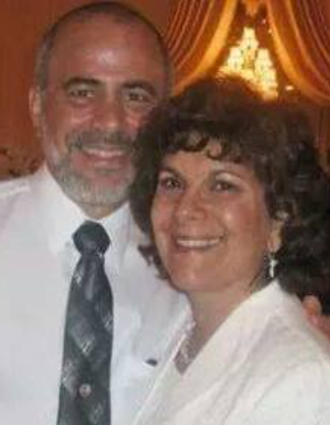
The profound words of Hoshea 2.19-20 were set to music by Rabbi Jan and Marlene Rosenberg, Messianic Rabbi in Jackson, NJ

Slide 24
Forever Loved betrothed = covenanted
From Hoshea 2.19-20; Jeremiah 31.3
by Rabbi Jan Rosenberg © 1996 Tovah Publications
Notes:
Makes a GREAT wedding march

Slide 25
וְאֵֽרַשְתִּיךְ לִי לְעוֹלָם
V‘ay rastikh lee layolam
[I will betroth you to Myself forever]
וְאֵֽרַשְתִּיךְ לִי בְּצֶדֶק
V‘ay rastikh lee b‘tsedek
[I will betroth you to Myself in righteousness]
Notes:
Bethroth means covenant

Slide 26
וּבְמִשְׁפָּט וּבְחֶסֶד וּבְרַֽחֲמִֽים
Oov’mishpat oov’khesed oov’rakhamim
[With justice, in love, and in compassion]
וְיָדַעַתְּ אֶת יְיָ
V’yada at et Adoshem
[And you shall know the L-rd]

Slide 27
I will betroth you to Myself forever
I will betroth you to Myself in righteousness
With justice, in love, and in compassion
And you shall know the L-rd

Slide 28
וְאֵֽרַשְתִּיךְ לִי בֶּאֱמוּנָה
V‘ay rastikh lee bey-emunah
I will betroth you to Myself in faithfulness

Slide 29
וְיָדַעַתְּ אֶת יְיָ
V’yada at et Adoshem
And you shall know Me intimately

Slide 30
Forever Loved, Forever Free,
Forever will you be married to me
For I’ve loved you with an everlasting love
And with cords of mercy have I drawn you near to me
My beloved, my beloved I’ve drawn you near to me

Slide 31
Wherever you go, I will follow you
Wherever you lead, I’ll be there
Wherever you lodge, that will be my home
Forever will I be wed to you

Slide 32
Come away with Me My sister, My bride
Come away with Me into a new life
Come away with Me My sister, My bride
Come away with Me with Me to abide

Slide 33
Come away (Wherever You lead me)
Come away (I’ll follow after You)
Come away (Where You lead I’ll follow)
Forever will we be together

Slide 34
Forever Loved, Forever Free,
Forever will you be married to me
For I’ve loved you with an everlasting love
And with cords of mercy have I drawn you near to me
My beloved, my beloved I’ve drawn you near to me

Slide 35
Wherever you go, I will follow you
Wherever you lead, I’ll be there
Wherever you lodge, that will be my home
Forever will I be wed to you

Slide 36
Come away with Me My sister, My bride
Come away with Me into a new life
Come away with Me My sister, My bride
Come away with Me with Me to abide

Slide 37
Come away (Wherever You lead me)
Come away (I’ll follow after You)
Come away (Where You lead I’ll follow)
Forever will we be together

Slide 38
Forever will we be together
Forever will we be together
Forever and forever Together Forever and forever

Slide 39
Betrothed = covenanted
G-d in Messiah’s covenantal love for us as individuals.
G-d in Messiah’s covenantal love for Israel.
Our covenantal love for…
Notes:
[Pause and invite]

Slide 40
^{MJ 9.15-17} It is because of this death that he is mediator of a new covenant [or testament]. Because a death has occurred which sets people free from the transgressions committed under the first covenant, those who have been called may receive the promised eternal inheritance.
Notes:
Meaning of “covenant or testament”
What “new covenant?”
Transgressions before?
Eternal inheritance and covenant.

Slide 41
Meaning of “covenant”
What “new covenant?”
Transgressions before?
Eternal inheritance and covenant.

Slide 42
^{Yermiyahu/Jer 31.31-33} “Here, the days are coming,” says Adoni, “when I will make a new covenant with the house of Isra’el and with the house of Y’hudah…“I will put my Torah within them and write it on their hearts; I will be their God,

Slide 43
^{Yermiyahu/Jer 31.31-33} and they will be my people…all will know me, from the least of them to the greatest; because I will forgive their wickednesses and remember their sins no more.”

Slide 44
^{Lk. 22.20-21} He took the cup after the meal, saying, “This cup is the new covenant in My blood, which is poured out for you

Slide 45
Meaning of “covenant”
What “new covenant?”
Transgressions before?
Eternal inheritance and covenant.

Slide 46
^{MJ 9.15-17} It is because of this death that he is mediator of a new covenant [or will]. Because a death has occurred which sets people free from the transgressions committed under the first covenant,
Notes:
In fact, all forgiveness in the Bible was because of Messiah Yeshua’s sacrifice. An animal has no moral value to lay down its life in your behalf. It can only lay down its life as your lamb chops or ribeye. All forgiveness in history has been through Yeshua. He is the Lamb slain from the foundation of the world.

Slide 47
^{MJ 9.15-17} It is because of this death that he is mediator of a new covenant [or will]. Because a death has occurred which sets people free from the transgressions committed under the first covenant, those who have been called may receive the promised eternal inheritance.

Slide 48
Meaning of “covenant”
What “new covenant?”
Transgressions before?
Eternal inheritance and covenant.
Notes:
Stern: These three words can be traced through the Tanakh as they outline one of its major themes.
Inheritance is a big issue in human civilization…

Slide 49
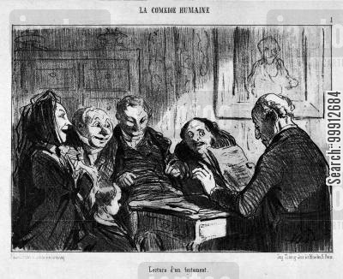
Relative awaiting the reading of the will.
Notes:
https://s3.amazonaws.com/lowres.jantoo.com/families-last_will-testament-inherit-estate-will-99912684_low.jpg

Slide 50
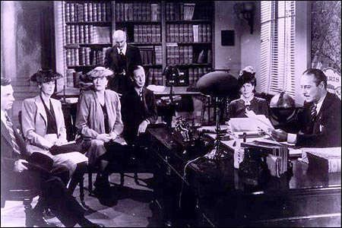
Notes:
https://www.hoyweb.com/CMS/uploadedImages/reading-450x300.will

Slide 51
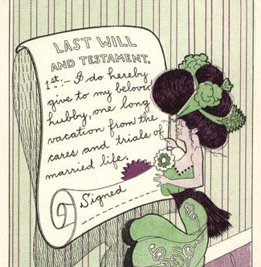
Notes:
https://www.cardcow.com/images/set382/card00139_fr.jpg

Slide 52
Eternal inheritance.

Slide 53
^{Ber./Gen 2.9} Adoni Elohim caused to sprout from the ground every tree that was desirable to look at and good for food. Now the Tree of Life was in the middle of the garden, and also the Tree of Knowledge of Good and Evil.
Notes:
Implying eternal life

Slide 54
^{Ber./Gen 2.16-17} Then Adoni Elohim commanded the man saying, “From all the trees of the garden you are most welcome to eat. But of the Tree of the Knowledge of Good and Evil you must not eat. For when you eat from it, you most assuredly will die!

Slide 55
^{Ber./Gen 3.22-23} Adoni, God, said, “See, the man has become like one of us, knowing good and evil. Now, to prevent his putting out his hand and taking also from the tree of life, eating, and living forever — ” therefore Adoni, God, sent him out of the garden of ‘Eden.

Slide 56
^{Ber./Gen 9.16} The rainbow will be in the cloud; so that when I look at it, I will remember the everlasting covenant between God and every living creature of any kind on the earth.”

Slide 57
^{Ber./Gen 13.15} For all the land that you are looking at, I will give to you and to your seed forever.
Notes:
God promised Avraham and his seed the Land of Israel for ever

Slide 58
^{Ber./Gen 15.7} “I am Adoni who brought you out from Ur of the Chaldeans, in order to give you this land to inherit it.
Notes:
the term "inherit" is first used in the Bible in connection with this promise

Slide 59
^{MJ 9.15 CJB} It is because of this death that he is mediator of a new covenant [or will or testament]. Because a death has occurred which sets people free from the transgressions committed under the first covenant, those who have been called may receive the promised eternal inheritance.

Slide 60
Meaning of “covenant”
What “new covenant?”
Transgressions before?
Eternal inheritance and covenant.
Notes:
More on eternal inheritance and covenant vs testament in those perplexing vss 16-17

Slide 61

^{MJ 9.16-17} For where there is a will / covenant, the death of the one who made it must be established.
Notes:
There must necessarily be produced the evidence of its maker's death. For wills this is self-evident; but it is also true for God's covenants, insofar as sacrifices are stand-ins for the death of the one offering them. Noah offered sacrifices (Genesis 8:20, 9:9). In the case of Avraham there were actual sacrifices (Genesis 15:9, 17-18) as well as the symbolism of the blood shed at circumcision (Genesis 17:11 The context ^{(vv. 15, 18-22)} is that of covenants as set forth in the Tanakh, where the Hebrew word "b'rit" must be translated "covenant" and cannot be rendered as "will." Although "will" is suggested by the last word of v. 15, "inheritance," the Tanakh uses "inheritance" to mean "that which is to be received" and knows nothing of wills.

Slide 62
^{MJ 9.16-17} For where there is a will / covenant, the death of the one who made it must be established. For a covenant is secured upon the basis of dead bodies, since it has no strength as long as the one who made it lives.

Slide 63

a will goes into effect only upon death, sacrifices are stand-ins for the death of the one offering them.
Notes:
On the day God cut a covenant with Avram that his descendants would inherit the Land, Avram cut animals in pieces and saw a burning lamp pass between them (Ber/Gen 15:7-21). ﻿

Slide 64
^{MJ 9.16-17 TLV} For where there is a covenant, the death of the one who made it must be established. For a covenant is secured upon the basis of dead bodies, since it has no strength as long as the one who made it lives.
Notes:
^{Shmot/Ex 24.8} Then Moshe took the blood, sprinkled it on the people, and said, “Behold the blood of the covenant, which Adoni has cut with you, in agreement with all these words.

Slide 65
Application
G-d made covenants of infinite unimaginably great love. It’s NOT 50/50. We just receive.
When we make covenants, it’s not 50/50. We just give.

Slide 66
Do you KNOW Yeshua and the assurance of sins forgiven?
Are you hearing daily from His Word?
How are you applying what you heard?
Are you asking this of another?
Notes:
Who are you discipling, building up?4

Slide 68
