Slide 1
e-handout
To have these notes
without taking notes
Go to OrHaOlam.com
Click on downloads,
messages, 2021

Slide 2
"Stewardesses" is the longest word typed with only the left hand
Notes:
My cousin Lowell Schatzer, Vietnam vet Marine

Slide 3
And "lollipop“ is the longest word typed with your right hand.

Slide 4
No word in the English language rhymes with month, orange, silver, or purple.

Slide 5
“Dreamt” is the only English word that ends in the letters "mt".

Slide 7
Where we left off in the study of Messianic Jews/Hebrews,
Oct. 9…
Testament or Covenant?
Notes:
Testament = one way gift
Covenant = mutual agreement.

Slide 8
^{MJ 9.15} It is because of this death that he is mediator of a new covenant [or testament or will].
Notes:
Rethink the beginning of this verse in the clarified understanding…
Covenant = divine leaning, initiated, empowered, impassioned relationship.
Application?

Slide 9
W.E. Vines Expository Dictionary:
“In contradistinction to the English word “covenant” (lit., “a coming together”), which signifies a mutual undertaking between two parties or more,
[50/50]
Notes:
https://studybible.info/vines/Covenant%20(Noun%20and%20Verb)

Slide 10
each binding himself to fulfill obligations, diathḗkē does not in itself contain the idea of joint obligation, it mostly signifies an obligation undertaken by a single person.”
Notes:
also are fully affirmed by the one entering the agreement.
W.E. Vines Expository Dictionary:
https://studybible.info/vines/Covenant%20(Noun%20and%20Verb)

Slide 11
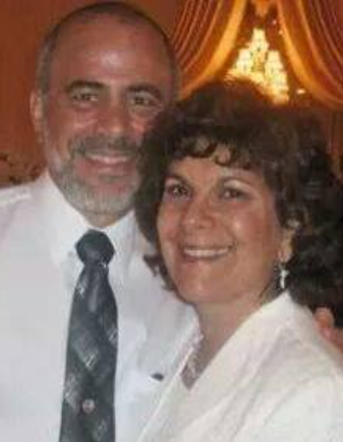
The profound words of Hoshea 2.19-20, Jer. 31.3, were set to music by Rabbi Jan and Marlene Rosenberg, Messianic Rabbi in Jackson, NJ
Notes:
~Hoshea to unfaithful Gomer
G-d binding Himself in covenantal love to wayward Israel and all people

Slide 12
I will betroth you to Myself forever
I will betroth you to Myself in righteousness
With justice, in love, and in compassion
And you shall know the L-rd

Slide 13
Forever Loved, Forever Free,
Forever will you be married to me
For I’ve loved you with an everlasting love
And with cords of mercy have I drawn you near to me
My beloved, my beloved I’ve drawn you near to me
Notes:
Jer 31.3

Slide 14
So, whenever you hear the words “New Testament” or “New Covenant” again, think of “love led, empowered covenant.”
Notes:
Not just a will, not just a covenant.
Not 50/50

Slide 15
So, whenever you hear the words “New Testament” or “New Covenant” again, think of “love led, empowered covenant.”
When we, people enter into a covenant, it’s also somewhat one-sided. YOU are the GIVER.
Notes:
Not just a will, not just a covenant.

Slide 16
“Love led, empowered covenant” thinking
goes farther in today’s reading: Heb./MJ 9.18-22

Slide 17
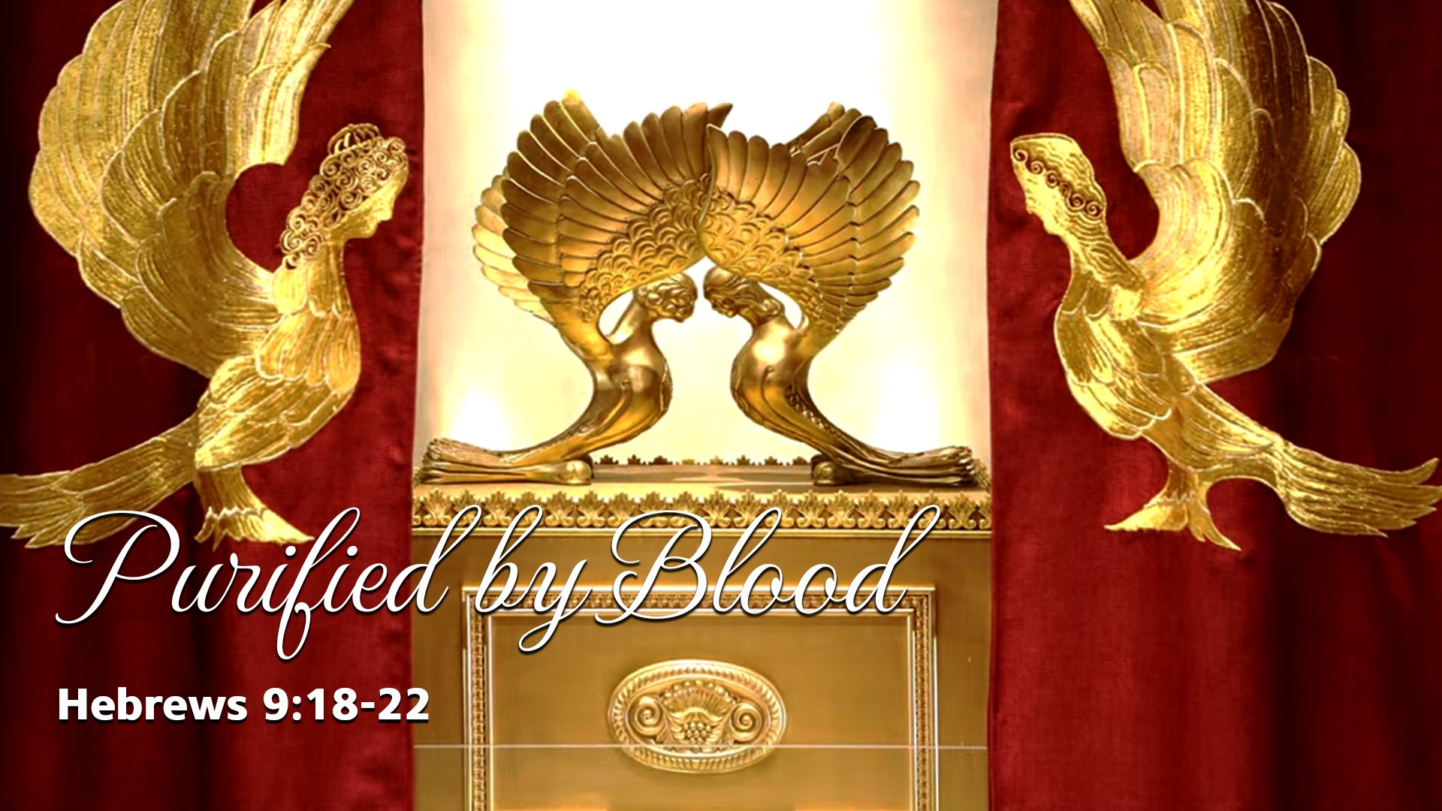

Slide 18
MJ [Hebrews, Messianic Jews] 9.18-22 The first covenant too was inaugurated with blood. After Moshe had proclaimed every command of the Torah to all the people, he took the blood of the calves with some water and used scarlet wool and hyssop to sprinkle

Slide 19
MJ [Hebrews, Messianic Jews] 9.18-22 both the scroll itself and all the people; and he said, “This is the blood of the covenant which God has ordained for you.” Likewise, he sprinkled with the blood both the Tent and all the things used in its ceremonies.

Slide 20
MJ [Hebrews, Messianic Jews] 9.18-22 In fact, according to the Torah, almost everything is purified with blood; indeed, without the shedding of blood there is no forgiveness of sins.
Notes:
Key thought. The Blood of Messiah represents His covenantal love.

Slide 21
“Love led, blood bought, empowered covenant” Heb./MJ 9.18-22
Outline: Purified by Blood
Mosaic context
Yeshua reality
Our blood

Slide 22
“Love led, blood bought, empowered covenant” Heb./MJ 9.18-22
Outline: Purified by Blood
Mosaic context
Yeshua reality
Our blood
Notes:
Look again at the MJ/Heb passage carefully. What is the context of Moshe doing this?
Note nine actions taken by Moshe described here.

Slide 23
MJ [Hebrews, Messianic Jews] 9.18-22 The first covenant too was inaugurated with blood. After Moshe had proclaimed every command of the Torah to all the people, he took ¹ the blood of the calves ² with some water and ³ used scarlet wool and ⁴ hyssop to sprinkle

Slide 24
MJ [Hebrews, Messianic Jews] 9.18-22 both ⁵ the scroll itself and ⁶ all the people; and he said, ⁷ “This is the blood of the covenant which God has ordained for you.” ⁸ Likewise, he sprinkled with the blood both the Tent and ⁹ all the things used in its ceremonies.
Notes:
Nine actions done by Moshe after reading the scroll.

Slide 25
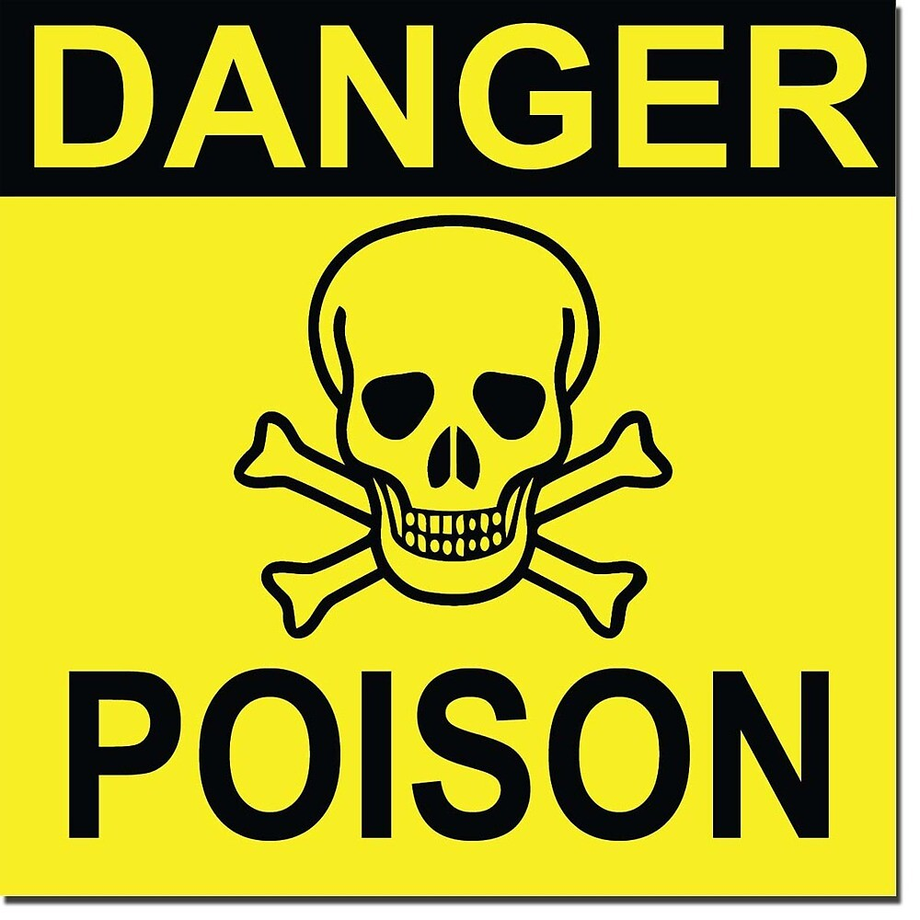

Notes:
https://clipground.com/images/poisened-clipart-13.jpg
https://ih1.redbubble.net/image.203343941.3185/flat,1000x1000,075,f.jpg

Slide 26
These 9 actions never happened all simultaneously together. Therefore, at least one major Bible teacher has discredited the Book of MJ/Hebrews, that it shouldn’t be considered inspired, and has removed it.
Notes:
Most apparent contradictions in the Bible, when researched, are faith builders!
When I was a young believer, and not so young, when an apparent contradiction in the scriptures came up, I would do the manly thing…and panic. Until I was shown this verse.

Slide 27
^{Yeshayahu/Is 28.19} Therefore thus says Adoni Elohim: ‘Behold, I am laying in Zion a stone, a tested stone, a costly cornerstone, a firm foundation— whoever trusts will not flee in haste. [that is, panic, be confounded.]
Notes:
Quoted in 1 Kefa/Peter 2.6 “confounded” KJV

Slide 28
Let’s look at the context.

Slide 29
Blood of calves
Water
Scarlet wool
Hyssop
Sprinkled the scroll
Sprinkled the people
Pronouncement
Sprinkled the tent
Sprinkled everything

Slide 31
^{Shmot/Ex 24.4-8} Moshe wrote down all the words of Adoni…He sent the young men of the people of Isra’el to offer burnt offerings and sacrifice peace offerings of oxen to Adoni. Moshe took half of the blood and put it in basins; the other half of the blood he splashed against the altar.

Slide 32
^{Shmot/Ex 24.4-8} Then he took the book of the covenant and read it aloud, so that the people could hear; and they responded, “Everything that Adoni has spoken, we will do and obey.” ⁶ Moshe took the blood, sprinkled it on the people and said,

Slide 33
^{Shmot/Ex 24.4-8} ⁷ “This is the blood of the covenant which Adoni has made with you in accordance with all these words.”

Slide 34
^{Vayikra/Lev 8.15} ¹ ⁸ ⁹ Moshe took the blood and put it on the horns of the altar all the way around with his finger, thus purifying the altar. The remaining blood he poured out at the base of the altar and consecrated it, to make atonement for it.

Slide 35
^{Vayikra/Lev 14.2,4} “This is the Torah of the one with tza’arat in the day of his cleansing. He should be brought to the kohen… then the kohen is to command that two clean living birds, cedar wood, scarlet and hyssop be brought for the one being cleansed.

Slide 36
^{Vayikra/Lev 14.6-7} As for the living bird, he is to take it, the cedar wood, the scarlet and the hyssop, and dip them with the living bird into the blood of the bird that was killed over the living water. ⁶ He is to sprinkle on the one being cleansed from the tza’arat seven times and pronounce him clean, then release the living bird over the open field.

Slide 37
^{Bamidbar/Nu 19.2} “This is the statute of the Torah which Adoni commanded saying: Speak to Sons of Yisrael that they bring to you a flawless red heifer on which there is no blemish and on which has never been a yoke.

Slide 38
^{Bamidbar/Nu 19.3-4} He will take her outside the camp and slaughter her in his presence. Then Eleazar the kohen is to take some of the blood on his finger and ⁸ sprinkle it seven times toward the front of the Tent of Meeting.

Slide 39
^{Bamidbar/Nu 19.5-6} “While watching, he is to burn the heifer, her hide, flesh, blood and refuse. The kohen is to take some cedar wood, ⁴ hyssop and ³ scarlet wool, and cast them into the midst of the burning heifer.

Slide 40
^{Bamidbar/Nu 19.17} They are to take some of the ash of the burnt purification offering, ² and pour some fresh water into a jar.

Slide 41
^{Bamidbar/Nu 19.18} Then a clean person will take some hyssop, dip it into the water, and, sprinkle it on the tent, ⁶ all of the furnishings, and the people who were there, as well as the one touching the bone, the one killed, the corpse or the grave.
Notes:
The scroll of the covenant, from which Moses read to the people, is nowhere mentioned as having been sprinkled; but since it was made by human hands, it too needed cleansing, even though the words in it were from God himself. ﻿ [Stern’s commentary]

Slide 43
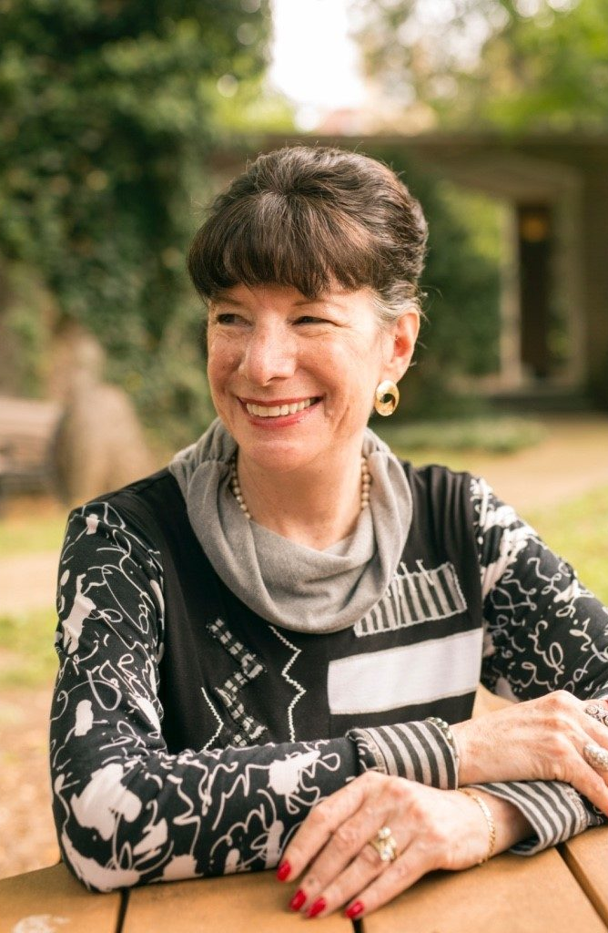
So, 8 of the 9 took place, but what Orthodox Jewish scholar, Vanderbilt U., Amy Jill Levine calls “conflating” the allusions.
Notes:
Amy-Jill Levine (born 1956) is E. Rhodes and Leona B. Carpenter Professor of New Testament Studies at Vanderbilt University Divinity School, Department of Religious Studies, and Graduate Department of Religion. Orthodox Jewish woman.

Slide 44
Exodus 40:9-10 says that the Tent and all the things used in its ceremonies were purified with oil, but it does not mention blood. However, Josephus, in retelling the story, writes that Moses purified
Notes:
We don’t know the exactly how the process of HOW the Mishkan / Tabernacle worship took place.

Slide 45
"the Tent and the vessels which belonged to it, both with oil that had first been incensed, and with the blood of bulls and rams." {Antiquities of the Jews 3:8:6) ﻿
Notes:
We don’t know the

Slide 46
So, now that we’ve addressed the skeptics objection to this scripture about blood anointed covenant of love, let’s consider the next verse…

Slide 47
MJ [Hebrews, Messianic Jews] 9.18-22 In fact, according to the Torah, almost everything is purified with blood; indeed, without the shedding of blood there is no forgiveness of sins.
almost everything??

Slide 48
^{Bamidbar/Nu 31:7, 11, 21-24} They fought against Midyan, as Adoni had ordered Moshe, and killed every male…They seized all the plunder and all the spoil, both people and animals. El‘azar the cohen said to the soldiers who had gone to the front,

Slide 49
^{Bamidbar/Nu 31:7, 11, 21-24} “This is the regulation from the Torah which Adoni has ordered Moshe. Even though gold, silver, brass, iron, tin and lead can all withstand fire, so that you are indeed to purify everything made of these materials by having them pass

Slide 50
^{Bamidbar/Nu 31:7, 11, 21-24} through fire; nevertheless they must also be purified with the water for purification. Everything that can’t withstand fire you are to have go through the water.

Slide 51
MJ [Hebrews, Messianic Jews] 9.18-22 In fact, according to the Torah, almost everything is purified with blood; indeed, without the shedding of blood there is no forgiveness of sins.

Slide 53
“Love led, empowered covenant”
Outline: Purified by Blood
Mosaic context
Yeshua reality
Our blood

Slide 54
Why is blood necessary?

Slide 55
(Leviticus 17:11, Jewish Publication Society translation) For the life of the flesh is in the blood; and I have given it to you upon the altar to make atonement for your souls; for it is the blood that maketh atonement by reason of the life.

Slide 56
It is not supposed here that a magical power resides in blood Rather, Vayikra/Lev 17:11 is one of the Torah’s clearest statements of the indissoluble connection between sin and death. Already at Genesis 2:17-21 it is clear that sin, defined as disobedience to God, requires the sinner's death.
Notes:
Stern’s commentary

Slide 57
^{Ber/Gen 2.17} Of the Tree of the Knowledge of Good and Evil you must not eat. For when you eat from it, you most assuredly will die!
^{Ro.6.23} For what one earns from sin is death.

Slide 58
^{Yn 10.11,17-18} “I am the Good Shepherd. The Good Shepherd lays down His life for the sheep…No one takes it away from Me, but I lay it down on My own. I have the authority to lay it down, and I have the authority to take it up again. This command I received from My Father.”
Notes:
Yeshua gave up His life, so we could receive it. That is the connection between His Blood and our receiving Eternal LIFE.

Slide 59
Animal sacrifices in the Tanakh were only a symbolic picture of the life surrendering and life giving atonement of the Messiah Yeshua.
Sacrifice was the ONLY thing unique to the Temple: prayer, song, dance could be anywhere.

Slide 60
^{Yn 4.14} But whoever drinks of the water that I will give him shall never be thirsty. The water that I give him will become a fountain of water within him, springing up to eternal life!

Slide 61
^{Yn 6.35} Yeshua said to them, “I am the bread of life. Whoever comes to Me will never be hungry, and whoever believes in Me will never be thirsty.

Slide 63
“Love led, blood bought, empowered covenant”
Outline: Purified by Blood
Mosaic context
Yeshua reality
Our blood

Slide 64
^{Yn 3.16} For God so loved the world that He gave His one and only Son, that whoever believes in Him shall not perish but have eternal life.

Slide 65
^{1 Yn 3.16} The way that we have come to know love is through his having laid down his life for us. And we ought to lay down our lives for the brothers!
Notes:
We imitate Him, but not just in our own strength. He is the Empowerment of Life, not just a prototype.

Slide 66
^{MJ/Heb 12.2-4} Focusing on Yeshua, the initiator and perfecter of faith. For the joy set before Him, He endured the execution stake, disregarding its shame; and He has taken His seat at the right hand of the throne of God.

Slide 67
^{MJ/Heb 12.2-4} Consider Him who has endured such hostility by sinners against Himself, so that you may not grow weary in your souls and lose heart. In struggling against sin, you have not yet resisted to the point of bloodshed.
Notes:
The heart and soul of the LIFE in Messiah is overcoming love. “Love suffers long” is the first description.

Slide 68
^{Acts 14.22} [They were] strengthening the talmidim, encouraging them to remain true to the faith, and reminding them that it is through many hardships that we must enter the Kingdom of God.

Slide 69
^{Acts 15.7} After lengthy contentious debate, Kefa got up and said to them, “Brothers, you yourselves know that a good while back, God chose…
Notes:
I don’t like confrontations a deep disagreements. However, such is NOT foreign to the kingdom. So, if you have an objection to a point in my message, or some practice at Or HaOlam, in invite you to speak up.
I think the contentious part we can avoid or tone down, but nevertheless, don’t squelch concerns. “Speaking the truth in love” is a key thought.

Slide 70
Later, just after the Jerusalem Council ended in blessed unified decision…
^{Acts 15.39} There was such contentious disagreement over this …

Slide 71
^{2 Cor.4.17} For our light and transient troubles are achieving for us an everlasting glory whose weight is beyond description.

Slide 72
From Pilgrim’s Progress: A little beyond it, they meet a bloody-faced pilgrim named Valiant-for-Truth. He explains that he was beset by three thieves who asked them to become one of their group, or else turn back, or be killed.
Notes:
Love Bunyan’s terminology. Valiant for truth, in a world of fake news. Our blood
https://www.litcharts.com/lit/the-pilgrim-s-progress/part-2-valiant-for-truth

Slide 73
Valiant fought them for hours and survived; the thieves fled moments before. Mr. Great-heart praises Valiant-for-Truth and admires his sword. After tending his wounds, they take him along.
Notes:
https://www.litcharts.com/lit/the-pilgrim-s-progress/part-2-valiant-for-truth

Slide 74
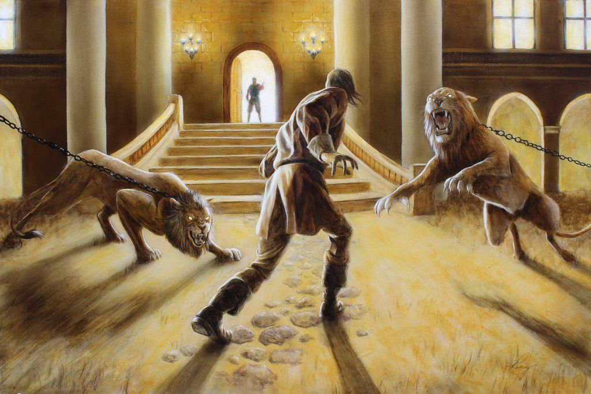
A scene from Pilgrim’s Progress
Notes:
https://external-content.duckduckgo.com/iu/?u=https%3A%2F%2Fi.pinimg.com%2Foriginals%2F0b%2F0f%2F1e%2F0b0f1e5daf88787271dc7d2018ec08c3.jpg&f=1&nofb=1

Slide 75
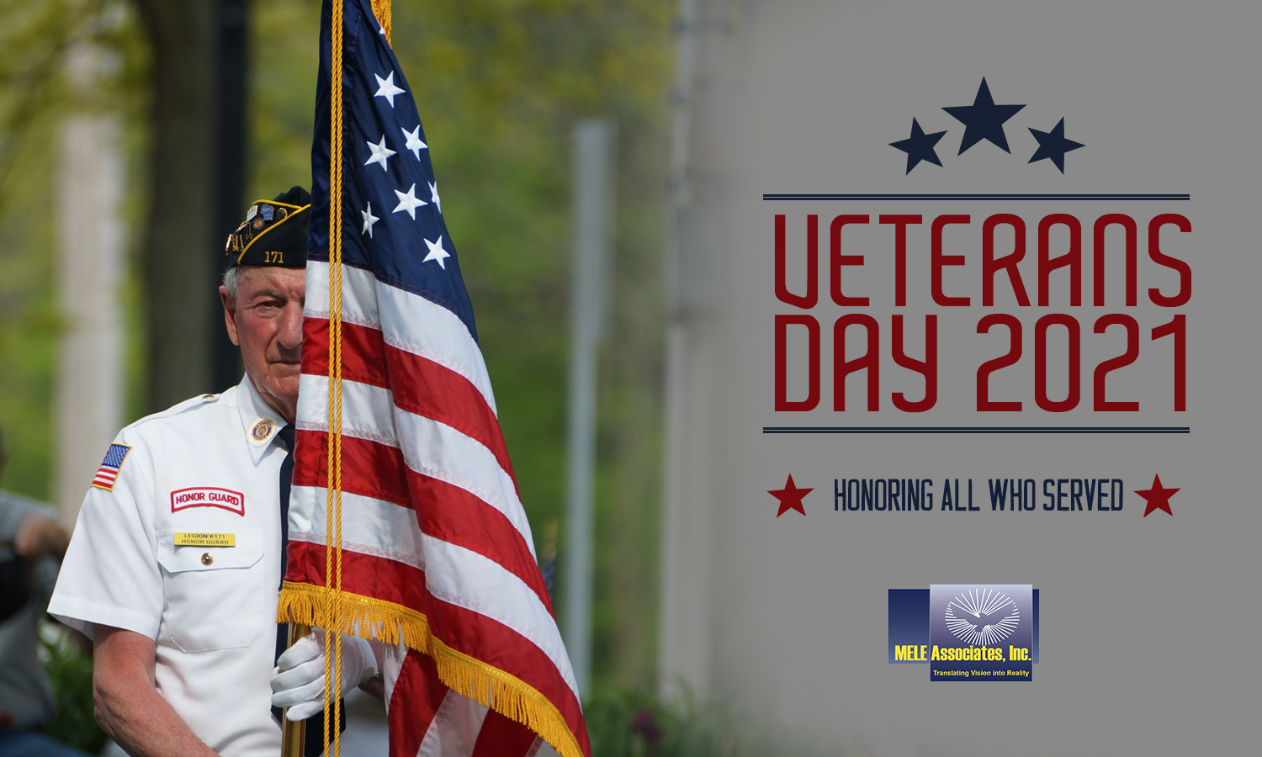
Notes:
https://external-content.duckduckgo.com/iu/?u=https%3A%2F%2Fwww.meleassociates.com%2Fwp-content%2Fuploads%2F2021%2F11%2FVeterans_Day_111121.jpg&f=1&nofb=1

Slide 76
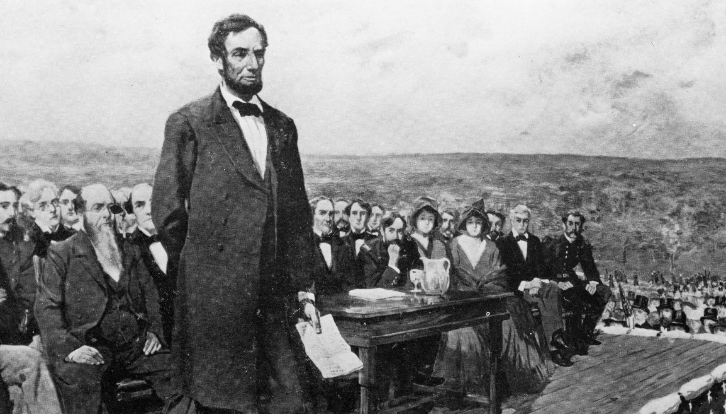
Abraham Lincoln’s Gettysburg
address, Nov. 19, 1863:
Notes:
https://external-content.duckduckgo.com/iu/?u=https%3A%2F%2Fpointofview.net%2Fwp-content%2Fuploads%2F2018%2F09%2FGettysburg-Address-Photo.jpg&f=1&nofb=1
I want to read these words to and about all our veterans. I am not one. I was one of those scraggly protesters.

Slide 77
The brave men, living and dead, who struggled here, have consecrated it, far above our poor power to add or detract. The world will little note, nor long remember what we say here, but it can never forget what they did here. It is for us the living, rather, to be dedicated here to the unfinished work

Slide 78
which they who fought here have thus far so nobly advanced. It is rather for us to be here dedicated to the great task remaining before us — that from these honored dead we take increased devotion to that cause for which they gave the last full measure of devotion

Slide 79
— that we here highly resolve that these dead shall not have died in vain — that this nation, under God, shall have a new birth of freedom — and that government of the people, by the people, for the people, shall not perish from the earth.
Notes:
Tony Perkins: Pray, vote, stand

Slide 80
^{Mtt 11.12} From the days of John the Immerser until now, the kingdom of heaven is treated with violence, and the violent grasp hold of it.

Slide 81
^{Eph. 5.25} Husbands, love your wives just as Messiah also loved His community and gave Himself up for her.
Notes:
Self aggrandizement, control? Doesn’t sound like it.
It’s not reciprocal. It’s husband initiated.
Wives, you are not off the hook, but higher responsibility to the men. Be a man and love, give, suffer.

Slide 82
We also have to be true to stand up boldly and graciously to the lies that our culture imbibes.

Slide 83
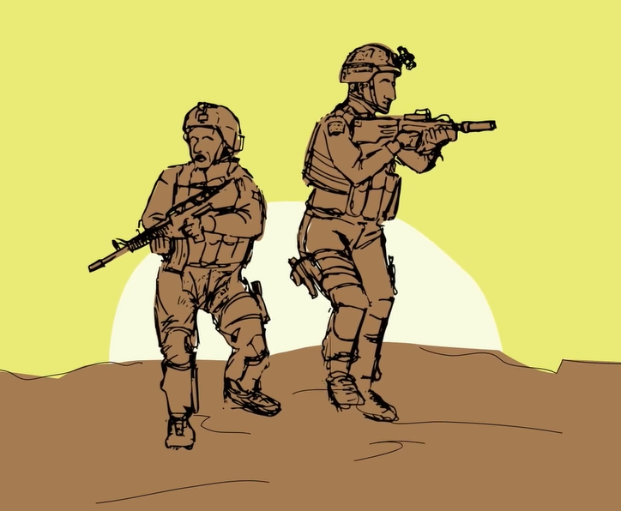
Yoseph Haddad, an Arab in the IDF
Notes:
https://www.prageru.com/video/arab-israeli-and-proud?utm_source=Iterable&utm_medium=email&utm_campaign=campaign_3156323
I sent a Dennis Prager article to some people, and was told that he, Dennis is a despicable man, the worst kind of Jew, a racist, a homophobe, and my character is in question for associating with him.
Painful to be so denounced for truth?
It’s the price of blood, so to speak. Suffering for righteousness.

Slide 84
From George Whitten: A new poll has shown that 61% of Americans who self-identify as born-again Evangelicals believe that all religious faiths have equal value when it comes to going to heaven, the Christian Post (CP) reports.
Notes:
https://www.worthynews.com/62509-us-poll-majority-of-born-again-christians-believe-all-religious-faiths-have-equal-value

Slide 85
Moreover, 60% of self-identifying born-again Evangelicals said that a person can earn their way into heaven through doing good works or being good, CP reports.
Notes:
https://www.worthynews.com/62509-us-poll-majority-of-born-again-christians-believe-all-religious-faiths-have-equal-value

Slide 87
“Love led, blood bought, empowered covenant”
Outline: Purified by Blood
Mosaic context
Yeshua reality
Our blood

Slide 88
Do you KNOW Yeshua and the assurance of sins forgiven?
Are you hearing daily from His Word?
How are you applying what you heard?
Are you asking this of another?
Notes:
Who are you discipling, building up?4

Slide 90
