Slide 1
e-handout
To have these notes
without taking notes
Go to OrHaOlam.com
Click on downloads,
messages, 2021

Slide 2
Notes:
From Jim Adler photog,
Facebook intel

Slide 3
Florida Woman Spots Alligator-Shaped
Cloud in Sunset
Notes:
https://www.theepochtimes.com/mkt_morningbrief/photo-florida-woman-spots-alligator-shaped-cloud-in-sunset-while-driving-home-from-work_4079022.html?utm_source=morningbriefnoe&utm_medium=email&utm_campaign=mb-2021-11-20&mktids=224cf8e35e67dc9b2ad5041f90a7960a&est=I41ccZbG9GW7kLk9987NbphI4mrV%2F2LBWK395eP84toBSa2QV%2BmSNZ2ho5EbL40ICA%3D%3D

Slide 4
This Thursday is
Thanksgiving Day.
Notes:
From last year, needed repeating
Also, I didn’t pre-invite Thanksgiving statements. Next week, two minutes. Let me know through the week.

Slide 5
Thanksgiving Americana

Slide 6
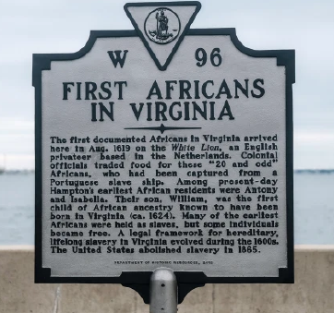

Slide 7
In August 1619, a pirate ship, the White Lion, stopped at Jamestown and traded 20-some captive Africans for food. The Africans were treated as indentured servants and most were soon released.
Notes:
https://nypost.com/2020/11/07/america-wasnt-founded-on-slavery-but-on-pilgrims-ideals/

Slide 8
Fifteen months later, in November 1620, an English ship blown off course on its way to Virginia ended up off the barren coast of Massachusetts. It landed more than 100 men, women and children. Those voyagers founded Plymouth Colony.
Notes:
https://nypost.com/2020/11/07/america-wasnt-founded-on-slavery-but-on-pilgrims-ideals/

Slide 9
This year, 2021, marks the 400th anniversary of the Pilgrims’ harvest celebration of 1621.

Slide 10
Which event mattered more? Slavery or Thanksgiving?
Recently, the New York Times declared that the arrival of the captives in Virginia was the “true beginning” of America — an America that the Times characterized as a “slavocracy.” The Times calls its campaign to promote this story The 1619 Project.
Notes:
https://nypost.com/2020/11/07/america-wasnt-founded-on-slavery-but-on-pilgrims-ideals/

Slide 12
to thanksgiving t
Notes:
https://www.jewishjewels.org/news-letters/thanks/

Slide 13
^{1Tim.4.7-8} Train, exercise yourself in godliness. For physical exercise has some benefit; but godliness is beneficial for all things, holding promise for both the present life and the one to come.
We don’t achieve godliness, but we grow in it or NOT!

Slide 14
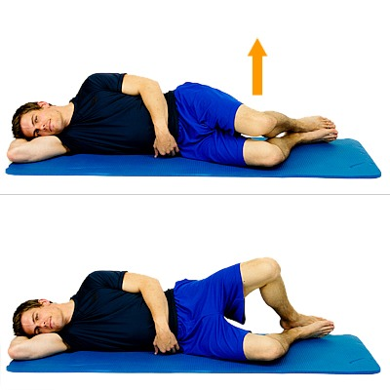
Clamshell exercise
After hip surgery, my physical therapist said that this muscle is traumatized and atrophied, as is the part of the brain that signals to it.
Notes:
So, he said, used what’s left of your brain to communicate with what’s left of your muscle to lift your leg.
Similarly, our praise “muscle” gets atrophied by lack of use, and by trauma.
https://www.google.com/url?sa=i&url=https%3A%2F%2Flillypt.com%2Fclamshell-exercise-for-knee-back-hip-ankle-pain%2F&psig=AOvVaw2Akb6MbtG2fE9i866K8kZo&ust=1607228258993000&source=images&cd=vfe&ved=0CAIQjRxqFwoTCOjxooP-te0CFQAAAAAdAAAAABAD

Slide 15
Every b’rakhah in Hebrew begins with the same six words,
בָּרוּךְ אַתָּה ה' אֱלֹהֵינוּ מֶלֶךְ הַעוֹלָם...
Barukh Atah Adoni Eloheinu Melekh HaOlam…

Slide 18
וְעַתָּה, יִשְׂרָאֵל--מָה יְיָ אֱלֹהֶיךָ
וְעַתָּה, יִשְׂרָאֵל--מֵאָה יְיָ אֱלֹהֶיךָ
And not Israel, what does Adoni
Talmud is suggestive, poetic, historic, never authoritative.
Notes:
They changed the Word of G-d, and are bragging about it. Not plain sense of scripture.
Pardes: pshat, remez, drash, sod.
It’s NOT an exposition of the verse. A poetic modification.
Nevertheless, 100 blessings is a great idea!

Slide 19
There are set blessings which were formulated around the year 350 B.C. which are still said today.
Blessings in prayers: 18 blessings = Shmoneh Esray “The prayer”
Notes:
https://www.jewishjewels.org/news-letters/thanks/
We do all of them in our monthly Shakharit. Glorious shakharit at the MLR Conf.

Slide 20
Blessings on the mitzvot
Blessings on the holidays
Blessings on tsitsit, tallit, mezuzah
Blessings in a meal.
Blessings for smells: trees, flowers, fruits, oils,
Notes:
https://en.wikipedia.org/wiki/List_of_Jewish_prayers_and_blessings

Slide 21
Blessings on sights and sounds: lightning, thunder, rainbow, the ocean, blossoming of the trees, new garment
Notes:
https://en.wikipedia.org/wiki/List_of_Jewish_prayers_and_blessings
Shopping blessing!

Slide 22
Blessings on bodily functions: “Thank You, God, who formed human beings with wisdom and created them with openings and orifices. If one of these orifices were ruptured or one of them blocked, whoa – it would be impossible to stand before You and survive. Blessed are You, God who heals all flesh and acts wondrously.”
Notes:
https://www.aish.com/sp/so/The-Bathroom-Blessing-Whisperer-.html

Slide 23
“Pray without ceasing, in everything give thanks; for this is the will of God in Messiah Yeshua for you” ^{(1 Thes. 5:17-18).} When we regard everything in life as an opportunity to bless the Lord, we are entering into the spirit of b’rakhot.

Slide 24
King David proclaimed in Psalm 34:2, “I will bless Adoni at all times; His praise shall continually be in my mouth.”

Slide 25
The noun “blessing” in the Bible is ברכה b’rakha.
The one being blessed is barukh ברוך.
Both Hebrew words are derived from the root bet-resh-kaf ב ר כ which means “knee.”
Notes:
https://www.jewishjewels.org/news-letters/thanks/

Slide 26
“Oh come, let us worship and bow down; let us kneel before Adoni our Maker” (Ps. 95:6).
But kneeling is rare in traditional Jewish synagogues.
Notes:
https://www.jewishjewels.org/news-letters/thanks/

Slide 27
The U.S. is the wealthiest country in the world. If you earn $20,000 or more per year, you are in the top 2% of the richest people in the world. The average laborer in Ghana would take 156 years to earn this amount. Your monthly income would pay the monthly salaries of 94 doctors in Kazakhstan.
Notes:
https://www.jewishjewels.org/news-letters/thanks/
2021 POVERTY GUIDELINES FOR THE 48 CONTIGUOUS STATES AND THE DISTRICT OF COLUMBIA
https://aspe.hhs.gov/topics/poverty-economic-mobility/poverty-guidelines/prior-hhs-poverty-guidelines-federal-register-references/2021-poverty-guidelines
1 person household $12,880
2 person $17,420

Slide 28
Did you know that 1/4 of all people worldwide live without electricity? 805 million people worldwide do not have enough food to eat. Hunger is the number one cause of death in the world. 1 billion children worldwide live in poverty.
Abba, please help us to be thankful—and generous.
Notes:
https://www.jewishjewels.org/news-letters/thanks/

Slide 29
^{Psalm 100:4}, “Enter into His gates with thanksgiving ( בתודהb’todah), and into His courts with praise. Be thankful (הודו hodu) to Him, and bless His name.” The New Covenant also exhorts us to be thankful: “And let the peace of God rule in your hearts, to which also you were called in one body; and be thankful” (Col. 3:15).

Slide 30
Sometimes, thanksgiving is our only means of deliverance.

Slide 31
to thanksgiving t

Slide 32
^{Divrei HaYamim B /2 Chron 20} Some time later, the people of Mo’av and the people of ‘Amon… came up to fight Y’hoshafat. Y’hoshafat was told, “A huge army from beyond the [Dead] Sea, from Aram, is on its way to fight you; right now they are in…‘Ein-Gedi). Y’hoshafat was frightened, so he determined to seek Adoni.

Slide 33
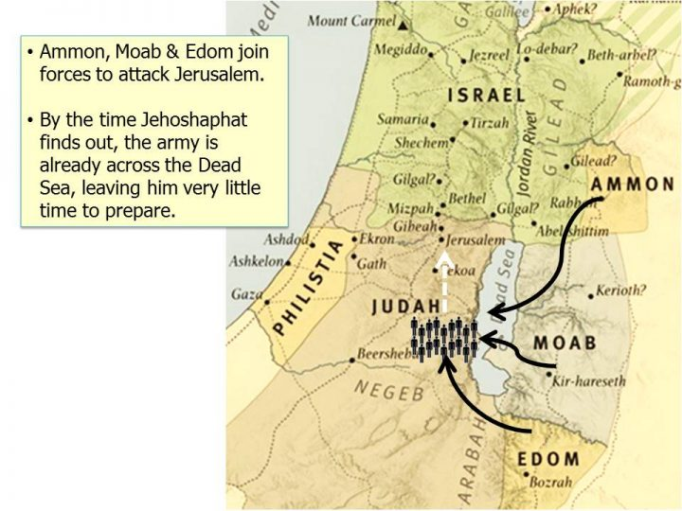

Slide 34
^{Divrei HaYamim B /2 Chron 20} He proclaimed a fast throughout all Y’hudah, and Y’hudah assembled to seek help from Adoni; they came from all the cities of Y’hudah to seek Adoni.

Slide 35
Yehoshaphat was frightened.
Do we have anything to fear?
Notes:
https://www.usdebtclock.org/
Worthy News · P.O. Box 78758 · Nashville, Tennessee 37207 · USA

Slide 36
Yehoshaphat was frightened.
Do we have anything to fear?
Chinese military now set for invasion of Taiwan, says Hill commission.
Europe imposes lockdown restrictions as fourth wave of coronavirus surges
Notes:
https://www.usdebtclock.org/
Worthy News · P.O. Box 78758 · Nashville, Tennessee 37207 · USA

Slide 37
California educators are engaged in a calculated and strategic effort to subvert parents and recruit middle school students into LGBTQ+ clubs, Abigail Shrier warns.
Notes:
https://www.foxnews.com/us/abigail-shrier-audio-exposes-california-teachers-efforts-to-subvert-parents-and-recruit-kids-to-lgbtq-clubs
Sent by Gavriel Rennels. Thank you.

Slide 38
UN atomic agency: The United Nations’ International Atomic Energy Agency reported Wednesday Nov 17, 2021, that Iran now has an estimated 39 pounds of uranium enriched at up to 60% fissile purity, a level that can easily be refined to make atomic weapons, the Associated Press (AP) reports.
Notes:
Worthy News · P.O. Box 78758 · Nashville, Tennessee 37207 · USA

Slide 39
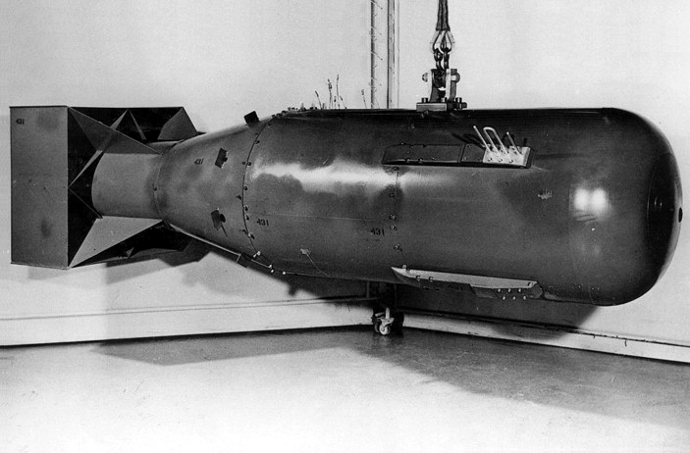
Photograph of a mock-up of the Little Boy nuclear weapon dropped on Hiroshima, Japan, in August 1945
Notes:
https://en.wikipedia.org/wiki/Little_Boy

Slide 40
It contained 141 lb of highly enriched uranium, although less than 2.2 lbs. underwent nuclear fission. It leveled a two-mile radius of the city, killing an estimated 80,000 people.
Notes:
https://en.wikipedia.org/wiki/Little_Boy
https://gizmodo.com/less-than-2-of-the-uranium-in-the-hiroshima-bomb-actua-1624444762

Slide 41
Levelled 2 mi radius, 80,000 instantly dead

Slide 42
Nuclear weapons since then have become remarkably efficient and small and capable of destruction that makes Hiroshima seem trivial.
39 pounds of uranium is enough. Little Boy only used 2.2 lbs.
Notes:
https://gizmodo.com/less-than-2-of-the-uranium-in-the-hiroshima-bomb-actua-1624444762

Slide 43
The temperature at ground level reached 7,000 degrees Fahrenheit in less than a second. The bomb vaporized people half a mile away from ground zero. Bronze statues melted, roof tiles fused together, and the exposed skin of people miles away burned from the intense infrared energy unleashed. At least 80,000 people died instantly.

Slide 44
At the base of the cloud, fires were springing up everywhere amid a turbulent mass of smoke that had the appearance of bubbling hot tar… The city we had seen so clearly in the sunlight a few minutes before was now an ugly smudge. It had completely disappeared under this awful blanket of smoke and fire.”
Notes:
https://www.nationalww2museum.org/war/articles/atomic-bomb-hiroshima

Slide 45
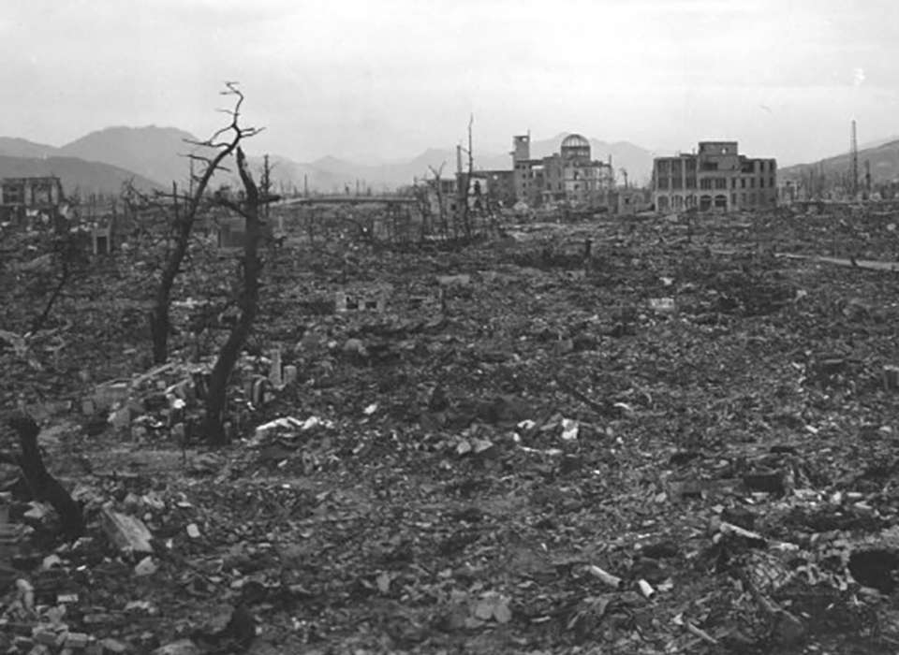
Notes:
https://www.nationalww2museum.org/war/articles/atomic-bomb-Hiroshima
This is the weapon that the Iranians imply that they will use on Tel Aviv and Jerusalem!

Slide 46
^{Divrei HaYamim B /2 Chron 20} Standing in front of the new courtyard in the house of Adoni, among those assembled from Y’hudah and Yerushalayim, Yehoshafat said: “Adoni, God of our ancestors, you alone are God in heaven. You rule all the kingdoms of the nations. In your hand are power and strength, so that no one can withstand you.

Slide 47
^{Divrei HaYamim B /2 Chron 20} So now, see: the people of ‘Amon, Mo’av and Mount Se‘ir, whom you would not let Isra’el invade when they came out of the land of Egypt, so that they turned away from them and did not destroy them, are now repaying us [evil]; they have come to throw us out of your possession, which you gave us as an inheritance.

Slide 48
^{Divrei HaYamim B /2 Chron 20} All Y’hudah stood before Adoni with their little ones, their wives and their children.
Then, in the middle of the assembly, the Spirit of Adoni came upon Yachzi’el the son of Z’kharyahu

Slide 49
^{Divrei HaYamim B /2 Chron 20} He said, “Listen, all Y’hudah, you who live in Yerushalayim and King Y’hoshafat: here is what Adoni is saying to you: ‘Don’t be afraid or distressed by this great horde; for the battle is not yours, but God’s. Tomorrow, go down against them.

Slide 50
^{Divrei HaYamim B /2 Chron 20} They will be coming up by the ascent of Tzitz, and you will find them at the end of the vadi, before the Yeru’el Desert. You won’t even need to fight this battle! Just take your positions,

Slide 51
^{Divrei HaYamim B /2 Chron 20} Y’hudah and Yerushalayim, stand still, and watch how Adoni will deliver you! Don’t be afraid or distressed; tomorrow, go out against them; for Adoni is with you.’”
Notes:
Doesn’t say hide under your covers. Go out and face your fears!! But NOT in your own strength!

Slide 52
^{Divrei HaYamim B /2 Chron 20} The next morning, they rose early and went out into the T’koa Desert. As they left, Y’hoshafat stood and said, “Listen to me, Y’hudah and you inhabitants of Yerushalayim! “Trust in Adoni your God, and you will be safe. Trust in his prophets,
and you will succeed.”

Slide 53
^{Divrei HaYamim B /2 Chron 20} After consulting with the people, he appointed those who would sing to Adoni and praise the splendor of his holiness as they went out ahead of the army, saying, “Give thanks to Adoni, for his grace continues forever.”

Slide 54
to thanksgiving t

Slide 55
^{Divrei HaYamim B /2 Chron 20} Then, during the time when they were singing and praising, Adoni brought a surprise attack against the people of ‘Amon, Mo’av and Mount Se‘ir who had come to fight Y’hudah; and they were defeated.

Slide 56
^{Divrei HaYamim B /2 Chron 20} What happened was that the people of ‘Amon and Mo’av began attacking those people who lived by Mount Se‘ir, to kill and destroy them completely; and when they had finished off the people from Se‘ir, they set to work slaughtering one another.

Slide 57
^{Divrei HaYamim B /2 Chron 20} They took three days just to collect the spoil, there was so much. On the fourth day, they assembled in the Valley of B’rakhah [blessing], where they blessed Adoni; hence that place is called the Valley of B’rakhah to this day.

Slide 58
What forces of Mo’av and the people of ‘Amon, and Edom, are arrayed against you?
Inner turmoil? Worry, lust, hurt, anger?
Marital distress?

Slide 59
Family estrangement?
Personal conflict?
Health failure?
Financial shortfall?

Slide 60
^{Phil 4.6-7} Do not be anxious [don’t worry] about anything—but in everything, by prayer and petition with thanksgiving, let your requests be made known to God. And the shalom of God, which surpasses all understanding, will guard your hearts and your minds in Messiah Yeshua
Notes:
I have 14 impossible situations that I am praying about.

Slide 61
How can we be sure of rescue, hope, deliverance?

Slide 62
^{Yeshayahu / Is 63.1-5} “Who is this coming from Edom, in crimsoned garments from Bozrah? This One splendid in His apparel, pressing forward in His great might?” “It is I who speak in righteousness, mighty to save.” “Why is Your apparel so red, and Your garments like one who treads in a wine press?”

Slide 63
^{Yeshayahu / Is 63.1-5} “I have trodden the winepress alone— from the peoples, no man was with Me. I trod them in My anger, and trampled them in My wrath. Their lifeblood spattered My garments, so I stained all My robes. For a day of vengeance was in My heart,

Slide 64
^{Yeshayahu / Is 63.1-5} and My year of redemption has come. I looked, but there was no one to help. I was amazed, but no one was assisting. So My own arm won victory for Me.
Notes:
Pause for prayer.

Slide 65
Jeff & Shaunti Feldhahn
Notes:
She is a recent cancer survivor.

Slide 66
In one key 2018 study in the journal Health Psychology, the researchers tried to understand why radiation fatigue affects some people so differently than others. Why, for example, does debilitating physical fatigue sometimes last for only a few weeks after treatment,
Notes:
https://www.patheos.com/blogs/askshaunti/2021/04/why-your-attitude-affects-others-and-your-health/?mc_cid=64aebafff2&mc_eid=fec1a78175

Slide 67
where in other cases it persists for many months? The researchers looked at every conceivable factor: whether the patient had chemo as well as radiation,

Slide 68
other pre-existing conditions, age, family history, and so on. Only two factors were statistically significant over time: obesity (which impacts estrogen levels in the body) and the person’s attitude!
Notes:
https://www.patheos.com/blogs/askshaunti/2021/04/why-your-attitude-affects-others-and-your-health/?mc_cid=64aebafff2&mc_eid=fec1a78175

Slide 69
The researchers found that if the patient “catastrophized” about their fatigue (Oh my, this is horrible, I’m so tired) it lasted far longer! They were much more likely to have their fatigue for months or even years. On the other hand,
Notes:
https://www.patheos.com/blogs/askshaunti/2021/04/why-your-attitude-affects-others-and-your-health/?mc_cid=64aebafff2&mc_eid=fec1a78175

Slide 70
if they had the attitude of Yeah, this is a pain in the neck but I’ll get through it and move on, they were much less likely to have the fatigue at all after a few weeks!
Their emotional and mental outlook led to a purely physical outcome.
Notes:
https://www.patheos.com/blogs/askshaunti/2021/04/why-your-attitude-affects-others-and-your-health/?mc_cid=64aebafff2&mc_eid=fec1a78175

Slide 71
I mentioned in an earlier blog just how supportive the cancer community is, and how striking is the sense of peace and even joy at the cancer center where I receive my own care. In thinking about all this, I realized that this mutually reinforcing positive attitude is one of the key factors responsible for that sense of support. Because a poor attitude is so out of place, it probably won’t last very long.
Notes:
https://www.patheos.com/blogs/askshaunti/2021/04/why-your-attitude-affects-others-and-your-health/?mc_cid=64aebafff2&mc_eid=fec1a78175

Slide 72
As we fix our minds on what is good, what is lovely, what is praiseworthy (Philippians 4:8), and as we orient our spirits toward the true source of joy, our bodies respond. Isn’t that a bit like a miracle?
Notes:
https://www.patheos.com/blogs/askshaunti/2021/04/why-your-attitude-affects-others-and-your-health/?mc_cid=64aebafff2&mc_eid=fec1a78175

Slide 74
Highly happy couples give their spouses most of the credit for their relationship success—and they live in regular, conscious gratitude as a result.
Notes:
Copyright © 2021 Shaunti Feldhahn, All rights reserved.

Slide 75
Even when these couples were dealing with real problems—money, kids, sex, and a host of other things that can drain a marriage—each partner still believed that they personally hit the jackpot. I would state this powerful little secret like this:
Notes:
Copyright © 2021 Shaunti Feldhahn, All rights reserved.

Slide 76
The Roman philosopher Cicero wrote, “Gratitude is not only the greatest of virtues, but the parent of all others.” The marital experience of highly happy couples seemed to bear this out. Their conscious gratitude for their mates seemed to have the effect of tempering other concerns and making them much happier in their marriages.
Notes:
Copyright © 2021 Shaunti Feldhahn, All rights reserved.

Slide 77
Happy Couples Think The Best Of Each Other
Notes:
Copyright © 2021 Shaunti Feldhahn, All rights reserved.

Slide 78
to thanksgiving t

Slide 79
We need to turn thanksgiving into thanks-living.
And yet in America all around we can find those who are grumbly hateful rather than humbly grateful.
Notes:
Adrian Rogers

Slide 80
You do not come to service to praise the Lord. You are to bring your praise with you to service. You don't commence your praise here, you continue.

Slide 81
^{Ro 6.4-5} Through immersion into his death we were buried with him; so that just as, through the glory of the Father, the Messiah was raised from the dead, likewise we too might live a new life. For if we have been united with him in a death like his, we will also be united with him in a resurrection like his.

Slide 82
^{Havakkuk 3.17-19} Though the fig tree does not blossom, and there is no yield on the vines, Though the olive crop fail, and the fields produce no food, the flock is cut off from the fold, and there is no cattle in the stalls.

Slide 83
^{Havakkuk 3.17-19} Yet will I triumph in Adoni, I will rejoice in the God of my salvation! Adoni my Lord, is my strength. He has made my feet like a deer’s, and will make me walk on my high places.

Slide 84
Do you KNOW Yeshua and the assurance of sins forgiven?
Are you hearing daily from His Word?
How are you applying what you heard?
Are you asking this of another?
Notes:
Who are you discipling, building up?4

