Slide 1
e-handout
To have these notes
without taking notes
Go to OrHaOlam.com
Click on downloads,
messages, 2021

Slide 2
A squirrel’s delight
Notes:
From Vicki Kline

Slide 3
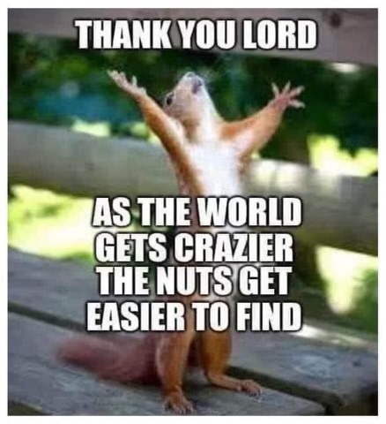
Notes:
From Vicki Kline

Slide 4
From Princess Bride
via Mike Boatright

Slide 5
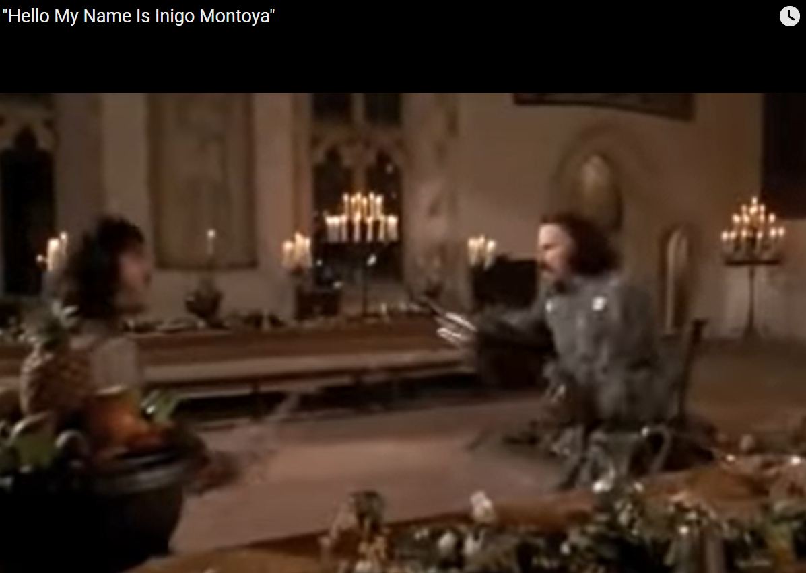
You killed my father, prepare to die
From Princess Bride
via Mike Boatright
Notes:
https://www.youtube.com/watch?v=kRAI9_MkmBM

Slide 6
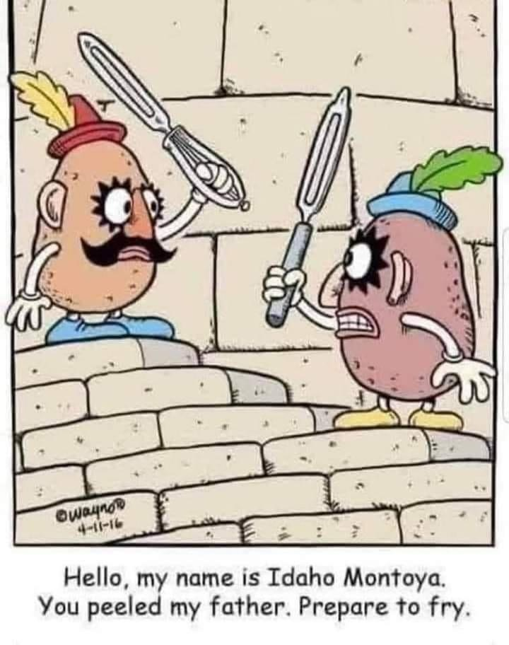
Hello, my name is Idaho Montoya.
You peeled my father.
Prepare to fry.

Slide 7
The threefold vision
of Or HaOlam

Slide 8
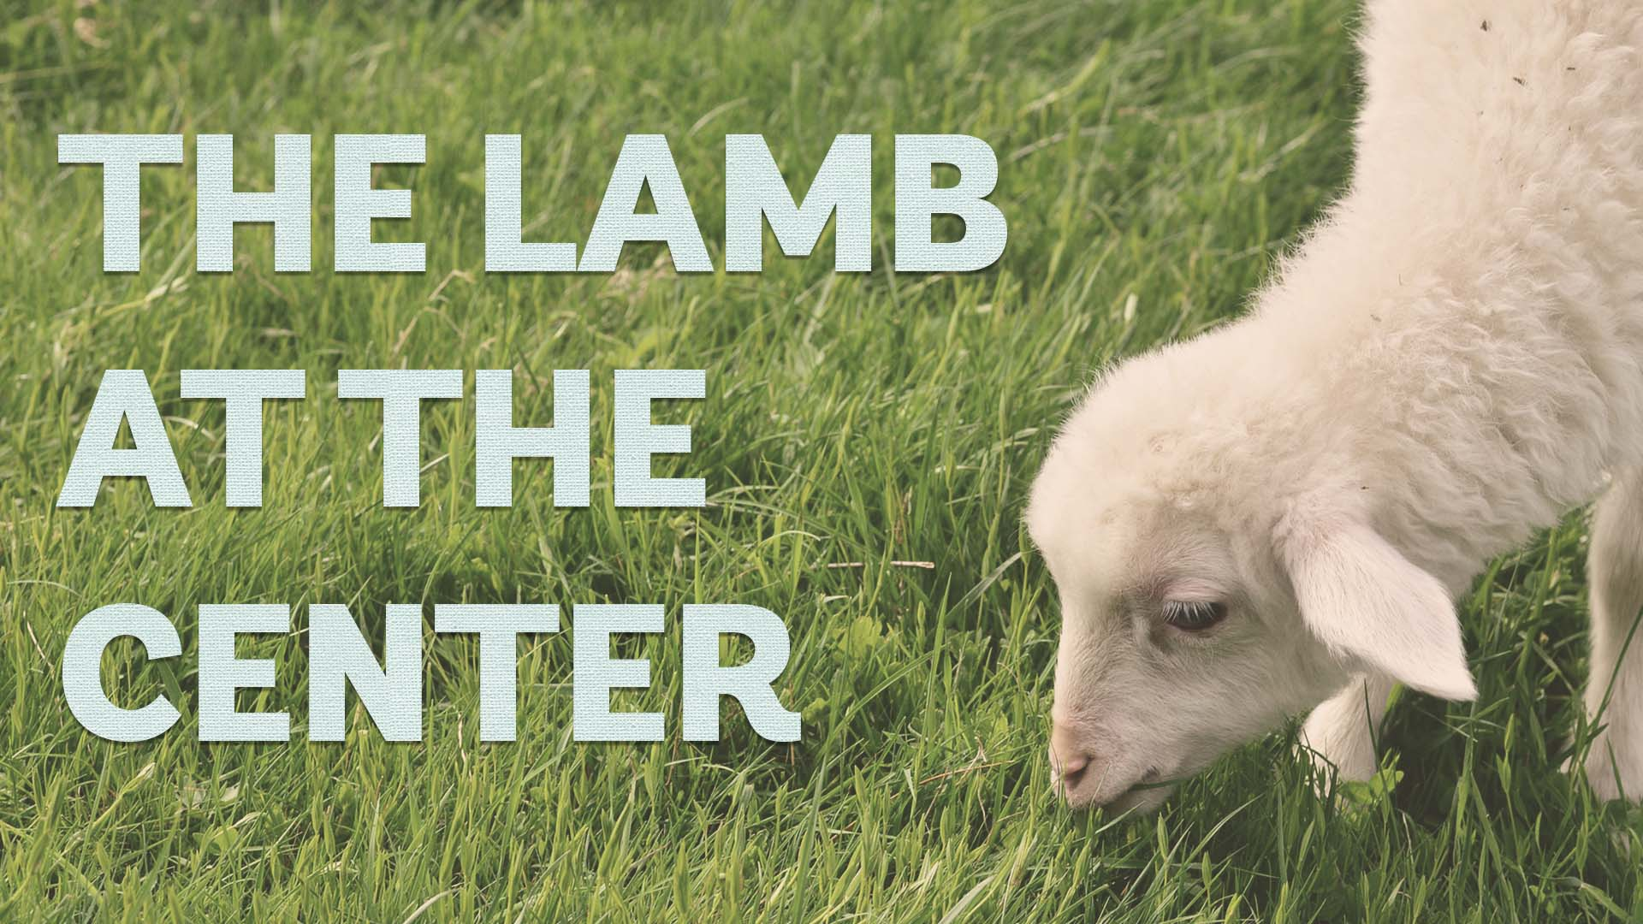
Notes:
Three motivators
~length, width, breadth; or x y z
~ Father, Son, Spirit

Slide 9
^{Rev. 7.17} “For the Lamb at the center of the throne will shepherd them, will lead them to springs of living water, and God will wipe every tear from their eyes.”

Slide 10
Every object has a center.
Center of mass.
Center of gravity.
Aircraft rotate around their center.
Notes:
An airplane in flight can be maneuvered by the pilot using the aerodynamic control surfaces; the elevator, rudder, or ailerons. As the control surfaces change the amount of force that each surface generates, the aircraft rotates about a point called the center of gravity.
https://www.grc.nasa.gov/WWW/K-12/airplane/acg.html

Slide 11
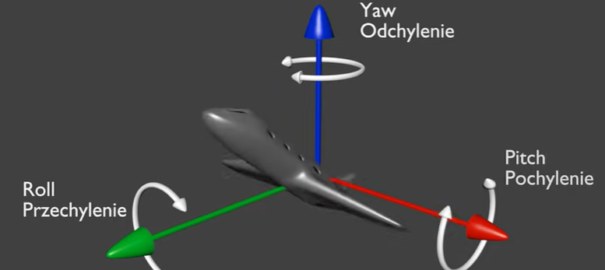
play
Notes:
https://youtu.be/pQ24NtnaLl8

Slide 12
^{Col. 1.14-20} It is through his Son that we have redemption — that is, our sins have been forgiven. He is the visible image of the invisible God. He is supreme over all creation, because in connection with him were created all things — in heaven and on earth,

Slide 13
^{Col. 1.14-20} visible and invisible, whether thrones, lordships, rulers or authorities — they have all been created through him and for him. He existed before all things, and he holds everything together. Also he is head of the Body, the Messianic Community — he is the beginning, the firstborn from the dead,
Notes:
He holds everything together. Center ~ sun in the solar system.

Slide 14
^{Col. 1.14-20} so that he might hold first place in everything. For it pleased God to have his full being live in his Son and through his Son to reconcile to himself all things, whether on earth or in heaven, making peace through him, through having his Son shed his blood by being executed on a stake.

Slide 15
^{Acts 17.28} In Him we live and move and have our existence.

Slide 16
Over the 26 years of Or HaOlam, it appears that we have three motivational axes of motion, in which we move forward.
All are centered on the Messiah.
Notes:
At least I have three passions, by which I am motivated to steer the ship.

Slide 17
Ruakh Presence
Covenantal understanding
Healing of body, soul, spirit
Notes:
These are the motivators, that precipitate all our actions.

Slide 18
Ruakh Presence
Covenantal understanding
Healing of body, soul, spirit
Notes:
Some of this is review, but never put together to present the big picture.

Slide 19
קוּמִי אוֹרִי כִּי בָא אוֹרֵךְ
Kumi ori, ki va orekh
Rise up, shine forth,
For, your Light has come.
Notes:
The light has come! We didn’t cause it. We didn’t make it, we didn’t earn it. But the light has come.

Slide 20
וּכְבוֹד יְיָ עָלַיִךְ זָרָח׃
Ukh-vod Adoni aliyikh zarakh
Shekhinah of Messiah in splendor has dawned.
Notes:
Not literal, but experiential
Zarakh ~ sunrise
Revelation of His redemption, His resurrection.
My “liquid love” experience in Schenectady NY April 1969

Slide 21
^{Mtt. 4.13-13} Leaving Natzeret, He came and settled in Capernaum…This was to fulfill what was spoken through Isaiah the prophet, saying … the people sitting in darkness have seen a great light, and those sitting in the region and shadow of death, on them a light has dawned.”
Notes:
Fulfillment of Isaiah prophecy

Slide 22
^{Acts 22.6-7} [Paul/Shaul] “As I was traveling and approaching Dammesek, around noon, suddenly a brilliant light from heaven flashed all around me! I fell to the ground…
Notes:
The light has come! We didn’t cause it. We didn’t make it, we didn’t earn it. But the light has come.

Slide 23
^{2 Cor 4.6} For it is the God who once said, “Let light shine out of darkness,” who has made his light shine in our hearts, the light of the knowledge of God’s glory shining in the face of the Messiah Yeshua.
Notes:
Do you, do I, have the light of Messiah shining into our hearts?
Do we have the witness of His Spirit that our names are written in the Book of Life?

Slide 24
הִנֵּה הַחֹשֶׁךְ יְכַסֶּה־אֶרֶץ
Henay hakhoshekh y’khaseh erets
See how darkness covers the earth

Slide 25
וַֽעֲרָפֶ֖ל לְאֻמִּ֑ים
V’arafel l’umim
And the nations in depth of night
When expounding on this two weeks ago, I skipped the MOST important darkness.
Notes:
The world culture is in DEEP darkness…

Slide 26
^{1 Tim. 1.15-16} Trustworthy is the saying and deserving of complete acceptance: “Messiah Yeshua came into the world to save sinners”—of whom I am foremost.
Notes:
Do we see the darkness of our own hearts,
how readily we can sin,
we can segue from the sublime to the corrupt?
How we can ascribe evil motives to people’s actions and words. “Love believes [the best possible] all things”
Selfishly apportion money, credit, glory.

Slide 27
^{1 Tim. 1.15-16} Yet for this reason I was shown mercy—so that in me as the foremost, Messiah Yeshua might demonstrate His complete patience, as an example for those about to put their trust in Him for eternal life.

Slide 28
^{Ro 6.12-14} Therefore do not let sin rule in your mortal body so that you obey its desires. And do not keep yielding your body parts to sin as tools of wickedness; but yield yourselves to God as those alive from the dead,

Slide 29
^{Ro 6.12-14} and your body parts as tools of righteousness to God. For sin shall not be master over you, for you are not under law but under grace.

Slide 30
It’s the glory of Yeshua brought to this sinful world, moreover, recognizing OUR sinful selves, that is our starting part.
We share this axis with the whole believing world.
Notes:
Not unique to the Messianic movement.

Slide 31
You could consider this the “pitch,” what lifts our heads up.

Slide 32
Notes:
https://youtu.be/pQ24NtnaLl8

Slide 33
This motivates us to
to seek the filling of the Ruakh / Spirit, and to not forbid speaking in tongues, at least at Teerosh.
to faithfully gather and worship in anointed song, dance, and learning.

Slide 34
This motivates us to
Do outreach to the Jews and Gentiles.
^{Ro. 1.16} For I am not ashamed of the Good News, for it is the power of God for salvation to everyone who trusts—to the Jew first and also to the Nations.
Notes:
Even in this we are different from the general body of Messiah among the Nations, that is, the church world. Most despair of reaching the Jewish people with Messiah. That is first place to us.

Slide 35
This motivates us to PRAY and read the scriptures, privately AND corporately. Teerosh Tuesday corporate prayer.

Slide 36
^{Acts 2.32-33} “This Yeshua God raised up—we all are witnesses! Therefore, being exalted to the right hand of God and receiving from the Father the promise of the Ruakh ha-Kodesh, He poured out this—what you now see and hear.
Notes:
Yeshua is directly, personally involved in every instance of the Spirit pour out. Not just a weird mysticism, but an expression of and extension of His Kingdom.

Slide 37
Are we filled with the Spirit?
Do we have joy in life? In troubles?
Do we have victory over secret sins?
Do we pray regularly and read the Word?
Notes:
First Axis

Slide 39
Ruakh Presence
Covenantal understanding
Healing of body, soul, spirit

Slide 40

Yaw, which way we turn.
Play
Notes:
https://youtu.be/rlVw-SNU8cM
Reflection of the Son?

Slide 41
B’resheet (Genesis) 12:2
ג כִּי שֵׁם יְהוָה אֶקְרָא ס הָבוּ גֹדֶל לֵאלֹהֵינוּ׃
ג כִּי שֵׁם יְהוָה אֶקְרָא ס הָבוּ גֹדֶל לֵאלֹהֵינוּ׃
וְאֶֽעֶשְׂךָ לְג֣וֹי גָּדוֹל וַאֲבָ֣רֶכְךָ וַאֲגַדְּלָה שְׁמֶךָ וֶהְיֵה בְּרָכָֽה׃
“I will make of you a great nation, I will bless you, and I will make your name great; and you are to be a blessing.
Notes:
This is the first half of the second part of the core understand of what Or HaOlam is about.
Descendants of Avram, later Avraham would be blessed of G-d, and bless the Nations of the earth.

Slide 42
B’resheet (Genesis) 12:3
ג כִּי שֵׁם יְהוָה אֶקְרָא ס הָבוּ גֹדֶל לֵאלֹהֵינוּ׃
ג כִּי שֵׁם יְהוָה אֶקְרָא ס הָבוּ גֹדֶל לֵאלֹהֵינוּ׃
וַאֲבָֽרְכָה מְבָ֣רְכֶיךָ וּמְקַלֶּלְךָ אָאֹר וְנִבְרְכוּ בְךָ כֹּל מִשְׁפְּחֹת הָאֲדָמָֽה׃
“I will bless those who bless you, but I will curse anyone who curses you; and by you all the families of the earth will be blessed.”
Notes:
This is the second half
The people in our community would bless Israel and receive blessing in the process.

Slide 43
A cycle of reciprocal blessing
Jews Nations

Slide 44
My view of one new man: it’s mutual, reciprocal blessing and participation in Jewish covenant and culture in Messiah! All participating. No difference. “I will bless you… and you are to be a blessing. I will bless those who bless you”
Notes:
It’s NOT cultural mixing!

Slide 45
The unique result
of Jewish renewal

Slide 46
^{Ro. 11.12,15} Now if their transgression leads to riches for the world, and their loss riches for the Gentiles, then how much more their fullness! …For if their rejection leads to the reconciliation of the world, what will their acceptance be but life from the dead?
Notes:
So, we love being scriptural Jews, and inviting the Nations, because there is a multiplying effect in the Ruakh/Spirit on the whole world. The Messianic Jewish awakening is NOT about the Jews only, but through the Jewish people, to the whole world!

Slide 47
^{Zekh 14.2, 16} I will gather all the nations against Jerusalem to wage war…Finally, everyone remaining from all the nations that came to attack Yerushalayim will go up every year to worship the king, Adoni-Tzva’ot, and to keep the festival of Sukkot.
Notes:
This is a festival in the Millennial Kingdom! We do Sukkot as a prep for the universal observation of Sukkot.
Implies that the other Lev holidays will be kept then too by all the world.

Slide 48
^{Zekh 8.23} Thus says Adoni-Tzva’ot, “In those days it will come to pass that ten men from every language of the nations will grasp the corner [tsitsit] of the garment of a Jew saying, ‘Let us go with you, for we have heard that God is with you.’”
Notes:
This covenantal identity is not in addition to Messiah Yeshua, it is HIS covenant.

Slide 49
^{Malakhi 3.1-3} Look! I am sending my messenger to clear the way before me; and the Lord, whom you seek, will suddenly come to his temple. Yes, the Messenger of the covenant, in whom you take such delight —
look! Here he comes,” says Adoni-Tzva’ot.
Notes:
Yeshua is not in addition to the covenants of Israel. He IS the Messenger of the covenant!

Slide 50
^{Malakhi 3.1-3} But who can endure the day when he comes? Who can stand when he appears? For he will be like a refiner’s fire, like the soap maker's lye. He will sit, testing and purifying the silver; he will purify the sons of Levi, refining them like gold and silver.

Slide 51
So this motivates us to
Love Jews.
study Jewish contextual cultural sources,
and foods,
encourage Aliyah
visit and bless Jews in the Land and in the Diaspora.

Slide 52
Love and study Hebrew
avoid assimilation by identifying our congregation as a part of Judaism >> Christianity.
Vote for political leaders who support Israel

Slide 53
You could consider this the “yaw” what turns us directionally left or right.

Slide 54
Yaw
Notes:
https://youtu.be/rlVw-SNU8cM

Slide 56
Ruakh Presence
Covenantal understanding
Healing of body, soul, spirit
Notes:
Ruakh Spirit pitch: head up
Covenant: Son: Yaw turn left and right, differentiate, Jacob dwell alone
Healing: Father’s love roll, from depression
This axis is not unique to Messianic Jews, except that neurotic dysfunctional families are really rife, common, in my family of origin. Then again, all people are pretty broken.

Slide 57
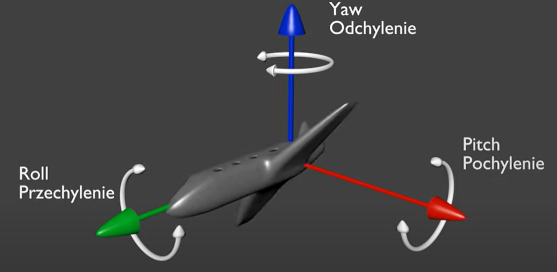
Notes:
Could be connected to the Father…the Father heart.

Slide 58
^{Yeshayahu/Is 61.1-2} The Ruakh of Adoni Elohim is on me, because Adoni has anointed me to proclaim Good News to the poor. He has sent me to bind up the brokenhearted, to proclaim liberty to the captives, and the opening of the prison to those who are bound, to proclaim the year of Adoni’s favor.
Notes:
Brokenhearted, emotional captives by fears, hurts, prisoners of wounds and scars.
Or HaOlam has been called a healing place from the beginning, in 1995.

Slide 59
^{Luke 4.17-21} He was given the scroll of the prophet Yesha‘yahu. Unrolling the scroll, he found the place where it was written, “The Spirit of Adoni is upon me; therefore he has anointed me to announce Good News to the poor;

Slide 60
^{Luke 4.17-21} he has sent me to proclaim freedom for the imprisoned and renewed sight for the blind, to release those who have been crushed, to proclaim a year of the favor of Adoni.”
Notes:
Minister to people crushed, by dysfunctional families, trauma, Holocaust.

Slide 61
^{Luke 4.17-21} After closing the scroll and returning it to the shammash, he sat down; and the eyes of everyone in the synagogue were fixed on him. He started to speak to them: “Today, as you heard it read, this passage of the Tanakh was fulfilled!”

Slide 62
^{1 Thes. 5. 16-26} Always be joyful. Pray regularly. In everything give thanks, for this is what God wants from you who are united with the Messiah Yeshua. Don’t quench the Spirit, don’t despise inspired messages.
Notes:
Definition of mental health: joy and thankfulness

Slide 63
^{1 Thes. 5. 16-26} But do test everything — hold onto what is good, but keep away from every form of evil. May the God of shalom make you completely holy — may your entire spirit, soul and body be kept blameless

Slide 64
^{1 Thes. 5. 16-26} for the coming of our Lord Yeshua the Messiah. The one calling you is faithful, and he will do it. Brothers, keep praying for us. Greet all the brothers with a holy kiss.

Slide 65
This motivates us to have
Family prayer [doesn’t solve everything, but changes the atmosphere]
Home groups
Mat 18 reconciliations
Notes:
If you come to me with a problem with someone, don’t expect me to fix it while you go home. I will be the one more, when WE go the person you with whom you are having a problem.

Slide 66
Ellel Conferences
Restoring the Foundation
Power of Joy, Jim Wilder
Ancient Paths, Craig Hill
Sozo
Garden of Peace, Shalom Arush
Notes:
Catherine and Lambert
Ira and Glorai Brawer

Slide 67
Notes:
Summary:

Slide 68
Ruakh Presence
Covenantal understanding
Healing of body, soul, spirit
Notes:
Ruakh Spirit pitch: head up
Covenant: Son: Yaw turn left and right, differentiate, Jacob dwell alone
Healing: Father’s love roll, from depression

Slide 69
These all work together to make a healthy community. We spin on all three axes as we move forward!

Slide 70
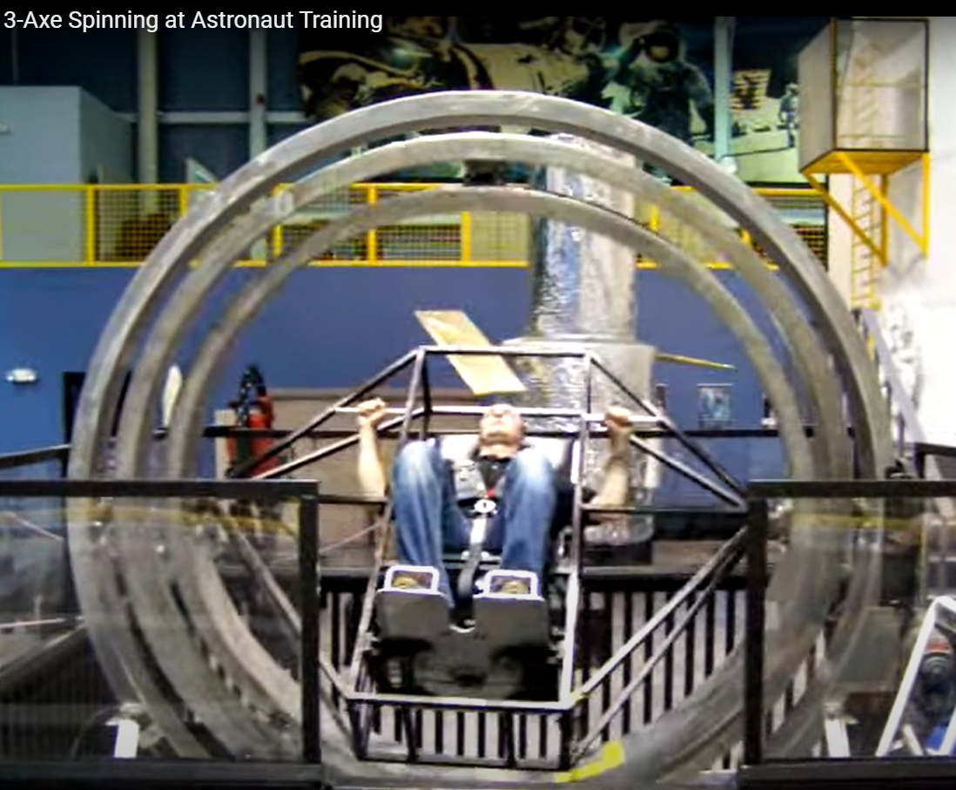
Pitch back and forth
[NASA training]
Notes:
https://www.youtube.com/watch?v=59kAQEOI0H4

Slide 71
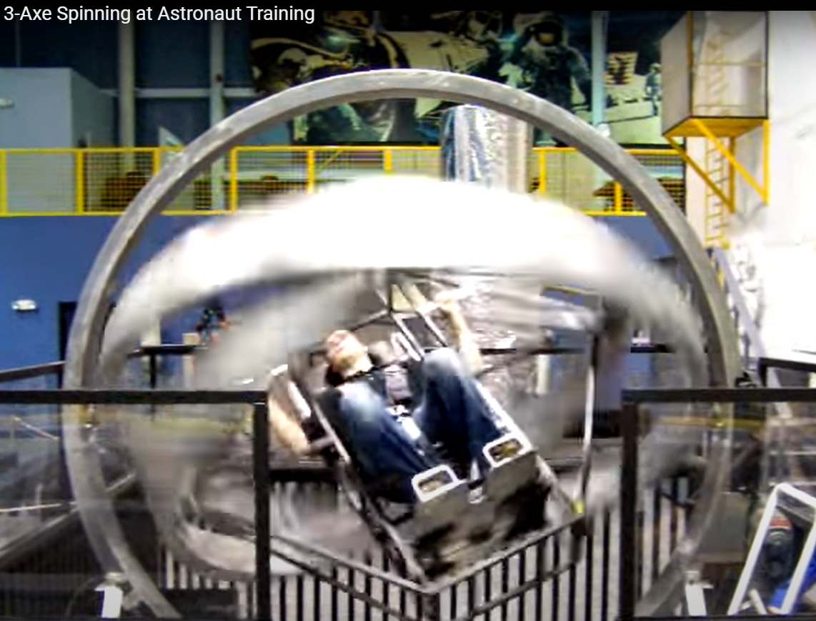
Pitch plus rollover left and right
Notes:
https://www.youtube.com/watch?v=59kAQEOI0H4

Slide 72
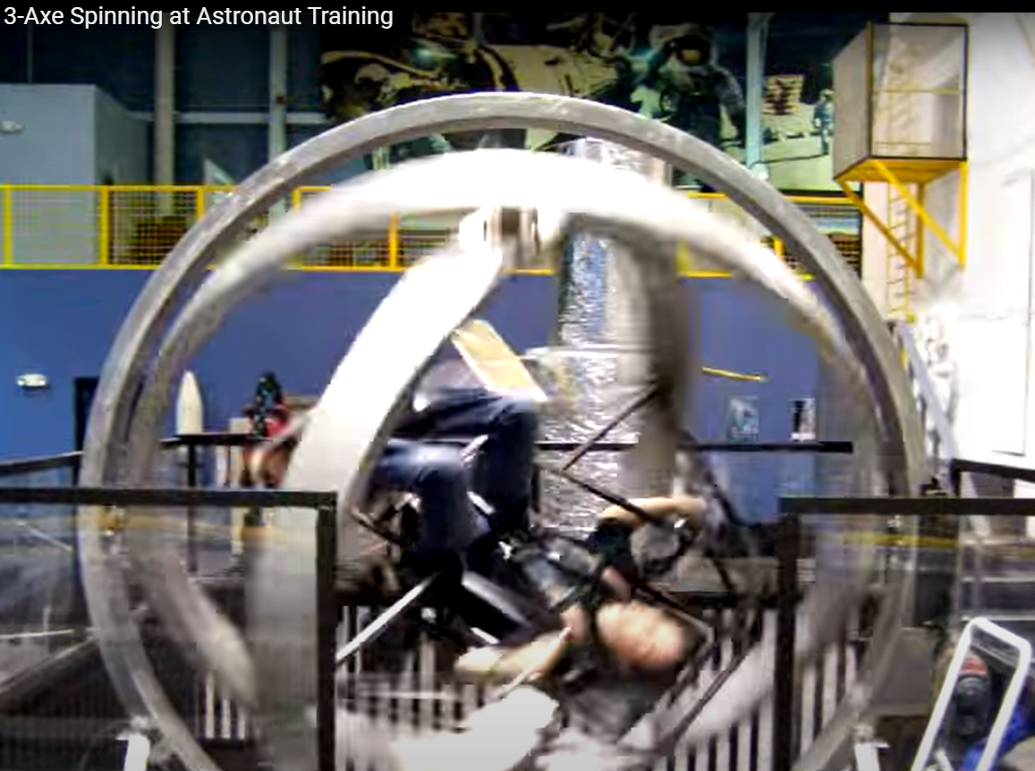
Pitch and roll and yaw turn left and right.
play
Notes:
https://www.youtube.com/watch?v=59kAQEOI0H4
If that’s what life is like at Or HaOlam…!
That’s why we keep busy!

Slide 73
Are we worshipers, filled with the Ruakh? [Spirit Pitched upward]
Are we minded to turn to bless Israel and be blessed? [Son, covenant]
Do we have inner healing, relational forgiving joy? [roll with the Father]
Notes:
Clear witness of the Spirit that you know that you know that your name is in the Lamb’s book of Life, only because of your trusting the atoning death of Yeshua.

Slide 74
Notes:
https://youtu.be/pQ24NtnaLl8

Slide 76
