Slide 1
e-handout
To have these notes
without taking notes
Go to OrHaOlam.com
Click on Messages tab,
2021 Messages

Slide 2
My #32 Wisdom tooth removed
Notes:
I may reflect 25% less wisdom today, but… the tooth is in my pocket. You can ask me for a close up look later.

Slide 3
Do the Greek Scriptures [New Testament] honestly translate the Hebrew Bible / Tanakh?

Slide 4
Do the Greek Scriptures [New Testament] honestly translate the Hebrew Bible / Tanakh?
There is an apparent forgery, forcing a bogus Messianic view!
Really?

Slide 6
Letter to the Messianic Jews a 10.05-10. A Body Prepared
Bona fide translation?
Application to us
Our suffering love
Our love of Torah
Our grasp of Yeshua’s deity
Our walking in holy joy
Notes:
Total outline of the message.

Slide 7
Letter to the Messianic Jews a 10.05-10. A Body Prepared
Bona fide translation?
Application to us
Our suffering love
Our love of Torah
Our grasp of Yeshua’s deity
Our walking in holy joy

Slide 8
Messianic Jews/Hebrews/MJ 10.5-10 This is why, on coming into the world, he says, [quoting Ps 40] “It has not been your will to have an animal sacrifice and a meal offering; rather, you have prepared for me a body.

Slide 9
Jewish Publication Society's rendering of Psalm 40:7: "Sacrifice and meal-offering You have no delight in; Mine ears have You opened;

Slide 10
CJB Heb/MJ 10.5 ^{quoting Ps 40.7} It has not been your will to have an animal sacrifice and a meal offering; rather, you have prepared for me a body. | JPS Ps 40.7 Sacrifice and meal-offering You have no delight in; Mine ears have You opened; | Ps 40.7 זֶבַח וּמִנְחָה לֹֽא־חָפַצְתָּ אָזְנַיִם כָּרִיתָ לִּי

Slide 11
CJB Heb/MJ 10.5 ^{quoting Ps 40.7} It has not been your will to have an animal sacrifice and a meal offering; rather, you have prepared for me a body. | JPS Ps 40.7 Sacrifice and meal-offering You have no delight in; Mine ears have You opened; | Ps 40.7 זֶבַח וּמִנְחָה לֹֽא־חָפַצְתָּ אָזְנַיִם כָּרִיתָ לִּי

Slide 12
Why would the Messianic Scripture writers dare change the word of G-d?
Notes:
Is our faith in Messiah contrived and bogus??
You can say “Of course not,” but many believers have stumbled.
Toviah Singer to BIAV in ~1998 we were invited by Rueven Jacobs formerly Ron Johnson son of Pastor Bob Johnson of Grandview Assembly. He and his wife converted to Orthodox Judaism from being an AG PK.

Slide 13
Firstly, the quotation is from the LXX, which was the authorized and accepted Rabbinic translation of the Tanakh into Greek, completed more than two centuries before Yeshua was born.
Notes:
But why change?

Slide 14
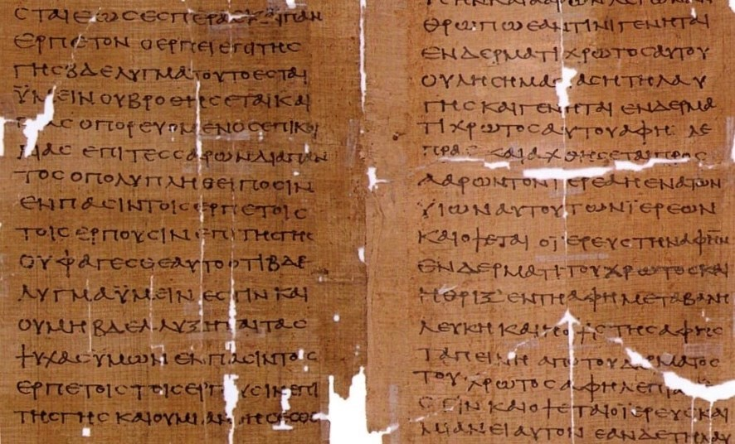
The Septuagint: The First of the
Bible Translations
Notes:
https://i1.wp.com/www.bibleblender.com/wp-content/uploads/ancient-copy-of-the-septuagint.jpg?fit=886%2C536&ssl=1
Into Greek in Alexandria

Slide 15
In 331 B.C., Alexander renamed an Egyptian town located along the Mediterranean Sea after himself: Alexandria. The city became a chief center for Hellenism (eclectic Greek culture) and housed the largest Jewish community in the world at that time.
Notes:
https://israelmyglory.org/article/the-septuagint-the-first-of-the-bible-translations/

Slide 16
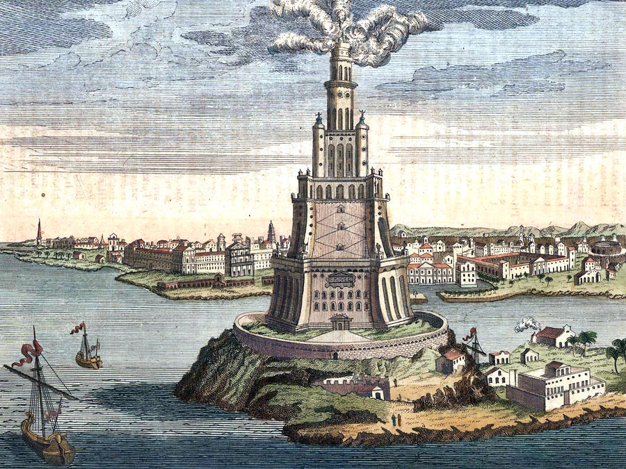
Ancient Alexandria, Egypt with Pharos lighthouse
Notes:
https://external-content.duckduckgo.com/iu/?u=https%3A%2F%2Fcdn.britannica.com%2F07%2F172307-120-30BB78AE.jpg&f=1&nofb=1

Slide 17
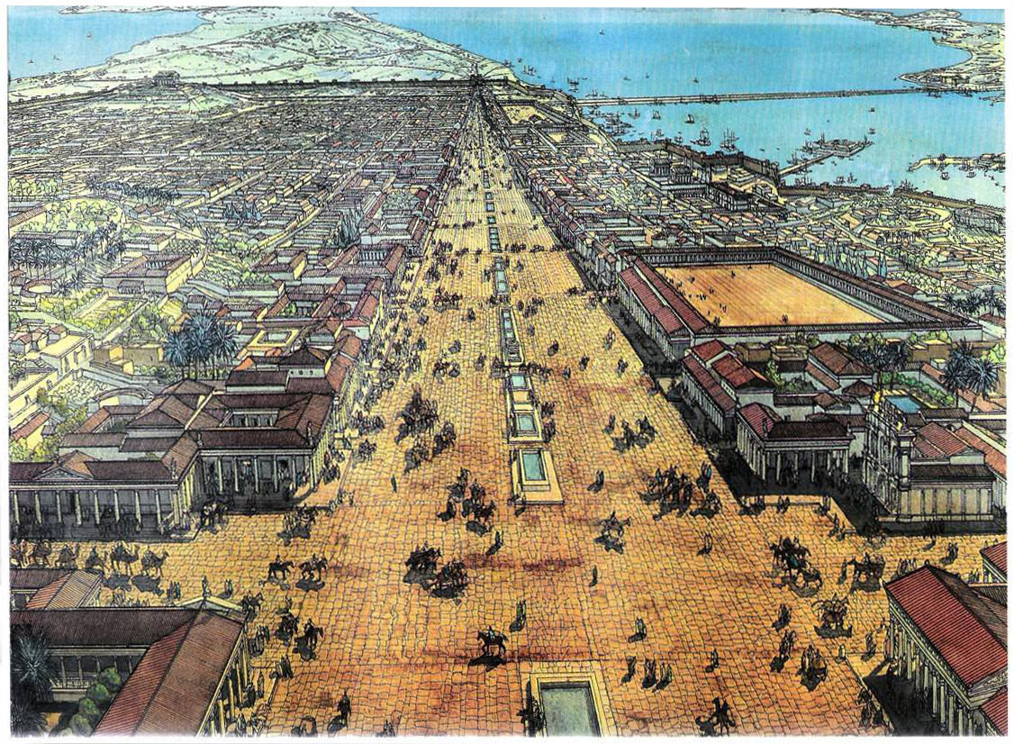
Ancient Alexan-dria, Egypt

Slide 18
However, within two or three generations, these Jewish people had forgotten their Hebrew language and spoke primarily Greek. Thus they needed the Hebrew Scriptures in Greek. They also wanted to contribute their Jewish religious knowledge to the Royal Library and museum of Alexandria.
Notes:
https://israelmyglory.org/article/the-septuagint-the-first-of-the-bible-translations/

Slide 19
Jewish legend alleges that in the 3rd century B.C., 72 respected elders of Israel were brought to Alexandria to translate the Torah into Greek. Working independently, they all had the exact same translation. So the LXX was consider ~inspired.
Notes:
https://israelmyglory.org/article/the-septuagint-the-first-of-the-bible-translations/

Slide 20
LXX Septuigint Ps 39.7 Sacrifice and offering you wanted not; but a body have you prepared me: whole-burnt-offering and [sacrifice] for sin you did not require.
Notes:
https://www.ellopos.net/elpenor/greek-texts/septuagint/chapter.asp?book=24&page=39

Slide 21
LXX Septuigint Ps 39.7 Sacrifice and offering you wanted not; but a body have you prepared me: whole-burnt-offering and [sacrifice] for sin you did not require.
But why the LXX so different from the Hebrew that we have?
Notes:
https://www.ellopos.net/elpenor/greek-texts/septuagint/chapter.asp?book=24&page=39

Slide 22
Adam Clarke in his commentary refers to a conjecture made by a Dr. Kennicott that the original ancient Hebrew might have read אז גוה, "then a body," instead of the current אָזְנַיִם, “my ears.”
Notes:
(Abingdon Press, Vol III, page 351).

Slide 23
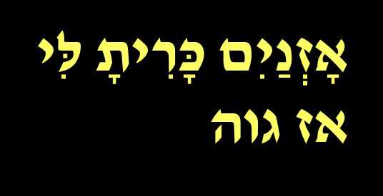
The three letters that need to be changed are
ג for a נ
ו for a י
מ for a ה
Easy scribal mistakes to make
Notes:
(Abingdon Press, Vol III, page 351).

Slide 24
CJB Heb/MJ 10.5 ^{quoting Ps 40.7} It has not been your will to have an animal sacrifice and a meal offering; rather, you have prepared for me a body. | JPS Ps 40.7 Sacrifice and meal-offering You have no delight in; Mine ears have You opened; | Ps 40.7 זֶבַח וּמִנְחָה לֹֽא־חָפַצְתָּ אָזְנַיִם כָּרִיתָ לִּי אזגוה
Notes:
So, maybe the LXX translators were reading from a Hebrew manuscript with az giveh instead of aznaim
אזגוה
אזנים

Slide 25
Ethiopic Bible in Geez has the LXX reading, and the Arabic has both. So “a body” may have been the actual ancient text that is reflected in the Letter to the Messianic Jews, and the Masoretic text is an error!
Notes:
(Abingdon Press, Vol III, page 351).

Slide 26
Thirdly, the sense of the ears being opened could be based on the cutting or piercing of the earlobes of the servant who stays with a slave owner for the sake of his family, indeed a redemptive picture. Both the body or the ears are yielded to G-d's will.

Slide 27
^{Shmot/Ex 21.5-6} “But if the servant plainly states, ‘I love my master, my wife and my children, and I will not go out free,’ then his master is to bring him to God, then take him to a door or to a doorpost. His master is to pierce his ear through with an awl, and he will serve him forever.

Slide 28
Lastly, as David Stern comments, "It is not known if the Septuagint translators worked form a different Hebrew text, or merely clarified the sense of the existing text, a common practice among the Targum translators."
Notes:
(page 703) Stern’s NT Commentary
So more of a paraphrase than a translation

Slide 29
This practice of clarification may seem to take undue liberties with the text, but generally was seen to reflect on a subtle meaning that was implicit to them in the text. The antiquity of their viewpoint commands respect.
Notes:
(page 703) Stern’s NT Commentary

Slide 30
Summary of reasons for the divergent reading:
Scribal error אָזְנַיִם אז גוה
LXX rendition
Dynamic translation

Slide 31
So, it’s bona fide to read Ps. 40 as “a body you have prepared for me.”

Slide 33
Letter to the Messianic Jews a 10.05-10. A Body Prepared
Bona fide translation?
Application to us
Our suffering love
Our love of Torah
Our grasp of Yeshua’s deity
Our walking in holy joy

Slide 34
His prepared body was cut; ours will be. Husbands, all.
^{Col 1.24} Now I rejoice in my sufferings for you, and in my physical body—for the sake of His body, Messiah’s community—I fill up what is lacking in the afflictions of Messiah.
Notes:
If your love for people is never with accepting suffering, then you are not loving aright. You’re just being a hero, a god, or seeking to be so treated..
Let the righteous smite me, it will be a kindness.

Slide 35
וּבַחֲבֻרָתוֹ נִרְפָּא-לָנוּ^{Yeshayahu/ Is 53:5} –
by his wounds we are healed.
By the wounds of Yeshua, our wounds are healed. Our wounds could not be healed if He was not willing to be wounded on our behalf. The place of His woundedness touches our place of woundedness; and heals us.
Notes:
Asher Intrater newsletter Dec 10, 2021

Slide 36
וּבַחֲבֻרָתוֹ נִרְפָּא-לָנוּ^{Yeshayahu/ Is 53:5} –
by his wounds we are healed.
The expression in Isaiah 53 is rather unique, and somewhat puzzling. The letter “bet” in the word for “wound” does not have a “dagesh” dot in it. With the dot it means “wound”, but without the dot it means “fellowship”.
Notes:
Asher Intrater
By His wounds or by His/our fellowship in woundedness

Slide 38
Yeshua told us to be encouraged, even though in this world we would have tribulation ^{(Yn 16:33).} He did not pray for us to be taken out of the world but to be protected in it ^{(Yn 17:15).}

Slide 39
Letter to the Messianic Jews a 10.05-10. A Body Prepared
Bona fide translation?
Application to us
Our suffering love
Our love of Torah
Our grasp of Yeshua’s deity
Our walking in holy joy

Slide 40
Messianic Jews/Hebrews/MJ 10.5-10 This is why, on coming into the world, he says, [quoting Ps 40] “It has not been your will to have an animal sacrifice and a meal offering; rather, you have prepared for me a body. No, you have not been pleased with burnt offerings and sin offerings.

Slide 41
“You have not been pleased with burnt offerings and sin offerings.” Replacement?
Above is a quote of Ps 40
Was the prophet Yeshayhu / Isaiah for replacement of Israel and the Temple worship?

Slide 42
^{~ Yeshayahu/Isaiah 1.11-15} “For what is it to Me-the multitude of your sacrifices?” says Adoni. “I am full of burnt offerings of rams and fat of fed animals. I have no delight in the blood of bulls, or of lambs or he-goats. When you come to appear before Me, who has required this at your hand— trampling My courts?

Slide 43
^{~ Yeshayahu/Isaiah 1.11-15} Bring no more worthless offerings! Incense is an abomination to Me. New Moon and Shabbat, the calling of convocations —I cannot endure it— iniquity with solemn assembly. Your New Moons and your Festivals My soul hates!

Slide 44
^{~ Yeshayahu/Isaiah 1.11-15} They are a burden to Me. I am weary to bear them. When you spread out your hands, I will hide My eyes from you. When you multiply prayers, I will not hear. Your hands are full of blood!”

Slide 45
Our love of Torah has to be in the spirit of love, joy, shalom.
^{2 Cor 3.6} He has even made us competent to be workers serving a New Covenant, the essence of which is not a written text but the Spirit. For the written text brings death, but the Spirit gives life.
Notes:
We teach the holidays, and Shabbat observance, and the dietary laws here, but as an expression of joy, family togetherness, shalom. NOT SEVERITY!!

Slide 48
Letter to the Messianic Jews a 10.05-10. A Body Prepared
Bona fide translation?
Application to us
Our suffering love
Our love of Torah
Our grasp of Yeshua’s deity
Our walking in holy joy

Slide 49
Messianic Jews/Hebrews/MJ 10.5-10 [still quoting Psalm 40] Then I said, ‘Look! In the scroll of the book it is written about me. I have come to do your will.’”

Slide 50
Did Yeshua fully know who He was as
An embryo / fetus
A newborn
A child
Theory: He saw Himself in scripture; at His immersion, full revelation.

Slide 51
^{Mtt. 3.16-17} After being immersed, Yeshua rose up out of the water; and behold, the heavens were opened to Him, and He saw the Ruakh Elohim descending like a dove and coming upon Him. And behold, a voice from the heavens said, “This is My Son, whom I love; with Him I am well pleased!

Slide 52
^{Matt. 4.1} Then the Spirit led Yeshua up into the wilderness to be tempted by the Adversary.
Yeshua is NOT half G-d and half man. He is FULLY G-d and FULLY man!
Was He REALLY tempted?
Notes:
Immediately after full revelation, need to process His role and redemptive task.

Slide 54
Letter to the Messianic Jews a 10.05-10. A Body Prepared
Bona fide translation?
Application to us
Our suffering love
Our love of Torah
Our grasp of Yeshua’s deity
Our walking in holy joy

Slide 55
Messianic Jews/Hebrews/MJ 10.5-10 Then I said, ‘Look! In the scroll of the book it is written about me. I have come to do your will.’” In saying first, “You neither willed nor were pleased with animal sacrifices, meal offerings, burnt offerings and sin offerings,” things which are offered in accordance with the Torah;

Slide 56
Messianic Jews/Hebrews/MJ 10.5-10 and then, “Look, I have come to do your will”; he takes away the first system in order to set up the second. It is in connection with this will that we have been separated for God and made holy, once and for all, through the offering of Yeshua the Messiah’s body.

Slide 57
“separated for God and made holy, once and for all, through the offering of Yeshua the Messiah’s body.”
So do we deal with life in frustration and irritation, or in trust and holy joy?

Slide 58
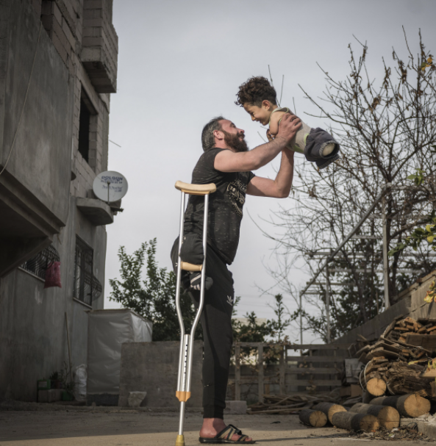
“Hardship of Life” by Turkish photog Mehmet Aslan took the place of overall winner in SIPA 2021. The emotionally-charged shot was taken in the district of Reyhanli, in the Turkish province of Hatay, at the border with Syria.
Notes:
https://www.theepochtimes.com/hardship-of-life-touching-photos-from-far-corners-of-the-world-win-international-photo-competition_4073536.html?utm_source=newsnoe&utm_medium=email&utm_campaign=breaking-2021-11-22-1&est=kx9M6xD%2FN6qKNK4cc6tLGMnMitNNW%2FAyv8jt0DawHoDCT0QqORDTsA4Xh60RfcQAFQ%3D%3D

Slide 59
A father, Munzir, who lost one leg when a bomb was dropped as he walked through a bazaar in Idlib, holds his son, Mustafa, who was born without lower or upper limbs due to a congenital disorder caused by medications during his mother’s treatment in the war in Syria.
Notes:
The photo was selected from tens of thousands of images submitted by photographers from 163 countries.

Slide 60
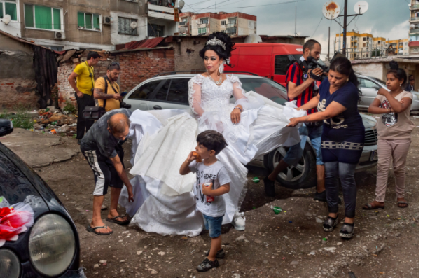
Notes:
A young bride is shown preparing for her wedding on a slum-like street in the crowded Roma ghetto of Stolipinovo, Bulgaria.
https://www.theepochtimes.com/hardship-of-life-touching-photos-from-far-corners-of-the-world-win-international-photo-competition_4073536.html?utm_source=newsnoe&utm_medium=email&utm_campaign=breaking-2021-11-22-1&est=kx9M6xD%2FN6qKNK4cc6tLGMnMitNNW%2FAyv8jt0DawHoDCT0QqORDTsA4Xh60RfcQAFQ%3D%3D

Slide 61
separated for God and made holy, once and for all, through the offering of Yeshua the Messiah’s body.
So do we deal with life in frustration and irritation, or in trust and holy joy?

Slide 62
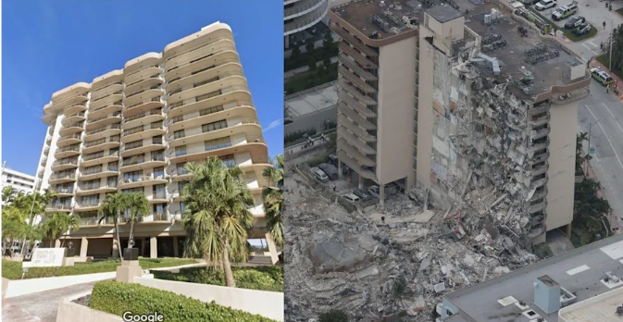
Before-and-after images of the Florida
condo collapse show the severity of
the disaster
Notes:
https://www.yahoo.com/entertainment/images-florida-condo-collapse-show-154448626.html

Slide 63
When the building collapsed in Surfside, Florida, the Israel Defense Forces deployed a rapid response elite squad to help with search and rescue. This team was credited with recovering 81 of the 97 bodies of victims due to its superior methods of mapping out potential locations.
Notes:
https://www.charismanews.com/world/86600-another-nation-makes-bold-move-to-stand-with-israel?utm_source=Charisma%20News%20Daily&utm_medium=email&utm_content=subscriber_id:5160390&utm_campaign=CNO%20daily%20-%202021-09-02

Slide 64
separated for God and made holy, once and for all, through the offering of Yeshua the Messiah’s body.
So do we deal with life in frustration and irritation, or in trust and holy joy?

Slide 65
The Gallup annual mental-health self-assessment released Friday indicated that Americans are struggling with the aftermath of COVID-19, with just 34% rating their mental well-being as “excellent,” the same as last year and a 21-year low for the survey.
Notes:
https://www.washingtontimes.com/news/2021/dec/6/regular-churchgoers-top-gallups-mental-health-poll/?utm_source=RSS_Feed&utm_medium=RSS

Slide 66
Those reporting the best mental state were the faithful: 44% of weekly churchgoers said their mental health was “excellent,” more than any subgroup tracked by Gallup and the only one to register higher levels of emotional health in 2021 than in 2019, before the pandemic.
Notes:
https://www.washingtontimes.com/news/2021/dec/6/regular-churchgoers-top-gallups-mental-health-poll/?utm_source=RSS_Feed&utm_medium=RSS

Slide 67
Bringing up the rear were low-income earners and Democrats. Only 28% of Democrats said they had “excellent” emotional well-being, even though the survey was conducted Nov. 1-16, a year after Joseph R. Biden defeated Donald Trump in the 2020 presidential race.
Notes:
https://www.washingtontimes.com/news/2021/dec/6/regular-churchgoers-top-gallups-mental-health-poll/?utm_source=RSS_Feed&utm_medium=RSS

Slide 68
By contrast, 42% of Republicans and 33% of independents reported “excellent” mental health. Both were well below the pre-pandemic 2019 ratings of 56% for Republicans and 44% for independents.
Notes:
https://www.washingtontimes.com/news/2021/dec/6/regular-churchgoers-top-gallups-mental-health-poll/?utm_source=RSS_Feed&utm_medium=RSS

Slide 69
separated for God and made holy, once and for all, through the offering of Yeshua the Messiah’s body.
So do we deal with life in frustration and irritation, or in trust and holy joy?

Slide 70
Revival of Judean dates from Masada destroyed by the Romans
The fruit of the tree symbolized life and prosperity and was praised in ancient literature for its unique medicinal properties. But the dates of Judea were made extinct by the Middle Ages. Romans destroyed much, Crusaders made them extinct.

Slide 71
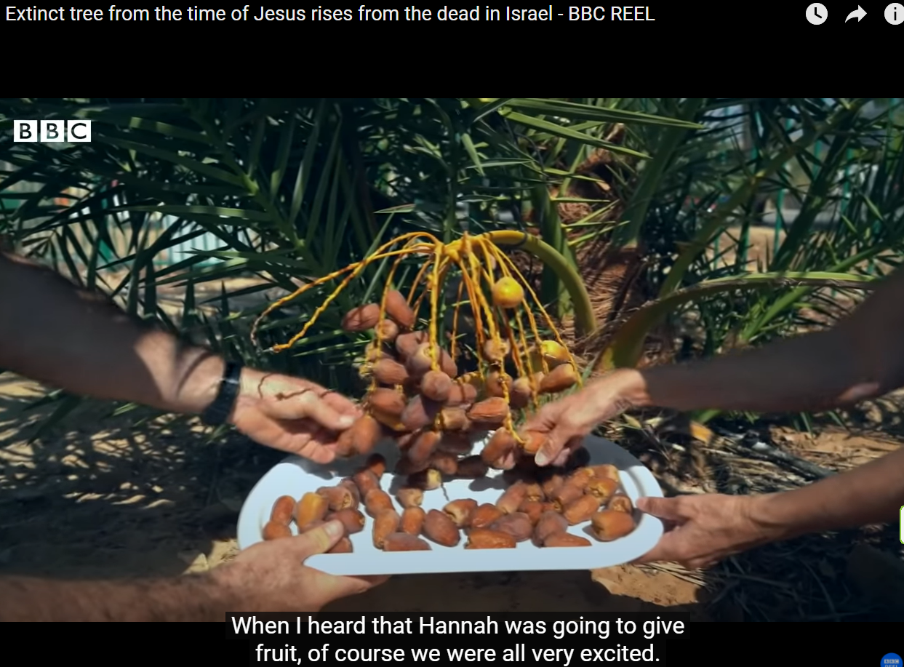
Notes:
https://youtu.be/o0y5Z8_tefY
If you are short on time, just watch
00 to 1.30 2.56 to 4.10 5.01 to 5.48 6.36 to 7.00
Also
https://www.youtube.com/watch?v=60oyN_J_7SQ

Slide 72
separated for God and made holy, once and for all, through the offering of Yeshua the Messiah’s body.
So do we deal with life in frustration and irritation, or in trust and holy joy?

Slide 73
(Worthy News) – The spokesman for the Islamic Republic of Iran’s armed forces, Brig.-Gen. Abolfazl Shekarchi, on Saturday urged the total elimination of the Jewish state during an interview with an Iranian regime-controlled media outlet.
Notes:
https://www.worthynews.com/63311-iranian-brig-gen-urges-destruction-of-israel-prior-to-nuke-talks

Slide 75
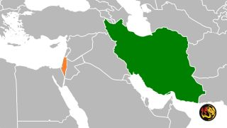
“We will not back off from the annihilation of Israel, even one millimeter. We want to destroy Zionism in the world,” Shekarchi told the Iranian Students News Agency.
Notes:
https://www.worthynews.com/63311-iranian-brig-gen-urges-destruction-of-israel-prior-to-nuke-talks

Slide 76
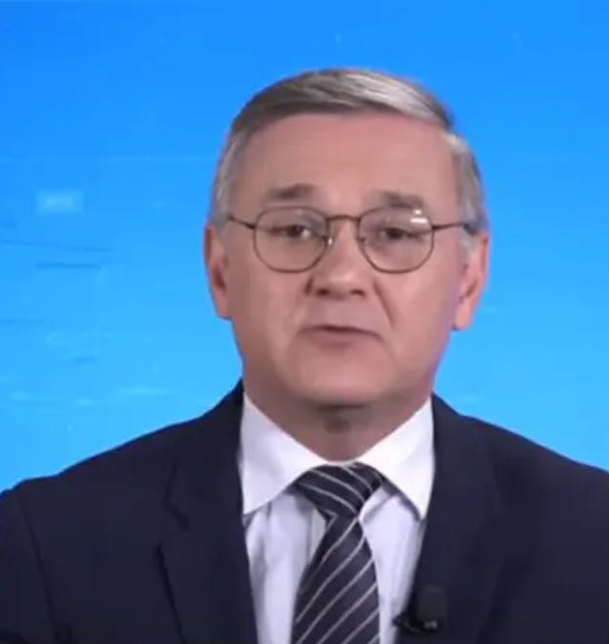
Jose Carlos Bernardi, a pundit for Jovem Pan, a Brazilian right-leaning radio and television station, made the comments
Notes:
https://vfinews.com/news/november-23-2021/brazilian-journalist-says-brazil-would-need-to-kill

Slide 77
in a discussion Tuesday, Nov. 23, 2021 about how Brazil could attain the economic development enjoyed by Germany . “Only by attacking Jews will we get there. If we kill a gazillion Jews and appropriate their economic power, then Brazil will get rich.
Later a lame apology.
Notes:
https://vfinews.com/news/november-23-2021/brazilian-journalist-says-brazil-would-need-to-kill

Slide 78
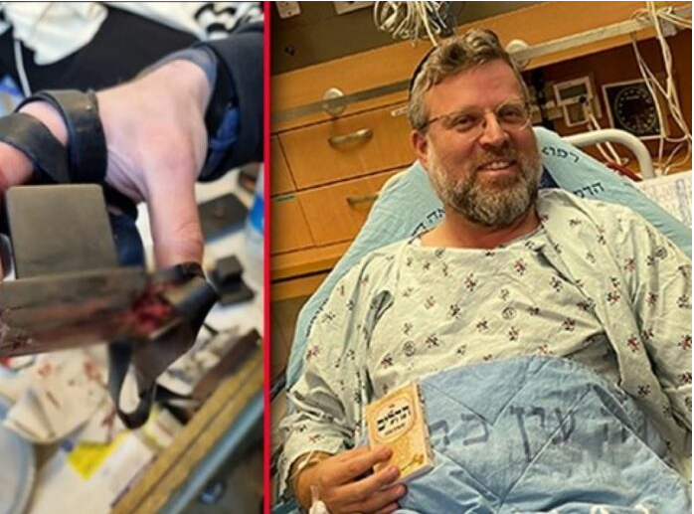
Life saved by tefillin!
Notes:
https://www.theyeshivaworld.com/news/headlines-breaking-stories/2031302/nissim-at-terror-attack-bullet-strikes-tefillin-shel-yad-saving-victims-life.html

Slide 79
Rabbi Ze’ev Katzenellenbogen was saved due to a bullet striking the exact place of his arm Tefillinשל יד shel yad, saving his life. Age 46, a father of 8 and a resident of the Jewish Quarter of the Old City, was on the way back from Shacharis at the Kosel, when he heard the sound of shooting.
Notes:
https://www.theyeshivaworld.com/news/headlines-breaking-stories/2031302/nissim-at-terror-attack-bullet-strikes-tefillin-shel-yad-saving-victims-life.html

Slide 80
“I was going home from Shacharis, still wrapped in my tallis and tefillin. I heard gunshots and chaos. Suddenly, I felt a sharp pain in my arm right at the place of my tefillin.
Notes:
https://www.theyeshivaworld.com/news/headlines-breaking-stories/2031302/nissim-at-terror-attack-bullet-strikes-tefillin-shel-yad-saving-victims-life.html

Slide 81
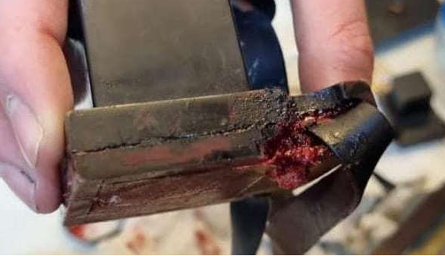
Notes:
https://www.charismanews.com/opinion/standing-with-israel/87532-hamas-terror-attack-in-jerusalem-kills-one-shows-christian-friends-depth-of-hamas-hatred

Slide 83
Letter to the Messianic Jews a 10.05-10. A Body Prepared
Bona fide translation?
Application to us
Our suffering love
Our love of Torah
Our grasp of Yeshua’s deity
Our walking in holy joy

Slide 84
Do you KNOW Yeshua and the assurance of sins forgiven?
Are you hearing daily from His Word?
How are you applying what you heard?
Are you asking this of another?
Notes:
By repentance and faith.
Who are you discipling, building up?4

