Slide 1
e-handout
To have these notes
without taking notes
Go to OrHaOlam.com
Click on downloads,
messages, 2020

Slide 2
What is the first food that had a known expiration date?
Notes:
Gavriel Rennels

Slide 3
What is the first food that had a known expiration date?
Mannah - expired in 24 hours
(or 48 on erev Shabbat / Friday).
Notes:
Gavriel Rennels

Slide 4


Slide 5
Good news from Israel

Slide 6
Just east of Nazareth is an army base where the IDF has at-risk Israeli 18-year-old men. The name of the base is “The Farm of the Guard” (Havat Hashomer חַוָּת השומר)
Notes:
https://www.israeltoday.co.il/read/rehabilitative-discipleship-in-the-idf/?utm_source=acfs&utm_medium=email&utm_term=all&utm_campaign=newsletter-2020-12-27

Slide 7
Even at eleven o’clock at night you can still hear the young recruits yelling to each other “Listen. Listen.” – ”Hakshev.” הקשב They are rewiring their neurons to listen to their commanders, who happen to be female basic-training drill sergeants.
Notes:
https://www.israeltoday.co.il/read/rehabilitative-discipleship-in-the-idf/?utm_source=acfs&utm_medium=email&utm_term=all&utm_campaign=newsletter-2020-12-27

Slide 8
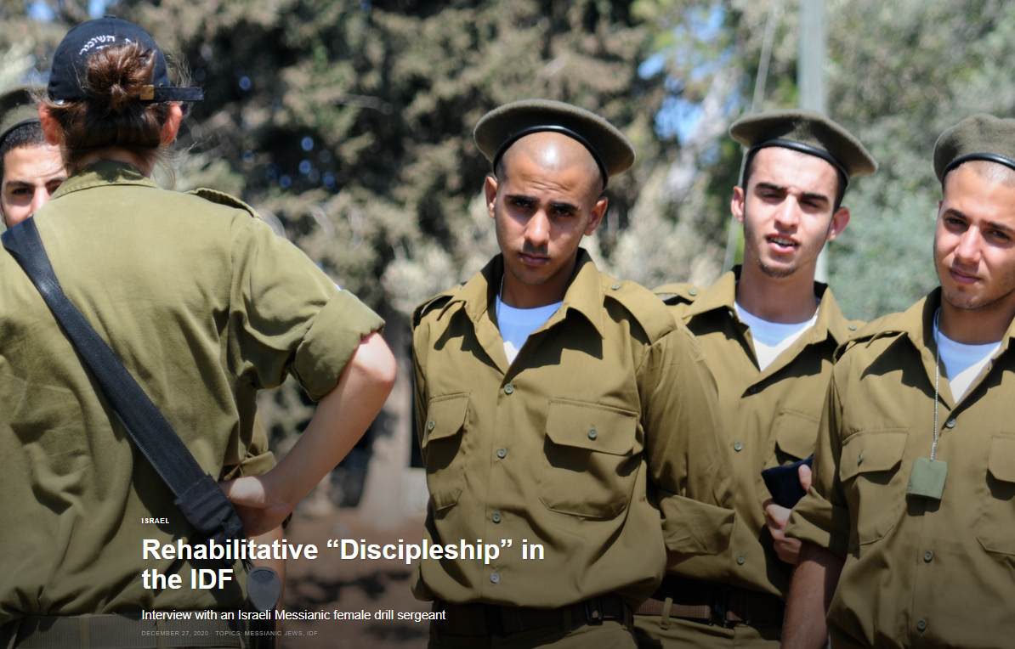
Israeli military rehab
Notes:
https://www.israeltoday.co.il/read/rehabilitative-discipleship-in-the-idf/?utm_source=acfs&utm_medium=email&utm_term=all&utm_campaign=newsletter-2020-12-27

Slide 9
All of their drill sergeants are female IDF soldiers! This cancels out the dangerous potential for a head-to-head “testosterone /machismo” conflict. Since 1981, they have worked with thousands of troubled young men.

Slide 11
Credit rating company Fitch has confirmed Israel’s status at A+ and maintained its forecast at “stable.” Factors: strong external accounts, a diversified economy, and a government debt-to-GDP ratio that is still high relative to reference countries, and ongoing political and security risks.
Notes:
https://vfinews.com/en/news/january-15-2021/fitch-confirms-israels-a-credit-rating

Slide 12
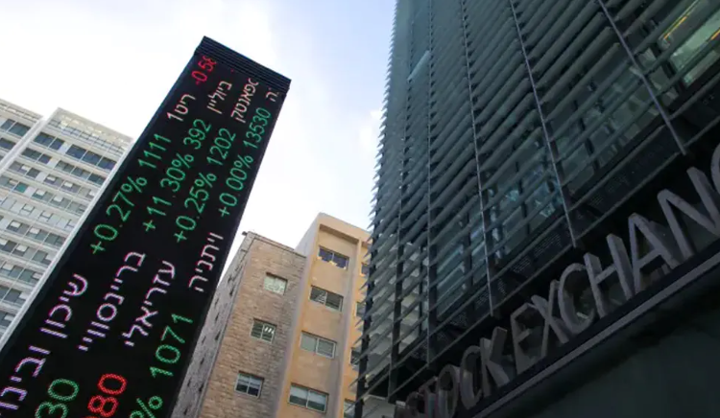
Notes:
https://vfinews.com/en/news/january-15-2021/fitch-confirms-israels-a-credit-rating
What does this have to do with spiritual revival? Ezek 37 dry bones before our eyes! Does it do something to see stock ticker numbers mixed with Hebrew?
About equal to loving the Hebrew roots revival is loving the Hebrews. Lox and dill pickle eating Hebrews. Pray for the peace of Jerusalem.

Slide 13
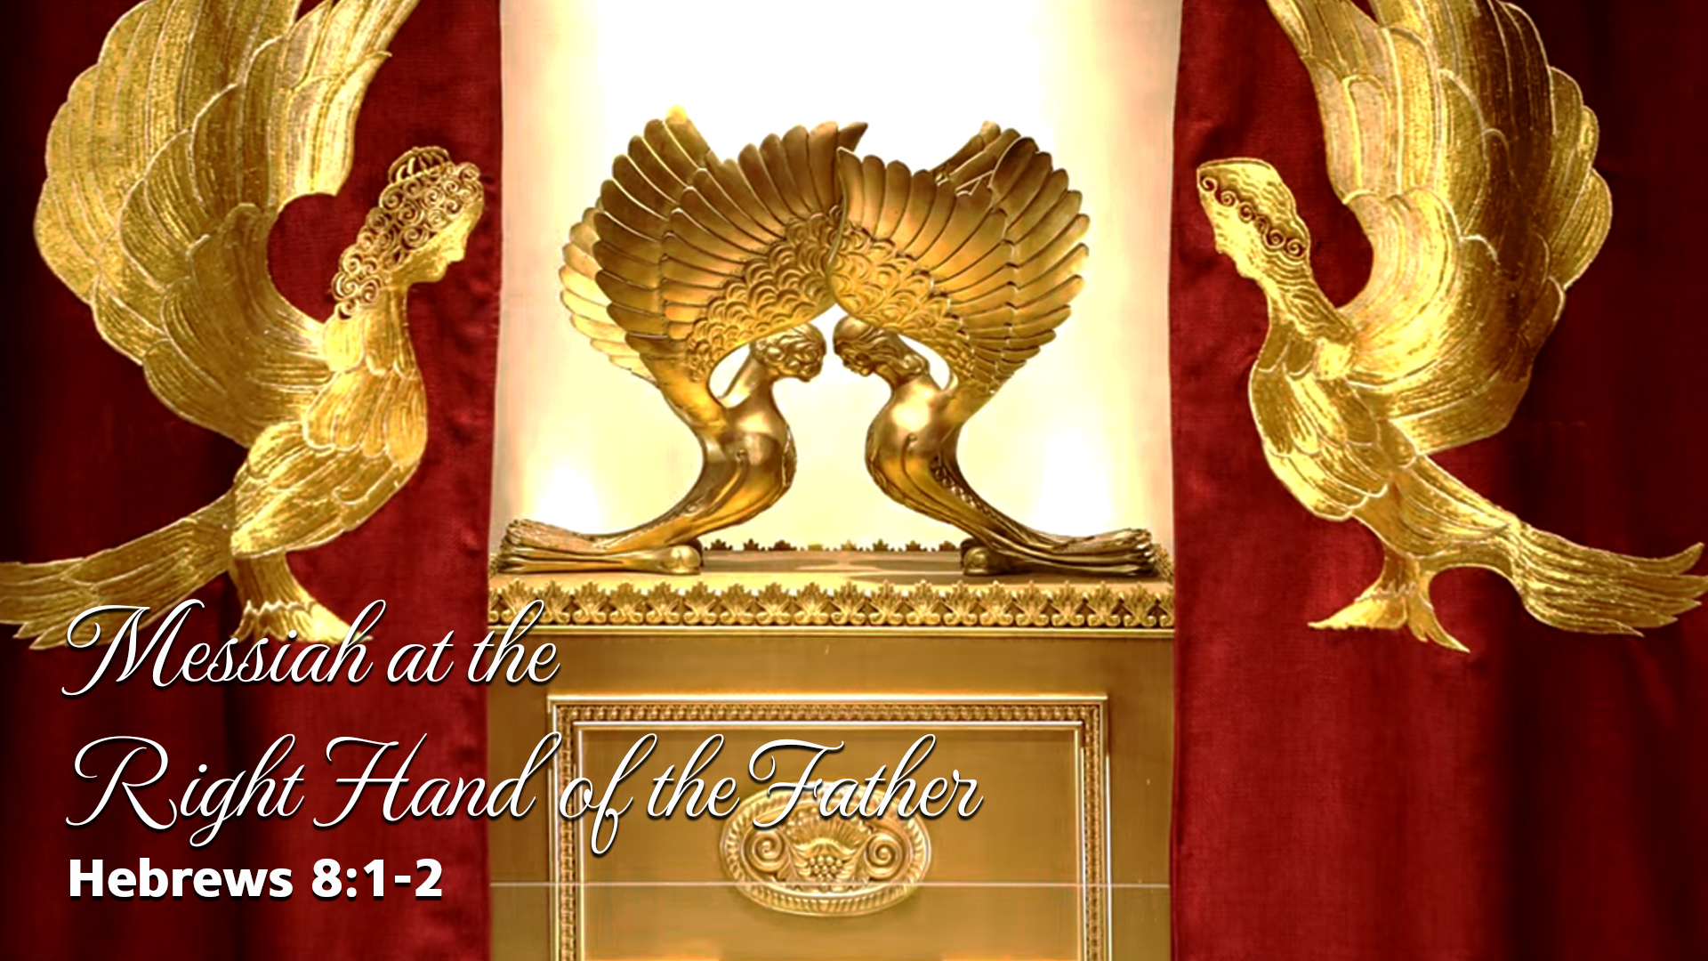
Notes:
https://www.templeinstitute.org/new-location.htm

Slide 14
^{MJ 8.1-2} Here is the whole point of what we have been saying: we do have just such a cohen gadol as has been described.
Notes:
Like Melki-Tsedek

Slide 15
^{MJ 7.26, 25} This is the kind of cohen gadol that meets our need — holy, without evil, without stain, set apart from sinners and raised higher than the heavens. He is totally able to deliver those who approach God through him; since he is alive forever and thus forever able to intercede on their behalf.

Slide 16
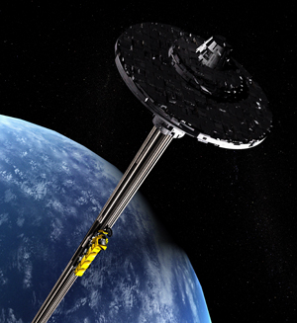
Resurrection
Spiritual
“Space”
Elevator

Slide 17
^{MJ 8.1-2} And he does sit at the right hand of HaG’dulah in heaven.
There he serves in the Holy Place, that is, in the true Tent of Meeting, the one erected not by human beings but by Adoni.
Notes:
This phrase is the center of this message. 13 x referenced in Mes Scrip.

Slide 18

^{MJ 8.1-2} ^{TLV} who has taken His seat at the right hand of the throne of the Majesty in the heavens.
And he does sit at the right hand of HaG’dulah in heaven. ^{CJB}

Slide 19
This vision is what transformed me in 1969, and is still why I get up in the morning.
^{Habakkuk 2.20} Adoni is in his holy temple; let all the earth be silent before him.

Slide 20
S’rafim stood over him…They were crying out to each other,
שְׂרָפִים עֹמְדִים מִמַּעַל לוֹ ...
וְקָרָא זֶה אֶל-זֶה וְאָמַר,

Slide 21
K'doosha Musaf קְדוּשָׁה
קָדוֹשׁ, קָדוֹשׁ, קָדוֹשׁ, יְיָ צְבָאוֹת,
מְלא כָל הָאָֽרֶץ כְּבוֹדוֹ:
Ka-dosh, ka-dosh, ka-dosh,
Adoni ts'va-ot,
m'lo khawl ha-aretz k'vodo.

Slide 22
K'doosha Musaf קְדוּשָׁה
Holy, Holy, Holy
is Adoni of Armies.
All the heavens is filled
with His Glory.

Slide 23
בָּרוּךְ כְּבוֹד יְיָ מִמְּקוֹמוֹ:
Ba-rookh k'vod Ado-ni
meem-ko-mo.
Blessed be the glory of Adoni from His place.

Slide 24
^{Yn 12.41} Isaiah…saw the Sh’khinah of Yeshua and spoke about him.

Slide 25
^{MJ 7.26, 25} This is the kind of cohen gadol that meets our need — holy, without evil, without stain, set apart from sinners and raised higher than the heavens. He is totally able to deliver those who approach God through him; since he is alive forever and thus forever able to intercede on their behalf.

Slide 26
^{MJ 8.1-2} And he does sit at the right hand of HaG’dulah in heaven. There he serves in the Holy Place, that is, in the true Tent of Meeting, the one erected not by human beings but by Adoni.

Slide 27
This seems to be the verse from the Hebrew scriptures MOST quoted in the Messianic Scriptures! 13 times.
Messiah seated at the right hand of the Father as our Cohen!
What does it mean??

Slide 28
Outline of this message
Central truth: Messiah at the right hand of the Father
We enter into this…

Slide 29
All based on
^{Psalm 110.1} Adoni says to my Lord, “Sit at my right hand until I make your enemies a footstool for Your feet.”
נְאֻם יְיָ לַאדֹנִי - שֵׁב לִימִינִי
עַד-אָשִׁית אֹיְבֶיךָ, הֲדֹם לְרַגְלֶיךָ.
Notes:
This is the verse quoted 13 times in the Messianic Writings/New Testament.
Conversation of two divine personalities. Glimpse into the pre-incarnate nature of Messiah!

Slide 30
1. Proof of deity of Messiah:
^{Mtt. 22.41-45} Then, turning to the assembled P’rushim, Yeshua put a question/ sheilah to them: “Tell me your view concerning the Messiah: whose son is he?” They said to him, “David’s.”

Slide 31
1. Proof of deity of Messiah:
^{Mtt. 22.41-45} “Then how is it,” he asked them, “that David, inspired by the Spirit, calls him ‘Lord,’ when he says, ‘Adoni said to my Lord, “Sit here at my right hand until I put your enemies under your feet”’?
Notes:
During debates in the Temple. It’s very Jewish to debate and argue.
Point to His debate partners, the Prushim/Pharisees in this chapter. Two divine personalities. So, not just Davidic dynasty. Greater than that.

Slide 32
1. Proof of deity of Messiah:
^{Mtt. 22.41-45} If David thus calls him ‘Lord,’ how is he his son?” No one could think of anything to say in reply; and from that day on, no one dared put to him another sh’eilah.

Slide 33
2. Yeshua Asserting Messiahship
^{Mtt 26.63-35} The kohen gadol said to Him, “I charge You under oath by the living God, tell us if You are Mashiach Ben-Elohim” [the Son of G-d]! “As you have said,” replied Yeshua. Ken כֵּן
Notes:
Perfect response in conflict. I’m not a conflict avoider, but a conflict delayer. Usually think of the perfect response the next day. Yeshua was PERFECT in conflict. Razor sharp

Slide 34
2. Yeshua Asserting Messiahship
^{Mtt 26.63-35} “Besides that, I tell you, soon after you will see the Son of Man sitting at the right hand of power and coming on the clouds of heaven.” Then the kohen gadol tore his clothes and said, “Blasphemy!
Notes:
Perfect response in conflict.
Adds Daniel 7.14 “clouds of heaven.”

Slide 35
3. Proclaiming the Messiahship of Yeshua
^{Acts 2. 33-35} “Moreover, he has been exalted to the right hand of God; has received from the Father what he promised, namely, the Ruakh HaKodesh; and has poured out this gift,
Notes:
For Biblically literate people. Jews in those days.

Slide 36
3. Proclaiming the Messiahship of Yeshua
^{Acts 2. 33-35} which you are both seeing and hearing. For David did not ascend into heaven. But he says, ‘Adoni said to my Lord, “Sit at my right hand until I make your enemies a footstool for your feet.”’

Slide 37
4. Followers Defending their role
^{Acts 5.29-31} Kefa and the other emissaries answered, “We must obey God, not men. The God of our fathers raised up Yeshua, whereas you men killed him by having him hanged on a stake.

Slide 38
4. Followers Defending their role
^{Acts 5.29-31} God has exalted this man at his right hand as Ruler and Savior, in order to enable Isra’el to do t’shuvah and have her sins forgiven.
Notes:
On hearing this, the members of the Sanhedrin were infuriated and wanted to put the emissaries to death. ³⁴ But one of the members of the Sanhedrin rose to his feet, a Parush named Gamli’el

Slide 39
5. Giving comfort to martyrs
^{Acts 7.55-57} But he, full of the Ruakh HaKodesh, looked up to heaven and saw God’s Sh’khinah, with Yeshua standing at the right hand of God. “Look!” he exclaimed, “I see heaven opened and the Son of Man standing at the right hand of God!”
Notes:
^{Preceding verse} When they heard these things, they became enraged and began gnashing their teeth at him. [rage and fury.]

Slide 40
5. Giving comfort to martyrs
^{Acts 7.55-57} At this, they began yelling at the top of their voices, so that they wouldn’t have to hear him; and with one accord, they rushed at him, threw him outside the city and began stoning him.

Slide 41
6. Making intercessory pleading for us
^{Ro 8.34} the Messiah Yeshua, who died and — more than that — has been raised, is at the right hand of God and is actually pleading on our behalf!
Notes:
by the presentation of his sacrifice, by offering up the prayers and praises of his people, by declaring it as his will, that such and such blessings be bestowed upon them, and by seeing to it, that the benefits of his death are applied to those, for whom they were designed; which intercession of Messiah proceeds upon the foot of a satisfaction made; it always continues, and is ever prevalent, and so has a considerable influence to secure from condemnation.

Slide 42
7. Is the seat of Kingdom authority ^{Eph 1.19-22} It [His power] works with the same mighty strength he used when he worked in the Messiah to raise him from the dead and seat him at his right hand in heaven,

Slide 43
7. Is the seat of Kingdom authority ^{Eph 1.19-22} far above every ruler, authority, power, dominion or any other name that can be named either in the ‘olam hazeh [this world] or in the ‘olam haba [the next world]. Also, he has put all things under his feet.

Slide 44
8. The focus of our affections
^{Col 3.1-2} Therefore, if you have been raised up with Messiah, keep seeking the things above—where Messiah is, sitting at the right hand of God. Focus your mind on things above, not on things on the earth.

Slide 45
9. Seat of ruling angels
^{1 Kefa/P 3.21-22} Yeshua the Messiah. He has gone into heaven and is at the right hand of God, with angels, authorities and powers subject to him.

Slide 46
Yeshua is seated at the right hand of the Father.
Receiving seraphic worship
Preparing to return
Pouring out the Ruakh /Spirit
Making His enemies His footstool = servants

Slide 47
Enables repentance Hashivenu = השיבינו = “cause us to return”
Stands up to welcome those who sufferer till death
Directing angels, authorities, and powers.

Slide 48
When we pray, we engage with the Son. ^{Ro 8.16-17} The Spirit himself bears witness with our own spirits that we are children of God; and if we are children, then we are also heirs, heirs of God and joint-heirs with the Messiah — provided we are suffering with him in order also to be glorified with him.
Notes:
Billheimer Destined for the Throne p 39-49
Download at
https://www.pinterest.co.kr/pin/586312445217599903/

Slide 49
So, how can we engage with the Son at the Right Hand of the Most High?
Resurrection
Elevator Strategies

Slide 50
Outline of this message
Central truth: Messiah at the right hand of the Father
We enter into this
  By trusting His rulership

Slide 51
^{Yermiyahu / Jer 29 4-7} Thus says Adoni-Tzva’ot, the God of Israel, to all those in captivity, whom I removed as captives into exile from Jerusalem to Babylon: “Build houses and live in them…Also seek the shalom of the city where I took you as captives in exile, and pray to Adonai for it—for in its shalom will you have shalom.”
Notes:
We are worried about the Equality Act. Reversal of the Mexico City Policy. We will have no religious recourse to transgender men wanting to use the women’s bathroom. Hate crime to stop them. I will go to jail to stop them.
Nevertheless, we will support, honor, and respect the new administration. Honorable speech.

Slide 52
^{Yn 18.36} Yeshua answered, “My kingdom is not of this world. If My kingdom were of this world, then My servants would be fighting so that I wouldn’t be handed over to the Judean leaders. But as it is, My kingdom is not from here.”

Slide 53
^{Daniel 5.21} The Most High God rules in the human kingdom and sets up over it whomever he pleases.

Slide 54
So, how can we engage with the Son at the Right Hand of the Most High?
Resurrection
Elevator Strategies

Slide 55
Outline of this message
Central truth: Messiah at the right hand of the Father
We enter into this
  By trusting His rulership
  By 24/7 intercession

Slide 56
24/7 Cyber prayer room
Notes:
Had this idea for about 8 years. Was told easy peasy. Have approached a number of web people. It wasn’t so easy.
The whole IHOP media team who LOVED the idea, but no one wanted to do it, for love or money. Finally, I was visiting with Valentin & Nina Jarov who referred me to someone who can do it!

Slide 57
 | Midnight | 1 a.m. | 2 a.m. | 3 a.m. | 4 a.m. | 5 a.m. | 6 a.m. | 7 a.m. | 8 a.m.
Sunday | Louise Warfare | Kathi Joy | Shmuel Sweet reality | Greg | Lori | Steve | Vicki | Jim A | Jude
Monday | Cathy A | Ramona | Amy Stewart | Amy Richardson | Marc Richardson | Mark Sherman | Joy
Tuesday
Wed.
Thursday
Friday

Slide 58
 | Midnight | 1 a.m. | 2 a.m. | 3 a.m.
Sunday | Louise Warfare children | Kathi Joy, music | Shmuel Sweet reality | Greg
Monday | Cathy A | Ramona | Amy Stewart | Amy Richardson
Notes:
- Password protected Joomla page with short registration form
- Staff can change the password at any time. Notify users of the new password.
- Staff can edit notes, instructions, messages shown to the users.
- Calendar of the week shown with the ability for any user to sign up for a 1/2 - 1 hour block
- Users can edit / delete their entry at any time
- Users may also optionally indicate that they are "attending" the event
- After the time has passed, the user can submit a short report
- Users can look backwards or forward through the calendar, either to review past signups, or to volunteer for times in the future

Slide 59
It will cost $950.
Or HaOlam will invest in it IF there is enough interest.
If you would like to take an hour, or half hour, once or more per week, email admin@orhaolam.com

Slide 60
So, how can we engage with the Son at the Right Hand of the Most High?
Resurrection
Elevator Strategies

Slide 61
Outline of this message
Central truth: Messiah at the right hand of the Father
We enter into this
  By trusting His rulership
  By 24/7 intercession
  By small groups intimacy

Slide 62
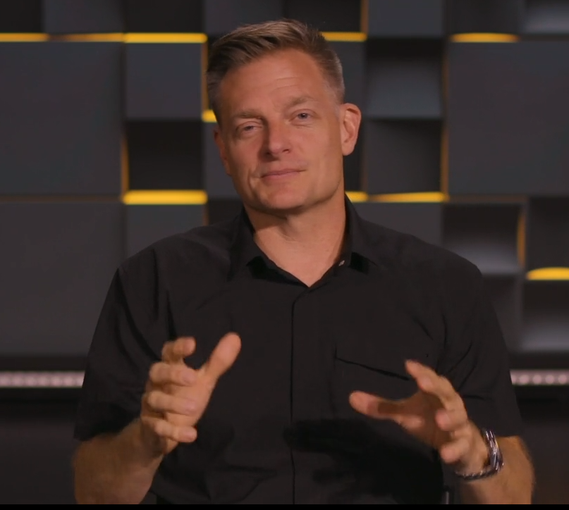
Notes:
https://growleader.com/what-we-do/#our-model 1.05 to 2.19

Slide 63
All you in-house or in cyber-land, who are aware of your need for fellowship for growth and healing, we would like build small groups and to recruit and train leaders for Zoom or in-person small groups.
Email admin@orhaOlam.com

Slide 64
So, how can we engage with the Son at the Right Hand of the Most High?
Resurrection
Elevator Strategies

Slide 65
Outline of this message
Central truth: Messiah at the right hand of the Father
We enter into this
  By trusting His rulership
  By 24/7 intercession
  By small groups intimacy
  By pro-life passion

Slide 66
From Stewart Winograd
January 22, 1973, is the day the landmark Supreme Court decision Roe vs Wade declared abortion legal in all 50 states. Since then about 63 million babies in the USA have been killed by abortion while in their mother’s womb.

Slide 67
On January 13, 1984, President Ronald Reagan issued a proclamation designating January 22 as the first National Sanctity of Human Life Day. Congregations around the United States use the day to celebrate God's gift of life,
Notes:
https://store.lifemattersww.org/sanctity-of-human-life-sunday

Slide 68
commemorate the many lives lost to abortion, and commit themselves to protecting human life at every stage.
This year it is Jan. 16-17
Notes:
https://store.lifemattersww.org/sanctity-of-human-life-sunday

Slide 69
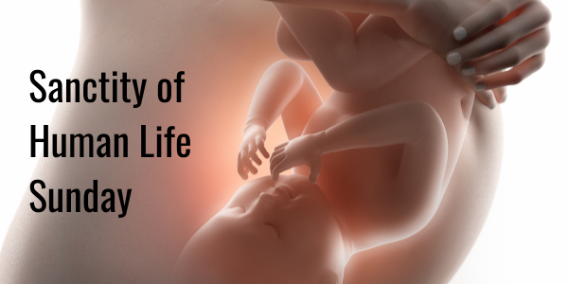
Shabbat, Jan. 16

Slide 70
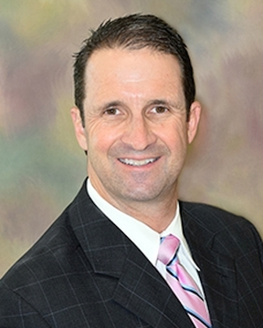
Dr. Lile is board certified in obstetrics and gynecology. Dr. Lile has a special interest in… managing high-risk pregnancies.
Notes:
Jan. 14, 2021 spoke on Family Talk James Dobson
I thought I understood the pro-life position

Slide 71
Dr. Lile: I was recently at the University of Florida College of Medicine. This is not like going up the Liberty University. This is not a Biblical based campus. We started off the presentation with "If a patient needs heart surgery, but they were not born in the United States, should they still be able to get that heart surgery?"
Notes:
https://familytalk.widen.net/view/pdf/7onqzyt0mn/01142021ACOMPASSIONATEARGUMENTFORPROLIFEADRSPERSPECTIVE1.pdf?t.download=true

Slide 72
All of the students are like, "Absolutely.“ I said, "What if they need spine surgery, but they don't have a birth certificate?" "Yeah, they should be able to get that." It's like, “Well, what do they need a lifesaving blood transfusion?”
Notes:
https://familytalk.widen.net/view/pdf/7onqzyt0mn/01142021ACOMPASSIONATEARGUMENTFORPROLIFEADRSPERSPECTIVE1.pdf?t.download=true

Slide 73
Are they entitled to get that lifesaving blood transfusion even if they weren't born here in the United States?" Universally, they were all saying, "Yes, yes, yes."
Notes:
https://familytalk.widen.net/view/pdf/7onqzyt0mn/01142021ACOMPASSIONATEARGUMENTFORPROLIFEADRSPERSPECTIVE1.pdf?t.download=true

Slide 74
I said, "Okay, these are all three patients of mine. All three have one thing in common and that thing in common is all three of these patients are still in the womb," and it got real quiet. One student said, “I’m pro-choice.” “But what about the pre-born baby’s choice?”
Notes:
https://familytalk.widen.net/view/pdf/7onqzyt0mn/01142021ACOMPASSIONATEARGUMENTFORPROLIFEADRSPERSPECTIVE1.pdf?t.download=true

Slide 75
We give blood transfusions as early as 18 weeks’ gestation. We are now doing heart surgery. We're doing valvuloplasty, septoplasty. If they are a patient, they're a person, and if they are a person, they deserve our protection, so science, we're going to follow. The science says that this is a patient.
Notes:
https://familytalk.widen.net/view/pdf/7onqzyt0mn/01142021ACOMPASSIONATEARGUMENTFORPROLIFEADRSPERSPECTIVE1.pdf?t.download=true

Slide 76
The abortion pill is indicated to take the life of the baby up to 70 days, 10 weeks after the first day of the last menstrual period. We have all seen our relatives and family members' ultrasounds where they come home and they say, "Look, I'm eight weeks along,"
Notes:
https://familytalk.widen.net/view/pdf/7onqzyt0mn/01142021ACOMPASSIONATEARGUMENTFORPROLIFEADRSPERSPECTIVE1.pdf?t.download=true

Slide 77
This is a combination of five pills that is 98% effective in killing the baby in the womb, and even more heinous [this is the fastest growing form of abortion - it is 39% of all the abortions in the United States are now being performed with the pill]
Notes:
https://familytalk.widen.net/view/pdf/7onqzyt0mn/01142021ACOMPASSIONATEARGUMENTFORPROLIFEADRSPERSPECTIVE1.pdf?t.download=true

Slide 78
but now there are actually websites online where you can obtain this combination of pills through the mail where the abortion pill can be mailed to you and you can have an abortion in the privacy of your own home.
Notes:
https://familytalk.widen.net/view/pdf/7onqzyt0mn/01142021ACOMPASSIONATEARGUMENTFORPROLIFEADRSPERSPECTIVE1.pdf?t.download=true

Slide 79
The abortion pill blocks the hormone progesterone. It would be like me unplugging your earphones. We know that after they've taken the first pill, support for the pregnancy starts to be withdrawn.
Notes:
https://familytalk.widen.net/view/pdf/7onqzyt0mn/01142021ACOMPASSIONATEARGUMENTFORPROLIFEADRSPERSPECTIVE1.pdf?t.download=true

Slide 80
The progesterone that we use for intervention is bioidentical, it is made from yams and it is made from soybeans, but chemical structure is the exact same as the hormone the mom creates. We supplement with a higher dose of this progesterone.
Notes:
https://familytalk.widen.net/view/pdf/7onqzyt0mn/01142021ACOMPASSIONATEARGUMENTFORPROLIFEADRSPERSPECTIVE1.pdf?t.download=true
As long as they get the mom started on progesterone supplement within 3 days of taking the progesterone blocker, there is a high chance of saving the baby.

Slide 81
A heartbeat starts about two weeks after the moment of conception.

Slide 82
I really want this to be part of the new terminology, using the term "preborn." Why? Because "preborn" means that the normal expectation of the preborn is if that are then going to be born, when we use that kind of terminology. Like “pre-school.”

Slide 83
They're talking about taking the life, giving a thumbs up or a thumbs down after birth.

Slide 84
Thankfully, abortions have been steadily decreasing in America for a good number of years. But that only means that the carnage has decreased from numbers as high as 1,360,000 abortions in 1996 to 862,000 in 2017. (Yes, chew on that: less than 900,000 babies terminated in their mother's wombs is considered to be progress.)
Notes:
https://www.charismanews.com/opinion/in-the-line-of-fire/82704-michael-brown-armageddon-and-abortion?utm_source=In%20the%20Line%20of%20Fire&utm_medium=email&utm_content=subscriber_id:5194514&utm_campaign=Blogger%20-%20Michael%20Brown%20-%202020-09-23

Slide 85
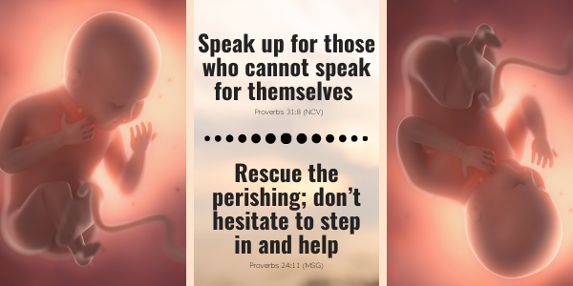

Slide 86
January is Sanctity of Human Life Month …. and Saturday - Sunday, January 16-17, is Sanctity of Human Life Shabbat-Sunday. It’s a time to mourn, to pray and refocus ourselves for godly and compassionate action.

Slide 87
According to World Health Organization, every year in the world there are an estimated 40-50 million abortions. This corresponds to approximately 125,000 abortions per day! A modern-day Holocaust, a tragedy for babies, mothers, fathers, and society!

Slide 88
If you are a follower of Yeshua and you are asking yourself what can I do to make a difference? Here are some simple and practical steps you can take:

Slide 89
Learn: read articles and books and go to Care-Net's resources for more info
Pray regularly
Contact your local Pregnancy Care Center for opportunities to get involved
Notes:
https://resources.care-net.org/free-resources/?utm_source=RII+Ministry+Updates&utm_campaign=13988d05fa-TEACHING_OF_THE_MONTH_AUGUST_10_2017_COPY_01&utm_medium=email&utm_term=0_ba72c609db-13988d05fa-179794581

Slide 90
Regularly donate money, baby and maternity clothes and items for those in need
Be a light to mothers and fathers grappling with this, speak with them, help practically, pray specifically, be compassionate and non-judgmental
Notes:
https://resources.care-net.org/free-resources/?utm_source=RII+Ministry+Updates&utm_campaign=13988d05fa-TEACHING_OF_THE_MONTH_AUGUST_10_2017_COPY_01&utm_medium=email&utm_term=0_ba72c609db-13988d05fa-179794581

Slide 91
There is forgiveness, healing and hope in Yeshua. Pregnancy Care Centers have programs to help mothers and fathers deal with the tragic reality of taking their unborn child's life.
Notes:
https://resources.care-net.org/free-resources/?utm_source=RII+Ministry+Updates&utm_campaign=13988d05fa-TEACHING_OF_THE_MONTH_AUGUST_10_2017_COPY_01&utm_medium=email&utm_term=0_ba72c609db-13988d05fa-179794581

Slide 92
Outline of this message
Central truth: Messiah at the right hand of the Father
We enter into this
  By trusting His rulership
  By 24 / 7 intercession
  By small groups intimacy
  By pro-life passion

Slide 94


