Slide 1
e-handout
To have these notes
without taking notes
Go to OrHaOlam.com
Click on downloads,
messages, 2020

Slide 2
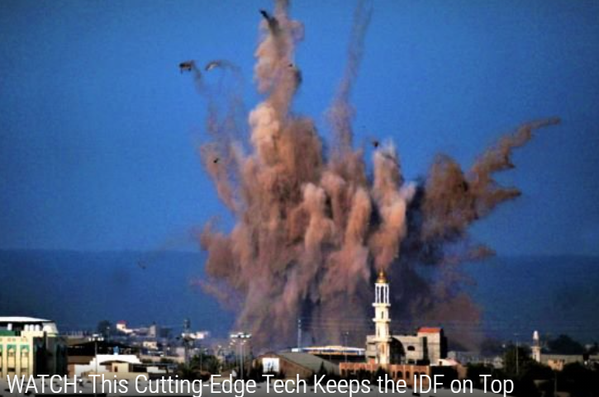
Israeli Tech
that Keeps them
Safe
Notes:
It’s a stressful time, so a nice testosterone clip to relax you.

Slide 3
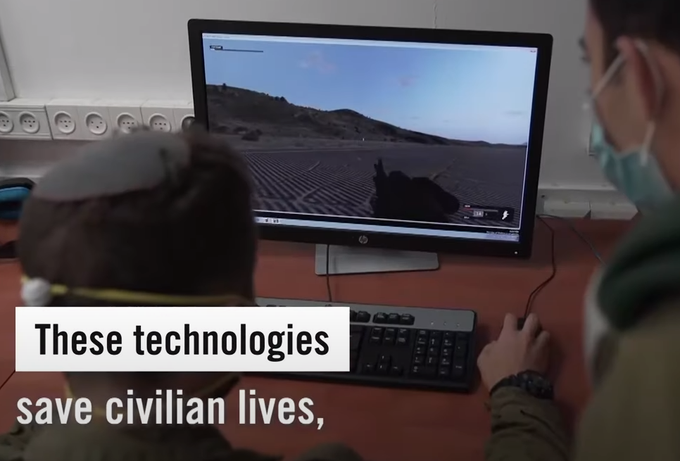

Slide 4
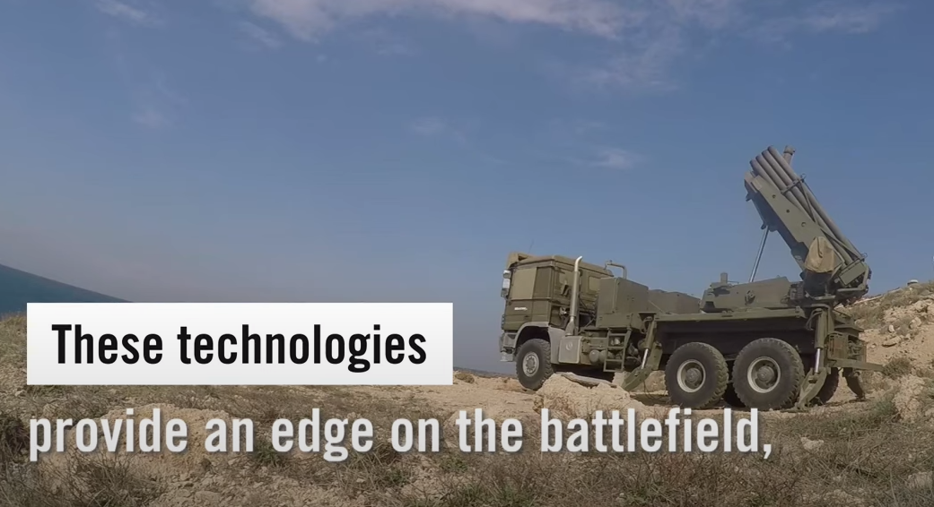
Notes:
https://youtu.be/hu40JYpclPM

Slide 5
2019: Stay away from negative people.
2020: Stay away from positive people.
Notes:
Josie Rothman

Slide 6
Never in a million years could I have imagined I would go up to a bank teller wearing a mask & ask for money.
Notes:
Josie Rothman

Slide 7
The dumbest thing I ever bought was a 2020 planner.
Notes:
Josie Rothman

Slide 8
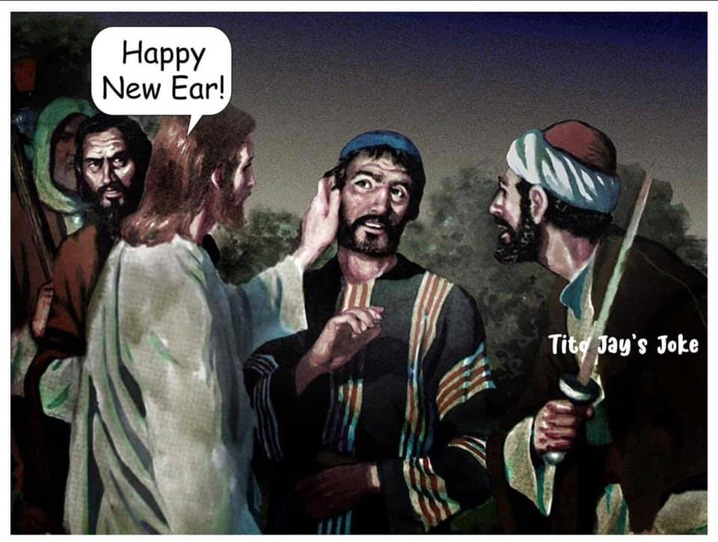
Notes:
Lori Wilson

Slide 9
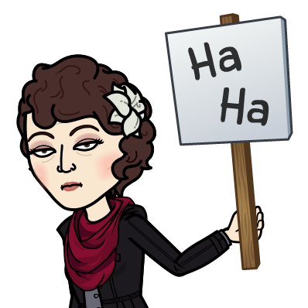

Slide 11
Context this chapter, MJ Hebrews 6
6: 1-3 Strong beginning
6: 4-8 Disastrous ending [Falling and Failing eternally]
6: 9-12 Glorious ending [Victory Crowns]
Sets stage today:
6: 13-20 Our Warranty
Notes:
Text without a context is a pretext ~I’m nice, religious, hard working, tithe, Jewishly correct.
Eternity: whole thing is too big, intimidating, three surprises as mentioned last week.
Can I make it fruitfully? [temper, lusts, pride, deceived] Can my family make it? Lost family members? Can Israel make it? Eternity!
What if we suffer persecution?
Will we make it to the end fruitfully? Will I make it fruitfully? Look left, right, will we see our whole community in eternity?
Illustration of securing possession…

Slide 12
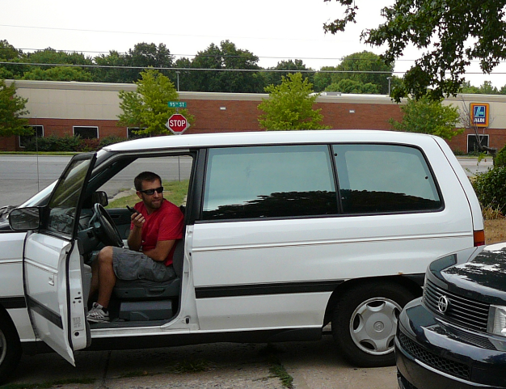
Our vehicle 1996 to 2012
Notes:
Before had this, April 1996, just after Passover seder, Abba Eban speaking here in KC. [first ישראלי Israeli ambassador to UN and US] famous orator.
On 73rd St. car turned left unexpectedly just in front of us, nowhere to go, no way to avoid. Screech → boom. Totaled previous vehicle.
His fault, he admitted to police, playing with radio, → insurance + savings [Ramsey]
Shopped around and prices dismaying. Dawn praying, impression to look in KC Star. 1994 MPV 3000 miles. ‘You mean 30,000’ Go. With friend: Original oil. ~$12K We wanted this new car. Wrote check immediately, before test ride. CLAIMED it. Deposit Guarantee purchase. This section about guarantee of acquisition. Another buyer came in during test drive, but it was locked. Drove it 16 years and saved up for next one.

Slide 13
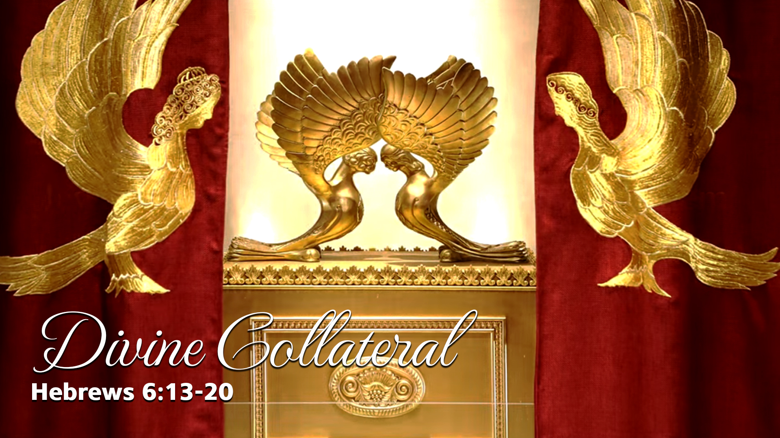
Notes:
Divine security deposit
G-d gives us a GREAT down payment, to insure and assure us that we will make it to eternity safely and gloriously, fruitfully. We just have to receive it.

Slide 14
Outline of this message
Goal at risk: van, Abe’s future, abundant eternal entrance
Goal guaranteed
Current risks and hazards
Current recourse

Slide 15
^{Messianic Jews 6.13 to 6.15} For when God made his promise to Avraham, he swore an oath to do what he had promised; and since there was no one greater than himself for him to swear by, He swore by Himself and said,
Notes:
Context beginning, bad ending, good ending Which for us?

Slide 16
^{Messianic Jews 6.13 to 6.15} “I will certainly bless you, and I will certainly give you many descendants”; and so, after waiting patiently, Avraham saw the promise fulfilled.
Notes:
What this about? NT is inspired commentary
Quote Beresheet/Gen 22: binding of Isaac
illustration above we were concerned about getting a van.
Avraham concern about life purpose and future nation.
You and me concerned about eternal entrance, getting there, and doing so fruitfully.

Slide 17
Tanakh [Hebrew scriptures] Background

Slide 18
^{Ber/Gen 22.1-2} After these things, God tested Avraham. He said to him, “Avraham!” and he answered, “Here I am.” He said, “Take your son, your only son, whom you love, Yitz’chak; and go to the land of Moriyah. There you are to offer him as a burnt offering on a mountain that I will point out to you.”
Notes:
Abe in a foreign land, some conflict with Canaanites, claiming land based on judgment of their sins, so underlying antagonism, conflict with sons Ishmael and Yitskhak/Isaac, conflict wives, conflict with Lot.
Needed another test? [You might say, another test?] I know a certain individual who has health issues, his wife has health issues, problems with one of his kids, told me sibling issues. I said, it seems you have enough issues already. Did you really need another one?
Do I need another challenge? Am I ready? Did Abe?
Surrender Yitzkhak
Surrender most heart significant treasure
Surrender legitimate treasure
Surrender all future hopes
Surrender whole calling
What will G-d test in your life and mine? pride? Posn?

Slide 19
^{Beresheet/Gen 22.10-11} Then Avraham put out his hand and took the knife to kill his son. But the angel of ADONI called to him out of heaven: "Avraham? Avraham!“…Now I know that you are a man who fears God, because you have not withheld your son, your only son, from me.”
Notes:
Feel the tension, even though you know the end? We don’t know Abe’s inner turmoil.
G-d didn’t know???? Wants us to walk things out.
Says in Messianic Scrip “after waiting patiently, Avraham saw the promise fulfilled.”
Doesn’t sound like “Patient” passive

Slide 20
^{Beresheet/Gen 22.13-14} Avraham raised his eyes and looked, and there behind him was a ram caught in the bushes by its horns. Avraham went and took the ram and offered it up as a burnt offering in place of his son. Avraham called the place Adoni Yir’eh [Adoni will see (to it), Adoni provides] — as it is said to this day, “On the mountain Adoni is seen.”
Notes:
Apparently, Abe had a vision of the Messiah as our offering. Adoni will provide. Earlier to Yitskhak, “God will provide himself the lamb for a burnt offering, my son”
אֱלֹהִים יִרְאֶה-לּוֹ הַשֶּׂה לְעֹלָה

Slide 21
^{Yn 8.56} Abraham rejoiced to see My day; he saw it and was thrilled.”
Notes:
In Messiah Yeshua we have hope!!

Slide 22
^{Beresheet/Gen 22.15-18} The angel of ADONI called to Avraham a second time out of heaven. He said, “I have sworn by myself - says ADONI - that because you have done this, because you haven't withheld your son, your only son, I will most certainly bless you; and I will most certainly increase
Notes:
Yellow highlights are what is quoted in MJ
Closer look at those phrases

Slide 23
^{Beresheet/Gen 22.15-18} your descendants to as many as there are stars in the sky or grains of sand on the seashore. Your descendants will possess the cities of their enemies, and by your descendants all the nations of the earth will be blessed — because you obeyed my order.””

Slide 24
He swore by Himself
וַיֹּאמֶר בִּי נִשְׁבַּעְתִּי נְאֻם-יְיָ:
"I will certainly bless you, and I will certainly give you many descendants";
כִּי-בָרֵךְ אֲבָרֶכְךָ, וְהַרְבָּה אַרְבֶּה אֶת-זַרְעֲךָ
Notes:
By Himself: we wrote a check to secure van, reassure seller
G-d said ME my honor, my name Sacred Namers often join us, appreciate faithfulness word. Not Name it’s character G-d, reality
If G-d said by heaven and earth, not so reassuring. Scientists measure the H fuel depletion of stars, our sun, till collapse → black hole.
REALLY BIG DEPOSIT: time and eternity
Doubling of the verb Barekh

Slide 25
כְּכוֹכְבֵי הַשָּׁמַיִם, וְכַחוֹל אֲשֶׁר עַל-שְׂפַת הַיָּם;
As stars in the sky or grains of sand on the seashore.
Notes:
Stars of the heaven taken as spiritual descendants: Gentiles
Sand of the sea: earthly descendents: Jews
Or
ישראל Yisrael obeys G-d, undefeatable ~ stars
ישראל Yisrael flouts will HaShem, trampled on by everyone ~sand
REALLY BIG DEPOSIT: greater than time and eternity
We gave ~$2000 to secure the white MPV
Back to MJ/Hebrews

Slide 26
^{MJ 6.16-20} Now people swear oaths by someone greater than themselves, and confirmation by an oath puts an end to all dispute. Therefore, when God wanted to demonstrate still more convincingly the unchangeable character of his intentions to those who were to receive what he had promised,

Slide 27
^{MJ 6.16-20} he added an oath to the promise; so that through two unchangeable things,

Slide 28
FIRST ^{Ber/Gen 12.1-3, 7} Now Adoni said to Avram, “Get yourself out of your country, away from your kinsmen and away from your father’s house, and go to the land that I will show you. I will make of you a great nation, I will bless you, and I will make your name great; and you are to be a blessing.
Notes:
Promise Gen 12

Slide 29
^{Ber/Gen 12.1-3, 7} I will bless those who bless you, but I will curse anyone who curses you; and by you all the families of the earth will be blessed.”… “To your descendants I will give this land.”
Notes:
Promise Gen 12

Slide 30
SECOND He swore by Himself
וַיֹּאמֶר, בִּי נִשְׁבַּעְתִּי נְאֻם-יְיָ:
"I will certainly bless you, and I will certainly give you many descendants";
כִּי-בָרֵךְ אֲבָרֶכְךָ, וְהַרְבָּה אַרְבֶּה אֶת-זַרְעֲךָ

Slide 31
^{Ber/Gen 22.17-18} give you many descendants; as many as there are stars in the sky or grains of sand on the seashore. Your descendants will possess the cities of their enemies, and by your descendants all the nations of the earth will be blessed — because you obeyed my order.”

Slide 33
^{MJ 6.16-20} he added an oath to the promise; so that through two unchangeable things, in neither of which God could lie, we, who have fled to take a firm hold on the hope set before us, would be strongly encouraged. We have this hope as a sure and safe
Notes:
Promise Gen 12 plus oath
We only gave one deposit check to motivate the seller to hold the van.
G-d gives us two security deposits to encourage our faith.

Slide 34
^{MJ 6.16-20} anchor for ourselves, a hope that goes right on through to what is inside the parokhet, where a forerunner has entered on our behalf, namely, Yeshua, who has become a cohen gadol forever, to be compared with Malki-Tzedek.
Notes:
two unchangeable things:
promise I will bless
Oath not said of G-d again until Is 54
Your concerns?
Make it to heaven: holiness of life [temper, lusts, pride, corruption]
Marriage survive
Children
Retirement $
Health
Extended family salvation
Israel

Slide 35
Outline of this message
Goal at risk: van, Abe’s future, abundant eternal entrance
Goal guaranteed
Current risks and hazards
Current recourse
Notes:
Two unchangeable things, but even stronger…

Slide 36
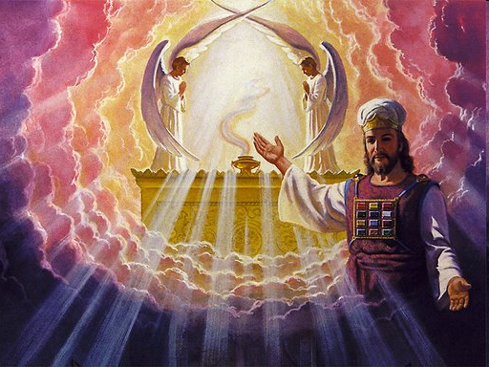
Notes:
goes right on through to what is inside the parokhet, where a forerunner has entered on our behalf, namely, Yeshua. He is there and active, sitting at the right hand of the Father, making intercession. Actively involved in our lives, our struggles, our apparent set backs.

Slide 37
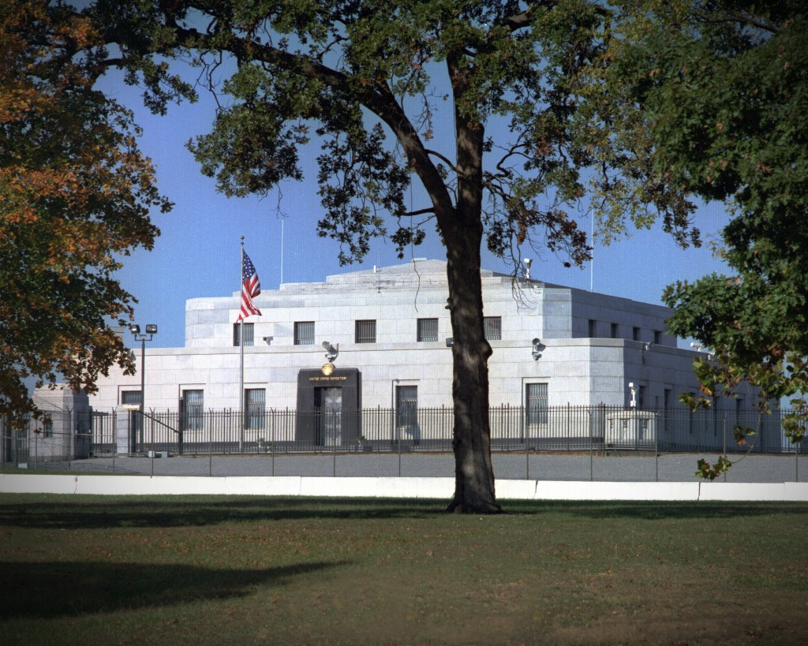
The United States Bullion Depository at Fort Knox, Kentucky
Notes:
The United States Bullion Depository present gold holdings: 147.3 million ounces. About half of the Treasury’s stored gold (as well as valuables of other federal agencies) is kept at Fort Knox. It is second in the United States only to the Federal Reserve Bank of New York's underground vault in Manhattan, which holds about 5,000 metric tonnes of gold in trust for many foreign nations, central banks and official international organizations. http://goldprice.org/index.html 1093/oz = $160,671,000,000 $160 billion
https://www.usmint.gov/about/mint-tours-facilities/fort-knox

Slide 38
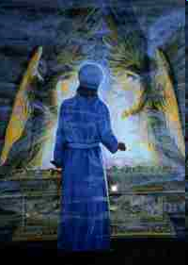
Notes:
This two level vault has a door weighing 24.6 tons, walls made of granite and the strength of the building can be estimated with the building materials used which include 16,000 cubic
feet of granite, 750 tons of steel, 670 tones of structural steel and 4,200 cubic yards of concrete. No visitors are allowed and no one person has access to all the combinations of
the vault, the entry being allowed only on president's orders. The facility is classified to an extent to have been visited by only two presidents Franklin Roosevelt and Harry S. Truman.

Slide 39
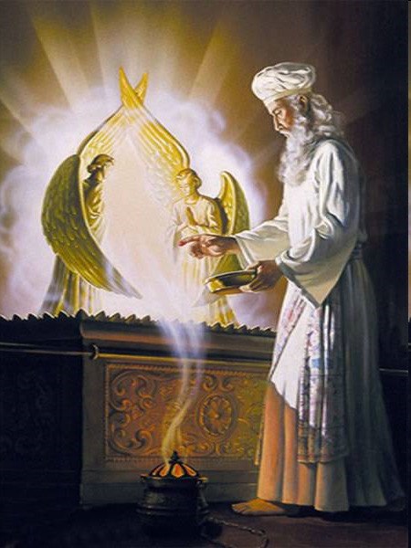

Slide 40
^{MJ 6.16-20} anchor for ourselves, a hope that goes right on through to what is inside the parokhet, where a forerunner has entered on our behalf, namely, Yeshua, who has become a cohen gadol forever, to be compared with Malki-Tzedek.
Notes:
two unchangeable things:
promise I will bless
Oath not said of G-d again until Is 54
Your concerns?
Make it to heaven: holiness of life [temper, lusts, pride, corruption]
Marriage survive
Children
Retirement $
Health
Extended family salvation
Israel

Slide 41
^{Rev.11.19} Then the Temple of God in heaven was opened, and the Ark of the Covenant was seen in his Temple; and there were flashes of lightning, voices, peals of thunder, an earthquake and violent hail.
Notes:
Where is the Aron/Ark today:
Rabbi Goren, Chaim Richman: under Jerusalem
Ron Wyatt: Jeremiah’s grotto
Ethiopia
Vatican

Slide 42
^{Messianic Jews 6.13 to 6.20} We have this hope as a sure and safe anchor for ourselves, a hope that goes right on through to what is inside the parokhet, where a forerunner has entered on our behalf, namely, Yeshua, who has become a cohen gadol forever, to be compared with Malki-Tzedek

Slide 43
Assurance, warranty of living in holiness, enduring to the end
He Himself is the deposit
Oath + promise
As an anchor line enters which into the Holy of Holies in G-d’s Presence, heaven, by Yeshua’s atoning blood
Notes:
If G-d had sworn just by heaven and earth…will pass away. Astronomers calculate the consumption of the H fuel in the sun, other stars, then collapse → black hole.

Slide 44
Gold standard
Silver certificate
Federal Reserve Note

Slide 45
Did those addressees, the ancient Messianic Jews, have disastrous challenges to their faith?

Slide 46
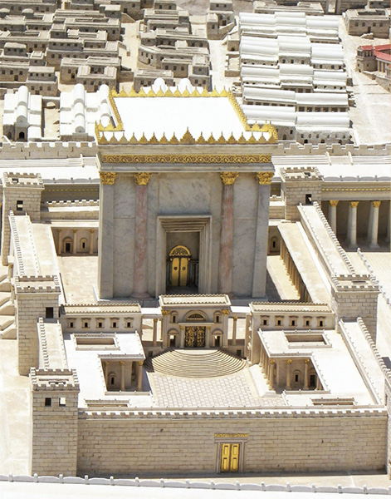
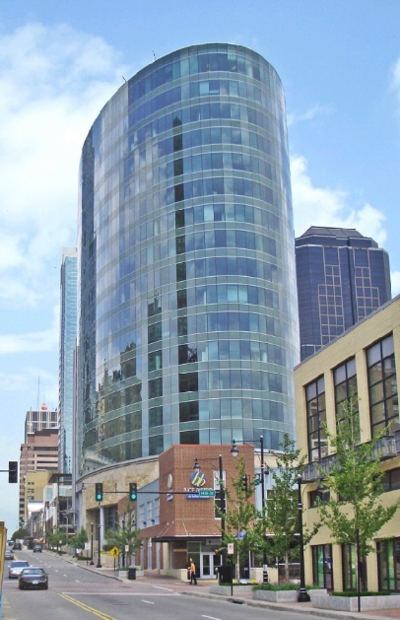
180 ft
H&R Block Bldg
17 stories ≈ 170 ft
Notes:
https://www.biblicalarchaeology.org/wp-content/uploads/herods-temple-avi-yonah.jpg
Larger and more magnificent than ANY other temple of antiquity, known throughout the Roman world. Certain sense of it’s invincibility. See doors and figure 30 feet.

Slide 47
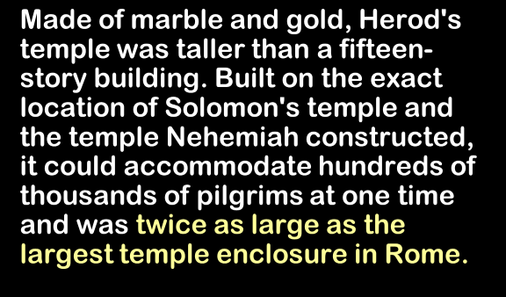

Slide 48
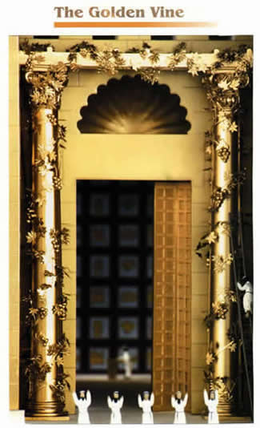
Notes:
https://www.google.com/search?q=golden+vine+of+the+Jerusalem+Temple&safe=active&source=lnms&tbm=isch&sa=X&ved=0ahUKEwj7ue3Kx9_ZAhWL0FMKHcLTC6kQ_AUIDCgD&biw=1282&bih=933#imgrc=AbD6B9jYL7UN2M:
Adding gold leaves.

Slide 49
The Golden Vine was one of the most remarkable in all the Temple precincts. [Talmud] Middot records that “A golden vine stood over the entrance to the sanctuary, trained over posts; and whosoever gave a leaf, or a berry, or a cluster as a freewill-offering
Notes:
https://www.ritmeyer.com/2015/12/14/the-gold-of-the-jerusalem-temple/

Slide 50
he brought it and the cohenim hung it thereon.” This vine was so famous that even Tacitus (History 5.5) wrote about it. Messiah may also have alluded to this very feature of the Temple when he said in John 15.1: “I am the true vine.”
Notes:
https://www.ritmeyer.com/2015/12/14/the-gold-of-the-jerusalem-temple/
Tacitus was the Roman general who demolished the Temple. Some say unintentionally.

Slide 51
The Temple, their center of worship, that Yeshua attended, where the Acts 2 message was likely given, was destroyed. Cataclysm. Either just before or just after this MJ scripture was written.

Slide 53
^{Messianic Jews 6.13 to 6.20} We have this hope as a sure and safe anchor for ourselves, a hope that goes right on through to what is inside the parokhet, where a forerunner has entered on our behalf, namely, Yeshua, who has become a cohen gadol forever, to be compared with Malki-Tzedek

Slide 54
Outline of this message
Goal at risk: van, Abe’s future, abundant eternal entrance
Goal guaranteed
Current risks and hazards
Current recourse

Slide 55
Did we in 2020 have significant challenges to our faith?

Slide 56
Earlier this year, New York Sen. David Carlucci introduced a bill that would require social media networks to ban and silence speech deemed hateful, a practice they seem to have already adopted.
Notes:
https://www.charismanews.com/world/83869-criminalizing-words-global-governments-transform-blasphemy-into-hate-speech-laws?utm_source=Charisma%20News%20Daily&utm_medium=email&utm_content=subscriber_id:5160390&utm_campaign=CNO%20daily%20-%202021-01-01

Slide 57
Leaders in the House of Representatives announced on Friday a rules package for the 117th Congress that includes a proposal to use “gender-inclusive language.”
Notes:
https://www.theepochtimes.com/mkt_app/proposed-house-rules-seek-to-erase-gendered-terms-such-as-father-mother-son-daughter_3640653.html?v=ul

Slide 58
Speaker Nancy Pelosi (D-Calif.) and Rules Committee Chairman James McGovern (D-Mass.) announced on Friday that the rules package includes changes that would “honor all gender identities by changing pronouns and familial relationships in the House rules to be gender neutral.”
Notes:
https://www.theepochtimes.com/mkt_app/proposed-house-rules-seek-to-erase-gendered-terms-such-as-father-mother-son-daughter_3640653.html?v=ul

Slide 59
Terms to be striked from clause 8(c)(3) of rule XXIII, the House’s Code of Official Conduct, as outlined in the proposed rules (pdf), include “father, mother, son, daughter, brother, sister, uncle, aunt, nephew, niece, husband, wife, father-in-law, mother-in-law…
Notes:
https://www.theepochtimes.com/mkt_app/proposed-house-rules-seek-to-erase-gendered-terms-such-as-father-mother-son-daughter_3640653.html?v=ul

Slide 60
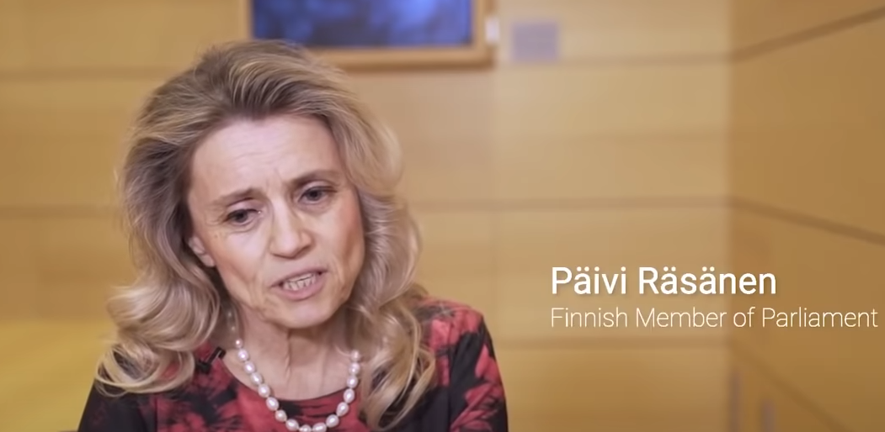
Notes:
https://adfinternational.org/news/major-free-speech-case-in-finland-2newinvestigations/

Slide 61
Member of the Finnish Parliament and former Minister of the Interior, Päivi Räsänen faces police investigations. In June 2019, she directed a tweet at the leadership of her church and questioned its official sponsorship of the LGBT event “Pride 2019”, accompanied by an image of a bible text.
Notes:
https://adfinternational.org/news/major-free-speech-case-in-finland-2newinvestigations/

Slide 62
What if it becomes a hate crime to
Preach Yakikra/Lev 18?
Maintain gender separated bathrooms?
refuse same sex weddings?
Lose our tax exemption?

Slide 63
Current election turmoil

Slide 64
In the United States constitution, a contingent election is the procedure used to elect the president or vice president in the event that no candidate for one or both of these offices wins an absolute majority of votes in the Electoral College.
Notes:
https://en.wikipedia.org/wiki/Contingent_election#:~:text=A%20presidential%20contingent%20election%20is,of%20the%20United%20States%20Senate.&text=Contingent%20elections%20have%20occurred%20only,1801%2C%201825%2C%20and%201837.

Slide 65
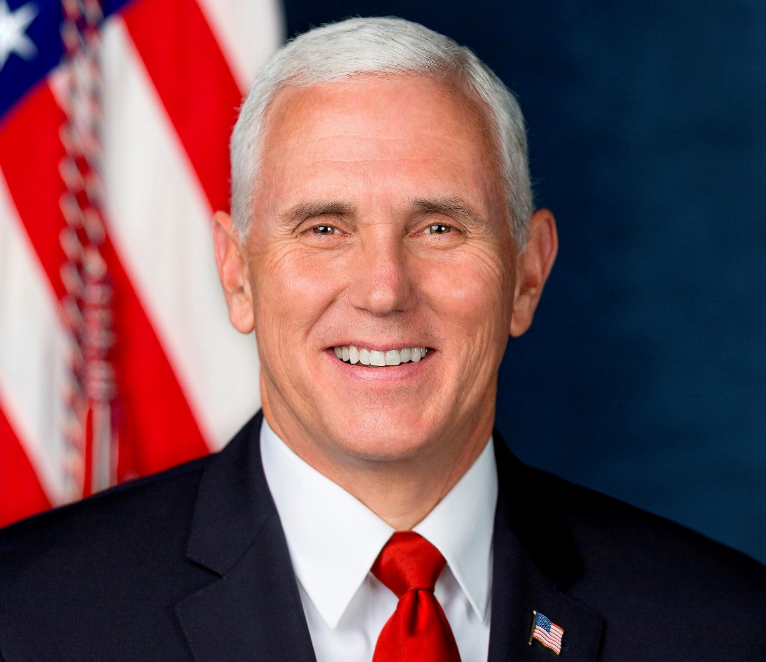
VP Michael Pence, also Pres. of the Senate

Slide 66
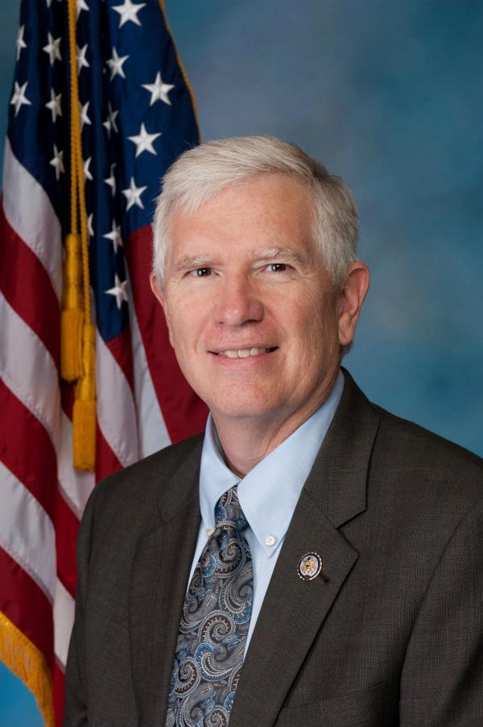
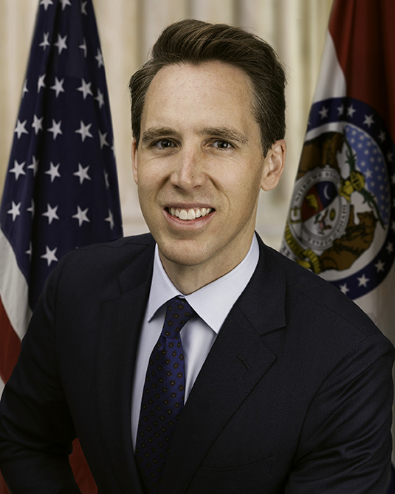
Rep Mo
Brooks
Sen. Josh
Hawley

Slide 67
In Article Two, S 1, Clause 3, modified by amendment 12 of the United States Constitution, the procedure is that…the House chooses one of the three candidates who received the most electoral votes. Each state's delegation casts one en bloc vote to determine the president
Notes:
https://en.wikipedia.org/wiki/Contingent_election#:~:text=A%20presidential%20contingent%20election%20is,of%20the%20United%20States%20Senate.&text=Contingent%20elections%20have%20occurred%20only,1801%2C%201825%2C%20and%201837.

Slide 68
Contingent elections have occurred only three times in American history: in 1801, 1825, and 1837. In 1800, Thomas Jefferson and Aaron Burr, the presidential and vice-presidential nominees on the ticket of the Democratic-Republican party, received the same number of electoral votes.
Notes:
https://en.wikipedia.org/wiki/Contingent_election#:~:text=A%20presidential%20contingent%20election%20is,of%20the%20United%20States%20Senate.&text=Contingent%20elections%20have%20occurred%20only,1801%2C%201825%2C%20and%201837.

Slide 69
John Adams was depressed that Thomas Jefferson was going to become the president of the United States. John Adams and every other conservative in his party believed that Thomas Jefferson was the worst nightmare, that he was going to bring into the United States
Notes:
https://familytalk.widen.net/view/pdf/ulmxuvxjd8/11172020THENEXTJIHAD2.pdf?t.download=true

Slide 70
all the worst impulses of the French Revolution. He was accused of being an atheist. He was everything that Washington and Adams had worked the hardest to protect from, and Jefferson won the election
Notes:
https://familytalk.widen.net/view/pdf/ulmxuvxjd8/11172020THENEXTJIHAD2.pdf?t.download=true

Slide 71
Outline of this message
Goal at risk: van, Abe’s future, abundant eternal entrance
Goal guaranteed
Current risks and hazards
Current recourse

Slide 72
I am calling a 3 day fast, Jan. 4-6, for Election Integrity and
^{1 Tim 2.1-4} “that requests, prayers, intercessions, and thanksgiving be made on behalf of all people— for kings and all who are in authority—so we may live a peaceful and quiet life in all godliness and respectfulness.

Slide 73
^{1 Tim 2.1-4} “ This is good and pleasing in the sight of God our Savior. He desires all men to be saved and come into the knowledge of the truth

Slide 74
“Come to me, all of you who are struggling and burdened, and I will give you rest.
בּוֹאוּ אֵלַי כָּל הָעֲמֵלִים וְהָעֲמוּסִים וַאֲנִי אַמְצִיא לָכֶם מְנוּחָה.
Subject pronoun doubled!

Slide 75
^{Col. 3.12-15} Therefore, as God’s chosen people, holy and dearly loved, clothe yourselves in tender compassion, kindness, humility, gentleness, and patience— bearing with one another and forgiving each other, if anyone has a grievance against another.
Notes:
We have a lot of disagreements here, masks, virus severity, election.

Slide 76
^{Col. 312-15} Just as the Lord pardoned you, so also you must pardon others. But above all these things put on love, which is the bond of perfect harmony. Let the shalom of Messiah rule in your hearts—to this shalom you were surely called in one body. Also be thankful.

Slide 77
Outline of this message
Goal at risk: van, Abe’s future, abundant eternal entrance
Goal guaranteed
Current risks and hazards
Current recourse

Slide 78
^{Messianic Jews 6.13 to 6.20} We have this hope as a sure and safe anchor for ourselves, a hope that goes right on through to what is inside the parokhet, where a forerunner has entered on our behalf, namely, Yeshua, who has become a cohen gadol forever, to be compared with Malki-Tzedek

Slide 80
