Slide 1
e-handout
To have these notes
without taking notes
Go to OrHaOlam.com
Click on downloads,
messages, 2020
Notes:
Lots of division among us about COVID, masks…

Slide 2

Notes:
Miriam Chernak
Last Shabbat I closed with an illustration that needs to be my beginning point…

Slide 3
^{Messianic Jews 6.13 to 6.20} We have this hope as a sure and safe anchor for ourselves, a hope that goes right on through to what is inside the parokhet, where a forerunner has entered on our behalf, namely, Yeshua, who has become a cohen gadol forever, to be compared with Malki-Tzedek.

Slide 4
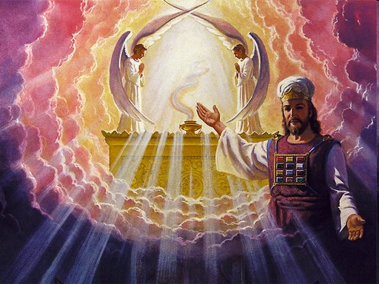

Slide 5
In 2019, the International Academy of Astronautics published “Road to the Space Elevator Era”. Development initiation is nearer than most think, based on a potential process for manufacturing macro-scale single crystal graphene with higher specific strength than carbon nanotubes.
Notes:
https://en.wikipedia.org/wiki/Space_elevator#21st_century

Slide 6
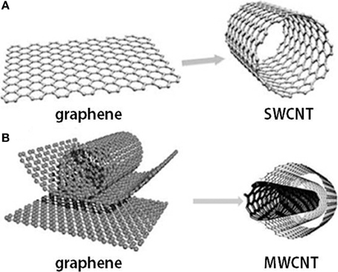
Notes:
https://www.google.com/url?sa=i&url=https%3A%2F%2Fwww.researchgate.net%2Ffigure%2FGraphene-and-carbon-nanotubes-as-A-single-wall-carbon-nanotube-SWCNT-and-B_fig1_263740854&psig=AOvVaw3MTjLKeZn7A9GVxN2EhE9b&ust=1610221183738000&source=images&cd=vfe&ved=0CAIQjRxqFwoTCJjyt8uLje4CFQAAAAAdAAAAABAJ

Slide 7
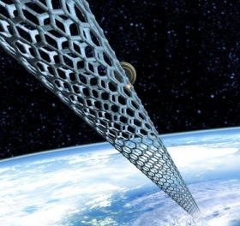
Notes:
https://www.google.com/url?sa=i&url=https%3A%2F%2Fwww.outerplaces.com%2Fscience%2Fitem%2F10468-we-might-be-able-to-build-a-space-elevator-made-of-microscopic-threads-of-diamonds&psig=AOvVaw1uK8JUr3w_WFQ0nfcjIko6&ust=1610220868441000&source=images&cd=vfe&ved=0CAIQjRxqFwoTCLiA5bOKje4CFQAAAAAdAAAAABAY

Slide 8
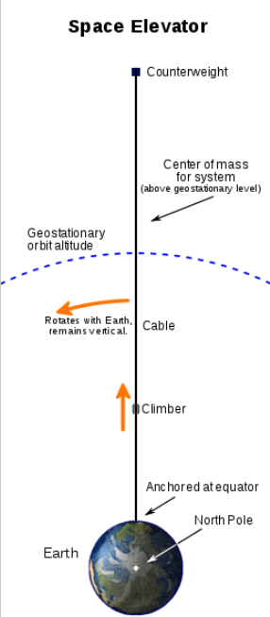
A space elevator is conceived as a cable fixed to the equator and reaching into space. Cable ~30,000 miles long!
Notes:
A counterweight at the upper end keeps the center of mass well above geostationary orbit level. This produces enough upward centrifugal force from Earth's rotation to fully counter the downward gravity, keeping the cable upright and taut. Climbers carry cargo up and down the cable.
https://en.wikipedia.org/wiki/Space_elevator#21st_century

Slide 9
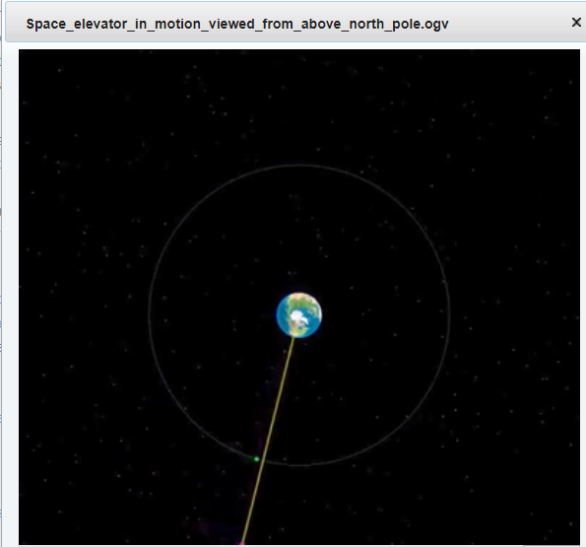
Notes:
https://upload.wikimedia.org/wikipedia/commons/transcoded/5/5c/Space_elevator_in_motion_viewed_from_above_north_pole.ogv/Space_elevator_in_motion_viewed_from_above_north_pole.ogv.360p.vp9.webm
https://en.wikipedia.org/wiki/Space_elevator#21st_century

Slide 10


Slide 11
^{Messianic Jews 6.13 to 6.20} We have this hope as a sure and safe anchor for ourselves, a hope that goes right on through to what is inside the parokhet, where a forerunner has entered on our behalf, namely, Yeshua, who has become a cohen gadol forever, to be compared with Malki-Tzedek.

Slide 12
We need to access
to higher places!

Slide 13
Outline of this message
Space elevator needed
Space elevator MelkiTsedek
Space elevator strategies
Notes:
#1 The culture is worse than we might think.

Slide 14
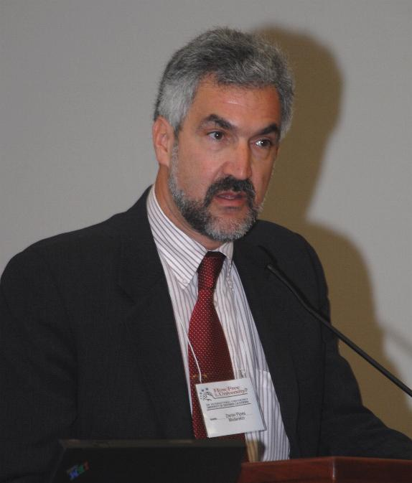
Daniel Pipes PhD from Harvard in 1978; two years in Cairo learning Arabic and studied the Quran. He wrote a book in colloquial Egyptian Arabic. He served as an adviser to Rudy Giuliani's 2008 presidential campaign.
Notes:
https://en.wikipedia.org/wiki/Daniel_Pipes
Mr. Pipes (DanielPipes.org, @DanielPipes) is president of the Middle East Forum. © 2020 by Daniel Pipes. All rights reserved.

Slide 15
Psychology Today in 2008 announced that "conservatism is a mild form of insanity." Four years later, Rick Perlstein, deemed conservatives "crazy." Others on the Left find conservatives inherently gullible, rigid or authoritarian.
Notes:
Mr. Pipes (DanielPipes.org, @DanielPipes) is president of the Middle East Forum. © 2020 by Daniel Pipes. All rights reserved.

Slide 16
Liberals who dare forward a conservative idea can find themselves unemployed. Larry Summers' presidency of Harvard ended when he suggested that "issues of intrinsic aptitude" might account for the paucity of women in science.

Slide 17
That the new Establishment – Amazon, Facebook, Google – has abandoned its libertarian roots and moved in near-synchrony to the left appears in retrospect as inevitable as it is disappointing.

Slide 18
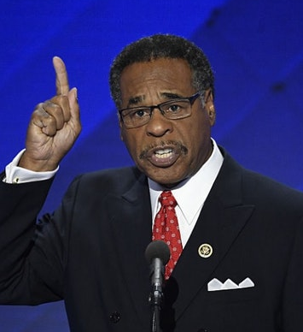
Rep. Emanuel Cleaver (D-MO), an ordained United Methodist minister, opened the first session of the 117th Congress on Sunday, Jan. 3, 2021
Notes:
https://www.foxnews.com/politics/rep-cleaver-ends-opening-prayer-for-new-congress-amen-and-awoman

Slide 19
Quoting the benediction from Numbers 6:24-26, Cleaver concluded, “Now may the God who created the world and everything in it bless us and keep us. May the Lord make his face to shine upon us and be gracious unto us.
Notes:
https://www.foxnews.com/politics/rep-cleaver-ends-opening-prayer-for-new-congress-amen-and-awoman

Slide 20
May the Lord lift up the light of his countenance on us and give us peace; peace in our families, peace across this land, and — dare I ask, O Lord — peace even in this chamber, now and evermore.”
Notes:
https://www.foxnews.com/politics/rep-cleaver-ends-opening-prayer-for-new-congress-amen-and-awoman

Slide 21
“We ask it in the name of the monotheistic God, Brahma, and ‘god’ known by many names by many different faiths,” said Cleaver. “Amen and A-woman,” he closed, in an apparent attempt to render the word fair to both sexes. אָמֵן
Notes:
https://www.foxnews.com/politics/rep-cleaver-ends-opening-prayer-for-new-congress-amen-and-awoman
Amen comes from the Hebrew language: faithfulness, truth. No reference to gender!!
Awomen comes from the Shebrew language! “Shebrew” found by Lori Wilson

Slide 22
So what is our elevator?

Slide 23
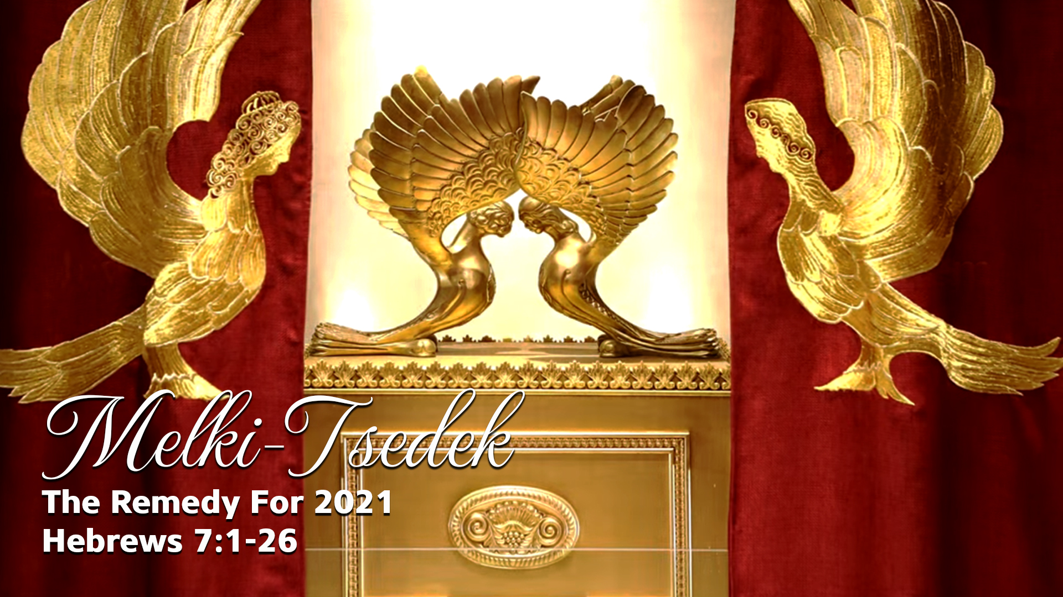
, the Remedy for 2021
Notes:
https://www.templeinstitute.org/new-location.htm
There is an enigmatic statement in T’hillim/Ps 110

Slide 24
Outline of this message
Space elevator needed
Space elevator MelkiTsedek
Space elevator strategies

Slide 25
^{T’hillim/Ps 110.4} Adoni has sworn it, and he will never retract — “You are a cohen forever, to be compared with Malki-Tzedek. [Melchizedek]”
Notes:
It’s a statement about Messiah, and VICTORY in this world! Ck the context…

Slide 26
^{T’hillim/Ps 110.1-2} Adoni says to my Lord, “Sit at my right hand, until I make your enemies your footstool.” Adoni will send your powerful scepter out from Tziyon, so that you will rule over your enemies around you.
Notes:
So this Melki-tsedek character is key to transformation of enemies according to the psalm.

Slide 27
The cohanut/priesthood of Melki-Tsedek is our hope, our space elevator.
What?

Slide 28
^{Mes Jews/Heb 7.1-2} This Malki-Tzedek, king of Shalem, a cohen of God Ha'Elyon, met Avraham on his way back from the slaughter of the kings and blessed him; also Avraham gave him a tenth of everything.
Notes:
Summary of history: Who is this guy?
Although Melchizedek is the first person in the Torah to be titled a Kohen (priest), the midrash records that he was preceded in priesthood (kehuna) by Adam. Rabbinic commentary to the Torah explain that Melchizedek — essentially Shem — was given the priesthood (Hebrew; kehuna) by receipt of his father Noah's blessing "G-d beatified Yefeth and will dwell in the house of Shem"; i.e., he will merit to serve and host God as a Kohen. Leviticus Rabbah 25:6 Rabbis taught that Melchizedek acted as a priest and handed down Adam’s robes to Abram (Numbers Rabbah 4:8).
Josephus refers to Melchizedek as a "Canaanite chief" in War of the Jews, but as a priest in Antiquities of the Jews.
Why Avraham tithe?

Slide 29
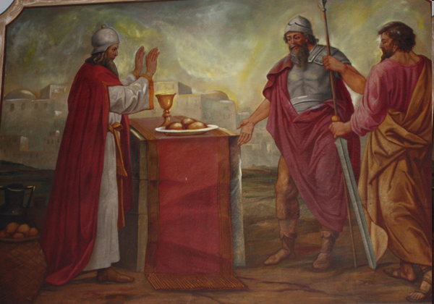
Avraham and Lot
meeting Melki-tsedek
Notes:
More of a Renaissance look than ancient Semitic

Slide 30
"The name of a person can determine his/her destiny" (Talmud B'rachot 7b)
Notes:
How do you know your destiny in Life.
Your name?

Slide 31
^{Mes Jews/Heb 7.2} Now first of all, by translation of his name, he is "king of righteousness"; and then he is also king of Shalem, which means "king of peace."

Slide 32
^{Mes Jews/Heb 7.3-4} There is no record of his father, mother, ancestry, birth or death; rather, like the Son of God, he continues as a cohen for all time. Just think how great he was! Even the Patriarch Avraham gave him a tenth of the choicest spoils.
Notes:
Seems like a pre-incarnation appearance of Yeshua
Another possibility. Note: “no record.” Not “no existence.”

Slide 33
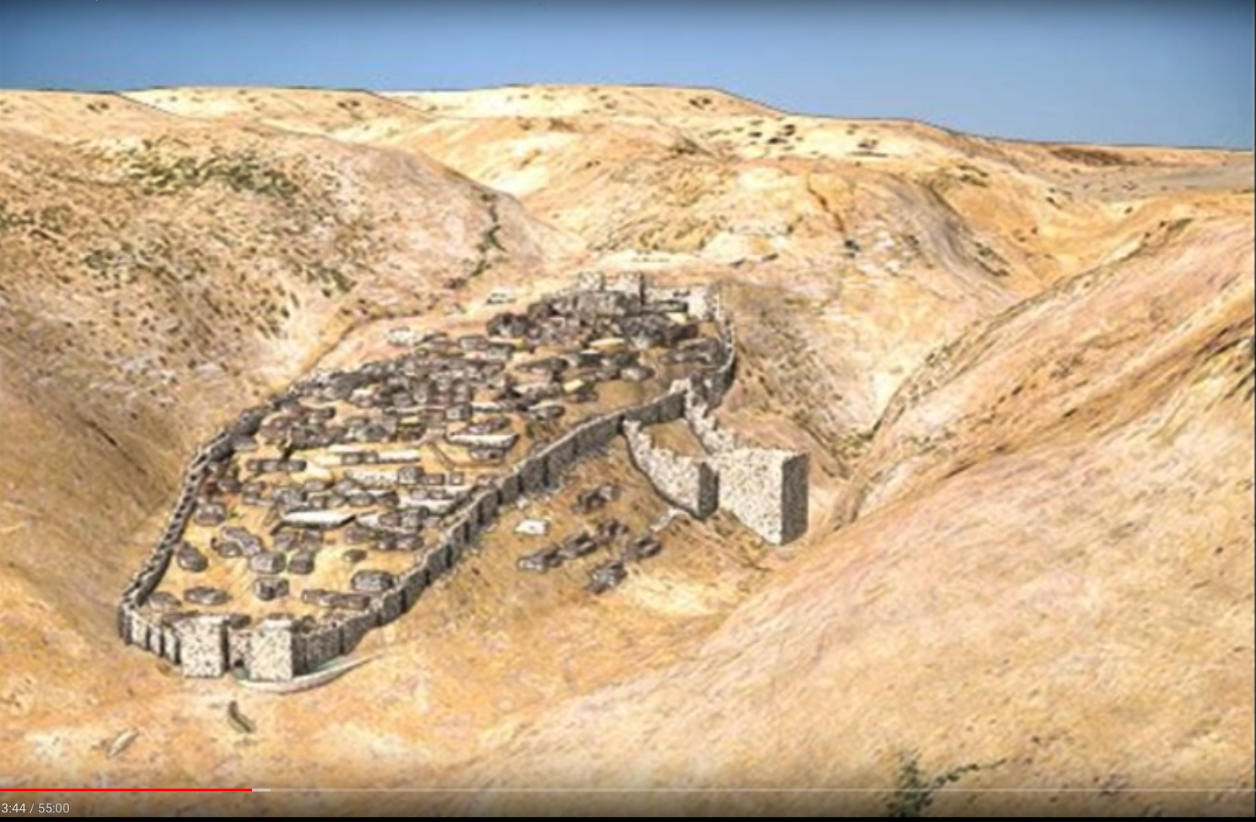
Jebusite [Jeru] salem
Notes:
…

Slide 34
A. A. Sayce, archeologist of the British Museum, using Hittite sources:
Jerusalem was a Hittite city with priestly population dedicated to the true monotheistic G-d
Notes:
https://www.christiancourier.com/articles/356-was-melchizedek-the-preincarnate-christ
Think ancient G-dly man, outside and before the revelation of Torah. Like Yetro/Jethro, Iyov/Job,

Slide 35
When priest/king died, all men and women voted for successor
Candidate could NOT have any previous royal family: no ancestry, no dynasty
Voted for godliest man [!]
Notes:
Just like USA.
MJ text goes on vss 5-10 talk about greatness of Melki-tsedek since
received tithe from Avraham [and all cohanim by implication],
gave blessing to Avraham [giver of blessing >> receiver] want to be great: give blessings
Why proph given?? Messiah like MelkiTsedek
Under the Torah, priests began their service at the age of 30, and the Levites served from age 30 to 50 (cf. Num. 4:3ff; 8:24-25). “without beginning and end” ie not fixed.

Slide 36
Melki-tsedek was a prototype of Messiah.
Righteous King
King of Shalom
Eternal dynasty
Priest King—He was the sacrifice

Slide 37
^{Mes Jews/Heb 7.6-7} But Malki-Tzedek, even though he was not descended from Levi, took a tenth from Avraham. Also, he blessed Avraham, the man who received God’s promises; and it is beyond all dispute that the one who blesses has higher status than the one who receives the blessing.
Notes:
If you want to be greater than others, give them a blessing. If you are irritated by something, give a blessing.

Slide 38
^{Mes Jews/Heb 7.8} Moreover, in the case of the cohanim, the tenth is received by men who die; while in the case of Malki-Tzedek, it is received by someone who is testified to be still alive.

Slide 39
^{Mes Jews/Heb 7.11} Therefore, if it had been possible to reach the goal through the system of cohanim derived from Levi (since in connection with it, the people were given the Torah)

Slide 40
^{Mes Jews/Heb 7.11} what need would there have been for another, different kind of cohen, the one spoken of as to be compared with Malki-Tzedek and not to be compared with Aharon?
Notes:
Ie. Why this prophecy necessary?

Slide 41
^{Mes Jews/Heb 7.12} For if the system of cohanim is transformed, there must of necessity occur a transformation of Torah.
Notes:
Transformation of Torah.
Before marriage, Mom begged me to see a rabbi. His question: Why don’t I live as an Orthodox Jew. I had to answer from Heb scriptures. Ps 110 proph.

Slide 42
The ancient rabbis anticipated a change in Torah when the Messiah came, and the end of days
The Talmud states the “the commandments will be abolished in the future” [Nedarim 61b, speaking of certain commandments that will be irrelevant after the resurrection; but this is part of a debate in the Talmud]

Slide 43
The expression “le-atid lavo” לעתיד לבוא, usually means the Messianic future.…The Jewish professor Joseph Klausner explains in his book, The Messianic Idea in Israel

Slide 44
that “by this is meant naturally that the Torah and commandments lose their significance in the days of the Messiah.” [M. Brown Answering Jewish Objections 4.259]

Slide 45
The Midrash to Ps. 146.7 asks “What is meant by ‘[Adoni] frees the prisoners’?” The answer given is “Some say that every creature that is considered unclean in the present world, the Holy One, Blessed be He, הקדוש ברוך הוא HaKadosh, Barukh Hu, will declare clean in the age to come.” [M. Brown Answering Jewish Objections 4.282]
Notes:
Yeshua from tribe of Yehuda/Judah, NOT cohen from Aharon, subdivision of Levi
Certain expectation change. Doesn’t say all gone, but change. Messianics been trying to figure that out.
Based on change of priesthood, cohanut.

Slide 46
^{Mes Jews/Heb 7.15-16} It becomes even clearer if a "different kind of cohen," one like Malki-Tzedek, arises, one who became a cohen not by virtue of a rule in the Torah concerning physical descent, but by virtue of the power of an indestructible life.
Notes:
Psalm: FOREVER. All cohaneem died. Many in that day corrupt. Therefore Essenes in Qumran community.
Psalm: Oath, no Aaronic had oath.
Forever implies only ONE

Slide 47
^{Mes Jews/Heb 7.25-28} He is totally able to deliver those who approach God through him; since he is alive forever and thus forever able to intercede on their behalf. This is the kind of cohen gadol that meets our need - holy, without evil, without stain, set apart from sinners and raised higher than the heavens;
Notes:
Totally able deliver
Here is our space elevator: resurrection power!
Your temper, irritability, sensitivity, lustful imaginations, hurts and bitterness, greed/insecurity, joylessness.
Love, joy, peace.
Do you have it, rabbi? Getting better!

Slide 48
So, how do we ride the elevator.
Repentance, faith, immersion, s’mikhah, the resurrection, and eternal punishment.
Consider JB Bernstein…

Slide 49
Outline of this message
Space elevator needed
Space elevator MelkiTsedek
Space elevator strategies
Notes:
Invite Eric Vetter to give two minute report.

Slide 50
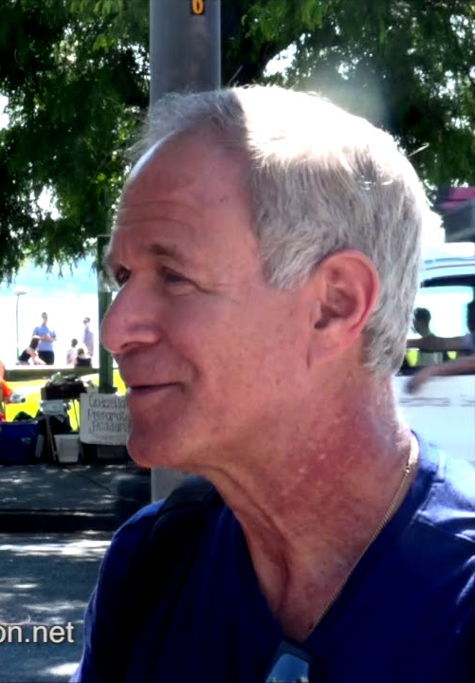
JB Bernstein: ^{Lk.3-2} In the fifteenth year of Emperor Tiberius’ rule; when Pontius Pilate was governor of Y’hudah, Herod ruler of the Galil, his brother Philip

Slide 51
ruler of Iturea and Trachonitis, and Lysanias ruler of Abilene, with ‘Anan and Kayafa being the cohanim g’dolim [High Priests];

Slide 52
Those guys, make your most [unacceptable] political figures today look like angels, no matter what side of the isle you are on!

Slide 53
The word of God came to [John] Yokhanan Ben-Z’kharyah in the desert, “The voice of someone crying out: ‘In the desert prepare the way for Adoni!

Slide 54
Yokhanan/John did lose his head, but he fulfilled the very purpose for which he was born.

Slide 55
It was also in this Theo-political environment that the ministry of the Messiah began! Did this stop Him?

Slide 56
Did He rally His disciples to bring down the corrupt government or the hypocritical religious politicians? No! He told them His kingdom was not of this world. He told them to put their swords away and not to oppose the evil leaders of their day!

Slide 57
What is my point? Our role, our primary assignment from God has nothing to do with politics nor what party is in power or even what system of government we are under! We are called to set our mind on things above not on this earth. The war we are called to fight is not a worldly one!
Notes:
JB Bernstein

Slide 58
James Dobson: John Adams was depressed that Thomas Jefferson was going to become the president of the United States. John Adams and every other conservative in his party believed that Thomas Jefferson was the worst nightmare, that he was going to bring into the United States
Notes:
https://familytalk.widen.net/view/pdf/ulmxuvxjd8/11172020THENEXTJIHAD2.pdf?t.download=true

Slide 59
all the worst impulses of the French Revolution. He was accused of being an atheist. He was everything that Washington and Adams had worked the hardest to protect from, and Jefferson won the election
Notes:
https://familytalk.widen.net/view/pdf/ulmxuvxjd8/11172020THENEXTJIHAD2.pdf?t.download=true

Slide 60
Michael Brown: Consider this grave warning from a powerful Christian leader who warned of what was coming to our country as it threatened to lurch to the left: “We may see the Bible cast into a bonfire, . . . our children, either wheedled or terrified, uniting in the mob, chanting mockeries against God . . .
Notes:
https://askdrbrown.org/library/it-very-bad-news-it-not-yet-end-america

Slide 61
Yet these words do not date to 2020 or 2021. Instead, they date back to 1798. And they were spoken by none other than Rev. Timothy Dwight, the respected president of Yale. He was describing what would happen should Thomas Jefferson be elected president. It would mean the destruction of America.
Notes:
https://askdrbrown.org/library/it-very-bad-news-it-not-yet-end-america

Slide 62
As recounted by historian Stephen Prothero, “Some New England ministers also saw a conspiracy afoot between Jeffersonians and the Order of Illuminati, a secret society of freethinkers that had supposedly masterminded the French Revolution and was now dedicated to creating a post-Christian ‘New World Order.’”
Notes:
https://askdrbrown.org/library/it-very-bad-news-it-not-yet-end-America
I doesn’t matter what the government is and does, G-d rules! And we can proclaim His Kingdom. And in the worst governments in the world today, there is GREAT revival: Iran, China.

Slide 63
^{Mes Jews/Heb 7.25-28} He is totally able to deliver those who approach God through him; since he is alive forever and thus forever able to intercede on their behalf. This is the kind of cohen gadol that meets our need - holy, without evil, without stain, set apart from sinners and raised higher than the heavens;
Notes:
Totally able deliver
Here is our space elevator: resurrection power!

Slide 65
Resurrection
Elevator Strategies

Slide 66
24/7 Cyber prayer room
Notes:
Had this idea for about 8 years. Was told easy peasy. Have approached a number of web people. It wasn’t so easy.
The whole IHOP media team who LOVED the idea, but no one wanted to do it, for love or money. Finally, I was visiting with Valentin & Nina Jarov who referred me to someone who can do it!

Slide 67
 | Midnight | 1 a.m. | 2 a.m. | 3 a.m. | 4 a.m. | 5 a.m. | 6 a.m. | 7 a.m. | 8 a.m.
Sunday | Louise Warfare | Kathi Joy | Shmuel Sweet reality | Greg | Lori | Steve | Vicki | Jim A | Jude
Monday | Cathy A | Ramona | Amy Stewart | Amy Richardson | Marc Richardson | Mark Sherman | Joy
Tuesday
Wed.
Thursday
Friday

Slide 68
 | Midnight | 1 a.m. | 2 a.m. | 3 a.m.
Sunday | Louise Warfare children | Kathi Joy, music | Shmuel Sweet reality | Greg
Monday | Cathy A | Ramona | Amy Stewart | Amy Richardson
Notes:
- Password protected Joomla page with short registration form
- Staff can change the password at any time. Notify users of the new password.
- Staff can edit notes, instructions, messages shown to the users.
- Calendar of the week shown with the ability for any user to sign up for a 1/2 - 1 hour block
- Users can edit / delete their entry at any time
- Users may also optionally indicate that they are "attending" the event
- After the time has passed, the user can submit a short report
- Users can look backwards or forward through the calendar, either to review past signups, or to volunteer for times in the future

Slide 69
It costs $950.
Or HaOlam will invest in it IF there is enough interest.
If you would like to take an hour, or half hour, once or more per week, email admin@orhaolam.com

Slide 70
Resurrection
Elevator Strategies

Slide 71

Notes:
https://growleader.com/what-we-do/#our-model 1.05 to 2.19

Slide 72
All you in-house or in cyber-land, who are aware of your need for fellowship for growth and healing, we would like build small groups and to recruit and train leaders for Zoom or in person small groups.
Email admin@orhaOlam.com

Slide 73
Resurrection
Elevator Strategies
Notes:
One of our sons who is very much off grid in his thinking is urging to put your money in tangibles.

Slide 74
Net Income for 2020: $18,491
$5000 to causes outside Or HaOlam
  $2000 to Evan Levine's HaTikva
  $2000 to Reach International [Stewart Winograd] Belarus, Israel, Himalayas

Slide 75
Net Income for 2020 $18,491
  $1000 to Messianic Congregation Congregation Mayim Chayim with congregants struggling immensely from Hurricane Sally: Rabbi David Tokajer

Slide 76
Net Income for 2020 $18,491
$5000 for Mortgage retirement
Balance to increase reserves a bit
600 CARES checks challenge

Slide 77
Dave Ramsey:
Why Giving
Makes You Feel So Good

Slide 78
1. Generosity is good for your brain.
Have you ever seen someone do something nice for someone else? Next time that happens, pay attention to the person who is doing the giving. They light up! That reaction is nicknamed "giver’s glow." According to researchers at Stony Brook University, when we’re generous our brains release several chemicals that give us a sense of joy and peace. So, it really is better to give than to receive.
Notes:
https://www.daveramsey.com/blog/why-giving-makes-you-feel-good?utm_source=newsletter&utm_medium=email&utm_content=NovCoNL_WhyGiving_blog&utm_term=stewardship_bu&utm_campaign=CoordinatorNewsletter&campaign_id=&utm_id=CoordinatorNewsletter&cd17=b2ch_FPCP-6951_NovemberCoordinatorNewsletter_A_191108&email_id=3105891

Slide 79
“including dopamine, endorphins that give people a sense of euphoria and oxytocin, which is associated with tranquility, serenity or inner peace.”
Notes:
https://www.daveramsey.com/blog/why-giving-makes-you-feel-good?utm_source=newsletter&utm_medium=email&utm_content=NovCoNL_WhyGiving_blog&utm_term=stewardship_bu&utm_campaign=CoordinatorNewsletter&campaign_id=&utm_id=CoordinatorNewsletter&cd17=b2ch_FPCP-6951_NovemberCoordinatorNewsletter_A_191108&email_id=3105891

Slide 80
2. Generosity makes you—and those around you—happier.
Generous people are fun to be around, aren’t they? They aren’t just generous with their checkbooks—they’re also generous with their time, their talents, and their words. They encourage others and inspire them to be better than before. They make their friends feel braver, stronger and smarter. And more than that: Their generosity is contagious. Generosity makes us feel good; and when we feel good, we’re better at making those around us feel good, too.
Notes:
https://www.daveramsey.com/blog/why-giving-makes-you-feel-good?utm_source=newsletter&utm_medium=email&utm_content=NovCoNL_WhyGiving_blog&utm_term=stewardship_bu&utm_campaign=CoordinatorNewsletter&campaign_id=&utm_id=CoordinatorNewsletter&cd17=b2ch_FPCP-6951_NovemberCoordinatorNewsletter_A_191108&email_id=3105891

Slide 81
3. Generosity can help you live longer.
It might surprise you to find out that generous people live longer than people who don’t give. But the research shows that generosity lowers your stress levels. That’s a big deal since stress is a known risk factor for a lot of chronic diseases. For example, a 2013 study from Carnegie Mellon University found that people who volunteer around four hours per week are 40% less likely to develop high blood pressure than those who don’t volunteer.
Notes:
https://www.daveramsey.com/blog/why-giving-makes-you-feel-good?utm_source=newsletter&utm_medium=email&utm_content=NovCoNL_WhyGiving_blog&utm_term=stewardship_bu&utm_campaign=CoordinatorNewsletter&campaign_id=&utm_id=CoordinatorNewsletter&cd17=b2ch_FPCP-6951_NovemberCoordinatorNewsletter_A_191108&email_id=3105891

Slide 82
4. Generosity counters depression.
Since depression affects millions of Americans today, this is an important discovery. Researchers with Project MATCH, a comprehensive alcoholism treatment trial, actually found that people in Alcoholics Anonymous double their chances of success when they help others. It makes sense, doesn’t it? When we focus on others, we learn more about ourselves. That same idea is being used to help people suffering from depression and other disorders.
Notes:
https://www.daveramsey.com/blog/why-giving-makes-you-feel-good?utm_source=newsletter&utm_medium=email&utm_content=NovCoNL_WhyGiving_blog&utm_term=stewardship_bu&utm_campaign=CoordinatorNewsletter&campaign_id=&utm_id=CoordinatorNewsletter&cd17=b2ch_FPCP-6951_NovemberCoordinatorNewsletter_A_191108&email_id=3105891

Slide 83
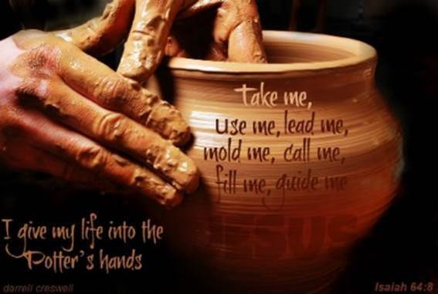
Notes:
Miriam Chernak

Slide 84
Outline of this message
Space elevator needed
Space elevator MelkiTsedek
Space elevator strategies

Slide 85
^{Mes Jews/Heb 7.25-28} He is totally able to deliver those who approach God through him; since he is alive forever and thus forever able to intercede on their behalf. This is the kind of cohen gadol that meets our need - holy, without evil, without stain, set apart from sinners and raised higher than the heavens;
Notes:
Totally able deliver
Here is our space elevator: resurrection power!

Slide 88


