Slide 1
e-handout
To have these notes
without taking notes
Go to OrHaOlam.com
Click on downloads,
messages, 2020

Slide 2
Rwandan COVID rule on gatherings…

Slide 3
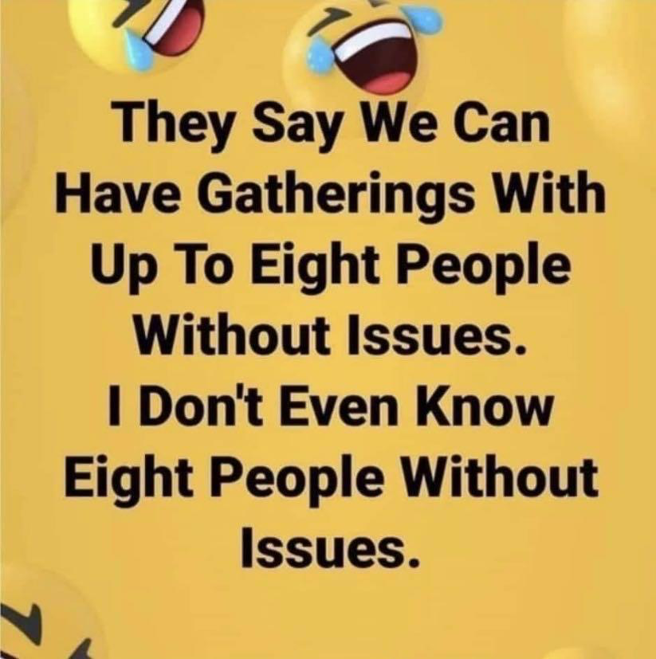

Slide 5
An African king had a long time friend who always looked at everything positively, always saying "This is good!" even in the face of the most difficult situations. Hunting one day, he was preparing the king’s guns. When the king took his first shot, his thumb was blown off.
Notes:
George Whitten

Slide 6
Though the friend realized that it was his grave mistake for not properly setting the gun, and even in the face of this furious, bleeding king, he looked at him and said, "This is good!" The king was LIVID and ordered that his friend be thrown in jail immediately.
Notes:
George Whitten

Slide 7
A year later the king was hunting in an area where he should have stayed clear and was suddenly captured by Cannibals. They tied him up and were preparing to cook him when they realized he had no thumb. They didn't eat anyone who was less than whole so they released him.
Notes:
George Whitten

Slide 8
On his way home, the king pondered the event that had taken his thumb in the first place. He went straight to the jail, told his friend what happened, and apologized in tears for sending him to jail as he did. His enthusiastic friend looked at the King and replied: "This is good!"
Notes:
George Whitten

Slide 9
The king, taken aback once again said "What do you mean 'this is good!' I sent you mercilessly to jail and you’ve been suffering for here for an entire year – how is that good?" His friend responded unwaveringly,
Notes:
George Whitten

Slide 10
"Well if I had not been in jail, I would have been with you!"
Notes:
George Whitten

Slide 11
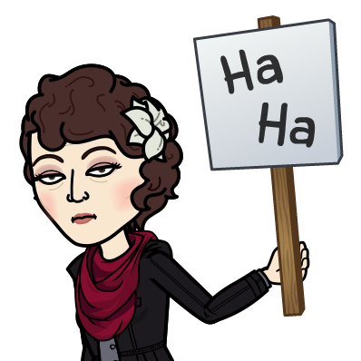
Notes:
Transition…

Slide 12
We have described Yeshua
The cohen/priest ~ Melkitsedek
His offering / our offering: ourselves
His Temple…?
Notes:
With the resurrection space elevator.
What is His Temple?
Who cares?
If we are to be accepted, our sins covered, flee the wrath to come on sin, humanity restored, He has to have a priesthood, an offering, and Temple. There is a lot at stake here!!
The next verses are about the Temple that Yeshua served in…

Slide 13
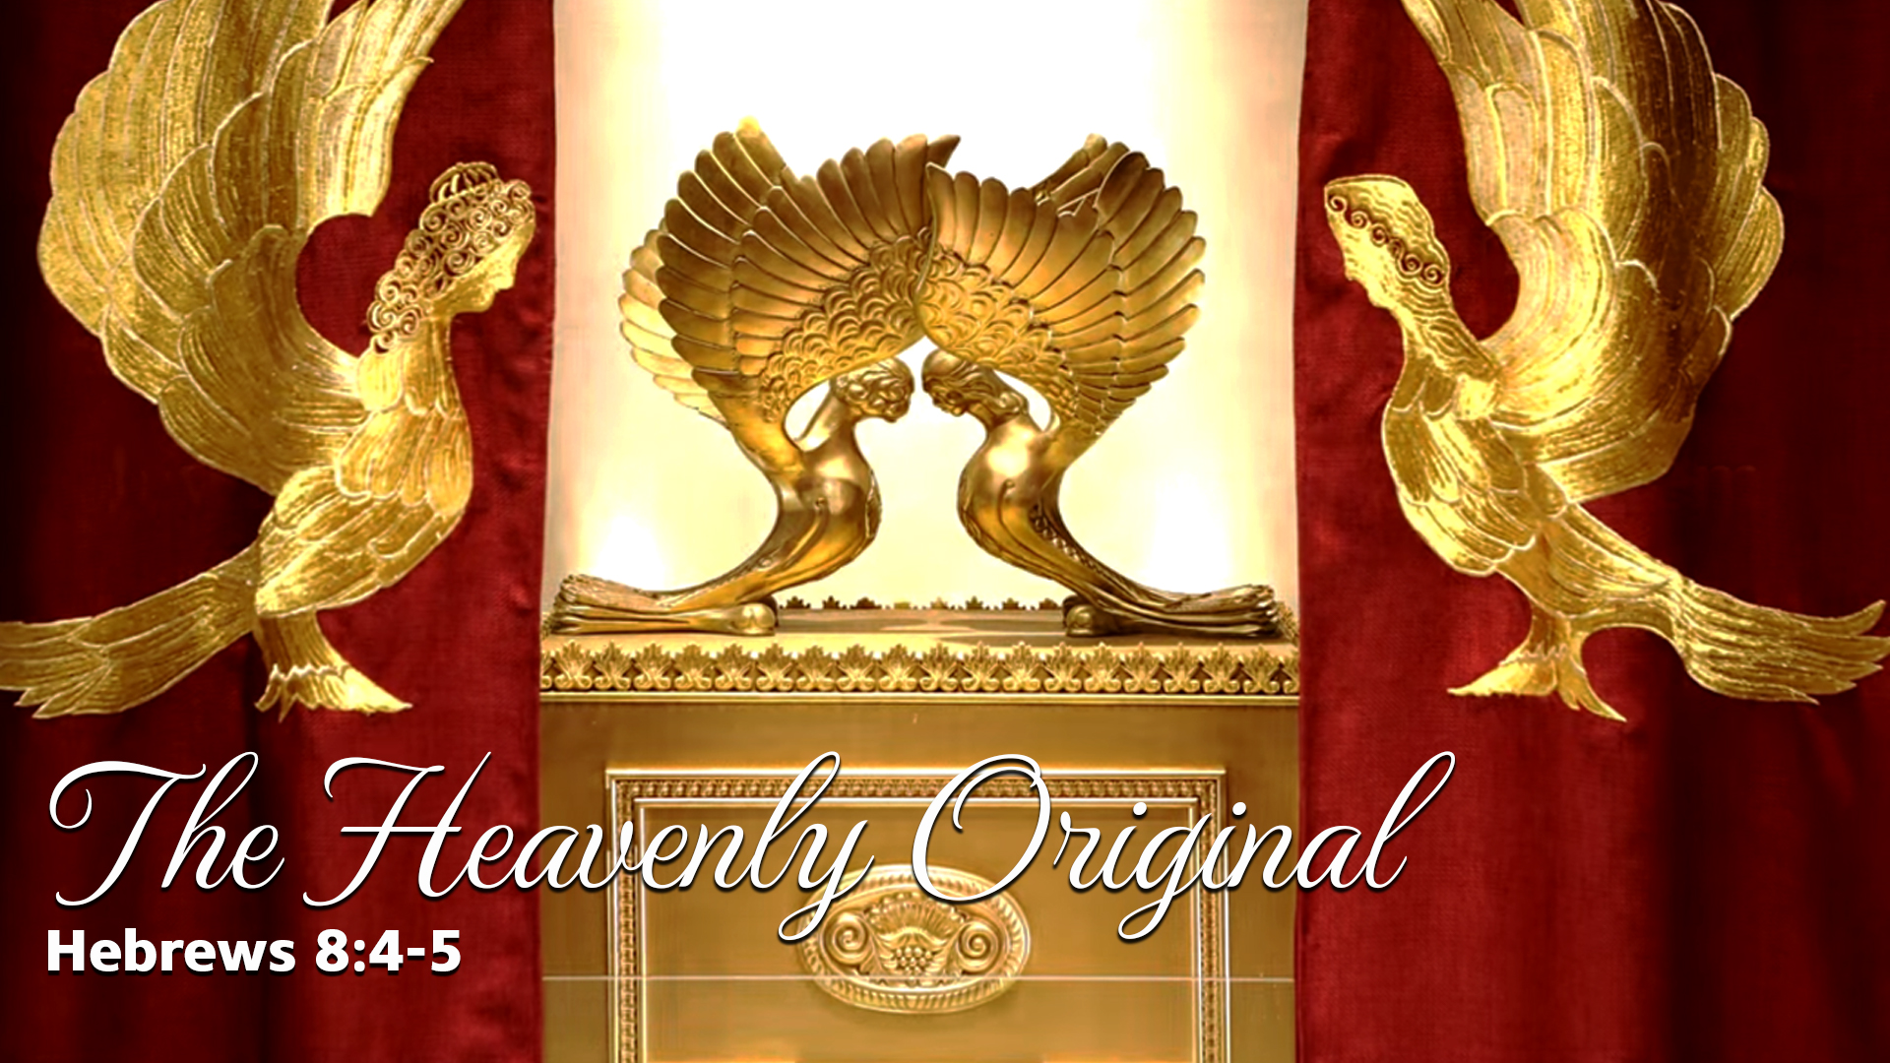

Slide 14
^{MJ 8.4-5} Now if he were on earth, he wouldn’t be a cohen at all, since there already are cohanim offering the gifts required by the Torah. But what they are serving is only a copy and shadow of the heavenly original;
Notes:
What does that mean “the heavenly original?”
Heavenly original Temple? Focus of this message.

Slide 15
^{MJ 8.4-5} for when Moshe was about to erect the Tent…

Slide 16
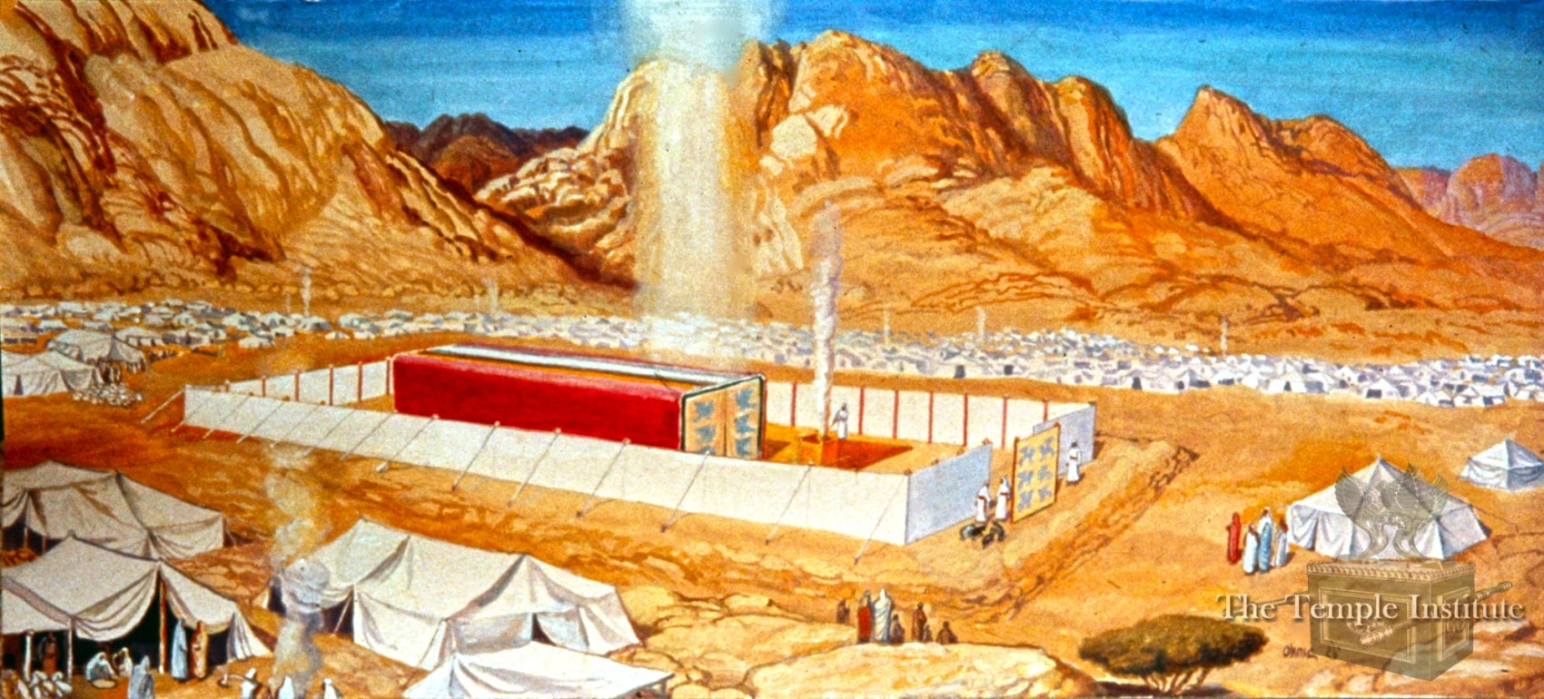
G-d was a pillar of cloud by day
Notes:
https://templeinstitute.org/tabernacle/?gclid=CjwKCAiA9vOABhBfEiwATCi7GFBNCPrHMcaPOH1o4zaf96BbY8egXdRS5-Nh3GSWxoQFy5rAdi9HthoCMI0QAvD_BwE
Passion to get to the Holy of Holies! One Thing…

Slide 17
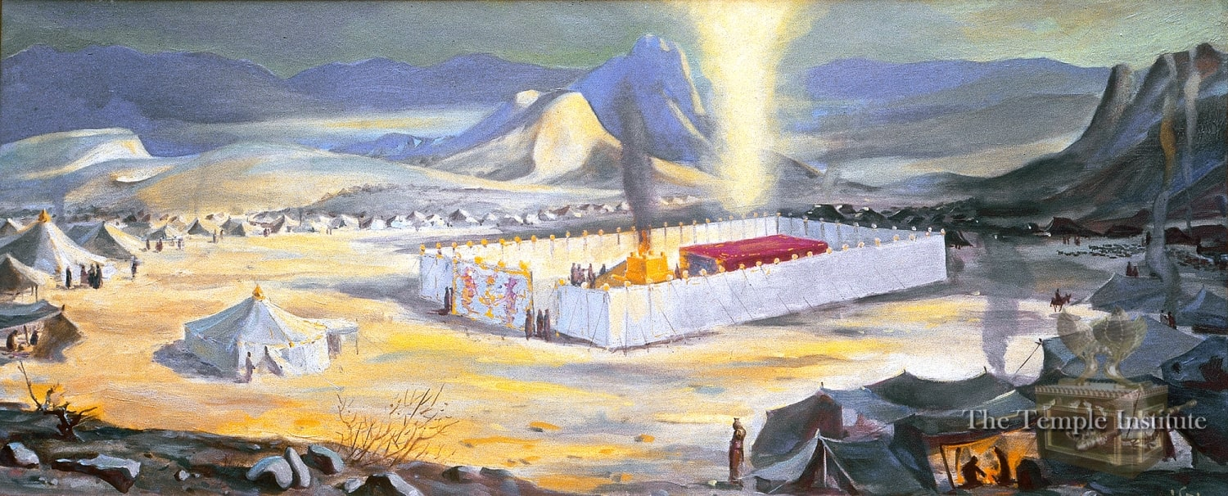
G-d was a pillar of fire by night
Notes:
https://templeinstitute.org/tabernacle/?gclid=CjwKCAiA9vOABhBfEiwATCi7GFBNCPrHMcaPOH1o4zaf96BbY8egXdRS5-Nh3GSWxoQFy5rAdi9HthoCMI0QAvD_BwE

Slide 18
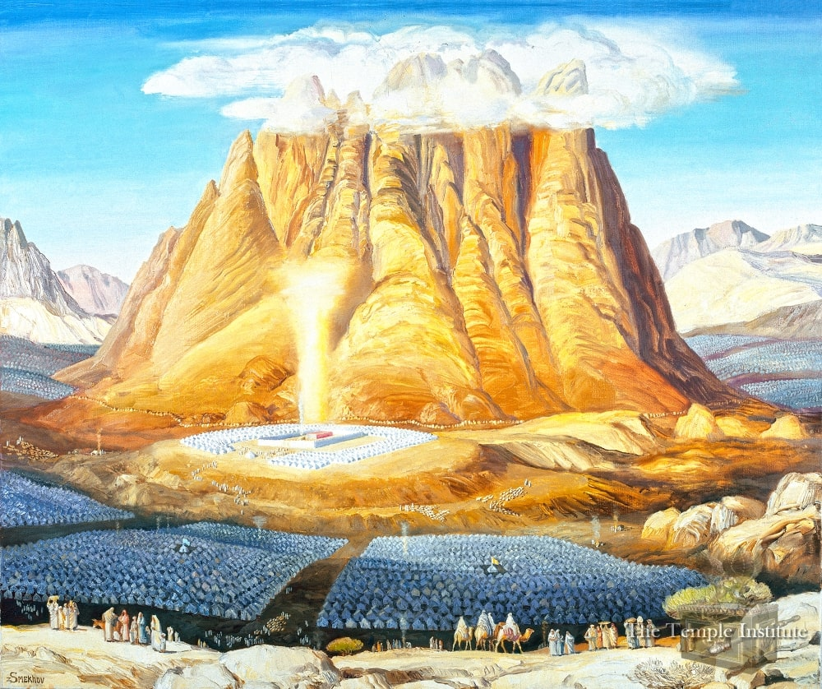
Notes:
https://templeinstitute.org/tabernacle/?gclid=CjwKCAiA9vOABhBfEiwATCi7GFBNCPrHMcaPOH1o4zaf96BbY8egXdRS5-Nh3GSWxoQFy5rAdi9HthoCMI0QAvD_BwE

Slide 19
^{MJ 8.4-5} for when Moshe was about to erect the Tent, God warned him, “See to it that you make everything according to the pattern you were shown on the mountain.”
a copy and shadow of the heavenly original
Notes:
What did Moshe see in Har Sinai, the mountain?

Slide 21
Outline
Moshe saw a pattern of Heavenly reality.
Yeshua lived in Heavenly reality. Gave that up for us!
We are assimilating into Heavenly Reality
Notes:
Third heaven, Paradise

Slide 22
FIRST
^{Exodus 25:9} You are to make it all precisely according to everything that I show you—the pattern of the Tabernacle and the pattern of all the furnishings within—just so you must make it.

Slide 23
Gabriel, the Talmud says, clothed himself with an apron, and showed to Moshe the work of the menorah; and it further says, that an ark of fire, and a table of fire; and a menorah of fire, descended from heaven, and Moshe saw them.
Notes:
T. Bab. Menachot, fol. 29. 1.

Slide 24
SECOND
^{Exodus 25:40} See that you make them according to their pattern being shown to you on the mountain.

Slide 25
THIRD
^{Ex 26:30} “You are to erect the tabernacle according to the design you have been shown on the mountain.

Slide 26
FOURTH
^{Shmot/Ex 27.8} The altar is to be made of planks and hollow inside. They are to make it just as you were shown on the mountain.

Slide 27
FIFTH
^{Bamidbar/Nu 8.4} Here is how the menorah was made: it was hammered gold from its base to its flowers, hammered work, following the pattern Adoni had shown Moshe. This is how he made the menorah.

Slide 28
FIVE times in the Torah the same instruction is given: “Follow the heavenly pattern.”
Heavenly reality. That’s what Moshe needed to follow.
A lesson for us?
Notes:
Fire image?
What is there?

Slide 29
^{2 Cor. 12.2-4} I know a man in union with the Messiah who fourteen years ago was snatched up to the third heaven…Such a man — whether in the body or apart from the body I don’t know, God knows — was snatched into Gan-‘Eden [Paradise] and heard things that cannot be put into words, things unlawful for a human being to utter.
Notes:
Was Shaul talking about himself, or a friend? Not clear.
First heaven: atmosphere with birds and planes.
Second heaven is outer space, no air.
Third heaven is the abode of G, another dimension

Slide 30
^{Shmot/Ex 31.1-6} Then Adoni spoke to Moses saying, “See, I have called by name Bezalel son of Uri son of Hur, of the tribe of Judah, and I have filled him with the Spirit of God, with wisdom, understanding and knowledge in all kinds of craftsmanship,

Slide 31
^{Shmot/Ex 31.1-6} to make ingenious designs, to forge with gold, silver and bronze, as well as cutting stones for setting and carving wood, to work in all manner of craftsmanship. …that they may make everything that I have commanded you:
Notes:
We think of them as primitive. Jewelry making tools was my father’s business.

Slide 32
^{Shmot/Ex 36.1} “So Betsalel and Oholiab are to work…to perform all the labor for the service of the Sanctuary, according to everything Adoni has commanded.”

Slide 33
Some of our synagogue furniture is symbolic to represent the heavenly glory pattern
The Eternal Light = Ner Tamid
The Aron = Torah Cabinet, Ark
Our Menorah ~ Temple menorah, but 9 branches.
Notes:
What Moshe saw in Har Sinai, Mt. Sinai gave him a taste and a passion for the Glory, the Presence.

Slide 34
^{Shmot Ex 33.18-23} Then he [Moshe] said, “Please, show me Your glory!” So He said, “I will cause all My goodness to pass before you, and call out the Name of Adonai before you. I will be gracious toward whom I will be gracious, and I will show mercy on whom I will be merciful.” But He also said, “You cannot see My face,

Slide 35
^{Shmot Ex 33.18-23} for no man can see Me and live.” Then Adoni said, “See, a place near Me—you will stand on the rock. While My glory passes by, I will put you in a cleft of the rock, and cover you with My hand, until I have passed by. Then I will take away My hand, and you will see My back, but My face will not be seen.”

Slide 37
Outline
Moshe saw a pattern of Heavenly reality.
Yeshua lived in Heavenly reality. Gave that up for us!
We are assimilating into Heavenly Reality

Slide 38
Outline
Moshe saw a pattern of Heavenly reality.
Yeshua lived in Heavenly reality. Gave that up for us!
We are assimilating into Heavenly Reality

Slide 39
^{Yn 3.13-15} How will you believe me when I tell you about the things of heaven? No one has gone up into heaven; there is only the one who has come down from heaven, the Son of Man.
Notes:
Moshe was shown some of heaven, but didn’t actually go up. Shaul/Paul or his friend got a glimpse, but Yeshua, it’s His hometown neighborhood.

Slide 40
^{Yn 3.13-15} Just as Moshe lifted up the serpent in the desert, so must the Son of Man be lifted up; so that everyone who trusts in him may have eternal life.
Notes:
This is the access.
Note: Son of Man…

Slide 41
^{Daniel 7.13-14} “I kept watching the night visions, when I saw, coming with the clouds of heaven, someone like a son of man. He approached the Ancient One and was led into his presence. To him was given rulership, glory and a kingdom.
Notes:
Two divine beings in the prophet Daniel. Great evidence of the deity of Messiah, the Son of Man. Bar Enosh Aramaic or Ben Adam in Hebrew.

Slide 42
^{Yn 6.62-64} Suppose you were to see the Son of Man going back up to where he was before? It is the Spirit who gives life, the flesh is no help. The words I have spoken to you are Spirit and life, yet some among you do not trust.”

Slide 43
^{Yn 17.1-3} After Yeshua had said these things, he looked up toward heaven and said, “Father, the time has come. Glorify your Son, so that the Son may glorify you — just as you gave him authority over all mankind,
Notes:
Called His High Priestly Cohen Gadol Prayer

Slide 44
^{Yn 17.1-3} so that he might give eternal life to all those whom you have given him. And eternal life is this: to know you, the one true God, and him whom you sent, Yeshua the Messiah.
Notes:
Eternal life is NOT just when we die, its KNOWING G-d and His glory in some measure.

Slide 45
^{Yn 17.4-5} “I glorified you on earth by finishing the work you gave me to do. Now, Father, glorify me alongside yourself. Give me the same glory I had with you before the world existed.
Notes:
He is the Glorious G-d, and purposes to bring us into that life with Him.

Slide 47
Outline
Moshe saw a pattern of Heavenly reality.
Yeshua lived in Heavenly reality. Gave that up for us!
We are assimilating into Heavenly Reality

Slide 48
Outline
Moshe saw a pattern of Heavenly reality.
Yeshua lived in Heavenly reality. Gave that up for us!
We are assimilating into Heavenly Reality
Notes:
If we have received Yeshua and His salvation, by the gate of repentance, faith, immersion and training, calling to service
New Identity, New community, New calling to serve the King, be His instruments to build the Kingdom.

Slide 49
^{T’hillim/Ps 27.4} One thing have I asked of Adoni, that will I seek: to dwell in the House of Adoni all the days of my life, to behold the beauty of Adoni, and to meditate in His Temple.
Notes:
This is really what life is about. Not going to eternal bliss, heaven, at death, but living in glory NOW.

Slide 50
^{1 Cor 13.12} For now we see in a mirror dimly, but then face to face. Now I know in part, but then I will know fully, even as I have been fully known.

Slide 51
^{2 Cor. 12.2-4} I know a man in union with the Messiah who fourteen years ago was snatched up to the third heaven…Such a man — whether in the body or apart from the body I don’t know, God knows — was snatched into Gan-‘Eden [Paradise] and heard things that cannot be put into words, things unlawful for a human being to utter.
Notes:
Was Shaul talking about himself, or a friend? Not clear.
First heaven: atmosphere with birds and planes.
Second heaven is outer space, no air.
Third heaven is the abode of G, another dimension

Slide 52
Outline
Moshe saw a pattern of Heavenly reality.
Yeshua lived in Heavenly reality. Gave that up for us!
We are assimilating into Heavenly Reality

Slide 53
Applications
Heavenly, spiritual realities are much greater, more powerful, more real than what we see!

Slide 54
^{MJ 11.24-26} Moshe, after he had grown up, refused to be called the son of Pharaoh’s daughter. He chose being mistreated along with God’s people rather than enjoying the passing pleasures of sin.

Slide 55
^{MJ 11.24-26} He had come to regard abuse suffered on behalf of the Messiah as greater riches than the treasures of Egypt, for he kept his eyes fixed on the reward.
Notes:
What have we given up?
I walked away from the family business. Yeshua says if you give up something 100 fold now in this life! Mtt 19.29

Slide 56
^{Phil 3.19-21} They are headed for destruction! Their god is the belly; they are proud of what they ought to be ashamed of, since they are concerned about the things of the world. But we are citizens of heaven, and it is from there that we expect a Deliverer,
Notes:
You are blessed. You are royalty.

Slide 57

politeuomai; a community, i.e. (abstractly) citizenship (figuratively) -- conversation.

Slide 58
Applications
We are children of heavenly blessing.

Slide 59
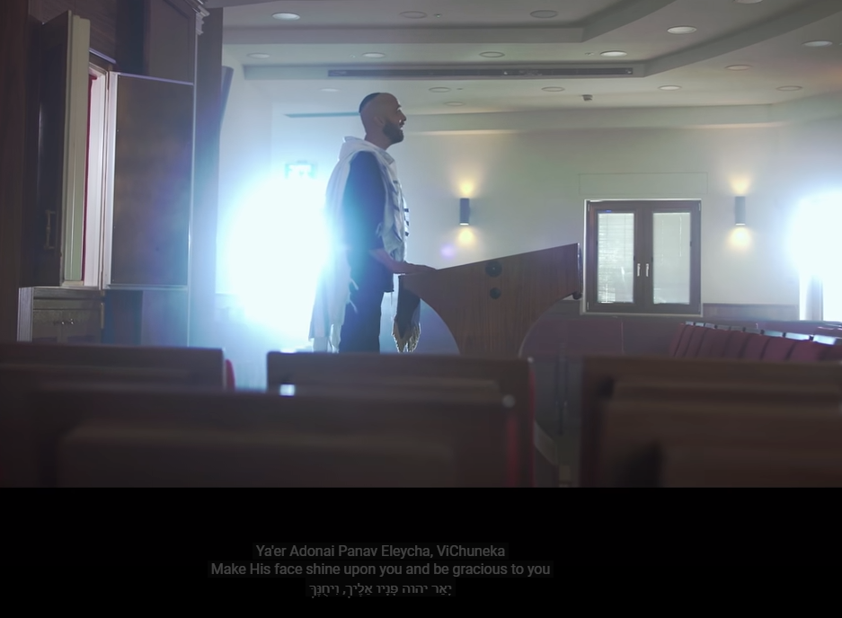
The Blessing הברכה

Slide 60
How many have heard of Bruchko? Best bio I ever read!

Slide 61
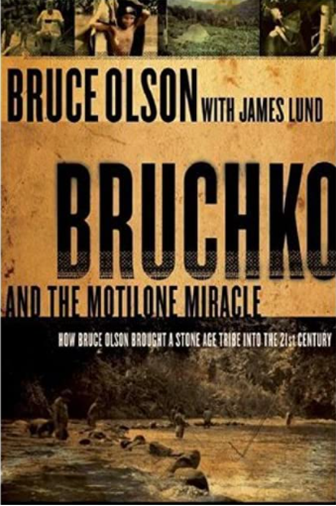
Bruchko: The Story of Bruce Olson

Slide 62
Raised in a legalistic Lutheran church with parents who were cold and indifferent to the Gospel, Olson embarked on a quest for genuine Christianity. He studied Greek and Hebrew and began reading the Bible in the original languages.
Notes:
https://www.thegospelcoalition.org/blogs/trevin-wax/bruchko-the-story-of-bruce-olson/

Slide 63
Olson feared the judgment of God and was eventually driven to his knees in repentance and faith. His Lutheran church offered no support for Olson’s newfound personal faith, so he began to attend an interdenominational church.
Notes:
https://www.thegospelcoalition.org/blogs/trevin-wax/bruchko-the-story-of-bruce-olson/

Slide 64
Olson felt God’s call to minister to Indians in South America. Rejected by all mission boards. When he was nineteen, 1962, he headed to South America with little more than the clothes on his back.
Notes:
https://www.thegospelcoalition.org/blogs/trevin-wax/bruchko-the-story-of-bruce-olson/

Slide 65
Local missionaries looked at Olson as an outsider and refused to include him in mission work because he had come without sponsorship. Olson attended a university in Venezuela and began learning Spanish and about the South American Indian tribes.
Notes:
https://www.thegospelcoalition.org/blogs/trevin-wax/bruchko-the-story-of-bruce-olson/
https://urbana.org/blog/bruce-olson

Slide 66
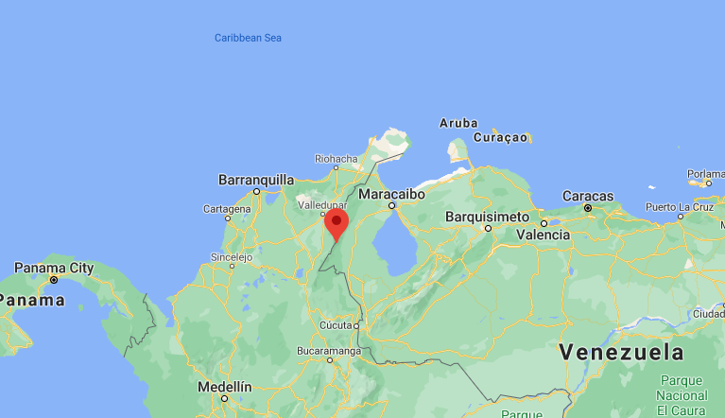

Slide 67
One tribe continually became of interest to him called the Molitone tribe who were known for being brutal, never having contact with any other people at all (without killing them). He threw himself into the jungle, first learning about the Yukos tribe (learning their language as well)
Notes:
https://www.goodreads.com/book/show/296696.Bruchko

Slide 68
who agreed to bring him as far as he could to the Molitones. After spending a year with the Yukos, he ventured deeper into the jungle to find the Motilones. His initial encounter with the Motilones was not good.
Notes:
https://www.goodreads.com/book/show/296696.Bruchko

Slide 69
He was pierced by an Indian arrow and later almost executed by the Motilone chief. Olson endured dysentery, hepatitis, and a chronic problem with parasites during his first few months in the jungle.
Notes:
https://www.thegospelcoalition.org/blogs/trevin-wax/bruchko-the-story-of-bruce-olson/
Tape worm story.

Slide 70
He slowly adjusted to the Motilone diet, and he began to pick up on the tribe’s tonal language. Still, he faced periods of discouragement as he did not know how to share the Messiah within this foreign and difficult context.
Notes:
https://www.thegospelcoalition.org/blogs/trevin-wax/bruchko-the-story-of-bruce-olson/

Slide 71
It took 5 years before he had been able to share his passion of Messiah with them. Olson received the name “Bruchko.” He began to accompany the men on their fishing and hunting expeditions.
Notes:
https://www.thegospelcoalition.org/blogs/trevin-wax/bruchko-the-story-of-bruce-olson/

Slide 72
An epidemic of pink eye hit the tribe. Olson obtained antibiotic cream for the Indians, only to find out that the witch doctor refused the outside help. In an ingenious attempt to win over the witch doctor,
Notes:
https://www.thegospelcoalition.org/blogs/trevin-wax/bruchko-the-story-of-bruce-olson/

Slide 73
Olson purposefully contracted pink eye and allowed the witch doctor to treat him with his own antibiotic cream. From that time on, the witch doctor began to use Western medicines and the tribe took steps to better sanitation.
Notes:
https://www.thegospelcoalition.org/blogs/trevin-wax/bruchko-the-story-of-bruce-olson/

Slide 74
In the jungle, he came upon several Motilone Indians who were digging a hole in an attempt to find God, a demon among the ants.
Notes:
https://www.thegospelcoalition.org/blogs/trevin-wax/bruchko-the-story-of-bruce-olson/

Slide 75
He then remembered a Motilone legend of a warrior who wanted to help ants build a better home. But being so big and unfamiliar he only frightened them.
Notes:
https://urbana.org/blog/bruce-olson

Slide 76
So, quite miraculously, he had become an ant, and guided them in building their home. Bruce used this legend to share how God had become a man to help us understand him.
Notes:
https://urbana.org/blog/bruce-olson

Slide 77
Olson had befriended a young Motilone warrior – Bobarishora (“Bobby” for short). Bobby became a leader of the tribe. Bobby was the first Motilone to convert to Christianity.
Notes:
https://www.thegospelcoalition.org/blogs/trevin-wax/bruchko-the-story-of-bruce-olson/

Slide 78
This extraordinary story that would stretch the credibility of many; except that as late as 2007,after 45 years, this genius of a missionary was still living among the tribe that adopted him, and their change and development is easy for all to see; so are the records of him speaking on their behalf at the United Nations.
Notes:
https://www.goodreads.com/book/show/296696.Bruchko

Slide 79
The Motilone/Bari people were the sort who are bulldozed into oblivion or alcoholism: small (2,500 people) and Amazonian. Olson brought the gospel to the people in a way that strengthened,
Notes:
https://www.goodreads.com/book/show/296696.Bruchko

Slide 80
rather than diminished, their local culture, and they thrived and survived the transition into the modern world. Many of their people have become university graduates (and have then gone back to the jungle).
Notes:
https://www.goodreads.com/book/show/296696.Bruchko

Slide 81
How would an ant understand human life? But they needed help.
No more can we understand heavenly realities. But we need help!!

Slide 82
^{Col. 3.1-4} So if you were raised along with the Messiah, then seek the things above, where the Messiah is sitting at the right hand of God. Focus your minds on the things above, not on things here on earth.

Slide 83
^{Col. 3.1-4} For you have died, and your life is hidden with the Messiah in God. When the Messiah, who is our life, appears, then you too will appear with him in glory!
Notes:
Money: tithing, giving
Anger, forgiving. Commit in your spirit. Ellel coming. Sozo
Purity of eyes, of life.
Enemies: two sides: confront their evil, repent of our evil 95% wrong. 100% wrong in that 5%.
Community. On line, here, if you aren’t in community, were not really serving you well. No spectators.
Life, healing in community, empowering, launch

Slide 84
^{Eph.4.22-23} So far as your former way of life is concerned, you must strip off your old nature, because your old nature is thoroughly rotted by its deceptive desires; and you must let your spirits and minds keep being renewed.

Slide 85
It’s been said that life crowds out our prayer time.
I heard recently that prayer should be our breath, and we should interrupt prayer as needed to do life!
Notes:
Bible school prayer room, splotchy painted foundation blocks became jewels.

Slide 86
^{Yn 4.13-14} Yeshua replied to her, “Everyone who drinks from this water will get thirsty again. But whoever drinks of the water that I will give him shall never be thirsty. The water that I give him will become a fountain of water within him, springing up to eternal life!”
Notes:
Remember drinking the Cool Aide?

Slide 87
^{Phil 3.19-21} The Lord Yeshua the Messiah, He will change the bodies we have in this humble state and make them like his glorious body, using the power which enables him to bring everything under his control.

Slide 88
Outline
Moshe saw a pattern of Heavenly reality.
Yeshua lived in Heavenly reality. Gave that up for us!
We are assimilating into Heavenly Reality
Notes:
Third heaven, Paradise

Slide 89
^{Phil 2.5-11} Let your attitude toward one another be governed by your being in union with the Messiah Yeshua: Though he was in the form of God, he did not regard equality with God something to be possessed by force. On the contrary, he emptied himself, in that he took the form of a slave by becoming like human beings are.

Slide 90
^{Phil 2.5-11} And when he appeared as a human being, he humbled himself still more by becoming obedient even to death — death on a stake as a criminal! Therefore God raised him to the highest place and gave him the name above every name;

Slide 91
^{Phil 2.5-11} that in honor of the name given Yeshua, every knee will bow — in heaven, on earth and under the earth — and every tongue will acknowledge that Yeshua the Messiah is Adoni to the glory of God the Father.

Slide 92
The Blessing הברכה

Slide 97


