Slide 1
e-handout
To have these notes
without taking notes
Go to OrHaOlam.com
Click on downloads,
messages, 2021

Slide 2
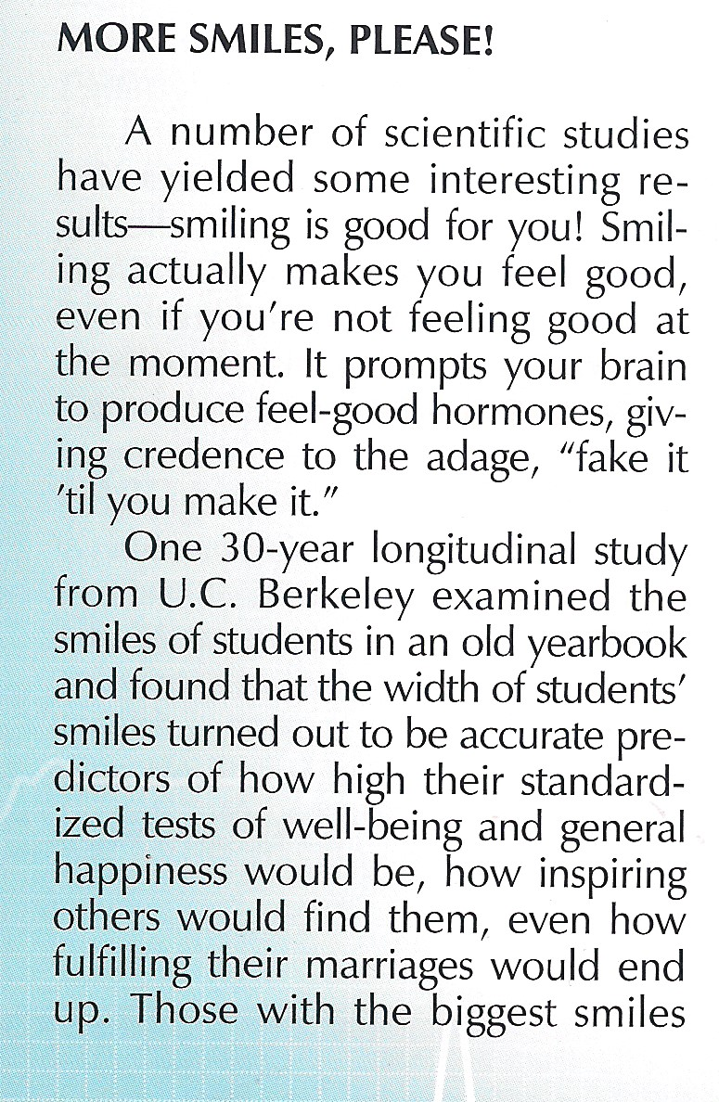
Notes:
G-d’s Revivalist Mag, Cincinnati, OH
Not just faking it, but the scripture commands: “Rejoice.”

Slide 4
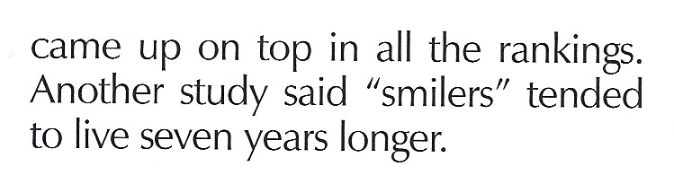
Notes:
Feel good hormones: endorphins, oxytocin
General happiness
Inspiring to others
Marriage fulfillment
Live seven years longer!

Slide 5


Slide 6
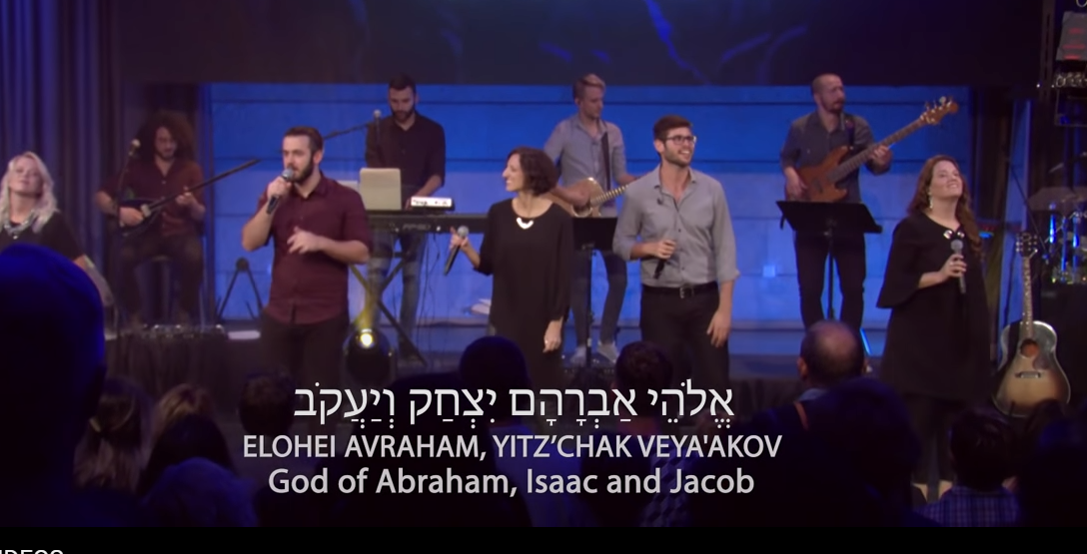
Notes:
https://youtu.be/0VLEva3jZjM
Almost impossible not to smile when dancing in praise.
Special little smile when worshipping.

Slide 7

Notes:
Turn to someone right now and smile, wide. You who are on line, do the same, and if alone, smile at me!!
If you are thinking, “I can’t smile. Too much against me.” Just think of Yeshua and His love for you IN your circumstances, and His resurrection power and His purposes, and rejoice in Him. His love is for you!
Smile one of those slightly crazy believer worship smiles. We’ll never do liturgy, or Hebrew, or dance, as well as the Chabad. But…we can smile a Ruakh smile.

Slide 8
Good news
about the Purim offering

Slide 9
^{Ester 9.20-22} They were to make [Purim] days of
celebrating and rejoicing,
sending portions [of food] to each other and
giving gifts to the poor.

Slide 10
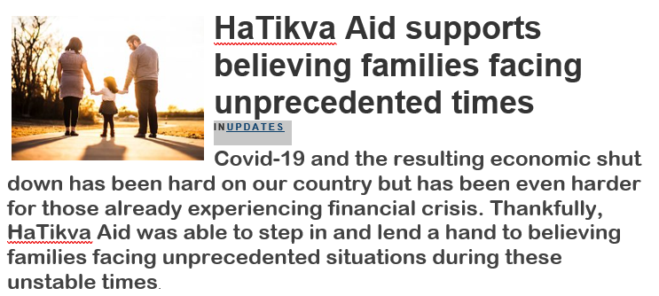
You gave $5000 to HaTikva Aid, Evan Levine!!
Notes:
Why believing families? Jewish charities help the general population. Some Christian charities in evangelistic fervor give to those NOT in the body of Messiah. Messianic believers fall in the cracks at times!
Transition to the topic of the day…

Slide 11
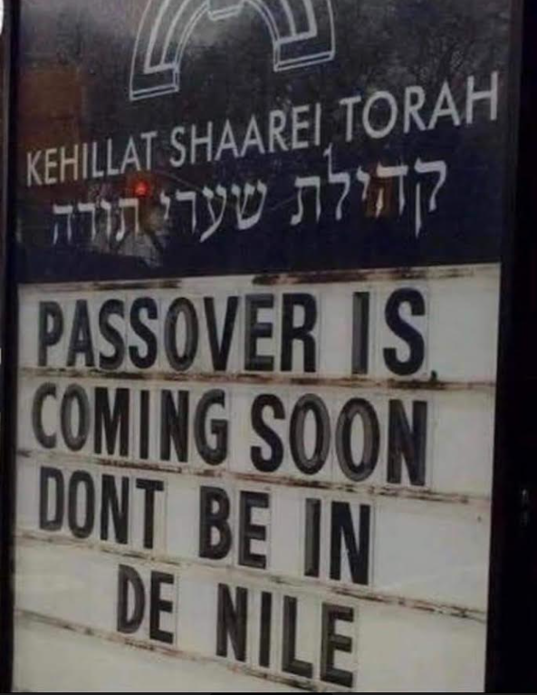
Notes:
Liberation Passover. Justice was the theme of the riots this summer. In my day, it was peace, love and truth, man.

Slide 12
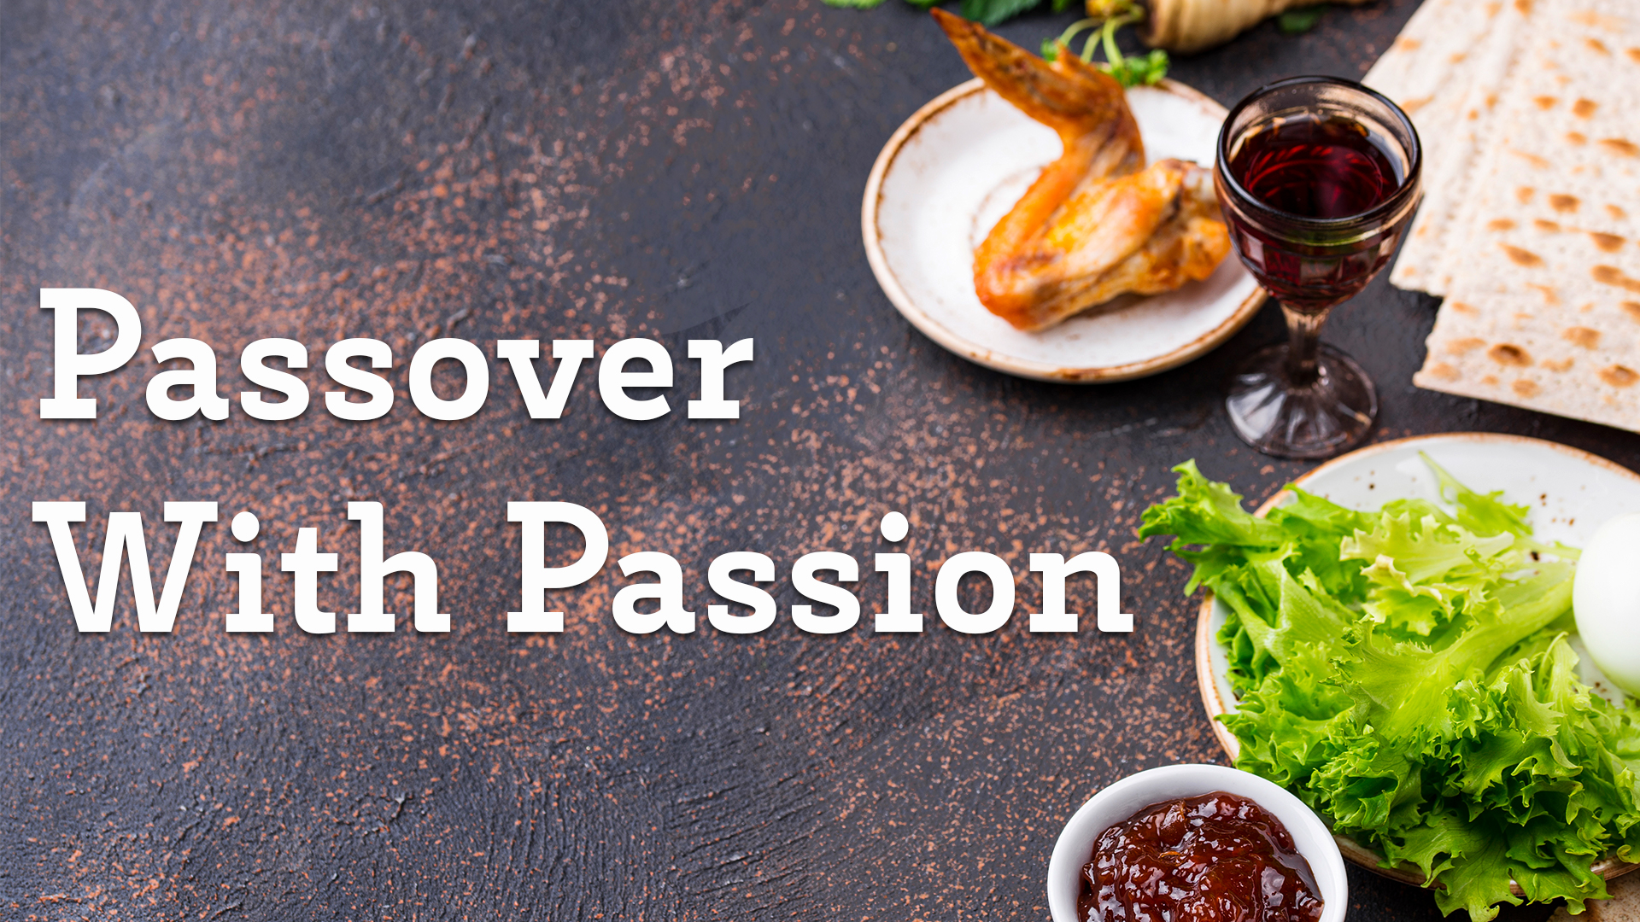
^{Lk 22.14-15}

Slide 13
^{Lk 22.14-15} When the time came, Yeshua and the emissaries reclined at the table, and he said to them, "I have really wanted so much to celebrate this Seder with you before I die!
Notes:
“With you” is the key phrase. Camaraderie, fellowship, intimacy in all we do. But first…[Ben Shapiro]
Thought I should clarify and debunk a detail however. “Reclined”

Slide 14
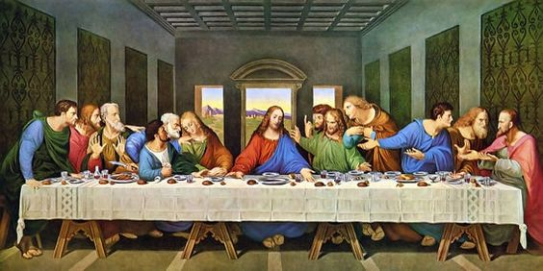
Notes:
Leonardo’s
Still daylight
Bread cf matzah
No families “When your son shall ask.”
Fish cf lamb
Only one person stereotypically Jewish looking, Yehuda/Judas
Straight table
This is one of the objects of Christian culture that precipitated the Messianic movement.

Slide 15
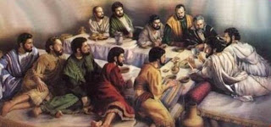
Notes:
Triclinium table. Note reclining.

Slide 16
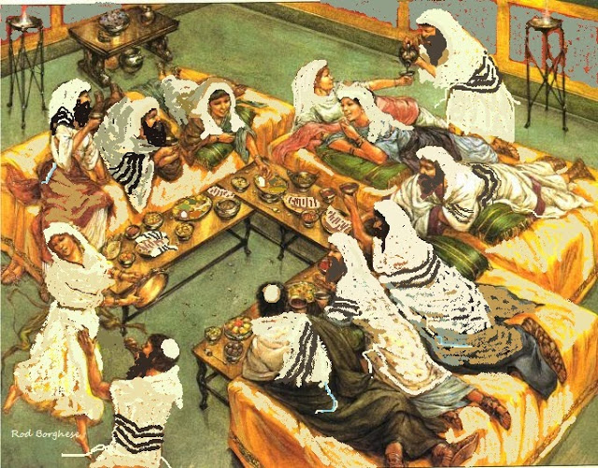
Notes:
https://www.artranked.com/images/cb/cbf2d222268f695163fcc913d363493f.jpg
Triclinium, dancing, women there, music.

Slide 17
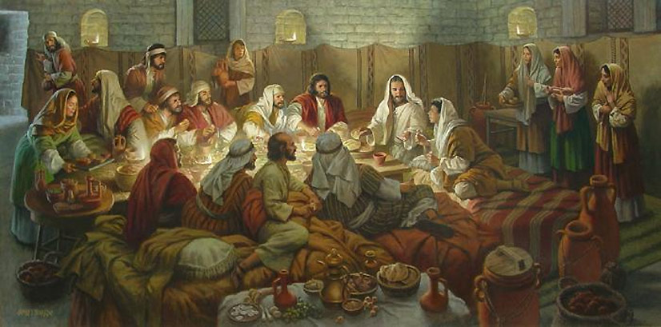
Notes:
https://external-content.duckduckgo.com/iu/?u=https%3A%2F%2Ftse3.mm.bing.net%2Fth%3Fid%3DOIP.04BANZFrs5OcGeXGE01anwHaDq%26pid%3DApi&f=1

Slide 18
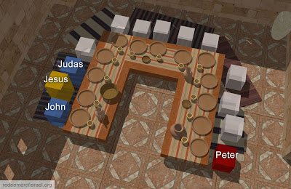
Notes:
https://blogs.bible.org/wp-content/uploads/2020/08/Last-Supper-Triclinium-2.jpg
Probable seating. John-Yokhanan at Yeshua’s right [bosom], Yehuda-Judas next to him for dipping. Kefa-Peter opposite Yokhanan so could ask him questions.

Slide 19
^{Lk 22.14-15}

Slide 20
^{Lk 22.14-15} When the time came, Yeshua and the emissaries reclined at the table, and he said to them, "I have really wanted so much to celebrate this Seder with you before I die!
Notes:
With you. Relational event. BIG deal to share.
In my most secular days, leaving Judaism before knowing where I was going, Sophomore undergrad, I skipped Yom Kippur. Chose NOT to fast. No reason to.
Don’t think I skipped Seder. Too warm and fuzzy, and food!

Slide 21
Passover is relational “with you.”
Love expressed in joy smiles
Love expressed in ritual: Leaven
Love expressed in confession

Slide 22
^{Shmot/Ex 12.3} On the tenth day of this month, each man is to take a lamb or kid for his family, one per household.
Lamb per household.
Family is a unit of worship.
70% of American Jews observe
Notes:
Original mentality.
70% USA today.
Seder relational. Family was a worship unit!
First date I had with Dawn was to take her to a Passover Seder.
My parents would fly me in from Cincinnati for Seder. After married, flew Dawn and me to NYC.
Last item to drop off radar when Jews assimilating. In FSU, Jewish practice prohib, but one woman only knew of “holiday crackers.” Till HS age then FSU passport, Yevrai. First time she found out she was Jewish. She came to faith in our Aleph outreach.

Slide 23
All the liturgy and Torah that we do has an underlying purpose.
All relational. “with you”
Love G-d.
Love your neighbor.

Slide 24
^{Mk 12.28-31} One of the Torah-teachers came up and heard them engaged in this discussion. Seeing that Yeshua answered them well, he asked him, “Which is the most important mitzvah of them all?” Yeshua answered, “The most important is, ‘Sh’ma Yisra’el, Adoni Eloheinu,

Slide 25
^{Mk 12.28-31} Adoni ekhad [Hear, O Isra’el, the Lord our God, the Lord is one], and you are to love Adoni your God with all your heart, with all your soul, with all your understanding and with all your strength.’ The second is this: ‘You are to love your neighbor as yourself.’ There is no other mitzvah greater than these.”
Notes:
No greater. Also, no other context. All fleshes out these two. Any other context is legalism and death!
Someone recently said that they came to Or HaOlam and felt a lot of love. Bless you all! Continue and build it!

Slide 26
How can we understand
“loving my neighbor?”

Slide 27
What Is Joy?
Defined
  “Being with someone who is glad as glad can be to be with me.”
Impact
  Feels good
  Dopamine released in both brains
  Always relational—distinguishing it from “pleasure.”
Transmission
  Non-verbal
  Authentic
  Cycles 6 complete transactions per second
Notes:
Defined
ADVANCE “Being with someone who is glad as glad can be to be with me.”
ADVANCE Impact
ADVANCE Feels good
ADVANCE Dopamine released in both brains
ADVANCE Always relational—distinguishing it from “pleasure.”
ADVANCE Transmission
Non-verbal
Authentic
Cycles 6 complete transactions per second and looks something like this:

Slide 28
Cycle of Joy
Joy
Level
Notes:
Person A sees Person B and before they are even consciously aware they see person B their brain remembers that they like person B and their brain releases a little dopamine which causes their face, specifically the eye to communicate, “I’m glad to see you.”
When person B

Slide 29
Cycle of Joy
Joy
Level
Notes:
receives that non-verbal, “I’m glad to be with you” message, it triggers a dopamine response in his brain that feels good and raises his joy level

Slide 30
Cycle of Joy
Joy
Level
Notes:
Person B then is “glad to be with their friend also” and reciprocates by sending a “I am glad be with you also” message back.
When person A receives that message it stimulates the pleasure center of his brain to release a little more dopamine and now he is even more glad to see his friend. So guess what he does

Slide 31
Cycle of Joy
Joy
Level
Notes:
He sends another message which feels good to both him and his friend and raises both their joy levels a little more.
And back and forth it goes

Slide 32
Cycle of Joy
Joy
Level
Notes:
And each transmission

Slide 33
Cycle of Joy
Joy
Level
Notes:
builds and amplifies

Slide 34
Cycle of Joy
Joy
Level
Notes:
previous transmissions

Slide 35
Cycle of Joy
Joy
Level
Notes:
And all this

Slide 36
Cycle of Joy
Joy
Level
Notes:
Happens

Slide 37
Cycle of Joy
Joy
Level
Notes:
At a rate

Slide 38
Cycle of Joy
Joy
Level
Notes:
of 6 complete cycles per second

Slide 39
Cycle of Joy
Joy
Level
6 Complete Cycles Per Second
Notes:
so what just took me two minutes and 11 PowerPoint slides to explain happens 6 times each and every second you are with someone who is glad to be with you.
That is one of the reasons it is always authentic. You can’t fake something that happens before you are even aware you are doing anything.
Fake it til you make it doesn’t work with joy. Or much else for that matter but we don’t have time for that discussion.
Best illustrated not with Darrell’s goofy blue faces but with a small child.

Slide 40
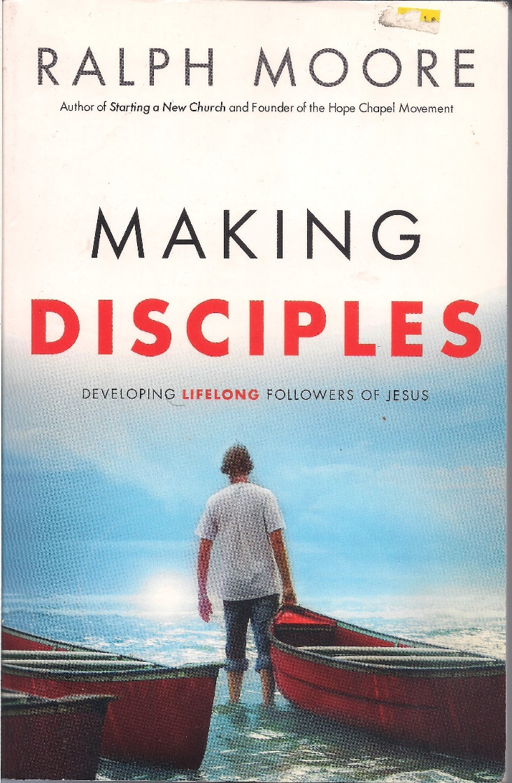
Similarly, the essence of discipleship is relational.

Slide 41
How are you doing?
What is G-d showing you in the Bible [Shma שמע]?
What are you doing with what G-d is showing you?
How are your disciples doing in their ministry?
Notes:
Is there someone of whom you are asking these questions? Is someone asking you these questions?

Slide 42
Does anyone know what’s going on in your life?
Does anyone care, or express caring?
Passover is a time to connect with G-d and each other.

Slide 43
^{Yn. 17.21-23} That they may all be one. Just as you, Father, are united with me and I with you, I pray that they may be united with us, so that the world may believe that you sent me. The glory which you have given to me, I have given to them;

Slide 44
^{Yn. 17.21-23} so that they may be one, just as we are one — I united with them and you with me, so that they may be completely one, and the world thus realize that you sent me, and that you have loved them just as you have loved me.

Slide 45
Yeshua came not only to share life with us, but to GIVE us life!

Slide 46
^{Lk 22.16-20} For I tell you, it is certain that I will not celebrate it again until it is given its full meaning in the Kingdom of God.” Then, taking a cup of wine, he made the b’rakhah and said, “Take this and share it among yourselves.
Notes:
Envision: He was looking at them with eyes of joy, delight, understanding = love.

Slide 47
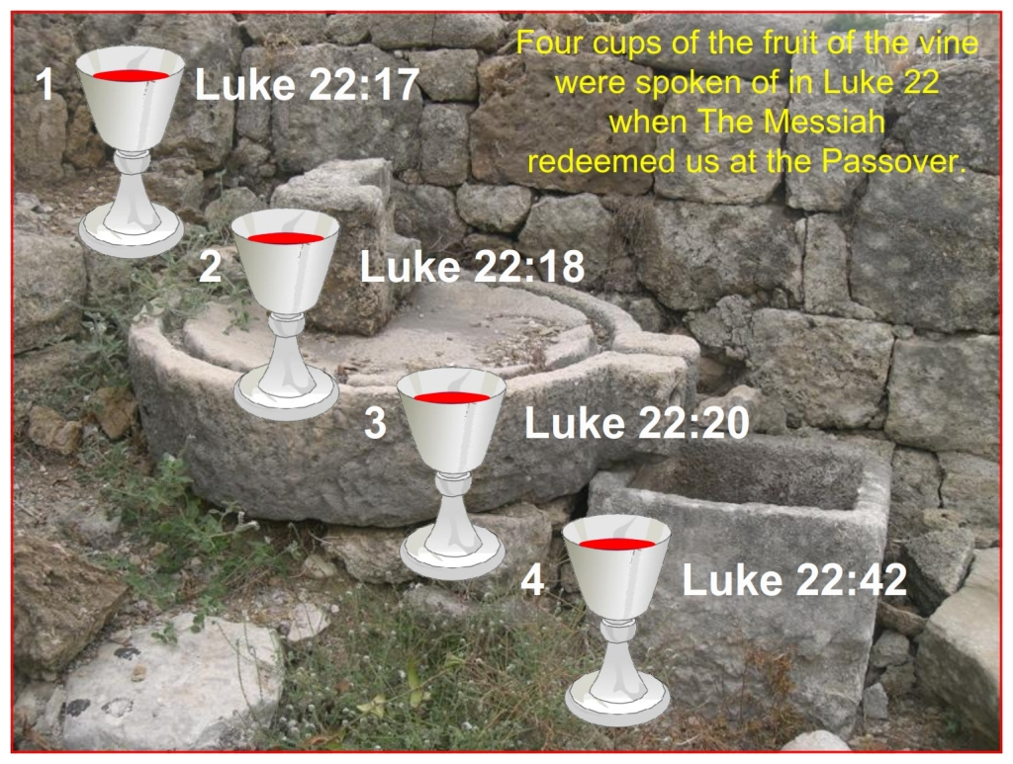
Notes:
https://scrolls4all.org/feasts/wp-content/uploads/sites/2/2014/08/en-feast-passover-figure-89-1024x773.jpg

Slide 48
THE FIRST CUP - THE CUP OF SANCTIFICATION קַדֵּשׁ Kaddaysh
בָּרוּךְ אַתָּה יְיָ, אֱלֹהֵינוּ מֶלֶךְ הָעוֹלָם
בּוֹרֵא פְּרִי הַגָּפֶן:
Ba-rukh atah Adoni, Eh-lo-hay-nu meh-lekh ha-olam, bo-ray pree ha-gafen
.
Blessed are You, Adoni our G-d, King of the universe, Creator of the fruit of the vine.
Notes:
Enter into a spirit of separation: TV, movies, newsp adds [car show]
.

Slide 49
^{Lk 22.16-20} For I tell you that from now on, I will not drink the ‘fruit of the vine’ until the Kingdom of God comes.”

Slide 50
^{Lk 22.16-20} Also, taking a piece of matzah, he made the b’rakhah, broke it, gave it to them and said, “This is my body, which is being given for you; do this in memory of me.”

Slide 51
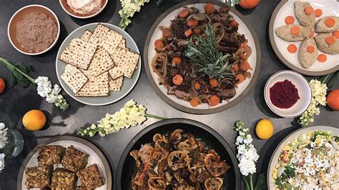
Notes:
https://cdn1.thr.com/sites/default/files/2020/04/passover_dinner_by_wexlers_deli.jpg

Slide 52
^{Lk 22.16-20} He did the same with the cup after the meal, saying, “This cup is the New Covenant, ratified by my blood, which is being poured out for you.
Notes:
We’ve been talking a lot about the New Covenant, Jer 31

Slide 53
Notes:
https://scrolls4all.org/feasts/wp-content/uploads/sites/2/2014/08/en-feast-passover-figure-89-1024x773.jpg

Slide 54
^{Lk 22. 39-44} On leaving, Yeshua went as usual to the Mount of Olives; and the talmidim followed him. When he arrived, he said to them, “Pray that you won’t be put to the test.” He went about a stone’s throw away from them, kneeled down and prayed, “Father, if you are willing, take this cup away from me;
Notes:
4th cup sort of

Slide 55
^{Lk 22. 39-44} still, let not my will but yours be done.” There appeared to him an angel from heaven giving him strength, and in great anguish he prayed more intensely, so that his sweat became like drops of blood falling to the ground.

Slide 56
Notes:
https://scrolls4all.org/feasts/wp-content/uploads/sites/2/2014/08/en-feast-passover-figure-89-1024x773.jpg

Slide 57
^{Lk 22.14-15}

Slide 58
Passover is relational “with you.”
Love expressed in joy smiles
Love expressed in ritual: Leaven
Love expressed in confession

Slide 59
Passover cleansing particulars…
Notes:
Leaven, leavened food, confusing. Need the Hebrew…

Slide 60
שְׂאֹר leavening agents s’or
חָמֵץ leavened food khametz
Khametz is a product that is both made from one of five types of grain and has been combined with water and left to stand raw for longer than eighteen minutes and becomes leavened.
Notes:
https://en.wikipedia.org/wiki/Chametz

Slide 61
חִטָּה Wheat Ḥittim,
כֻּסְמִין Spelt Kusmin,
שְׂעוֹרָה barley Se’orah,
שִׁבֹּלֶת שׁוּעָל oats Shibbolet shual,
שִׁיפוֹן rye shifon
Notes:
https://en.wikipedia.org/wiki/Chametz
fox = שׁוּעָל

Slide 62
Leavening agents, such as yeast or baking soda, are not themselves khametz. Rather, it is the fermented grains. Thus yeast may be used in making wine, and kefir.
Notes:
https://en.wikipedia.org/wiki/Chametz
Also Kefir

Slide 63
Similarly, baking soda may be used in Passover baked goods made with matzoh meal and in matzoh balls. Since the matzoh meal used in those foods is already baked, the grain will not ferment.
Notes:
https://en.wikipedia.org/wiki/Chametz
Also Kefir

Slide 64
This applies to April 3 Oneg. Please, no khametz: leavened grain products.
No: Bread, crackers [except matzah], pasta, cakes, cookies.
Noon, Friday, Sept 26, leaven burning bonfire.

Slide 65
What about rice, corn, lentils, beans, and peanuts?
They don’t leaven, but may appear to. So, Ashkenazic Jews forbid, called kitnayot.
Sephardic Jewish communities they are OK.
Or HaOlam follows the Sephardi.
Notes:
https://www.thoughtco.com/passover-forbidden-foods-2076548
Sephardi more Biblical, less add ons. Great music too.

Slide 66
So it’s a practice in observant Jewish homes to do a THOROUGH Spring cleaning! Get ALL the khametz out of every corner.
Burn the crumbs
And then a prayer of covering.

Slide 67
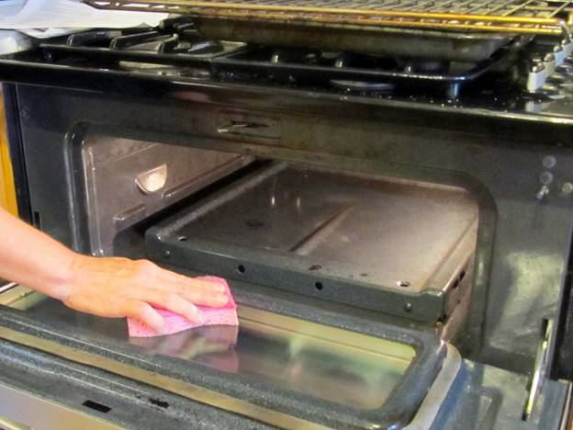

Slide 68
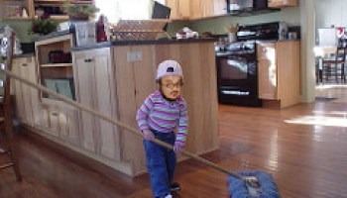
Notes:
https://www.google.com/search?q=chametz+burning&safe=active&tbm=isch&tbs=rimg:CXGR7-dDLk5BIjg1IMGltlriQnD5c6B2s6UdbVpRCvMgvCD5eE9MM8tiLT6XdlbuvnKoOO-5WSZnkZtz2ub3eWX4TyoSCTUgwaW2WuJCEWAR8_1Sg2G0sKhIJcPlzoHazpR0RiWrzQiq97U8qEgltWlEK8yC8IBEIpVnCqYqZzSoSCfl4T0wzy2ItET70tzS7UCuxKhIJPpd2Vu6-cqgRoFDs8WYCBXEqEgk477lZJmeRmxGgUOzxZgIFcSoSCXPa5vd5ZfhPEaBQ7PFmAgVx&tbo=u&sa=X&ved=2ahUKEwjFwo7F3YPaAhWKqlMKHVlIAzMQ9C96BAgAEBs&biw=1282&bih=884&dpr=1#imgrc=yXlZZUKJdFanwM:
A new Israeli military version, getting out the impurities, corruptions..

Slide 69
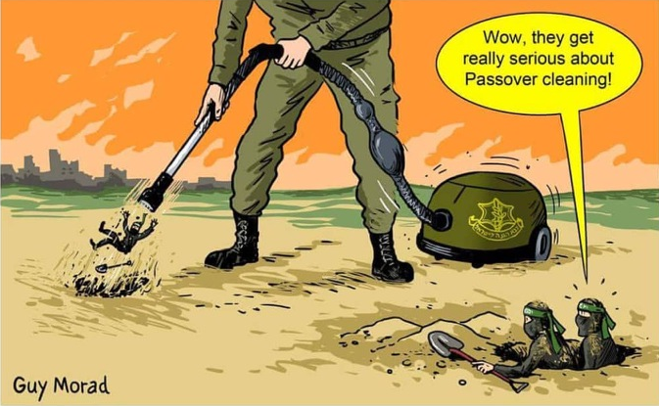
Notes:
From Checho Rojas’ Facebook.
After we’ve cleaned all, we burn the leftovers.

Slide 70
^{Lk 22.14-15}

Slide 71
^{Lk 22.14-15} When the time came, Yeshua and the emissaries reclined at the table, and he said to them, "I have really wanted so much to celebrate this Seder with you before I die!
Notes:
With you. Relational event. BIG deal to share.

Slide 72
Passover is relational “with you.”
Love expressed in joy smiles
Love expressed in ritual: Leaven
Love expressed in confession

Slide 73
All the liturgy and Torah that we do has an underlying purpose.
All relational. “with you”
Love G-d.
Love your neighbor.

Slide 74
Why do we get leavened products, khametz out of our lives for the week?
All relational…

Slide 75
^{1 Cor. 5. 6-8} Your boasting is no good. Don’t you know that a little hametz leavens the whole batch of dough? Get rid of the old hametz, so you may be a new batch, just as you are unleavened—for Messiah, our Passover Lamb,

Slide 76
^{1 Cor. 5. 6-8} has been sacrificed. Therefore let us celebrate the feast not with old hametz, the hametz of malice and wickedness, but with unleavened bread—the matzah of sincerity and truth.

Slide 77
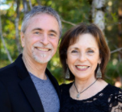
From Hylan Slobodkin, rabbi of Beit Tikvah since 1996, near Seattle, WA
Applied to leaven.

Slide 78
Revival is in the air once again Many are praying for revival. While states legalize marijuana and grow rich on the tax revenue, brokenness abounds in our culture. Substance abuse and immoral lifestyles abound.
Notes:
Hylan Slobodkin Rabbi of Beit Tikvah, Seattle WA

Slide 79
We have over 2.2 million people incarcerated, more than any other country in the world. Our illiteracy rate, which is almost 25% of the total U.S. population, has crippling effects on our society
Notes:
Hylan Slobodkin Rabbi of Beit Tikvah, Seattle WA

Slide 80
I could list all the ills of our nation, but it would only make you depressed. In some ways, it seems like we’ve passed the point of no return. But Someone is going to return, a second time, to those who eagerly await Him. Many wonder if there is hope for a culture in such deep darkness?
Notes:
Hylan Slobodkin Rabbi of Beit Tikvah, Seattle WA

Slide 81
^{2 Timothy 3:1-4} But realize this, that in the last days difficult times will come. For people will be lovers of self, lovers of money, boastful, arrogant, slanderers, disobedient to parents, ungrateful, unholy,
Notes:
Hylan Slobodkin Rabbi of Beit Tikvah, Seattle WA

Slide 82
^{2 Timothy 3:1-4} unloving, irreconcilable, malicious gossips, without self-control, brutal, haters of good, treacherous, reckless, conceited, lovers of pleasure rather than lovers of God,
Notes:
Hylan Slobodkin Rabbi of Beit Tikvah, Seattle WA

Slide 83
^{2 Timothy 3:13-15} But evil people and impostors will proceed from bad to worse, deceiving and being deceived. You, however, continue in the things you have learned and become convinced of, knowing from whom
Notes:
Hylan Slobodkin Rabbi of Beit Tikvah, Seattle WA

Slide 84
^{2 Timothy 3:13-15} you have learned them, and that from childhood you have known the sacred writings which are able to give you the wisdom that leads to salvation through faith which is in Messiah Yeshua
Notes:
Hylan Slobodkin Rabbi of Beit Tikvah, Seattle WA

Slide 85
In 18th century England [1700’s] , poverty was widespread and endemic. The nation was on the verge of revolution. Many women had turned to prostitution. Thousands died from syphilis and gonorrhea.
Notes:
Hylan Slobodkin Rabbi of Beit Tikvah, Seattle WA

Slide 86
Crime abounded, seemingly unabated. Slavery was widespread and brutal. Was there hope for England?
Notes:
Hylan Slobodkin Rabbi of Beit Tikvah, Seattle WA

Slide 87
Within this darkness, the Wesleyan revival broke out. John Wesley began with small groups meeting in homes and offices around London. They called them bands. This is from The Radical Wesley, by Howard Snyder:
Notes:
Hylan Slobodkin Rabbi of Beit Tikvah, Seattle WA

Slide 88
Band members were expected to abstain from doing evil, to be zealous in good works, including giving to the poor, and to use all the means of grace. The design of our meeting is to obey that command of God: “Confess your faults one to another, and pray for one another, that ye may be healed.”
Notes:
Hylan Slobodkin Rabbi of Beit Tikvah, Seattle WA

Slide 89
To this end, we intend,
To meet once a week, at the least.
To come punctually at the hour appointed, without some extraordinary reason.
To begin (those of us who are present) exactly at the hour, with singing or prayer.
Notes:
Hylan Slobodkin Rabbi of Beit Tikvah, Seattle WA

Slide 90
To speak each of us in order, freely and plainly, the true state of our souls, with the faults we have committed in thought, word, or deed, and the temptations we have felt, since our last meeting.
To end every meeting with prayer, suited to the state of each person present.
Notes:
Hylan Slobodkin Rabbi of Beit Tikvah, Seattle WA
This is related to Passover and the removal of leaven.

Slide 91
To desire some person among us to speak his own state first, and then to ask the rest, in order, as many and as searching questions as may be, concerning their state, sins, and temptations.
Notes:
Hylan Slobodkin Rabbi of Beit Tikvah, Seattle WA

Slide 92
Questions to be asked each week were:
What known sins have you committed since our last meeting?
What temptations have you met with?
How were you delivered?
Notes:
Hylan Slobodkin Rabbi of Beit Tikvah, Seattle WA

Slide 93
What have you thought, said, or done, of which you doubt whether it be sin or not?
Notes:
Hylan Slobodkin Rabbi of Beit Tikvah, Seattle WA

Slide 94
The revival was so dramatic, many historians credit them with ushering in the Victorian age, a time when the poor began to matter and “doing the right thing” became the norm. A time when the social order was restored, crime was dramatically reduced, and the future began to look hopeful.
Notes:
Hylan Slobodkin Rabbi of Beit Tikvah, Seattle WA

Slide 95
Bars closed and jails closed, as there were few people to arrest. When he died, Wesley left 129,000 Methodists behind. As the flames of revival broke out in what was once darkness, historians marvel at how the movement of revival was sustained for 100 years.
Notes:
Hylan Slobodkin Rabbi of Beit Tikvah, Seattle WA

Slide 96
G-d spoke thru the prophet Isaiah:
^{Isaiah 60:2} For behold, darkness will cover the earth, and deep darkness the peoples, but the Lord will rise upon you and His glory will appear upon you.
Notes:
Hylan Slobodkin Rabbi of Beit Tikvah, Seattle WA

Slide 97
Things are shaking all around us, but we serve a God whose Kingdom cannot be shaken. God allows things to happen to get our attention, to make changes in nations, in communities, and in us personally.
Notes:
Hylan Slobodkin Rabbi of Beit Tikvah, Seattle WA

Slide 98
JB Bernstein: I love hearing about the moves of God in the past but what about now? I long for the second Mezuzah Street Revival!

Slide 99
^{Lk 22.14-15}

Slide 100
^{Lk 22.14-15} When the time came, Yeshua and the emissaries reclined at the table, and he said to them, "I have really wanted so much to celebrate this Seder with you before I die!
Notes:
Clarification from last week.

Slide 101
Passover is relational “with you.”
Love expressed in joy smiles
Love expressed in ritual: Leaven
Love expressed in confession

Slide 102
All the liturgy and Torah that we do has an underlying purpose.
All relational. “with you”
Love G-d.
Love your neighbor.
Clarification from last week…

Slide 103
A subtle difference Jews and Nations-Gentiles:
A. ^{Acts 15.10} So why are you putting God to the test now by placing a yoke on the neck of the talmidim which neither our fathers nor we have had the strength to bear?

Slide 104
B. ^{Acts 15.19} We should not put obstacles in the way of the Goyim who are turning to God.
C. ^{Acts 15.28} For it seemed good to the Ruach HaKodesh and to us not to lay any heavier burden

Slide 105
D. ^{Acts 21.25} “However, in regard to the Goyim who have come to trust in Yeshua, we all joined in writing them a letter with our decision

Slide 106
Four words of differentiation of Jews and the Nations/Gentiles
Yoke, obstacles, heavier burden, decision.
These words were never defined in terms of practice.

Slide 107
Yoke, obstacles, heavier burden, decision.
These words were defined in terms of effect.

Slide 108
^{Ro. 11.12} Now if their transgression leads to riches for the world, and their loss riches for the Gentiles, then how much more their fullness!

Slide 109
^{Ro.11.15} For if their rejection leads to the reconciliation of the world, what will their acceptance be but life from the dead?

Slide 110
If you are not of Jewish ancestry you keep Torah because
it is the right and blessed way to live.
It provokes Jewish people to jealousy.

Slide 111
If you are of Jewish ancestry you keep Torah because
it is the right and blessed way to live.
It brings life from the dead and greater riches to the Nations!
Notes:
Galatians 2.7 goes so far as to describe this as a different “good news = gospel” Different outlook.

Slide 112
Passover is relational
Love expressed in joy smiles
Love expressed in ritual: Leaven
Love expressed in confession

Slide 113
Conclusion:

Slide 114
Do you KNOW Him and the assurance of sins forgiven?
Are you surrendered to Him, body, soul, spirit? Walking in relational love, confessing?
Are you filled with His Spirit, transforming your life?
Notes:
Who are you discipling, building up?4

Slide 116


