Slide 1
e-handout
To have these notes
without taking notes
Go to OrHaOlam.com
Click on downloads,
messages, 2021

Slide 2
Good News from Israel

Slide 3
Sheba Hospital one of the World’s Top 10
For the 3rd consecutive year, Newsweek magazine has ranked Sheba Medical Center amongst the “Top 10 Best Hospitals in the World”, placing it at #10 in 2021.
Notes:
https://vfinews.com/news/march-5-2021/sheba-hospital-still-one-of-the-worlds-top-10

Slide 4
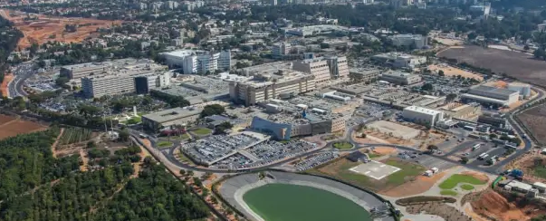
Sheba Medical Center, Tel Hashomer, Israel

Slide 5
Newsweek.com site on Wednesday, once again cited Sheba’s superior healthcare, as well as its medical innovation and cutting-edge research.
Notes:
https://vfinews.com/news/march-5-2021/sheba-hospital-still-one-of-the-worlds-top-10

Slide 6
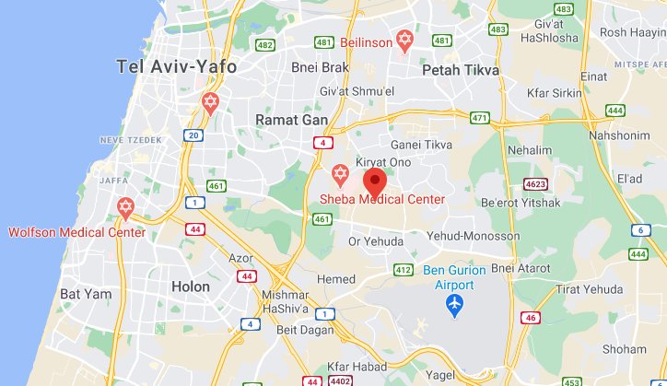

Slide 7
Sheba faced stiffer global competition, as the annual Newsweek/Statista ranking featured more countries and expanded from 1,000 hospitals in 2019 to 2,000 in 2021.
Notes:
https://vfinews.com/news/march-5-2021/sheba-hospital-still-one-of-the-worlds-top-10

Slide 8
Israel Apartheid?

Slide 9
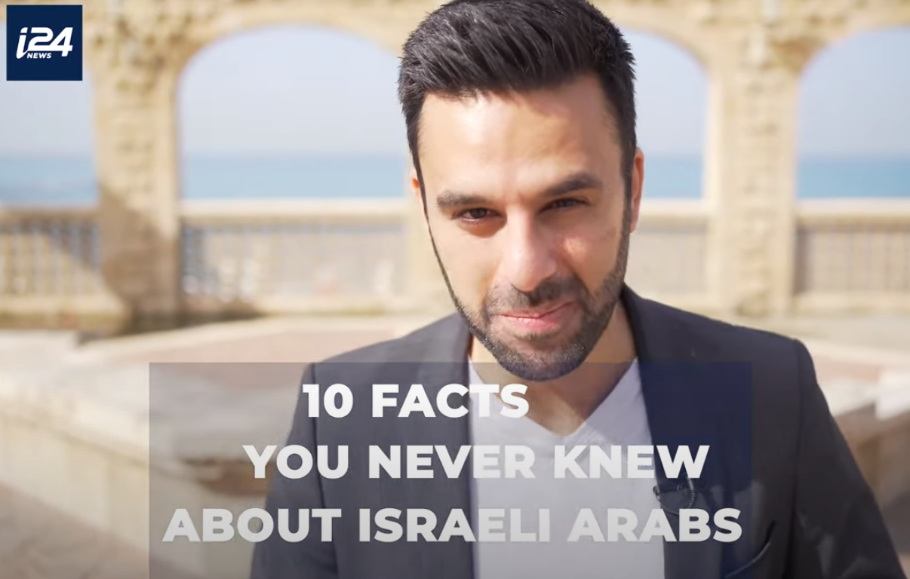
Notes:
https://youtu.be/VbKpYNYtq1k
And Israel is charged with being an apartheid state, and guilty of war crimes!!

Slide 10
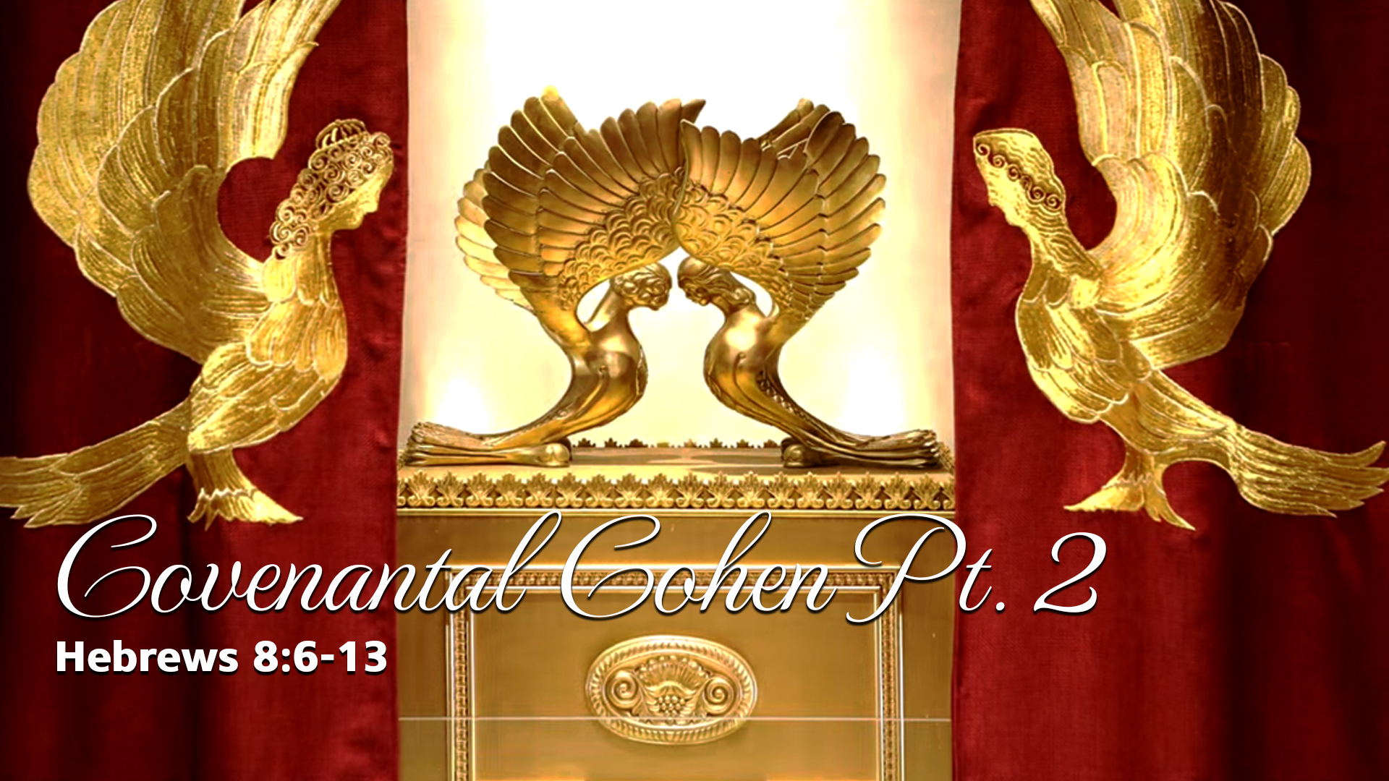
Notes:
https://www.templeinstitute.org/new-location.htm
Note: Part 2 Continuation of two weeks ago, some points didn’t get to.

Slide 12
Review / Outline of Feb. 20, 2021
What is a covenant?
What are the covenants in scripture?
What is Yeshua’s covenant?
How does this apply to us.
Notes:
Mostly #4 new stuff.

Slide 13
^{MJ 8.6} But now the work Yeshua has been given to do is far superior to theirs, just as the covenant he mediates is better. For this covenant has been given as Torah on the basis of better promises.
Notes:
Does He need a covenant?

Slide 14
^{MJ 8.7} Indeed, if the first covenant had not given ground for faultfinding, there would have been no need for a second one.

Slide 15
^{MJ 8.8-9} For God does find fault with the people when he says, “‘See! The days are coming,’ says Adoni, ‘when I will establish over the house of Isra’el and over the house of Y’hudah a new covenant. “‘It will not be like the covenant which I made with their fathers

Slide 16
^{MJ 8.8-9} on the day when I took them by their hand and led them forth out of the land of Egypt; because they, for their part, did not remain faithful to my covenant; so I, for my part, stopped concerning myself with them,’ says Adoni.

Slide 17
^{Mes Jews 8.10} “‘For this is the covenant which I will make with the house of Isra’el after those days,’ says Adoni:

Slide 18
^{MJ 8.11}‘I will put my Torah in their minds and write it on their hearts; I will be their God, and they will be my people. “‘None of them will teach his fellow-citizen or his brother, saying, “Know Adoni!” For all will know me, from the least of them to the greatest,

Slide 19
^{MJ 8.12-13} because I will be merciful toward their wickednesses and remember their sins no more.’” By using the term, “new,” he has made the first covenant “old”; and something being made old, something in the process of aging, is on its way to vanishing altogether.

Slide 20
Notes:
https://www.templeinstitute.org/new-location.htm

Slide 21
Review / Outline
What is a covenant?
What are the covenants in scripture?
What is Yeshua’s covenant?
How does this apply to us.

Slide 22
בְּרִית brit כָּרַת בְּרִית carat brit
to cut a covenant
Covenant, treaty pact, alliance, constitution, ordinance, between monarch and subjects, or individual, or nations
Notes:
What are examples of covenantal conduct today?

Slide 23
ברית נישואיןCovenant of Marriage
Brit N’su-in
United States אַרְצוֹת הַבְּרִית
Artsot HaBrit
Soviet Union בְּרִית הַמּוֹעָצוֹת
Brit Hamoastot
Notes:
The only reason for weddings? Party/celebrate? Presents? Showcase the beautiful bride? It’s her day! Initiate sex?
→ Hearing of the covenantal vows and when you hear you are a participant!
If a tree falls in the forest and no one hears it, does it make a sound?
If a vow is made that no one hears, is it a vow?
https://www.marriagebuilders.com/whats-the-purpose-of-a-wedding.htm
[Ravi Zacharias, Les Miles, LSU football coach]
Could be said, the heart, essence of life is our covenants.

Slide 24
Covenant power of words.
^{Yeshayahu/Is 40.8} The word of our God stands forever.
דְבַר-אֱלֹהֵינוּ יָקוּם לְעוֹלָם.
D’var Elohim yakum l’olam

Slide 25
^{Mtt. 12.36-37} Moreover, I tell you this: on the Day of Judgment people will have to give account for every careless word they have spoken; for by your own words you will be acquitted, and by your own words you will be condemned.”
Notes:
Wedding vows are not approximate words. I’ll be faithful to you mostly.
I have wrecked the flow of good jokes because part of the story was inaccurate. Be precise in your speech.
I am guilty of saying things backwards. “Went to Walmart yesterday.” Really three days ago. Ugh!

Slide 26
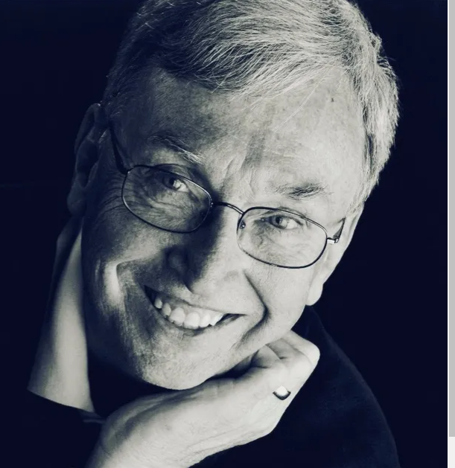
Tim Gustafson, Consultant and Counselling
Corporate Director of Or HaOlam

Slide 27
Gus at our leadership meeting:
“Don’t teach, instruct, correct, judge, or define anyone unless
God told me too,
they’re asking me,
or it’s 911.

Slide 28
And only out of love. All come with a great price.”
Ask our kids, spouse, friends, “Do I teach, instruct ...
If so, do you love and appreciate it? Is it working? Probably not
Notes:
Our words can heal or hurt…powerfully.

Slide 29
Notes:
https://www.templeinstitute.org/new-location.htm

Slide 30
Review / Outline
What is a covenant?
What are the covenants in scripture?
What is Yeshua’s covenant?
How does this apply to us.

Slide 31
Edenic, before the Fall
Adamic, after the Fall
Noakhic, after the Flood
Avrahamic
Mosaic
Moavi Moabite: Land return
Davidic: Kingdom
Renewed: Messiah’s
Notes:
I spent most of my time two weeks ago on this. None of them replaces the previous. Yeshua fulfills in the sense of empowers each, but doesn’t eliminate / fulfill any.

Slide 32
Seven of eight are still in force!
Seven of eight are enacted with sacrifice.
Five of eight covenants were made with Israel, the Jewish people. Abrahamic, Mosaic, Moabite, Davidic, Renewed Loving Jews!
Notes:
Eden is gone. No sacrifice in Gan Eden. No death. Yeshua fulfilled in the sense of empowered the ones in force, didn’t fulfill in the sense of replacing

Slide 33
Notes:
https://www.templeinstitute.org/new-location.htm

Slide 34
Review / Outline
What is a covenant?
What are the covenants in scripture?
What is Yeshua’s covenant?
How does this apply to us.

Slide 35
^{MJ 8.11}‘I will put my Torah in their minds and write it on their hearts; I will be their God, and they will be my people. “‘None of them will teach his fellow-citizen or his brother, saying, “Know Adoni!” For all will know me, from the least of them to the greatest,

Slide 36
^{MJ 8.12-13} because I will be merciful toward their wickednesses and remember their sins no more.’” By using the term, “new,” he has made the first covenant “old”; and something being made old, something in the process of aging, is on its way to vanishing altogether.

Slide 37
It is a covenant of power!
Inward Ruakh /Spirit guidance, empowerment to obey holiness.
Experience of G-d and Messiah!
Experiential forgiveness: received and given.
Notes:
Do you know G-d’s forgiveness → joy? Do you know G-d’s power to change? Filling with the Spirit?
There is much to say on G-d’s power!

Slide 38
Yeshua gave Israel the New Covenant, and invites the Nations to be grafted in!
Does not abrogate other covenants with Israel.
Covenants are enacted with sacrifice.

Slide 40
Notes:
https://www.templeinstitute.org/new-location.htm

Slide 41
Review / Outline
What is a covenant?
What are the covenants in scripture?
What is Yeshua’s covenant?
How does this apply to us.

Slide 42
First application: an apparent heresy by us Messianics!
Textual error and violation of the Hebrew scriptures in the Messianic Scriptures?

Slide 43
^{Yer/Jer 31.31} because they, for their part, violated my covenant, even though I, for my part, was a husband to them,”

Slide 44
^{MJ 8.8-9} for their part, did not remain faithful to my covenant; so I, for my part, stopped concerning myself with them,’ says Adoni.
NOT AN ACCURATE QUOTE?!

Slide 45
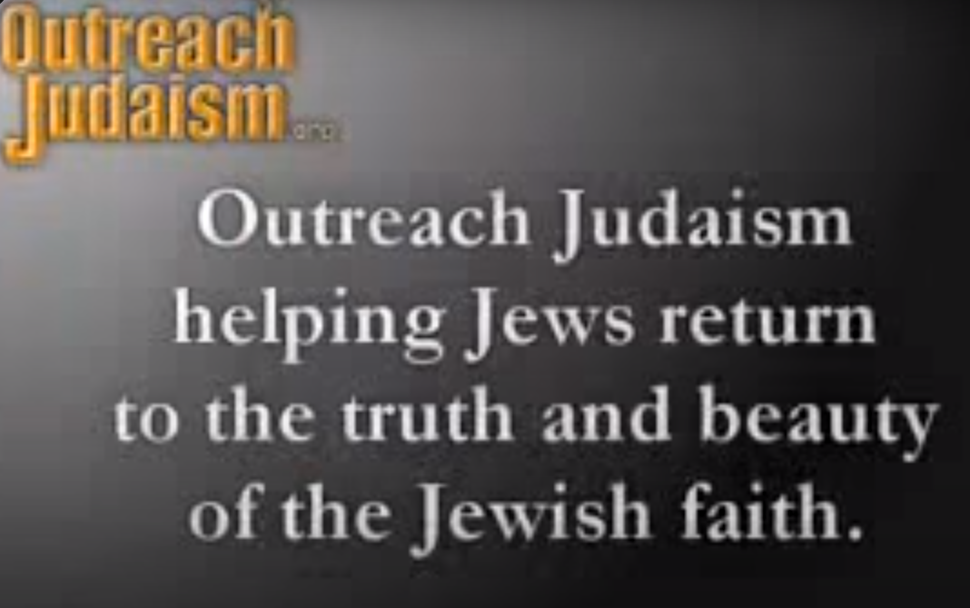

Slide 46
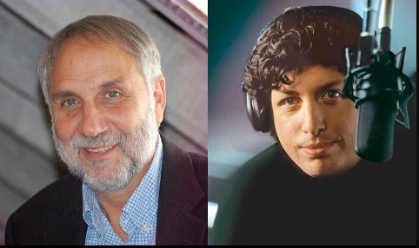
Rabbi Tovia Singer Debates
Jhan Moskowitz.

Slide 47
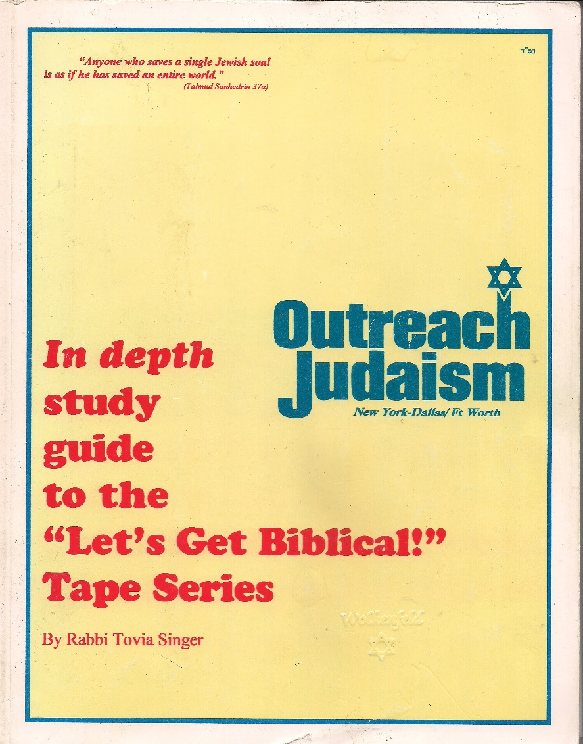
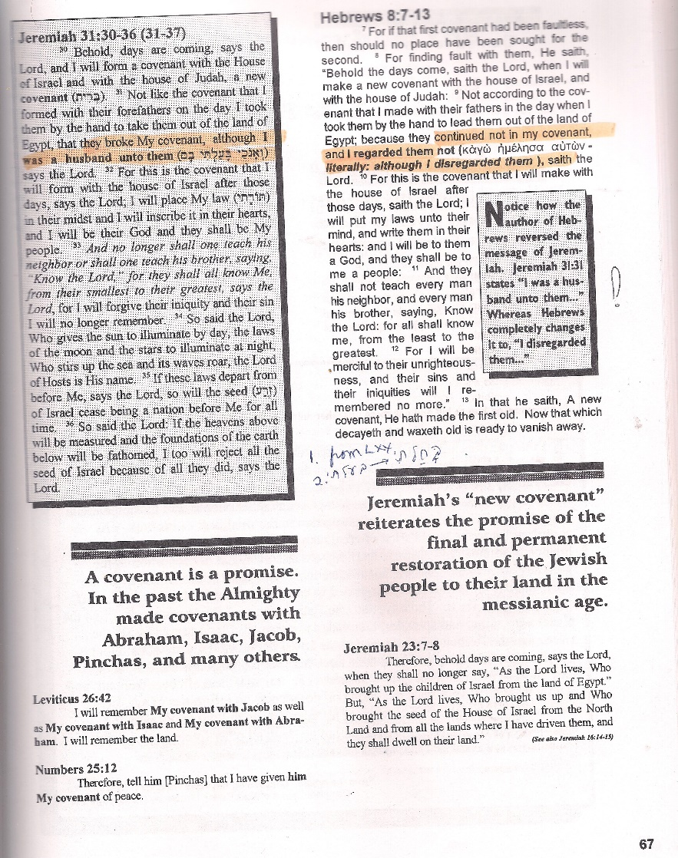

Slide 48

Jer 31.31 MJ 8.9
Tovia: How dare these Christians
defile our text??!!

Slide 49
In ~1998 Tovia Singer came to BIAV Synagogue, and Or HaOlam was invited!

Slide 50
Resolution:
^{Yer 31.31} Even though I, for my part, was a husband to them,” says Adoni. וְאָנֹכִי בָּעַלְתִּי בָם--נְאֻם-יְיָ Baalti
^{MJ 8.9} I, for my part, stopped concerning myself with them,’ says Adoni. וְאָנֹכִי בָּחַלְתִּי בָם--נְאֻם-יְי
Bakhalti

Slide 51
The MJ author quotes the Septuagint, whose translators had a different Hebrew text than the one we have now; it must have said "bakhalti" בָּחַלְתִּי ("I disdained them") instead of "ba'alti" בָּעַלְתִּי("I was a husband [or "lord") to them"), as in our present Hebrew version.
Notes:
https://kifakz.github.io/eng/bible/stern/stern_evreyam_08.html
Which text was the original from Yermiyahu’s hand? Masoretic or on LXX used?

Slide 52
Rashi, cited in Mikra 'ot G 'dolot, makes the same point in his discussion of this verse of Jeremiah.
Notes:
https://kifakz.github.io/eng/bible/stern/stern_evreyam_08.html

Slide 53
"bakhalti" בָּחַלְתִּי ("I disdained them")
"ba'alti" בָּעַלְתִּי(“I was a husband [or lord] to them”)
Notes:
https://kifakz.github.io/eng/bible/stern/stern_evreyam_08.html
Doesn’t mean G-d was and is not disinterested in Israel, but He gave up on that generation.

Slide 54
Review / Outline
What is a covenant?
What are the covenants in scripture?
What is Yeshua’s covenant?
How does this apply to us.

Slide 55
TWO: What is the meaning of v 13
“New” and “old”
“Vanishing”

Slide 56
a. The word ‘New’
^{MJ 8.13} By using the term, “new,” he has made the first covenant “old”; and something being made old, something in the process of aging, is on its way to vanishing altogether.
Notes:
A superficial reading of this would imply, take the Tanakh and fugetabotit. It’s old, and vanishing!

Slide 57
There are two words for "new" in Greek, "kainos" and "neos.“
Neos means something which has never before existed
Kainos freshness and renewal of something which has existed (^{Mt.9:17} wineskins).
Notes:
https://kifakz.github.io/eng/bible/stern/stern_evreyam_08.html

Slide 58
Chapter 8 in the phrase, "New Covenant," is always "kainos," renewal because the New Covenant renews, empowers the Old Covenant. All the promises of the New Covenant existed in some degree in the Tanakh.
Notes:
https://kifakz.github.io/eng/bible/stern/stern_evreyam_08.html

Slide 59
^{MJ 8.11}‘I will put my Torah in their minds and write it on their hearts; I will be their God, and they will be my people. “‘None of them will teach his fellow-citizen or his brother, saying, “Know Adoni!” For all will know me, from the least of them to the greatest,

Slide 60
It is a covenant of power!
Inward Ruakh /Spirit guidance, empowerment to obey holiness.
Experience of G-d and Messiah!
Experiential forgiveness: received and given.
Notes:
All these things existed before, but in limited measure in limited number of individuals.
This is the way…walk in it. David…guidance.
This says the High and Lofty One, Is 57
Ps 32 Blessed is the man whose sin is forgiven.
But now more generally available, and deeper.

Slide 61
b. Vanishing?
something being made old, something in the process of aging, is on its way to vanishing altogether.

Slide 62
“Since the laws concerning the sacrificial system and priesthood constitute the majority of the Mosaic prescriptions, it is not an inappropriate figure of speech to say that the Old Covenant itself is aging and about to disappear.” David Stern’s Commentary
Notes:
https://kifakz.github.io/eng/bible/stern/stern_evreyam_08.html
The priesthood was about to disappear, at least as a means of salvation. It will apparently return as a form of worship in the Millennial Kingdom in Yekhez/Ezek 40-48
This could be an implication that the Temple was still standing. His arguments do provide a rationale for Messianic Jews not to be distressed by the passing of the Temple and to carry on anyhow;

Slide 63
“The role of the book of Messianic Jews is comparable with that of the Yavneh Council in non-Messianic Judaism (c. 90 C.E.), which transferred its focus from the Temple to the Written and Oral Torah.”
Notes:
Rabbi Yokhanan ben Zakkai.
What has changed is the cohen. Not the Torah.

Slide 64
Other traditional Jewish objections:
Mosaic covenant eternal so no possibility of “new.” [Davidic]
All covenants with Jews. This one with Gentiles. [Grafted in]
Why don’t all grafted in keep Torah? [Serious question]
Notes:
Answers in bracketed words.

Slide 65
A subtle difference Jews and Nations:
A. ^{Acts 15.10} So why are you putting God to the test now by placing a yoke on the neck of the talmidim which neither our fathers nor we have had the strength to bear?

Slide 66
B. ^{Acts 15.19} We should not put obstacles in the way of the Goyim who are turning to God.
C. ^{Acts 15.28} For it seemed good to the Ruach HaKodesh and to us not to lay any heavier burden

Slide 67
D. ^{Acts 21.25} “However, in regard to the Goyim who have come to trust in Yeshua, we all joined in writing them a letter with our decision

Slide 68
Four words of differentiation of practice by Jews and the Nations/Gentiles
Yoke, obstacles, heavier burden, decision.
Notes:
What do these words mean? There is SOME difference!
The issue gets worse…Some commentators see that there are two forms of the good news, gospel.

Slide 69
^{Gal. 2.7} On the contrary, they saw that I had been entrusted with the Good News for the Uncircumcised, just as Kefa had been for the Circumcised;

Slide 70
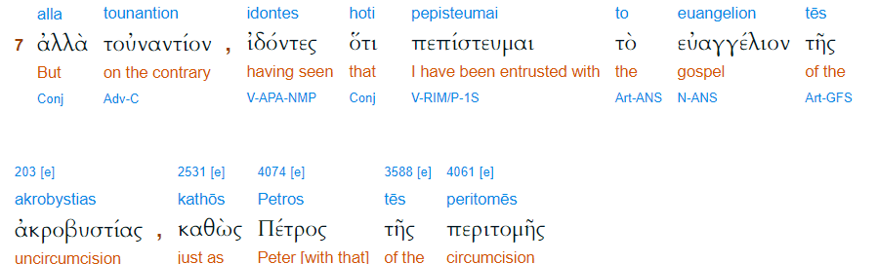
Gal. 2.7

Slide 71
Paul used an expression found nowhere else in his writings. He had been entrusted with the "gospel of the uncircumcision" just as Peter had been assigned the "gospel of the circumcision." But how can this claim be squared with Paul's earlier insistence that there really is no "other" good news?

Slide 72
^{Ro. 11.12} Now if their transgression leads to riches for the world, and their loss riches for the Gentiles, then how much more their fullness!

Slide 73
^{Ro.11.15} For if their rejection leads to the reconciliation of the world, what will their acceptance be but life from the dead?

Slide 74
Summary
of discussion v 13, words “new” and “vanishing”

Slide 75
^{MJ 8.13} By using the term, “new,” he has made the first covenant “old”; and something being made old, something in the process of aging, is on its way to vanishing altogether.

Slide 76
The sacrificial system, covenant with Aharon has vanished as an avenue of salvation.
G-d’s Presence can be anywhere, through any people.

Slide 77
The purpose of existence of a Messianic Jewish Synagogue, this Messianic Jewish synagogue, is to bring end times “much greater riches” and “life from the dead” to all Nations through the salvation and Jewish covenantal identity of the Jewish people.

Slide 78
If you are not of Jewish ancestry you keep Torah because
it is the right and blessed way to live.
It provokes Jewish people to jealousy.

Slide 79
If you are of Jewish ancestry you keep Torah because
it is the right and blessed way to live.
It brings life from the dead and greater riches to the Nations!
Notes:
Galatians goes so far as to describe this as a different “good news = gospel” Different outlook.

Slide 80
For example…

Slide 81
The commandment to wear the tsitsit was given to Israel, and people of all Nations are invited to join in.

Slide 82
For example…

Slide 83
No person is greater than his/her prayer life.
The rabbi / leader who is not praying is playing.
People who are not praying are straying.
Failing in prayer, we fail everywhere.
Notes:
Daniel and Carol Ketchum

Slide 84
Leonard Ravenhill says the Congregation includes:
many organizers, but few agonizers
many players and payers, few pray-ers
Notes:
Daniel and Carol Ketchum

Slide 85
many fears, few tears
much fashion, little passion
many interferers, few intercessors
Notes:
Daniel and Carol Ketchum

Slide 86
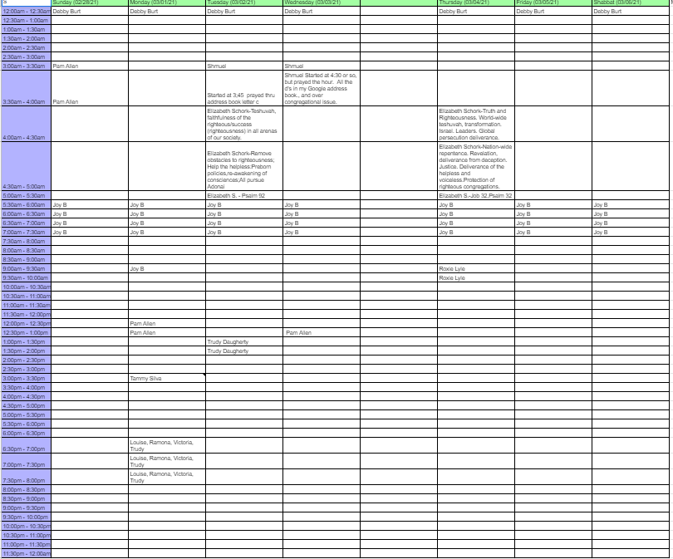
Cyber prayer room is active!
But, not full.

Slide 87
For example…

Slide 88
^{1 Cor. 14.40} Let all things be done in a proper and orderly way.
^{Phil 2.14} Do everything without grumbling or arguing,
In 1780 John Adams wrote, “The new U.S. would be ‘a nation of laws not men.’”
Notes:
https://shows.acast.com/deepstateradio/episodes/rip-a-nation-of-laws-not-men-1780-2019
This may seem to be a trivial example, but it reflects on community

Slide 89
Chili is to be judged on the following criteria:
whole-number score for each category of 0 to 10, with 10 being the highest in each category.

Slide 90
A.) Aroma: it should smell appetizing. A good aroma is a tip off to a good taste.
B.) Appearance: it should look GOOD, tempting to eat.
C.) Texture: it should be a nice combination of ingredients and sauce, not too thick or too thin. Should not be dry, watery, grainy, lumpy, or greasy, but just good and fairly smooth with the exception of meat chunks or beans.

Slide 91
D.) Taste: it should taste good above all else.
E.) Aftertaste: it should have a pleasant taste after swallowing. Aftertaste should not be bitter or metallic. Look for a unique chili recipe, of course, but taste is very important as always!

Slide 92
3rd prize - scored 116
2nd prize - scored 118
1st prize - scored 132

Slide 93
^{1 Cor. 14.40} Let all things be done in a proper and orderly way.
^{Phil 2.14} Do everything without grumbling or arguing,
In 1780 John Adams wrote, “The new U.S. would be ‘a nation of laws not men.’”
Notes:
https://shows.acast.com/deepstateradio/episodes/rip-a-nation-of-laws-not-men-1780-2019

Slide 94
For example…

Slide 95
^{Ester 9.20-22} They were to make [Purim] days of
celebrating and rejoicing,
sending portions [of food] to each other and
giving gifts to the poor.

Slide 96
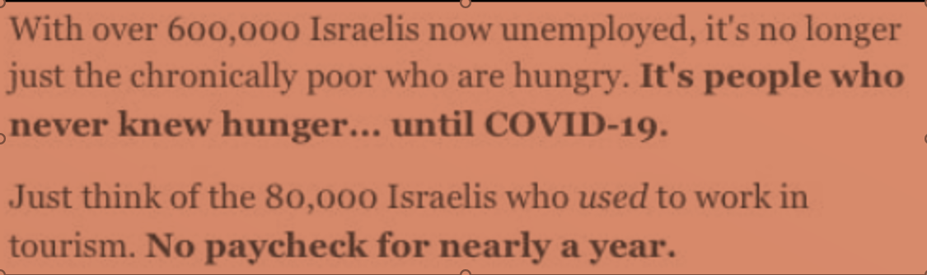
Notes:
https://mail.google.com/mail/u/0/#inbox/FMfcgxwLsdHTNGxzSZQcCgvfkzLZnmhP
Video clip of Israelis stealing in stores, minor amounts. Caught on security cameras, but let go כי need!

Slide 97
Conclusion:

Slide 98
Do you KNOW Him and the assurance of sins forgiven?
Are you surrendered to Him, body, soul, spirit? Fulfilling your covenantal calling?
Are you filled with His Spirit, transforming your life?

Slide 100
