Slide 1
Kids today don't know how easy they have it.
Notes:
Mary Ann Dixon

Slide 2
Kids today don't know how easy they have it. When I was young, I had to walk 9 feet through shag carpet to change the TV channel.
Notes:
Mary Ann Dixon

Slide 3
I love being 70: I learn something new every day
Notes:
Mary Ann Dixon

Slide 4
I love being 70: I learn something new every day and forget 5 other things.
Notes:
Mary Ann Dixon

Slide 5
A thief broke into my house last night. He started searching for money
Notes:
Mary Ann Dixon

Slide 6
A thief broke into my house last night. He started searching for money so I got up and searched with him.
Notes:
Mary Ann Dixon

Slide 7
Just remember, once you're over the hill you begin to pick up speed.
Notes:
Mary Ann Dixon

Slide 8
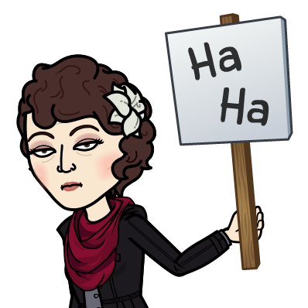

Slide 9
Last message in this series in the Letter to the Messianic Jews / Hebrews / MJ
was about worship furniture of the Messiah.
We considered the pure golden Menorah, pure light…
Notes:
One item of extensive attention last week that makes our light impure is debt…

Slide 10
Correction
Notes:
Mary Ann Dixon

Slide 11
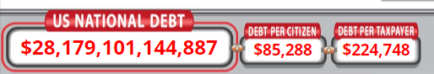
Let’s examine ourselves for purity consistency of truth.
Debt:
Notes:
https://www.usdebtclock.org/
as of April 16, 2021 10 p.m.

Slide 12
Not $28 trillion, but…
True national debt exceeds
$123 trillion, or nearly $800,000 per taxpayer
Notes:
https://www.theepochtimes.com/mkt_morningbrief/true-national-debt-exceeds-123-trillion-or-nearly-800000-per-taxpayer_3782624.html?utm_source=Morningbrief&utm_medium=email&utm_campaign=newsletterguide

Slide 13
America’s national debt now exceeds $123 trillion, according to a new report, or more than four times the official figure of $28 trillion, as calculated by the U.S. Treasury Department at the end of March.
Notes:
https://www.theepochtimes.com/mkt_morningbrief/true-national-debt-exceeds-123-trillion-or-nearly-800000-per-taxpayer_3782624.html?utm_source=Morningbrief&utm_medium=email&utm_campaign=newsletterguide

Slide 14
“Elected and non-elected officials have made repeated financial decisions that have left the federal government with a debt burden of $123.11 trillion, including unfunded Social Security and Medicare promises.”
Notes:
https://www.theepochtimes.com/mkt_morningbrief/true-national-debt-exceeds-123-trillion-or-nearly-800000-per-taxpayer_3782624.html?utm_source=Morningbrief&utm_medium=email&utm_campaign=newsletterguide
I believe in helping the poor. But most of our debt is greed and irresponsibility.
Get out of personal debt!

Slide 15
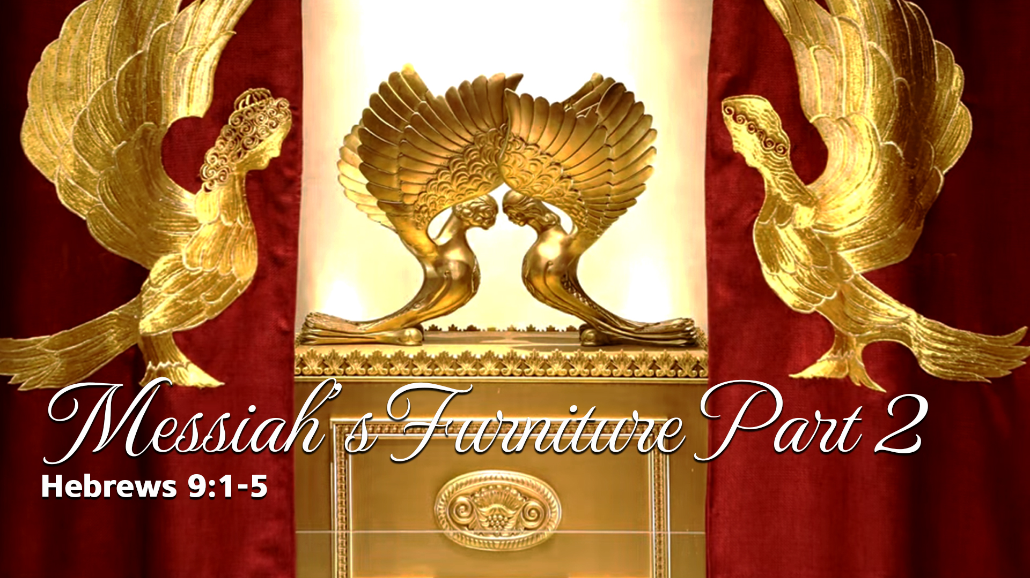
Notes:
https://www.templeinstitute.org/new-location.htm
But first, as Ben Shapiro says….

Slide 16
^{Sanh. 99 a} ‘All the prophets prophesied not but of the days of the Messiah.’
^{Sanh. 98 b} ‘The world was not created but only for the Messiah.’
Notes:
This is not to minimize the importance of the Mishkan/Tabernacle, rather eternally validate it all. In fact, EVERYTHING that we do at Or HaOlam should be focused, motivated by the worship and glorify of King Messiah Yeshua!

Slide 17
^{MJ 9.1-5} Now even the first one [Mishkan/Tabernacle] had regulations for worship and the earthly sanctuary. For a tent was prepared: in the outer part were the menorah, the table, and the presentation of the bread —

Slide 18
^{MJ 9.1-5} this is called the Holy Place. Beyond the second curtain was a dwelling called the Holy of Holies. It held a golden altar of incense and the ark of the covenant, completely covered with gold. In the ark was a golden jar holding the manna,

Slide 19
^{MJ 9.1-5} Aaron’s rod that budded, and the tablets of the covenant and above it, cherubim of glory overshadowing the mercy seat. But it is not now possible to speak in detail about these things.
Notes:
Not for the writer of Mes Jews, but for us, consider the scripture and the history…

Slide 20
There are five historical formulations of this building.
The Mishkan/Tab of Moshe.
The Mishkan/Tab at Shiloh.
The Temple of Solomon.
The Temple of Zerubavel.
The Temple of Herod.
Notes:
Coming, two more…
the Tribulation Temple that the Orthodox Jews will be empowered to build, and the anti-Messiah will take over
The Millennial Temple that Yeshua will reign in, which will STILL have sacrifice…commemorative.

Slide 21
There are five historical formulations of this building.
The Mishkan/Tab of Moshe.
The Mishkan/Tab at Shiloh.
The Temple of Solomon.
The Temple of Zerubavel.
The Temple of Herod.
Notes:
We will mostly be speaking about the Mishkan of Moshe.
Temple Institute graphics are basically about #5
Reference to “first one”

Slide 22
^{MJ 9.2} in the outer part were the menorah, the table, and the presentation of the bread —
Original instructions in the Torah…

Slide 23
^{Shmot/Ex 25. 23-30} “You are to make a table of acacia-wood three feet long, eighteen inches wide and eighteen inches high. Overlay it with pure gold, and put a molding of gold around the top of it. Make around it a rim a handbreadth wide, and put a molding of gold around the rim.

Slide 24
^{Shmot/Ex 25. 23-30} Make four gold rings for it, and attach the rings to the four corners, near its four legs. The rings to hold the poles used to carry the table are to be placed close to the rim. Make the poles of acacia-wood, overlay them with gold, and use them to carry the table.

Slide 25
^{Shmot/Ex 25. 23-30} On the table you are to place the bread of the presence in my presence always.
לֶחֶם פָּנִים לְפָנַי תָּמִיד.
Literally: Bread of Presence
Panim means inner
Also means face
Notes:
Strange title…

Slide 27
From the Showbread Institute:
‘"Panimפנים " face or "inner spirituality“ The hidden secrets of the Showbread Table made by Betzal'el in the Tabernacle and King Solomon in the Temple
Notes:
https://www.showbreadinstitute.org/

Slide 28
and the Showbread baked by the Garmu family during the 2nd Temple period, have remained a mystery for almost 2000 years.’
Maybe not.
Notes:
https://www.showbreadinstitute.org/
But let’s explore the reality of the showbread = bread of Presence.

Slide 29
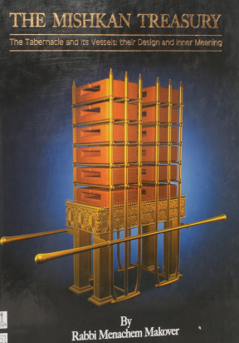
Notes:
Why did it have all that shelving?

Slide 30
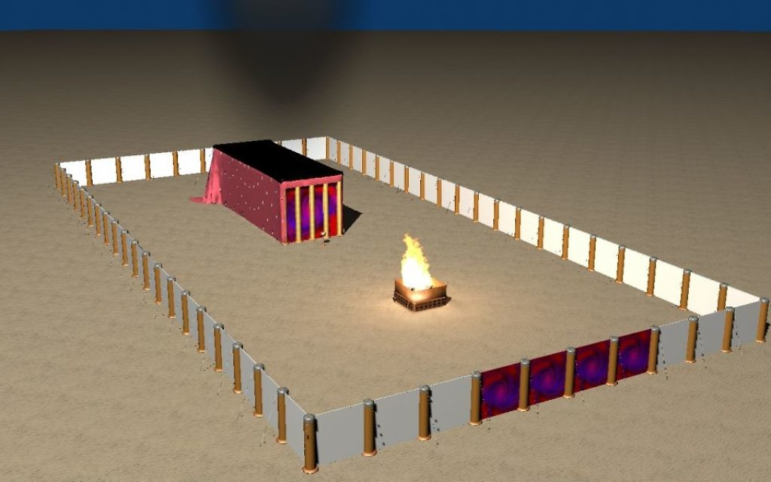
Notes:
https://static.timesofisrael.com/atlantajewishtimes/uploads/2018/02/Tabernacle_Mishkan_Tent-1024x640.jpg

Slide 31
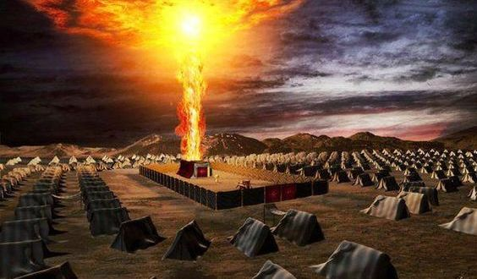
Notes:
https://i1.wp.com/www.torahmusings.com/wp-content/uploads/2018/03/Mishkan-Night.jpg?resize=564%2C330&ssl=1

Slide 32
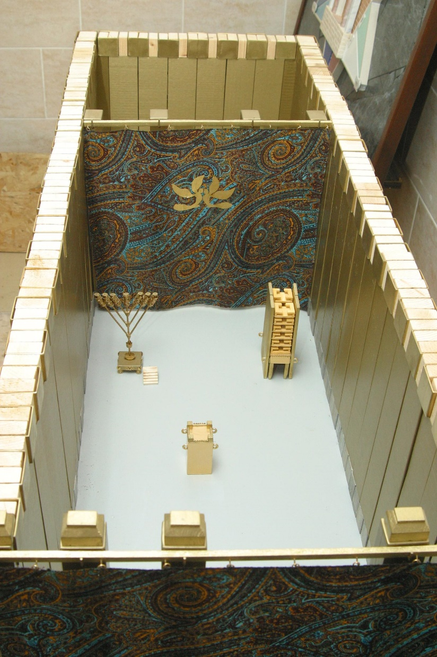
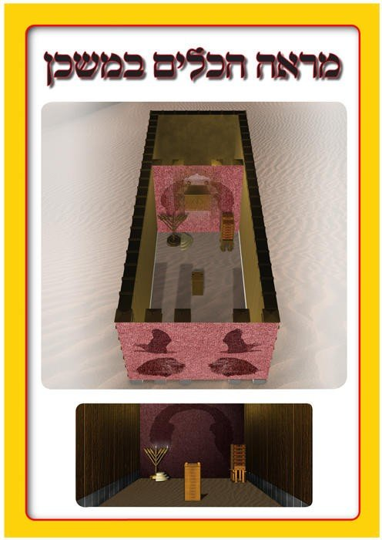
Notes:
https://external-content.duckduckgo.com/iu/?u=https%3A%2F%2Fupload.wikimedia.org%2Fwikipedia%2Fcommons%2F6%2F6b%2FMishkan5_big.jpg&f=1&nofb=1

Slide 33
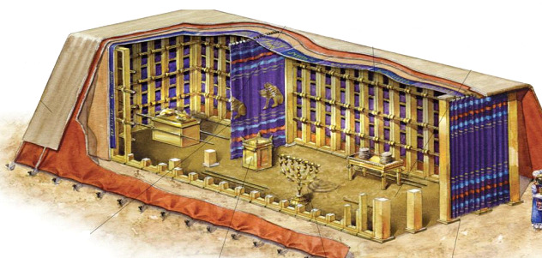
Notes:
http://www.messengerofthename.com/wp-content/uploads/2015/03/Tabernacle1.png
This rendering has a simple table, and simple loaves. One interpretation.

Slide 34
^{Vayikra 24.5-9} “You are to take fine flour and use it to bake twelve loaves,
two tenths [esron עֶשְׂרֹנִים] of an ephah in each cake
שְׁנֵי עֶשְׂרֹנִים יִהְיֶה הַחַלָּה הָאֶחָת
5 lbs flour / loaf !!
Notes:
one gallon per loaf = שְׁנֵי עֶשְׂרֹנִים יִהְיֶה, הַחַלָּה הָאֶחָת
עֶשְׂרֹנִים = עֲשִׂירִית הָאֵיפָה Numbers 28:5; i.e = עֹמֶר
e•phah ē′fə, ĕf′ä n. An ancient Hebrew unit of dry measure, equal to a tenth of a homer or about one bushel (35 liters)
"two tenth parts of an ephah" of flour (Leviticus 24:5–6) (approx 4.9 pounds). [https://en.wikipedia.org/wiki/Showbread

Slide 35
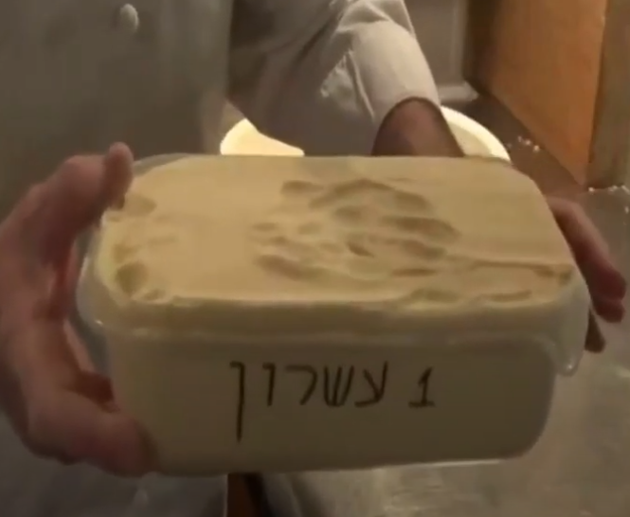
two tenths [esronim עֶשְׂרֹנִים] of an ephah in each cake
Notes:
Two of the above in each loaf of weekly showbread/ bread of Presence
https://youtu.be/olpLEGY5qDo?t=2325
https://www.youtube.com/watch?v=olpLEGY5qDo

Slide 36
5 lb bag flour = ~18 cups
~4 cups in a typical loaf of bread
These loaves were 4x the amount of flour we normally see!

Slide 37
^{Vayikra 24.5-9} Arrange them in two rows, six in a row, on the pure table before Adoni. Put frankincense with each row to be an offering made by fire to Adoni in place of the bread and as a reminder of it.

Slide 38
Josephus states that the cakes were placed in two equal piles (rather than rows), as does the Mishnah, which describes the existence of hollow golden tubes to carry air between the bread, and two golden fork-shaped supports attached to the table, each one to hold up a pile.
Notes:
https://en.wikipedia.org/wiki/Showbread

Slide 39
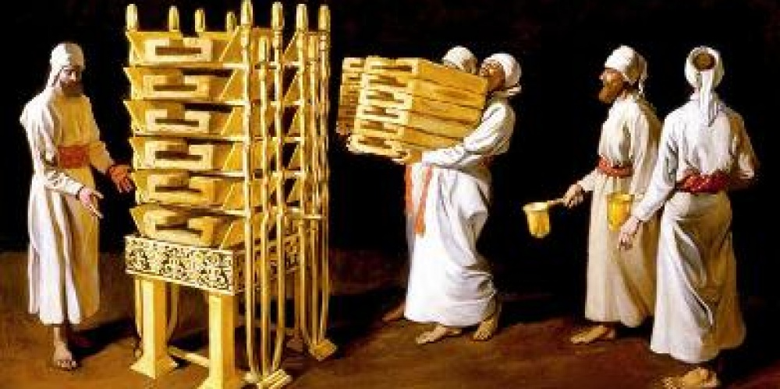
Notes:
https://www.torahinmotion.org/sites/default/files/styles/blog_image_full/public/Arranging_the_Showbread_2.jpg?itok=1z9JPfB5

Slide 40
^{Vayikra 24.5-9} Regularly, every Shabbat, he is to arrange them before Adoni ; they are from the people of Isra’el, as a covenant forever. They will belong to Aharon and his sons; and they are to eat them in a holy place; because for him they are, of the offerings for Adoni made by fire, especially holy. This is a permanent law.”

Slide 41
Solomons expansion:
Divrai HaYamim ב / 2 Chron 4.7-10 He also made ten tables and placed them in the Temple, five on the right side and five on the left.
Plus the original in the front.

Slide 42
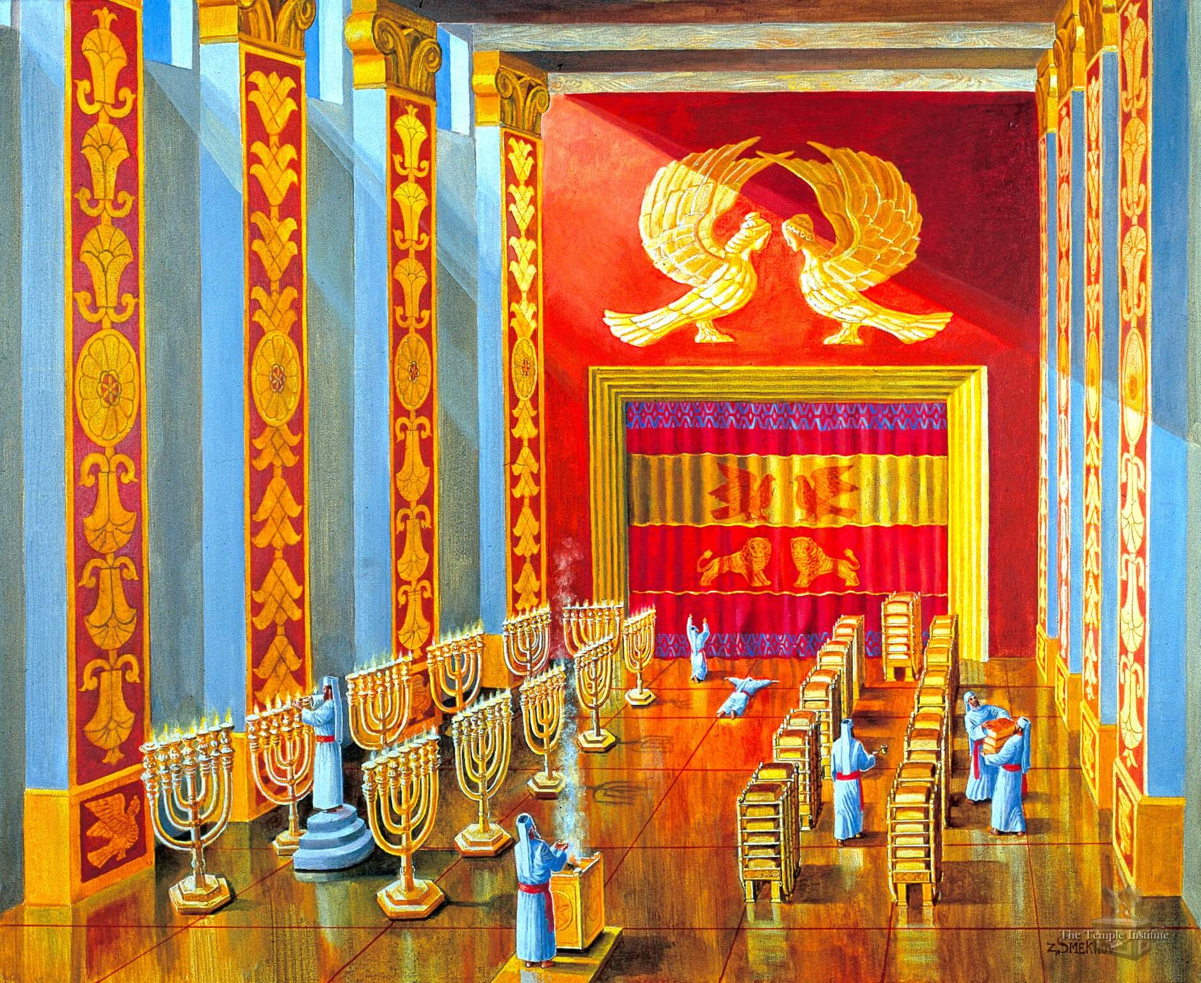
Solomon’s Temple had 10 additional
bread tables
and 10 added menorot
Notes:
https://templeinstitute.org/illustrated-tour-the-mikdash-sanctuary/
In addition to the original Menorah and Showbread Table from the time of the Tabernacle, King Solomon added another ten Menorot and ten Showbread Tables.

Slide 43
The Mishnah states that to replace the bread, two priests would enter the sanctuary ahead of another four priests carrying the replacement bread; the two priests without the bread would go to the southern end of the table,
Notes:
https://en.wikipedia.org/wiki/Showbread#cite_note-9

Slide 44
while those with the new bread would go to the northern end, and while the priests at the south removed the old bread from the table, it would be replaced with the new bread by the priests at the northern side, so that the bread would always be present.
Notes:
https://en.wikipedia.org/wiki/Showbread#cite_note-9
That means this bread was ALWAYS in the environment of the Shekhinah, and the incense.

Slide 45
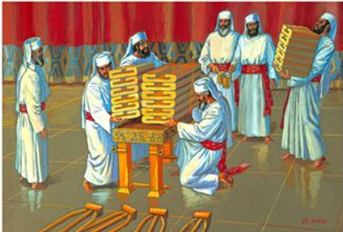

Slide 46
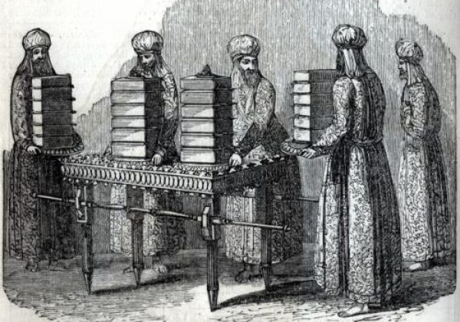
Notes:
Baked on Friday and replaced for Shabbat. Eaten by Cohanim.
David and his men, pursued by murderous King Saul, had some of this.

Slide 47
^{1 Shmuel 21.4-7} So now, what do you have on hand? Give me five loaves of bread or whatever can be found.” The kohen answered David saying, “There is no common bread on hand, but there is consecrated bread לֶחֶם קֹדֶשׁ lekhem kodesh —so long as the young men have kept themselves from women.”
Notes:
in a ritually pure state,

Slide 48
^{1 Shmuel 21.4-7} “Of course women have been kept from us, as on previous campaigns,” David answered the kohen. So the kohen gave him consecrated bread לֶחֶם קֹדֶשׁ lekhem kodesh, for there was no bread there but the bread of the Presence, which was taken out from the presence of Adoni in order to replace it with hot bread on the day it was taken away.

Slide 49
The Showbread Institute was established in 2018 by Eliezer Meir Saidel, a master baker by profession, after many years of research into the Meal Offerings of the Temple and particularly the Showbread.
Notes:
https://www.showbreadinstitute.org/

Slide 50
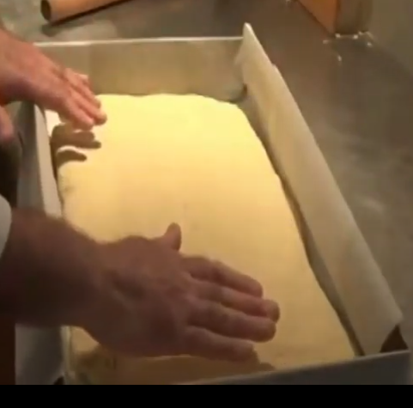
One esron loaf for Shavuot
Notes:
https://www.youtube.com/watch?v=olpLEGY5qDo

Slide 51
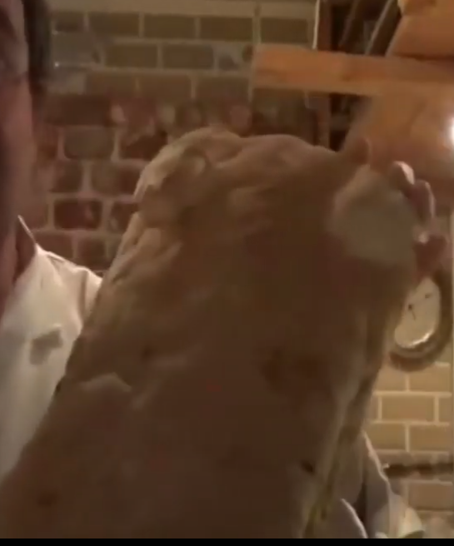
One esron loaf for Shavuot, half the size of the showbread = bread of the Presence
Notes:
https://www.youtube.com/watch?v=olpLEGY5qDo
https://youtu.be/olpLEGY5qDo?t=3858

Slide 52
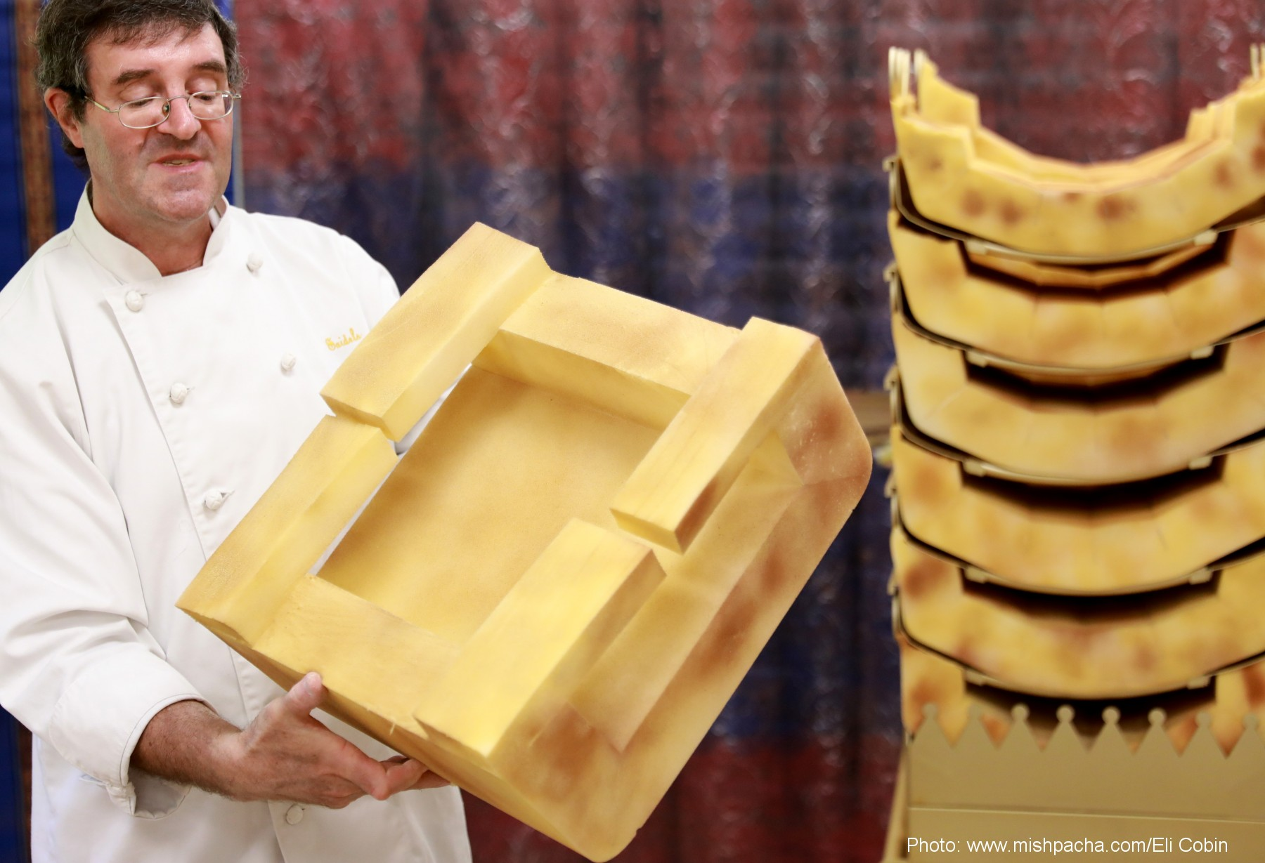
Notes:
https://external-content.duckduckgo.com/iu/?u=https%3A%2F%2Fwww.showbreadinstitute.org%2Fimages%2Ful240756%2Fda7fbd8ac1d6a5273f8474c42c5d2acd.jpg&f=1&nofb=1

Slide 53
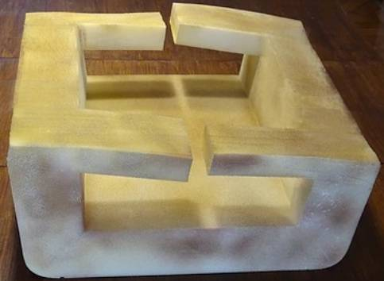

Slide 54
In a Mishna (Menahot 96a) it states –
“The Showbread is ten [tefakhim / handbreadths] long and 5 [tefachim/handbreadths] wide and its “kranot” are 7 eztbaot (finger widths)”.
Notes:
https://www.showbreadinstitute.org/

Slide 55
Rashi (ibid.) in reference to the Two Loaves offering says – “Its ‘kranot’ קרנות : that he would stick dough on each corner זוית of the bread, like horns קרניים and the length of each horn קרן is 4 finger widths”.
Notes:
https://www.showbreadinstitute. /

Slide 56
And later on he continues regarding the Showbread – “That it should have ‘panim’ פנים: flanks/sides. [another version] corners זָוִיות and they are the ‘kranotקרנות ’”
Notes:
https://www.showbreadinstitute.org/

Slide 57
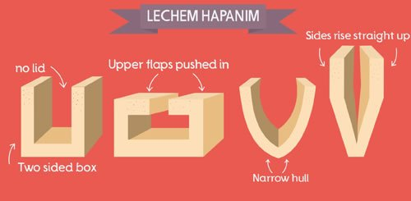
Notes:
https://w3.chabad.org/media/images/894/RxVK8943560.jpg
Why so huge?
Abundance. G-d desires us to live in abundance.
Prosperity? Maybe, but first an foremost, inner.

Slide 58
^{Eph 3.16-21} I pray that from His glorious riches He would grant you to be strengthened in your inner being with power through His Ruakh, so that Messiah may dwell in your hearts through faith. I pray that you, being rooted and grounded in love,

Slide 59
^{Eph 3.16-21} may have strength to grasp with all the kedoshim what is the width and length and height and depth, and to know the love of Messiah which surpasses knowledge, so you may be filled up with all the fullness of God. Now to Him who is able to do far beyond all that we ask or imagine,

Slide 60
^{Eph 3.16-21} by means of His power that works in us, to Him be the glory in the community of believers and in Messiah Yeshua throughout all generations forever and ever! Amen.

Slide 61
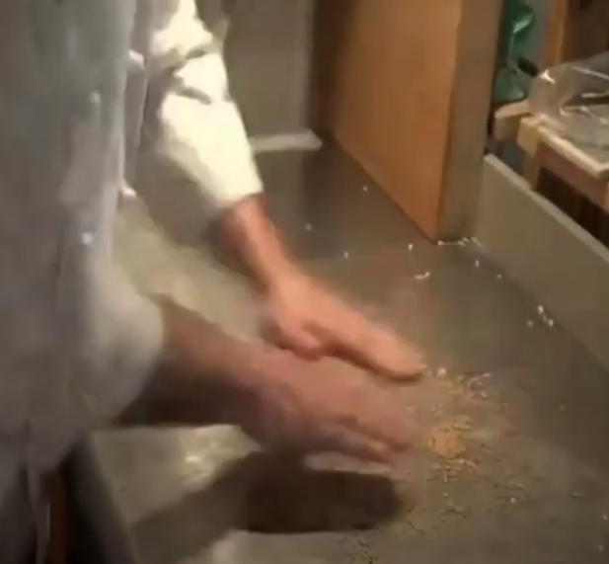
Punishing the grain
Notes:
https://www.showbreadinstitute.org/

Slide 62
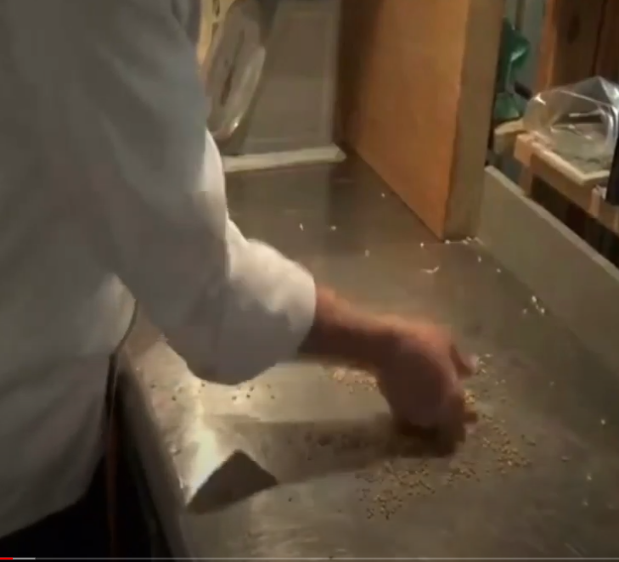
Beating the grain 500x
Notes:
https://www.showbreadinstitute.org/

Slide 63
^{Yn 12.24-25} Amen, amen I tell you, unless a grain of wheat falls to the earth and dies, it remains alone. But if it dies, it produces much fruit. He who loves his life will lose it, and the one who hates his life in this world will keep it forever.
Notes:
https://www.showbreadinstitute.org/
Yeshua is here discussing the grain becoming seed and growing a crop.
Similar concept if grain to become bread.
Similar for you and me. “If G-d wants to use a man or woman, he has to wound him first.”

Slide 64
Also, Manna
Gather every morning
Special provision on Shabbat
Certain divine monotony. Like monogamy. Red Hot Mongamy

Slide 65
Yeshua said to them, “I am the bread of life. Whoever comes to Me will never be hungry, and whoever believes in Me will never be thirsty.
"Panimפנים " face or "inner spirituality“
Notes:
Get it through the authorities!
Get it with inner truth.
Ps 51 Still, you want truth in the inner person; so make me know wisdom in my inmost heart. Ellel

Slide 66
^{Yn 6.28-40} Then they said to Him, “What shall we do to perform the works of God?” Yeshua answered them, “This is the work of God, to trust in the One He sent.” So they said to Him, “Then what sign do You perform, so that we may see and believe You? What work do You do?

Slide 67
^{Yn 6.28-40} Our fathers ate the manna in the wilderness; as it is written, ‘Out of heaven He gave them bread to eat.’” Yeshua answered them, “Amen, amen I tell you, it isn’t Moses who has given you bread from heaven, but My Father gives you the true bread from heaven. For the bread of God

Slide 68
^{Yn 6.28-40} is the One coming down from heaven and giving life to the world.” So they said to Him, “Sir, give us this bread from now on!” Yeshua said to them, “I am the bread of life. Whoever comes to Me will never be hungry, and whoever believes in Me will never be thirsty. But I told you that you have seen Me, yet you do not believe.
Notes:
New or old, starter or veteran, increased faith!

Slide 69
^{Yn 6.28-40} Everyone the Father gives Me will come to Me, and anyone coming to Me I will never reject. For I have come down from heaven not to do My own will but the will of the One who sent Me. “Now this is the will of the One who sent Me,

Slide 70
^{Yn 6.28-40} that I lose not one of all He has given Me, but raise each one on the last day. For this is the will of My Father, that everyone who sees the Son and trusts in Him may have eternal life; and I will raise him up on the last day.”
Notes:
Here is the discussion summary of John Piper’s son, of Ravi Zacharias tragic end.
Keep full of His Bread!!

Slide 71
^{Kohelet/Ecc 11.1} Cast your bread upon the waters, for after many days you will find it.
שַׁלַּח לַחְמְךָ, עַל-פְּנֵי הַמָּיִם: כִּי-בְרֹב הַיָּמִים, תִּמְצָאֶנּוּ.
Send your resources out over the seas; eventually you will reap a return.
Notes:
There are many outreach things we could be doing.
20% of the people do 80% of the work.
20% of the people give 80 of the money.
We don’t come to faith to only eat the bread, but to share it.

Slide 72
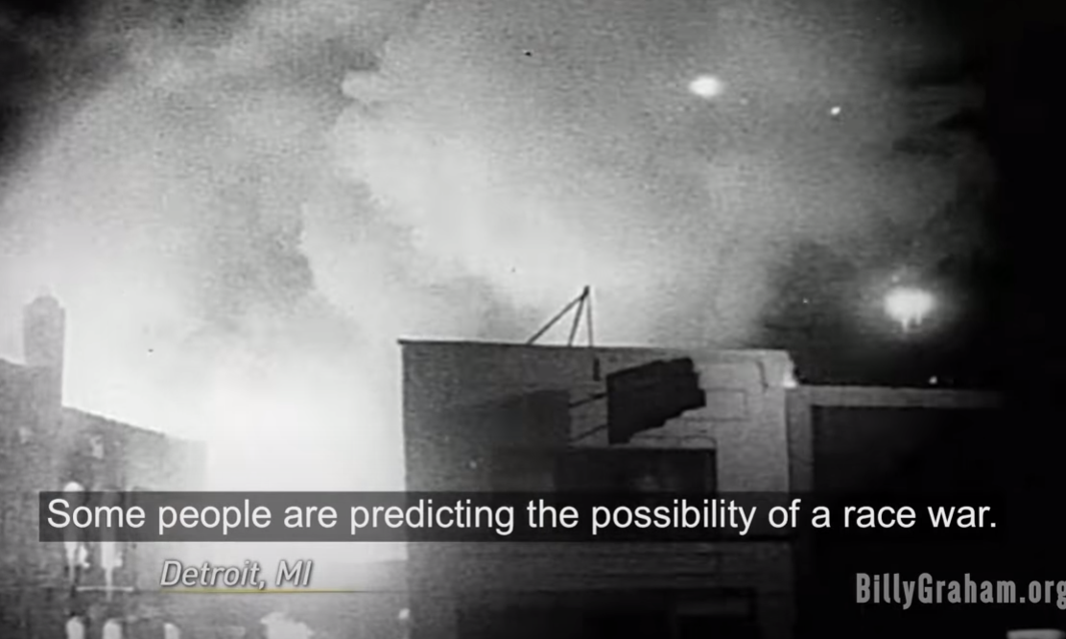
1960’s

Slide 73
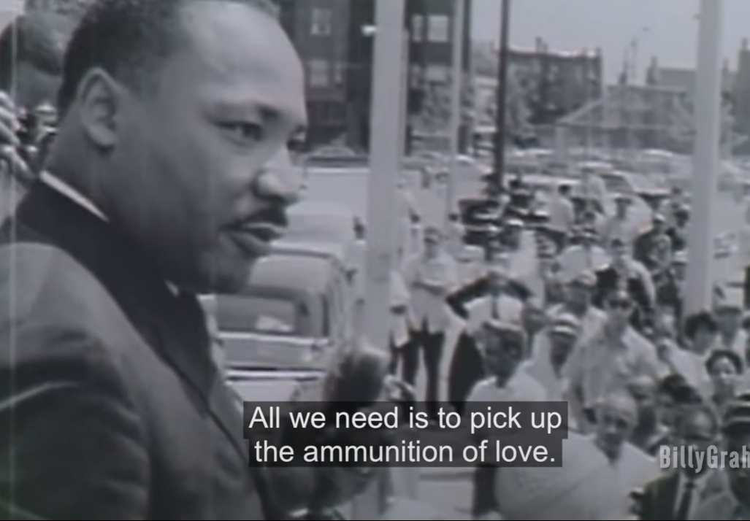

Slide 74
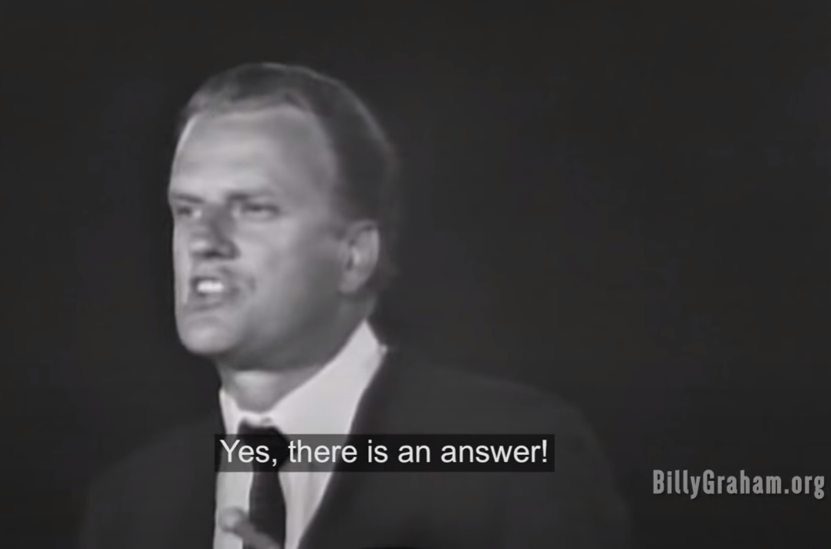

Slide 75
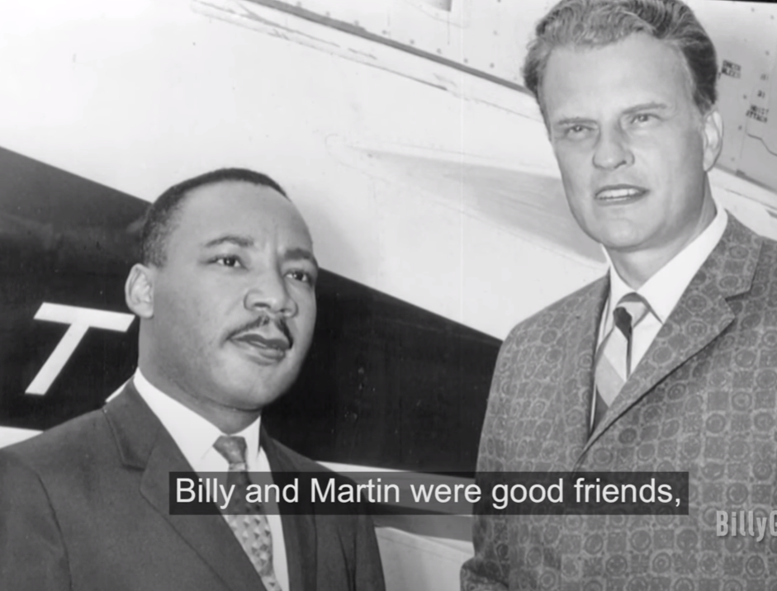

Slide 76
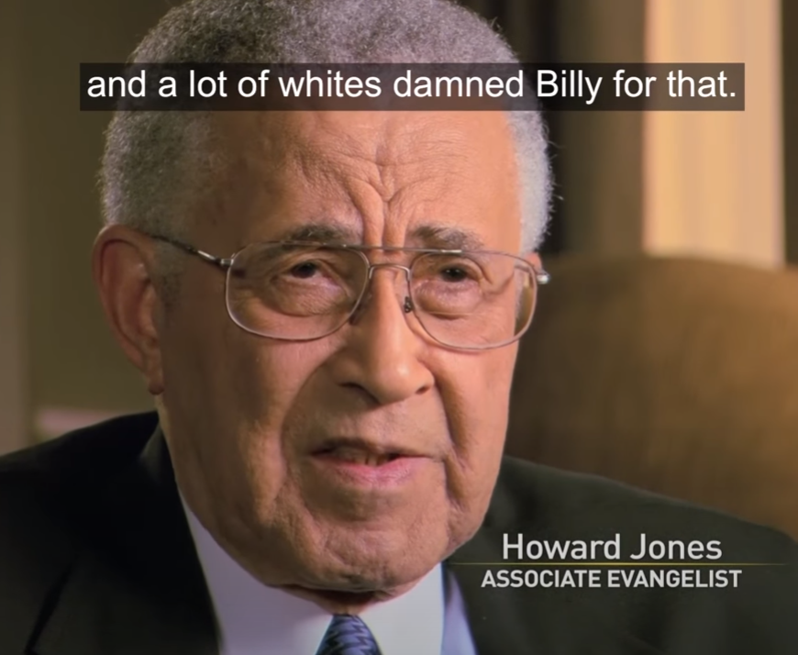

Slide 77
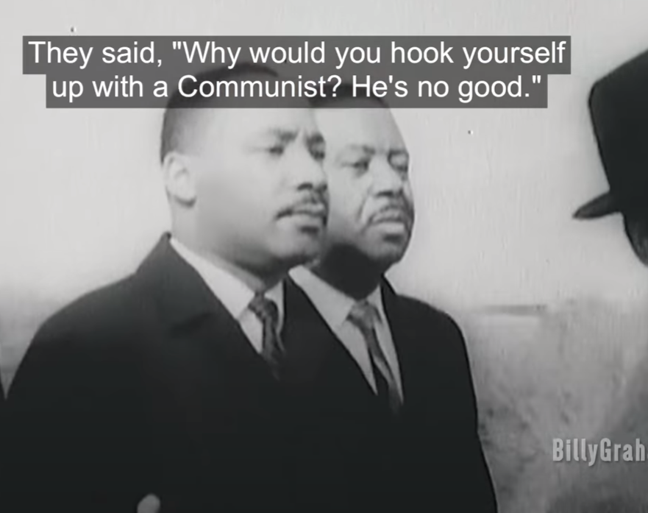

Slide 78
^{MJ 9.2b} For a tent was prepared: in the outer part were…the presentation of the bread —this is called the Holy Place
Notes:
Presentation = inner bread, inner truth, of light before Yeshua

Slide 79
But we often get into a rut, miss the inner bread of the Presence.
Skip the hidden bread.
Gloss over inner sin
Miss or don’t seek opportunities to share the Bread.

Slide 81
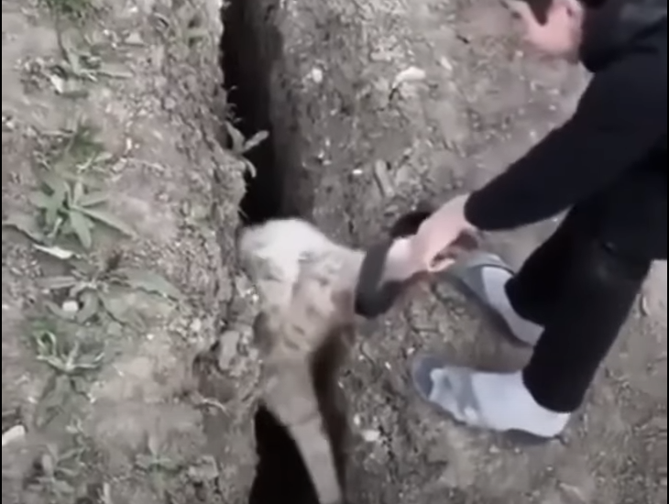
Same ol’ same ol’
Notes:
https://youtu.be/T-Wc8vluyp0

Slide 82
Does that hit home with you, too? I see that sheep struggle free, bound away, soar eagerly into the air –and straight back to where it was before. There is a wincing realization that this is so often me. (And that the Bible’s description of us as “sheep” is not a compliment!)
Notes:
https://shaunti.us7.list-manage.com/track/click?u=fb85a6a1934ba4e14bd874fd9&id=9420acd1d4&e=fec1a78175

Slide 83
Doing something repeatedly forms those neural pathways
Practice, practice, practice the thoughts or actions that you want to make “your” gully.
Notes:
Daily bread: receive and share.

Slide 84
Are we getting filled with His bread, His presence, daily?
Are we sharing His bread?

Slide 85
Do you KNOW Him and the assurance of sins forgiven?
Are you surrendered to Him?
Are you filled with His Spirit, transforming your life?
Are you seeking to win others?

Slide 86


