Slide 1
e-handout
To have these notes
without taking notes
Go to OrHaOlam.com
Click on downloads,
messages, 2021

Slide 2
The Ruakh / wind defends Israeli honor…

Slide 3
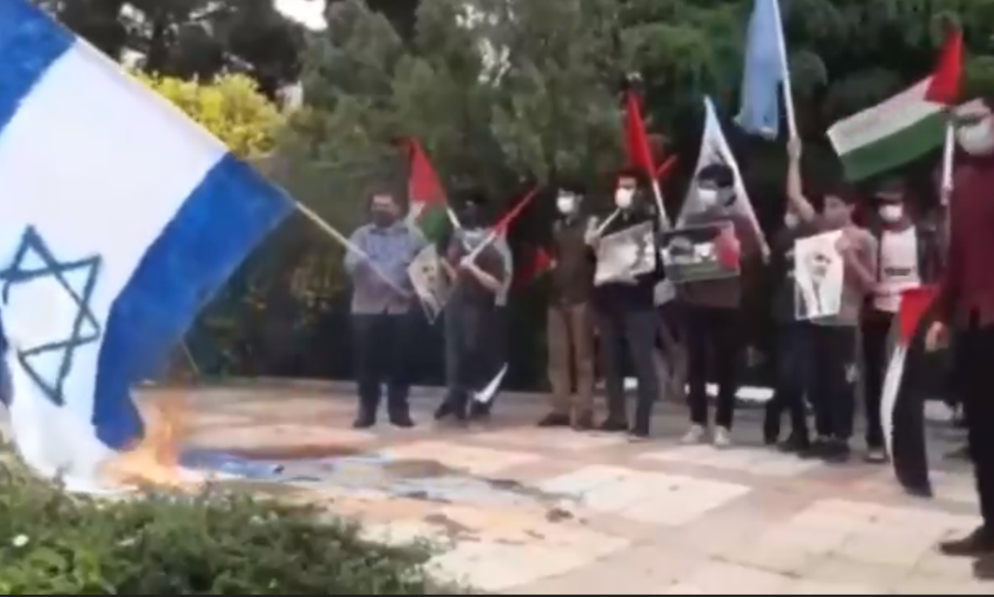
Notes:
https://worthy.watch/be-careful-if-you-decide-to-burn-a-flag
Interesting signs at an airport…

Slide 4
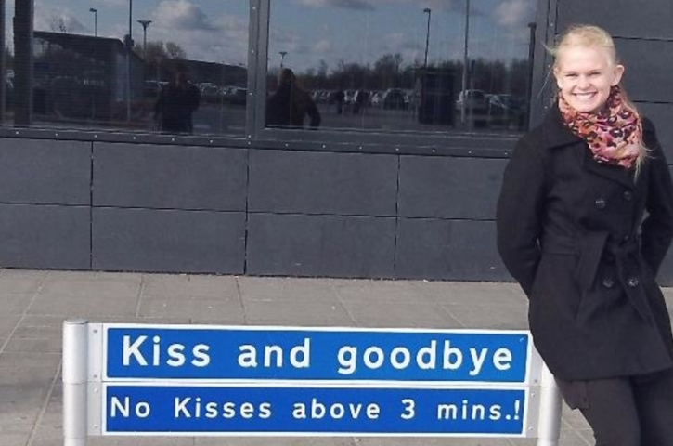
Notes:
https://www.lifestyle-a2z.com/the-most-hilarious-photos-captured-at-the-airport-3/7/?xcmg=1

Slide 5
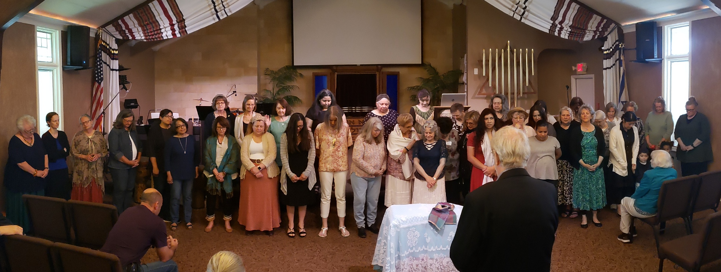
Mother’s Day 2021

Slide 6
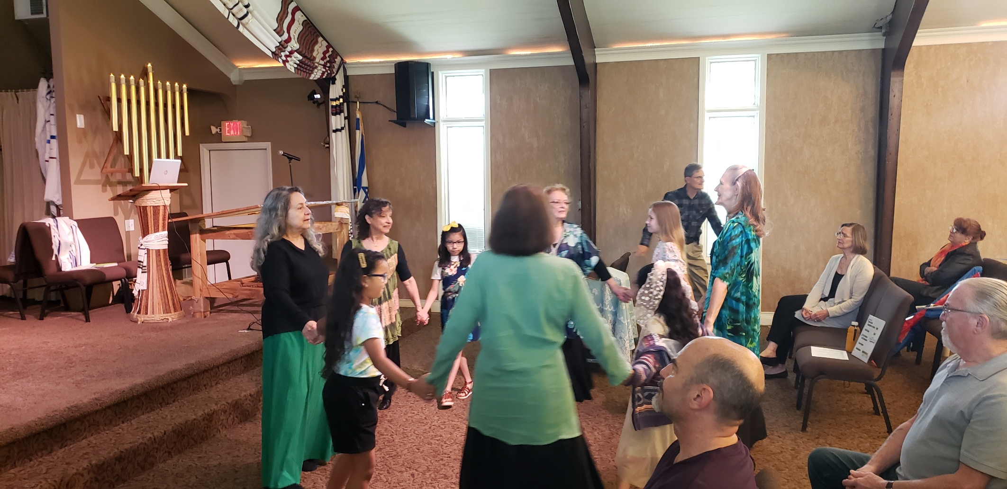
L’dor vador dance, from
generation to generation

Slide 7
Shavuot
Messianic terminology innovation

Slide 8
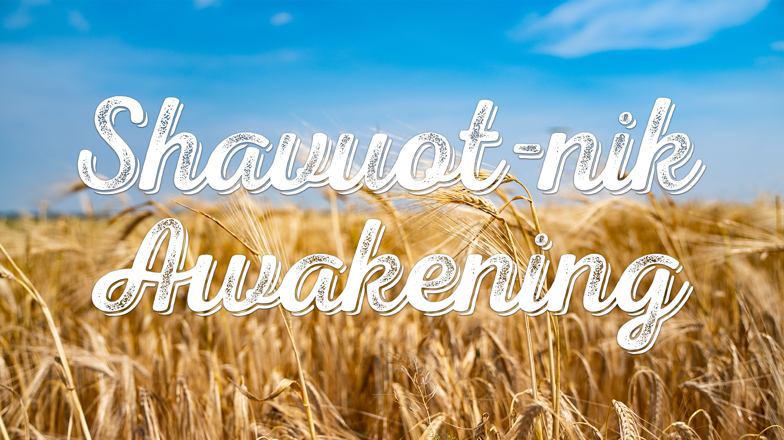

Slide 9
The term Shavuotnik
How to become one amidst adversity
Adversity in the US
Adversity in Israel

Slide 10
The term “Pentecostal” is derived from Pentecost [50] = Shavuot [weeks] an event that commemorates the descent of the Holy Spirit upon the followers of the Messiah Yeshua, and the speaking in "foreign" tongues.
Notes:
So, we are sort of “Pentecostal”

Slide 11
Pentacost [50] = Shavuot [wks]
Notes:
So, we are sort of “Pentecostal”

Slide 12
Pentacost [50] = Shavuot [wks]
Pentacostal = Shvuotniks
Notes:
So, we are “Shavuotniks”
If someone asks what is Or HaOlam’s theology, tell them we are Shavuotniks.

Slide 13
The English suffix -nik is of Slavic origin. It approximately corresponds to the suffix "-er" and nearly always denotes an agent noun.
Beatnik
Refusenik
Notes:
https://en.wikipedia.org/wiki/-nik

Slide 14
Neatnik: a neat-freak
Nogoodnik: a lazy, incompetent or malicious person
Peacenik: a pacifist; a hippie
Rudenik: a rude person
Wordnik
Notes:
https://en.wikipedia.org/wiki/-nik
Plural neatnikim accent on the last syllable

Slide 15
Jewish adaptation:
Chabadnik follower of Chabad
Jobnik: a non-combat soldier who performs secretarial work
Kibbutznik: member of a Kibbutz
Lamedvavnik ל"ו = 30 + 6
36 righteous
Notes:
R Abaye says: The world has no fewer than thirty-six righteous people in each generation who greet the Divine Presence every day, as it is stated: “Happy are all they that wait for Him [lo]” (Isaiah 30:18)? The numerological value of lo, spelled lamed vav, is thirty-six, alluding to the fact that there are at least thirty-six full-fledged righteous individuals in each generation. Sukkah 45b

Slide 16
Likudnik: supporter of Israeli political party Likud
Moshavnik: member of a Moshav
Mossadnik: Mossad agent
Nudnik: a nagging, boring or awkward person

Slide 17
Shvuotnik = someone whose life is centered on the working of the of Shavuot reality: Ruakh / Spirit given to us in abundance on Shavuot, because of the Atonement of the Messiah Yeshua!
Notes:
And connected to Jewish covenantal identity!
Context of Shavuot:
^{Viyikra/Lev 23.16-18} The day after the seventh week; you are to count fifty days; and then you are to present a new grain offering to Adonai. You must bring bread from your homes for waving — two loaves made with one gallon of fine flour, baked with leaven — as firstfruits for Adonai. Along with the bread
Then Torah כי Sinai on Shavuot. Torah is the milk of the Word, so dairy.
Then the Ruakh.

Slide 20
The term Shavuotnik
How to become one amidst adversity
Adversity in the US
Adversity in Israel

Slide 21
^{Acts 2.1-4} When the day of Shavuot had come

Slide 22


from sum and pléroó, to fill up completely, hence to fulfill
Notes:
Seems to imply counting up to it, ie the Omer count…In their days, it really was a wheat crop marked and counted. Wheat crop a big deal. We will have a wheat bread procession later.

Slide 23
^{Acts 2.1-4} they were all together in one place.

Slide 24
John Gill: They were very unanimous and peaceable; there were no jars nor contentions among them; they were of the same mind and judgment in faith and practice, and of one heart and soul, and had a cordial affection for one another;
Notes:
https://www.biblestudytools.com/commentaries/gills-exposition-of-the-bible/acts-2-1.html
Are we like that? Or HaOlam?

Slide 25
We have a wide variety of differing opinions on many issues at Or HaOlam. All of them are important and seemingly irreconcilable. All the opinions are strongly supported by scientists, historians, scholars. But, we maintain fellowship.

Slide 26
Yeshua coming any time | Yeshua coming after tribulation
Masking is helpful | Masking is bad
Election stolen | Crutch removed
Tongues is Spirit | Tongues is satanic
Vaccine is bad | Vaccine is needed
Old earth creationism | 7 literal days.
Notes:
Some fervently feel that Yeshua will return in a pre-Trib Rapture. Some fervently feel that we must be ready to walk through the Great Tribulation.
Some fervently feel that masks and separation are vital. Some think that masks are ineffective and counterproductive.
So, some fervently feel the election was stolen. Some think that this idea of the election steal is insane paranoia. Messiah Mag article.
Some fervently feel that we should speak in glossolalia, unknown tongues, as evidence of being filled with the Spirit, or of salvation. Some think that tongues are of the devil.
Some fervently feel that the vaccine is important. Some fervently feel that the vaccine is a death trap or close.

Slide 27
So, how do we survive?
^{Mtt. 17.10-12} The talmidim asked him, “Then why do the Torah-teachers say that Eliyahu must come first?” He answered, “On the one hand, Eliyahu is coming and will restore all things; on the other hand,

Slide 28
^{Mtt. 17.10-12} I tell you that Eliyahu has come already, and people did not recognize him but did whatever they pleased to him. In the same way, the Son of Man too is about to suffer at their hands.”

Slide 29
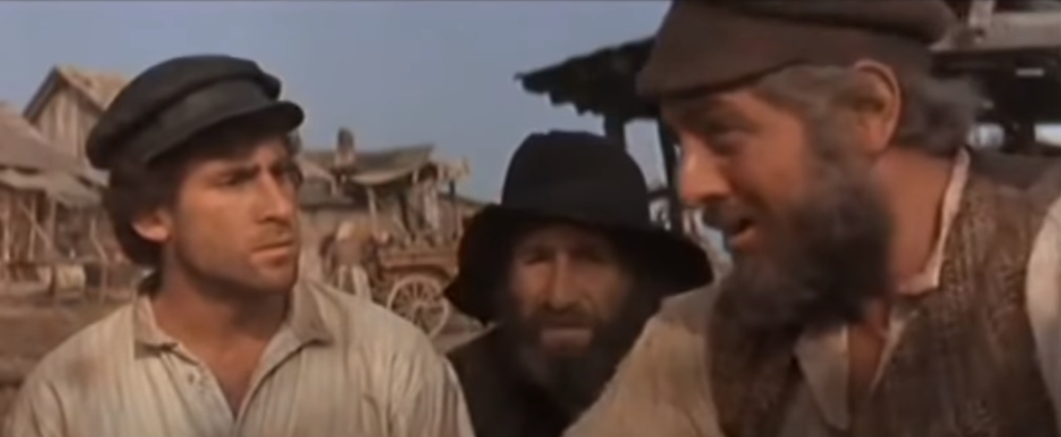
Notes:
https://www.youtube.com/watch?v=s7RmcdHrYuk better sound
https://www.youtube.com/watch?v=lN5EKyNNaZ0 better graphics

Slide 30
There is ambiguity in the Kingdom. We don’t know all the particulars.

Slide 31
^{Eph. 4.2-3} Always be humble, gentle and patient, bearing with one another in love, and making every effort to preserve the unity the Spirit gives through the binding power of shalom.

Slide 32
^{Eph. 431-32} Get rid of all bitterness and rage and anger and quarreling and slander, along with all malice. Instead, be kind to one another, compassionate, forgiving each other just as God in Messiah also forgave you.

Slide 33
^{Acts 2.1-4} they were all together in one place.
Notes:
Consider someone you disagree with.

Slide 34
^{Acts 2.1-4} Suddenly there came from heaven a sound like a mighty rushing wind, and it filled the whole house where they were sitting. And tongues like fire spreading out appeared to them and settled on each one of them.

Slide 35
^{Acts 2.1-4} They were all filled with the Ruakh ha-Kodesh and began to speak in other languages as the Ruakh enabled them to speak out…
Notes:
Without PowerPoint, but power.
Without ProPresenter, but presence…

Slide 36
^{Acts 2.41} …So those who received his message were immersed, and that day about three thousand souls were added.

Slide 38
Shvuotnik = someone whose life is centered on the working of the of Shavuot reality: Ruakh / Spirit given to us in abundance on Shavuot, because of the Atonement of the Messiah Yeshua!
Notes:
And connected to Jewish covenantal identity!
Context of Shavuot:
^{Viyikra/Lev 23.16-18} The day after the seventh week; you are to count fifty days; and then you are to present a new grain offering to Adonai. You must bring bread from your homes for waving — two loaves made with one gallon of fine flour, baked with leaven — as firstfruits for Adonai. Along with the bread
Then Torah כי Sinai on Shavuot. Torah is the milk of the Word, so dairy.
Then the Ruakh.

Slide 39
The term Shavuotnik
How to become one amidst adversity
Adversity in the US
Adversity in Israel

Slide 40
So, how do we enter into this life of the Ruakh / Spirit?
How do we become true Shavuotniks?
Notes:
Above, no contentiousness. Grace, humility. Messiah Mag article: people came to me love it, hate it. Author’s opinion.

Slide 41
^{Acts 2.38-39} “Turn from sin, return to God, and let each of you be immersed in the name of Messiah Yeshua for the removal of your sins, and you will receive the gift of the Ruakh ha-Kodesh. For the promise is for you and your children, and for all who are far away—as many as Adonai our God calls to Himself.”
Notes:
Repenting, reforming, receiving.

Slide 42
^{Acts 3.19-20} “Therefore, repent and turn to God, so that your sins may be erased; so that times of refreshing may come from the Lord’s presence;
Notes:
Repenting, reforming, receiving.

Slide 43
^{Acts 4.24-31} They raised their voices to God with singleness of heart. “Master,” they prayed, “You made heaven, earth, the sea and everything in them. By the Ruach HaKodesh, through the mouth of our father David, your servant, you said, ‘Why did the nations rage and the peoples devise useless plans?

Slide 44
^{Acts 4.24-31} The kings of the earth took their stand; and the rulers assembled together against Adoni and against his Messiah.’ “This has come true in this city, since Herod and Pontius Pilate, with Goyim and the peoples of Isra’el, all assembled against your holy servant Yeshua, whom you made Messiah,

Slide 45
^{Acts 4.24-31} to do what your power and plan had already determined beforehand should happen. “So now, Lord, take note of their threats; and enable your slaves to speak your message with boldness! Stretch out your hand to heal and to do signs and miracles

Slide 46
^{Acts 4.24-31} through the name of your holy servant Yeshua!” While they were still praying, the place where they were gathered was shaken. They were all filled with the Ruakh HaKodesh, and they spoke God’s message with boldness.
Notes:
receiving

Slide 47
They noted that scripture was being fulfilled around them.
They noted that scripture was being fulfilled in opposition and adversity.
They prayed the scripture. Repented and received.
Notes:
We can do that! Pause…

Slide 48
We will do that more Sunday night.
Study Scripture
Worship
Seek G-d amid adversity.
Notes:
Different

Slide 49
It is the practice of the Jewish people generally, and also Or HaOlam, to spend the night of Shavuot in Bible study, worship, and prayer, alternating with a time of dairy, veggies, coffee, ice cream, etc. The time is called
Tikkun Leil Shavuot תקון ליל שבועות
Repair of Shavuot Evening
Notes:
Shir Hashirim Rabbah, ch. 1, pg. 12b Midrash: The morning, when it came time for the Torah to be given, the place was empty. The entire Jewish people had slept in. The Midrash even recounts that Moshe had to wake them—causing G‑d to later lament, “Why have I come and no one is here to receive me?”

Slide 51
7-8:30 Baruch Burt
9-10:30 Brett Clear
11-12.30 Samuel Okello from South Sudan Carole Ward Favor of God Ministries.

Slide 52
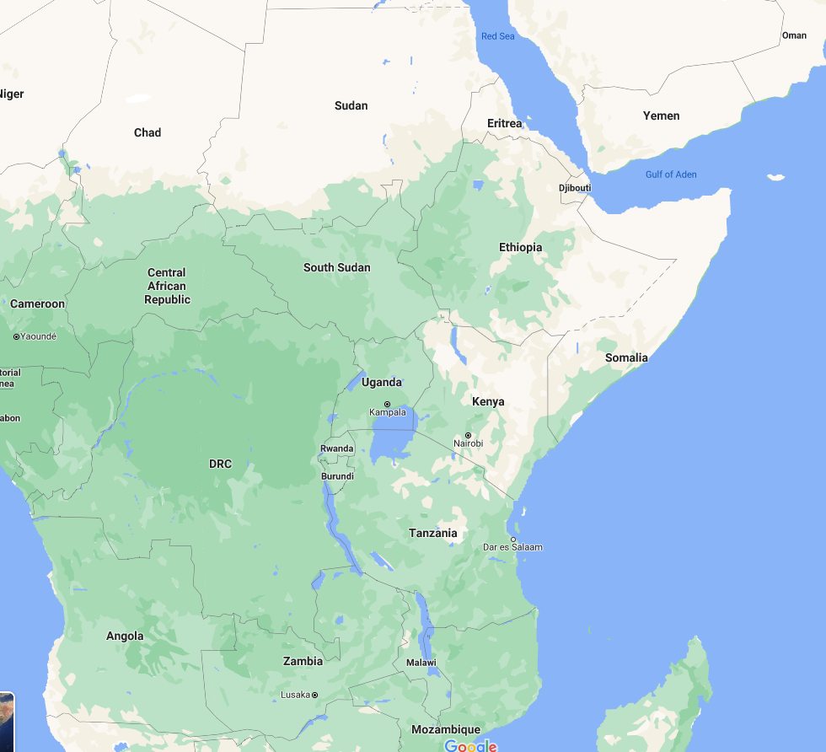

Slide 54
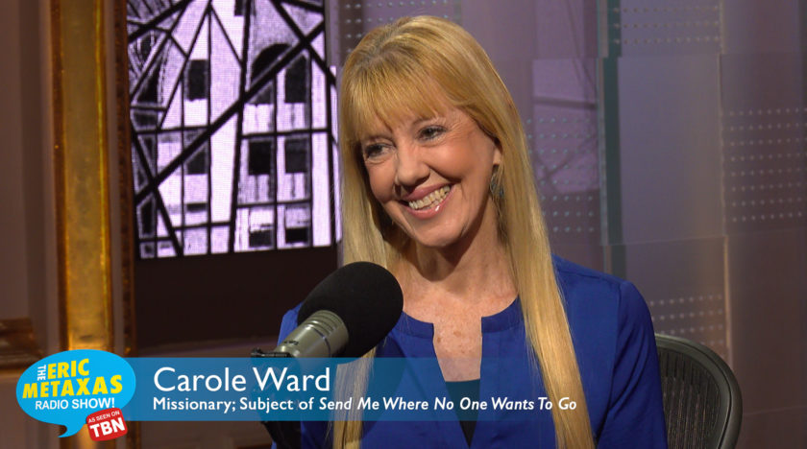

Slide 55
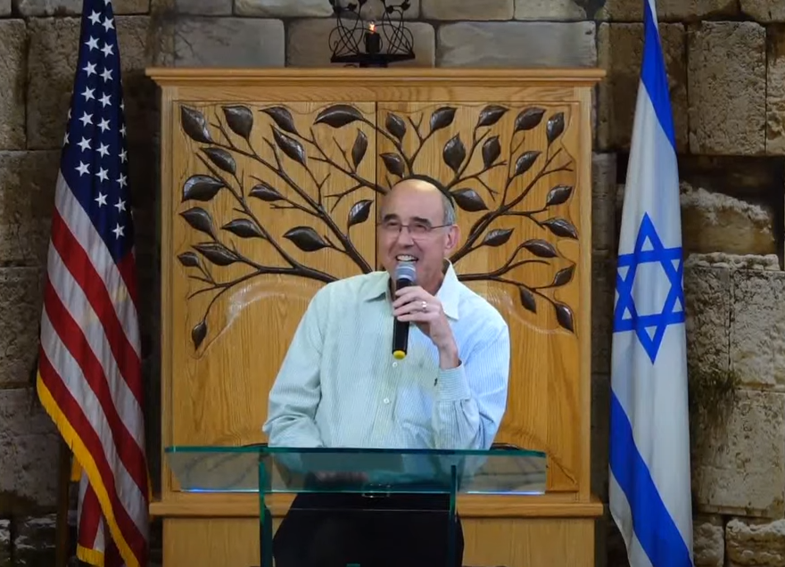
Notes:
Messianic Rabbi Don Goldstein hosting Carole

Slide 56
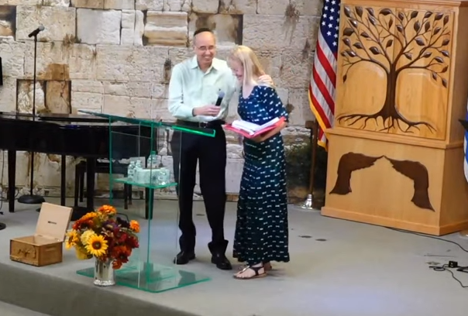

Slide 57
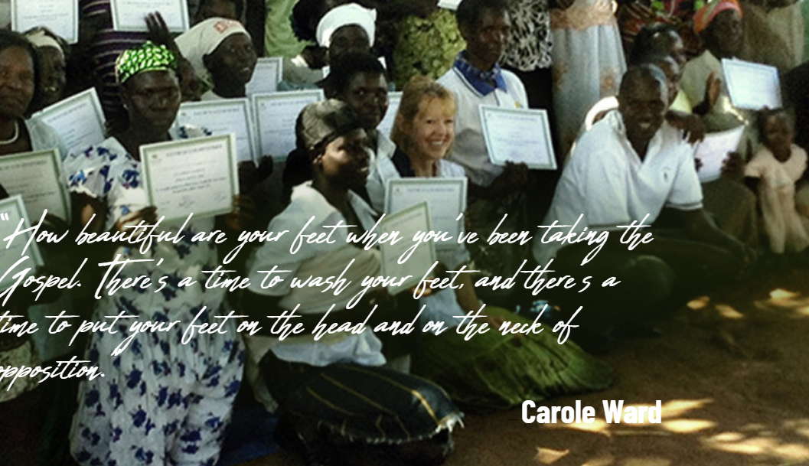
Notes:
P 8-9 Carole’s background,
12-14 Call to Uganda Joseph Kony territory. LRA
3 day stadium prayer 2005
56 Satanic fires burn one hut, not next one
60 five witch doctors repented
83 thirteen year old
88-89 Ochan 20 years Israeli trained fighter pilot, then 20 years LRA

Slide 59
Are we in a time of adversity?

Slide 60
The term Shavuotnik
How to become one amidst adversity
Adversity in the US
Adversity in Israel

Slide 61
Are there spiritual issues to fight for?
Some with political overtones!

Slide 62
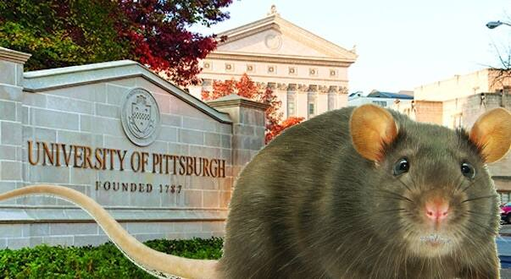
Transplanting scalps of aborted
babies onto rodents raises ethical
concerns.
Notes:
https://metrovoicenews.com/transplanting-scalps-of-aborted-babies-onto-rodents-raises-ethical-concerns/

Slide 63
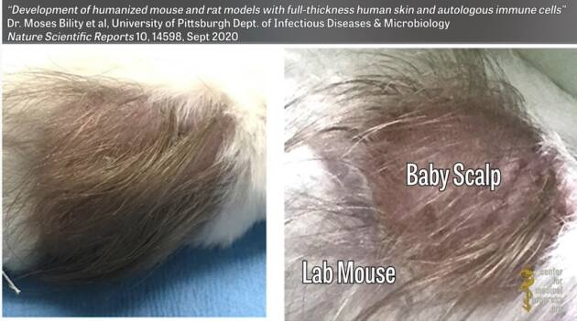
Notes:
https://metrovoicenews.com/transplanting-scalps-of-aborted-babies-onto-rodents-raises-ethical-concerns/

Slide 64
The Pennsylvania Family Institute letter :
“We call on the University of Pittsburgh to stop all experimentation on aborted babies and the inhumane practice of grafting their skin and body parts onto rodents,” it says.
Notes:
https://metrovoicenews.com/transplanting-scalps-of-aborted-babies-onto-rodents-raises-ethical-concerns/

Slide 65
They urged the state legislature to conduct a full investigation of the university, Planned Parenthood and other groups involved in the experiments. “This ghastly finding is a product of Pitt’s systemic practices of using aborted babies for inhumane research,” they wrote.
Notes:
https://metrovoicenews.com/transplanting-scalps-of-aborted-babies-onto-rodents-raises-ethical-concerns/

Slide 66
“Pitt has been involved in hundreds of fetal kidneys and other organs from aborted babies being distributed for research as part of a project funded by the National Institute of Health. Pitt has also had scientists harvesting fetal livers ‘in vivo’ from fetuses delivered via labor induction.”
Notes:
https://metrovoicenews.com/transplanting-scalps-of-aborted-babies-onto-rodents-raises-ethical-concerns/
More info on U Pitt experiments at
https://youtu.be/c-JUzqswKZs

Slide 67
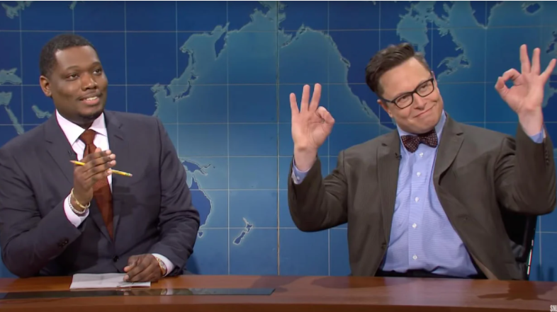
Elon Musk on Saturday Night Live
Notes:
https://www.theblaze.com/news/writer-elon-musk-burns-alive-ok-sign

Slide 68
Daisy Barringer, a self-proclaimed freelance editor and writer who is verified on Twitter, said that she hoped Tesla CEO Elon Musk would burn to death in one of his Teslas after she insisted he flashed
Notes:
https://www.theblaze.com/news/writer-elon-musk-burns-alive-ok-sign

Slide 69
a "white power" hand sign during his recent "Saturday Night Live" hosting duties.
Barringer's tweets are now protected at the time of this writing.
Notes:
https://www.theblaze.com/news/writer-elon-musk-burns-alive-ok-sign

Slide 70

The "OK" hand gesture is among 36 new entries in the Anti-Defamation League's "Hate on Display" database.
Notes:
https://www.npr.org/2019/09/26/764728163/the-ok-hand-gesture-is-now-listed-as-a-symbol-of-hate
lucapierro/Getty Images/RooM RF
https://www.adl.org/hate-symbols?cat_id[153]=153
https://www.adl.org/hate-symbols
https://www.adl.org/education/references/hate-symbols/okay-hand-gesture

Slide 71
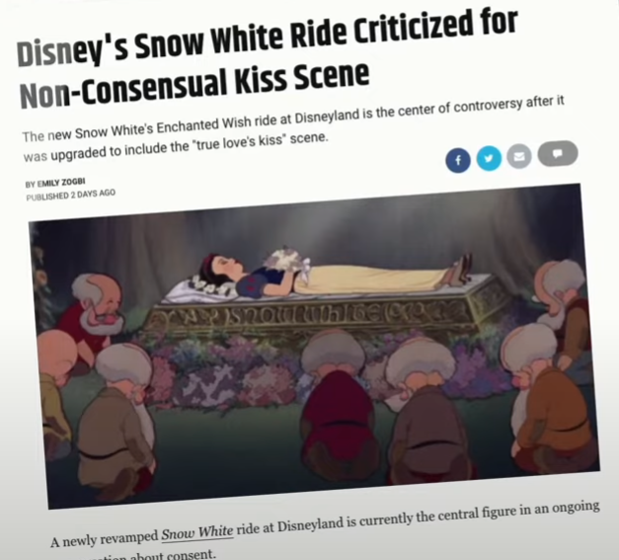
Notes:
https://www.youtube.com/watch?v=LJGSjxGuyzg [youtube not shown in message, but just for documentation from Dr. Michael Brown]
Our culture has gone insane. Insane. You and must speak love and grace and the Ruakh filled Yeshua Messiah like life in grace, boldness, humility, amidst adversity.

Slide 72
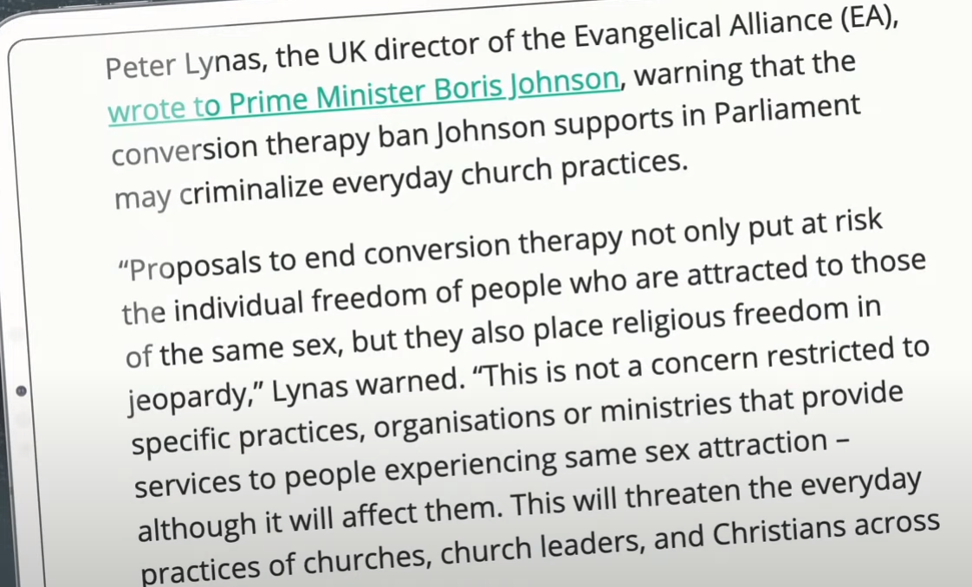
Notes:
https://www.youtube.com/watch?v=S0SDIK0LKaY

Slide 73
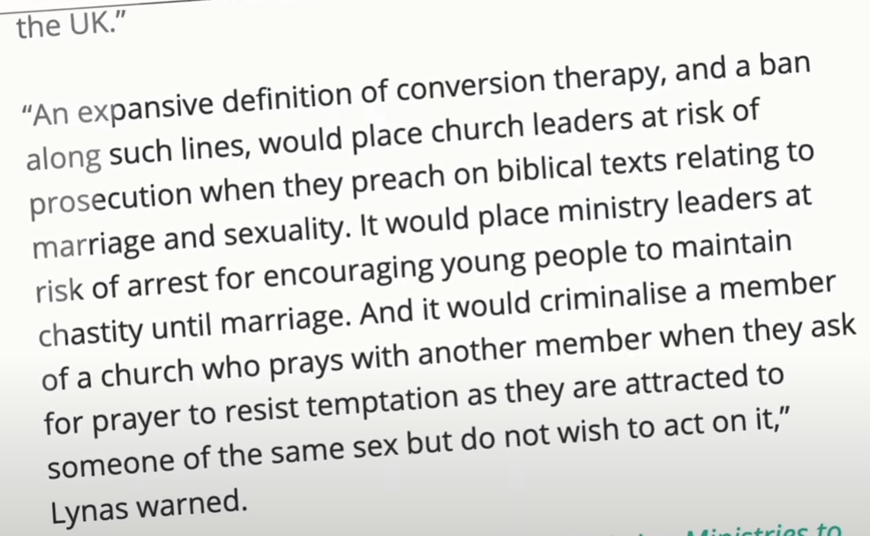
Notes:
https://www.youtube.com/watch?v=S0SDIK0LKaY

Slide 75
The term Shavuotnik
How to become one amidst adversity
Adversity in the US
Adversity in Israel

Slide 76
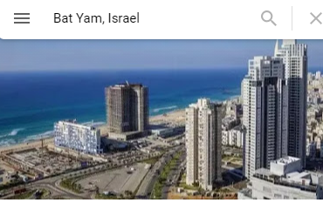
From my Zoom prayer meeting Thursday morning, May 13, 2021
Shmuel Birnbaum: Bat Yam closed
due to fear of lynchings. Jewish and Arab youth angry. Arabs smashed an ice cream shop.

Slide 77
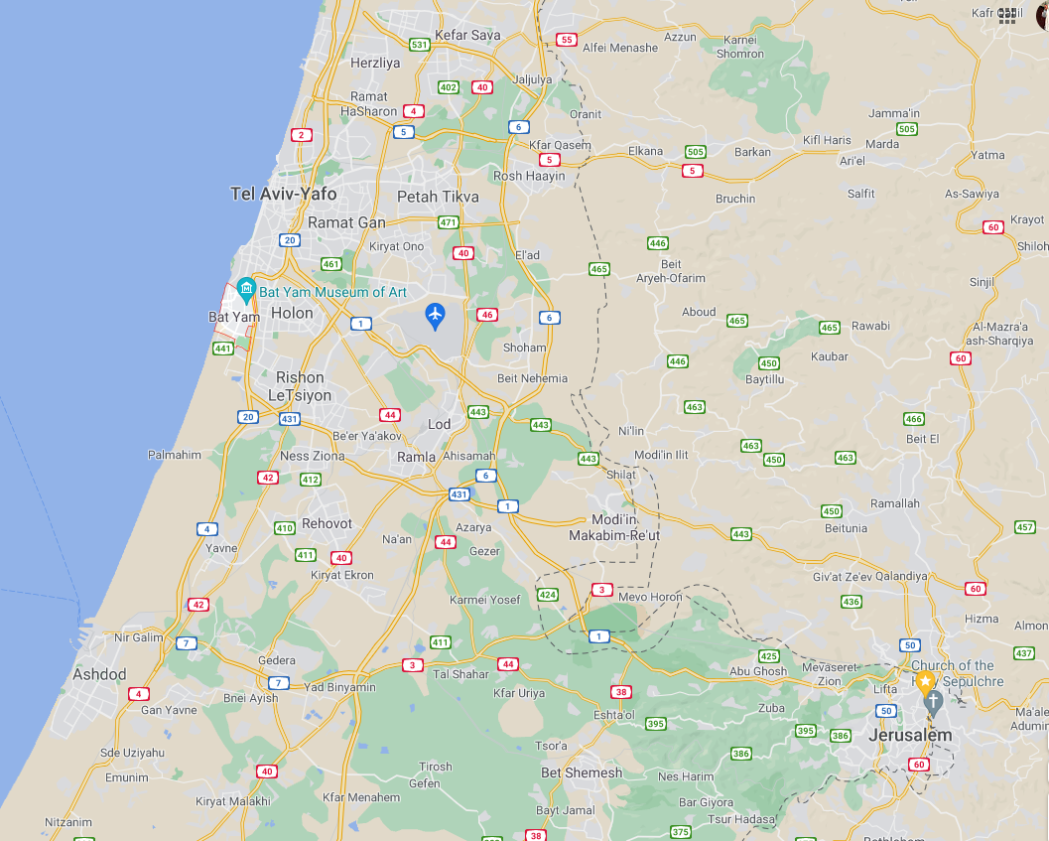
One of Birnbaum’s congregants has a beach house, and heard Haredi youth yelling “Death to the Arabs.” ~Rwanda

Slide 78
Avi Mizrachi: One of his congregants is married to a Russian new immigrant [olah hadashah עולה חדשה]]. Avi’s daughter went to visit and woman crying in panic “Never happened to me before.” Wept together and shared Yeshua!

Slide 79
Avi Mizrachi: 1400 rockets [as of Thursday] launched, 6 Israeli killed, 50 wounded. No believers. Amazing protection.
Went to a prayer meeting in Nazareth [north] only 20 showed, but great love Arab Christians and Messianic Jews!

Slide 80
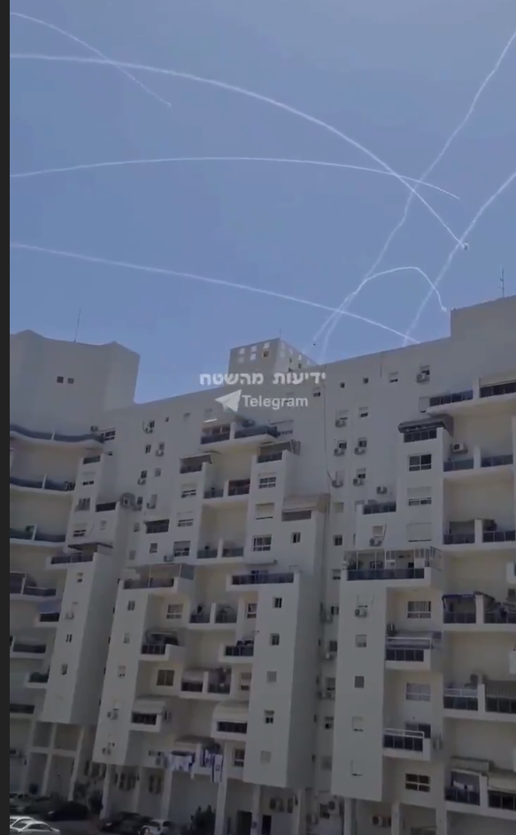
Beautiful Israeli apartment building under rocket contrails
[note staggered terraces for Sukkot]

Slide 81
Stewart Winograd:
His daughter Miriam in bomb shelter and tried to talk to people about Yeshua, but too much panic, survival mode, keep kids calm.
Apps with rocket warning.

Slide 82
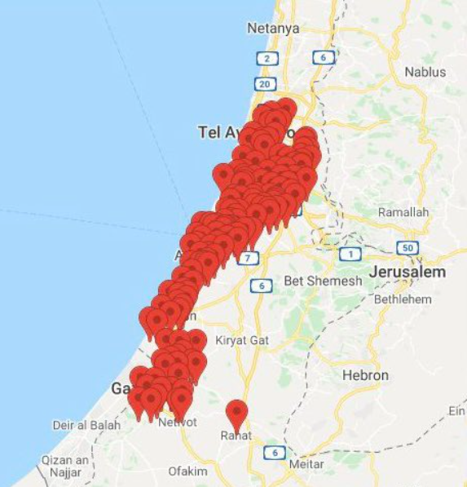

Slide 83
David Silver: riots in Haifa, Akko, Tiberias, Lod, Bat Yam

Slide 84


Slide 85
During the Islamic holiday of Ramadan, tensions began to increase among the Arabs and there was great anger and agitation over a possible eviction of a Palestinian family from their home of 60 years by Israeli courts. (long story!!)
Notes:
https://zionsglory.activehosted.com/index.php?action=social&chash=99c5e07b4d5de9d18c350cdf64c5aa3d.752&s=80ef67840a49f350765635c6ffe2a5ec

Slide 86
The East Jerusalem land dispute was being negotiated by Israeli Jews and Palestinians. The Jewish landlords would own the land and the Palestinians would pay rent. However, the PA threatened the Palestinians with violence if they entered into any agreement. Therefore, the Palestinians stopped paying rent to prevent hostilities from PA.
Notes:
https://honestreporting.com/daniel-pomerantz-on-knesset-channel-this-is-how-honestreporting-defends-israel/

Slide 87
Trying to keep order, the police put up barricades to prevent the Ramadan worshippers from congregating in one place as they left the Mosque each evening. This angered the Muslims and violent demonstrations against the police began. At one point, the police had to go up to the Mosque in order to restore order. This was a travesty for the Muslims.
Notes:
https://zionsglory.activehosted.com/index.php?action=social&chash=99c5e07b4d5de9d18c350cdf64c5aa3d.752&s=80ef67840a49f350765635c6ffe2a5ec

Slide 88
There were protesters and counter protesters and what was different yet, for me, very significant was that they were all young. As I watched on TV, I was struck by the spirit of a deep hatred that I saw on these young men's faces.
Notes:
https://zionsglory.activehosted.com/index.php?action=social&chash=99c5e07b4d5de9d18c350cdf64c5aa3d.752&s=80ef67840a49f350765635c6ffe2a5ec

Slide 89
They were yelling "Free Jerusalem and Al Aqska (Golden Dome Mosque). In response the religious Jewish youth with the same spirit were countering with "Death to the Arabs." It was not easy to watch.
Notes:
https://zionsglory.activehosted.com/index.php?action=social&chash=99c5e07b4d5de9d18c350cdf64c5aa3d.752&s=80ef67840a49f350765635c6ffe2a5ec

Slide 90
Yesterday though, for the first time, this nation experienced something that we haven't seen here. Israeli Arabs, again all young men began to protest while the rockets were falling. They took to the streets and were throwing rocks and firebombs at the police,
Notes:
https://zionsglory.activehosted.com/index.php?action=social&chash=99c5e07b4d5de9d18c350cdf64c5aa3d.752&s=80ef67840a49f350765635c6ffe2a5ec

Slide 91
vandalizing and causing great damage wherever they could. This started happening in many Israeli Arab towns. In the city of Lod which experienced the greatest violence, in their hatred, they actually set three synagogues on fire.
Notes:
https://zionsglory.activehosted.com/index.php?action=social&chash=99c5e07b4d5de9d18c350cdf64c5aa3d.752&s=80ef67840a49f350765635c6ffe2a5ec

Slide 92
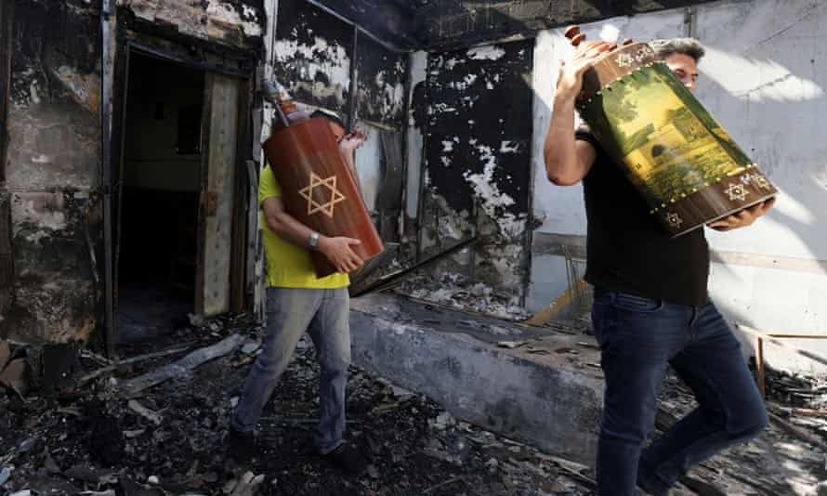
Notes:
https://zionsglory.activehosted.com/index.php?action=social&chash=99c5e07b4d5de9d18c350cdf64c5aa3d.752&s=80ef67840a49f350765635c6ffe2a5ec
בית כנסת שרוף בעיר לוד, רק בנס לא נשרפו ספרי התורה.

Slide 93
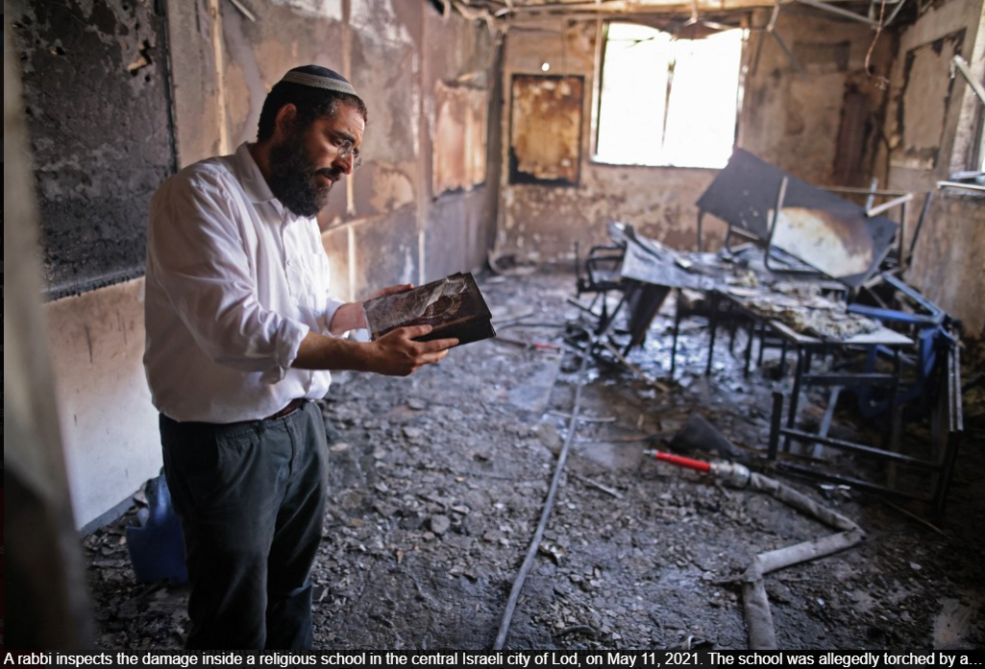
Notes:
mob of local Arab residents on the night of May 10. (Ahmad GHARABLI / AFP)

Slide 94
Lod Mayor Revivo had warned “this is too big for the police.” “This is Kristallnacht in Lod,” Revivo said on Channel 12. “I have called on the prime minister to declare a state of emergency in Lod. To call in the IDF. To impose a curfew. To restore quiet…

Slide 95
There is a failure of governance… This is a giant incident — an intifada of Arab Israelis. All the work we have done here for years [on coexistence] has gone down the drain.”

Slide 96
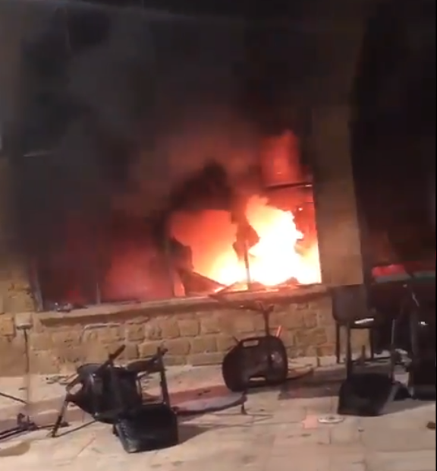
A pogrom in
Lod.

Slide 97
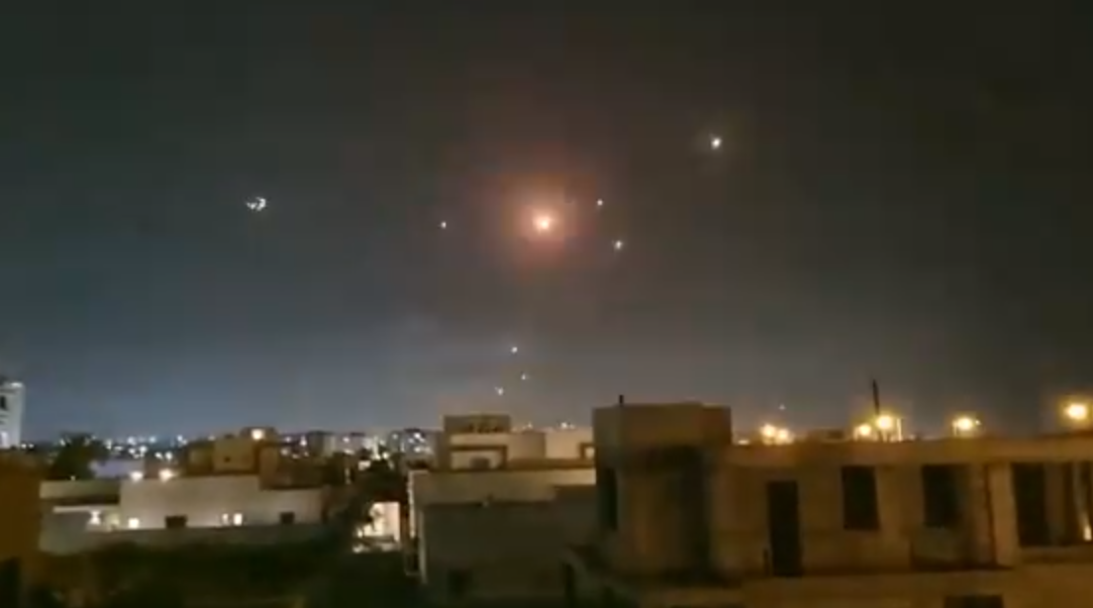
Notes:
video
https://worthywatch-h45go6maxh5rpepgu.netdna-ssl.com/wp-content/uploads/2021/05/israel-may-10-2.mp4?_=2

Slide 98
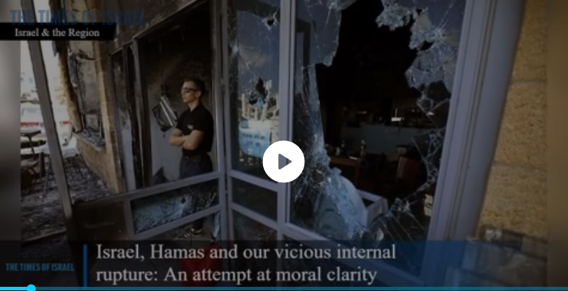

Slide 99
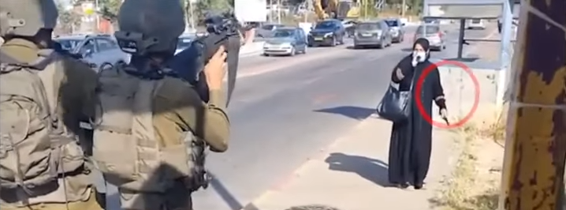
Elderly woman approaching IDF soldiers with an attack knife
Notes:
https://youtu.be/GLrwxvVnL3A
3.26 to 5.42
Another situation:
I’ve also spoken with Jewish Arabs who’ve describe how their North African Muslim friends laughed and then wept with them as they explained that, although they loved their Jewish friends, that one day they would still have to kill them—it was nothing “personal.” https://thejewishvoice.com/2021/05/a-fifth-column/

Slide 100
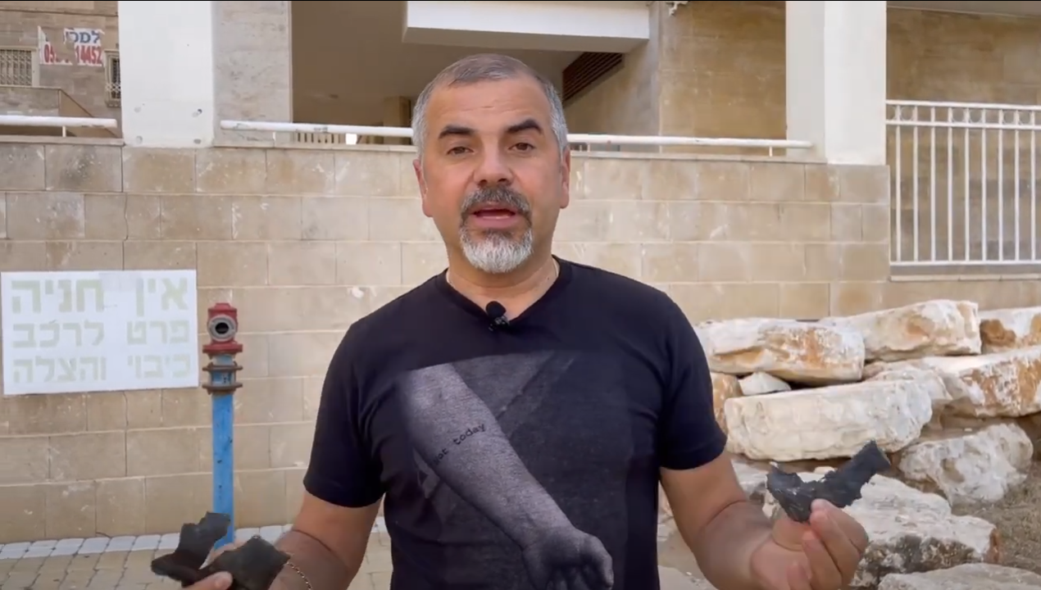
Notes:
https://youtu.be/Niwx6aDgP-c

Slide 101
From this evening onwards me, my team, and our congregation will be meeting in our congregation's bomb-shelter to seek the Lord's face for deliverance from the current situation, for the salvation of Israel, and for revival in the land. We praise God that we have a bomb-shelter from which we are able to continue in worship despite the continued attacks from Gaza

Slide 102
Also please pray for our team who are going out into the streets despite the rocket attacks and sirens, to deliver humanitarian aid to the homes of the poor and needy, to help them cope during these difficult times and to bring encouragement and the love of Yeshua (Jesus) to those who are in fear during these times.

Slide 104
The term Shavuotnik
How to become one amidst adversity
Adversity in the US
Adversity in Israel

Slide 105
Do you KNOW Yeshua and the assurance of sins forgiven?
Are you surrendered to Messiah, body, soul, spirit? Walking in relational love, confessing?
Are you filled with His Spirit, transforming your life?
Notes:
Who are you discipling, building up?4

Slide 106
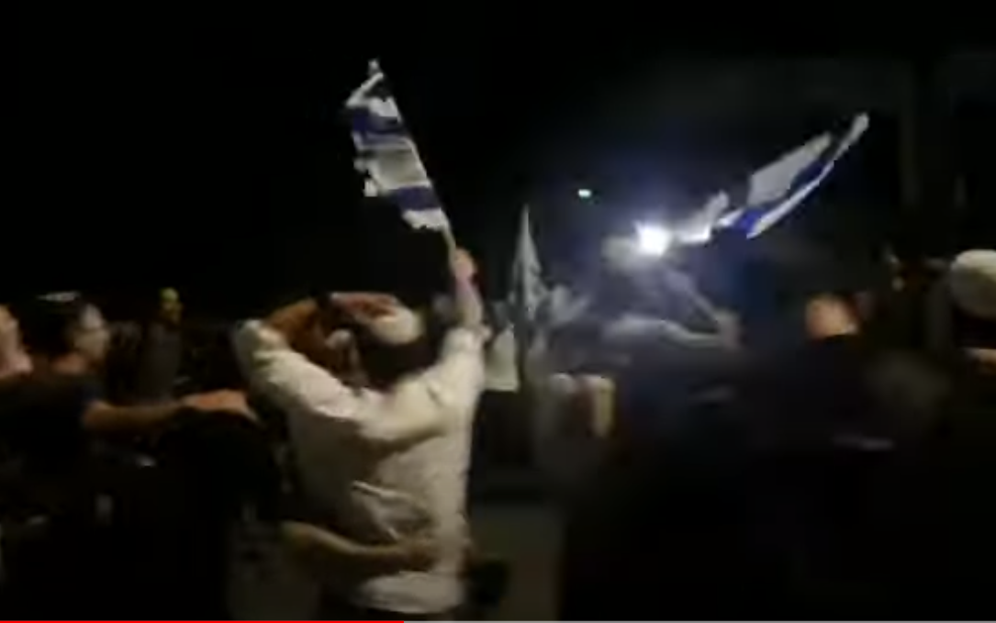
Hundreds of Jews dance and
sing in the streets of Lod as border
police disperse Arab rioters.
Notes:
https://youtu.be/4DSk30cLl98

Slide 115


