Slide 1
e-handout
To have these notes
without taking notes
Go to OrHaOlam.com
Click on downloads,
messages, 2021

Slide 2
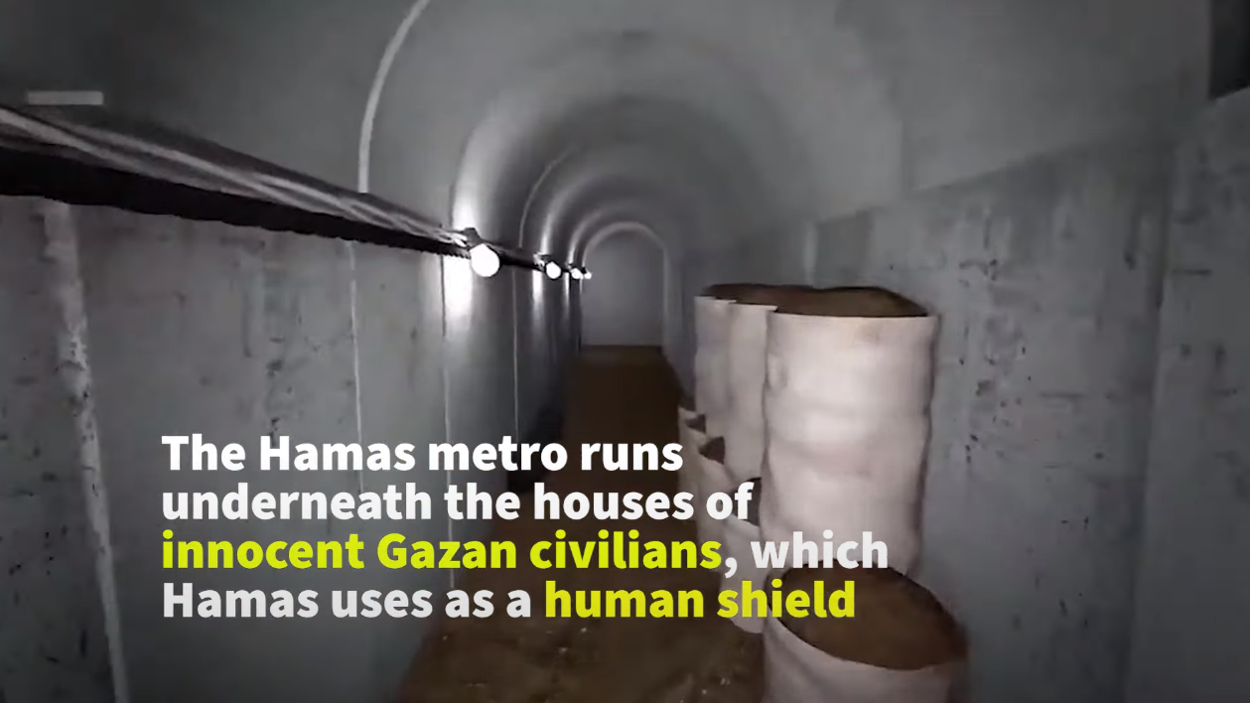
Notes:
I grew up as a subway user: to Hebrew School, to my father’s workplace in Manhattan. Here is the Hamas version of the subway.
https://youtu.be/RM8sJq2hBNQ

Slide 3
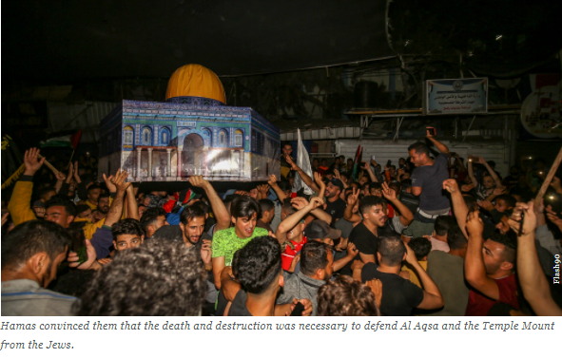
Notes:
https://www.israeltoday.co.il/read/in-photos-palestinians-of-gaza-celebrate-victory-over-israel/?utm_source=acfs&utm_medium=email&utm_term=all&utm_campaign=newsletter-2021-05-21&__cf_chl_jschl_tk__=63426eaba6237c2b2e73fdf21ed7053a46bbbd6d-1621614340-0-AfQm5VD2Lw40fLYpMmF5WCGBMwW9l3ylv-dRhy8xZThIBYVtP-TQsxNa80JK4xeEHJG7gzUTDydMmeorOpWIwlx_wSA112flCqLjHF48pk-blD_HIR5zgkBEmG27ws3rOhMnObdBlBZq_PT5vDz7mlIeAXmu4g8Vnp3uh6amTbe7RCHjQ-0cufN5_tuXpYugqDfiay0di2-Es6UclHn3mwPqD6Xzb3wr4iWYpBCC_OfZc0F0Jp3D7tpXYONRxlcf1sFY-ezML0RN7rP4NDaXOKMritMnBbZYGhkr9loOJnUNzzsXegGmj3Z8LQrT7WsuyUC-RnAgSuQc-JuEES90MtLP9pu9yo2o5l0aSkM_7oQ0CEXqT5REPzk78tpKsaHB2yS5NOkGpcJGq03jRtLb8Ldz4flInsIKG1SHDpRl_HlWM95zt1YGignqDBC9yrlv_7tx7UWI-2VyuhCP-JePEG-SFE09USU4nsrk-L1Qff87lIfbaN_b4f_9ZIkKAtY0c84ReupgEMFk5am9vkyPh04uOItsnwdaTxB0W1YYBhoQPvXZqWVweBA9uOi0Wuc9WxJW5WF4y0e3Hd_VKvTiFFM

Slide 4
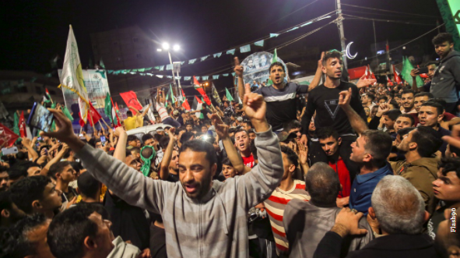
Notes:
There is a cease fire, but they are all psyched for the next war! This war was not about Israeli aggression in a real estate deal, this is about Islamist [not Islamic] commitment to the destruction of the Jews.
https://www.israeltoday.co.il/read/in-photos-palestinians-of-gaza-celebrate-victory-over-israel/?utm_source=acfs&utm_medium=email&utm_term=all&utm_campaign=newsletter-2021-05-21&__cf_chl_jschl_tk__=63426eaba6237c2b2e73fdf21ed7053a46bbbd6d-1621614340-0-AfQm5VD2Lw40fLYpMmF5WCGBMwW9l3ylv-dRhy8xZThIBYVtP-TQsxNa80JK4xeEHJG7gzUTDydMmeorOpWIwlx_wSA112flCqLjHF48pk-blD_HIR5zgkBEmG27ws3rOhMnObdBlBZq_PT5vDz7mlIeAXmu4g8Vnp3uh6amTbe7RCHjQ-0cufN5_tuXpYugqDfiay0di2-Es6UclHn3mwPqD6Xzb3wr4iWYpBCC_OfZc0F0Jp3D7tpXYONRxlcf1sFY-ezML0RN7rP4NDaXOKMritMnBbZYGhkr9loOJnUNzzsXegGmj3Z8LQrT7WsuyUC-RnAgSuQc-JuEES90MtLP9pu9yo2o5l0aSkM_7oQ0CEXqT5REPzk78tpKsaHB2yS5NOkGpcJGq03jRtLb8Ldz4flInsIKG1SHDpRl_HlWM95zt1YGignqDBC9yrlv_7tx7UWI-2VyuhCP-JePEG-SFE09USU4nsrk-L1Qff87lIfbaN_b4f_9ZIkKAtY0c84ReupgEMFk5am9vkyPh04uOItsnwdaTxB0W1YYBhoQPvXZqWVweBA9uOi0Wuc9WxJW5WF4y0e3Hd_VKvTiFFM

Slide 5
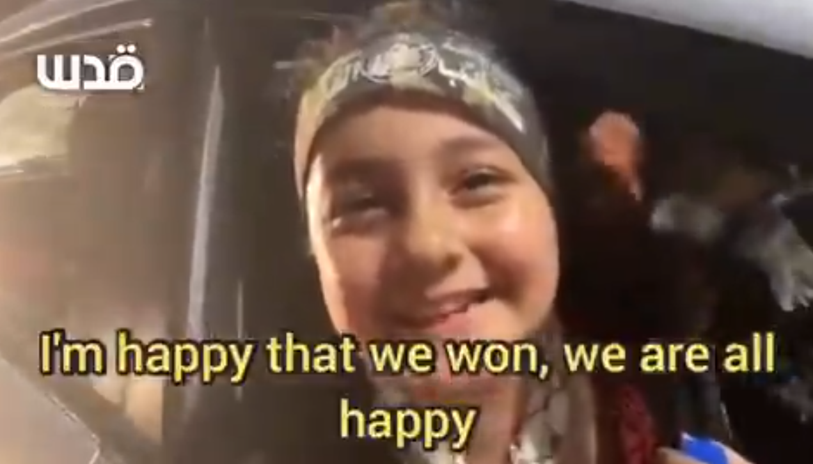
Notes:
https://twitter.com/i/status/1395684668998029314
But, on to the message of the day…from Barri Mallin Seif:

Slide 6
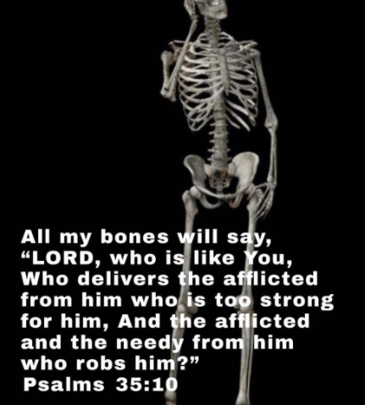
Notes:
Bari Mallin Seif Instagram

Slide 7
So if a cow doesn't produce milk, is it a milk dud or an udder failure?
Notes:
Mary Ann Dixon

Slide 8
In the series on Messianic Jews/ Hebrews, there is a theme I skipped, that I feel a need to go back to.

Slide 9
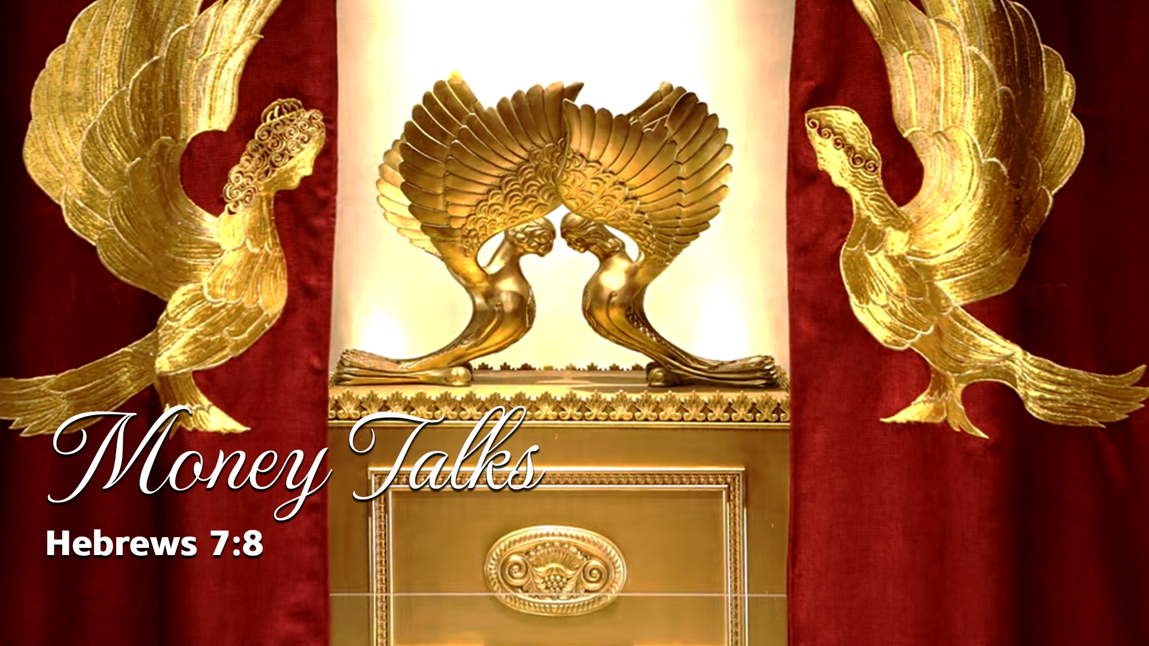
Notes:
Crazy Eddy: Money Talks, Nobody Walks.

Slide 10
Outline of this message:
Definition of tithe
Implication of tithe: money talks.

Slide 11
^{MJ 7.8} Moreover, in the case of the cohanim, the tenth is received by men who die; while in the case of Melki-Tzedek, it is received by someone who is testified to be still alive.
Notes:
Just a side note of vocabulary clarification…

Slide 12


a tenth part, a tithe, 10% “deka”
Some say, “I give a 5% tithe.” or
“I give $50 as my tithe.”

Slide 13

Vayikra / Lev 27.30
tenth part, tithe, 10%
Notes:
Some say, “We are not obligated to tithe anyway. That is for the Jews, Tanakh.”
Address this later. This is a whole new approach.

Slide 14
Outline of this message:
Definition of tithe
Implication of tithe: money talks.
  a. Money talks cohanut / priesthood

Slide 15
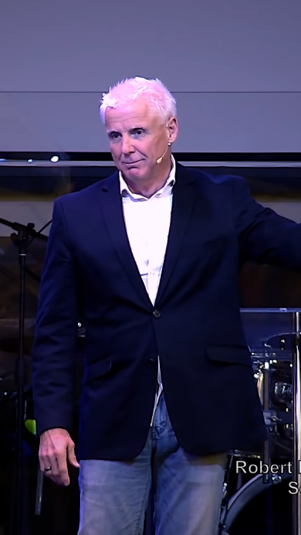
Robert Henderson:
Courts of Heaven
Notes:
https://www.youtube.com/watch?v=A-MANcuJwVo
Sent to me by my son Baruch, some of you know.

Slide 16
^{MJ 7.8} Moreover, in the case of the cohanim, the tenth is received by men who die; while in the case of Melki-Tzedek, it is received by someone who is testified to be still alive.
Notes:
Our tithe ties us to the recipient:
Temple cohanut/priesthood, mortal men
or to the Melki-Tzedek cohanut/priesthood, Yeshua is resurrected.

Slide 18
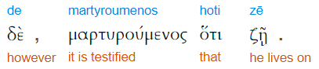
witness, bear witness, give evidence, testify, give a good report.
Notes:
The tithe says something.

Slide 19
^{New Century} Priests receive a tenth, even though they are only men who live and then die. But Melchizedek, who received a tenth from Abraham, continues living, as the Scripture says.

Slide 20
^{Darby} And here dying men receive tithes; but there [one] of whom the witness is that he lives.

Slide 21
Our words and actions are held in a heavenly court for or against us.
Our tithe identifies us with the eternal, resurrected, living Messiah, who is of the order of Melki-tsedek. Money Talks.
Notes:
We are saved by faith in and identifying with the death and resurrection of Messiah.
Our tithe releases a testimony that we believe He lives. It affirms the resurrection. Sometimes seems impossible to give and live financially, but tithing affirms belief in G-d’s power.

Slide 22
Outline of this message:
Definition of tithe
Implication of tithe: money talks.
  Money talks cohanut / priesthood
  Money talks accusatorily

Slide 23
^{Yaakov/James 5.4} Listen! The wages you have fraudulently withheld from the workers who mowed your fields are calling out against you, and the outcries of those who harvested have reached the ears of Adonai-Tzva’ot.
Notes:
Our words and actions are held in a heavenly court for or against us.
Not only the workers, but the wages call out.
Money talks against us.

Slide 24
Outline of this message:
Definition of tithe
Implication of tithe: money talks.
  Money talks cohanut / priesthood
  Money talks accusatorily
  Money talks well

Slide 26
^{Acts 10.1-4} Now in Caesarea there was a man named Cornelius, a centurion of what was called the Italian Cohort. He was a devout man, revering God with all his household. He gave tzedakah generously to the people and prayed to God continually.

Slide 27
^{Acts 10.1-4} About the ninth hour of the day, he saw clearly in a vision an angel of God coming and saying to him, “Cornelius!” He stared at him in terror and said, “What is it, Lord?” The angel said to him, “Your prayers and tzedakah have gone up as a memorial offering before God. Money talks for us
Notes:
Our words and actions are held in a heavenly court for or against us.

Slide 28
^{Daniel 7.10} Thrones were set in place; and the Ancient One took his seat. His clothing was white as snow, the hair on his head was like pure wool. His throne was fiery flames, with wheels of burning fire.

Slide 29
^{Daniel 7.10} A stream of fire flowed from his presence; thousands and thousands ministered to him, millions and millions stood before him. Then the court was convened, and the books were opened.

Slide 30
Courts of Heaven:
accusers and affirmers.

Slide 31
^{Iyov/Job 1.6-11} It happened one day that the sons of God came to serve Adoni, and among them came the Adversary [the Satan]. Adoni asked the Adversary, “Where are you coming from?” The Adversary answered Adonai, “From roaming through the earth, wandering here and there.”

Slide 32
^{Iyov/Job 1.6-11} Adoni asked the Adversary, “Did you notice my servant Iyov, that there’s no one like him on earth, a blameless and upright man who fears God and shuns evil?” The Adversary answered Adoni, “Is it for nothing that Iyov fears God?

Slide 33
^{Iyov/Job 1.6-11} You’ve put a protective hedge around him, his house and everything he has. You’ve prospered his work, and his livestock are spread out all over the land. But if you reach out your hand and touch whatever he has, without doubt he’ll curse you to your face!”
Notes:
A movie illustration of the importance of witnesses for us in court…

Slide 34
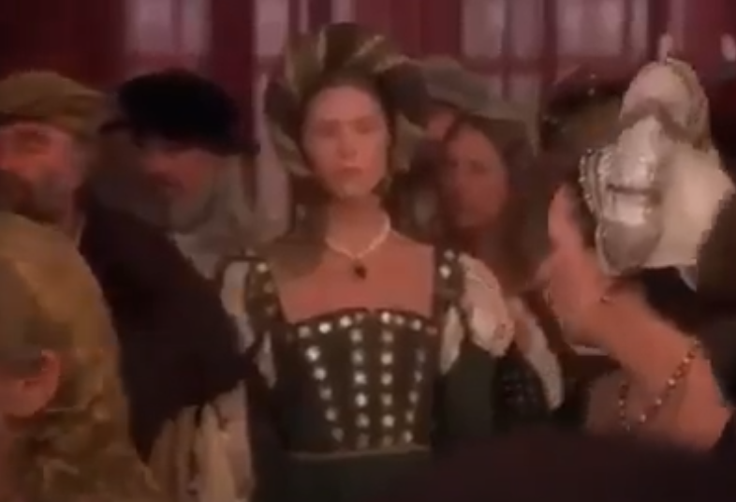
Ever After royal court scene
Notes:
In the movie Ever After, the stepmother is ultimately caught and accused of contriving to promote her daughter, and lying to the Queen. The King asks, “Did you lie to the Queen of France?”
Guilty, unless good deeds and friends speak up.
https://www.youtube.com/watch?v=XOeC6JMCOTY
from 1.24 to 2.06
Similarly, our deeds speak for us.

Slide 35
^{Shmot/Ex 34: 6-7} Then Adoni passed before him, and proclaimed, “Adoni, Adoni, the compassionate and gracious God, slow to anger, and abundant in lovingkindness and truth, showing mercy to a thousand generations, forgiving iniquity and transgression and sin,

Slide 36
^{Shmot/Ex 34: 6-7} yet by no means leaving the guilty unpunished, but bringing the iniquity of the fathers upon the children, and upon the children’s children, to the third and fourth generation.”
Notes:
Generational iniquity: occult, perversion, Masons, Shriners, Knights of Pythias כי Jews not allowed in the other lodges history need to be renounced.

Slide 37
^{Mtt. 12.36-37} But I tell you that on the Day of Judgment, men will give account for every careless word they speak. For by your words you will be justified, and by your words you will be condemned.”

Slide 38
^{2 Tim 2.16-17} But avoid godless chatter, for it will lead to further ungodliness and their words will spread like cancer.

Slide 39
^{MJ 12.23-24} God the Judge of all, and to the spirits of the righteous ones made perfect, and to Yeshua, the Mediator of a new covenant, and to the sprinkled blood that speaks of something better than the blood of Abel.
Notes:
I don’t want my past or my parents or grandparents past sins to speak for me, but the Blood of Yeshua.
If you have never received Him, or if there are generational sins to renounce, we could do that even now…
Here is a clip from the teacher, Robert Henderson, from whom I got this unique insight on tithing associates us, speaks for us…our money talks…

Slide 40
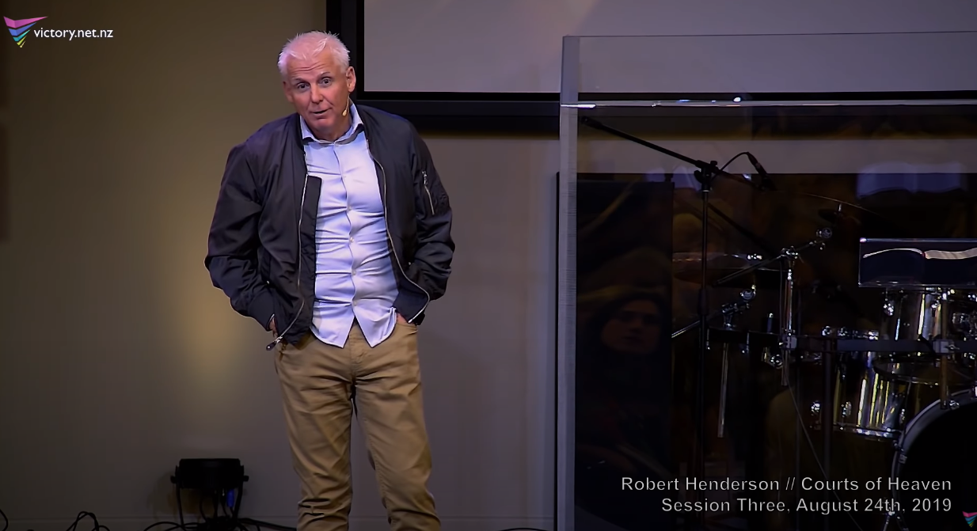
Notes:
https://www.youtube.com/watch?v=6bIv14RGkWg
53.22 to 56.20

Slide 41
So the tithe is the 10% that identifies with the cohanut of Yeshua in Melki-tsedek, and speaks well for us.

Slide 42
I wrote to the Rabbi’s Forum about this recently. One response.
David Schneier [Apr 1, 2021]: At Beth Hallel Birmingham, in order to be a member, you agree in writing and sign the membership card that you will tithe.
Notes:
David and his wife Leslye are lawyers.

Slide 43
Also, Yeshua said, “When you tithe…” That should be enough. Tithing in ancient Israel amounted to about 23% so 10% is a “discount!”
There was a second and third tithe.
Notes:
David and his wife Leslye are lawyers.

Slide 44
First tithe to the Leviim, Cohenim
Second tithe for family celebration in Yerushaliyim except third and sixth year given to poor
Schneier put that together as 23%

Slide 45
^{1 Cor. 9.13-14} Those who work in the Temple get their food from the Temple, and those who serve at the altar get a share of the sacrifices offered there?
Notes:
This is a חידוש khiddush, an innovation by Shaul. Applied specific Temple regulation to ministers of B’sorah/Good News of Yeshua.

Slide 46
^{1 Cor. 9.13-14} In the same way, the Lord directed that those who proclaim the Good News should get their living from the Good News.
Even so NKJV
Along the same lines Message
Notes:
This is a חידוש khiddush, and innovation by Shaul. Applied specific Temple regulation to ministers of B’sorah/Good News of Yeshua.
Temple was still standing then.

Slide 47
Kent’s presentation…
Notes:
Put money into tangibles…inflation coming.

Slide 48
There is an old Indian fable that tells of a mouse who was in constant distress because of its fear of cats. So a magician took pity on it and turned it into a cat so it would have no more fear. Now, as a cat, it was in fear of dogs. So the magician turned it into a dog.
Notes:
George Whitten

Slide 49
Now, as a dog, it was stressed out in fear of tigers. Then the magician turned the dog into a tiger. Now, as a tiger, it was shaking in fear of hunters. The magician finally said to the tiger, "Be a mouse again. You only have the heart of a mouse, and I cannot help you."
Notes:
George Whitten

Slide 50
As Hebrews describes through Yeshua's death, "He might destroy the one who has power of death, that is the devil, and deliver all those who through fear of death were subject to a lifetime of slavery." [Hebrews 2:14-15]
Notes:
George Whitten

Slide 51
In Revelation, the description given to those who were victorious ... "conquered by the blood of the Lamb, and by the word of their testimony, for they loved not their lives unto the death." [Revelation 12:11]
Notes:
George Whitten

Slide 52
^{Luke 6.38} Give, and you will receive gifts — the full measure, compacted, shaken together and overflowing, will be put right in your lap. For the measure with which you measure out will be used to measure back to you!”

Slide 53
Stewart Winograd from Israel: About 100 Jewish homes have been torched, more than 300 Jewish homes have been looted. Jewish prayer books and Torah scrolls have been vandalized.

Slide 54
Over 4,000 rockets have been fired and as of this writing, 12 people in Israel have been killed including a 6-year-old boy, an Arab Israeli family, and foreign workers from Thailand and India.

Slide 55
Here is a quote from a resident of the Israeli city of Lod:“You can hide from missiles in a bomb shelter, but how can you protect yourself from the mobs who break through your door?
Notes:
Stewart Winograd

Slide 56
On the first night in Lod, several apartment buildings were evacuated, where Arabs and Jews lived together peacefully before. When the mob came, Arab neighbors led them to Jewish apartments.
Notes:
Stewart Winograd

Slide 57
Pray for protection for the Jewish community worldwide. There have been protests across Europe and the US outside of Israeli embassies and synagogues with crowds calling for all Jews to be attacked because of the war.
Notes:
Stewart Winograd

Slide 58
I owned a hotel once. Like Monopoly, only better; real people came to stay. They told stories, we told stories, everyone listened to everyone.
Notes:
https://blogs.timesofisrael.com/a-violent-mob-destroyed-the-oasis-we-created-in-acre/?utm_source=The+Blogs+Weekly+Highlights&utm_campaign=blogs-weekly-highlights-2021-05-20&utm_medium=email

Slide 59
It started with an Ottoman ruin in the Old City of Acre that I bought as a home and studio, but after three years of massive conservation and renovation efforts, my son Micha and I turned the building into a tiny boutique hotel and artists’ residency called Arabesque
Notes:
https://blogs.timesofisrael.com/a-violent-mob-destroyed-the-oasis-we-created-in-acre/?utm_source=The+Blogs+Weekly+Highlights&utm_campaign=blogs-weekly-highlights-2021-05-20&utm_medium=email

Slide 60
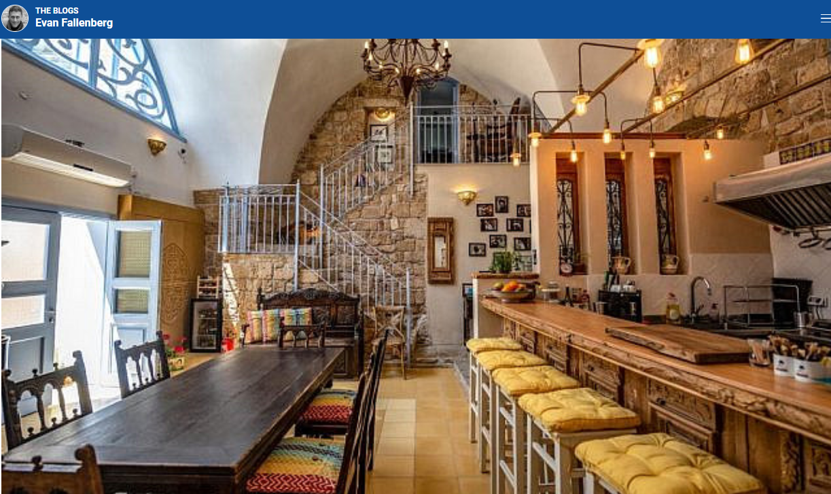
Notes:
https://blogs.timesofisrael.com/a-violent-mob-destroyed-the-oasis-we-created-in-acre/?utm_source=The+Blogs+Weekly+Highlights&utm_campaign=blogs-weekly-highlights-2021-05-20&utm_medium=email

Slide 61
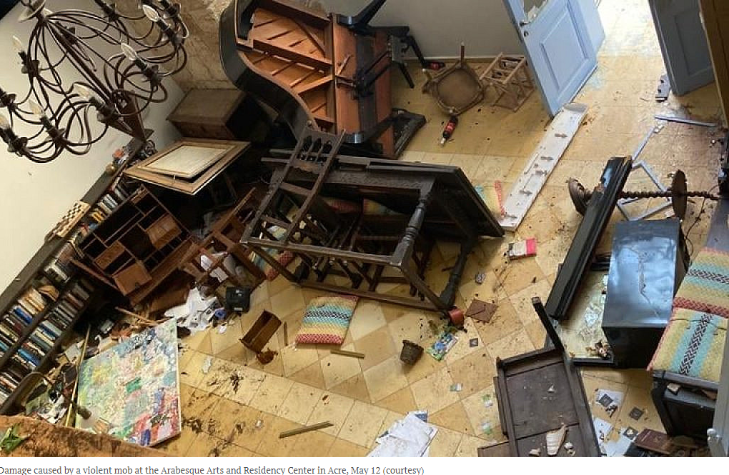
Notes:
https://blogs.timesofisrael.com/a-violent-mob-destroyed-the-oasis-we-created-in-acre/?utm_source=The+Blogs+Weekly+Highlights&utm_campaign=blogs-weekly-highlights-2021-05-20&utm_medium=email

Slide 62
Micha and I are Jewish; all our neighbors are Arabs — mostly Muslim, with some Christian descendants from the city’s Crusader past. That mattered, certainly, in a country obsessed with tribal boundaries and religious identifications. But our experience was one of welcome and warmth. We became part of the fabric of the city.
Notes:
https://blogs.timesofisrael.com/a-violent-mob-destroyed-the-oasis-we-created-in-acre/?utm_source=The+Blogs+Weekly+Highlights&utm_campaign=blogs-weekly-highlights-2021-05-20&utm_medium=email

Slide 63
On Wednesday, shortly after midnight, Arabesque fell to the hands of a violent mob, in spite of the best efforts of our neighbors, who deflected the attack time and again until the mob grew to 50 and there were threats to burn down the entire neighborhood.
Notes:
https://blogs.timesofisrael.com/a-violent-mob-destroyed-the-oasis-we-created-in-acre/?utm_source=The+Blogs+Weekly+Highlights&utm_campaign=blogs-weekly-highlights-2021-05-20&utm_medium=email

Slide 64
It is no small feat to upturn a grand piano or split a sink in two or rip a television or air conditioner into its tiniest parts. The anger and hatred necessary are beyond my own imagination
Notes:
https://blogs.timesofisrael.com/a-violent-mob-destroyed-the-oasis-we-created-in-acre/?utm_source=The+Blogs+Weekly+Highlights&utm_campaign=blogs-weekly-highlights-2021-05-20&utm_medium=email

Slide 65
Pro-Palestinian thugs attack Jews in Los Angeles, New York, Chicago, Toronto, Montreal and Albuquerque, where a college student was hospitalized. In Canada, pro-Israel supporters were attacked in Toronto and Montreal, with the pro-Palestinian attackers screaming “death to the Jews” and “we will finish what Hitler started,” the Toronto Sun reported.
Notes:
https://unitedwithisrael.org/pro-palestinian-mobs-physically-attack-jews-across-us-canada/?utm_source=newsletters_unitedwithisrael_org&utm_medium=email&utm_content=Israel+Downs+Iranian+Attack+Drone%3B+Pro-Palestinian+Thugs+Attack+Jews+in+US%3B+Black+Israeli+Blasts+BLM%27s+Terror+Support%3B+Nikki+Haley+Blasts+Biden+Pressure&utm_campaign=20210520_m163298110_Israel+Downs+Iranian+Attack+Drone%3B+Pro-Palestinian+Thugs+Attack+Jews+in+US%3B+Black+Israeli+Blasts+BLM%27s+Terror+Support%3B+Nikki+Haley+Blasts+Biden+Pressure&utm_term=more_btn_light_png

Slide 66
In Los Angeles, police are searching for the perpetrators after a mob of pro-Palestinian demonstrators physically attacked a group of Jewish men at a restaurant.
The attack began as the men demanded, “Who’s Jewish?”
Notes:
https://unitedwithisrael.org/pro-palestinian-mobs-physically-attack-jews-across-us-canada/?utm_source=newsletters_unitedwithisrael_org&utm_medium=email&utm_content=Israel+Downs+Iranian+Attack+Drone%3B+Pro-Palestinian+Thugs+Attack+Jews+in+US%3B+Black+Israeli+Blasts+BLM%27s+Terror+Support%3B+Nikki+Haley+Blasts+Biden+Pressure&utm_campaign=20210520_m163298110_Israel+Downs+Iranian+Attack+Drone%3B+Pro-Palestinian+Thugs+Attack+Jews+in+US%3B+Black+Israeli+Blasts+BLM%27s+Terror+Support%3B+Nikki+Haley+Blasts+Biden+Pressure&utm_term=more_btn_light_png

Slide 67
​ Did you know that 20 synagogues were destroyed and firebombed by the Arabs during the riots - but not one Mosque? Guess that says everything.
Notes:
My cousin in Tel Aviv.

Slide 68


Slide 69
Registration necessary for Pro-Israel Rally 4 pm Sunday at the JCC
https://form.jotform.com/211395923530151

Slide 70
Do you KNOW Yeshua and the assurance of sins forgiven?
Are you surrendered to Messiah, body, soul, spirit? Walking in relational love, confessing, tithing?
Are you filled with His Spirit, transforming your life?
Notes:
Who are you discipling, building up?4

Slide 71


