Slide 1
e-handout
To have these notes
without taking notes
Go to OrHaOlam.com
Click on downloads,
messages, 2021

Slide 2
Greetings from Israel
Benyamin and Romema Schlossberg

Slide 3
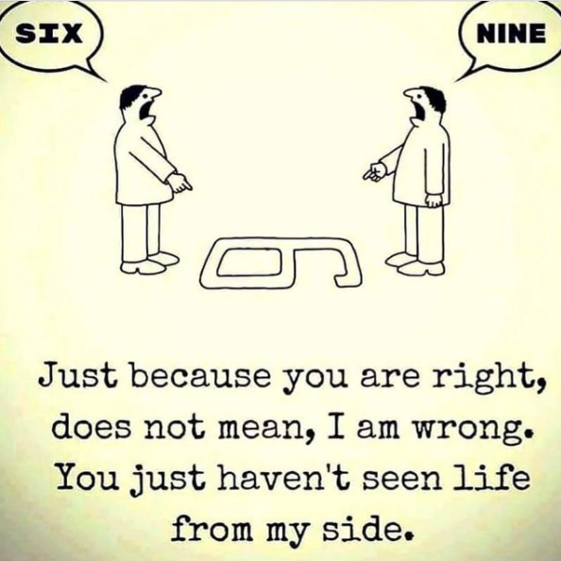
Notes:
Luanne

Slide 4
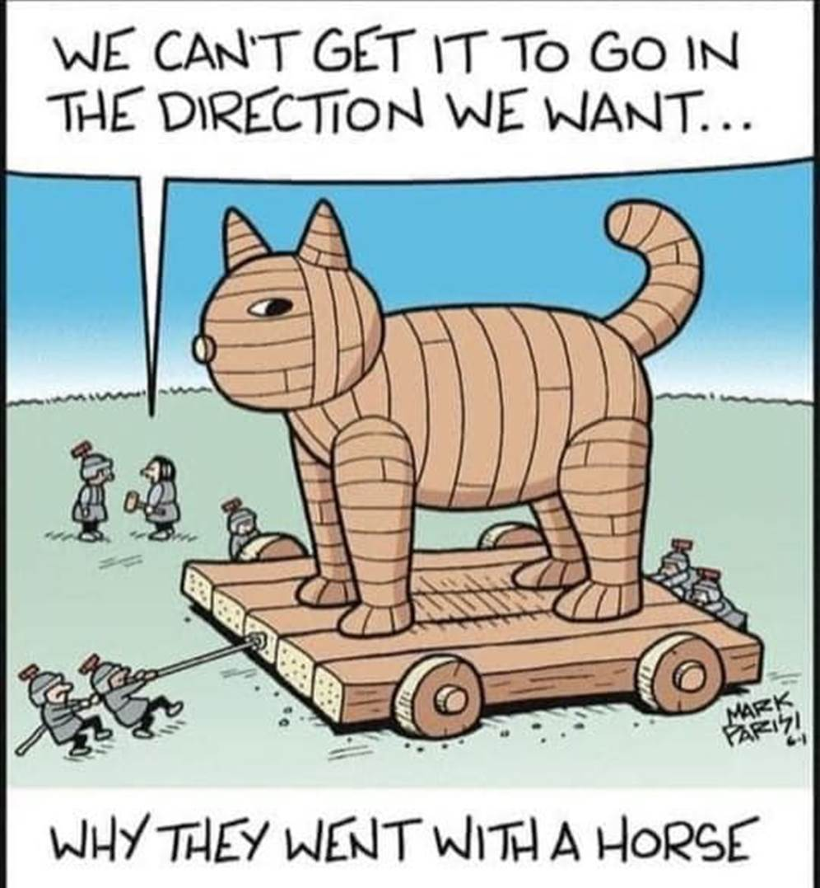
Notes:
Luanne

Slide 5
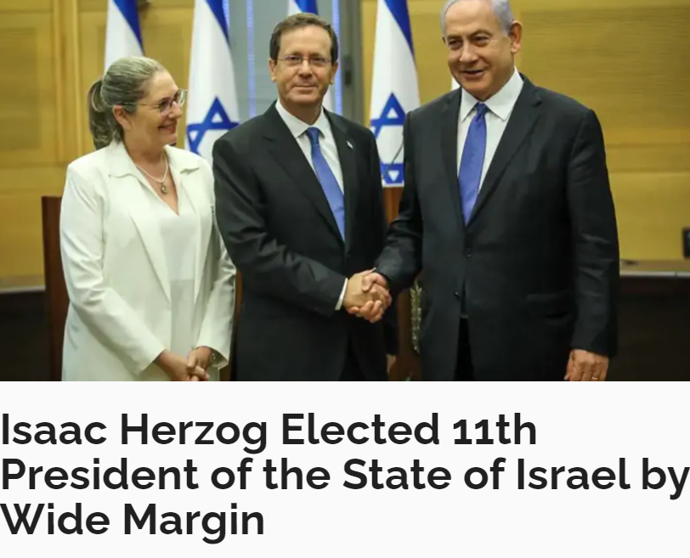
Notes:
The son of former Israeli President Chaim Herzog, he is a lawyer by profession
His paternal grandfather, Rabbi Yitzhak HaLevi Herzog, was the first Chief Rabbi of Ireland from 1922 to 1935 and Ashkenazi Chief Rabbi of Israel from 1936 to 1959.
member of the Knesset from 2003 to 2018.
Formerly the chairman of the Labor Party 2013 -2017
Sort of royalty in Israeli society
Herzog met with Palestinian President Mahmoud Abbas to pledge his support for the two-state solution.

Slide 6
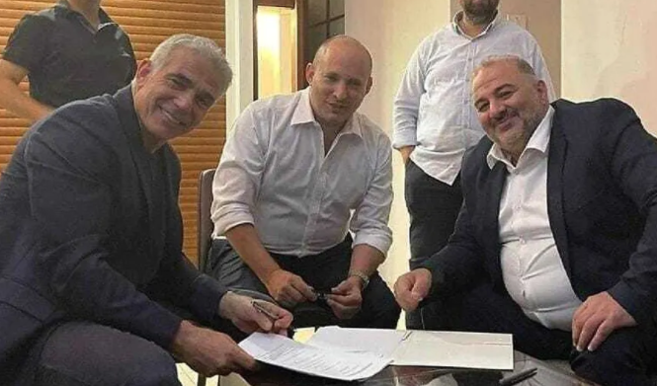
Yair Lapid Naphtali Bennet, Mansour Abbas
Notes:
Ra’am leader Mansour Abbas threw his support behind the would-be government late on Wednesday night, setting up his Islamist party to be the first majority Arab party in decades to be part of a ruling coalition.

Slide 7
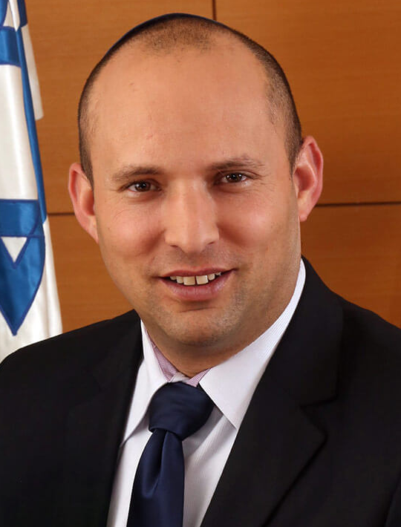
Naphtali Bennet
Born in Haifa of American parents imparted Modern Orthodox Judaism. They made aliya before he was born. His family then spent several years of his childhood in the U.S. before returning to Israel.
Notes:
He served in combat operations as an officer in Israel’s special forces. Bennett went on to create several highly-successful software companies and sold them for about $300 million. He entered politics in 2006 serving as Chief of Staff for PM Netanyahu. He opposes the creation of a Palestinian state. He is for investing in building roads for Palestinians so they can travel in their own areas without checkpoints. His plans include creating joint industrial zones for Jewish and Arab workers because, he says, “Peace grows from below—through people in daily life.”

Slide 8
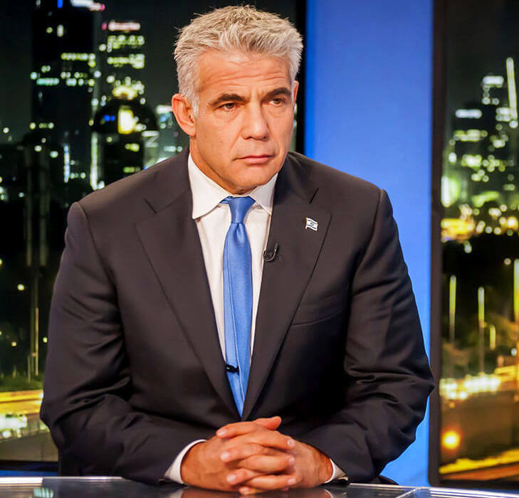
Yair Lapid
Yesh Atid
יש עתיד
“There is a Future.”
Notes:
His father was a Holocaust survivor and a politician who was a strong enemy of the ultra-Orthodox. The son is less extreme, but as prime minister his platform includes passing a law that insists ultra-Orthodox men must serve in the army. Lapid is left-leaning on the peace process. He would be ready to halt construction in Israeli settlements. He is willing to seek a Palestinian state if the Palestinians will stop their violence.

Slide 9
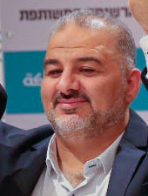
Mansour Abbas, leader of the Islamist party Ra’am, which shares the vision of Yasser Arafat and the PLO. Following what many now refer to as the “2021 Pogroms” for example,

Slide 10
Abbas said the burning of synagogues, homes, cars, shops and so on, fall into the category of “legal and legitimate protests.” Abbas, to clarify, does not refer to himself as an Israeli Arab, but as a Palestinian citizen of Israel.
Notes:
https://www.israeltoday.co.il/read/is-israels-new-government-wholesaling-the-jewish-state/?utm_source=acfs&utm_medium=email&utm_term=all&utm_campaign=newsletter-2021-06-10

Slide 12
Outline
Fatherhood in scripture
Feelings of fatherlessness
Overcoming Fatherlessness
A civilization of Fatherlessness
Standing in the Father’s love
Notes:
G-d as Father is a foundational concept.

Slide 13
^{Mtt. 6.9} You, therefore, pray like this: ‘Our Father in heaven!
אָבִינוּ שֶׁבַּשָּׁמַיִם Avinu Sheh-ba-shamayim
Notes:
Foundational prayer thought.

Slide 14
^{Ro. 8.15} These are sons of God... did not receive the spirit of slavery to fall again into fear; rather…received the Spirit of adoption, by whom we cry, “Abba! Father!” The Ruakh Himself bears witness with our spirit that we are children of God.
Notes:
First experience in New Birth

Slide 15
^{T’hillim/Ps 103.13} As a father has compassion on his children, so Adoni has compassion on those who fear Him.
Notes:
Father models, exemplifies compassion.

Slide 16
^{Yeshayahu/Is 9.6} His Name will be called Wonderful Counselor, Mighty God, My Father of Eternity.
^{Yn14.26} But the Counselor, the Ruakh HaKodesh, whom the Father will send in my name, will teach you everything; that is, he will remind you of everything I have said to you.
Notes:
Fatherhood undergirds the universe
Father lovingly active in our life

Slide 17
^{1 Yn 3.1} See what great love the Father has lavished on us in letting us be called God’s children! For that is what we are.

Slide 18
Definition of father: a male human parent
Words related: encourager, galvanizer, inspirer
Notes:
https://www.merriam-webster.com/thesaurus/father
Definition needed? Most people DON’T have a good definition in their kishkas. Maybe theoretically, but not a feeling.

Slide 20
Tools for the Trade
Steve chapman/1986/dawn treader music/bmi
If you are a father, you are a builder
And your children will become what you've made.
Please do your best,
Please don't forget,
God gave you the tools for the trade.

Slide 21
He gave you arms to hold them
When they are afraid
And time to wait until they’re calm
Ears to hear between their lines
And tears to cry when they’re gone

Slide 22
He gave you eyes to see
Where your child might go wrong,
And feet to lead them
safely through.
Hands to hold their hands
And lips to say “I love you."

Slide 23
And your knees are for playing
And they're also for praying
That God will watch over the child
And in those times when you can't say it
But they still need to hear it
You can say "I love you" with your smile.

Slide 24
If you are a father, you are a builder
And your children will become what you've made.
Please do your best,
Please don't forget,
God gave you the tools for the trade.
Notes:
But we don’t live there in our culture. We have an epidemic of Fatherlessness. Promise Keepers men’s ministry developed to address that.

Slide 25
Outline
Fatherhood in scripture
Feelings of fatherlessness
Overcoming Fatherlessness
A civilization of Fatherlessness
Standing in the Father’s love

Slide 26
PERCEPTION OF

Slide 27
Sounds of [fatherly] Silence
You are worthless and your life is hopeless.
You are not loved or lovable.
You mess everything up.
You can’t do anything right.
Notes:
Background brain music.

Slide 28
If people really knew you, they wouldn’t love you.
Everyone betrays you; you are all alone.
You are a failure.
You are not as bad off as others; you don’t need help.

Slide 29
G-d does not love you.
G-d has not protected you.
You would be better off dead.
It would be best if you weren’t born.
You are an accident/ unplanned/ unwanted.
Notes:
FreedomFighters.org Foundations booklet

Slide 30
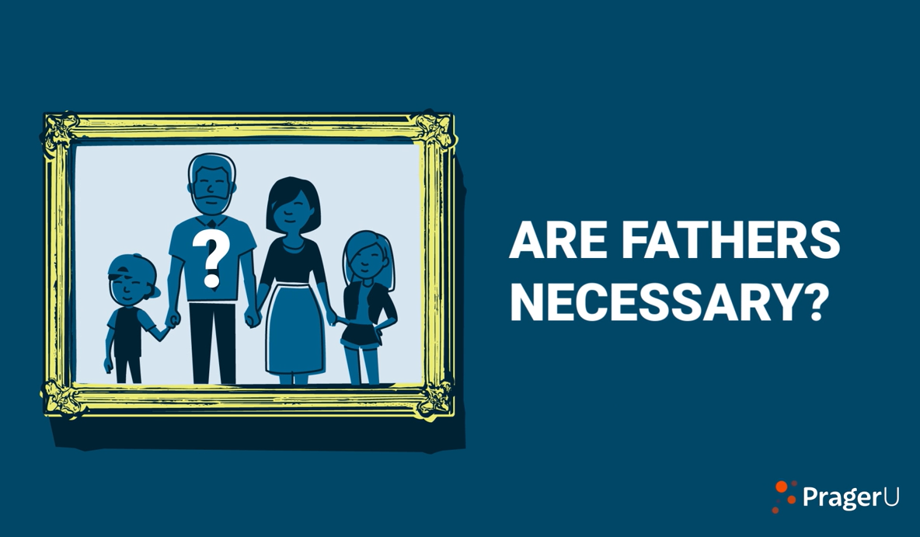
Notes:
https://www.prageru.com/video/are-fathers-necessary/?utm_source=Iterable&utm_medium=email&utm_campaign=campaign_2413996
To 5.27

Slide 31
Outline
Fatherhood in scripture
Feelings of fatherlessness
Overcoming Fatherlessness
A civilization of Fatherlessness
Standing in the Father’s love

Slide 32
Implanting vision to overcome

Slide 33
1. He is protective: A good dad protects his kids by drawing clear boundaries, considers their best interests, talks to them about things they should be aware of and puts things in place. He teaches his kids about consequences of making the wrong choices. Fathers instill character development in kids

Slide 34
2. Affection is his middle name:
A good father is affectionate to his children. Though he may not hug and kiss the child like a mother does, his affection is no less than a mother’s. He lets the children know they can count on him.

Slide 35
3. A wall of trust and security: The children believe that their father is always right. He will never lie to them, he will never betray them, he will never leave them in the lurch. That is the trust a good father builds in a child. The kids know that their father is always there whenever they want some help or whenever they are in trouble.
Notes:
Not always correct, but always righteous.

Slide 36
4. The source of encouragement: You are the source of encouragement to your kid. Be it a football match or a debate competition, your presence at the venue gives a boost to your child’s confidence. You are the happiest when they succeed and you are the one who will make them strive better if they fail.

Slide 37
Your words will make a world of difference to your child. Your words have the power to make or break them.

Slide 38
5. Has the patience to listen:
A good father takes out time to listen to their children. He gives his kids undivided attention and tries to understand things from their perspective.

Slide 39
6. Provides the necessities of life:
As the head of the family, the father is responsible for giving a decent living for his children, be it a home, food, education or love, security, and attention.

Slide 40
7. Respects the mother of his children:
Children do well when they see their parents working together. A good father teaches his children how to respect their mother, and this he does by respecting his partner.

Slide 41
He honors her views and does not argue with her in front of the kids. This sends the right message to the children that their parents work together, and they need to respect them both equally.

Slide 42
8. Spending time with him is fun for kids: If the dad is at home, it is a fun time for kids. He plays with them, shares some tricks and shortcuts, makes their artwork easy, and their homework enjoyable. He involves them in things he likes to do. Television, laptops, and phones are put aside.
Notes:
Emergency frisbee in my trunk

Slide 43
9. He is the best teacher: A father teaches lessons not just for academics but about life. He shows how children can channelize their emotions when met with failure or disappointment, how they can use their energy for their good, how they can plan their careers or study hours.

Slide 44
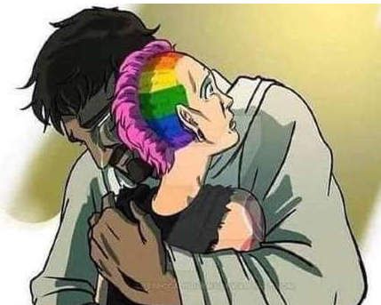
Notes:
On June 7, the Christian rock band Seventh Day Slumber shared an illustration on their Facebook page of Yeshua embracing an LGBTQ person with a pink mohawk, the pride colors prominently displayed on the individual's shaved scalp.
The caption reads, "This picture is a powerful reminder of who God is, how God loves, and how none of us are out of His reach! You can come to Him in your hurt, you can come to Him in your pain, you can come to Him in your sin, you can come to Him in your brokenness. He loves you where you're at. He also loves you too much to leave you there. Be kind to one another. You never know what someone has been through."

Slide 46
Outline
Fatherhood in scripture
Feelings of fatherlessness
Overcoming Fatherlessness
A civilization of Fatherlessness
Standing in the Father’s love

Slide 47
A civilization built with

Slide 48
In the Middle East, where Islam is the dominant religion, the Qur’an teaches that god is not a father to anyone. According to both the Qur’an and Hadith, there are 99 names of god and not one of them reference him as a father. Allah is just another one of those names.
Notes:
https://www.catalyticministries.com/blog/2019/5/21/spiritual-fatherlessness

Slide 49
Nakba Day (يوم النكبة yawm in-nakbah), "day of the catastrophe,” an annual day of commemoration for the Palestinian Arab people of the anniversary of the creation of Israel, every May 15, the day after Israelis celebrate their Independence Day.

Slide 50
Real Naqba, real wound, and hope
^{Beresheet/Genesis 16.1-2} Now Sarai Avram's wife had not borne him a child. But she had an Egyptian slave-girl named Hagar; so Sarai said to Avram, "Here now, ADONI has kept me from having children;
Notes:
Abe w great wisdom and holiness
Hagar ~16 maybe in love some appropriate young man
Snatched by complaining matriarch

Slide 51
^{Beresheet/Genesis 16.1-2} so go in and sleep with my slave-girl. Maybe I'll be able to have children through her.“ Avram listened to what Sarai said.
Notes:
Abe w great wisdom and holiness
Hagar ~16 maybe in love some appropriate young man
Snatched by complaining matriarch

Slide 52
First trouble
^{Beresheet/Genesis 16.4} Avram had sexual relations with Hagar, and she conceived. But when she became aware that she was pregnant, she looked on her mistress with contempt.
Notes:
Tone
Baby grew up w contempt in family,
Hagar prob festering anger כי forced
Hormones → fetus

Slide 53
First Reaction
^{Beresheet/Genesis 16.5-6} Sarai said to Avram, "This outrage being done to me is your fault! True, I gave my slave-girl to you to sleep with; but when she saw that she was pregnant, she began holding me in contempt. May ADONI decide who is right - I or you!”
Notes:
Sarah’s response: Contempt and harshness: babies hear emotional messages

Slide 54
First Reaction
^{Beresheet/Genesis 16.5-6} However, Avram answered Sarai, “Look, she's your slave-girl. Deal with her as you think fit.” Then Sarai treated her so harshly that she ran away from her.
Notes:
Sarah’s response: Contempt and harshness: babies hear emotional messages

Slide 55
First Restoration
^{Beresheet/Genesis 16.7-9} The angel of ADONI found her by a spring in the desert, the spring on the road to Shur, and said, "Hagar! Sarai's slave-girl! Where have you come from, and where are you going?" She answered, "I'm running away

Slide 56
First Restoration
^{Beresheet/Genesis 16.7-9} from my mistress Sarai." The angel of ADONI said to her, "Go back to your mistress, and submit to her authority."

Slide 57
First Redemption
^{Beresheet/Genesis 16.10-12} The angel of ADONI said to her, "I will greatly increase your descendants; there will be so many that it will be impossible to count them." The angel of ADONI said to her, "Look, you are pregnant, …"
Notes:
Three promises

Slide 58
First Redemption
^{Beresheet/Genesis 16.10-12} and you will give birth to a son. You are to call him Yishma'el [God pays attention] because ADONI has paid attention to your misery. He will be a wild donkey of a man…"
Notes:
Three promises

Slide 59
First Redemption
^{Beresheet/Genesis 16.13} So she named ADONI, who had spoken with her, El Ro'i [God of seeing], because she said, "Have I really seen the One who sees me [and stayed alive]?“
Firsts:
Multitude of offspring [almost first]
Gender prediction
Divine Naming Yishmael יִשְׁמָעאל

Slide 60
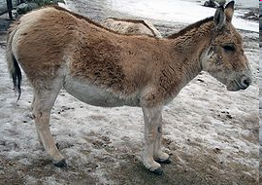
First Character prediction: Wild donkey: The Asian wild ass, also called the onager
Notes:
3.5 First angelic visit
Proud nomadic unconq, independent, to a slave girl forced to an old man FREE
Other not so flattering names: Dan a serpent, Benj a ravenous wolf
~Am mustang

Slide 61
They can run faster than any other horse or donkey, reaching and sustaining speeds of up to about forty-four miles (70 km) per hour.
http://animal.discovery.com/guides/mammals/habitat/aridland/asianass.html
First revelation, seeing G-d ‘El Ro'i [God of my seeing], because she said, “Have I really
Notes:
Saw ישוע first
12 princes Abu Saada p 208
Jeff Seif:
David could be another mother Ps 51
David’s sister Avigayil married Yeter the Yishmaeli 2 Sam 19.13 [355] Amasa nephew of David
1 Chron 2.17 [1152 cjb]
[2 Sam 17.25 complicates]
Camels 1 Chron 27.30 1181

Slide 62
seen the One who sees me [and stayed alive]?”’
First prediction of progeny: 12 17.20 to this day
Notes:
Saw ישוע first
12 princes Abu Saada p 208
Jeff Seif:
David could be another mother Ps 51
David’s sister Avigayil married Yeter the Yishmaeli 2 Sam 19.13 [355] Amasa nephew of David
1 Chron 2.17 [1152 cjb]
[2 Sam 17.25 complicates]
Camels 1 Chron 27.30 1181

Slide 63
First circumcised? Likely, age 13
NOT a cursed son
NOT the covenantal son:
blessing, destiny, Land

Slide 64
Finalized Trouble
^{Beresheet/Genesis 21.8-9} Yitz'chak…grew and was weaned, and Avraham gave a great banquet on the day that Yitz'chak was weaned. But Sarah saw the son of Hagar the Egyptian, whom Hagar had borne to Avraham, making fun of Yitz'chak
Notes:
Making fun means??
Bad relations

Slide 65
Finalized Reaction
^{Beresheet/Genesis 21.10} Sarah said to Avraham, "Throw this slave-girl out! And her son! I will not have this slave-girl's son as your heir along with my son Yitz'chak!"
Expected to have the double blessing of the firstborn
Notes:
NO inheritance
Not correct, instruct, discipline
My Dad threatened repeatedly w me
All to mom anyway

Slide 66
Finalized Status
^{Beresheet/Genesis 21.10} God said to Avraham, "Don't be distressed because of the boy and your slave-girl. Listen to everything Sarah says to you, because it is your descendants through Yitz'chak who will be counted.
Notes:
Sarah didn’t say starve them.
Abe took further, mabye in bitterness “This woman, schemes, complains, rages”

Slide 67
Finalized Rejection: The real Naqba, the real wound
^{Beresheet/Genesis 21.10} Avraham got up early in the morning, took bread and a skin of water and gave it to Hagar, putting it on her shoulder, and the child; then he sent her away.
Cp 25.5-6 “Avraham gave everything he owned to Yitz'chak
Notes:
211-12 Taysir

Slide 68
Finalized Rejection: The real Naqba, the real wound
^{Beresheet/Genesis 21.10} But to the sons of the concubines he made grants while he was still living and sent them off to the east.” No camel or tent for this now single mom?
Notes:
211-12 Taysir

Slide 69
Rejection: You may live or die, it’s of no consequence. You’re dishonorable.
Kicked out of the house, 4000 years trying to get back in. Koran, Land
Doesn’t justify terror.
Notes:
211 Abu Saada
Who of us cares about Arabs?
First time I heeard Tass, hesitant till he apologized.
Our wound, our need,
Presented to Tass, take me to Europe.
Start w me and you → MBB 6 million/yr

Slide 70
Explains?
Hope
Some Jewish leader, Israeli leader, Netanyahu previously or now Naftali Bennet bless the Arabs
Notes:
211 Abu Saada
Who of us cares about Arabs?
First time I heeard Tass, hesitant till he apologized.
Our wound, our need,
Presented to Tass, take me to Europe.
Start w me and you → MBB 6 million/yr

Slide 71
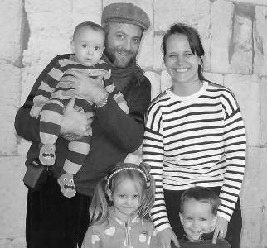
Ariel and Vered Blumenthal
May 2016,
Notes:
As so often happens in this Gathering movement, the Holy Spirit moved powerfully on the group through prophetic, "identificational" acts of reconciliation, intercession and unity - this time bringing healing to the Abrahamic family by us repenting (especially Vered "standing in" as Sarah) and welcoming Hagar and Ishmael (the Egyptians) back into the family.

Slide 72
On the third day of our meeting we had a clear sense that God had brought us together "for such a time as this" (Esther 4:14). As it was with Esther, this time we were led by the women in our midst.

Slide 73
"Egyptian women willingly identified with Hagar and confessed the rejection, envy and resentment she felt when Abraham cast her out of the family as Sarah demanded. (This spirit of rejection has dogged the Arab peoples every generation since.

Slide 74
Those who have been set free from it are often magnificent people, but the ethnic type prevails.) Agonized tears were wept by the Egyptians and everyone else as we experienced a measure of those emotions.

Slide 75
They confessed that they had hated and mocked "Isaac" and his offspring. Then an Israeli mother [Vered] stepped forward to plead, "There are two empty places at our family table. Won't you come home? Our family is not complete.

Slide 76
Isaac needs his older brother, who was blessed by God first." These words don't begin to express the depth of significance and emotion of the moment. I hope you can imagine a bit of the atmosphere

Slide 77
There was much weeping and rejoicing following this time of sharing. And then, the Egyptians began to sing over us, while our 8 month old boy, Lavi, sat on my shoulders giggling and smiling (as he almost always does). It was as if Hagar and Ishmael were singing

Slide 78
rejoicing over Isaac! (Perhaps that's what we should have named our laughing boy.)

Slide 79
Possibly for the first time in history, descendants of Abraham, Isaac, and Jacob came together with the family of Hagar and Ishmael, all of us secure in our eternal inheritance because of our faith in our great, older

Slide 80
brother, Abraham's greatest Son, Yeshua (Romans 8:29-30).

Slide 81
Outline
Fatherhood in scripture
Feelings of fatherlessness
Overcoming Fatherlessness
A civilization of Fatherlessness
Standing in the Father’s love

Slide 82
No one is a cursed son or daughter.
No one is ultimately fatherless.
We all need to receive the Father’s blessing.
We fathers need to GIVE blessing, even if estranged.
Notes:
Pause

Slide 84
Pastor Che Ahn,
Pasedena,
CA

Slide 85
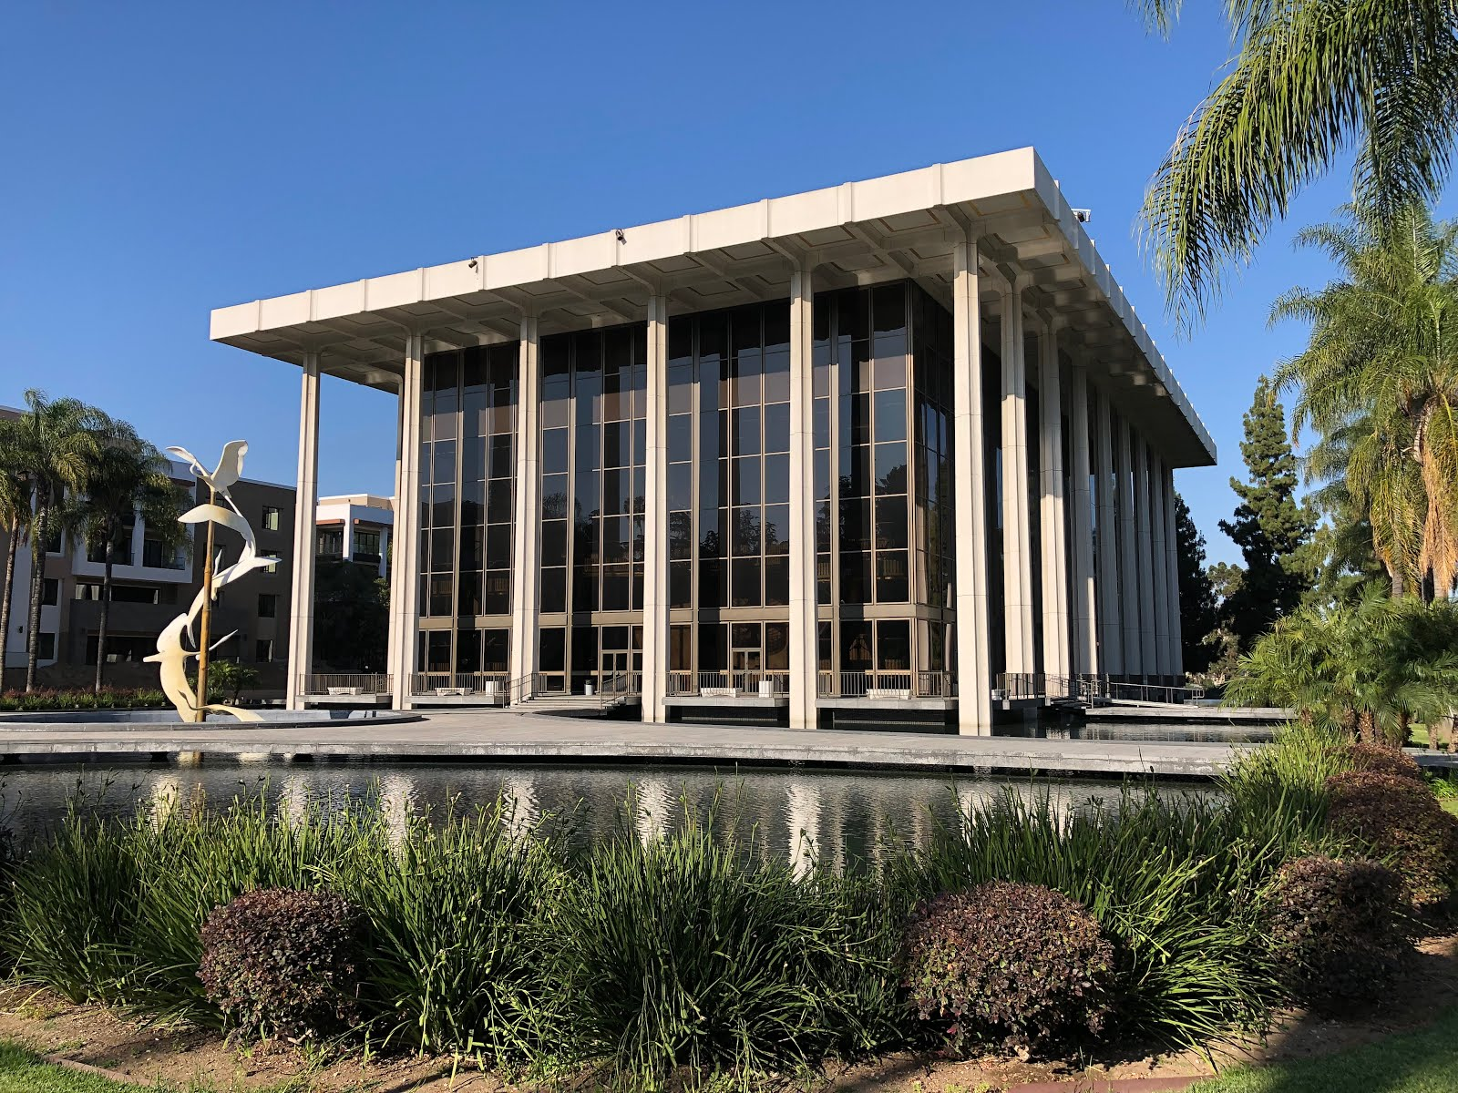

Slide 86
Liberty Counsel, a Christian legal organization that defends religious freedom, filed the lawsuit on behalf of Pastor Che Ahn. Atty Matt Staver recounted that Pastor Ahn "got a letter from the Pasadena criminal prosecutor, threatening him, his staff.”
Notes:
https://www.frc.org/get.cfm?i=WA21E37&f=WU21E12

Slide 87
The letter threatened any churchgoer with "criminal charges, up to one year in prison, and daily fines of a thousand dollars. And so [Pastor Ahn] had to tell his church members" that they could face criminal charges for coming to church.
Notes:
https://www.frc.org/get.cfm?i=WA21E37&f=WU21E12

Slide 88
Pastor Ahn worried that many people would refrain from coming to church. Yet, the opposite turned out to be the case. Most of the congregation continued attending services, and other Christians looking for a church and even non-believers who were interested starting attending Harvest Rock Church.
Notes:
https://www.frc.org/get.cfm?i=WA21E37&f=WU21E12

Slide 89
Staver says that other pastors who stood up to unfair coronavirus restrictions are experiencing similar growth. Churches that "stood up against this adversity, this persecution, they're seeing revival happening in their communities.“
Notes:
https://www.frc.org/get.cfm?i=WA21E37&f=WU21E12

Slide 90
Governor Newsom's yearlong COVID-19 restrictions on churches were so strict that Californians were even banned from participating in Bible studies in private homes and singing. With the new permanent statewide injunction, this will never be allowed to happen in California again.
Notes:
https://www.frc.org/get.cfm?i=WA21E37&f=WU21E12

Slide 91
In a February 11 "directive," HUD announced penalties, including possible jail time and up to hundreds of thousands of dollars in fines, for all institutions receiving federal funds which maintained separate bathrooms, showers, and housing based on sex or gender identity.
Notes:
https://www.frc.org/get.cfm?i=WA21F32&f=WU21F11
Tony Perkins

Slide 92
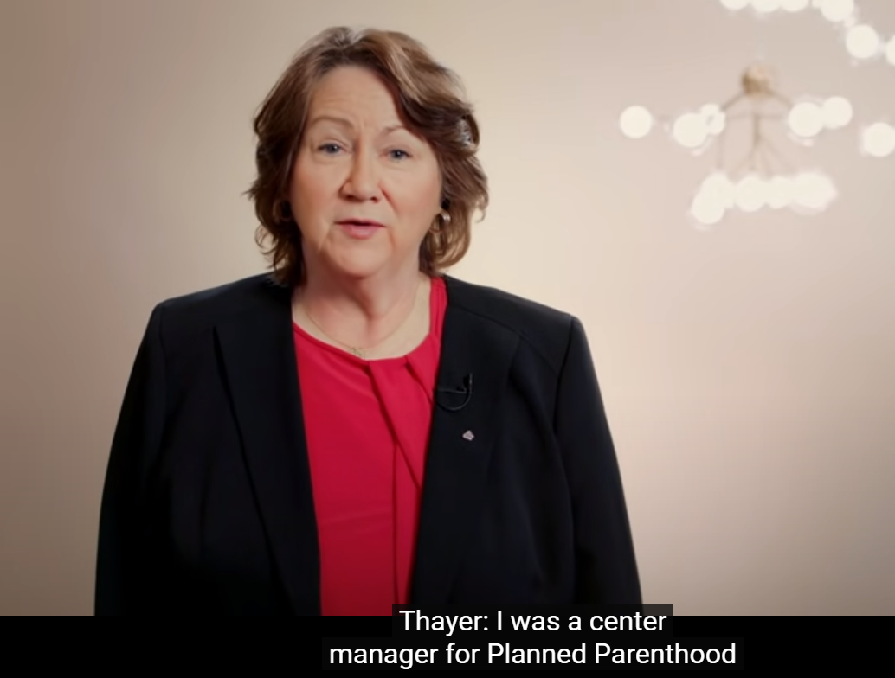
Sue Thayer, center manager for Planned Parent-hood 18 years
Notes:
https://www.youtube.com/watch?app=desktop&v=e67UKZEUDWo&feature=share
3.10 to 5.13
OH Oct 19, 2021

Slide 93
Notes:
https://www.youtube.com/watch?v=L9hd9AIgmL4&t=7s
13.13 to 13.44 and 29.23 to 31.02

Slide 94
Do you KNOW the Father’s love in Yeshua and sins forgiven?
Are you surrendered to Messiah, body, soul, spirit? Walking in relational love, confessing?
Are you filled with His Spirit, transforming your life?
Who are you discipling, building up?

