Slide 1
e-handout
To have these notes
without taking notes
Go to OrHaOlam.com
Click on downloads,
messages, 2021

Slide 2
Kataluna Enriquez
Miss Nevada 2021
Ángela Ponce
Miss Universe Spain 2018
Notes:
To any listening, particularly any who are in a gay or transgender lifestyle, we DON'T deride you or demean you or ridicule you. Neither do we minimize any wounds that may have driven your lifestyle decisions. G-d's ways of simplicity of two genders from conception may seem simplistic and rigid, and have been presented with cruelty, and we deeply regret that and disavow anything but love for you.

Slide 3
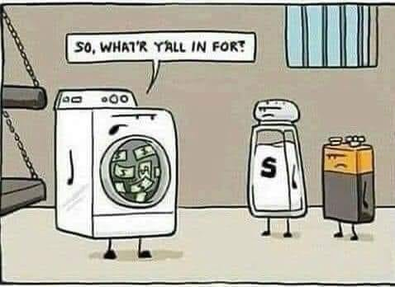

Slide 4
Money laundering, assault and battery
Notes:
Lori Wilson

Slide 5
The Scream: the agonized face in the painting has become one of the most iconic images of art, seen as symbolizing the anxiety of the human condition.
Notes:
The Norwegian title is Skrik (Shriek), created by Norwegian Expressionist artist Edvard Munch in 1893
The rest of the story…

Slide 6
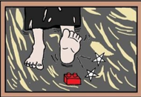
Notes:
Lori Wilson

Slide 7
From the Kansas Airshow,
New Century AirCenter, Olathe, July 4, 2021

Slide 8
F-18 Super Hornets

Slide 9
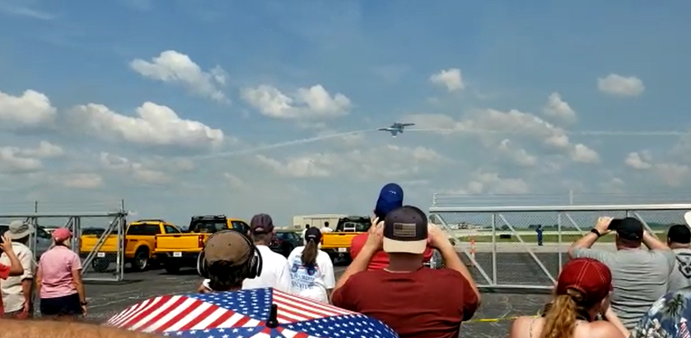
Notes:
Greg McIntire photog

Slide 10
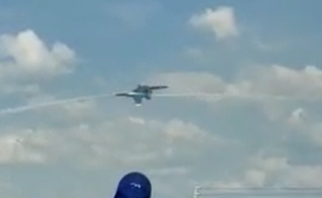

Slide 11
^{Eikhah/ Lam. 5.21} הֲשִׁיבֵנוּ Hashivenu

Slide 12
Tisha B’Av 9th of Av
[Hebrew calendar]
July 17 evening, 2021

Slide 13
Tisha B’Av commemorates the pattern of sin and wrath, and is the premier expression of repentance.

Slide 14
The Twelve Spies sent by Moses to observe the land of Canaan returned from their mission.
The First Temple built by King Solomon was destroyed by Nebuchadnezzar in 587 BCE,

Slide 15
The Second Temple built by Ezra and Nehemiah was destroyed by the Romans in 70 CE [hatred]
The Romans subsequently crushed Bar Kokhba's revolt and destroyed the city of Betar, killing over 500,000 Jewish civilians

Slide 16
The First Crusade officially commenced on August 15, 1096
The Jews were expelled from England on July 18, 1290
The Jews were expelled from France on July 22, 1306
The Jews were expelled from Spain on July 31, 1492

Slide 17
^{Eikhah/ Lam. 5.21} הֲשִׁיבֵנוּ Hashivenu
Cause us to Return
Adoni, turn us back to you; and we will come back;
renew our days,
as they were in the past.

Slide 19
Outline
Why have a Messianic Jewish Congregation?

Slide 20
Outline
Why have a Messianic Jewish Congregation? To show the power of G-d in Messiah, to the Jew first
Blessing
Wrath
Notes:
Note the dual nature of the concept.

Slide 21
^{Ro. 1.16} The Good News…is the power of God for salvation to everyone who trusts—to the Jew first and also to the Greek.
Notes:
Blessing

Slide 22
^{Ro. 2.9} He will pay back misery and anguish to every human being who does evil, to the Jew first, then to the Gentile.
Notes:
Wrath
This is a basic concept of history, from G-d’s point of view. Exploring today.

Slide 23
Original covenant to the Jews of was also of Blessing / wrath
Notes:
From the Torah…

Slide 24
^{Vayikra/Lev 26.3-7}“If you walk in My statutes, keep My mitzvot and carry them out, then I will give you rains in their season, the land will yield its crops, and the trees of the field will yield their fruit. Your threshing will last until grape gathering, the grape gathering will last until the sowing time,

Slide 25
^{Vayikra/Lev 26.3-7}you will eat your bread to the full, and live securely in your land. “I will bring shalom in the land, and you will lie down, with no one making you afraid. I will remove dangerous beasts from the land and no sword will pass through your land. You will chase your enemies and they will fall before you by the sword.
Notes:
This was actually the convincing argument in my own soul in April 1969, that convinced me that the Jewish people did NOT have the right relationship with our G-d.

Slide 26
^{Vayikra/Lev 26.14-17} “But if you will not listen to Me, nor carry out all these mitzvot, and if you reject My statutes and if your soul abhors My ordinances, so that you do not keep all My mitzvot, but instead break My covenant, then I will do the following to you in return.

Slide 27
^{Vayikra/Lev 26.14-17} I will appoint terror over you, wasting disease and fever that will dim the eyes and cause the soul to pine away. You will sow your seed in vain, because your enemies will eat it. I will set My face against you and you will be routed before your enemies. Those who hate you will rule over you, and you will flee when no one pursues you.
Notes:
Listen to these words. They are….Biblical proportions!
Terror, disease, poverty, enemies, subjugation!
And then…multipliers. Note verse numbers.

Slide 28
^{Vayikra/Lev 26.18} “If you, in spite of these things, will not listen to Me, then I will chastise you seven times more for your sins…
^{Vayikra/Lev 26.21} then I will multiply the plagues on you seven times like your sins.

Slide 29
^{Vayikra/Lev 26.23-24} “Now if in spite of these things you will not be chastened by Me, but walk contrary to Me instead, then I will also walk contrary to you. Then I will strike you, I Myself, seven times for your sins…

Slide 30
^{Vayikra/Lev 26.27-29} “Yet if in spite of this you will not listen to Me but walk contrary to Me, then I will walk contrary to you in wrath. So I will chastise you seven times for your sins. You will eat the flesh of your sons and you will eat the flesh of your daughters.
7 x 7 x 7 x 7 = 7⁴ = 2401 fold
Notes:
Starvation → cannibalism of one’s own kids would seem to be the 2401 fold.
I was at a Bar Mitzvah where this was read, and the parents were giving a drash. They were able to reassure the Bar Mitzvah boy that since they were vegans, this wouldn’t happen.

Slide 31
Then it happened over Jewish history.
The kings and leadership, and the vast majority of the Jewish people, gave themselves to debauched, sensual idolatry, and ultimately the Babylonians came.

Slide 32
605 BCE N’vukhadnetzar of Babylon besieged Jerusalem and took nobles captive. Daniel 1.
598 He took 10,000 prisoners and some Temple treasures.
586 9th of Av, burned the city, the Temple, took more captives
Notes:
3 week conquest starting Tzom Tammuz 17, Sunday, June 27 till July 17
June 27 fast commemorating breaching of the walls of Jerusalem, beginning of conquests, before the destruction of the Second Temple July 17. We didn’t promote it at all.

Slide 33
The Book אֵיכָה Eikhah Lamentations was written by the prophet Yermiyahu/Jeremiah, lamenting the tragedy of the destruction of Jerusalem. It seems to fulfill the 2401 fold prophecy of punishment.
Notes:
We like to say that G-d doesn’t cause tragedy, but it’s a human condition that He allows.
Not always. Yermiyahu/ Jeremiah seems to see the direct wrath of G-d on Israel.

Slide 34
Verses describing the 7⁴ = 2401 fold wrath…

Slide 35
^{Eikhah /Lam 1.1} How lonely sits the city, once so full of people! has become like a widow.
אֵיכָה יָשְׁבָה בָדָד הָעִיר רַבָּתִי עָם ,הָיְתָה כְּאַלְמָנָה

Slide 36
^{1.5} Adoni has made her suffer because of her many sins. Her young children have gone away captive before the foe.
Notes:
Note causality…

Slide 37
^{1.7} Her enemies are gloating over her, mocking her desolation.
^{1.8} Yerushalayim sinned grievously;
therefore she has become unclean.
All who honored her now despise her, because they have seen her naked.
Notes:
Shame, abandonment, contempt

Slide 38
^{1.11} All her people are groaning,
as they search for something to eat….how despised I am
^{1.12} Look and see! Is any suffering like my suffering that was brought on me, that Adoni has inflicted in the day of His fierce anger?
^{1.14} Adoni has put me into the power
of those I cannot withstand.
Notes:
Note causality…Adoni did this

Slide 39
^{1.13} “From on high, he sent down fire
deep into my bones; he spread a net to catch my feet; he turned me back; he left me desolate, in misery all day long.

Slide 40
^{1.14-15} Adoni has put me into the power
of those I cannot withstand. “All the strong men within my walls Adoni has rejected. He has set a specific time for crushing my young men. Adoni has trodden, like grapes in a winepress, the virgin daughter of Y’hudah.

Slide 41
^{1.17} Concerning Ya‘akov, Adoni has ordered those around him to be his foes; Yerushalayim has become for them an unclean, filthy thing.
^{1.21} All my foes have heard of my trouble; they are glad that you have done it.

Slide 42
2.1 How enveloped in darkness Adoni, in his anger, has made the daughter of Tziyon! He has thrown down from heaven to earth the splendor of Isra’el, forgotten his footstool [the sanctuary] on the day of his anger.

Slide 43
^{2.3-4} In his fierce anger he cut off all the power of Isra’el, He bent his bow like an enemy, with his right hand set like a foe. He killed all who were pleasant to see. He bent his bow like an enemy, with his right hand set like a foe. He killed all who were pleasant to see.

Slide 44
2.7 Adoni rejected his altar, disowned his sanctuary, and gave her palace walls over to the power of the foe, who raised such shouts in the house of Adoni that it sounded like a festival day.

Slide 45
^{2.8} Adoni resolved to destroy the wall of the daughter of Tziyon. He measured it with his line and did not stay his hand until it was all in ruins. He brought grief to rampart and wall; together they lie dejected.

Slide 46
^{2.9} Her bars He destroyed and shattered. Her king and princes are among nations. There is no more Torah. Also her prophets find no vision from Adoni.

Slide 47
2.11-12 My eyes are worn out from weeping, everything in me is churning; I am empty of emotion because of the wounds to my people, because children and infants are fainting away in the streets of the city.

Slide 48
2.11-12 They keep asking their mothers, “Where is something to eat or drink?” as they faint away in the streets of the city, gasping out their last breath in their mother’s bosom.

Slide 49
^{2.17} Adoni has done what he planned, he has fulfilled his promise, which he decreed in ancient times. He has destroyed without pity, he has let the enemy gloat over you and filled your foes with pride.

Slide 50
^{2.20-21} Look, Adoni, and consider with whom You have dealt so severely! Should women eat their offspring, their healthy newborn infants? Should kohen and prophet be slain in the Sanctuary of Adoni?

Slide 51
^{2.20-21} On the ground in the streets lie both young and old. My maidens and my young men have fallen by the sword. You slew them in the day of Your anger. You slaughtered them without pity.

Slide 52
^{2.22} On the day of Adoni’s anger, not one escaped; not one survived — the children I held in my arms and raised, my enemy has destroyed.

Slide 53
^{3.4} He made my flesh and my skin waste away, broken my bones. He has besieged me and surrounded me with bitterness and hardship.

Slide 54
^{3.10-11} He lies in wait for me like a bear, like a lion in hiding. He has forced me aside and torn me to pieces, leaving me stunned.
^{3.16-17} He has broken my teeth with gravel and pressed me down into ashes. I have been so deprived of peace, I have so forgotten what happiness is.

Slide 55
^{3.44-45} You have covered yourself with a cloud so thick that no prayer can pass through. You have reduced us to rubbish and filth among the peoples.

Slide 56
^{4.10-11} With their own hands compassionate women have cooked their own children; their children became their food when the daughter of my people was destroyed. Adoni has finished with his fury, he has poured out his blazing wrath; he kindled a fire in Tziyon that consumed its very foundations.

Slide 57
^{4.4-6} The tongue of the baby at the breast sticks to the roof of its mouth from thirst; young children are begging for bread, but no one is giving them any. People who once ate only the best lie dying in the streets;

Slide 58
^{4.4-6} those who were raised wearing purple are clawing at piles of garbage. For the offense of the daughter of my people is greater than the sin of S’dom, which was overthrown in an instant, without a hand to help her.

Slide 59
^{5.1-4} Remember, Adoni, what has happened to us; look, and see our disgrace. The land we possessed has been passed on to strangers, our homes to foreigners. We have become fatherless orphans, our mothers now are widows. We have to pay to drink our own water; we have to buy our own wood.

Slide 60
Outline
Why have a Messianic Jewish Congregation? To show the power of G-d in Messiah to the Jew first
Blessing
Wrath

Slide 61
Yet, verses in Eikhah/Lamentations describing mercy and blessing…

Slide 62
^{2.18-19} Their hearts cried out to Adoni, “Wall of the daughter of Tziyon! Let your tears stream down like a torrent, day and night! Give yourself no respite, give your eyes no rest! “Get up! Cry out in the night, at the beginning of every watch!
Notes:
This is the prophet’s remedy.

Slide 63
^{2.18-19} Pour your heart out like water before the face of Adoni! Lift up your hands to him for the lives of your babies, who are fainting away from hunger at every street corner.”

Slide 64
^{3.21-32} This I recall to my heart— therefore I have hope: Because of the mercies of Adoni we will not be consumed, for His compassions never fail. They are new every morning! Great is Your faithfulness. “Adoni is my portion,” says my soul, “therefore I will hope in Him.”
Notes:
In the midst of this darkness and despair!

Slide 65
^{3.21-32} Adoni is good to those who wait for Him, to the soul that seeks Him. It is good to wait quietly for the salvation of Adoni. It is good for a man to bear the yoke in his youth. Let him sit alone and be silent, since He has laid it upon him.

Slide 66
^{3.21-32} Let him put his mouth in the dust— there may yet be hope. Let him offer his cheek to the one who strikes him. Let him have his fill of disgrace. For Adoni will not reject forever. For though He has caused grief, yet He will have compassion according to His abundant mercies.

Slide 67
^{3.38-42} Don’t both bad things and good proceed from the mouth of the Most High? Why should anyone alive complain, even a strong man, about the punishment for his sins? Let us examine and test our ways and return to Adoni.

Slide 68
^{3.38-42} Let us lift up our hearts and our hands to God in heaven and say, “We, for our part, have transgressed and rebelled; you, for your part, have not forgiven.
Notes:
Examine our hearts: personal, also identificational repentance.

Slide 69
^{5.21} Bring us back to You, Adoni, and we will return. Renew our days as of old.
הֲשִׁיבֵנוּ יְיָ אֵלֶיךָ וְנָשׁוּבָה, חַדֵּשׁ יָמֵינוּ כְּקֶדֶם.
Hashivenu, hashivenu, Adoni eilekha, v’nashuva.
Khadesh, khadesh, yamenu k’kedem
Notes:
This pattern hasn’t stopped. There is yet unmitigated, unreasonable, implacable destructive hatred for Jews and Israel.

Slide 70
^{Eikhah/ Lam. 5.21} הֲשִׁיבֵנוּ Hashivenu

Slide 71
Outline
Why have a Messianic Jewish Congregation? To show the power of G-d in Messiah to the Jew first
Blessing
Wrath

Slide 72
The wrath is not over…

Slide 73
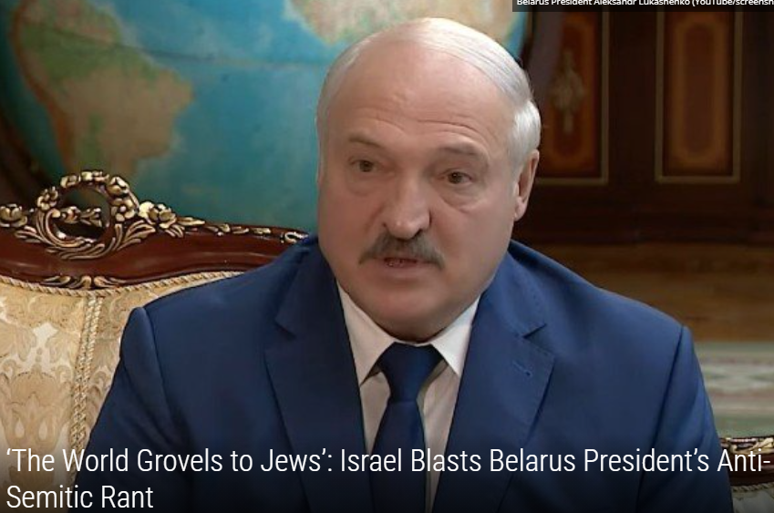
Belarus President Aleksandr Lukashenko
Notes:
https://unitedwithisrael.org/the-world-grovels-to-jews-israel-blasts-belarus-presidents-anti-semitic-rant/?utm_source=newsletters_unitedwithisrael_org&utm_medium=email&utm_content=Spy+for+a+Day%3F+Israeli+President+Goes+%E2%80%98Undercover%E2%80%99%E2%80%99%3B+Tlaib%27s+Comedian+Pal+Hates+Israel%2C+but+Enjoys+Citizenship%3B+%E2%80%98Israel+Did+It%E2%80%99%3A+Iran+Accuses+%E2%80%98Zionists%E2%80%99+of+Attack+on+Nuclear+Site&utm_campaign=20210707_m163915298_Spy+for+a+Day%3F+Israeli+President+Goes+%E2%80%98Undercover%E2%80%99%E2%80%99%3B+Tlaib%27s+Comedian+Pal+Hates+Israel%2C+but+Enjoys+Citizenship%3B+%E2%80%98Israel+Did+It%E2%80%99%3A+Iran+Accuses+%E2%80%98Zionists%E2%80%99+of+Attack+on+Nuclear+Site&utm_term=more_btn_dark_jpg

Slide 74
Addressing an Independence Day event in the capital of Minsk on Saturday, the Belarussian strongman said, “The Jews managed to force the world to remember the Holocaust. The entire world grovels before them and gives in to them. They are afraid to say a single word out of place.”
Notes:
https://unitedwithisrael.org/the-world-grovels-to-jews-israel-blasts-belarus-presidents-anti-semitic-rant/?utm_source=newsletters_unitedwithisrael_org&utm_medium=email&utm_content=Spy+for+a+Day%3F+Israeli+President+Goes+%E2%80%98Undercover%E2%80%99%E2%80%99%3B+Tlaib%27s+Comedian+Pal+Hates+Israel%2C+but+Enjoys+Citizenship%3B+%E2%80%98Israel+Did+It%E2%80%99%3A+Iran+Accuses+%E2%80%98Zionists%E2%80%99+of+Attack+on+Nuclear+Site&utm_campaign=20210707_m163915298_Spy+for+a+Day%3F+Israeli+President+Goes+%E2%80%98Undercover%E2%80%99%E2%80%99%3B+Tlaib%27s+Comedian+Pal+Hates+Israel%2C+but+Enjoys+Citizenship%3B+%E2%80%98Israel+Did+It%E2%80%99%3A+Iran+Accuses+%E2%80%98Zionists%E2%80%99+of+Attack+on+Nuclear+Site&utm_term=more_btn_dark_jpg

Slide 75
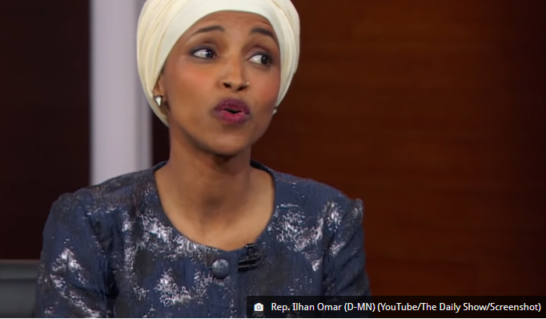

Slide 76
Omar’s aim is to delegitimize Israel as no longer the necessary and indigenous safe haven for persecuted world Jewry, but rather the final stand of colonialism that must be destroyed. Then one must delegitimize Jewish victimhood altogether.
Notes:
https://worldisraelnews.com/opinion-diagnosing-ilhan-omars-anti-semitic-disease/?utm_source=newsletters_worldisraelnews_com&utm_medium=email&utm_content=Biden+Freezes+Trump%E2%80%99s+Israeli-Arab+Abraham+Fund%3B+Sarsour+Plays+Victim+After+Slamming+Israeli+Rescue+Efforts+in+Miami%3B+Stabbing+of+Rabbi+Not+%E2%80%98Fit+to+Print%E2%80%99+in+NY+Times&utm_campaign=20210707_m163914710_Biden+Freezes+Trump%E2%80%99s+Israeli-Arab+Abraham+Fund%3B+Sarsour+Plays+Victim+After+Slamming+Israeli+Rescue+Efforts+in+Miami%3B+Stabbing+of+Rabbi+Not+%E2%80%98Fit+to+Print%E2%80%99+in+NY+Times&utm_term=_0D_0A_09_09_09_09_09_09_09_09_09_09Read+Now_0D_0A_09_09_09_09_09_09_09_09_09

Slide 77
With that, it’s not only easier for Omar to isolate and cast Jews as white racists to conceal her anti-Semitic goals, but she can also effortlessly deflect the anti-Semitic label by in turn accusing Jews of being bigoted toward her, a Muslim woman of color.
Notes:
https://worldisraelnews.com/opinion-diagnosing-ilhan-omars-anti-semitic-disease/?utm_source=newsletters_worldisraelnews_com&utm_medium=email&utm_content=Biden+Freezes+Trump%E2%80%99s+Israeli-Arab+Abraham+Fund%3B+Sarsour+Plays+Victim+After+Slamming+Israeli+Rescue+Efforts+in+Miami%3B+Stabbing+of+Rabbi+Not+%E2%80%98Fit+to+Print%E2%80%99+in+NY+Times&utm_campaign=20210707_m163914710_Biden+Freezes+Trump%E2%80%99s+Israeli-Arab+Abraham+Fund%3B+Sarsour+Plays+Victim+After+Slamming+Israeli+Rescue+Efforts+in+Miami%3B+Stabbing+of+Rabbi+Not+%E2%80%98Fit+to+Print%E2%80%99+in+NY+Times&utm_term=_0D_0A_09_09_09_09_09_09_09_09_09_09Read+Now_0D_0A_09_09_09_09_09_09_09_09_09

Slide 78
her 2012 claim that Israel had “hypnotized the world, may Allah awaken the people and help them see the evil doings of Israel,”
her 2019 tweet in which she claimed that the American-Israeli alliance is “all about the Benjamins,”
Notes:
https://worldisraelnews.com/opinion-diagnosing-ilhan-omars-anti-semitic-disease/?utm_source=newsletters_worldisraelnews_com&utm_medium=email&utm_content=Biden+Freezes+Trump%E2%80%99s+Israeli-Arab+Abraham+Fund%3B+Sarsour+Plays+Victim+After+Slamming+Israeli+Rescue+Efforts+in+Miami%3B+Stabbing+of+Rabbi+Not+%E2%80%98Fit+to+Print%E2%80%99+in+NY+Times&utm_campaign=20210707_m163914710_Biden+Freezes+Trump%E2%80%99s+Israeli-Arab+Abraham+Fund%3B+Sarsour+Plays+Victim+After+Slamming+Israeli+Rescue+Efforts+in+Miami%3B+Stabbing+of+Rabbi+Not+%E2%80%98Fit+to+Print%E2%80%99+in+NY+Times&utm_term=_0D_0A_09_09_09_09_09_09_09_09_09_09Read+Now_0D_0A_09_09_09_09_09_09_09_09_09

Slide 79
Antisemitism is a “disease of the mind,”
Jews are covetous capitalists and conniving communists
Christ-killing religious fanatics and godless atheists
Notes:
https://worldisraelnews.com/opinion-diagnosing-ilhan-omars-anti-semitic-disease/?utm_source=newsletters_worldisraelnews_com&utm_medium=email&utm_content=Biden+Freezes+Trump%E2%80%99s+Israeli-Arab+Abraham+Fund%3B+Sarsour+Plays+Victim+After+Slamming+Israeli+Rescue+Efforts+in+Miami%3B+Stabbing+of+Rabbi+Not+%E2%80%98Fit+to+Print%E2%80%99+in+NY+Times&utm_campaign=20210707_m163914710_Biden+Freezes+Trump%E2%80%99s+Israeli-Arab+Abraham+Fund%3B+Sarsour+Plays+Victim+After+Slamming+Israeli+Rescue+Efforts+in+Miami%3B+Stabbing+of+Rabbi+Not+%E2%80%98Fit+to+Print%E2%80%99+in+NY+Times&utm_term=_0D_0A_09_09_09_09_09_09_09_09_09_09Read+Now_0D_0A_09_09_09_09_09_09_09_09_09

Slide 80
superhuman rulers of the world, and subhuman leeches of society
Notes:
https://worldisraelnews.com/opinion-diagnosing-ilhan-omars-anti-semitic-disease/?utm_source=newsletters_worldisraelnews_com&utm_medium=email&utm_content=Biden+Freezes+Trump%E2%80%99s+Israeli-Arab+Abraham+Fund%3B+Sarsour+Plays+Victim+After+Slamming+Israeli+Rescue+Efforts+in+Miami%3B+Stabbing+of+Rabbi+Not+%E2%80%98Fit+to+Print%E2%80%99+in+NY+Times&utm_campaign=20210707_m163914710_Biden+Freezes+Trump%E2%80%99s+Israeli-Arab+Abraham+Fund%3B+Sarsour+Plays+Victim+After+Slamming+Israeli+Rescue+Efforts+in+Miami%3B+Stabbing+of+Rabbi+Not+%E2%80%98Fit+to+Print%E2%80%99+in+NY+Times&utm_term=_0D_0A_09_09_09_09_09_09_09_09_09_09Read+Now_0D_0A_09_09_09_09_09_09_09_09_09

Slide 81
Foundations:
Islamophobia and anti-Semitism
Fear of crocodiles and dragons
Notes:
https://thejewishvoice.com/2021/07/the-surfeit-of-politeness-rutgers-apology-to-anti-semites-is-bizarre-and-sick/

Slide 82
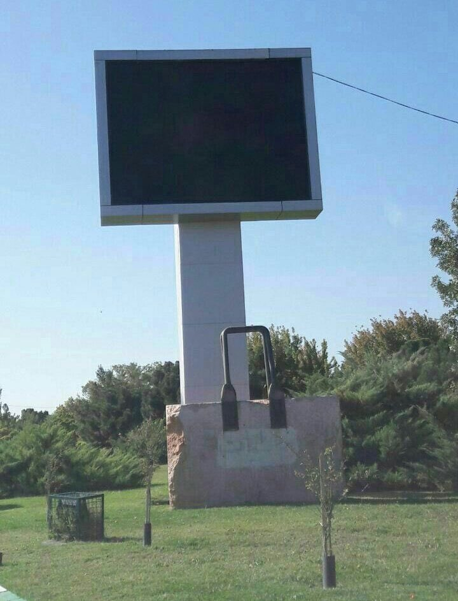
Iranians have erected at least two such countdown clocks since Supreme Leader Ayatollah Ali Khamenei declared in 2015 that Israel would cease to exist by the year 2040.
Notes:
From Roxie Lyle

Slide 83
Iranian regime’s countdown to Israel’s annihilation clock has stopped working because of the power outages that have swept across Iran.
Notes:
From Roxie Lyle

Slide 84
Outline
Why have a Messianic Jewish Congregation? To show the power of G-d in Messiah to the Jew first
Blessing
Wrath

Slide 85
The mercy and redemptive power is not over either

Slide 86
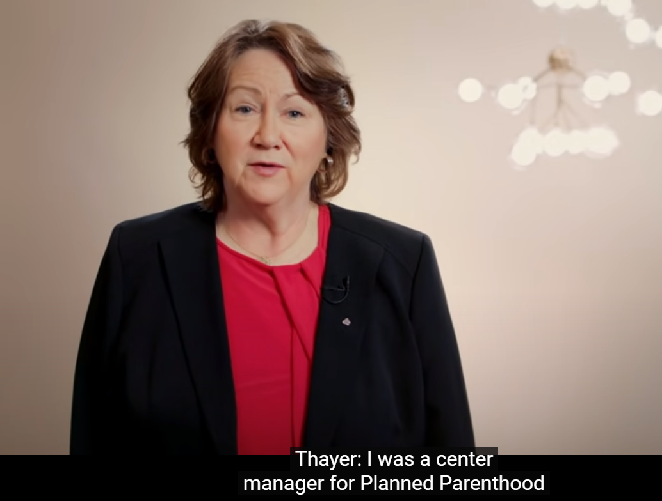
Sue Thayer, center manager for Planned Parent-hood 18 years
Notes:
https://www.youtube.com/watch?app=desktop&v=e67UKZEUDWo&feature=share
3.10 to 5.13
Oct 19

Slide 87
David Yonggi Cho is the founder and pastor of Yoido Full Gospel Church in Seoul, Korea, the largest church in the world with 750,000 members. The key factor in the church’s growth has been an emphasis upon prayer. One of the greatest lies of Satan is that we don’t have enough time to pray.
Notes:
https://learntobewise.com/book-reviews/prayer-that-brings-revival-by-david-yonggi-cho/

Slide 88
However, all of us have enough time to sleep, eat, and breathe. As soon as we realize that praying is as important as sleeping, eating, and breathing, we will be amazed at how much more time will be available to us for prayer. The church has a prayer center called prayer mountain.
Notes:
https://learntobewise.com/book-reviews/prayer-that-brings-revival-by-david-yonggi-cho/

Slide 89
There are normally 3 or 4 thousand believers fasting and praying there during the week and ten thousand on weekends.
Prayer + addictive service.
Notes:
https://learntobewise.com/book-reviews/prayer-that-brings-revival-by-david-yonggi-cho/

Slide 90
^{Ro.2.10-11} Glory and honor and shalom to everyone who keeps doing what is good, to the Jew first, then to the Gentile. For God does not show favoritism.

Slide 91
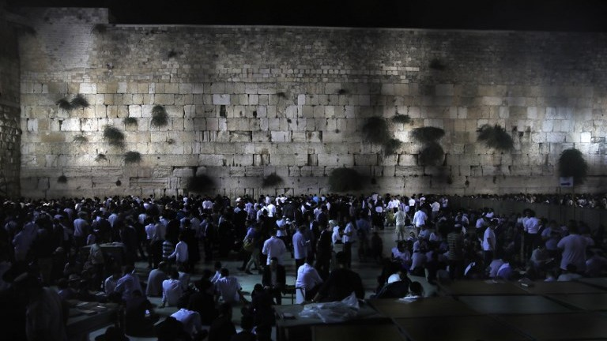
All night prayer on Tisha B’Av
Notes:
https://worldisraelnews.com/opinion-diagnosing-ilhan-omars-anti-semitic-disease/?utm_source=newsletters_worldisraelnews_com&utm_medium=email&utm_content=Biden+Freezes+Trump%E2%80%99s+Israeli-Arab+Abraham+Fund%3B+Sarsour+Plays+Victim+After+Slamming+Israeli+Rescue+Efforts+in+Miami%3B+Stabbing+of+Rabbi+Not+%E2%80%98Fit+to+Print%E2%80%99+in+NY+Times&utm_campaign=20210707_m163914710_Biden+Freezes+Trump%E2%80%99s+Israeli-Arab+Abraham+Fund%3B+Sarsour+Plays+Victim+After+Slamming+Israeli+Rescue+Efforts+in+Miami%3B+Stabbing+of+Rabbi+Not+%E2%80%98Fit+to+Print%E2%80%99+in+NY+Times&utm_term=_0D_0A_09_09_09_09_09_09_09_09_09_09Read+Now_0D_0A_09_09_09_09_09_09_09_09_09

Slide 92
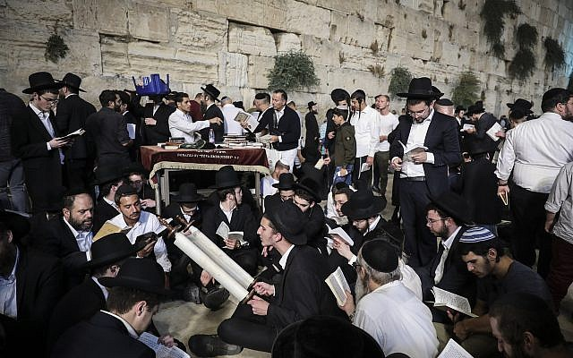

Slide 93
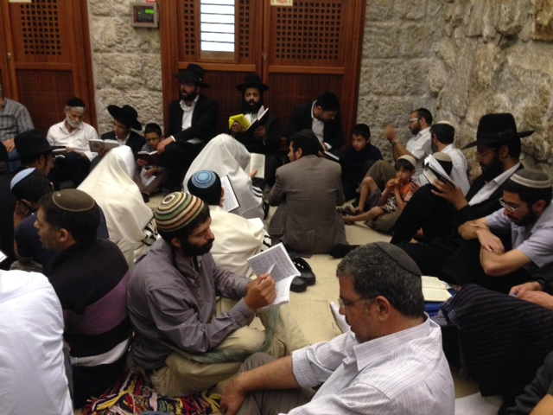
Notes:
https://external-content.duckduckgo.com/iu/?u=https%3A%2F%2Fwww.jewelsofjudaism.com%2Fwp-content%2Fuploads%2F2014%2F08%2FTisha-BAv1.jpg&f=1&nofb=1

Slide 94
You have heard of the Azusa St. revival?

Slide 95
You have heard of the Azusa St. revival?
We are anticipating the Mezuzah St. revival.

Slide 96
Did Yeshua pray?
Yeshua probably came closer to never stopping than any person who has ever lived on this planet. He was continually in a prayer mode. He is shown to pray: alone (Mt 14:23)(Mk 1:35)(Lk 9:18)(Lk 22:39-41), in public (Jn 11:41-42)(Jn 12:27-30), before meals (Mt 26:26)(Mk 8:6)(Lk 24:30)(Jn 6:11), before important decisions (Lk 6:12-13), before healing (Mk 7:34-35), after healing (Lk 5:16), to do the Father’s will (Mt 26:36-44), among other things. He also taught on the importance of prayer (Mt 21:22)(Mk 11:24-26)(Mt 7:7-11)(Lk 11:9-13)(Jn 14:13-14)(Jn 15:7,16)(Jn 16:23-24)(Mt 5:44)(Lk 6:27-28)(Mt 6:5-15: including the Lord’s Prayer)(Lk 11:2-4)(Mt 18:19-20). If you take all of the places that show Yeshua praying, you will have a PERFECT outline of how to pray (check out Jn 17).
Notes:
https://jesusalive.cc/times-jesus-prayed/

Slide 97
Prayer and fasting extra, now till Tisha B’Av. Sign up for 24/7 cyber prayer room.

Slide 98
Do you KNOW Yeshua and the assurance of sins forgiven?
Are you hearing daily from His Word?
What are you doing with what you hear?
Who are you asking this?
Notes:
Who are you discipling, building up?4

Slide 99
^{Eikhah/ Lam. 5.21} הֲשִׁיבֵנוּ Hashivenu

Slide 100
^{5.21} Bring us back to You, Adoni, and we will return. Renew our days as of old.
הֲשִׁיבֵנוּ יְיָ אֵלֶיךָ וְנָשׁוּבָה, חַדֵּשׁ יָמֵינוּ כְּקֶדֶם.
Hashivenu, hashivenu, Adoni eilekha, v’nashuva.
Khadesh, khadesh, yamenu k’kedem
Notes:
This pattern hasn’t stopped. There is yet unmitigated, unreasonable, implacable destructive hatred for Jews and Israel.

Slide 102
