Slide 1
e-handout
To have these notes
without taking notes
Go to OrHaOlam.com
Click on downloads,
messages, 2021

Slide 2


Slide 3


Slide 4


Slide 5
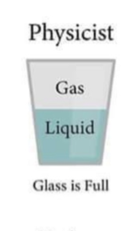

Slide 6


Slide 7


Slide 8


Slide 9
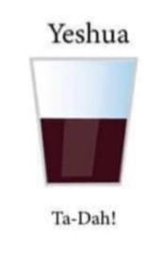

Slide 10
Some local good news

Slide 11
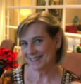
Traci McCabe: Wallet found at Aldis. To the person who found my 92 year old father’s wallet at Aldis at 95th & Antioch & turned it in with EVERYTHING intact, including a lot of cash, THANK YOU! It just proves that there are kind, honest & wonderful people in our neighborhood!
Notes:
https://nextdoor.com/p/96ZQS_Gkddrp?view=detail

Slide 12
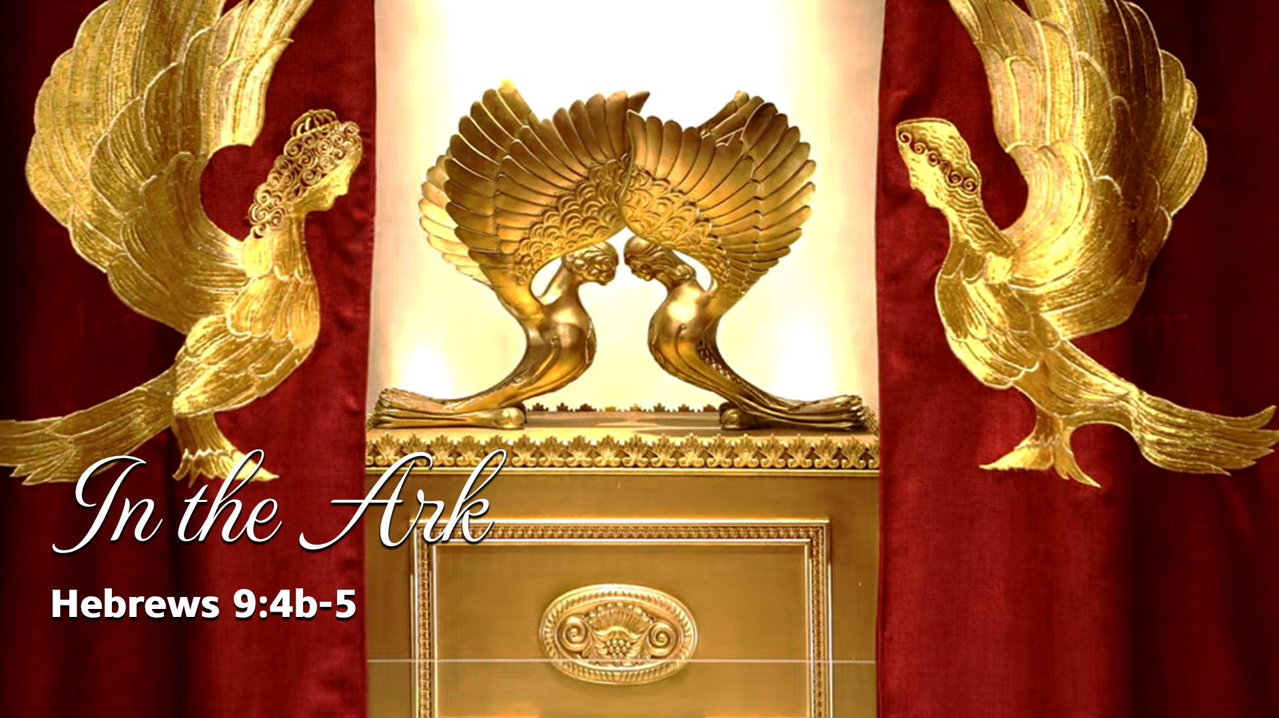

Slide 13
^{MJ 9.4b-5} In the Ark were the gold jar containing the man, Aharon’s rod that sprouted and the stone Tablets of the Covenant; and above it were the k’ruvim representing the Sh’khinah, casting their shadow on the lid of the Ark.

Slide 14
^{MJ 9.4b-5} In the Ark
Original Word: ἐν
Transliteration: en
Definition: in, on, at, by, with

Slide 15
^{MJ 9.4b-5} By the Ark were the gold jar containing the man, Aharon’s rod that sprouted and the stone Tablets of the Covenant; and above it were the k’ruvim representing the Sh’khinah, casting their shadow on the lid of the Ark.

Slide 16
Outline
Supernatural provision: Man מָן

Slide 17
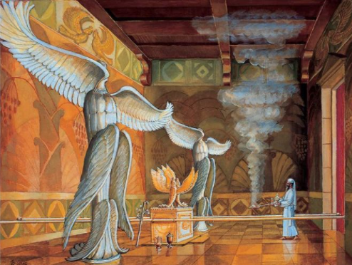
Temple
Institute
rendering
of Solomon’s
Temple

Slide 18
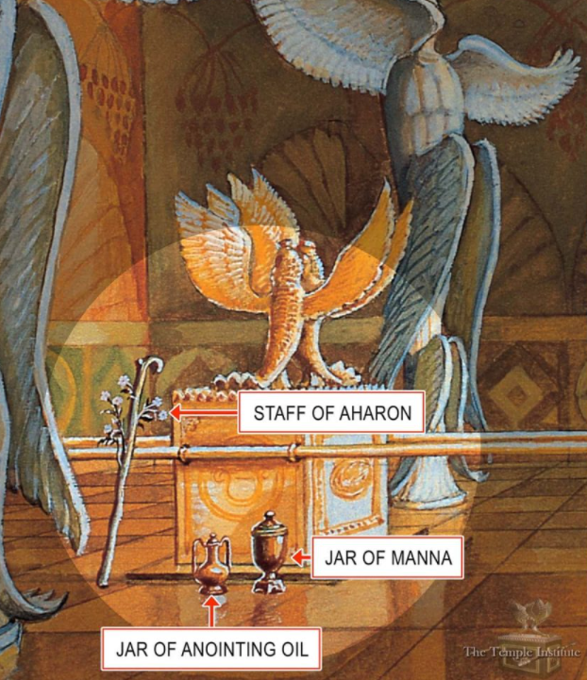
^{Shmot/Ex 16 .32} Moshe
said, “Here is what
Adoni has ordered:
‘Let two quarts of
man be kept through
all your generations,
so that they will be
able to see the

Slide 19
bread which I fed you in the desert when I brought you out of Egypt.’” Moshe said to Aharon, “Take a jar, put in it two quarts of man, and set it aside before Adoni to be kept through all your generations.” Just as Adoni ordered Moshe, Aharon set it aside before the testimony to be kept.

Slide 20
^{Dvarim/Dt 8.3} He fed you manna—which neither you nor your fathers had known—in order to make you understand that man does not live by bread alone but by every word that comes from the mouth of Adonai.
Notes:
Is that how we live? Daily?

Slide 21
Outline: In the Ark
Supernatural provision: Man מָן
Notes:
Divine miracle:
Fresh every morning
Repeat every morning: sameness. Monogamy?

Slide 23
Outline
Supernatural provision: Man מָן
Aharon’s rod that sprouted

Slide 24
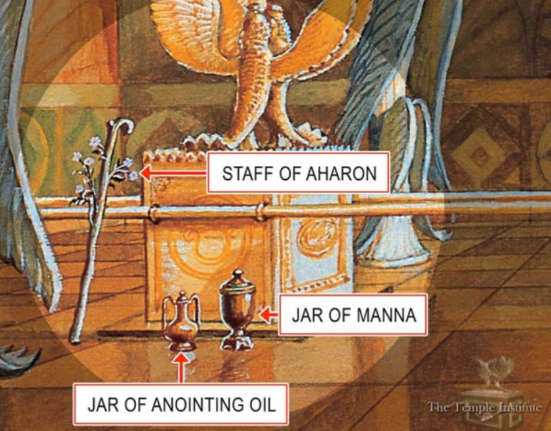

Slide 25
What is the story of the budding rod?

Slide 26
^{Bamidbar 16.1-2} Now Korach the son of Yitz’har, the son of K’hat, the son of Levi, along with Datan and Aviram…rebelled against Moshe. Siding with them were 250 men of Isra’el, leaders of the community, key members of the council, men of reputation.

Slide 27
^{Bamidbar 16.1-2} They assembled themselves against Moshe and Aharon and said to them, “You take too much on yourselves! After all, the entire community is holy, every one of them, and Adoni is among them. So why do you lift yourselves up above Adoni’s assembly?”
Notes:
These guys, the sons of Korakh, felt slighted. Not promoted, rejection, abandoned. RTF “Abandonment is the key to all other wounds.” Gan Eden!
Do you or I have any unforgiven wounds, hurts, slights? Danger!
The essence of leadership is the example of Yeshua: He had no form or majesty that we should look at Him, nor beauty that we should desire Him. He was despised and rejected by men, a man of sorrows, acquainted with grief,
One from whom people hide their faces.
He was despised, and we did not esteem Him.
Love is patient and kind, not jealous, not boastful, not proud. He that is greatest will be your servant.

Slide 28
Moshe’s first strategy:
[Prayer]
^{BaMidbar/Nu.16.4} When Moshe heard this he fell on his face.
Notes:
Moshe’s greatest strength as a leader is his dependence on G-d. On prayer to G-d . On the reality of G-d’s moving in ישראל
Teerosh
Cyber prayer
Not really Jewish? התבודד

Slide 29
Moshe’s second strategy: [Censer test, revelation in prayer?]
^{Bamidbar/Nu 16.6-7} Do this: take censers, Korach and all your group; put fire in them; and put incense in them before Adoni tomorrow. The one whom Adoni chooses will be the one who is holy! It is you, you sons of Levi, who are taking too much on yourselves!"
Notes:
All your group, only cohanim supposed to burn incense.
V 17 Each of you take his fire pan and put incense in it; every one of you, bring before ADONI his fire pan, 250 fire pans, you too, and Aharon - each one his fire pan."
Sort of trial by ordeal, see what happens.

Slide 30
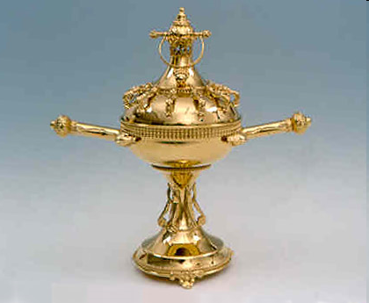
ADONI
ADONI
ADONI
Incense chalice, firepan, מַחְתָּה
ADONI
Notes:
½ oz of incense.
The chalice is carried into the Sanctuary of the Temple, where the golden incense altar stands. Upon entering the Sanctuary the priest sounds the small ring-shaped bell seen on the top of the chalice cover.

Slide 31
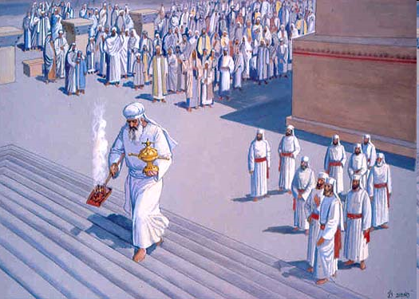
Notes:
Yom Kippur use

Slide 32
^{Bamidbar/Nu} ¹⁶ ¹⁹ When Korah and all his following had assembled in opposition to them at the entrance to the Tent of Meeting, then the glory of Adoni appeared to the entire assembly.
Notes:
Opposers weren’t convinced. Still in opposition!

Slide 33
Moshe’s Third strategy: [Judgment]
^{Nu 16..25-26} Moshe got up and went to Datan and Aviram, and the leaders of Isra'el followed him. There he said to the assembly, "Leave the tents of these wicked men! Don't touch anything that belongs to them, or you may be swept away in all their sins."
Notes:
Really G-d’s strategy

Slide 34
^{Bamidbar/Nu} ^{16.31-33} The ground split under them. The earth opened its mouth and swallowed them, along with all their households, all of Korah’s people and all their possessions. They went down alive into Sheol, they the ground split under them.

Slide 35
^{Bamidbar/Nu} ^{16.35 35} Fire also came out from Adoni and consumed the 250 men offering the incense.

Slide 36
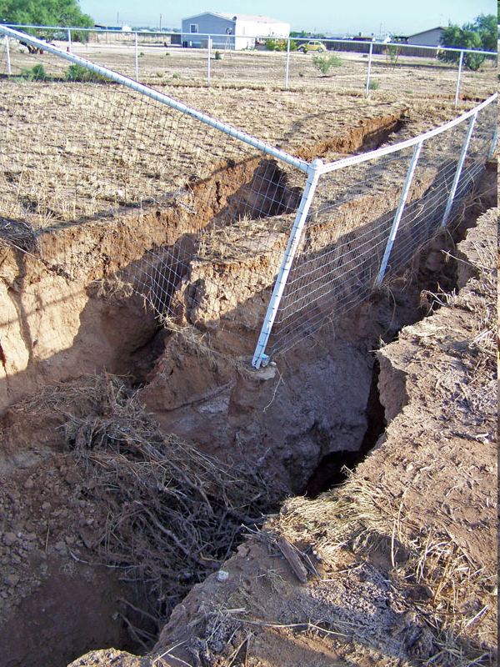
Notes:
sometimes radically surprising things happen

Slide 37
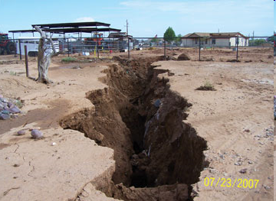

Slide 38
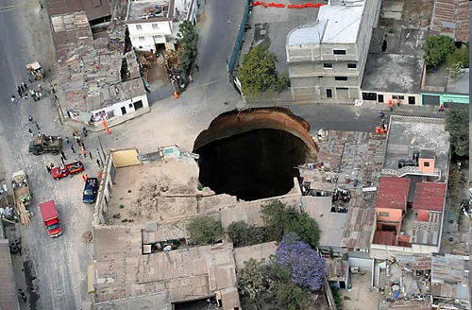
Notes:
Guatemala, also Florida sinkholes
YOU Sometimes our lives seem collapse
Visible
Hidden
BREAK POWER SINK HOLES

Slide 39
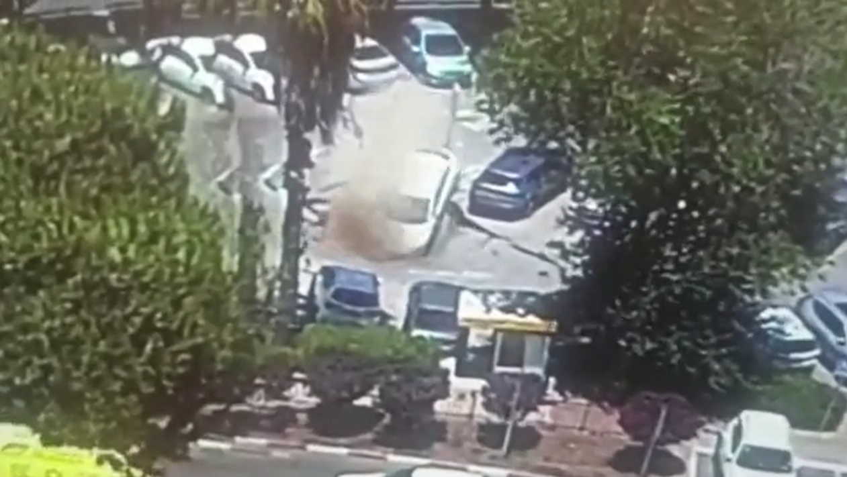
Jerusalem sinkhole swallows up
parked cars Mon, June 7, 2021,
10:41 AM Shaare Zedek
Medical Center
Notes:
https://news.yahoo.com/jerusalem-sinkhole-swallows-parked-cars-154133135.html 0 to 22 sec

Slide 40
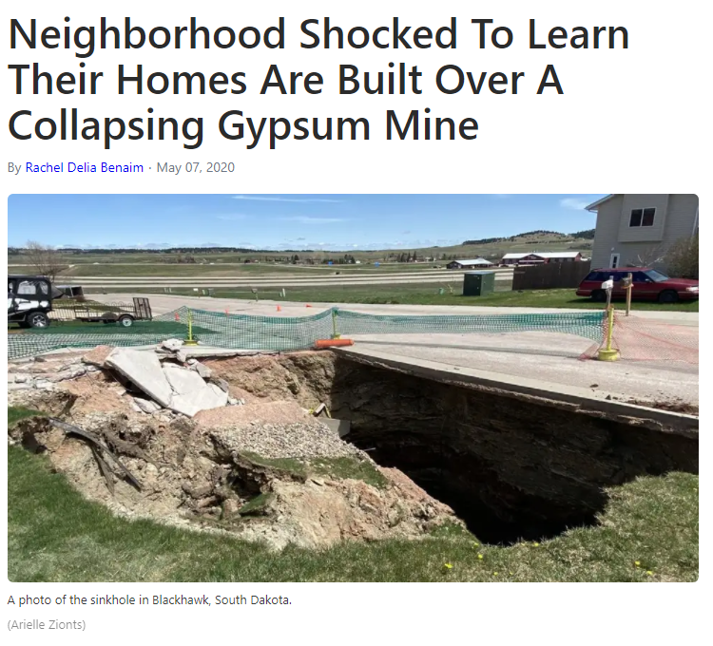
Notes:
https://weather.com/news/news/2020-05-06-blackhawk-south-dakota-sinkhole-over-a-mine
Several homes in the Rapid City area were evacuated after a sinkhole opened into an abandoned gypsum mine located beneath residential homes. actually opened into an abandoned gypsum mine that’s at least 600 feet long and filled with holes from drilling and mining equipment.
Twelve families in Meade County's Blackhawk have been evacuated because of the April 27, 2020
Sometimes we THINK our lives are on a sound footing. But unless built on the Rock of Yeshua…

Slide 41
Response of Israel:
^{Bamidbar/Nu 17.6} But the very next day, the whole community of the people of Isra’el complained against Moshe and Aharon: “You have killed Adoni’s people!”
Notes:
Still rebellion NOT squelched.

Slide 42
Moshe’s fourth strategy intercession amidst plague:
^{Bamidbar/ Nu} ^{17.9-11}Adoni said to Moshe, “Get away from this assembly, and I will destroy them at once!” But they fell on their faces. Moshe said to Aharon,

Slide 43
^{Bamidbar/Nu 17.11-15} “Take your fire pan, put fire from the altar in it, lay incense on it, and hurry with it to the assembly to make atonement for them, because anger has gone out from Adoni, and the plague has already begun!” he added the incense and made atonement for the people. He stood between the dead and the living,

Slide 44
^{Bamidbar/Nu 17.11-15} and the plague was stopped. Those dying from the plague numbered 14,700 — besides those who died in the Korach incident. Aharon returned to Moshe at the entrance to the tent of meeting, and the plague was stopped.
Notes:
Still no apparent repentance

Slide 45
G-d’s/Moshe’s fifth strategy: Fruitfulness
^{Nu 17.16-18} Adoni said to Moshe, “Speak to the people of Isra’el, and take from them staffs, one for each ancestral tribe from each leader of a tribe, twelve staffs.

Slide 46
G-d’s/Moshe’s fifth strategy: Fruitfulness
^{Nu 17.16-18} Write each man’s name on his staff; and write Aharon’s name on the staff of Levi, for each tribe’s leader is to have one staff.

Slide 47
^{Nu 17.21-28} Moshe spoke to the people of Isra’el, and all their leaders gave him staffs, one for each leader, according to their ancestral tribes, twelve staffs. Aharon’s staff was among their staffs… The next day Moshe went into the tent of the testimony, and there he saw that Aharon’s staff for the house of Levi

Slide 48
^{Nu 17.21-28} had budded — it had sprouted not only buds but flowers and ripe almonds as well… But the people of Isra’el said to Moshe, “Oh no! We’re dead men! Lost! We’re all lost! Whenever anyone approaches the tabernacle of Adoni, he dies! Will we all perish?”
Notes:
^{Bamidbar/Nu 17 25} Adoni said to Moshe, “Return Aharon’s staff to its place in front of the testimony. It is to be kept there as a sign to the rebels, so that they will stop grumbling against me and thus not die.”

Slide 50
What couldn’t affect Israel by consuming fire, by geologic fissure, by virulent plague, was won by flowers and fruitfulness.
That is apparently why Aharon’s rod was in the Aron / Ark.

Slide 51
What didn’t change hearts in this story?
Prayer
Appearance of Glory
Earth splitting judgment
Fast acting, high morbidity plague

Slide 52
What did change hearts in this story?
Flowers
Fruitfulness
Notes:
Are we keeping our joy, sweetness, fruit of the Spirit in our battles.

Slide 53
Are we in a culture aggressively opposed to G-d and His standards, opposed to us?

Slide 55
Outline
Supernatural provision: Man מָן
Aharon’s rod that sprouted
  Commemorates foundation failure

Slide 56
Lesson for us:
Sometimes the foundations under us seem totally undermined.
Sometimes there are wounded people that challenge Biblical norms until their wound and human intervention seem to totally undermine life.

Slide 57
^{T’hillim/Ps 11.1-5} If the foundations are destroyed, what can the righteous do?”

Slide 58
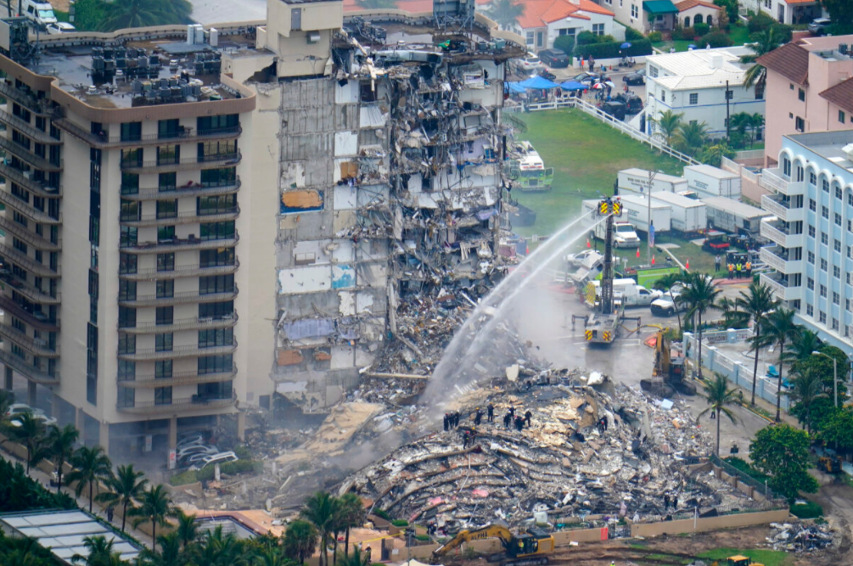
Notes:
https://www.theepochtimes.com/mkt_breakingnews/five-dead-156-missing-in-florida-building-collapse-as-sister-building-could-be-evacuated_3876139.html?utm_source=newsnoe&utm_medium=email&utm_campaign=breaking-2021-06-27-1&mktids=fd3634515b964b960d762725aa65defd&est=sQqQrtYsRft6LbO%2Fw%2FbY%2Fo7eM%2Bz7aFucBagkMPGdi3%2BrCNpNO09xAtVOAfbL38JhcQ%3D%3D

Slide 59
A visitor…Adriana Gonzalez Chi had previously expressed concerns about the condo’s structural safety, while also citing complaints of frequent leaks and mold.
Notes:
https://www.theepochtimes.com/mkt_breakingnews/mom-with-broken-pelvis-rescues-daughter-during-surfside-condo-collapse-after-falling-4-stories_3875244.html?utm_source=newsnoe&utm_medium=email&utm_campaign=breaking-2021-06-30-1&mktids=1877fd736d9f5116c27a039b9c75bda7&est=u81iG45i9PaeWTMvyPuvLzLOM6n2HxzuPmyXw4CcN5RzFgjVCXTY1ql1lDtqsF23ig%3D%3D

Slide 60
“About a month ago I was standing on the balcony and saying, ‘This is not safe,’” said Chi. “I looked at my niece and said, ‘If you feel the building tremble, run.’”
Notes:
https://www.theepochtimes.com/mkt_breakingnews/mom-with-broken-pelvis-rescues-daughter-during-surfside-condo-collapse-after-falling-4-stories_3875244.html?utm_source=newsnoe&utm_medium=email&utm_campaign=breaking-2021-06-30-1&mktids=1877fd736d9f5116c27a039b9c75bda7&est=u81iG45i9PaeWTMvyPuvLzLOM6n2HxzuPmyXw4CcN5RzFgjVCXTY1ql1lDtqsF23ig%3D%3D

Slide 61
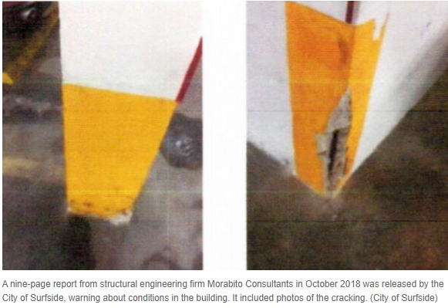
Notes:
https://www.theepochtimes.com/mkt_breakingnews/five-dead-156-missing-in-florida-building-collapse-as-sister-building-could-be-evacuated_3876139.html?utm_source=newsnoe&utm_medium=email&utm_campaign=breaking-2021-06-27-1&mktids=fd3634515b964b960d762725aa65defd&est=sQqQrtYsRft6LbO%2Fw%2FbY%2Fo7eM%2Bz7aFucBagkMPGdi3%2BrCNpNO09xAtVOAfbL38JhcQ%3D%3D

Slide 62
The foundations of sanity are crumbling in our culture.
Do we have ground to stand?
Notes:
From George Whitten’s Worthy News…

Slide 63

Transgender contestant defeats 21 women to win Miss Nevada USA pageant
Notes:
https://worthy.watch/transgender-contestant-defeats-21-women-to-win-miss-nevada-usa-pageant

Slide 64
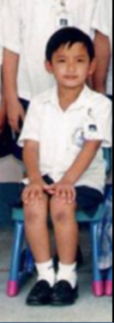


Notes:
https://heightzone.com/kataluna-enriquez-as-a-boy-miss-nevada-before-transition-surgery-details/

Slide 65
Kataluna writes: My journey to self love was never easy. At a young age, I had to learn to live in the shadows to survive. I lived two separate lives. I was beaten, physically & sexually assaulted, refused basic human rights,
Notes:
https://www.instagram.com/mskataluna/

Slide 66
bullied and even prayed many nights to never wake up. I was shown the lowest so I can learn to reach my highest. But it was never the destination that kept me thriving, it was the journey to #selflove.
Notes:
https://www.instagram.com/mskataluna/

Slide 67
Are we absurdly obsolete in our thinking?
Rigidly compassionless?
Is our foundation of truth solid?
Notes:
How can we deny the pain of such people?
How can we be sure we are right, not rigid?
Right response: purity of mind, virginity, love, warmth, build your marriages. Courtesy, chivalry.

Slide 68
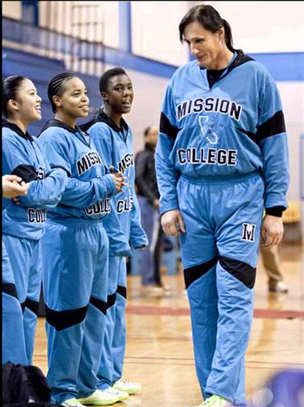
Gabrielle Ludwig, 50, a transgender basketball player at Mission College in Santa Clara, CA.
Notes:
https://www.usatoday.com/story/sports/ncaab/2012/12/04/college-basketball-transgender-player-gabrielle-ludwig-robert-ludwig-mission-college/1744703/

Slide 69
The woman teammates call Gabbi, Giant or Big Sexy was born Robert John Ludwig in Germany three decades before any of them were a glimmer in their parents' eyes. Ludwig, who did not know his birth father, followed his mother, Elfie, and Al, the military man his mother fell in love with, to America.
Notes:
https://www.usatoday.com/story/sports/ncaab/2012/12/04/college-basketball-transgender-player-gabrielle-ludwig-robert-ludwig-mission-college/1744703/

Slide 70
Childhood was laden with positive experiences, Ludwig says, except for the feeling that something was terribly off-kilter inside, that every time Ludwig looked in the mirror she saw the wrong image staring back. At every opportunity she would try on her mother's dresses and experiment with makeup only to rush to slip off the clothing and wash away the lipstick before her parents could catch her.
Notes:
https://www.usatoday.com/story/sports/ncaab/2012/12/04/college-basketball-transgender-player-gabrielle-ludwig-robert-ludwig-mission-college/1744703/

Slide 71
Are we absurdly obsolete in our thinking?
Rigidly compassionless?
Is our foundation of truth solid?

Slide 72
^{T’hillim/Ps 11.1-5} In Adoni I find refuge. So how can you say to me, “Flee like a bird to the mountains! See how the wicked are drawing their bows and setting their arrows on the string, to shoot from the shadows at honest men.

Slide 73
^{T’hillim/Ps 11.1-5} If the foundations are destroyed, what can the righteous do?” Adoni is in his holy temple. Adoni, his throne is in heaven. His eyes see and test humankind. Adoni tests the righteous;
but he hates the wicked and the lover of violence.

Slide 74
We may be on the wrong side of history with our views, but we are on the right side of eternity.
Jim Garlow

Slide 75
In a February 11 "directive," HUD announced penalties, including possible jail time and up to hundreds of thousands of dollars in fines, for all institutions receiving federal funds which maintained separate bathrooms, showers, and housing based on sex or gender identity.
Notes:
https://www.frc.org/get.cfm?i=WA21F32&f=WU21F11
Tony Perkins

Slide 76
^{Dvarim/Dt 23.35-36} Vengeance is Mine, and payback, for the time when their foot staggers. Surely their day of disaster is near— what is prepared rushes on them. For Adoni will judge His people—
for His servants, He will relent
Notes:
Sinners in the hands…

Slide 77
Consider: Critical Race Theory

Slide 78
Color and race are the most important identity markers for humanity.
Three primary applications:
One white supremacy is the greatest threat to racial equality.

Slide 79
Two, the institutions of law must play a role in equalizing the relationship between the races.
Three: The concept doesn’t include who you are, behavior, values, environment, crimes committed, or religious beliefs. It’s solely based on race.
Notes:
Martin Luther King: judged by the content of his character.

Slide 80
C .S. Lewis on the common proverb:
We may be so heavenly minded that we are of no earthly good.
In fact, unless we are heavenly minded, we are of no earthly good.
Notes:
From Jamie Lash…

Slide 81

From Jamie Lash, Jewish Jewels

Slide 82
One radical feminist, Ruth Barrett, wrote: “There are over seven billion human beings on the planet. Therefore, there have to be over seven billion genders. No one is special if we are all unique.”
Notes:
https://www.jewishjewels.org/news-letters/we-are-at-war/

Slide 83
Since as early as 1968, according to Dr. Michael Brown in his book Jezebel’s War with America. A group known as “The Feminists,” determined to annihilate sex roles, also called for the elimination of marriage which they labeled a “slavery-like practice.”
Notes:
https://www.jewishjewels.org/news-letters/we-are-at-war/

Slide 84
Students on college campuses, for example, are stating how they want to be identified, by what pronoun: e.g., perself, humself, itself, and more.
We must pray for transgender individuals, that they will see the truth, embrace their Creator,
Notes:
https://www.jewishjewels.org/news-letters/we-are-at-war/

Slide 85
and walk in their divine destiny. We must always remember that people are not our enemies; our warfare is with spirits of darkness. We are commanded to love.
Notes:
https://www.jewishjewels.org/news-letters/we-are-at-war/

Slide 86
^{Mark 13.22-23} There will appear false Messiahs and false prophets performing signs and wonders for the purpose, if possible, of misleading the chosen. But you, watch out!

Slide 87
Marine Lance Corporal Manifa Sterling—a Christian who was recently court-martialed, demoted and discharged for refusing to remove a Bible verse from her desk. Oscar Rodriguez, Jr.—decorated Air Force veteran who was forcefully dragged out of a retirement ceremony for mentioning the word “God.”
Notes:
https://www.jewishjewels.org/news-letters/we-are-at-war/

Slide 88
Colonel Leland Bohamon— decorated Air Force commander who was denied promotion, removed from command, and reprimanded for refusing to sign a homosexual marriage certificate.
Notes:
https://www.jewishjewels.org/news-letters/we-are-at-war/

Slide 90
Outline
Supernatural provision: Man מָן
Aharon’s rod that sprouted
  Commemorate foundation failure
  Our foundation will stand!
Notes:
We are in the three weeks “Bayn HaMetsarim” “Between the straits” time when the walls of ancient Jerusalem were breached and the Babylonians fought their way to the Temple. Tisha B’Av, July 17, they burned Solomon’s Temple. Time for intercession, fasting. Haven’t gotten much response yet for Tisha B’Av, intercession still works…

Slide 91
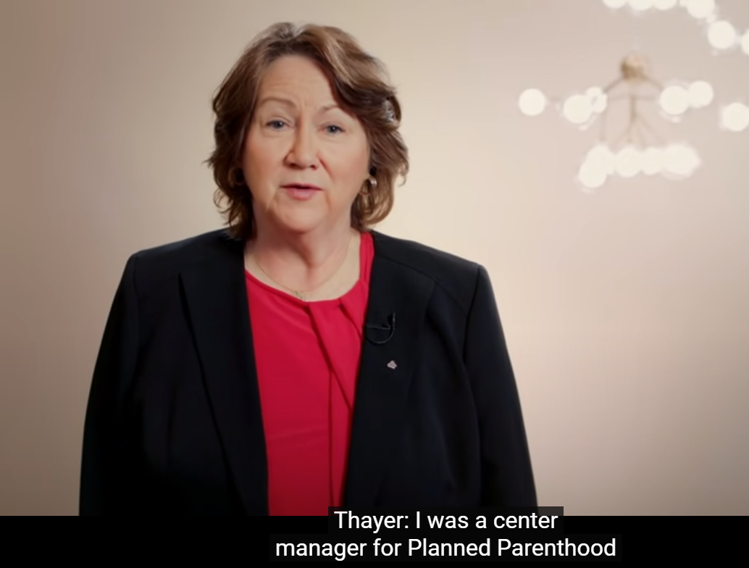
Sue Thayer, center manager for Planned Parent-hood 18 years
Notes:
https://www.youtube.com/watch?app=desktop&v=e67UKZEUDWo&feature=share
3.10 to 5.13
Oct 19

Slide 92
California Governor Gavin Newsom's ability to close congregations or limit their occupancy due to COVID-19 restrictions came to a sharp end this week. The state of California settled a lawsuit over coronavirus restrictions placed on churches, earning religious liberty a major legal victory.
Notes:
https://www.frc.org/get.cfm?i=WA21E37&f=WU21E12

Slide 93


Slide 94
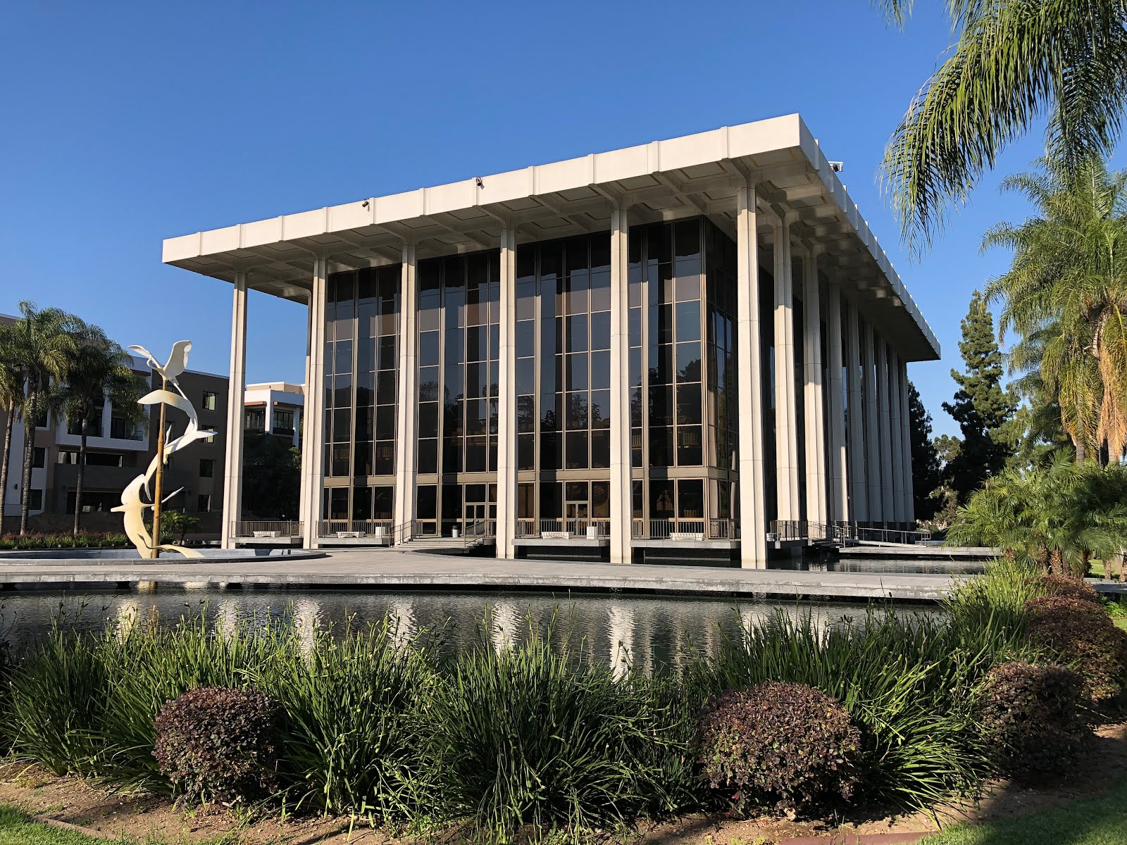

Slide 95
Pastor Che Ahn "got a letter from the Pasadena criminal prosecutor, threatening him, his staff." The letter threatened any churchgoer with "criminal charges, up to one year in prison, and daily fines of a thousand dollars. And so [Pastor Ahn] had to tell his church members" that they could face criminal charges for coming to church.
Notes:
https://www.frc.org/get.cfm?i=WA21E37&f=WU21E12

Slide 96
Pastor Ahn worried that many people would refrain from coming to church. Yet, the opposite turned out to be the case. Most of the congregation continued attending services, and other Christians looking for a church and even non-believers who were interested starting attending Harvest Rock Church.
Notes:
https://www.frc.org/get.cfm?i=WA21E37&f=WU21E12

Slide 97
Staver says that other pastors who stood up to unfair coronavirus restrictions are experiencing similar growth. Churches that "stood up against this adversity, this persecution, they're seeing revival happening in their communities.”
Notes:
https://www.frc.org/get.cfm?i=WA21E37&f=WU21E12

Slide 98
Governor Newsom's yearlong COVID-19 restrictions on churches were so strict that Californians were even banned from participating in Bible studies in private homes and singing. With the new permanent statewide injunction, this will never be allowed to happen in California again.
Notes:
https://www.frc.org/get.cfm?i=WA21E37&f=WU21E12

Slide 99
From Sally Shiff, June newsletter: There is a fresh wind of the Holy Spirit in my congregation. The younger generation is increasing not only in number but in hunger for Yeshua. Part of my reluctance to travel to my family was the happenings around my congregation and the people I love. With prayer meetings either face to face or virtually every day, a greater dependence on God and His response is taking place. People are getting saved, healed and strong in Him.
Notes:
https://news.kehila.org/author/sallyshiff/

Slide 100
Outline
Supernatural provision: Man מָן
Aharon’s rod that sprouted
  Commemorates foundation failure
  Our foundation will stand!

Slide 101
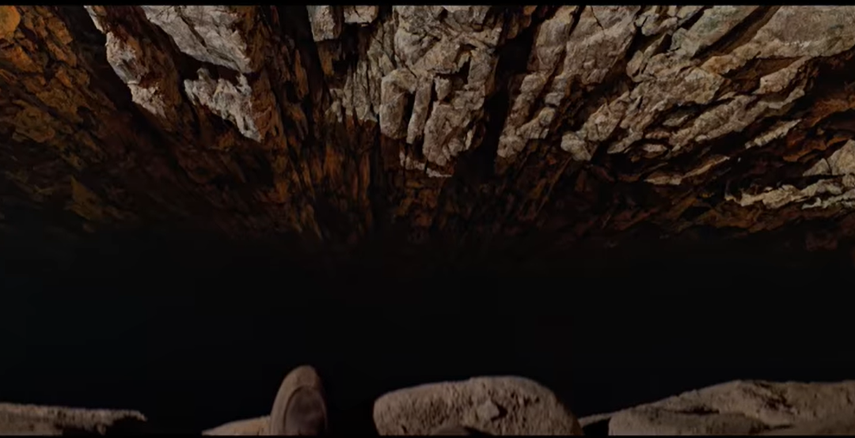
Indiana Jones –
The Last Crusade (1989)
- Leap of Faith
Notes:
https://youtu.be/sBBbq2g7yf8
Voltaire house
Time Magazine: G-d is Dead, then Jesus Revolution
OH and building, March of Remem
Children, marriages, finances, health, holiness
Foundation: repentance, faith,

Slide 102
Do you KNOW Yeshua and the assurance of sins forgiven?
Are you hearing from G-d in the Word.
What are you doing with what you hear?
Are you asking this of someone?
Notes:
Who are you discipling, building up?4

Slide 104


