Slide 1
e-handout
To have these notes
without taking notes
Go to OrHaOlam.com
Click on downloads,
messages, 2021

Slide 2

Notes:
Lori

Slide 3
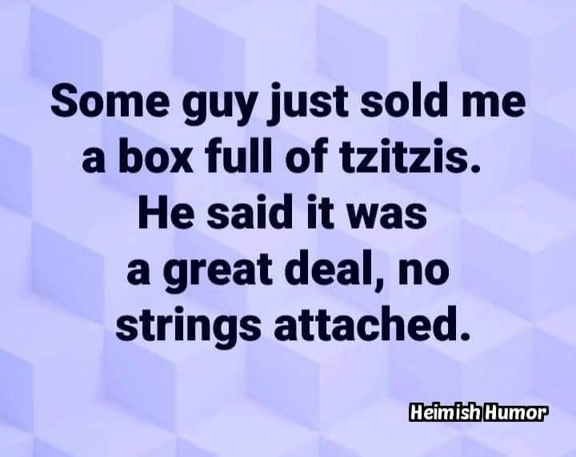
Notes:
Lori

Slide 4
Last week I spoke
on the Sh’khinah

Slide 5
Sh’khinah = Kavod Adoni
כָּבוֹד יְיָ = שְׁכִינָה
Divine dwelling = Glory of G-d
Metaphorically the cherubs / keruvim represent this.
Notes:
Practice pronunciation? Altogether now.
Only thing that was important in Bible days.

Slide 6
^{T’hillim / Ps 27.4} One thing have I asked of Adoni, that will I seek: to dwell in the House of Adoni all the days of my life, to behold the beauty of Adoni, and to meditate in His Temple.
Notes:
Beauty = Shekhinah = Kavod Adoni = glory of G-d Note Ps 27
Need to add…

Slide 7
^{Rev. 1.12-16} I turned around to see who was speaking to me; and when I had turned, I saw seven gold menorahs; and among the menorahs was someone like a Son of Man, wearing a robe down to his feet and a gold band around his chest.

Slide 8
^{Rev. 1.12-16} His head and hair were as white as snow-white wool, his eyes like a fiery flame, his feet like burnished brass refined in a furnace, and his voice like the sound of rushing waters. In his right hand he held seven stars, out of his mouth went a sharp double-edged sword, and His face was like the sun shining at full strength.

Slide 9
Messiah Yeshua
IS the Sh’khinah,
the Kavod Adoni!

Slide 10
^{1 Cor 4.6} For it is the God who once said, “Let light shine out of darkness,” who has made his light shine in our hearts, the light of the knowledge of God’s glory shining in the face of the Messiah Yeshua.

Slide 11
We are in the Hebrew calendar month of Elul
This relates to the Sh’khinah…

Slide 12
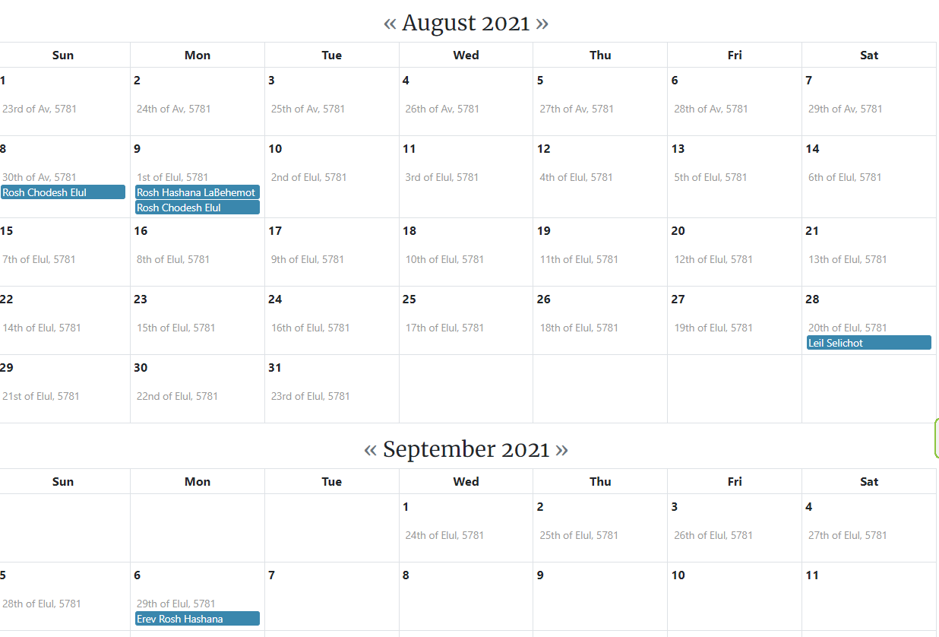
Hebrew
Calendar
Month of
Elul
אלול
Aug. 9 to Sept. 6

Slide 13
The name of the month Elul, like the names of the rest of the Hebrew calendar months, was brought from the Babylonian captivity, and originated from the Akkadian word for “harvest.”
Notes:
https://en.wikipedia.org/wiki/Elul
However, the rabbis saw an acronym

Slide 14
Jewish sources from the 14th century and on write that the Hebrew word "Elul" can be understood to be an acronym for the phrase "Ani L'dodi V'dodi Li" – "I am my beloved's and my beloved is mine"
Notes:
Hebrew alphabet acronym

Slide 15
אֲנִי לְדוֹדִי וְדוֹדִי לִי ← אלול ← אֱלוּל
Anee l’dodi, v’dodi li
I am my beloved’s and he is mine.

Slide 16
Elul אֱלוּל Beloved
Song of Songs 6.3
I belong to the man I love, and he belongs to me.
אֲנִי לְדוֹדִי וְדוֹדִי לִי ← אלול ← אֱלוּל
Anee l’dodi, v’dodi li
Notes:
TLV: I am my beloved’s and my beloved is mine. Passion for G-d and His Glory!

Slide 17

אֲנִי לְדוֹדִי
Ani l’dodi

Slide 18
In Jewish tradition, the month of Elul is a time of loving repentance in preparation for the High Holy Days of Rosh Hashanah and Yom Kippur. Of preparing to approach the Sh’khinah, the Beloved.

Slide 19
It is customary to blow the shofar every morning. The blasts are meant to awaken one's spirits and inspire him to begin the soul searching which will prepare him for the High Holy Days.

Slide 20
As part of this preparation, Elul is the time to begin the sometimes-difficult process of granting and asking for forgiveness. It is also customary to recite Psalm 27 every day from Rosh Hodesh Elul through Hoshanah Rabbah on Sukkot.
Notes:
I forgive you for…
Will you forgive me for…

Slide 21
There are three variant forms of the Ani l’dodi statement

Slide 22
^{Song 2.16} My lover is mine, and I am his!
דּוֹדִי לִי וַאֲנִי לוֹ Dodi li v’ani lo
Notes:
This is the one we sing.

Slide 23
^{Song of Songs 6.3} I belong to the man I love, and he belongs to me.
אֲנִי לְדוֹדִי וְדוֹדִי לִי ← אלול ← אֱלוּל
Anee l’dodi, v’dodi li
Notes:
TLV: I am my beloved’s and my beloved is mine. Passion for G-d and His Glory!
This is the one the month of Elul is said to incorporate.

Slide 24
^{Song 7.11} I am my lover’s, and his desire is for me.
אֲנִי לְדוֹדִי, וְעָלַי תְּשׁוּקָתוֹ.
Ani l’dodi, v’eilei t’shukato
Notes:
This is the final and highest form.

Slide 25
We will do an extended study in the book of the Song of Songs for the month of Elul.

Slide 26
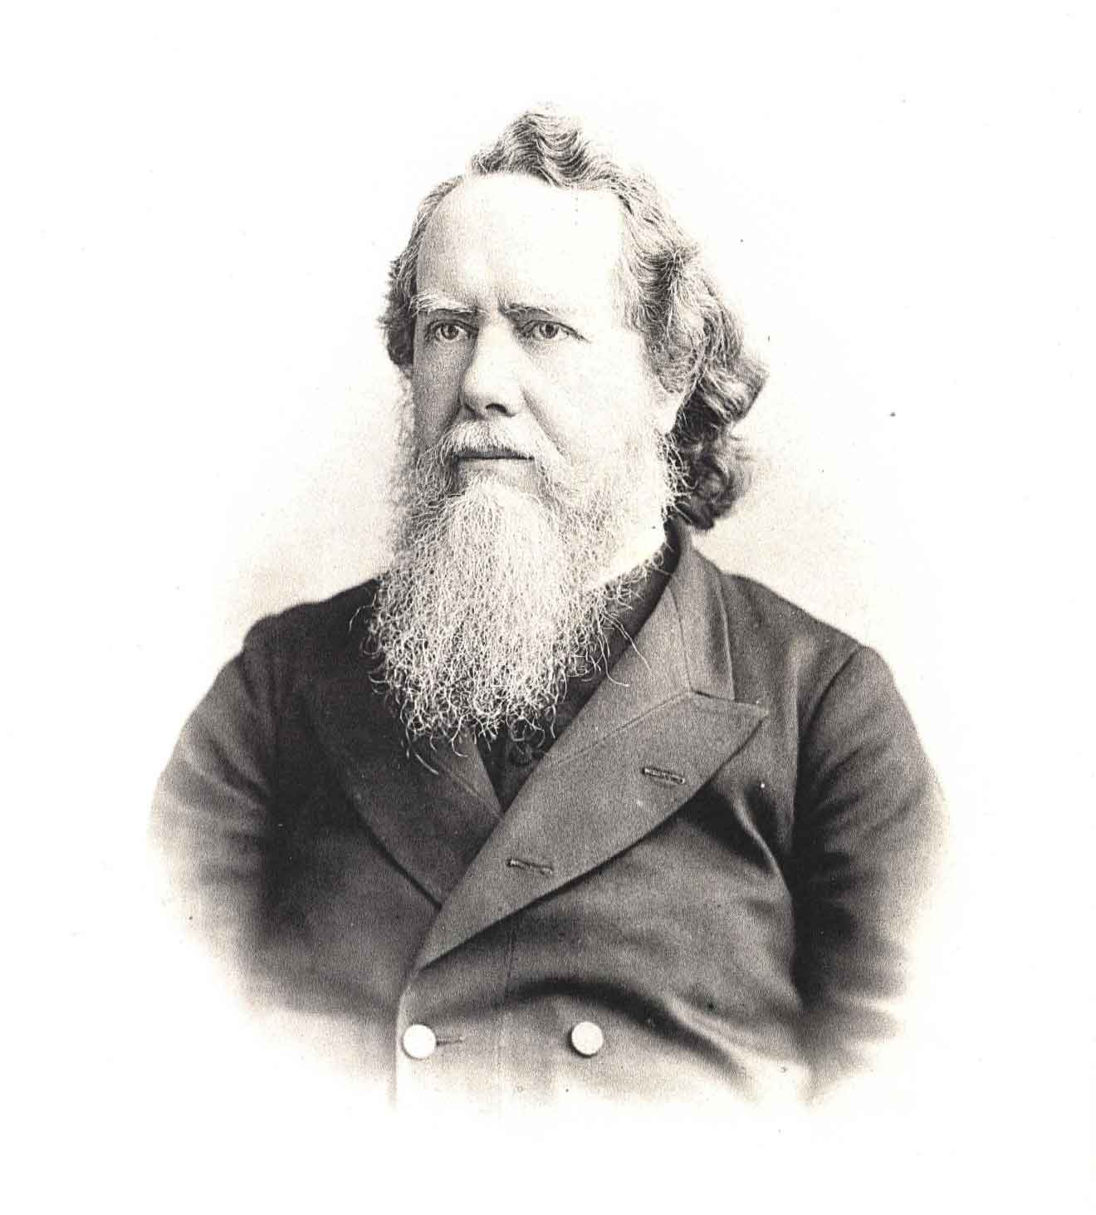

Hudson Taylor, 1832-1905
Notes:
The society that he began was responsible for bringing over 18,000 Chinese people to faith in Messiah, 800 missionaries to the country who started 125 schools as well as the establishment of more than 300 stations of work with more than 500 local helpers in all eighteen provinces https://en.wikipedia.org/wiki/Hudson_Taylor
Work among God’s ancient people occupied a special place in the prayerful sympathy of both Mr. and Mrs. Taylor. On the first day of every year during his time as head of the China Inland Mission, Hudson Taylor sent a check to the Mildmay Mission to the Jews, London, on which was written, “To the Jew first.” https://jewinthepew.org/2016/01/01/1-january-1897-to-the-jew-first-hudson-taylor-sends-donation-to-john-wilkinson/

Slide 27
Introduction to the
Song of Songs

Slide 28
Full name of the book is after the first line:
^{Song 1.1} The song of songs, of Solomon
שִׁיר הַשִּׁירִים, אֲשֶׁר לִשְׁלֹמֹה
Shir hashirim, asher l’Shlomo

Slide 29
Song of Songs, Shir haShirim,
שִׁיר הַשִּׁירִים Superlative song!
~King of kings, Lord of lord, Holy of Holies
Superlative union of branch and vine →

Slide 30
^{Yn 15.11-13} I have said this to you so that my joy may be in you, and your joy be full…No one has greater love than a person who lays down his life for his friends.

Slide 31
^{1 Yn 1.3-4} Our fellowship is with the Father and His Son, Yeshua the Messiah. These things we write so our joy may be full.

Slide 32
Outline of Song of Songs

Slide 33
Six sections
Unsatisfied life and remedy 1.2-2.7
Intimacy Broken, restoration 2.8-3.5
Unbroken intimacy 3.6-5.1

Slide 34
Intimacy again broken, restoration 5.2-6.10
Fruits of recognized union 6.11-8.4
Unrestrained intimacy 8.5-14
Notes:
We will cover the first section today, and continue, I believe next week.

Slide 35
Three speakers in this book
The bride, Shulamit
The bridegroom, Shomo / Solomon, the King
The Daughters of Jerusalem chorus

Slide 36
Text study of Song of Songs

Slide 37
Unsatisfied life and remedy 1.2-2.7
  ^{Song 1.2 [She]} Let him smother me with kisses from his mouth, for your love is better than wine.
Notes:
Dissatisfied lover. She is missing his presence, his touch. Kisses from His Word. No satisfaction without His contact.

Slide 38
^{Gal. 4.15} So what has become of the joy you felt?
~^{Iyov/Job 23.3} I wish I knew where I could find him; then I would go to where he is.
^{Rev. 2.4} But I have this against you: you have lost the love you had at first.

Slide 39
^{Yermiyahu/Jer 2.1-4} Again the word of Adoni came to me, saying: “Go, and cry in the ears of Jerusalem, saying, thus says Adoni: I remember the devotion of your youth, your love as a bride, and the way you followed Me in the wilderness, in a land not sown.

Slide 40
^{Yermiyahu/Jer 2.1-4} Israel was kadosh to Adoni, the firstfruits of the harvest…
“What fault did your fathers find in Me that they strayed so far from Me?
Notes:
So what is the holdup? Hudson Taylor offers some possibilities, based on the context: She retains her own name/identity, will to obey, surrender [dance], control of possessions, money, service energy
Why? Distrust of the Divine Lover. Deep seated distrust of our loving Lord is great proof of the deep Fall of mankind…hesitate to give ourselves entirely to Him.

Slide 41
^{Yeshayahu/ Is 30.18} Yet Adoni is just waiting to show you favor, ^{CJB}
Therefore Adoni is longing to be gracious to you. ^{TLV}
Thus He will be exalted, so He may have mercy on you.
For Adoni is a God of justice.

Slide 42
^{Song 2.14 [He]} Let me see your face and hear your voice; for your voice is sweet, and your face is lovely.
Notes:
This is what G-d in Messiah thinks of us!!

Slide 44
^{Song 1.3} ^{[She]} Your anointing oils have a wonderful fragrance; your name is like perfume poured out. This is why young women love you.
Notes:
Reminiscing of His presence. No oil like Cohen Hagadol/High Priest. She cannot dismiss her fears, yet tremblingly yields all…fearful of poverty mentality, ascetism…rather…

Slide 45
^{Song 1.4 [She]} “Take me with you. We will run after you.”
Notes:
Statement of surrender!

Slide 46
^{Song 1.4 [She]} The king has brought me into his rooms.
^{Tehillim/Ps 5.3} Adoni, in the morning You hear my voice. In the morning I order my prayer before You and watch expectantly.
Notes:
Private, personal intimacy with His wondrous love. He desires us. Not for begrudging obedience, but glad surrender. “We do not admire selfish children who only think of what they can get from their parents, and are unmindful of the pleasure that they may give or the service they can offer”
Cf: morning watch. World is relatively still. Sound of traffic minimal. Text messages email, maybe not yet. Brain is not cluttered with stressors. No time so profitable. If not…other times, but special.
Leave with expectation that the day will be wrought in His power.

Slide 47
Song 1.4 [Chorus: Daughters of Zion] Let us rejoice and be glad in you; let us extol your love more than wine.
Rightly do they love you!
Notes:
So, the day is improved by definition. Chorus cheers her decision!
Next verse is politically incorrect. Bible days no mania for suntan. Somewhat gone away with concerns over skin cancer. Arabs to this day. Not ~Doonesbury competing in the for big tanning competitions like the George Hamilton Cocoa Butter Open. Still ten tanning salons within the OP region

Slide 48
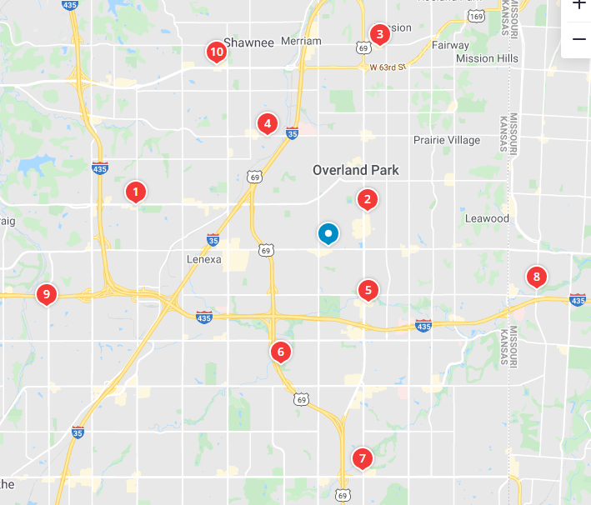
Tanning salons in the Overland Park area still!

Slide 49
^{Song 1.5 [She]} I am dark tan
^{[He]} but beautiful,
^{[She]} you daughters of Yerushalayim, like the tents of Kedar,
^{[He]} like the curtains of Shlomo.
Notes:
She sees herself as flawed. But the Heavenly lover, Bridegroom G-d, sees her potential, her redeemed self.

Slide 50
^{Song 1.6 [She]} Don’t stare at me because I’m dark; it’s the sun that tanned me. My mother’s sons were angry with me and made me look after the vineyards. But I haven’t cared for my own vineyard.
Notes:
Fundamental mistake in serving Messiah Yeshua, is being busy in the vineyard, and not caring for your spirit, your joy, your attitudes, your love! Remove speck from brother’s eye, and not tend to the beam in our own.
What we are is >> than what we do! But what we do is visible. Tyranny of the urgent.
Time…with Adoni Yeshua, with spouse, with children, with friends.
Remember, this was written by a man that lead 18,000 to Messiah and a large organization.

Slide 51
^{Song 1.7 [She]} Tell me, my love, where you pasture your flock, where you have them rest at noon; for why should I veil myself [like a prostitute] beside the flocks of your friends?
Notes:
She wants to work, but WITH Him.
Zeal asks, “What can I do for G-d.”
Maturity asks, “What is G-d doing, that I can join in?”
Winograd: If you labor because you see a need, you will kill yourself and your loved ones.
If you labor because of Yeshua, you will be energized, and bless others.
Lots of ways to serve here: children’s Ed., Oneg, ushers, sound booth, Sukkot outreach. But be led, subject to training, energized. Me?

Slide 52
Song 1.8 [Daughters of Jerusalem] If you yourself do not know, O most beautiful among women, go out yourself in the footsteps of the flock and graze your kids by the shepherds’ tents.
Notes:
Find Him by seeking those He is caring for.

Slide 53
^{~Yn 21.15} After breakfast, Yeshua said to Shim‘on Kefa, “Shim‘on Bar-Yochanan, do you love me more than these?” He replied, “Yes, Lord, you know I’m your friend.” He said to him, “Feed my lambs.”
Notes:
If not sure of ministry calling…Caring for His lambs will enrich you in His presence.

Slide 54
^{Mtt. 25.40} The King will say to them, ‘Yes! I tell you that whenever you did these things for one of the least important of these brothers of mine, you did them for me!’
Notes:
Least of them. Several possible meanings. Some say the Jewish people. Holocaust
Another interpretation is the disabled. Whole ministry of justice to the disenfranchised. We might bristle and government overreach in OSHA requirements, but…

Slide 55
Our neighborhood City Wide Prayer meeting had a presentation by Doc Steve Hunsley, a retired pediatrician, who had a son with Dravet Syndrome and autism. 90% of congregations couldn’t handle disabled. 1/6 kids today some disability!

Slide 56

Notes:
https://youtu.be/VfhQ8Gf5jAc
SOAR - Why your Church needs a Special Needs Ministry - YouTube

Slide 57
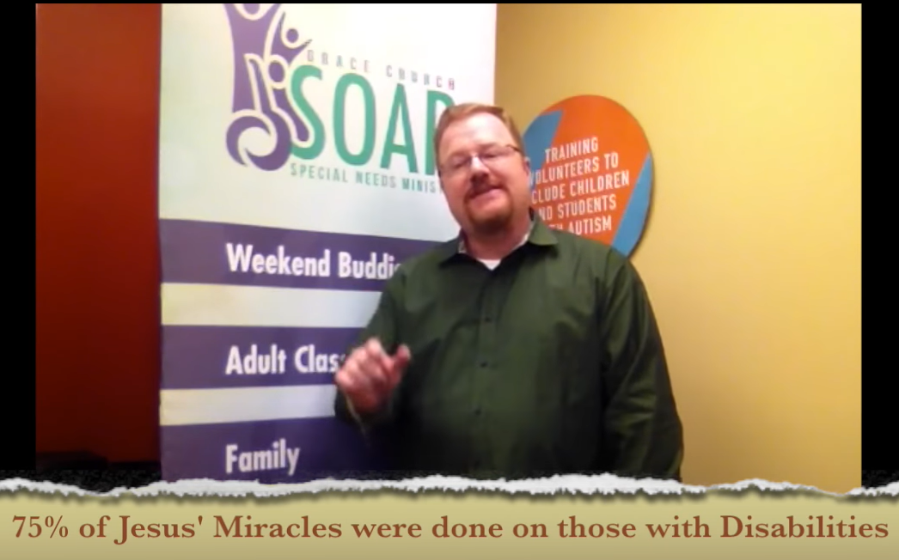

Slide 58
The bridegroom responds with his commendation of her heart desire…in their cultural terms:

Slide 59
^{Song 1.9 [He]} My love, I compare you with my mare, pulling one of Pharaoh’s chariots.
Notes:
Hudson Taylor illus Best horses from Arabia, from Egypt. p 35-36

Slide 60
^{Song 1.10-11 [He]} Your cheeks are lovely with ornaments, your neck with its strings of beads; we will make you ornaments of gold, studded with silver.
Notes:
She is beautiful, stately, useful, adorned, and He will add with value and excellence.

Slide 61
^{Song 1.12-14 [She]} While the king is on his couch, my spikenard spreads its fragrance. My lover is my pouch of myrrh, passing the night between my breasts. My love is to me a spray of henna blooms in the vineyards of Ein-gedi.
In His presence, we can share Life!
Notes:
En-gedi is a luxuriant oasis in the moonscape of the Dead Sea coast. The Dead Sea coast is horrifically desolate, barren, death valley.

Slide 62
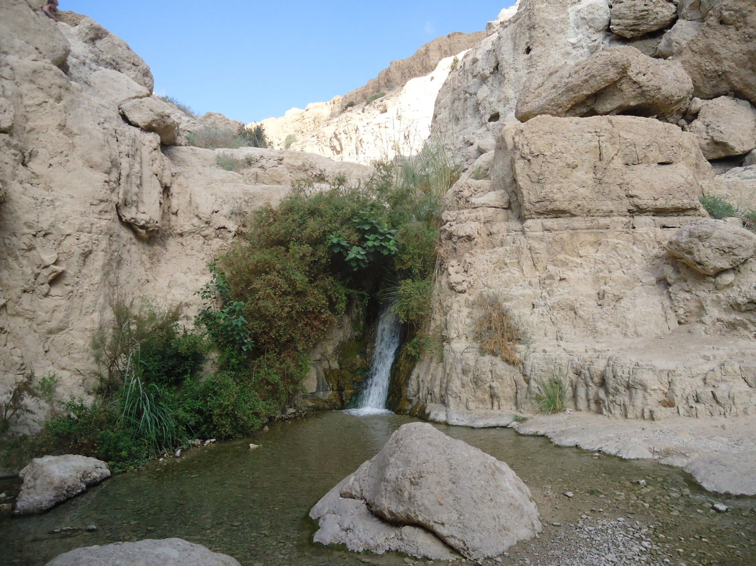
Ein Gedi
oasis
Notes:
https://external-content.duckduckgo.com/iu/?u=http%3A%2F%2Fs8319.pcdn.co%2Fwp-content%2Fuploads%2F2013%2F11%2FDSC05448.jpg&f=1&nofb=1

Slide 63
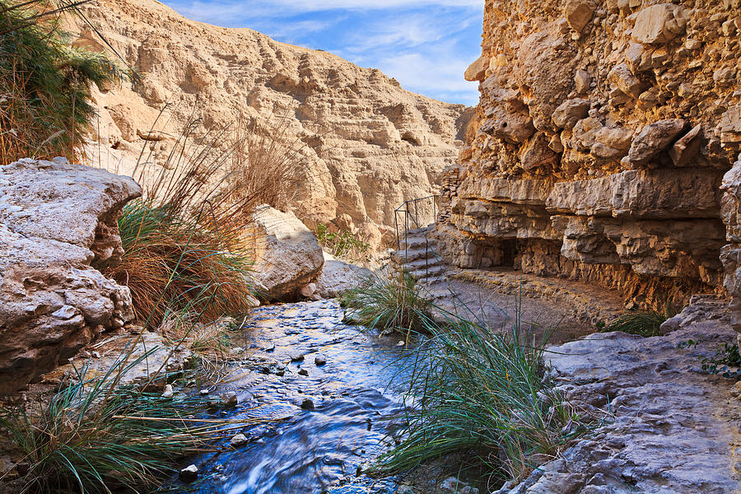
Notes:
You can almost feel the presence of David and his men, hiding from murderous King Shaul.

Slide 64
^{Song 1.12-14 [She]} While the king is on his couch, my spikenard spreads its fragrance. My lover is my pouch of myrrh, passing the night between my breasts. My love is to me a spray of henna blooms in the vineyards of Ein-gedi.
In His presence, we can share Life!
Notes:
En-gedi is a luxuriant oasis in the moonscape of the Dead Sea coast. The Dead Sea coast is so desolate, barren, death valley.

Slide 65
^{2 Cor. 2.15-16} For we are the aroma of Messiah to God, among those who are being saved and those who are perishing — to the one an aroma from death to death, to the other an aroma from life to life. Who is competent for these things?
Notes:
What is your aroma?

Slide 66
^{Song 1.15 [He]} How lovely you are, my darling, how lovely! Your eyes are as doves.
How can that be truthfully said?

Slide 67
^{2 Cor. 3.18} All of us, with faces unveiled, see as in a mirror the glory of the Lord; and we are being changed into his very image, from one degree of glory to the next, by Adoni the Spirit.

Slide 68
^{Song 1.15 [He]} Your eyes are as doves.

Slide 69
^{Song 1.15 [He]} Your eyes are as doves.
Hawks also have beautiful eyes

Slide 70
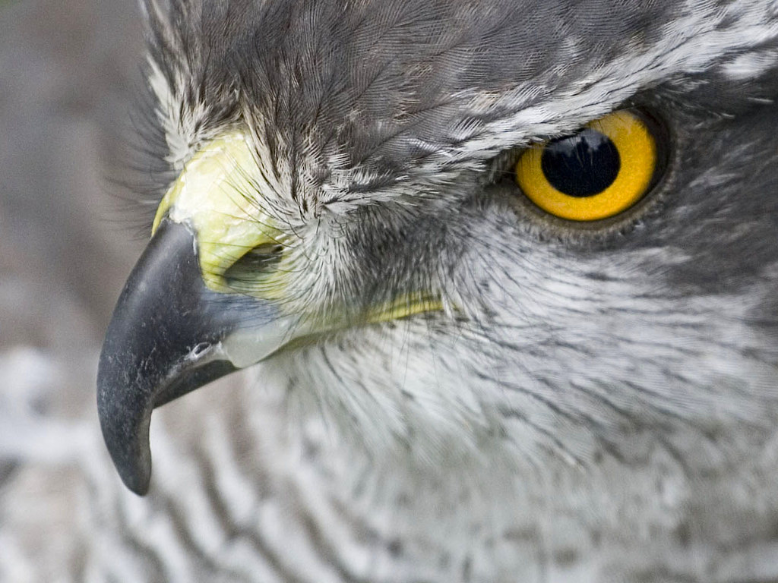
Hawk eyes
Notes:
Hawk eyes beautiful, quick, penetrating ready for attacking, killing, devouring prey.

Slide 71
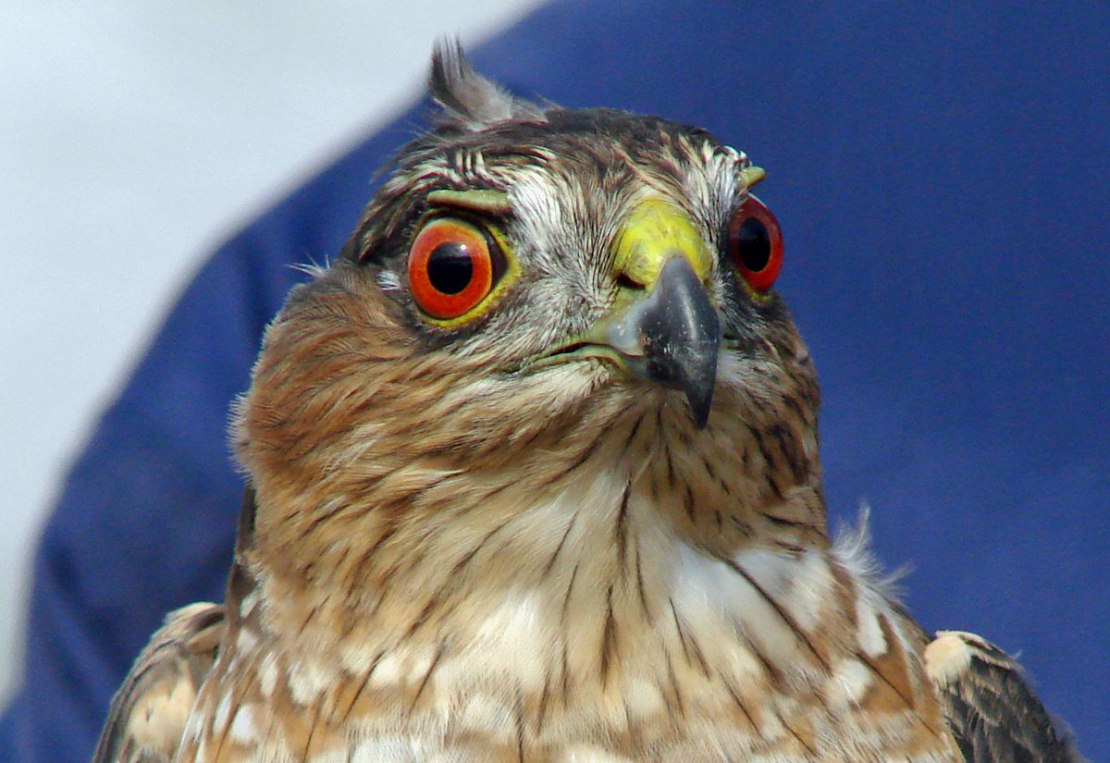
Hawk eyes
Notes:
https://external-content.duckduckgo.com/iu/?u=http%3A%2F%2Fwww.animalspot.net%2Fwp-content%2Fuploads%2F2014%2F12%2FSharp-Shinned-Hawk-Eyes.jpg&f=1&nofb=1

Slide 72
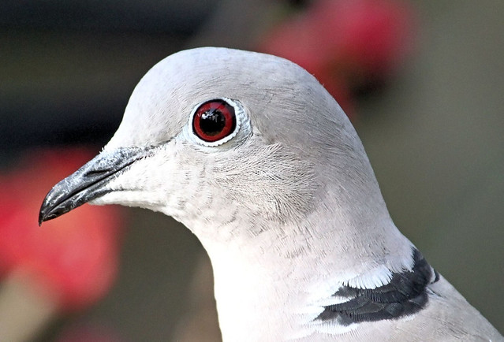
Dove eyes
Notes:
Breathe a sigh of relaxation when see

Slide 73
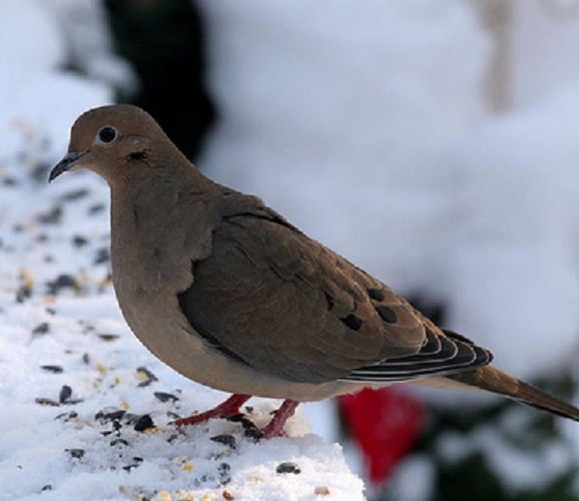
Dove eyes
Notes:
https://external-content.duckduckgo.com/iu/?u=http%3A%2F%2F1.bp.blogspot.com%2F-PcHki8lEWnk%2FT3Pt8rxB4II%2FAAAAAAAADzA%2FfZrNQAJLetM%2Fw1200-h630-p-nu%2Fdove.jpg&f=1&nofb=1

Slide 74
David had many flaws, adultery, murder, lying.
But he was not allowed to build the Temple because of his warlike nature. War is good and necessary, but

Slide 75
“If we would be soul-winners and build up the Kingdom, which is His temple, let us note this: not [only] by discussion or by argument, but by lifting up Messiah.” Hudson Taylor Union and Communion p 41
Notes:
Man who won 18,000 souls

Slide 76
^{Song 1.16-2.1 [She]} How handsome you are, my lover! Oh, so delightful! Yes, our couch is luxuriant. The beams of our houses are cedar trees, our panels are cypress trees. I am but a rose from the Sharon, just a lily in the valleys.
Notes:
אֲנִי חֲבַצֶּלֶת הַשָּׁרוֹן, שׁוֹשַׁנַּת הָעֲמָקִים

Slide 77
^{Song 2.2 [He]} Like a lily among thorns is my darling among the other women.
^{Song 2.3 [She]} Like an apple tree among the trees of the forest, so is my lover among the sons. In his shadow I delighted to sit, and his fruit was sweet to my taste.
Notes:
Refreshing fruit, shade, rest. Her distrust formerly has vanished.

Slide 78
^{Song 2.3-7 [She]} He brings me to the banquet hall; his banner over me is love. Sustain me with raisin cakes, refresh me with apples— for I am weak with love. His left hand is under my head
Notes:
2.3 fearlessly she can sit at His side at His acknowledged spouse.
2.5 -6 Blessedness of being possessed.

Slide 79
^{Song 2.3-7 [She]} and his right hand embraces me. Daughters of Jerusalem, I charge you, by the gazelles and does of the field: Do not arouse or awaken love until it delights.
Notes:
You may always be abiding,
If you will at Yeshua’s side,
In the secret of His presence,
You may every moment hide.
His love does not fail. “Abide in Me, and I in you.”

Slide 80
Roger Babson, a famous statistician was having lunch with the President of Argentina, "Mr. Babson," the President said, "I have been wondering why it is that South America, with all its natural advantages, mines of iron, copper, coal and silver,
Notes:
George Whitten

Slide 81
rivers and great waterfalls is so far behind North America?" Babson replied, "Well, Mr. President, what do you think is the reason?" He answered, "..South America was founded by the Spanish who came in search of gold. North America was founded by the Pilgrims who went there in search of God."
Notes:
George Whitten

Slide 82
Six sections
Unsatisfied life and remedy 1.2-2.7
Intimacy Broken, restoration 2.8-3.5
Unbroken intimacy 3.6-5.1

Slide 83
Elul continues till Rosh HaShanah at the first of Tishri, Oct. 6, Labor Day.

Slide 84
Hebrew
Calendar
Month of
Elul
אלול

Slide 85
I would challenge us to enter into an Elul seeking of the Bridegroom in fasting. Suggested by Stewart Winograd, actually until Yom Kippur, Tishri 10.

Slide 86
From Stewart:
The focus I have been given from the Lord is this:
Passionate intercession for an awakening (revival) in the body of Messiah, for all believers in Yeshua, starting with our own hearts.

Slide 87
A desperate cry for a great outpouring of the Ruakh Ha Kodesh. (Like we saw in the Book of Acts and in various times and places in history.) The purpose and desired result of the above leads us to:

Slide 88
Urgent, compassion-filled prayer for the lost. For the good news of Yeshua's salvation to go viral through His revived body; for a great harvest of thousands, even tens of thousands, of Jews and Gentiles in the coming year.

Slide 89
“Is not this the fast I choose: to release the bonds of wickedness, to untie the cords of the yoke, to let the oppressed go free, and to tear off every yoke?" ^{Isaiah 58:6}

Slide 90
Remember the purpose of fasting is to make yourself less sensitive to the things that satisfy your flesh and more sensitive to the things of God's Spirit and to give more time to focused prayer.

Slide 91
We set aside the time we would be preparing meals and eating; to pray, read the Bible, and worship. We are hungry for God and to see His breakthroughs.

Slide 92
Fast from solid foods.
Fast from solid foods at a specific time each day (i.e. 10 am-7 pm, sunup to sundown, etc.).
Fast from solid food one meal per day or eat only one meal of solid food per day.

Slide 93
Daniel Fast, fast from prepared foods and wine (alcohol).... eat fruits, vegetables, nuts, and liquids.
You can also mix and match these fasts, perhaps doing a different fast each week of the 40 days.
Notes:
Not quite 40 days left, but now, or soon, till YK. Intensify during the 10 days from RH to YK, especially considering Sukkot outreach.

Slide 94
In addition to the food-based fasts above, consider adding a fast from your favorite TV show, internet browsing, social media, and/or some other pleasures

Slide 95
^{Song 2.16} My lover is mine, and I am his! He grazes his flocks among the lilies.
דּוֹדִי לִי וַאֲנִי לוֹ הָרֹעֶה בַּשּׁוֹשַׁנִּים
Dodi li v’ani lo, ha ro-eh ba-shoshanim
Notes:
This is the one we sing.

Slide 96
Do you KNOW Yeshua and the assurance of sins forgiven?
Are you hearing daily from His Word?
How are you applying what you heard?
Are you asking this of another?
Notes:
Who are you discipling, building up?4

Slide 97


