Slide 1
e-handout
To have these notes
without taking notes
Go to OrHaOlam.com
Click on downloads,
messages, 2021

Slide 2
A minister, a priest and a rabbit walked into a blood donation center.
Notes:
Richard Ridgeway

Slide 3
A minister, a priest and a rabbit walked into a blood donation center.
The rabbit said “I must be a type O”.
Notes:
Richard Ridgeway

Slide 4
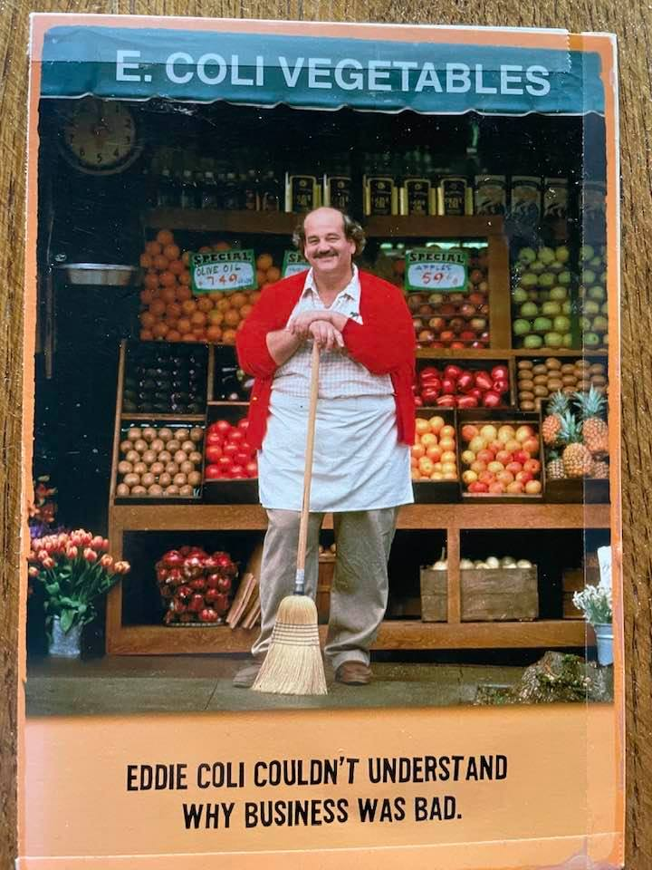
Eddie Coli proprietor
Notes:
Bad presentation

Slide 5
marketing:
E. Coli veggies

Slide 6

Song 3.7-8

Slide 7
^{Song 3.7-8} Shlomo’s litter, escorted by sixty valiant men chosen from Isra’el’s finest; all of them wield the sword and are expert fighters; each one has his sword ready at his side to combat the terrors of night.

Slide 8
Outline
Devastation: political and spiritual
Remedy

Slide 9
We all saw the horrific images this week of the rout and catastrophe of Afghanistan.

Slide 10
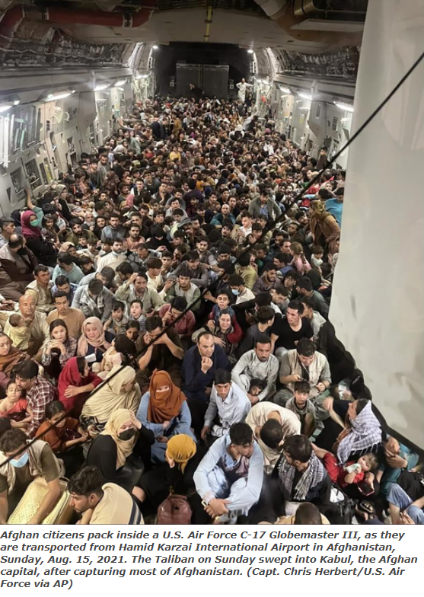
There have been zero US casualties since Feb. 2020 according to Ben Shapiro.
Notes:
So there was not bleeding necessity to withdraw.

Slide 11
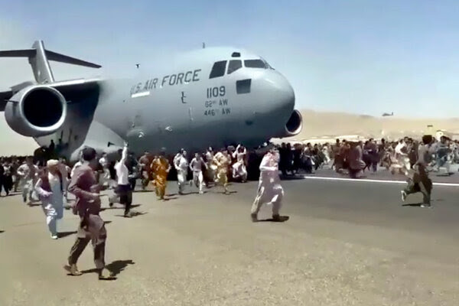
Notes:
We left the army without it’s basic strategy that we’d taught them: air cover. Pulled all AF and contractors!

Slide 12
This is not the first horrific loss of a nation and people with at least a commitment to the Western nations, nominally Biblical culture, and/or a Western civilization, to a MUCH worse one taking possession of the nation.

Slide 13
1917

Slide 15

Notes:
https://duckduckgo.com/?q=bolshevik+revolution&iax=videos&ia=videos&iai=https%3A%2F%2Fwww.youtube.com%2Fwatch%3Fv%3D9HrRnsJgQ6g
The tyrannical and oppressive reign of the Tsars needed to be overthrown. Then two parties fought for control, the Bolsheviks above and the liberal democratic Mensheviks, supported by troops from the US, France, and England. Communist idealism: no aristocracy; from each laborer according to his ability, to each according to his needs. Doesn’t work.

Slide 16
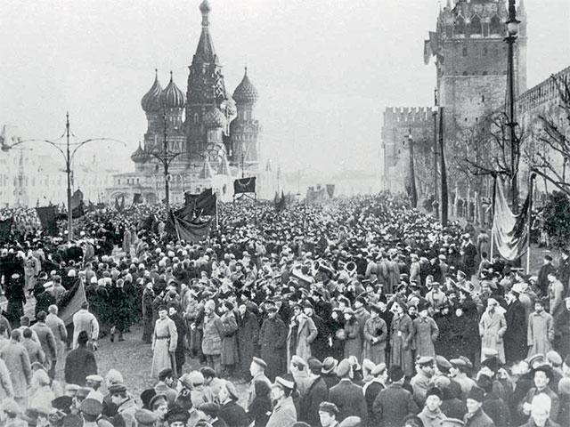
Notes:
The Bolsheviks won.

Slide 17
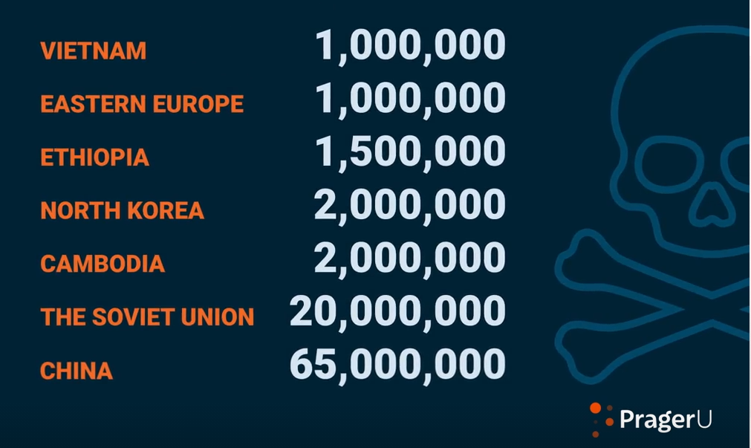
Civilian deaths
Notes:
https://www.prageru.com/video/is-communism-moral/
Civilian deaths, not soldiers. Kulaks farmers, dissenters.
Was there underground revival? Some.

Slide 18
1949

Slide 19
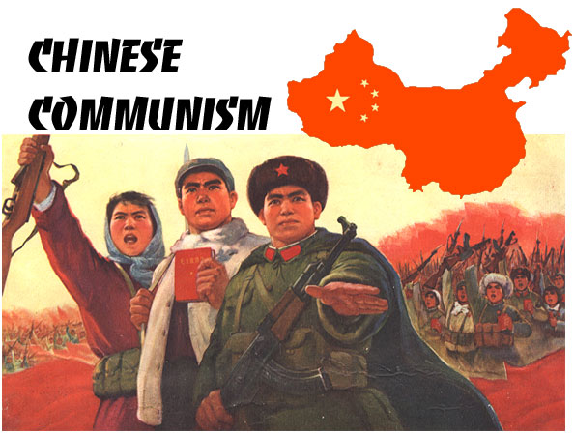
1949
Currently 1.4 billion people
Notes:
https://external-content.duckduckgo.com/iu/?u=https%3A%2F%2Fwww.marxists.org%2Fsubject%2Fchina%2Fcc.jpg&f=1&nofb=1

Slide 20
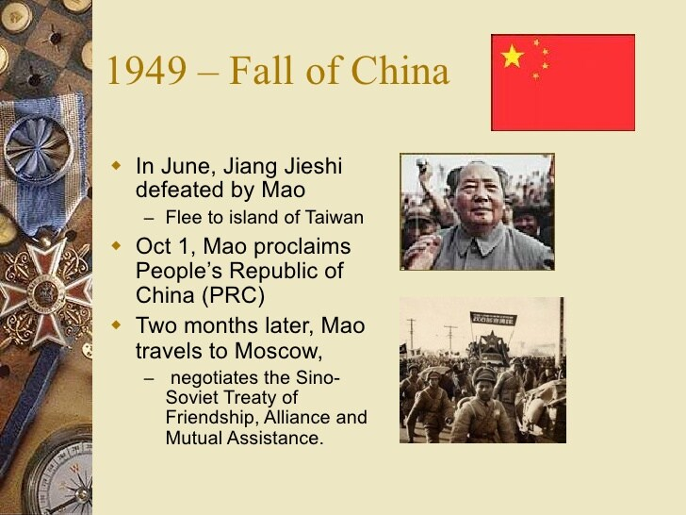
[Chiang Kai-shek]
Notes:
https://image.slidesharecdn.com/thecoldwar-tsothers-120516183334-phpapp02/95/the-cold-wartsothers-12-728.jpg?cb=1337193302
Generalissimo Chiang Kai-shek and his wife Soong were besieged with corruption, factionalism, and opium addiction. Communist idealism, again, but it doesn’t work.
The New Life Movement was set up by Generalissimo Chiang Kai-shek and his wife http://restoremymusclecar.com/pip.php?jul=chiang-kai-shek-history-corruption

Slide 21

Civilian deaths
Notes:
https://www.prageru.com/video/is-communism-moral/
Civilian deaths, not soldiers.

Slide 22
1959

Slide 23
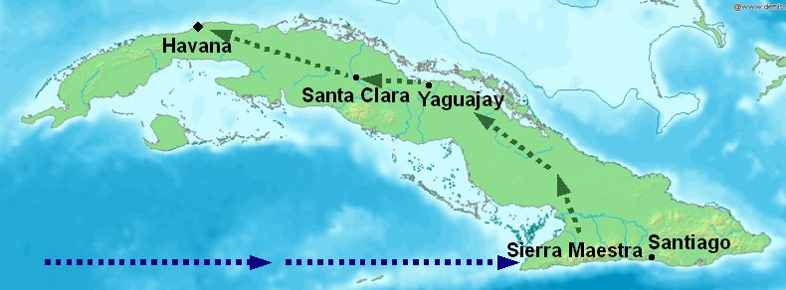
Notes:
Map of Cuba showing the location of the arrival of the rebels on the Granma in late 1956, the rebels' stronghold in the Sierra Maestra, and Guevara and Cienfuegos' route towards Havana via Las Villas Province in December 1958
https://upload.wikimedia.org/wikipedia/commons/3/33/Revolution_Map_of_progress.jpg

Slide 24
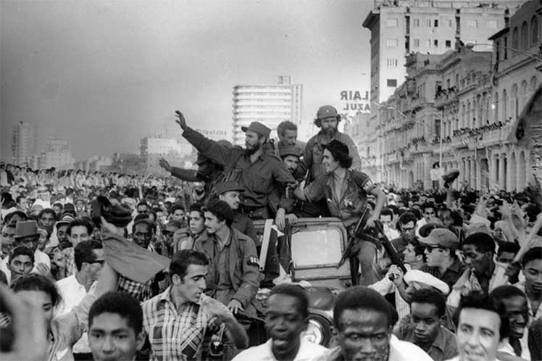
Havana entrance Fidel Castro
January 8, 1959
Notes:
The Cuban Revolution was an armed revolt conducted by Fidel Castro and his fellow revolutionaries against the military dictatorship of Cuban Fulgencio Batista. The Republic of Cuba at the turn of the 20th Century was largely characterized by a deeply ingrained tradition of corruption where political participation resulted in opportunities for elites to engage in opportunities for wealth accumulation. Batista antagonized the population by forming lucrative links to organized crime and allowing American companies to dominate the Cuban economy, especially sugar-cane plantations and other local resources.^{[36][37][38]} US presidents recognized its corruption and the justifiability of removing it

Slide 25
1975

Slide 26
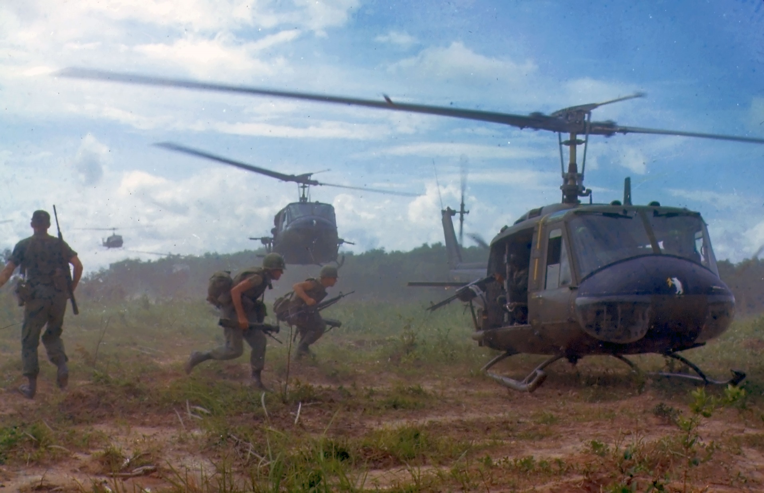
UH-1D helicopters airlift members
of a U.S. infantry regiment, 1966
Notes:
The Vietnam War was the prolonged struggle between nationalist forces attempting to unify the country of Vietnam under a communist government and the United States (with the aid of the South Vietnamese) attempting to prevent the spread of communism. Continuation of their rebellion against the French colonial masters.

Slide 27
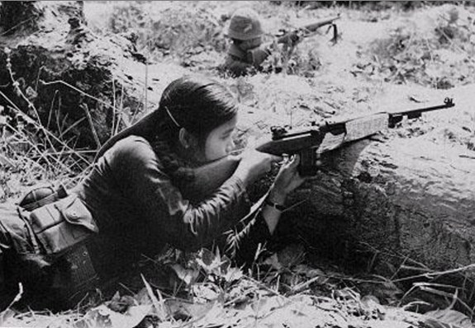
Female Viet Cong
guerrilla in combat
Notes:
https://upload.wikimedia.org/wikipedia/commons/7/78/Female_Vietcong_Guerrilla.jpg

Slide 28
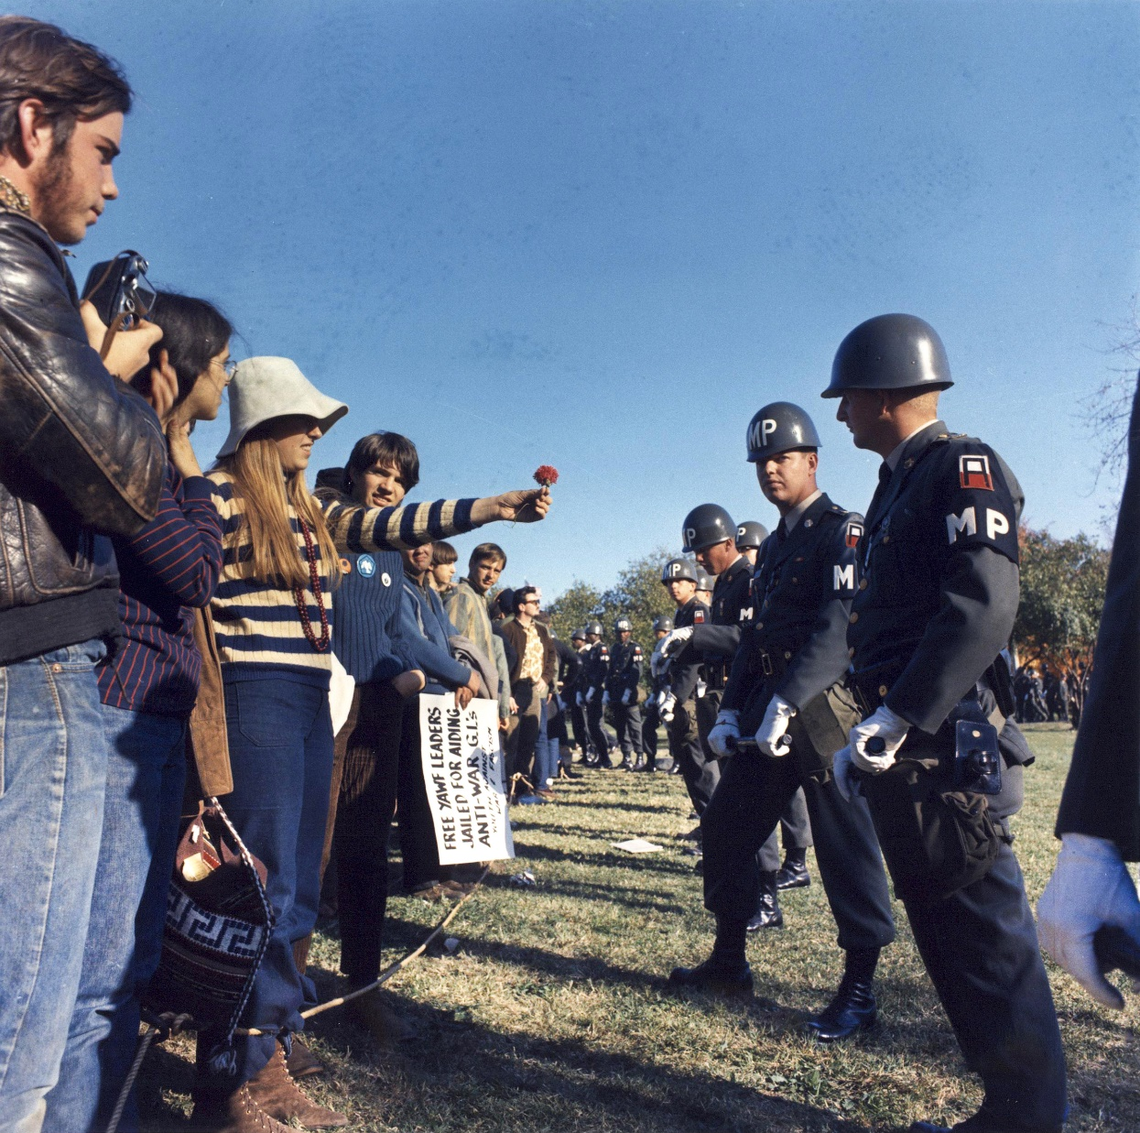
Anti-war demonstration in the US, 1967

Slide 29
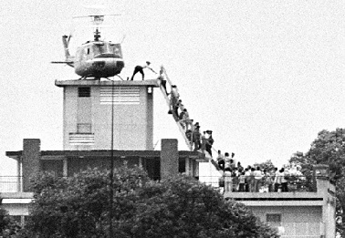
US embassy
evacuation
Notes:
https://external-content.duckduckgo.com/iu/?u=https%3A%2F%2Fwritemakesmight.net%2Fwp-content%2Fuploads%2F2021%2F08%2F08-17-2021-THE-FALL-OF-SAIGON-REDUX.jpeg&f=1&nofb=1
Disastrous humiliating defeat.

Slide 30
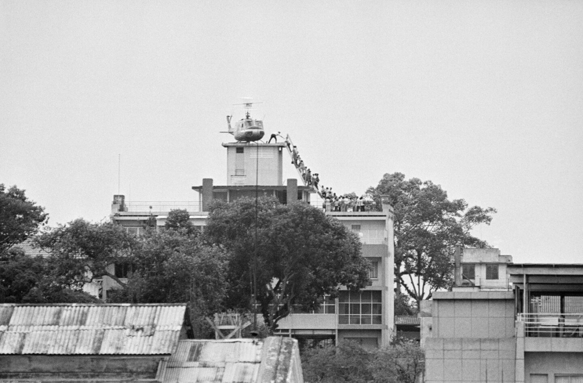
The Fall Of Saigon April 30 1975

Slide 31
Civilian deaths
Notes:
https://www.prageru.com/video/is-communism-moral/
Civilian deaths, not soldiers.

Slide 32
1979

Slide 33
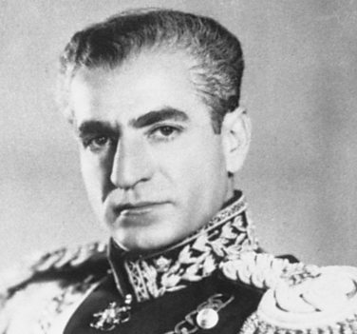
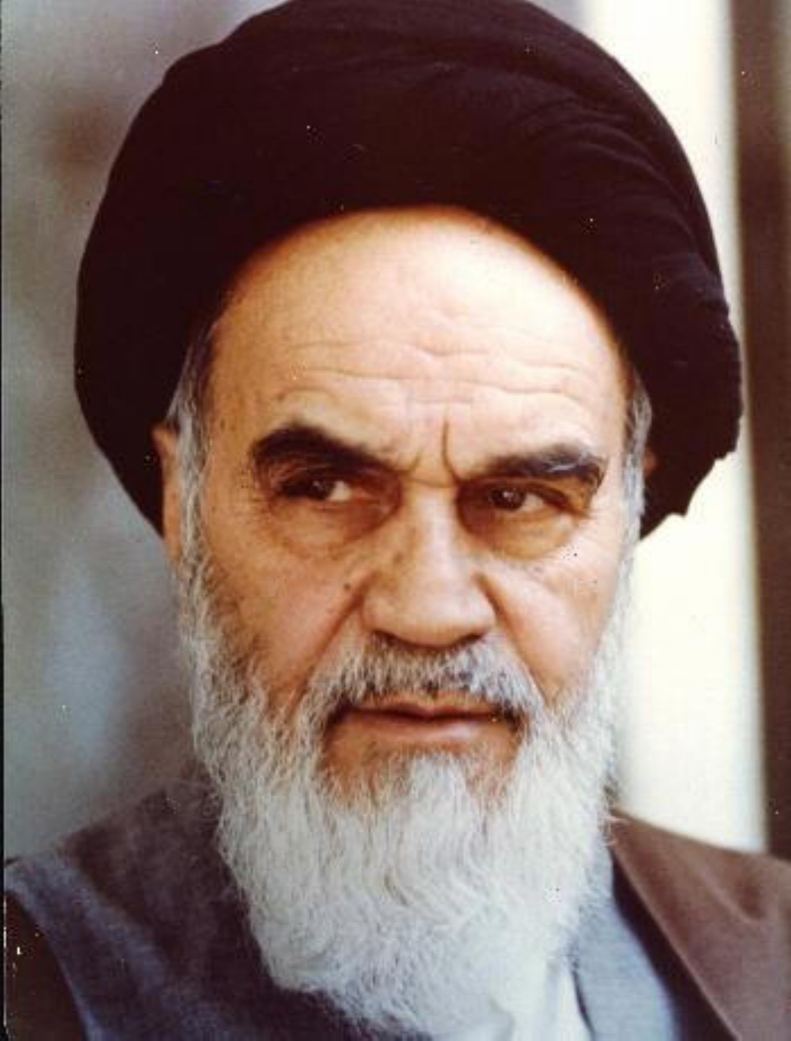
Ayatollah
Ruhollah Khomeini.
Shah Mohammad
Reza Pahlavi
Notes:
https://external-content.duckduckgo.com/iu/?u=http%3A%2F%2F1.bp.blogspot.com%2F_8_ENa7sVpug%2FTSxng8K7CtI%2FAAAAAAAARl8%2FVvA2izJliLY%2Fs1600%2FAyatollah%252BKhomeini.jpg&f=1&nofb=1
Shah US backed, secular. Khomenini exiled to Paris 1964 for 14 years

Slide 34
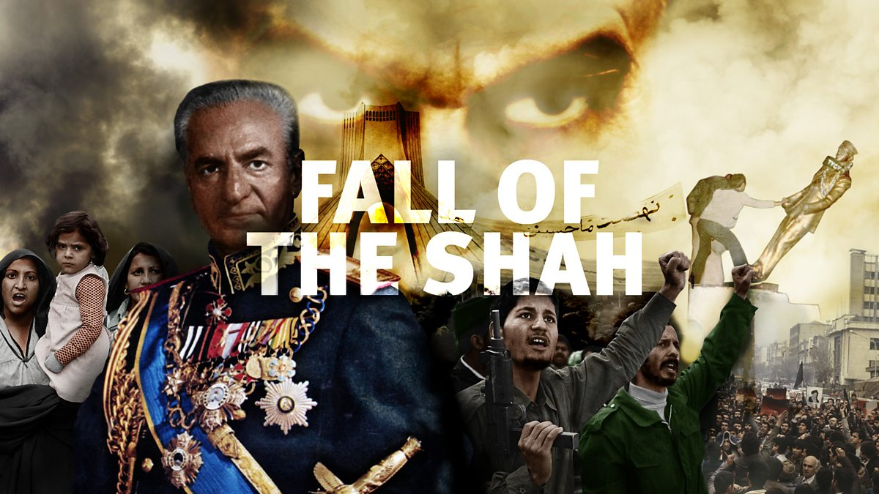
Notes:
https://external-content.duckduckgo.com/iu/?u=https%3A%2F%2Ftse1.mm.bing.net%2Fth%3Fid%3DOIP.QNWuoGXXu_HdUec6IXArKwHaEK%26pid%3DApi&f=1
"Few expected the regime of the Shah, which had international support and a modern army of 400,000, to crumble in the face of unarmed demonstrators within a matter of months."^{[53]}
Another historian noted the revolution was "unique in the annals of modern world history in that it brought to power not a new social group equipped with political parties and secular ideologies, but a traditional clergy armed with mosque pulpits and claiming the divine right to supervise all temporal authorities, even the country's highest elected representatives."^{[54]}
https://en.wikipedia.org/wiki/Background_and_causes_of_the_Iranian_Revolution

Slide 35
The Shah left Iran in exile on 16 January 1979, the last Persian Monarch. The royal reign collapsed shortly after, on 11 February, when guerrillas and rebel troops overwhelmed troops loyal to the Shah in armed street fighting, bringing Khomeini to official power
Notes:
Causes: conservative backlash opposing the westernization, modernization and secularization efforts of the Western-backed Shah,^{[1]} as well as from a more popular reaction to social injustice and other shortcomings of the ancien régime.^{[2]}
https://listverse.com/2020/01/13/10-horrific-ways-iran-is-slaughtering-its-own-people/

Slide 36
10 Horrific Ways
Iran Is Slaughtering Its Own People
https://listverse.com/2020/01/13/10-horrific-ways-iran-is-slaughtering-its-own-people/

Slide 37
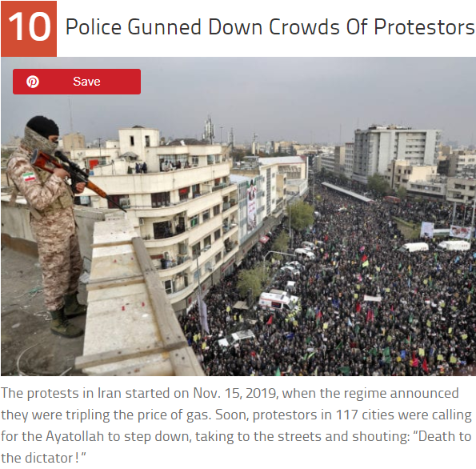
A protestor was killed – shot in the head by police – on the very first night. And from there, things only got worse.
Notes:
https://listverse.com/2020/01/13/10-horrific-ways-iran-is-slaughtering-its-own-people/

Slide 38
Five examples of horrific loss of a nation and people with at least a openness to the West and to the Bible, and/or a Western civilization, to a MUCH worse one taking possession of the nation.

Slide 39
Russia
China
Viet Nam
Cuba
Iran
All the worse for their revolutions. Overrun by disastrous ideas.

Slide 40
The prophet Havakkuk was in a similar situation, seeing rebellions Yehuda/Judah about to be destroyed by the much more debauched Babylonians.

Slide 41
^{Havakuk/Hab 1.13} Your eyes are too pure to see evil, you cannot countenance oppression. So why do you countenance traitors? Why are you silent when evil people swallow up those more righteous than they?
Notes:
Why is G-d allowing all these devastating turns to history?

Slide 42
I would like to offer a sixth such nation overrun.

Slide 43
The United States of America is is Kabul.

Slide 44
The United States of America is is Kabul.
We are overrun.

Slide 45
Our culture allows and accepts the murder of 62 million babies in the womb. [consequence]
Notes:
Lev 18 Innocent blood

Slide 46
Our culture allows and accepts the murder of 62 million babies in the womb. [consequence]
Our culture allows and accepts as normal and celebrated all LGBTQ variants. [consequence]
Notes:
Lev 18 Innocent blood

Slide 47
Our culture allows and accepts the murder of 62 million babies in the womb.
Our culture allows and accepts as normal all LGBTQ variants.
Our culture allows and accepts Critical Race Theory
Notes:
Lev 18 Innocent blood

Slide 48
CRT 101: Color and race are the most important identity markers for humanity.
Three primary applications:
White supremacy is the greatest threat to racial equality.
Notes:
MLK content of his character

Slide 49
The institutions of law must play a role in equalizing the relationship between the races.
The concept doesn’t include who you are, behavior, values, environment, crimes committed, or religious beliefs. It’s solely based on race. 1619 Project
Notes:
So, police defunding, riots excused.

Slide 50
Our culture allows and accepts unrestrained debt. We’ve lost our work ethic. Plymouth colony

Slide 51
After posting a 10.4% increase in May, consumer debt continued to expand, growing by a record rate in June, by $37.69 billion in June.
Notes:
https://thejewishvoice.com/2021/08/americans-collectively-owe-4-32-trillion-in-consumer-debt/

Slide 52


Slide 53
Americans collectively owe $4.32 trillion in consumer debt.
When you include mortgages, Americans are buried under nearly $15 trillion in debt.
Notes:
https://thejewishvoice.com/2021/08/americans-collectively-owe-4-32-trillion-in-consumer-debt/

Slide 54
Social media inconsistencies.
The Taliban is banned from Facebook and its subsidiaries WhatsApp and Instagram, as well as TikTok and YouTube – but it is allowed on Twitter.
Notes:
https://thejewishvoice.com/2021/08/taliban-mocks-joe-biden-social-media-censorship-as-twitter-bans-americans-not-terrorists/

Slide 55
Social media inconsistencies.
The Taliban is banned from Facebook and its subsidiaries WhatsApp and Instagram, as well as TikTok and YouTube – but it is allowed on Twitter.
Zabihullah Mujahid has 310,000 followers on Twitter.
Notes:
https://thejewishvoice.com/2021/08/taliban-mocks-joe-biden-social-media-censorship-as-twitter-bans-americans-not-terrorists/

Slide 56
NBC News is telling us that a “terror alert” has just been issued by Homeland Security, and during their report on this new “terror alert” a very alarming graphic was shown to the viewers. Under the heading “POTENTIAL TERROR THREATS”, the following categories were listed…
Notes:
https://thejewishvoice.com/2021/08/1984-society-ominous-new-definitions-for-what-constitutes-domestic-terrorism/

Slide 57
-“OPPOSITION TO COVID MEASURES”
-“CLAIMS OF ELECTION FRAUD, BELIEF TRUMP CAN BE EINSTATED”
-For example, earlier today I was absolutely shocked to learn that you can get banned on YouTube for offering to pray for someone that has COVID. Apparently that can qualify as “content” that encourages people to avoid needed medical treatment…
Notes:
https://thejewishvoice.com/2021/08/1984-society-ominous-new-definitions-for-what-constitutes-domestic-terrorism/

Slide 58
“Content that encourages the use of home remedies, prayer, or rituals in place of medical treatment such as consulting a doctor or going to the hospital”
Notes:
https://thejewishvoice.com/2021/08/1984-society-ominous-new-definitions-for-what-constitutes-domestic-terrorism/

Slide 59
A few days ago, a bill has actually been introduced in Congress which would permanently ban those that have not been fully vaccinated from ever flying again.
Notes:
https://thejewishvoice.com/2021/08/1984-society-ominous-new-definitions-for-what-constitutes-domestic-terrorism/

Slide 60
Anti-Semism has
become more the norm

Slide 61
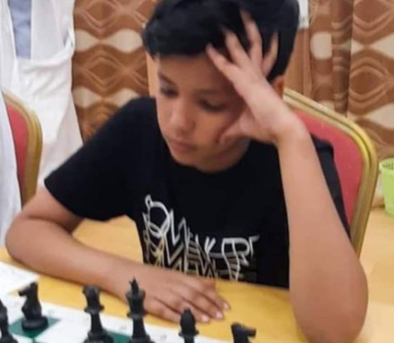
14-year-old Mauritanian chess player has pulled out of the Junior World Cup because the draw set him up to face an Israeli player.
Notes:
https://thejewishvoice.com/2021/08/mauritania-chess-player-pulls-out-of-junior-world-cup-to-avoid-israel-player/

Slide 62
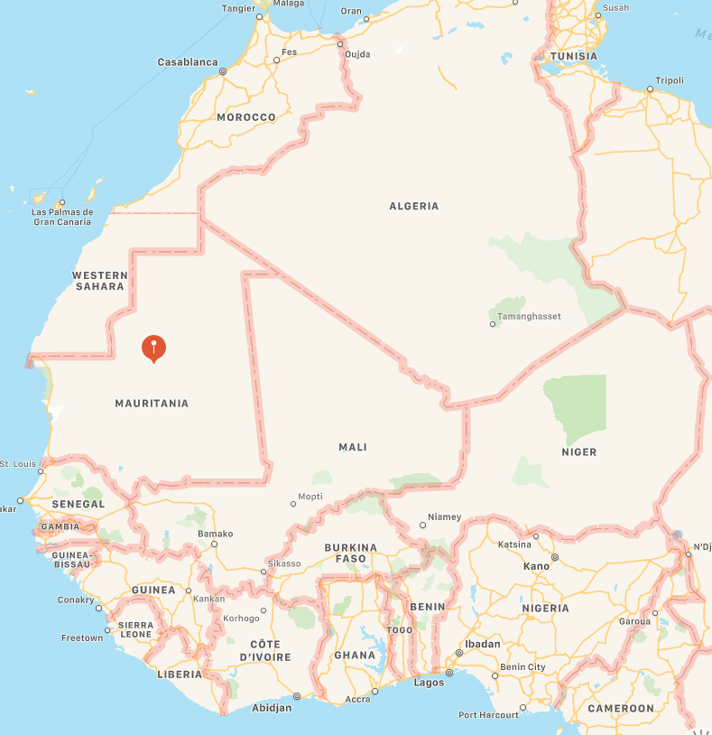
“I decided to retire, because I refuse to play with a rep of a fictional country that in reality does not exist,” Abdel Rahim Al-Talib Muhammad said. He ranked 47th out of 215 players in the world.

Slide 63
You might say, “Culture change and deterioration can’t come to our synagogue community. We are safe.”

Slide 64
It already has. How many estranged children, other previously warm relationships, financial portfolios have been shipwrecked?
Notes:
or apostate

Slide 65
Outline
Devastation: political and spiritual
Remedy

Slide 66
The United States of America is is Kabul.
We are overrun.

Slide 67
The United States of America is is Kabul.
We are overrun.
But NOT overcome.

Slide 68
^{Havakuk/Hab 2.1-4} Then Adoni answered me and said: “Write down the vision, make it plain on the tablets, so that the reader may run with it. For the vision is yet for an appointed time. It hastens to the end and will not fail.

Slide 69
^{Havakuk/Hab 2.1-4} If it [the resolution o of this question] should be slow in coming, wait for it, For it will surely come—it will not delay.” Behold, the puffed up one— his soul is not right within him, But the righteous will live by his trust.
Notes:
We may or may not solve the overrunning of the United States. We will sure try. Some of you support Convention of States. But we can, if in this wonderful building, or in jail, solve the overcoming of our souls! Prepare your minds?

Slide 70
^{Song 3.6-9} Who is this, coming up from the desert like a column of smoke, perfumed with myrrh and frankincense, chosen from the merchant’s crushed spices? It is Shlomo’s litter, escorted by sixty valiant men chosen from Isra’el’s finest;

Slide 71
^{Song 3.6-9} all of them wield the sword and are expert fighters; each one has his sword ready at his side to combat the terrors of night. King Shlomo made himself a royal litter of wood from the L’vanon.
אַפִּרְיוֹן canopy; sedan chair, apiryon palanquin, litter

Slide 72
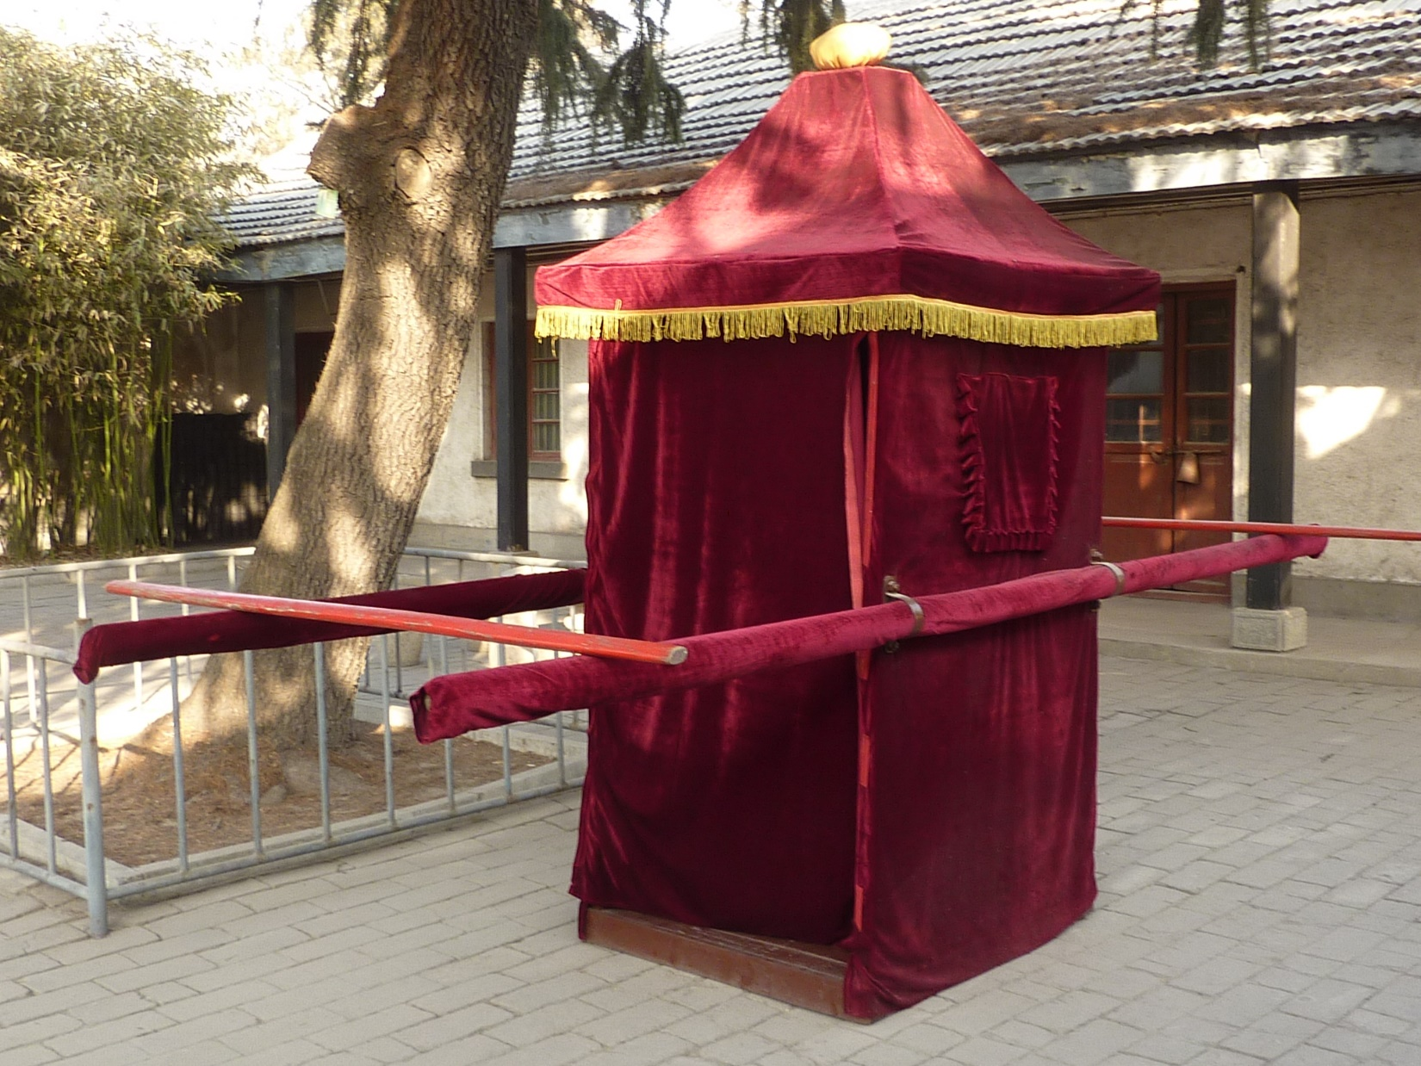
Notes:
https://external-content.duckduckgo.com/iu/?u=https%3A%2F%2Fupload.wikimedia.org%2Fwikipedia%2Fcommons%2F0%2F0a%2FMencius_Mansion_-_palanquin_-_P1050942.JPG&f=1&nofb=1

Slide 73
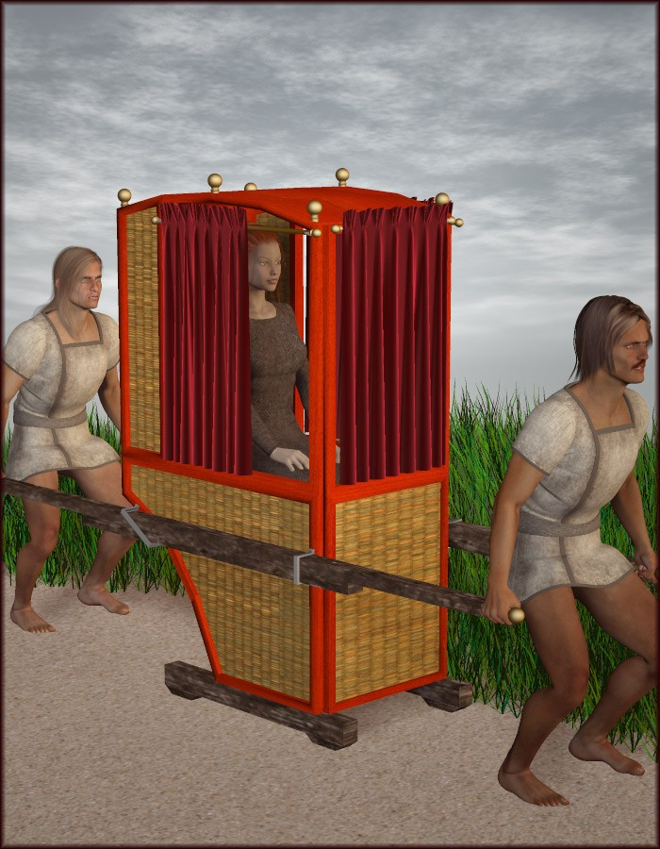
Notes:
For years, observers around the world have been stunned by the rapid rise of the underground Christian church in China. There are an estimated 97 million Christians in China, a staggering number when you consider that the growth has been under communism for 70 years.
https://www.opendoorsusa.org/christian-persecution/stories/on-chinas-70th-anniversary-is-the-worlds-largest-church-preparing-to-go-underground-again/

Slide 74
^{T’hillim/Ps 45.3-6} You are the most handsome of men; gracious speech flows from your lips. For God has blessed you forever. Warrior, strap your sword at your thigh; [gird on] your splendor and majesty.

Slide 75
^{T’hillim/Ps 45.3-6} In your majesty, succeed, ride on in the cause of truth, meekness and righteousness. May your right hand teach you awesome things. Your arrows are sharp. The people fall under you, as they penetrate the hearts of the king’s enemies.

Slide 76
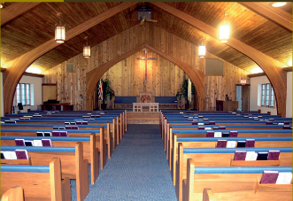
Pilgrim Holiness Church
Notes:
Cong with LOTS of rules: sleeves, no makeup, no jewelry, no TV, no movies. Donald Hardy became pastor. Logger 6’ 5” kick up his leg and say, I had and experience…in the body or out…don’t know. Got people loving G-d!! Sr. Davis “groanings that cannot be uttered? Golden glow up in the laminated rafters. “Cloud of liquid love.” April 13, 1969 I experienced New Birth. Many young people similarly seeking.
Went home few weeks later. “Mom, Dad, I’ve found the answer to life’s problems. It’s not in drugs, or revolution, but in the love of Jesus Christ.”
Sent me to psychiatrist.
“You’re worse than Hitler. He destroyed our bodies. You are destroying our souls.”
But I was lost to them, in the Presence of the Messiah, King, Warrior G-d, lover.

Slide 77
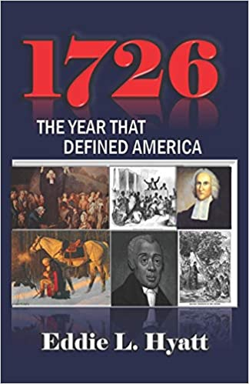
1726 was a defining year for America. 1776 would never have happened apart from 1726. The Great Awakening that began that year transformed Colonial America and laid the spiritual, moral, and philosophical foundations for the beginning of a great new nation. It also unleashed the anti-slavery sentiments and moral outrage
Notes:
https://www.amazon.com/1726-Year-that-Defined-America/dp/1888435402?dchild=1&keywords=Eddie+Hyatt&qid=1629074577&sr=8-3&linkCode=sl1&tag=httpwwweddieh-20&linkId=46c6223c14d12b60251048b3f51ffb12&language=en_US&ref_=as_li_ss_tl

Slide 78
that eventually brought about slavery’s demise in America. The late Harvard professor, Perry Miller, was correct in saying, “The Declaration of Independence of 1776 was a direct result of the preaching of the evangelists of the Great Awakening.”
Notes:
https://www.amazon.com/1726-Year-that-Defined-America/dp/1888435402?dchild=1&keywords=Eddie+Hyatt&qid=1629074577&sr=8-3&linkCode=sl1&tag=httpwwweddieh-20&linkId=46c6223c14d12b60251048b3f51ffb12&language=en_US&ref_=as_li_ss_tl

Slide 79
The Great Awakening of which he speaks began in 1726. This is the story of America that has been censured from modern textbooks. It is the story of the faith and spiritual vision of those who brought this nation into existence.
Notes:
https://www.amazon.com/1726-Year-that-Defined-America/dp/1888435402?dchild=1&keywords=Eddie+Hyatt&qid=1629074577&sr=8-3&linkCode=sl1&tag=httpwwweddieh-20&linkId=46c6223c14d12b60251048b3f51ffb12&language=en_US&ref_=as_li_ss_tl

Slide 81
We are in the Hebrew calendar month of Elul

Slide 82
אֲנִי לְדוֹדִי וְדוֹדִי לִי ← אלול ← אֱלוּל
Anee l’dodi, v’dodi li
I am my beloved’s and he is mine.

Slide 83
Summary of last week’s message
§1 Unsatisfied life and remedy 1.2-2.7
She is feeling distant from Him.
Likely making work >> worship.

Slide 84
She looks for His flock to find him.
^{Song 2.16} My lover is mine, and I am his! My lover is mine, and I am his! He grazes his flocks among the lilies.
דּוֹדִי לִי וַאֲנִי לוֹ הָרֹעֶה בַּשּׁוֹשַׁנִּים
Dodi li v’ani lo ha roeh ba shoshanim
Notes:
Serve the least of them.

Slide 85
He commends her beauty, servant heart, and dove eyes.
They are united at a banquet. [lit. house of wine]
הֱבִיאַנִי אֶל-בֵּית הַיָּיִן Heviani el bet hayin
Notes:
~Pharoah’s horses, peaceful. Solomon and Shulamit.

Slide 86
§2. Intimacy Broken, restoration 2.8-3.5

Slide 87
^{Song 2.8-13} The voice of my lover! Behold, he is coming— leaping over the mountains, springing over the hills! My lover is like a gazelle or a young buck among the stags. Look! He is standing behind our wall— gazing through the windows, peering through the lattice. In response my lover said to me:

Slide 88
Song 2.8-13 [She is quoting Him] “Get yourself up, my darling, my beauty, and come, come! For behold, the winter has past, the rain is over, it has gone. Blossoms appear in the land, the time of singing has come,

Slide 89
^{Song 2.8-13} and the voice of the turtle-dove is heard in our land. The fig tree ripens its early figs. The blossoming vines give off their fragrance. Arise, come, my darling!”

Slide 90
Song 3.7-8

Slide 91
^{Song 3.7-8} Shlomo’s litter, escorted by sixty valiant men chosen from Isra’el’s finest; all of them wield the sword and are expert fighters; each one has his sword ready at his side to combat the terrors of night.

Slide 92
I would challenge us to live in Elul seeking of the Bridegroom in fasting. Suggested by Stewart Winograd, actually until Yom Kippur, Tishri 10.

Slide 93
From Stewart:
The focus I have been given from the Lord is this:
Passionate intercession for an awakening (revival) in the body of Messiah, for all believers in Yeshua, starting with our own hearts.

Slide 94
A desperate cry for a great outpouring of the Ruakh Ha Kodesh. (Like we saw in the Book of Acts and in various times and places in history.) The purpose and desired result of the above leads us to:

Slide 95
Urgent, compassion-filled prayer for the lost. For the good news of Yeshua's salvation to go viral through His revived body; for a great harvest of thousands, even tens of thousands, of Jews and Gentiles in the coming year.

Slide 96
“Is not this the fast I choose: to release the bonds of wickedness, to untie the cords of the yoke, to let the oppressed go free, and to tear off every yoke?" ^{Isaiah 58:6}

Slide 97
Remember the purpose of fasting is to make yourself less sensitive to the things that satisfy your flesh and more sensitive to the things of God's Spirit and to give more time to focused prayer.

Slide 98
We set aside the time we would be preparing meals and eating; to pray, read the Bible, and worship. We are hungry for God and to see His breakthroughs.

Slide 99
Fast from solid foods.
Fast from solid foods at a specific time each day (i.e. 10 am-7 pm, sunup to sundown, etc.).
Fast from solid food one meal per day or eat only one meal of solid food per day.

Slide 100
Daniel Fast, fast from prepared foods and wine (alcohol).... eat fruits, vegetables, nuts, and liquids.
You can also mix and match these fasts, perhaps doing a different fast each week of the 40 days.
Notes:
Not quite 40 days left, but now, or soon, till YK. Intensify during the 10 days from RH to YK, especially considering Sukkot outreach.

Slide 101
In addition to the food-based fasts above, consider adding a fast from your favorite TV show, internet browsing, social media, and/or some other pleasures, from yelling under any circumstances.

Slide 102
Song 3.7-8

Slide 103
^{Song 3.7-8} Shlomo’s litter, escorted by sixty valiant men chosen from Isra’el’s finest; all of them wield the sword and are expert fighters; each one has his sword ready at his side to combat the terrors of night.

Slide 104
Do you KNOW Yeshua and the assurance of sins forgiven?
Are you hearing daily from His Word?
How are you applying what you heard?
Are you asking this of another?
Notes:
Who are you discipling, building up?4

Slide 107


