Slide 1
e-handout
To have these notes
without taking notes
Go to OrHaOlam.com
Click on downloads,
messages, 2021

Slide 2
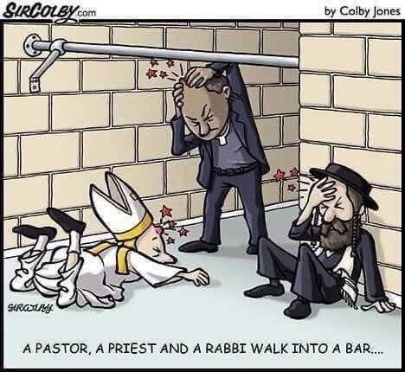
Notes:
Gavriel

Slide 3
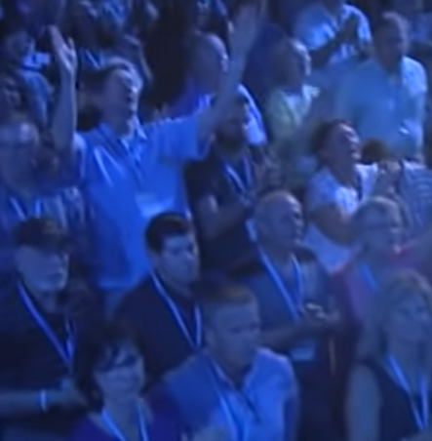
Eric and Joy Poling at 3:55 on the Roar from Zion live recording at King of Kings Auditorium
Notes:
We will try to go to their service on our tour next summer, if we can have one.

Slide 4
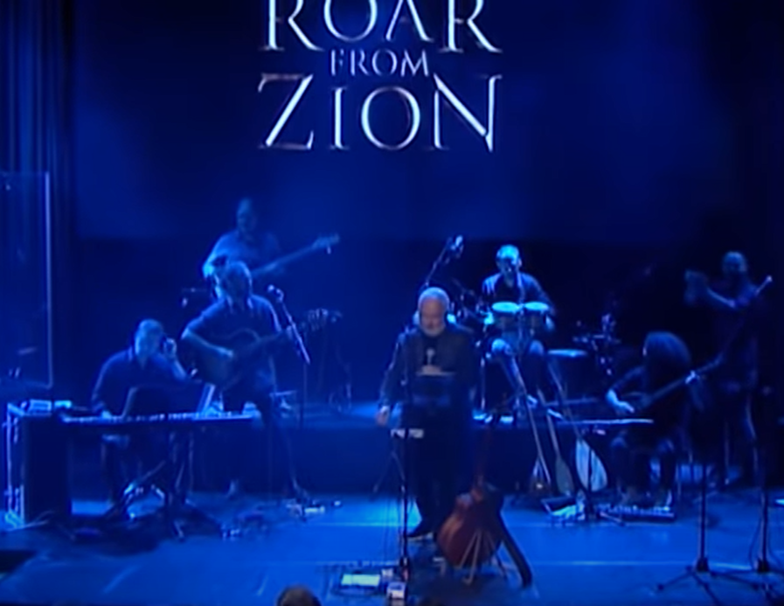
Notes:
https://youtu.be/SMjubP0nrG0 3.42 to the end

Slide 5
Where did that phrase
“roar from Zion”
come from?

Slide 6
^{Amos 1.2} יְיָ מִצִּיּוֹן יִשְׁאָג, וּמִירוּשָׁלִַם יִתֵּן קוֹלוֹ
יְיָ מִצִּיּוֹן יִשְׁאָג, וּמִירוּשָׁלִַם יִתֵּן קוֹלוֹ ^{Yoel 4.16}
Adoni will roar from Tziyon, he will thunder from Yerushalayim
Notes:
Two places, and a slight variant in Hoshea, then a variant in Revelation

Slide 7
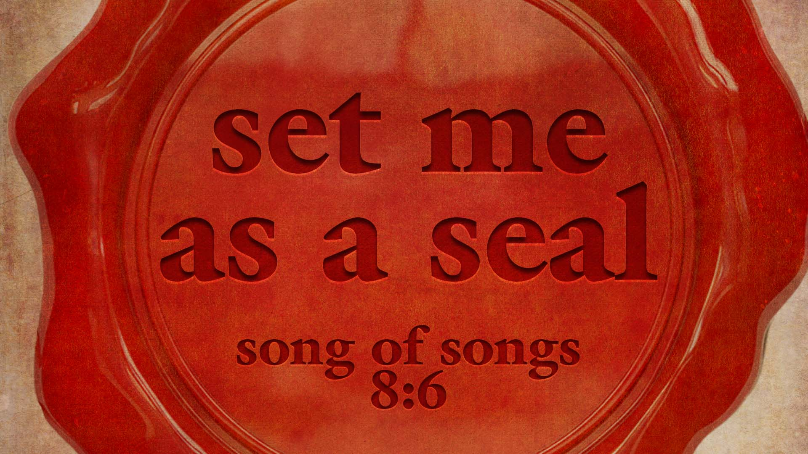

Slide 8
Set Me As a Seal, Song of Songs 8.6
Roar [of love] from Zion:
Yoel over land grant
Amos over attacking nations
Hoshea over Israel’s failures
Revelation: Messiah redeeming

Slide 9
Set Me As a Seal
Song of [love] Songs
§3. Unbroken intimacy 3.6-5.1
§4. Intimacy again broken, restoration 5.2-6.10
§5. Fruits of recognized union 6.11-8.4
§6 Unrestrained intimacy 8.5-14

Slide 10
^{FIRST Yoel 4.1-2} “For behold, in those days and at that time, when I restore Judah and Jerusalem from exile, I will gather all nations and bring them down to the valley of Jehoshaphat. I will plead with them there on behalf of My people, even My inheritance, Israel, whom they scattered among the nations and they divided up My land.

Slide 11
^{Yoel 4. 14-18} Such enormous crowds in the Valley of Decision! For the Day of Adoni is upon us in the Valley of Decision! The sun and moon have grown black, and the stars have stopped shining. Adoni will roar from Tziyon, he will thunder from Yerushalayim, the sky and the earth will shake.[they divided up My land.]
Notes:
The first reference to roaring is relative to dividing up the Land of Israel.

Slide 12
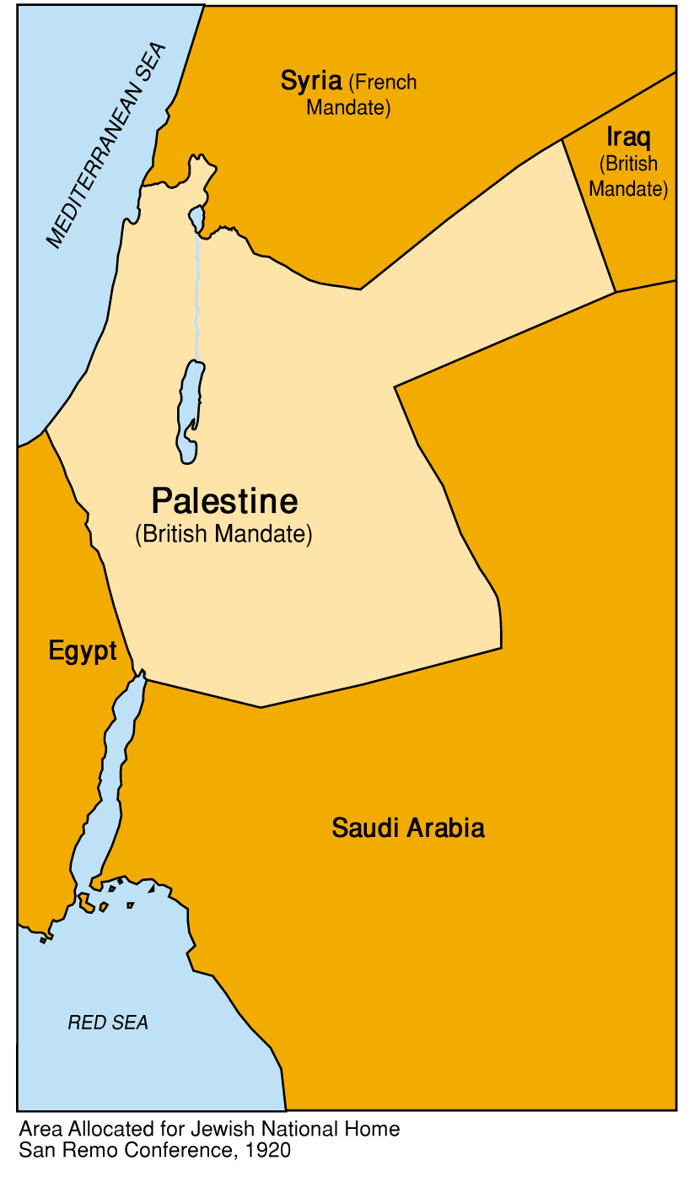
Area Allocated for Jewish National Home San Remo Conference, 1920
A small part of land grant to Avraham.
Notes:
Original, divine mandate was from the Euphrates to the Nile. MUCH more. Mostly happened under David and Solomon.

Slide 13
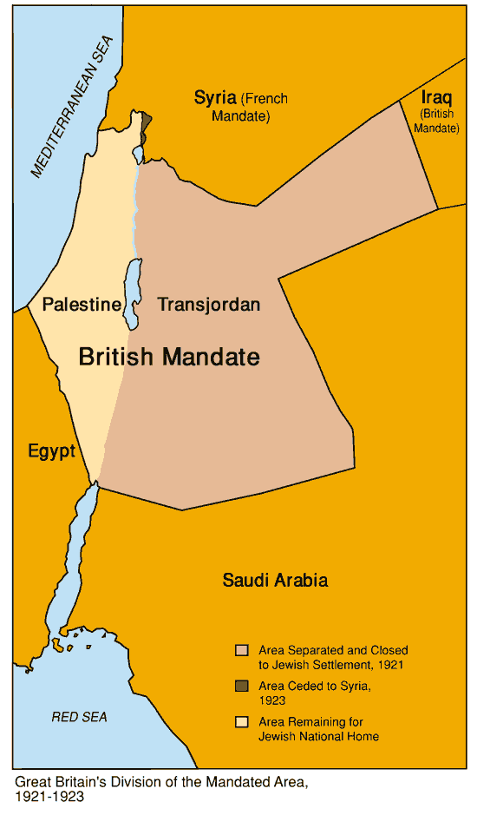
Winston Churchill liked to boast that in 1921 he created the British mandate of Transjordan, the Kingdom of Jordan, “with the stroke of a pen, one Sunday afternoon in Cairo.”
Notes:
https://winstonchurchill.hillsdale.edu/creating-jordan/
https://www.jewishvirtuallibrary.org/when-churchill-severed-transjordan-from-palestine

Slide 14
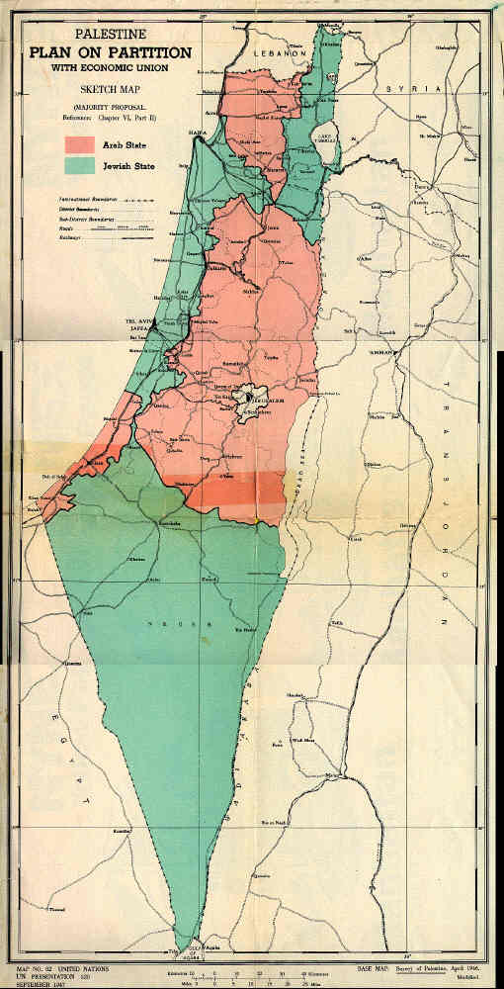
The United Nations partition, voted Nov. 1947
Notes:
https://www.jewishvirtuallibrary.org/the-partition-plan
https://external-content.duckduckgo.com/iu/?u=https%3A%2F%2Fpanathinaeos.files.wordpress.com%2F2016%2F09%2Farab-israeli-war_1948__1_.jpg%3Fresize%3D640%252C553&f=1&nofb=1

Slide 15
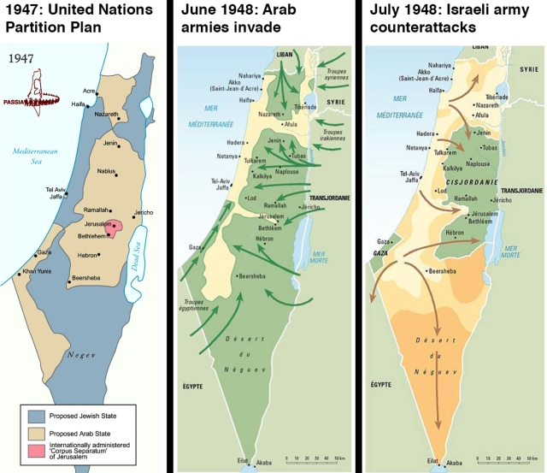
Notes:
https://www.jewishvirtuallibrary.org/the-partition-plan
https://external-content.duckduckgo.com/iu/?u=https%3A%2F%2Fpanathinaeos.files.wordpress.com%2F2016%2F09%2Farab-israeli-war_1948__1_.jpg%3Fresize%3D640%252C553&f=1&nofb=1

Slide 16
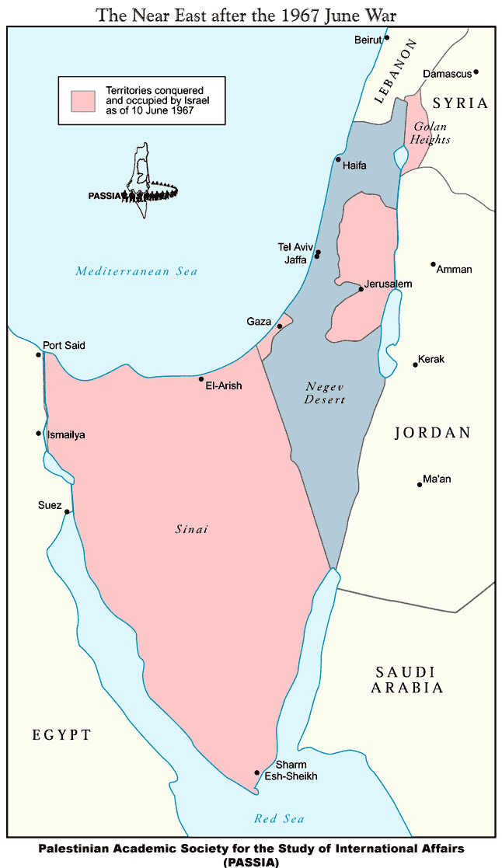
Israel after the 1967 Six Day War.
Notes:
http://www.sweetliberty.org/issues/israel/greater_israel_files/after1967.gif
Sinai given to Egypt. Gaza given independence → Hamas.
Now international attempts to divide Judea, Samaria [West Bank] from Israel.

Slide 17
^{Yoel 4.1-2} They divided up My land.
^{Yoel 4. 14-18} Adoni will roar from Tziyon, he will thunder from Yerushalayim, the sky and the earth will shake.

Slide 18
Set Me As a Seal Song 8.6
Roar [of love] from Zion:
Yoel over land grant
Amos over attacking nations
Hoshea over Israel’s failures
Revelation: Messiah redeeming

Slide 19
^{SECOND Amos 1.2} Adoni is roaring from Tziyon, thundering from Yerushalayim…“For Dammesek’s three crimes, no, four — I will not reverse it.
Damascus, Azah עזה Gaza, Tzor/Tyre, Edom, Amon, Moav, Yehuda, Israel.

Slide 20
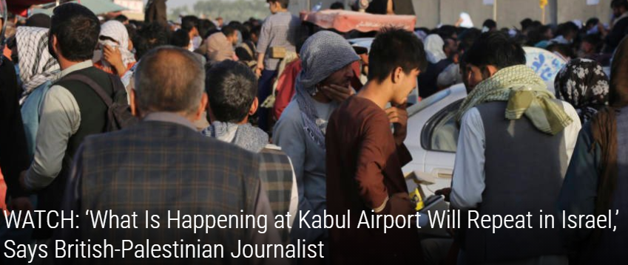

Slide 21
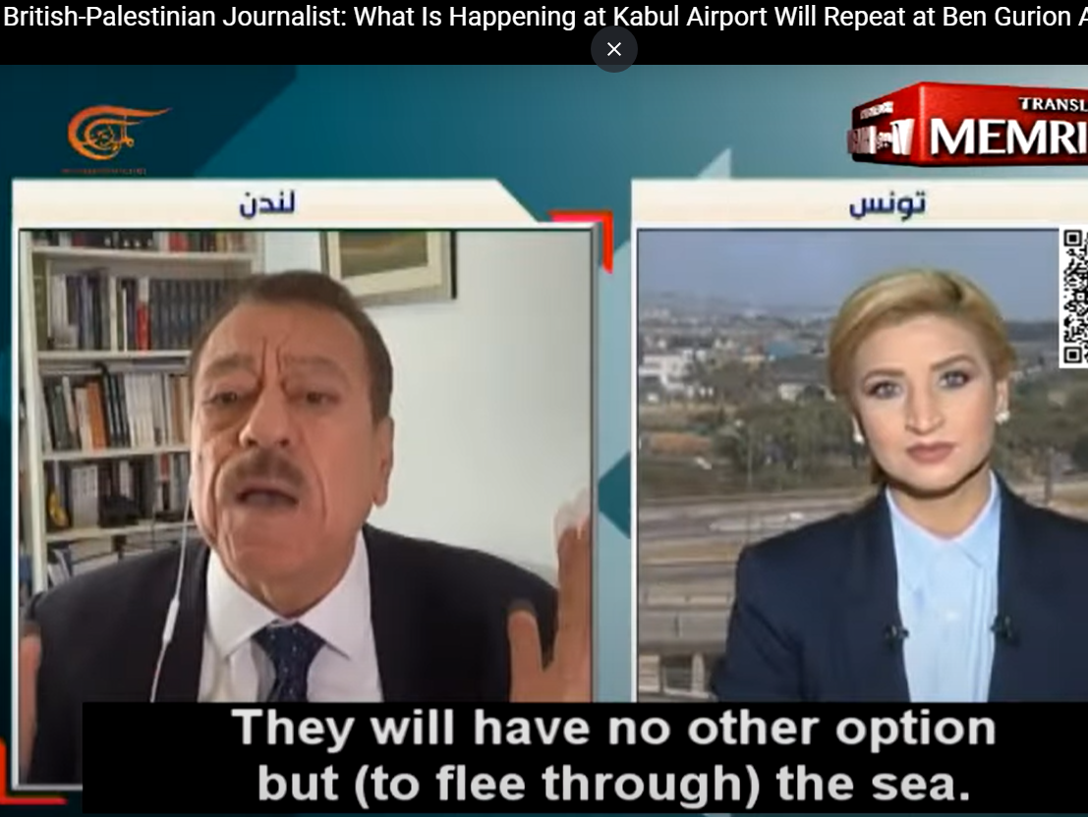
Notes:
https://youtu.be/C3yO0wmHe4s
05 to 1.26

Slide 22
^{SECOND Amos 1.2} Adoni is roaring from Tziyon, thundering from Yerushalayim…“For Dammesek’s three crimes, no, four — I will not reverse it.
Damascus, Azah עזה Gaza, Tzor/Tyre, Edom, Amon, Moav, Yehuda, Israel.

Slide 23
^{THIRD Hoshea 11.8-9} Efrayim, how can I give you up, or surrender you, Isra’el? How could I treat you like Admah or make you like Tzvoyim? My heart recoils at the idea, as compassion warms within me.
Notes:
Israels own failures

Slide 24
^{Hoshea 11.8-9} I will not give vent to the fierceness of my rage, I will not return to destroy Efrayim; for I am God, not a human being, the Holy One among you; so I will not come in fury.

Slide 25
^{Hoshea 11.10} They will walk after Adoni. He will roar like a lion.
Indeed, He will roar and the children will come trembling from the west.

Slide 26
^{FOURTH Rev 5.1-5} And I saw in the right hand of the One seated upon the throne a scroll, written on both the front and the back, sealed with seven seals. I also saw a mighty angel proclaiming with a loud voice, “Who is worthy to open the scroll and to break its seals?”

Slide 27
^{Rev 5.1-5} No one in heaven or on the earth or under the earth was able to open the scroll or to look into it. I began to weep loudly because no one was found worthy to open the scroll or to look into it.

Slide 28
^{Rev 5.1-5} Then one of the elders tells me, “Stop weeping! Behold, the Lion of the tribe of Judah, the Root of David, has triumphed—He is worthy to open the scroll and its seven seals.”
Notes:
Derek Prince

Slide 29
Seven ways the United States has been overrun.
62 million aborted babies.
Celebration of LGBTQ
Critical Race Theory 1619 hyp
Uncontrolled debt
Social media fallacies
Growing anti-Semitism

Slide 30
Last Shabbat theme:
We are overrun, but NOT overcome.

Slide 31
^{Rev 5.1-5} Then one of the elders tells me, “Stop weeping! Behold, the Lion of the tribe of Judah, the Root of David, has triumphed—He is worthy to open the scroll and its seven seals.”
Notes:
Derek Prince statement

Slide 32
^{Revelation 5. 8-12} When he took the scroll, the four living beings and the twenty-four elders fell down in front of the Lamb. Each one held a harp and gold bowls filled with pieces of incense, which are the prayers of God’s people; and they sang a new song,

Slide 33
^{Revelation 5. 8-12} “You are worthy to take the scroll and to open its seals. For You were slain, and by Your blood You redeemed for God those from every tribe and tongue and people and nation. You have made them for our God a kingdom and kohanim, and they shall reign upon the earth.”

Slide 34
^{Revelation 5. 9-12} “Worthy is the Lamb who was slain, to receive power and riches and wisdom and might and honor and glory and blessing!”

Slide 35
^{Rev 5.1-5} Then one of the elders tells me, “Stop weeping! Behold, the Lion of the tribe of Judah, the Root of David, has triumphed—He is worthy to open the scroll and its seven seals.”

Slide 37
Set Me As a Seal Song of Songs 8.6
Roar [of love] from Zion:
Yoel over land grant
Amos over attacking nations
Hoshea over Israel’s failures
Revelation: Messiah redeems

Slide 38
Set Me As a Seal
Song of [love] Songs
§3. Unbroken intimacy 3.6-5.1
§4. Intimacy again broken, restoration 5.2-6.10
§5. Fruits of recognized union 6.11-8.4
§6 Unrestrained intimacy 8.5-14
Notes:
This is Elul, and the Song of Songs theme is an acrostic in the name of the month.

Slide 39
§3. Unbroken intimacy 3.6-5.1
^{Song 3.11 [She]} Daughters of Tziyon, come out, and gaze upon King Shlomo, wearing the crown with which his mother crowned him
on his wedding day, his day of joy!
Notes:
Hudson Taylor p64

Slide 40
^{Song 4.3 [He]} Your lips are like a scarlet thread and your speech is lovely.
^{Song 4.7 [He]} You are altogether lovely, my darling, and no blemish is in you.
Notes:
HT: The lips that speak only of Him are like a thread of scarlet; the mouth or speech which has no word of self, or for self, is beautiful, comely in His sight. [Pause] Take your failures, deficiencies, although you may have been trying to do right, your temper, impatience, desires got the momentary best of you. Repent, confess, trust.
Our beauty is in reflecting Him, and quickly confessing and repenting of any deficiencies.

Slide 41
^{Song 4.8-10 [He]} Come with me from the L’vanon, my bride, come with me from the L’vanon. Come down from the heights of Amanah, from the heights of S’nir and Hermon, down from the lions’ lairs and the leopard-haunted hills.
Notes:
The joy of outreach. Ending message at 11.55 to present in a bit more detail our outreach off line for a little longer. Zoom meeting Wednesday. Email admin@orhaolam.com. Secular arena. Could be hostile. Great joy if do it WITH Messiah. Wednesday night a Zoom call 7:30 for brainstorming.

Slide 42
^{Mtt 28.18-20} Yeshua came and talked with them. He said, “All authority in heaven and on earth has been given to me. Therefore, go and make people from all nations into talmidim /disciples, immersing them into the reality of the Father,

Slide 43
^{Mtt 28.18-20} the Son and the Ruach HaKodesh, and teaching them to obey everything that I have commanded you. And remember! I will be with you always, yes, even until the end of the age.”

Slide 44
^{Song 4.8-10 [He]} My sister, my bride, you have carried my heart away! With just one glance, with one bead of your necklace you have carried my heart away. My sister, my bride, how sweet is your love! How much better your love than wine, more fragrant your perfumes than any spice!
Notes:
^{Acts 28.15} Now the brothers there, when they heard about us, came as far as the Forum of Appius and the Three Taverns to meet us. When Paul saw them, he gave thanks to God and took courage.

Slide 45
^{Song 4.11-15 [He]} Your lips, my bride, drip honey from the honeycomb. Honey and milk are under your tongue. The scent of your garments is like the aroma of Lebanon. A locked garden is my sister, my bride, an enclosed spring, a sealed fountain.
Notes:
HT 70

Slide 46
^{Song 4.11-15 [He]} Your shoots are an orchard of pomegranates with choice fruit, henna with nard—nard and saffron, calamus and cinnamon—with all the trees of frankincense, myrrh and aloes, along with all the finest spices— a garden spring, a well of living water
and flowing streams from Lebanon.
Notes:
Living water bottles!!

Slide 47
^{Song 4.16 [She]} Awake, north wind! Come, south wind! Blow on my garden to spread its fragrance. Let my darling enter his garden and eat its finest fruit.
Notes:
She is ready for any experience that will draw her to Him. Love Adoni with all…m’odekha. Easier to say than to live out.

Slide 48
^{1 Cor 12.9-10} He told me, “My grace is enough for you, for my power is brought to perfection in weakness.” Therefore, I am very happy to boast about my weaknesses, in order that the Messiah’s power will rest upon me.

Slide 49
^{1 Cor 12.9-10} Yes, I am well pleased with weaknesses, insults, hardships, persecutions and difficulties endured on behalf of the Messiah; for it is when I am weak that I am strong.

Slide 50
What are some north winds blowing on us now?
Notes:
Besides your personal life…the international picture

Slide 51
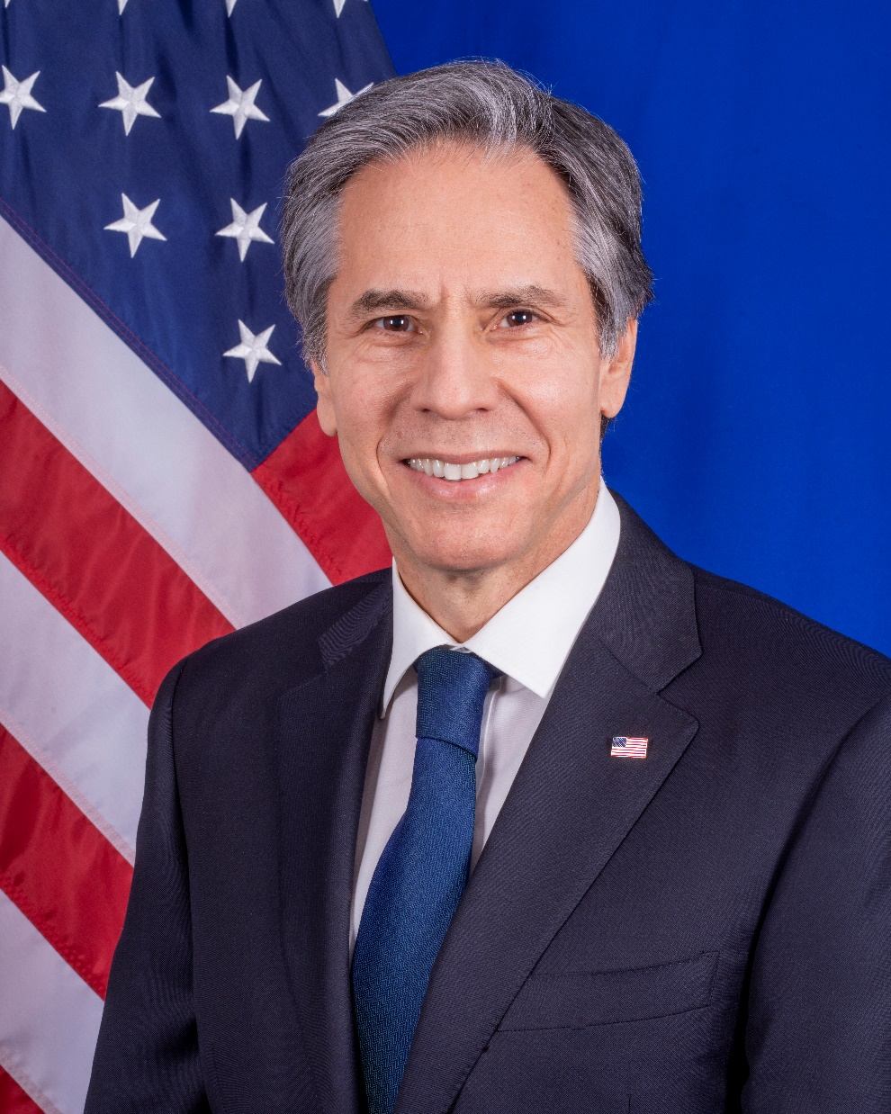
Antony Blinken the 71st United States Secretary of State

Slide 52
His stepfather, Samuel Pisar, was the only Holocaust survivor of the 900 children of his school in Poland. Pisar found refuge in a US tank after making a break into the forest during a Nazi death march.
Notes:
https://en.wikipedia.org/wiki/Antony_Blinken

Slide 53
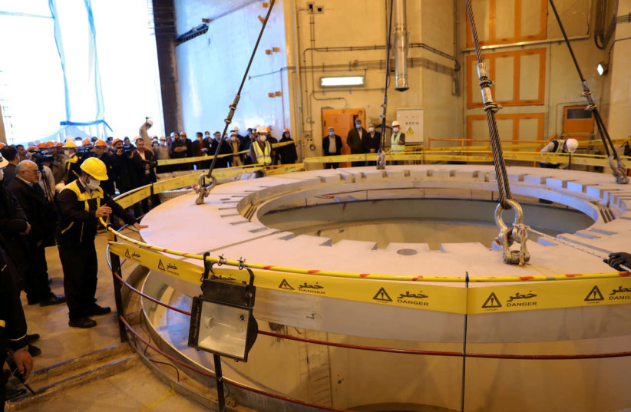
The water nuclear reactor at Arak, Iran December 23, 2019.
Notes:
https://www.jpost.com/breaking-news/blinken-weighs-possible-sanctions-north-korea-as-russia-iran-loom-657419

Slide 54
Blinken: Iran could be weeks away from enough nuclear material for bomb.

Slide 55
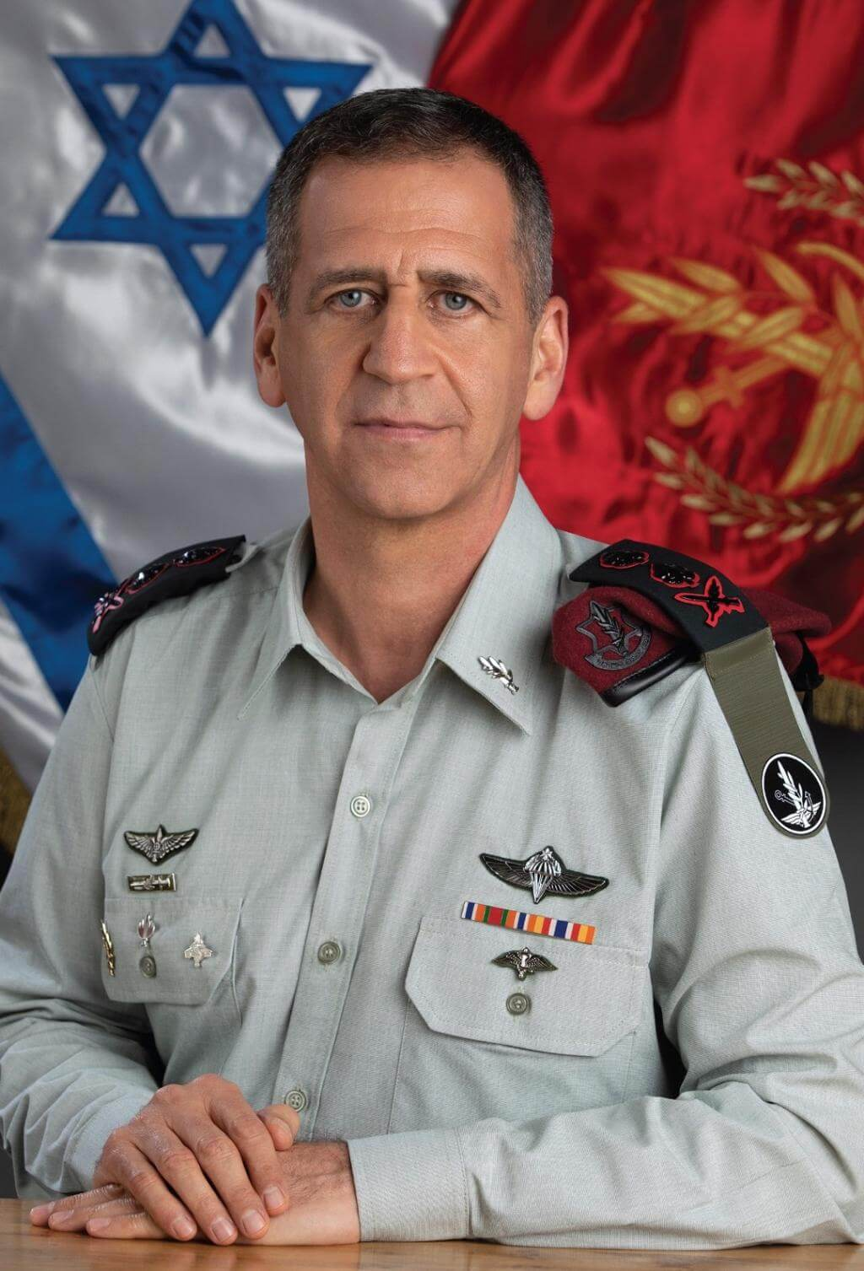
Israel’s military is working hard to develop plans to strike Iran’s nuclear facilities, the IDF Chief of Staff Aviv Kochavi revealed on Wednesday.
Notes:
https://www.worthynews.com/61054-idf-preparing-to-strike-iranian-nuclear-sites-as-gantz-warns-of-nuclear-capability-within-months
Why are they announcing it??!!

Slide 56
Candace Owens gives a short history of slavery.
Notes:
https://www.prageru.com/video/a-short-history-of-slavery/?utm_source=Iterable&utm_medium=email&utm_campaign=campaign_2758799
Beginning to 5.28

Slide 57
Set Me As a Seal
Song of [love] Songs
§3. Unbroken intimacy 3.6-5.1
§4. Intimacy again broken, restoration 5.2-6.10
§5. Fruits of recognized union 6.11-8.4
§6 Unrestrained intimacy 8.5-14

Slide 58
^{Song 5.2-6} [She] I am asleep, but my heart is awake. Listen! I hear my darling knocking!
[He] Open for me, my sister, my love, my dove, my flawless one! For my head is wet with dew, my hair with the moisture of the night.

Slide 59
^{Rev 3.20-22} Here, I’m standing at the door, knocking. If someone hears my voice and opens the door, I will come in to him and eat with him, and he will eat with me. I will let him who wins the victory sit with me on my throne,

Slide 60
^{Rev 3.20-22} just as I myself also won the victory and sat down with my Father on his throne. Those who have ears, let them hear what the Spirit is saying to the Messianic communities.”’”

Slide 61
^{Song 5.2-6 [She]} I’ve removed my coat; must I put it back on? I’ve washed my feet; must I dirty them again? The man I love put his hand through the hole by the door-latch, and my heart began pounding at the thought of him.

Slide 62
^{Song 5.2-6 [She]} I got up to open for the man I love. My hands were dripping with myrrh — pure myrrh ran off my fingers onto the handle of the bolt. I opened for my darling, but my darling had turned and gone.

Slide 63
Charles Finney, the father of modern revivalism, made this piercing statement:
"There is a certain type of believer that although being constructively involved in the congregation and passes off as being a very good believer,
Notes:
https://www.charismanews.com/opinion/the-flaming-herald/86531-can-you-be-a-christian-without-believing-in-jesus?utm_source=Charisma%20News%20Daily&utm_medium=email&utm_content=subscriber_id:5160390&utm_campaign=CNO%20daily%20-%202021-08-27

Slide 64
is useless in revival. I do not mean that they are wicked, but they have a form of piety which has no fire or efficiency and actually repels new believers, and wards off the truth."
Notes:
https://www.charismanews.com/opinion/the-flaming-herald/86531-can-you-be-a-christian-without-believing-in-jesus?utm_source=Charisma%20News%20Daily&utm_medium=email&utm_content=subscriber_id:5160390&utm_campaign=CNO%20daily%20-%202021-08-27

Slide 65
You must ask yourself why you are serving God. Is it for the blessings and what He can give you out of life, or what you can give back to Him for giving you His life? That's the basic difference between a true and a false conversion.
True repentance leads to obedience and the pursuit of holiness.
Notes:
https://www.charismanews.com/opinion/the-flaming-herald/86531-can-you-be-a-christian-without-believing-in-jesus?utm_source=Charisma%20News%20Daily&utm_medium=email&utm_content=subscriber_id:5160390&utm_campaign=CNO%20daily%20-%202021-08-27

Slide 66
"Pursue peace with all people, and holiness, without which no one will see the Lord" ^{(Heb. 12:14)}
Without holiness you won't see the Lord. Without purity of heart you can't see God.
"Blessed are the pure in heart, for they shall see God" ^{(Matt. 5:8).}
Notes:
https://www.charismanews.com/opinion/the-flaming-herald/86531-can-you-be-a-christian-without-believing-in-jesus?utm_source=Charisma%20News%20Daily&utm_medium=email&utm_content=subscriber_id:5160390&utm_campaign=CNO%20daily%20-%202021-08-27

Slide 67
^{Song 5.6b-7 [She]} My heart had failed me when he spoke — I sought him, but I couldn’t find him; I called him, but he didn’t answer. The watchmen roaming the city found me; they beat me, they wounded me; they took away my cloak, those guardians of the walls!

Slide 68
^{Song 5.9 [Chorus]} How does the man you love differ from any other, you most beautiful of women? How does the man you love differ from any other?

Slide 69
^{Song 5.10-11 [She]} The man I love is radiant and ruddy; he stands out among ten thousand. His head is like the finest gold; his locks are wavy and black as a raven.

Slide 70
^{Song 5.15-16 [She]} His appearance is like the L’vanon, as imposing as the cedars. His words are sweetness itself; he is altogether desirable. This is my darling, and this is my friend, daughters of Yerushalayim.

Slide 72
Set Me As a Seal
Song of [love] Songs
§3. Unbroken intimacy 3.6-5.1
§4. Intimacy again broken, restoration 5.2-6.10
§5. Fruits of recognized union 6.11-8.4
§6 Unrestrained intimacy 8.5-14

Slide 73
^{Song 8.6-7 [She]} Set me like a seal on your heart, like a seal on your arm; for love is as strong as death, passion as cruel as Sh’ol; its flashes are flashes of fire, [as fierce as the] flame of Yah.

Slide 74
^{Song 8.6-7 [She]} No amount of water can quench love, torrents cannot drown it. If someone gave all the wealth in his house for love, he would gain only utter contempt.

Slide 75
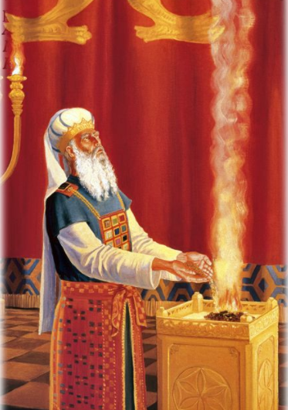
^{Shmot/Ex 28.10-12} Take two onyx stones and engrave on them the names of the sons of Isra’el — six of their names on one stone and the six remaining names on the other, in the order of their birth.
Notes:
http://2.bp.blogspot.com/_nbNVAcrsK3A/SjZiTpe_vUI/AAAAAAAAAbY/32a_E_zzQ-s/s400/templeinst.jpg

Slide 76
^{Shmot/Ex 28.10-12} An engraver should engrave the names of the sons of Isra’el on the two stones as he would engrave a seal. Mount the stones in gold settings, and put the two stones on the shoulder-pieces of the vest as stones calling to mind the sons of Isra’el.

Slide 77
^{Shmot/Ex 28.10-12} Aharon is to carry their names before Adoni on his two shoulders as a reminder.

Slide 78
^{Song 8.6-7 [She]} Set me like a seal on your heart, like a seal on your arm; for love is as strong as death, passion as cruel as Sh’ol; its flashes are flashes of fire, [as fierce as the] flame of Yah.

Slide 79
^{MJ/Heb. 9.28} Messiah was offered once to bear the sins of many. He will appear a second time, apart from sin, to those eagerly awaiting Him for salvation.

Slide 80
Do you KNOW Yeshua and the assurance of sins forgiven?
Are you hearing daily from His Word?
How are you applying what you heard?
Are you asking this of another?
Notes:
Who are you discipling, building up?4

