Slide 1
e-handout
To have these notes
without taking notes
Go to OrHaOlam.com
Click on downloads,
messages, 2021

Slide 2
Yom Kippur greeting
צום קל
Tsom Kal
Easy Fast

Slide 3
As a Jew or Messianic Gentile, am I allowed to eat McDonalds today, on Yom Kippur?

Slide 4
As a Jew or Messianic Gentile, , am I allowed to eat McDonalds today, on Yom Kippur?
Yes, I know it's Yom Kippur. But McDonalds is fast food.

Slide 5
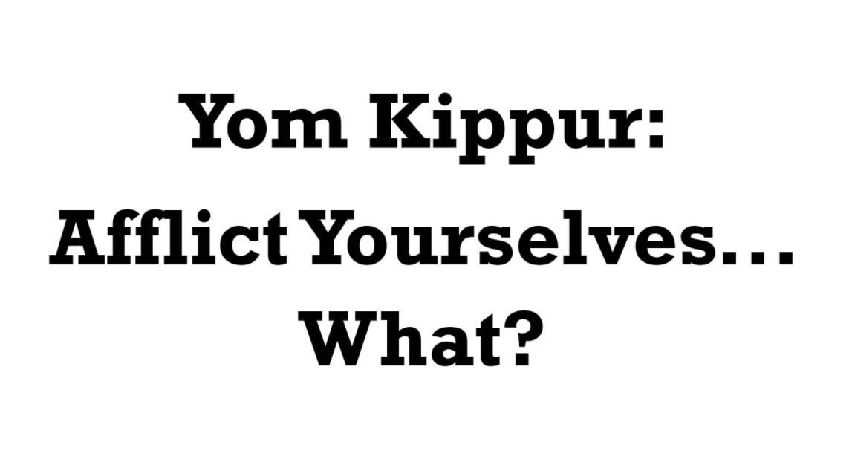

Slide 6
There is much more information given about the Spring festivals than the Fall festivals.
Spring
Pesakh [Seder]
Barley First fruits [Omer count]
Wheat First fruits Shavuot

Slide 7
Fall
Rosh HaShanah Yom T’ruah [loud sound to remember, two words]
Yom Kippur [affliction, one word]
Sukkot [lots]
Notes:
Maybe because Spring festivals already fulfilled in Messiah. At the beginning of the season of His Kingdom.

Slide 8
For Yom Kippur, there is lots of information on the worship / avodah עבודה in the Temple, but little instruction for the rest of the population.

Slide 9
^{Vayikra/Lev 23.27-29} The tenth day of this seventh month is Yom HaKippurim, יוֹם הַכִּפֻּרִים a holy convocation to you, so you are to afflict עִנִּיתֶם yourselves. You are to bring an offering made by fire to Adoni.

Slide 10
^{Vayikra/Lev 23.27-29} You are not to do any kind of work on that set day, for it is Yom Kippur, to make atonement for you before Adoni your God. For anyone who does not deny himself לֹא-תְעֻנֶּה on that day must be cut off from his people.

Slide 11
^{Vayikra/Lev 23.27} “Yom Kippur… you are to afflict yourselves.”
Notes:
Pause to pray

Slide 12
^{Vayikra/Lev 23.27} “Yom Kippur… you are to afflict yourselves.”
Rabbis’ have five ways of affliction. Some are amplifications of scripture. Don’t stress out over doing all.

Slide 13
There are five areas of pleasure that we avoid on Yom Kippur
Eating or drinking.
Wearing leather footwear. [comfortable]
Bathing or washing.
Notes:
https://www.chabad.org/library/article_cdo/aid/995074/jewish/An-Overview-of-Yom-Kippur-Laws.htm

Slide 14
Applying ointment, lotions, or creams.
Engaging in any form of spousal intimacy.
Notes:
https://www.chabad.org/library/article_cdo/aid/995074/jewish/An-Overview-of-Yom-Kippur-Laws.htm
Let’s look at them in detail

Slide 15
Eating or drinking. Levels of this
Daniel fast: ^{Dan 10.2-3} In those days, I, Daniel was mourning for three whole weeks. I ate no rich food, nor did meat or wine enter my mouth, nor did I anoint myself with oil, until the end of three weeks.
Notes:
https://www.chabad.org/library/article_cdo/aid/995074/jewish/An-Overview-of-Yom-Kippur-Laws.htm

Slide 16
Eating or drinking. Levels of this
Abstaining from specific pleasures or behaviors: favorite food, criticism and negative speech, certain media, all media
Notes:
https://www.chabad.org/library/article_cdo/aid/995074/jewish/An-Overview-of-Yom-Kippur-Laws.htm

Slide 17
Eating or drinking. Levels of this
Ester fast: ^{Ester 4.16}“Go, assemble all the Jews to be found in Shushan, and have them fast for me, neither eating nor drinking for three days, night and day; also I and the girls attending me will fast the same way.
Notes:
https://www.chabad.org/library/article_cdo/aid/995074/jewish/An-Overview-of-Yom-Kippur-Laws.htm
This is the YK form. I seldom do, really just on YK. Usually water, light foods: grapes. Now: nada.
Weakness, brain fog. Affliction.

Slide 18
Wearing leather footwear. [comfortable]
Maybe from the fact that the priests must be barefoot when conducting the temple service.
Notes:
https://www.chabad.org/library/article_cdo/aid/995074/jewish/An-Overview-of-Yom-Kippur-Laws.htm

Slide 19
The priests wore no shoes or sandals; they would walk barefoot on the marble floors of the Temple courts. This is because the floor of the Temple complex was itself sanctified, just as the Temple proper.
Notes:
https://templeinstitute.org/priestly-garments-4/

Slide 20
Therefore there must be nothing interrupting between the priests and the floor ^{Zevachim 2, 1}, to the extent that if something comes in the way of contact between the priest's feet and the floor, his service is invalid (Maimonides).
Notes:
https://templeinstitute.org/priestly-garments-4/

Slide 21
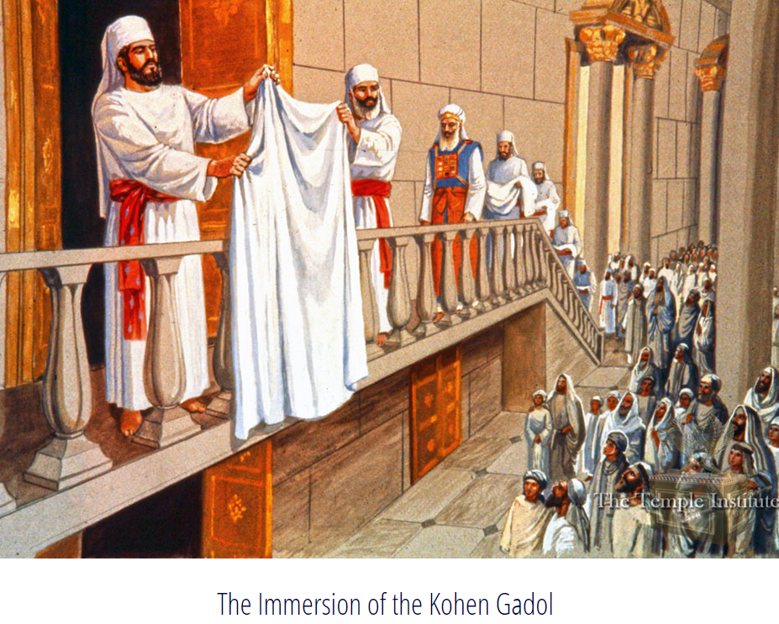
All the cohenim were barefoot
Notes:
https://templeinstitute.org/yom-kippur-part-2/

Slide 22
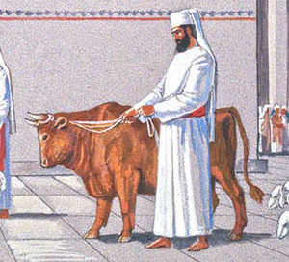
All barefoot
Notes:
https://templeinstitute.org/yom-kippur-part-2/

Slide 23
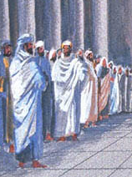
All worshipers barefoot too, men and women.
Notes:
https://templeinstitute.org/yom-kippur-part-2/

Slide 24
Messianic Rabbi Peter Oliver in Rhode Island always preaches barefoot
Notes:
https://www.chabad.org/library/article_cdo/aid/995074/jewish/An-Overview-of-Yom-Kippur-Laws.htm
An extension of that…

Slide 25
^{T’hillim/Ps. 35.13} But as for me, when they were sick, my clothing was sackcloth. I afflicted my soul with fasting.

Slide 26
^{Yoel 1.8} Wail like a virgin dressed in sackcloth for the husband of her youth!

Slide 27
^{Ester 4.1} When Mordekhi learned everything that had been done, he tore his clothes, put on sackcloth and ashes and went out through the city, lamenting and crying bitterly.

Slide 28
A prophetic extreme
[not done since this prophet]

Slide 29
^{Yesha‘yahu [Isaiah] 2-4} Adoni, speaking through Yesha‘yahu [Isaiah] the son of Amotz, said, “Go and unwind the sackcloth from around your waist, and take your sandals off your feet.” So he did it, going about unclothed and barefoot. In time, Adoni said,

Slide 30
^{Yesha‘yahu [Isaiah] 2-4} “Just as my servant Yesha‘yahu has gone about unclothed and barefoot for three years as a sign and portent against Egypt and Ethiopia, so will the king of Ashur lead away the captives of Egypt and the exiles of Ethiopia, young and old, unclothed and barefoot, with their buttocks exposed, to the shame of Egypt.
Notes:
Why even bring up that weird event?
YK no leather footwear → barefoot cohenim.

Slide 31
3. Bathing or washing.
4. Applying ointment, lotions, or creams.
^{Mt. 6.17} But when you fast, anoint your head and wash your face.
The Cohen HaGadol had many immersions on Yom Kippur.
Notes:
So, Messiah didn’t, and therefore I don’t agree with Rabbinic halakha on these two
If private fast: “so that no one will know you are fasting — except your Father, who is with you in secret. Your Father, who sees what is done in secret, will reward you.”

Slide 32
5. Engaging in any form of spousal intimacy.
^{1 Cor 7.5} Do not deprive each other, except for a limited time, by mutual agreement, and then only so as to have extra time for prayer; but afterwards, come together again.
Notes:
https://www.chabad.org/library/article_cdo/aid/995074/jewish/An-Overview-of-Yom-Kippur-Laws.htm

Slide 34
What does it mean to be afflicted?
עִנָּה פ' פיעל
to torture, to fast, deprive oneself, mortify oneself

Slide 35
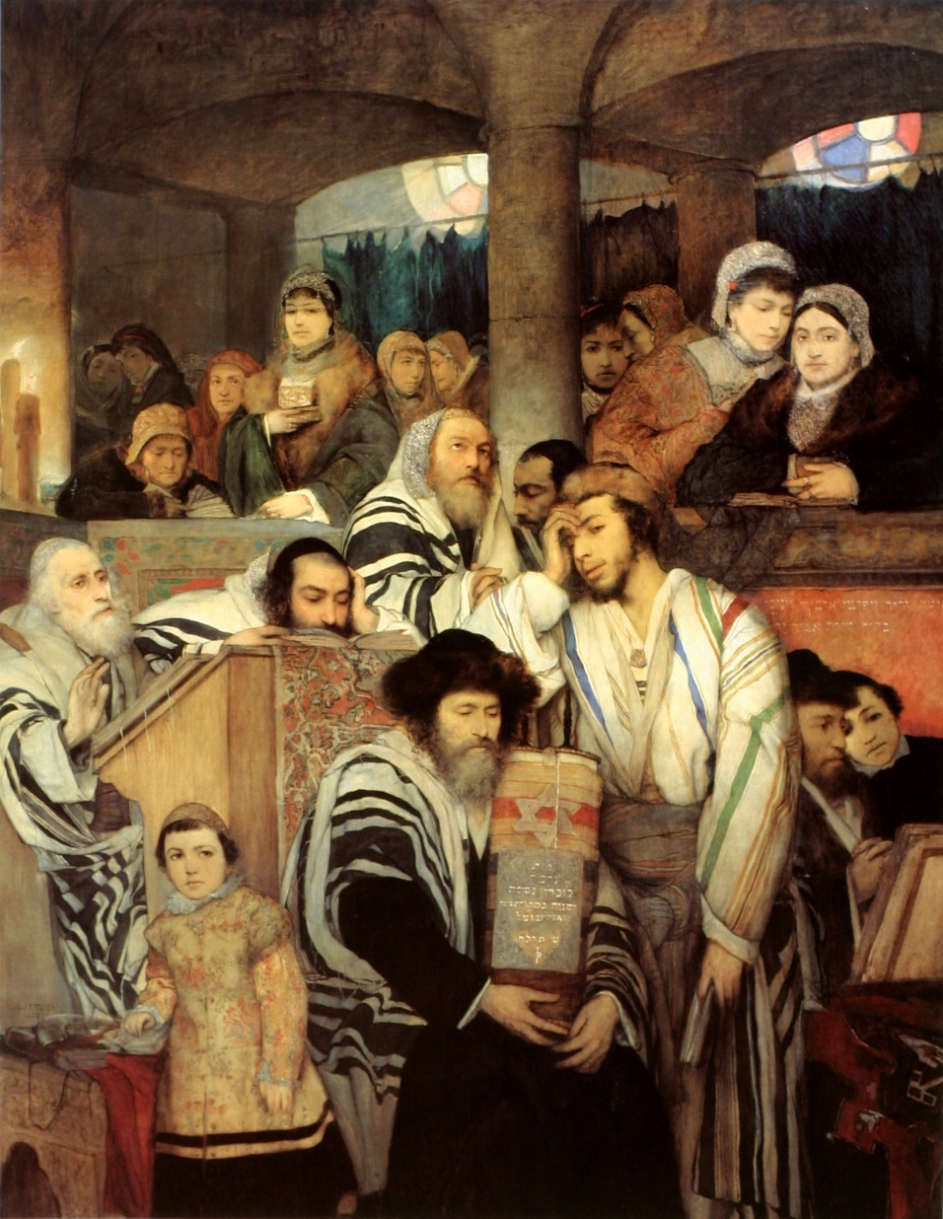
Jewish People Praying in the Synagogue on Yom Kippur, by Maurycy Gottlieb (1878)

Slide 36
^{Mtt 18.3-4} Amen, I tell you, unless you turn and become like children, you shall never enter the kingdom of heaven. Whoever then shall humble himself like this child, this one is the greatest in the kingdom of heaven.
Notes:
Trusting, cheerful [unless abused]

Slide 37
^{Yaakov 4.7-10} Draw near to God, and He will draw near to you. Cleanse your hands, you sinners, and purify your hearts, you double-minded! Lament and mourn and weep! Let your laughter be turned into mourning, and your joy into gloom. Humble yourselves in the sight of Adoni, and He shall lift you up.

Slide 38
^{Yoel 2.12-13} “Yet even now,” says Adoni, “turn to me with all your heart, with fasting, weeping and lamenting.” Tear your heart, not your garments; and turn to Adoni your God.
Notes:
Contemplating judgments coming on America and the world.

Slide 39
Leonard Ravenhill often said that we must "weep before we whip." Before Yeshua cleansed the temple, He wept over the depraved condition of Jerusalem. Sadly, most believers are either whipping or whining;
Notes:
https://www.charismanews.com/politics/opinion/86663-america-s-new-civil-war-a-battle-without-weapons?utm_source=Charisma%20News%20Daily&utm_medium=email&utm_content=subscriber_id:5160390&utm_campaign=CNO%20daily%20-%202021-09-08

Slide 40
very few are spending time weeping before God, seeking a broken and contrite heart. No wonder many of our prayers are never answered
Notes:
https://www.charismanews.com/politics/opinion/86663-america-s-new-civil-war-a-battle-without-weapons?utm_source=Charisma%20News%20Daily&utm_medium=email&utm_content=subscriber_id:5160390&utm_campaign=CNO%20daily%20-%202021-09-08

Slide 41
Four ways to get humble [afflicted].
Humble ourselves. Painful “I was wrong.”
Identificational humbling.
Be humbled by another. More painful. Receive correction.
Forgive someone. Release your anger and bitterness.
Notes:
We don’t get married to correct our spouse. We get married to grow from him/her, to be corrected by G-d in the relationship.
We can only delight in this if we are single minded for Messiah.

Slide 42
^{Psalm 27:4} One thing I have desired of the Lord, That will I seek: That I may dwell in the house of the Lord All the days of my life, To behold the beauty of the Lord, And to inquire in His temple.
Notes:
George Whitten

Slide 43
The Hebrew word for "face" is "panim", (the Hebrew letters, peh-nun-yud-mem), literally "faces", a plural word. Normally, when we think about God, we focus only upon one of His "faces” at a time. God is "love" – or He is "holy"-- or He is "just"--- or He's a God of "wrath".
Notes:
George Whitten

Slide 44
Yet, of course, ALL these "faces" are His at once; and so the word "panim" accurately reflects the truth of God's multifaceted being. As we get to know Him better we begin to appreciate the complexity of His nature
Notes:
George Whitten

Slide 45
and the fact that our focus on one "face" is a very limited view, since there's so much more going on in His amazing "Personality".
Notes:
George Whitten

Slide 46
Now the same four Hebrew letters which form the word "face", (peh-nun-yud-mem), also form the Hebrew word for "inside" or "interior". * This would seem to contradict the first meaning, "face", since "face" is the external part of a person or thing, not the inside.
Notes:
George Whitten

Slide 47
Yet here, as with many Hebrew words and concepts lies a deep truth, a paradox which expresses two sides of reality. The "face" is intimately connected with the "interior", and may accurately reveal the true "interior" of someone.
Notes:
George Whitten

Slide 48
There's even a science (or perhaps you might call it an art) of reading peoples' true attitudes and character by looking carefully at their facial expressions. So while we don't "judge a book by it's cover", we may begin to know a person better by carefully looking at her face.
Notes:
George Whitten

Slide 49
^{Psalm 27:4} One thing I have desired of the Lord, That will I seek: That I may dwell in the house of the Lord All the days of my life, To behold the beauty of the Lord, And to inquire in His temple.
Notes:
George Whitten

Slide 50
^{T’hillim/Ps 17.5} But my prayer, in righteousness, is to see your face; on waking, may I be satisfied with a vision of you.

Slide 51
^{2 Cor.3.18} So all of us, with faces unveiled, see as in a mirror the glory of the Lord; and we are being changed into his very image, from one degree of glory to the next, by Adoni the Spirit.

Slide 52
^{Col. 1.24} Now I rejoice in my sufferings for you, and in my physical body—for the sake of His body, Messiah’s community—I fill up what is lacking in the afflictions of Messiah.

Slide 53
Most importantly…

Slide 54
^{Yeshayahu/Isaiah 53:4} Surely He has borne our griefs and carried our pains. Yet we esteemed Him stricken, struck by God, and afflicted.
נָגוּעַ מֻכֵּה אֱלֹהִים וּמְעֻנֶּה.

Slide 55
נִגַּשׂ וְהוּא נַעֲנֶה
^{Isaiah 53.7} He was oppressed and He was afflicted
He is our example and empowerment of affliction to receive and give joy

Slide 56
Discussion of a point from Brett’s message:
In summation: Despite the paucity of rabbinic sources, the notion that the Kohen Gadol wore a rope around his ankle when entering the Kodesh Hakodashim is widespread.
Notes:
https://jewishaction.com/religion/jewish-law/whats_the_truth_about_-_the_kohen_gadols_rope/

Slide 57
The historical evidence of such a rope or chain seems dubious and the halachic acceptability of such an arrangement is questionable.
Notes:
https://jewishaction.com/religion/jewish-law/whats_the_truth_about_-_the_kohen_gadols_rope/

Slide 58
If such a rope was indeed used, it reflected the sorrowful state of affairs prevalent in the late Second Temple period, when so many Kohanim Gedolim were unworthy and therefore liable to perish in the Kodesh Hakodashim.
Notes:
https://jewishaction.com/religion/jewish-law/whats_the_truth_about_-_the_kohen_gadols_rope/

Slide 59
The author closes with this prayer:
May we be zocheh [worthy] to soon see a worthy “unchained” Kohen Gadol perform the Yom Kippur service in his pure white garments in the rebuilt Beit Hamikdash.
Notes:
https://jewishaction.com/religion/jewish-law/whats_the_truth_about_-_the_kohen_gadols_rope/
We will never be worthy, however…

Slide 60
^{MJ 9.11-12} But when Messiah appeared as Kohen Gadol of the good things that have now come, passing through the greater and more perfect Tent not made with hands (that is to say not of this creation),

Slide 61
^{MJ 9.11-12} He entered into the Holies once for all—not by the blood of goats and calves but by His own blood, having obtained eternal redemption.

Slide 62
Conclusion: Every hunger pain,[affliction] every time of brain fog, every bit of weakness, offer to Him as a plea in flames of holy love, for Him to bear the weakness, to carry you, and do.

Slide 63
^{Daniel 9.19} Adoni, hear! Adoni, forgive! Adoni, pay attention, and don’t delay action — for your own sake, my God, because your city and your people bear your name!”

Slide 64
Do you KNOW Yeshua and the assurance of sins forgiven?
Are you hearing daily from His Word?
How are you applying what you heard?
Are you asking this of another?
Notes:
Who are you discipling, building up?4

