Slide 1
e-handout
To have these notes
without taking notes
Go to OrHaOlam.com
Click on downloads,
messages, 2021

Slide 2
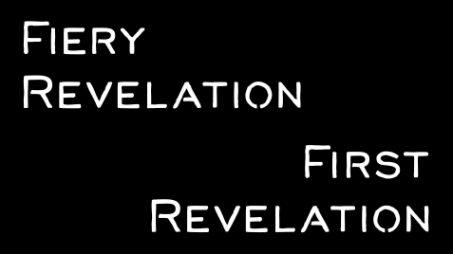

Slide 3
Dvarim
Beresheet

Slide 4
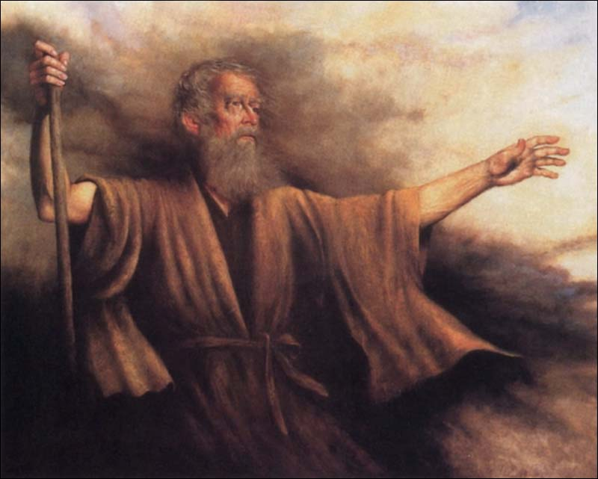
D’varim דְּבָרִים
(Deuteronomy) 33:2-4
(from) Vezot ha’Bracha This is the blessing וזאת הברכה

Slide 5
D’varim (Deuteronomy) 33:2
ג כִּי שֵׁם יְהוָה אֶקְרָא ס הָבוּ גֹדֶל לֵאלֹהֵינוּ׃
ג כִּי שֵׁם יְהוָה אֶקְרָא ס הָבוּ גֹדֶל לֵאלֹהֵינוּ׃
וַיֹּאמַ֗ר יְיָ מִסִּינַ֥י בָּא֙ וְזָרַ֤ח מִשֵּׂעִיר֙ לָ֔מוֹ
הוֹפִ֙יעַ֙ מֵהַ֣ר פָּארָ֔ן וְאָתָ֖ה מֵרִבְבֹ֣ת קֹ֑דֶשׁ מִימִינ֕וֹ אֵ֥שׁ דָּ֖ת לָֽמוֹ׃
“Adoni came from Sinai; from Se‘ir he dawned on his people, shone forth from Mount Pa’ran; and with him were myriads of holy ones; at his right hand was a fiery law for them.

Slide 6
D’varim (Deuteronomy) 33:3
ג כִּי שֵׁם יְהוָה אֶקְרָא ס הָבוּ גֹדֶל לֵאלֹהֵינוּ׃
ג כִּי שֵׁם יְהוָה אֶקְרָא ס הָבוּ גֹדֶל לֵאלֹהֵינוּ׃
אַ֚ף חֹבֵ֣ב עַמִּ֔ים כׇּל־קְדֹשָׁ֖יו בְּיָדֶ֑ךָ וְהֵם֙ תֻּכּ֣וּ
לְרַגְלֶ֔ךָ יִשָּׂ֖א מִדַּבְּרֹתֶֽיךָ׃
“He truly loves the peoples — all his holy ones are in your hand; sitting at your feet, they receive your instruction,

Slide 7
D’varim (Deuteronomy) 33:4
ג כִּי שֵׁם יְהוָה אֶקְרָא ס הָבוּ גֹדֶל לֵאלֹהֵינוּ׃
ג כִּי שֵׁם יְהוָה אֶקְרָא ס הָבוּ גֹדֶל לֵאלֹהֵינוּ׃
תּוֹרָ֥ה צִוָּה־לָ֖נוּ מֹשֶׁ֑ה מוֹרָשָׁ֖ה קְהִלַּ֥ת
יַעֲקֹֽב׃
“the Torah Moshe commanded us
as an inheritance for the community of Ya‘akov.”

Slide 8
D’varim (Deuteronomy) 33:2
ג כִּי שֵׁם יְהוָה אֶקְרָא ס הָבוּ גֹדֶל לֵאלֹהֵינוּ׃
ג כִּי שֵׁם יְהוָה אֶקְרָא ס הָבוּ גֹדֶל לֵאלֹהֵינוּ׃
וַיֹּאמַ֗ר יְיָ מִסִּינַ֥י בָּא֙ וְזָרַ֤ח מִשֵּׂעִיר֙ לָ֔מוֹ
הוֹפִ֙יעַ֙ מֵהַ֣ר פָּארָ֔ן וְאָתָ֖ה מֵרִבְבֹ֣ת קֹ֑דֶשׁ מִימִינ֕וֹ אֵ֥שׁ דָּ֖ת לָֽמוֹ׃
“Adoni came from Sinai; from Se‘ir he dawned on his people, shone forth from Mount Pa’ran; and with him were myriads of holy ones; at his right hand was a fiery law for them.

Slide 9
D’varim (Deuteronomy) 33:3
ג כִּי שֵׁם יְהוָה אֶקְרָא ס הָבוּ גֹדֶל לֵאלֹהֵינוּ׃
ג כִּי שֵׁם יְהוָה אֶקְרָא ס הָבוּ גֹדֶל לֵאלֹהֵינוּ׃
אַ֚ף חֹבֵ֣ב עַמִּ֔ים כׇּל־קְדֹשָׁ֖יו בְּיָדֶ֑ךָ וְהֵם֙ תֻּכּ֣וּ
לְרַגְלֶ֔ךָ יִשָּׂ֖א מִדַּבְּרֹתֶֽיךָ׃
“He truly loves the peoples — all his holy ones are in your hand; sitting at your feet, they receive your instruction,

Slide 10
D’varim (Deuteronomy) 33:4
ג כִּי שֵׁם יְהוָה אֶקְרָא ס הָבוּ גֹדֶל לֵאלֹהֵינוּ׃
ג כִּי שֵׁם יְהוָה אֶקְרָא ס הָבוּ גֹדֶל לֵאלֹהֵינוּ׃
תּוֹרָ֥ה צִוָּה־לָ֖נוּ מֹשֶׁ֑ה מוֹרָשָׁ֖ה קְהִלַּ֥ת
יַעֲקֹֽב׃
“the Torah Moshe commanded us
as an inheritance for the community of Ya‘akov.”

Slide 11
Two themes here:
at his right hand was a fiery law for them. אֵ֥שׁ דָּ֖ת לָֽמוֹ׃ מִימִינ֕וֹ
He truly loves the peoples
אַ֚ף חֹבֵ֣ב עַמִּ֔ים

Slide 12
at his right hand was a fiery law for them. אֵ֥שׁ דָּ֖ת לָֽמוֹ׃ מִימִינ֕וֹ

Slide 13
the Targum of Onkelos,
“the brightness of his glory from Seir was shown unto us;‘’
Targum of Jonathan,
“and the brightness of the glory of his Shekhinah went from Gebal:”

Slide 14
^{Shmot/Ex 20.18} All the people experienced the thunder, the lightning, the sound of the shofar, and the mountain smoking. When the people saw it, they trembled.

Slide 15
^{Shmot/Ex 20.18} Standing at a distance, they said to Moshe, “You, speak with us; and we will listen. But don’t let God speak with us, or we will die.”

Slide 16
Other examples of G-d revealing His word in light and fire.
Yeshua the Messsiah IS the light and the fire!

Slide 17
1. ^{Yermiyahu/ Jer 23.29} “Isn’t my word like fire,” asks Adoni, “like a hammer shattering ^{rocks?}
2. ^{Dvarim/Dt 5.19} Adoni spoke to all your assembly on the mountain from the midst of the fire, the cloud and the fog, with a great voice.
Notes:
Is His word to you like fire? Daily dose keeps me going in spite of challenges!
Stress $, health, relations? Fire of His word. “You always say that!” “That’s my life message.”
“More than my necessary bread”

Slide 18
3. ^{T’hillim 119.105} Your word is a lamp to my feet and a light to my path.
4.^{Yermihu/Jer 5.14} I will make my words fire in your mouth, [Yirmeyahu,]
and this people wood; so that it will devour them.

Slide 19
5. ^{Yer. 20.8-9} For the word of Adoni is scorn and ridicule to me all day long. But if I say: “I won’t mention Him, or speak any more in His Name,” then it is like fire burning in my heart —shut up in my bones— I weary myself holding it in, but I cannot.

Slide 20
6. ^{Yeshayahu/Is 8.23} But there will be no more gloom for those who are now in anguish. In the past the land of Z’vulun and the land of Naftali were regarded lightly;but in the future he will honor the way to the lake, beyond the Yarden, Galil-of-the-Goyim.

Slide 21
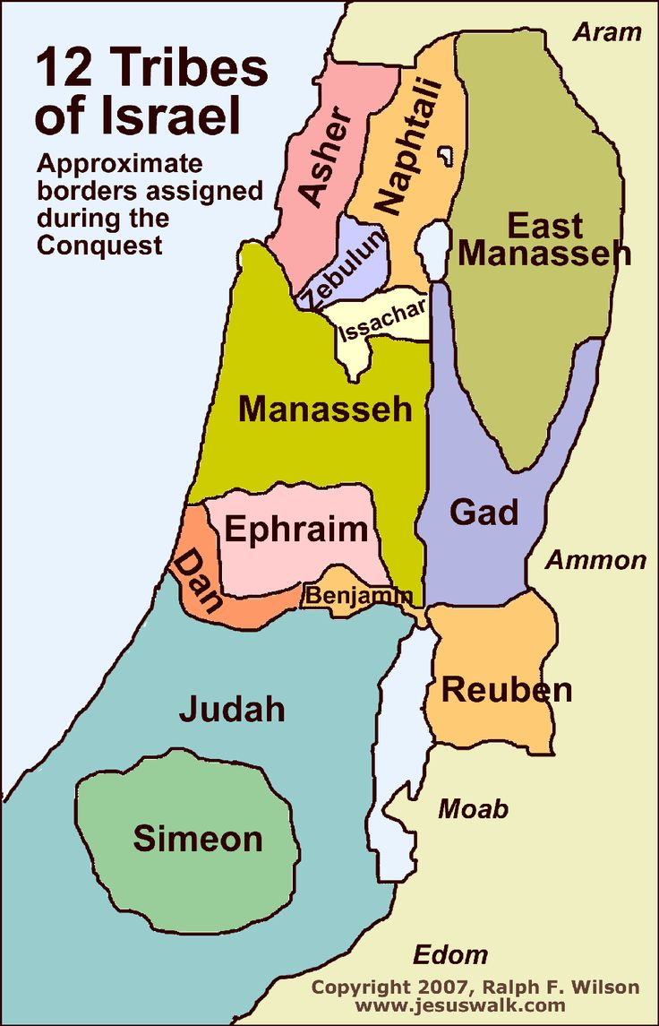
Notes:
https://i.pinimg.com/736x/2b/fb/21/2bfb21e0c007d2e685d4c16b5fa73ea0--dna-genealogy-anthropology.jpg

Slide 22
^{Yeshayahu/Is 9.1} The people walking in darkness will see a great light. Upon those dwelling in the land of the shadow of death, light will shine

Slide 23
^{Mtt.4.14-17} This happened in order to fulfill what Yesha‘yahu the prophet had said, “Land of Z’vulun and land of Naftali, toward the lake, beyond the Yarden, Galil-of-the-Goyim — the people living in darkness have seen a great light;

Slide 24
^{Mtt.4.14-17} upon those living in the region, in the shadow of death, light has dawned.” From that time on, Yeshua began proclaiming, “Turn from your sins to God, for the Kingdom of Heaven is near!
Notes:
That IS the light. The message of repentance and faith in the King and His Kingdom!

Slide 25
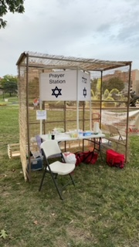

Slide 26
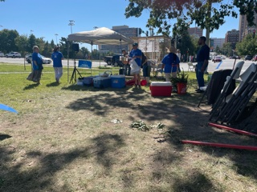

Slide 27
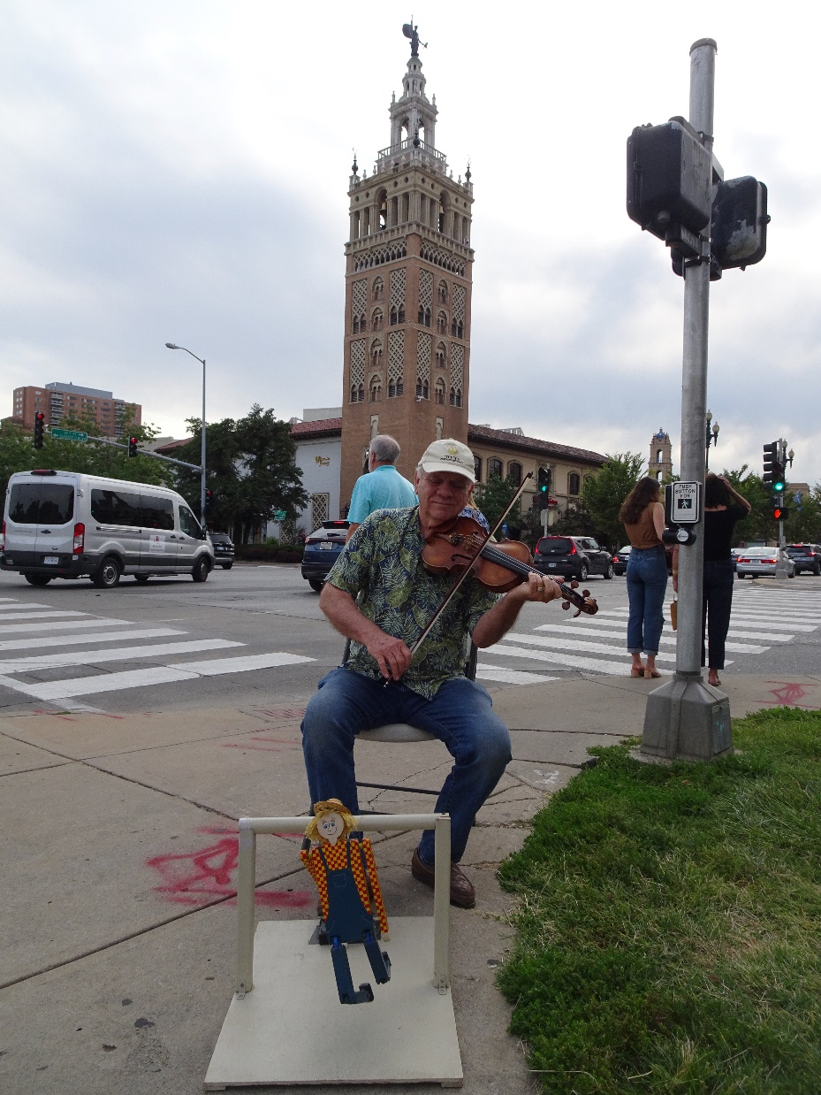

Slide 28
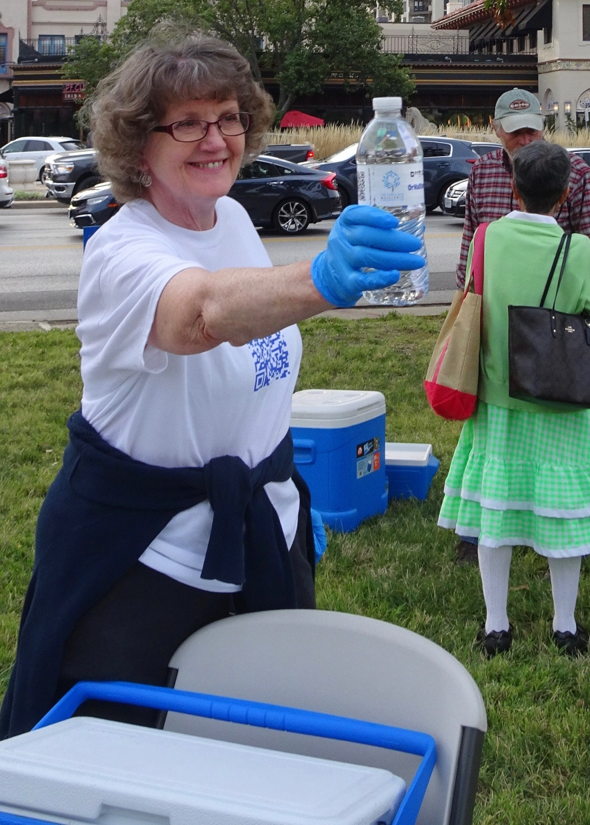

Slide 29
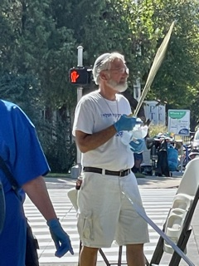

Slide 30
Of 2500 water bottles, we gave out 1400. 1100 left.
Good visits. Praying for responses.
There was great joy and glory!

Slide 32
7. ^{Luke 24.32} They said to each other, “Didn’t our hearts burn inside us as he spoke to us on the road, opening up the Tanakh to us?”

Slide 33
8. ^{Yn 7.46} The guards replied, “No one ever spoke the way this man speaks!”

Slide 34
9. ^{Acts 22.6-9} As I was traveling and drawing near to Damascus, about noon a great light from heaven suddenly flashed all around me. I fell to the ground and heard a voice saying to me,

Slide 35
^{Acts 22.6-9} ‘Saul, Saul, why do you persecute Me?’ “I answered, ‘Who are you, Lord?’ “He said to me, ‘I am Yeshua ha-Natzrati, whom you are persecuting.’

Slide 36
^{Acts 22.9-11} “Now those who were with me saw the light, but did not understand the voice of the One who was speaking to me. So I said, ‘What shall I do, Lord?’

Slide 37
^{Acts 22.9-11} “And the Lord said to me, ‘Get up, and go to Damascus. There you will be told all that you have been appointed to do.’

Slide 38
^{Acts 22.9-11} “But since I could not see because of the brilliance of that light, I was led by the hand by those who were with me and came into Damascus.

Slide 39
10. ^{2 Cor. 4.6} For it is the God who once said, “Let light shine out of darkness,” who has made his light shine in our hearts, the light of the knowledge of God’s glory shining in the face of the Messiah Yeshua.

Slide 40
^{2 Cor. 3.18} So all of us, with faces unveiled, see as in a mirror the glory of the Lord; and we are being changed into his very image, from one degree of glory to the next, by Adoni the Spirit.
Notes:
Our experience with Him should be transformative. I was once asked to do a certain ministry for a couple, and asked how long they’d been married. X years. Married X years? “Well, together some years, then married.” “So, you have repented and received forgiveness for the years together before marriage?”
“We’ll get someone else to do ministry. You are judging.” I was fired, so to speak.
No such thing as co-habiting followers of Messiah. Intellectual believers, but NOT followers, OK for this life or the next. Am I politically incorrect?

Slide 41
11. From David Stern about Rabbi Daniel Zion of Bulgaria:
One of the most remarkable of these appearances of Yeshua the Messiah was to the former Chief Rabbi of Bulgaria, Daniel Zion.
Notes:
https://kifakz.github.io/eng/bible/stern/stern_deyatelnost_09.html

Slide 42
One morning at sunrise, as he was praying Shakharit, he saw Yeshua. The vision repeated itself on several occasions; and in the period following he, like Sha'ul, came to trust Yeshua as Israel's Messiah. ﻿
Notes:
https://kifakz.github.io/eng/bible/stern/stern_deyatelnost_09.html
So, this is why you should come to Shakharit!

Slide 43
Daniel Zion was Chief Rabbi of Bulgaria from 1928 to 1948. He authored over twenty books, including the first translation of the Siddur (the Jewish prayerbook) into Bulgarian.
Notes:
https://kifakz.github.io/eng/bible/stern/stern_deyatelnost_04.html

Slide 44
Sometime in the 1930's he came to faith in Yeshua the Messiah. When Hitler wanted to deport the Jews of Bulgaria to the Polish death camps, Rav Daniel prevailed on King Boris not to permit it. As a result, 86% of Bulgaria's 50,000 Jews survived World War II
Notes:
https://kifakz.github.io/eng/bible/stern/stern_deyatelnost_04.html

Slide 45
Later, leading most of Bulgarian Jewry, Rav Daniel made aliyah and became rabbi of a synagogue in Yafo [Jaffa]. On Shabbat he would conduct regular services in the morning
Notes:
https://kifakz.github.io/eng/bible/stern/stern_deyatelnost_04.html

Slide 46
and teach from the New Testament at home in the afternoon. He retained the respect of Israel's Bulgarian Jewish community, even though his faith in Yeshua was well known.
Notes:
https://kifakz.github.io/eng/bible/stern/stern_deyatelnost_04.html
Avi Mizrachi is his spiritual grandson. Avi’s mother was in Rabbi Daniel Zion’s cong.

Slide 47
Two themes here:
at his right hand was a fiery law for them. אֵ֥שׁ דָּ֖ת לָֽמוֹ׃ מִימִינ֕וֹ
He truly loves the peoples
אַ֚ף חֹבֵ֣ב עַמִּ֔ים
(biblical) to love; to like, to cherish

Slide 48
חַבִּיבִּי Habibi (Arabic) (slang) my friend, friend, mate (Australian usage), man (US usage)

Slide 49
^{Hosh 3.1} Adoni said to me, “Go once more, and show love to [this] wife [of yours] who has been loved by her boyfriend, to this adulteress — just as Adoni loves the people of Isra’el, even though they turn to other gods and love the raisin cakes [offered to them].”

Slide 51
Roll the scroll

Slide 52
B’resheet בְּרֵאשִׁית
(Genesis) 3:8
בְּרֵאשִׁית (from) B’resheet (In the beginning)

Slide 53
Dvarim
Beresheet

Slide 54
B’resheet (Genesis) 3:8
ג כִּי שֵׁם יְהוָה אֶקְרָא ס הָבוּ גֹדֶל לֵאלֹהֵינוּ׃
ג כִּי שֵׁם יְהוָה אֶקְרָא ס הָבוּ גֹדֶל לֵאלֹהֵינוּ׃
וַֽיִּשְׁמְע֞וּ אֶת־ק֨וֹל יְיָ אֱלֹהִ֛ים מִתְהַלֵּ֥ךְ בַּגָּ֖ן לְר֣וּחַ הַיּ֑וֹם וַיִּתְחַבֵּ֨א הָֽאָדָ֜ם וְאִשְׁתּ֗וֹ מִפְּנֵי֙ יְיָ אֱלֹהִ֔ים בְּת֖וֹךְ עֵ֥ץ הַגָּֽן׃
They heard the voice of Adoni, G-d,
walking in the garden at the time of the
evening breeze, so the man and his wife hid
themselves from the presence of Adoni,
G-d, among the trees in the garden.

Slide 55
The beginning of human history, walking with G-d!
The Targums of Onkelos and Jonathan paraphrase it, "the voice of the Word of the Lord God"
Notes:
Targum Onkelos on the Torah (Written Law)
Targum Jonathan on the Nevi'im (Prophets)
https://www.biblestudytools.com/commentaries/gills-exposition-of-the-bible/genesis-3-8.html

Slide 56
^{Shmot/Ex 19.19} As the sound of the shofar grew louder and louder, Moshe spoke; and God answered him with a voice.

Slide 57
MEMRA = "Ma'amar" or "Dibbur," "Logos“
Memra is an Aramaic term related to the Hebrew word אמר pronounced amar, which means word, decree, or speech. Sometimes, the Hebrew wordדבר pronounced debair, is used instead of memra, which also means word, as well as matter, thing, and issue.
Notes:
https://www.jewishencyclopedia.com/articles/10618-memra

Slide 58
in the translations…to Aramaic, the Jewish People learned that God had a helper of sorts:
“From the beginning with wisdom the Memra (Word) of the Lord created and perfected the heavens and the earth … And the Memra (Word) of the LORD said, ‘Let there be light’; and there was light by His Memra (Word). A (Genesis 1:1–3; Targum Neofiti)
Notes:
https://free.messianicbible.com/feature/beginning-memra/

Slide 59
In this Targum, the Word or Memra is doing, being, and acting as God and yet we see that he is also with God, a distinct essence apart from Him.
Notes:
https://free.messianicbible.com/feature/beginning-memra/

Slide 60
In fact, the Memra is the one who rested after all his work:
“On the seventh day, the Memra of the LORD completed his work which he had created, and there was Sabbath.” (Genesis 2:3; Targum Neofiti)
Notes:
https://free.messianicbible.com/feature/beginning-memra/

Slide 61
Yokhanan used this very Jewish understanding of the Memra (Word of the LORD) to introduce Messiah Yeshua, who is God and yet a distinct essence apart from God. He writes:
Notes:
https://free.messianicbible.com/feature/beginning-memra/

Slide 62
“In the beginning was the Memra (Word), and the Memra (Word) was with God, and the Memra (Word) was God. He was in the beginning with God. All things came into being through him, and without him not one thing came into being.” (John 1:1–3)
Notes:
https://free.messianicbible.com/feature/beginning-memra/

Slide 63
Or HaOlam is not primarily about Torah.
Or HaOlam is about Yeshua Who is
  the Davar דבר Word expressed in Torah, all Tanakh, Messianic Scriptures
  Memra ממרא, Logos Λόγος
Notes:
That’s your opinion. Yes that my opinion.

Slide 64
Yn 1.14 The Word became a human being and lived with us, and we saw his Sh’khinah, the Sh’khinah of the Father’s only Son, full of grace and truth.

Slide 65
^{Yn 1.12-13} But to as many as did receive him, to those who put their trust in his person and power, he gave the right to become children of God, 13 not because of bloodline, physical impulse or human intention, but because of God.
Notes:
Do you KNOW the living G-d? Sins forgiven? A good time to seek Him.

Slide 66
Grand processional shortly.
We are dancing with King Yeshua in the scrolls.
Those who read an average of 1 chapter / day, are invited to dance.

