Slide 1
e-handout
To have these notes
without taking notes
Go to OrHaOlam.com
Click on downloads,
messages, 2021

Slide 2
Rosh HaShanah greetings
Shana Tovah שָׁנָה טוֹבָה
[Have a] Good Year
לשָׁנָה טוֹבָה וּמְתוּקָה
L’Shana Tova oo-m’tukah
[Have a] Good and sweet year
Notes:
In traditional Jewry, Rosh HaShanah is celebrated two days. Uncertainty when new moon was.
Also L’shana tovah t’katevu. לשָׁנָה טוֹבָה תכתבו May a good year be written to you. Based on Rabbinic legend that your fate for the next year is determined and sealed from now to YK. A cute idea, to really repent now to YK, but not TRUE. Some Messianics in KC teach as if it is true.
Practice…

Slide 3
We never tire of wishing you this Goodyear
5782
Shana Tova
Notes:
From Lori Wilson

Slide 4
Outline
Name of this holiday.
Renewal in this holiday.
Hindrances to Renewal.
Remedy to renewal.

Slide 5
Concerning the name of this holiday: scripture says:
^{Vayikra/Lev 23.24} In the seventh month, the first of the month is to be for you a day of complete rest for remembering, a holy convocation announced with blasts on the shofar. T’ruah. תְּרוּעָה
Notes:
Scripture doesn’t say “Shofar” Just “blasts,” loud sounds. “Shofar” is a very helpful rabbinic interpretation. So you can shout praise when you hear the Shofar later. We will have a powerful shofar service in which we will remember our spiritual needs.
It doesn’t say what to remember either.
However, context…

Slide 6
The ancient historian Josephus, and the ancient Aramaic translation of the Bible, the Targum Jonathan, identify Rosh HaShanah as the New Year observed by the people of Israel before the holiday of Passover was instituted.
Notes:
Encyclopaedia Judaica

Slide 7
The traditional Jewish concept is that the world, Adam and Khava/Eve, were created on Rosh HaShanah, so this day is indeed the beginning of the year chronologically.
Birthday of the world!
Notes:
https://en.wikipedia.org/wiki/Rosh_Hashanah
Definitely for young earthers. True in a spiritual sense in any case.

Slide 8
The Babylonian month name Tishri seems to derive from the root Ugaritic or Akkadian seru, which means "to begin." The ancient Semitic peoples thought of the year as beginning in the autumn, at the time of the late harvest. This was the beginning of the economic year, when crops began to be sold.
Notes:
Encyclopedia Judaica
School year too, probably based on agricultural cycle.

Slide 9
G-d made a spiritual cycle to start on Pesakh, but the chronological year didn't change. So, Jews have two new years, [actually more] a chronological one, and a spiritual one. Passover is described in these terms:

Slide 10
^{Shmot/Ex. 12:1-2} Now Adoni said to Moshe and Aharon in the land of Egypt, "This month shall be the beginning of months for you; it is to be the first month of the year to you." NASU
So, it’s scripturally and historically OK to call this holiday Rosh HaShanah, New Year!

Slide 11
New:
^{Rev. 21.5} And the One seated upon the throne said, “Behold, I am making all things new!” Then He said, “Write, for these words are trustworthy and true.” Then He said to me, “It is done!
Notes:
This is the word/concept that the Ruakh highlighted to me for this message. Renewal is the focus of our “remembering.”

Slide 12
^{Rev. 21.6-7} I am the Alpha and the Omega, the Beginning and the End. To the thirsty I will freely give from the spring of the water of life. The one who overcomes shall inherit these things, and I will be his God and he shall be My son.
Notes:
Overcomes what? I thought all things new!

Slide 13
khadashחָדָשׁ new ; unused adj
Verb to be renewed ; to be recommenced, to be re-established ; to be rejuvenated, to be refurbished ; to be initiated, to be launched, to be instigated

Slide 14
Rosh HaShanah renewal

Slide 15
Rosh HaShanah renewal
Why needed?
^{2 Cor. 5.17-18} Therefore if anyone is in Messiah, he is a new creation. The old things have passed away; behold, all things have become new.

Slide 16
^{2 Cor. 5.17-18} Now all these things are from God, who reconciled us to Himself through Messiah and gave us the ministry of reconciliation.
Notes:
So when we experience the new birth, we are all clean, everything is now from G-d, and we are zealous to share. Fun to hear a newborn in Messiah share.

Slide 17
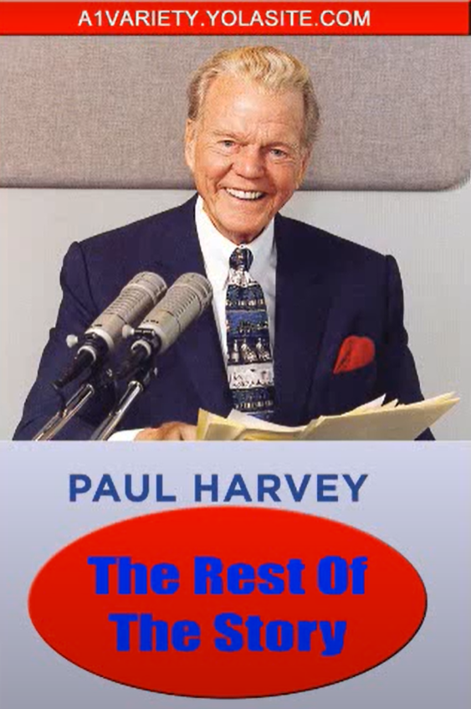
Notes:
https://youtu.be/IpUtseL291o
0:00 to 0:04

Slide 19
The War Within

Slide 20
^{Gal.5.16-17} For the old nature wants what is contrary to the Spirit, and the Spirit wants what is contrary to the old nature. These oppose each other, so that you find yourselves unable to carry out your good intentions.

Slide 21
^{Gal.5.16-17} What I am saying is this: run your lives by the Spirit. Then you will not do what your old nature wants.
Notes:
We are new, but not totally…

Slide 22
Notes:
https://www.chrisaomministries.com/wp-content/uploads/chrisaomministries.files_.wordpress.com/2016/09/body-soul-spirit.png
Where is this found in scripture?
Spirit is where you have consciousness of self, G-d, and others. Where your conscience is.
Soul is intellect, will, emotions. Sometimes in scripture there are conversations between them. Ps 42 Why are you cast down.
Body is the physical self.

Slide 23
^{1 Thes. 5.23-24} Now may the God of shalom Himself make you completely holy; and may your whole spirit and soul and body be kept complete, blameless at the coming of our Lord Yeshua the Messiah. Faithful is the One who calls you — and He will make it happen!

Slide 24
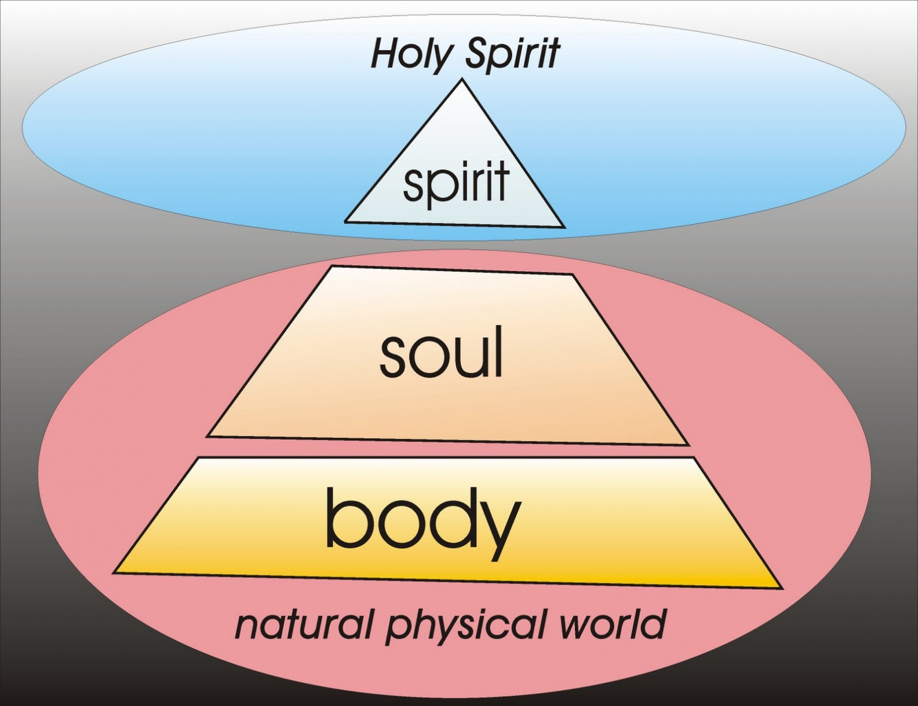
Notes:
https://external-content.duckduckgo.com/iu/?u=http%3A%2F%2F1.bp.blogspot.com%2F_wemj_tQtDd4%2FTGqzUULT14I%2FAAAAAAAAAGw%2FxmL5vbvx9kQ%2Fs1600%2FSpiritSoulBody-3.jpg&f=1&nofb=1

Slide 25
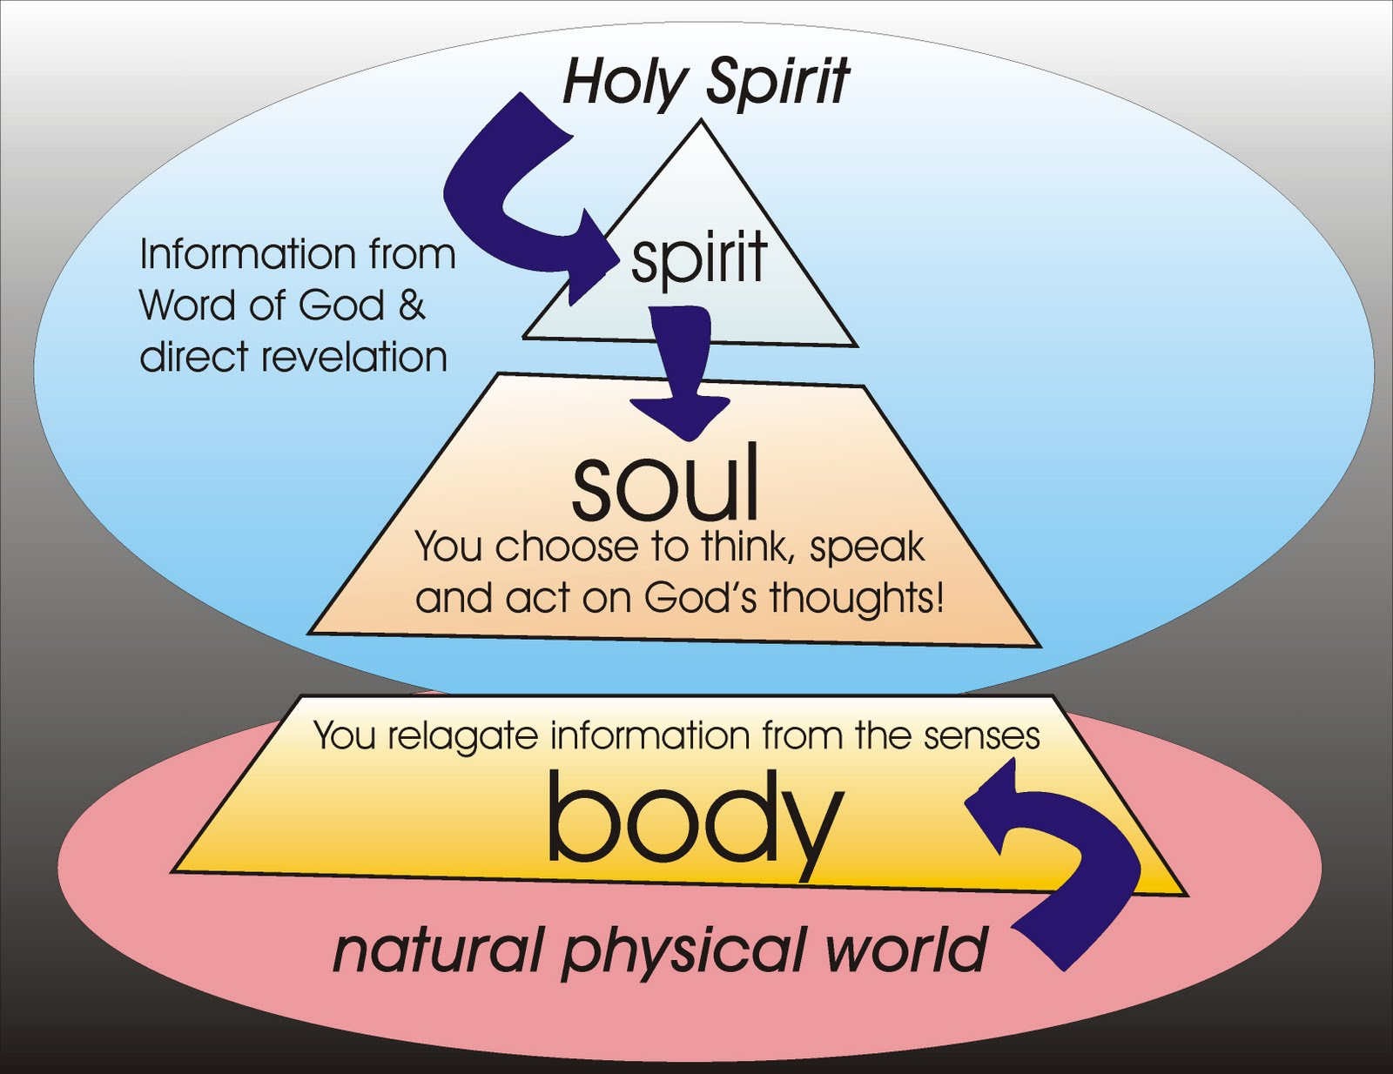
Notes:
http://2.bp.blogspot.com/-Pr6H334W4TM/TfZCsyuLqjI/AAAAAAAAAcI/3MktLSh6Ieg/s1600/SpiritSoulBody-3C.jpg

Slide 26
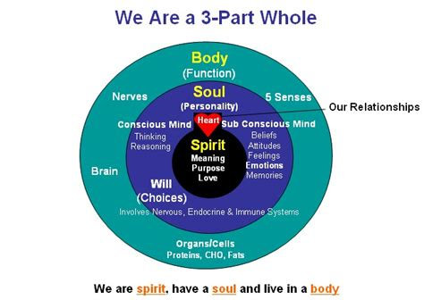
Notes:
https://external-content.duckduckgo.com/iu/?u=https%3A%2F%2Ftse3.mm.bing.net%2Fth%3Fid%3DOIP.1Y2FsfSVjd_ZEq3FDP61HAHaFQ%26pid%3DApi&f=1

Slide 27
So we have, for renewal:
our purified spirit,
Our soul, corrupted mind, will, emotions to purify.
Notes:
Our own bad choices, evil habits, impure memories, wounds, bitterness, unforgiveness.
Plenty of holdovers in most of us to repent of, seek deeply…

Slide 28
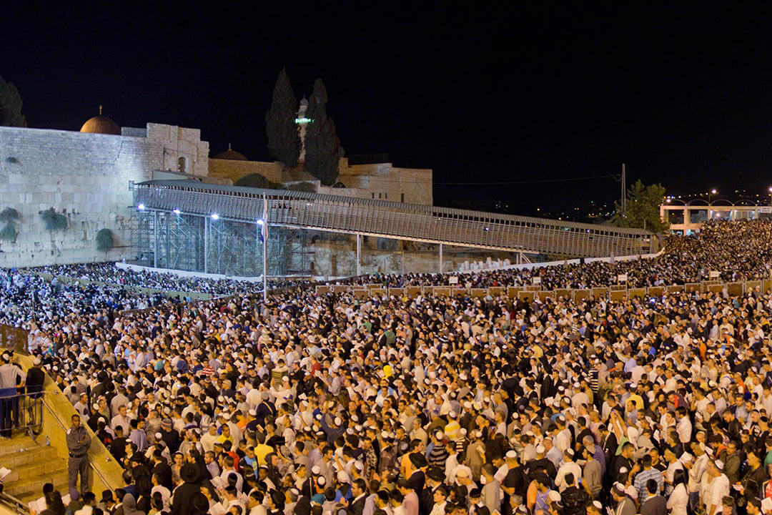
100,000 Jews praying Slikhot,
סְלִיחות for forgiveness
Notes:
Why? Are they more sinful than you or me?
Just more honest, introspective.
So, Rosh HaShanah is about repentance in the soul: mind: learning and beliefs, memories, choices and habits. Then ten days of seeking, repenting.

Slide 29
Notes:
https://youtu.be/IpUtseL291o
0:00 to 0:04

Slide 31
So we have
our purified spirit,
Our soul, corrupted mind, will, emotions to purify.
Moreover, there is generational “old stuff” of corruption within.

Slide 32
^{Ex 34.6-7} [ADONI] is God, merciful and compassionate, slow to anger, rich in grace and truth; showing grace to the thousandth generation, forgiving iniquity and transgression and sin, Avon
נֹצֵר חֶסֶד לָאֲלָפִים, נֹשֵׂא עָוֺן וָפֶשַׁע וְחַטָּאָה

Slide 33
^{Ex 34.6-7} yet not exonerating the guilty, but bringing the iniquity of the fathers upon the children, and upon the children’s children, to the third and fourth generation.”עֲוֺן אָבוֹת עַל-בָּנִים וְעַל-בְּנֵי
בָנִים, עַל-שִׁלֵּשִׁים וְעַל-רִבֵּעִים.
Notes:
Note iniquity Avon עֲוֺן

Slide 34
Terms of the new covenant
^{Yer.31.32-33} “For this is the covenant I will make with the house of Isra’el after those days,” says Adoni: “I will put my Torah within them and write it on their hearts; I will be their God, and they will be my people…

Slide 35
^{Yer.31.32-33} “for all will know me, from the least of them to the greatest; because I will forgive their wickednesses and remember their sins no more.”
כִּי אֶסְלַח לַעֲוֺנָם, וּלְחַטָּאתָם לֹא אֶזְכָּר-עוֹד.
עֲוֺן Avon, wickedness, iniquity
Notes:
Avon עֲוֺן, singular

Slide 36
Rabbi Jim Appel makes an important distinction between sin and iniquity עֲוֺן . Sin, in the Hebrew mind, is missing the mark, falling short of God’s standards, the violation of a commandment, an action (khata חטא in Hebrew).
Notes:
http://www.jewishjewels.org/blog/a-holy-month-repentance-to-redemption/

Slide 37
Iniquity, on the other hand, is our natural inclination to sin, a state of being, avon (ah-VON) in Hebrew. Avon עֲוֺן is passed down from generation to generation.
Notes:
http://www.jewishjewels.org/blog/a-holy-month-repentance-to-redemption/

Slide 38
Orthodox Judaism calls avon Yetzer HaRa, the evil inclination. While the Torah speaks of a sin offering, it never mentions an offering to remove iniquity. Their Avon עֲוֺנָם
Notes:
http://www.jewishjewels.org/blog/a-holy-month-repentance-to-redemption/

Slide 39
Yet, the consequence of iniquity is serious, as declared by the prophet Isaiah, “Your iniquities עֲוֺן have made a separation between you and your God, and your sins have hidden His face from you, so that He does not hear” ^{Isa. 59:2.}
Notes:
http://www.jewishjewels.org/blog/a-holy-month-repentance-to-redemption/
We are separated from G-d, not just because of a few mistakes, misdeeds, but because of an underlying corruption, avon, עֲוֺן iniquity that motivates us to lie, be selfish, mean, lustful.

Slide 40
G-d doesn’t punish the next generation, but the sins continue.
The consequences continue.
[Science illustration and digression]
Notes:
Think of the Mafia families. I’m a New Yorker, so the Gambinos, Gattis. In KC, the Pendergasts. Crime continues.
Alcoholics Anonymous says tendency for three of four generations!

Slide 41
Epigenetics
Genetics is the study of DNA sequences. 4 nucleic acids are the alphabet of life:
C A T G
Cytosine, adenine, thyamine, guanine
Notes:
Nothing in life can change your DNA sequence. Radiation can destroy it. mRNA vaccines don’t change DNA.

Slide 42
epigentic methyl group
Epigenetics is affected by behavior.
Notes:
Four colors are the four nucleic acids, guanine, cytosine, adenine, thiamine. Controlling components, alphabet of life. Determines if an organism is a fish or an elephant. All have the same DNA alphabet.
Epigentics doesn’t change the underlying guanine, cytosine, adenine, thiamine. But DOES affect expressions: on/off switch. Behavior of past generations affects your tendency to behave a certain way. TENDENCY.
Sins of our ancestors can make a proclivity in us. BUT, ancestors added it on by willful behavior, we can overcome by willful choices.

Slide 43
Environmental stress has been shown to increase the risk of substance use. In an attempt to cope with stress, alcohol and drugs can be used as an escape. Once substance use commences, however, epigenetic alterations may further exacerbate the biological
Notes:
http://en.wikipedia.org/wiki/Behavioral_epigenetics
Once aberrant behavior, hormonal activity occurs, epigenetic alterations may exacerbate the biological.

Slide 44
and behavioral changes associated with addiction.
Even short-term substance use can produce long-lasting epigenetic changes in the brain of rodents, via DNA methylation and histone modification
Notes:
http://en.wikipedia.org/wiki/Behavioral_epigenetics

Slide 45
DNA [genetics] cannot be changed by behavior. But the molecules surrounding it [epi] can be changed.
Notes:
http://en.wikipedia.org/wiki/Behavioral_epigenetics

Slide 46
Identical twins have identical DNA, which leads to the perceived conclusion that all identical twins are either heterosexual or homosexual. However, it is evident that this is not the case, consequently leaving a gap in the explanation for homosexuality.
Notes:
http://en.wikipedia.org/wiki/Epigenetic_theories_of_homosexuality
Repeat:
A gay gene does not exist that causes homosexuality.
Parental, ancestral behavior [porn, sin, imaginations] give the appearance of genetic proclivity. It’s really epi-genetic proclivity.
Time Mag May 25, 2015, epigenetic pot addiction tendency.

Slide 47
A "gay" gene does not produce homosexuality, rather, epigenetic modifications act as a temporary "switches" that regulate how the genes are expressed.
Notes:
http://en.wikipedia.org/wiki/Epigenetic_theories_of_homosexuality
Repeat:
A gay gene does not exist that causes homosexuality.
Parental, ancestral behavior [porn, sin, imaginations] give the appearance of genetic proclivity. It’s really epi-genetic proclivity.
Time Mag May 25, 2015, epigenetic pot addiction tendency.

Slide 48
Only twenty percent of identical twins are both homosexual which leads to the hypothesis that even though identical twins share the same DNA, homosexuality is created by something else rather than the genes.
Notes:
http://en.wikipedia.org/wiki/Epigenetic_theories_of_homosexuality

Slide 49
Epigenetic transformation allows the on and off switch of certain genes, subsequently shaping how cells respond to androgen signaling, which is critical in sexual development.
Notes:
http://en.wikipedia.org/wiki/Epigenetic_theories_of_homosexuality

Slide 50
Notes:
In biology, and specifically genetics, epigenetics is the study of inherited changes in phenotype (appearance) or gene expression caused by mechanisms other than changes in the underlying DNA sequence, hence the name epi- (Greek: επί- over, above) -genetics. These changes may remain through cell divisions for the remainder of the cell's life and may also last for multiple generations.
“third or fourth generation…”

Slide 51
^{Vayikra/Lev 26.40-42} “But if they confess their iniquity and that of their fathers, in the treachery they committed against Me, and how they walked contrary to Me …and if at that time their uncircumcised heart becomes humbled,
Notes:
We’ve seen this in Sozo. People locked onto the behaviors of their abuse families by unforgiveness, forgiving and releasing.
“I won’t be like my father whom I am so angry at. I hate him”
You are consumed by him. Like him in spirit.
I release my father in forgiveness and receive Messiah Yeshua’s love for him.

Slide 52
^{Vayikra/Lev 26.40-42} so that they accept the punishment for their iniquity, then I will remember My covenant with Jacob and also My covenant with Isaac and My covenant with Abraham, and I will remember the land.

Slide 53
So we have our soul, our corrupted mind, will, emotions to purify.
And we have our inherited iniquity to purify.

Slide 54
Notes:
https://youtu.be/IpUtseL291o
0:00 to 0:04

Slide 56
We have Satanic goading, to stir and inflame our soulful weakness, and trigger our inherited corruption.

Slide 57
^{Eph. 2.2-3} You walked in the way of this world, in conformity to the ruler of the domain of the air—the ruler of the spirit who is now operating in the sons of disobedience. We too all lived among them in the cravings of our flesh, indulging the desires of the flesh and the mind. By nature we were children of wrath, just like the others.

Slide 58
So now you know the rest of the story
Corruption of the flesh
Corruption of our inheritance, epigenetics
Intensified by the devil.

Slide 60
Remedy:
Repentance of our deeds.
Renunciation of our thoughts and tendencies.
Releasing, forgiveing of our forebears.
Resisting the devil.
Notes:
consider if there are repetitive family traits that you have seen in yourself even though you hated it in your parents. “I am becoming my mother.” “I hear my father from my mouth.”
Derek Prince, forgive, exhale.
As the shofar is blown, let us ask G-d that in the hearing of the sound, we will enter into this repenting, renouncing, releasing, resisting…

Slide 61
Outline
Name of this holiday.
Renewal in this holiday.
Hindrances to Renewal.
Remedy to renewal.

