Slide 1
e-handout
To have these notes
without taking notes
Go to OrHaOlam.com
Click on Messages tab,
2022 Messages

Slide 2
Is it ignorance or apathy that's destroying the world today?

Slide 3
Is it ignorance or apathy that's destroying the world today?
I don't know and don't really care.

Slide 4
Notes:
Rukhel Wisoff Fields original

Slide 5
I wasn’t originally going to get a brain transplant,

Slide 6
I wasn’t originally going to get a brain transplant, but then I changed my mind.

Slide 7
Error correction
From last week

Slide 8
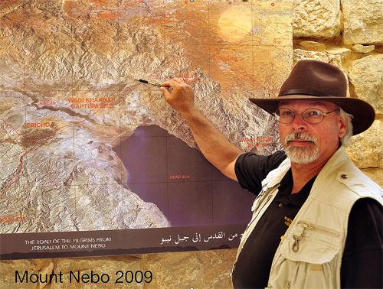
Dr. Steven Collins
pointing to the site of
Tall el-Hammam [Sdom]
Last week I mistakenly
Said that he was pointing
Southwest of the Dead
Sea.
Notes:
https://www.ritmeyer.com/wp-content/uploads/2015/05/SC.jpg
Dr. Steven Collins pointing to the site of Tall el-Hammam on an aerial photograph displayed on Mount Nebo in 2009. Photo: Leen Ritmeyer

Slide 9
S’dom is NE of the Dead Sea
Notes:
https://www.youtube.com/watch?v=KVE2PdY-qqk

Slide 10
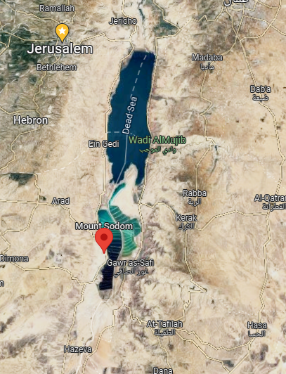
Sdom was commonly identified as SW shore of the Dead Sea.
Notes:
https://goo.gl/maps/FRvz68Y4z9pejbgZ8

Slide 11
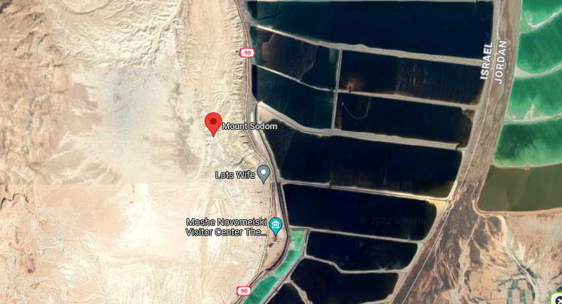
There is a
Salt pillar
Considered
To be Lot’s
wife
Notes:
https://goo.gl/maps/FRvz68Y4z9pejbgZ8

Slide 12
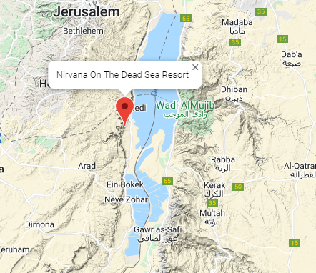
Dawn and I stayed in that resort area in 1998, 25th anniv trip.

Slide 13
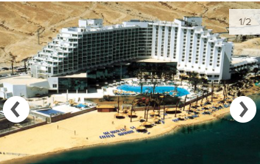
Nirvana Hotel

Slide 14
Notes:
https://www.youtube.com/watch?v=KVE2PdY-qqk

Slide 15
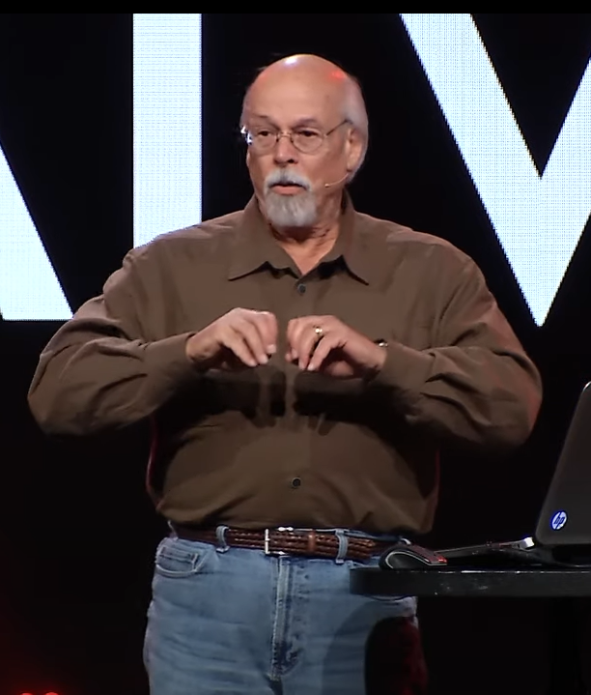
Dr. Steven Collins, discoverer of S’dom
Archeology day May 7, 1:30
Notes:
https://youtu.be/TlWuCzSntbA

Slide 16
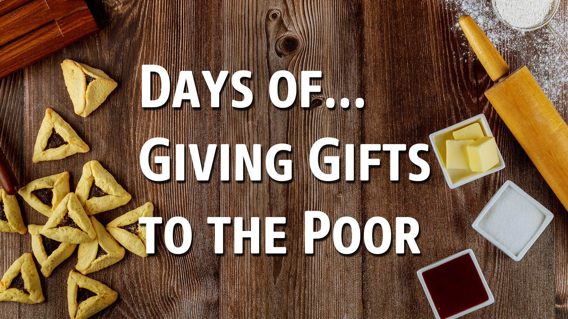
Purim Assignment:

Slide 17
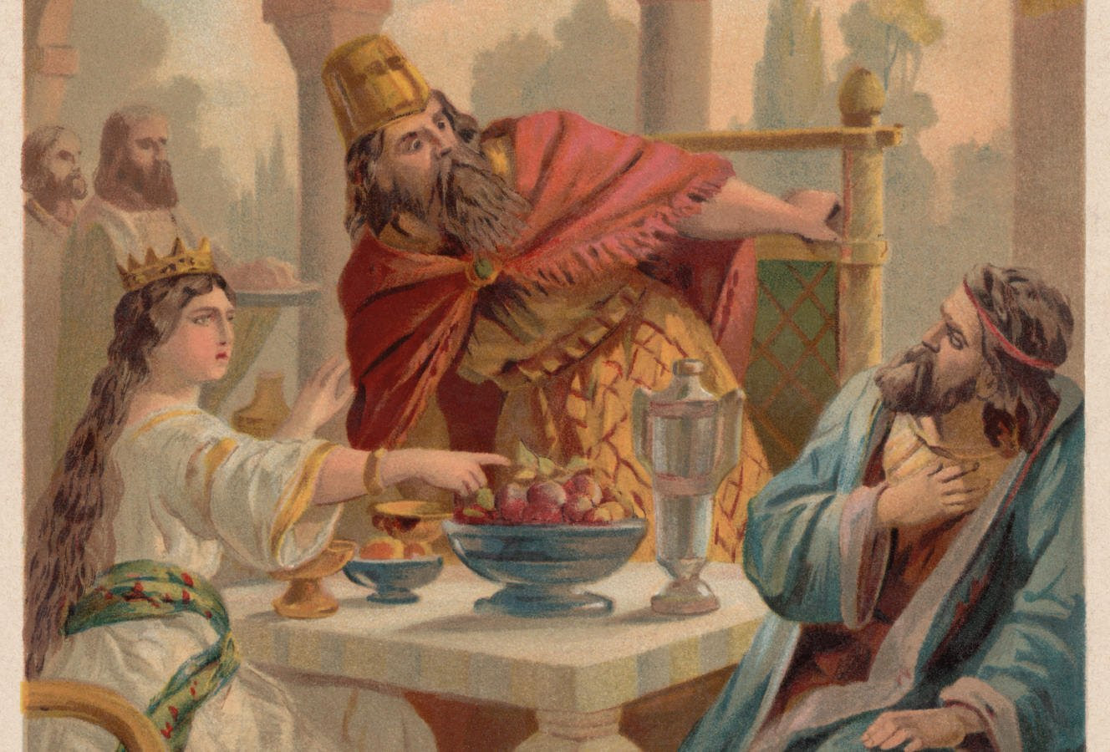
Notes:
Synopsis: Haman was enraged at the Jews because Mordekhi would not bow to him. Made a genocidal plot that Queen Esther exposed. Haman was hung on the gallows he intended for Mordekhi.

Slide 18
^{Ester 9.20-22} Mordekhi recorded these events and sent letters to all the Jews in all the provinces of King Akhashverosh, both near and far, instructing them to observe the fourteenth day of the month of Adar and the fifteenth day, every year,

Slide 19
^{Ester 9.20-22} [to commemorate] the days on which the Jews obtained rest from their enemies and the month which for them was turned from sorrow into gladness and from mourning into a holiday;
נֶהְפַּךְ לָהֶם מִיָּגוֹן לְשִׂמְחָה Nehpakh
Notes:
Nehpakh overturned
A great Hebrew word to know, pray, cling to.
Like the line:
tsadeek bi-emunato yikheeyeh. צדיק באמונתו יחיה

Slide 20
^{Ester 9.20-22} they were to make them days of celebrating and rejoicing, sending portions [of food] to each other and giving gifts to the poor.
Notes:
Offering for Reach again today and tomorrow.

Slide 21
Concern for the impoverished has always been a big concern of G-d.

Slide 22
^{Shmot/Ex 22.24} If you loan money to one of my people who is poor, you are not to deal with him as would a creditor; and you are not to charge him interest.

Slide 23
^{Shmot/Ex 23.10-11} For six years you are to sow your fields and harvest the crops, but during the seventh year let the land lie unplowed and unused. Then the poor among your people may get food from it.

Slide 24
^{Vayikra/Lev. 19.10} Likewise, don’t gather the grapes left on the vine or fallen on the ground after harvest; leave them for the poor and the foreigner; I am Adoni your God.
Notes:
Like Ruth did. Biblical welfare-workfare.

Slide 25
^{Vayikra/Lev 19:15} You are to do no injustice in judgment. You are not to be partial toward the poor nor show favoritism toward the great, but you are to judge your neighbor with fairness.
Notes:
In other words, no Robin Hood mentality. The poor are no more worthy of consideration, enough to break the law.

Slide 26
^{Luke 4.18} “The Ruakh Adoni is on me, because He has anointed me to proclaim Good News to the poor. He has sent me to heal the broken-hearted, to proclaim release to the captives and recovery of sight to the blind, to set free those who have been crushed.
Notes:
Yeshua was quoting Yeshayahu/Isaiah.

Slide 27
^{Yeshayahu/Is 61.1-2} The Ruakh of Adoni Elohim is on me, because Adoni has anointed me to proclaim Good News to the poor. He has sent me to bind up the brokenhearted,

Slide 28
^{Yeshayahu/Is 61.1-2} to proclaim liberty to the captives, and the opening of the prison to those who are bound, to proclaim the year of Adoni’s favor and the day of our God’s vengeance, to comfort all who mourn.

Slide 29
^{Matthew 19:21} Yeshua said to him, “If you are serious about reaching the goal, go and sell your possessions, give to the poor, and you will have riches in heaven. Then come, follow me!”
Notes:
Carried thru the Shlikhim/apostles…

Slide 30
^{Gal 2.9-10} Realizing the favor that had been given to me, Ya‘akov, Kefa and Yochanan—who are the recognized pillars—shook hands in partnership with Barnabas and me, so that we would go to the Gentiles and they to the Jews. They asked only that we remember the poor—something I also was eager to do.

Slide 31
Purim Assignment:

Slide 32
Who are the poor?
Physically
Spiritually
Prophetically

Slide 33
Who are the poor?
Physically
Spiritually
Prophetically

Slide 34
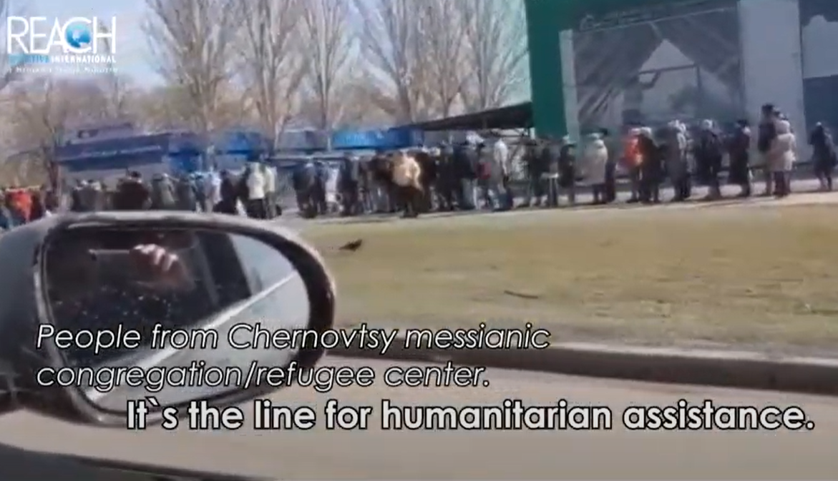
Our brave partners delivering
life saving aid to besieged Mykolaiv
Notes:
https://youtu.be/CPDNYtbVB9w
Offering later

Slide 35
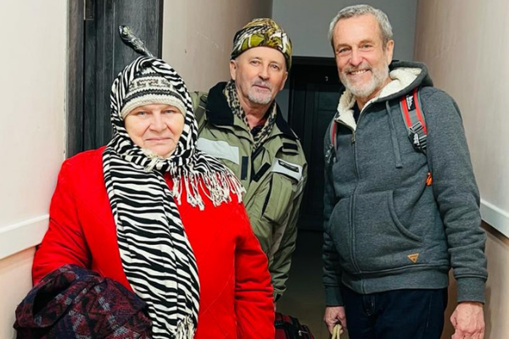
Stewart, with his brother’s wife’s elderly relatives.

Slide 36
Late last night, we also rescued elderly relatives of my brother’s wife. They initially fled from Sumy, a city on the northern border with Belarus which has been heavily bombed. They slept at the Refugee Center in Chernivtsi and at night we ushered them across the border to Romania.

Slide 37
Due to the 10 pm curfew in Ukraine, (all lights must be out) we were stopped on the road going to the border, but we are thankful that the police were very understanding and let us pass.

Slide 38
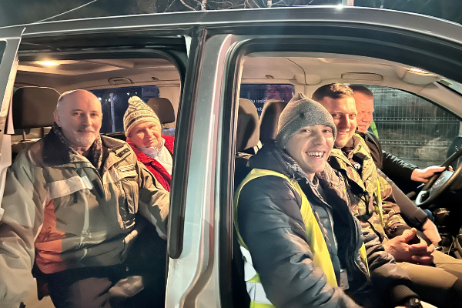
Stewart’s brother’s wife’s elderly relatives in the van at the border during this late-night rescue operation.

Slide 39
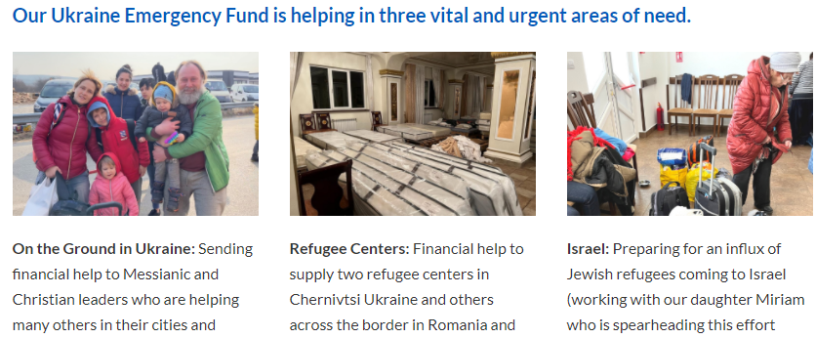
https://reachii.org/ukraine-helping/
Notes:
Reach gives aid
on the ground in Ukraine
Refugee centers in the perimeter country of Romania
Help to Aliyah centers to receive refugees home to Israel. Such as Haim Malespin.
By the way, I know many of you love New Jerusalem Band. Vadim, the keyboardist, is a pastor now in Kyiv. Yesterday we met one of his sons along with his wife and young baby. 15 members of Vadim’s family have fled ( including with a newborn baby born a week after the war began- and she spent much time with her newborn in bomb shelters before fleeing). Vadim and his wife have stayed behind to help people in Kyiv.

Slide 40
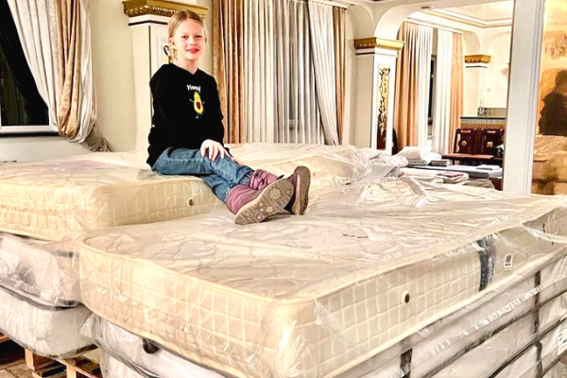
Notes:
The congregation in Chernivtsi. Rented a restaurant and created rooms with curtains in order to give people some kind of privacy. The people in this center will stay long term not just for a few nights.

Slide 41
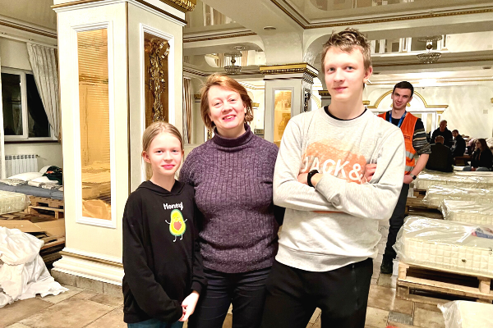

Slide 42
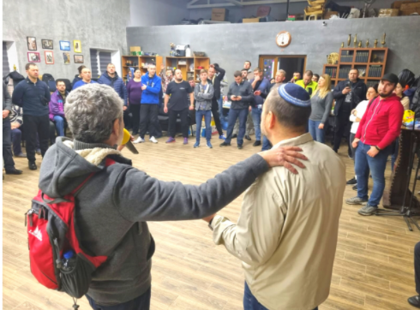

Slide 43
We have joined one of our partners on the ground in Romania and make trips into Ukraine from there. The pastor of the church we are partnering with is Jewish and has a brother living in Israel. This brother connected us when the conflict started. and after hearing how this church had dropped everything to serve refugees crossing the border.

Slide 44
Rabbi David Fohrman: The two cardinal mitzvot of the day – gifts to the destitute, and mishloach manot, the sending of delectable delights to friends -- these things ask us to brighten the days of others, to find delight and satisfaction in the smiles of those we touch.

Slide 45
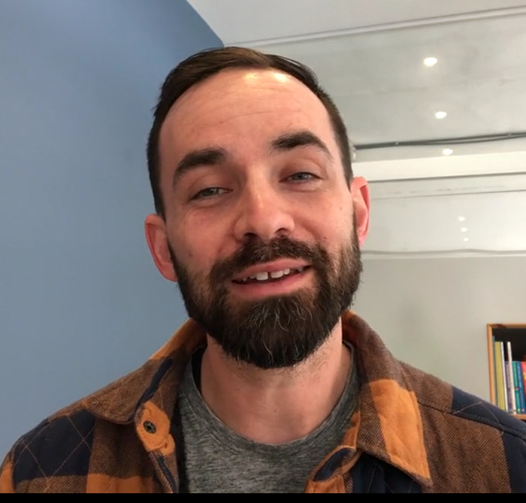
A Story of Hope from HaTikva Dental, Evan Levine
Notes:
https://vimeo.com/685620755

Slide 46
Purim Assignment:

Slide 47
Who are the poor?
Physically
Spiritually
Prophetically

Slide 48
Notes:
© 2022 Brandeis University Maurice and Marilyn Cohen Center for Modern Jewish Studies www.brandeis.edu/cmjs

Slide 49
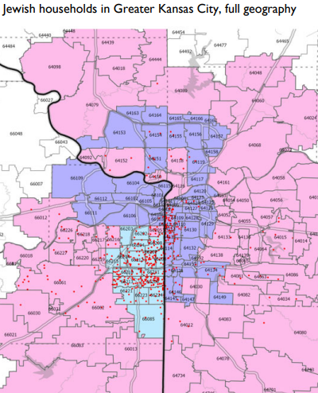
© 2022 Brandeis University Maurice and Marilyn Cohen Center for Modern Jewish Studies www.brandeis.edu/cmjs

Slide 50
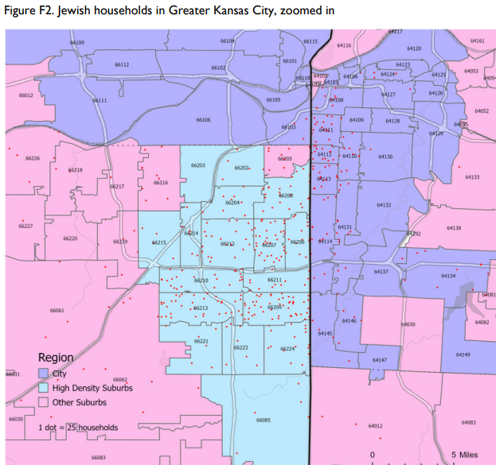
Notes:
© 2022 Brandeis University Maurice and Marilyn Cohen Center for Modern Jewish Studies www.brandeis.edu/cmjs

Slide 51
Notes:
© 2022 Brandeis University Maurice and Marilyn Cohen Center for Modern Jewish Studies www.brandeis.edu/cmjs

Slide 52
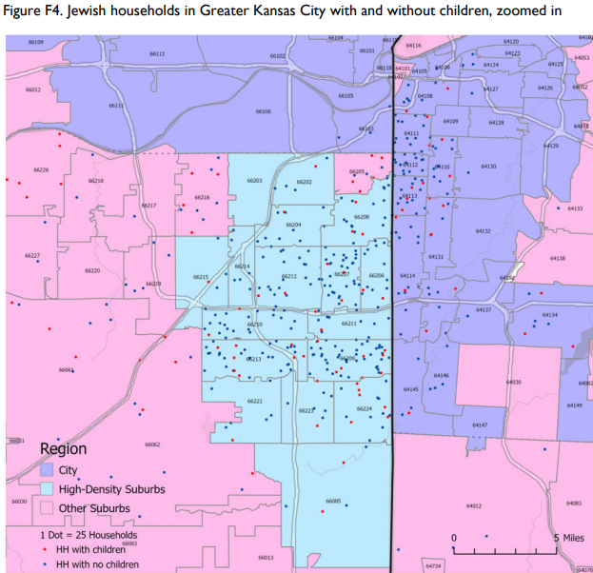
Notes:
© 2022 Brandeis University Maurice and Marilyn Cohen Center for Modern Jewish Studies www.brandeis.edu/cmjs

Slide 53
The Greater Kansas City Jewish community numbers approximately
28,300 adults and children,
of whom 22,100 are Jewish, living in 12,600 households.
18,400 Jewish adults
3,600 Jewish children
5,200 non-Jewish adults 1,100 non-Jewish children
Notes:
© 2022 Brandeis University Maurice and Marilyn Cohen Center for Modern Jewish Studies www.brandeis.edu/cmjs

Slide 54
44% Reform, slightly higher than the national average of 37%.
(18%) Conservative Jews
Notes:
© 2022 Brandeis University Maurice and Marilyn Cohen Center for Modern Jewish Studies www.brandeis.edu/cmjs

Slide 55
32% Jews of no particular denomination are nearly identical to the national averages, but there are
4% Orthodox Jews
2% Jews who identify with other denominations. Reconstructionis, Renewal, Jubus.
Notes:
© 2022 Brandeis University Maurice and Marilyn Cohen Center for Modern Jewish Studies www.brandeis.edu/cmjs

Slide 56
6% of Jewish adults in Greater Kansas City identify as LGBTQ.
4% grew up in Russian-speaking households.
4% of Jewish adults in Greater Kansas City identify as Israeli citizens
Notes:
© 2022 Brandeis University Maurice and Marilyn Cohen Center for Modern Jewish Studies www.brandeis.edu/cmjs

Slide 57
63%of Jewish adults in Greater Kansas City identify politically as very liberal or liberal.
23% describe themselves as moderate
14% are very conservative or conservative
Notes:
© 2022 Brandeis University Maurice and Marilyn Cohen Center for Modern Jewish Studies www.brandeis.edu/cmjs

Slide 58
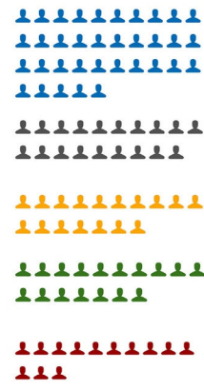
35% Occasional participation in Jewish life
19%Strong support, not
affiliated
17% affiliated less participation
17% less organized participation
13% immersed High particip

Slide 59
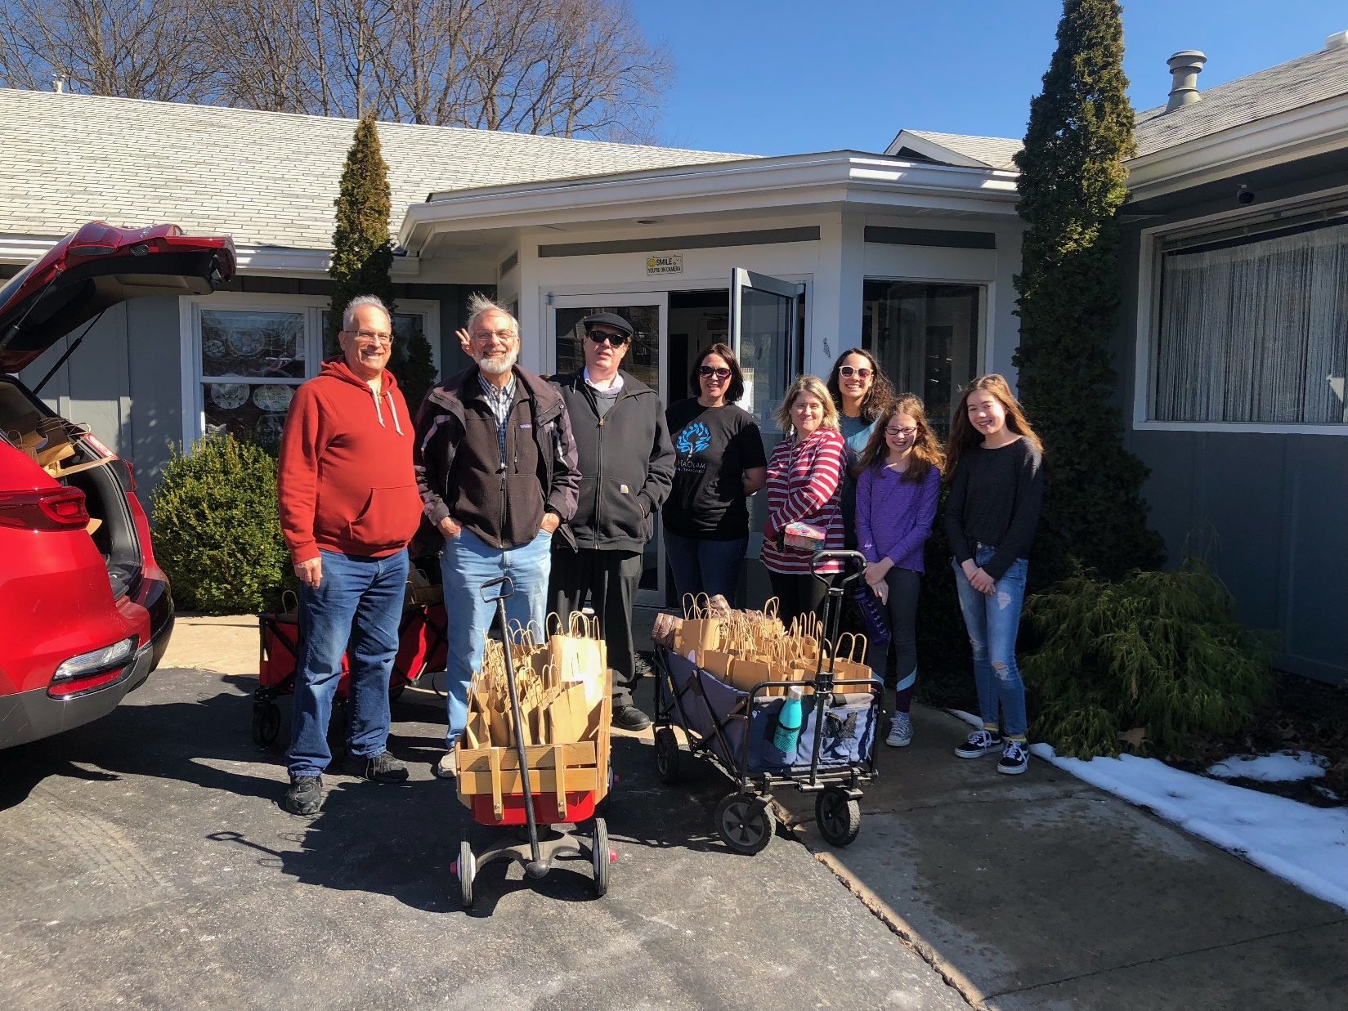
Notes:
Plus some others not pictured

Slide 60
Louise testimony

Slide 61
Purim preparation
Games, activities
Decorations
Drama
Food
PEOPLE: prepare to love!
Notes:
Start with each other. Look for newcomers. Befriend and love those closest → overflow.

Slide 62
^{Yn 17.20-23} “I pray not only for these, but also for those who will trust in me because of their word, that they may all be one. Just as you, Father, are united with me and I with you, I pray that they may be united with us, so that the world may believe that you sent me.
Notes:
Start with each other. I disagree with him. I don’t like the way she does that. Befriend and love those closest → overflow.
Look for newcomers.

Slide 63
^{Yn 17.20-23} The glory which you have given to me, I have given to them; so that they may be one, just as we are one — I united with them and you with me, so that they may be completely one, and the world thus realize that you sent me, and that you have loved them just as you have loved me.
Notes:
Start with each other. Look for newcomers. Befriend and love those closest → overflow.

Slide 64
Ari Hauben greeting

Slide 65
Purim Assignment:

Slide 66
Who are the poor?
Physically
Spiritually
Prophetically

Slide 67
Though in the Book of Esther the fate of the Jewish people seems to turn on something as capricious ­as the ‘purim’, the lot, the ‘toss of the dice’ – the Jewish people’s survival rests in very secure divine hands.

Slide 68
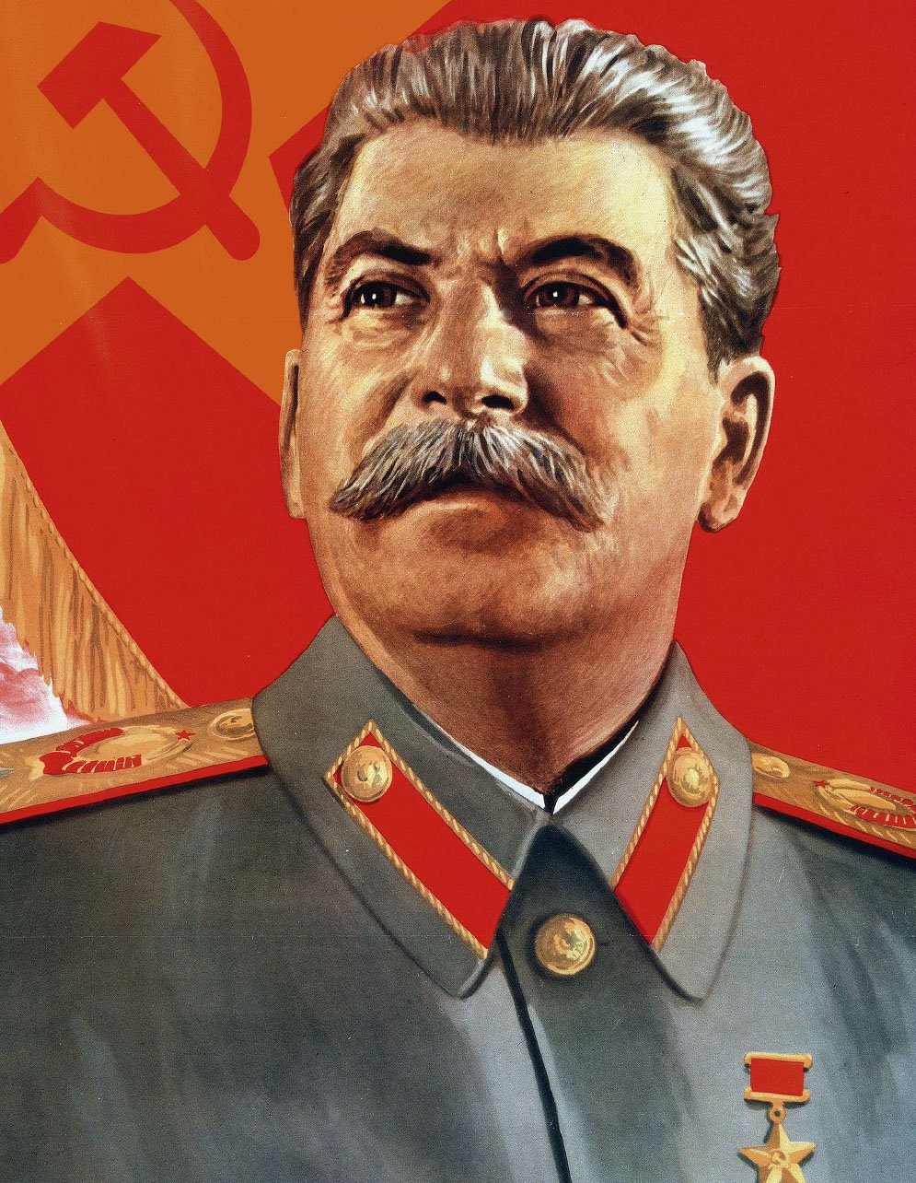

Slide 69
People’s Commissar and General Secretary Joseph Stalin was suddenly paralyzed on Purim, March 1, 1953, and died four days later. As a result of his death, nationwide pogroms against Jews throughout the Soviet Union connected to Stalin’s anti-Semitic and murderous Doctor’s Plot pogrom was averted.
Notes:
Avner Boskey

Slide 70
Julius Streicher, publisher of the Nazi Der Stürmer, ascended the gallows on October 16, 1946 with this declaration as his last words, “Purim-Fest 1946!” (‘The Feast of Purim – 1946!’). Streicher was ironically stating that the Jewish people would remember his own hanging in their future history books
Notes:
Avner Boskey newletter www.davidstent.org

Slide 71
in the same way as they remembered the divine victory at the Feast of Purim – the hanging of Haman and his ten sons (Esther 7:9-10). Haman had called for and planned the genocide of the Jewish people (Esther 5:13-14) as had Hitler, but in the end he was destroyed on the very gallows he intended to use against Mordechai.
Notes:
Avner Boskey newletter www.davidstent.org

Slide 72
God seems to be ‘hiding His face’ (‘hester panim’ in Hebrew, a wordplay on the Hebrew name ‘Esther’), but in no way is He sleeping or slumbering. He protects us, preserves us, and will fulfill every prophetic promise over us to bring us back ­both to the Land of Israel and to Himself.

Slide 73
Why do you say, Jacob, and you assert, Israel, “My way is hidden from Adoni, and the justice due me escapes the notice of my God”? Do you not know? Have you not heard? The Everlasting God, Adoni, the Creator of the ends of the earth

Slide 74
does not become weary or tired. His understanding is unsearchable. He gives strength to the weary, and to the one who lacks might He increases power. (Isaiah 40:27-29)

Slide 75
^{Yeshayahu/Isaiah 53.1-5} Who believes our report? To whom is the arm of Adoni revealed? For before him he grew up like a young plant, like a root out of dry ground. He was not well-formed or especially handsome; we saw him, but his appearance did not attract us.

Slide 76
^{Yeshayahu/Isaiah 53.1-5} People despised and avoided him, a man of pains, well acquainted with illness. Like someone from whom people turn their faces, he was despised; we did not value him. In fact, it was our diseases he bore, our pains from which he suffered;

Slide 77
^{Yeshayahu/Isaiah 53.1-5} yet we regarded him as punished, stricken and afflicted by God. But he was wounded because of our crimes, crushed because of our sins; the disciplining that makes us whole fell on him, and by his bruises* we are healed.

Slide 78
Purim Assignment:

Slide 79
Who are the poor?
Physically
Spiritually
Prophetically

Slide 80
Russia has lost 81 planes, 95 helicopters, 404 tanks, 150 artillery and 1,279 armored vehicles. A total of 13,500 troops have been killed in Ukraine. The media is seeing this as a tremendous victory for the Ukrainians. But it could be just the opposite.
Notes:
https://www.charismanews.com/world/88658-why-putin-may-have-no-conscience-when-it-comes-to-employing-nuclear-arsenal-in-Ukraine
Russia's losses: Over 13,500 personnel, 404 tanks, 81 planes, 95 helicopters (ukrinform.net)

Slide 81
Mike Evans
is a Nobel Peace Prize nominee and New York Times bestselling author with 108 published books.
founder of the Friends of Zion Heritage Center in Jerusalem,
the Ten Boom Holocaust Museum in Haarlem, Holland,
Jerusalem Prayer Team, the largest religious Facebook page in the world.
Notes:
https://www.charismanews.com/world/88658-why-putin-may-have-no-conscience-when-it-comes-to-employing-nuclear-arsenal-in-ukraine?utm_source=Charisma%20News%20Daily&utm_medium=email&utm_content=subscriber_id:5160390&utm_campaign=CNO%20daily%20-%202022-03-18

Slide 82
Putin really believes he is the savior of the Orthodox Church of the world. He also believes he's the savior of the world and that Ukraine is an existential threat to Russia. Since the Orange Revolution of 2004, Putin sees the European Union and America as backers of a pro-democracy movement.
Notes:
https://www.charismanews.com/world/88658-why-putin-may-have-no-conscience-when-it-comes-to-employing-nuclear-arsenal-in-ukraine

Slide 83
He sees what's transpired in Ukraine with its nationalism movement as 100 times more serious a crisis for Russia than America's Cuban Missile Crisis. Putin is a trapped rat in a corner believing that he and he alone can save Russia. He will, in fact, use nuclear weapons if he believes that it's the only alternative.
Notes:
https://www.charismanews.com/world/88658-why-putin-may-have-no-conscience-when-it-comes-to-employing-nuclear-arsenal-in-ukraine?utm_source=Charisma%20News%20Daily&utm_medium=email&utm_content=subscriber_id:5160390&utm_campaign=CNO%20daily%20-%202022-03-18

Slide 84
Putin has put his nuclear weapons on heightened alert, and he has almost half the nuclear weapons of the entire world. That's over 6,255 of the 13,080 in the world, and America has 5,550.
Notes:
https://www.charismanews.com/world/88658-why-putin-may-have-no-conscience-when-it-comes-to-employing-nuclear-arsenal-in-ukraine?utm_source=Charisma%20News%20Daily&utm_medium=email&utm_content=subscriber_id:5160390&utm_campaign=CNO%20daily%20-%202022-03-18

Slide 85
וַאלְלָה Walla
(Arabic) (slang) Wow!
Really! You don't say!

Slide 86
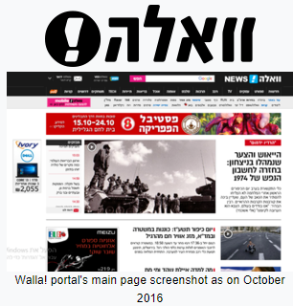
Walla! Communications Ltd. is an Israeli internet company headquartered in Tel Aviv and is fully owned by The Jerusalem Post. Walla!'s web portal provides news…
Notes:
https://en.wikipedia.org/wiki/Walla!

Slide 87
On the Walla site itself, the article’s headline read: Is a Biblical prophecy about the end of the world coming true? “Corona and the war in Europe are the first signs”
Notes:
https://www.israeltoday.co.il/read/israeli-news-wonders-is-jesus-about-to-return/

Slide 88
The headline was citing, and the Hebrew-language article focuses on, recent remarks by Pastor Greg Laurie.
Notes:
https://www.israeltoday.co.il/read/israeli-news-wonders-is-jesus-about-to-return/

Slide 89
“Ezekiel says that the Jewish people would be scattered and regathered in their land again. …Israel officially again became a nation on May 14, 1948, so that part of the prophecy has been fulfilled. But then Scripture says a nation from the extreme north of Israel will march on her called Gog and Magog. When I see the aggression of Russia, Magog if you will, it’s a reminder that that’s what we are going to see when Magog attacks Israel.
Notes:
https://www.israeltoday.co.il/read/israeli-news-wonders-is-jesus-about-to-return/

Slide 90
The Walla article then followed Laurie’s lead by quoting from Matthew 24:3-14, where Messiah tells his disciples that they will know the time of his return has come when the world is engulfed in “wars and rumors of wars…famine and pestilence…false prophets” and more.
Notes:
https://www.israeltoday.co.il/read/israeli-news-wonders-is-jesus-about-to-return/

Slide 91
Walla [said]…but after what we have experienced over the past two years, can we really remain so cynical?
Notes:
https://www.israeltoday.co.il/read/israeli-news-wonders-is-jesus-about-to-return/

Slide 92
If someone had told you five years ago that in 2020 the entire world would be crippled by a pandemic, or that just as that crisis was ending Russia would begin invading its neighbors, would you have believed it?
Notes:
https://www.israeltoday.co.il/read/israeli-news-wonders-is-jesus-about-to-return/

Slide 93
On the Walla site itself, the article’s headline read: Is a biblical prophecy about the end of the world coming true? “Corona and the war in Europe are the first signs”
Notes:
https://www.israeltoday.co.il/read/israeli-news-wonders-is-jesus-about-to-return/

Slide 94
Purim Assignment:

Slide 95
Physically
Spiritually
Prophetically

Slide 96
Prayer point for third hour of prayer…

Slide 97
Purim Assignment:

Slide 98
Praying for the poor
Physically:
Derek Prince: Shaping History through Pray and Fasting
^{Ps 83.17} Fill their faces with shame,
so that they will seek your name, Adoni.

Slide 99
^{Daniel 4} I blessed the Most High and I praised and honored Him who lives forever…He does as He wills with the army of heaven and the inhabitants of the earth. No one can hold back His hand, or say to Him, ‘What have you done?’

Slide 100
Praying for the poor
Physically:
Help, spare Ukrainians,
overthrow Vladimir Putin,
Xi Jinping,
Supreme Leader Ali Khamenei and President Ebrahim Raisi

Slide 101
Praying for the poor
Spiritually:
our Purim misloakh manot gift bags impact our neighbors
Our newcomers are welcomed and touched by the Ruakh

Slide 102
Praying for the poor
Prophetically:
Your kingdom come תבוא מלכותך
Notes:
Supreme Leader
Ali Khamenei• President
Ebrahim Raisi

