Slide 1
e-handout
To have these notes
without taking notes
Go to OrHaOlam.com
Click on Messages tab,
2022 Messages
Notes:
You may notice that I’m slowing down in my rate of speech. This is because we may be getting language translation equipment for simultaneous translation.

Slide 2
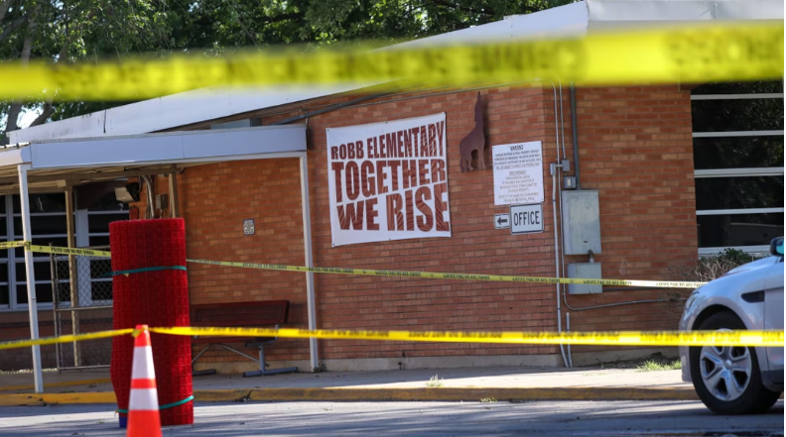
Today, we mourn for the
victims of Uvalde.
Notes:
Yasin Ozturk/Anadolu Agency via Getty Images

Slide 3
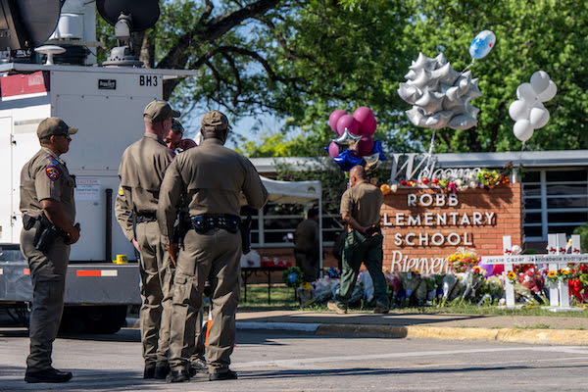
Notes:
Brandon Bell/Getty Images
Daily Wire
As I recite the names, we could all pray silently for the families to survive, and for our nation to repent.

Slide 4
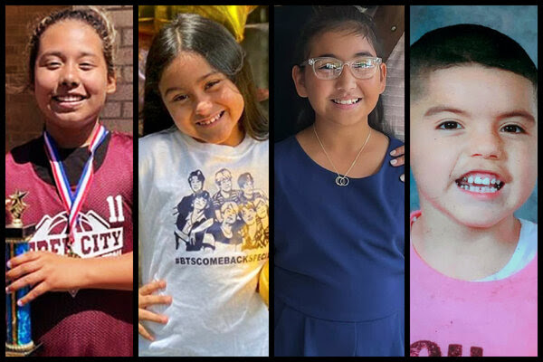
Notes:
From left: Alexandria “Lexi” Aniyah Rubio, Amerie Jo Garza, Tess Marie Mata and Jose Flores.
The New York Times Company. 620 Eighth Avenue New York, NY 10018 Claire Moses, Ian Prasad Philbrick, Tom Wright-Piersanti, Ashley Wu and Sanam Yar contributed to The Morning. You can reach the team at themorning@nytimes.com.

Slide 5
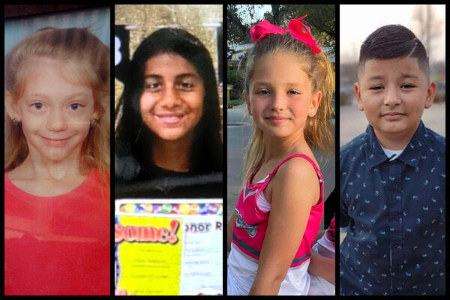
Notes:
From left: Miranda Mathis, Maite Rodriguez, Makenna Lee Elrod, Xavier Lopez
The New York Times Company. 620 Eighth Avenue New York, NY 10018 Claire Moses, Ian Prasad Philbrick, Tom Wright-Piersanti, Ashley Wu and Sanam Yar contributed to The Morning. You can reach the team at themorning@nytimes.com.

Slide 6
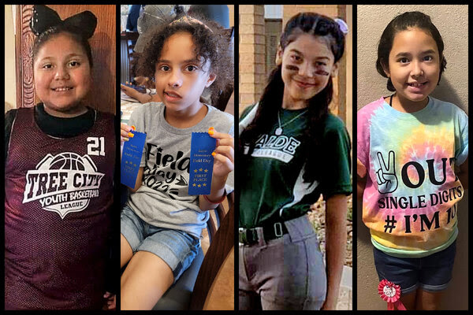
Notes:
From left: Eliana “Ellie” Garcia, Layla Salazar, Eliahana Cruz Torres, Alithia Ramirez
The New York Times Company. 620 Eighth Avenue New York, NY 10018 Claire Moses, Ian Prasad Philbrick, Tom Wright-Piersanti, Ashley Wu and Sanam Yar contributed to The Morning. You can reach the team at themorning@nytimes.com.

Slide 7
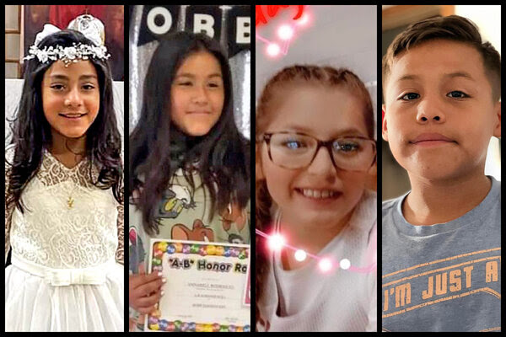
Notes:
From left: Jackie Cazares, Annabelle Rodriguez, Jailah Silguero, Jayce Luevanos
The New York Times Company. 620 Eighth Avenue New York, NY 10018 Claire Moses, Ian Prasad Philbrick, Tom Wright-Piersanti, Ashley Wu and Sanam Yar contributed to The Morning. You can reach the team at themorning@nytimes.com.

Slide 8
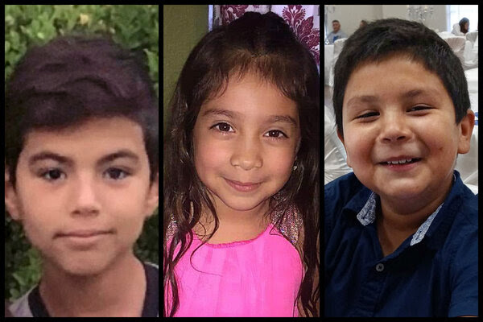
Notes:
From Left: Uziyah Garcia, Nevaeh Bravo, Rojelio Torres
The New York Times Company. 620 Eighth Avenue New York, NY 10018 Claire Moses, Ian Prasad Philbrick, Tom Wright-Piersanti, Ashley Wu and Sanam Yar contributed to The Morning. You can reach the team at themorning@nytimes.com.

Slide 9
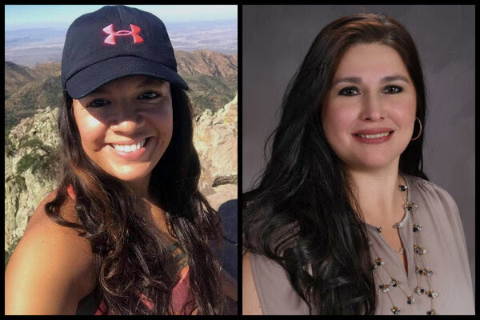
Notes:
From left: Eva Mireles, Irma Garcia
Joe Garcia, who was 50, had just returned home from leaving flowers at a makeshift memorial for Irma Thursday morning when he suddenly collapsed while sitting at the kitchen table with family members, his nephew, John Martinez, told the USA TODAY Network. He could not be revived. Broken heart syndrome is technically stress cardiomyopathy or “takotsubo syndrome.” It’s a temporary heart condition first described in 1990 by doctors in Japan.
The New York Times Company. 620 Eighth Avenue New York, NY 10018 Claire Moses, Ian Prasad Philbrick, Tom Wright-Piersanti, Ashley Wu and Sanam Yar contributed to The Morning. You can reach the team at themorning@nytimes.com.

Slide 10
קָדֶשׁ Kaddish (The Sanctification)
Public Domain

Slide 11
Magnified and sanctified
be His great name in the world
which He has created
according to His will.
May He establish His kingdom during your life and
during your days,

Slide 12
and cause His salvation to sprout, and bring near His Messiah, during the life of
all the house of Israel,
even speedily and at a near time.
And all say, "A-mayn."

Slide 13
Let His great name be blessed forever and to all eternity.
[Ee-yov [Job] 1:21, Dan 2:20, Tehillim 113:2]
Blessed, praised, and glorified, exalted, extolled, and honored, magnified, and lauded
be the name of the Holy One,
blessed be He;

Slide 14
though He be high above all the blessings and hymns,
praises and consolations,
which are uttered in the world;
and all say, "A-mayn."

Slide 15
May there be abundant
peace from heaven,
and a happy life for us
and for all Israel;
and all say, "A-mayn."

Slide 16
He who makes peace
in His high places,
[Ee-yov [Job] 25:2]
may He in His mercy
make peace for us
and for all Israel;
and all say, "A-mayn."

Slide 17
יִתְגַּדַּל Yeet-ga-dal
וְיִתְקַדַּשׁ V'yeet-ka-dash
שְׁמֵהּ רַבָּא. Sh'mayh ra-ba.
[Y'khezkel 38:23, Ee-yov [Job] 1:21]

Slide 18
בְּעָלְמָא דִּי בְרָא כִרְעוּתֵהּ,
B'al-ma dee v'ra kheer-u-tayh
וְיַמְלִיךְ מַלְכוּתֵהּ
V'yam-leekh mal-khu-tayh

Slide 19
וְיַצְמַח פּוּרְקַּנֶה
V'yats-makh pur-ka-neh
וִיְקַּרֵב מְשִׁיחֵה
Veey-ka-rayv M'shee-khay
בְּחַיֵּיכוֹן וּבְיוֹמֵיכוֹן
B'khi-yay-khon uv-yo-may-khon

Slide 20
וּבְחַיֵּי דְכָל בֵּית יִשְׂרָאֵל.
uv-khi-yay d'khawl
bayt Yees-ra-ayl
בַּעֲגָלָא וּבִזְמַן קָרִיב
B'ah-ga-la u-veez-man ka-reev
[Congregation:]
וְאִמְרוּ אָמֵן: V'eem-ru a-mayn

Slide 21
יְהֵא שְׁמֵהּ רַבָּא מְבָרַךְ
לְעָלַם וּלְעָלְמֵי עָלְמַיָּא: יִתְבָּרַךְ...
Y'hay sh'may ra-ba m'va-rakh
[Ee-yov [Job] 25:2, Dan 2:20]
L'a-lam ul-al-may al-may-a.
Yeet ba-rakh.

Slide 22
[Leader:]
יִתְבָּרַךְ וְיִשְׁתַּבַּח,
Yeet-bar-akh v'yeesh-ta-bakh
וְיִתְפָּאַר וְיִתְרוֹמַם וְיִתְנַשֵּׂא
V'yeet-pa-ar v'yeet-ro-mam
V'yeet-na-say

Slide 23
ווְיִתְעַלֶּה וְיִתְהַלָּל וְיִתְהַדָּר
V’yit-a-leh v'yeet-ha-lal
v’yit-ha-dar
שְׁמֵהּ דְּקֻדְשָׁא
Sh'may d'kud'sha
[Congregation:]
בְּרִיךְ הוּא B'reekh hu

Slide 24
[Leader:]
לְעֵלָּא מִכָּל בִּרְכָתָא
L'ay-lah mee-kawl beer-kha-ta
וְשִׁירָתָא,
V'shee-ra-ta

Slide 25
תֻּשְׁבְּחָתָא וְנֶחֱמָתָא,
Tush-b'kha-ta v'neh-kheh-ma-tah
דַּאֲמִירָן בְּעָלְמָא,
Da-a-mee-ran b'al-ma
וְאִמְרוּ אָמֵן:
V'eem'ru a-mayn

Slide 26
יְהֵא שְׁלָמָא רַבָּא מִן שְׁמַיָּא
Y'hay sh'la-ma ra-ba
meen sh’mi-ya
וְחַיִּים עָלֵינוּ וְעַל כָּל יִשְׂרָאֵל,
וְאִמְרוּ אָמֵן:
v'khi-yeem a-lay-nu v'al kawl
Yees-ra-ayl, v'eem'ru a-mayn.

Slide 27
עשֶׂה שָׁלוֹם Oseh shalom (Make Peace)
Public Domain
Based on Ee-yov [Job] 25:2

Slide 28
עשֶׂה שָׁלוֹם בִּמְרוֹמָיו
הוּא יַעֲשֶׂה שָּׁלוֹם עָלֵינוּ
O-seh sha-lom beem-ro-mav
Hu ya-a-seh sha-lom a-lay-nu
וְעַל כָּל יִשְׂרָאֵל, וְאִמְרוּ, וְאִמְרוּ אָמֵן:
V'al kawl Yis-ra-el, V'eem-ru,
V'eem-ru, A-mayn [repeat]

Slide 29
יַעֲשֶׂה שָּׁלוֹם, יַעֲשֶׂה שָּׁלוֹם
Ya-a-seh sha-lom. (x2)
שָּׁלוֹם עָלֵינוּ וְעַל כָּל יִשְׂרָאֵל
Sha-lom a-lay-nu,
V'al kawl Yis-ra-el
[repeat all]
[May He Who makes peace in the heavenlies (Eph. 4: 10)
Make peace for us, and for all Israel. (Matt. 16: 19) ]

Slide 30
עשֶׂה שָׁלוֹם בִּמְרוֹמָיו
הוּא יַעֲשֶׂה שָּׁלוֹם עָלֵינוּ
O-seh sha-lom beem-ro-mav
Hu ya-a-seh sha-lom a-lay-nu
וְעַל כָּל יִשְׂרָאֵל, וְאִמְרוּ, וְאִמְרוּ אָמֵן:
V'al kawl Yis-ra-el, V'eem-ru,
V'eem-ru, A-mayn [repeat]

Slide 31
Prayer for the grieving families, and our nation.

Slide 32
Officials said that the gunman had entered the school unimpeded, contradicting reports of a confrontation with an officer.
Other reports the police delayed intervening.
Notes:
.
Morning Wire is a daily email newsletter exclusively for Daily Wire members.

Slide 33
Some in Congress have proposed measures like protecting schools with more armed security, claiming that politicians, museums, and banks are protected with armed guards and that schools should be no different.
Notes:
Morning Wire is a daily email newsletter exclusively for Daily Wire members.

Slide 34
They’ve also called for schools to begin implementing systems that require just one entrance to protect against intruders.
Notes:
Morning Wire is a daily email newsletter exclusively for Daily Wire members.
We have only two open entrances during the 10 to noon time, both carefully watched by ushers. Some armed
However, more Americans owned guns in the mid-to-late 90’s than own guns now, and that mass shootings, especially at schools, were nearly non-existent up until the turn of the century.
Also NY Times

Slide 35
The biographical details of the mass shooter in Uvalde, Texas are unsurprising. He didn’t have many friends. He spent most of his time alone, online, staring at screens. He had a history of bizarre, disturbing behavior. He once came to school with self-inflicted cuts all over his face. He had a history of violence.
Notes:
Matt Walsh Host, The Matt Walsh Show © Copyright 2022, The Daily Wire

Slide 36
I convey this with hesitation: And of course — the most inevitable detail of all — he did not have a father in the home. Not much is known about the father except that he lives somewhere else in the neighborhood, and he has a criminal record. So does the mother.
Notes:
Matt Walsh Host, The Matt Walsh Show © Copyright 2022, The Daily Wire

Slide 37
Another revelation that surprises no one. Shortly before the shooting, he moved out of his mom’s house to live with his grandmother. His grandmother was the first person he shot on the day of his bloody rampage.
Notes:
Matt Walsh Host, The Matt Walsh Show © Copyright 2022, The Daily Wire

Slide 38
Over 60% of youth suicides are from fatherless homes. Over 80% of youths in prison are from fatherless homes. Over 70% of high school dropouts are from fatherless homes. Over 70% of kids in drug abuse treatment centers are from fatherless homes
Notes:
Matt Walsh Host, The Matt Walsh Show © Copyright 2022, The Daily Wire

Slide 39
Almost all of the gun violence in our cities is committed by young males who were raised without fathers. We know that because the fatherless home rate in those communities often runs upwards of 80 percent or higher. The fatherless home epidemic is a verified national emergency, and should be treated as such.
Notes:
Matt Walsh Host, The Matt Walsh Show © Copyright 2022, The Daily Wire

Slide 40
This is NOT a condemnation of single moms. Most do superbly EXCELLENT. But it’s an uphill battle.
This is a charge to men to be there!
There is a cry to our culture!

Slide 41
How long can we take morality out of our culture?
How long can the reality of G-d be denied in our media?
How long can prayer be excluded from our practice?
Notes:
But, we can’t legislate this back in.

Slide 42
What is the remedy for America?
Notes:
There is a time sensitive solution that goes along with last week’s theme.

Slide 43
Yn 4.35-36
Harvest in Adversity

Slide 45
We are in the last Ten Days
of the Omer count
from Yom Aliyah to Shavuot.
Notes:
Omer time is the risky harvest season. We ARE at risk!

Slide 46
We are in the last Ten Days
of the Omer count
from Yom Aliyah to Shavuot.
Yom Aliyah??
Aliyah Day??
Notes:
Omer time is the risky harvest season. We ARE at risk!

Slide 47
^{Acts 1.1-3} In the first book, I wrote about everything Yeshua set out to do and teach, until the day when, after giving instructions through the Ruakh HaKodesh to the emissaries whom he had chosen, he was taken up into heaven. Aliyah / Ascension
Notes:
Taken up? Aliyah! When and where?

Slide 48
^{Acts 1.1-3} After his death he showed himself to them and gave many convincing proofs that he was alive. During a period of forty days they saw him, and he spoke with them about the Kingdom of God.

Slide 49
Omer Count for
Wednesday Night / Thursday
May 25, 2022
40 Days in the Omer
Notes:
Day = Yom

Slide 50
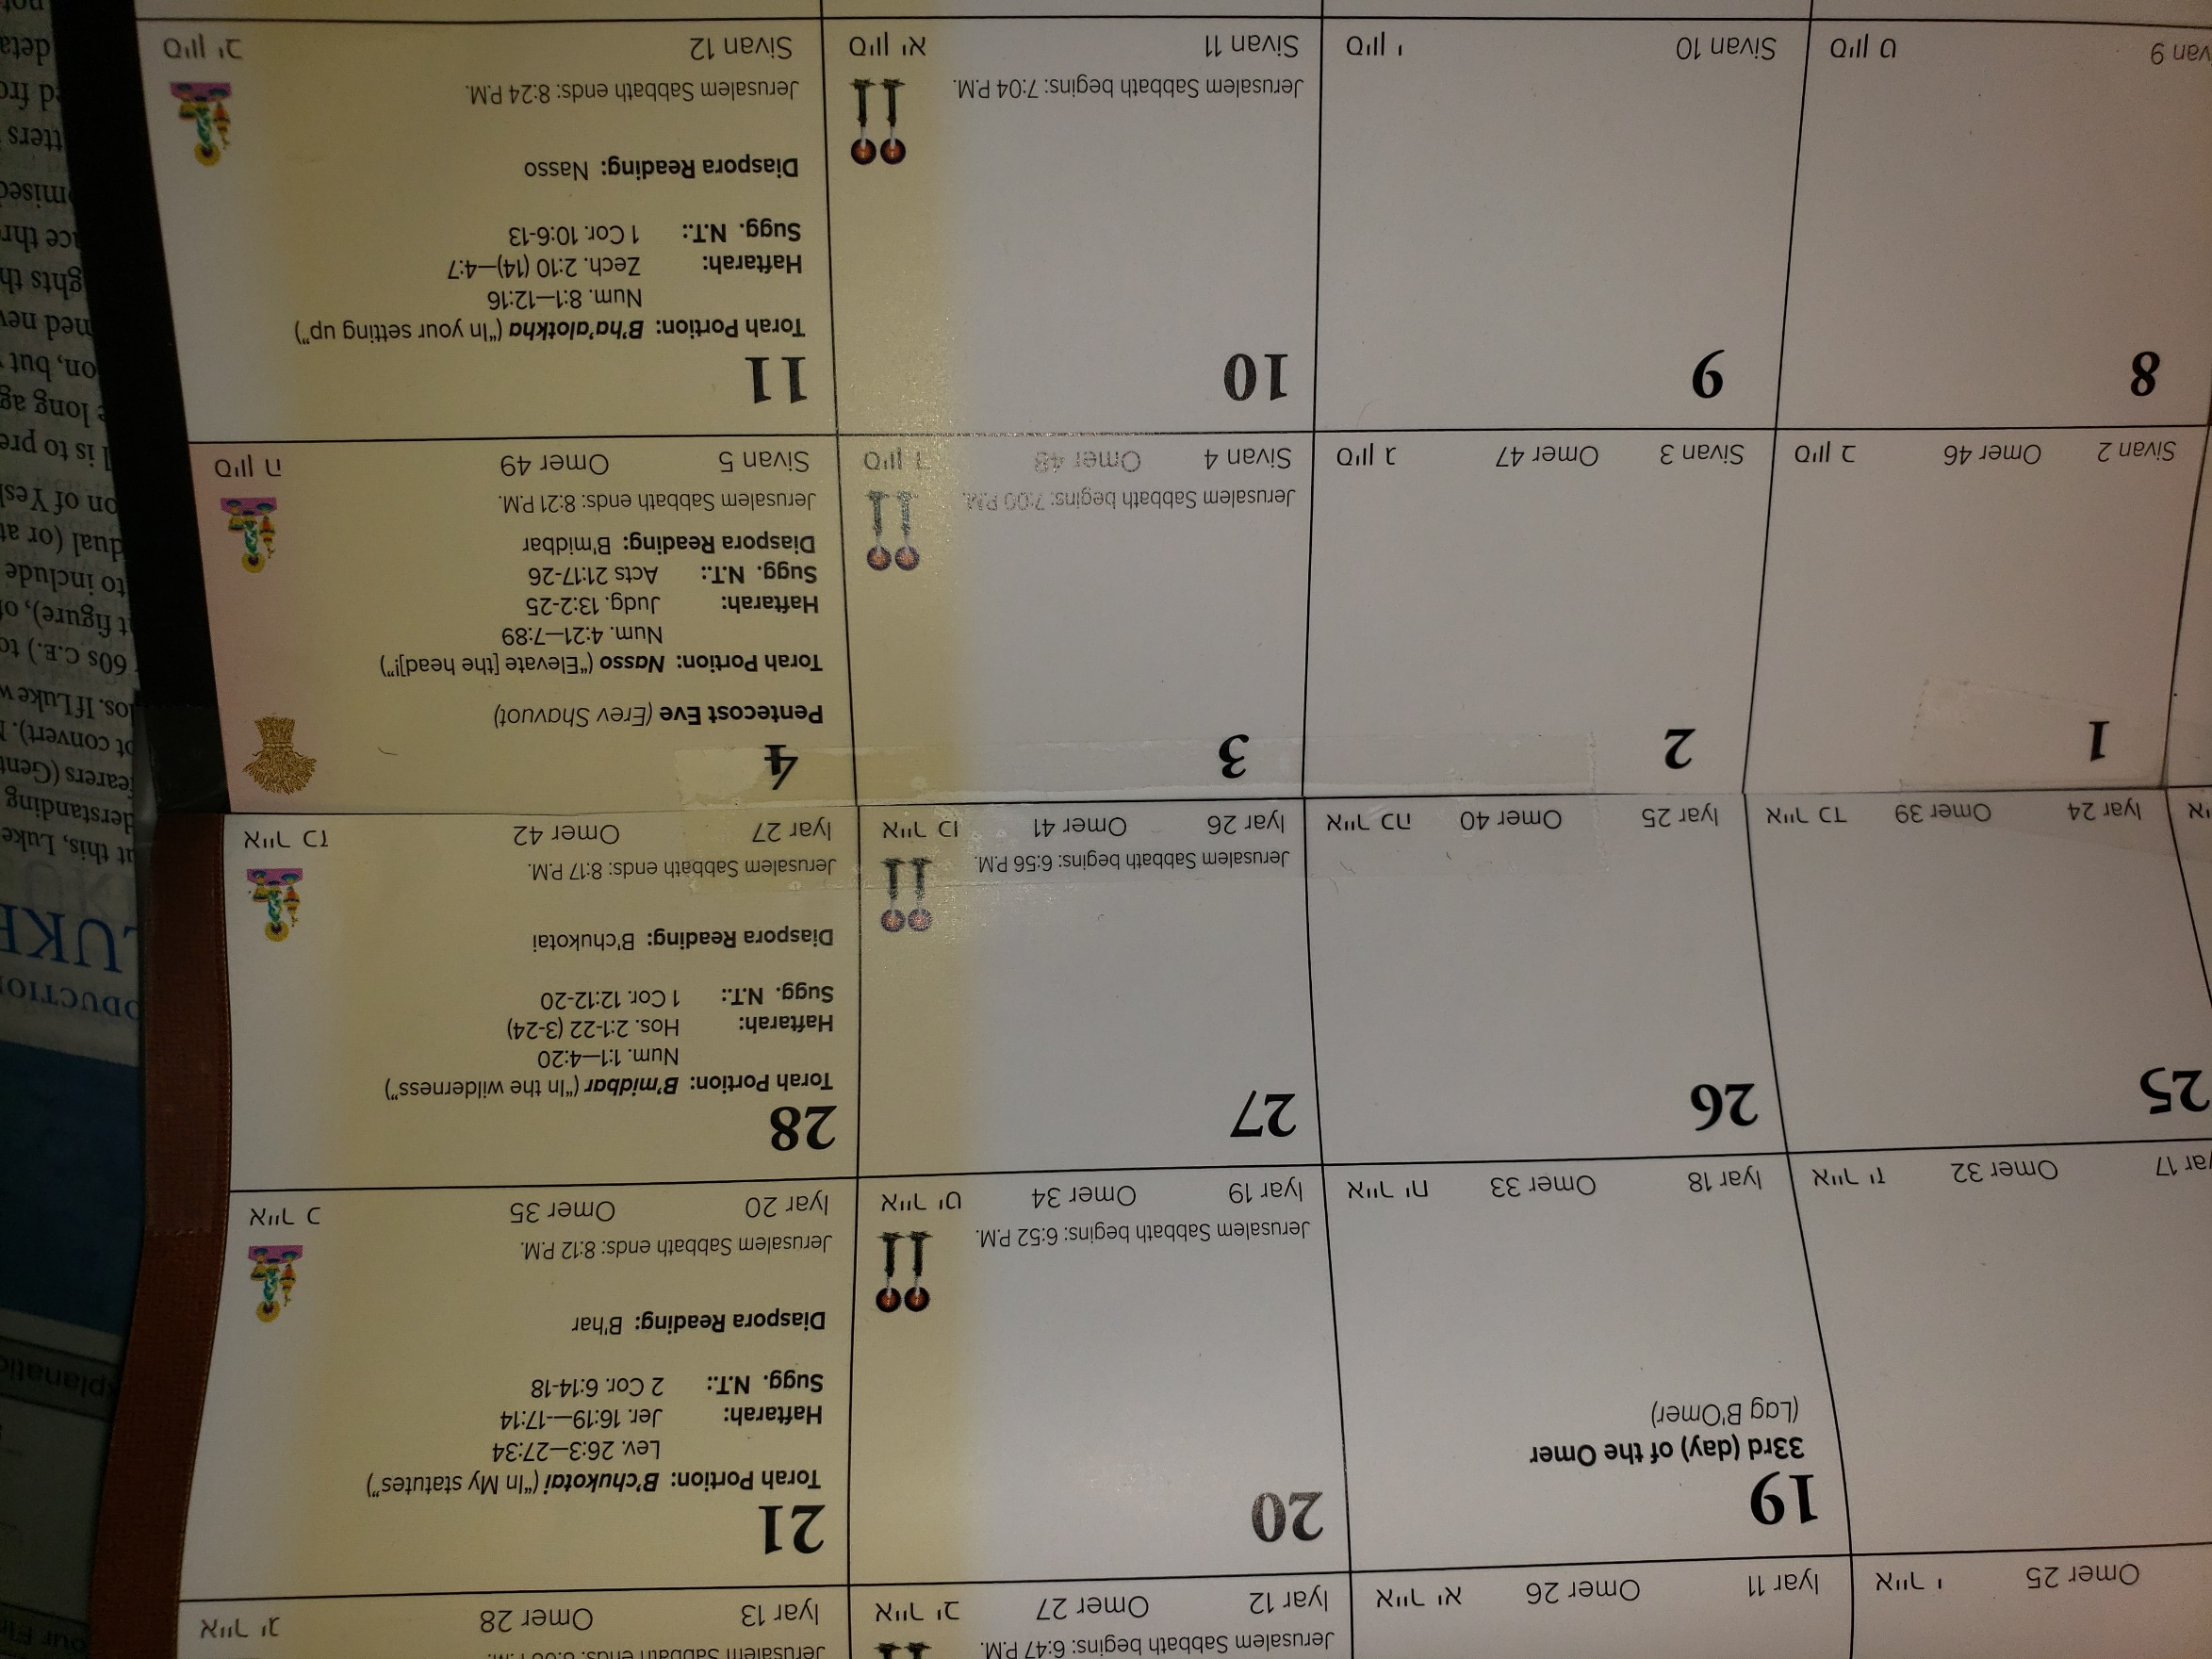
Thurs., May 26, was Yom Aliyah
Ascension Day

Slide 51
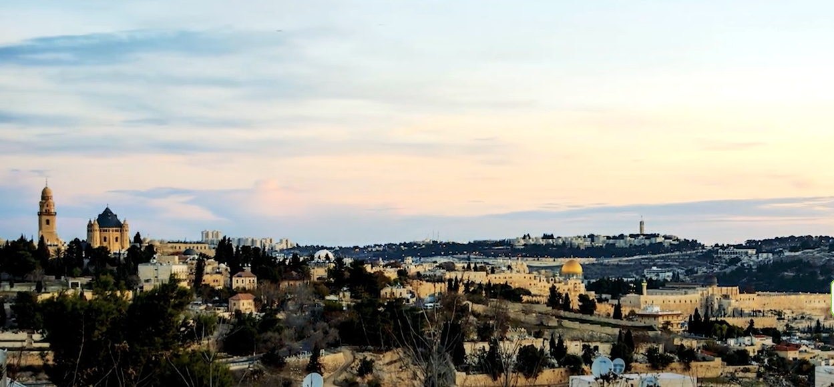
Notes:
https://youtu.be/UfMGV9v3b5M

Slide 52
Notes:
https://youtu.be/UfMGV9v3b5M
I went to summer school Hebrew Univ Mt Scopus 1971. Just south is the Augusta Victoria Hospital.
Apart from the hospital, today the complex also includes the German Protestant^{[2]} Church of the Ascension with a c. 50 metre high belltower,

Slide 53
Notes:
https://external-content.duckduckgo.com/iu/?u=https%3A%2F%2Fholidays-today.com%2Fholidays%2Fwp-content%2Fuploads%2F2019%2F02%2F41-1920x1080.jpg&f=1&nofb=1

Slide 54
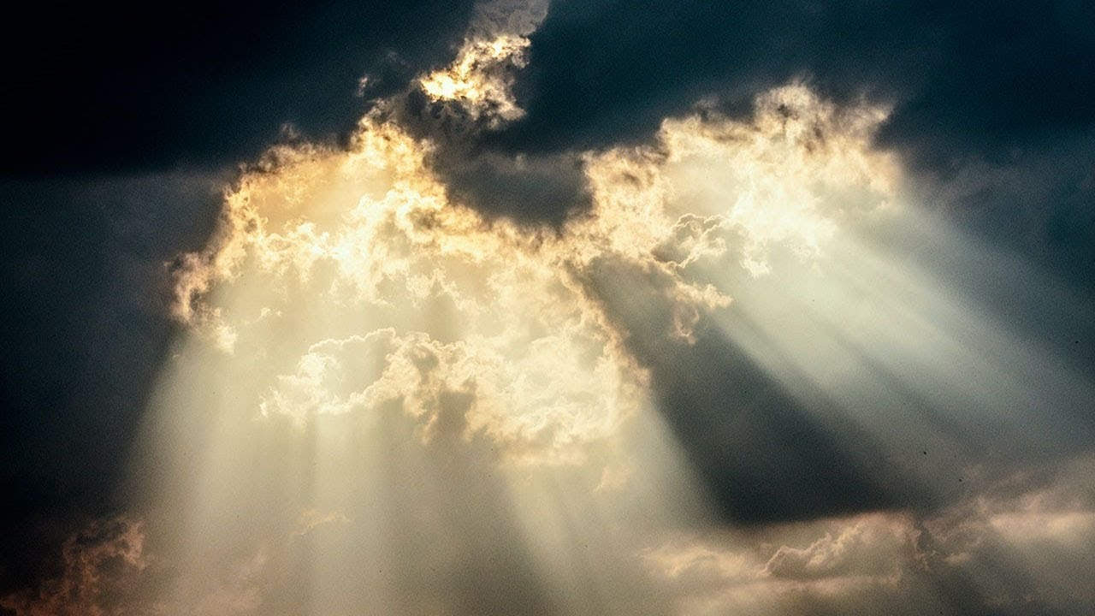
Yom Aliyah = Ascension Day

Slide 55
Should we be celebrating Aliyah / Ascension Day? I think the answer is a resounding "yes!" It’s a significant day and in some respects represents an event in the life of the Master that is at least as important as his death and resurrection.
Notes:
BY TOBY JANICKI
https://ffoz.org/discover/messianic-jewish-calendar/yom-haaliyah-the-celebration-of-ascension-day.html
Reese Howells? We speak of the executed atoning Messiah, the resurrected Messiah, but what about the ascended, reigning Messiah. We do Him a disservice and don’t recognized His Prominence, Power, Position of rulership!!

Slide 56
The Ascension symbolizes the kingdom when the Master ascends to the heavenly realms and takes up his throne at the right hand of the Father. It is at this point that the Master takes up all authority and everything is placed under his feet. This motif is found in Psalm 110
Notes:
https://ffoz.org/discover/messianic-jewish-calendar/yom-haaliyah-the-celebration-of-ascension-day.html

Slide 57
^{T’hillim/Ps 110.1-2} Adoni declares to my Lord: “Sit at My right hand until I make your enemies a footstool for Your feet.” Adoni will extend your mighty rod from Zion: “Rule in the midst of your enemies.”
Notes:
https://ffoz.org/discover/messianic-jewish-calendar/yom-haaliyah-the-celebration-of-ascension-day.html

Slide 58
Psalm 110 is the most frequently quoted text from the Hebrew Scriptures in the New Testament.
Matt. 22:44; Acts 2:34-35; 1 Cor. 15:25; Heb. 1:13.
Notes:
https://ffoz.org/discover/messianic-jewish-calendar/yom-haaliyah-the-celebration-of-ascension-day.html
FFOZ left out one of my favorite verses in all of the Scripture.

Slide 59
^{Col 3.1-4} So if you were raised along with the Messiah, then seek the things above, where the Messiah is sitting at the right hand of God. Focus your minds on the things above, not on things here on earth.

Slide 60
^{Col 3.1-4} For you have died, and your life is hidden with the Messiah in God. When the Messiah, who is our life, appears, then you too will appear with him in glory!
Notes:
Foundational to cong. leadership and organization.

Slide 61
^{Eph. 4.7-13} Each one of us, however, has been given grace to be measured by the Messiah’s bounty. This is why it says, “After he went up into the heights, he led captivity captive and he gave gifts to mankind.” Now this phrase, “he went up,” what can it mean if not that he first went down into the lower parts, that is, the earth?

Slide 62
^{Eph. 4.7-13} The one who went down is himself the one who also went up, far above all of heaven, in order to fill all things. Furthermore, he gave some people as emissaries, some as prophets, some as proclaimers of the Good News, and some as shepherds and teachers.

Slide 63
^{Eph. 4.7-13} Their task is to equip God’s people for the work of service that builds the body of the Messiah, until we all arrive at the unity implied by trusting and knowing the Son of God, at full manhood, at the standard of maturity set by the Messiah’s perfection.
Notes:
Back to the Acts narrative

Slide 64
^{Acts 1.4-7} At one of these gatherings, he instructed them not to leave Yerushalayim but to wait for “what the Father promised, which you heard about from me. For Yokhanan used to immerse people in water; but in a few days, you will be immersed in the Ruakh HaKodesh!”

Slide 65
^{Acts 1.4-7} When they were together, they asked him, “Lord, are you at this time going to restore self-rule to Isra’el?” He answered, “You don’t need to know the dates or the times; the Father has kept these under his own authority.
Notes:
NOYB for the nationalism, for now. NOT denied restoration of self rule, just no timetable there.

Slide 66
^{Acts 1.8-11} But you will receive power when the Ruakh ha-Kodesh has come upon you; and you will be My witnesses in Jerusalem, and through all Judah, and Samaria, and to the end of the earth.” After saying all this—while they were watching—He was taken up, and a cloud received Him out of their sight. Aliyah! = Ascension!
Notes:
Power to live, power to share. June 21 at the Plaza.
Yeshua started His ministry with call to be fishers of men, outreach. Last statement same thrust.
Message: Ruakh/Spirit empowered living, loving, serving, outreach.

Slide 67
^{Acts 1.8-11} While they were staring into heaven as He went up, suddenly two men stood with them in white clothing. They said, “Men of Galilee, why do you keep standing here staring into heaven? This Yeshua, who was taken up from you into heaven, will come in the same way as you saw Him go into heaven.”

Slide 68
^{Acts 1.12-15} Then they returned the Shabbat-walk distance from the Mount of Olives to Yerushalayim. After entering the city, they went to the upstairs room where they were staying... These all devoted themselves single-mindedly to prayer,
Notes:
Shabbat walk NOT in Tanakh/Old Testament anywhere. Rabbinic notion treated as scripture. As much as I reject the Rabbinic rejection of Yeshua and salvation, I have to love their general understanding.

Slide 69
^{Acts 1.12-15} along with some women, including Miryam (Yeshua’s mother), and his brothers. During this period, when the group of believers numbered about 120, Kefa stood up and addressed his fellow-believers.
Notes:
There is a prayer movement going on in synch with this. International, Jewish aware

Slide 71
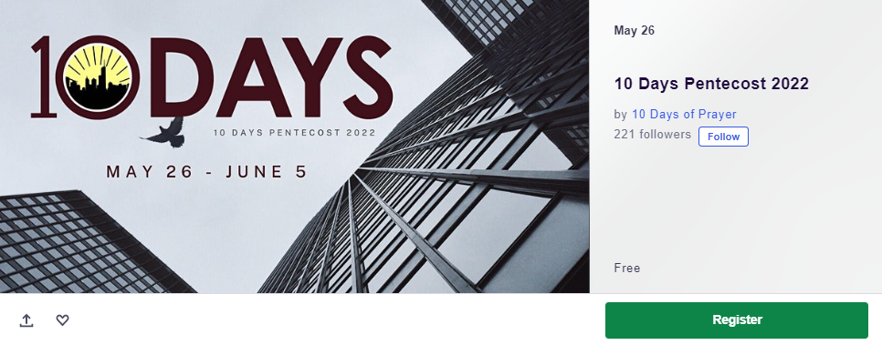
from Yom Aliyah to Shavuot
Notes:
TinyUrl.com/10DaysPentecost

Slide 72
TinyUrl.com/10DaysPentecost

Slide 73
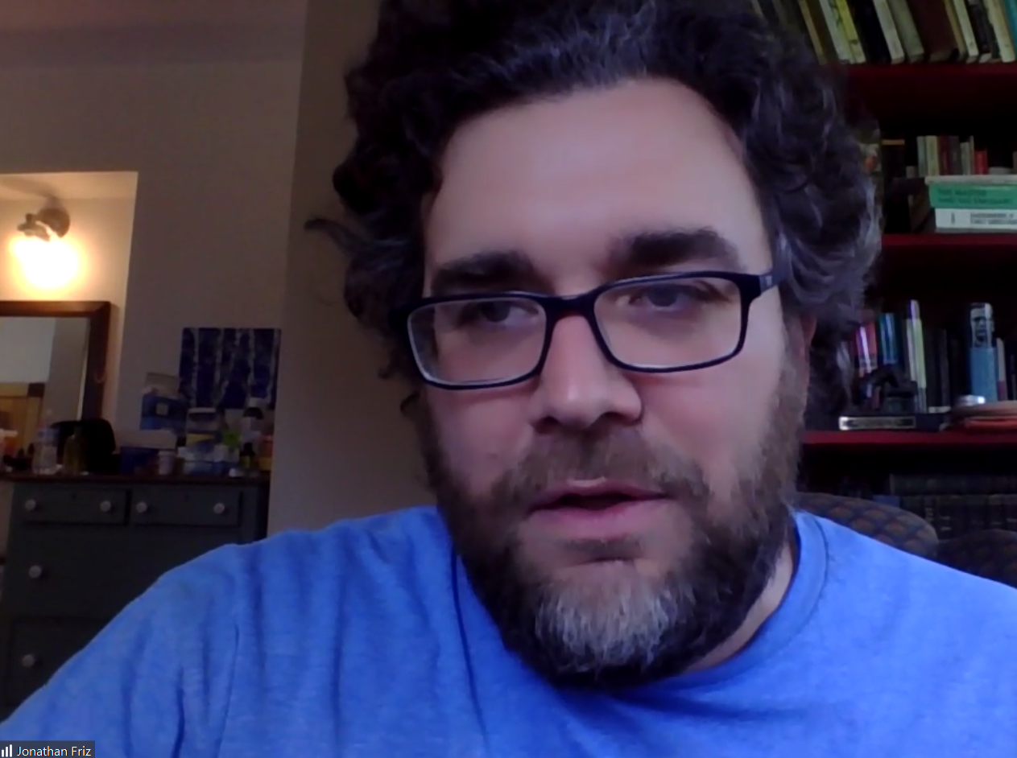
Jonathan Friz
Notes:
www.10Days.net Yn 17 “ekkelesia in the city” CityWide passion. City stopping ~ Covid. ~Ninevah, like Aliyah to Shavuot. 176 at 11.51 a.m. Thursday
~RH to YK Song of Songs bring me back to the apple tree where I was conceived. ~Jewish connection Jerusalem

Slide 74
Our teaching and prayer times are focused on the following Biblical topics:
Personal Repentance and Transformation
The Salvation of all Nations (The Harvest)
Supernatural Unity in the Body of Messiah (John 17)
Notes:
https://www.eventbrite.co.uk/e/10-days-pentecost-2022-tickets-305742743777
I personally attend City Wide Prayer meetings, joint prayer with KL, IHOPKC people

Slide 75
The Outpouring of the Holy Spirit (Revival)
The Salvation of the Jewish People
The Preparation of the Bride for the Lord's Return
The Lord's Return
Notes:
https://www.eventbrite.co.uk/e/10-days-pentecost-2022-tickets-305742743777

Slide 76
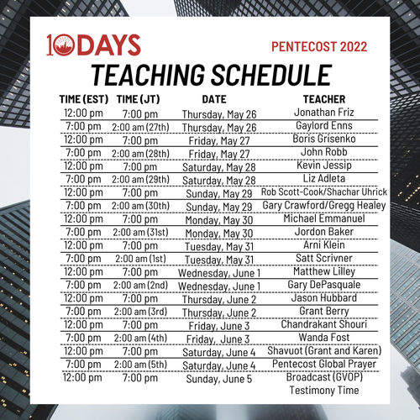

Slide 77
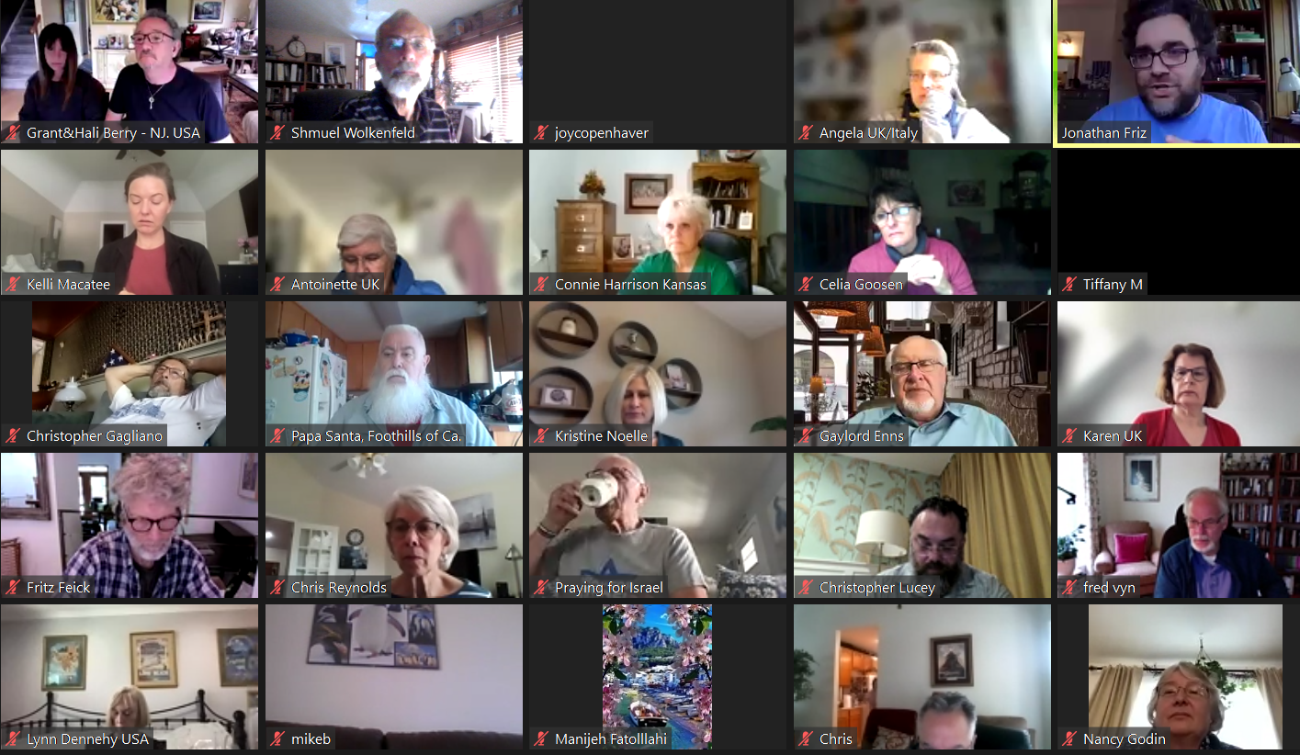
Notes:
www.10Days.net
176 at 11.51 a.m. Thursday Personally only know Grant and Hali Berry

Slide 78
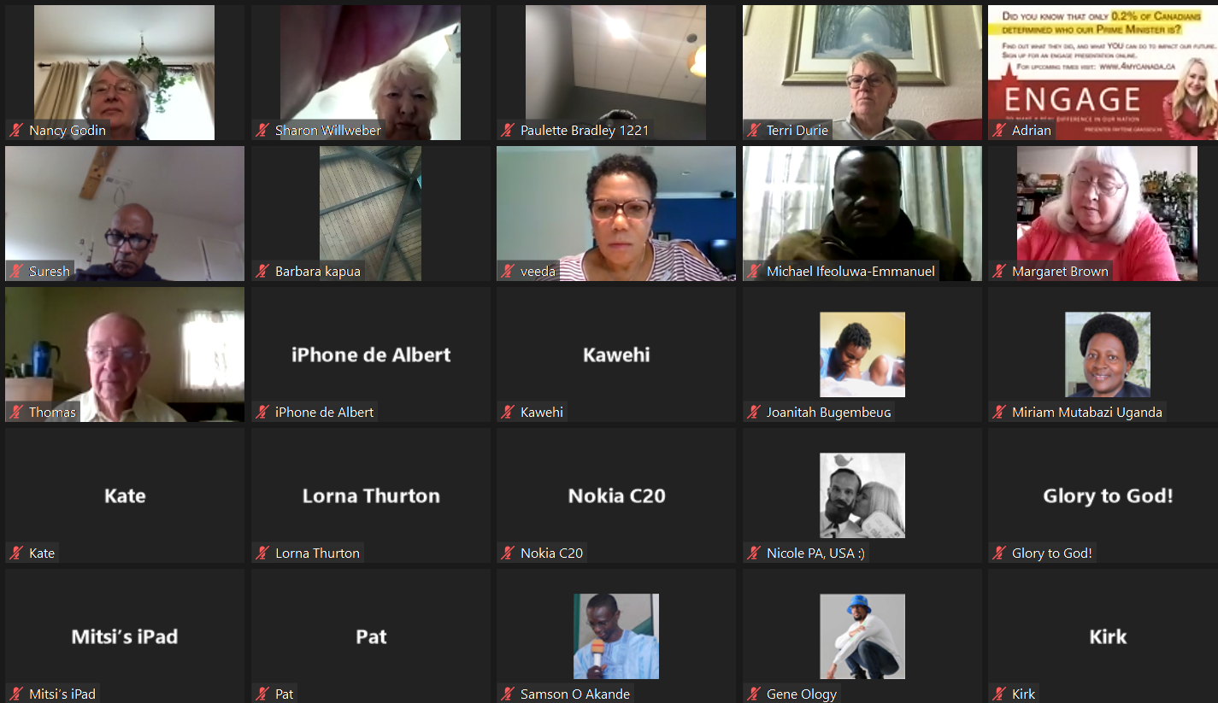
Notes:
www.10Days.net 171 participants 11.38 a.m. Thursday

Slide 82
During my message prep about the ominous time of the Omer count, the Sefira, ספירה, I felt a pretty strong impression to do an intercessory fast until the Shavuot Saturday evening service June 4. I also felt that I should call the community to do this as much as you feel led.

Slide 83
For information, go to
www.10Days.net
Notes:
Tinyurl.com/10DaysPentecost

Slide 84
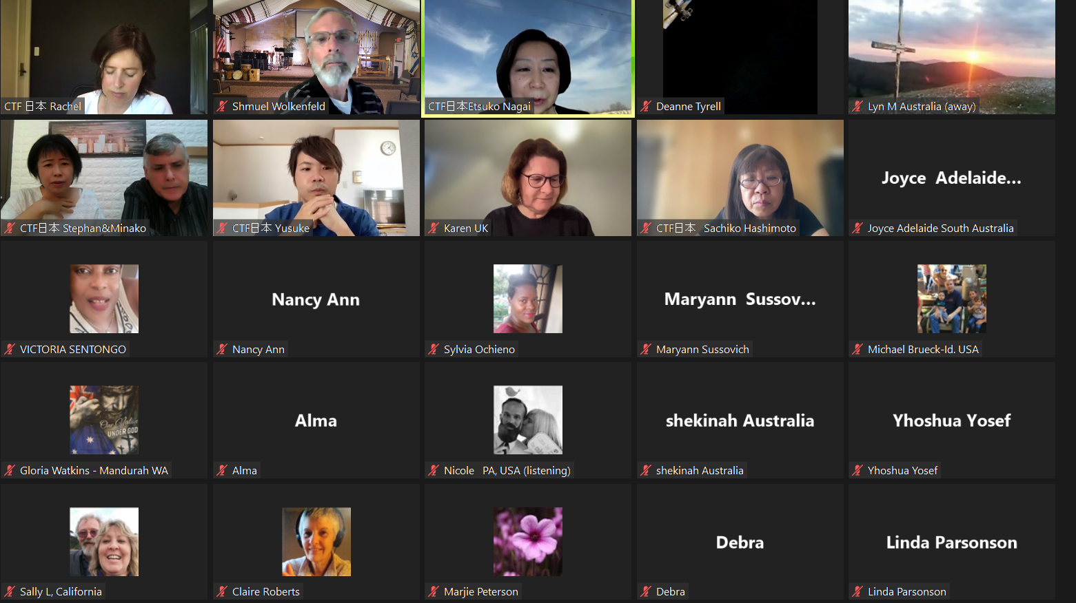
Notes:
11:25 p.m. Friday CST May 27 30 participants
20 participants this morning 8.53am

Slide 85
^{Lk.24.42-49} They gave Him a piece of broiled fish, and He took it and ate it in their presence. Then He said to them, “These are My words which I spoke to you while I was still with you—everything written concerning Me in the Torah of Moshe and the Prophets and the Psalms must be fulfilled. [Tanakh]

Slide 86
^{Lk.24.42-49} Then He opened their minds to understand the Scriptures, and He said to them, “So it is written, that the Messiah is to suffer and to rise from the dead on the third day, and that repentance for the removal of sins is to be proclaimed in His name to all nations, beginning from Jerusalem.

Slide 87
^{Lk.24.42-49} You are witnesses of these things. And behold, I am sending the promise of My Father upon you; but you are to stay in the city until you are clothed with power from on high.” He led them out toward Beit-Anyah;

Slide 88
^{Lk.24.42-49} then, raising his hands, he said a b’rakhah over them; and as he was blessing them, he withdrew from them and was carried up into heaven.

Slide 89
^{Acts 1.4-7} At one of these gatherings, he instructed them not to leave Yerushalayim but to wait for “what the Father promised, which you heard about from me. For Yokhanan used to immerse people in water; but in a few days, you will be immersed in the Ruakh HaKodesh!”

Slide 90
^{Acts 1.8-11} But you will receive power when the Ruakh ha-Kodesh has come upon you; and you will be My witnesses in Jerusalem, and through all Judah, and Samaria, and to the end of the earth.” After saying all this—while they were watching—He was taken up, and a cloud received Him out of their sight. Aliyah! = Ascension!

Slide 91
TinyUrl.com/10DaysPentecost

