Slide 1
e-handout
To have these notes
without taking notes
Go to OrHaOlam.com
Click on Messages tab,
2022 Messages
Notes:
You may notice that I’m slowing down in my rate of speech. This is because we may be getting language translation equipment for simultaneous translation.

Slide 2
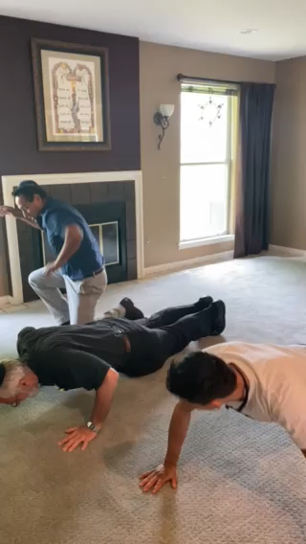
Notes:
A true story…

Slide 3
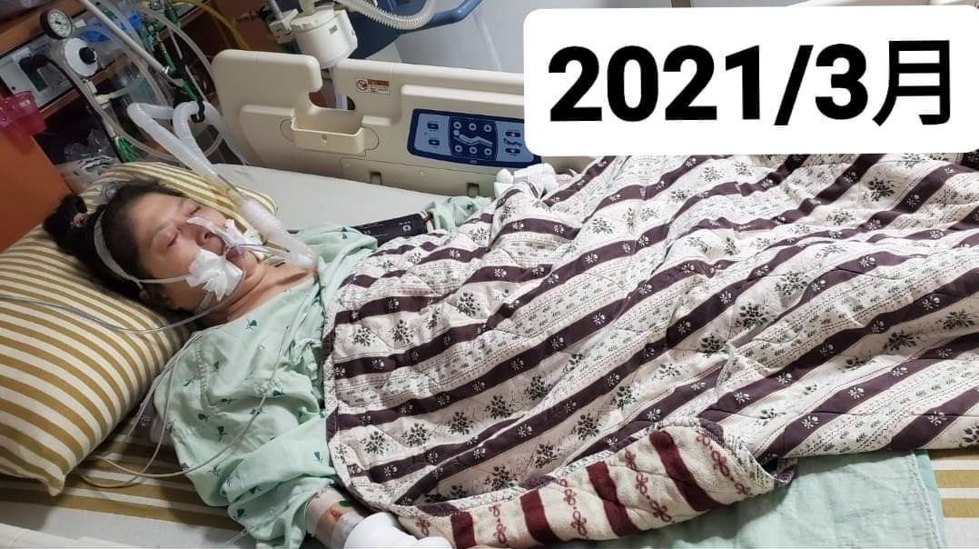
Jung-Hua Chen is intubated in the
hospital in March 2021. (Courtesy of Daniel)
Notes:
From the Epoch Times

Slide 4
Jung-Hua Chen was hospitalized with a fractured lumbar spine in 2020. She was bedridden for one year with artificial braces. In March 2021, a sudden breathlessness prompted an examination in the hospital. She had both heart and lung failure. She was soon transferred to the ICU and intubated for nearly 20 days.
Notes:
https://www.theepochtimes.com/from-icu-to-gym-66-year-old-reversed-disability-and-controlled-diabetes-in-1-year_4436016.html?utm_source=healthnoe&utm_campaign=health-2022-05-25&utm_medium=email&est=aWN%2BzAvC46P%2B27vKIKTAPGQ%2B6jsyRM0flmQLasQFgwhKAbICPnCDg6qG6rVrGNSS4w%3D%3D

Slide 5
During those difficult and long days, Chen was unable to speak due to intubation, so she could only lie on the hospital bed and look at the ceiling every day. On the notebook she communicated with her family, she wrote “I’m in so much pain” with wrists and fingers that were barely able to move.
Notes:
https://www.theepochtimes.com/from-icu-to-gym-66-year-old-reversed-disability-and-controlled-diabetes-in-1-year_4436016.html?utm_source=healthnoe&utm_campaign=health-2022-05-25&utm_medium=email&est=aWN%2BzAvC46P%2B27vKIKTAPGQ%2B6jsyRM0flmQLasQFgwhKAbICPnCDg6qG6rVrGNSS4w%3D%3D

Slide 6
Her son Daniel recalled that the doctor told him that if her lung failure and lung infection have not improved; they would probably have to prepare for a funeral.
Notes:
https://www.theepochtimes.com/from-icu-to-gym-66-year-old-reversed-disability-and-controlled-diabetes-in-1-year_4436016.html?utm_source=healthnoe&utm_campaign=health-2022-05-25&utm_medium=email&est=aWN%2BzAvC46P%2B27vKIKTAPGQ%2B6jsyRM0flmQLasQFgwhKAbICPnCDg6qG6rVrGNSS4w%3D%3D

Slide 7
After hearing the news, as Christians, they began to pray for their mother. Chen also kept praying, asking the Lord Yeshua to heal her disease. So when doctors announced that her lung infection had improved and she could be transferred to a general ward, she believed that God had helped her.
Notes:
https://www.theepochtimes.com/from-icu-to-gym-66-year-old-reversed-disability-and-controlled-diabetes-in-1-year_4436016.html?utm_source=healthnoe&utm_campaign=health-2022-05-25&utm_medium=email&est=aWN%2BzAvC46P%2B27vKIKTAPGQ%2B6jsyRM0flmQLasQFgwhKAbICPnCDg6qG6rVrGNSS4w%3D%3D

Slide 8
“I’ve been a physical trainer for so many years, but I couldn’t help her,” Daniel said. When his mother was moved to the general ward, “I cried begging her to let me help her, and don’t let us have any regrets. She finally nodded.”
Notes:
https://www.theepochtimes.com/from-icu-to-gym-66-year-old-reversed-disability-and-controlled-diabetes-in-1-year_4436016.html?utm_source=healthnoe&utm_campaign=health-2022-05-25&utm_medium=email&est=aWN%2BzAvC46P%2B27vKIKTAPGQ%2B6jsyRM0flmQLasQFgwhKAbICPnCDg6qG6rVrGNSS4w%3D%3D

Slide 9
So, he brought elastic bands, dumbbells, and other equipment to the ward to train his mother and help her recover her physical strength and muscle strength.
again.”
Notes:
https://www.theepochtimes.com/from-icu-to-gym-66-year-old-reversed-disability-and-controlled-diabetes-in-1-year_4436016.html?utm_source=healthnoe&utm_campaign=health-2022-05-25&utm_medium=email&est=aWN%2BzAvC46P%2B27vKIKTAPGQ%2B6jsyRM0flmQLasQFgwhKAbICPnCDg6qG6rVrGNSS4w%3D%3D

Slide 10
They mother and son started with once or twice weekly sessions. In a few weeks, her physical strength had improved, and the doctor said she could go home. As they walked out of the hospital, both Chan and her son turned around and said to the hospital, “Will never come back again.”
Notes:
https://www.theepochtimes.com/from-icu-to-gym-66-year-old-reversed-disability-and-controlled-diabetes-in-1-year_4436016.html?utm_source=healthnoe&utm_campaign=health-2022-05-25&utm_medium=email&est=aWN%2BzAvC46P%2B27vKIKTAPGQ%2B6jsyRM0flmQLasQFgwhKAbICPnCDg6qG6rVrGNSS4w%3D%3D

Slide 11
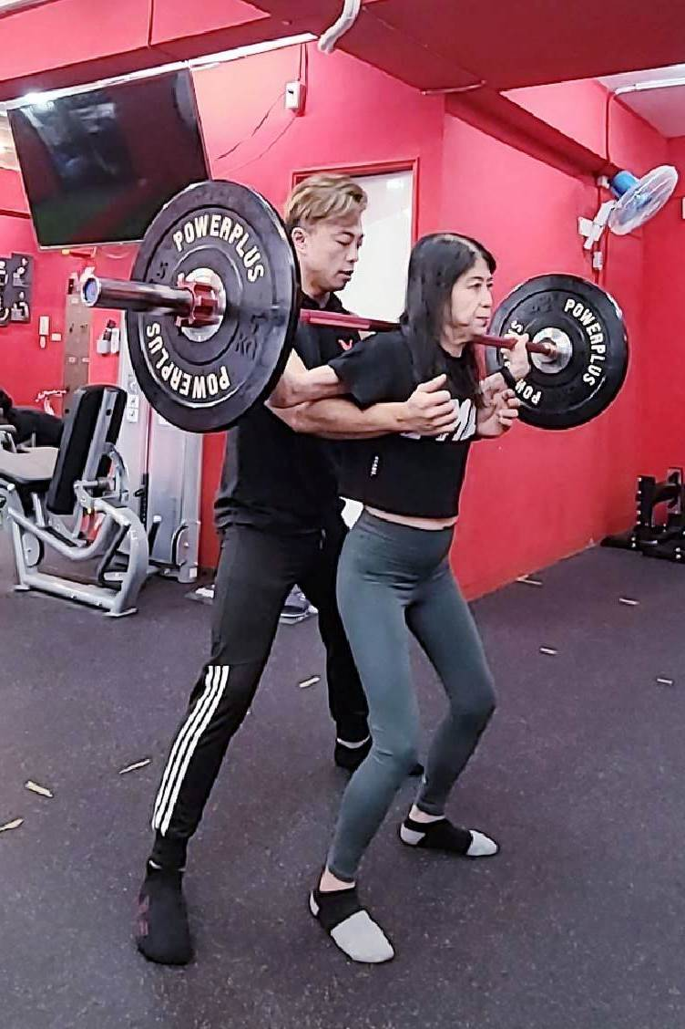
Jung-Hua Chen exercises in the gym with the help of her son, also the fitness coach, Daniel. (Courtesy of Daniel, founder of FMC Fitness Space)

Slide 12

Notes:
Jung-Hua Chen exercises in the gym with the help of her son and fitness coach, Daniel.

Slide 13
^{1 Tim.4.8} For physical exercise has some benefit; but godliness is beneficial for all things, holding promise for both the present life and the one to come.
Oligos ὀλίγος : few, little, small
Notes:
We have been counting the Omer to Shavuot. Some participated in the 10 days Pentecost 24/7 Prayer room.
I am convicted that when I get up in the morning, before I get into my daily responsibilities, I have to do pushups, bridges, planks, pulse ups, etc., then read two chapters Tanakh two chapters Mes Scriptures, then prayer list.
As I do exercise, pray this will count to my joy in Yeshua, mental acuity, immune system, abs.

Slide 14
Yeshua said,
^{Mt. 24.21} There will be great trouble, such as has not happened since the beginning of the world until now, nor ever will.
Notes:
Physical fitness, spiritual fitness.
Central to spiritual fitness…

Slide 15
Acts 2.4
Filled with the Ruakh ha-Kodesh,
the Holy Spirit

Slide 16


Slide 17
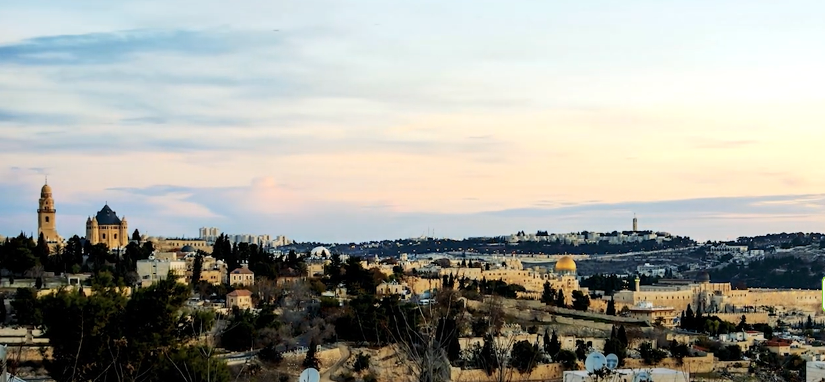

Notes:
https://youtu.be/UfMGV9v3b5M

Slide 18

Notes:
https://external-content.duckduckgo.com/iu/?u=https%3A%2F%2Fholidays-today.com%2Fholidays%2Fwp-content%2Fuploads%2F2019%2F02%2F41-1920x1080.jpg&f=1&nofb=1

Slide 19

Yom Aliyah = Ascension Day

Slide 20
^{T’hillim/Ps 110.1-2} Adoni declares to my Lord: “Sit at My right hand until I make your enemies a footstool for Your feet.” Adoni will extend your mighty rod from Zion: “Rule in the midst of your enemies.”
Notes:
https://ffoz.org/discover/messianic-jewish-calendar/yom-haaliyah-the-celebration-of-ascension-day.html

Slide 21
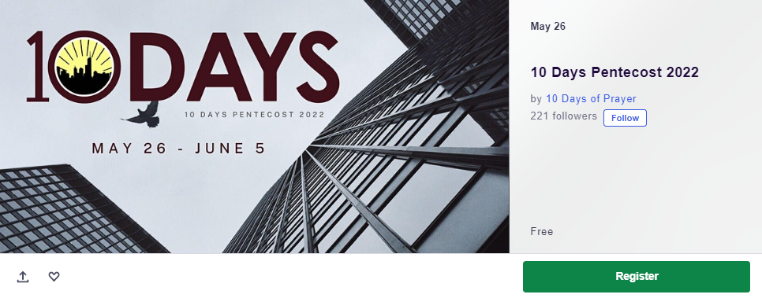
TinyUrl.com/10DaysPentecost
Notes:
Some have been fasting and praying these 10 days with me.

Slide 22
^{Acts 1.12-14} Then they returned the Shabbat-walk distance from the Mount of Olives to Yerushalayim. After entering the city, they went to the upstairs room where they were staying…

Slide 23
^{Acts 1.12-14} These all devoted themselves single-mindedly to prayer, along with some women, including Miryam (Yeshua’s mother), and his brothers.
Notes:
Counting the wheat omer, thinking also of the giving of the Torah

Slide 24
^{Acts 2.1-4} The festival of Shavu‘ot arrived, and the believers all gathered together in one place. Suddenly there came a sound from the sky like the roar of a violent wind, and it filled the whole house where they were sitting.
Notes:
Wheat harvest, giving of the Torah, and now, the giving of the Ruakh/Spirit

Slide 25
^{Acts 2.1-4} Then they saw what looked like tongues of fire, which separated and came to rest on each one of them. They were all filled with the Ruakh HaKodesh /Holy Spirit and began to talk in different languages, as the Spirit enabled them to speak.
Notes:
Reminiscent of the fire of Mt. Sinai.

Slide 26
Filled with the Ruakh/Spirit
What does that mean?
How did they get it? How do we get it?
Notes:
Kefa/ Peter’s explanation and teaching at the event…

Slide 27
^{Acts 2.14-21} Kefa / Peter stood up with the Eleven and raised his voice to address them…this is what was spoken about through the prophet Yo’el 3:1–5:
‘Adoni says: “In the Last Days, I will pour out from my Spirit upon ₁everyone.
Notes:
Universally available

Slide 28
Acts 2.14-21 quoting Yo’el 3:1–5 Your sons and daughters will prophesy₂, your young men will see visions₃, your old men will dream dreams₄. Even on my slaves, both men and women₅, will I pour out from my Spirit in those days; and they will prophesy.
Notes:
Ministry gifting.
Spiritual insight, supernaturally, understanding scripture, transformation.
Old men: Big picture
All inclusive, even servant class, no gender discrimination

Slide 29
Acts 2.14-21 quoting Yo’el 3:1–5 I will perform miracles in the sky above and signs on the earth below —blood, fire and thick smoke. The sun will become dark and the moon blood before the great and fearful Day of Adoni comes₆. And then, whoever calls on the name of Adoni will be saved.₇”’
Notes:
Supernatural calamity
Salvations

Slide 31
7 Points Kefa / Peter’s message
Universal outpouring
Gifts given, prophecy, etc.
Transforming vision youth
Old men dream dreams
No gender, class discrimination.
Natural calamities
Salvations of Jews and the Nations

Slide 32
7 Points Kefa / Peter’s message
Universal outpouring
Gifts given, prophecy, etc.
Transforming vision youth
Old men dream dreams
No gender, class discrimination.
Natural calamities
Salvations of Jews and the Nations

Slide 33
Universally available: in Tanakic times [Old Testament] the Spirit was given only to specially called people in [before Yeshua]. Moshe, elders of Israel, Shaul/Saul, David
Notes:
Some will teach that the religion in the Tanakh was dry, sterile, obedience. Not so. The Ruakh was given, but just to key individuals.

Slide 34
^{Bamidbar/Nu 25.11} Adoni descended in the cloud and spoke with him [Moshe]. He took some of the Ruakh / Spirit that was on him and placed it on each of the 70 elders. It so happened that when the Ruakh first rested on them, they prophesied—but never again.

Slide 35
^{1 Shmuel 10.1-7} Then Sh’mu’el /Samuel took a flask of oil he had prepared and poured it on Sha’ul’s head. He kissed him and said, “Adoni has anointed you to be prince over his inheritance…You will come to Giv‘ah [hill] of God…You will meet a group of prophets

Slide 36
^{1 Shmuel 10.1-7} coming down from the high place, preceded by lutes, tambourines, flutes and lyres; and they will be prophesying. Then the Spirit of Adoni will fall on you; you will prophesy with them and be turned into another man!

Slide 37
^{1 Shmuel 10.10} As it happened, as soon as he had turned his back to leave Sh’mu’el, God gave him another heart; and all those signs took place that day. When they arrived at the hill, and there in front of him was a group of prophets, the Spirit of God fell on him and he prophesied along with them.

Slide 38
^{1 Shmuel 16.18} One of the young men answered and said, “I have seen a son of Jesse the Beth-lehemite who is skillful in playing music. He is a mighty man of valor, a warrior, prudent in speech, a handsome man, and Adoni is with him.”

Slide 39
^{T’hillim/Ps 51.12-13} Create in me a clean heart, O God, and renew a steadfast spirit within me. Do not cast me from Your presence— take not Your Ruakh ha-Kodesh from me.

Slide 41
7 Points Kefa / Peter’s message
Universal outpouring
Gifts given, prophecy, etc.
Transforming vision youth
Old men dream dreams
No gender, class discrimination.
Natural calamities
Salvations of Jews and the Nations

Slide 42
Your sons and daughters will prophesy₂
  That is, given spiritual abilities. ^{Cor. 12.7} To each person is given the manifestation of the Ruakh for the benefit of all. [nine gifts on this list]

Slide 43
^{1 Cor. 12.8-11} a word of wisdom, a word of knowledge according to the same Ruakh, faith, gifts of healings, workings of miracles, prophecy, discerning of spirits, different kinds of tongues,

Slide 44
^{1 Cor. 12.8-11} the interpretation of tongues. But one and the same Ruakh activates all these things, distributing to each person individually as He wills.
Notes:
Tongues, languages, are a gift. To my understanding, NOT the evidence of the filling of the Ruakh.
Some cases a known language.
Some cases an empowering in prayer. Prayer language.

Slide 45
^{Ro.12.6-8} We have gifts that differ according to the grace that was given to us—prophecy, service, teaching, exhortation, the one who gives, the one who leads, the one who shows mercy.

Slide 47
7 Points Kefa / Peter’s message
Universal outpouring
Gifts given, prophecy, etc.
Transforming vision youth
Old men dream dreams
No gender, class discrimination.
Natural calamities
Salvations of Jews and the Nations

Slide 48
Your young men will see visions₃
    Transformative insight, scripture or dirct.
    Yeshayahu/Isaiah saw the holiness → woe is me.

Slide 49
^{Acts 15.7-9} “Brothers, you know that in the early days God chose from among you, that by my mouth the Gentiles should hear the message of the Good News and believe. And God, who knows the heart, testified to them by giving them the Ruakh ha-Kodesh

Slide 50
^{Acts 15.7-9} just as He also did for us. He made no distinction between us and them, purifying their hearts through faith [cleansed their heart by trust.]
The filling of the Spirit is cleansing vision.

Slide 51
One overview of Spirit life:
The followers of Yeshua experienced being born of the Spirit when He was alive. Names written in heaven. ^{Lk10.20} Rejoice that your names have been written in the heavens.
Notes:
Yeshua Yn 3 to Nicodemus.

Slide 52
They had a visionary, cleansing, empowering experience at the Shavuot filling of the Spirit.
Romans outline
  Ch 3-5 about justification
  Ch 6-8 about in-filling
Notes:
Two major steps in the life of a believer. Many incremental steps.

Slide 53
^{1 Thes 5.23-24} Now may the God of shalom Himself make you completely holy; and may your whole spirit and soul and body be kept complete, blameless at the coming of our Lord Yeshua the Messiah. Faithful is the One who calls you—and He will make it happen!
Notes:
Holiness comes in a moment and in a lifelong process. My main heritage from 25 years in the Holiness segment of the body of Messiah: Nazarenes, Wesleyans, Pilgrims.

Slide 54
7 Points Kefa / Peter’s message
Universal outpouring
Gifts given, prophecy, etc.
Transforming vision youth
Old men dream dreams
No gender, class discrimination.
Natural calamities
Salvations of Jews and the Nations

Slide 55
Your old men will dream dreams₄
    Old men have the big picture

Slide 56
^{Ezra 3.10-12} When the builders laid the foundation of the temple of Adoni, the cohanim in their robes, with trumpets, and the L’vi’im the sons of Asaf, with cymbals, took their places to praise Adoni, as David king of Isra’el had instructed. They sang antiphonally, praising and giving

Slide 57
^{Ezra 3.10-12} “thanks to Adoni, for he is good, for his grace continues forever” toward Isra’el. All the people raised a great shout of praise to Adoni, because the foundation of the house of Adoni had been laid.

Slide 58
^{Ezra 3.10-12} But many of the cohanim, L’vi’im and heads of fathers’ clans, the old men who had seen the first house standing on its foundation, wept out loud when they saw this house; while others shouted out loud for joy.
Notes:
Older brains not as quick, but have more connections neurally. Wisdom, hopefully. Experience.

Slide 60
7 Points Kefa / Peter’s message
Universal outpouring
Gifts given, prophecy, etc.
Transforming vision youth
Old men dream dreams
No gender, class discrimination.
Natural calamities
Salvations of Jews and the Nations

Slide 61
Even on my slaves, both men and women₅, will I pour out from my Spirit in those days; and they will prophesy.
      No gender or economic class discrimination in the Filling.

Slide 62
^{Gal. 3.27-28} For all of you who were immersed in Messiah have clothed yourselves with Messiah. There is neither Jew nor Greek, there is neither slave nor free, there is neither male nor female—for you are all one in Messiah Yeshua.
Notes:
Some use this verse to cite the end of the Jewish covenants. NOT so. All Spirit filled alike, pray alike, praise alike, serve alike. But differences between male and female persist! So do coveanantal differences Jew and Gentile.

Slide 64
7 Points Kefa / Peter’s message
Universal outpouring
Gifts given, prophecy, etc.
Transforming vision youth
Old men dream dreams
No gender, class discrimination.
Natural calamities
Salvations of Jews and the Nations

Slide 65
I will perform miracles in the sky above and signs on the earth below —blood, fire and thick smoke. The sun will become dark and the moon blood before the great and fearful Day of Adoni comes₆
Notes:
This is the sovereign work of G-d. Not subject to ministry.

Slide 67
7 Points Kefa / Peter’s message
Universal outpouring
Gifts given, prophecy, etc.
Transforming vision youth
Old men dream dreams
No gender, class discrimination.
Natural calamities
Salvations of Jews and the Nations

Slide 68
And then, whoever calls on the name of Adoni will be saved.₇”’
      Spirit filled believers have an increased passion to see salvations.
      Kefa/Peter continues preaching, concludes…

Slide 69
^{Acts 2.36} Therefore, let the whole house of Isra’el know beyond doubt that God has made him both Lord and Messiah — this Yeshua, whom you executed on a stake!”

Slide 70
^{Acts 2.37-39} On hearing this, they were stung in their hearts; and they said to Kefa and the other emissaries, “Brothers, what should we do?” Kefa answered them, “Turn, repent from sin, return to God, and each of you be immersed

Slide 71
^{Acts 2.37-39} on the authority of Yeshua the Messiah into forgiveness of your sins, and you will receive the gift of the Ruakh HaKodesh! For the promise is for you, for your children, and for those far away — as many as Adoni our God may call!”

Slide 72
^{Acts 2.41} So those who received his message were immersed, and that day about three thousand souls were added.

Slide 73
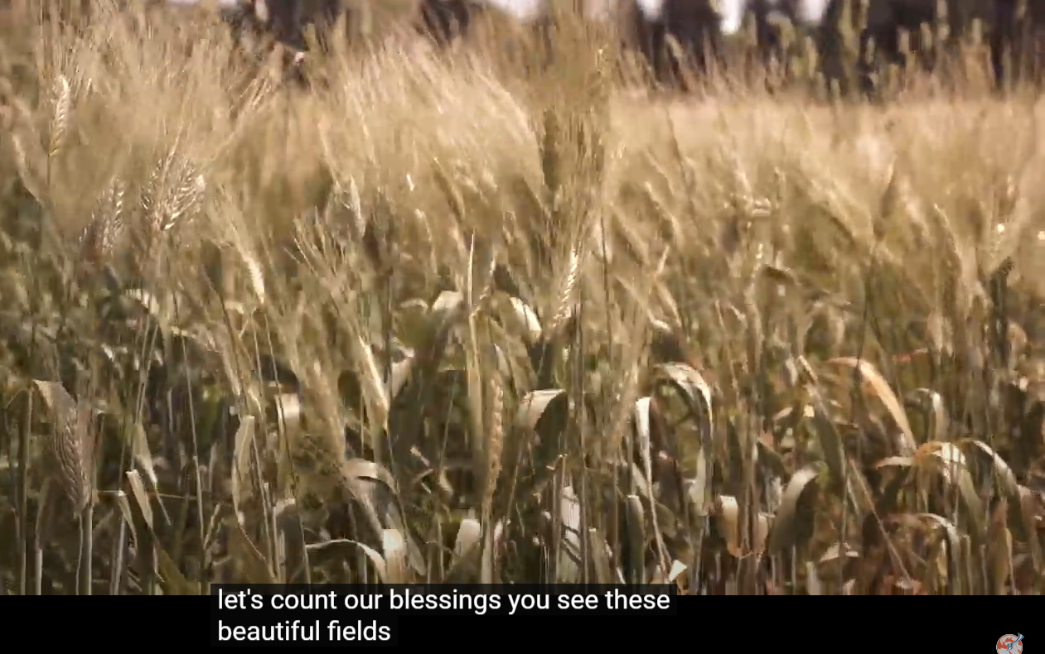
Notes:
https://www.beithallel-israel.org/video/the-promise-behind-shavuot-and-the-power-behind-pentecost/

Slide 74

Don’t you have a saying, ‘Four more
months and then the harvest’? Well,
what I say to you is: open your eyes and look at the fields! They’re already ripe for harvest!
Notes:
Every department of Or HaOlam is a department of outreach, evangelism
https://www.beithallel-israel.org/video/the-promise-behind-shavuot-and-the-power-behind-pentecost/

Slide 75
Every study over the last 30 years has found this to be true… Word of mouth and a personal invitation is the most common reason for people to visit a congregation. Even in this digital world where social media is all the rage, a personal invitation is the most effective way to invite someone to service.

Slide 76
^{Lk.15.7} I tell you that in the same way, there will be more joy in heaven over one sinner who turns to God from his sins than over ninety-nine righteous people who have no need to repent.
Notes:
We all, always, have some need to repent. But this is in contrast to people far from G-d.

Slide 77
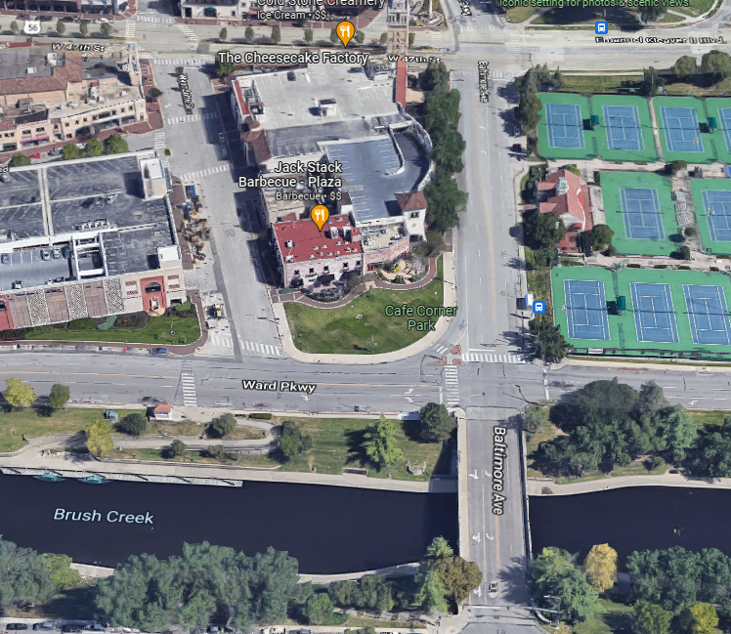
Next outreach:
KC Music Festival
Tues., June 21, 5.30-8.30p

Slide 78
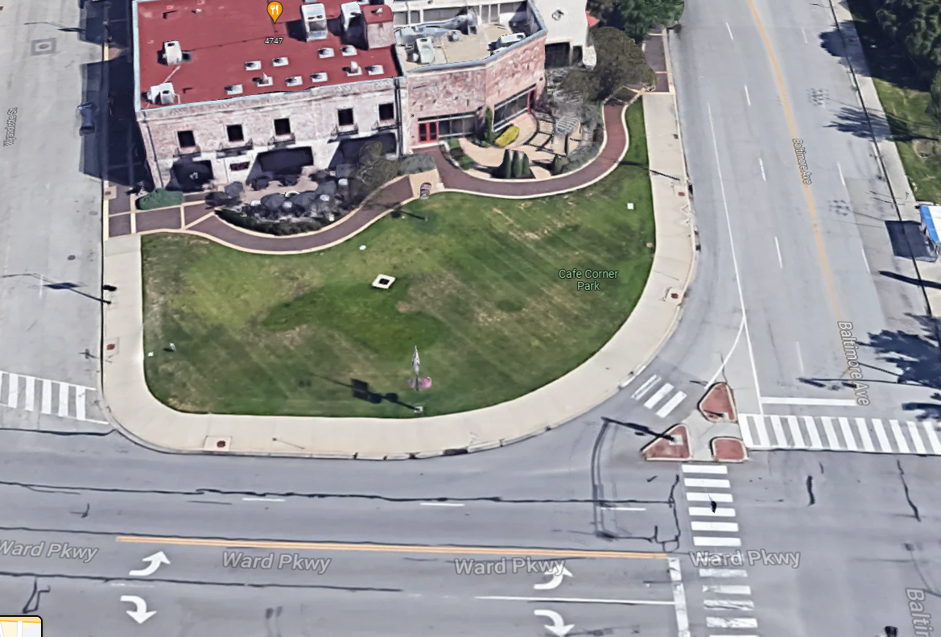
Jack Stack BBQ
Café Corner

Slide 79
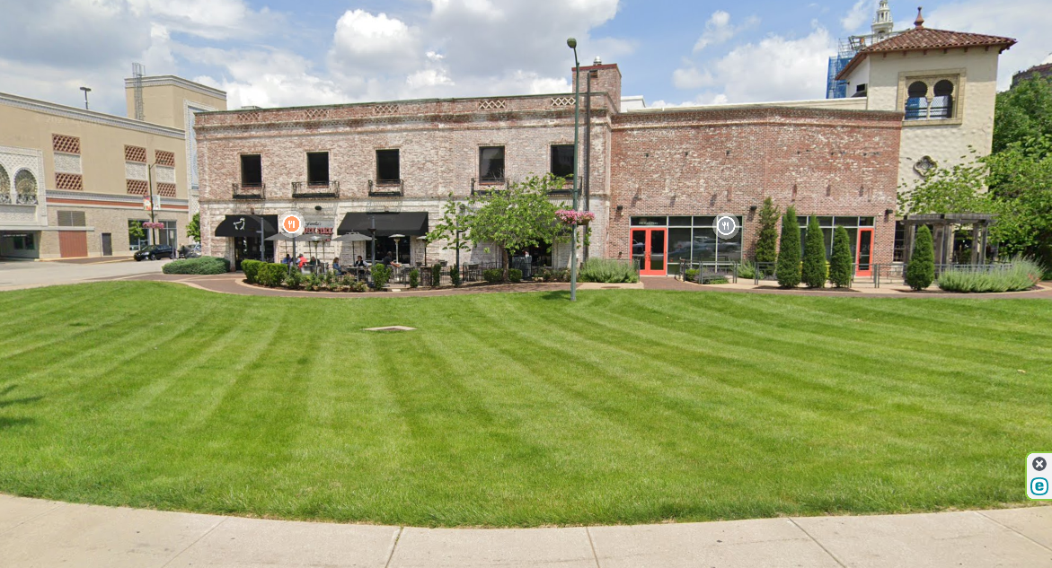
Jack Stack BBQ
Notes:
Volunteer: see Lori.
Get your sons and daughters involved. Need teens!

Slide 80
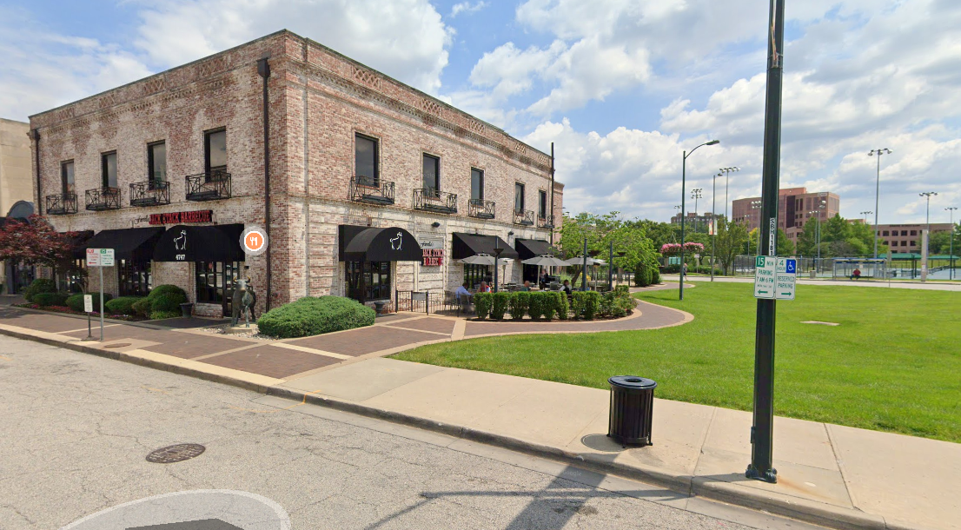
Jack Stack BBQ

Slide 82
7 Points Kefa / Peter’s message
Universal outpouring
Gifts given, prophecy, etc.
Transforming vision youth
Old men dream dreams
No gender, class discrimination.
Natural calamities
Salvations of Jews and the Nations

Slide 83
How do we receive the in-filling?

Slide 84
^{Acts 1.12-14} These all devoted themselves single-mindedly to prayer!

Slide 85
^{Yermiyahu/Jer 33.2-3} “Thus says Adoni the maker, Adoni who formed [the universe] so as to keep directing it — Adoni is his name: ‘Call out to me, and I will answer you — I will tell you great things, hidden things of which you are unaware.’”

Slide 86
Do you KNOW Yeshua and the assurance of sins forgiven?
Are you hearing daily from His Word?
How are you applying what you heard?
Are you seeking the filling of the Spirit?
Notes:
Who are you discipling, building up?4

Slide 88


