Slide 1
e-handout
To have these notes
without taking notes
Go to OrHaOlam.com
Click on Messages tab,
2023 Messages

Slide 2
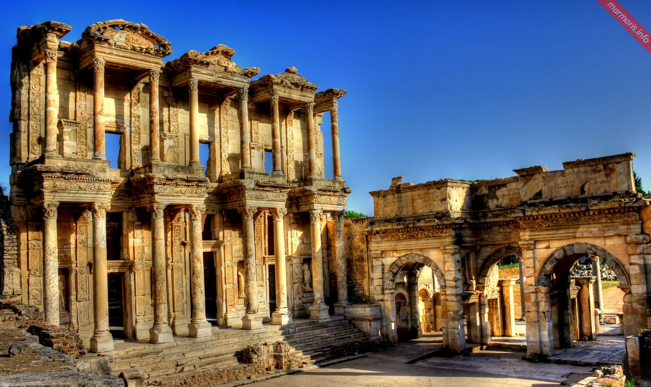
Book of Ephesians study
Book of Ephesians
Notes:
https://marmaris.info/wp-content/uploads/2014/11/ephesus-4.jpg

Slide 3
Review Ephesians ch 1
Vss 1-6 He chose us in love
Vss 7-10 His secret plan
Vss 11-12 Inheritance of Love
Vss 13-14 Really Hearing Shma!
Vss 15-23 Power Working in Us The person next to you is your $10 million treasure!!
Notes:
Third bullet: ~$10 million inheritance

Slide 4
Eph. 2.1-3 Spiritually Deceased, Dead, Inanimate
We were dead
We were ruled by ha-satan
Includes Jewish people
Repentance of believers
Bringing life to the dead

Slide 5
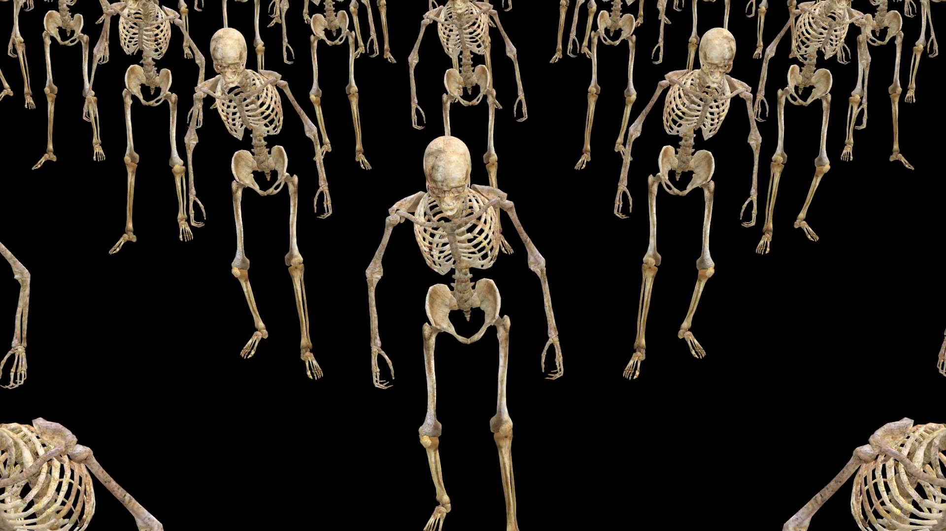
Notes:
https://external-content.duckduckgo.com/iu/?u=https%3A%2F%2Fdm0qx8t0i9gc9.cloudfront.net%2Fthumbnails%2Fvideo%2FCWsBQHy%2Fvideoblocks-a-crowd-of-skeletons-are-walking_scmdoaimz_thumbnail-1080_01.png&f=1&nofb=1&ipt=e06524f2c6bdf93d6ba4c182f8d4a41ea1e9e4fca95f164ae73a332b876ab293&ipo=images

Slide 6
^{Eph. 2.4-10} But God is so rich in mercy and loves us with such intense love that, even when we were dead because of our acts of disobedience, he brought us to life along with the Messiah — it is by grace that you have been delivered. That is, God raised us up with the Messiah Yeshua and seated us with him in heaven,

Slide 7
^{Eph. 2.4-10} in order to exhibit in the ages to come how infinitely rich is his grace, how great is his kindness toward us who are united with the Messiah Yeshua. For you have been delivered by grace through trusting, and even this is not your accomplishment but God’s gift.

Slide 8
^{Eph. 2.4-10} You were not delivered by your own actions; therefore no one should boast. For we are of God’s making, created in union with the Messiah Yeshua for a life of good actions already prepared by God for us to do.

Slide 9
Eph. 2.4 Intense Love
Eph. 2.5 Made us alive, Alive with the Messiah
Eph. 2.6 Raised us up--seated with Him
Eph. 2.7 Ages to come showpiece

Slide 10
Eph. 2.4 Intense Love
Eph. 2.5 Made us alive, Alive with the Messiah
Eph. 2.6 Raised us up--seated with Him
Eph. 2.7 Ages to come showpiece

Slide 11
^{Eph. 2.4-10} But God is so rich in mercy and loves us with such intense love
Notes:
Two strong phrases

Slide 12
rich in mercy. וְרַב⁠־חָֽסֶד׃ rav khesed
More than mercy, but loyalty to covenant obligations, even when Israel is not loyal to Him.
Sometimes translated “rich in grace”
Grace is receiving undeserved blessings
Mercy is withholding of deserved punishment
Notes:
According to Amy Jill Levine Vanderbilt U.
Marriages are built on: covenant love
Say Rav khesed

Slide 13
^{Shmot /Ex 34.6} Adoni is God, merciful and compassionate, slow to anger, rich in grace and truth;
רַח֣וּם וְחַנּ֣וּן יְי אֶ֖רֶךְ אַפַּ֣יִם וְרַב⁠־חָֽסֶד׃
rav khesed
Notes:
Right after sin of golden calf
For G-d so loved the world…

Slide 14
רַח֣וּם וְחַנּ֣וּן יְי אֶ֖רֶךְ אַפַּ֣יִם וְרַב⁠־חָֽסֶד׃
rav khesed
^{T’hillim 103.8} Adoni is merciful and compassionate, slow to anger and rich in grace.
^{Bamidbar/Nu 14.18} ‘Adoni is slow to anger, rich in grace.
Notes:
After report of the 12 spies, and rebellion. G-d about to destroy the people.

Slide 15
^{Yoel 2.13} Tear your heart, not your garments; and turn to Adoni your God. For he is merciful and compassionate, slow to anger, rich in grace. וְרַב⁠־חָֽסֶד׃ rav khesed
Notes:
Invasion of locusts

Slide 16
^{Yonah 4.2} That’s what I anticipated, fleeing to Tarshish—for I knew that you are a gracious and compassionate God, slow to anger and full of kindness.
רַב⁠־חָֽסֶד׃ rav khesed

Slide 17
^{Nekh 9.17} But because you are a God of forgiveness, merciful, full of compassion, slow to grow angry and full of grace, you did not abandon them.
רַב⁠־חָֽסֶד׃ rav khesed
Notes:
Great and repeated them. Trademark of the G-d of the Bible.

Slide 18
^{Eph. 2.4-10} But God is so rich in mercy and loves us with such intense love
Notes:
Two strong phrases

Slide 19
Intense love
Preempts our coming to Him ^{1 Yn 4.19} We love, because He first loved us.
Intense, covenant love opposite ancient religions: Epic of Gilgamesh—humanity is destroy because it has become a nuisance to the gods who cannot sleep.
Notes:
You will never be a nuisance to G-d in Messiah.
He always has time for you, Shilo ben Hod song. All the Solu men are in uniform now.

Slide 20
Covenantal love is also in great contrast to the heartbeat, passion of Islam, which is the ultimate source of the Oct. 7 War.
[Lengthy illustration following]

Slide 21
Muhammad ascribed many names to Allah and these names reveal Allah’s character. As examples there are Al Muntaqim - The Avenger, Ar-Raoof - The Compassionate, and Ar-Razzaq - The Provider. You can search through Allah’s 99 names and you’ll find many characteristics that a good father should have.
Notes:
https://www.answering-islam.org/Silas/no_father.htm

Slide 22
But one name is missing that is one of the most wonderful of God’s names, and that is "Father".
Why is this name missing? Why isn’t Islam’s god a loving father like Judaism’s and Christianity’s? Why the gaping hole in Muhammad’s spirituality?
Notes:
https://www.answering-islam.org/Silas/no_father.htm

Slide 23
After all, Muhammad believed in the validity of Judaism and Christianity, their teachings and their books, but his Quran and theology conspicuously lack a God who is a loving Father. Why couldn’t the spiritual power that drove Muhammad give him the tender love that the God of the Bible gave His people?
Notes:
https://www.answering-islam.org/Silas/no_father.htm

Slide 24
Because the spiritual being that Muhammad believed to be God was unable to be a loving father to Muhammad. Islam’s god is indeed a master, and he can be a kind and forgiving master, but he can not deliver the goods as a God of infinite mercy and love.
Notes:
https://www.answering-islam.org/Silas/no_father.htm

Slide 25
And this is why there is a dearth of description of Allah being a loving god in the Quran. Because it is not in Islam’s god’s nature to be a father.
Orphan spirit in Islam.
Notes:
https://www.answering-islam.org/Silas/no_father.htm

Slide 26
A digression on the love of G-d in Messiah to explore the nature of the current war in Israel.

Slide 27
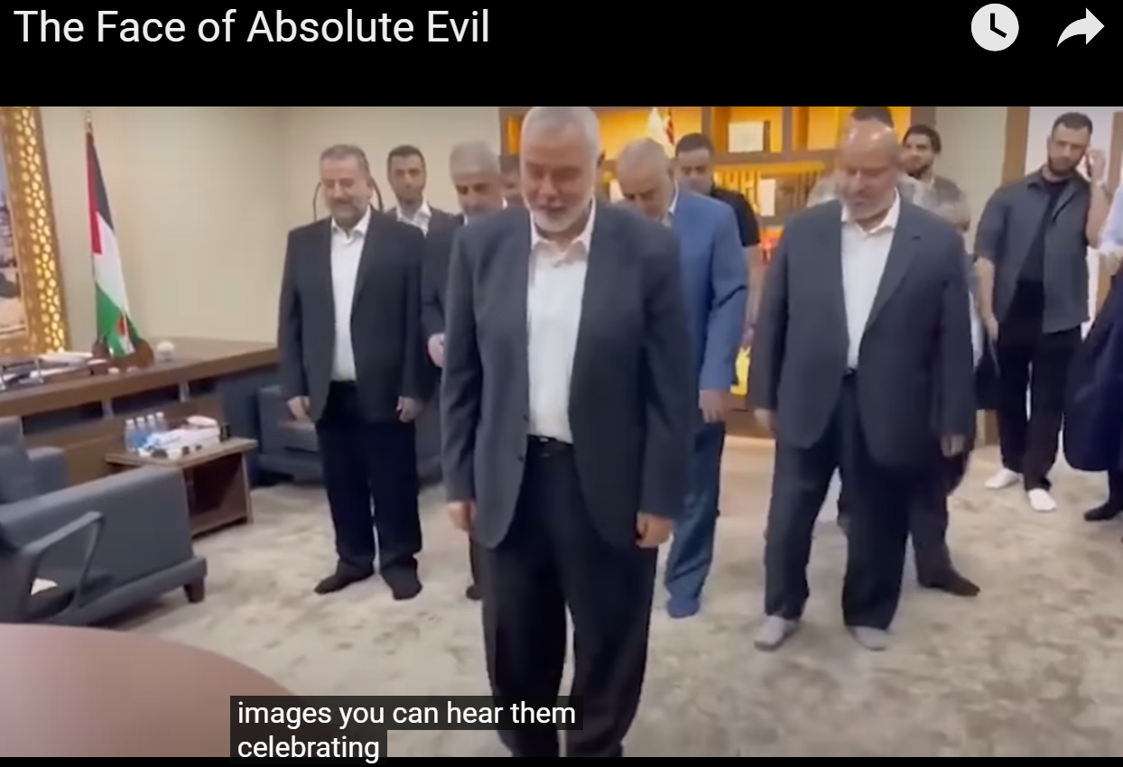
Notes:
Here is the leadership of Hamas, worshipping on the report of the Gaza murders and mayhem. Ismail Hanieh, Yaha Sinwar, Kalil Mashal
Ben Shapiro Daily Wire

Slide 28
Notes:
Celebrating the vicious murder of babies, and the rape of women.
Ben Shapiro Daily Wire

Slide 29
Notes:
Ben Shapiro Daily Wire

Slide 30
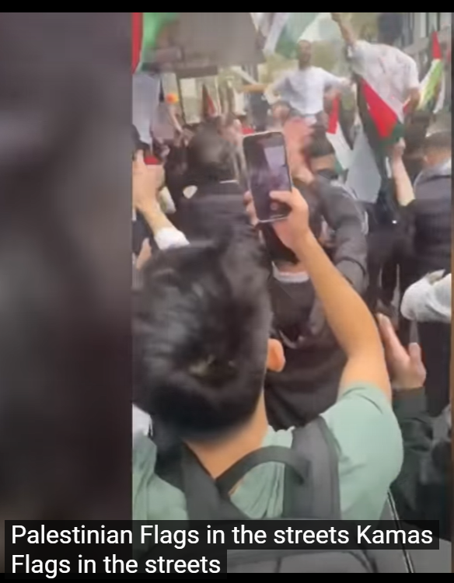
Celebrating in Rotterdam

Slide 31
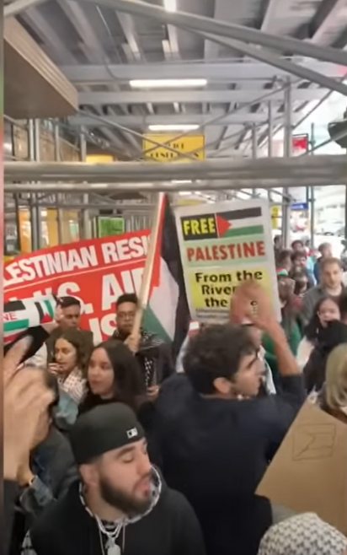
Cheering Hamas in New York City

Slide 32
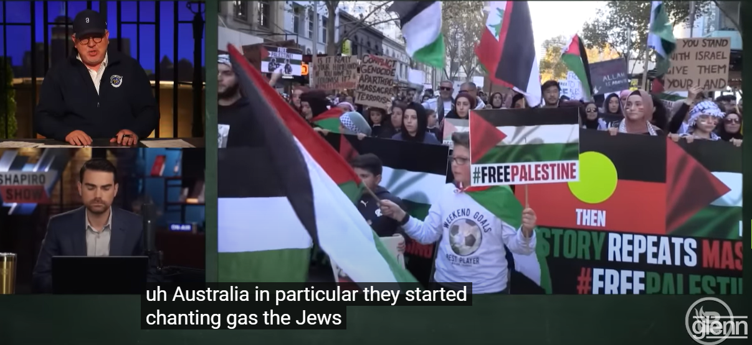
Notes:
https://www.youtube.com/watch?v=R0tA2WePlDM

Slide 33
Cardinal Pierbattista Pizzaballa, the Latin Patriarch of Jerusalem, issued a stunning declaration, offering himself to Hamas if the terrorists would let the child hostages go. “I am ready for an exchange, anything, if this can lead to freedom, to bring the children home.”
Notes:
Ben Shapiro

Slide 34
Avner Boskey: The Arabic word Hamas can mean zeal, enthusiasm, fire, ardor, fervor or fanaticism. Used as an Arabic acronym HaMaS is the short form of Harakat al-Muqawima al-Islamiyya, which means ‘The Islamic Resistance Movement’.
Notes:
https://davidstent.org/hurtling-through-the-fog-of-war-a-messianic-perspective-on-the-new-hamastan/

Slide 35
“The Platform of The Islamic Resistance Movement (ed., Hamas): Israel will rise and will remain erect until Islam eliminates it as it had eliminated its predecessors…Our struggle against the Jews is extremely wide-ranging and grave…until the enemies are defeated and Allah’s victory prevails”
Notes:
https://davidstent.org/when-arrows-strike-the-ground/

Slide 36
“There is no solution to the Palestinian problem except by Jihad. The initiatives, proposals and International Conferences are but a waste of time, an exercise in futility” (Article #13).
Notes:
https://davidstent.org/when-arrows-strike-the-ground/
No fatherly love in Islam Orphan religion.

Slide 37
“Hamas has been looking forward to implement Allah’s promise whatever time it might take. The prophet, prayer and peace be upon him, said: ‘The time will not come until Muslims will fight the Jews (and kill them); until the Jews hide behind rocks and trees, which will cry: O Muslim! There is a Jew hiding behind me, come on and kill him! (Article #7).
Notes:
No fatherly love in Islam Orphan religion.

Slide 38
One of Mohammed’s closest generals and most brilliant military commanders was Khalid bin al-Walid, (or the drawn sword of Allah). Between 629-636 AD/CE he was responsible for over one hundred military victories, including the conquests of Arabia, Persian Mesopotamia, Roman Syria, Yarmouk, Damascus and Jerusalem.
Notes:
https://davidstent.org/when-arrows-strike-the-ground/

Slide 39
At the Battle of Ullais it is recorded that he oversaw the decapitation of 70,000 Persian soldiers. Hamas’ decapitation of Jewish babies, women and soldiers on Kibbutz Kfar Aza is in keeping with this ancient tradition. It should come as no surprise that jihadis take the Quran literally in their conquest of the Middle East: “When you meet the unbelievers (in battle), strike off their heads.”
Notes:
https://davidstent.org/when-arrows-strike-the-ground/

Slide 40
“I will instill terror into the hearts of the unbelievers. Therefore, strike off their heads and strike off every one of their fingertips… Strike terror (into the hearts of) the enemies of Allah and your enemies” (Surah 8:12, 60).
Notes:
No fatherly love in Islam Orphan religion.

Slide 41
From Daniel Pipes interviewer:
Is the slaughter of Jews perpetrated by Hamas in Israel – beheadings, rapes, hostages and women captured as sex slaves – an expression of Islamic brutality in its most unadulterated form?

Slide 42
Daniel Pipes: Yes, and it is similar to the brutality of the Islamic State of Iraq and Syria (ISIS) in its 2014-15 heyday. ISIS made a point of providing meticulous Islamic justifications for its barbarism. Their example points, once again, to the urgent need for Islam to be modernized.

Slide 43
The detailed plans for the cross-border massacre—labeled “top secret” in Arabic—were found on the corpses of Hamas terrorists and shared with the US media outlet by Israeli first responders.
Notes:
https://www.israeltoday.co.il/read/documents-on-slain-terrorists-show-hamas-plan-to-target-children/?mc_cid=1692a6884d&mc_eid=9f06d9f262
https://allisrael.com/president-herzog-reveals-hamas-instruction-manual-for-atrocities-shows-horrific-extent-of-planning-in-massacre-of-israeli-civilians

Slide 44
A Hamas hit squad that targeted Alumim was directed to “achieve the highest level of human losses” and then take captives.
“The dental office, the supermarket, the dining hall,”
Notes:
https://www.israeltoday.co.il/read/documents-on-slain-terrorists-show-hamas-plan-to-target-children/?mc_cid=1692a6884d&mc_eid=9f06d9f262

Slide 45
They were on a mission to hurt and murder as many innocent civilians as possible,” Tal Heinrich, a spokeswoman for Israeli Prime Minister Benjamin Netanyahu, told The Wall Street Journal, in reference to “maps and documents found on the bodies of Hamas terrorists.”
Notes:
https://www.israeltoday.co.il/read/documents-on-slain-terrorists-show-hamas-plan-to-target-children/?mc_cid=1692a6884d&mc_eid=9f06d9f262

Slide 46
According soldiers who took part in the battle and were amongst the first to inspect the grisly scenes in the homes taken over by terrorists on October 7th, roughly 40 babies and young children were brutally torn apart – most of them with their heads cut off.
Notes:
https://unitedwithisrael.org/sickening-40-babies-children-found-slaughtered-many-decapitated/

Slide 47
The children’s families were found shot to death, often in their beds.
In other instances, the residents’ charred remains were found in safe rooms – the shelters designed to provide enhanced protection during rocket attack.
Notes:
https://unitedwithisrael.org/sickening-40-babies-children-found-slaughtered-many-decapitated/

Slide 48
Based on testimonies from witnesses in other towns, the 70 or so terrorists who seized control of Kfar Azza attempted to lure out residents, in some cases speaking to them in Hebrew, pretending to be Israeli police.
Notes:
https://unitedwithisrael.org/sickening-40-babies-children-found-slaughtered-many-decapitated/

Slide 49
When residents refused, the terrorists attempted to break down the reinforced door. If that failed, they set the house on fire, leaving a number of residents of Kfar Aza to burn to death inside safe rooms in their own homes.
Notes:
https://unitedwithisrael.org/sickening-40-babies-children-found-slaughtered-many-decapitated/

Slide 50
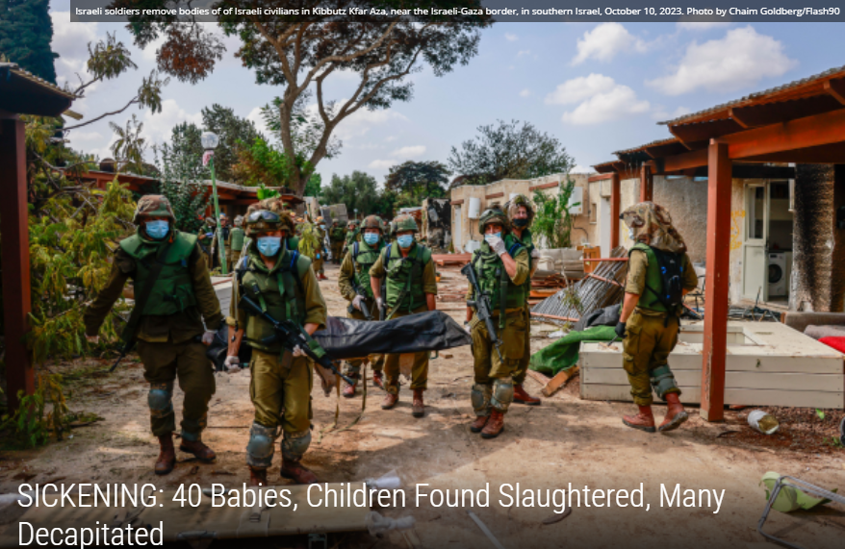
Notes:
https://unitedwithisrael.org/sickening-40-babies-children-found-slaughtered-many-decapitated/

Slide 51
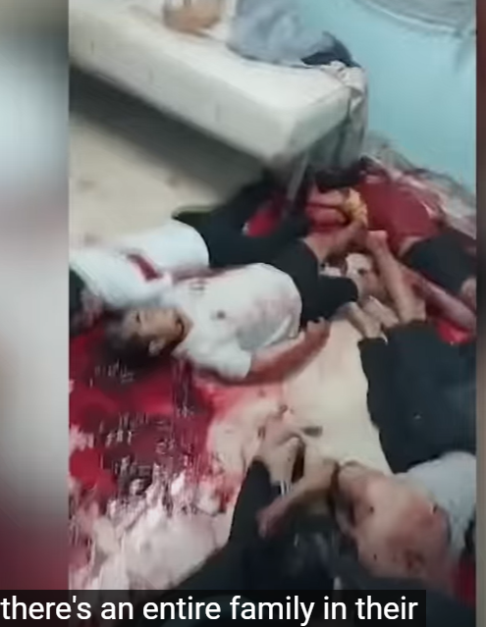
Notes:
https://www.youtube.com/watch?v=U-b5ZOEcLOM

Slide 52
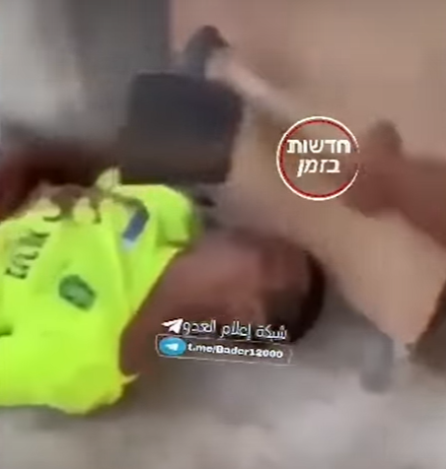
Notes:
https://www.youtube.com/watch?v=U-b5ZOEcLOM
Note the hoe above the body.
Even the Nazis tried to cover up their actions. Dynamited the gas chambers of Auschwitz-Berkineau when the Russian armies were coming. Hamasniks use go-pro body cameras to advertise and upload all the savagery. They are bragging about it.

Slide 53
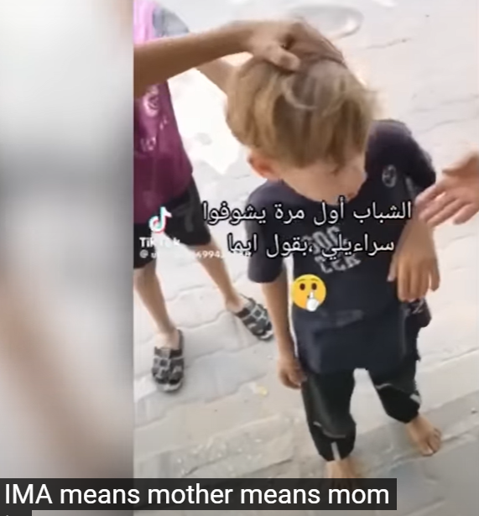
Notes:
Not since the Nazis have Jewish children been humiliated and terrified.
https://www.youtube.com/watch?v=U-b5ZOEcLOM
Warsaw Ghetto 1943
https://www.dailymail.co.uk/news/article-3973320/The-photos-changed-world-Terrified-children-running-napalm-attack-man-walking-Moon-kiss-mark-end-war-Nessie-Time-magazine-s-influential-images-time.html

Slide 54
Gina Semiatich, a 90-year-old Czech-born Holocaust survivor, was tragically murdered in her home at Kibbutz Kissufim, less than two miles from the Gaza border. According to reports in Israel, Semiatich was dragged from her home shelter by the terrorists and shot in the head in her living room.
Notes:
https://vfinews.com/news/idf-says-it-is-not-responsible-for-hospital-strike/the-impact-and-atrocities-of-the-war?subscribed=true&mc_cid=168aedfac2&mc_eid=UNIQID

Slide 56
Comment on the idolatrous, sensual, intoxicated Rave Party where ~260 Jewish young people were murdered
____________________________________
Revelers at the Rave party, just before Hamas struck.
Notes:
Dancing around a statue of Buddha.

Slide 57
^{Zekh 1.14-16} The angel speaking with me then said to me, “Here is what Adoni-Tzva’ot says: ‘I am extremely jealous on behalf of Yerushalayim and Tziyon; and [to the same degree] I am extremely angry with the nations that are so self-satisfied;
Notes:
Love of Israel as is?

Slide 58
^{Zekh 1.14-16} because I was only a little angry [at Yerushalayim and Tziyon], but they made the suffering worse.’ Therefore Adoni says, ‘I will return to Yerushalayim with merciful deeds. My house will be rebuilt there,’ says Adoni-Tzva’ot; ‘
Notes:
“A little angry”?? Moloch worship, killing babies in incendiary sacrifice, cult prostitution.

Slide 59
The Iranian Embassy in Syria also tweeted ““Time is OVER! time is up” in both Hebrew and Arabic. The troubling message came just days after Amir-Abdollahian warned that a regional network of militias dubbed the “axis of resistance” would open “multiple fronts” against Israel if it continued to kill civilians in Gaza.
Notes:
https://vfinews.com/news/plethora-of-evidence-showing-hospital-strike-was-islamic/iran-warns-time-is-up-in-ominous-message-to-israel

Slide 60
Hossein Amir-Abdallahian shared the following message, “After the terrible crime of the Zionist regime in the bombing and massacre of more than 1,000 innocent women and children in the hospital, the time has come for the global unity of humanity against this fake regime more hated than ISIS and its killing machine.”
Notes:
https://vfinews.com/news/plethora-of-evidence-showing-hospital-strike-was-islamic/iran-warns-time-is-up-in-ominous-message-to-israel
Totally bogus report. Confirmed that an Islamic Jihad missile misfired and destroyed the hospital. Several hundred deaths at MOST. Not an Israeli strike.

Slide 61
“Ilhan Omar is spreading dangerous misinformationaccusing Israel of killing children.
Notes:
https://unitedwithisrael.org/ilhan-omar-sparks-outrage-by-falsely-labeling-a-decade-old-syrian-photo-in-attempt-to-smear-israel/

Slide 62
Her post was accompanied by a community fact-check saying, “This photo is NOT from Gaza/Palestine. It’s from the sarin attack launched by [Syrian President Bashir] Assad’s forces against E. Ghouta, Syria in August 2013.”
Notes:
https://unitedwithisrael.org/ilhan-omar-sparks-outrage-by-falsely-labeling-a-decade-old-syrian-photo-in-attempt-to-smear-israel/
This was the event that Obama said would trigger US response. Instead, he waffled, and many attribute the Russian invasion of Crimea as emboldened.

Slide 63
The highest profile example came from Harvard, where over 30 student groups signed a statement saying “The apartheid regime [Israel] is the only one to blame.”
Even before the attacks last weekend, the University of Pennsylvania controversially hosted a literature festival called “Palestine Writes,” featuring speakers who have called for the destruction of Israel.
Notes:
Daily Wire

Slide 64
While UPenn President Liz Magill eventually distanced the school from the speakers, saying the university “doesn’t endorse these speakers or their views,” it took several weeks and a lot of outcry before she did so.
Now…A growing number of high-profile donors have severed ties with universities over their lack of moral clarity on the crisis.
Notes:
Daily Wire

Slide 65
So, what is next?
Notes:
Theme, acting without the context of G-d’s love.

Slide 66
The majority of Israelis have been so shocked by Hamas’ latest massacre on October 7, 2023 – involving mass murder (including babies and decapitations), mass rape, mass kidnapping, mass burning of live victims, etc. – that many voices are calling for a decisive and final destruction of Hamas and Islamic Jihad

Slide 67
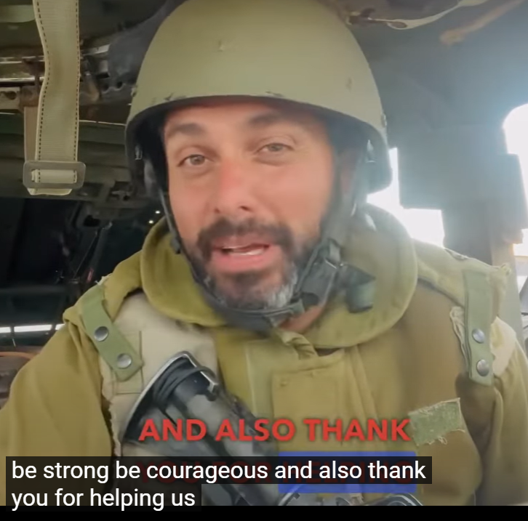
Sgt Maj Chaim Malespin in uniform
Yahalom unit
Special ops

Slide 69
History of war strategies
Can’t be hunkering down behind walls. Maginot line, Bar lev, Great Wall China.
If war in the north??

Slide 70
Part of recent Israeli history involves Hamas terror attacks on Israeli citizens, followed by IDF military responses of the jihadi group. 15 such military clashes since 2004. These mini-wars have broken out every two years on the average, and sometimes twice a year.
Notes:
Avner Boskey

Slide 71
The IDF and IAF then damage Hamas or Islamic Jihad infrastructure, occasionally entering Gaza with tanks and infantry, and then withdraw.
Notes:
Avner Boskey

Slide 72
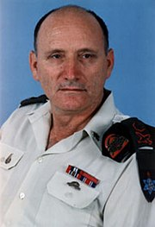
Retired IDF General Yitzhak Brik
יצחק בריק
Notes:
https://en.wikipedia.org/wiki/Itzhak_Brik
Very serious prayer request here!!

Slide 73
Yitzhak Brik might be the only Israeli military official to see what was coming. Brik cautioned, months ago, among other things, of problems with the competence of ground forces. Hamas are preparing equipped, trained fighters who will cross the border
Notes:
https://www.israeltoday.co.il/read/delusional-or-prophetic-one-idf-general-warned-a-massacre-would-happen/

Slide 74
on foot and attack and occupy our settlements in the south. The likelihood of this happening is very high. Hamas will conquer settlements, throw grenades into bunkers and shelters and cause a massacre. The local residents, you and me, must defend these communities because the army will not be there.” He was considered unsound.
Notes:
https://www.israeltoday.co.il/read/delusional-or-prophetic-one-idf-general-warned-a-massacre-would-happen/

Slide 75
After the massacre in the south, everyone now has an ear for retired general, even Bibi. The general made it clear to Netanyahu that his position was to continue the surgical strikes, divide the armed forces and find a solution through a hermetic siege of the Gaza Strip.
Notes:
https://www.israeltoday.co.il/read/delusional-or-prophetic-one-idf-general-warned-a-massacre-would-happen/

Slide 76
“The current situation of the land forces is tragic, they are not ready for war. Emergency supplies are not available, exercises have stopped and the battalions have not trained in years. There is also no weapons training and education, and the army is not capable of carrying out an attack.”
Notes:
https://www.israeltoday.co.il/read/delusional-or-prophetic-one-idf-general-warned-a-massacre-would-happen/

Slide 77
“We have lost the ability to field an effective army and have become a one-dimensional aerial power that cannot win a war on its own.” “In my role as general, I have visited more than 1,400 units and spoken to tens of thousands of commanders and soldiers,
Notes:
https://www.israeltoday.co.il/read/delusional-or-prophetic-one-idf-general-warned-a-massacre-would-happen/

Slide 78
three to four times a week, four hours in each unit. “I have seen soldiers who do not take care of their weapons before leaving the base. The soldiers carry their smartphones with them everywhere. Commands are sent via WhatsApp groups. These phones are being tracked by the enemy.”
Notes:
https://www.israeltoday.co.il/read/delusional-or-prophetic-one-idf-general-warned-a-massacre-would-happen/

Slide 79
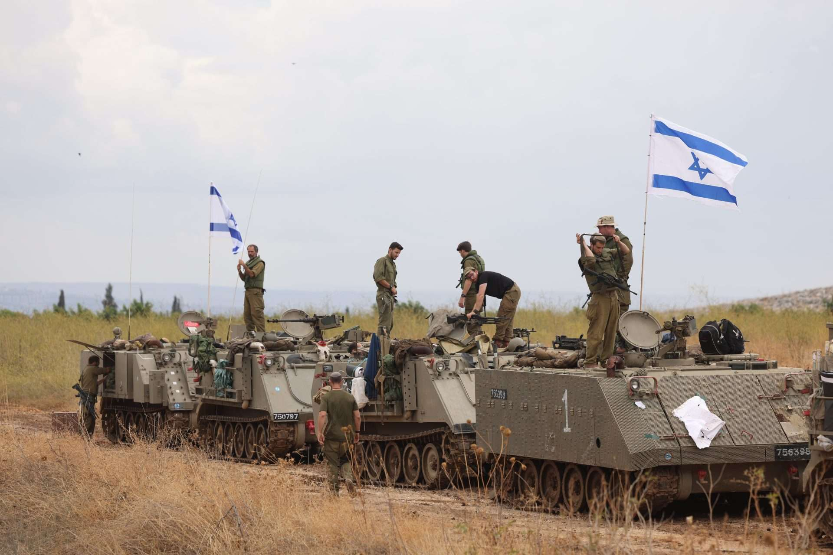
Israeli soldiers in a mobilization area
near Israel’s border with Lebanon
October 15, 2023. Photo: David Cohen/Flash90
Notes:
https://www.israeltoday.co.il/read/delusional-or-prophetic-one-idf-general-warned-a-massacre-would-happen/

Slide 80
Commands are said to have been sent via email and then deleted, meaning no follow-up action is possible. “Our system has lost all control. Have we gone crazy? I cannot sleep at night.” Israel’s entire security apparatus has failed and relied too heavily on technology, with an unhealthy dash of arrogance.
Notes:
https://www.israeltoday.co.il/read/delusional-or-prophetic-one-idf-general-warned-a-massacre-would-happen/

Slide 81
Jerusalem Post: While Eisenkot and the military publicly rejected Brik’s report, former defense minister Avigdor Liberman told a conference in late November that he had personally heard the army’s chief of staff admitting that “90% to 95%” of Brik’s criticism was correct.
Notes:
https://www.jpost.com/arab-israeli-conflict/idf-brick-is-wrong-we-are-ready-and-prepared-for-war-575454
Remember this as a prayer point after the message.
https://frontline.news/post/israeli-government-sorry-about-that

Slide 82
The Great Wall of China
at Jinshanling
Notes:
https://upload.wikimedia.org/wikipedia/commons/2/23/The_Great_Wall_of_China_at_Jinshanling-edit.jpg

Slide 83
But the wall, expansive and imposing though it may be, was not always the militaristic trump card it appeared. Although certainly helpful in defending the Chinese homelands, the Great Wall proved at various times to be more permeable than we might think.
Notes:
https://www.discovermagazine.com/uncategorized/did-the-great-wall-of-china-actually-keep-invaders-out

Slide 84
The defensive characteristics of the Great Wall were enhanced by the construction of watchtowers, troop barracks, garrison stations, signaling capabilities through the means of smoke or fire, and the fact that the path of the Great Wall also served as a transportation corridor.
Notes:
https://en.wikipedia.org/wiki/Great_Wall_of_China

Slide 85
The Maginot Line was an “impenetrable” barrier to the Germans, build in the 1930s.

Slide 86
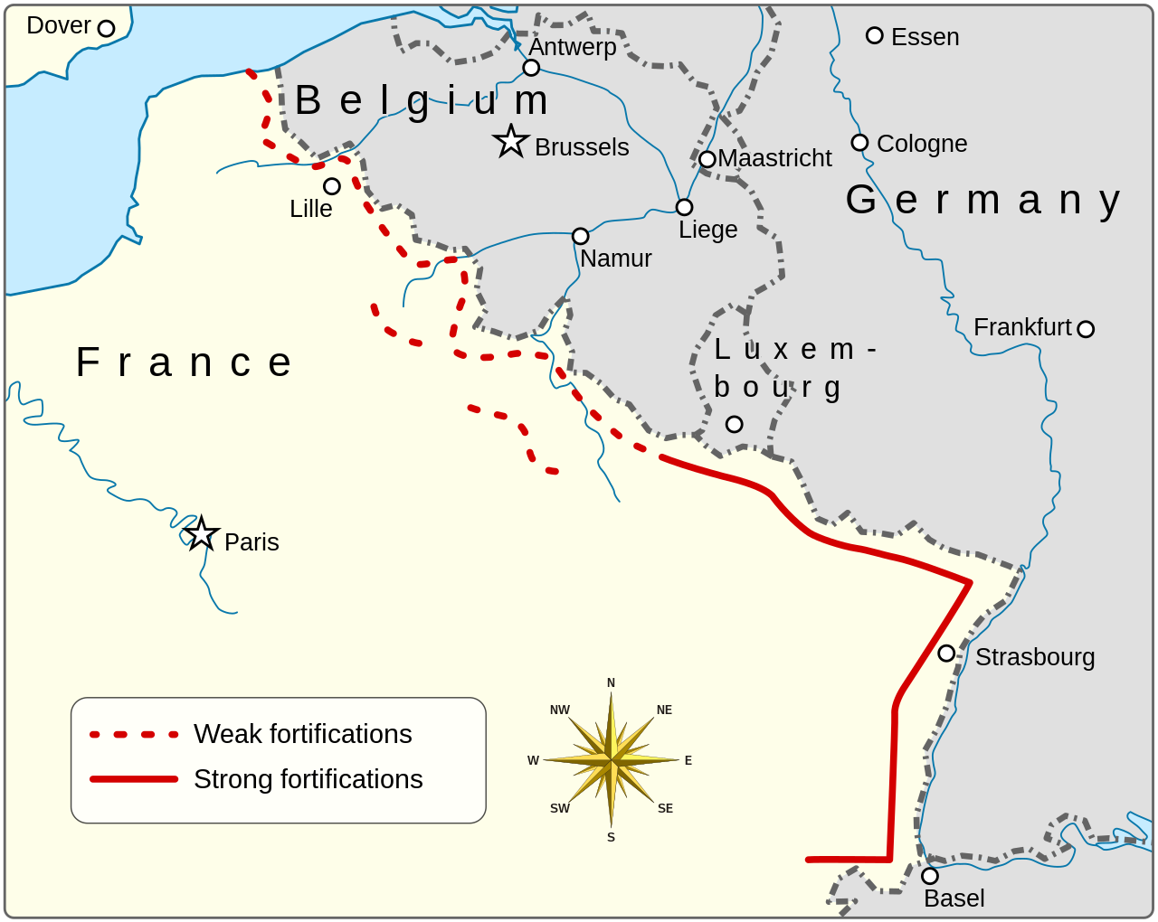
Migonot Line

Slide 87
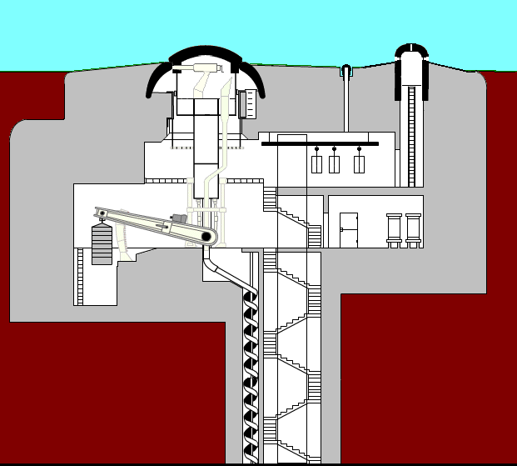
Retractable turret on the Maginot line fortification
Notes:
https://en.wikipedia.org/wiki/Maginot_Line

Slide 88
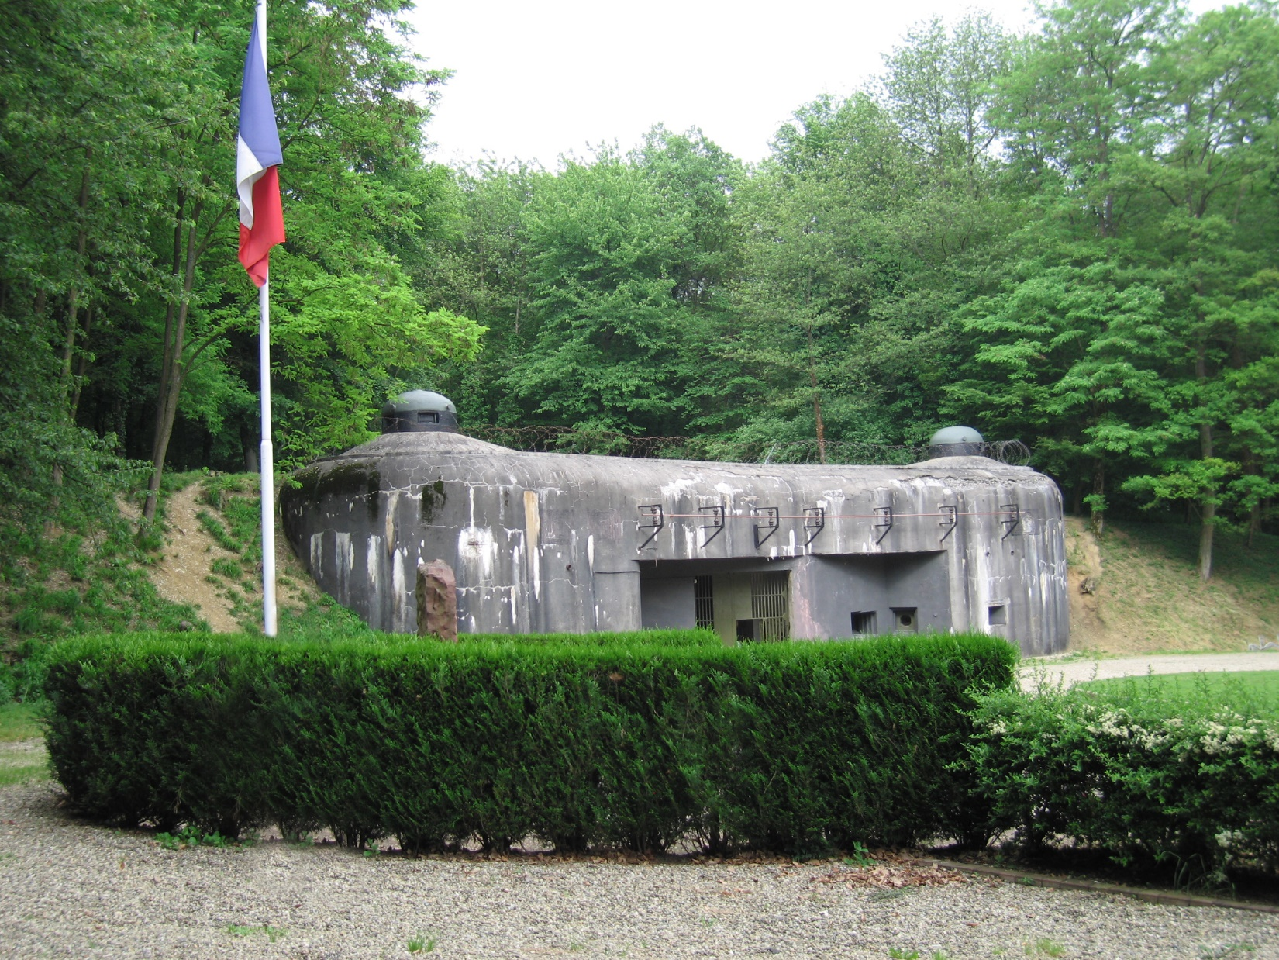
The munitions entrance to Ouvrage Schoenenbourg along the Maginot Line in Alsace.
Notes:
https://en.wikipedia.org/wiki/Maginot_Line

Slide 89
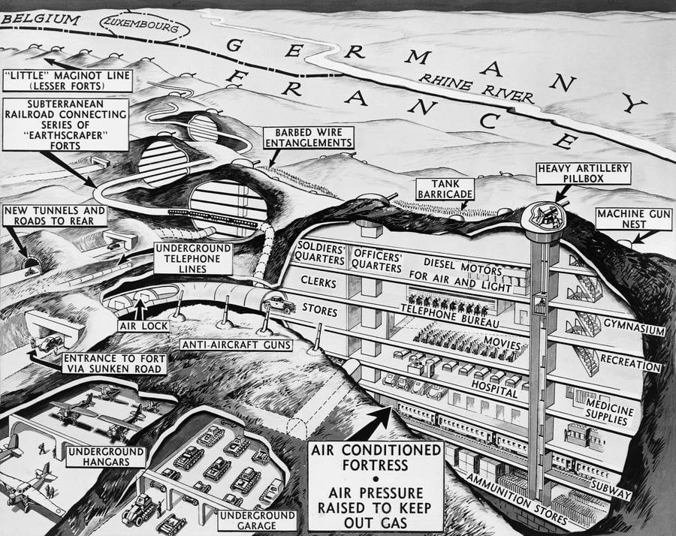
Notes:
https://upload.wikimedia.org/wikipedia/en/7/7c/Line_maginot_tunel.jpg

Slide 90
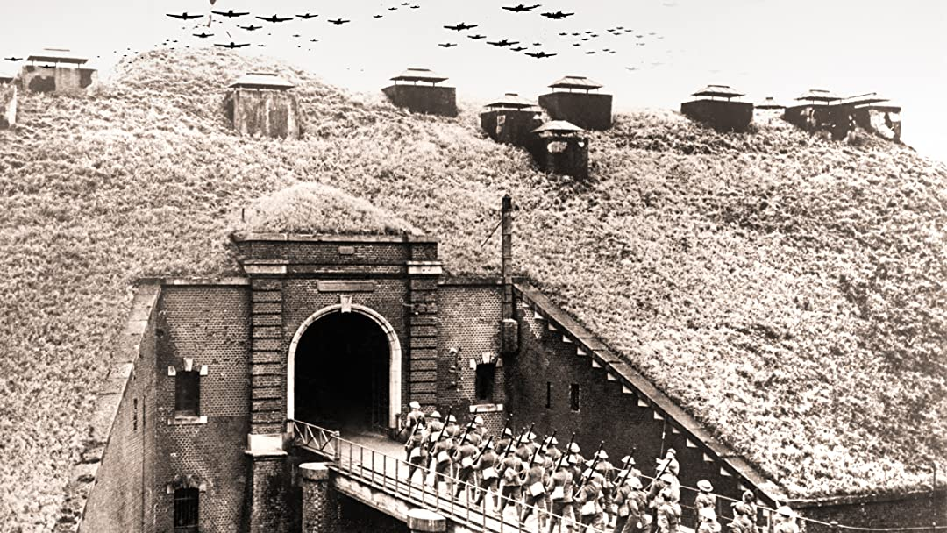
Notes:
https://external-content.duckduckgo.com/iu/?u=https%3A%2F%2Flh3.googleusercontent.com%2FR0C0mnDA7SZfTsAvC5_EcD-PuUosqpLxYY3Ly8URYBtZtPpJ3RjwRYqdGgwUPKJbrzL_SzXQmq5vwwr2OgRcU_mT-q8OTamC9GB0PkoUn4TyuYyiprZ16ygLYSJ-hEjC1ZJvrI0Q&f=1&nofb=1&ipt=6095764d0bf087f2abbfae56ebc8f585c47fdfb06d3a0c78009016c540cd7db3&ipo=images

Slide 91
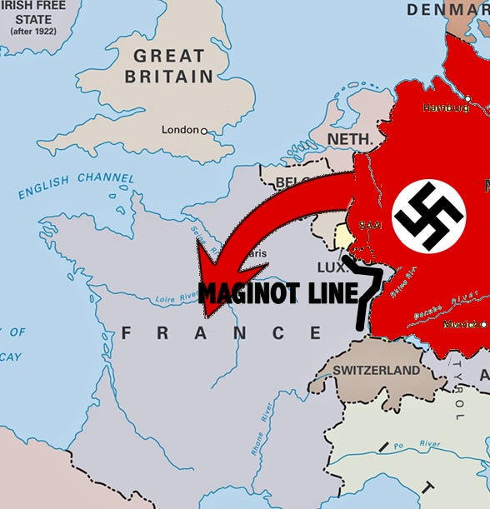
German bypass of the Maginot line
Notes:
https://external-content.duckduckgo.com/iu/?u=https%3A%2F%2Fcdn-images-1.medium.com%2Fmax%2F600%2F1*LE8JvU4Ca9ZOnTDI5l8MPQ.jpeg&f=1&nofb=1&ipt=e5526bd571c5a3c9405684fb7b216016328ec89b422bd4d9affe9afc535d9ba4&ipo=images

Slide 92
Lesson for us:
No safety in hunkering down. Need exploits. Orde Wingate.
Win the lost. Outreach
Vote and political activism.
The best defense is a good offense.

Slide 93
Israel withdrew from Gaza in 2005. No “occupation” that is, no Jews left. Israel thought that a contained Gaza would seek prosperity.
80 places the impenetrable wall breached
Notes:
Even at their best, Israel had miracles. 1967 War Egyptians out to breakfast. Attack on Saddam’s nuclear reactor, jets were seen by King Abdullah’s yacht.

Slide 94
Israel failed to find decent partners when it left Gaza in 2005 and handed the territory to Yasser Arafat. Where is Gaza's Konrad Adenauer? Good German
Or Abdel el-Sisi. Good Egyptian.
Notes:
Good German,

Slide 95
Jews have experience with betrayal by “friends.”
Bombing of Auschwitz Birkenau
1973 Yom Kippur War
2023 Biden’s aircraft carriers?
Notes:
Prayer issue

Slide 96
On November 8, 1944, the Director of the War Refugee Board, John Pehle, wrote to Assistant US Secretary of War John McCloy to advocate for the bombing of Auschwitz-Birkenau. Pehle, who had just read an extensive and graphic report describing the process of arrival, selection, and gassing of victims at Auschwitz, wrote,
Notes:
Avner Boskey newsletter FINAL FRONTIER MINISTRIES

Slide 97
“I strongly recommend that the War Department give serious consideration to the possibility of destroying the execution chambers and crematories in Birkenau through direct bombing action.” McCloy's response stated that the planes capable of these attacks were not in range of the camp.
Notes:
Avner Boskey newsletter FINAL FRONTIER MINISTRIES

Slide 98
Moreover, the War Department was unwilling to move medium or heavy bombers into range in order to target the gas chambers or crematoria: “At the present critical stage of the war in Europe, our strategic air forces are engaged in the destruction of
Notes:
Avner Boskey newsletter FINAL FRONTIER MINISTRIES

Slide 99
industrial target systems vital to the dwindling war potential of the enemy, from which they should not be diverted.
Notes:
Avner Boskey newsletter FINAL FRONTIER MINISTRIES
So, 6 million, or what was left, just perished.

Slide 100
In 1973, the Nixon White House ordered the NSA to withhold from Israel, intercepts of Soviet communications verifying that Egypt and Syria would attack on the afternoon of October 6, 1973. “We knew it was coming. We knew when. We knew where. We were told to shut up and let it happen” says a former NASH employee.
Notes:
Avner Boskey newsletter FINAL FRONTIER MINISTRIES
Israelis eventually overcame Egyptian and Syrian invaders, but it cost thousands of lives.
Movie Golda

Slide 101
In Oct., 2023 Some in Israel [Caroline Glick] are vocal in expressing concerns that the arrival of aircraft carriers, President, Secretary of State, Special Ops forces, etc., comes with a price: the binding of the IDF’s hands to decisively end Hamas’ and Islamic Jihad’s existence, and the hobbling of Israel’s deterrent power to destroy all vestiges of a terror empire in Gaza.
Notes:
Avner Boskey newsletter FINAL FRONTIER MINISTRIES

Slide 102
A little bit of encouragement

Slide 103
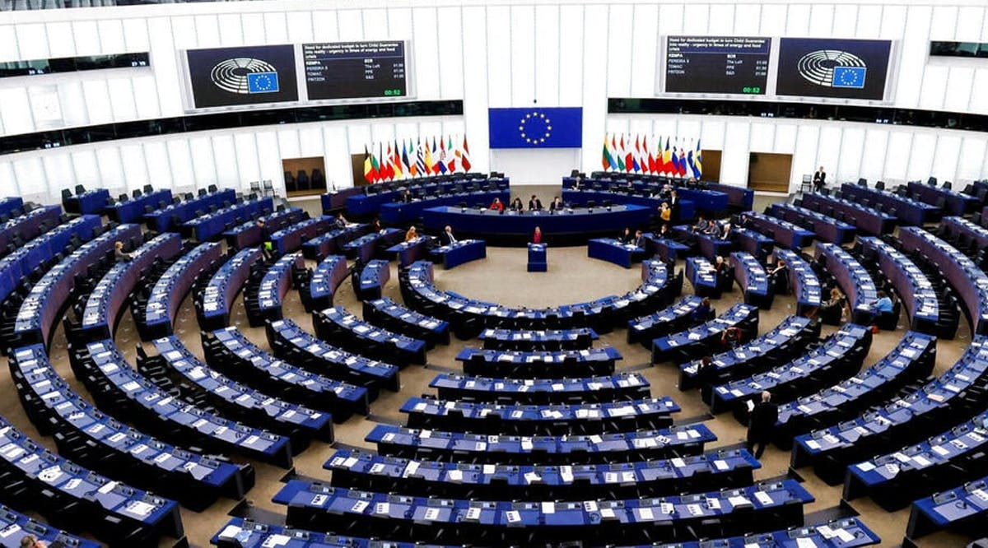
European Parliament
Notes:
https://vfinews.com/news/plethora-of-evidence-showing-hospital-strike-was-islamic/european-parliament-calls-for-elimination-of-hamas

Slide 104
The European Parliament on Thursday, October 19, condemned Hamas’ despicable terrorist attacks against Israel and also expressed serious concern over the humanitarian situation in the Gaza Strip.
Notes:
https://vfinews.com/news/plethora-of-evidence-showing-hospital-strike-was-islamic/european-parliament-calls-for-elimination-of-hamas

Slide 105
In a non-binding resolution adopted with 500 votes in favor, 21 against, and 24 abstentions, MEPs strongly condemned the brutal attacks, expressed their support to Israel and its people, and underlined the need to “eliminate the terrorist organization Hamas”.
Notes:
https://vfinews.com/news/plethora-of-evidence-showing-hospital-strike-was-islamic/european-parliament-calls-for-elimination-of-hamas

Slide 106
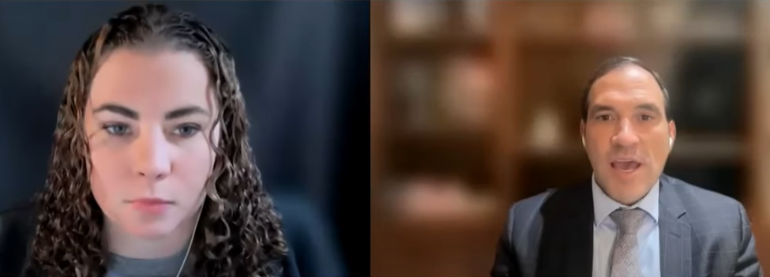
Daniel Pipe’s Middle East Forum
Stacy Roman, moderator Aryeh Lightstone
Notes:
Maybe not exactly encouraging, but attention getting. Game changing.

Slide 107
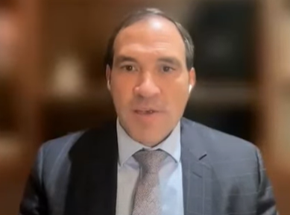
Senior adviser to the US ambassador to Israel from 2017 to 2021, and was tasked with putting the Abraham Accords into action.
Aryeh Lightstone
Notes:
https://www.youtube.com/watch?v=YrFXI0Jc34Y
He is the author of Let My People Know: The Incredible Story of Middle East Peace – and What Lies Ahead (Encounter Books, July 2022).
https://www.jpost.com/author/aryeh-lightstone

Slide 108
He helped advance U.S.-Israel relations with a focus on economic development and technology cooperation. He also worked on opening of the U.S. embassy in Jerusalem and its merger with the Jerusalem consulate.
When asked about Hezbollah entering the war from Lebanon in the North…
Notes:
https://www.youtube.com/watch?v=YrFXI0Jc34Y

Slide 109
There will not be a war between Israel and Lebanon because there will not be a Lebanon.
such as if you touch where Lebanon used to be, there will be an indent.
Notes:
https://www.youtube.com/watch?v=YrFXI0Jc34Y

Slide 110
“If Hezbollah wants to fight a war of extinction, they will get a few shots off, then they will no longer exist on this planet.”
Notes:
https://www.youtube.com/watch?v=YrFXI0Jc34Y
This is what is impending strategy in the north.

Slide 111
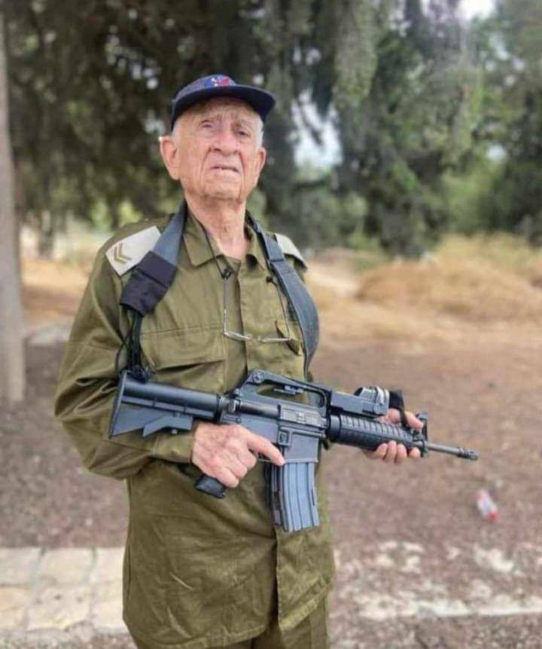
From Vicky Hartzher, former Congresswoman:
Ezra Yachin, 95, is pictured in his old uniform holding a rifle.
Notes:
From Vicky Hartzler

Slide 112
Israeli reserves received a boost from 95-year-old Ezra Yachin. Yachin, a combatant in Israel’s War of Independence, has taken up arms to once again defend the Jewish state from Arab violence:
Notes:
From Vicky Hartzler

Slide 113
Ezra Yachin served as a combat soldier with Lehi — an underground paramilitary group active during British rule — who fought against the British and the Arabs to create a Jewish homeland.
Notes:
From Vicky Hartzler

Slide 114
He has now been called back up “to motivate the IDF troops and to recount how he survived Arab pogroms in Jerusalem during his childhood,” according to Israel National News.”
Notes:
From Vicky Hartzler

Slide 116
^{Eph. 2.4-10} But God is so rich in mercy and loves us with such intense love that, even when we were dead because of our acts of disobedience, he brought us to life along with the Messiah
Notes:
I only have one experience with CPR.

Slide 117
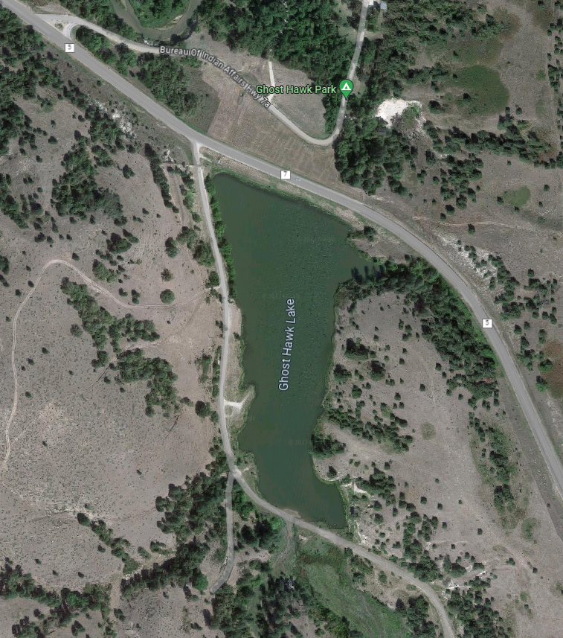
Rosebud Indian Reservation, South Dakota
Notes:
Young man, volunteer from a Bible College, serving the Society of Indian Missions. Some guys went for a swim, and one commented, “Look at X blowing bubbles.” He didn’t come up. I am a certified WSI with the Red Cross, and went out an found him. Did CPR for about an hour before ambulance arrived. Didn’t recover.

Slide 118
Eph. 2.4 Intense Love
Eph. 2.5 Made us alive, Alive with the Messiah
Eph. 2.6 Raised us up--seated with Him
Eph. 2.7 Ages to come showpiece

Slide 119
^{Y’khezkel/Ezk 37.11-13} Then He said to me, “Son of man, these bones are the whole house of Israel. Behold, they say: ‘Our bones are dried up; our hope is lost; we are cut off—by ourselves.’
אָבְדָה תִקְוָתֵנוּ Avdah tikvatenu

Slide 120
^{Y’khezkel/Ezk 37.11-13} Therefore prophesy and say to them, thus says Adoni Elohim: ‘Behold, I will open your graves. I will bring you up out of your graves, My people. I will bring you back to the land of Israel. You will know that I am Adoni,

Slide 121
Pray for the complete defeat and elimination of Hamas and their Gaza partner in terror, Islamic JIhad. Israeli army competency!
Pray for the Israeli families who fled the Hamas terror from the South of Israel and those being evacuated from the North of Israel
Notes:
Stewart Winograd newsletter

Slide 122
Pray for continued USA and international solidarity with Israel. No betrayal.
Pray for all those who have lost loved ones or been injured.
Notes:
Stewart Winograd newsletter

Slide 123
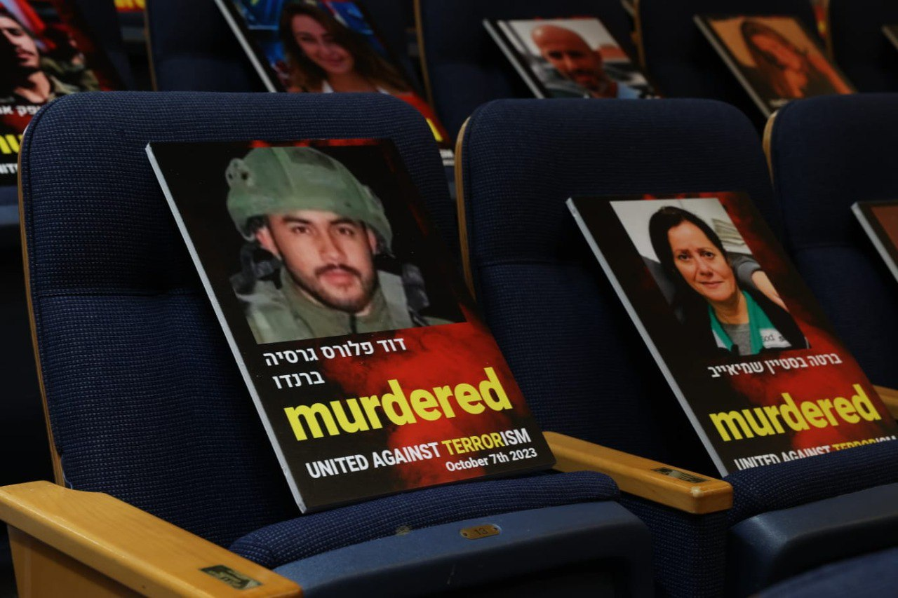
Pictures of victims from the Hamas
massacre on Oct. 7, 2023
(Photo: Tel Aviv Univeristy)
Notes:
https://allisrael.com/images-of-1-000-victims-of-hamas-assault-displayed-at-tel-aviv-university

Slide 124
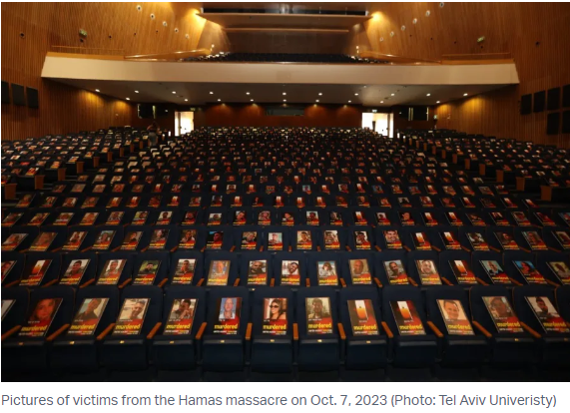
Notes:
https://allisrael.com/images-of-1-000-victims-of-hamas-assault-displayed-at-tel-aviv-university

Slide 125
Pray that in the midst of this turmoil and war, many Israelis (and Palestinians and Arabs) would embrace the Prince of Peace, the Messiah of Israel and the Savior of the World, Yeshua.
Notes:
Stewart Winograd newsletter

Slide 126
Pray for the Israeli government and IDF leadership who will need to make many very difficult decisions in the coming days and week
Pray for the men and women in the IDF fighting a very difficult war to defeat Hamas, defend their northern border and prevent the atrocities of October 7 from happening again.
Notes:
Stewart Winograd newsletter

Slide 127
Pray that from now on there would be a minimal loss of innocent life, both in Israel and among the Palestinians. Heartbreaking that in all wars, civilians suffer and die.
The terror group Hezbollah, north of Israel in Lebanon, is attacking on a daily basis. Pray they back off and cease.
Notes:
Stewart Winograd newsletter

Slide 128
Pray for the safe rescue and return of all hostages, and strength for them in captivity.

Slide 129
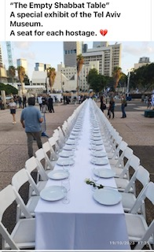
“The Empty Shabbat Table” A special exhibit of the Tel Aviv Museum.
A seat for each hostage.

