Slide 1
e-handout
To have these notes
without taking notes
Go to OrHaOlam.com
Click on Messages tab,
2023 Messages

Slide 2
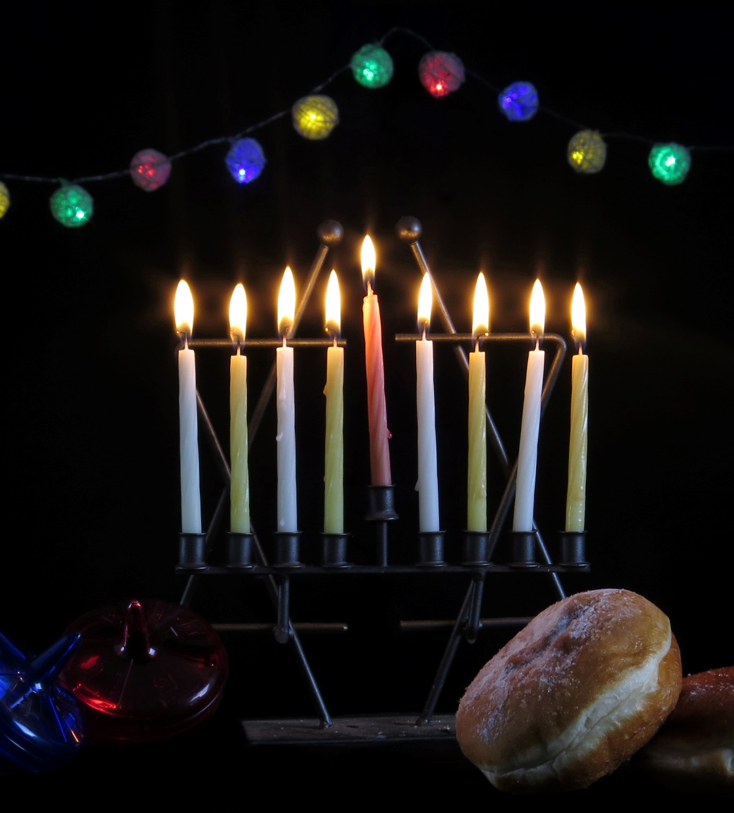
If you look up Hanukkah on Wikipedia,
19 images are candles, donuts, latkes
5 images are war

Slide 3
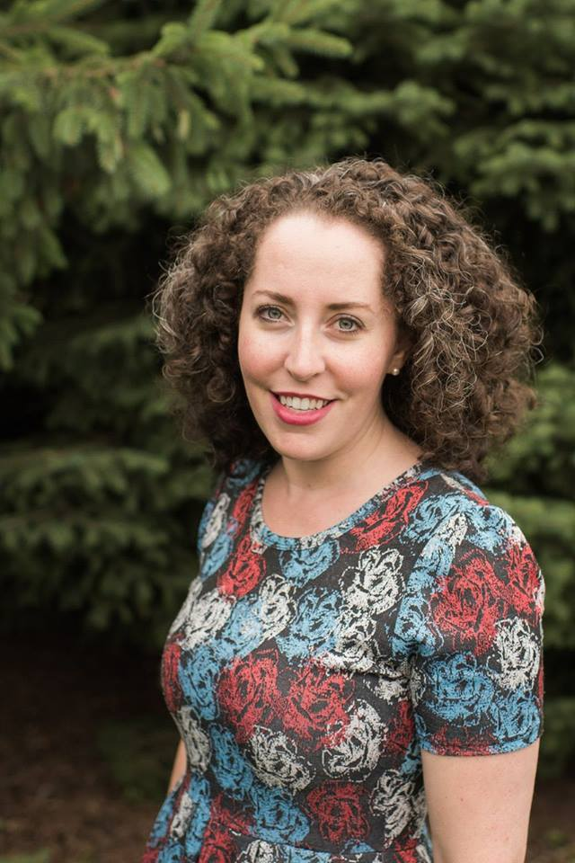
UMJC former EXECUTIVE DIRECTOR
Monique Brumbach is a granddaughter of German Jewish Holocaust survivors, a human rights lawyer. She has been involved in the UMJC since her Bat Mitzvah in 1994, when her parents founded Adat Yeshua, the first Messianic Jewish congregation in New Orleans.
Notes:
A rabbi’s wife married to Rabbi Josh Brumbach

Slide 4
“When our Gentile friends or co-workers ask us ‘what’s Hanukkah about, anyway?’ we tend to give them sugar-coated references to light, miracles, and funny games with spinning tops. But this is only half of the story. [or less!]
Notes:
https://www.umjc.org/commentary/2022/12/16/what-would-the-maccabees-do

Slide 5
“The full story of Hanukkah must include the catalyst: a tyrant invaded our ancestral land and made our way of life illegal.”
Notes:
https://www.umjc.org/commentary/2022/12/16/what-would-the-maccabees-do

Slide 6
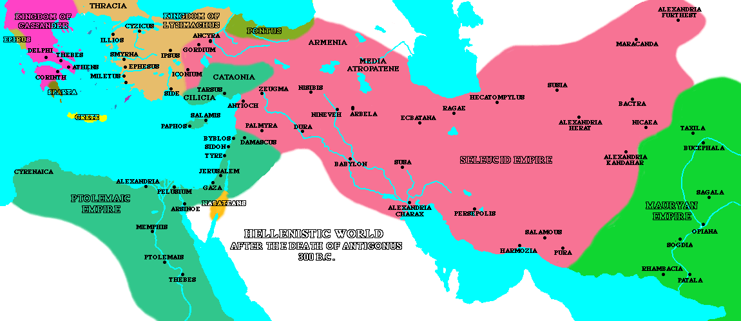
Notes:
Naval interference of Romans → fury of Antiochus the Syrian
In 175 BC, a new king, Antiochus IV (also called "Epihpanes") ascended the throne in Syria. Under the "auspices" of his regime, Jerusalem began to look more and more like a Greek city as Hellenistic culture was officially promoted. Antiochus allowed Hellenistic Jews to have prominent roles in the Holy Temple - so much so that even a non-priest (named Menelaus) was given the role of being the Temple's Kohen Gadol (High Priest). This enraged many Jews, however, who then called for Egyptian rule instead of Syrian (the Egyptians were more tolerant of local customs and did not force Hellenization). Later, when Antiochus returned from an unsuccessful military campaign against Egypt, he decided to quell the Jewish call for Egyptian rule and murdered some 40,000 people in Jerusalem.

Slide 7
^{Daniel 11.29-35} “At the time designated, he will come back to the south. But this time, things will turn out differently than before; because ships from Kittim will come against him, so that his courage will fail him.

Slide 8
^{Daniel 11.29-35} Then, in retreat, he will take furious action against the holy covenant, again showing favor to those who abandon the holy covenant. Armed forces will come at his order and profane the sanctuary and fortress.

Slide 9
^{Daniel 11.29-35} They will abolish the daily burnt offering and set up the abomination that causes desolation. Those who act wickedly against the covenant he will corrupt with his blandishments,

Slide 10
^{Daniel 11.29-35} but the people who know their God will stand firm and prevail. Those among the people who have discernment will cause the rest of the people to understand
Notes:
Hence the story of Mattathias the cohen/ priest in Modi’in, Israel

Slide 11
^{Daniel 11.29-35} what is happening; nevertheless, for a while they will fall victim to sword, fire, exile and pillage. When they stumble, they will receive a little help, although many who join them will be insincere.
Notes:
“We can still be Jews, but embrace new insights, sports, activities, learning…”
Nudity, death, sensuality, violence, intellectual fads and pride

Slide 12
^{Daniel 11.29-35} Even some of those with discernment will stumble, so that some of them will be refined, purified and cleansed for an end yet to come at the designated time.

Slide 13
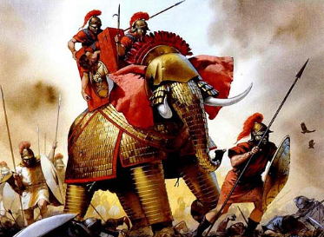

Slide 14
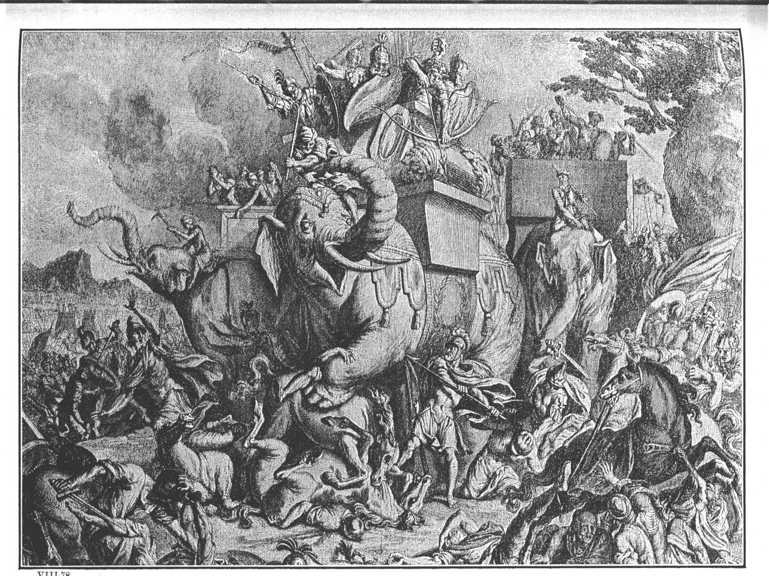
Elazar 162 BCE
Notes:
166 to 164 to liberate Jerusalem
Liberation Jerusalem, cleansed the Temple. Enacted Holiday ~Sukkot
Ever other situations like that?

Slide 15
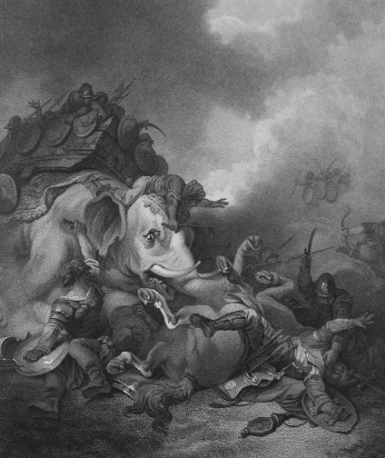
Eleazer (the younger brother of
Judah) died when he single-handedly
attacked a large elephant believed
to be carrying the enemy king I Mac 6:42-46)

Slide 16
“But a band of religious zealots planned a rebellion in the caves of Judea, and waged a prolonged campaign of guerilla warfare that finally drove out the occupiers.”
Notes:
https://www.umjc.org/commentary/2022/12/16/what-would-the-maccabees-do

Slide 17
“For over two thousand years we have dared to light miniature menorahs and display them outside our homes, not as an act of nostalgia, or an attempt to compete with Santa, but as an act of defiance.
Notes:
https://www.umjc.org/commentary/2022/12/16/what-would-the-maccabees-do
Keep this in mind. Defiance of fear.

Slide 18
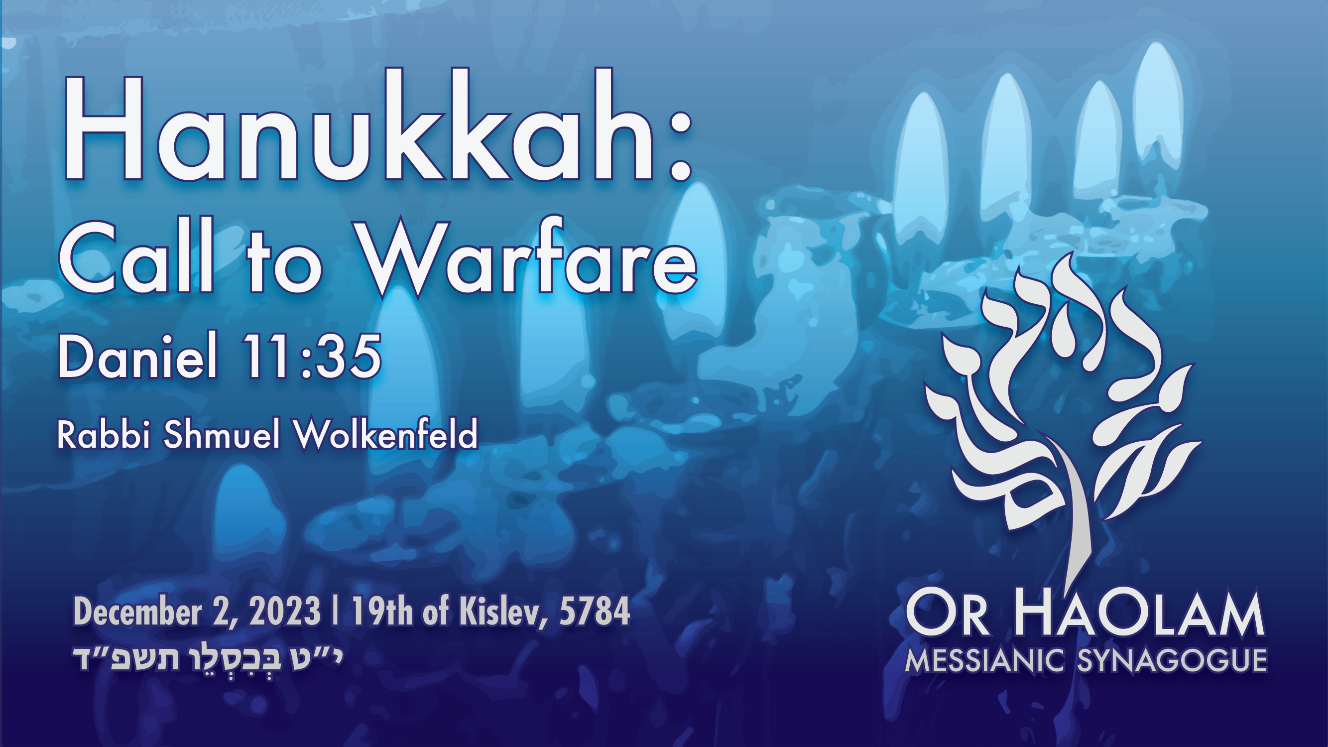
Notes:
Warfare over fear

Slide 19

Hanukkah: Call to Warfare
Occasions of fear
Scriptures on fear
Applications to current war

Slide 20
Hanukkah: Call to Warfare
Occasions of fear
Scriptures on fear
Applications to current war

Slide 21
Fear in London

Slide 22
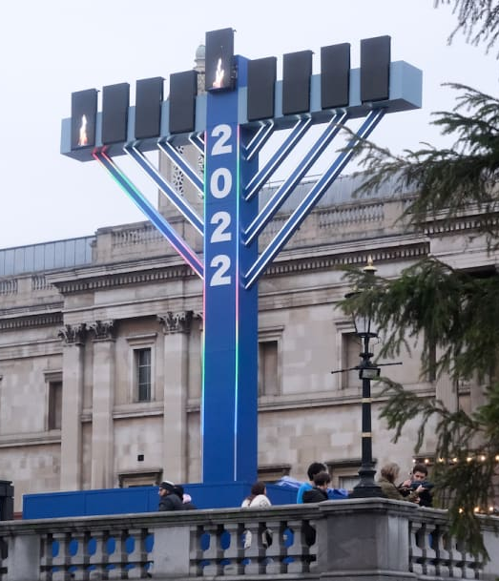
30 ft Menorah set up in Trafalgar Square in London for Hanukkah celebrations
Notes:
https://allisrael.com/east-london-town-hall-will-not-light-the-menorah-candles-for-hanukkah-this-year

Slide 23
A London town hall is refusing to light the Hanukkah menorah for the upcoming 8-day Jewish holiday for fear of sparking conflict, according to the British Daily Telegraph.
Notes:
https://allisrael.com/east-london-town-hall-will-not-light-the-menorah-candles-for-hanukkah-this-year

Slide 24
Fear in Lawrence, KS
KU

Slide 25
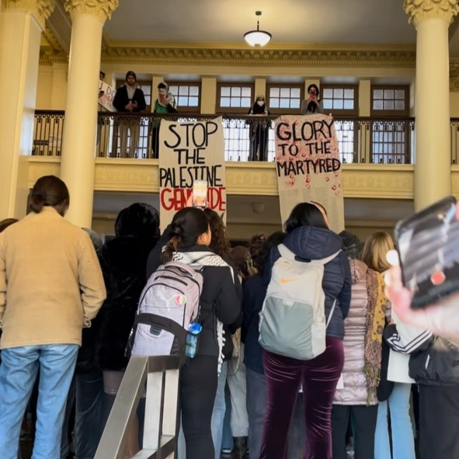
Two student-led anti-Israel walkouts occurred at the University of Kansas,
Notes:
https://kcjc.com/current-news/top-stories/9182-anti-israel-student-protests-ongoing-at-ku

Slide 26
and dozens of student protestors engaged in antisemitic chants while carrying signs and posters.
Notes:
https://kcjc.com/current-news/top-stories/9182-anti-israel-student-protests-ongoing-at-ku

Slide 27
The walkouts, organized by KU’s Muslim Student Association (MSA), are being held to demand that KU Chancellor Douglas Girod issue a statement on behalf of the university in solidarity with Palestinian and Muslim students.
Notes:
https://kcjc.com/current-news/top-stories/9182-anti-israel-student-protests-ongoing-at-ku
https://allisrael.com/hamas-wanted-to-sacrifice-thousands-of-children-so-israel-can-take-the-blame-says-son-of-hamas-co-founder

Slide 28
Nov. 27 protest repeating the antisemitic chant “From the river to the sea, Palestine will be free.” Two two-story banners were also hung from the balcony of Strong Hall; one read “Stop the Palestine Genocide; Free Gaza.”
Notes:
https://kcjc.com/current-news/top-stories/9182-anti-israel-student-protests-ongoing-at-ku

Slide 29
Fear in Ypslanti, MI

Slide 30
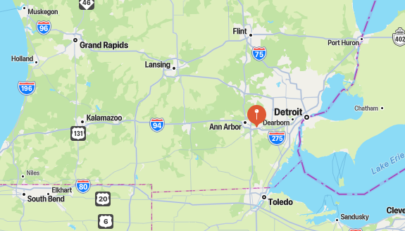
Ypsalanti Michigan
Notes:
Between Detroit and Ann Arbor

Slide 31
Residents in Ypsilanti, who gathered with their families for an annual Christmas tree lighting and carol singing, were accosted by a pro-Palestinian mob. The demonstrators terrified the children while they chanted anti-American slogans.
Notes:
Dr. James Dobson's Family Talk

Slide 32
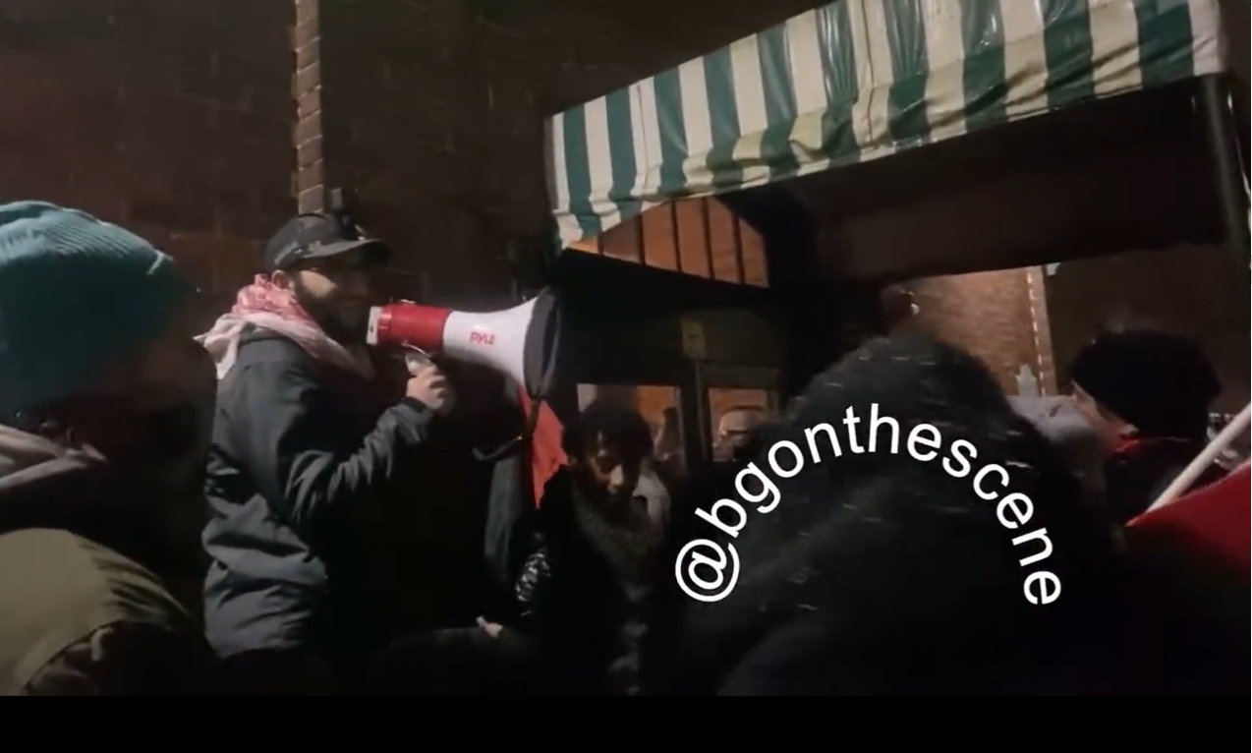
“We cancelled Christmas.”
Notes:
https://www.toddstarnes.com/crime/pro-muslim-mob-disrupts-michigan-christmas-tree-ceremony/

Slide 33
Families were forced to retreat to a nearby building in the hope that a local children’s choir could still sing carols. Unfortunately, the mob broke into that building, too, and deliberately chanted offensive slogans behind the children, drowning out their singing. Some protestors yelled, “Christmas is cancelled everywhere until Palestine is free.”
Notes:
Dr. James Dobson's Family Talk

Slide 34
Fearful reality
in Gaza elementary schools

Slide 35
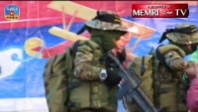
Gaza Kindergarden Graduation
Notes:
https://youtu.be/dtErUuBvcRc?si=oEh6tH49YoLtSA3W
Gaza kindergarten graduation.
0.15 to 2.33

Slide 36
Fearful reality
in Gaza captivity

Slide 37
Eitan Yahalomi, 12, was according to his aunt, in an interview to French television, subjected to unending blows from Palestinian civilians as he was snatched and taken on a motorbike to Gaza captivity. That was just the beginning.
Notes:
Sally Shiff
https://virtualjerusalem.com/reports-of-palestinians-torturing-israeli-mothers-and-childen-emerge/

Slide 38
Eitan was forced to watch, again and again, films of his neighbors being slaughtered and dismembered on October 7. He was threatened at gunpoint if he cried or made sounds.
Other children were kept in total isolation for 12 or 13 days. They were covered with lice and received no treatment.
Notes:
Sally Shiff
https://virtualjerusalem.com/reports-of-palestinians-torturing-israeli-mothers-and-childen-emerge/

Slide 39
Another young hostage, Emily Hand, who turned 9 years old during her captivity in Gaza, only whispers now when she speaks.
“The most shocking, disturbing part of meeting her was she was just whispering, you couldn’t hear her. I had to put my ear on her lips,” her father Thomas Hand said. “She’d been conditioned not to make any noise.”
The 9-year-old girl, held hostage for 50 days, thought she had been in captivity for a year.
Notes:
https://allisrael.com/hostages-returning-from-hamas-captivity-tell-of-starvation-and-horrific-abuse-and

Slide 40
Comparing the release of Palestinian prisoners, who enjoyed internationally lawful conditions including regular ICRC visits, to 3-year-old girls who witnessed their parents' murder and were held against their will, is either a case of severe misinformation or sheer malice,” Eyal wrote in X.

Slide 41
A medical official told the Israeli newspaper Maariv that the released hostages arrived in hospitals "suffering from malnutrition and electrolyte imbalances," according to the World. "Some have substantial weight loss, sensitivity to light, and instinctively talk in whispers," the Times reported.
Notes:
https://davidstent.org/when-justice-and-intercession-are-absent/

Slide 42
The hostages "slept on rows of three chairs tied together, like benches in a waiting room, and had to knock on the door to gain their captors' attention when they needed to use the bathroom," the Washington Post reported. "The wait sometimes lasted several hours."
Notes:
https://davidstent.org/when-justice-and-intercession-are-absent/

Slide 43
According to Israeli media reports, these women were kept in cages, a claim supported by videos from Hamas' Telegram channel in the aftermath of the October 7 attacks.
Survivors, who recently gained their freedom, reported enduring limited food rations and dire living conditions during their captivity.
Notes:
https://www.i24news.tv/en/news/israel-at-war/1701194841-women-were-held-in-cages-israeli-hostage-testimonies-expose

Slide 44
Female hostages were kept in cages, the Hostages and Missing Families Forum, a group set up in the wake of the attack, revealed on Monday.
Children were branded lest they escape, according to Yaniv Yaakov, the uncle of the brothers Or, 16, and Yagil, 12, who were freed on Nov. 27.
Notes:
https://www.israeltoday.co.il/read/israeli-hostages-recount-beatings-death-threats-in-captivity/?mc_cid=12a7093c3c&mc_eid=9f06d9f262

Slide 45
“Every child that Hamas took was taken on a motorcycle, and they took each child and put their leg in front of the exhaust pipe, which caused a burn to mark the children so that in case they ran away or fled, they could find them,” he said.
Notes:
https://www.israeltoday.co.il/read/israeli-hostages-recount-beatings-death-threats-in-captivity/?mc_cid=12a7093c3c&mc_eid=9f06d9f262

Slide 46
Tom Hand, the father of Irish-Israeli Emily Hand, a 9-year-old who was among 13 Israeli hostages freed on Nov. 25, said she was shockingly pale, her faced hollowed out and her head full of lice.
“The most shocking, disturbing part of meeting her was she was just whispering, you couldn’t hear her. I had to put my ear on her lips,” he told CNN on Tuesday. “She’d been conditioned not to make any noise.”
Notes:
https://www.israeltoday.co.il/read/israeli-hostages-recount-beatings-death-threats-in-captivity/?mc_cid=12a7093c3c&mc_eid=9f06d9f262

Slide 48
Hanukkah: Call to Warfare
Occasions of fear
Scriptures on fear
Applications to current war

Slide 49
^{Rev 21.6-8} Then He said to me, “It is done! I am the Alpha and the Omega, the Beginning and the End. To the thirsty I will freely give from the spring of the water of life. The one who overcomes shall inherit these things, and I will be his God and he shall be My son.

Slide 50

^{Rev 21.6-8} But for the cowardly

Slide 51
^{Rev 21.6-8} But for the cowardly
deilos: cowardly, fearful refers to an excessive fear (dread) of "losing," causing someone to be fainthearted (cowardly) – hence, to fall short in following Messiah as Adon, Lord.
Notes:
Courage is NOT the lack of fear, it is doing what is right in spite of fear.

Slide 52
^{Rev 21.6-8} But for the cowardly and unbelieving and detestable and murderers and sexually immoral and sorcerers and idolaters and all liars — their lot is in the lake that burns with fire and brimstone, which is the second death.”
Notes:
Remember Yeshua’s interpretation of murder, includes settled anger. Courage to forgive in relationships.
Yeshua’s interp of immorality is internal as well, images in the mind or on screen!

Slide 53
^{Mt 10.34-36} “Don’t suppose that I have come to bring peace to the Land. It is not peace I have come to bring, but a sword! For I have come to set a man against his father, a daughter against her mother, a daughter-in-law against her mother-in-law, so that a man’s enemies will be the members of his own household.
Notes:
Not all sweet and harmonious.

Slide 54
^{2 Tim. 1.7-10} For God gave us a Spirit who produces not timidity [fear], but power, love and self-discipline. So don’t be ashamed of bearing testimony to our Lord or to me, his prisoner. On the contrary, accept your share in suffering disgrace for the sake of the Good News.
Notes:
Opposite of fear is power to love. Love whom, where? Love yourself, your family, your community, those you are at odds with.

Slide 55
^{2 Tim. 1.7-10} God will give you the strength for it, since he delivered us and called us to a life of holiness as his people. It was not because of our deeds, but because of his own purpose and the grace which he gave to us who are united with the Messiah Yeshua.

Slide 56
^{2 Tim. 1.7-10} He did this before the beginning of time, but made it public only now through the appearing of our Deliverer, the Messiah Yeshua, who abolished death and, through the Good News, revealed life and immortality.

Slide 57
^{2 Tim 2.3-4} Suffer hardship with me, as a good soldier of Messiah Yeshua. No one serving as a soldier entangles himself in the activities of everyday life, so that he might please the one who enlisted him.
Notes:
That is, suffer fearful circumstances.

Slide 58
^{2 Tim. 2.8-9} Remember Yeshua the Messiah, who was raised from the dead, who was a descendant of David. This is the Good News I proclaim, and for which I am suffering to the point of being bound in chains — but the Word of God is not bound in chains!

Slide 59
^{1Yn 4.18-21} There is no fear in love, but perfect love drives out fear. For fear has to do with punishment, and the one who fears has not been made perfect in love. We love, because He first loved us. If anyone says, “I love God,”
Notes:
Not absence of fear, but overcomes by decision of love.
Yeshua based, empowered loving fearlessness.

Slide 60
^{1Yn 4.18-21} and hates his brother, he is a liar. For the one who does not love his brother, whom he has seen, cannot love God, whom he has not seen. And this commandment we have from Him: that the one who loves God should also love his brother.
Notes:
Here is the real application. I am mostly talking about big events: city central, universities, war on another continent. But here is where it hits home. Fear and love. Deal with issues at home, family, congregants, friends. Then we have inner resource to face the global enemies.

Slide 61
^{Lk 21.7-11} And they questioned Him, saying, “Teacher, so when will these things happen? What will be the sign that these things are about to take place?”…When you hear of wars and chaos, do not be terrorized. For these things need to happen first, but the end will not come at once.”

Slide 62
^{Lk 21.7-11} Then He continued telling them, “Nation will rise up against nation, and kingdom against kingdom. There will be great earthquakes along with famines and epidemics in various places, and there will be terrors along with great signs from heaven.

Slide 63
^{2 Cor 10.4-6} The weapons we use to wage war are not worldly. On the contrary, they have God’s power for demolishing strongholds. We demolish arguments and every arrogance that raises itself up against the knowledge of God;

Slide 64
^{2 Cor 10.4-6} we take every thought captive and make it obey the Messiah. And when you have become completely obedient, then we will be ready to punish every act of disobedience.

Slide 65
^{(Isaiah 43:1-5)} But now, this is what Adoni says, He who is your Creator, Jacob, and He who formed you, Israel: “Do not fear, for I have redeemed you. I have called you by name; you are Mine! When you pass through the waters, I will be with you, and through the rivers, they will not overflow you.
Notes:
https://davidstent.org/when-justice-and-intercession-are-absent/

Slide 66
^{(Isaiah 43:1-5)} When you walk through the fire, you will not be scorched, nor will the flame burn you. For I am Adoni your God, the Holy One of Israel, your Savior. I have given Egypt as your ransom, Cush and Seba in exchange for you.
Notes:
https://davidstent.org/when-justice-and-intercession-are-absent/

Slide 67
^{(Isaiah 43:1-5)} Since you are precious in My sight, since you are honored and I love you, I will give other people in your place and other nations in exchange for your life. Do not fear, for I am with you. I will bring your offspring from the east, and gather you from the west
Notes:
https://davidstent.org/when-justice-and-intercession-are-absent/

Slide 68
Surprising to many, God lays out a hierarchy of priorities here: He sees the ransoming of Jewish captives as of a higher priority in a crisis situation than hostages from other nations – whether Egypt, Cush (Ethiopia) or Seba (Yemen). And the Scriptures teach that this divine ‘hostage rescue protocol’ is based on His covenant love for the Jewish people. This applies not only to hostage rescue, but also to YHVH’s international relations and priorities as well.
Notes:
https://davidstent.org/when-justice-and-intercession-are-absent/

Slide 70
Hanukkah: Call to Warfare
Occasions of fear
Scriptures on fear
Applications to current war

Slide 71
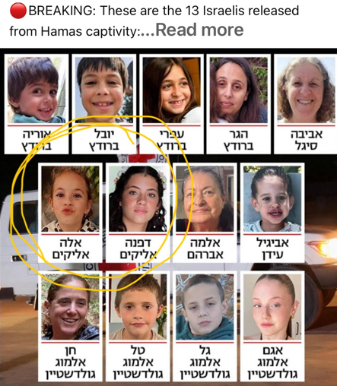
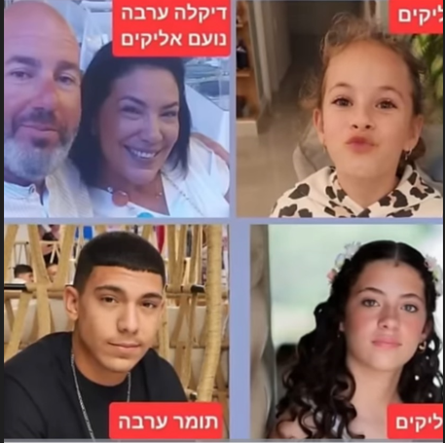
Notes:
Raquel prayed specifically for Dafna 15 and Ella 8

Slide 72

Daniel Pipes was born
into a Jewish family in
Boston, Massachusetts, in 1949. His parents had each fled German-occupied Poland
https://www.meforum.org/
Notes:
The BEST source of info on Israel and the Middle East. Something radical coming, that I’ve said previously…

Slide 73
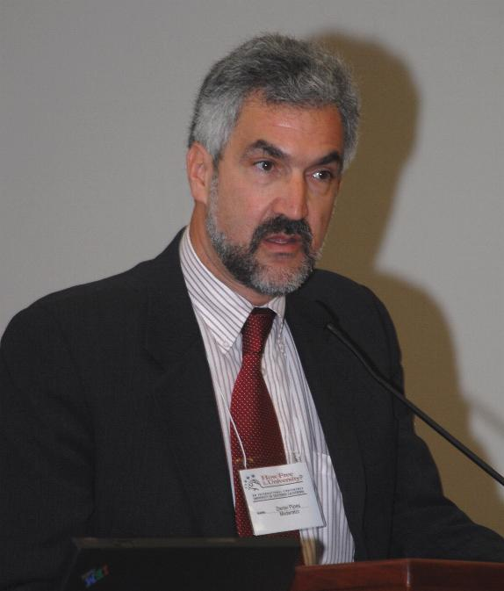
PhD from Harvard in 1978, two years in Cairo, where he continued learning Arabic and studied the Quran, which he states gave him an appreciation for Islam.
Notes:
Perfect Arabic

Slide 74
Daniel Pipes: No matter how dysfunctional, the same attitudes and reflexes reappear ad nauseum: Palestinian rejectionism and Israeli conciliation. [fear world opionion]
Immediately after Oct. 7, it seemed that Israelis had broken with conciliation; now we see that was not the case, at least among the politicians and the security establishment.
Notes:
https://www.meforum.org/65255/daniel-pipes-assessing-the-terrible-israel-hamas?goal=0_086cfd423c-e9c5286f61-33765913&mc_cid=e9c5286f61&mc_eid=2515d15785
Israel gave the Temple Mount away to the Waqf in 1967 in a fit of conciliation.

Slide 75
Daniel Pipes: Where does one start?
1. Benjamin Netanyahu made his name as a counterterrorism specialist who repeatedly insisted that one does not negotiate with terrorists.
Notes:
https://www.meforum.org/65255/daniel-pipes-assessing-the-terrible-israel-hamas?goal=0_086cfd423c-e9c5286f61-33765913&mc_cid=e9c5286f61&mc_eid=2515d15785

Slide 76
2. Israel has a very painful history of releasing security prisoners who then went on to wreak destruction on it; Yahya Sinwar, a leader behind Oct. 7 is just the latest example.
3. Israel passed a law in 2014 forbidding exactly this sort of exchange; how is this legal?
Notes:
https://www.meforum.org/65255/daniel-pipes-assessing-the-terrible-israel-hamas?goal=0_086cfd423c-e9c5286f61-33765913&mc_cid=e9c5286f61&mc_eid=2515d15785
Yaha Sinwar had surgery on a brain tumor in an Israeli hospital. He owes his life and health to Israel.

Slide 77
L'Informale: How will Israel's war against Hamas end: a failure, a half-failure, or victory?
DP: A half failure looks most likely. Perhaps popular dissatisfaction with the war against Hamas will then lead to an anger that brings on a change that ends the historic Israeli mentality of conciliation.
Notes:
https://www.meforum.org/65255/daniel-pipes-assessing-the-terrible-israel-hamas?goal=0_086cfd423c-e9c5286f61-33765913&mc_cid=e9c5286f61&mc_eid=2515d15785

Slide 78
One cannot fight a war if the families of hostages sit in the war room and have a large role in determining strategy.
Palestinian rejectionism and Israeli conciliation [desperate to please the fearful enemies]
Notes:
https://www.meforum.org/65255/daniel-pipes-assessing-the-terrible-israel-hamas?goal=0_086cfd423c-e9c5286f61-33765913&mc_cid=e9c5286f61&mc_eid=2515d15785

Slide 79
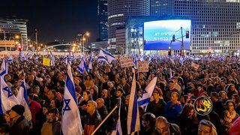
Tel Aviv rally for the release of
hostages
Notes:
https://www.worthynews.com/90992-tel-aviv-rally-calling-for-the-releases-of-all-hostages-draws-over-100000
(Worthy News) – On Saturday night, over 100,000 Israelis gathered in what is now referred to as “Hostage Square” outside the Tel Aviv Museum of Art. The assembly marked the “50 Days of Hell” since Hamas’ attack on Israel on November 7, known as the “Black Sabbath,” during which the terrorist organization abducted approximately 240 hostages.

Slide 80
^{Dan. 11.33} The people who know their God will stand firm and prevail.
Notes:
Know their G-d. Discernment.
Wisdom. Likely first guerilla warfare in history.
What opposition do you face? What will be the price for us to maintain worship. How are we dedicated to the living God?

Slide 81
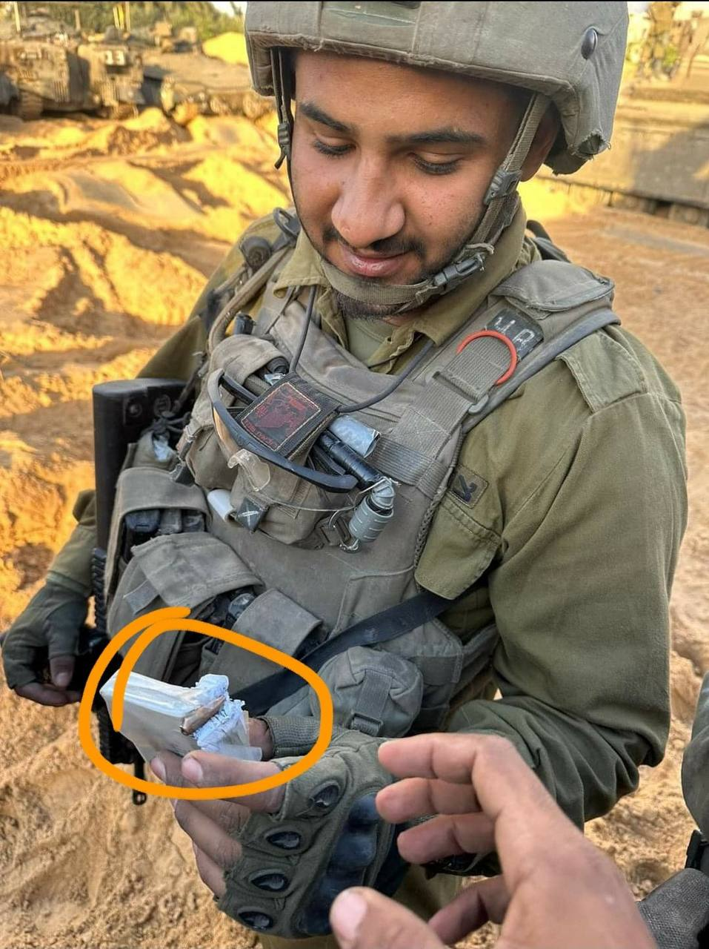
Israeli soldier saved by book of Psalms
^{Psalm 86:17} “Give me a sign of your goodness, that my enemies may see it and be put to shame, for you, Adoni, have helped me and comforted me.”
Notes:
(Worthy Insights) – So, get this – an Israeli soldier had a book of Psalms in his pocket, and it saved him. Some folks might call it a sign. Check out Just another miracle … and yet they happen every day … if you just look around!
https://worthyinsights.com/israeli-soldier-saved-by-book-of-psalms/

Slide 82
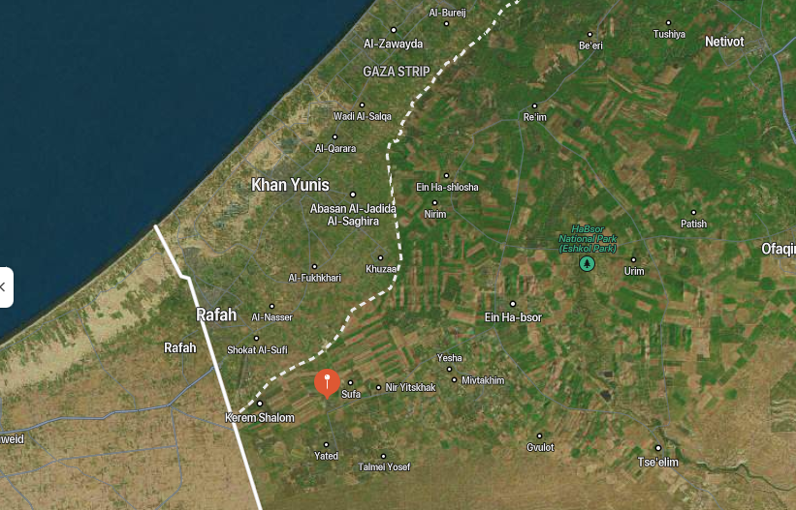
Holit

Slide 83
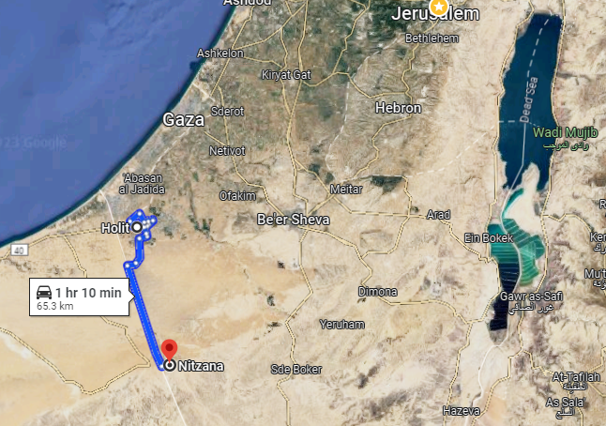

Slide 84
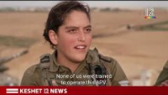
Notes:
Showed in shul 0.47 to 6.59
https://www.youtube.com/watch?v=xjy0wpdSAI0
Kibbutz Holit.

Slide 85
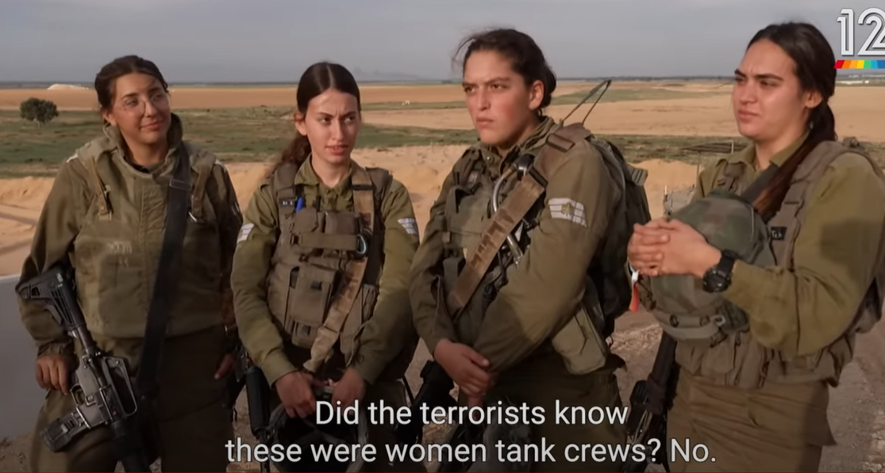
Notes:
https://www.youtube.com/watch?v=xjy0wpdSAI0

Slide 86
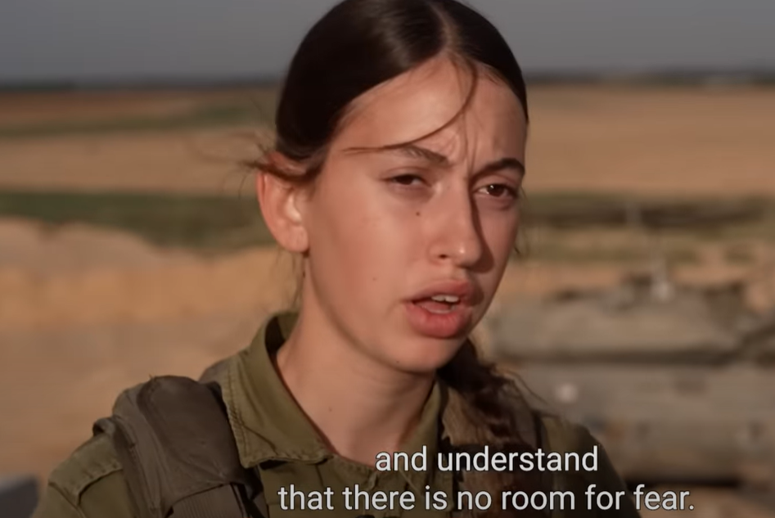
Notes:
https://www.youtube.com/watch?v=xjy0wpdSAI0
0.47 to 6.59

Slide 87
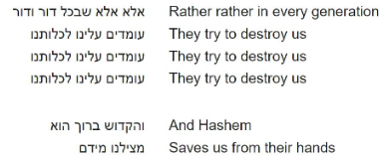
Notes:
www.ulpanor.com
https://www.youtube.com/watch?v=DjPqwkd4-uc

Slide 88
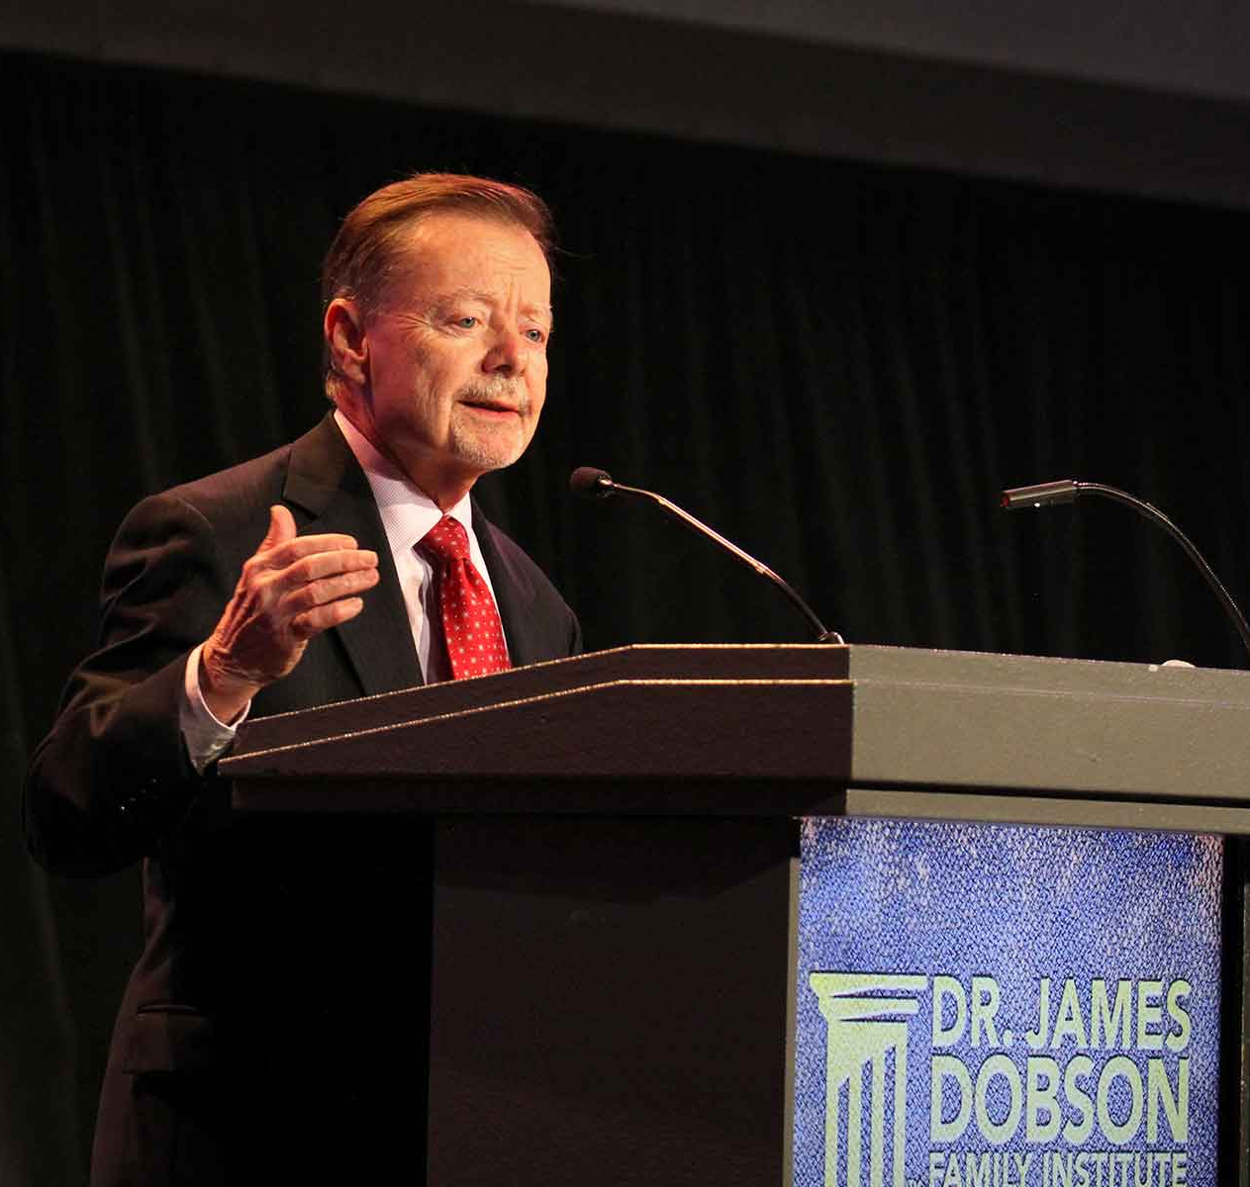
Gary Bauer on James Dobson Family Talk, Nov 29-30

Slide 89
The 1960s had a lot of this stuff we're dealing with, but it was a counterculture. It was challenging the prevalent culture in America. Now it is the culture of America. We're the counterculture. So it's not really the 1960s.
Notes:
https://familytalk.widen.net/view/pdf/7pv50wmktq/11292023CHRISTIANAMERICAATACROSSROADS1.pdf?t.download=true&u=o5dst7

Slide 90
It's a lot closer to the 1850s, quite frankly. In the 1850s, we had one difference of opinion that could not be reconciled, could not be compromised. Either one man could own another man or one man could never own another man. What's the middle ground there?
Notes:
https://familytalk.widen.net/view/pdf/7pv50wmktq/11292023CHRISTIANAMERICAATACROSSROADS1.pdf?t.download=true&u=o5dst7

Slide 91
There had to be a great war. 600,000 people died to prove that no man is born with a saddle on his back. Another man born with spurs to ride him. Well, I can list 10
different things of which there are irreconcilable differences today.
Notes:
https://familytalk.widen.net/view/pdf/7pv50wmktq/11292023CHRISTIANAMERICAATACROSSROADS1.pdf?t.download=true&u=o5dst7

Slide 92
What we're seeing in the streets of America, this hundreds of thousands of people chanting gas to Jews, death to the Jews. There's never been anything like
this in the history of America.
Notes:
https://familytalk.widen.net/view/pdf/7pv50wmktq/11292023CHRISTIANAMERICAATACROSSROADS1.pdf?t.download=true&u=o5dst7

Slide 93
Oh, look, there's been many, many years, many decades when a Jew couldn't get into certain country clubs. Might not be able to get into every college
Notes:
https://familytalk.widen.net/view/pdf/7pv50wmktq/11292023CHRISTIANAMERICAATACROSSROADS1.pdf?t.download=true&u=o5dst7

Slide 94
Did you hear the phone call that one of the men that carried out the massacre made?
Notes:
https://familytalk.widen.net/view/pdf/7pv50wmktq/11292023CHRISTIANAMERICAATACROSSROADS1.pdf?t.download=true&u=o5dst7

Slide 95
our state Department in Pentagon and our president are going to microphones and saying, well, as soon as this trouble is over with, the only long-term solution is two states living side by side in peace. This is insanity.
Notes:
https://familytalk.widen.net/view/pdf/7pv50wmktq/11292023CHRISTIANAMERICAATACROSSROADS1.pdf?t.download=true&u=o5dst7

Slide 96
We're being buried in a blizzard of lies and our children more so than anybody else, lies like there is no God, that America was never great, that our founders were evil, that your son or daughter is trapped in the wrong body.
Notes:
https://familytalk.widen.net/view/pdf/7pv50wmktq/11292023CHRISTIANAMERICAATACROSSROADS1.pdf?t.download=true&u=o5dst7

Slide 97
Revelations 20:8 helpfully lists which people it will be that will be thrown into the lake of brimstone and fire to die a second death, and most of the people on the list won't surprise you. The polluted, murderers, fornicators, sorcerers, idolaters, liars that I didn’t mention. The first group listed cowards. That's the first group that will go into the burning lake, cowards.
Notes:
https://familytalk.widen.net/view/pdf/7pv50wmktq/11292023CHRISTIANAMERICAATACROSSROADS1.pdf?t.download=true&u=o5dst7

Slide 98
They intend to destroy you. They will isolate and crush you. They will dehumanize you. They are already doing that with the words they use to describe us.
Notes:
https://familytalk.widen.net/view/pdf/7pv50wmktq/11292023CHRISTIANAMERICAATACROSSROADS1.pdf?t.download=true&u=o5dst7

Slide 99
They're already putting us in jail. There are grandmothers and grandfathers that didn't push any policemen on January 6th. People in their sixties and seventies in some cases on videotape being welcomed into the Capitol building.
Notes:
https://familytalk.widen.net/view/pdf/7pv50wmktq/11292023CHRISTIANAMERICAATACROSSROADS1.pdf?t.download=true&u=o5dst7

Slide 100
They have been put on trial. They've been found guilty and they have been given sentences worse than carjackers and drug pushers yet in Washington, D.C. Do you think that's because they thought those grandmas and granddads were a threat to the republic?
Notes:
https://familytalk.widen.net/view/pdf/7pv50wmktq/11292023CHRISTIANAMERICAATACROSSROADS1.pdf?t.download=true&u=o5dst7

Slide 101
There's a federal law that prohibits demonstrations outside the homes of federal judges. The Biden Administration’s Justice Department doesn't enforce that law. They're too busy putting grandmothers in the DC jail. What message is that sending?
Notes:
https://familytalk.widen.net/view/pdf/7pv50wmktq/11292023CHRISTIANAMERICAATACROSSROADS1.pdf?t.download=true&u=o5dst7

Slide 102
A few weeks ago, we observed the 22nd anniversary of the attack on 9/11.
Notes:
https://familytalk.widen.net/view/pdf/7pv50wmktq/11292023CHRISTIANAMERICAATACROSSROADS1.pdf?t.download=true&u=o5dst7

Slide 103
The flight that took off from Newark, New Jersey, was United Airlines flight 93. The passengers on that flight found themselves in the middle of a nightmare.
Notes:
https://familytalk.widen.net/view/pdf/7pv50wmktq/11292023CHRISTIANAMERICAATACROSSROADS1.pdf?t.download=true&u=o5dst7

Slide 104
The plane had been hijacked. Several of the stewardesses had their throats cut. The pilot and copilot were dead. The passengers gathered in the back of the plane to talk about what do we do? By the way, there was a disagreement. Some said, "You know what? We need to get back in our seats. The plane’s going to land.
Notes:
https://familytalk.widen.net/view/pdf/7pv50wmktq/11292023CHRISTIANAMERICAATACROSSROADS1.pdf?t.download=true&u=o5dst7

Slide 105
There'll be negotiations. [fearful compliance!] That's the best chance we've got." Other passengers said, "No, no, no. There's something else going on here. We need to fight back." You have any idea of what they did, these Americans who disagreed on the morning that our enemies meant to take down our constitutional republic?
Notes:
https://familytalk.widen.net/view/pdf/7pv50wmktq/11292023CHRISTIANAMERICAATACROSSROADS1.pdf?t.download=true&u=o5dst7

Slide 106
They voted. "Everybody in favor of fighting back, raise your hand. Everybody who thinks we ought to take our seats, raise your hand." The ones that wanted to fight back won the vote.
Notes:
https://familytalk.widen.net/view/pdf/7pv50wmktq/11292023CHRISTIANAMERICAATACROSSROADS1.pdf?t.download=true&u=o5dst7

Slide 107
Now, a lot of these passengers wanted to make a last phone call home. They called mothers and fathers, children, parents simply to say, one more time, I love you. Don’t forget me. Tell the children every day what they meant to me
Notes:
https://familytalk.widen.net/view/pdf/mlkou6md9j/11302023CHRISTIANAMERICAATACROSSROADS2.pdf?t.download=true&u=o5dst7

Slide 108
One of the men on the plane that made one of those calls was a guy, you’ll recognize the name Todd Beamer, a Christian man, a graduate of Wheaton, as fate would have it, when he made his phone call home, the call was redirected by the federal government to the GTE headquarters in Chicago.
Notes:
https://familytalk.widen.net/view/pdf/mlkou6md9j/11302023CHRISTIANAMERICAATACROSSROADS2.pdf?t.download=true&u=o5dst7

Slide 109
They were in charge of the phone system on the plane, and our government wanted to hear from these calls as much information as they could get about what was happening on the plane. And so Todd Beamer didn't get to tell his wife again that he loved her. He was talking to a woman named Lisa Jefferson who worked for GTE, and he extracted from her a promise that she would call his wife and tell her about the phone call.
Notes:
https://familytalk.widen.net/view/pdf/mlkou6md9j/11302023CHRISTIANAMERICAATACROSSROADS2.pdf?t.download=true&u=o5dst7

Slide 110
Lisa Jefferson and Todd Beamer talked for 13 minutes. During that time, and it’s not clear how it happened, they started saying the Lord's Prayer together. Lisa Jefferson said she could hear other passengers joining in, deliver us from evil. Then a little later they recited together the 23rd Psalm. Though I walked through the valley of the shadow of death, I will fear no evil. Shortly after that, Lisa Jefferson said I could tell that Todd was not talking to me anymore. I could hear other people's voices and I heard him say,
Notes:
https://familytalk.widen.net/view/pdf/mlkou6md9j/11302023CHRISTIANAMERICAATACROSSROADS2.pdf?t.download=true&u=o5dst7

Slide 111
"Are you ready? Are you ready to go?" And then the phrase that became iconic, let's roll, as he led the passengers running down the aisle into the teeth of men armed with box cutters. You can hear on the recording the brutal battle that ensues, the screams, the crashing plates and carts and yells. You can even hear at the beginning, one of the hijackers saying to his fellow murderers, they're coming.
Notes:
https://familytalk.widen.net/view/pdf/mlkou6md9j/11302023CHRISTIANAMERICAATACROSSROADS2.pdf?t.download=true&u=o5dst7

Slide 112
Your fellow citizens broke into the cockpit. The struggle ensued. Nobody could get control of the plane. Witnesses on the ground said they saw it beginning to fly erratically and then go into a dive and it crashed into the ground. Everybody on board dead. Did God not hear that phone call? Did He not hear the prayers? Of course he heard them and he answered them. You see, the enemy that day meant for us to endure even more suffering than we did.
Notes:
https://familytalk.widen.net/view/pdf/mlkou6md9j/11302023CHRISTIANAMERICAATACROSSROADS2.pdf?t.download=true&u=o5dst7

Slide 113
That plane was on the way either to the Capitol or the White House or maybe a nuclear power plant. The experts differ, but the disaster would've been even larger than it was. And so God gave those passengers the strength to understand the time it was. They voted, they prayed and then they fought because that was the only option left. By doing so, they saved countless Americans in our country.
Notes:
https://familytalk.widen.net/view/pdf/mlkou6md9j/11302023CHRISTIANAMERICAATACROSSROADS2.pdf?t.download=true&u=o5dst7

Slide 114
I believe that if we will all do that and with some grace from God and strength from God and some protection from God, that five years from now and 50 years from now and 100 years from now or until our Savior returns that the star of David will continue to fly over Jerusalem, the city of the free undivided nation of Israel, and that the stars and stripes will continue to fly over Washington, D.C., the capital of the free and undivided people of the United States of America
Notes:
https://familytalk.widen.net/view/pdf/mlkou6md9j/11302023CHRISTIANAMERICAATACROSSROADS2.pdf?t.download=true&u=o5dst7

Slide 116
Hanukkah: Call to Warfare
Occasions of fear
Scriptures on fear
Applications to current war

Slide 117
^{Daniel 11.33} The people who know their God will stand firm and prevail.

Slide 118
Do you KNOW G-d in Messiah, forgiveness, “Abba Father.”
Are you reading from His word daily and hearing His voice?
Are you doing what He says?
Are you sharing that with others?
Notes:
https://familytalk.widen.net/view/pdf/mlkou6md9j/11302023CHRISTIANAMERICAATACROSSROADS2.pdf?t.download=true&u=o5dst7

