Slide 1
e-handout
To have these notes
without taking notes
Go to OrHaOlam.com
Click on Messages tab,
2023 Messages

Slide 2
Hebrew mini-lesson
1. Adoni starts with the AH sound, as in Father, not the short A sound as in Dad.
Notes:
Use for worship more than general speech.

Slide 3
In honor of Kokeb
Notes:
Story of us rooming on an Israel R2J tour. He left the group to minister in Israel, rejoined us at next hotel.

Slide 4
In honor of Kokeb
2.שָׁכַחְתָּ אֶת מִכְנָסַיִם שֶׁלְּךָ
Sha-khakh-ta et
mikh-na-saim shelkha
You forgot your pants.
Notes:
Repeat….
Past Second person ah ah tah
Et, direct object marker
Dual form
your

Slide 5
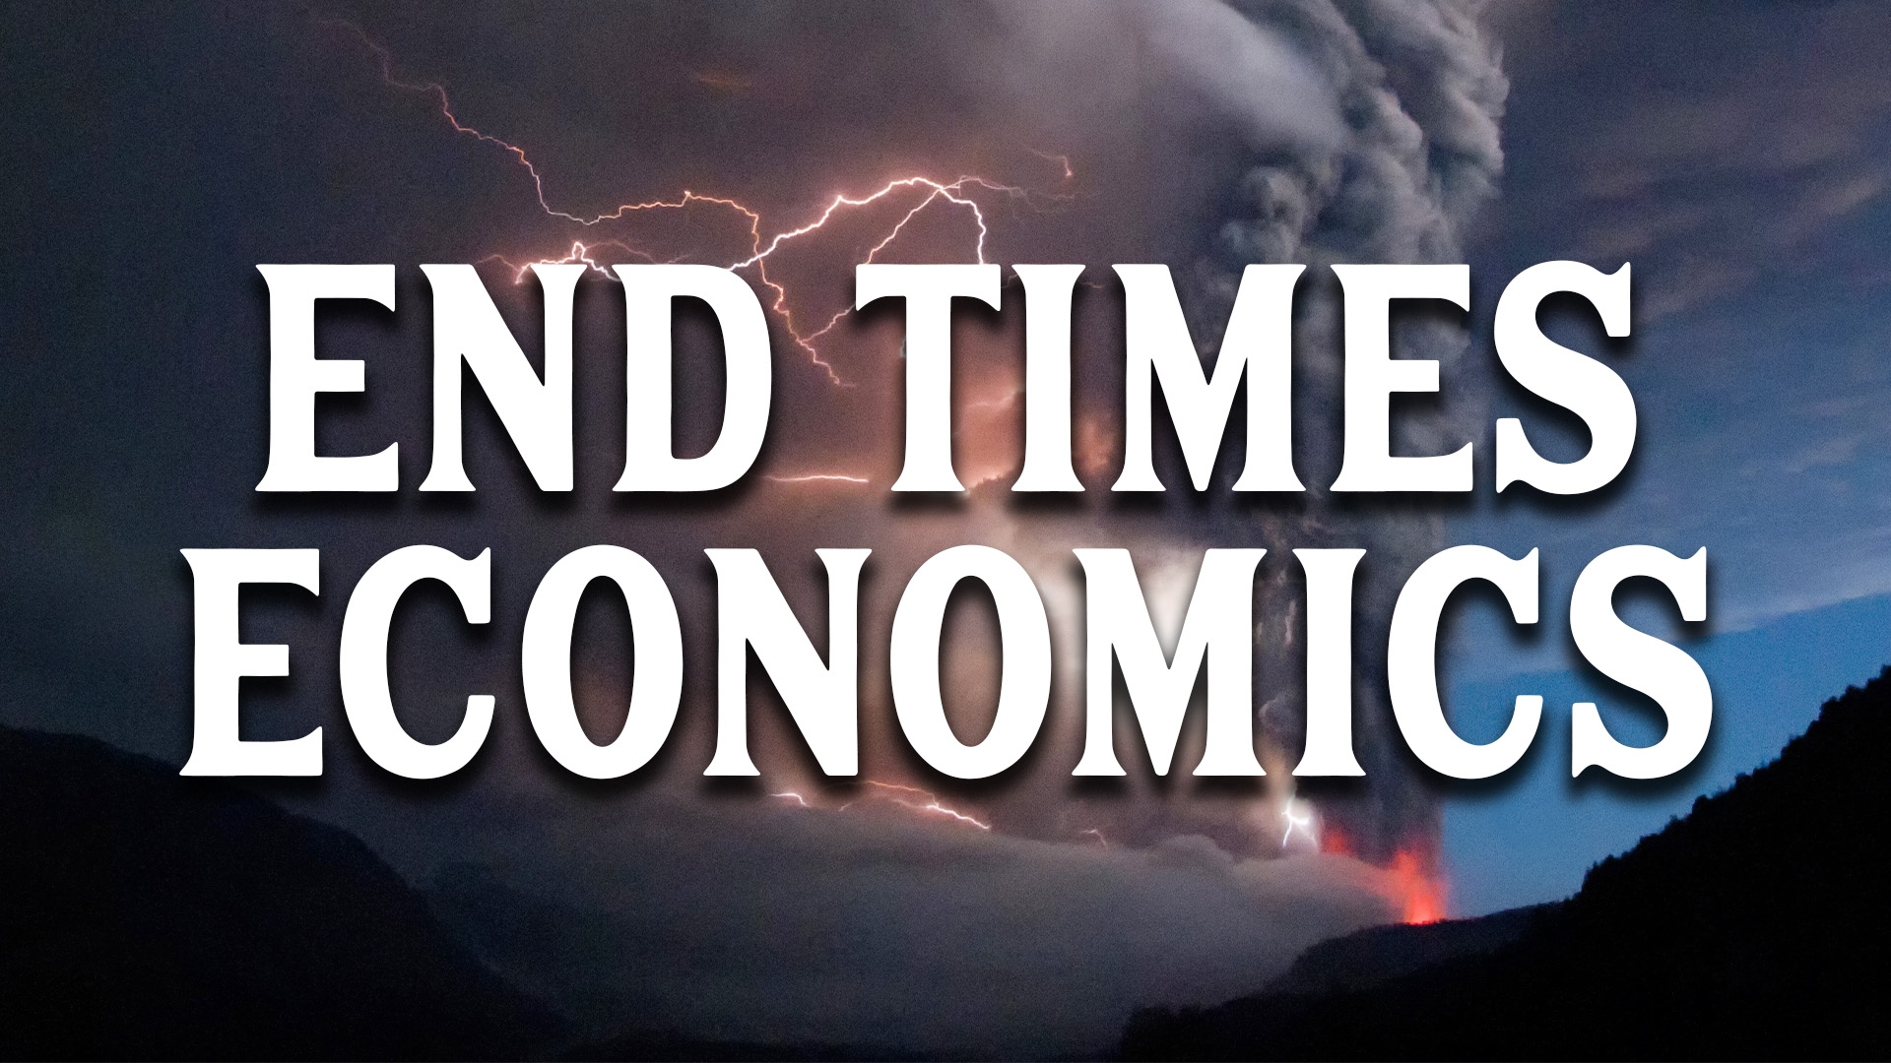
The bad news

Slide 6
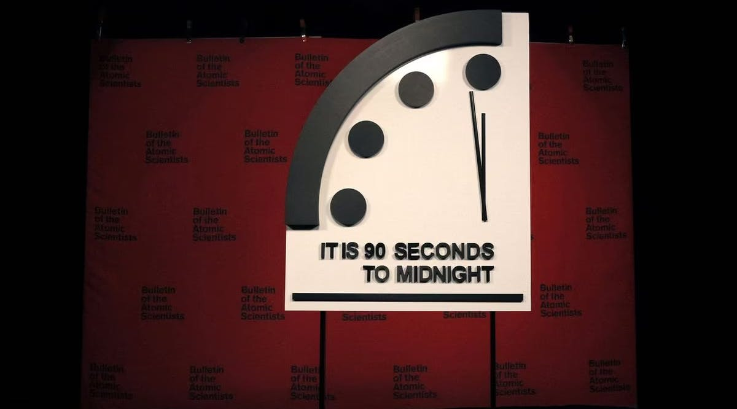
Doomsday Clock World Closer
to Doomsday Than Ever

Slide 7
The Doomsday Clock was first created in 1947 as a metaphorical countdown to the end of the world as we know it.
Upon its unveiling in 1947, the clock was seven minutes to midnight. Since that time, it has moved back and forth a total of 24 different times.
Notes:
https://vfinews.com/news/hezbollah-ramping-up-presence-on-israeli-border/90-seconds-to-midnight-world-closer-to-doomsday-than?subscribed=true&mc_cid=49ac2d3243&mc_eid=UNIQID

Slide 8
Adjusted every January upon review by scientists from the Bulletin of the Atomic Scientists.
This is the closest the clock has ever been to reaching the dreaded midnight. This marks a 10-second change compared to 2022 when the Doomsday Clock was set at 100 seconds to midnight.
Notes:
https://vfinews.com/news/hezbollah-ramping-up-presence-on-israeli-border/90-seconds-to-midnight-world-closer-to-doomsday-than?subscribed=true&mc_cid=49ac2d3243&mc_eid=UNIQID

Slide 9
The change was largely due to the Russian invasion of Ukraine and the subsequently increased possibility of nuclear war.
Notes:
https://vfinews.com/news/hezbollah-ramping-up-presence-on-israeli-border/90-seconds-to-midnight-world-closer-to-doomsday-than?subscribed=true&mc_cid=49ac2d3243&mc_eid=UNIQID

Slide 10
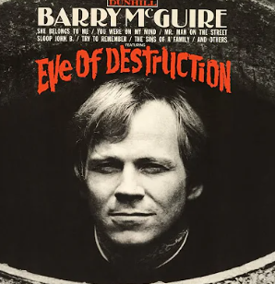

Slide 11
Don't you understand what I'm trying to say?
Can't you feel the fear that I'm feeling today?
If the button is pushed, there's no running away
There'll be no one to save with the world in a grave
Notes:
https://www.songlyrics.com/bob-dylan/eve-of-destruction-lyrics/
Sung by Barry McGuire

Slide 12
Take a look around you boy, it's bound to scare you, boy
But you tell me over and over and over again, my friend
Ah, you don't believe we're on the eve of destruction.
Notes:
https://www.songlyrics.com/bob-dylan/eve-of-destruction-lyrics/
Sung by Barry McGuire

Slide 13
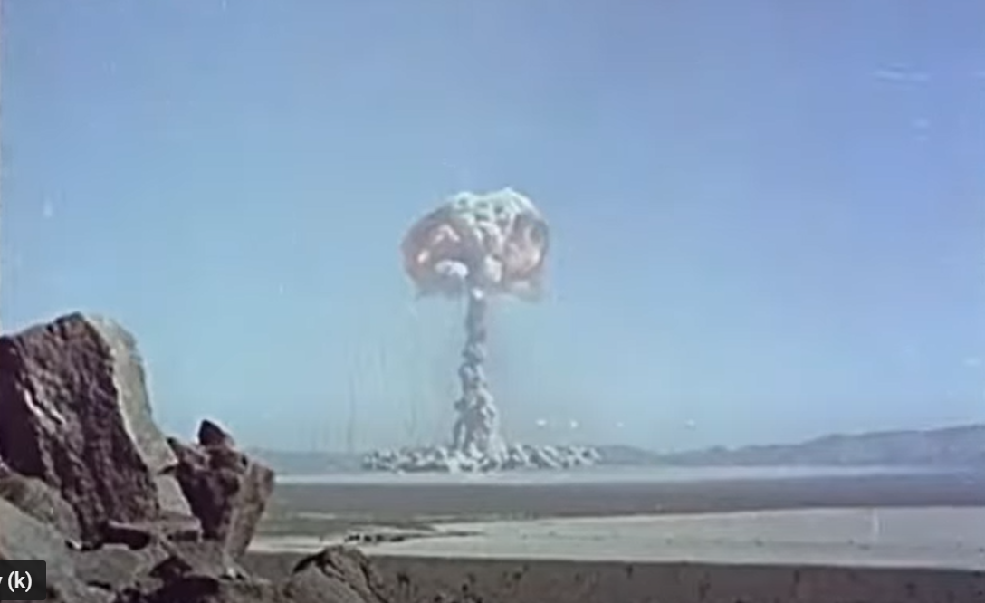
Notes:
Atom bomb

Slide 14
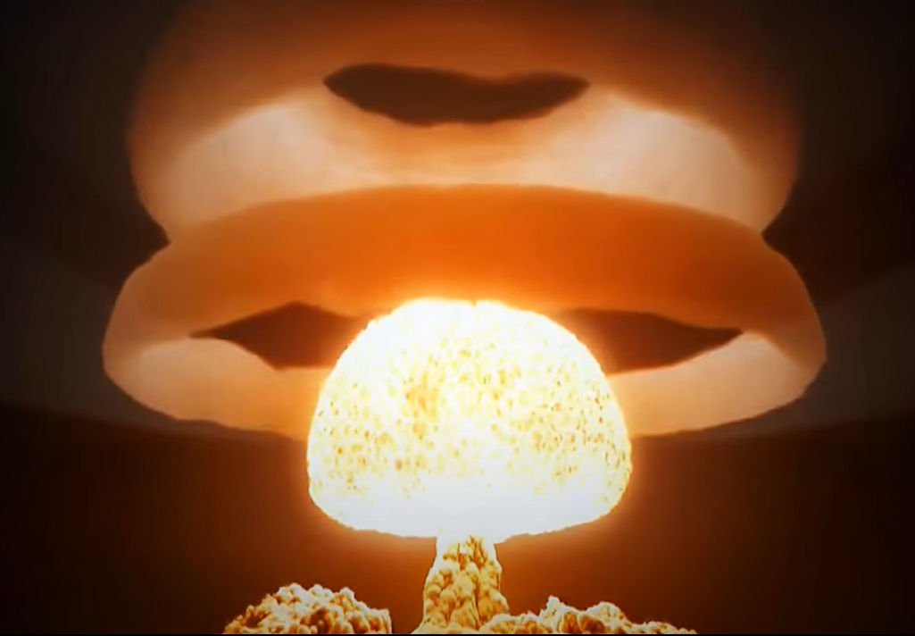
Notes:
https://youtu.be/30EoIh2kADk
Tsar Bomba(s) 1080p ᴴᴰ Novaya Zemlya Russia equal to about 58 megatons of TNT [Mt] (240 PJ)

Slide 15
Mass Layoffs In January alone, Google’s parent company Alphabet announced it would cut 12,000 jobs – 6% of their total workforce. Microsoft cut another 10,000 jobs, while Wayfair cut 10% of its workforce and Amazon cut 18,000 workers.
COVID work force?
Notes:
Morning Wire <morningwire@messages.dailywire.com> Unsubscribe
11:24 AM (17 minutes ago)
to me
Friday, January 27, 2023

Slide 16

Notes:
Morning Wire <morningwire@messages.dailywire.com> (Photo by Daniel Grill via Getty Images)

Slide 17
For example, on Thursday, IBM laid off 3900 employees while SAP, the largest software company in Europe, cut 2800 workers. Economists caution that moves like this are a canary in the coal mine and warn of an ominous economic future.
Notes:
Morning Wire <morningwire@messages.dailywire.com> Unsubscribe
11:24 AM (17 minutes ago)
to me
Friday, January 27, 2023

Slide 18
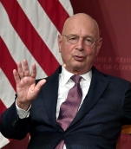
Klaus Schwab is the head of the World Economic Forum; he founded the organization in 1971
Notes:
https://www.cnsnews.com/commentary/ben-shapiro/ben-shapiro-kick-back-relax-and-let-davos-elitists-cure-world

Slide 19
Ben Shapiro: Schwab says, “The future is not just happening. The future is built by us, by a powerful community such as you here in this room”…will cure the world of its ills, so long as we grant them power.
Notes:
https://www.cnsnews.com/commentary/ben-shapiro/ben-shapiro-kick-back-relax-and-let-davos-elitists-cure-world
Great reset?

Slide 20
The hope

Slide 21
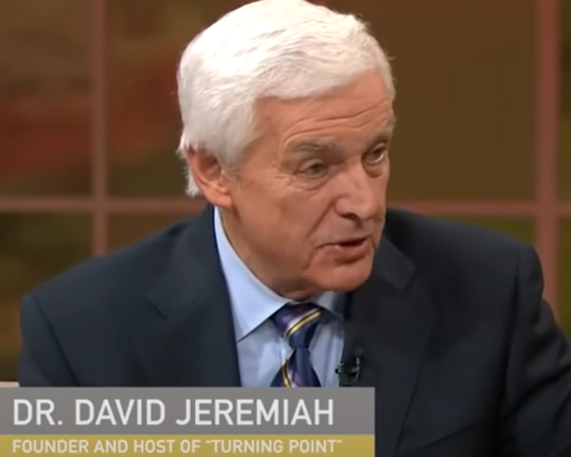
Notes:
https://www.charismanews.com/marketplace/91288-dr-david-jeremiah-shares-7-biblical-principles-to-prepare-for-a-2023-recession

Slide 22
Decide to trust in Adoni.
  ^{Psalm 37:3} "Trust in Adoni, and do good; dwell in the land, and practice faithfulness." Trust is not an emotion, it's a decision you have to make within yourself.
Notes:
https://www.charismanews.com/marketplace/91288-dr-david-jeremiah-shares-7-biblical-principles-to-prepare-for-a-2023-recession
If fear is in the mix, no way to move forward. Fear is paralyzing.
MJ is obedience to a lifestyle of Torah. Not feeling. Worship is the act. Avodah = work = worship.

Slide 23
^{Iyov/Job 3.25-26} What I feared has come upon me; what I dreaded has happened to me. I have no peace, no quietness; I have no rest, but only turmoil.
Notes:
https://www.charismanews.com/marketplace/91288-dr-david-jeremiah-shares-7-biblical-principles-to-prepare-for-a-2023-recession

Slide 24
^{T’hillim /Ps 34.9-10} Fear Adoni, His holy people, For those who fear Him lack nothing. Young lions may lack, and go hungry, but those who seek Adoni want for no good thing.
Notes:
https://www.charismanews.com/marketplace/91288-dr-david-jeremiah-shares-7-biblical-principles-to-prepare-for-a-2023-recession

Slide 25
^{Yeshayahu/Is 12.2} Behold, God is my salvation! I will trust and will not be afraid. For Adoni Adoni is my strength and my song. He also has become my salvation.” Incredible promise…but a decision.

Slide 26
^{T’hillim/Ps 56.3-4} When I am afraid, I put my trust in you. In God, whose word I praise—in God I trust and am not afraid. What can mere mortals do to me?
Notes:
Chris Coursey “Joy Starts Here” weekend.

Slide 27
Do things that honor Adoni. Instead of sitting home and worrying about what you're losing, spend your time giving. It takes the enemy by surprise.
Notes:
https://www.charismanews.com/marketplace/91288-dr-david-jeremiah-shares-7-biblical-principles-to-prepare-for-a-2023-recession
Fear of loss paralyzes us.

Slide 28
Go to hospital. Go to outreach.
^{Mtt 28 19-20} Therefore, go and make people from all nations into talmidim, immersing them into the reality of the Father, the Son and the Ruach HaKodesh,

Slide 29
^{Mtt 28 19-20} and teaching them to obey everything that I have commanded you. And remember! I will be with you always, yes, even until the end of the age.”
Even thinking about serving someone else increase endorphins.

Slide 30
3. Dwell on the faithfulness of Adoni.
Notes:
https://www.charismanews.com/marketplace/91288-dr-david-jeremiah-shares-7-biblical-principles-to-prepare-for-a-2023-recession

Slide 31
^{Ps. 43 2-5} Why do I go about gloomy because of the oppression of the enemy? Send forth Your light and Your truth— let them guide me. Let them bring me to Your holy mountain and to Your dwelling places. Then I will come to the altar of God, to the God of my exceeding joy,
Notes:
Amazing phrase. Consider the Hebrew…

Slide 32

Notes:
Doubled joy of my spinning
Sarah Liberman set this to music.

Slide 33

^{Ps. 43 2-5} and praise You upon the harp —O God, my God. Why are You downcast, O my soul? Why are you murmuring within me? Hope in God, for I will yet praise Him, the salvation
of my
countenance.
Notes:
Praise you = remember all the good things.
Sometimes discouragement, depression makes your cheek muscles sink. Heavy. Can’t smile. He is the salvation/Yeshua of my face.

Slide 34
4. Delight yourself in Adoni.
  ^{T’hillim/Ps 37:4} Delight yourself in Adoni, and He will give you the desires of your heart.
Notes:
https://www.charismanews.com/marketplace/91288-dr-david-jeremiah-shares-7-biblical-principles-to-prepare-for-a-2023-recession
Approaching March of Remembrance and friendly eviction from 74th St. facility, time of fear. CHOSE to trust.
1967 before Six Day War, Schneerson called for a global Tefillin campaign, to see that Jews observe the Mitzvah of wearing Tefillin as a means of ensuring divine protection against Israel's enemies.[154] Speaking to a crowd of thousands of people on May 28, 1967, only a few days before the outbreak of the war, he assured the world that Israel would be victorious
When we were down to 10 people in the sanctuary for COVID, refused CARES $, joy.

Slide 35
^{MJ/Heb 13.15} Through Yeshua then, let us continually offer up to God a sacrifice of praise — the fruit of lips giving thanks to His name.

Slide 36
5. Dedicate your life to Adoni.
^{Psalm 37:5} "Commit your way to Adoni; trust also in Him, and He will bring it to pass." In these hard moments you go back to the simplicity of your faith, the purpose of why you have faith in the first place.
Notes:
https://www.charismanews.com/marketplace/91288-dr-david-jeremiah-shares-7-biblical-principles-to-prepare-for-a-2023-recession

Slide 37
^{Mtt 8.23-27} As He got into the boat, His disciples followed Him. Suddenly a great storm arose on the sea, so that the boat was being covered by the waves. But Yeshua kept on sleeping. So they came and woke Him up, saying, “Master, save us! We’re perishing!”

Slide 38
^{Mtt 8.23-27} He said to them, “Why are you afraid, O you of little faith?” Then He got up and rebuked the winds and the sea, and it became totally calm. The men were amazed, saying, “What kind of person is this? Even the winds and the sea obey Him!”
Notes:
They’d never been in a storm before. We’ve never been in these circumstances before. Little faith

Slide 39
6. Upload your worry to Adoni.
^{T’hillim/Psalm 37:7} "Rest in Adoni, and wait patiently for Him; do not fret because of those who prosper in their way, because of those who make wicked schemes."
Notes:
https://www.charismanews.com/marketplace/91288-dr-david-jeremiah-shares-7-biblical-principles-to-prepare-for-a-2023-recession

Slide 40
Worry is fearing the future. The Bible reminds us that tomorrow has enough problems of it's own and to focus on the day your are living in.
Notes:
https://www.charismanews.com/marketplace/91288-dr-david-jeremiah-shares-7-biblical-principles-to-prepare-for-a-2023-recession
We are to live one day at a time. Daily faith. Hourly faith. Minute by minute. Don’t live in the unlived future. Day tight compartments.

Slide 41
^{Mtt 6.31-34} “Therefore do not worry, saying, ‘What will we eat?’ or ‘What will we drink?’ or ‘What will we wear?’ For the pagans eagerly pursue all these things; yet your Father in heaven knows that you need all these. But seek first the kingdom of God and His righteousness,

Slide 42
^{Mtt 6.31-34} and all these things shall be added to you. Therefore do not worry about tomorrow, for tomorrow will worry about itself. Each day has enough trouble of its own.”

Slide 43

^{T’hillim 118.24} This is the day that Adoni has made!
Let us rejoice and be glad in it!
Notes:
Same as Ps 43. “We will spin and rejoice.”

Slide 44
7. Discipline yourself to wait on Adoni. "Waiting is purifying. Waiting produces patience. Waiting reminds you that while you live in a time zone, Almighty God does not." God allows time between hearing His promises for our life and watching them come to pass, to deepen our trust in Him.
Notes:
https://www.charismanews.com/marketplace/91288-dr-david-jeremiah-shares-7-biblical-principles-to-prepare-for-a-2023-recession
Wait: go out to eat, wait for table, menu, food, dessert, check. And the server is called the waiter.

Slide 45
Discipline yourself
^{Ro 13.8} Don’t owe anyone anything — except to love one another; for whoever loves his fellow human being has fulfilled Torah.
Notes:
I know there are strategies of investment and leveraging, but for me, I am simple.
Our 2011 Mazda CX-9 died at 179k miles. Dawn called me at Rabbi’s Conf, “It won’t start.” “Battery is a year old. Call AAA to tow to Tires Plus.” AAA guy came and said, “Anti-freeze in oil.” Towed to Casey’s and confirmed. $6500 new or rebuilt engine. Not worth it. 2011 vehicle. However, we had been making car payments to the bank for 8 years, and bought the 2019 Volvo XC-90 T-6 Momentum for cash. Now starting payments for the next one.
Live by cash only. [Debit cards OK] If you don’t have the money for something, then it’s G-d’s will for you NOT to buy it. Tear up credit cards, unless pay off monthly. OH practice.

Slide 46
Decide to trust
Do positive things
Dwell on His faithfulness
Delight in Adoni
Dedicate yourself
Upload worry
Discipline yourself

Slide 47
The Doomsday Clock response

Slide 49
^{Iyov/Job 38 4-7} “Where were you when I founded the earth? Tell me, if you know so much. Do you know who determined its dimensions or who stretched the measuring line across it? On what were its bases sunk, or who laid its cornerstone, when the morning stars sang together, and all the sons of God shouted for joy?

Slide 50
^{Ro 8.22} We know that until now, the whole creation has been groaning as with the pains of childbirth.
Notes:
They DON’T know.

Slide 51
Israel WILL survive!

Slide 52
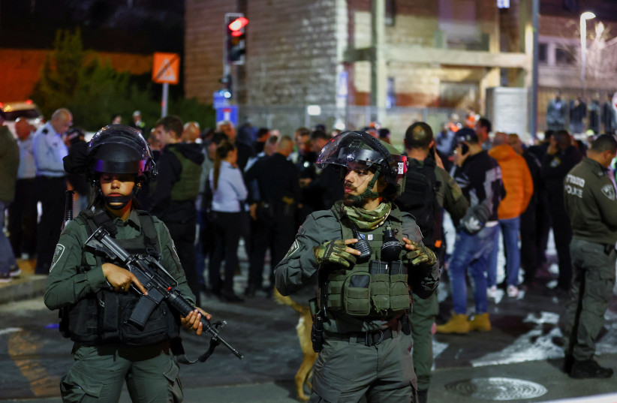
Israel Border Police officers
at the scene of the Neve
Yaakov terror attack
in Jerusalem, January 27, 2023.
Notes:
(photo credit: REUTERS/Ronen Zvulun)
https://www.jpost.com/breaking-news/article-729860
Jerusalem synagogue killing spree leaves seven dead, three injured, done on International Holocaust Remembrance Day

Slide 53
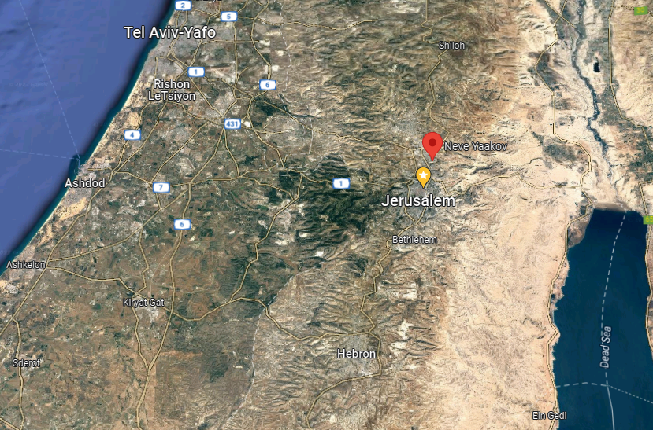

Slide 54
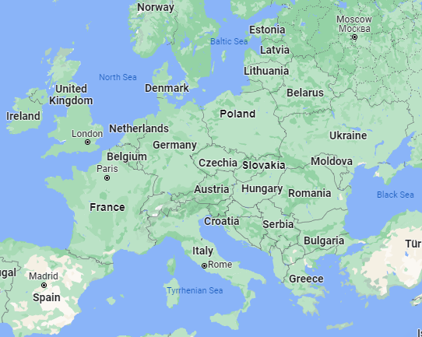

Slide 55
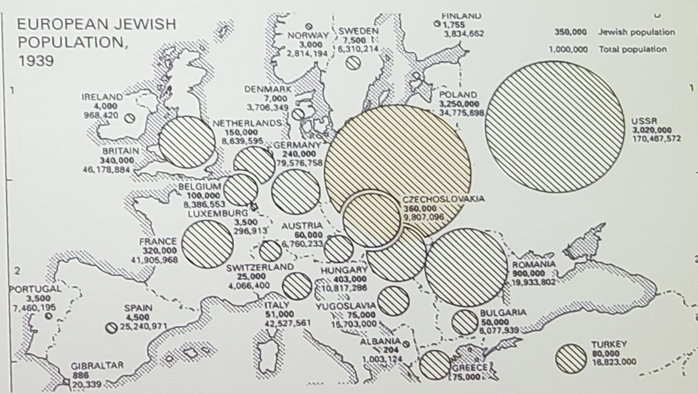
Notes:
The Nazis instituted Extermination Camps because killing civilians by bullets was giving PTSD to the soldiers.

Slide 56
^{Yermiyahu/Jer 31.34-35} Thus says Adoni, who gives the sun as a light by day and the fixed order of the moon and the stars as a light by night, who stirs up the sea so its waves roar, Adoni-Tzva’ot is His Name:

Slide 57
^{Yermiyahu/Jer 31.34-35} “Only if this fixed order departs from before Me” —it is a declaration of Adoni— “then also might Israel’s offspring cease from being a nation before Me—for all time.”

Slide 58
Some good signs

Slide 59
The Trend
A survey conducted by the American Enterprise Institute showed that overall the number of Americans who never attend worship rose from 25% to 33%, but among liberals and those under 30, that number leapt from 30% to almost 45%.
Notes:
Morning Wire is a daily email newsletter exclusively for Daily Wire members.

Slide 60
The large drop among not just people under 30, but also those who have never been married, from rarely attending to never could be a harbinger of lasting change. People in their 20s, who don’t have kids, have always tended to stray from observance, but often come back as they get older or feel a desire to bring their children into their faith.
Notes:
Morning Wire is a daily email newsletter exclusively for Daily Wire members.

Slide 61
Exceptions and Consequences
Some congregations are bucking this trend – and in fact seeing many more worshipers. More traditional congregations are experiencing significant growth - counterintuitively,
Notes:
Morning Wire is a daily email newsletter exclusively for Daily Wire members.

Slide 62
communities that demand more of their members tend to be much more stable than watered down or popularized sects. Biblically based congregations are growing!
Notes:
Morning Wire is a daily email newsletter exclusively for Daily Wire members.

Slide 63
Trends are not set in stone. The United States has had several periods of religious revival in its history in the 19th and 20th Century and we could be on the verge of another.
Notes:
Morning Wire is a daily email newsletter exclusively for Daily Wire members.

Slide 64

Notes:
https://washingtonstand.com/news/the-number-of-children-growing-up-in-intact-families-is-rising

Slide 65
A new analysis from Lyman Stone, a research fellow at the Institute for Family Studies, found that “[s]ince a low ebb around 2014, the share of kids living with their parents has actually risen by about 1.5 percentage points.
Notes:
https://washingtonstand.com/news/the-number-of-children-growing-up-in-intact-families-is-rising
This is not to belittle those who are in single parent circumstances, but to encourage young adults to live pure then marry wisely, and married people to stay together, solve the issues.
Children raised in intact homes are “more likely to be flourishing economically, educationally, and socially” with regard to child poverty, college graduation rates, and rates of incarceration.

Slide 66
I came into the kingdom in chaotic times transformed by radical new births of unlikely candidates. I’m stuck there.
Radical new birth and Biblical living beats the Doomsday Clock!

Slide 67
Do you KNOW Yeshua and walking in TRUST?
Are you hearing daily from His Word?
How are you applying what you heard?
Are you offering that water of life to anyone?

