Slide 1
e-handout
To have these notes
without taking notes
Go to OrHaOlam.com
Click on Messages tab,
2023 Messages
Notes:
You may notice that I’m slowing down in my rate of speech. This is because we may be getting language translation equipment for simultaneous translation.

Slide 2
Notes:
Kathi Hartog

Slide 3
Notes:
Kathi Hartog

Slide 4
In honor of Kokeb
2.שָׁכַחְתָּ אֶת מִכְנָסַיִם שֶׁלְּךָ
Sha-khakh-ta et
mikh-na-saim shelkha
You forgot your pants.
Notes:
Past Second person ah ah tah
Et, direct object marker
Dual form
your

Slide 5
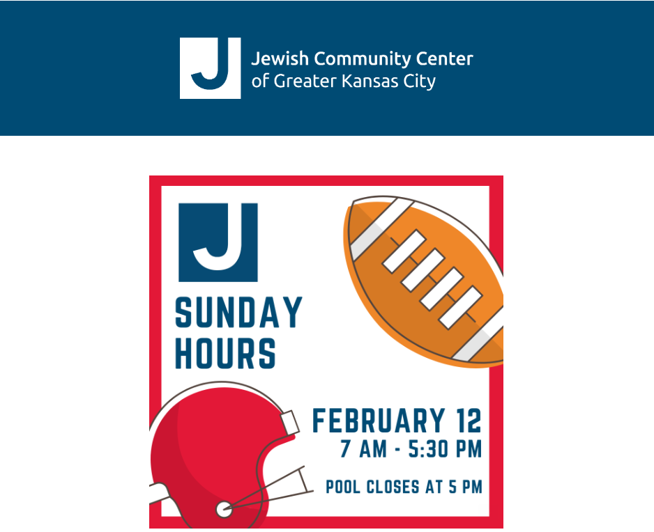
A new holiday closure…

Slide 6
Continuing series in Messianic Jews/ Hebrews

Slide 8
Sacrifice of Praise
Points of Provision
Points of Praise

Slide 9
Sacrifice of Praise
Points of Provision
Points of Praise

Slide 10
^{MJ 13.10-15} We have an altar from which those who serve in the Mishkan/ Tabernacle are not permitted to eat. For the Cohen HaGadol brings the blood of animals into the Holiest Place as a sin offering, but their bodies are burned outside the camp.

Slide 11
^{MJ 13.10-15} So too Yeshua suffered death outside the gate, in order to make the people holy through his own blood. Therefore, let us go out to him who is outside the camp and share his disgrace. For we have no permanent city here;
Notes:
D Leviticus 7:12; 22:29; Psalms 50:14, 23; 107:22; 116:17; 2 Chronicles 29:31

Slide 12
^{MJ 13.10-15} on the contrary, we seek the one to come. Through him, therefore, let us offer God a sacrifice of praise continually. For this is the fruit of lips that acknowledge his name.

Slide 13
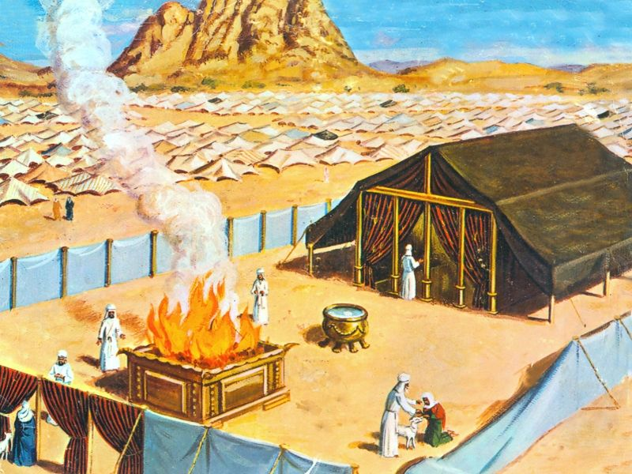
^{MJ 13.10} We have an altar
Mishkan/ Tabernacle of Moshe

Slide 14
^{MJ 8.1-2} He sits at the right hand of HaG’dulah [the great One] in heaven. There he serves in the Holy Place, that is, in the true Mishkan, the one erected not by human beings but by Adoni.

Slide 15
^{MJ 9.11-12} But when Messiah appeared as Cohen Gadol of the good things that have now come, passing through the greater and more perfect Mishkan not made with hands (that is to say not of this creation), He entered into the Holies once for all

Slide 16
^{Yn 20.15-17} Thinking he was the gardener, she said to him, “Sir, if you’re the one who carried him away, just tell me where you put him; and I’ll go and get him myself.” Yeshua said to her, “Miryam!” Turning, she cried out to him in Hebrew, “Rabbani!”

Slide 17
^{Yn 20.15-17} (that is, “Teacher!”) “Stop holding onto me,” Yeshua said to her, “because I haven’t yet gone back to the Father.
Notes:
Some interpret this as that Yeshua had not yet presented the Blood to His Father, in the Court of Heaven, the Ark of the Covenant there.

Slide 18
^{MJ 13.10} We have an altar from which those who serve in the Mishkan/ Tabernacle are not permitted to eat.
Temple/Tab/Mishkan worshipers not allowed at our altar?!?
Notes:
I was at a Yeshiva class with Michael Brown, whom I highly esteem as the premier defender and presenter, apologist, in an MLR class in Branson, and we were talking about the possibly rebuilt Temple in Jerusalem. I said that if the Temple were rebuilt, I would be the first in line to offer a sacrifice. MB looked horrified, since it will be built under the authority of the anti-messiah.
However, Shaul/Paul’s example.

Slide 19
^{Acts 21.26} The next day Sha’ul took the men, purified himself along with them and entered the Temple to give notice of when the period of purification would be finished and the offering would have to be made for each of them.
[End of a Nazirite vow.]

Slide 20
^{Bamidbar/Nu 6.13-15} “Then this is the Torah of the Nazir, Nazirite when his period of separation is over. He must be brought to the entrance of the Tent of Meeting. He is to present his offering to Adoni: ₁a year-old male lamb without flaw as a burnt offering,

Slide 21
^{Bamidbar/Nu 6.13-15} ₂a year-old female lamb without flaw as a sin offering, ₃a flawless ram as a fellowship offering, ₄along with a basket of matzah
And Shaul/Paul had to pay for all this for himself plus 4 men.

Slide 22
∴ “Those who serve in the Mishkan/ Tabernacle are not permitted to eat” is really to be understood:
Stern interprets as: Nonbelievers are not permitted to partake of Yeshua unless and until they put their trust in Yeshua.
Notes:
Hearts are serving. Maybe a reference to Seder of Messiah. Specifically, the metaphorical "eating" is of the spiritual truth available through the Ruach HaKodesh to those who have trusted Yeshua. ﻿

Slide 23
^{MJ 13.11} For the Cohen HaGadol brings the blood of animals into the Holiest Place as a sin offering, but their bodies are burned outside the camp.
A clear Yom Kippur/Day of Atonement allusion.

Slide 24
^{Vayikra/Lev 16.27,30} The bull for the sin offering and the goat for the sin offering, whose blood was brought in to make atonement in the Holy Place, is to be carried outside the camp; there they are to burn up completely their hides, meat and dung…

Slide 25
^{Vayikra/Lev 16.27,30} For on this day, atonement will be made for you to purify you; you will be clean before Adoni from all your sins.

Slide 26
^{MJ 13.10-15} So too Yeshua suffered death outside the gate, in order to make the people holy through his own blood.
Yeshua is our Yom Kippur sin offering!
Notes:
Some of you grew up in the synagogue, and had a long day of beautiful prayers, confessions, sitting standing, sitting standing. No food, no water. It was the right thing to do. But was there forgiveness?

Slide 27
^{Yn 19. 17-20} Then they took Yeshua. He went out, carrying His own crossbar, to the Place of a Skull, which in Aramaic is called Golgotha. Yeshua was put on the stake, and with Him two others, one on each side and Yeshua in between.

Slide 28
^{Yn 19. 17-20} Pilate also wrote a sign and put it on the execution stake. It was written, “YESHUA HA-NATZRATI, THE KING OF THE JEWS.” Many Judeans read this sign, because the place where Yeshua was executed was near the city; it was written in Hebrew, Latin, and Greek.

Slide 29
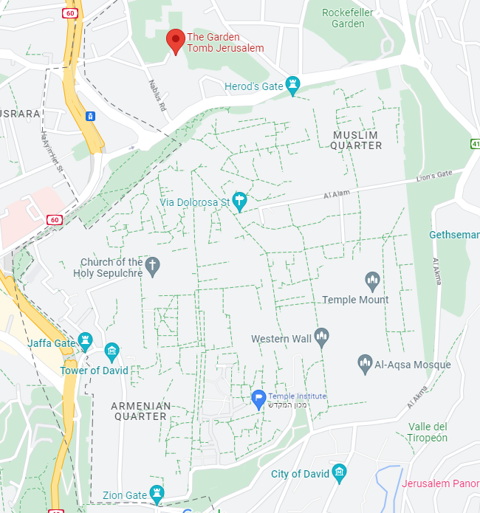
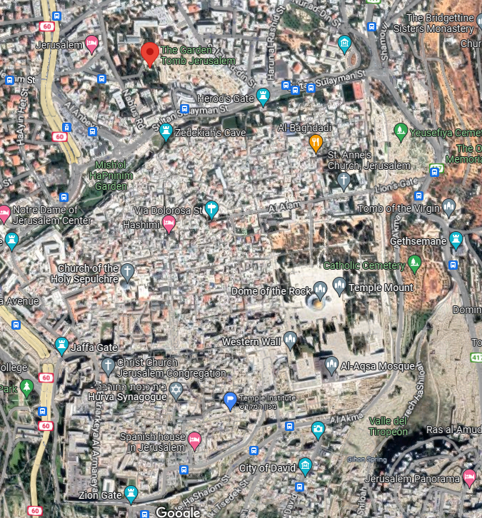
Notes:
Two celebrated possibilities:
The Church of the Holy Sepulchre, RC, now within the walls but in Yeshua’s day not so.
The Garden Tomb, just north of the Damascus Gate on the modern [1500s] walls.

Slide 30
^{MJ 13.10-15} Therefore, let us go out to him who is outside the camp and share his disgrace. For we have no permanent city here. On the contrary, we seek the one to come.
Possible allusion to destruction of the Temple.

Slide 31
Five images
Yeshua was a sin offering. ^{1Cor 5.21} God made this sinless man be a sin offering on our behalf, so that in union with him we might fully share in God’s righteousness.”

Slide 32
^{Vayikra/Lev 4.2,3,12} ‘If anyone sins inadvertently against any of the mitzvot of Adoni…he is to offer Adoni a young bull without defect as a sin offering for the sin he committed... the entire bull — he is to bring outside the camp to a clean place…There he is to burn it on wood with fire.
Notes:
Inadvertently; b’shgagah, בשגגה, as a result of carelessness. Rambam helps us understand that there is still culpability. If the person had been more careful, the violations would not have occurred. My own thinking: sins of evil inclination, tendencies from abuse, trauma, dysfunction, stress, that make us abrasive even abusive unintentionally to others, fit here. Wayward children will use the defects that you didn’t realize, unintentional, to defect from the faith. Is there forgiveness and hope? Consider the great intercessory prayer of Daniel ch 9, set to music by KSM…

Slide 33
^{Daniel 9.18-19} My God, turn your ear, and hear; open your eyes and see how desolated we are, as well as the city which bears your name. For we plead with you not because of our own righteousness, but because of your compassion. Adoni, hear!

Slide 34
^{Daniel 9.18-19} Adoni, forgive! Adoni, pay attention, and don’t delay action — for your own sake, my God, because your city and your people bear your name!”
Notes:
Did Daniel sin? Not that we know of. Maybe praying confession corporately, or maybe for inner issues.

Slide 35
2. Impurity: Just as lepers and other people declared impure had to remain outside the camp in disgrace, Yeshua was executed as a criminal outside the walls.
Notes:
Impure from toxic memories of pornography…plead the power of the Blood of Yeshua’s atonement.

Slide 36
3. Separation: Being outside the camp in disgrace implies not only impurity but separation from the Jewish people. Messianic Jews, who go out to him who is outside the camp to share his disgrace, remain, like him, part of the Jewish people, even though
Notes:
Me and cousin at Mom’s home in Boynton Beach.
Rabbi at the J.
Rabbi’s offer in Jerusalem: if I
prayed in Yeshua’s Name OK, but to Him is idolatry.
Kept a kosher kitchen
Prayed 3x/day
He would write a letter of Jewish authenticity that would be accepted by the Israeli government, Misrad HaPanim, for immigration to Israeli citizenship.

Slide 37
like him, we may not be so regarded. Messianic Gentiles, who identify with Israel, may similarly be regarded as separated from their own people. Outside!
Notes:
Cast out, rejected, abandoned, cancelled!
Basic human needs: Some examples of emotional needs might include feeling appreciated, feeling accomplished, feeling safe, feeling part of a community, privacy, self, meaning.
https://www.mindbodygreen.com/articles/9-emotional-needs-according-to-maslow-s-hierarchy

Slide 38
4. Purification from shame, guilt, condemnation. ^{MJ 9.13-14} For if the blood of goats and bulls and the ashes of a heifer sprinkling those who have been defiled sanctify for the cleansing of the flesh, how much more will the blood

Slide 39
of Messiah—who through the eternal Spirit offered Himself without blemish to God—cleanse our conscience from dead works to serve the living God?
A portable pocket mikvah!
Notes:
Dead works: works that lead to death. Lust, greed, jealousy, pride, rage.

Slide 40
^{Bamidbar/Nu 19.1-3} This is the regulation from the Torah which Adoni has commanded. Tell the people of Isra’el to bring you a young red female cow without fault or defect and which has never borne a yoke. You are to give it to El‘azar the cohen; it is to be brought outside the camp and slaughtered in front of him.
Notes:
Red heifer for purification.

Slide 42
Sacrifice of Praise
Points of Provision
Points of Praise

Slide 43
^{MJ 13.10-15} Through him, therefore, let us offer God a sacrifice of praise continually. For this is the fruit of lips that acknowledge his name.
Notes:
We are going to consider the word “Therefore”

Slide 44
Therefore. What is this connector there for? Yeshua is…
Access to the true altar.
Daily Yom Kippur w/o fasting.
Sin offering constantly available
Portable, pocket mikveh and red heifer..

Slide 46
^{Vayikra/Lev 22:29-30} When you offer a sacrifice of thanksgiving to Adoni, you are to present it so that you may be accepted. It is to be eaten on the same day. You are to leave none of it until the morning. I am Adoni.

Slide 47
^{T’hillim/Ps 50:14-15} Offer thanksgiving as your sacrifice to God, pay your vows to the Most High, and call on me when you are in trouble; I will deliver you, and you will honor me.”

Slide 48
^{T’hillim/Ps 50.23} Whoever offers thanksgiving as his sacrifice honors me; and to him who goes the right way I will show the salvation of God.”

Slide 49
^{T’hillim / Ps 50.21-22} Let them give thanks to Adoni for his grace, for his wonders bestowed on humanity! Let them offer sacrifices of thanksgiving and proclaim his great deeds with songs of joy.

Slide 50
^{T’hillim / Ps 116.17-18} I will offer a sacrifice of thanks to you and will call on the name of Adoni. I will pay my vows to Adoni in the presence of all his people,

Slide 51
^{T’hillim / Ps 107.22} Let them give thanks to Adoni for his grace, for his wonders bestowed on humanity! Let them offer sacrifices of thanksgiving and proclaim his great deeds with songs of joy.

Slide 52
^{Divrei HaYamimm B 2 Chr 29:31} Hizkiyahu responded by saying, “Now that you have consecrated yourselves to Adoni, come close, and bring sacrifices and thank offerings into the house of Adoni. So the community brought in sacrifices and thank offerings, and as many as were willing volunteered burnt offerings.

Slide 53
Luann
As Sean Steckbeck so aptly said, “People are drawn to lovers, not ‘knowers’.”
We were drawn to the joy and sense of community and fellowship. And the teaching has been very eye-opening.

Slide 54
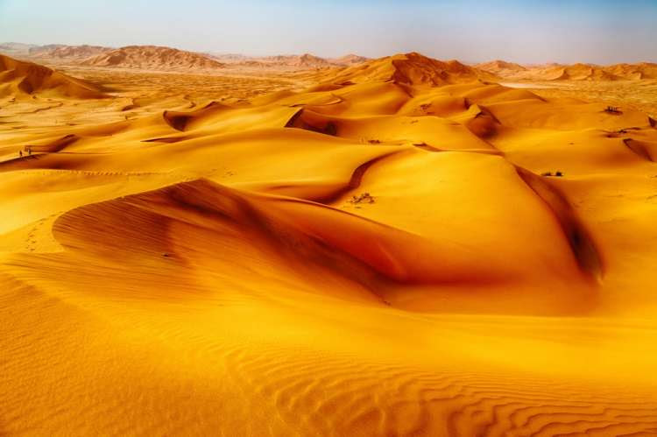
Notes:
Ulpan-Or 3rd Yad Harutzim St. Jerusalem, Yerushalayim 93141 Israel (+972) 2-561-1132

Slide 55
Why was the Torah given in a desert - a desolate and inhospitable locale?
And indeed the Hebrew word Sinai is related (sound-wise) to the Hebrew word for "hatred" (Sin’ah).
It alludes to heightened disdain of the people of Israel for the subterfuges of materialism.
Notes:
Ulpan-Or 3rd Yad Harutzim St. Jerusalem, Yerushalayim 93141 Israel (+972) 2-561-1132

Slide 56
The Sinai desert was not only ownerless but also barren; there was no water and no vegetation to provide food or clothing.
According to the Midrash, God gave the Torah in the desert because He wanted to teach us a fundamental truth about it.
Notes:
Ulpan-Or 3rd Yad Harutzim St. Jerusalem, Yerushalayim 93141 Israel (+972) 2-561-1132

Slide 57
If G-d had given the Torah in a settled area, that would have implied that it was tied somehow specifically to the people of that place.
He therefore gave the Torah in the ownerless desert, making it clear that it does not belong to anybody in particular; anybody that so chooses, can make the Torah their own.
Notes:
Ulpan-Or 3rd Yad Harutzim St. Jerusalem, Yerushalayim 93141 Israel (+972) 2-561-1132

Slide 58
According to the Talmud, God gave the Torah in the desert because He wanted to teach us a fundamental truth about the nature of the study of the Torah.
"If a person humbles himself like the wilderness, which everybody treads upon, then the Torah is given to him as a gift."
Notes:
Ulpan-Or 3rd Yad Harutzim St. Jerusalem, Yerushalayim 93141 Israel (+972) 2-561-1132

Slide 59
It is interesting to note the in Hebrew the root דבר
"DAVAR" is the same one for the following words:
Desert - miDBAR - מדבר
Speak - meDABER - מדבר
Word / Thing - DAVAR - דבר
Notes:
Ulpan-Or 3rd Yad Harutzim St. Jerusalem, Yerushalayim 93141 Israel (+972) 2-561-1132

Slide 60
Commandment - DIBER - דבר
Ten commandments - ASERET HADIBROT - עשרת הדברות
It implies that when a person is in a desert (miDBAR) - remote from obstruction of "noises" of the daily life, he can then be exposed to the real WORD (DAVAR), absorb and internalize it.
Notes:
Ulpan-Or 3rd Yad Harutzim St. Jerusalem, Yerushalayim 93141 Israel (+972) 2-561-1132

Slide 61
^{Shmot/Ex 19.3-4} Moshe went up to God, and Adoni called to him from the mountain: “Here is what you are to say to the household of Ya‘akov, to tell the people of Isra’el: ‘You have seen what I did to the Egyptians, and how I carried you on eagles’ wings and brought you to myself.

Slide 63
^{MJ 13.10-15} Through him, therefore, let us offer God a sacrifice of praise continually. For this is the fruit of lips that acknowledge his name.
Notes:
We are going to consider the word “Therefore”

Slide 64
Do you KNOW Yeshua and in a relationship of praise?
Are you hearing daily from His Word?
How are you applying what you heard?
Are you offering that water of life to anyone?

