Slide 1
e-handout
To have these notes
without taking notes
Go to OrHaOlam.com
Click on Messages tab,
2023 Messages

Slide 2
Summer of 1970 story of spiritual feast.
Notes:
Picked up Dawn after her work as secretary at the Baptist home. Borrowed car, three on the tree, no AC, Cincinnati summer. Told her I was just having a feast in my dorm room. What were you eating? No, revival…

Slide 3


Slide 4
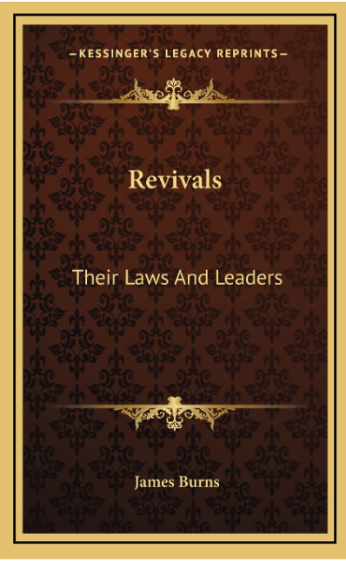
Law of progress
Law of Periodicity
  Ebbing tide
  Fulness of time
The Awakening
A sense of sin against divine love
Notes:
^{Ro 2.4} God’s kindness leads you to repentance.
Only way I could see the evil of my porn, rage. Could justify anything, but not relative to the love of G-d in Yeshua.

Slide 5
Wonderful outburst of joy!
Effect large numbers in the community.
Notes:
Me and “Holy Holy Holy” Mountains and the hills shall break forth with singing.
P 44
Weekly Bible studies that I thought would go on all summer!
P 56

Slide 6
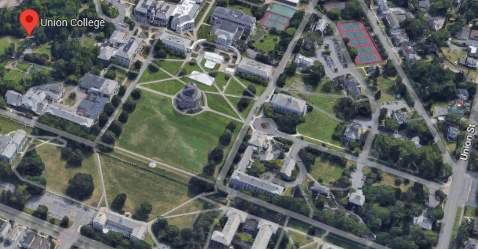

Slide 7
Wonderful outburst of joy!
Effect large numbers in the community.
Law of Variety
Law of recoil
Theology: centered on the execution stake of Yeshua.
Notes:
p 58

Slide 8
Francis of Assisi
Savonarola
Luther
Calvin
John Knox

Slide 9
On Feb. 8th students at Asbury University gathered together in Hughes Auditorium for a chapel service. One week later, that service hasn't stopped. So what happened?

Slide 10
Asbury University Reverend Zach Meerkreebs was preaching to the students about love. Now thousands from around the country have flocked to the sleepy town of Wilmore, Kentucky to partake in the miraculous move of God.

Slide 11
Is it real? Will it last.
Some opinions on site and remote…

Slide 12
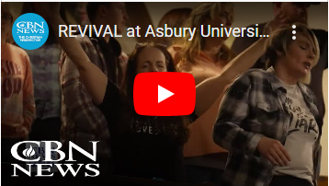
Notes:
https://youtu.be/vkdi7c7Vs6o?t=35
All good, but particularly 0:35 to 2.15

Slide 14
Rabbi Brian Samuel Mishkahn David
North Smithfield, RI
I'm not sure what constitutes a revival, and what the national impact of one would be. But whatever that is, it does seem to be a very good thing that is going on.

Slide 15
It seems to be more focused on holiness, intimacy with God, and love. And less about traditional Pentecostal manifestations (not that there's anything wrong with that, to quote Seinfeld.)

Slide 16
Rabbi Jacob Rosenberg, PhD
Adat Hatikvah Messianic Synagogue, Chicago
All the people I know connected say that this is a real outbreak of the spirit based on repentance and worship.
Notes:
Where my son Daniel attended when he was at IIT in Chicago.

Slide 17
Michael Wolf Beth Messiah, Cinti, OH
I’ve watched some of it, and it seems to have genuine revival earmarks. This is where a revival broke out in the 1700s when itinerant evangelist Francis Asbury preached there during the first great awakening.
Notes:
Where Dawn and I had our first date at their Passover Seder.

Slide 18
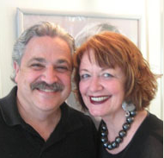
from David and Leslye Schneier
Leader of Beth Hallel, Birmingham, AL Drove about 8 hours
Worship and praise were genuine and powerful. There wasn't any one person that was running this revival.
Notes:
http://www.shalombirmingham.com/index.php/about-beth-hallel/about-rabbi-rebbetzin
Both DC lawyers about 20 years till called into service in Eastern Europe. Crimea.

Slide 19
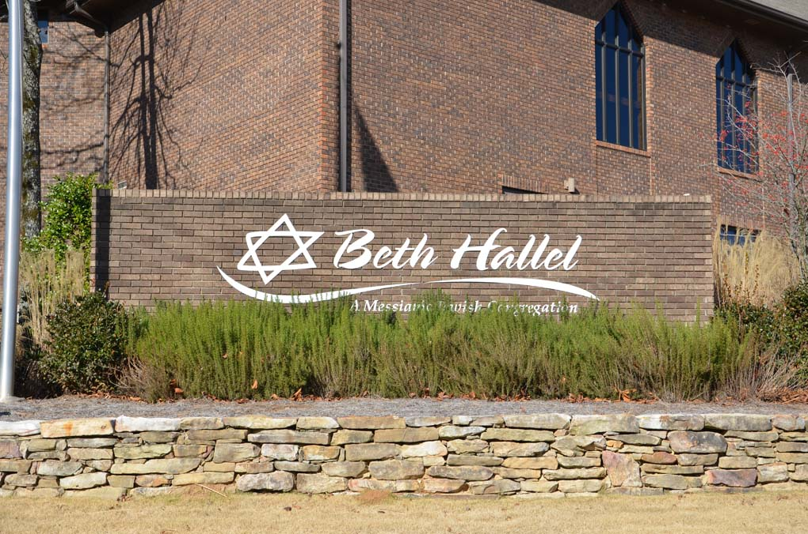
Birmingham, AL

Slide 20
It was student run. No one was looking to be lifted up. Testimonies of students of what had happened to them there were tied to biblical passages. The times of sharing from the word were powerful and simple. People were giving from their time, tithes and talents although no offerings were taken.
Notes:
David and Leslye Schneier

Slide 21
John Wesley: five marks that were true in every genuine work of God.
Yeshua is honored;
Satan’s kingdom is opposed through repentance;
God’s Word is highly regarded;
God’s truth is revealed;
Notes:
David and Leslye Schneier

Slide 22
5. God and others are loved.
This moment of a change of hearts and renewal of trust in the Lord and His word came from the HS which fell on the students at Asbury on February 8th and has continued to this day. It also came because the students prevailed in prayer and the Lord took notice of that.
Notes:
David and Leslye Schneier

Slide 23
Schneiers: Other times G-d moved at Asbury
February 1905, during a blizzard, a prayer meeting in the men’s dormitory spilled out to the rest of campus and the town of Wilmore.
In February 1908, revival broke out while someone prayed in chapel; the revival lasted two weeks and was signified by prevailing prayer and intercession.
Notes:
David and Leslye Schneier

Slide 24
In February 1950 a student testimony led to confessions, victories, and more testimonies. This went on uninterrupted for 118 hours and became the second leading news story nationwide; it is estimated that 50,000 people found a new experience in Messiah
Notes:
David and Leslye Schneier

Slide 25
On Feb. 3, 1970, a revival erupted at what was then Asbury College. That one, also began at a morning chapel service. It lasted 185 hours non-stop. Intermittently it continued for weeks. Ultimately it spread across the United States and to other countries. The revival came during a time of intensity in America, particularly among students.
Notes:
David and Leslye Schneier

Slide 26
Feb. 3, 1970 Demonstrations were taking place at universities nationwide. In May 1970, several unarmed students were shot and killed at Kent State University. That's when revival poured out on our nation! [Including Messianic Jewish awakening!]
Notes:
David and Leslye Schneier

Slide 27
What is this revival focusing on? Reconnecting to the love of God, loving Yeshua again, loving His word and loving your neighbor. The students, the worship teams, those who preach and those who serve have no desire to be known.
Notes:
David and Leslye Schneier

Slide 28
From Sean Steckbeck who travelled to Asbury in Wilmore, KY
Last night as I gazed on the hunger, worship, repentance, confession of sin, love for one another, and simplicity of the weight of God’s glory at Asbury… I couldn’t help but to be arrested by thankfulness.

Slide 29
In the midst of four years in America watching programs, time clocks in the back of sanctuaries for pastors and worship teams to watch a countdown, smoke fog machines, hyped up professional bands, and seeker sensitive attractions,

Slide 30
and even manifestation crazy charismania- I became cynical of the American church. Repentance, hunger, and holiness was replaced with positive messages on identity and positive personal prophecies. As a person who works in missions with the underground persecuted church, it was all hard for me to watch… really hard!!!

Slide 31
Last night one of the students involved in missions and worship team at Asbury repented for his cynicism. I joined him. It turned into thankfulness. God is giving the American believers another chance. I wept in thankfulness!

Slide 32
There were no fog machines, no charismatic hype, the worship teams were good but weren’t professional. Their secret ingredient was hunger. The sound system went out many times and nobody cared. The drums were offbeat. Nobody cared.

Slide 33
It was mostly Gen Zers, younger millennials, and Alpha generation. They didn’t want all the bells and whistles. They didn’t want relevance, they didn’t want hype. They wanted Yeshua!
As we approach the return of the Lord, it gives me great hope that there is a generation that doesn’t need the bells and whistles to spiritually survive what is coming. If they go to jail for their faith; Jesus is enough.

Slide 34
Thank you Yeshua for what you are pouring out! Yeshua satisfies with an unsatiated hunger.
I have hope for the young people of America as I am on a plane to Israel.
Real revival is here, let it spread! Let’s embrace it… including it’s simple sweet form of nameless and faceless hunger!

Slide 35
History of Revivals

Slide 36
^{Shmot/Ex 2.23-25} During those many years the king of Egypt died, but the people of Isra’el still groaned under the yoke of slavery, and they cried out, and their cry for rescue from slavery came up to God. God heard their groaning, and God remembered his covenant with Avraham, Yitz’chak and Ya‘akov. God saw the people of Isra’el, and God acknowledged them.

Slide 37
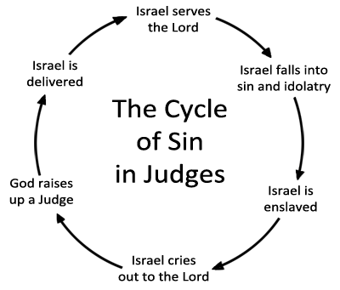
Notes:
https://www.relentlessstudents.com/post/the-judges-cycle

Slide 38
^{Shoftim/Ju 3.9} But when the people of Isra’el cried out to Adoni, Adoni raised up a savior for the people of Isra’el; and he rescued them; this was ‘Otni’el, the son of Kalev’s younger brother K’naz.

Slide 39
^{Shoftim/Ju 3.12,15} But the people of Isra’el again did what was evil from Adoni’s perspective, so Adoni strengthened ‘Eglon the king of Mo’av against Isra’el… But when the people of Isra’el cried out to Adoni, Adoni raised up for them a savior, Ehud the son of Gera

Slide 40
^{Shoftim/Ju 4.1-4, 6} But after Ehud had died, the people of Isra’el again did what was evil from Adoni’s perspective. So Adoni handed them over to Yavin king of Kena‘an…The people of Isra’el cried out to Adoni, because he had 900 iron chariots,

Slide 41
^{Shoftim/Ju 4.1-4, 6} and for twenty years he cruelly oppressed the people of Isra’el. Now D’vorah, a woman and a prophet, the wife of Lapidot, was judging Isra’el at that time… She sent for Barak the son of Avino‘am.

Slide 42
Notes:
https://www.relentlessstudents.com/post/the-judges-cycle

Slide 43
^{Shoftim/Ju 6} Did evil, cried out, Midian oppressed, Gideon

Slide 44
^{1 Shmuel 7.8-10} The people of Isra’el said to Sh’mu’el, “Don’t stop crying out to Adoni our God for us, to save us from the power of the P’lishtim.” Sh’mu’el took a baby lamb and offered it as a whole burnt offering to Adoni. Then Sh’mu’el cried to Adoni for Isra’el, and Adoni answered him.

Slide 45
^{1 Shmuel 7.8-10} As Sh’mu’el was presenting the burnt offering, the P’lishtim advanced to attack Isra’el. But this time, Adoni thundered violently over the P’lishtim, throwing them into such confusion that they were struck down before Isra’el.

Slide 46
^{Divrei HaYamim ב 29.1-6} Hizkiyahu was twenty-five years old when he began his reign…He did what was right from Adoni’s perspective, following the example of everything David his ancestor had done…”For our ancestors acted treacherously, they did what is evil from the perspective of Adoni our God,

Slide 47
^{Divrei HaYamim ב 29.1-6} they abandoned him, they turned their faces away from where Adoni lives and turned their backs on him. They sealed the doors of the vestibule, put out the lamps and stopped burning incense and offering burnt offerings in the Holy Place to the God of Isra’el.”

Slide 48
Because of this, Adoni’s anger has settled on Y’hudah and Yerushalayim; and he has made them an object of horror, astonishment and mocking…After these events and this faithfulness of [Hizkiyahu’s], Sancheriv king of Ashur came, invaded Y’hudah and besieged the fortified cities, thinking that he would break in [and capture] them.
Notes:
Remember the story of Sancheriv’s army 180,000 died overnight, angelic attack.
Repentance, renewal, joy, transformation, protection.

Slide 49
The GREAT Shavuot outpouring.

Slide 50
The (First) Great Awakening
In the New World a series of revivals, known as the Great Awakening, spread through the American colonies between 1725 and 1760.
Notes:
https://decisionmagazine.com/five-key-revivals/

Slide 51
The Second Great Awakening
America’s next revival began in 1801 at the Cane Ridge camp meeting in Kentucky, where as many as 3,000 were converted. The banner year for camp meetings was 1811, when approximately one-third of all Americans attended one of them.
Notes:
https://decisionmagazine.com/five-key-revivals/

Slide 52
By 1806 the Awakening had reached Williams College in Massachusetts. There, five students prayed during a thunderstorm in the shelter of a haystack, four of the five committing themselves to becoming missionaries. The Haystack Prayer Meeting, as it came to be called, was the beginning of the American foreign mission movement.
Notes:
https://decisionmagazine.com/five-key-revivals/

Slide 53
The Prayer Meeting Revival
Beginning as a prayer meeting of six people on Fulton Street in New York City in 1857, the Prayer Meeting Revival spread quickly throughout the world. Over the next two years, a million converts were added to American congregations and a million to congregations in England and Ireland.
Notes:
https://decisionmagazine.com/five-key-revivals/
In the financial district, Wall St.

Slide 54
The Welsh Revival
The Welsh Revival began in 1904 under the preaching of Evan Roberts. Within two years, 100,000 converts were added to the Welsh believers. More than 5 million came to Messiah as the revival spread throughout the world.
Notes:
https://decisionmagazine.com/five-key-revivals/

Slide 55
As part of this same outpouring of the Spirit, revival came in 1906 to a mission led by William Seymour in a dilapidated building on Azusa Street in Los Angeles. The Azusa Street Revival was the formative event of early Pentecostalism.
Notes:
https://decisionmagazine.com/five-key-revivals/

Slide 56
Hazard of Revivals

Slide 57
^{Vayikra/Lev 6.2-6 (9-13)} “Give this order to Aharon and his sons: ‘This is the law for the burnt offering [עולה oleh] : it is what goes up [עלה alah] on its firewood upon the altar all night long, until morning; in this way the fire of the altar will be kept burning. When the fire has consumed the burnt offering on the altar, the cohen, having put on his linen garment

Slide 58
^{Vayikra/Lev 6.2-6 (9-13)} and covered himself with his linen shorts, is to remove the ashes and put them beside the altar. Then he is to remove those garments and put on others, before carrying the ashes outside the camp to a clean place. In this way, the fire on the altar will be kept burning and not be allowed to go out.

Slide 59
^{Vayikra/Lev 6.2-6 (9-13)} Each morning, the cohen is to kindle wood on it, arrange the burnt offering and make the fat of the peace offerings go up in smoke. Fire is to be kept burning on the altar continually; it is not to go out.

Slide 60
^{Vayikra/Lev 9:24} “Fire came out from the presence of Adoni and consumed the burnt offering and the fat portions on the altar. And when all the people saw it, they shouted for joy and fell facedown.”

Slide 61
When G-d begins to move powerfully in your midst, guard the flame carefully, fueling the fire with prayer, with faith, with repentance, with compassionate ministry, with outreach. It is a holy opportunity not to be squandered.
Notes:
https://askdrbrown.org/article/guard-the-holy-flame?vcrmeid=6GFb23W65kKD6tyLTqFniw&vcrmiid=n8-9Ls_siEGdG64--fUPAw

Slide 62
And by all means, let us not quench the fire through pride or stiff traditionalism or spiritual foolishness.
Notes:
https://askdrbrown.org/article/guard-the-holy-flame?vcrmeid=6GFb23W65kKD6tyLTqFniw&vcrmiid=n8-9Ls_siEGdG64--fUPAw

Slide 63
It is my prayer that, in the days ahead, as revival fires burn all across the nation, we may walk worthy of this high and sacred calling.
Let us guard the flame!

Slide 64
^{T’hillim/Ps 85} Restore us, God of our salvation, renounce your displeasure with us. Are you to stay angry with us forever? Will your fury last through all generations? Won’t you revive us again, so your people can rejoice in you?

Slide 65
^{T’hillim/Ps 85} Show us your grace, Adoni; grant us your salvation. I am listening. What will God, Adoni, say? For he will speak peace to his people, to his holy ones — but only if they don’t relapse into folly.

Slide 66
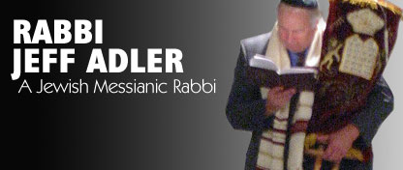
A revival at Asbury in 1970 played a major part in kicking off the Jesus Movement. Recap film currently!!!
Jeff Adler
of Sha’arey
Yeshua in Indy.

Slide 67
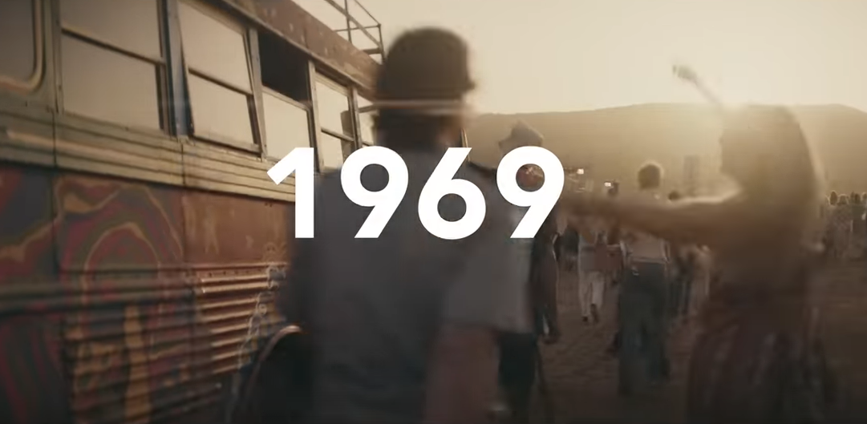
Notes:
If you have a VW Vanagan, from those days, my Daniel in CA says they are trophies worth 100,000s.

Slide 68


Slide 69
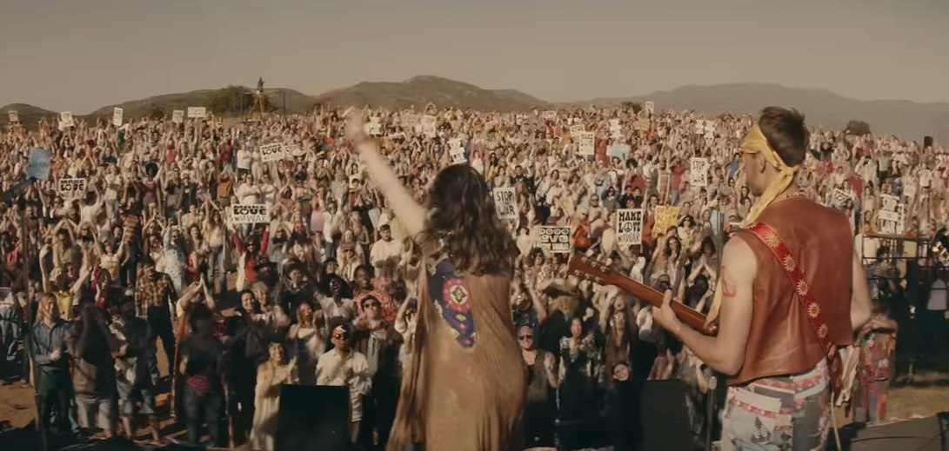

Slide 70
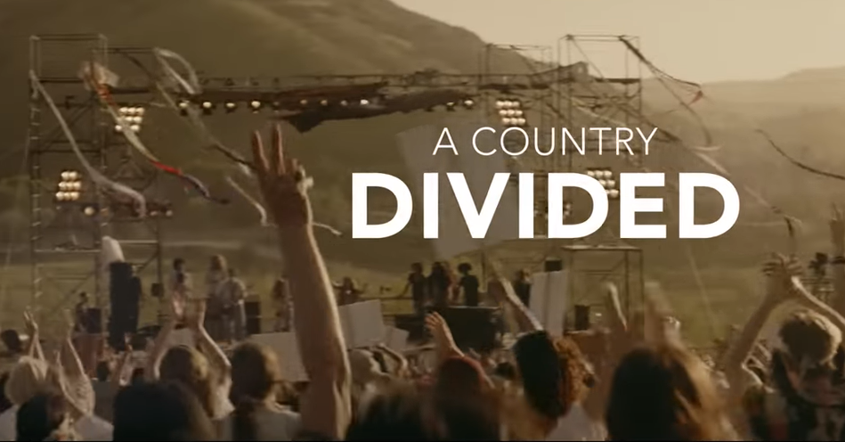

Slide 71
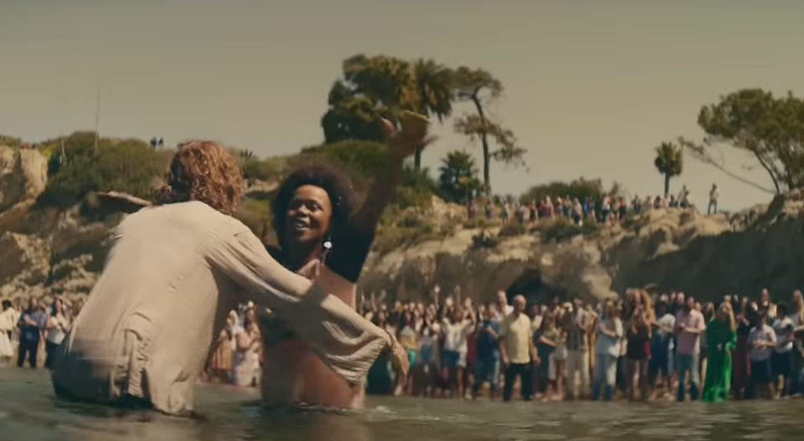

Slide 72
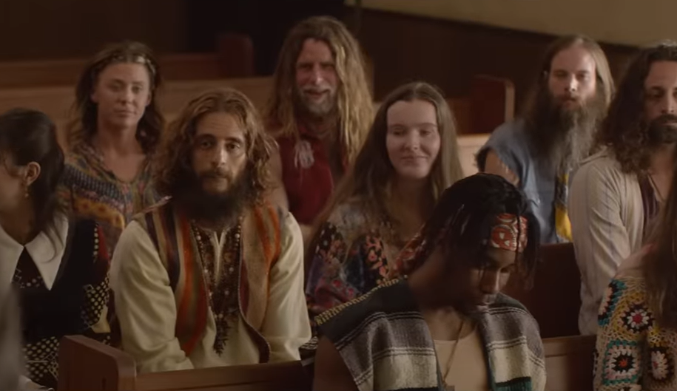
Notes:
It was just like that in Schenectady NY in 1969 to 1970. Barefoot, long hair, bearded in a Conservative Holiness Church. They loved us! Took us in.

Slide 73
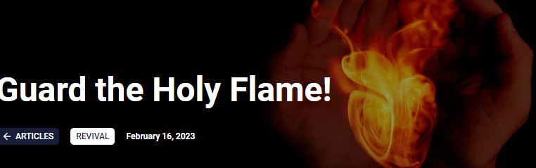

Slide 74
Flame quenchers
Lack of personal repentance
Judgementalism of each other
Unforgiveness of each other
Condemnation of the movement
Prayerlessness
Ceasing to study.
Woke-ism compromise.
Notes:
This is a Christian thing. What about Torah and mitzvot?
Other places of surprising seeking of G-d…

Slide 75
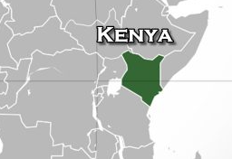
In response to the ongoing drought in his country, the president of Kenya called for a national day of prayer Tuesday.
Notes:
https://www.worthynews.com/83042-kenya-holds-first-national-day-of-prayer-to-ask-for-divine-help-to-end-crippling-drought-we-now-need-god

Slide 76
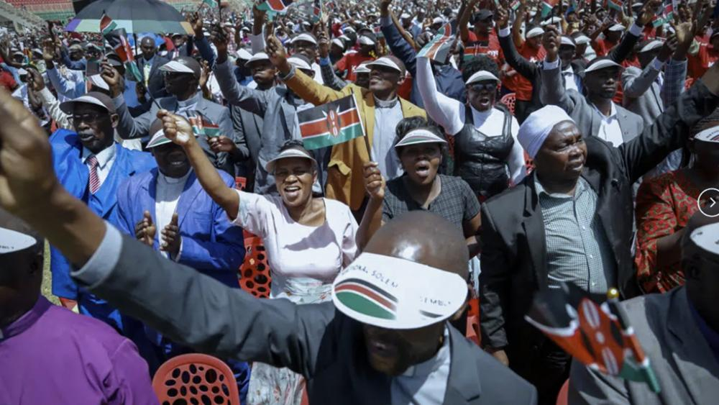
Notes:
Kenyans attend a national day of prayer event held at Nyayo stadium in the capital Nairobi, Kenya, Tuesday, Feb. 14, 2023. (AP Photo/Brian Inganga
https://www1.cbn.com/cbnnews/world/2023/february/kenya-holds-first-national-day-of-prayer-to-ask-for-divine-help-to-end-crippling-drought-we-now-need-god

Slide 77
Kenyan Pres. William Ruto announced the plans for the country's first-ever day of prayer on Sunday at a service in the drought-stricken city of Nakuru, some 100 miles from the capital Nairobi. It follows a joint call by the country's spiritual leaders to dedicate an entire day to prayer to ease drought conditions in the nation.
Notes:
https://www1.cbn.com/cbnnews/world/2023/february/kenya-holds-first-national-day-of-prayer-to-ask-for-divine-help-to-end-crippling-drought-we-now-need-god

Slide 78

Notes:
https://youtu.be/AmvYQ-Zp79A

Slide 79
Prayer
Repentance
Forgiveness
Awakening: Jails quiet
Ecology recovered.
Notes:
https://youtu.be/AmvYQ-Zp79A

Slide 80
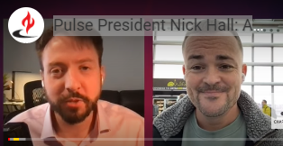
Notes:
https://youtu.be/TzME33kDW5g?t=72
All good, but showing 1.14 to 6:55

Slide 81
Do you KNOW Yeshua and are you fanning the flame of the Ruakh?
Are you hearing daily from His Word?
How are you applying what you heard?
Are you offering that fire to anyone?

