Slide 1
e-handout
To have these notes
without taking notes
Go to OrHaOlam.com
Click on Messages tab,
2023 Messages

Slide 2
What do you call someone who is driving to slow in Missouri?

Slide 3
What do you call someone who is driving to slow in Missouri?
Solomon
Notes:
From Jim Templer, MODOT engineer

Slide 4
What do you call someone who is driving to slow in Missouri?
Solomon
Why? Because they were driving Shlomo!
Jim Templer, MODOT engineer

Slide 5
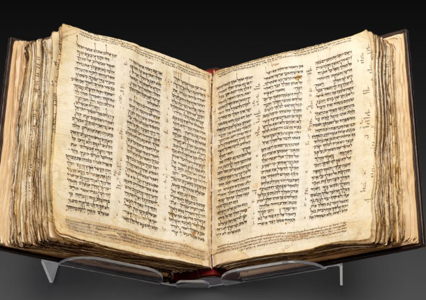

Slide 6
At more than 1,000 years old, the Codex Sassoon is the world’s earliest near-complete Hebrew Bible. Soon, it could also become the “most valuable historical document ever sold at auction,” according to a statement from Sotheby’s. The auction house expects to sell it for between $30 and $50 million in May.
Notes:
https://www.smithsonianmag.com/smart-news/the-oldest-nearly-complete-hebrew-bible-is-going-up-for-auction-180981658/

Slide 7
The Codex Sassoon is roughly a century older than the Leningrad Codex, the oldest entirely complete Hebrew Bible, per Sotheby’s. It’s closer in age to the Aleppo Codex, which dates to around 930—but Aleppo is missing nearly 2/5 of its pages.
Notes:
https://www.smithsonianmag.com/smart-news/the-oldest-nearly-complete-hebrew-bible-is-going-up-for-auction-180981658/

Slide 8
Historians say a scribe wrote out the text on roughly 400 sheets of parchment in the late ninth or early tenth century. Eventually, the book landed at a synagogue in present-day Syria, which was then destroyed around the 13th or 14th century.
Notes:
https://www.smithsonianmag.com/smart-news/the-oldest-nearly-complete-hebrew-bible-is-going-up-for-auction-180981658/

Slide 9
Notes in the codex indicate that its next steward was Salama bin Abi al-Fakhr, who was supposed to keep it safe until the synagogue was rebuilt. It wasn’t rebuilt—and the codex disappeared for the next 600 years.
Notes:
https://www.smithsonianmag.com/smart-news/the-oldest-nearly-complete-hebrew-bible-is-going-up-for-auction-180981658/

Slide 10
It resurfaced in 1929, when British collector David Solomon Sassoon purchased it for £350, Sassoon’s heirs had it until 1978, when the British Rail Pension Fund purchased it for $320,000. It was sold for $3.19 million in 1989.
Notes:
https://www.smithsonianmag.com/smart-news/the-oldest-nearly-complete-hebrew-bible-is-going-up-for-auction-180981658/

Slide 11
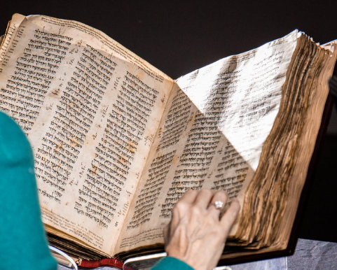
Notes:
https://www.smithsonianmag.com/smart-news/the-oldest-nearly-complete-hebrew-bible-is-going-up-for-auction-180981658/

Slide 12
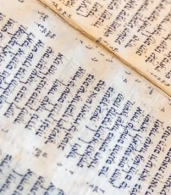
וַיֹּאמֶר שָׁאוּל נֵרְדָה אַחֲרֵי פְלִשְׁתִּים לַיְלָה וְנָבֹזָה בָהֶם עַד-אוֹר הַבֹּקֶר, וְלֹא-נַשְׁאֵר בָּהֶם אִישׁ, וַיֹּאמְרוּ, כָּל-הַטּוֹב בְּעֵינֶיךָ עֲשֵׂה;

Slide 13
In addition to the 24 books of the Hebrew Bible, the Codex Sassoon’s pages also include ownership records and detailed notes on how words should be written and recited.
Notes:
https://www.smithsonianmag.com/smart-news/the-oldest-nearly-complete-hebrew-bible-is-going-up-for-auction-180981658/

Slide 14
Continuing the study in the Book to the Messianic Jews…

Slide 15
^{Mes Jews/Heb 12.14-15} Pursue shalom with everyone, and the holiness without which no one will see the Lord. See to it that no one misses out on God’s grace, that no root of bitterness springing up causes trouble and thus contaminates many.
Notes:
Summary statement of the Book.

Slide 16
1. The challenge

Slide 17
^{Vayikra/Lev 19.2} “Speak to the entire community of Isra’el; tell them, ‘You people are to be holy because I, Adoni your God, am holy.
Notes:
Entire community, not just Aharon first, Elders, 50’s. This all encompassing.
G-d has many attributes: Infinite, Self Existing, immutable, Omniscient, Omnipresent, All Powerful, Self sufficient, All wise, Good, Just, Merciful, Loving, Glorious. This is the first one that G-d urges us to enter into.
This chapter many mitzvot by which to be holy.

Slide 18
^{Vayikra/Lev. 20.26} You people are to be holy for me; because I, Adoni, am holy; and I have set you apart from the other peoples, so that you can belong to me.

Slide 19
^{Shmot/Ex 25.8} They are to make me a sanctuary, so that I may live among them.
Notes:
Ayelet Steckbeck, Yeshiva girl, heard a rabbi explain, “among them” means not just among the camp, but in their spirits. But few are worthy. She determined to be worthy. Eventually came to faith in Messiah, while in the women’s Yeshiva in Jerusalem.

Slide 20
^{Dvarim/Dt. 7.5-7} For you are a people set apart as holy for Adoni your God. Adoni your God has chosen you out of all the peoples on the face of the earth to be his own unique treasure. Adoni didn’t set his heart on you or choose you because you numbered more than any other people — on the contrary, you were the fewest of all peoples.

Slide 21
2. Holiness by mitzvot
and Presence

Slide 22
^{Shmot/Ex 34.29} When Moshe came down from Mount Sinai with the two tablets of the testimony in his hand, he didn’t realize that the skin of his face was sending out rays of light as a result of his talking with [Adoni].

Slide 23
^{T’hillim/Ps 51.11-12} Turn away your face from my sins, and blot out all my crimes. Create in me a clean heart, God; renew in me a resolute spirit.

Slide 24
3. Holiness Promised

Slide 25
^{D’varim 10.12-13,16} “So now, Isra’el, all that Adoni your God asks from you is to fear Adoni your God, follow all his ways, love him and serve Adoni your God with all your heart and all your being; to obey, for your own good,

Slide 26
^{D’varim 10.12-13,16} the mitzvot and regulations of Adoni which I am giving you today…Therefore, circumcise the foreskin of your heart; and don’t be stiffnecked any longer!
Notes:
No on can do this, except a friend who had open heart surgery, and had his pericardial membrane opened for surgery. But, it was closed up later anyway.
No one can perfectly reflect the character of G-d, keep mitzvot.

Slide 27
^{D’varim 30.5-6} Adoni your God will bring you back into the land your ancestors possessed, and you will possess it; he will make you prosper there, and you will become even more numerous than your ancestors.

Slide 28
^{D’varim 30.5-6} Then Adoni your God will circumcise your hearts and the hearts of your children, so that you will love Adoni your God with all your heart and all your being, and thus you will live.
Notes:
Not exclusively THEN, but a new level of return!! Seen in the modern State of Israel.

Slide 29
^{Yeshayahu/Is 61.1-3} The Ruach of Adoni Elohim is on me, because Adoni has anointed me to proclaim the year of the favor of Adoni and the day of vengeance of our God;

Slide 30
^{Yeshayahu/Is 61.1-3} to comfort all who mourn, yes, provide for those in Tziyon who mourn, giving them garlands instead of ashes, the oil of gladness instead of mourning, a cloak of praise instead of a heavy spirit,

Slide 31
^{Yeshayahu/Is 61.1-3}, so that they will be called oaks of righteousness planted by Adoni, in which he takes pride.

Slide 32
^{Yekhezkael/Ezk 37.12-14} Therefore prophesy; say to them that Adonai Elohim says, ‘My people! I will open your graves and make you get up out of your graves, and I will bring you into the land of Isra’el. Then you will know that I am Adoni —.”

Slide 33
^{Yekhezkael/Ezk 37.12-14} when I have opened your graves and made you get up out of your graves, my people! I will put my Spirit in you; and you will be alive. Then I will place you in your own land; and you will know that I, Adoni, have spoken, and that I have done it,’ says Adoni.”

Slide 34
^{Yoel 3.1-5} After this, I will pour out my Spirit on all humanity. Your sons and daughters will prophesy, your old men will dream dreams, your young men will see visions; and also on male and female slaves in those days I will pour out my Spirit…At that time, whoever calls on the name of Adoni will be saved.
Notes:
Combination of mitzvot, doing right, and Presence.

Slide 35
^{Yermiyahu 31.30-33} “Here, the days are coming,” says Adoni, “when I will make a ₁new covenant with the house of Isra’el and with the house of Y’hudah. It will not be like the covenant I made with their fathers on the day I took them by their hand and brought them out of the land of Egypt…

Slide 36
^{Yermiyahu 31.30-33} For this is the covenant I will make with the house of Isra’el after those days,” says Adoni: “I will put my Torah within them and write it on their hearts; I will be their God, and they will be my people. No longer will any of them teach his fellow community member or his brother,

Slide 37
^{Yermiyahu 31.30-33} ‘Know Adoni’; for all will know me, from the least of them to the greatest; because ₂ I will forgive their wickednesses and remember their sins no more.”
Notes:
A promise of entering into Holiness.

Slide 38
4. Holiness Imparted

Slide 39
^{LK.22.20} He took the cup after the meal, saying, “This cup is the new covenant in My blood, which is poured out for you.

Slide 40
^{Mtt 26.28} For this is my blood,
Notes:
Some mss. say: new covenant.

Slide 41
^{Mtt 26.28} [which ratifies] the New Covenant, my blood shed on behalf of many,
Notes:
Some mss. say: new covenant.

Slide 42
^{Mtt 26.28} so that they may have their sins forgiven.
Notes:
Some mss. say: new covenant.
Corresponds to Jeremiah: term “New Covenant” forgiven.
Implied: imparted holiness.
Duality of Mitzvot and presence!

Slide 43
^{2 Cor.3.18} But we all, with unveiled face beholding as in a mirror the glory of the Lord, are being transformed into the same image from glory to glory—just as from the Lord, who is the Spirit.

Slide 44
5. Holiness and the Holy Spirit

Slide 45
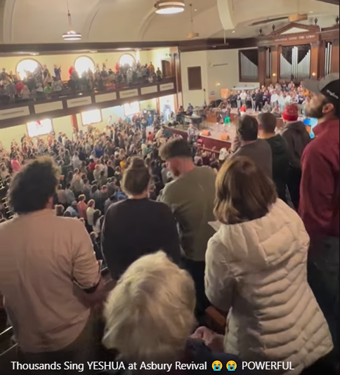
Thousands sing Yeshua at the Asbury Revival
Notes:
https://fb.watch/iRXSi0CBG_/

Slide 46
My Thoughts on the Asbury Revival Phil Cohen
On Wednesday, February 8, 2023, Pastor Zach Meerkreebs shared a devotional with a handful of students at a small Christian college in the remote town of Wilmore, Kentucky. He encouraged students to “sit in the love of God—to taste, see, and experience the power of the Holy Spirit.”
Notes:
From my friend Phillip Cohen

Slide 47
Asbury received word that the movement has traveled to other college campuses
University of Kentucky
Eastern Kentucky University
Kentucky Christian
Christ for the Nations in Dallas, Texas
Notes:
https://fox56news.com/news/local/asbury-university-revival-sparks-global-movement/amp/
From Josie Rothman

Slide 48
Jackson High School in Jackson, Georgia
Cedarville University in Cedarville, Ohio
Ohio Christian University
Lee University, Tennessee
Bethel in Austin, Texas
Notes:
https://fox56news.com/news/local/asbury-university-revival-sparks-global-movement/amp/
From Josie Rothman

Slide 49
Park University in Parkville, MO
Indiana Wesleyan University
The Gate Church Charlotte in North Carolina
King’s Way Church in Birmingham, Alabama
Kingdom Life Church in Waterville, Maine
Notes:
https://fox56news.com/news/local/asbury-university-revival-sparks-global-movement/amp/
From Josie Rothman

Slide 50
What about Asbury University?
Is it sound doctrinally?
Does it apply to our quest for holiness?

Slide 51
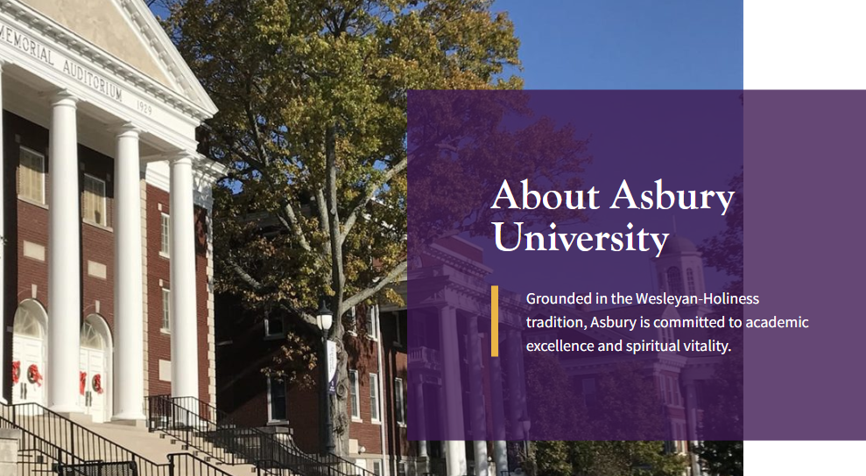
Notes:
https://www.asbury.edu/about/

Slide 52
Asbury U Statement of faith
That entire sanctification is that act of divine grace, through the baptism with the Holy Spirit, by which the heart is cleansed from all sin and filled with the pure love of God.
Notes:
https://www.asbury.edu/about/spiritual-vitality/

Slide 53
contd This is a definite, cleansing work of grace in the heart of a believer, subsequent to conversion, resulting from full consecration and faith in the cleansing merit of the blood of Messiah Yeshua.
Notes:
https://www.asbury.edu/about/spiritual-vitality/

Slide 54
That the Holy Spirit bears witness both to the new birth and to entire sanctification, enables the believer to live a godly life, to grow in the graces of the Spirit, and to walk blamelessly in His holy commandments.
Notes:
https://www.asbury.edu/about/spiritual-vitality/

Slide 55
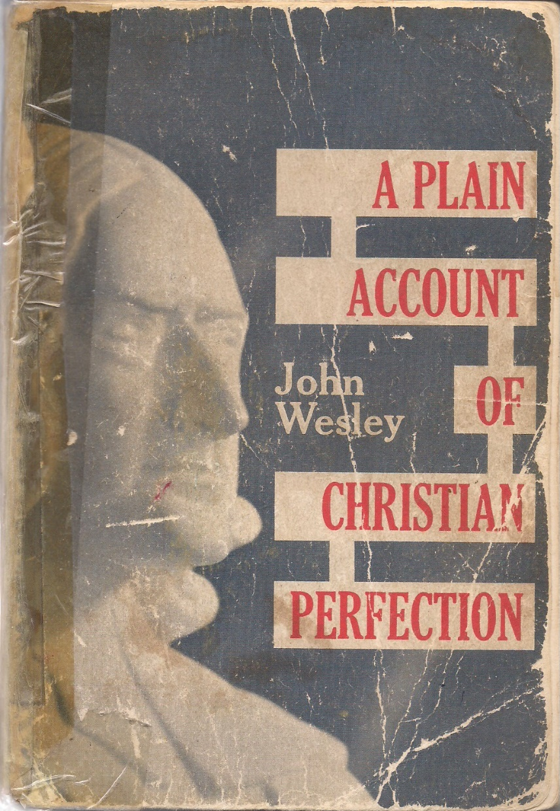
Entire sanctification?

Slide 56
Entire sanctification he described in 1790 as the "grand depositum which God has lodged with the people called 'Methodists'." Wesley taught that entire sanctification was obtainable after justification by faith, between justification and death. Wesley defined it as:
Notes:
https://en.wikipedia.org/wiki/John_Wesley

Slide 57
"That habitual disposition of soul which, in the sacred writings, is termed holiness; and which directly implies, the being cleansed from sin, ‘from all filthiness both of flesh and spirit;’
Notes:
https://en.wikipedia.org/wiki/John_Wesley

Slide 58
and, by consequence, the being endued with those virtues which were in Messiah Yeshua; the being so ‘renewed in the image of our mind,’ as to be ‘perfect as our Father in heaven is perfect."
Notes:
https://en.wikipedia.org/wiki/John_Wesley

Slide 59
John Wesley was the first to articulate that there is another significant experience in the life of believers after the new birth. Other terms:
Filled with the Spirit
Immersed in the Spirit
Indwelling of the Spirit
Notes:
I grew up spiritually under this teaching. I never really experience Entire Sanctification, although apparently some did.

Slide 60
Or HaOlam Statement of Faith https://orhaolam.com/uploads/Statement_of_Faith.pdf
5. I am enjoying or seeking the indwelling of the Holy Spirit, empowering me to live a holy and effective life.

Slide 61
6. Holiness Revival History

Slide 62
In 1700s England, poverty was widespread and endemic. One out of every four women were prostitutes, many of them as young as eight years old. Thousands died annually from syphilis and gonorrhea. Crime abounded. Slavery was widespread and brutal. Gambling widespread, whole country was a casino.
Notes:
https://seedbed.com/wesley-wrath-revival-changed-nation/

Slide 63
The Wesleyan Methodist movement grew rapidly, numbering 450,000 members by the end of the 1800s.
The slave trade was abolished, huge social gains by spiritual reformation!
Notes:
https://www.britannica.com/topic/Methodism#ref466642
Most say that the Wesleyan revival is the reason England did not have the violent destructive revolution that the French did.
There were spiritual manifestations. The jerks. No speaking in tongues, just transformed lives.

Slide 64
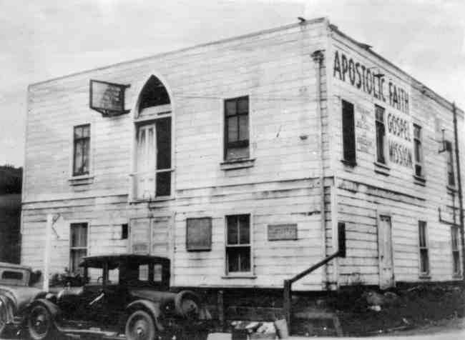

Slide 66
The Azusa Street Revival was a historic series of revival meetings that took place in Los Angeles, California. It was led by William J. Seymour, an African-American preacher. The revival began on April 9, 1906, and continued until roughly 1915.
Notes:
https://en.wikipedia.org/wiki/Azusa_Street_Revival

Slide 67
On the night of April 9, 1906, Seymour and seven men were waiting on God, "when suddenly, as though hit by a bolt of lightning, they were knocked from their chairs to the floor," and the other seven men began to speak in tongues and shout out loud praising God.
Notes:
https://en.wikipedia.org/wiki/Azusa_Street_Revival
Other congregations which taught the filling of the spirit [Holiness] thought tongues was of the devil. This was my teaching as a new believer, 1969 till 1999.
Many teach speaking in unknown languages = tongues is the evidence of the filling of the Ruakh. I just believe that such is a gift of G-d for building you up in the Ruakh, intercession.

Slide 68
7. Holiness Scripture Summary

Slide 70
^{Acts 20.20-21}“I did not shrink back from proclaiming to you anything that was profitable, teaching you publicly as well as from house to house, testifying to both Jewish and Greek people repentance to God and trust in our Lord Yeshua.

Slide 71
^{Acts 20.32} Now I commit you to God and the word of His grace, which is strong to build you up and to give you the inheritance among all who have been made holy.

Slide 72
^{Acts 26.17-18} I will rescue you from your own people, and from the Gentiles to whom I am sending you, to open their eyes—so they may turn from darkness to light and from the power of satan to God, that they may receive release from sins as well as a place among those who are made holy through trusting in Me.’

Slide 73
^{1 Thes 5.12-23} Now we ask you, brothers and sisters, to recognize those who work hard among you and are over you in the Lord and correct you, and to esteem them beyond all measure in love because of their work. Keep shalom among yourselves. We urge you, brothers and sisters,

Slide 74
^{1 Thes 5.12-23} correct the unruly, comfort the fainthearted, help the weak, be patient with everyone. See that no one repays evil for evil to anyone, but always pursue what is good for one another and for all. Rejoice always, pray constantly, in everything give thanks; for this is God’s will for you in Messiah Yeshua.

Slide 75
^{1 Thes 5.12-23} Do not quench the Spirit, do not despise prophetic messages, but test all things, hold fast to what is good, keep away from every kind of evil. Now may the God of shalom Himself make you completely holy; and may your whole spirit and soul and body be kept complete,

Slide 76
^{1 Thes 5.12-23} blameless at the coming of our Lord Yeshua the Messiah. Faithful is the One who calls you—and He will make it happen!

Slide 77
^{Eph 5.18-20} Don’t get drunk with wine, because it makes you lose control. Instead, keep on being filled with the Spirit — sing psalms, hymns and spiritual songs to each other; sing to the Lord and make music in your heart to him; always give thanks for everything to God the Father in the name of our Lord Yeshua the Messiah.
Notes:
Have you ever been filled with the Spirit as an additional experience from G-d since being born again?

Slide 78
^{Gal 2.20-21} When the Messiah was executed on the stake as a criminal, I was too; so that my proud ego no longer lives. But the Messiah lives in me, and the life I now live in my body I live by the same trusting faithfulness that the Son of God had, who loved me and gave himself up for me.

Slide 79
^{Gal 2.20-21} I do not reject God’s gracious gift; for if the way in which one attains righteousness is through legalism, then the Messiah’s death was pointless.
Notes:
Ie, mitzvot and not Presence

Slide 80
^{Ro 12.1-2} I exhort you, therefore, brothers, in view of God’s mercies, to offer yourselves as a sacrifice, living and set apart for God. This will please him; it is the logical “Temple worship” for you. In other words, do not let yourselves be conformed to the standards of the ‘olam hazeh.

Slide 81
^{Ro 12.1-2} Instead, keep letting yourselves be transformed by the renewing of your minds; so that you will know what God wants and will agree that what he wants is good, satisfying and able to succeed.

Slide 82
^{Ro 6.19} I speak in human terms because of the weakness of your flesh. For just as you yielded your body parts as slaves to uncleanness and lawlessness, leading to more lawlessness, so now yield your body parts as slaves to righteousness, resulting in holiness.

Slide 84
Holiness Challenge
Holiness by Mitzvot and Presence
Holiness Promised
Holiness Imparted
Holiness and the Ruakh/ Spirit
Holiness Revival History
Holiness Scripture Summary

Slide 85
Let’s seek Him [repentance and faith] in the new birth.
Let’s seek Him [ inner repentance] for the filling of the Spirit, for Holiness imparted, for inner transformation. Commit to resources of study, prayer, faith, obedience.

