Slide 1
e-handout
To have these notes
without taking notes
Go to OrHaOlam.com
Click on Messages tab,
2023 Messages

Slide 2

Notes:
From Scott Hahn, our Culligan Water man. He should know!

Slide 3
Notes:
I thought I was done with the Book of Mes Jews/ Hebrews. On and off since Jan 25, 2020! Then as considering message, sense to look at that last chapter…

Slide 4

Mes Jews/Hebrew 13.1-3
and Holiness

Slide 5
^{Mes Jews/Hebrew 13.1-3} Let brotherly love continue. Do not neglect to show hospitality to strangers — for in doing so, some have entertained angels without knowing it. Remember the prisoners as if you were fellow prisoners, and those who are mistreated as if you also were suffering bodily.
Notes:
I’m using ‘hospitality’ in a wider sense. Food, also a welcoming embracing spirit.

Slide 6
Value of Hospitality
Hospitality and revival
Hospitality and revival prep
Hospitality applied
Hospitality happening.

Slide 7
Value of Hospitality
Hospitality and revival
Hospitality and revival prep
Hospitality applied
Hospitality happening.

Slide 8
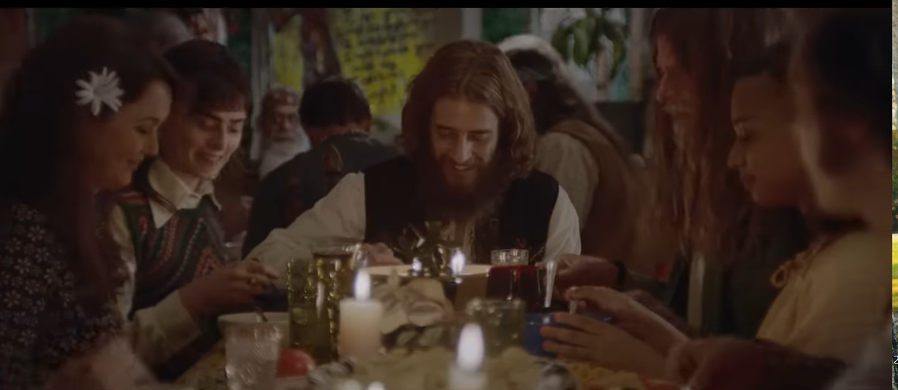
fromYeshua Revolution movie.
Notes:
OK for me to call it that?
I wept through at least half of it. It was my story. Centered on Chuck Smith, Lonnie Frisbee, Greg Laurie. [Left out the whole Jewish awakening piece since too broad of a story. Lamb,.Israel’s Hope. Bob Dylan, Keith Green. Lamb music often in the top three of the national Contemporary Music and sales charts all through the 1970’s.]
Here is a table of joyful community. Maybe to many of them, previously unknown joyful community. Me, the Quintanas invited us home after service. First EVER interaction of husband wife, parents children, NOT friction. My beloved Aunt and Uncle…

Slide 9
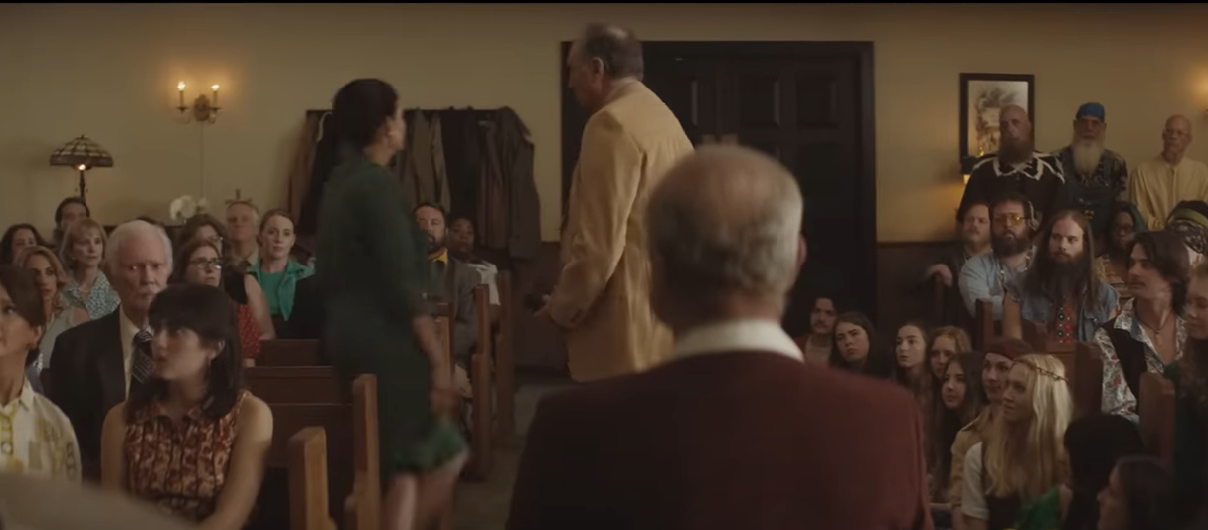
Irate congregants leaving “invaded” space
Notes:
Not ready to show hospitality to strangers…

Slide 10
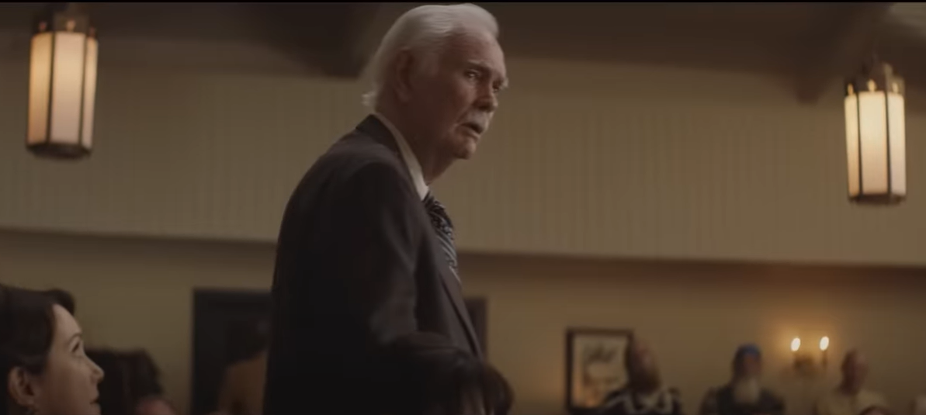
Uncertain congregant response…

Slide 11
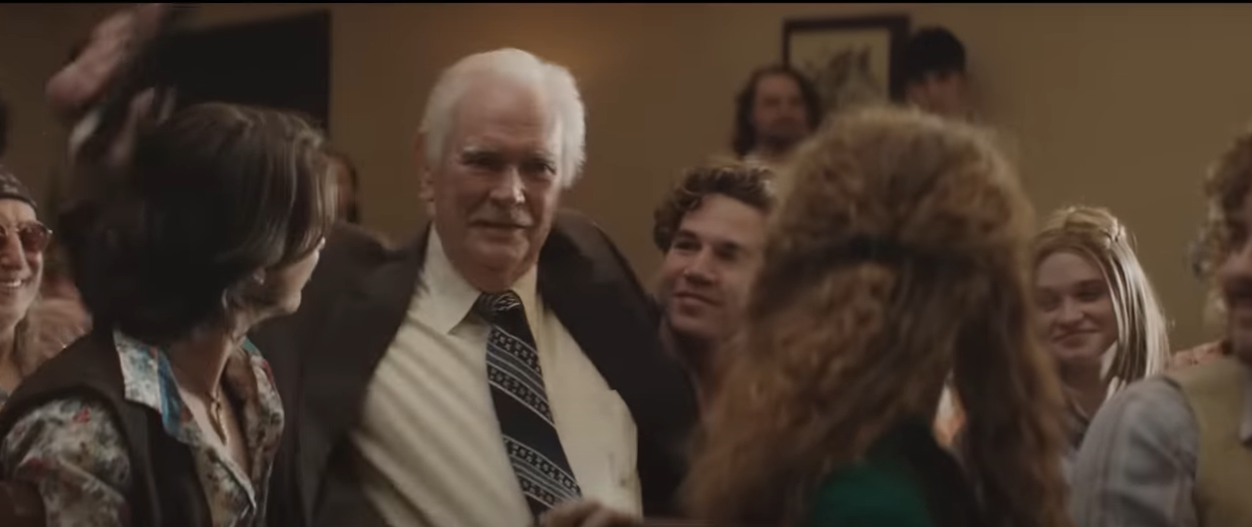
“Let’s get on with it!
Notes:
Hospitality can mean hugs!

Slide 12
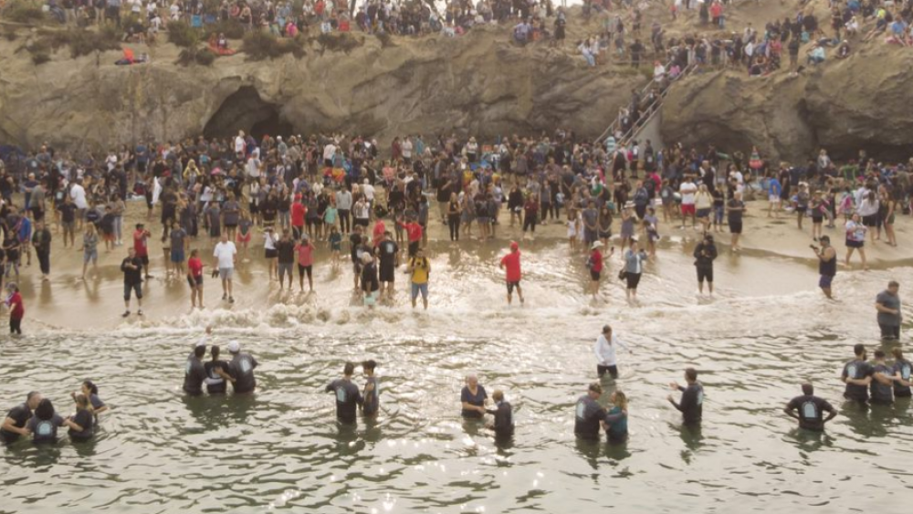
Pirate’s Cove Immersions
Notes:
https://external-content.duckduckgo.com/iu/?u=https%3A%2F%2Fwww.faithwire.com%2Fwp-content%2Fuploads%2F2020%2F09%2Fcalvarychurch.png&f=1&nofb=1&ipt=1bdab1241640ce315ab173c5c8e3edad0754a33a257273fa88719f6539fc66ab&ipo=images

Slide 13
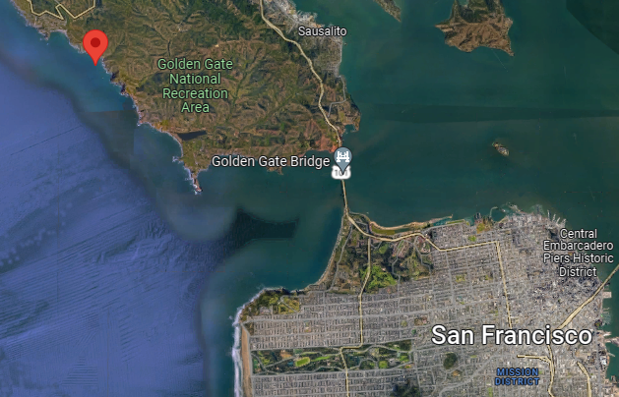
Notes:
https://www.google.com/maps/place/Pirates+Cove/@37.8483477,-122.5782237,27003m/data=!3m1!1e3!4m6!3m5!1s0x80858fbb5b2d9b69:0xe6d49e336004124b!8m2!3d37.8504028!4d-122.564848!16s%2Fm%2F03c247g
Pirate’s Cove just north of San Francisco

Slide 14
Later a scene where about a dozen kids came unannounced from Texas to Pirate’s Cove to be immersed. Greg Laurie was there.
~1970 Rob A. from Harvard U in Boston. One Wednesday night to Schenectady PHC prayer meeting! Felt the PRESENCE.
Notes:
Transformative immersion?
Chuck L and Pam shared with him about salvation in Harvard dorm.

Slide 15
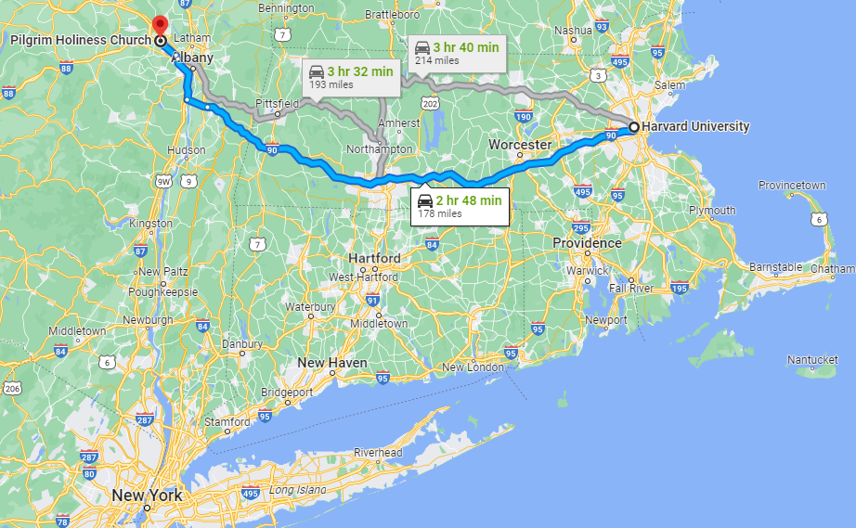
Notes:
2 hr 48 min (178 miles)

Slide 16
Mes Jews/Hebrew 13.1-3
and Holiness

Slide 17
Value of Hospitality
Hospitality and revival
Hospitality and revival prep
Hospitality applied
Hospitality happening.

Slide 18
Key to Readiness
for Revival / Awakening?

Slide 19
^{Ro. 2.4} God’s kindness is intended to lead you to turn from your sins in repentance.
^{Mark 1.14-15} Yeshua came into the Galilee, proclaiming the Good News of God. “Now is the fullness of time,” He said, “and the kingdom of God is near! Turn away from your sins, and believe in the Good News!”
Notes:
Everything we do…elegant music, dance, Torah, message, lifestyle, holidays, food, to express Glory of King Yeshua, draw men and women to see their sins and repentance to LIFE.

Slide 20
Brent McCorkle, who directed the film alongside Erwin, said, “‘Jesus Revolution’ is all about love. After all, you can’t spell ‘revolution’ without ‘love.’ My heart for this film is that people who watch it have a stirring inside that calls them back to love, to getting back to the practice of caring for each other again, just as Yeshua did.
Notes:
https://metrovoicenews.com/jesus-revolution-movie-quadruples-box-office-expectations/

Slide 21
^{Ro.14.17} The Kingdom of God is not eating and drinking, but righteousness, shalom and joy in the Ruakh HaKodesh.
Notes:
NOT dismissing dietary laws, just FOCUS.

Slide 22
^{Yn 16.7-11} The comforting Counselor…I will send him to you. “When he comes, he will show that the world is wrong about sin, about righteousness and about judgment — about sin, in that people don’t put their trust in me;

Slide 23
^{Yn 16.7-11} about righteousness, in that I am going to the Father and you will no longer see me; about judgment, in that the ruler of this world has been judged.

Slide 24
^{Eph 3.10-11} Through Messiah’s community the multi-faceted wisdom of God might be made known to the rulers and authorities in the heavenly places, which is in keeping with the eternal purpose that He carried out in Messiah Yeshua our Lord.
Notes:
YOUR LIFE vindicates and glorifies and accomplishes G-d’s purposes in Messiah’s redemption. You are significant.
Iyov/Job complained that his sufferings were meaningless…

Slide 25
^{Iyob 19.21-27} “Pity me, friends of mine, pity me! For the hand of God has struck me! Must you pursue me as God does, never satisfied with my flesh? I wish my words were written down, that they were inscribed in a scroll, that, engraved with iron and filled with lead, they were cut into rock forever!
Notes:
His life seemed hopeless and meaningless. G-d doesn’t care. All useless. You may think that, but even your meals are to His glory.

Slide 26
^{Iyob 19.21-27} “But I know that my Redeemer lives, that in the end he will rise on the dust; so that after my skin has been thus destroyed, then even without my flesh, I will see God. I will see him for myself, my eyes, not someone else’s, will behold him. My heart grows weak inside me!

Slide 27
^{1 Cor.10.31} Therefore, whether you eat or drink or whatever you do, do all to the glory of God.

Slide 28
Oft repeated summary of all Jewish holidays:
They tried to kill us.
G-d saved us.
Let’s eat.
Notes:
Other ethnicities might say, “Let’s drink.” Green one.

Slide 29
and Holiness

Slide 30
Value of Hospitality
Hospitality and revival
Hospitality and revival prep
Hospitality applied
Hospitality happening.

Slide 31
How do we receive people, new and known?
It’s not about food, [The Kingdom of God is not eating and drinking] but it is about eating.

Slide 32

I read it as a teen, and remember a profound statement:
“You haven’t been anywhere until you’ve eaten a meal with the people.”
Notes:
https://www.amazon.com/Travels-Charley-Search-America-Classics/dp/0143107003/ref=asc_df_0143107003?tag=bngsmtphsnus-20&linkCode=df0&hvadid=79920869053526&hvnetw=s&hvqmt=e&hvbmt=be&hvdev=c&hvlocint=&hvlocphy=&hvtargid=pla-4583520396021919&psc=1
Can’t document it. Wasted too much time looking for the quote.

Slide 33

Notes:
https://external-content.duckduckgo.com/iu/?u=https%3A%2F%2Fkwize.com%2Fpics%2FJohn-Steinbeck-quote-about-sadness-from-Travels-with-Charley-1d9541.jpg&f=1&nofb=1&ipt=21b45efdb286d20b46cf0a5b3f11c3de3d4627338c863dd114b8e8e73d75d4dd&ipo=images

Slide 34
Eating together was always impressed on us as vital. It was the crucial ritual that held the family together, and even in my teenage rebellion, I knew that it was. Knowing that there was always a place for me at the table gave me the security in myself to find the independence I so craved. I can see it now very clearly.
Notes:
https://www.finedininglovers.com/article/eating-alone-against-our-nature

Slide 35
Sometimes, eating alone can be the loneliest of experiences.
Between 2014 and 2018 it is reported that restaurant dining alone in New York has increased by 80%.
Notes:
https://www.finedininglovers.com/article/eating-alone-against-our-nature

Slide 36
We are becoming more and more disconnected from society, retreating into our own private world, increasingly connected online.
Notes:
https://www.finedininglovers.com/article/eating-alone-against-our-nature

Slide 37
Food delivery services are booming and much of their use is for single meals to be consumed alone.
Up until very recently the focal point of every family has been sitting around the table eating. It has been very hard to break, but to a certain extent the food industry has achieved it.
Notes:
https://www.finedininglovers.com/article/eating-alone-against-our-nature

Slide 38
Look at the French paradox, they eat a lot of fatty food, but they’re not fat, because of the very structured and controlled way in which they eat - small portions and eating slowly, talking between courses, so you feel satiated sooner.
Notes:
https://www.finedininglovers.com/article/eating-alone-against-our-nature

Slide 39
Analysis of a survey of about 8,000 adults by Oxford Economics and the National Centre for Social Research suggested eating alone has a stronger link to being unhappy than any other factor except mental illness.
Notes:
https://www.finedininglovers.com/article/eating-alone-against-our-nature

Slide 40
Eating together creates social bonds, it’s one way to ensure we spend less time alone.
Maybe we simply don’t have the time to sit down and eat together every evening as we used to, but despite the phalanx of factors pushing us to dine alone, that desire to come together around food remains indominable.
Notes:
https://www.finedininglovers.com/article/eating-alone-against-our-nature

Slide 41
“The feeling of cooking for people you love and sitting down to eat it together, and feel the bonding, is the most human thing we can do. It’s what brings us together and keeps us together. Maybe we need that now more than ever. We lose it at our peril.”
Notes:
https://www.finedininglovers.com/article/eating-alone-against-our-nature

Slide 42
Mes Jews/Hebrew 13.1-3
and Holiness

Slide 43
Value of Hospitality
Hospitality and revival
Hospitality and revival prep
Hospitality applied
Hospitality happening.

Slide 44
Scriptures on the table, that is, on meals together.

Slide 45
^{T’hillim/Psalm 133.1} Oh, how good, how pleasant it is for brothers to live together in harmony.
שֶׁבֶת אַחִים גַּם-יָחַד.
Shevet akhim gam yakhad.
Translations of שֶׁבֶת
Sittting, seat, dwelling

Slide 46
^{Beresheet/Gen 18.1-8, 16-17} Adoni appeared to Avraham by the oaks of Mamre as he sat at the entrance to the tent during the heat of the day. He raised his eyes and looked, and there in front of him stood three men. On seeing them, he ran from the tent door to meet them, prostrated himself on the ground, and said,
Notes:
Tanakh reference in MJ text.

Slide 47
^{Beresheet/Gen 18.1-8, 16-17} “my Lord, if I have found favor in your sight, please don’t leave your servant. Please let me send for some water, so that you can wash your feet; then rest under the tree, and I will bring a piece of bread. Now that you have come to your servant, refresh yourselves before going on.” “Very well,” they replied,

Slide 48
^{Beresheet/Gen 18.1-8, 16-17} “do what you have said.” Avraham hurried into the tent to Sarah and said, “Quickly, three measures of the best flour! Knead it and make cakes.” Avraham ran to the herd, took a good, tender calf and gave it to the servant, who hurried to prepare it.

Slide 49
^{Beresheet/Gen 18.1-8, 16-17} Then he took curds, milk and the calf which he had prepared, and set it all before the men; and he stood by them under the tree as they ate…The men set out from there and looked over toward S’dom, and Avraham went with them to see them on their way. Adoni said, “Should I hide from Avraham what I am about to do?”
Notes:
One of the visitors was Adoni! Described as an angel, or messenger. Yeshua! How did Avraham welcome them? With food!

Slide 50
^{T’hillim/Psalm 23.5-6} You prepare a table for me, even as my enemies watch; you anoint my head with oil from an overflowing cup. Goodness and grace will pursue me every day of my life; and I will live in the house of Adoni for the length of days.

Slide 51
^{T’hillim/Psalm 41.10} Even my close friend, on whom I relied, who shared my table, has turned against me.

Slide 52
^{T’hillim/Psalm 128.3-4} Your wife will be like a fruitful vine within your house. Your children will be like olive saplings around your table. Behold, thus will the man be blessed who fears Adoni.

Slide 53
That is why erev Shabbat meal and blessings have developed in Jewish culture as so significant!
Candle lighting, Song, Blessing on the wife, the husband, the children, the wine, the bread/food.
Notes:
“I don’t know the blessings.”

Slide 54


Slide 55
https://orhaolam.com/index.php/downloads/blessings-2

Slide 56
^{Gal 2.11-12} Furthermore, when Kefa came to Antioch, I opposed him publicly, because he was clearly in the wrong. For prior to the arrival of certain people from [the community headed by] Ya‘akov,

Slide 57
^{Gal 2.11-12} he had been eating with the Gentile believers; but when they came, he withdrew and separated himself, because he was afraid of the faction who favored circumcising Gentile believers.
Notes:
Doesn’t say he ate pork or unkosher food, but visiting!

Slide 58
No one should sit alone at Oneg. Look for isolated people.

Slide 59
^{1 Tim 5.9-10} Let a widow be enrolled on the list of widows only if she is more than sixty years old, was faithful to her husband, and is known for her good deeds — as one who has reared her children well, showed hospitality, washed the feet of God’s people, helped those in trouble, and engaged in all kinds of good work.

Slide 60
^{Ro 12. 11-13} Don’t be lazy when hard work is needed, but serve the Lord with spiritual fervor. Rejoice in your hope, be patient in your troubles, and continue steadfastly in prayer. Share what you have with God’s people, and practice hospitality.

Slide 61
^{1 Kefa/Pet 4.9-10} Above all, keep your love for one another constant, for “love covers a multitude of sins.” Be hospitable one to another without grumbling. As each one has received a gift, use it to serve one another, as good stewards of the many-sided grace of God.
Notes:
I LOVE to hear stories of congregants socializing.

Slide 62
^{Iyov/Job 31.16-18} “If I held back anything needed by the poor or made a widow’s eye grow dim [with tears], or ate my portion of food by myself,
without letting the orphan eat any of it — No! From my youth he grew up with me as if with a father, and I have been her guide
from my mother’s womb! —
Notes:
Evidence of Iyov/Job’s righteousness. Invited needy people to table fellowship.

Slide 63
^{Beresheet/Gen 26 26-30} Now Avimelech went to him from [Philistine] Gerar along with Achuzzat his friend and Phicol the commander of his army…They said, Let there now be an agreement between us—between us and you—and let us make a covenant with you: that you will do us no harm,

Slide 64
^{Beresheet/Gen 26 26-30} just as we haven’t touched you and just as we did nothing to you but good, and sent you away in shalom. You are now blessed by Adonai.”
Then he made a feast for them and they ate and drank.
Notes:
Covenant ratified by eating!

Slide 65
Meals at weddings, Bar Mitzvahs, Brit Milah express covenant.
Kiddish cup at a wedding IS the covenant meal.
You can likely entertain one or two at your home!

Slide 66
One remarkable feature of Oriental hospitality is that sometimes an enemy is received as a guest, and as long as he remains in that relationship, he is perfectly safe and is treated as a friend. There are certain Oriental tribes of tent-dwellers who have the rule that an enemy who has "once dismounted and touched the rope of a single tent, is safe."
Notes:
https://www.ancient-hebrew.org/manners/the-sacred-duty-of-hospitality.htm

Slide 67
^{Acts 2.46-47} Day by day they continued with one mind, spending time at the Temple and breaking bread from house to house. They were sharing meals with gladness and sincerity of heart, praising God and having favor with all the people. And every day the Lord was adding to the community those being saved.
Notes:
Fellowship over food was a key factor in the revival environment.

Slide 68
^{Rev.19.9} How blessed are those who have been invited to the wedding banquet of the Lamb!
Notes:
Doesn’t merely say to the wedding, but to the wedding banquet. Covenant celebration!

Slide 69
A practical matter…

Slide 70
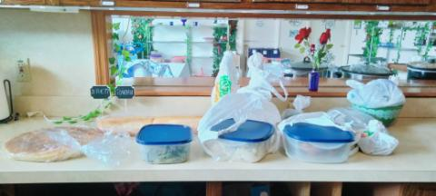
Oneg contribution Mar. 4, 2023 needing preparation
Notes:
Arrived during worship dance.

Slide 71
For oneg contributions
Please bring salad food ready to serve: sliced, mixed, cut up, chopped, stirred, so volunteers just bring it out from the refrigerator
If hot food, please put in warming oven [no plastic] [under microwave] or in crock pot plugged in.

Slide 72
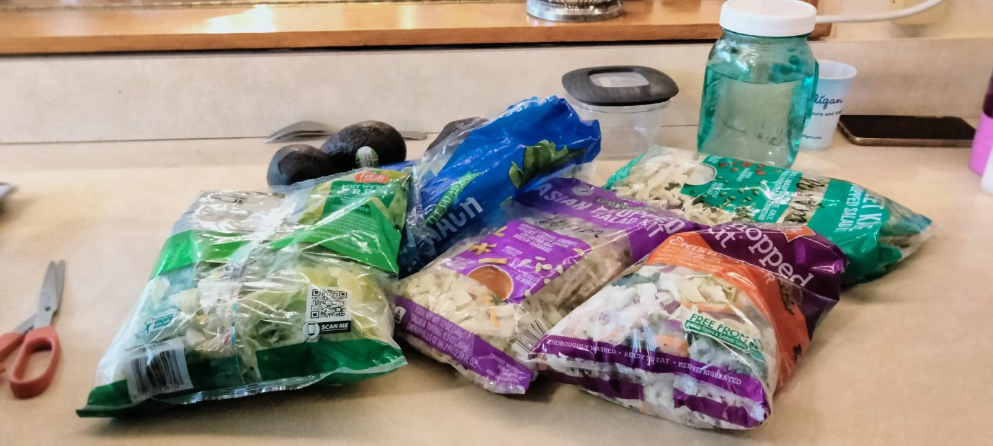
3/4/2023 needing preparation
Notes:
Arrived during worship dance

Slide 73
Mes Jews/Hebrew 13.1-3
and Holiness

Slide 74
Value of Hospitality
Hospitality and revival
Hospitality and revival prep
Hospitality applied
Hospitality happening.

Slide 75
In the 1960’s nuclear war threat, pollution, Vietnam, crass materialism led to a deep void in our hearts, one that led many of us to a transformational encounter with the Lord during the Yeshua Revolution.
Notes:
https://askdrbrown.org/article/the-hijacking-of-empathy-and-equality?vcrmeid=UqlK1HfhqUK5DFXSeMqX6A&vcrmiid=n8-9Ls_siEGdG64--fUPAw

Slide 76
Unfortunately, it was not only the Lord who filled that void.
Satan and the world rushed in to fill it too, especially with sex, drugs, rock music, and Eastern religion. That was the path many of us took before we came to know the Lord, a path from which many others never returned.
Notes:
https://askdrbrown.org/article/the-hijacking-of-empathy-and-equality?vcrmeid=UqlK1HfhqUK5DFXSeMqX6A&vcrmiid=n8-9Ls_siEGdG64--fUPAw

Slide 77
In our day, as a young generation deals with its own set of uncertainties and frustrations, longing to see justice and equality prevail, Satan and the world have rushed in to hijack these sentiments, many of which are good and noble in themselves.
Notes:
https://askdrbrown.org/article/the-hijacking-of-empathy-and-equality?vcrmeid=UqlK1HfhqUK5DFXSeMqX6A&vcrmiid=n8-9Ls_siEGdG64--fUPAw

Slide 78
Nowhere is this clearer than in the hijacking of empathy, defined as “the ability to understand and share the feelings of another.
Notes:
https://askdrbrown.org/article/the-hijacking-of-empathy-and-equality?vcrmeid=UqlK1HfhqUK5DFXSeMqX6A&vcrmiid=n8-9Ls_siEGdG64--fUPAw

Slide 79
It is partly because of empathy that a disproportionate percent of Gen Z’ers identify as LGBTQ+, even though only a small percentage of them are actively, let alone exclusively, involved in same-sex relationships and activity.
Notes:
https://askdrbrown.org/article/the-hijacking-of-empathy-and-equality?vcrmeid=UqlK1HfhqUK5DFXSeMqX6A&vcrmiid=n8-9Ls_siEGdG64--fUPAw

Slide 80
What can we offer?
^{Mt.10.42} Indeed, if someone gives just a cup of cold water to one of these little ones because he is my talmid — yes! — I tell you, he will certainly not lose his reward!”
With the WATER of LIFE in Yeshua!

Slide 81
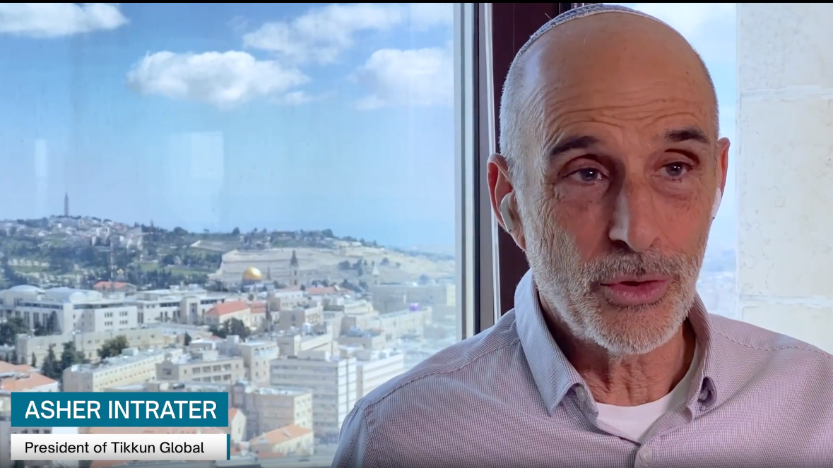
Stress and
Pressure
Notes:
https://video.wixstatic.com/video/c39fc4_c7073b7c7bef4c2d9462551dcce0e08c/1080p/mp4/file.mp4

Slide 82
Nick Hall and his Pulse ministry held an event in downtown Minneapolis, Minnesota. More than 600 people showed up at the impromptu worship service that ran 53 hours and was filled with repentance, healing, literal addictions being broken, marriages being healed, he recalled.
Notes:
https://www1.cbn.com/cbnnews/us/2023/march/new-reports-of-revival-20-baptisms-at-purdue-evangelist-chastises-critics-god-is-moving-its-just-starting
We went to the Plaza next to Jack Stack last summer. Had a sweet response. Not this yet.

Slide 83
One place where the outpouring is being felt is Purdue University in West Lafayette, Indiana. At a recent meeting, 300 students came to watch the Collegiate Day of Prayer simulcast from Asbury in Wilmore, Kentucky. Dr. Malachi O'Brien posted to Twitter on Wednesday that the students brought in a pool for what they thought would be three baptisms – instead 20 people came forward to be baptized.
Notes:
https://www1.cbn.com/cbnnews/us/2023/march/new-reports-of-revival-20-baptisms-at-purdue-evangelist-chastises-critics-god-is-moving-its-just-starting
Purdue University is a public land-grant research university in West Lafayette, Indiana, and the flagship campus of the Purdue University system. The university was founded in 1869 after Lafayette businessman John Purdue donated land and money to establish a college of science, technology, and agriculture in his name.

Slide 84
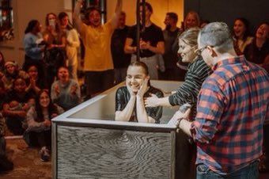
Notes:
https://www1.cbn.com/cbnnews/us/2023/march/new-reports-of-revival-20-baptisms-at-purdue-evangelist-chastises-critics-god-is-moving-its-just-starting

Slide 85
From Stewart Winograd:
We first met Zoya at a holiday event for new immigrants from Ukraine, Russia, and other parts of Eastern Europe, hosted by our daughter Miriam. There she told her story about her escape from Mariupol, one of the worst hit cities in Ukraine, with her young daughter and son in March 2022, soon after the war started.

Slide 86
She recalled the horrors of packing her two scared kids in her car, kissing her husband goodbye not knowing if she would ever see him again, and driving to leave Ukraine while missiles and bombs were going off all around them.

Slide 87
While she drove, she said there were no street signs on the road (all signs had been removed), no traffic lights or street lights were working anymore, and there was no internet to use GPS. She just kept hoping and praying she was driving in the right direction towards the border of Moldova and wouldn't run into any Russian check points, as she heard they were opening fire on civilian cars.

Slide 88
Though she was very afraid, Zoya kept herself composed for the sake of her two children. She drove for two days without sleeping, not allowing herself to rest until she crossed the Moldovan border. From there, she immigrated to Israel.

Slide 89
Just this month, Miriam and a congregational leader took Zoya and two other new immigrants on a small personal tour of the Judean desert, where they stopped at th e Dead Sea, visited Qumram, and most importantly, went to the Jordan River, where Yeshua Himself was immersed.

Slide 90
Zoya told Miriam "Today, I want to be immersed in the same place where Yeshua was immersed!" And so she was!

Slide 91
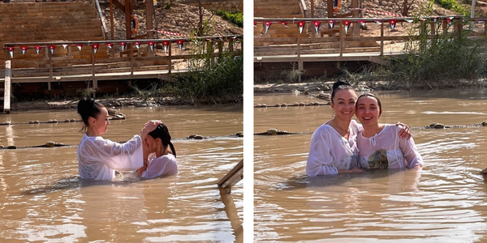
Notes:
Qasr al-Yahud
קאסר אל יהוד
https://en.wikipedia.org/wiki/Qasr_al-Yahud

Slide 92
Our upcoming outreaches
Passover April 6
Lag B’Omer bonfire Monday 5/8
Shavuot/Memorial Day 5/28
All involve food hospitality!

Slide 93
Mes Jews/Hebrew 13.1-3
and Holiness

Slide 94
Value of Hospitality
Hospitality and revival
Hospitality and revival prep
Hospitality applied
Hospitality happening.

Slide 95
^{T’hillim/Psalm 133.1} Oh, how good, how pleasant it is for brothers to live together in harmony.
שֶׁבֶת אַחִים גַּם-יָחַד.
Shevet akhim gam yakhad.
Translations of שֶׁבֶת
Sittting, seat, dwelling

Slide 96
Do you KNOW Yeshua and drinking the water of LIFE?
Are you hearing daily from His Word?
How are you applying what you heard?
Are you offering that water of life to anyone?

