Slide 1
e-handout
To have these notes
without taking notes
Go to OrHaOlam.com
Click on Messages tab,
2023 Messages
Notes:
We WILL be soon getting language translation equipment for simultaneous translation.

Slide 2
Dad, are we pyromaniacs?
Notes:
Ted Alongi

Slide 3
Dad, are we pyromaniacs?
Yes, we arson.
Notes:
Ted Alongi

Slide 4
What do you call a pig
with laryngitis?
Notes:
Ted Alongi

Slide 5
What do you call a pig
with laryngitis?
Disgruntled.
Notes:
Ted Alongi

Slide 6
Writing my name in cursive
is my signature move.
Notes:
Ted Alongi

Slide 7
Why do bees stay in their hives during winter?
Notes:
Ted Alongi

Slide 8
Why do bees stay in their hives during winter?
Swarm
Notes:
Ted Alongi

Slide 10
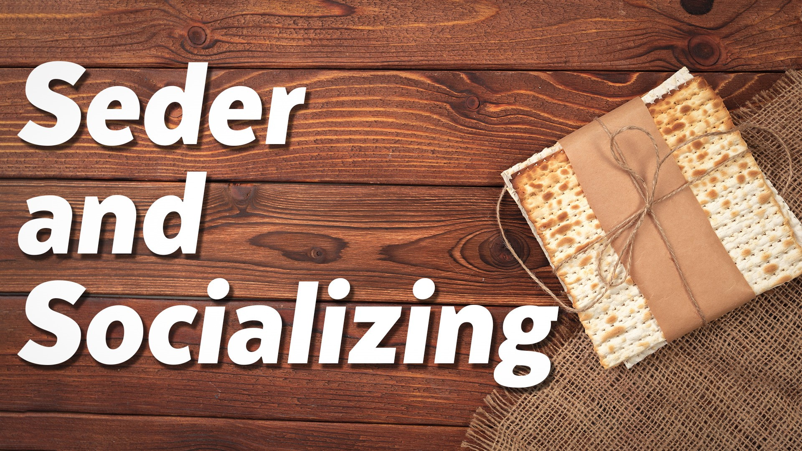
^{Mes Jews/Heb 13.5-6}
Notes:
Actually a continuation of the series in Mes Jews/ Hebrews.
Last week I had a class on mechanics of Seder “how to”
This is “Why”

Slide 11
^{Mes Jews/Heb 13.5-6} Keep your lives free from the love of money and be content with what you have, because God has said, “Never will I leave you; never will I forsake you.” So we say with confidence, “The Lord is my helper; I will not be afraid. What can mere mortals do to me?”
Notes:
ABOUT THE PASSOVER SEDER?
RTF: Abandonment is the foundation of all wounds. Wounded people wound people. Epidemic of loneliness. 2018 30% 2019 58%
The Seder meal is the epitome of the expression of community. My memories.
The Seder meal represents LEAVING Egypt in community, an impossible feat, NEVER otherwise done in world history. A nation leaving the thralls, control, bondage of slave masters and going to their own homeland. Many revolts and revolutions. US, Mexican and all Latin America from Spain, India from Britain. Always in the own land defending it, liberating it. Passover is a historic anomaly, expressing the love of G-d for Israel, and ultimately for all people in slavery to habits, failures, sins, abuse. FREEDOM! Author [Luke] quoting Tanakh/Heb scriptures…

Slide 12
^{Dvarim 31.6-8} Khazak! Be courageous! Do not be afraid or tremble before them. For Adoni your God—He is the One who goes with you. He will not fail you or abandon you.” Then Moshe summoned Joshua and said to him in the sight of all Israel, “Be strong! Be courageous!
Notes:
Some people love confrontation.
Others tremble at the thought.
I’m not a conflict avoider, but I AM a conflict delayer, hoping the problem will be resolved without me, or diminish, or go away.

Slide 13
^{Dvarim 31.6-8} For you [Yehoshua] are to go with this people into the land Adoni has sworn to their fathers to give them, and you are to enable them to inherit it. Adoni — He is the One who goes before you. He will be with you. He will not fail you or abandon you. Do not fear or be discouraged.”

Slide 14
^{T’hillim 118.6} Adoni is for me — I will not fear! What can man do to me?
Yeshua’s Passover expression of this…
Notes:
Not fear Pharoah or Satan or people.
A choice, not to fear!

Slide 15
^{Lk 22.14} When the time came, Yeshua and the emissaries reclined at the table, and he said to them, “I have really wanted so much to celebrate this Seder with you before I suffer!”
^{TLV} “I have eagerly desired to eat this Passover with you before I suffer.”
Notes:
He desires YOU.
Think of Passover Pesakh as a time King Messiah desires YOU.

Slide 16
^{Mes Jews/Heb 13.5-6}

Slide 17
How and why He desires us.
How we can imitate His passion.
What about discord?
Some helps.

Slide 18
How and why He desires us.
How we can imitate His passion.
What about discord?
Some helps.

Slide 19
He desired them as his mystical spouse and bride; despite all their backslidings and revolting.
From everlasting was his desire; as it is to all his people:
Notes:
Difficult to use this imagery in our day of transgenderism and gay life. His love for us is passionate and pure! David and Jonathan love > woman. Kindred spirits, Anne of Green Gables. Cf epidemic of loneliness: know you deeply.

Slide 20
^{Yermihahu 31.2-4} From afar Adoni appeared to me. “Yes, I have loved you with an everlasting love. Therefore I have drawn you with lovingkindness. Again I will build you, so you will be rebuilt, virgin Israel!”
Notes:
Seder expression. Drawn you: Egypt, also your own stuff, toxicity, sin, unintentional sin.
Literal fulfillment. Kibbutz history, Christians helping. HaYovel. Ultimately, spiritual fulfillment

Slide 21
^{Yermihahu 31.2-4} Again you will take up your tambourines as ornaments, and go out to dances of merrymakers. Again you will plant vineyards on the hills of Samaria.
Notes:
Literal and spiritual
Dance was NEVER part of synagogue worship until the Messianic Rabbi Murray Silberling initiated it.
Dancing for Joy book.

Slide 22
He delighted in the beauty of the bride, which he himself has put upon them;
Notes:
Yeshua thinks you are impressive, handsome, beautiful. His own beauty, but reflected. He wants to be with you, for you and me to reflect him.

Slide 23
^{2 Cor. 4.6} For it is the God who once said, “Let light shine out of darkness,” who has made his light shine in our hearts, the light of the knowledge of God’s glory shining in the face of the Messiah Yeshua.

Slide 24
^{Song of Songs 6.10} Who is this that appears like dawn? As beautiful as the moon, bright as the sun, awesome as an army with banners.
Notes:
Of course, Dawn is the epitome of beauty. The moon’s light is only the reflected light of the sun. We need to reflect His glory. Time with Him and His Word. Daily. Passover Seder is one of the times, if rightly understood.

Slide 25
He desired justice to be satisfied, the Torah be fulfilled in the sense of us empowered to walk in it, sin atoned for, and the salvation of his elect obtained.
Notes:
There is a cosmic purpose of your life, and it’s romance with the King of the Universe in His Son. He desires you to walk in your cosmic purpose.

Slide 26
^{Eph 3.8-10} The Good News of the Messiah’s unfathomable riches…letting everyone see how this secret plan is going to work out. This plan, kept hidden for ages by God, the Creator of everything, is for the rulers and authorities in heaven to learn, through the existence of the Messianic Community, how many-sided God’s wisdom is.
Notes:
He wanted to be with them at the Seder to further their redemptive, prophetic destiny!

Slide 27
He desired to celebrate the liberation of Israel, spiritually, ultimately physically “with you.”
Notes:
Yeshua a Zionist? Advantage to going there. Next Spring, 2024! Feel the Presence and Joy of G-d, simultaneously the warfare.

Slide 28
His desire is towards their being with him to all eternity, and which he delighted in the views of eternity, described later that evening.

Slide 29
^{Yn 17 24-26} “Father, I want those you have given me to be with me where I am; so that they may see my glory, which you have given me because you loved me before the creation of the world. Righteous Father, the world has not known you,
Notes:
So we can radiate it back.

Slide 30
^{Yn 17 24-26} and these people have known that you sent me. I made your name known to them, and I will continue to make it known; so that the love with which you have loved me may be in them, and I myself may be united with them.”

Slide 31
He desired to see the accomplishment of all his prayers and intercession.

Slide 32
He desired to see justice satisfied, the Torah be fulfilled, in the sense of us being empowered to obey it, sin atoned for, and the salvation of his elect obtained;

Slide 33
Another reason He desired the Seder: It was not judged proper that a man should eat much on the day before the Passover, that he might be hungry, and eat the Passover, (b’ta-a-vaon) ,“with desire.” ^{Maim., Mishn, Pesachim} He was made under the Torah, and that was in his heart, constant attendance on it from his youth.
Notes:
So, maybe he desire to have the Seder with us, because He was hungry!

Slide 34
He was accused of being a glutton, at the tables of P’rushim, and of publicans and sinners; yet not so: fast of 40 days and 40 nights, and sometimes obliged his disciples to beg and remind Him to eat.
He IS a glutton for US.

Slide 35
^{Mes Jews/Heb 13.5-6}

Slide 36
How and why He desires us.
How we can imitate His passion.
What about discord?
Some helps.

Slide 37
How do we do likewise, and say to G-d and man,
“I have really wanted so much to celebrate this Seder with you!”

Slide 38
^{1 Cor 5.8} So let us celebrate the Seder not with leftover hametz, the hametz of wickedness and evil, but with the matzah of purity and truth.
Notes:
Get rid of leaven. Literally, housecleaning…Relational issues, confessional issues. Bonfire Wed. noon, April 5. Bring some khametz.

Slide 39

We were drawn to the joy and sense of community and fellowship. And the teaching has been very eye-opening.
Luann Ridgway

Slide 40
As Sean Steckbeck so aptly said, “People are drawn to lovers, not ‘knowers’.”

Slide 41
A surprising sociological find that might help us:

Slide 42


Slide 43
This year, Israel earned the fourth spot out of 109 ranked countries, an improvement over last year’s ranking of ninth.
Notes:
https://vfinews.com/news/israel-warns-passover-travelers-of-iranian-plots-to/israel-is-the-fourth-happiest-country-in-the-world

Slide 44
Main tools the report uses are called “positive affect” and “negative affect,” which essentially refer to positive and negative emotions, respectively. “Positive affect is given by the average of individual yes or no answers about three emotions: laughter, enjoyment, and interest,” the report explains.
Notes:
https://vfinews.com/news/israel-warns-passover-travelers-of-iranian-plots-to/israel-is-the-fourth-happiest-country-in-the-world

Slide 45
“Negative affect is given by the average of individual yes or no answers about three emotions: worry, sadness and anger.”
Notes:
https://youtu.be/pu3H7QXUz7I
Up to 1:34
https://vfinews.com/news/israel-warns-passover-travelers-of-iranian-plots-to/israel-is-the-fourth-happiest-country-in-the-world

Slide 46
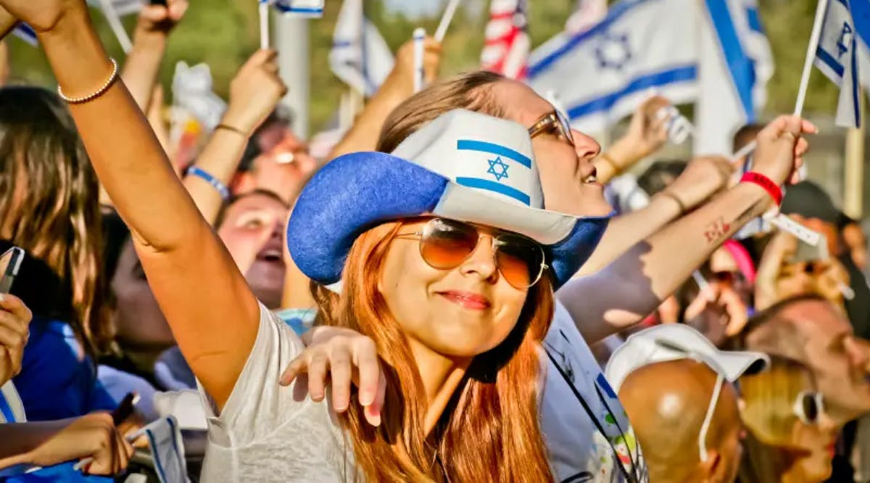
Notes:
https://vfinews.com/news/israel-warns-passover-travelers-of-iranian-plots-to/israel-is-the-fourth-happiest-country-in-the-world
Topping the list is Finland, which leads by a significant margin. Finland is followed by Denmark and Iceland. Strikingly, every nation that precedes Israel in happiness equality is far more homogeneous by nearly every demographic metric available in the CIA World Factbook. (JPost / VFI News)

Slide 47
How can Israelis be the 4th happiest nation in the world with the enemies, the terrorism, the arguments among themselves?
A large part is Shabbat and the holidays. The sense of family, unity. Celebration together.
Notes:
First night we DON’T have our community Seder so you can be home with your family. Invite someone, someone out of your circle. Seder Socializing.
Universal army experience brings a lot of social intimacy.

Slide 48
Delight/blessing/affirmation:
tender, permitted touch;
gentle tones [even when irritated],
loving eye contact

Slide 49
What about the discord
and protests?

Slide 50
^{Mes Jews/Heb 13.5-6}

Slide 51
How and why He desires us.
How we can imitate His passion.
What about discord?
Some helps.

Slide 52
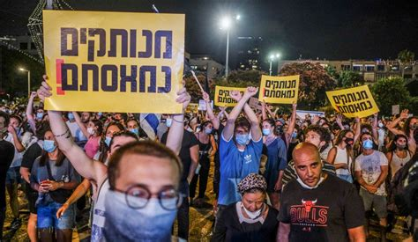
Notes:
מנותקים נמאסתם
Disconnected and fed up
100,000’s demonstrating for weeks about judicial reform. Self appointing Supreme Court succession of judges
From Shlomy
It's disconnected (The govt from the people the AM Israel)
The latter nee-mas-tem, we say to the govt (the AM Israel)
Meaning inferring Disgusting, we want nothing more with you.

Slide 53
Israel Today:
The reforms will largely return Israel to the situation that prevailed before 1993, when Supreme Court President Aharon Barak launched his revolutionary campaign of judicial activism.
Notes:
https://www.israeltoday.co.il/read/israels-post-democracy-moment/

Slide 54
Application: Keep your joy even in discord. Keep your focus on G-d even in stress.
Always easier to say than to do.

Slide 55
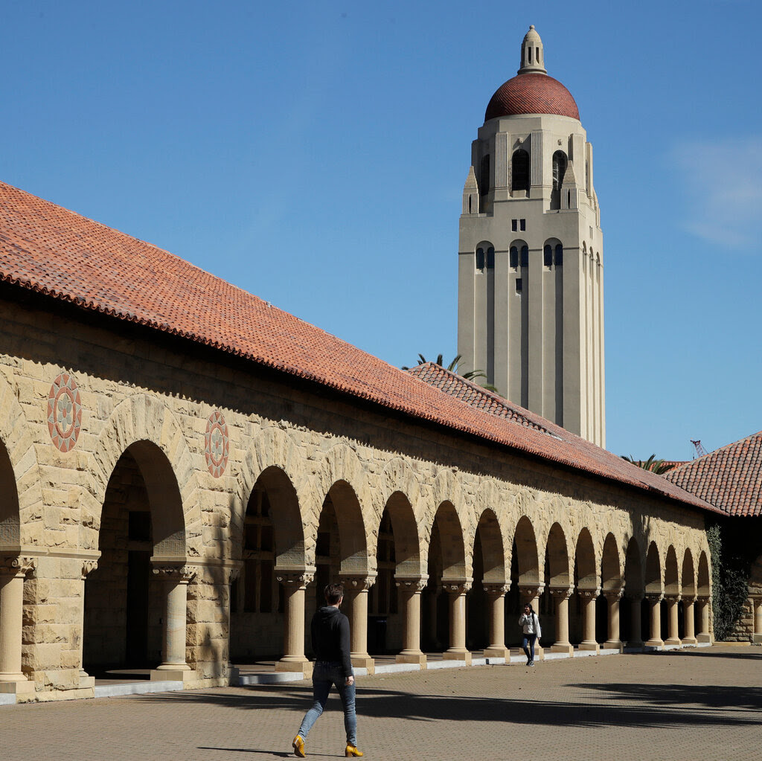
Stuart Kyle Duncan — a federal appeals court judge appointed by Donald Trump — visited Stanford Law School this month to give a talk. It didn’t go well.
Notes:
https://mail.google.com/mail/u/0/#inbox/FMfcgzGslkhQQnxMzBLrFGzfWSDdQHJC

Slide 56
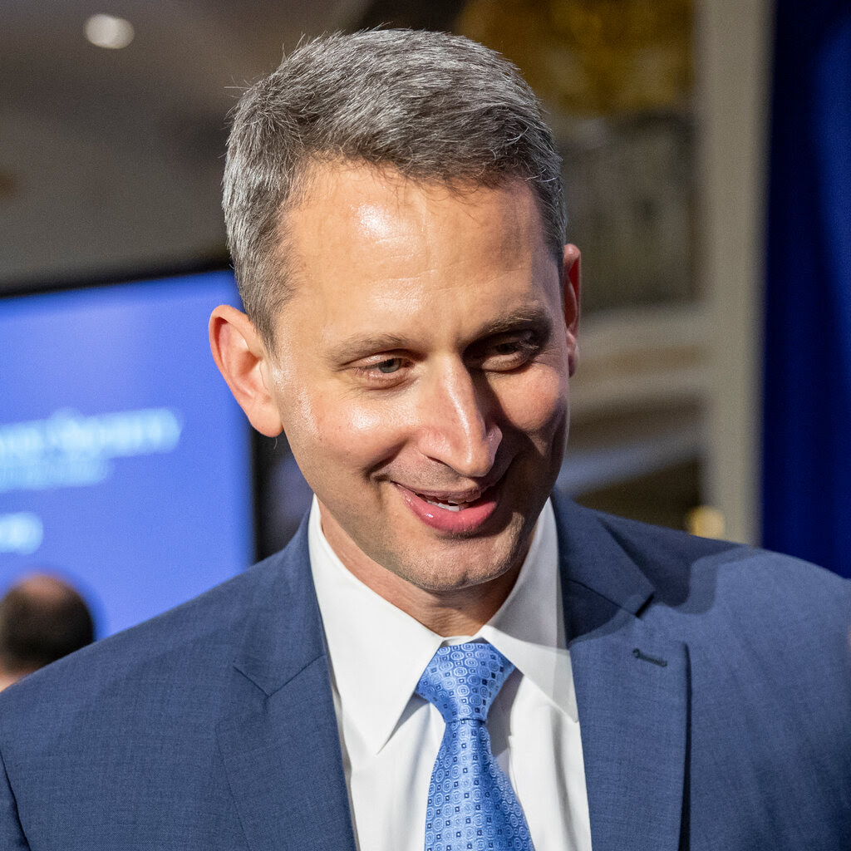
Students frequently interrupted him with heckling. One protester called for his daughters to be raped, Duncan said.

Slide 57
When he asked Stanford administrators to calm the crowd, the associate dean for diversity, equity and inclusion walked to the lectern and instead began her remarks by criticizing him. “For many people here, your work has caused harm,” she told him.
Notes:
https://mail.google.com/mail/u/0/#inbox/FMfcgzGslkhQQnxMzBLrFGzfWSDdQHJC

Slide 58
Tirien Steinbach — the associate dean who rose to speak during the event is now on leave.
Notes:
https://mail.google.com/mail/u/0/#inbox/FMfcgzGslkhQQnxMzBLrFGzfWSDdQHJC

Slide 59
A friend of mine, who is also a therapist said everyone is insecure at some level.
I believe we operate our best when we operate from that level of insecurity, as we obey God‘s commands. Also, as we love others when we see their insecurities and cover them.
Notes:
Phil Cohen

Slide 60
Some helps to maintain joy, Seder socializing joy:
Always worship, trust and praise.

Slide 61
Worship is the goal of the Exodus from Egypt. Why then does the Torah seem to make worship so difficult in the Book of Vayikra/Leviticus? Surely it is our understanding that is at fault; the rules of offering do not make worship more difficult;
Notes:
https://www.umjc.org/commentary/2023/3/22/god-calls-across-the-divide
Russ Resnik

Slide 62
rather they make it possible. There is a vast gulf between man and God. God calls to man (or his representative Moses) across that gulf to provide a way for man to worship him.
Notes:
https://www.umjc.org/commentary/2023/3/22/god-calls-across-the-divide
Russ Resnik

Slide 63
God is everywhere, but his holiness keeps us at a distance. If altar and priesthood served not to create a barrier between man and God, but to bridge the divide, what bridges that divide now that they have passed away? What, or who, will bring us near to the holy God?
Notes:
https://www.umjc.org/commentary/2023/3/22/god-calls-across-the-divide
Yeshua! And Yeshua in the moedim, the appointed festivals, particularly this one.

Slide 64

Notes:
https://www.umjc.org/commentary/2023/3/22/god-calls-across-the-divide

Slide 65
God calls to Moses across the distance of his holiness and gives him instructions on how one can draw near to the holy. The offering itself bridges the distance between man and God, for it is korban, that which comes near, and a man must come near to present it.
Notes:
https://www.umjc.org/commentary/2023/3/22/god-calls-across-the-divide

Slide 66
Some helps to maintain joy
Always worship, trust and praise.
Seek to serve and help others
Notes:
Yeshua wanted to be with them, and started by washing their feet. How do we serve others. Seek the lost, build up the saved, bless the community?

Slide 67
^{Mtt 28.19-20} Therefore, go and make people from all nations into talmidim, immersing them into the reality of the Father, the Son and the Ruach HaKodesh, and teaching them to obey everything that I have commanded you. And remember! I will be with you always, yes, even until the end of the age.
Notes:
Wash feet, so to speak. Volunteer to help with Seder. Offer to Debby Burt.

Slide 68
Some helps to maintain joy
Always worship, trust and praise.
Seek to serve and help others
Some wisdom

Slide 69
The desire for others’ approval and reassurance creates sensitivity to real or imagined signs of rejection.
^{Jennifer Crocker & Lora Park}
Notes:
https://positivepsychology.com/self-acceptance-quotes/

Slide 70
Generally, self-acceptance is conceptualized as an affirmation or acceptance of self in spite of weaknesses or deficiencies.
Notes:
https://positivepsychology.com/self-acceptance-quotes/

Slide 71
Continually feeding our need for positive self-evaluation is a bit like stuffing ourselves with candy. We get a brief sugar high, then a crash.
Kristin Neff
Notes:
https://positivepsychology.com/self-acceptance-quotes/

Slide 72
When you learn to accept fear, you cease making a catastrophe of it. Then it ceases to be your master.
Nathaniel Branden
Notes:
https://positivepsychology.com/self-acceptance-quotes/
,

Slide 73
Briefly, unconditional acceptance means liking yourself, others, and the world when you are not getting what you want and in spite of your getting what you don’t want.
Albert Ellis
Notes:
https://positivepsychology.com/self-acceptance-quotes/

Slide 74
^{Mes Jews/Heb 13.5-6}

Slide 75
^{Mes Jews/Heb 13.5-6} Keep your lives free from the love of money and be content with what you have, because God has said, “Never will I leave you; never will I forsake you.” So we say with confidence, “The Lord is my helper; I will not be afraid. What can mere mortals do to me?”

Slide 76
^{Lk 22.14} When the time came, Yeshua and the emissaries reclined at the table, and he said to them, “I have really wanted so much to celebrate this Seder with you before I suffer!”
Notes:
He desires YOU.

Slide 77
Are you walking in intimacy with Yeshua, who greatly desires to be WITH YOU.
Are you hearing from Him by His Word and Ruakh/Spirit?
What are you doing with what you hear?
Are you sharing with others?

