Slide 1
To easily follow these notes,
Go to OrHaOlam.com
Click on downloads, messages, 2023 messages

Slide 2
This is a major theme of this holiday and of the song.
נַהֲפוֹךְ הוּא nahafokh hu
On the contrary, the reverse is true
Notes:
It’s become a bit of a theme in Jewish thinking, maybe literature. Let’s practice it.

Slide 3
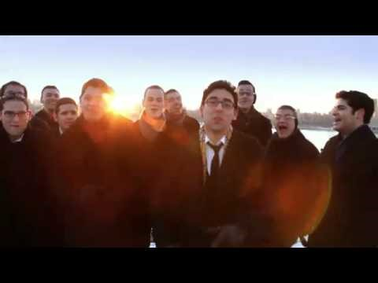
Purim
reversal
Notes:
https://youtu.be/bWCwr2e0VWs

Slide 4
^{Ester 9.1-2} The time approached for the king's order and decree to be carried out, the day when the enemies of the Jews hoped to overpower them. But, as it turned out, the opposite took place - the Jews overpowered those who hated them.
נַהֲפוֹךְ הוּא nahafokh hu
One the contrary, the reverse is true

Slide 5

נַהֲפוֹךְ הוּא nahafokh hu

Slide 6
נַהֲפוֹךְ הוּא nahafokh hu
On the contrary, the reverse is true. The Scroll of Ester is about hidden, unexpected reversal.
The concept
The Problem, application to us
The reversal then and today

Slide 7
Stand, stand for a tale so grand
Shushan is the place where it all began
The hidden miracle
One man, second in command
Slay all the Jews was his wicked plan
A scheme so miserable
He chose a day for the disaster
It's ironic what came after
Notes:
Loosely rhymes

Slide 8
He didn't know
a girl named Esther
Would turn it upside down
So raise your glass
if you can see
the hidden meaning,
it's right in front of you,
Notes:
Raise your glass high ref to Ad Lo Yada. Also a popular song.
Raise your praises high. Hidden meaning is what this day is about. G-d working in the hidden place.

Slide 9
we will never be never be anything but proud to tell the story,
nahafokh hu ְנַהֲפוֹךְ הוּא
(It was turned upside down)
Notes:
Maybe grateful better thought than proud

Slide 10
Won't you come on and come on and raise your glass
Esther became the queen
Cuz' God was pulling strings from behind the scenes

Slide 11
She wore the royal crown
3 days the Jews just prayed,
Queen Esther risked her life went to save the day
She took Haman down

Slide 12
The streets were filled with celebration
Everyone ate Hamantashen
Jubilation for the nation
Ken tihiyeh lanu...כן תהיה לנו
(So should it be for us)
Notes:
A line from the Havdalah [close of Shabbat] service.

Slide 13
So raise your glass if you can see,
the hidden meaning,
it's right in front of you,
we will never be never be anything but proud to tell the story,
nahafokh hu נַהֲפוֹךְ הוּא

Slide 14
Won't you come on and come on and raise your glass
just come on and come on and raise your glass
So get your costumes on
Make noise and drown out Haman
Don't drink like a fool

Slide 15
And remember and remember
What the day's about...
So raise your glass if you see God in hidden places,
He's right in front of you,

Slide 16
We will never be never be anything but proud to tell our story
nahafokh hu נַהֲפוֹךְ הוּא
So raise your glass if you can see the hidden meaning,

Slide 17
it's right in front of you,
we will never be never be anything but proud to tell the story,
nahafokh hu נַהֲפוֹךְ הוּא

Slide 18
נַהֲפוֹךְ הוּא nahafokh hu
On the contrary, the reverse is true
The Scroll of Ester is about a Hidden miracle, unexpected reversal.
The word Ester in Persian means star,
in Hebrew is הֶסְתֵּר related to secret, hiding, concealing
Notes:
The King Akhashverosh gave her the Persian name, but G-d still is in charge, and there was a hidden Hebrew meaning! Secret. סתר Seter

Slide 19
The Book of Ester has NO mention of any of the names of G-d. He’s hidden.
Costumes are about hidden identity

Slide 20
נַהֲפוֹךְ הוּא nahafokh hu

Slide 21
נַהֲפוֹךְ הוּא nahafokh hu
On the contrary, the reverse is true. The Scroll of Ester is about hidden, unexpected reversal.
The concept
The Problem, application to us
The reversal then and today
Notes:
Concept: hidden reversal

Slide 22
^{Ester 3.14} Letters were sent by courier to all the royal provinces “To destroy, kill and exterminate all Jews, from young to old, including small children and women, on a specific day, the thirteenth day of the twelfth month, the month of Adar, and to seize their goods as plunder."
Notes:
How could anyone just announce such a thing?
Would anyone declare such a thing today? Declared genocide? The world would react. Maybe not. Iran says it all the time about Israel.

Slide 23
Do we face anything analogous to that?
Militant Progressive agenda.
Sensual culture normative.
Threats on Israel.
Growing anti-Semitism.
Replacement Theology

Slide 24
What if you are facing rejection?
Marital hostility
Estranged children
Isolation
Friendlessness
Overload Stress
Fix the problems?

Slide 25
If you decide not to acquiesce to the latest LGBTQ talking points on the job or in school, you will be vilified, marginalized and demonized. You will be excluded, marked, mocked and even canceled.
Notes:
https://www.charismanews.com/opinion/in-the-line-of-fire/91608-michael-brown-the-opposition-to-holiness-is-mounting

Slide 26
May the Lord open our eyes to eternal realities and deliver us from the fear of man and the desire to be praised by man. As a colleague of mine once said, "When you are on your knees [meaning, in prayer], the praise and the criticism go right over your head."
Notes:
https://www.charismanews.com/opinion/in-the-line-of-fire/91608-michael-brown-the-opposition-to-holiness-is-mounting

Slide 27
Hamas Threatens: The Attacks Will Spread to All of Judea, Samaria and Jerusalem
Hamas spokesman Abdul Latif al-Qanoua welcomed the shooting attack in the Jericho area on Monday, February 27, in which a 27-year-old man was murdered.
Notes:
https://vfinews.com/news/fri.-march-3--no-more-terror--vfi-news/hamas-threatens-the-attacks-will-spread-to-all-of?subscribed=true&mc_cid=5461df970a&mc_eid=UNIQID

Slide 28
The Israeli-American man who was shot and killed during the terror attack in the West Bank was named as Elan Ganeles, an Israel Defense Forces veteran, originally from West Hartford, Connecticut.
Notes:
https://vfinews.com/news/fri.-march-3--no-more-terror--vfi-news/hamas-threatens-the-attacks-will-spread-to-all-of?subscribed=true&mc_cid=5461df970a&mc_eid=UNIQID

Slide 29
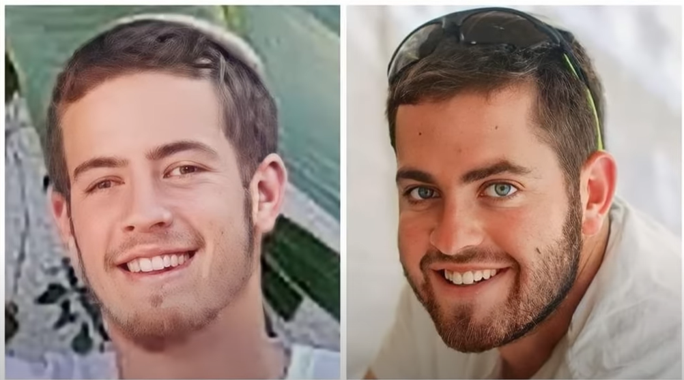

Slide 30
Two brothers, Hillel and Yagel Yaniv, aged 19 and 21, were gunned down in their car while driving through the Arab village of Huwarrah. There have been fourteen Jews killed in terrorist attacks already in 2023, but this one hit closer to home than ever before.

Slide 31
The brothers were from Har Bracha, the same Jewish community where our organization [HaYovel] is based. The Yaniv family were essentially our neighbors. Some of our staff had met the brothers, and we worked with their father from time to time.

Slide 32
נַהֲפוֹךְ הוּא nahafokh hu

Slide 33
נַהֲפוֹךְ הוּא nahafokh hu
On the contrary, the reverse is true. The Scroll of Ester is about hidden, unexpected reversal.
The concept
The Problem, application to us
The reversal then and today

Slide 34
^{Ester 4.12-16} Mordekhai asked them to give Ester this answer: “Don’t suppose that merely because you happen to be in the royal palace you will escape any more than the other Jews. For if you fail to speak up now, relief and deliverance will come to the Jews

Slide 35
^{Ester 4.12-16} from a different direction; but you and your father’s family will perish. Who knows whether you didn’t come into your royal position precisely for such a time as this.” Ester had them return this answer to Mordekhai:
Notes:
The kingdom will prevail, but will YOU and I be among the leaders?

Slide 36
^{Ester 4.12-16} “Go, assemble all the Jews to be found in Shushan, and have them fast for me, neither eating nor drinking for three days, night and day; also I and the girls attending me will fast the same way. Then I will go in to the king, which is against the law; and if I perish, I perish.”
Notes:
Implies prayer. Hence the fast of Ester, Monday, Mar 6.
Can we say that? “If I perish, walking in this way of Yeshua and holiness, I perish?”

Slide 37
The name given to her by her parents was Hadassah הֲדַסָּה. The name given to her by the surrounding rulers when she became queen was Esther אֶסְתֵּר
Notes:
http://www.ulpanor.com/
There is a significant interplay in the names. Note!

Slide 38
The name Esther אֶסְתֵּר means "hidden," in Hebrew, [star in Persian] and indeed, Esther's true identity was hidden in plain sight, so she could bring salvation for her people.
Notes:
http://www.ulpanor.com/

Slide 39
For many years, no one knew that Queen Esther was Jewish - the Megillah tells us: "Esther did not reveal her race or nationality, because her cousin Mordekhi had ordered her not to".
The name Hadassah comes from the word "Hadas," - הֲדַס which means myrtle.
Notes:
http://www.ulpanor.com/

Slide 40

The myrtle is a rather plain-looking plant, but when its leaves are bruised and crushed they give forth a very sweet fragrance.
Notes:
http://www.ulpanor.com/

Slide 41
[A​s a matter of fact, some people use the crushed leaves for spices during Havdalah on Saturday night].
Notes:
http://www.ulpanor.com/

Slide 42
There she was, in the city of Shushan in Persia, living as an orphan with her cousin Mordekhi in exile. Esther was taken away from her cousin's home and forced to become the wife of a Gentile King. Esther, who was orphaned at a young age, now had to live her adult life in frustration as well.
Notes:
http://www.ulpanor.com/

Slide 43
Esther lived at the king's palace for nine years before revealing herself as the events of Purim took place.
Just as the "Hadas" which is only fragrant when it is bruised and crushed,
Notes:
http://www.ulpanor.com/

Slide 44
so often must we undergo suffering in order to fully show our potential traits. Our good and sweet smell is inherent, but it does not always manifest until brought forth through difficult times.
And the two names: Hadas and Esther work hand in hand delivering the following message:
Notes:
http://www.ulpanor.com/
Myrtle, hidden power

Slide 45
Whatever trouble we may be going through, for whatever reason, we may need to be "bruised and crushed," like Hadasהדס myrtle.
But there is always an "Ester", a hidden salvation waiting for us, prepared for us long before the hard times began.
Notes:
http://www.ulpanor.com/

Slide 46
Ken tihiyeh lanu כֵּן תְהִיָה לָנוּ...(So should it be for us)
^{1 Cor 1.26-31} For God’s “nonsense” is wiser than humanity’s “wisdom.” And God’s “weakness” is stronger than humanity’s “strength.” …But God chose what the world considers nonsense
Notes:
A line in the Havdalah liturgy.

Slide 47
^{1 Cor 1.26-31} in order to shame the wise; God chose what the world considers weak in order to shame the strong; and God chose what the world looks down on as common or regards as nothing in order to bring to nothing
Notes:
A line in the Havdalah liturgy.

Slide 48
^{1 Cor 1.26-31} what the world considers important; so that no one should boast before God. It is his doing that you are united with the Messiah Yeshua. He has become wisdom for us from God, and righteousness and holiness and redemption as well!

Slide 49
^{1 Cor 1.26-31} Therefore - as the Tanakh says - "Let anyone who wants to boast, boast about ADONI."
נַהֲפוֹךְ הוּא nahafokh hu
One the contrary, the reverse is true
Notes:
Review some examples

Slide 50

The Myrtle worm
Notes:
Stuxnet reportedly ruined almost one-fifth of Iran's nuclear centrifuges.^{[10]} Targeting industrial control systems, the worm infected over 200,000 computers and caused 1,000 machines to physically degrade.
The only identifier was the word “Myrtle” the translation of the name of Hadassah, or Ester, who brought down the ancient Persian scheme to destroy the Jews.

Slide 51
Ester/Hadassah
Beautiful G-dly young woman, contemplating a future husband, children ➔ a pagan harem
  Submission to Mordekhi
  Submission to the government
  Trust in the hidden hand of HaShem
Notes:
Cousin Morde, do you really know what you are doing?
If you are doing right, and the best you can figure, the results will surprise you. Eventually.

Slide 52
Moshe and his parents
Where is this basket going?
Will the crocidiles get him?
Who will find him?
After he was returned…will he remember?
נַהֲפוֹךְ הוּא nahafokh hu
One the contrary, the reverse is true
Notes:
I think there was one praying mother, father sister and brother!
In the Prince of Egypt movie, Miriam sang her mother’s song, riveted Moshe’s attention. Maybe it happened.

Slide 53
Messiah’s redemption
Year of obscurity
Year of celebrity
Year of adversity, arrest, execution!
RESURRECTION!!
נַהֲפוֹךְ הוּא nahafokh hu
One the contrary, the reverse is true

Slide 54
^{1 Cor 2.7-8} On the contrary, we are communicating a secret wisdom from God which has been hidden until now but which, before history began, God had decreed would bring us glory. Not one of this world’s leaders has understood it; because if they had, they would not have executed the Lord from whom this glory flows.

Slide 55
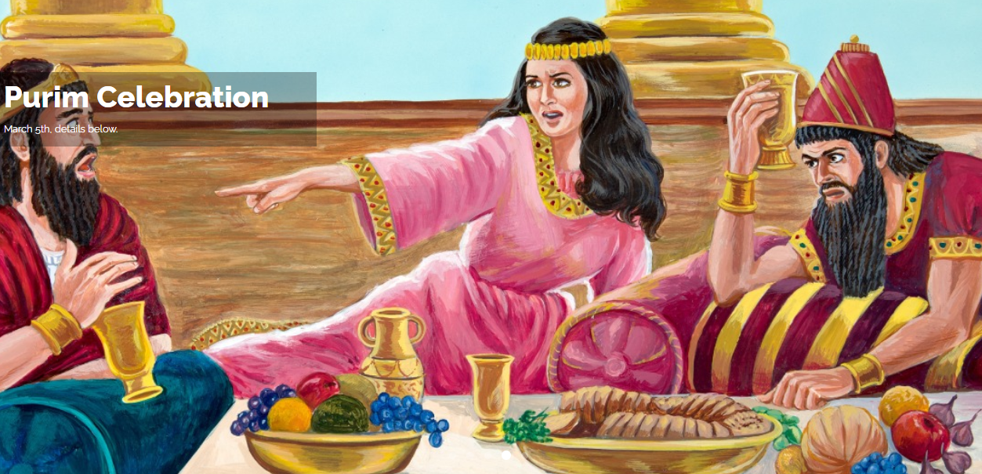

Slide 56
^{1 Yn 3.1} See what love the Father has lavished on us in letting us be called God’s children! For that is what we are. The reason the world does not know us is that it has not known him.
Notes:
Hidden wealth, joy, source of praise.

Slide 57
^{Acts 3.13-21} The God of Avraham, Yitz’chak and Ya‘akov, the God of our fathers, has glorified his servant Yeshua — the same Yeshua you handed over and disowned before Pilate, even after he had decided to release him. You denied the holy and innocent one, and instead asked for the reprieve of a murderer! You killed the author of life!

Slide 58
^{Acts 3.13-21} “But God has raised him from the dead! Of this we are witnesses. And it is through putting trust in his name that his name has given strength to this man whom you see and know. Yes, it is the trust that comes through Yeshua which has given him this perfect healing in the presence of you all.

Slide 59
^{Acts 3.13-21} “Now, brothers, I know that you did not understand the significance of what you were doing; neither did your leaders. But this is how God fulfilled what he had announced in advance, when he spoke through all the prophets, namely, that his Messiah was to die.

Slide 60
^{Acts 3.13-21}. “Therefore, repent and turn to God, so that your sins may be erased; so that times of refreshing may come from the Lord’s presence; and he may send the Messiah appointed in advance for you, that is, Yeshua. He has to remain in heaven until the time comes for restoring everything.

Slide 61
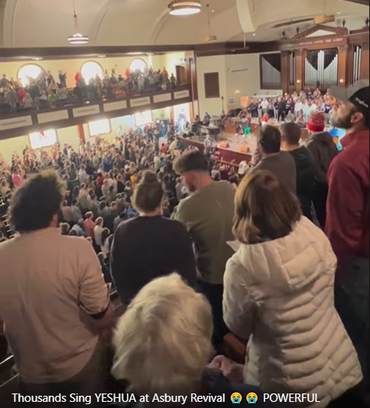
Thousands sing Yeshua at the Asbury Revival
Notes:
https://fb.watch/iRXSi0CBG_/

Slide 62

Notes:
https://www.frc.org/get.cfm?c=TE&track=0&ri=CC23C06&f=WU23C03&email=shmuel.wolk@gmail.com

Slide 63
March 2, 2023 New York City Mayor Eric Adams (D) sparked a firestorm of backlash for his comments about prayer at an interfaith prayer breakfast in Manhattan on Tuesday. “When we took prayers out of schools, he said, “guns came into schools.”
Notes:
https://washingtonstand.com/commentary/nyc-mayors-comments-on-prayer-spark-backlash

Slide 64
In addition, he stated, “Don’t tell me about no separation of church and state. State is the body. Church is the heart. You take the heart out of the body, the body dies.
Notes:
https://washingtonstand.com/commentary/nyc-mayors-comments-on-prayer-spark-backlash

Slide 65
The reality is that America’s youth are struggling. A recent CDC study found that 42% percent of high school students reported feeling persistent sadness.
Notes:
https://washingtonstand.com/commentary/nyc-mayors-comments-on-prayer-spark-backlash

Slide 66
There are likely many reasons for this. Increasing isolation, social media use, consumption of pornography, and lack of a secure identity all plague American teens.
Notes:
https://washingtonstand.com/commentary/nyc-mayors-comments-on-prayer-spark-backlash

Slide 67
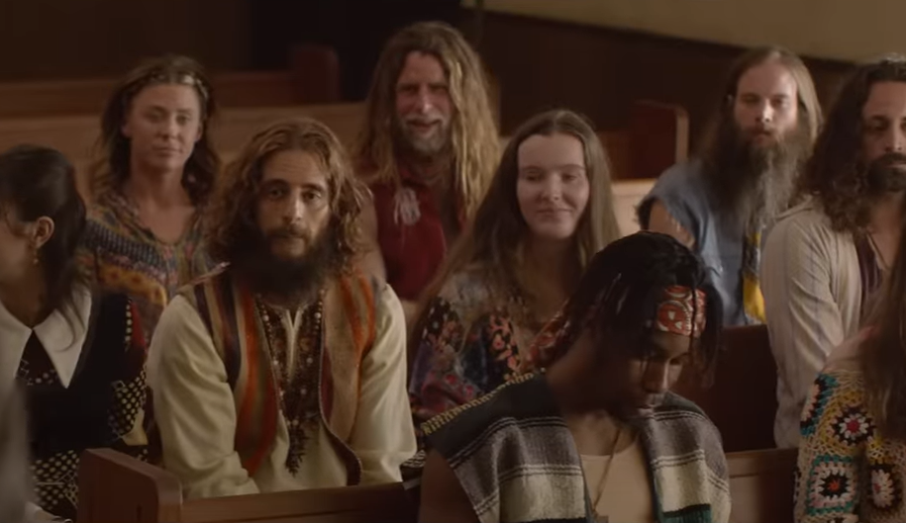
Notes:
It was just like that in Schenectady NY in 1969 to 1970. Barefoot, long hair, bearded in a Conservative Holiness Church. They loved us! Took us in.

Slide 68
Today, we must recognize that behind the outward and the obvious – the radical movements like Antifa and BLM; the strong identification with LGBTQ+ causes and people;
Notes:
https://askdrbrown.org/article/lessons-from-the-old-jesus-revolution-for-the-new-jesus-revolution?vcrmeid=SFDi6r9MoUCNxB0rHd7ZCA&vcrmiid=n8-9Ls_siEGdG64--fUPAw

Slide 69
the lack of a biblical worldview; the addiction to social media; the “Shout your abortion” movement – there is a hunger for justice, a longing for a better world, a desire for meaning, a search for authenticity, and more.
Notes:
https://askdrbrown.org/article/lessons-from-the-old-jesus-revolution-for-the-new-jesus-revolution?vcrmeid=SFDi6r9MoUCNxB0rHd7ZCA&vcrmiid=n8-9Ls_siEGdG64--fUPAw

Slide 70
Every good thing these young people are searching for can be found in Yeshua, and it is to Him and the transformation He offers that we must point them.
Notes:
https://askdrbrown.org/article/lessons-from-the-old-jesus-revolution-for-the-new-jesus-revolution?vcrmeid=SFDi6r9MoUCNxB0rHd7ZCA&vcrmiid=n8-9Ls_siEGdG64--fUPAw

Slide 71
Many congregational leaders at that time saw the obvious and the outward – the rebellion, the rise of radical feminism, the birth of the gay liberation movement, the decadence, the immorality – while failing to see the spiritual hunger that also burned in these young hearts.
Notes:
https://askdrbrown.org/article/lessons-from-the-old-jesus-revolution-for-the-new-jesus-revolution?vcrmeid=SFDi6r9MoUCNxB0rHd7ZCA&vcrmiid=n8-9Ls_siEGdG64--fUPAw

Slide 72
One leader said to me years ago, “It’s exactly as you said. We had about 30 hippies show up in our congregation back then, long hair, beads, and all. They attended our services for a while, but we weren’t able to assimilate them. Eventually, all of them left except one.”
Notes:
https://askdrbrown.org/article/lessons-from-the-old-jesus-revolution-for-the-new-jesus-revolution?vcrmeid=SFDi6r9MoUCNxB0rHd7ZCA&vcrmiid=n8-9Ls_siEGdG64--fUPAw
Our task is NOT to assimilate newcomers, but to love and disciple. Homes, hearts. Smiles.

Slide 73
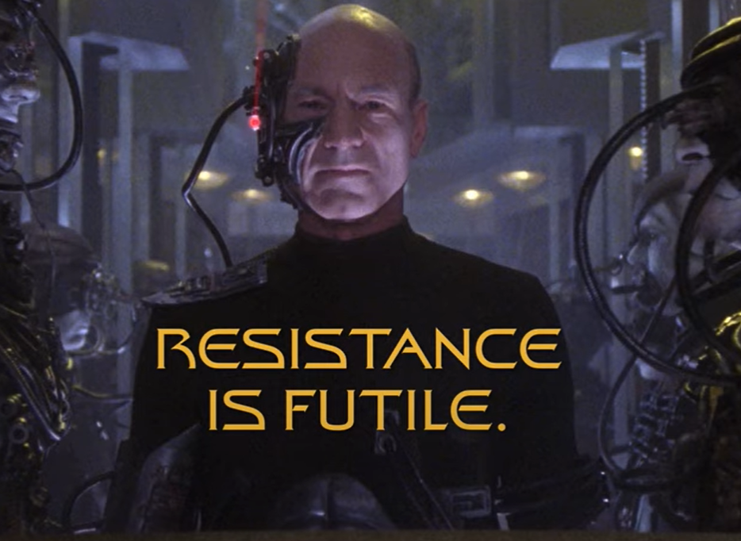
We are the Borg.
You will be assimilated.
Notes:
https://external-content.duckduckgo.com/iu/?u=https%3A%2F%2Ftse1.mm.bing.net%2Fth%3Fid%3DOVP.4rtSXf0oirjQOge32Cr20gEsDh%26pid%3DApi&f=1&ipt=d75863c77d57ff61cebf052228dc25f0b0ba50e1b69e4cf1a2dd5655747a6085&ipo=videos

Slide 74
I fully expect that among them will be many who identify as LGBTQ+, including men wearing dresses and carrying Bibles, and same-sex couples, telling us how they really felt the Spirit in our services.
Notes:
https://askdrbrown.org/article/lessons-from-the-old-jesus-revolution-for-the-new-jesus-revolution?vcrmeid=SFDi6r9MoUCNxB0rHd7ZCA&vcrmiid=n8-9Ls_siEGdG64--fUPAw
Fornicating couple

Slide 75
Will we have wisdom to meet them where they are, helping them truly encounter the Lord while the Spirit convicts them and changes them?
Will we have the patience to recognize that they are coming from many different backgrounds and, in some cases, are totally without biblical foundations?
Notes:
https://askdrbrown.org/article/lessons-from-the-old-jesus-revolution-for-the-new-jesus-revolution?vcrmeid=SFDi6r9MoUCNxB0rHd7ZCA&vcrmiid=n8-9Ls_siEGdG64--fUPAw

Slide 76
Will we have sensitivity without compromise?
Notes:
https://askdrbrown.org/article/lessons-from-the-old-jesus-revolution-for-the-new-jesus-revolution?vcrmeid=SFDi6r9MoUCNxB0rHd7ZCA&vcrmiid=n8-9Ls_siEGdG64--fUPAw

Slide 77
נַהֲפוֹךְ הוּא nahafokh hu

Slide 78
^{Ester 9.20-22} Mordekhi recorded these events and sent letters to all the Jews in all the provinces of King Akhashverosh, both near and far, instructing them to observe the fourteenth day of the month of Adar and the fifteenth day, every year,

Slide 79
^{Ester 9.20-22} ₁ [to commemorate] the days on which the Jews obtained rest from their enemies and the month which for them was turned from sorrow into gladness and from mourning into a holiday;
Notes:
Read the scroll, which we did a bit today, and fully on Tuesday.

Slide 80
^{Ester 9.20-22} ₂ they were to make them days of celebrating and rejoicing, ₃ sending portions [of food] to each other and ₄ giving gifts to the poor.
Notes:
2. Party tomorrow
3. Mishloakh Manot
4. Offering for the earthquake victims

Slide 81
נַהֲפוֹךְ הוּא nahafokh hu

Slide 82
The 7.8 magnitude quake has had at least 1,206 recorded aftershocks, leaving many neighborhoods and entire city blocks completely flattened.
Notes:
Shepherd of Israel Ministries Inc | 4067 Sparkleberry Drive, San Bernardino, CA 92407-0601 www.soiministries.org

Slide 83
The new tally brings to 50,325 the total number of deaths caused by the disaster across both countries.
A total of 5,951 people were killed across Syria, while Turkey recorded 44,374 deaths after the February 6 earthquake.
Notes:
https://news.abs-cbn.com/overseas/02/28/23/quake-killed-more-than-50000-in-turkey-syria-revised-toll
Posted at Feb 28 2023

Slide 84
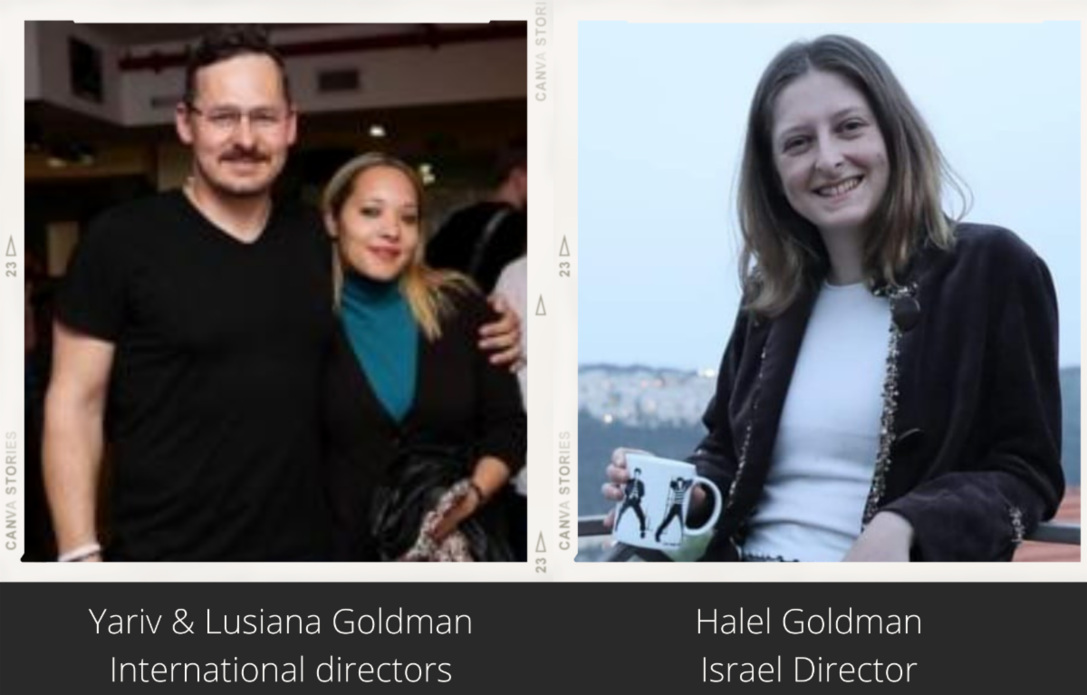
Hands of Mercy
Notes:
Started by Vietnam Vet, American Jewish believer Yeshi Rhinehart, felt called to help terror victims in Israel. Lived in Sderot. Yeshi went to be with Yeshua.
Yariv Goldman Rakhamim Avakesh. רחמים אבקש
Daughter ministers with Sean Steckbeck as well
https://www.youtube.com/watch?v=RXQe90qxJ2Y
Ma Yedidot מה ידידות
https://www.youtube.com/watch?v=_lnlKSlCX6E

Slide 85
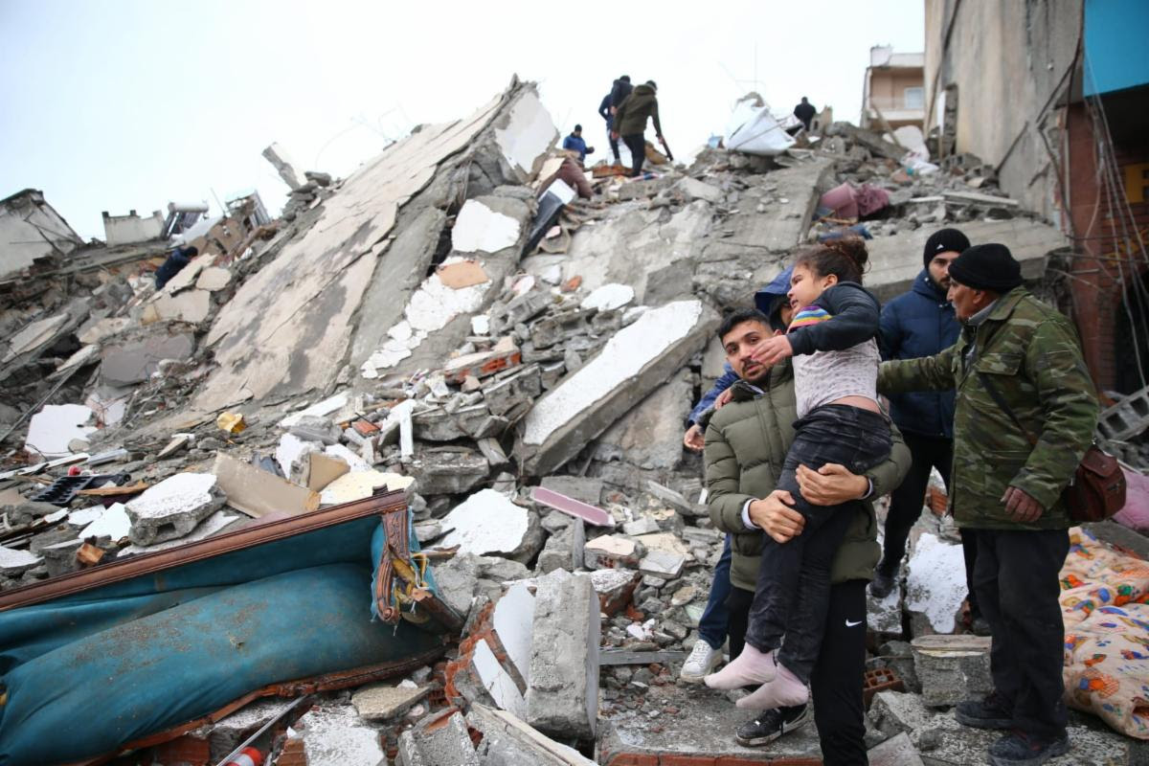

Slide 86
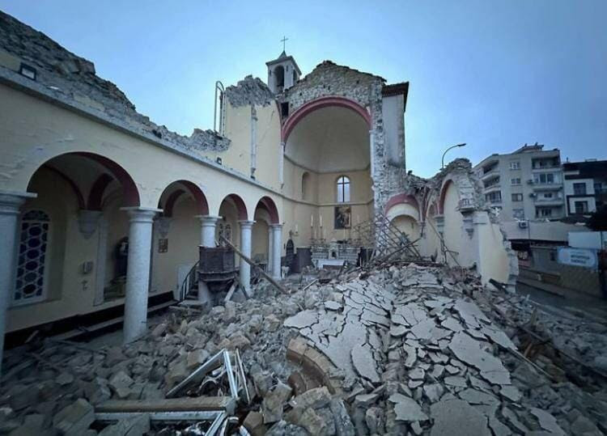

Slide 87
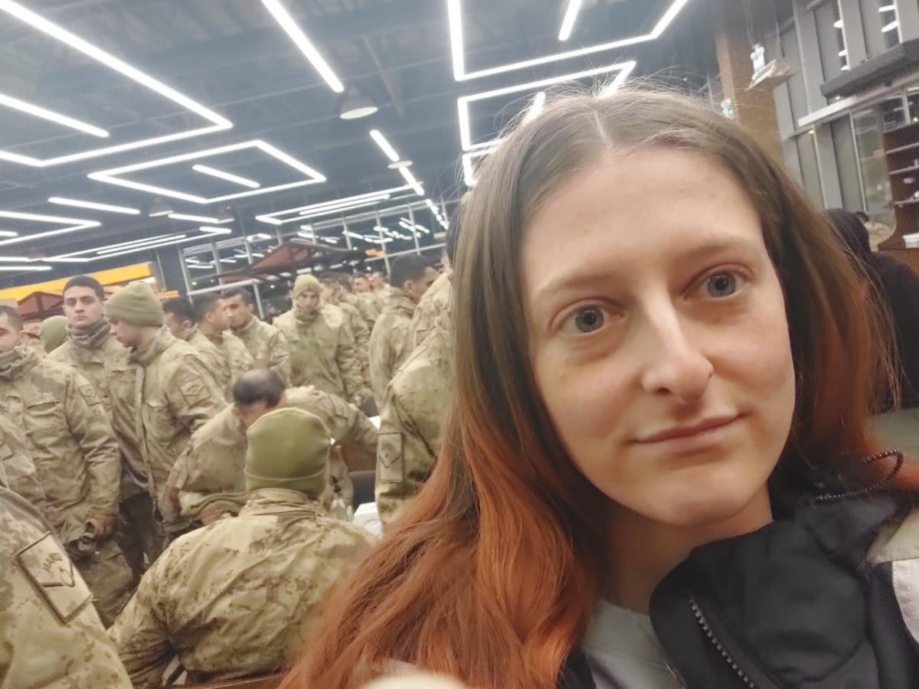
Halel
Goldman

Slide 88
Halel Goldman, Hands of Mercy's Israel's director, arrived with the first team of 5 people on Wednesday. On their first day in Turkey, Halel and the volunteers of the first team secured a car and some basic supplies,

Slide 89
and obtained the necessary permissions from the Turkish government through a local humanitarian organisation, to volunteer and bring humanitarian aid to disaster-stricken areas.

Slide 90
We chose to go first to one of the most unreached areas, which is the area of Antakya. From there, we are spreading as needed. We chose Antakya, as it is further away from bigger cities and airports.
Notes:
Shepherd of Israel Ministries Inc | 4067 Sparkleberry Drive, San Bernardino, CA 92407-0601 www.soiministries.org
https://www.israel-handsofmercy.org/

Slide 91
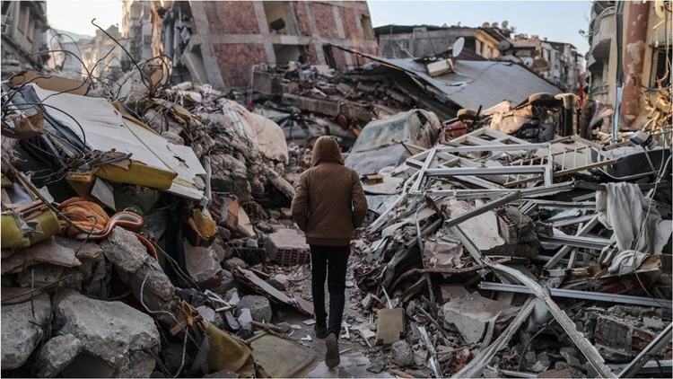
Notes:
https://philnews.ph/2023/03/01/death-toll-of-earthquake-in-turkey-syria-goes-above-50000/
March 1, 2023

Slide 92
^{Habakkuk 3.17-19} Though the fig tree does not blossom, and there is no yield on the vines, Though the olive crop fail, and the fields produce no food, the flock is cut off from the fold, and there is no cattle in the stalls.

Slide 93
^{Habakkuk 3.17-19} Yet will I triumph in Adoni, I will rejoice in the God of my salvation! Adoni my Lord, is my strength. He has made my feet like a deer’s, and will make me walk on my high places.

Slide 94
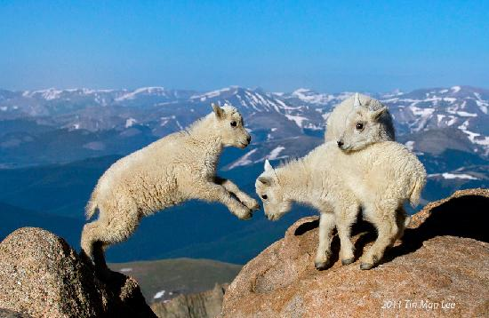
Lambs on high places!
Notes:
Copyrighted image:
https://www.google.com/search?q=mountain+goat&safe=active&source=lnms&tbm=isch&sa=X&ved=0ahUKEwj3w8nCxb3ZAhXRzlMKHcSiDA0Q_AUICigB&biw=1282&bih=884#imgdii=YT89DdgmgcQE0M:&imgrc=zMWk58FPXAT0aM:
Mount Evans, Denver Picture: Mountain goat kids jumping with rocky mountain background

Slide 95
נַהֲפוֹךְ הוּא nahafokh hu
One the contrary,
the reverse is true
But, we have to stand!!

Slide 96
Fearfulness, insecurity, shame, dread, panic
^{1 Kefa/Pet 5.8-9} Stay sober, stay alert! Your enemy, the Adversary, Ha-Satan, stalks about like a roaring lion looking for someone to devour. Stand against him, firm in your trust.
Notes:
The lion that roars is the old toothless one. Drives prey to the young ones ready to pounce. Run toward your fear.

Slide 97
Run toward your fear. Faith!!!
Some really politically incorrect advice: If there was an active shooter, we are told to run, hide, fight.
What if we all immediately rushed him? Threw stuff.
Airplanes?
Notes:
I think the real reason that there have been no hijackings is that there is enough anger in America that if someone stood up to hijack a plane, we would all immediately rush him in fury!!

Slide 98
נַהֲפוֹךְ הוּא nahafokh hu
One the contrary,
the reverse is true
But, we have to stand!!
Notes:
.

Slide 99
נַהֲפוֹךְ הוּא nahafokh hu

Slide 100
נַהֲפוֹךְ הוּא nahafokh hu
On the contrary, the reverse is true. The Scroll of Ester is about hidden, unexpected reversal.
The concept
The Problem, application to us
The reversal then and today

