Slide 1
e-handout
To have these notes
without taking notes
Go to OrHaOlam.com
Click on Messages tab,
2023 Messages

Slide 2
David Zinn is an artist from Michigan . He runs around all day in the streets of Ann Arbor , with street construction, cracks, etc. on the road with chalk to create a lot of street fairy tales.
Notes:
Ted Alongi

Slide 3
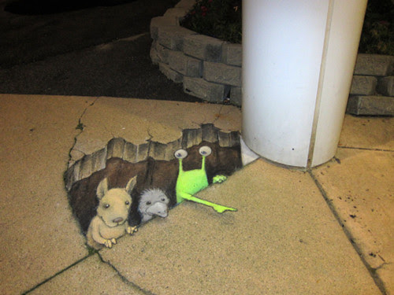

Slide 4
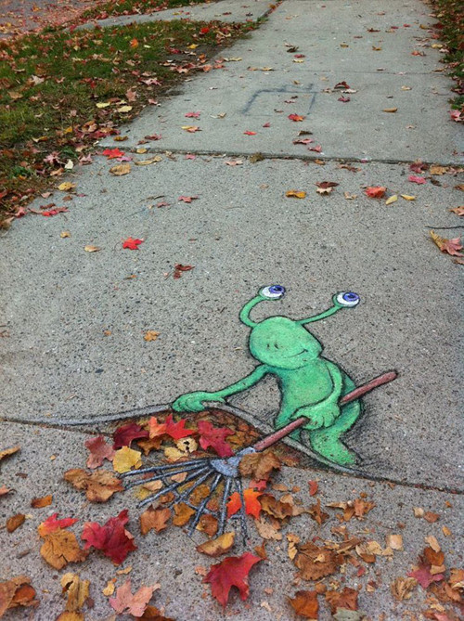

Slide 5


Slide 7
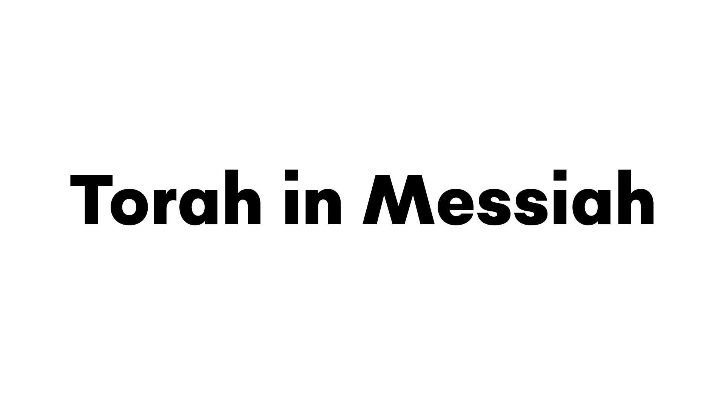
^{Yn 5.39-40} You keep examining the Tanakh because you think that in it you have eternal life. Those very Scriptures bear witness to me. Yet you are unwilling to come to Me so that you may have life!

Slide 8
^{Yn 5.39-40} You keep examining the Tanakh because you think that in it you have eternal life.

Slide 9
^{Yn 5.39-40} You keep examining the Tanakh because you think that in it you have eternal life.
Is this a bad thing to do?
Yeshua’s surprising comment.

Slide 10
^{Yn 5.39-40} You keep examining the Tanakh because you think that in it you have eternal life. Those very Scriptures bear witness to me. Yet you are unwilling to come to Me so that you may have life!
Notes:
Who could talk like that, except G-d come to earth?

Slide 11
^{Yn 5.39-40} You keep examining the Tanakh because you think that in it you have eternal life. Those very Scriptures bear witness to me. Yet you are unwilling to come to Me so that you may have life! TWO SYSTEMS
Eternal life through the scriptures.

Slide 12
^{Yn 5.39-40} You keep examining the Tanakh because you think that in it you have eternal life. Those very Scriptures bear witness to me. Yet you are unwilling to come to Me so that you may have life! TWO SYSTEMS
Eternal life through the scriptures.
Eternal life through Yeshua.
Notes:
Aren’t these the same?

Slide 13
There are two fundamentally different spiritual systems of salvation, of righteousness, and of life, as taught in Torah and pointed out by Rav Shaul. This is MUCH more than just acknowledging that eternal salvation is by Yeshua and not earned by obedience. We are examining a spirit, an energy of living.

Slide 14
^{Yn 5.39-40} You keep examining the Tanakh because you think that in it you have eternal life. Those very Scriptures bear witness to me. Yet you are unwilling to come to Me so that you may have life!
Shaul’s / Paul’s credentials
Notes:
For those who might say, we’ll Paul undermined the faith of Yeshua; made a new religion.

Slide 15
Shaul certainly understood Rabbinics, and never renounced Torah. He grew up in the warp and woof of it, he made a Temple sacrifice at the end of the Book of Acts, and referred to Israel as his people. So Shaul understood Rabbinics and Torah in a profound way. Paul is arguing that there is a wrong interpretation of the Torah, two approaches to Torah.

Slide 16
^{Acts 28.19-20} But when the Judean leaders protested, I was forced to appeal to Caesar—not that I had any charge to bring against my own nation. For this reason, therefore, I have requested to see you and to speak with you—since it is for the hope of Israel that I am bearing this chain.”

Slide 18
^{Yn 5.39-40} You keep examining the Tanakh because you think that in it you have eternal life. Those very Scriptures bear witness to me. Yet you are unwilling to come to Me so that you may have life!
Two systems in Romans10

Slide 19
^{Ro. 10.2-4} I can testify to their [the P’rushim] zeal for God. But it is not based on correct understanding; for, since they are unaware of God’s way of making people righteous and instead seek to set up their own, they have not submitted themselves to God’s way of making people righteous.
Notes:
P’rushim, Pharisees, proto Rabbis

Slide 20
God’s way of making people righteous is in keeping with Shaul’s intro in Ro 10.4 “For the goal at which the Torah aims is the Messiah, who offers righteousness to everyone who trusts.”
Why we need to do Ingathering.
Notes:
We used to call it outreach. Ingathering is a MUCH better term, noted by Mike Boatright.

Slide 21
FIRST SYSTEM ^{Ro 10.5} For Moshe writes about the righteousness grounded in the Torah that the person who does these things will attain life through them. [quoting Vayikra/Lev. 18:5.]
Notes:
Does these things → life. Sounds good. Is good. Mostly, but there is a subtle nuance.

Slide 22
SECOND SYSTEM ^{Ro 10.6-8} Moreover, the righteousness grounded in trusting says: “Do not say in your heart, ‘Who will ascend to heaven?’” — [D’varim 30:11–14]
that is, to bring the Messiah down

Slide 23
SECOND SYSTEM ^{Ro 10.6-8} or, “‘Who will descend into Sh’ol?’” —that is, to bring the Messiah up from the dead. What, then, does it say? “The word is near you, in your mouth and in your heart.”

Slide 24
Then Shaul’s spiritual exposition —
^{Ro 10.8-9} that is, the word about trust which we proclaim, namely, that if you acknowledge publicly with your mouth that Yeshua is Lord and trust in your heart that God raised him from the dead, you will be delivered.
Notes:
Based on D’varim/Dt. 30:11–14

Slide 25
The second of the systems is in keeping with Shaul’s intro in Ro 10.4 “For the goal at which the Torah aims is the Messiah, who offers righteousness to everyone who trusts.”
Righteousness by effort.
Righteousness by supernatural power, then effort.

Slide 26
A similar, and perhaps more emphatic, exposition of scripture is found in Galatians 3.1-14

Slide 27
FIRST SYSTEM ^{Galatians 3.1-2} O unthinking Galatians, who cast a spell on you? Before your eyes Yeshua the Messiah was clearly portrayed as having been put to death as a criminal! I want to find out just one thing from you: did you receive the Ruach by deeds based on Torah, or by hearing based on trust?

Slide 28
^{Galatians 3.3-5} Are you so unthinking? After beginning with the Ruach, will you now reach the goal in the flesh? Did you endure so much for nothing — if it really was for nothing? So then, the One who gives you the Ruach and works miracles among you—does He do it because of your deeds based on Torah or your hearing based on trust and faithfulness?

Slide 29
SECOND SYSTEM ^{Galatians 3.6-8} Just as Abraham “believed God, and it was credited to him as righteousness,” [Genesis 15:6] know then that those who have faith are children of Abraham. The Scriptures, foreseeing that God would justify the Gentiles by faith, proclaimed the Good News

Slide 30
^{Galatians 3.8-9} to Abraham in advance, saying, ^{Genesis 12:3} “All the nations shall be blessed through you.” So then, the faithful are blessed along with Abraham, the faithful one.

Slide 31
^{Galatians 3.10-11} For all who rely on the deeds of Torah are under a curse—for the Scriptures say, “Cursed [in practical terms, a frustrated spirit] is everyone who does not keep doing everything written in the scroll of the Torah.” ^{Dvarim Dt. 27:26} It is clear that no one is set right before God by Torah, for “the righteous shall live by emunah.” Habakkuk 2:4

Slide 32
^{Galatians 3.12-13} However, Torah is not based on trust and faithfulness; on the contrary, “the one who does these things shall live by them Vayikra ^{Lev. 18:5} Messiah liberated us from Torah’s curse, having become a curse for us (for it is written,
Notes:
The curse is of the frustration of imperfect obedience. Liberated to joyful receiving.

Slide 33
^{Galatians 3.13-14} “Cursed is everyone who hangs on a tree^{” Dvarim/Dt 21:22–23} in order that through Messiah Yeshua the blessing of Abraham might come to the Gentiles, so we might receive the promise of the Ruach through trusting faith.

Slide 34
So, this is not just about salvation, but about the flow of spiritual life. BTW, I realize that the two systems overlap and interrelate a lot, which make the presentation of the starkly different streams very subtle at times.

Slide 35
Application: So is your eternal confidence based in what you do?
Or based on who you ARE in Messiah’s loving atonement?
That should motivate what we do!
Human being or human doing.
Work FROM rest, or work TO rest.

Slide 37
^{Yn 5.39-40} You keep examining the Tanakh because you think that in it you have eternal life. Those very Scriptures bear witness to me. Yet you are unwilling to come to Me so that you may have life!
Two systems the Talmud

Slide 38
Very illustrative of this is the story of The Oven of Akhnai, a Talmudic story found in Bava Metzia 59a-b which is set around the early 2nd century CE This story is so clearly depicts the two streams that it almost seems that Shaul used some language from the story, a century in advance, prophetically.

Slide 39
In this story, the R. Eliezer, possibly a Messianic believer, is condemned.
Notes:
https://www.storyboardthat.com/storyboards/e1b1a174/ari-and-rachel-oven-of-akhnai-comic2/copy

Slide 40
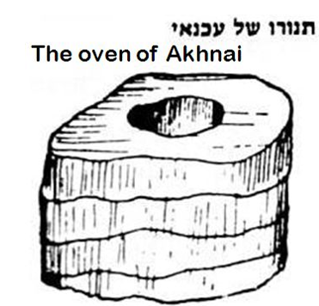
עַכְנַאי
(Talmudic Heb.)
snake
The structure was spiral, coiled ~snake.
Notes:
https://www.chabad.org/library/article_cdo/aid/5455793/jewish/59b.htm

Slide 41
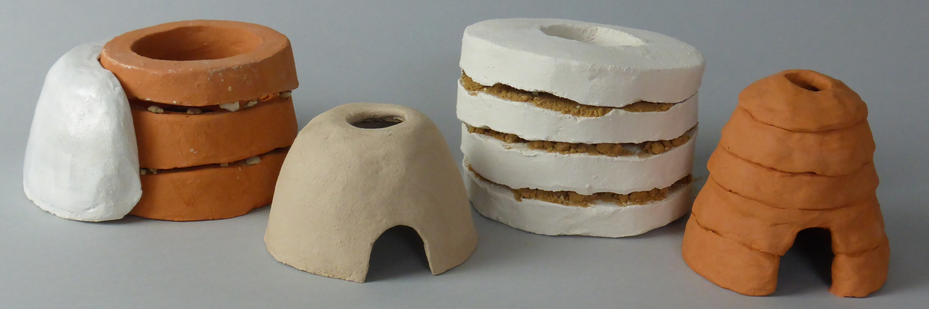
Notes:
https://external-content.duckduckgo.com/iu/?u=http%3A%2F%2Fwww.ruthschreiber.com%2Fwp-content%2Fuploads%2F2019%2F12%2FP1110610-300dpi.jpg&f=1&nofb=1&ipt=dbd0e185b554c5912d07a87c9c0f18fe6de506fa53e8210131c5a49edcc6a189&ipo=images

Slide 42
And this is known as the oven of akhnai. The Gemara asks: What is the relevance of akhnai, a snake, in this context? Rav Yehuda said that Shmuel said: It is characterized in that manner due to the fact that the Rabbis surrounded it with
Notes:
Bava Metzia 59b
https://www.sefaria.org/Bava_Metzia.59b.1?lang=bi

Slide 43
their statements like this snake, which often forms a coil when at rest, and deemed it impure. The Sages taught: On that day, when they discussed this matter, Rabbi Eliezer answered all possible answers in the world to support his opinion, but the Rabbis did not accept his explanations from
Notes:
Bava Metzia 59b
https://www.sefaria.org/Bava_Metzia.59b.1?lang=bi

Slide 44
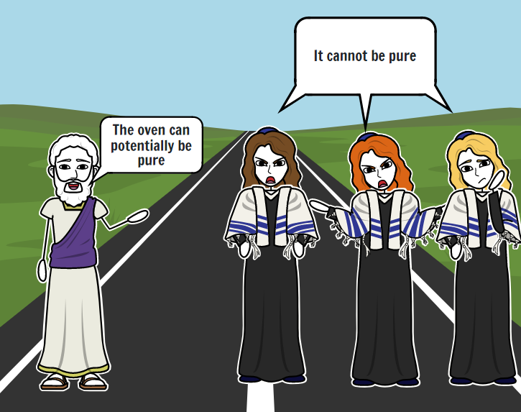
Notes:
https://www.storyboardthat.com/storyboards/e1b1a174/ari-and-rachel-oven-of-akhnai-comic2/copy

Slide 45
After failing to convince the Rabbis logically, Rabbi Eliezer said to them: If the halakha is in accordance with my opinion, this carob tree will prove it. The carob tree was uprooted from its place one hundred cubits, and some say four hundred cubits. The Rabbis said to him: One does not cite halakhic proof from the carob tree.
Notes:
Bava Metzia 59b
https://www.sefaria.org/Bava_Metzia.59b.1?lang=bi

Slide 46
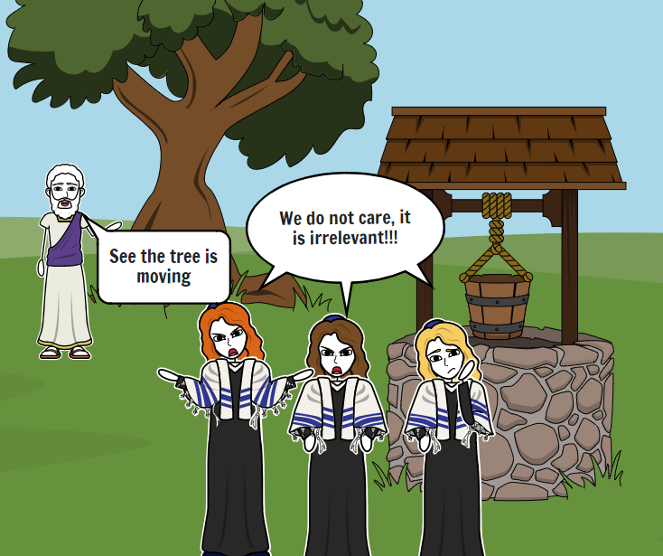
Notes:
https://www.storyboardthat.com/storyboards/e1b1a174/ari-and-rachel-oven-of-akhnai-comic2/copy

Slide 47
Rabbi Eliezer then said to them: If the halakha is in accordance with my opinion, the stream will prove it. The water in the stream turned backward and began flowing in the opposite direction. They said to him: One does not cite halakhic proof from a stream.

Slide 48
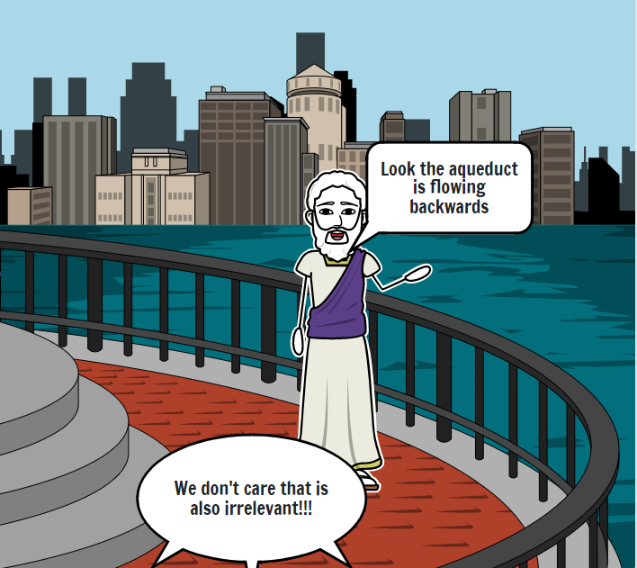
Notes:
https://www.storyboardthat.com/storyboards/e1b1a174/ari-and-rachel-oven-of-akhnai-comic2/copy

Slide 49
Rabbi Eliezer then said to them: If the halakha is in accordance with my opinion, the walls of the study hall will prove it. The walls of the study hall leaned inward and began to fall. Rabbi Yehoshua scolded the walls and said to them: If Torah scholars

Slide 50
are contending with each other in matters of halakha, what is the nature of your involvement in this dispute? The Gemara relates: The walls did not fall because of the deference due Rabbi Yehoshua, but they did not straighten because of the deference due Rabbi Eliezer, and they still remain leaning.
Notes:
Bava Metzia 59b
https://www.sefaria.org/Bava_Metzia.59b.1?lang=bi

Slide 51
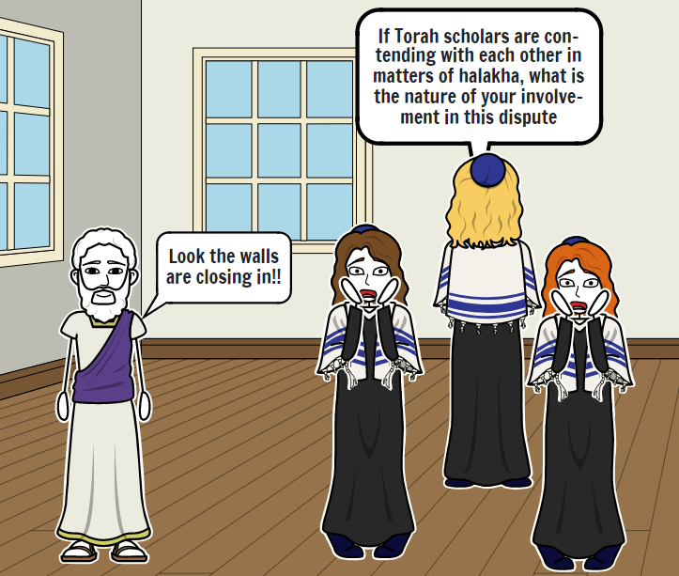
Notes:
https://www.storyboardthat.com/storyboards/e1b1a174/ari-and-rachel-oven-of-akhnai-comic2/copy

Slide 52
Summary of the story thus far: R. Eliezer made and got divine approval of his case by
• Logic
• Supernatural intervention in moving a tree
• Supernatural intervention in reversal of a stream
• Supernatural intervention in collapse of walls
Notes:
None of these were acceptable to the other sages.

Slide 53
Rabbi Eliezer then said to them: If the halakha is in accordance with my opinion, Heaven will prove it. A Divine Voice emerged from Heaven and said: Why are you differing with Rabbi Eliezer, as the halakha is in accordance with his opinion in every place that he expresses an opinion?

Slide 54
Rabbi Yehoshua stood on his feet and said: It is written: “It is not in heaven” (Deuteronomy 30:12). The Gemara asks: What is the relevance of the phrase “It is not in heaven” in this context? Rabbi Yirmeya says: Since the Torah was already given at Mount Sinai,

Slide 55
we do not regard a Divine Voice, as You already wrote at Mount Sinai, in the Torah: “After a majority to incline” (Exodus 23:2). Since the majority of Rabbis disagreed with Rabbi Eliezer’s opinion, the halakha is not ruled in accordance with his opinion.

Slide 56
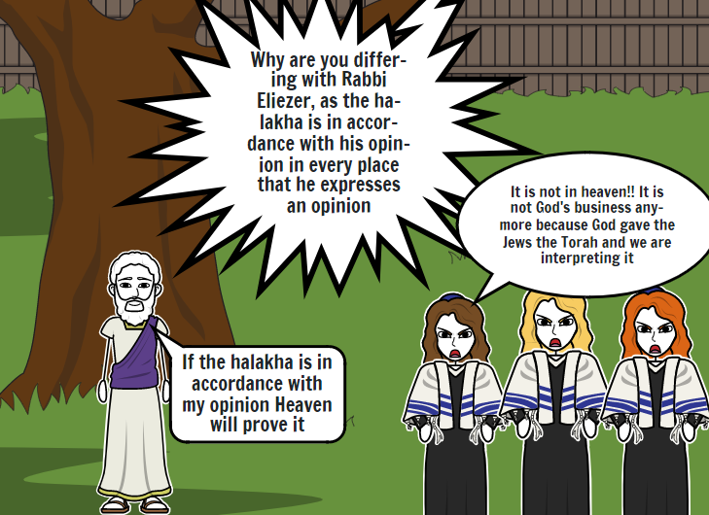
Notes:
https://www.storyboardthat.com/storyboards/e1b1a174/ari-and-rachel-oven-of-akhnai-comic2/copy

Slide 57
Eliezer represents living by the power of G-d.
The Trio [majority] represents group opinion.

Slide 58
The Gemara relates: Years after, Rabbi Natan encountered Elijah the prophet and said to him: What did the Holy One, Blessed be He, do at that time, when Rabbi Yehoshua issued his declaration? Elijah said to him: The Holy One, Blessed be He, smiled and said:

Slide 59
My children have triumphed over Me; My children have triumphed over Me.
Notes:
This last is a view of G-d that is cringeworthy.

Slide 60
Further inquiry:
R. Yirmiya cited the source/grid of Rabbinic authority, more than heavenly voices and miracles. He says. it has already been written in the Torah “You shall follow after the Majority.”’
Where does it say that?]

Slide 61
Shmot/Ex 23:2. This verse is used as an asmakhtah אַסְמַכְתָּא (Aramaic) written proof, that in Biblical matters we follow the majority, whether in making legal decisions, or with mixtures of kosher and non-kosher food items etc.

Slide 62
[Here is the key] Shmot/Ex 23:2
לֹא-תִהְיֶה אַחֲרֵי-רַבִּים לְרָעֹת; וְלֹא-תַעֲנֶה עַל-רִב ,לִנְטֹת אַחֲרֵי רַבִּים לְהַטֹּת.
Do not follow the majority when it does what is wrong; and don't allow the popular view to sway you into offering testimony for any cause if the effect will be to pervert justice.

Slide 63
The phrase was taken out of context to reverse the meaning!! The word “NOT” was deleted and it reversed the plain sense.

Slide 64
[Here is the key] Shmot/Ex 23:2
לֹא-תִהְיֶה אַחֲרֵי-רַבִּים לְרָעֹת; וְלֹא-תַעֲנֶה עַל-רִב ,לִנְטֹת אַחֲרֵי רַבִּים לְהַטֹּת.
Do not follow the majority when it does what is wrong; and don't allow the popular view to sway you into offering testimony for any cause if the effect will be to pervert justice.

Slide 65
Summary of the whole story: R. Eliezer made and got divine approval of his case by
• Logic
• Supernatural intervention in moving a tree

Slide 66
Supernatural intervention in reversal of a stream
• Supernatural intervention in collapse of walls
• G-d spoke from heaven.
Genuine Heavenly voice was rejected

Slide 67
Majority opinion of rabbis deemed supreme.
• Basis of majority opinion is violation and reversal of Ex 23.2
• G-d is construed to like the idea that His will and opinion is overcome.

Slide 68
^{Yn 5.39-40} You keep examining the Tanakh because you think that in it you have eternal life. Those very Scriptures bear witness to me. Yet you are unwilling to come to Me so that you may have life!
Two systems: all works based
Notes:
Not just Jewish, many religious groups have a works based lifestyle. It’s generally very lovely.

Slide 69
So is your eternal confidence based in what you do?
Or based on who you ARE in Messiah’s loving power and atonement?
That should motivate what we do!
Human being or human doing.
Work FROM rest, or work TO rest.

Slide 70
Yeshua’s challenge to human /rabbinic consensus and knowledge became a source of great rage. Why? Then and why still? Some may say that Jewish anger at Messianics is because of the depredations of Christians, nominal and genuine Christians

Slide 71
over the millennia. But that can’t apply to Shaul and first century rabbis. No travesties were yet done.. I offer that the rage is a product of the sense of challenge to the human / rabbinical attainment of righteousness. If we really need this level of inner repentance,

Slide 72
and divine righteousness, then pride is deeply broken.

Slide 73
^{Acts 26.11} Often I went from one synagogue to another, punishing them and trying to make them blaspheme; and in my wild fury against them, I even went so far as to persecute them in cities outside the country.

Slide 74
^{Acts 7.56-58a} “I see heaven opened and the Son of Man standing at the right hand of God!” At this, they began yelling at the top of their voices, so that they wouldn’t have to hear him; and with one accord, they rushed at him, threw him outside the city and began stoning him.

Slide 75
^{Acts 8.3} But Sha’ul set out to destroy the Messianic Community — entering house after house, he dragged off both men and women and handed them over to be put in prison.

Slide 76
^{Acts 22.1, 21-23} ‘Get going! For I am going to send you far away — to the Goyim!’” They had been listening to him up to this point; but now they shouted at the top of their lungs, “Rid the earth of such a man! He’s not fit to live!” They were screaming, waving their clothes and throwing dust into the air.

Slide 77

Notes:
http://wolkenraum.quickconnect.to/d/s/tGdOtODp2QtVIrbLoBZE7xQmKWsuOgD0/Zxbxu-Lm13Ubr34ha6yflla8q2YnBnCh-aLCg8D4OYgo
or
https://wolkenraum.direct.quickconnect.to:5001/raum/?launchApp=SYNO.SDS.VideoPlayer2.Application&SynoToken=QlbZ7iqDzjvWE&launchParam=url%3Dwebapi%252Fentry.cgi%253Fapi%253DSYNO.SynologyDrive.Files%2526method%253Ddownload%2526version%253D2%2526files%253D%25255B%252522id%25253A748171958654382107%252522%25255D%2526force_download%253Dtrue%2526is_preview%253Dtrue%2526download_serial%253D%252522%25255C%2525223vU0lM0AQr%25255C%252522%252522%2526SynoToken%253DQlbZ7iqDzjvWE%26filename%3D2023-04-06%2520Ben%2520Shapiro%2520clip.mov

Slide 78
^{Yn 5.39-40} You keep examining the Tanakh because you think that in it you have eternal life. Those very Scriptures bear witness to me. Yet you are unwilling to come to Me so that you may have life!
Energized by Love, Joy, Shalom

Slide 79
In conclusion, statement from Dan Juster, with permission to quote:
I read through the Talmud 45 years ago, and read the Mishnah a year ago, the whole thing. No one can believe that this is the heart of God,

Slide 80
the extensive legalism and debates over minutiae us astonishing.
[Consider the laws of carrying in https://www.thetorah.com/article/the-prohibition-to-carry-on-shabbat-historical-and-exegetical-development]

Slide 81
The danger of Rabbinic Judaism is in the soul realm.
It will fascinate, stimulate, complicate and suffocate

Slide 82
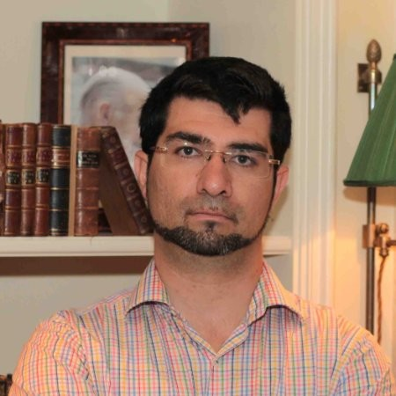
Israeli Eli Nacht, Israeli lawyer Owner of a Law Company, specializing on Government Relations & Bussiness sector. - Founder of Israel Empowerment Lobby
Notes:
Rejecting Yeshua in the Jewish world
Law of return excluding Messianic Jews
Matrilineal descent determining Jewish ID weddings in Israel
Culture of non-work and non-military service and anti-Zionism among Haredim.
During niddah, among some groups, husband can seek another woman, like concubines. One believing family I know personally the young women was solicited.

Slide 83
^{Yn 5.39-40} You keep examining the Tanakh because you think that in it you have eternal life. Those very Scriptures bear witness to me. Yet you are unwilling to come to Me so that you may have life!
Energized by Love, Joy, Shalom

Slide 84
So is your eternal confidence based in what you do?
Or based on who you ARE in Messiah’s loving atonement?
That should motivate what we do!
Human being or human doing.
Work FROM rest, or work TO rest.

