Slide 1
e-handout
To have these notes
without taking notes
Go to OrHaOlam.com
Click on Messages tab,
2023 Messages

Slide 2
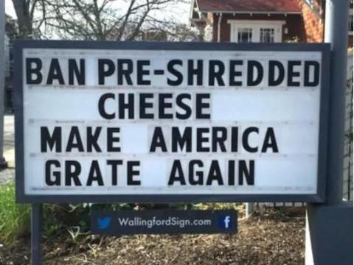

Slide 3
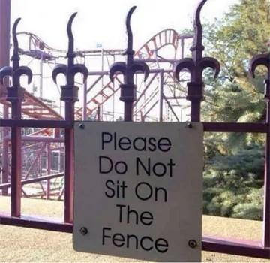

Slide 4
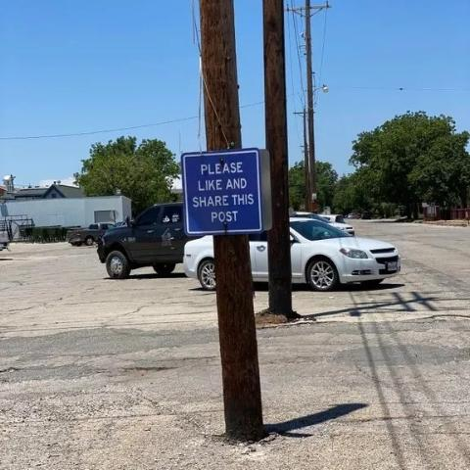

Slide 7
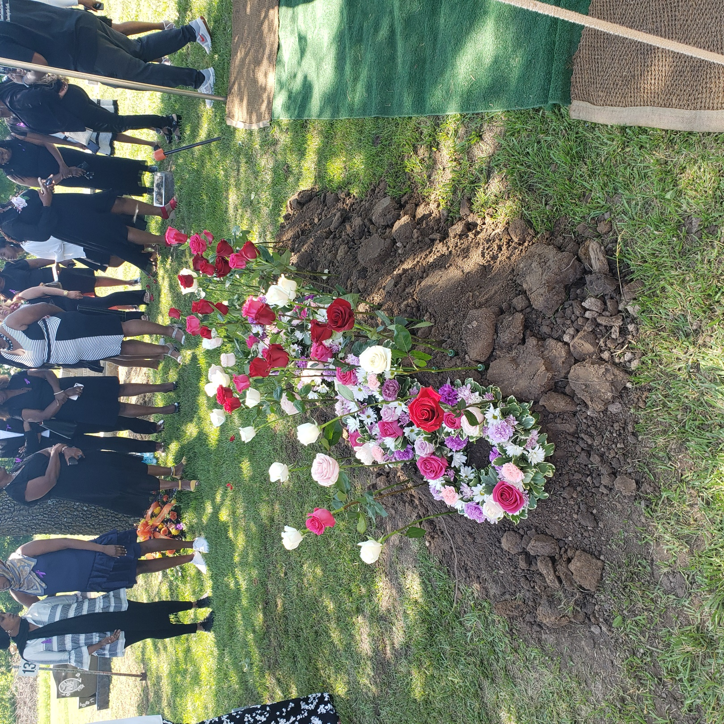
Floral display on Nadyne Lloyd’s grave
Beautiful
Kenyan custom
Kalenjin ethnic group

Slide 8
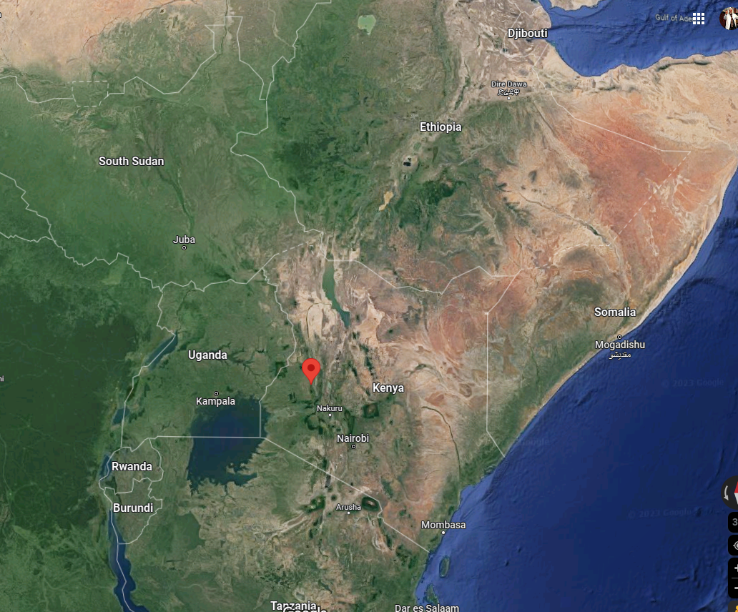
Great Rift Valley
Notes:
Kalenjins ethnic group win most marathons!
Great Rift Valley 8000 ft altitude
4 lb calf muscles, most people 8 lbs

Slide 9
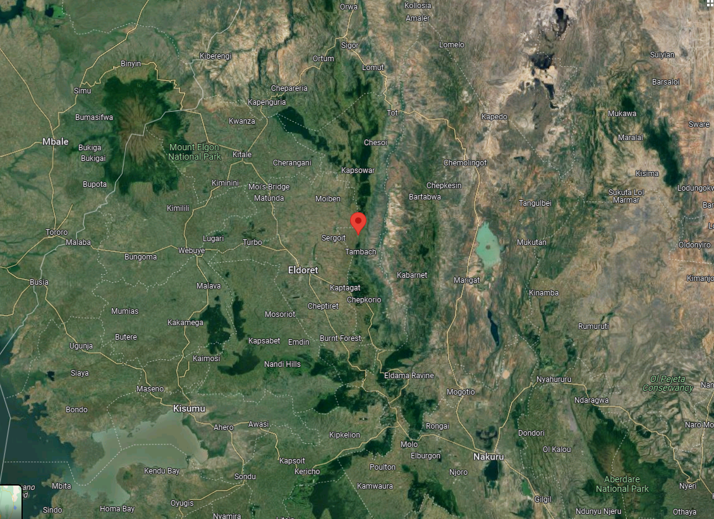
Notes:
the passion for running across generations, turning the Rift Valley – especially the small town of Iten – into a mecca for the nation’s elite long distance runners. There, children start running at a young age.

Slide 12
There are three themes to Shavuot large loaves
Large loaves?
Wheat harvest
Receiving of the Torah
Receiving of the Ruakh/Spirit

Slide 13
^{Vayikra/Lev 23.15} "'From the day after the day of rest -that is, from the day you bring the sheaf for waving [April 7, 2023] -you are to count seven full weeks,
Notes:
So, vs 15 about sheaf for waving right after Pesakh
Messiah is firstfruits, right after Pesakh
ActorBible group was here

Slide 14
^{Vayikra/Lev 23.15} First sheaf for waving was the day after Pesakh: [ActorBible here then] what?
Barley. Coarser grain. Bread of poor people.
Unleavened
Notes:
How do you know barley?

Slide 15
^{Shmot/ Ex 9.31-33} [Passover time] The flax and barley were destroyed, since the barley had headed and the flax was in bloom. The wheat and spelt, however, were not destroyed, because they ripen later.) Then Moses left Pharaoh and went out of the city.

Slide 16
^{1 Cor 15.20} But the fact is that the Messiah has been raised from the dead, the firstfruits of those who have died…

Slide 17
^{1 Cor 15. 22-23} For just as in connection with Adam all die, so in connection with the Messiah all will be made alive. But each in his own order: the Messiah is the firstfruits;
Notes:
Bread that represents Him was during Pesakh week, therefore unleavened barley bread.
[Unleavened called bread of affliction: someone who likes bread of affliction matsochist. Someone likes to offer bread of affliction to others: Seder Matsochist.]
We all die, and we all are worthy of death.
He had to be pure and perfect. Unleavened = w/o pride, sin, inflated lusts, inflated ego, easily offended.
50 days after unleavened barley firstfruits, Shavuot also called Bikkurim = firstfruits.
Firstfruits barley = Messiah
Firstfruits wheat, this weekend, us and other things

Slide 18
^{Vayikra/Lev 23.15} "'From the day after the day of rest -that is, from the day you bring the sheaf for waving [April 7, 2023] -you are to count seven full weeks,
[Messiah’s resurrection on the Day of Firstfruits, after Pesakh.]

Slide 19
^{Vayikra/Lev 23.16-17} until the day after the seventh week; you are to count fifty days; and then you are to present a new grain offering to Adoni. You must bring bread from your homes for waving — two loaves made with one gallon of fine flour, baked with leaven — as firstfruits for Adoni.
One gallon = 16 cups

Slide 20
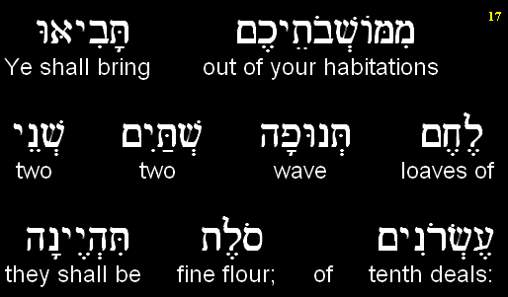
Vayikra (Leviticus) 23.17a
Notes:
Two tenths deal? = one gallon ~ Stern CJB
waving-two loaves made with one gallon of fine flour, baked with leaven -as firstfruits for ADONI.
Dawn’s hallah 3 cups. Gallon is 16 cups. 5x
each loaf or cake, according to Maimonides, was seven hands' breadths long x four hands' breadths broad x four fingers high Hilchot Tamidin c. 8. sect. 10.
28” long 16” wide x 4” = 1792 cu in
Typical loaf 15 x 6 x 4 = 360 cu in
5x volume!!

Slide 21
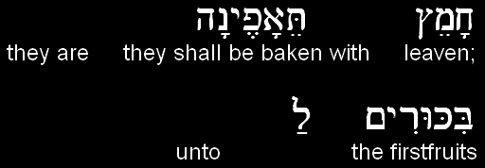
Vayikra (Leviticus) 23.17b
יְיָ
ADONI.

Slide 22
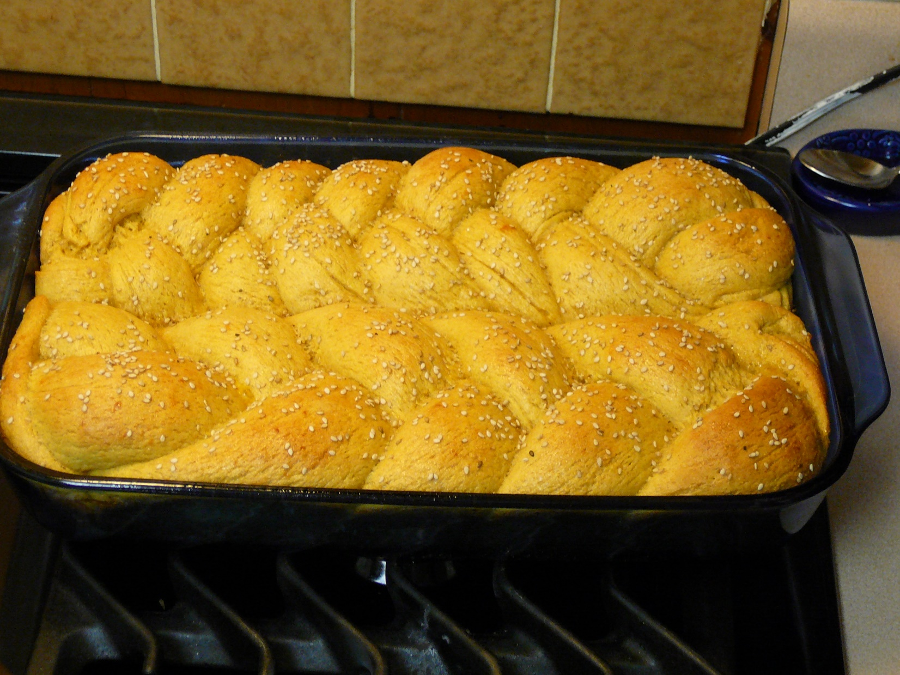
Each loaf 3 cups.
Notes:
Each loaf 3 cups. 6 cups here.
My wife’s hallah is the BEST in the galaxy. Like John Stewart’s chicken salad is the best in the galaxy.

Slide 23
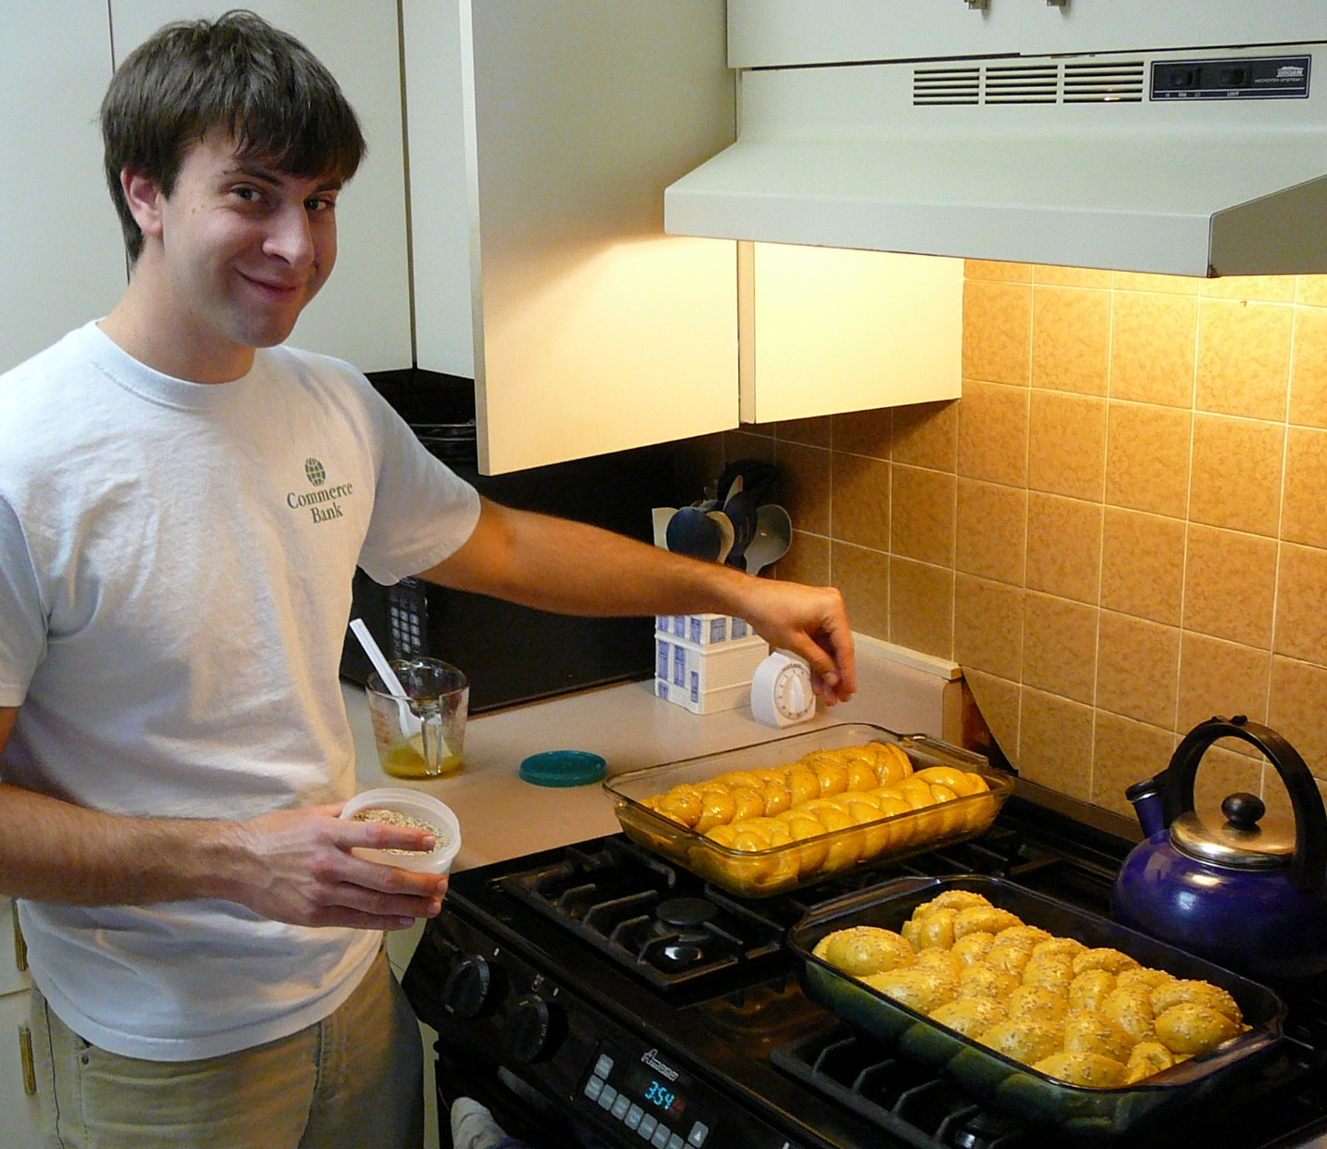
Notes:
Concept:
Shavuot is about a BIG loaf
Leavened loaf
First Bikkurim just after Pesakh is Messiah.
Shavuot is the leavened. Us. Not so perfect in and of ourselves, BUT, we are the fruit.
Or HaOlam. He is the Light, we bear the light, transmit the Light. People deal with us, see the light.

Slide 24
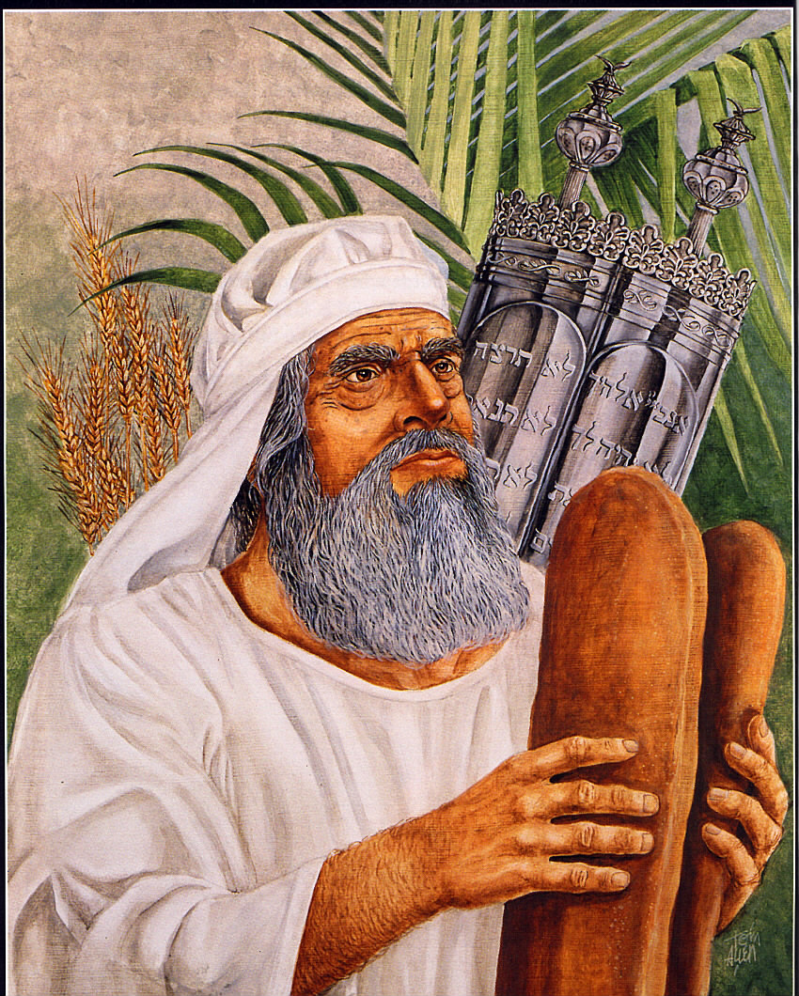
Each loaf a gallon of flour = 16 cups
Five times our hallah at home!
Notes:
Absurdly large loaf
Twice normal wave loaf
Gallon flour = 16 cup loaf

Slide 25
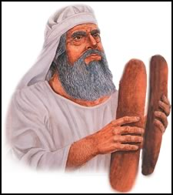
Notes:
https://external-content.duckduckgo.com/iu/?u=https%3A%2F%2Fwww.sabbathcog.org%2FWaveLoaves.jpg&f=1&nofb=1&ipt=22658a5809a991c9eaf727285f3bb242918572105fbc245a24a1249d8daf79e5&ipo=images

Slide 26
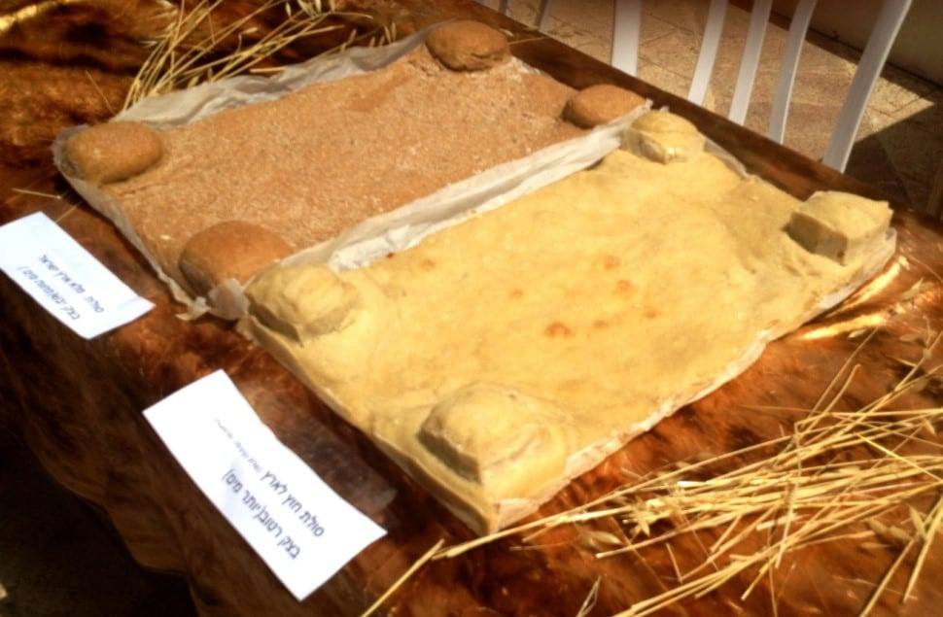
Notes:
https://www.israel365news.com/298508/jewish-priests-perform-pentecost-temple-service-fulfillment-biblical-prophecy-jerusalem/
Taken from the first wheat of the season to ripen, they were large, rectangular in shape with four mini towers at each corner of the loaf.

Slide 27
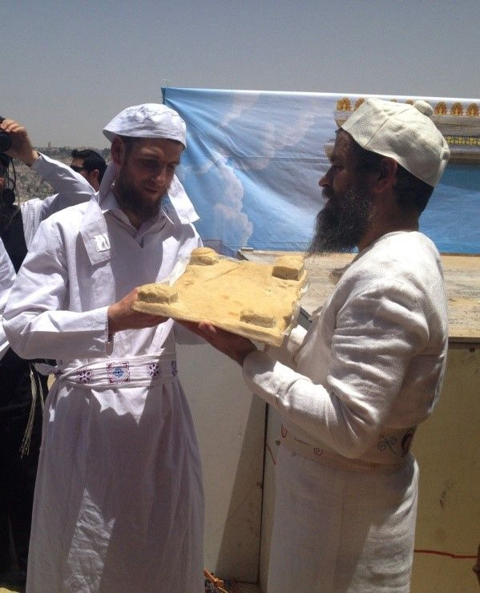
Notes:
https://i.pinimg.com/originals/e1/81/c8/e181c854bd8c3a6228de8c4aaec81d9f.jpg
https://www.israel365news.com/298508/jewish-priests-perform-pentecost-temple-service-fulfillment-biblical-prophecy-jerusalem/

Slide 28
^{Rashi 89b} With regard to the lamb offering that comes with the omer meal offering…the quantity of flour used in its meal offering is doubled.
Notes:
https://www.sefaria.org/Menachot.89b.3?lang=bi&with=all&lang2=en

Slide 29
^{BaMidbar 15.1-4} Adoni said to Moshe, “Tell the people of Isra’el, ‘When you have come into the land where you are going to live, which I am giving to you, and want to make an offering by fire to Adoni — a burnt offering or sacrifice to fulfill a special vow, or to be a voluntary offering, or at your designated times, to make a fragrant aroma for Adoni —

Slide 30
^{BaMidbar 15.1-4} then, whether it is comes from the herd or from the flock, the person bringing the offering is to present Adoni with a grain offering consisting of two quarts of fine flour mixed with one quart of olive oil, 5 and one quart of wine for the drink offering. This is what you are to prepare with the burnt offering or for each lamb sacrificed.

Slide 31
Bamidbar/Nu 15.4

Slide 32
Vayikra (Leviticus) 23.17a
Notes:
Two tenths deal? = one gallon
waving-two loaves made with one gallon of fine flour, baked with leaven -as firstfruits for ADONI.
Dawn’s hallah 3 cups. Gallon is 16 cups. 5x
each loaf or cake, according to Maimonides F23, was seven hands' breadths long [21”] four hands' breadths broad [12”], and four fingers high: Hilchot Tamidin c. 8. sect. 10.
28” long 16” wide x 4”

Slide 33
A typical hallah at home is 3 cups.
A loaf for a usual wave offering is 8 cups.
The Shavuot offering is 16 cups.
Why?

Slide 35
^{Yer/Jer 29.12-14} “Then you will call on Me, and come and pray to Me, and I will listen to you. You will seek Me and find Me, when you will search for Me with all your heart. Then I will be found by you,” says Adoni.
50 days of seeking. 21 days?

Slide 36
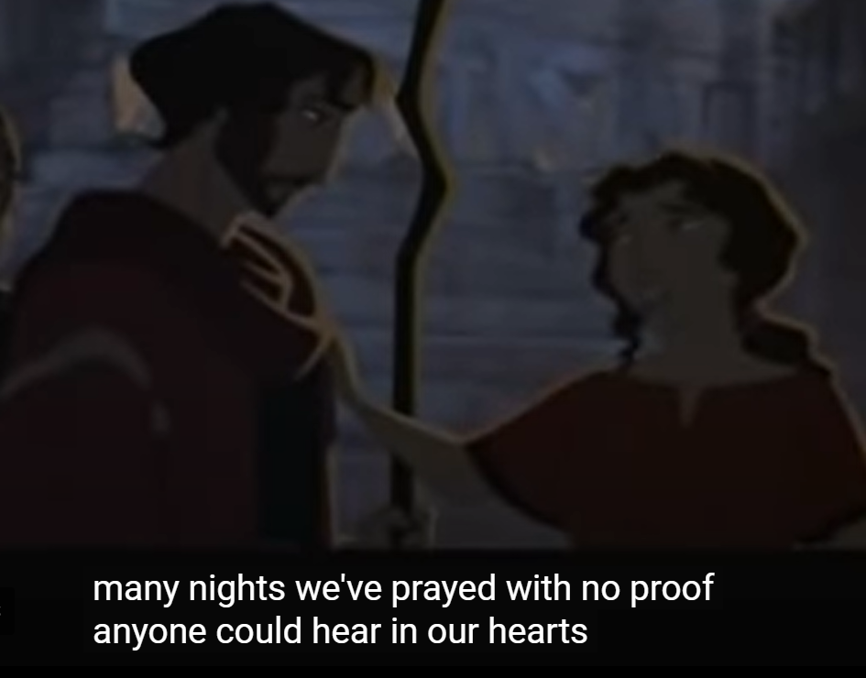
Notes:
Miriam with Moshe just returned.

Slide 37
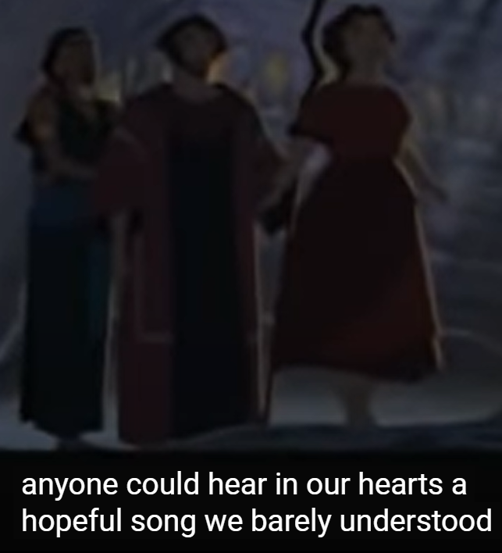
Notes:
Zipporah, Moshe, Miriam in the darkness

Slide 38
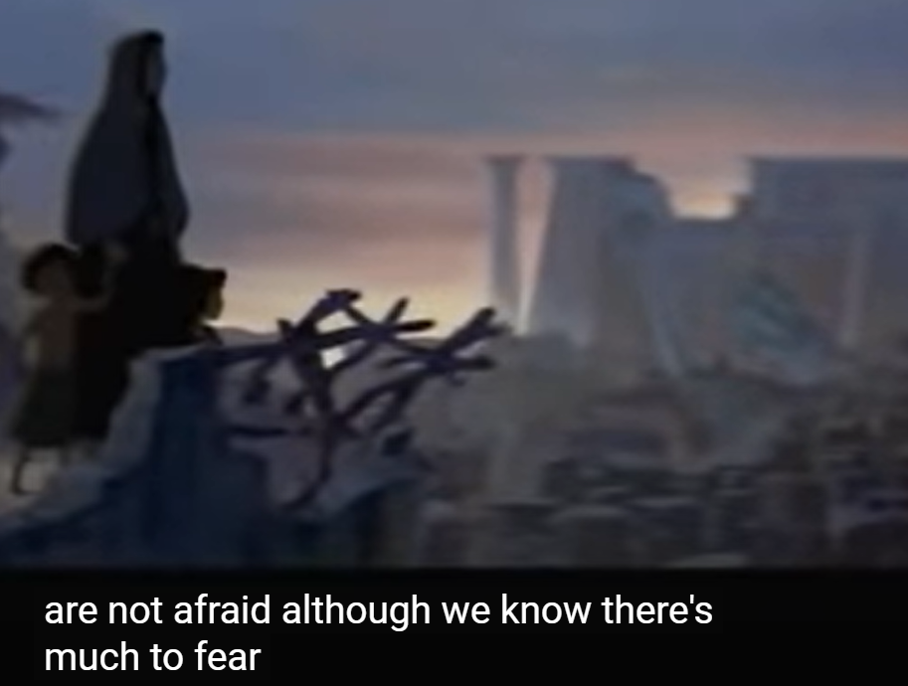
We
We were moving mountains long
before we know we could.
Notes:
This clip always makes me cry. 400 years of intercession!

Slide 39
^{Shmot/Ex 2. 23-25} Sometime during those many years the king of Egypt died, but the people of Isra’el still groaned under the yoke of slavery, and they cried out, and their cry for rescue from slavery came up to God. God heard their groaning, and God remembered his covenant with Avraham, Yitz’chak and Ya‘akov. God saw the people of Isra’el, and God acknowledged them.

Slide 40
^{Mtt.7.7-8} Ask, and it shall be given to you. Seek, and you shall find. Knock, and it shall be opened to you. For everyone who asks receives, and the one who seeks finds, and to the one who knocks it shall be opened.

Slide 41
Notes:
https://youtu.be/5krYI8ihxxk

Slide 42
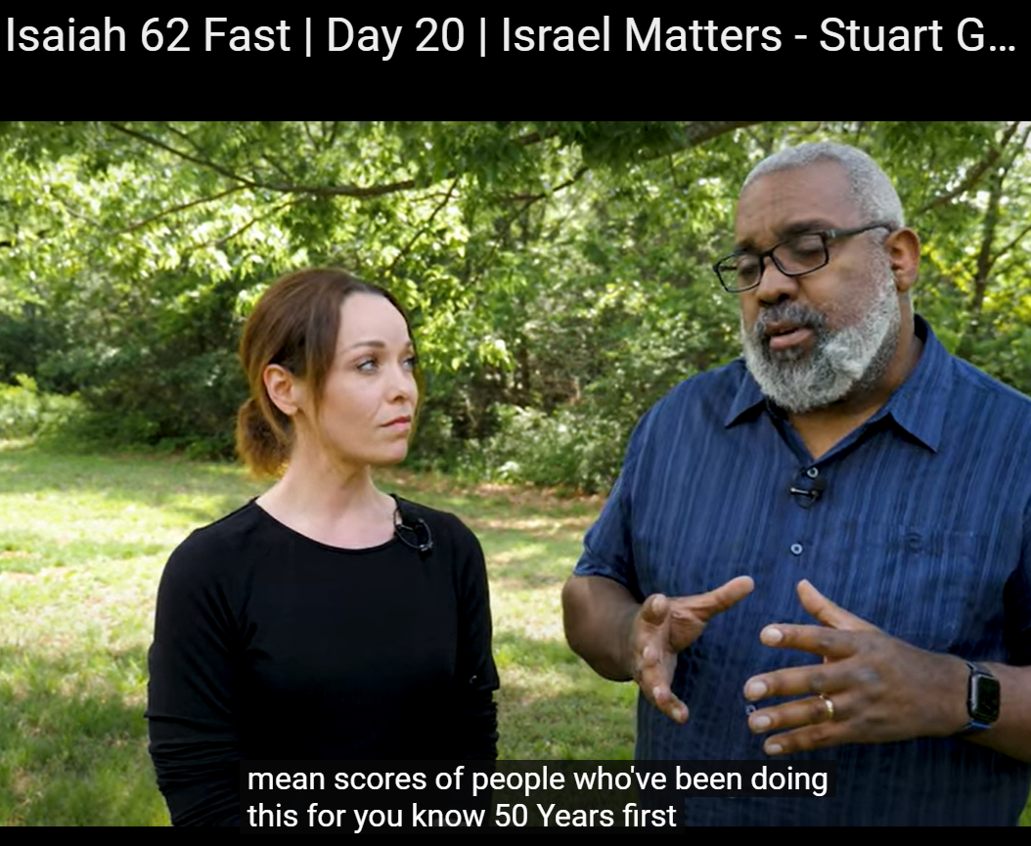
Notes:
https://youtu.be/AM90qeb8ZuI

Slide 44
There are three themes to Shavuot large loaves
Large loaves?
Wheat harvest
Receiving of the Torah
Receiving of the Ruakh/Spirit
Walk in abundance in Messiah!
Notes:
If you don’t know Him, seek Him. If you do, seek Him in transformation!!

Slide 45
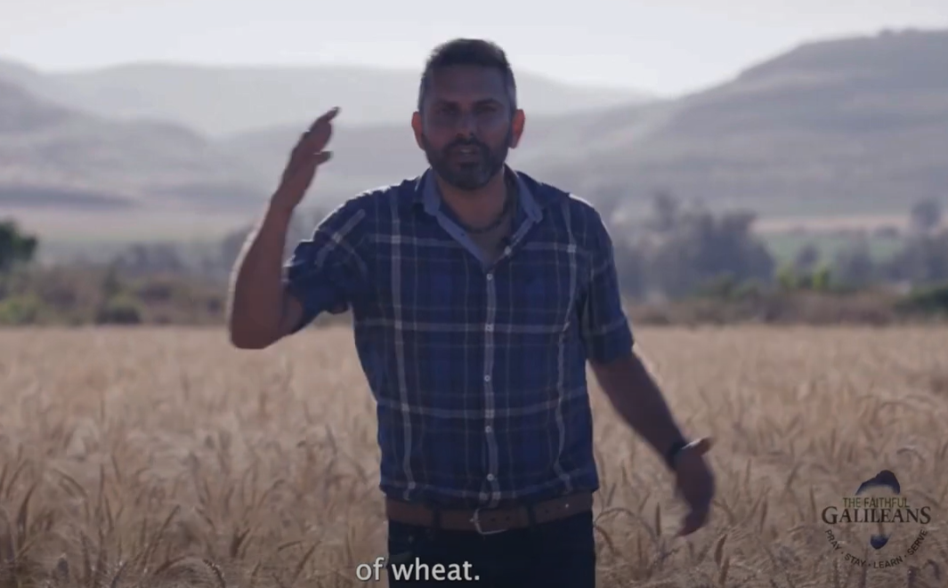
Chaim Malespin in a field of wheat
Notes:
https://youtu.be/JweocfE8PMY
Keep pressing on. Shavuot abundant victory.

Slide 46
^{Ro 8.32} He who did not spare His own Son but gave Him up for us all, how shall He not also with Him freely give us all things?

Slide 47
^{Phil 4.18-20} But I have received everything and have more than enough. I am amply supplied, having received from Epaphroditus what you sent— fragrant aroma, an acceptable sacrifice, pleasing to God. My God will fulfill every need of yours according to the riches of His glory in Messiah Yeshua. To our God and Father be the glory forever and ever! Amen.
Notes:
But it’s not always how we would order it.

Slide 48
^{Yn 10.10-11} The thief comes only to steal, slaughter, and destroy. I have come that they might have life, and have it abundantly! “I am the Good Shepherd. The Good Shepherd lays down His life for the sheep.
Notes:
I believe in blessings, but NOT the prosperity doctrine, where your spirituality is measured, or manifested by your Rolex. Nothing wrong with a Rolex, but if it’s the symbol of your life in Messiah, you’re missing it.

Slide 49
^{Mark 10.29-31} Yeshua said, “Yes! I tell you that there is no one who has left house, brothers, sisters, mother, father, children or fields, for my sake and for the sake of the Good News, who will not receive a hundred times over, now, in the ‘olam hazeh [this world], homes, brothers, sisters, mothers, children and lands — with persecutions! —
Notes:
I calculated out my Dad’s business, 23 employees, to which they said they would disinherit me. So, whatever I lost I would receive 100x!!
But, with persecutions!
We can expect abundance, but with suffering. Chuck Swindol had an amazing teaching on suffering. EVERYONE has pain.

Slide 50
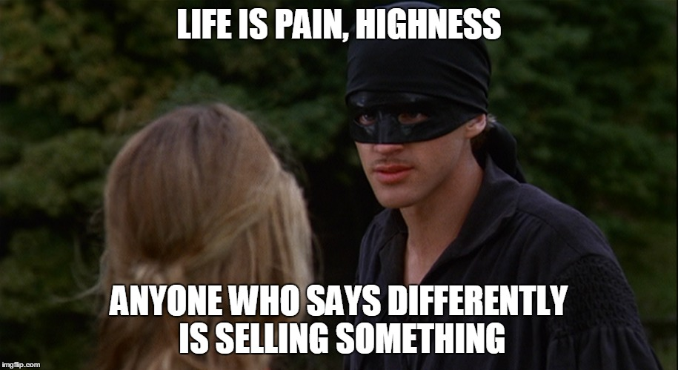

Slide 51
^{Mark 10.29-31} and in the ‘olam haba, [world to come] eternal life. But many who are first will be last, and many who are last will be first!”

Slide 53
^{1 Cor 13.4} Love suffers long and is kind
Longsuffering is a great and noble concept to honor…until
offense,

Slide 54
^{1 Cor 13.4} Love suffers long and is kind
Longsuffering is a great and noble concept to honor…until
offense,
depression,

Slide 55
^{1 Cor 13.4} Love suffers long and is kind
Longsuffering is a great and noble concept to honor…until
offense,
depression,
fight,

Slide 56
^{1 Cor 13.4} Love suffers long and is kind
Longsuffering is a great and noble concept to honor…until
offense,
depression,
fight,
flight

Slide 57
^{Dvarim/Dt. 8.7-10} ADONI your God is bringing you into a good land, a land with streams, springs …a land of wheat and barley, grapevines, fig trees and pomegranates; a land of olive oil and honey;
Notes:
Set to melody, Birkat HaMazon
According to David Pawson, there is enough grain to feed all the world. The problem with the starvation is the distribution, the villains in N. Korea, Darfur, etc.

Slide 58
^{Dvarim/Dt. 8.7-10} a land where you will eat food in abundance and lack nothing in it; …So you will eat and be satisfied, and you will bless ADONI your God for the good land he has given you.

Slide 59
G-d has been faithful to Or HaOlam for 27 years
People
Funds
Presence
We need to continue in humility and seeking!

Slide 61
There are three themes to Shavuot large loaves
Large loaves?
Wheat harvest
Receiving of the Torah
Receiving of the Ruakh/Spirit
Walk in abundance in Messiah!
Notes:
Shavuot study Ulises and Amy.

Slide 62
Abundance blessing of the Torah

Slide 63
Abundance blessing of the Torah

Slide 64
Abundance blessing of the Torah

Slide 65
Abundance blessing of the Torah

Slide 66
Abundance blessing of the Torah
Notes:
Not that Churchill did much for Israel after WW II

Slide 67
Abundance blessing of the Torah

Slide 68
Abundance blessing of the Torah

Slide 70
There are three themes to Shavuot large loaves
Large loaves?
Wheat harvest
Receiving of the Torah
Receiving of the Ruakh/Spirit
Walk in abundance in Messiah!

Slide 71
Abundance of the blessing of the Ruakh.
^{Yn/Jn 14.12-16} Whoever trusts in me will also do the works I do! Indeed, he will do greater ones, because I am going to the Father...
Notes:
We will do greater works???

Slide 72
Abundance of the blessing of the Ruakh.
^{Yn/Jn 14.12} I will ask the Father, and he will give you another comforting Counselor like me, the Spirit of Truth, to be with you forever.
Notes:
We will do greater works???

Slide 73
Abundance of the blessing of the Ruakh. ^{Yn 16.13-14} When the Spirit of Truth comes, he will guide you into all the truth; for he will not speak on his own initiative but will say only what he hears. He will also announce to you the events of the future. He will glorify me, because he will receive from what is mine and announce it to you.

Slide 74
Abundance of the blessing of the Ruakh
^{Mtt. 11.10-11} This is the one about whom the Tanakh says, `See, I am sending out my messenger ahead of you; he will prepare your way before you.'
Notes:
Yeshua speaking of His cousin Yokhanan.
Really? Greater tha

Slide 75
Abundance of the blessing of the Ruakh
^{Mtt. 11.10-11} Yes! I tell you that among those born of women there has not arisen anyone greater than Yochanan the Immerser! Yet the one who is least in the Kingdom of Heaven is greater than he!
Notes:
Yeshua speaking of His cousin Yokhanan.
Really? Greater tha

Slide 76
Abundance of the blessing of the Ruakh.
^{Eph 2.17-20} The God of our Lord Yeshua the Messiah, the glorious Father, [Adon HaKavod]…give you a spirit of wisdom and revelation…
Notes:
Adon HaKavod

Slide 77
Abundance of the blessing of the Ruakh.
^{Eph 2.17-20} light to the eyes of your hearts, so that you will understand the hope to which he has called you, what rich glories there are in the inheritance he has promised his people,
Notes:
Adon HaKavod

Slide 78
^{Eph 2.17-20} and how surpassingly great is his power working in us who trust him. It works with the same mighty strength he used when he worked in the Messiah to raise him from the dead and seat him at his right hand in heaven,
Notes:
Resurrection power in US. Look to your left and right. “You are powerful.”

Slide 79
^{Eph 3.3-8} It was by a revelation that this secret plan was made known to me…that in union with the Messiah and through the Good News the Gentiles were to be joint heirs, a joint body and joint sharers with the Jews in what God has promised.

Slide 80
^{Eph 3.3-8} To me, the least important of all God's holy people, was given this privilege of announcing to the Gentiles the Good News of the Messiah's unfathomable riches
Notes:
the riches of the Messiah, as God, lie in the perfections of his nature, in the works of his hands, in his empire and dominion over all, and in the revenues of glory, which result from thence; and these riches are underived and incommunicable, and are ineffable, yea inconceivable: his riches, as Mediator, lie in the persons of the elect, in the grace that is laid up in him for them, called the riches of grace, and in the inheritance he is possessed of for them, called the riches of glory; and these rich things are communicable, as well as solid, satisfying, and lasting; and they are unsearchable to the natural man, and cannot be fully investigated by believers themselves; they will be telling over to all eternity: and they will appear unsearchable, when it is considered what they have procured, and what blessings have been dispensed according to them; what a large family the Messiah has maintained by them, and how richly and fully he has provided for them, and to what honor and grandeur he raises them all.

Slide 81
Abundance of the blessing of the Ruakh.
^{Eph 3.14-20} I fall on my knees before the Father, …I pray that from the treasures of his glory he will empower you with inner strength by his Spirit, so that the Messiah may live in your hearts through your trusting…

Slide 82
Abundance of the blessing of the Ruakh.
^{Eph 3.14-20} that you will be rooted and founded in love, so that you, with all God's people, will be given strength to grasp the breadth, length, height and

Slide 83
Abundance of the blessing of the Ruakh.
^{Eph 3.14-20} depth of the Messiah's love, yes, to know it, even though it is beyond all knowing,
Notes:
This is all sort of theoretical. Illustration.

Slide 84
Abundance of the blessing of the Ruakh.
^{Eph 3.14-20} so that you will be filled with all the fullness of God. Now to him who by his power working in us is able to do far beyond anything we can ask or imagine.
Notes:
This is all sort of theoretical. Illustration.

Slide 85
^{Ro. 8.16} The Spirit Himself bears witness with our own spirits that we are children of God;
^{Ro. 8.6} Having one's mind controlled by the old nature is death, but having one's mind controlled by the Spirit is life and shalom.

Slide 86
When Yeshua is my only true love, I will spend every moment in his presence. I will know his voice so well, I can pick it out in the noisy crowd of the world, the demons that torment me with shame, guilt, and fear, and the chatter and passions inside my mind and emotions. I will listen only for his voice and follow it.
Notes:
Philip Cohen

Slide 87
I knew a man who had been a prison guard. He told me that as part of his training, he was asked to put on noise-canceling headphones. A voice spoke into the headphones, representing his commander. He was to memorize the voice.
Notes:
Philip Cohen

Slide 88
Then they filled the headphones with the wild, crazy sound of hundreds of prisoners rioting. He was to ignore all those other voices and follow only his commander’s voice.
Notes:
Philip Cohen

Slide 89
It’s fairly easy to hear the voice of Yeshua when we’re in worship service. But what about when we leave and go out into the world of many voices?
Wait in silence for his voice. Memorize the voice. Then carry it through your day. Ps
Notes:
Philip Cohen

Slide 91
An illustration of why we NEED an outpouring of the Ruakh…

Slide 92
A Canadian innovation:
“Medical Assistance in Dying,” or MAID
Notes:
Matt Walsh Host, The Matt Walsh Show

Slide 93
Canadian doctor named Joshua Tapper was able to authorize the killing of a 23-year old named Kiano. Why? According to the substack "Common Sense," Kiano was "depressed, he was diabetic, and he had lost vision in one eye." On top of that, he "didn't have a girlfriend." On those grounds alone, the doctor authorized the state to kill Kiano.
Notes:
Matt Walsh Host, The Matt Walsh Show

Slide 94
There are many more stories like this. There's Amir Farsoud, who was approved for MAID because he was homeless. There's the army veteran Christine Gauthier, who was told by the Canadian government to consider euthanasia rather than endure the wait for a stair lift in her home.
This is eugenics.
Notes:
Matt Walsh Host, The Matt Walsh Show
“Medical Assistance in Dying,” or MAID

Slide 95
More than 25 percent of Canadians now believe the homeless and the poor should be able to access MAID.
Notes:
Matt Walsh Host, The Matt Walsh Show

Slide 96
notes
Notes:
Pierre and Laurence: Being with the Kiev Messianic congregation for the 6 days retreat (prayer and fasting) was a wonderful experience: In brief they are experiencing a gathering of continuous prayer and worship with miracles and new births.
They have a joy that I have never experienced anywhere else : Celebration of joy with dancing like David but as a body of believers. The whole crowd of believers is moving, no one is seating (anyway they remove the seats for worship and set them for the teachings). Messiah Yeshua is loved, honored and praised. He is celebrated as the King of Israel with so much dance and enthusiasm ! He is enthroned in the midst of His people. Many times it seems that He was present specifically in the center of the 2, 3, 4, or 5 circles of dancing believers, like in heaven as He is surrounded with all the worshipers. [says seated]
Deaf people hear (about 15 in one service), an almost blind man (3% of vision) see, tumors disappear, physical vision is restored to people with disabilities , pains leave the bodies, etc, etc. etc. Miracles are the norm ! The whole body of believers is serving the Lord on a daily basis and many are preparing for the mission field. The level of service and commitment is amazing. I had two translators taking turn for about 7-9 hours a day during the 8 days. I was the only Westerner who needed English translation! They did it only for me with kindness! Kiev Messianic congregation is welcoming new believers weekly. They gave a clear message of repentance with a message of full grace.
In one sentence: I felt that I saw one modern Messianic community described in Acts that I have longed for so many years.

Slide 97
How does the synagogue in Kiev do it?
“6 days retreat (prayer and fasting)”
Personal prayer lives??
Notes:
Lots laughter in Boris’ family
I Might say they have Boris, and you’ve got me.
I’ve got you.

Slide 98
Notes:
2008

Slide 99
Notes:
2008

Slide 100
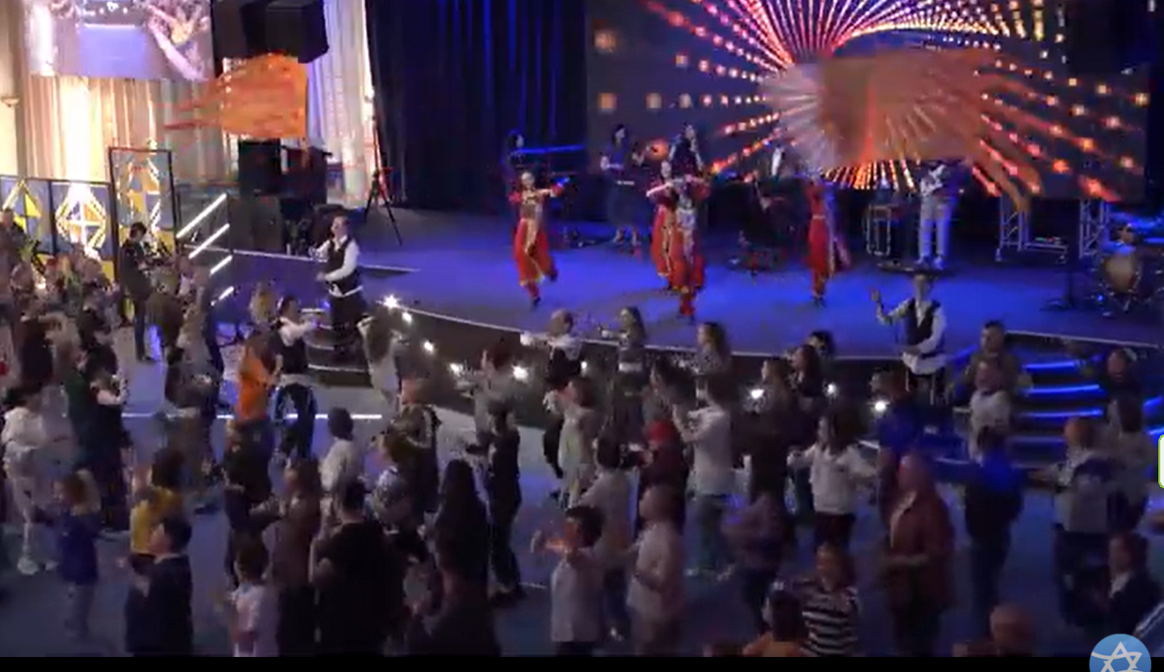
May, 2023 Kyiv
Notes:
https://youtu.be/_DwuPMhevt4?list=PLTDWro7RYh5OtBVhqw8WbHfPGgh1pF9tJ

Slide 103
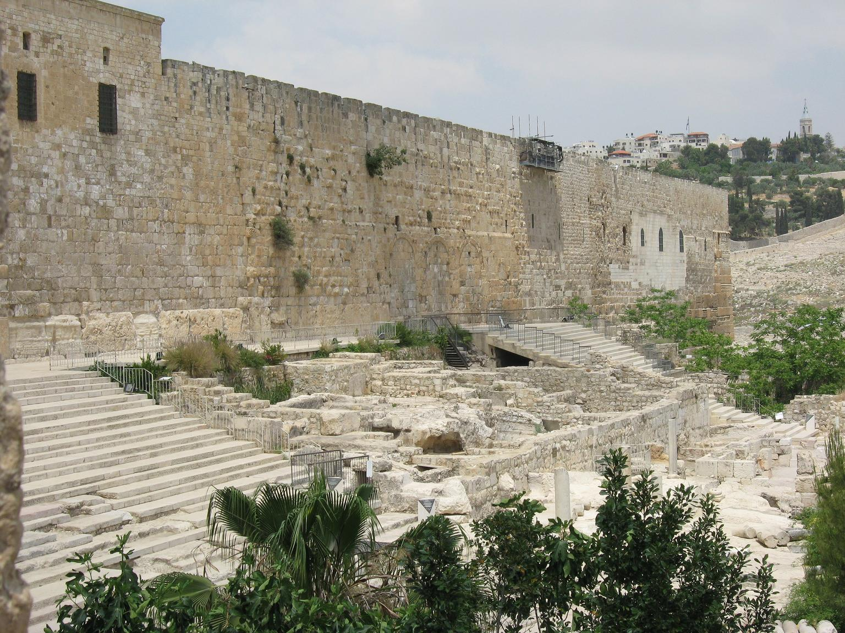
Southern steps Temple Mount
currently
Notes:
https://upload.wikimedia.org/wikipedia/commons/0/0f/Temple_Mount_southern_wall_200509.jpg

Slide 104
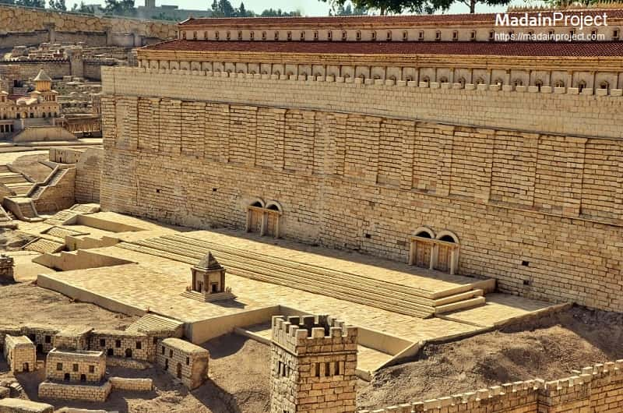
Southern steps Temple Mount
Model Yeshua’s day
Notes:
https://external-content.duckduckgo.com/iu/?u=https%3A%2F%2Fmadainproject.com%2Fcontent%2Fmedia%2Fcollect%2Fjerusalem_ophel_730.jpg&f=1&nofb=1&ipt=76b6223b0a5b49f1dfa455226e31ec96f8c982c514d2cd2230daf04b74298c5a&ipo=images

Slide 105
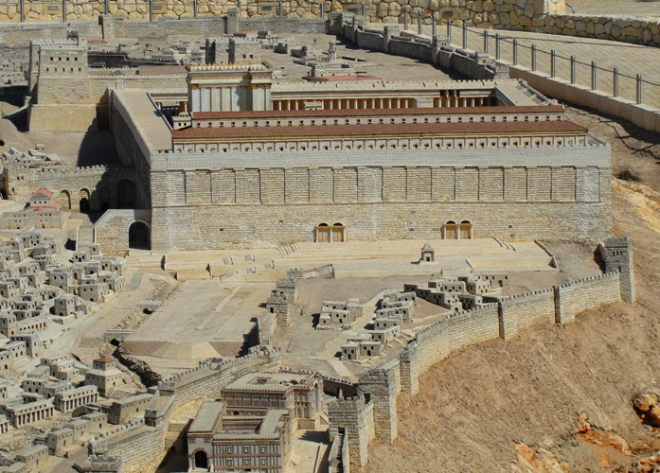
Notes:
https://external-content.duckduckgo.com/iu/?u=https%3A%2F%2Fbramanswanderings.files.wordpress.com%2F2013%2F05%2Ftemple-model-south-stairs.jpg&f=1&nofb=1&ipt=58c6b53bd1722ca669966c9fbb14b76c9fe5e99d7de50e5a06a37a6e57e23c5a&ipo=images

Slide 106
www.pentecost2023.org

Slide 107
These culminate in an event tomorrow, Sunday, May 28, 10 am to noon. It will be on our big screen and sound system, coming live from the south steps of the Temple Mount. Many Messianic groups from Israel and the US and houses of prayer and Christian organizations will be there. We hope you will be here to worship and celebrate!

Slide 108
Lukas (Luke) 24.49
49הִנְנִי שׁוֹלֵחַ לָכֶם אֶת אֲשֶׁר הִבְטִיחַ אָבִי, וְאַתֶּם שְׁבוּ בָּעִיר עַד שֶׁתִּלְבְּשׁוּ עֹז מִמָּרוֹם."
Now I am sending forth upon you what my Father promised, so stay here in the city until you have been equipped with power from above.”
Notes:
לָבַשׁ
to put on a garment, to dress, to wear ; (literary) to wear, to be covered

Slide 110
There are three themes to Shavuot large loaves
Large loaves?
Wheat harvest
Receiving of the Torah
Receiving of the Ruakh/Spirit
Walk in abundance in Messiah!

