Slide 1
e-handout
To have these notes
without taking notes
Go to OrHaOlam.com
Click on Messages tab,
2023 Messages

Slide 2
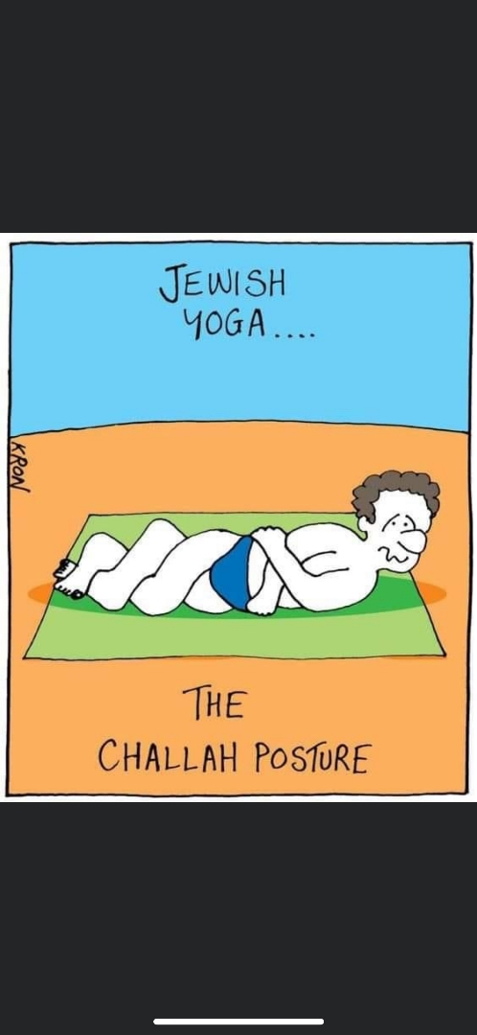

Slide 4
Yeshua isn't allowed in jewelry stores,

Slide 5
Yeshua isn't allowed in jewelry stores, they're afraid he'll break all the chains.
Notes:
Joy Burlison

Slide 6


Slide 7

Father Nurture
The Yeshua heart of a father.
The Expressions of the heart.
Single moms.

Slide 8
Father Nurture
The Yeshua heart of a father.
The Expressions of the heart.
Single moms.

Slide 9
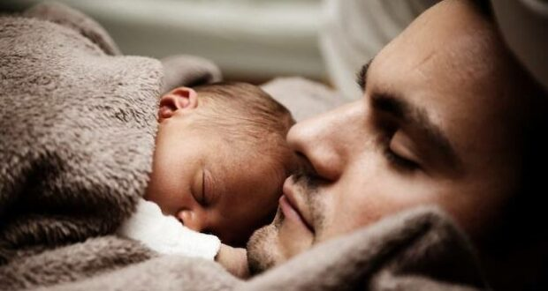
Fatherhood changes men’s brains according to MRI scans
Notes:
https://metrovoicenews.com/wp-content/uploads/2022/12/father-baby-620x330.jpg

Slide 10

^{Eph 6.4 KJV modernized} And, you fathers, provoke not your children to wrath: but bring them up in the nurture and admonition of the
L-rd.
Notes:
I did my first 10 or so years as a believer, and all my undergrad studies, in the KJV. I memorized the first 9.5 chapters of the book of MJ/Heb in the KJV. So, it’s made a deep mark on me.

Slide 11
FATHER NURTURE = paideia
instruction that trains someone to reach full development (maturity).
the Septuigint for מוּסָר musar includes also the care and training of the body

Slide 12
FATHER NURTURE = paideia
whatever in adults also cultivates the soul, especially by correcting mistakes and curbing the passions

Slide 13
Moshe makes an amazing statement about a father’s heart and nurture, a father’s transformed brain, only apparent in the Hebrew…

Slide 14
Bamidbar Nu. 11.11-12 KJV modernized And Moshe said unto Adoni, why have you afflicted your servant? and why have I not found favor in your sight, that you lay the burden of all this people upon me? Have I conceived all this people?

Slide 15
^{Bamidbar Nu. 11.11-12 KJV} Have I begotten them, that you should say unto me, Carry them in your bosom, as a nursing father bears the sucking child, unto the land which you swore unto their fathers?

Slide 16
^{Bamidbar Nu. 11.11-12 KJV} Have I begotten them, that you should say unto me, Carry them in your bosom, as a nursing father bears the sucking child, unto the land which you swore unto their fathers?
What is a nursing father??

Slide 17


Bamidbar
Nu.
11.12

Slide 18
Bamidbar
Nu.
11.12
This word omen appears only 2x more.

Slide 19



^{Ruth 4.4} Na‘omi took the child, laid it on her breast and became its nurse.
Notes:
Female form. Omenet

Slide 20

^{2 Sam 4.4} His nurse had gathered him up and fled
V’tisa-eh-hu omanto vatavos
אוֹמֵן = אֹמֵן
Notes:
Possessive female form, omanto, his nurse.

Slide 21
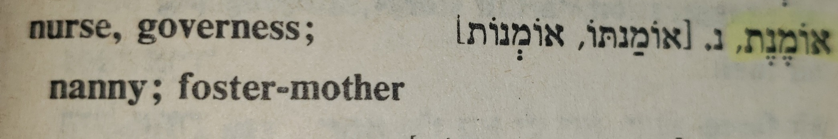
Female form of אוֹמֵן

Slide 22
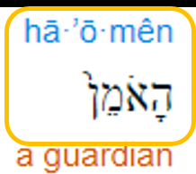
Moshe describes himself as an oman a term that is generally reserved for nursing mothers, describing the intensity of his passion for his people.
Notes:
This is NOT a trans thing, it’s a passion thing.

Slide 23
Fatherhood changes men’s brains according to MRI scans
Notes:
https://metrovoicenews.com/wp-content/uploads/2022/12/father-baby-620x330.jpg
This is the MetroVoice article that precipitated this message.

Slide 24
Recent research has found compelling evidence that pregnancy can enhance neuroplasticity, or remodeling, in the structures of a woman’s brain. Using magnetic resonance imaging, researchers have identified large-scale changes in the anatomy of women’s brains from before to after pregnancy.
Notes:
https://metrovoicenews.com/fatherhood-changes-mens-brains-according-to-mri-scans/

Slide 25
Compared with childless women, the new mothers’ brain volume was smaller. Researchers believe these brain changes may facilitate mothers’ sensitive caregiving of newborns, who demand constant attention and cannot verbalize their needs.
Notes:
https://metrovoicenews.com/fatherhood-changes-mens-brains-according-to-mri-scans/
We presented this at Mother’s Day. Something new…

Slide 26
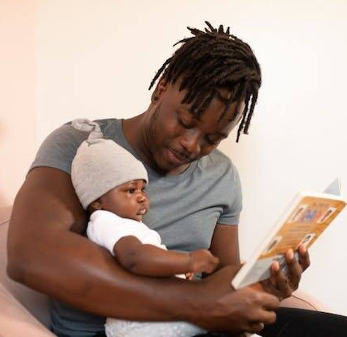
Dads’ brains change, too.
Notes:
https://metrovoicenews.com/wp-content/uploads/2022/12/father-reading.jpeg

Slide 27
As with practicing any new skill, the experience of caring for an infant might leave a mark on the brains of new parents. This is what neuroscientists call experience-induced brain plasticity – like the brain changes that occur when you learn a new language or master a new musical instrument.
Notes:
Only fatherhood may be more significant brain change.

Slide 28
To learn more about plasticity in new dads’ brains, our research groups at the University of Southern California in Los Angeles and the Instituto de Investigación Sanitaria Gregorio Marañón in Madrid, associated with the BeMother project,
Notes:
https://metrovoicenews.com/fatherhood-changes-mens-brains-according-to-mri-scans/

Slide 29
collaborated on a new study. We recruited 40 men – 20 in Spain and 20 in California – and put each into an MRI scanner twice: first during their partner’s pregnancy, and again after their baby was 6 months old. We also included a control group of 17 childless men.
Notes:
https://metrovoicenews.com/fatherhood-changes-mens-brains-according-to-mri-scans/

Slide 30
In both the Spanish and Californian samples, fathers’ brain changes appeared in regions of the cortex that contribute to visual processing, attention and empathy toward the baby. Brain changes in fathers were almost half the magnitude of the changes observed in the mothers.
Notes:
https://metrovoicenews.com/fatherhood-changes-mens-brains-according-to-mri-scans/

Slide 31
Spanish fathers, who, on average, have more generous paternity leaves than fathers have in the U.S., displayed more pronounced changes in brain regions that support goal-directed attention, which may help fathers attune to their infants’ cues, compared with Californian fathers.
Notes:
https://metrovoicenews.com/fatherhood-changes-mens-brains-according-to-mri-scans/

Slide 32
Messiah like role of fathers…

Slide 33
^{Phil 2.6-9} The Messiah Yeshua: Though he was in the form of God, he did not regard equality with God something to be possessed by force. On the contrary, he emptied himself,
Greek: ἐκένωσεν (ekenōsen)
deprive of content, make unreal.

Slide 34
tsimtsum צִמְצוּם
primordial initial contraction
Olam — the Hebrew for "World/Realm" — is derived from the root עלם meaning "concealment".

Slide 35
^{Phil 2.6-9} in that he took the form of a slave by becoming like human beings are. And when he appeared as a human being, he humbled himself still more by becoming obedient even to death — death on a stake as a criminal! Therefore God raised him to the highest place and gave him the name above every name.

Slide 36
In a much lesser but analogous sense, every father has reduced himself, and dies for his family.
Reduction, incarnation, servanthood life, death, resurrection is the deepest role model of fatherhood, and motherhood.

Slide 38
Father Nurture
The Yeshua heart of a father.
The Expressions of the heart.
Single moms.

Slide 39
So, how to apply this?
Give LIFE to your family:
  Do your BEST to make sure they are safe, protected, provided for.
  Verbalize and hug. Love language.
  Give them order, chores, behavior standards.

Slide 40

Notes:
https://www.charismanews.com/images/stories/2023/6/Akers-children-Warren.jpeg

Slide 41
Children today can't possibly love God and love their neighbor if they don't love themselves. One of the biggest reasons that many youth today are turning to transgenderism is that they do not love themselves.
Notes:
https://www.charismanews.com/culture/92536-this-timeless-weapon-will-shield-your-kids-from-today-s-perilous-culture

Slide 42
There are many reasons for that, and it all begins in the home and specifically with fathers, whether they are present or absent in the home.
“Basically, transgenderism stems from a rejection of yourself.”
Notes:
https://www.charismanews.com/culture/92536-this-timeless-weapon-will-shield-your-kids-from-today-s-perilous-culture

Slide 43
As Chuck Swindoll has written, "Masculinity is vanishing. Throughout the land, fathers have lost their way to true manhood and have thrown responsibility to the wind. Sex roles are blurring, masculine leadership is disappearing, and like dominoes, homes and marriages are collapsing."

Slide 44
Dr. James Dobson says, "The Western world stands at a great crossroads in its history. It is my opinion that our very survival as a people will depend on the presence or absence of masculine leadership in millions of homes."

Slide 45
Dads, Give LIFE to your families
  spiritual: prayer, worship, reading, study together and individually, and as a couple, attendance, service, example, making sure of salvation.

Slide 46
Spend TIME: Early on in the lockdown phase, a Harvard report found that fathers were growing closer and closer with their kids. Regardless of racial background, socio-economic status, education, and a host of other factors, nearly 70% of men felt closer to their kids and more than half said their kids were talking to them more about emotional matters.
Notes:
Copyright (C) 2023 Shaunti Feldhahn. All rights reserved.

Slide 47
^{Dvarim/Dt 1.30-31} Adoni your God, who goes before you, He Himself will fight for you—just as He did for you in Egypt before your own eyes, and in the wilderness, where you saw how Adoni your God carried you as a man carries his son, everywhere you went until you came to this place.’

Slide 48
Give LIFE to your family:
  “If you hold back your foot on Shabbat from pursuing your own interests on my holy day; if you call Shabbat a delight, Adoni’s holy day, worth honoring.
  Love the Jewish people and Israel; visit there if you can

Slide 49
Give life emotionally: Concerning marriage ^{Dt. 24.5} “He is to be free at home for one year and make his wife happy.”
That applies to your kids as well.

Slide 50


Slide 51
Shaunti Feldhahn:
I’m quite sure that is not a surprise to any mom reading this. I dare say most of us have experienced those slightly amused, slightly terrified feelings of watching the latest flip-them-in-the-air thing our husband was doing with our toddler.

Slide 52

Notes:
https://www.charismanews.com/images/stories/2023/6/Fathers-Day-Reflect.jpeg

Slide 53
Some of you may remember…

Slide 54
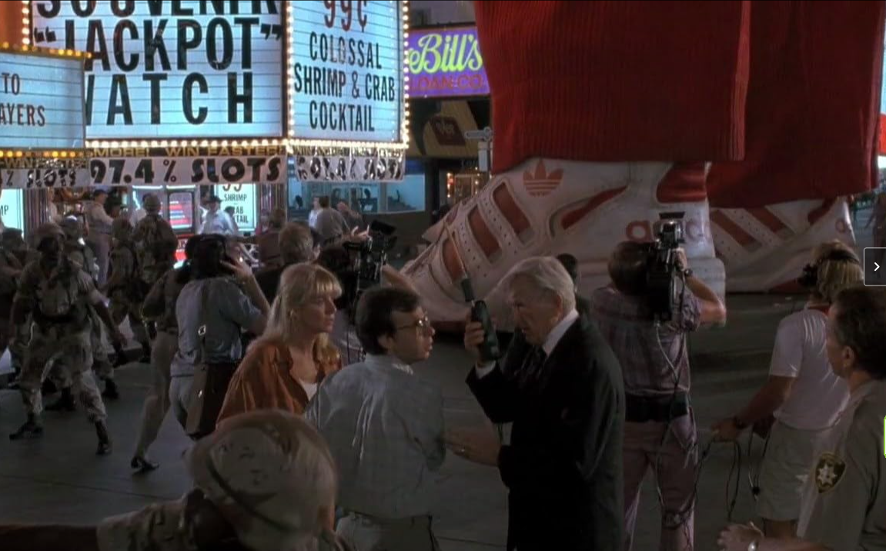
Notes:
https://www.imdb.com/title/tt0104437/mediaviewer/rm658676481/

Slide 55
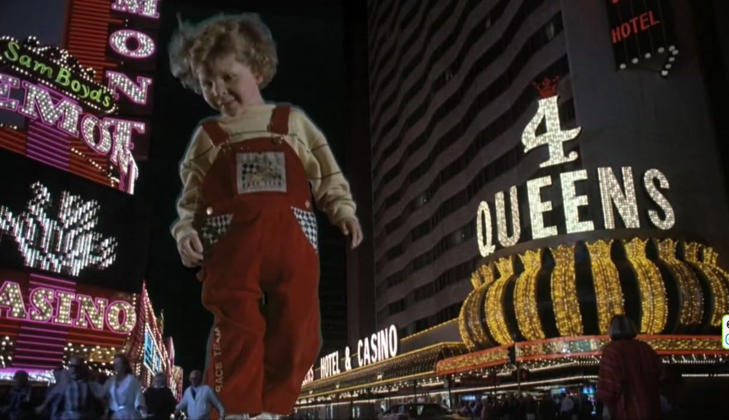
Notes:
https://www.imdb.com/title/tt0104437/mediaviewer/rm3661732609/

Slide 56

Diane:
There's one thing every little kid knows. Daddies mean fun; mommies mean business.
Notes:
I always have an emergency frisbee in the trunk of my car. Even my son who is not exactly on my spiritual wavelength, said once, that he can never remember NOT knowing how to throw a frisbee.

Slide 57
The Great Commandments

Slide 58
^{Mark 12.28-31} One of the Torah-teachers…asked him, “Which is the most important mitzvah of them all?” Yeshua answered, “The most important is, ‘Sh’ma Yisra’el, Adonai Eloheinu, Adonai echad [Hear, O Isra’el, the Lord our God, the Lord is one],

Slide 59
^{Mark 12.28-31} and you are to love Adoni your God with all your heart, with all your soul, with all your understanding and with all your strength.’ The second is this: ‘You are to love your neighbor as yourself.’

Slide 60
But what about the
Great Commission?

Slide 61
^{Mtt 28.19-20} Therefore, go and make people from all nations into talmidim, immersing them into the reality of the Father, the Son and the Ruakh HaKodesh, and teaching them to obey everything that I have commanded you. And remember! I will be with you always, yes, even until the end of the age.”

Slide 62

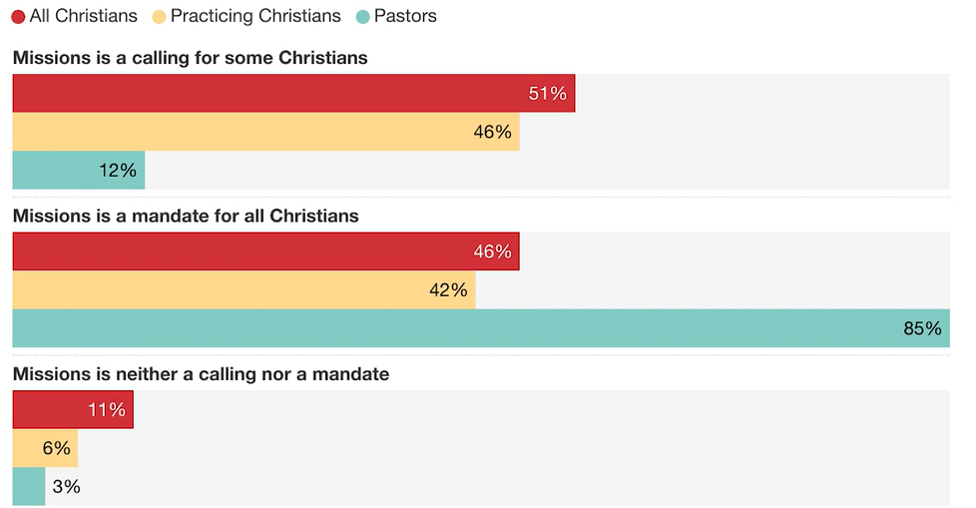
believers
believers
Notes:
https://barna.gloo.us/videos/barna-minute-missions-mandate?vgo_ee=JRP9ZRQREyBsdIZc%2F%2Bh7NcX81gPQcfL0AhAQRcYoEmLpZUidJA%3D%3D%3AbJfy4HwqsTBHhzjQ9VBZ7GRtEgIar2GY

Slide 63
Commit to the practice of prayer for your children daily.
Remain in a posture of faith no matter what comes your way.
Endeavor to be led by the Spirit in line with the Word of God.
Obey God's Word in everything, being quick to repent for laziness, compromise or disobedience.

Slide 64
Focus more on building character than bringing creature comforts.
Be vigilant monitoring all areas of media and relational influence affecting your children (association brings assimilation).
Celebrate family Scripture study but keep it meaningful, relevant and short!

Slide 65
Communicate love and encouragement consistently knowing that rules without relationship can foster rebellion.
Schedule regular family fun times to make memories and keep their emotional tanks full!
Honor Biblical education reinforcing values taught at home.

Slide 66
Be intentional with consistent family meal times to enhance communication and stay current.
Plan individual "date times" and service trips for your children.

Slide 67
Cultivate a culture of honor regarding spouses, grandparents, widows and orphans plus church and civic leaders.
Celebrate with creativity life's seasons, passages and family traditions.

Slide 69
Father Nurture
The Yeshua heart of a father.
The Expressions of the heart.
Single moms.
Notes:
Father’s Day can be painful to those with deadbeat Dads and husbands.
Wednesday, I met a lady at the local leader’s prayer group Baruch and I attend, call Lori Unthank, who runs the single mom kc

Slide 70
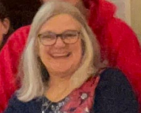
Lori Unthank
thesinglemomkc.org/

Slide 71
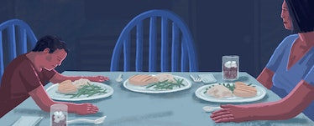
Deadbeat Dads.
Notes:
https://imgix.bustle.com/fatherly/2019/08/deadbeatdad.jpg?w=768&h=310&fit=crop&crop=faces&auto=format%2Ccompress

Slide 72
Of the roughly 36 million men who fathered the 74 million American children under the age of 18, about nine million do not live with all of their minor children most or all of the time. Several million more see their kids at least once a week.
Notes:
https://www.fatherly.com/love-money/deadbeat-dad-the-myth-and-reality-of-americas-feckless-fathers

Slide 73
Five out of six single-parent households are headed by women and the percentage of kids living only with their mothers has tripled between 1960 and 2016 to 23 percent.
Notes:
https://www.fatherly.com/love-money/deadbeat-dad-the-myth-and-reality-of-americas-feckless-fathers

Slide 74
40% of children in Kansas City are growing up in single-parent homes, compared to the national average of 34%.
That’s 60,000 children in the KC Metro!
Notes:
https://www.thesinglemomkc.org/

Slide 75
75% of the single-parent families in Kansas City are single-mother families
Notes:
https://www.thesinglemomkc.org/

Slide 76
46% is the poverty rate for children living in single-mom families, which is 4X greater than those living in married-couple families
Notes:
https://www.thesinglemomkc.org/

Slide 77
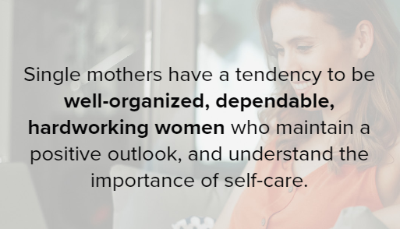
Notes:
https://www.thesinglemomkc.org/

Slide 78
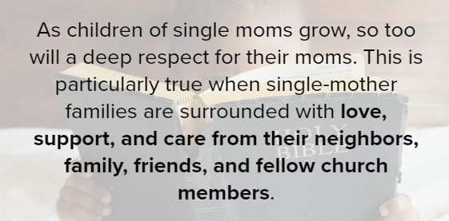
Notes:
https://www.thesinglemomkc.org/

Slide 79
^{Malakhi 3.23-24} Look, I will send to you Eliyahu the prophet before the coming of the great and terrible Day of Adoni. He will turn the hearts of the fathers to the children and the hearts of the children to their fathers.
Notes:
https://www.thesinglemomkc.org/

Slide 80
^{Isaiah 9.5} For a child is born to us,
a son is given to us; dominion will rest on his shoulders, and he will be given the name Pele-Yo‘etz El Gibbor Avi-‘Ad Sar-Shalom
[Wonder of a Counselor, Mighty God, Father of Eternity, Prince of Peace],

Slide 82
Father Nurture
The Yeshua heart of a father.
The Expressions of the heart.
Single moms.

Slide 83
Invite Dads up for blessing.

Slide 84
Prayer points: Fatherhood Revival
Those of us who are fathers would be better, more Ruakh empowered. Receive Yeshua and walk in Him!!
Those dads who have abandoned their families would repent.
G-d would strengthen single moms.

