Slide 1
e-handout
To have these notes
without taking notes
Go to OrHaOlam.com
Click on Messages tab,
2023 Messages

Slide 2
When Louis was younger, he just hated going to Bar Mitzvahs. All of his uncles and aunts used to come up to him, poke him in the ribs, and say to him, "Yours is soon, Louis."

Slide 3
But they stopped doing that after Louis started doing the same thing to them at funerals.

Slide 4
TORAHFIED n.
Notes:
source: http://www.jokebuddha.com/Mitzvah#ixzz3CV2cuktD

Slide 5
TORAHFIED n. Inability to remember one's lines at one's Bar / Bat Mitzvah.
Notes:
source: http://www.jokebuddha.com/Mitzvah#ixzz3CV2cuktD

Slide 8
Bat Mitzvah Maturity
History of Bar/Bat Mitzvahs

Slide 9
Why do we do Bar Mitzvah? How did it start? Origins of Bar Mitzvah
The Great Synagogue in Rome records the custom of a young woman [!] being called up in synagogue before the entire community dates back to the early years of the Roman Jewish community approximately 2,300 years ago. 200 BCE
Notes:
Continued as practice in the Roman synagogue.
http://en.wikipedia.org/wiki/Bar_and_Bat_Mitzvah#History

Slide 10
Pirkei Avot/Ethics of the Fathers 5.22 [~200 CE]
Five years is the age for the study of Scripture.
Ten, for the study of Mishnah.
Thirteen, for the obligation to observe the mitzvot.
Fifteen, for the study of Talmud.
Notes:
Old enough to fast on YK.
https://www.sefaria.org/Pirkei_Avot.5.21?lang=bi&with=all&lang2=en

Slide 11
Pirkei Avot/Ethics of the Fathers 5.22 [~200 CE]
Eighteen, for marriage.
Twenty, to pursue [a livelihood].
Thirty, for strength,
Forty, for understanding.
Fifty, for counsel.
Sixty, for sagacity.

Slide 12
Pirkei Avot/Ethics of the Fathers 5.22 [~200 CE]
Seventy, for elderliness.
Eighty, for power.
Ninety, to stoop.
A hundred-year-old is as one who has died and passed away and has been negated from the world.

Slide 13
2nd century [100’s CE] Rabbi Shimon bar Yokhai made a Bar Mitzvah feast which was akin to a wedding celebration.
Notes:
Big time celebration early on in our people’s history.
http://www.sichosinenglish.org/books/bar-mitzvah/02.htm
http://www.chabad.org/library/article_cdo/aid/484213/jewish/What-is-the-Origin-of-the-Bar-Mitzvah-Celebration.htm

Slide 14
^{Luke 2. 41-47} Every year Yeshua's parents went to Yerushalayim for the festival of Pesach. When he was twelve years old, they went up for the festival, as custom required. But after the festival was over, when his parents returned,
Notes:
Seems this was His first trip with them for the Regalim, the Pilgrim Holidays. Sort of a proto Bar Mitzvah. Then He got engaged with the teachers…

Slide 15
^{Luke 2. 41-47} Yeshua remained in Yerushalayim...they spent a whole day on the road before they began searching…

Slide 16
^{Luke 2. 41-47} They returned to Yerushalayim to look for him. On the third day they found him -- he was sitting in the Temple court among the rabbis, not only listening to them but questioning what they said; and everyone who heard him was astonished at his insight and his responses…
Notes:
Yeshua appeared to be enamored with the learning, and responded. Some theologians said He didn’t fully understand His Divine identity and destiny until His mikveh/immersion.

Slide 17
^{Luke 2. 41-47} So he went with them to Natzeret and was obedient to them. And Yeshua grew both in wisdom and in stature, gaining favor both with other people and with God.

Slide 18
^{Luke 2. 41-47} Yeshua ישוע grew
intellectually,
physically,
socially, and
spiritually.
Notes:
For all that, he returned to the authority of his parents. But growth was significant enough to be noted in scripture.
Famous line: You are a Bar Mitzvah. Today you are a man. Monday you return to 8th grade.
But He grew. In His love for scripture learning, and social skills, and submission to His parents, He grew. You are already a mighty woman, but there is more to come! You come from G-dly parents. May you further that in Yeshua ישוע !

Slide 20
Bat Mitzvah Maturity
History of Bar/Bat Mitzvahs
What is a Bar / Bat Mitzvah?

Slide 21
What is a Bat Mitzvah? בַּת מִצְוָה
בַּת daughter
מִצְוָה שֵם נfemale noun
(religion) commandment, precept; decree, edict; good deed, act of kindness
Notes:
Daughter and commandment seem opposite.
Daughter is the epitome of beloved and precious.
Commandment sound legal, military.
It’s being engaged, involved, enamored with the TRUTH of the Word. The daughterhood dimension is because the Word is a love letter of family identity. Covenantal family identity. Covenant is the key word.

Slide 22
בָּרוּךְ אַתָּה, בְּבֹאֶךָ; וּבָרוּךְ אַתָּה, בְּצֵאתֶךָ
^{Dt. 28.6} “A blessing on you when you go out, and a blessing on you when you come in.”
God meets us at transition points:
Birth and Brit Milah/circumcision, Puberty, Marriage, Death
Celebration
Notes:
Celebrate transitions. Taking the transition point as an expression of Divine transition. G-d and Yeshua bless the change point, and community does. Honor, celebrate the entering into adulthood of Miranda Whitlock.

Slide 23
^{Yaakov/Jas 1.4 NIV} Let perseverance finish its work so that you may be mature and complete, not lacking anything.
Notes:
https://biblehub.com/greek/5046.htm

Slide 24
5046 teleios having reached its end, complete, perfect
complete in all its parts,
full grown, of full age,
specially of the completeness of Messiah like character.
Notes:
https://biblehub.com/greek/5046.htm

Slide 25
It is well-illustrated with the old pirate's telescope, unfolding (extending out) one stage at a time to function at full-strength (capacity effectiveness).
Notes:
https://biblehub.com/greek/5046.htm

Slide 26
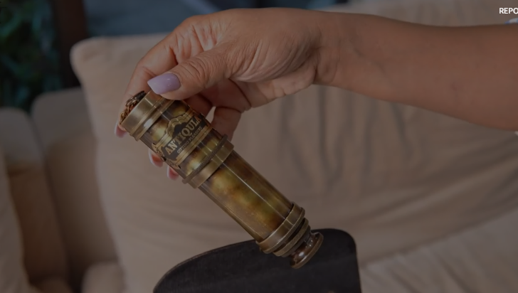
Notes:
https://www.amazon.com/Antique-Vintage-Telescope-Decorative-Navigation/dp/B07GJN4H3G/ref=asc_df_B07GJN4H3G?tag=bngsmtphsnus-20&linkCode=df0&hvadid=80745508122386&hvnetw=s&hvqmt=e&hvbmt=be&hvdev=c&hvlocint=&hvlocphy=&hvtargid=pla-4584345033001233&th=1

Slide 28
One of the best books ever on spiritual emotional maturity.
Notes:
Read Life Model p 47-48

Slide 29
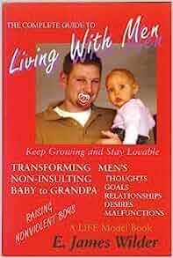
Follow up book to Life Model
Not really about men, but an inviting title.

Slide 30
Basic premise of the Life Model and Jim Wilder is that people were designed to live in joy.
Notes:
How do you wake up? What is your default view of situations? Of life?

Slide 31
^{Yaakov/Jas 1.4 NIV} Let perseverance finish its work so that you may be mature and complete, not lacking anything.
Notes:
https://biblehub.com/greek/5046.htm

Slide 32
^{Yn 15.11} These things I have spoken to you so that My joy may be in you, and your joy may be full.

Slide 33
^{YN 16.22-24} You do indeed feel grief now, but I am going to see you again. Then your hearts will be full of joy, and no one will take your joy away from you.

Slide 34
^{YN 16.22-24} Till now you haven’t asked for anything in my name. Keep asking, and you will receive, so that your joy may be complete.

Slide 35
^{Ro 14.17} Kingdom of God is not eating and drinking, but righteousness, shalom and joy in the Ruakh HaKodesh.

Slide 36
Life Model defines 5 levels of emotional maturity in joy-based living: infant, child, adult, parent, elder
Infant:
Receives love and joy,
Graduates when believes that normal adults are loving.
Develops trust, and can receive.
Notes:
Life Model p 51-55
That’s why we smile at babies.
Parents have to discern and meet needs.
Parents communicate joy.
Parents discern uniqueness and individuality.

Slide 37
Begins to organize self identity through relationships.
Learns to return to joy from unpleasant emotions.
Notes:
Life Model p 51-55
If fails, weak identity, fear and coldness, or manipulation, performance based identity. Worry and depression.
Is there remediation? Yes, in Yeshua, but it is work. We’ll talk about it a bit.

Slide 38
Child ~age 4-12:
Learns to articulate needs: ask.
Graduates when can rejoice that he/she can care for some of his/her own needs.
Expresses himself.
Persistence to do some hard things.
Notes:
Life Model p 51-55
If needs not met, can be passive aggressive. Can be obsessed with food, drugs, sex, fantasy life.
Community listen to needs. Help child evaluate consequences of behavior. Educates about family and community history.

Slide 39
Adult: ~age 13 to birth first child
Cares for self and others simultaneously.
Gives joy and receives joy.
Bonds with peers.
Contributes to the community.
Notes:
Otherwise, a loner, self centered, peer pressured, controlling, self proving.
Community provides opportunity to serve and lead, even in difficulty.
Here is where you are, Miranda, and others your age, if not in the ceremony and celebration.
I had a very dysfunctional family, and no Yeshua, Ruakh training. Nevertheless, on my Bar Mitzvah day…

Slide 40
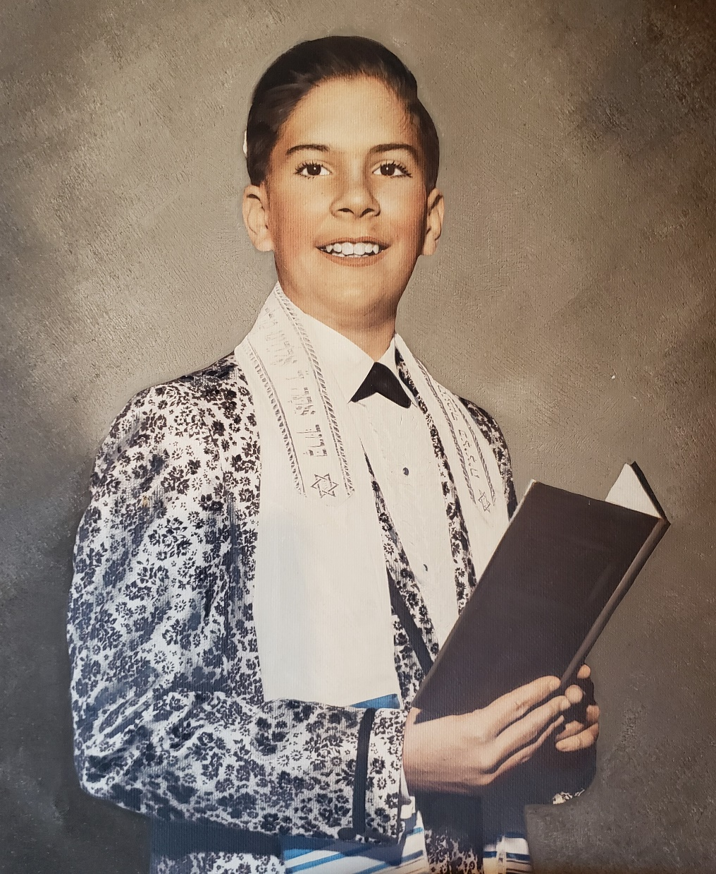
Me at my Bar Mitzvah reception.
Charm anointing to serve and bless.
Left me afterward.
Notes:
Jacket was actually gold, but b/w photo colorized.

Slide 41
Parent: Birth of 1st child till empty nest -- all children adults
Sacrificially takes care of children, without expectations.
Imparts joy.
Stable and joyful in difficulty.
Prizes each community member.

Slide 42
Elder: Adult children till…
Sacrificially cares for a community.
Establishes community identity
Gives life to those without family through spiritual adoption
Notes:
If not, meaningless disorder, pleasure, fragile, at risk
Community recognizes, provided opportunities to interact, high value on those with no family.

Slide 43
“Many, if not most people in America have gotten stuck at this first identity transformation point.” Living with Men p 59
“Is life safe and joyful?”
Notes:
Do you wake up saying, This is the day that Adoni has made, I will be rejoice and be glad in it.

Slide 44
^{1 Yn 1.14} You young people, I have written you because you are strong — the Word of God remains in you, and you have overcome the Evil One.

Slide 45
What does it mean to be strong?
How do we get strong?
Notes:
Confident in the Father’s love
In the Word How can a young man keep his way pure? By guarding it according to Your word.
I treasure your word in my heart, so that I won’t sin against you.
Courage against opposition,
love/joy/peace/
Calm, not panicking in adversity
Sexual purity
NO to drugs, alcohol
Not laugh at vile jokes.

Slide 46
We all come into the world helpless, dependent and needing acceptance, to be treated as worthy, and to be blessed. The father wound is the absence of this love from your birth father.
Notes:
https://www.focusonthefamily.ca/content/understanding-and-healing-the-father-wound

Slide 47
^{Eph. 3.14-17} For this reason I bow my knees before the Father— from Him every family in heaven and on earth receives its name. I pray that from His glorious riches He would grant you

Slide 48
^{Eph. 3.14-17} to be strengthened in your inner being with power through His Ruakh, so that Messiah may dwell in your hearts through faith. I pray that you [would], being rooted and grounded in love.

Slide 50
Bat Mitzvah Maturity
History of Bar/Bat Mitzvahs
What is a Bar / Bat Mitzvah?
A significant challenge to faith.

Slide 51
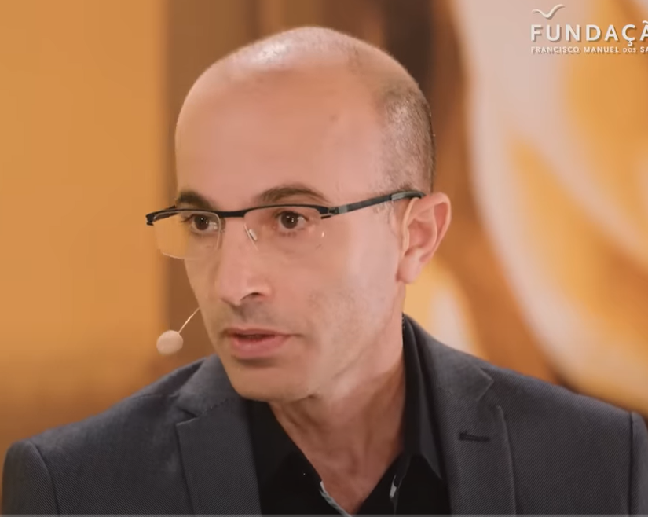
Yuval Harari Israeli historian, professor, Heb. U. of Jerusalem
Notes:
Yuval Noah Harari is an Israeli public intellectual, historian and professor in the Department of History at the Hebrew University of Jerusalem.
https://www.christianpost.com/news/israeli-futurist-predicts-ai-will-soon-write-a-new-bible.html

Slide 52
AI Artificial Intelligence
Can create new ideas
Can make decisions.
Can impersonate humans and convince us better alternatives.
Notes:
Printing press, could replication Bible, no new ideas. Newspaper, no new news. AI can.
A-bomb destroy cities. Can’t decide which city.
Propaganda and lies
Each religion claims outside human race intel.

Slide 53
Can liberate you from your body and space/time limitations with a screen and 3D headset
Better suggestions, better data.
New superhuman intelligence, new god, new “Bible.”
AI in its infancy.
Notes:
6. Communication more yet less.
7. Design
Will claim this is the real power of the future, in jobs, in social interactions.

Slide 55
Bat Mitzvah Maturity
History of Bar/Bat Mitzvahs
What is a Bar / Bat Mitzvah?
The significant challenge to faith.
The answer to the challenge.
The true super-Intelligence!

Slide 56
^{T’hillim 19.7-10} The Torah of ADONI is perfect, restoring the inner person. The instruction of ADONI is sure, making wise the thoughtless. The precepts of ADONI are right, rejoicing the heart. The mitzvah of ADONI is pure, enlightening the eyes. The fear of ADONI is clean, enduring forever.
Notes:
The scripture is TRUE. Objectively factually TRUE.

Slide 57
^{T’hillim 19.7-10} The rulings of ADONI are true, they are righteous altogether, more desirable than gold, than much fine gold, also sweeter than honey or drippings from the honeycomb.

Slide 58
^{Yn 14.15-19} "If you love me, you will keep my commands; and I will ask the Father, and he will give you another comforting Counselor like me, the Spirit of Truth, to be with you forever…

Slide 59
^{Yn 14.15-19} I will not leave you orphans -- I am coming to you…In just a little while, the world will no longer see me; but you will see me. Because I live, you too will live.
Notes:
You will see Him if you are regularly, in the Word. Better than AI construct

Slide 60
^{Thillim/Ps 112.1} Halleluyah! How happy is anyone who fears ADONI, who greatly delights in his mitzvot.

Slide 61
^{Thillim/Ps 119.30-32} I choose the way of trust; I set your rulings [before me]. I cling to your instruction; ADONI, don't let me be put to shame! I will run the way of your mitzvot, for you have broadened my understanding.

Slide 62
^{Thillim/Ps 119.46-48} I will speak of your instructions even to kings without being ashamed. I will delight myself in your mitzvot, which I have loved. I will lift my hands to your mitzvot, which I love; and I will meditate on your laws.
Notes:
This is really what the Shma is about: Hearing from G-d. As Messianics we have an added, empowering dimension.

Slide 63
^{Song of Songs 2.10-13} My beloved spoke and said to me, “Arise, my darling, my beautiful one, come with me. See! The winter is past; the rains are over and gone. Flowers appear on the earth; the season of singing has come, the cooing of doves is heard in our land. The fig tree forms its early fruit;

Slide 64
^{Song of Songs 2.10-13} the blossoming vines spread their fragrance. Arise, come, my darling; my beautiful one, come with me.”

Slide 65
Believers who are heavily engaged with the Bible and their faith “flourish in every domain of human experience,” according to new research from the State of the Bible 2023 report from the American Bible Society.
Notes:
https://metrovoicenews.com/active-christians-flourish-in-life-compared-to-others-study-finds/

Slide 66
The research examined respondents’ scores on the Human Flourishing Index, which asks about people’s “happiness and life satisfaction,” “mental and physical health,” “meaning and purpose,” “character and virtue,” “close societal relationships” and “financial and material stability.”
Notes:
https://metrovoicenews.com/active-christians-flourish-in-life-compared-to-others-study-finds/

Slide 67
On the Human Flourishing Index as a whole, practicing Believers received an average score of 7.8 compared to 6.9 for non-practicing Believers and 6.7 for non-Believers.
Notes:
https://metrovoicenews.com/active-christians-flourish-in-life-compared-to-others-study-finds/

Slide 68
Forgiveness is key to human flourishing. Without exception, the more forgiving people are, the more they flourish. Those who strongly agree with the statement “I am able to sincerely forgive whatever someone else has done to me, regardless of whether they ever ask for forgiveness or not” score 7.7
Notes:
https://metrovoicenews.com/active-christians-flourish-in-life-compared-to-others-study-finds/

Slide 69
on the Human Flourishing Index, compared with 7.1 for those who somewhat agree, 6.6 for those who somewhat disagree, and 6.0 for those who strongly disagree
Notes:
https://metrovoicenews.com/active-christians-flourish-in-life-compared-to-others-study-finds/

Slide 70
This phenomenon extended to the happiness and life satisfaction domain, where practicing Believers received an average score of 7.8, followed by non-practicing Believers at 6.8 and non-Believers at 6.5.

Slide 71
^{Mes Jews/Heb 13.20-21} Now may the God of shalom, who brought up from the dead the great Shepherd of the sheep by the blood of an everlasting covenant, our Lord Yeshua, make you complete in every good thing to do His will, accomplishing in us what is pleasing in His sight, through Messiah Yeshua. To Him be the glory forever and ever. Amen.

Slide 73
Bat Mitzvah Maturity
History of Bar/Bat Mitzvahs
What is a Bar / Bat Mitzvah?
The significant challenge to faith.
The answer to the challenge.
The true super-Intelligence!

Slide 74
Do you KNOW Yeshua and the assurance of sins forgiven?
Are you hearing daily from His Word?
How are you applying what you heard?
Are you asking this of another?
Notes:
Who are you discipling, building up?4

