Slide 1
e-handout
To have these notes
without taking notes
Go to OrHaOlam.com
Click on Messages tab,
2023 Messages

Slide 2
I was told I use the word “anyhow” repeatedly, excessively.
Anyhow challenge…

Slide 3
SYNONYMS FOR ANYHOW
any which way
anyway
at any rate
however
in any case
in any respect
in any way
in either way
in one way or another
in whatever way
nevertheless
regardless
under any circumstances
whatever happens
Notes:
https://www.thesaurus.com/browse/anyway

Slide 5
Rabbi Levy gets to the entrance of heaven.
Told: Need 100 points to get in.
Married 65 years faithfully.

Slide 6
Rabbi Levy gets to the entrance of heaven.
Told: Need 100 points to get in.
Married 65 years faithfully
3 points

Slide 7
Rabbi Levy gets to the entrance of heaven.
Told: Need 100 points to get in.
Married 65 years faithfully
3 points
Raised 5 children to love Messiah.

Slide 8
Rabbi Levy gets to the entrance of heaven.
Told: Need 100 points to get in.
Married 65 years faithfully
3 points
Raised 5 children to love Messiah.
2 points

Slide 9
Served my synagogue 30 years.

Slide 10
Served my synagogue 30 years.
1 point

Slide 11
Served my synagogue 30 years.
1 point
That’s only 6 points for all that. At this rate, I’ll only get in by the grace and mercy of G-d.

Slide 12


Slide 13

Bar Mitzvah Warrior
Young people are strong
What are the seductions that
rob strength?
How do you get strong?

Slide 14
^{1 Yn 2.12-14} You children, I am writing you because your sins have been forgiven for his sake.
You fathers, I am writing you because you have known him who has existed from the beginning.
You young people, I am writing you because you have overcome the Evil One.

Slide 15
^{1 Yn 2.12-14} You children, I have written you because you have known the Father.
You fathers, I have written you because you have known him who has existed from the beginning.
You young people, I have written you because you are strong — the Word of God remains in you, and you have overcome the Evil One.
Notes:
Youth are STRONG. Not wild party animals, into dark rebellion. STRONG for the KING Messiah Yeshua!

Slide 16


Notes:
https://www.chosenpeople.com/wp-content/uploads/2023/07/2307NL_JUL7-1.pdf

Slide 17
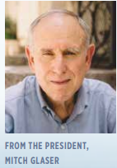
God is moving among second-generation Israeli young believers who are actively proclaiming the message of Messiah among their friends, and many are coming to faith in Yeshua the Messiah!
Notes:
https://www.chosenpeople.com/wp-content/uploads/2023/07/2307NL_JUL7-1.pdf

Slide 18
I can only describe this movement as a second-generation movement of the Holy Spirit.
Notes:
https://www.chosenpeople.com/wp-content/uploads/2023/07/2307NL_JUL7-1.pdf

Slide 19
Their parents and congregational leaders have done a great job leading this next generation to the Lord and providing opportunities for their discipleship.
Notes:
https://www.chosenpeople.com/wp-content/uploads/2023/07/2307NL_JUL7-1.pdf
Sometimes we get discouraged, where is our next gen. It IS happening. In Israel, soon here.
Bar Mitzvah entering into mighty manhood!
Bat Mitzvah entering into mighty womanhood!

Slide 22
Bar Mitzvah Warrior
Young people are strong
What are the seductions that
rob strength?
How do you get strong?

Slide 23
^{1 Yn 2.15-17} Do not love the world or the things of the world. If someone loves the world, then love for the Father is not in him; because all the things of the world — the physical desires of the old nature, the desires of the eyes [for possessions],
Notes:
Only three

Slide 24
^{1 Yn 2.15-17} and the pride and pretensions of life — are not from the Father but from the world. And the world is passing away, along with its desires. But whoever does God’s will remains forever.

Slide 25
You young people, I have written you because you are strong — the Word of God remains in you, and you have overcome the Evil One.

Slide 26
Messiah’s great warning about our strength in the end of days, the akarit ha-yamim אחרית הימים

Slide 27
Mattityahu (Matthew) 24:4
Yeshua replied: “Watch out! Don’t let anyone fool you!
πλανάω planaó
lead astray, deceive, cause to wander
Notes:
Significant problem in the Kingdom, from beginning until now. Especially now.
Context…

Slide 28
Mattityahu (Matthew) 24:1
As Yeshua left the Temple and was going away, his talmidim came and called his attention to its buildings.

Slide 29
^{Mark 13.1} As Yeshua came out of the Temple, one of the talmidim said to him, “Look, Rabbi! What huge stones! What magnificent buildings!”
^{Luke 21.5} Some people were remarking about the Temple, how beautiful its stonework and memorial decorations were.
Notes:
I didn’t really have a good perspective on this until this study…

Slide 30
Made of marble and gold, Herod's temple was taller than a fifteen-story building. Built on the exact location of Solomon's temple and the temple Nehemiah constructed, it could accommodate hundreds of thousands of pilgrims at one time and was twice as large as the largest temple enclosure in Rome.
Notes:
https://www.thattheworldmayknow.com/herods-temple
We don’t usually GET the glory of this building!

Slide 31
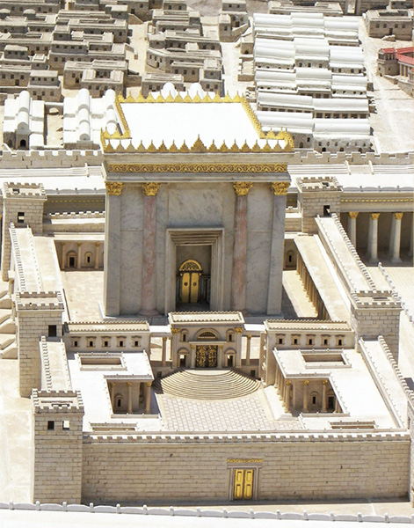

17 stories ≈ 170 ft
180 ft
H&R Block
Building KC,MO
Notes:
https://www.biblicalarchaeology.org/wp-content/uploads/herods-temple-avi-yonah.jpg
Larger and more magnificent than ANY other temple of antiquity, known throughout the Roman world. Keener p 560 Certain sense of it’s invincibility. See doors and figure 30 feet.

Slide 32

Notes:
https://www.google.com/search?q=golden+vine+of+the+Jerusalem+Temple&safe=active&source=lnms&tbm=isch&sa=X&ved=0ahUKEwj7ue3Kx9_ZAhWL0FMKHcLTC6kQ_AUIDCgD&biw=1282&bih=933#imgrc=AbD6B9jYL7UN2M:
Adding gold leaves.

Slide 33
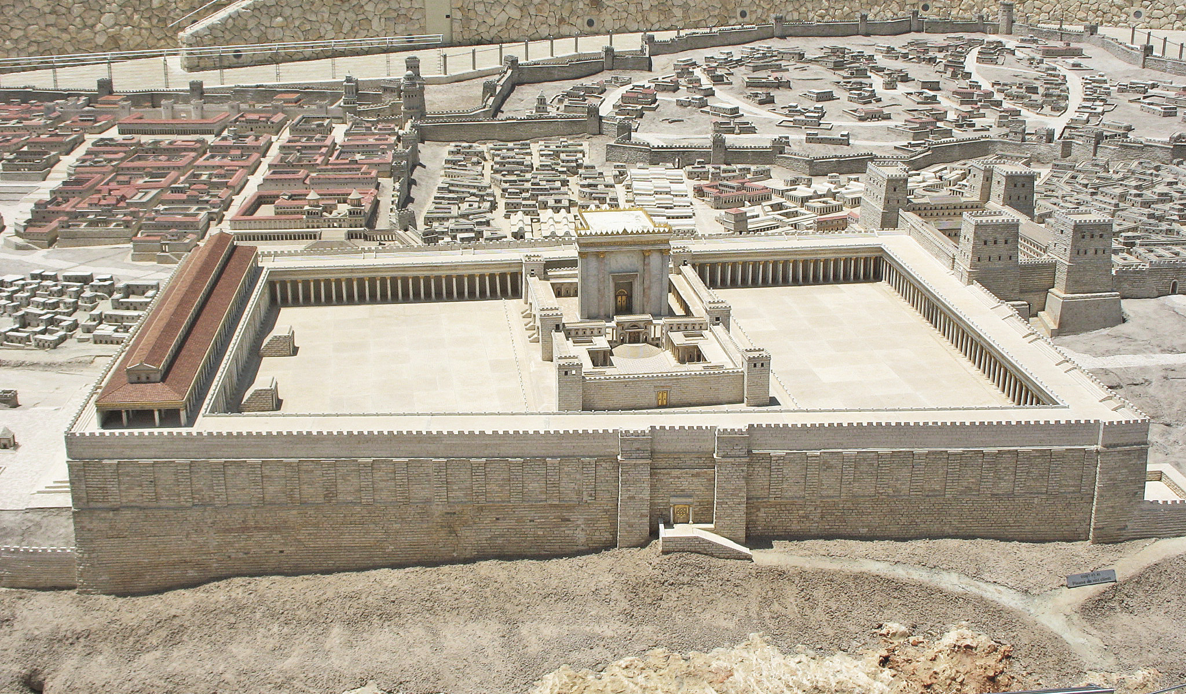

Notes:
https://www.google.com/search?q=second+temple+of+jerusalem&safe=active&source=lnms&tbm=isch&sa=X&ved=0ahUKEwi5uu_lz-3aAhWBwYMKHVGVA44Q_AUICigB&biw=1165&bih=848#imgrc=tHsIaWdSDtDUkM:
It’s hard to get a handle on the grandeur, but if you factor in that the Temple is taller than the H&R Block Tower downtown, it gets more breathtaking.

Slide 34
Mattityahu (Matthew) 24:2
But he answered them, “You see all these? Yes! I tell you, they will be totally destroyed — not a single stone will be left standing!”

Slide 35
Mattityahu (Matthew) 24:3
When he was sitting on the Mount of Olives, the talmidim came to him privately. “Tell us,” they said,

Slide 36
Mattityahu (Matthew) 24:3
“when will these things happen? And what will be the sign that you are coming, and that the ‘olam hazeh is ending?”

Slide 37
Mattityahu (Matthew) 24:4
Yeshua replied: “Watch out! Don’t let anyone fool you!
πλανάω planaó
lead astray, deceive, cause to wander
Notes:
Significant problem in the Kingdom, from beginning until now. Especially now.

Slide 38
^{Acts 20.29-30} I know that after my departure, savage wolves will come in among you, not sparing the flock. Even from among yourselves will arise men speaking perversions, to draw the disciples away after themselves.

Slide 39
^{1 Tim. 3.13} Evil people and impostors will go from bad to worse, deceiving others and being deceived themselves.
Notes:
Worst deception is when people really buy into falsehood.

Slide 40
^{1 Tim. 4.1} The Spirit expressly states that in the akharit hayamim, end of days, some people will apostatize from the faith by paying attention to deceiving spirits and things taught by demons.
Notes:
Deceit and false religion endemic in last days!

Slide 41
Mattityahu (Matthew) 24:5
For many will come in my name, saying, ‘I am the Messiah!’ and they will lead many astray.

Slide 42
First seduction

Slide 43

Notes:
https://live.childrenshealthdefense.org/chd-tv/shows/good-morning-chd/mind-manipulation--who-is-in-control-part-2/

Slide 44

Notes:
https://live.childrenshealthdefense.org/chd-tv/shows/good-morning-chd/mind-manipulation--who-is-in-control-part-2/

Slide 45
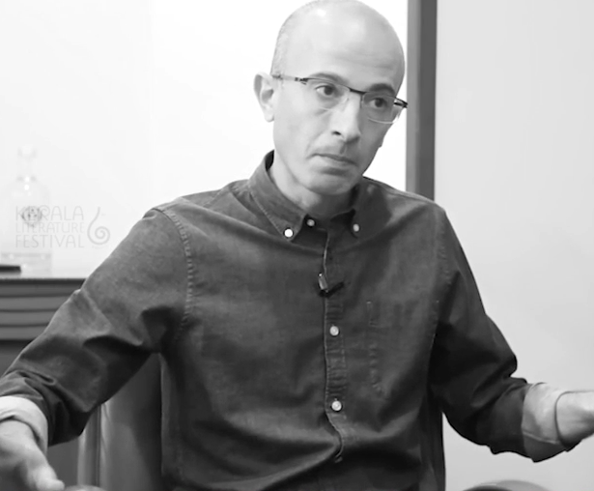
You have a spy in your pocket collecting data all the time.
Yuval Harrari
Notes:
https://live.childrenshealthdefense.org/chd-tv/shows/good-morning-chd/mind-manipulation--who-is-in-control-part-2/
Say “OK, Google” means always listening. Always. Stewart in Belarus.

Slide 46

Notes:
https://www.theepochtimes.com/iphone-surveillance-government-can-spy-on-you-through-your-camera-and-microphone_5381170.html?src_src=Goodevening&src_cmp=gv-2023-07-15

Slide 47
The French leadership under Emmanuel Macron used the recent riots to usher in new policies of mass government surveillance. News headlines in France have said that every phone in the country can now be used as a spying device by police. But this actually goes further—the measures include computers and other devices as well.
Notes:
https://www.theepochtimes.com/iphone-surveillance-government-can-spy-on-you-through-your-camera-and-microphone_5381170.html?src_src=Goodevening&src_cmp=gv-2023-07-15
If you say, “OK Google” your Android phone will turn on. Means…it’s always listening

Slide 48

Notes:
https://live.childrenshealthdefense.org/chd-tv/shows/good-morning-chd/mind-manipulation--who-is-in-control-part-2/

Slide 49
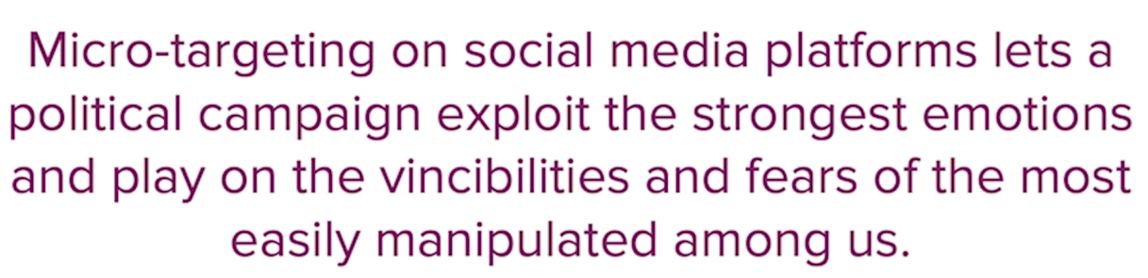
Notes:
https://live.childrenshealthdefense.org/chd-tv/shows/good-morning-chd/mind-manipulation--who-is-in-control-part-2/

Slide 50


Slide 51


Slide 52
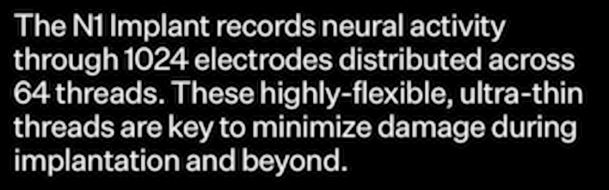

Slide 53


Slide 54


Slide 55


Slide 56
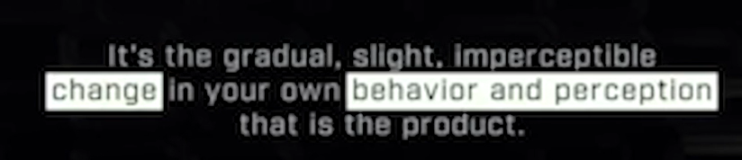
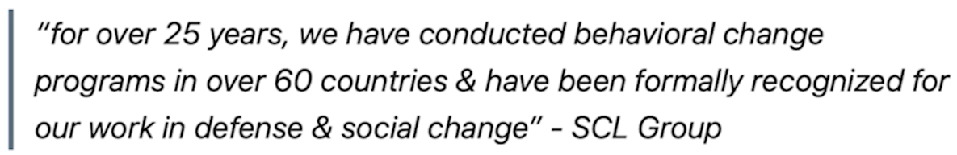
Notes:
Cambridge Analytica SCL

Slide 57
Don’t believe everything you hear from social media. It’s trendy, cool, tech savvy, but full of seduction!
Notes:
Impressive, like the Temple in Yeshua’s day.

Slide 58
Second seduction

Slide 59

From Senator Roger Marshall:

Slide 60
Third seduction
Another greatly accepted deception

Slide 61
Some say that sexuality and habits are inherited.
Half truth.
G-d doesn’t punish the next generation, but the sins continue.
The consequences continue.
[Science illustration and digression]

Slide 62
^{Shmot/Ex 34.7} Showing grace to the thousandth generation, forgiving offenses, crimes, and sins,
נֹצֵר חֶֽסֶד לָאֲלָפִים
נֹשֵׂא עָוֹן וָפֶֽשַׁע וְחַטָּאָה
No-tsayr khe-sed a-ah-la-feem,
no-say ah-von v'feh-shah v'kha-ta-ah
Notes:
Forgiving offenses (nosei avon) Avon refers to intentional sin, which God forgives if the sinner turns back to him.
Crimes (pesha)—Pesha is sin with malicious intent, rebellion against God. God allows teshuva, turning back, leading to forgiveness even for this.
And sins (v’hata’ah)—And God forgives sins committed out of carelessness, thoughtlessness, or apathy.

Slide 63
^{Shmot/Ex 34.7} but causing the negative effects of the parents’ offenses to be experienced by their children and grandchildren, and even by the third and fourth generations.
Notes:
I takes 3 or 4 generations for epigenetic factors to dissipate!!

Slide 64
Epigenetics
Genetics is the study of DNA sequences. 4 nucleic acids are the alphabet of life:
C A T G
Cytosine, adenine, thyamine, guanine

Slide 65
Genetics, DNA cannot be changed by behavior. But the molecules surrounding the DNA [epi] can be changed.
Notes:
http://en.wikipedia.org/wiki/Behavioral_epigenetics

Slide 66
Environmental stress [and sin] has been shown to increase the risk of substance use. In an attempt to cope with stress, alcohol and drugs can be used as an escape. Once substance use commences, however, epigenetic alterations may further exacerbate the biological
Notes:
http://en.wikipedia.org/wiki/Behavioral_epigenetics
Once aberrant behavior, hormonal activity occurs, epigenetic alterations may exacerbate the biological. So it SEEMS to be a genetic tendency, but

Slide 67
and behavioral changes associated with addiction.
Even short-term substance use can produce long-lasting epigenetic changes in the brain of rodents, via DNA methylation and histone modification
Notes:
http://en.wikipedia.org/wiki/Behavioral_epigenetics

Slide 68
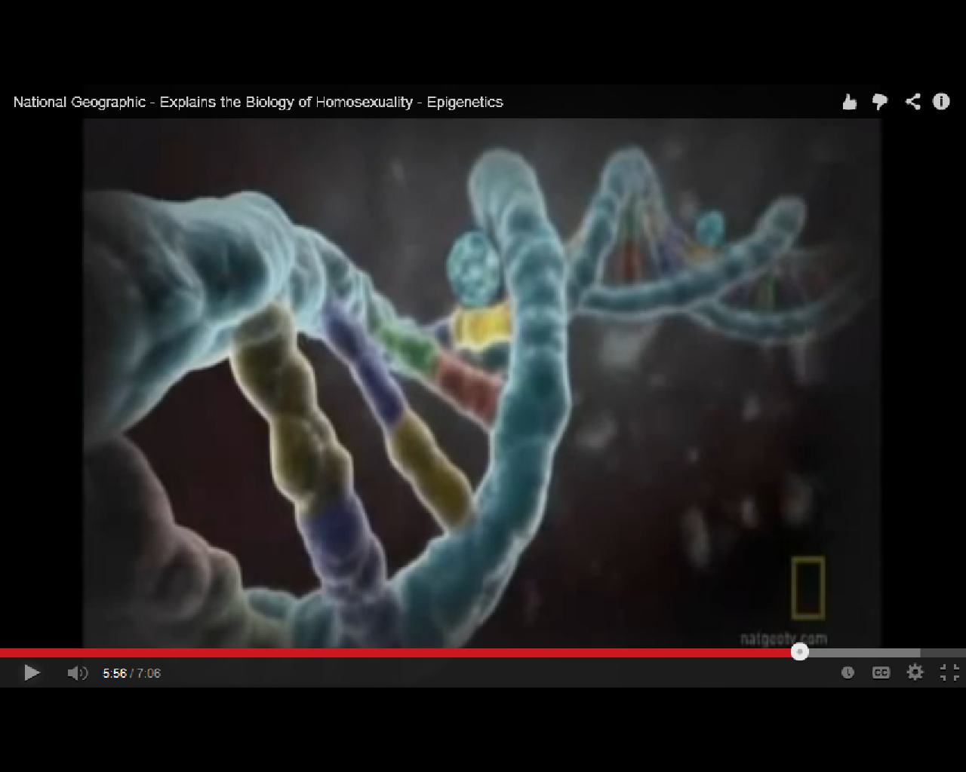
epigentic methyl group
Epigenetics is affected by behavior.
Notes:
Four colors are the four nucleic acids, guanine, cytosine, adenine, thiamine. Controlling components, alphabet of life. Determines if an organism is a fish or an elephant. All have the same DNA alphabet.
Epigentics doesn’t change the underlying guanine, cytosine, adenine, thiamine. But DOES affect expressions: on/off switch. Behavior of past generations affects your tendency to behave a certain way. TENDENCY.
Sins of our ancestors can make a proclivity in us. BUT, ancestors added it on by willful behavior, we can overcome by willful choices.

Slide 69
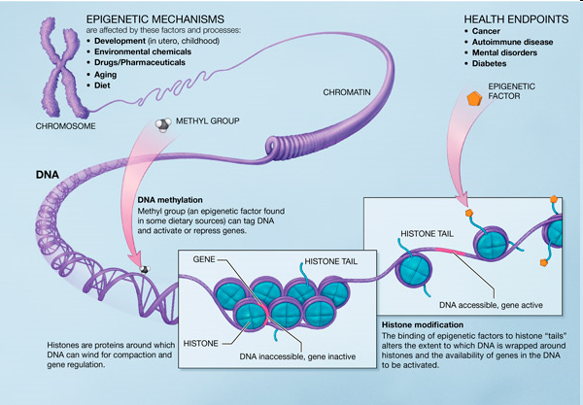
Notes:
In biology, and specifically genetics, epigenetics is the study of inherited changes in phenotype (appearance) or gene expression caused by mechanisms other than changes in the underlying DNA sequence, hence the name epi- (Greek: επί- over, above) -genetics. These changes may remain through cell divisions for the remainder of the cell's life and may also last for multiple generations.
“third or fourth generation…”

Slide 70
So someone can appear to be genetically prone to a behavior: alcoholism, homosexuality, drugs.
But they are only epigenetically prone to the behavior.
Notes:
We can bring the epigenetic tendencies in, we can bring them out. Gone in 3 or 4 generations!

Slide 71
^{Shmot/Ex 34.7} Showing grace to the thousandth generation, forgiving offenses, crimes, and sins,
נֹצֵר חֶֽסֶד לָאֲלָפִים
נֹשֵׂא עָוֹן וָפֶֽשַׁע וְחַטָּאָה
No-tsayr khe-sed a-ah-la-feem,
no-say ah-von v'feh-shah v'kha-ta-ah
Notes:
Forgiving offenses (nosei avon) Avon refers to intentional sin, which God forgives if the sinner turns back to him.
Crimes (pesha)—Pesha is sin with malicious intent, rebellion against God. God allows teshuva, turning back, leading to forgiveness even for this.
And sins (v’hata’ah)—And God forgives sins committed out of carelessness, thoughtlessness, or apathy.

Slide 72
^{Shmot/Ex 34.7} but causing the negative effects of the parents’ offenses to be experienced by their children and grandchildren, and even by the third and fourth generations.
Notes:
I takes 3 or 4 generations for epigenetic factors to dissipate!!

Slide 73
Fourth seduction
Another greatly accepted deception: that the unborn are just a blob of tissue.
Notes:
https://www.youtube.com/watch?v=4TQVwNjz_cY

Slide 75
Bar Mitzvah Warrior
Young people are strong
What are the seductions that
rob strength?
How do you get strong?

Slide 76
A strong epigenetic tendency to alcoholism, smoking, sexual preferences can be built in to the nature of the succeeding generations. But those are tendencies caused by behavior and choices of the forebears, and can be reversed by the behavior and choices of the descendants.

Slide 77

These attributes call for teshuva, a U-turn from our own ways and back to God.
Notes:
https://www.umjc.org/commentary/2022/9/14/its-time-for-a-spiritual-u-turn?utm_source=UMJC+News&utm_campaign=b88721f923-EMAIL_CAMPAIGN_2020_12_10_08_42_COPY_01&utm_medium=email&utm_term=0_cd802052fa-b88721f923-203688328

Slide 78
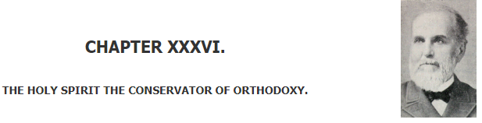
Daniel Steele (1824 -1914) In 1886, Professor of Doctrinal Theology at Boston University.
Notes:
http://www.craigladams.com/Steele/

Slide 79
The fulness of the Holy Spirit in rabbi and people will always insure a correct theology. St. John in his First Epistle, ii. 20-27, regards the anointing or full immersion of the Spirit as the great safeguard against being drawn away by the falsity of anti-Messiah. Says Dr. Whedon:
Notes:
http://www.craigladams.com/Steele/page215/page254/

Slide 80
The word ‘Messiah' signified anointed, as ‘mashiakh’ signifies oil, or the anointment. Here the anointing is used in contrast to the anti-Messiahs who became such because they had no such sanctifying anointing. As long as we possess the holy anointing, we will adhere to the holy Messiah.
Notes:
http://www.craigladams.com/Steele/page215/page254/

Slide 82
Bar Mitzvah Warrior
Young people are strong
What are the seductions that
rob strength?
How do you get strong?

Slide 83
You young people, I have written you because you are strong — the Word of God remains in you, and you have overcome the Evil One.

Slide 84
בָּרוּךְ שֶׁפְּטָרַנִי מֵעָנְשׁוֹ שֶׁלָזֶה.
Ba-rookh shep-ta-ra-nee
may-an-sho sheh-lah-zeh.
Blessed is He Who has released me from full responsibility
for the character and deeds of my son and daughter.

