Slide 1
e-handout
To have these notes
without taking notes
Go to OrHaOlam.com
Click on Messages tab,
2023 Messages

Slide 2
Some Rosh Hashanna greetings
L’Shana Tovah לְשָׁנָה טוֹבָה
[Have a] Good Year
שָׁנָה טוֹבָה וּמְתוּקָה
Shana Tova oo-m’tukah
[Have a] Good and sweet year
Notes:
2
These are entirely Biblical.
There is a variant of a good year be written unto you. More complex Hebrew and not Biblical.

Slide 3
Yiddish version: Good Yontiff
Notes:
Yontiff is from the Hebrew Yom tov, so really redundant.

Slide 4
Yiddish version: Good Yontiff
At the Vatican:

Slide 5
Yiddish version: Good Yontiff
At the Vatican:
Good Yontiff Pontiff

Slide 7
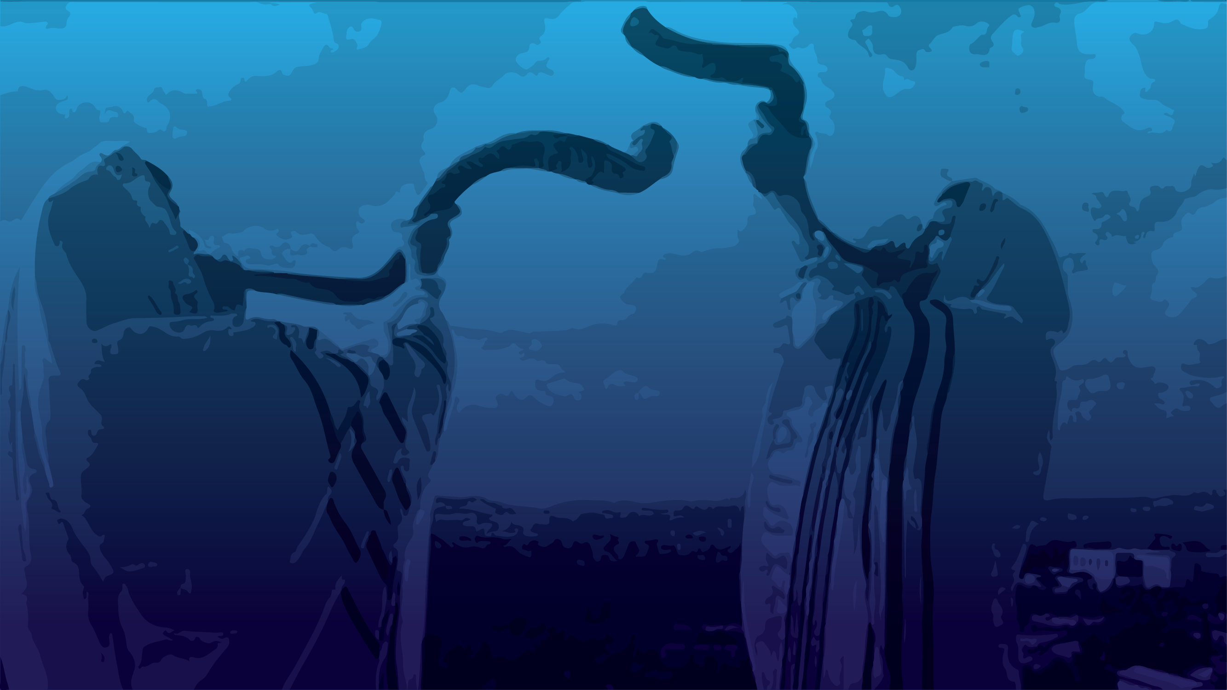
Rosh HaShanah
The name
Meaning of Rosh Hashanna תְּרוּעָה Teruah
An example in scripture of this holiday being celebrated.
A modern example of VICTORY!

Slide 8
Rosh HaShanah
The name
Meaning of Rosh Hashanna תְּרוּעָה Teruah
An example in scripture of this holiday being celebrated.
A modern example of VICTORY!

Slide 9
Scriptural basis of the name.
Rosh HaShanah means literally “the head of the year” or New Year. The day is not designated in scripture as a New Year.
Notes:
But historically…

Slide 10
The Babylonian name of the month Tishri seems to derive from the root [Ugaritic or Akkadian] seru, which means “to begin.” The ancient Semitic peoples thought of the year as beginning in the autumn, at the time of the late harvest. This was the beginning of the economic year, when crops began to be sold.
Notes:
Encyclopedia Judaica

Slide 11
The historian Josephus, and the ancient Aramaic translation of the Bible, the Targum Jonathan, identify Rosh HaShannah as the New Year observed by the people of Israel before the holiday of Passover was instituted.
In addition, the traditional Jewish concept is that the world was created on Rosh HaShannah,

Slide 12
so this day is indeed the beginning of the year chronologically.
G-d made a spiritual cycle to start on Pesakh, but the chronological year didn't change. So, Jews have at least two new years, a chronological one, and a spiritual one.
Notes:
Actually 4 new years.

Slide 13
Passover is described in these terms for it is written, ^{Ex. 12:1-2} Now Adoni said to Moses and Aaron in the land of Egypt, “This month shall be the beginning of months for you; it is to be the first month of the year to you.”
Therefore, it is not unscriptural to call this holiday the New Year, or Rosh HaShannah.

Slide 15
Rosh HaShanah
The name
Meaning of Rosh Hashanna תְּרוּעָה Teruah
An example in scripture of this holiday being celebrated.
A modern example of VICTORY!

Slide 16
^{Vayikra/Lev 23.24} “Tell the people of Isra’el, ‘In the seventh month, the first of the month is to be for you a day of ₁complete rest [Shabbaton] ₂for remembering, ₃a holy convocation ₄announced with blasts on the shofar [teruah תְּרוּעָה]. Four key things:

Slide 17
Shabbaton, remembering, Teruah, holy gathering
שַׁבָּתוֹן, זִכְרוֹן, תְּרוּעָה, מִקְרָא-קֹדֶשׁ
It doesn’t actually say blowing of shofar, but the shofar was the best teruah of the time.

Slide 18
Meaning of Rosh Hashanna
No work
Gathering
Remember
Teruah תְּרוּעָה Loud sound
Notes:
Some suggest calling it Yom Teruah. OK, but unfamiliar to the culture.

Slide 19
תְּרוּעָה שֵם נ’ teruah
shout, cry; blast (trumpet, shofar); teruah (series of tremulous notes of the shofar).
A loud call or loud shout expressing a strong emotion such as enthusiasm or joy.
Some Biblical usages of teruah:
Notes:
It doesn’t’say Shofar, but that is the prime maker of teruah in ancient times.
https://translate.google.com/?sl=iw&tl=en&text=%D7%A7%D7%A8%D7%99%D7%90%D7%94%20%D7%97%D7%96%D7%A7%D7%94%20%D7%90%D7%95%20%D7%A6%D7%A2%D7%A7%D7%94%20%D7%A8%D7%9E%D7%94%20%D7%94%D7%9E%D7%91%D7%99%D7%A2%D7%94%20%D7%A8%D7%92%D7%A9%20%D7%A2%D7%96%20%D7%9B%D7%92%D7%95%D7%9F%20%D7%94%D7%AA%D7%9C%D7%94%D7%91%D7%95%D7%AA%20%D7%90%D7%95%20%D7%A9%D7%9E%D7%97%D7%94.%20&op=translate

Slide 20
Leviticus 25:9;
Hosea 5:8;
Psalm 81:3-4
2 Samuel 6:15;
Ezra 3:11;
Job 8:21;
Psalm 27:6)
(Psalm 150:5)
Notes:
Some scriptures, picked by Avner Boskey, that have the verb form or noun teruah. To get context of the word use. Some have the shofar as the source of the loud sound. Some just have the noise, by shouting.

Slide 21
^{Lev 25.9} Then, on the tenth day of the seventh month, on Yom-Kippur, you are to וְהַעֲבַרְתָּ שׁוֹפַר תְּרוּעָה sound a blast on the shofar; you are to sound the shofar all through your land; and you are to consecrate the fiftieth year, proclaiming freedom throughout the land to all its inhabitants. It will be a yovel for you.
Notes:
Both shofar and teruah.

Slide 22
Vayikra /Leviticus 25:9 Jubilee LIBERTY
Notes:
Sound of liberty. Braveheart: Freedom.

Slide 23
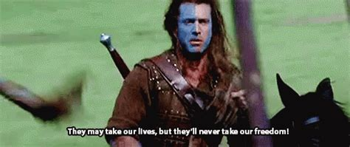
Notes:
https://external-content.duckduckgo.com/iu/?u=https%3A%2F%2Fmedia1.tenor.com%2Fimages%2F1dd7e3c71e9b555b2b3383cc2efba3af%2Ftenor.gif%3Fitemid%3D5665109&f=1&nofb=1&ipt=e3410ce494f249be16779b5d7804f72eb0731cc912f998284bdc02e3426ce577&ipo=images
End of movie, Mel Gibson/ was brutally killed, shouting “Freedom”

Slide 24
^{Hoshea 5.7-8} Now within the month the invaders will devour their lands. Blow the shofar in Giv‘ah, a trumpet at Ramah; sound [teruah תְּרוּעָה] an alarm at Beit-Aven.
Notes:
Both shofar and teruah
War! Invaders!

Slide 25
Leviticus 25:9; Jubilee LIBERTY
Hosea 5:8; War, invaders

Slide 26
^{T’hillim/Ps 81.2-4} Sing for joy to God our strength, shout [teruah תְּרוּעָה] to the God of Jacob! Lift up a song and sound a tambourine, a sweet lyre with a harp. Blow the shofar at the New Moon.
Notes:
Joy
Both shofar and teruah

Slide 27
Leviticus 25:9; Jubilee LIBERTY
Hosea 5:8; War, invaders
Psalm 81:3-4 Joyful celebration

Slide 28
^{2 Shmuel 6:15} So David and all the house of Isra’el brought up the ark of Adoni with shouting [teruah תְּרוּעָה] and the sound of the shofar.
Notes:
Victory celebration.
Both shofar and shout.

Slide 29
Leviticus 25:9; Jubilee LIBERTY
Hosea 5:8; War, invaders
Psalm 81:3-4 Joyful celebration
2 Shmuel 6:15 Victory celebration

Slide 30
^{Ezra 3.11} They sang antiphonally, praising and giving “thanks to Adoni, for he is good, for his grace continues forever” toward Isra’el. All the people raised a great shout of praise
הֵרִיעוּ תְרוּעָה גְדוֹלָה to Adoni, because the foundation of the house of Adoni had been laid.
Notes:
Praise for accomplishment.
No shofar, just the shout of teruah

Slide 31
Leviticus 25:9; Jubilee LIBERTY
Hosea 5:8; War, invaders
Psalm 81:3-4 Joyful celebration
2 Shmuel 6:15 Victory celebration
Ezra 3:11; Joyful celebration
Notes:
Of a great accomplishment

Slide 32
^{Iyov/Job 8.21} He will yet fill your mouth with laughter and your lips with shouts [teruah תְּרוּעָה] of joy.
Notes:
Joy
No shofar, just Teruah.

Slide 33
Leviticus 25:9; Jubilee LIBERTY
Hosea 5:8; War, invaders
Psalm 81:3-4 Joyful celebration
2 Shmuel 6:15 Victory celebration
Ezra 3:11; Joyful celebration
Iyov 8:21; Spiritual joy

Slide 34
^{T’hillim / Ps 27.6} Then my head will be lifted up above my surrounding foes, and I will offer in his tent
sacrifices with shouts [teruah תְּרוּעָה] of joy;
Notes:
וְאֶזְבְּחָה בְאָהֳלוֹ, זִבְחֵי תְרוּעָה;
Doesn’t say joy, just implied in the teruah
Doesn’t say shofar.
Victory over foes.

Slide 35
Leviticus 25:9; Jubilee LIBERTY
Hosea 5:8; War, invaders
Psalm 81:3-4 Joyful celebration
2 Shmuel 6:15 Victory celebration
Ezra 3:11; Joyful celebration
Job 8:21; Spiritual joy
Psalm 27:6 Victory over foes

Slide 36
^{T’hillim / Ps 150 5} Praise him with clanging cymbals! Praise him with loud crashing [teruah תְּרוּעָה] cymbals!
Notes:
הַלְלוּהוּ בְּצִלְצְלֵי תְרוּעָה.

Slide 37
Leviticus 25:9; Jubilee LIBERTY
Hosea 5:8; War, invaders
Psalm 81:3-4 Joyful celebration
2 Shmuel 6:15; Joyful celebration
Ezra 3:11; Joyful celebration
Job 8:21; Spiritual joy
Psalm 27:6 Victory over foes
Psalm 150:5 Joyful celebration
Notes:
All these verses have teruah,
First four teruah from the shofar and the shout,
Last four just the vocal shout.
So, when the shofar is blown, it’s important to enter into it with a shout. What? Halleluyah!! Praise the L-rd. Barukh Shem Yeshua. I love you Lord. My son will be free. Our need will be met. The walls will come down, impossible relationship mended. I will be healed.

Slide 38
^{Yehoshua/Josh 6.5} Then they are to blow a long blast on the shofar. On hearing the sound of the shofar, all the people are to shout as loudly as they can; and the wall of the city will fall down flat. Then the people are to go up into the city, each one straight from where he stands.”
Notes:
Both shofar and teruah

Slide 39
^{Josh 6.5} Hebrew reads right to left

Slide 40
^{Yehoshua/Josh 6.20} So the people shouted, with the shofars blowing. When the people heard the sound of the shofars, the people let out a great shout; and the wall fell down flat; so that the people went up into the city, each one straight ahead of him; and they captured the city.
Notes:
Archeologists have a time with the wall falling flat. Sort of elevator lowering.

Slide 41
Josh 6.20 right to left

Slide 42
^{1 Thes 4.16-17} The Lord himself will come down from heaven with a rousing cry, with a call from one of the ruling angels, and with God’s shofar; those who died united with the Messiah will be the first to rise; then we who are left still alive will be caught up with them in the clouds to meet the Lord in the air;
Notes:
Shout AND shofar in return for His bride.
Are you sure you are united with Him? Confessed sin, repented, changed, believed in His atoning death and resurrection, received Him into your heart of hearts to rule?

Slide 43
^{1 Cor.15.52} It will take but a moment, the blink of an eye, at the final shofar. For the shofar will sound, and the dead will be raised to live forever, and we too will be changed.
Notes:
I used to be a firm pre-Tribber. Now I’m a moderate pre Tribber. Joel Rosenberg. Amir Tsafati.
Yeshua’s shout and shofar could be today!
Are you ready??

Slide 45
Rosh HaShanah
The name
Meaning of Rosh Hashanna תְּרוּעָה Teruah
An example in scripture of this holiday being celebrated.
A modern example of VICTORY!

Slide 46
City wall finished Elul 25 ~Sept 21, 2022, 3 days later…
^{Nekhmyah 8.1-10} When the seventh month arrived, after the people of Isra'el had resettled in their towns, all the people gathered with one accord in the open space in front of the Water Gate
Notes:
46
These are returnees from Bab exile. “We want to know.”

Slide 47
Notes:
https://i.pinimg.com/564x/99/7c/5c/997c5ca9cd434b34a09e99a4b418d23a.jpg
In Bible times the Kidron Valley and the Tyropean Valley may have been streams.

Slide 48
^{Nekhmyah 8.1-10} and asked 'Ezra the Torah-teacher to bring the scroll of the Torah of Moshe, which ADONI had commanded Isra'el. 'Ezra the cohen brought the Torah before the assembly,
Notes:
48

Slide 49
^{Nekhmyah 8.1-10} which consisted of men, women and all children old enough to understand. It was the first day of the seventh month. Facing the open space in front of the Water Gate,
Notes:
49
First day of the seventh month. RH. Seventh month as defined by Pesakh.

Slide 50
^{Nekhmyah 8.1-10} he read from it to the men, the women and the children who could understand from early morning until noon; and all the people listened attentively to the scroll of the Torah.
Notes:
50
Can you imagine. Listened to reading 6 a.m. to noon??!!

Slide 51
^{Nekhmyah 8.1-10} 'Ezra the Torah-teacher stood on a wood platform which they had made for the purpose; beside him on his right stood Mattityah, Shema, 'Anayah, Uriyah, Hilkiyah and Ma'aseiyah; while on his left were P'dayah, Misha'el, Malkiyah, Hashum, Hashbadanah, Z'kharyah and Meshulam.
Notes:
51
Don’t need belabor all the names here, some later.

Slide 52
^{Nekhmyah 8.1-10} 'Ezra opened the scroll where all the people could see him, because he was higher than all the people; when he opened it, all the people rose to their feet.
Notes:
52
Custom of rising when scroll brought out

Slide 53
^{Nekhmyah 8.1-10} 'Ezra blessed ADONI, the great God; and all the people answered, "Amen! Amen!" as they lifted up their hands, bowed their heads and fell prostrate before ADONI with their faces to the ground
Notes:
53
Hence custom of Torah blessing.
Demonstrative worship?? Was this really Jewish? We don’t do that when scrolls brought out…maybe tomorrow?

Slide 54
^{Nekhmyah 8.1-10} The L’vi’im Yeshua, Bani, Sherevyah, Yamin, ‘Akuv, Shabtai, Hodiyah, Ma‘aseiyah, K’lita, ‘Azaryah, Yozavad, Hanan and P’layah explained
Notes:
Yeshua was a common Hebrew name.

Slide 55
^{Nekhmyah 8.1-10} the Torah to the people, while the people remained in their places. They read clearly from the scroll, in the Torah of God, translated it, and enabled them to understand the sense of what was being read.
Notes:
55
Translated?? Maybe into Chaldean / Aramaic ki exiles just returned.
Artscroll: “Clearly, with the application of wisdom, and they helped the people understand the reading.”
NIV: making it clear and giving the meaning so that the people could understand what was being read

Slide 56
^{Nekhmyah 8.1-10} Nekhemyah the Tirshata, 'Ezra the cohen and Torah-teacher and the L'vi'im who taught the people said to all the people, "Today is consecrated to ADONI your God;
Notes:
56
.

Slide 57
^{Nekhmyah 8.1-10} don't be mournful, don't weep." For all the people had been weeping when they heard the words of the Torah. Then he said to them, "Go, eat rich food, drink sweet drinks,
Notes:
57
Grand reaction: dread and mourning. We’re in deep trouble. All this stuff we missed. Spirit of mourning and lamenting.
Nekhemyahs response?
Essence of Jewish piety: eat.
Apparent source of the custom of apples and honey later tonight.

Slide 58
^{Nekhmyah 8.1-10} and send portions to those who can't provide for themselves; for today is consecrated to our Lord. Don't be sad, because the joy of ADONI is your strength." In this way the L'vi'im quieted the people, as they said,
Notes:
58
We’re accustomed to being sad and praying. There is another direction to deal.
Sending portions. We can do this in the future.

Slide 59
^{Nekhmyah 8.1-10} "Be quiet, for today is holy; don't be sad." Then the people went off to eat, drink, send portions and celebrate; because they had understood the words that had been proclaimed to them.
Notes:
59
Therefore apples and honey shortly.
Where do the Jewish people get the idea of this as a Day of Judgement? Yom HaDin?
From remembering! Hard to remember without some guilt.

Slide 60
Paraphrase: Today is Yom Teruah [first day of the seventh month]
Shout for joy, for victory, for celebration!
Don’t be sad.
Eat and share!
Notes:
It doesn’t look like it.
Sometimes the teruah first. Yerikho / Jericho

Slide 62
Rosh HaShanah
The name
Meaning of Rosh Hashanna תְּרוּעָה Teruah
An example in scripture of this holiday being celebrated.
A modern example of VICTORY!

Slide 63
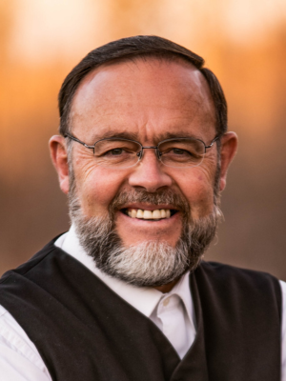
Pastor Henry Hildebrandt was facing 15 years in prison and $52,000,000 in fines. For what? For having service during Covid.
Notes:
https://wellversedworld.org/media/tf82qm7/wpn-268a-an-update-on-canada-s-persecuted-pastors

Slide 64
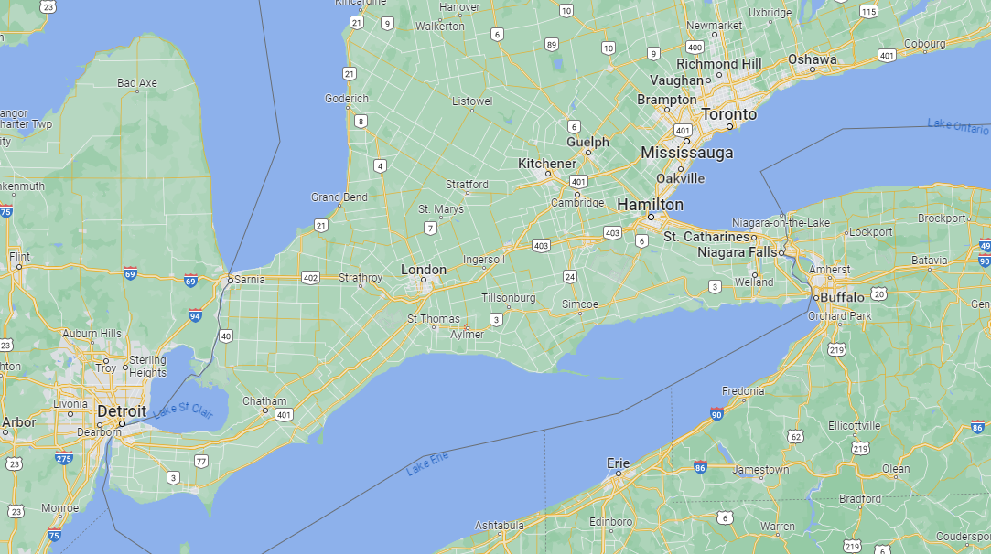
Dawn’s hometown
Aylmer
Notes:
https://www.google.com/maps/place/Aylmer,+ON,+Canada/@42.7749226,-81.0029146,8z/data=!4m6!3m5!1s0x882e7cd2361c7cb9:0xb9a13d3e2d284cd5!8m2!3d42.7729381!4d-80.9828842!16zL20vMDF5MmRi?entry=ttu

Slide 65
He offered online services for all who wanted that. But many wanted to meet and worship in-person together. By the way, there was not one single case of Covid in his congregation. Not one. But still, the totalitarian government of Ontario used the opportunity to try to crush him.
Notes:
https://wellversedworld.org/media/tf82qm7/wpn-268a-an-update-on-canada-s-persecuted-pastors

Slide 67
We are about to hear the shofars, but it’s NOT passive. We need to shout and praise G-d in Messiah for…

Slide 68
Leviticus 25:9; Jubilee LIBERTY
Hosea 5:8; War, invaders
Psalm 81:3-4 Joyful celebration
2 Shmuel 6:15; Joyful celebration
Ezra 3:11; Joyful celebration
Job 8:21; Spiritual joy
Psalm 27:6 Victory over invaders
Psalm 150:5 Joyful celebration
Notes:
All these verses have teruah,
First four teruah from the shofar and the shout,
Last four just the vocal shout.
So, when the shofar is blown, it’s important to shout. What? Halleluyah!! Praise the L-rd. Barukh Shem Yeshua. I love you Lord. My son will be free. Our need will be met. The walls will come down, impossible relationship mended. I will be healed.
If you don’t have salvation victory, seek it now!!

Slide 69
Rosh HaShanah
The name
Meaning of Rosh Hashanna תְּרוּעָה Teruah
An example in scripture of this holiday being celebrated.
A modern example of VICTORY!

Slide 70
Do you KNOW Yeshua and ready for the teruah of His return?
Are you hearing daily from His Word?
How are you applying what you heard?
Are you offering that life to anyone?

