Slide 1
e-handout
To have these notes
without taking notes
Go to OrHaOlam.com
Click on Messages tab,
2023 Messages

Slide 2
What do you get
when you cross
a fish with an elephant?
Notes:
Matt Hershey

Slide 3
What do you get
when you cross
a fish with an elephant?
Swimming trunks
Notes:
Matt & Karen Hershey

Slide 4
The newest innovation
in Rosh HaShanah
apples and honey.

Slide 5
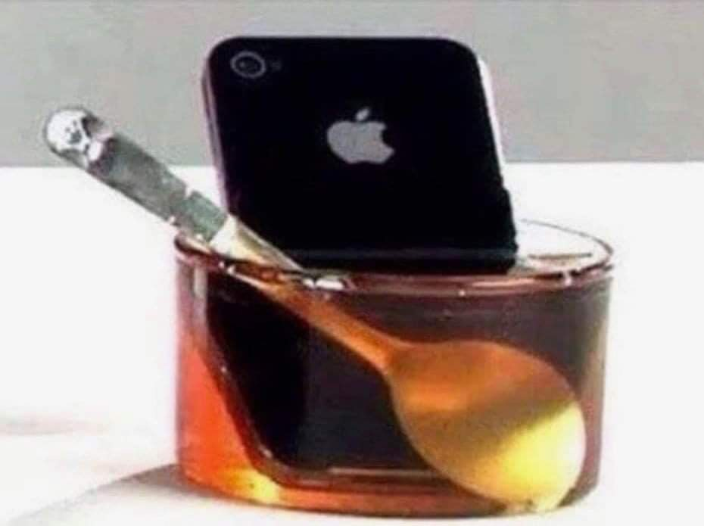
Notes:
JB Bernstein

Slide 6
Notes:
What is Naqba?? How fit in the theme of RH?

Slide 7
Nakba Day (يوم النكبة yawm in-nakbah), "day of the catastrophe,” an annual day of commemoration for the Palestinian Arab people of the anniversary of the creation of Israel, every May 15, the day after Israelis celebrate their Independence Day.

Slide 8
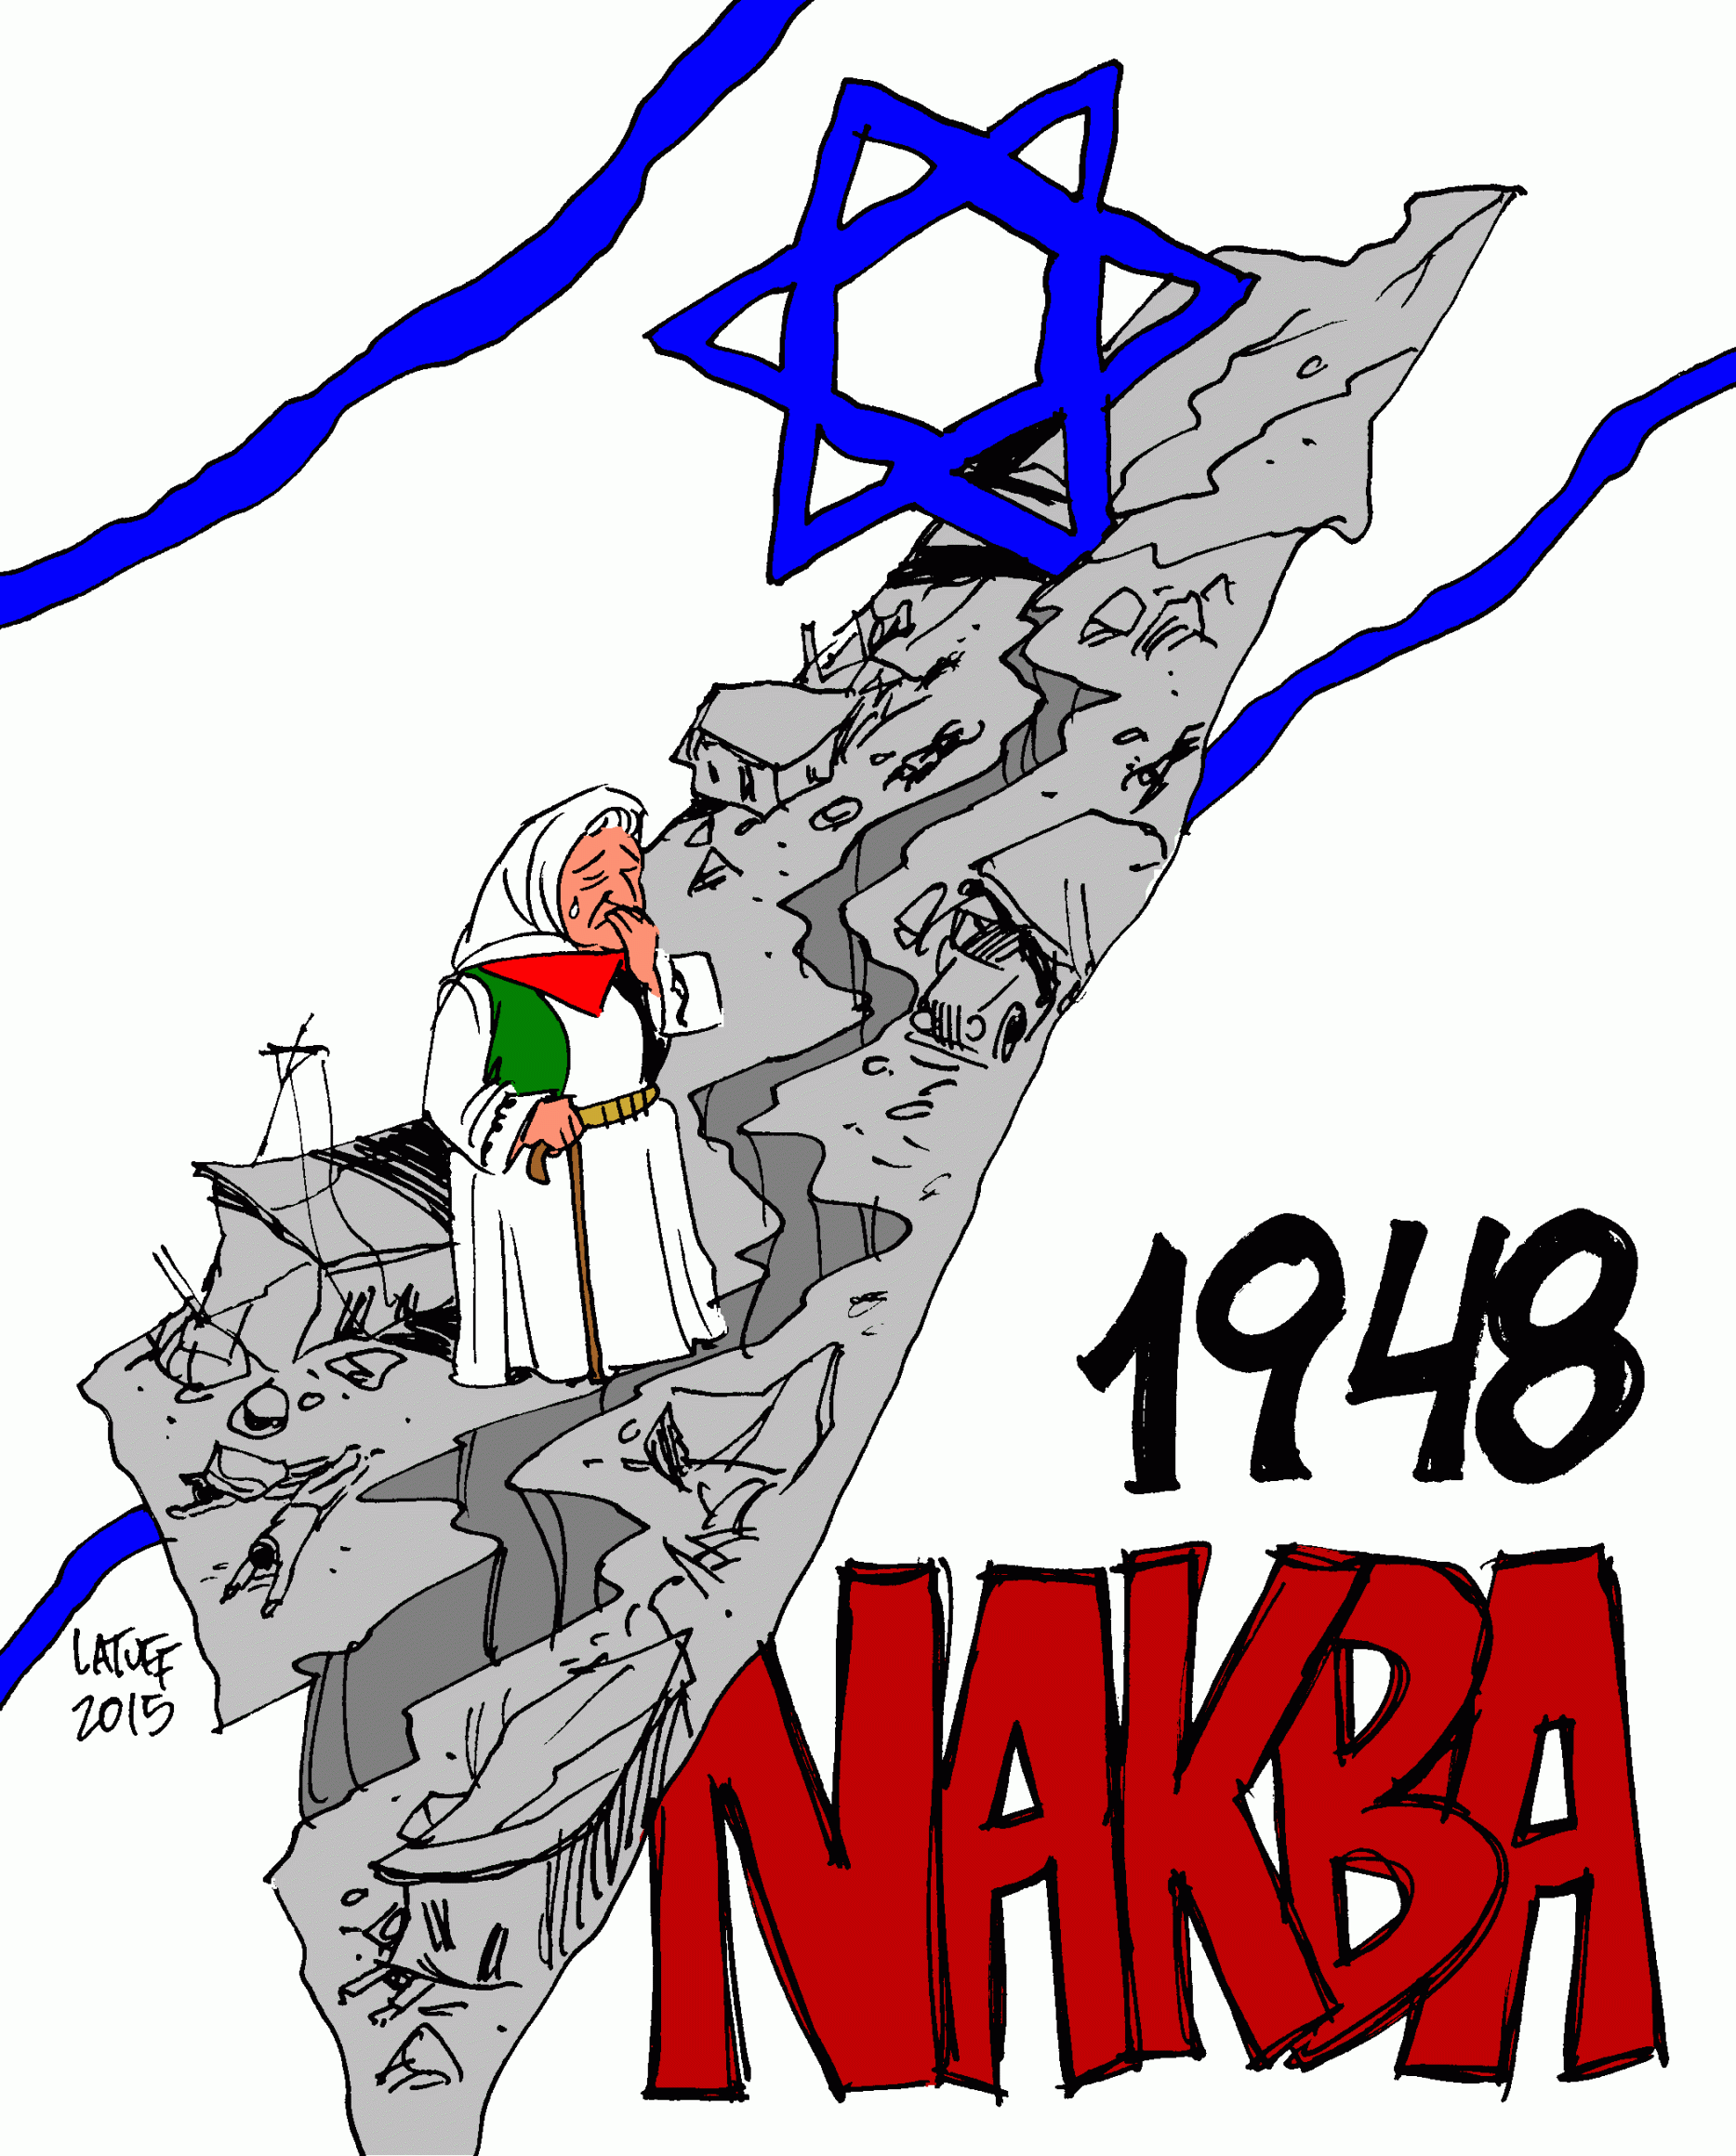
‘Nakba’ means ‘catastrophe’ in Arabic

Slide 9
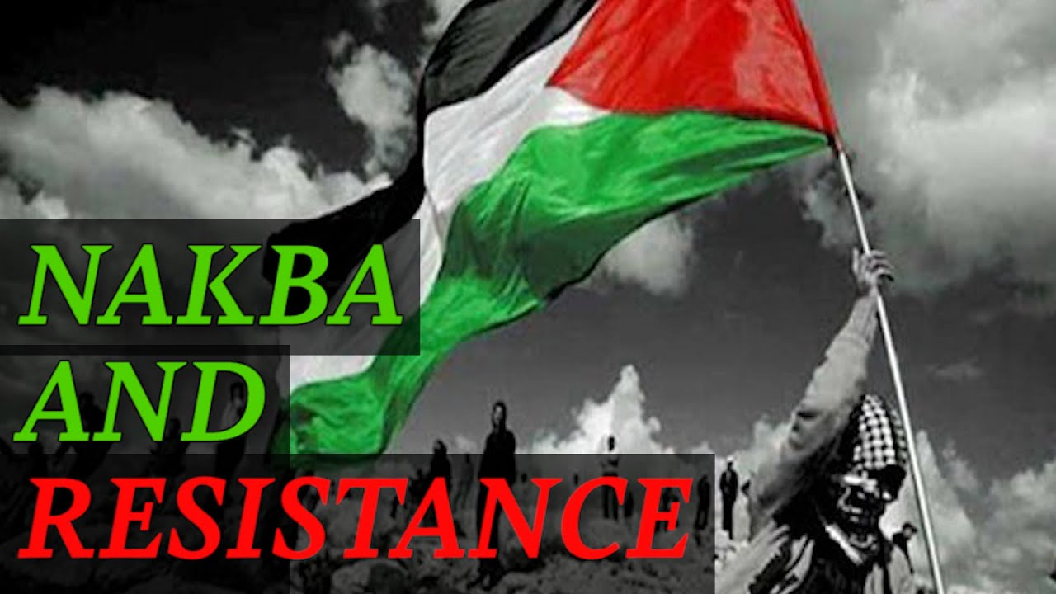
Notes:
https://i.ytimg.com/vi/sBCBqWIbMxE/maxresdefault.jpg

Slide 10
Palestinians mark Naqba
in Gaza: 'We will return home'
Notes:
Home: Jaffa, Tel Aviv,
Determined opposition to the existence of the State of Israel

Slide 11
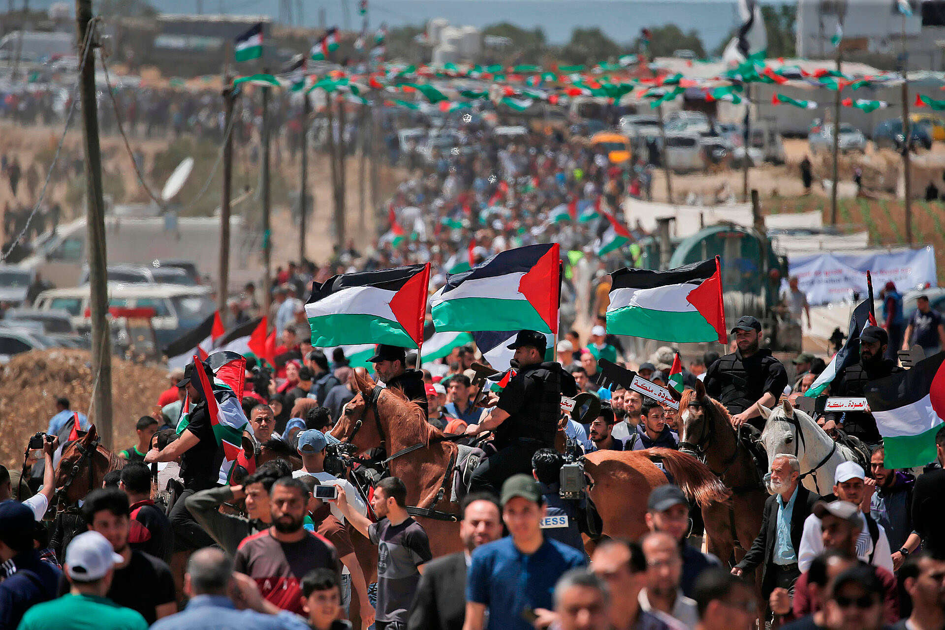
Notes:
https://www.israelhayom.com/wp-content/uploads/2019/05/AFP_1GH0JO.jpg

Slide 12
Notes:
What is Naqba?? How fit in the theme of RH?

Slide 13
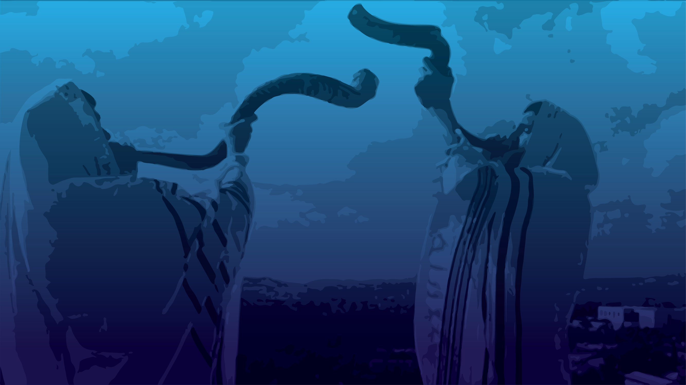
Outline
Miraculous start of the Jewish nation.
Bitter catastrophe in the history.
Messiah’s Ruakh redemption

Slide 14
Outline
Miraculous start of the Jewish nation.
Bitter catastrophe in the history.
Messiah’s Ruakh redemption

Slide 15
Why is this passage read on Rosh HaShanah?
Quoting Rabbi Nosson Scherman Stone Edition Chumash commentary: “According to tradition, Sarah conceived on Rosh HaShanah. Therefore, this narrative is the reading of that day.” So, what is the application to us, today?
Notes:
[R. Scherman doesn’t give a source of this tradition.]
Is there a lesson for us?

Slide 16
Backstory to the reading:
^{Ber/Gen 20.1-2} Avraham traveled from there [near Hevron] toward the Negev and lived between Kadesh and Shur. While living as an outsider in G’rar, Avraham said of Sarah his wife, “She is my sister”; so Avimelekh king of G’rar sent and took Sarah.
Notes:
Into his harem!!

Slide 17
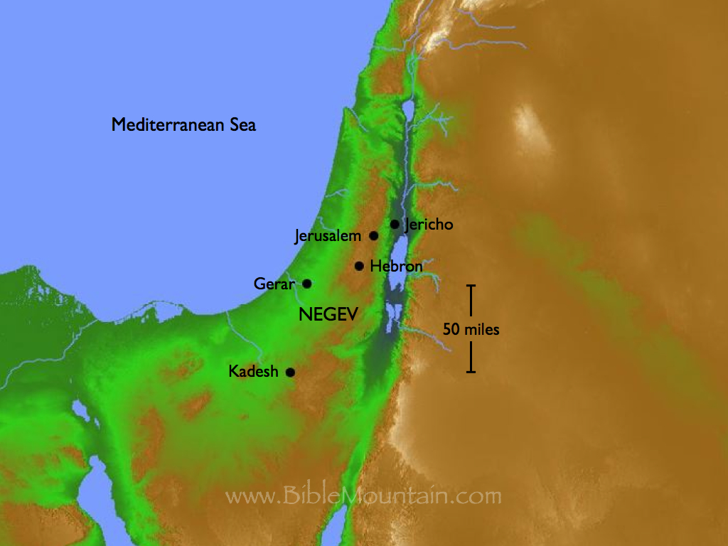
Notes:
https://i0.wp.com/www.biblemountain.com/wp-content/uploads/2014/04/Gen020001020007.001.jpg?ssl=1

Slide 18
^{Ber/Gen 20.3} But God came to Avimelech in a dream at night and said to him, “Behold, you are as good as dead, because of the woman whom you have taken—since she is a married woman.” Now Avimelech had not come near her. So he said, “My Lord, will You slay a nation, even though innocent?
Notes:
So King Avimelech confronted Avraham.
Avraham: She is my half sister.

Slide 19
^{Ber/Gen 20.17-18} Then Avraham prayed to God and God healed Avimelech, his wife and his female slaves so that they could bear children. For Adoni had completely locked up every womb in Avimelech’s household because of Sarah, Avraham’s wife.
Notes:
Amazing to me that Avraham lied, caused infertility in Avimelech’s family, then Avraham was the pray-er.
So, Sarah is restored to Avraham, and the story continues. Next verse immediately following is next chapter…

Slide 20
^{Ber/Gen 21.1} Adoni remembered Sarah as he had said, and Adoni did for Sarah what he had promised. Sarah conceived and bore Avraham a son in his old age, at the very time God had said to him. Halleluyah moment!!
Notes:
Note:
Avraham just prayed this for Avimelech, and there is a Talmudic concept [Bava Kama 92a] that if you pray for someone else, something that you need, the answer will surely come.
Says “Sarah…bore Avraham a son.” Since she had been in Avimelech’s harem, though allegedly untouched, the paternity could have been questioned.
Yitskhak / Isaac born in old age? Could have been in prime childbearing years? Demonstrates divine intervention. History Jews divine intervention. History Or HaOlam divine working!
“Sarah conceived” on RH, according to tradition. High note in the story!

Slide 21
^{Ber/Gen 21.2-8} Avraham circumcised his son Yitz’chak when he was eight days old, as God had ordered him to do…Sarah said, “God has given me good reason to laugh now…I have borne him a son in his old age!”
Circumcision = Brit Milah, is a GREAT great party time still. Photog, food.
Notes:
I know a Messianic rabbi who was a professional photog, who recorded these.
Who are you going to show the recordings to?
We’ve done many Brit Milah here.

Slide 22
^{Ber/Gen 21.2-8} The child grew and was weaned, and Avraham gave a great banquet on the day that Yitz’chak was weaned.
Notes:
Weaning then and there was a great celebration. I’ve never heard of, or been invited to a weaning party.

Slide 23
^{Ber/Gen 21.2-8} The child grew and was weaned, and Avraham gave a great banquet on the day that Yitz’chak was weaned.
Then it went from celebration to historic catastrophe!
Notes:
Catastrophe for all history established.

Slide 24
Notes:
What is Naqba?? How fit in the theme of RH?

Slide 25
Outline
Miraculous start of the Jewish nation.
Bitter catastrophe in the history.
Messiah’s Ruakh redemption

Slide 26
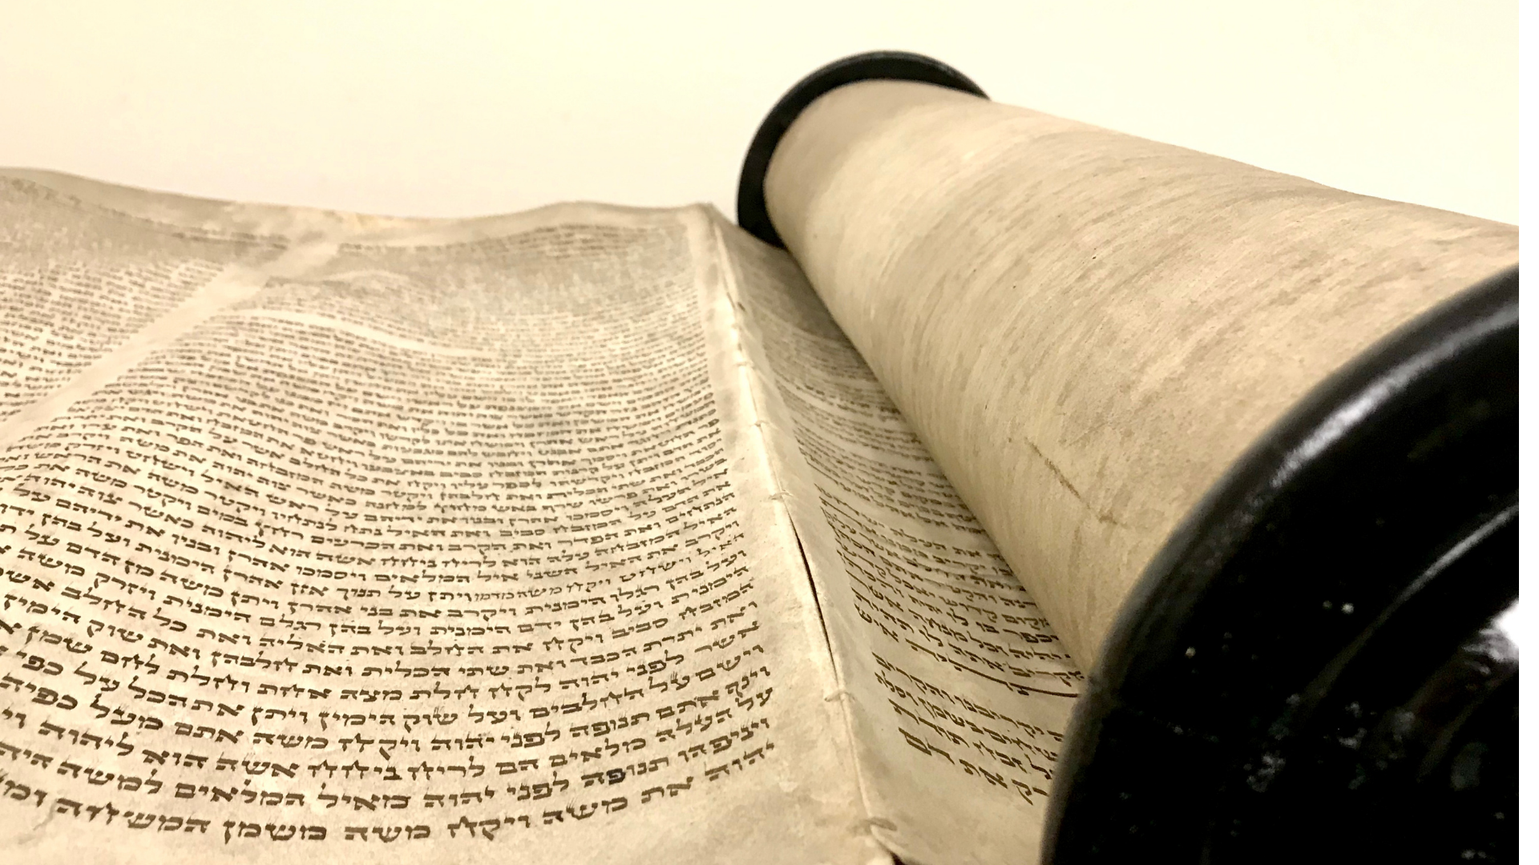
ְבְּרֵאשִׁית B’resheet
(Genesis) 21:9-13
(from) Vayera
(He appeared)
וירא

Slide 27
B’resheet (Genesis) 21:9
וַתֵּ֨רֶא שָׂרָ֜ה אֶֽת־בֶּן־הָגָ֧ר הַמִּצְרִ֛ית אֲשֶׁר־יָלְדָ֥ה לְאַבְרָהָ֖ם מְצַחֵֽק׃
But Sarah saw the son of Hagar the Egyptian, whom Hagar had borne to Avraham, making fun of Yitz’chak;

Slide 28
B’resheet (Genesis) 21:10
וַתֹּ֙אמֶר֙ לְאַבְרָהָ֔ם גָּרֵ֛שׁ הָאָמָ֥ה הַזֹּ֖את וְאֶת־בְּנָ֑הּ כִּ֣י לֹ֤א יִירַשׁ֙ בֶּן־הָאָמָ֣ה הַזֹּ֔את עִם־בְּנִ֖י עִם־יִצְחָֽק׃
so Sarah said to Avraham, “Throw this slave-girl out! And her son! I will not have this slave-girl’s son as your heir along with my son Yitz’chak!”

Slide 29
B’resheet (Genesis) 21:11
וַיֵּ֧רַע הַדָּבָ֛ר מְאֹ֖ד בְּעֵינֵ֣י אַבְרָהָ֑ם עַ֖ל אוֹדֹ֥ת בְּנֽוֹ׃
Avraham became very distressed over this matter of his son.

Slide 30
B’resheet (Genesis) 21:12
וַיֹּ֨אמֶר אֱלֹהִ֜ים אֶל־אַבְרָהָ֗ם אַל־יֵרַ֤ע בְּעֵינֶ֙יךָ֙ עַל־הַנַּ֣עַר וְעַל־אֲמָתֶ֔ךָ כֹּל֩ אֲשֶׁ֨ר תֹּאמַ֥ר אֵלֶ֛יךָ שָׂרָ֖ה שְׁמַ֣ע בְּקֹלָ֑הּ כִּ֣י בְיִצְחָ֔ק יִקָּרֵ֥א לְךָ֖ זָֽרַע׃
But God said to Avraham, “Don’t be distressed because of the boy and your slave-girl. Listen to everything Sarah says to you, because it is your descendants through Yitz’chak who will be counted.

Slide 31
B’resheet (Genesis) 21:13
וְגַ֥ם אֶת־בֶּן־הָאָמָ֖ה לְג֣וֹי אֲשִׂימֶ֑נּוּ כִּ֥י זַרְעֲךָ֖ הֽוּא׃
“But I will also make a nation from the son of the slave-girl, since he is descended from you.”

Slide 32
^{Ber/Gen 21.10} Avraham got up early in the morning, took bread and a skin of water and gave it to Hagar, putting it on her shoulder, and the child; then he sent her away.
No camel, no servant, no tent, no land grant for this single mom!

Slide 33
Compare, later after Sarah’s death:
^{Ber/Gen 25.5-10} “Avraham gave everything he owned to Yitz'chak…But to the sons of the concubines he made grants while he was still living and sent them off to the east.”
Notes:
Land grant? Some significant wealth. Gifts. מתנות

Slide 34
This was the essence of rejection. Ishmael has lived in rejection by the people of Isaac Yitzkhak ever since.

Slide 35
Rejection: You may live or die, it’s of no consequence. You’re dishonorable.
Kicked out of the house, 4000 years trying to get back in.
A culture and spirit of fatherlessness
Notes:
No servant, no camel, no gift, no tent.

Slide 36
The Qur’an teaches that god to them is not a father to anyone. According to both the Qur’an and Hadith, there are 99 names of god and not one of them reference him as a father. Allah is just another one of those names.
Notes:
https://www.catalyticministries.com/blog/2019/5/21/spiritual-fatherlessness

Slide 37
Real Naqba, real wound, and hope: beginning of the issue
^{Beresheet/Genesis 16.1-2} Now Sarai Avram's wife had not borne him a child. But she had an Egyptian slave-girl named Hagar; so Sarai said to Avram, "Here now, ADONI has kept me from having children;

Slide 38
^{Beresheet/Genesis 16.1-2} so go in and sleep with my slave-girl. Maybe I'll be able to have children through her.“ Avram listened to what Sarai said.
Notes:
Abe w great wisdom and holiness
Hagar ~16 maybe in love some appropriate young man
Snatched by complaining matriarch

Slide 39
First trouble
^{Beresheet/Genesis 16.4} Avram had sexual relations with Hagar, and she conceived. But when she became aware that she was pregnant, she looked on her mistress with contempt.
Notes:
Tone
Baby grew up w contempt in family,
Hagar probably festering anger since forced
Hormones → fetus

Slide 40
First Reaction
^{Beresheet/Genesis 16.5-6} Sarai said to Avram, "This outrage being done to me is your fault! True, I gave my slave-girl to you to sleep with; but when she saw that she was pregnant, she began holding me in contempt. May ADONI decide who is right - I or you!”
Notes:
Sarah’s response: Contempt and harshness: babies hear emotional messages

Slide 41
First Reaction
^{Beresheet/Genesis 16.5-6} However, Avram answered Sarai, “Look, she's your slave-girl. Deal with her as you think fit.” Then Sarai treated her so harshly that she ran away from her.

Slide 42
First Restoration
^{Beresheet/Genesis 16.7-9} The angel of ADONI found her by a spring in the desert, the spring on the road to Shur, and said, "Hagar! Sarai's slave-girl! Where have you come from, and where are you going?" She answered, "I'm running away

Slide 43
First Restoration
^{Beresheet/Genesis 16.7-9} from my mistress Sarai." The angel of ADONI said to her, "Go back to your mistress, and submit to her authority."

Slide 44
First Redemption
^{Beresheet/Genesis 16.10-12} The angel of ADONI said to her, "I will greatly increase your descendants; there will be so many that it will be impossible to count them." The angel of ADONI said to her, "Look, you are pregnant, …"
Notes:
Three promises

Slide 45
First Redemption
^{Beresheet/Genesis 16.10-12} and you will give birth to a son. You are to call him Yishma'el [God pays attention] because Adoni has paid attention to your misery. He will be a wild donkey of a man…"
Notes:
Three promises

Slide 46
First Redemption
^{Beresheet/Genesis 16.13} So she named ADONI, who had spoken with her, El Ro'i [God of seeing], because she said, "Have I really seen the One who sees me [and stayed alive]?“
Firsts:
Multitude of offspring [almost first]
Gender prediction
Divine Naming Yishmael יִשְׁמָעאל

Slide 47
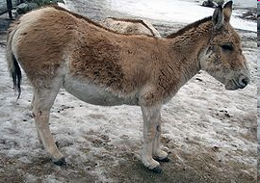
First Character prediction: Wild donkey: The Asian wild ass, also called the onager
Notes:
3.5 First angelic visit
Proud nomadic unconq, independent, to a slave girl forced to an old man FREE
Other not so flattering names: Dan a serpent, Benj a ravenous wolf
~Am mustang

Slide 48
They can run faster than any other horse or donkey, reaching and sustaining speeds of up to about forty-four miles (70 km) per hour.
http://animal.discovery.com/guides/mammals/habitat/aridland/asianass.html
First revelation, seeing G-d ‘El Ro'i [God of my seeing], because she said, “Have I really
Notes:
Saw ישוע first
12 princes Abu Saada p 208
Jeff Seif:
David could be another mother Ps 51
David’s sister Avigayil married Yeter the Yishmaeli 2 Sam 19.13 [355] Amasa nephew of David
1 Chron 2.17 [1152 cjb]
[2 Sam 17.25 complicates]
Camels 1 Chron 27.30 1181

Slide 49
seen the One who sees me [and stayed alive]?”’
First prediction of progeny: 12 17.20 to this day
Notes:
Saw ישוע first
12 princes Abu Saada p 208
Jeff Seif:
David could be another mother Ps 51
David’s sister Avigayil married Yeter the Yishmaeli 2 Sam 19.13 [355] Amasa nephew of David
1 Chron 2.17 [1152 cjb]
[2 Sam 17.25 complicates]
Camels 1 Chron 27.30 1181

Slide 50
First circumcised? Likely, age 13
NOT a cursed son
NOT the covenantal son:
blessing, destiny, Land

Slide 51
This was the essence of rejection. Ishmael has lived in rejection by the people of Isaac Yitzkhak ever since.
Enacted at a celebratory party over a miraculous birth! From blessing to catastrophe!

Slide 52
Rejection: You may live or die, it’s of no consequence. You’re dishonorable.
Kicked out of the house, 4000 years trying to get back in.
A culture and spirit of fatherlessness
Notes:
No servant, no camel, no gift, no tent.

Slide 53
Notes:
What is Naqba?? How fit in the theme of RH?

Slide 54
Outline
Miraculous start of the Jewish nation.
Bitter catastrophe in the history.
Messiah’s Ruakh redemption

Slide 55
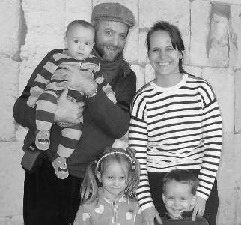
Ariel and Vered Blumenthal
May 2016,
Notes:
As so often happens in this Gathering movement, the Holy Spirit moved powerfully on the group through prophetic, "identificational" acts of reconciliation, intercession and unity - this time bringing healing to the Abrahamic family by us repenting (especially Vered "standing in" as Sarah) and welcoming Hagar and Ishmael (the Egyptians) back into the family.

Slide 56
On the third day of our meeting we had a clear sense that God had brought us together "for such a time as this" (Esther 4:14). As it was with Esther, this time we were led by the women in our midst.

Slide 57
"Egyptian women willingly identified with Hagar and confessed the rejection, envy and resentment she felt when Abraham cast her out of the family as Sarah demanded. (This spirit of rejection has dogged the Arab peoples every generation since.

Slide 58
Those who have been set free from it are often magnificent people, but the ethnic type prevails.) Agonized tears were wept by the Egyptians and everyone else as we experienced a measure of those emotions.

Slide 59
They confessed that they had hated and mocked "Isaac" and his offspring. Then an Israeli mother [Vered] stepped forward to plead, "There are two empty places at our family table. Won't you come home? Our family is not complete.

Slide 60
Isaac needs his older brother, who was blessed by God first." These words don't begin to express the depth of significance and emotion of the moment. I hope you can imagine a bit of the atmosphere

Slide 61
There was much weeping and rejoicing following this time of sharing. And then, the Egyptians began to sing over us, while our 8 month old boy, Lavi, sat on my shoulders giggling and smiling (as he almost always does). It was as if Hagar and Ishmael were singing

Slide 62
rejoicing over Isaac! (Perhaps that's what we should have named our laughing boy.)

Slide 63
Possibly for the first time in history, descendants of Abraham, Isaac, and Jacob came together with the family of Hagar and Ishmael, all of us secure in our eternal inheritance because of our faith in our great, older

Slide 64
brother, Abraham's greatest Son, Yeshua (Romans 8:29-30).

Slide 65
Other ministries of such reunification of the sons and daughters of Isaac and Yishmael:

Slide 66
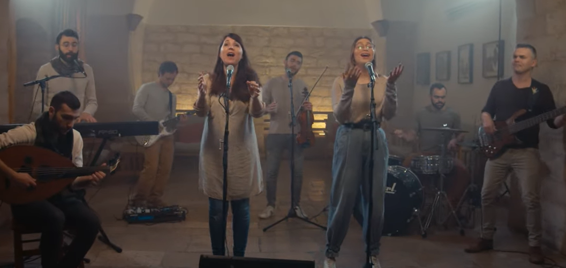
Notes:
Evan told me this is now one of Sarah’s main focus. Welcoming Ishmael back to the table.
Sarah’s music: Gadol Adoni Great is the Lord.
This groundbreaking project includes worship songs from Israel translated and sung in Arabic. The heart behind this project is to call the prodigals of the Middle East back to their Father’s tent.
https://news.kehila.org/video-fire-of-your-spirit-arabic-version-the-invitation/

Slide 67
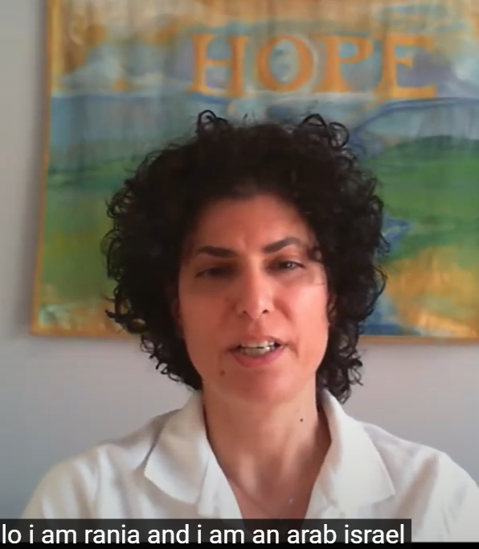
Rania Sayegh, director of a house of prayer in Nazareth, Israel, offers an Arab perspective on Christian reconciliation.
Notes:
I met Rania at an IHOPKC prayer meeting. When she understood that I was a Messianic Jewish rabbi, she got on her knees there, publicly to ask forgiveness! Rosemarie Schindler was with her.
https://www.youtube.com/watch?v=kIUnDeZ6vv4

Slide 68
Yeshua is the Prince of Peace, and the only answer between both Jewish and Arab people in the land. We find that praying and worshiping together is one way of making peace. Through our House of Prayer also, and events and gatherings, we have Messianic Jewish young people also coming to pray and fellowship with our Arab young people.
Notes:
https://www.youtube.com/watch?v=kIUnDeZ6vv4

Slide 69
Also, through ELAV [youth] conferences, that were done by dear friends of ours, Rick and Patty Ridings from Jerusalem – Succat Hallel [house of prayer]. During these conferences, we used to bring Arab young people to be part of this three or four days of worshiping
Notes:
https://www.youtube.com/watch?v=kIUnDeZ6vv4

Slide 70
praying, and coming together where our hearts are softened towards each other.
Another such Jewish Arab worship ministry:
Notes:
https://www.youtube.com/watch?v=kIUnDeZ6vv4

Slide 71
Notes:
https://dorhaba.com/en/about-2/

Slide 72
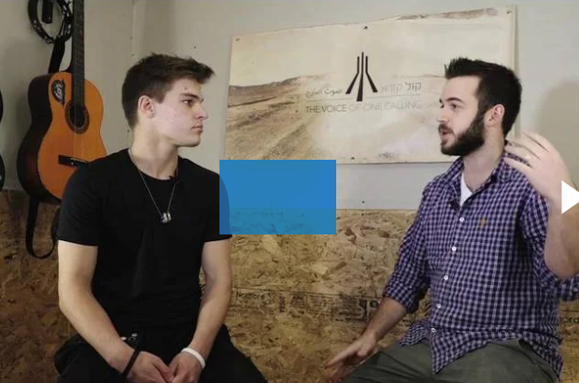
Shilo ben Hod
Notes:
Our new Hebrew-Arabic worship recording, “The Voice of One Calling”, is a gathering. Jews and Arabs living in Israel came together to worship Him.
https://dorhaba.com/en/shiloh-ben-hod-interview/

Slide 73
Every summer we organise a Worship and Prayer training camp in Israel for Jewish and Arab youth called the Dor Haba Camp. We also produce worship music in Hebrew and Arabic, specifically songs written by the younger generation in Israel, in collaboration with songwriters and worship leaders from surrounding Middle Eastern countries.
Notes:
https://dorhaba.com/en/about-2/

Slide 74
Conclusion for us: generations, centuries, millennia of contempt, bitterness, hostility can be melted by the Presence of the Ruakh, together.

Slide 75
The teruah [shofar / shout] is the sound of worship and breakthrough praise
Notes:
Is that all? The only RH lesson for us from this story?

Slide 76
Leviticus 25:9; Jubilee LIBERTY
Hosea 5:8; War, invaders
Psalm 81:3-4 Joyful celebration
2 Shmuel 6:15 Victory celebration
Ezra 3:11; Joyful celebration
Job 8:21; Spiritual joy
Psalm 27:6 Victory over foes

Slide 77
In her blog called The Palliative Provocateur, Rebecca Gagne-Henderson, Ph.D., APRN, ACHPN, a palliative care specialist who has worked with dying patients for 27 years, tells a convincing story about this human hunger.
Notes:
https://palliativeprovocateur.com/2022/04/13/a-story-of-grace-redemption-and-remoralization/

Slide 78
"Jackie," a local gang member, learned she was dying at age 22. Initially bitter and hostile, she slowly softened under the care of her kind hospice nurse, Pat. In a vulnerable moment, Jackie told Pat the one thing she wanted before dying was for her mom and dad to care for her together.
Notes:
https://palliativeprovocateur.com/2022/04/13/a-story-of-grace-redemption-and-remoralization/

Slide 79
Jackie's embittered parents had divorced 17 years earlier, leaving her and her siblings in the care of revolving family members.
Notes:
https://palliativeprovocateur.com/2022/04/13/a-story-of-grace-redemption-and-remoralization/

Slide 80
Through the perseverance of the hospice chaplain, Jackie’s parents miraculously agreed to stay with her for three days, bathing, changing, and feeding her, caring for her in a way Jackie likely dreamed of since she was 5.
Notes:
https://palliativeprovocateur.com/2022/04/13/a-story-of-grace-redemption-and-remoralization/

Slide 81
By the third day, the hate and anger between Jackie’s parents melted, and the three wept together as they forgave each other.
The next day, Jackie, once rife with bitterness over dying, told Pat, “Now I can die, and it is OK. I did what I was supposed to do."
Notes:
https://palliativeprovocateur.com/2022/04/13/a-story-of-grace-redemption-and-remoralization/

Slide 82
Another story of redemption, from George Whitten:

Slide 83
Php 1:21 For to me to live is Messiah, and to die is gain. From George Whitten
I happened (on rare occasion) the other day to see a CNN headline, "Health Officials Brace for Three Major Viruses this Fall". Immediately, I thought, "Not again!" Yet, scouring the headlines, it now appears that several colleges are instituting mask mandates even though there isn't a case of illness yet.
Notes:
George Whitten

Slide 84
While the world is being prepared for an "outbreak" of disease, I'm hoping we may learn a lesson from history so that, perhaps, we'll see an "outbreak" of revival!
Church history reveals that God used pandemics to test the saints, demonstrate their faith, courage, and love, and dramatically advance the gospel.
Notes:
George Whitten

Slide 85
The Antonine Plague in the 2nd century lasted over 10 years, resulting in at least 5 million deaths. The Plague of Cyprian in the 3rd century devastated the population of Alexandria, dropping it from 500,000 to 190,000.
Notes:
George Whitten

Slide 86
While pagan priests were fleeing the plague and leaving the sick to die, it was the steadfast faith of the saints that cared for the sick in the face of death. This rarely acknowledged Christian heroism radically transformed the Roman Empire, leading to the eradication of the pagan gods and eventually to a massive social transformation.
Notes:
George Whitten

Slide 87
Cyprian, the bishop of Carthage, witnessed and described the atmosphere of the time:
"There is nothing remarkable in cherishing merely our own people with the due attentions of love, but that one might become perfect, he who should do something more than heathen men or publicans; overcoming evil with good,
Notes:
George Whitten

Slide 88
and practicing a merciful kindness like that of God, he should love his enemies as well…Thus the good was done to all men, not merely to the household of faith."
"By the terrors of mortality and of the times, lukewarm men are heartened, the listless nerved, the sluggish awakened; deserters are compelled to return
Notes:
George Whitten

Slide 89
heathens brought to believe; the congregation of established believers is called to rest; fresh and numerous champions are banded in heartier strength for the conflict, and having come into warfare in the season of death, will fight without fear of death, when the battle comes."
Notes:
George Whitten

Slide 90
Historians noted that the Christians' compassion and devotion to tending the sick during the pandemics caused the pagan world to collapse and saw an explosive growth of Christianity with many coming to faith.
Notes:
George Whitten

Slide 91
Let’s apply that to our worst enemies and distresses.
Add compassionate service to the list of repentance as we hear the shofar.

Slide 92
Notes:
What is Naqba?? How fit in the theme of RH?

Slide 93
Outline
Miraculous start of the Jewish nation.
Bitter catastrophe in the history.
Messiah’s Ruakh redemption

Slide 94
Do you KNOW Yeshua and ready for the teruah of His return?
Are you hearing daily from His Word?
How are you applying what you heard?
Are you offering that life to anyone?

