Slide 1
e-handout
To have these notes
without taking notes
Go to OrHaOlam.com
Click on Messages tab,
2023 Messages

Slide 2
Yom Kippur greeting:
Tsom kal um’vorakh!
צום קל ומבורך!
Have an easy and blessed fast!

Slide 3
Tekiah G’dolah
Grand shofar blast

Slide 4
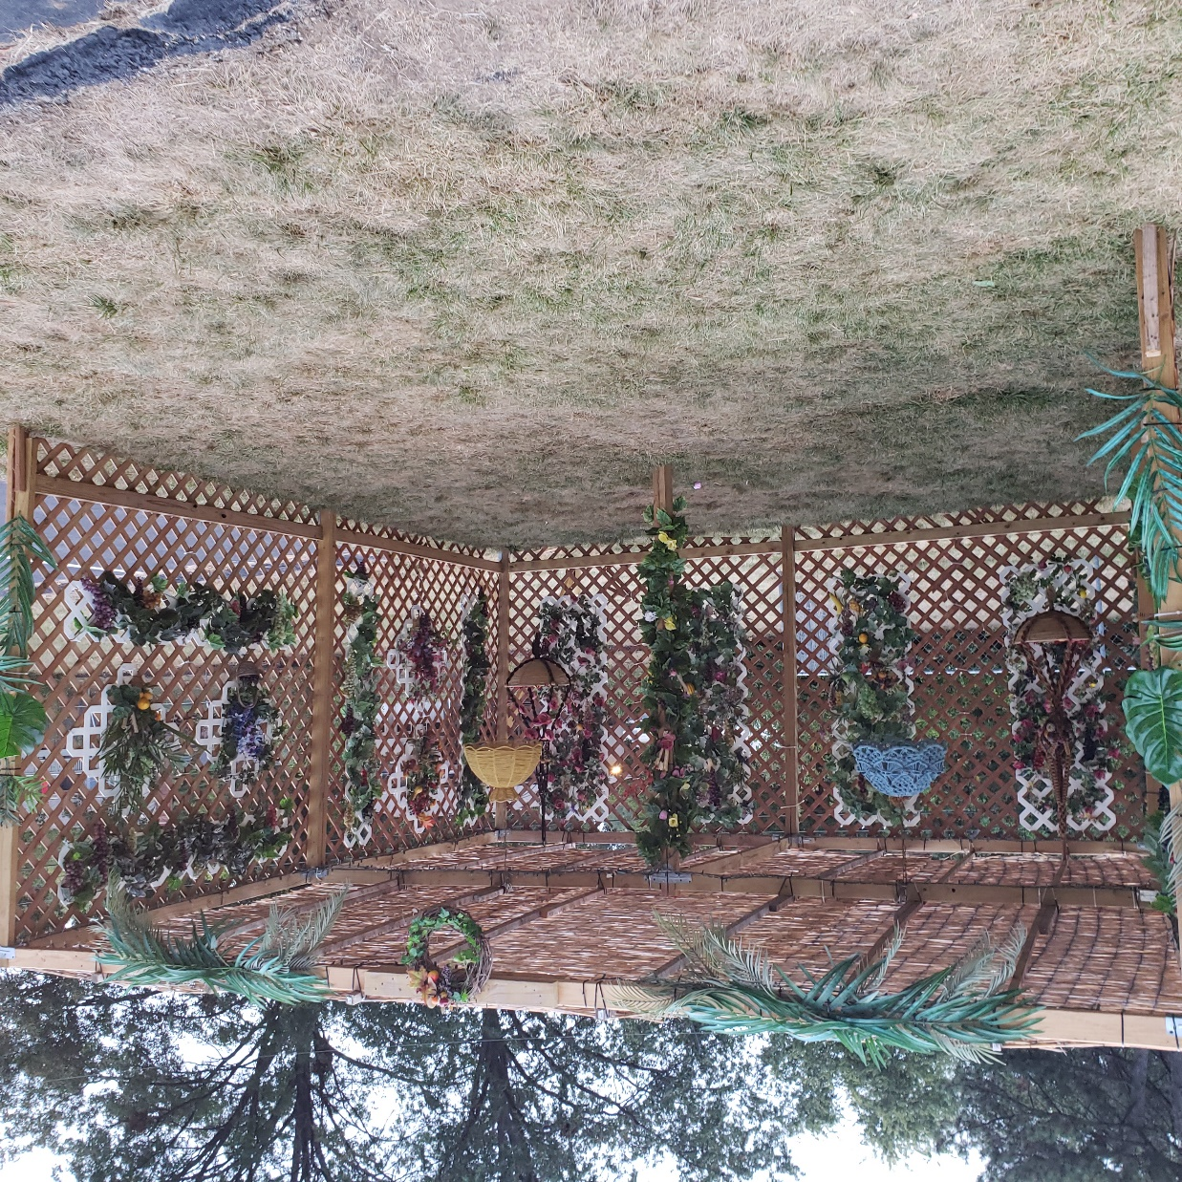
Or HaOlam Sukkah 2023
Notes:
Thanks all the guys and boy who built it, all the ladies and girls who decorated it. Please stand!! Cassie and Miranda decorated the pillar!

Slide 5
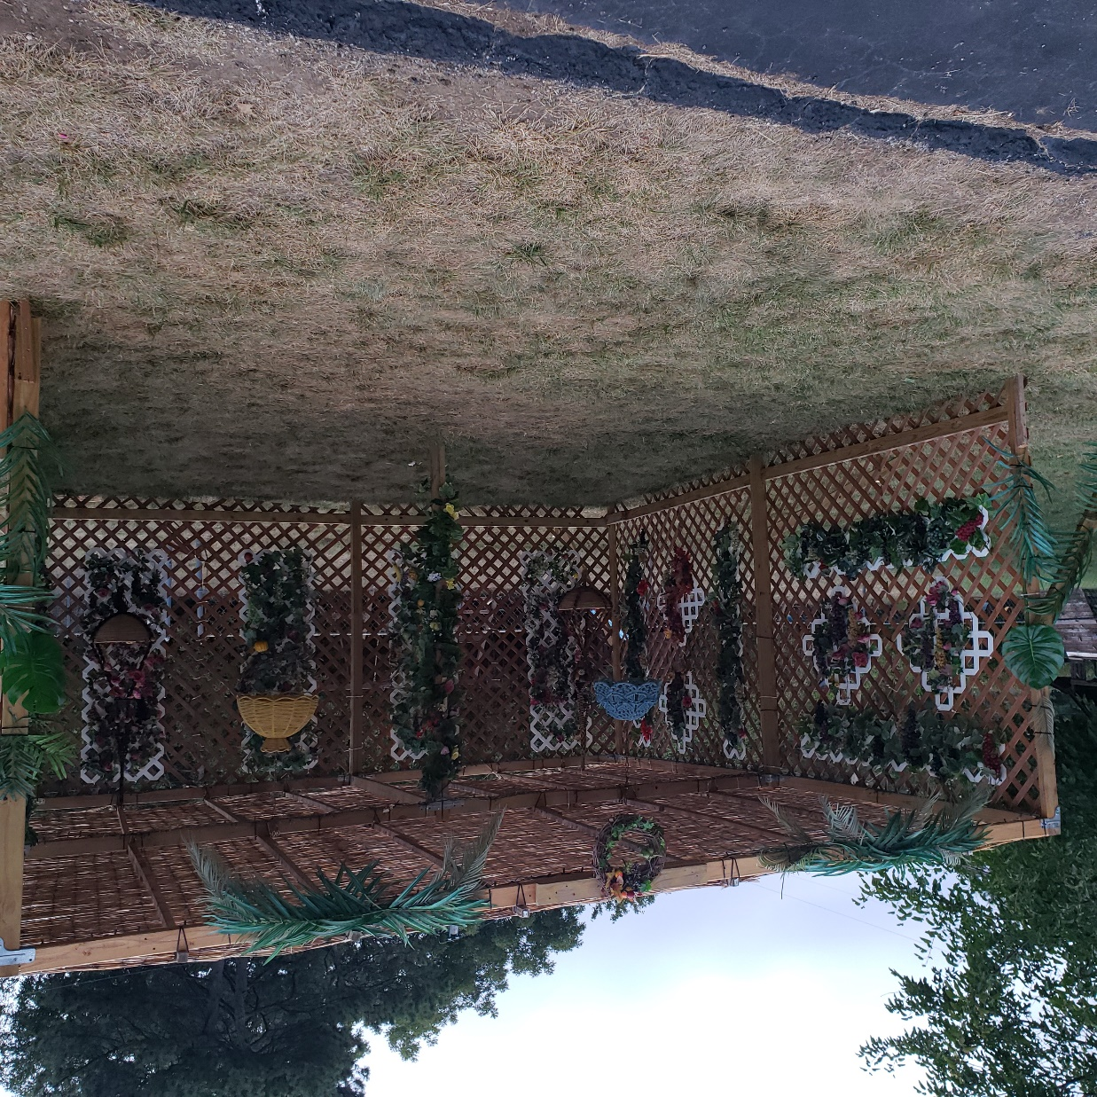
Or HaOlam Sukkah 2023

Slide 6
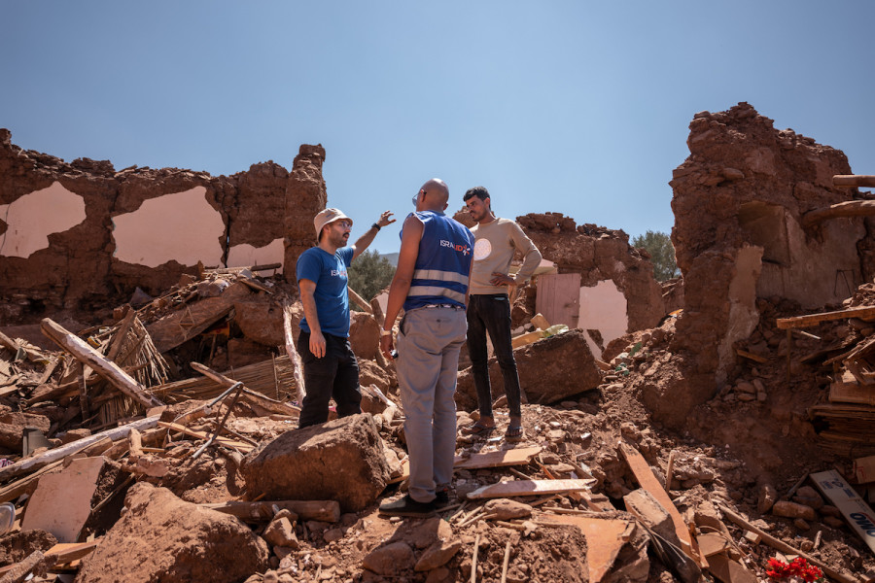
IsraAid team in Morocco following
the earthquake Sept. 2023
(Photo: IsraAid/Facebook)
Notes:
https://allisrael.com/israaid-fulfills-divine-calling-to-bless-the-nations-provides-essential-support-following-natural-disasters-worldwide

Slide 7
Astronomy news for Oct. 14, 2023
Notes:
https://www.theepochtimes.com/_next/image?url=https://img.theepochtimes.com/assets/uploads/2023/08/29/id5482849-34534456t45-eclipse-solar-43567-567.jpg&w=1200&q=75

Slide 8
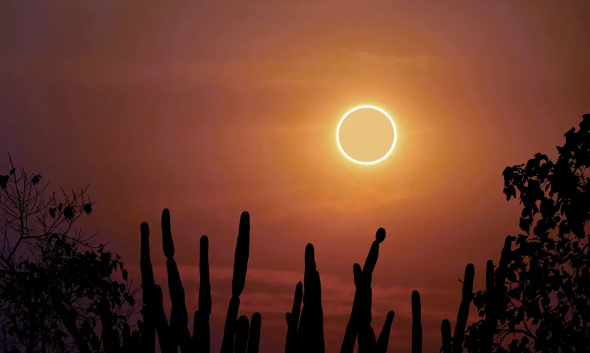
A full annular solar eclipse viewed above
cacti in a desert region.
(Darkfoxelixir/Shutterstock)

Slide 9
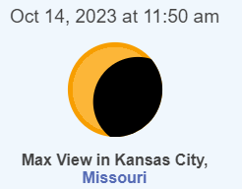
Partial annular eclipse
Notes:
I will be away, but hopefully, Baruch Burt will let you out at noon to view. Need eclipse lenses.

Slide 10
Notes:
https://www.timeanddate.com/eclipse/in/usa/kansas-city?iso=20231014
Video at 500x speed

Slide 12
Today is called Shabbat Shuva
What is Shabbat Shuva?
Why is Shabbat Shuva?
Hannah’s story of mockery for barrenness
Hannah’s miraculous fruitfulness

Slide 13
Today is called Shabbat Shuva
What is Shabbat Shuva?
Why is Shabbat Shuva?
Hannah’s story of mockery for barrenness
Hannah’s miraculous fruitfulness

Slide 14
What Is Shabbat Shuvah? שׁוּבָה
The Shabbat between
Rosh Hashanah [the day of loud sounds], and
Yom Kippur [day of Atonement]
emphasizes themes of return and repentance.
Summary of Rosh HaShanah:
Notes:
https://www.myjewishlearning.com/article/shabbat-shuvah/

Slide 15
Leviticus 25:9; Jubilee LIBERTY
Hosea 5:8; War, invaders
Psalm 81:3-4 Joyful celebration
2 Shmuel 6:15 Victory celebration
Ezra 3:11; Joyful celebration
Job 8:21; Spiritual joy
Psalm 27:6 Victory over foes

Slide 16
שׁוּבָה shuva
Rest, tranquility, calmness, peacefulness, quiet
תְּשׁוּבָה t’shuva
answer, reply, solution, retort, return, repentance
Shabbat of Repentance
Notes:
Hebrew is low on vocabulary, so each word has nuanced meanings, according to the context.

Slide 17
Historically, Shabbat Shuvah was also a time when the rabbi of the community would present a special sermon to the congregation. In previous eras a rabbi’s sermon was expected only twice a year: on Shabbat Shuvah and on Shabbat Hagadol, the Shabbat just prior to Passover.
Notes:
Sermons on Shabbat Shuvah traditionally focus on themes of repentance, prayer, and charity.
https://www.myjewishlearning.com/article/shabbat-shuvah/

Slide 18
Today is called Shabbat Shuva
What is Shabbat Shuva?
Why is Shabbat Shuva?
Hannah’s story of mockery for barrenness
Hannah’s miraculous fruitfulness

Slide 19
Return and repentance.
Why do we still need to repent?
^{1 Yn 1.8-10} If we claim not to have sin, we are deceiving ourselves, and the truth is not in us. If we acknowledge our sins, then, since he is trustworthy and just,
Notes:
I thought I already did that!

Slide 20
^{1 Yn 1.8-10} he will forgive them and purify us from all wrongdoing. If we claim we have not been sinning, we are making him out to be a liar, and his Word is not in us.
Notes:
So, there is more to deal with. Moreover…

Slide 21
In the book of Yoel, the people of Israel were facing a dreadful calamity by locusts and caterpillars, and drought. Considered a severe judgement of G-d.
Are we facing judgement?
Notes:
Traditionally read on this day.
Were there righteous in this population in Israel? Still included in the calamity of judgement.

Slide 22
Notes:
http://joshstreetdesign.com/wp-content/uploads/2015/09/Joel-Prophet-Image.jpg

Slide 23
^{Yoel 2.15-18} Blow the shofar in Tziyon! Proclaim a holy fast, call for a solemn assembly.” ₁Gather the people; ₂consecrate the congregation; ₃assemble the leaders; ₄gather the children, ₅even infants sucking at the breast; ₆let the bridegroom leave his room and the bride the bridal chamber.
Notes:
7 groups called to gather!

Slide 24
^{Yoel 2.15-18} ₇Let the cohanim, who serve Adoni, stand weeping between the vestibule and the altar. Let them say, “Spare your people, Adoni! Don’t expose your heritage to mockery, or make them a byward among the Goyim.

Slide 25
^{Yoel 2.15-18} Why should the peoples say, ‘Where is their God?’” Then Adoni will become jealous for his land and have pity on his people. Here is how Adoni will answer his people: “I will send you grain, wine and olive oil, enough to satisfy you.”
Notes:
Are we facing the world that challenges our validity? Where is your G-d?

Slide 26
But what about the righteous remnant?
^{Song of Songs 6.10} Who is this that appears like dawn? As beautiful as the moon, bright as the sun, formidable as an army with banners.
“As beautiful as the moon.” ??
Notes:
When I consider this Kehilah, this congregation, it is beautiful. The worship, dance, creativity in Chilren’s Ed., in the Sukkah building and decoration, food, fellowship, BEAUTIFUL!!

Slide 27
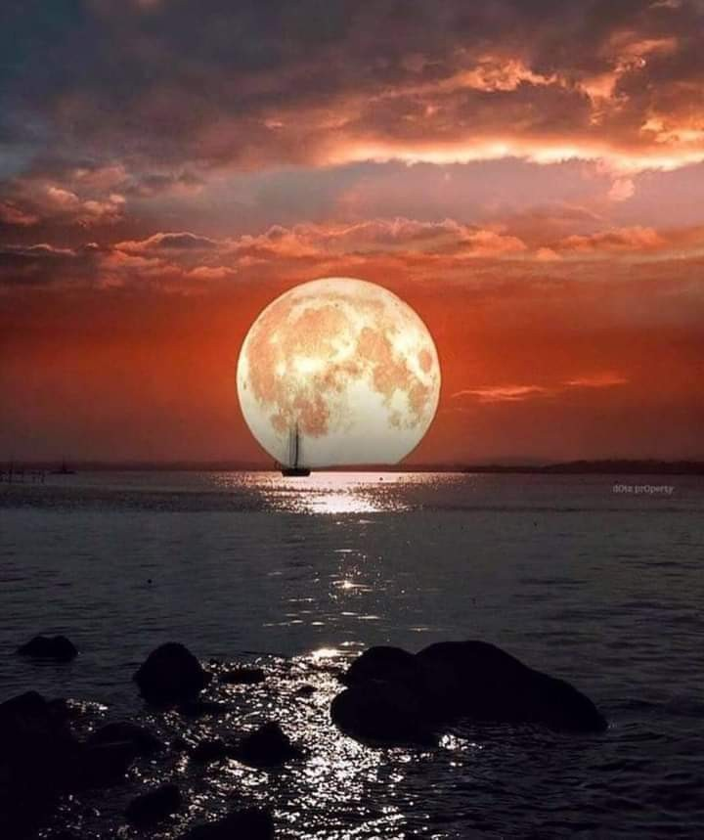
Notes:
https://external-content.duckduckgo.com/iu/?u=https%3A%2F%2Fleilaworldblog.files.wordpress.com%2F2021%2F06%2Ffb_img_16232456851771015290655659934290.jpg&f=1&nofb=1&ipt=10d785efe5b4233a85120af08d9c6933ecda8028a19e9e536c895ab36703ee7c&ipo=images

Slide 28
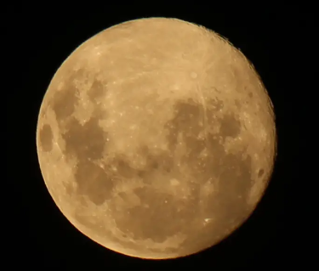
Notes:
https://external-content.duckduckgo.com/iu/?u=https%3A%2F%2Ftakashionary.com%2Fwp-content%2Fuploads%2F2020%2F04%2FIMG_9069-copy.jpg&f=1&nofb=1&ipt=e0517a3dfd1ec82f34f7611a7b6dc7446ec53cb4a7c159cb0f62863c9a5883d3&ipo=images

Slide 29
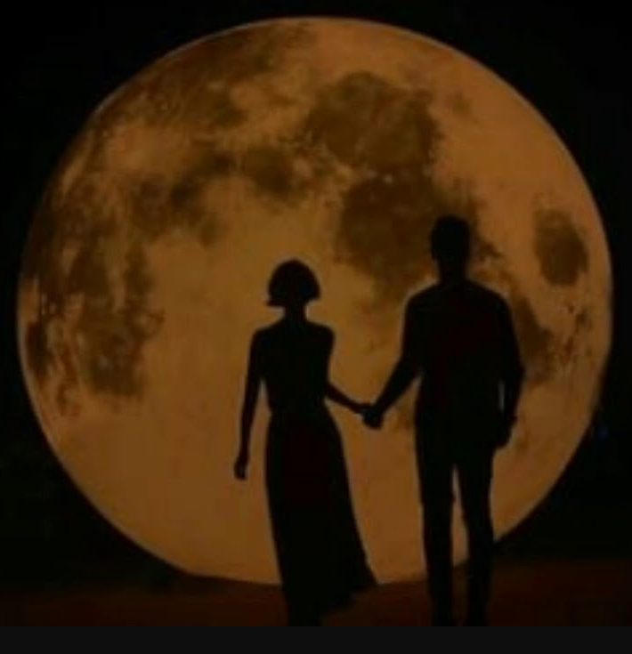
Notes:
Jonathan Cahn Book of Mysteries p 169
https://i.ytimg.com/vi/YYeHdpdjoeg/maxresdefault.jpg

Slide 30
^{2 Cor. 3.18} But we all, with unveiled face beholding as in a mirror the glory of the Lord, are being transformed into the same image from glory to glory—just as from the Lord, who is the Spirit.
Notes:
Not our beauty, but His.
You have lunar like beauty!! I won’t call you Moonies, that has another meaning.

Slide 31
Why do we still need to repent?
Our personal shortcomings, hurting others. Commission
Our lack of fruitfulness. Omission
Notes:
~Craters on the moon.
Yet not unappreciative of all the great good in Messiah.

Slide 32
Why are we here?
Notes:
Because we are not all there.

Slide 33
Why are we here?
^{Yn 15. 16-18} You did not choose me, I chose you; and I have commissioned you ₁to go and bear fruit, fruit that will last; ₂so that whatever you ask from the Father in my name he may give you. This is what I command you: ₃keep loving each other! ₄“If the world hates you, understand that it hated me first.
Chosen: Fruit, prayer, love, opposition
Notes:
“I chose this life, community, spouse, occupation…because I like the food, the music, the teaching/doctrine.” All good things.

Slide 34
Fruit of the Spirit: do people see? ^{Gal 5.22-25} But the fruit of the Ruakh is love, joy, peace, patience, kindness, goodness, faithfulness, gentleness, and self-control—against such things there is no law. Now those who belong to Messiah have crucified the flesh with its passions and desires.
Notes:
Like the moon with it’s marks, scars, craters, meteor hits, the best of us at our best, could be better.

Slide 35
1. Fruit of the Spirit: do people see? ^{Gal 5.22-25} If we live by the Ruakh, let us also walk by the Ruakh. Let us not become conceited—provoking one another, envying one another.
Notes:
Is it evident in your life to yourself and to others. Singing in your heart,
My beloved is mine, and I am His.
דודי לי ואני לו
Dodi li, va-ani lo.

Slide 36
Fruit: participate effectively in winning people to life and love in Yeshua. Jewish people first, and all nations.
Notes:
Again, deep caveat, qualification of this. You ARE serving Adoni elegantly. Moreover, So many great heroes in the believing world have failed, and congregations have gone down, that it’s a GREAT thing that we are persevering.
Ravi Zacharias, Bill Gothard my heroes. Nevertheless, we are urged to build, grow, expand.
Story of Hannah. Doing everything right, yet childless.

Slide 37
Today is called Shabbat Shuva
What is Shabbat Shuva?
Why is Shabbat Shuva?
Hannah’s story of mockery for barrenness
Hannah’s miraculous fruitfulness

Slide 38
^{1 Shmuel 1.4-6} One day, when Elkanah was sacrificing, he gave a portion of the sacrifice to his wife P’ninah and portions to each of her sons and daughters; but to Hannah he gave a double portion, because he loved Hannah, even though Adoni had kept her from having children. Her rival taunted her and made her feel bad, because Adoni had kept her from having children

Slide 39
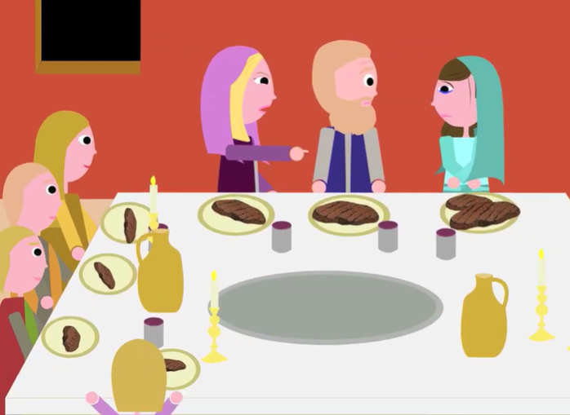
Notes:
Hannah with the double portion of love from Elkanah, yet mockery from Peninah.
[All artwork from website of R David Fohrman]

Slide 40
Is the world taunting us, believers in Messiah, for barrenness?
Plans of “salvation” of the world, with no regard to Biblical world view.
Notes:
World considers us ineffective to transform the world, the culture?

Slide 41
C40 is a global network of nearly 100 mayors of the world’s leading cities that are united in action to confront the climate crisis.
Notes:
https://frontline.news/post/alarm-grows-over-major-climate-proposal-to-slash-flights-food-clothing
Is there really a climate crisis?

Slide 42
Participating cities include Los Angeles, New York City, Washington DC, Dubai, Mumbai, Barcelona, Paris, London, Tel Aviv, Beijing, Cape Town, Tokyo, Sydney, and others.
Notes:
https://frontline.news/post/alarm-grows-over-major-climate-proposal-to-slash-flights-food-clothing

Slide 43
Backed by the UK government, Google, the World Bank, George Soros’ Open Society Foundations, and many other entities.
Alarm grows over major climate proposal to slash flights, food, clothing:
Notes:
https://frontline.news/post/alarm-grows-over-major-climate-proposal-to-slash-flights-food-clothing

Slide 44
a meal plan for taxpayers called the Planetary Health Diet. The diet is limited to 2,500 calories a day and is mostly plant based, with 50% fruits and vegetables and 50% other foods such as whole grains, plant-based protein, legumes, nuts, and small amounts of animal-sourced protein.
Notes:
https://frontline.news/post/alarm-grows-over-major-climate-proposal-to-slash-flights-food-clothing

Slide 45
limiting taxpayers to one flight every two years
reducing the consumption of clothing and textiles by 39% by 2030, which tallies to eight new garments a year.
Notes:
https://frontline.news/post/alarm-grows-over-major-climate-proposal-to-slash-flights-food-clothing

Slide 46
By 2050, however, the C40 intends for there to be no dairy or meat consumption at all.
The UK…plans to outlaw fuel-powered vehicles by 2030.
Is our culture thriving as it is?
Notes:
https://frontline.news/post/alarm-grows-over-major-climate-proposal-to-slash-flights-food-clothing

Slide 47
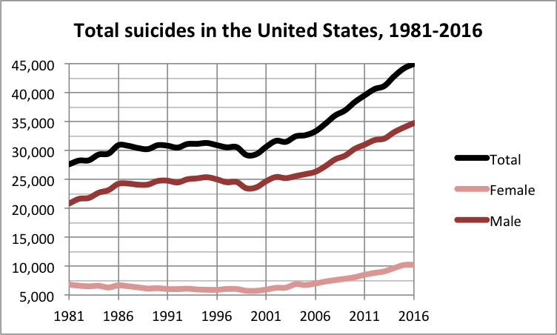
49,500 in 2022
Notes:
https://en.wikipedia.org/wiki/Suicide_in_the_United_States
In 2022, around 49,500 people died by suicide according to the CDC, which is the highest number ever recorded

Slide 48
On average, adjusted for age, the annual U.S. suicide rate increased 30% between 2000 and 2020, from 10.4 to 13.5 suicides per 100,000 people
Notes:
https://en.wikipedia.org/wiki/Suicide_in_the_United_States

Slide 49
Our republic is being undermined by the 1619 Project and Critical Race Theory.
David Horowitz was on Dr. Dobson’s program this week:

Slide 50
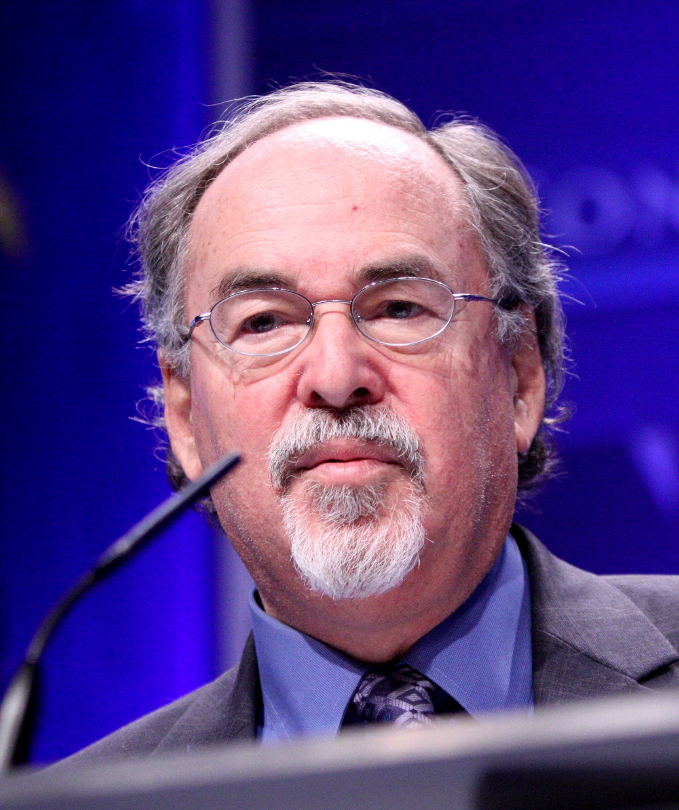
From 1956 to 1975, David Horowitz was an outspoken adherent of the New Left. He later rejected progressive ideas and became a defender of neoconservatism.
Notes:
https://upload.wikimedia.org/wikipedia/commons/thumb/e/ed/David_Horowitz_by_Gage_Skidmore.jpg/220px-David_Horowitz_by_Gage_Skidmore.jpg
Jewish agnostic. Raised by communist parents, David Horowitz was once a strong voice for the American Left in the 1960s. But after awakening to the evil it was doing, this Jewish writer went on to embrace American exceptionalism, birthed from Protestant Christianity.

Slide 51
Free speech, freedom of expression, freedom of conscience, these are all Biblical ideas and they're Protestant ideas. America is a product of the Protestant Reformation.
Notes:
https://www.drjamesdobson.org/broadcasts/dark-agenda-the-war-to-destroy-christian-america-part-1

Slide 52
It could not have been founded by any other religion, including and especially, atheism. Until the reformation, or before the reformation, you couldn't get to heaven except by going through the Catholic Church and its priesthood.
Notes:
https://www.drjamesdobson.org/broadcasts/dark-agenda-the-war-to-destroy-christian-america-part-1

Slide 53
But the Catholic Church, like every church, is a human institution. Therefore, it’s subject to human corruptions. So the Protestants came up with this idea of the priesthood of all believers, and that is the idea from which America was created.
Notes:
https://www.drjamesdobson.org/broadcasts/dark-agenda-the-war-to-destroy-christian-america-part-1

Slide 54
Think about it for a moment. The idea of the priesthood of all believers is that everybody is on an equal footing, in terms of confronting their creator one-on-one without the intermediary of a church or a priest.
Notes:
https://www.drjamesdobson.org/broadcasts/dark-agenda-the-war-to-destroy-christian-america-part-1

Slide 55
The priesthood of all believers includes Black slaves, and that's why America was a pioneer in freeing the slaves.
But our principles are being denied and mocked.
Notes:
https://www.drjamesdobson.org/broadcasts/dark-agenda-the-war-to-destroy-christian-america-part-1

Slide 56
Notes:
You’re childless, no future to your ways.

Slide 57
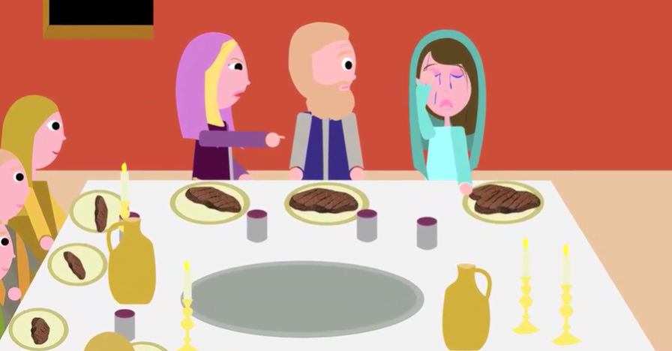
Notes:
Hannah couldn’t eat for grief at her barrenness. She was a good wife, a sweet woman, apparently GREATLY loved by her husband Elkanah with a double portion. Fair as the moon to him. But barren. Craters of failure.

Slide 58
^{1 Shmuel 1.10-12} In deep depression she prayed to Adoni and cried. Then she took a vow; she said, “Adoni -Tzva’ot, if you will notice how humiliated your servant is, if you will remember me and not forget your servant but will give your servant a male child,

Slide 59
^{1 Shmuel 1.10-12} then I will give him to Adoni for as long as he lives; and no razor will ever come on his head.” She prayed for a long time before Adoni;

Slide 60
^{1 Shmuel 1.12-16} and as she did so, ‘Eli was watching her mouth. Hannah was speaking in her heart — her lips moved, but her voice could not be heard — so ‘Eli thought she was drunk. ‘Eli said to her, “How long are you going to stay drunk? Stop drinking your wine!” But Hannah answered,

Slide 61
Notes:
https://www.alephbeta.org/playlist/how-to-get-closer-to-god
Rabbi David Fohrman

Slide 62
^{1 Shmuel 1.12-16} “No, my lord, I am a very unhappy woman. I have not drunk either wine or other strong liquor; rather, I’ve been pouring out my soul before Adoni. Don’t think of your servant as a worthless woman; because I have been speaking from the depth of my distress and anger.”
Notes:
Worthless woman Bat Belial בת בליעל
https://www.alephbeta.org/playlist/how-to-get-closer-to-god

Slide 63
Notes:
Without yoke = out of control, not serving, not caring. She was exemplary, but barren. We are in many ways exemplary, but barren. Fair as the moon, but cratered, deficiencies.
https://www.alephbeta.org/playlist/how-to-get-closer-to-god

Slide 64
Today is called Shabbat Shuva
What is Shabbat Shuva?
Why is Shabbat Shuva?
Hannah’s story of mockery for barrenness
Hannah’s miraculous fruitfulness

Slide 65
^{1 Sam 1.17-18} Then ‘Eli replied, “Go in peace. May the God of Isra’el grant what you have asked of him.” She replied, “May your servant find favor in your sight.” So the woman went on her way, and she ate, and her face was no longer sad.
Notes:
Blessed of the cohen ~ word of G-d. Lifted her spirits, that her prayer was received. Ever get that sense “That was a good prayer. Received.”

Slide 66
^{1 Sam 1.119-20} Adoni remembered her. She conceived; and in due time she gave birth to a son, whom she named Sh’mu’el, “because I asked Adoni for him.”
Hannah eventually presented Shmuel to Eli to serve in the Mishkan/ Tabernacle.

Slide 67
^{2 Shmuel 2.21} So Adoni took notice of Hannah, and she conceived and bore three more sons and two daughters. Meanwhile, the boy Sh’mu’el grew in the presence of Adoni.
Great story: exemplary life, but reproach, distress, intercession, supernatural answer with unexpected abundance!
Notes:
She got far more than she prayed for!!

Slide 68
^{Yoel 2.15-18} Why should the peoples say, ‘Where is their God?’” Then Adoni will become jealous for his land and have pity on his people. Here is how Adoni will answer his people: “I will send you grain, wine and olive oil, enough to satisfy you.”
Notes:
Fiji and the coral reefs restored.
Tekhelet mollusk restored.

Slide 69
^{Yn 15. 16-18} You did not choose me, I chose you; and I have commissioned you to go and bear fruit, fruit that will last; so that whatever you ask from the Father in my name he may give you. This is what I command you: keep loving each other! “If the world hates you, understand that it hated me first.
Chosen: Fruit, prayer, love, opposition

Slide 70
Is it still possible?
U.S. congregations, universities, and the army say “revival fires” have broken out across the United States, with many turning to faith in the Messiah and impromptu massive immersion services.
Notes:
https://www.worthynews.com/88501-revival-fires-reported-across-us-worthy-news-in-depth

Slide 71
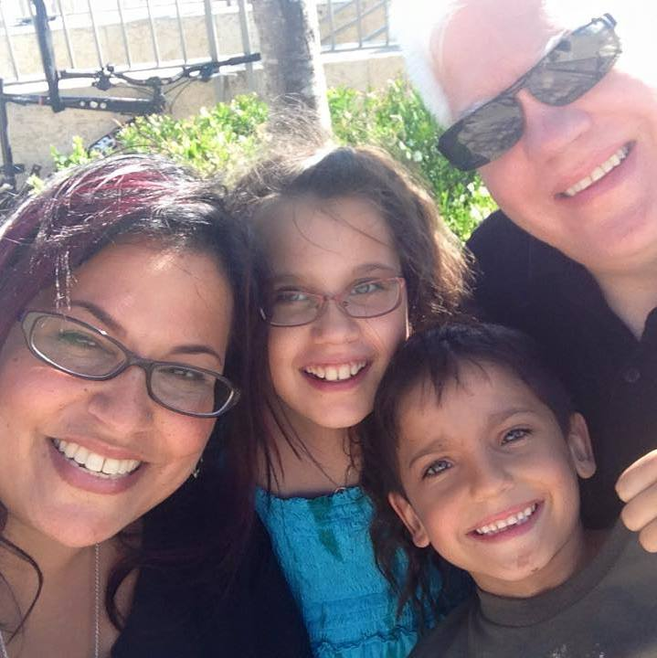
George and Bat Rivka Whitten. He is founder and director of Worthy News.
Notes:
Rivka has visited and sung her multiple times, and George preached here, and built out our livestream equipment, which was subsequently upgraded by Steve Kline and others.
https://www.worthynews.com/88501-revival-fires-reported-across-us-worthy-news-in-depth

Slide 72
Lead Pastor Bruce Frank, of the Biltmore Congregation in Arden, NC said on social media that it was an “Awesome day as we saw 282 people profess faith in Messiah through baptism.” They scheduled 3 people, but another 279 came forward.
Notes:
https://www.worthynews.com/88501-revival-fires-reported-across-us-worthy-news-in-depth

Slide 73
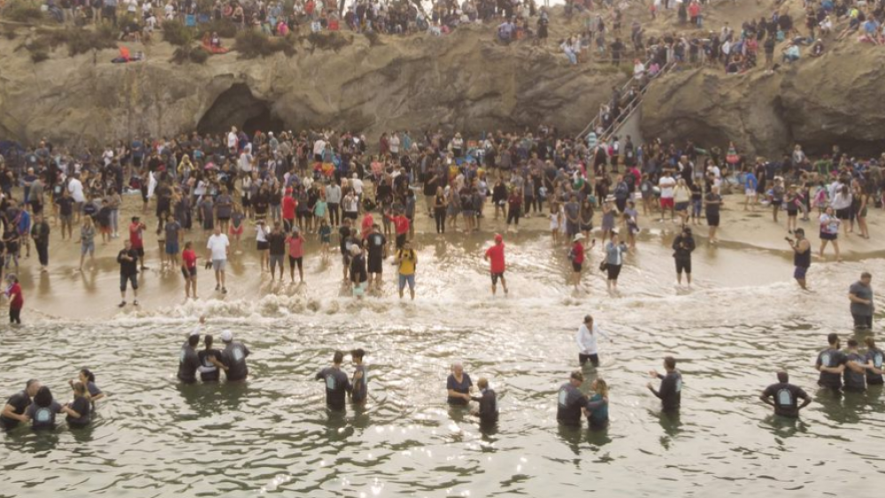
Pirate’s Cove Immersions in the
Yeshua Revolution
Notes:
https://external-content.duckduckgo.com/iu/?u=https%3A%2F%2Fwww.faithwire.com%2Fwp-content%2Fuploads%2F2020%2F09%2Fcalvarychurch.png&f=1&nofb=1&ipt=1bdab1241640ce315ab173c5c8e3edad0754a33a257273fa88719f6539fc66ab&ipo=images

Slide 74
Later a scene where about a dozen kids came unannounced from Texas to Pirate’s Cove to be immersed. Greg Laurie was there.
~1970 Rob A. from Harvard U in Boston. One Wednesday night to Schenectady PHC prayer meeting! Felt the PRESENCE.
Notes:
Transformative immersion?
Chuck L and Pam shared with him about salvation in Harvard dorm.

Slide 75
2. Auburn University in Alabama Neville Arena hosted a massive crowd late Tuesday night, September 12, 2023 for the “Unite Auburn” in Messiah event. What started with one student wanting to be baptized grew to hundreds who decided to express their faith through baptism, according to witness accounts.
Notes:
https://www.worthynews.com/88501-revival-fires-reported-across-us-worthy-news-in-depth
More than 5,000 people showed up to Unite Auburn’s “Night of Worship,” according to CBN estimates.

Slide 76
There wasn’t a tub available to baptize the students, so thousands of people headed over to a ‘lake’ at Auburn’s Red Barn. “People surrounded the lake ’til almost midnight, hearing the stories of life change and shouting and cheering and praying together. God is moving, and He isn’t stopping.”
Notes:
https://www.worthynews.com/88501-revival-fires-reported-across-us-worthy-news-in-depth

Slide 77
3. In August, New Life Congregation in the Texas state city of Corpus Christi, held its annual outreach gathering. One thousand students attended, and 124 made professions of faith and were baptized. “We are seeing these people repent from
Notes:
https://www.worthynews.com/88501-revival-fires-reported-across-us-worthy-news-in-depth
Alabama, North Carolina, this illustration Texas

Slide 78
compromise and make a decision to make a public declaration of, ‘No, I want to give my whole life to Messiah starting today.’ And then we see them radically transformed.”
Notes:
https://www.worthynews.com/88501-revival-fires-reported-across-us-worthy-news-in-depth

Slide 79
4. And the “revival fires” are spreading to the U.S. Army, too, according to believers involved in the events. A U.S. Army chaplain said he recently baptized more than 150 soldiers during summer basic training in the U.S. state of Missouri, saying it was a “joy to see” God move among new trainees.
Notes:
https://www.worthynews.com/88501-revival-fires-reported-across-us-worthy-news-in-depth

Slide 80
Chaplain Logan Lair said he had been serving at basic training camps since 2019 but saw recently “a move of God’s Spirit” among trainees at Fort Leonard Wood, Missouri, that brought him to tears – almost daily.
Notes:
https://www.worthynews.com/88501-revival-fires-reported-across-us-worthy-news-in-depth

Slide 81
5+. Researchers say these are just a few examples of a broader trend among evangelicals in the country.
Notes:
https://www.worthynews.com/88501-revival-fires-reported-across-us-worthy-news-in-depth
Remember, this is not a flaky report. George Whitten. Possible here? With Jews, and the Nations?

Slide 82
^{Yoel 2.15-18} Blow the shofar in Tziyon! Proclaim a holy fast, call for a solemn assembly.” ₁Gather the people; ₂consecrate the congregation; ₃assemble the leaders; ₄gather the children, ₅even infants sucking at the breast; ₆let the bridegroom leave his room and the bride the bridal chamber.

Slide 83
^{Yoel 2.15-18} Let the cohanim, who serve Adoni, stand weeping between the vestibule and the altar. Let them say, “Spare your people, Adoni! Don’t expose your heritage to mockery, or make them a byward among the Goyim.
Notes:
Call to prayer for mercy on our heart, families, US population of Jews and the Nations!

Slide 84
^{Yoel 2.15-18} Why should the peoples say, ‘Where is their God?’” Then Adoni will become jealous for his land and have pity on his people. Here is how Adoni will answer his people: “I will send you grain, wine and olive oil, enough to satisfy you.”
Notes:
Fiji
Tekhelet

Slide 85
^{Yn 15. 16-18} You did not choose me, I chose you; and I have commissioned you ₁to go and bear fruit, fruit that will last; ₂so that whatever you ask from the Father in my name he may give you. This is what I command you: ₃keep loving each other! ₄“If the world hates you, understand that it hated me first.
Chosen: Fruit, prayer, love, opposition
Notes:
We considered increased fruit, Spirit and outreach.
Next consider our prayer, asking, keep on asking, receiving. Increased attendance last Tuesday Teerosh. No Teerosh this week. Day after YK. But next week!
Yeshua makes a special point about love, loving each other. “I get annoyed, irritated.”
The world’s opposition. We don’t have to work on that one, but just be prepared to receive.

Slide 86
A great example of repentance

Slide 87
Ffyona Campbell (born 1967 in Totnes, Devon) is an English long distance walker who walked around the world between 1983 and 1995. She covered 20,000 mi over 11 years and raised £180,000 for charity. She wrote about her experience in a series of three books.
Notes:
https://en.wikipedia.org/wiki/Ffyona_Campbell
$221,000 US dollars

Slide 88
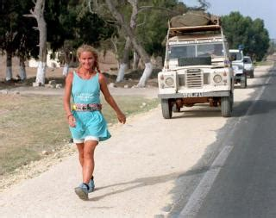
Notes:
https://external-content.duckduckgo.com/iu/?u=https%3A%2F%2Fpictures.abebooks.com%2Fisbn%2F9781857979466-es.jpg&f=1&nofb=1&ipt=d67c452f3931b97997f1ab96a152531aa83df779aa2f7bcd9e7c9cce898e33a2&ipo=images

Slide 89
She spent 11 years walking around the world. Her goal was to make it into the Guinness Book of Records. Her long journey came to an end in October of 1994 at the northern tip of Scotland before thousands of cheering fans.
Notes:
https://familytalk.widen.net/view/pdf/jy4opljbbo/09212023DARKAGENDATHEWARTODESTROYCHRISTIANAMERICA1.pdf?t.download=true&u=i21id9
Great and fulfilling day. Dr. Dobson majored on the emotional validation on that day that she sought.

Slide 90
But, her heart was heavy because she knew she had cheated. While walking across the United States, she became weary and accepted a ride for 1,000 miles. In the months to come, the shame of having cheated drove her to drugs and alcohol, she even considered suicide.
Notes:
https://familytalk.widen.net/view/pdf/jy4opljbbo/09212023DARKAGENDATHEWARTODESTROYCHRISTIANAMERICA1.pdf?t.download=true&u=i21id9

Slide 91
Campbell said she rode in her support truck for the leg between Indianapolis and Fort Summer, N.M.
"I got into the back of the vehicle and drove ahead and didn't drive back to continue walking properly," she said.
She completed her walk in Scotland to cheering crowds in 1994. "They were walking beside me as a role model. They were respecting me. To them I owe the biggest apology."
Notes:
https://www.deseret.com/1996/11/3/19286463/woman-admits-cheating-on-global-walk

Slide 92
To appease her conscience, she made the trip to America and finished the 1,000-mile stretch in secret, but even that didn't help. So she called the Guinness Office and asked that her name be removed from the record book, and then she publicly apologized.
Notes:
https://familytalk.widen.net/view/pdf/jy4opljbbo/09212023DARKAGENDATHEWARTODESTROYCHRISTIANAMERICA1.pdf?t.download=true&u=i21id9

Slide 93
The lesson Ffyona learned is a timeless one. It's possible to live without the admiration of others, what we can't live without is self-respect. One more thought, isn't it interesting that Ffyona is most respected for having the courage
to admit her mistake and make it right?
Notes:
https://familytalk.widen.net/view/pdf/jy4opljbbo/09212023DARKAGENDATHEWARTODESTROYCHRISTIANAMERICA1.pdf?t.download=true&u=i21id9

Slide 94
Notes:
https://www.alephbeta.org/playlist/teshuvah-steps-to-repentance
Is 55.7
Jer 31.19
Hos. 14.3-4

Slide 95
^{Is 55.7} Let the wicked person abandon his way and the evil person his thoughts; let him return to Adonai, and he will have mercy on him; let him return to our God, for he will freely forgive.
Jer 31.19
Hos. 14.3-4

Slide 96
^{Jer 31.18} For after I was turned, I repented, and after that I was instructed, I struck my thigh— I was ashamed and also umiliated, for I bore the disgrace of my youth.’

Slide 97
^{Hos. 14.3-4} Take words with you, and return to Adoni; say to him, “Forgive all guilt,
and accept what is good;
we will pay instead of bulls
[the offerings of] our lips.

Slide 98
Can we cry out to G-d in Messiah in repentance over being lunar exemplary but…
Barrenness or minimal
Prayerlessness or minimal
Lovelessness or minimal
Hostility at persecution

Slide 100
Today is called Shabbat Shuva
What is Shabbat Shuva?
Why is Shabbat Shuva?
Hannah’s story of mockery for barrenness
Hannah’s miraculous fruitfulness

