Slide 1
e-handout
To have these notes
without taking notes
Go to OrHaOlam.com
Click on Messages tab,
2023 Messages

Slide 2
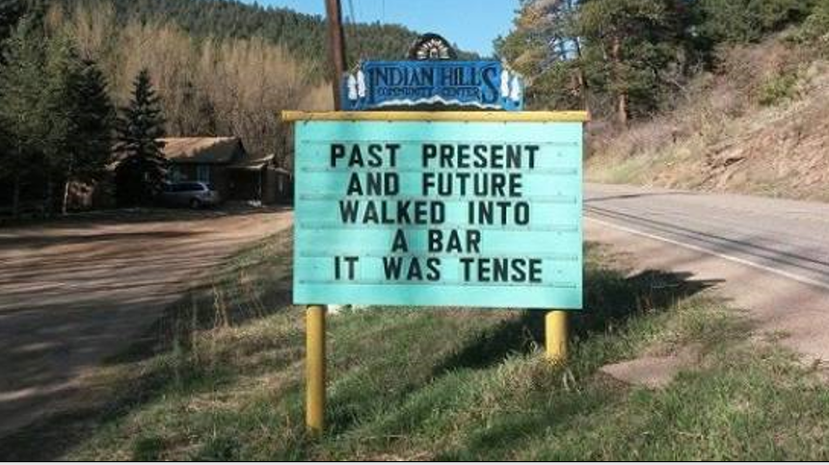
Notes:
https://izismile.com/2018/08/21/come_to_the_indian_hills_community_center_for_some_funny_signs_28_pics-6.html
Richard & Luann Ridgeway I think

Slide 3
Notes:
https://izismile.com/2018/08/21/come_to_the_indian_hills_community_center_for_some_funny_signs_28_pics-6.html
Richard & Luann Ridgeway I think

Slide 4
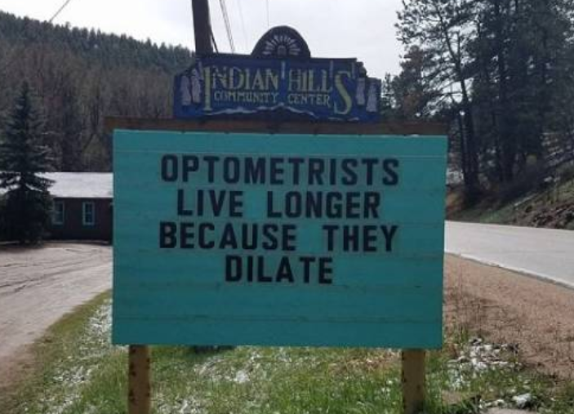
Notes:
https://izismile.com/2018/08/21/come_to_the_indian_hills_community_center_for_some_funny_signs_28_pics-6.html

Slide 5
Notes:
https://izismile.com/2018/08/21/come_to_the_indian_hills_community_center_for_some_funny_signs_28_pics-6.html

Slide 6
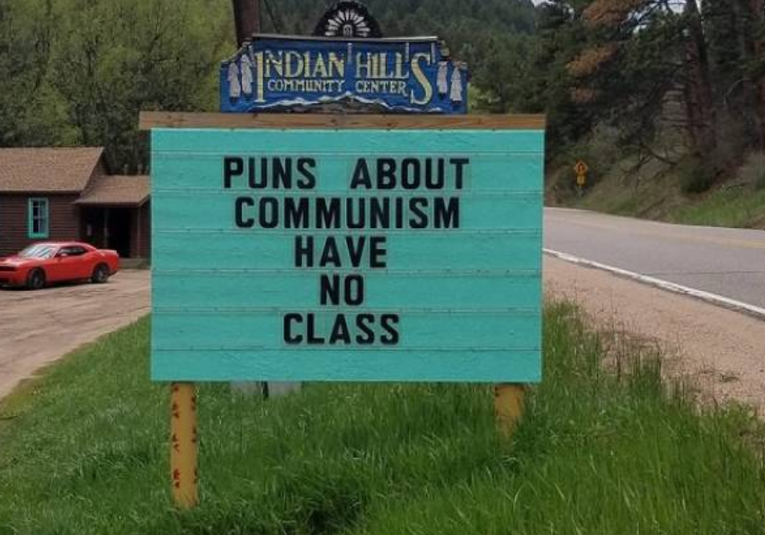
Notes:
https://izismile.com/2018/08/21/come_to_the_indian_hills_community_center_for_some_funny_signs_28_pics-6.html

Slide 7
Notes:
https://izismile.com/2018/08/21/come_to_the_indian_hills_community_center_for_some_funny_signs_28_pics-6.html

Slide 8
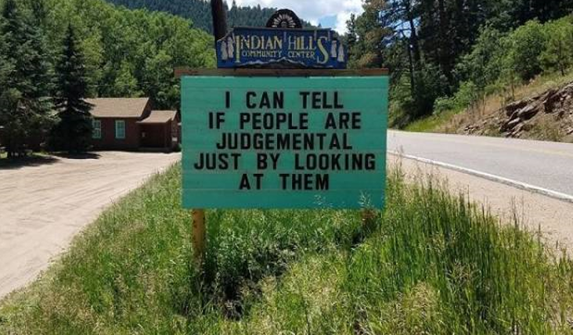
Notes:
https://izismile.com/2018/08/21/come_to_the_indian_hills_community_center_for_some_funny_signs_28_pics-6.html

Slide 9
Review Ephesians ch 1
Vss 1-6 He chose us in love
Vss 7-10 His secret plan
Vss 11-12 Inheritance of Love
Vss 13-14 Really Hearing Shma!
Vss 15-23 Power Working in Us The person next to you is your $10 million treasure!!
Notes:
~$10 million inheritance

Slide 10
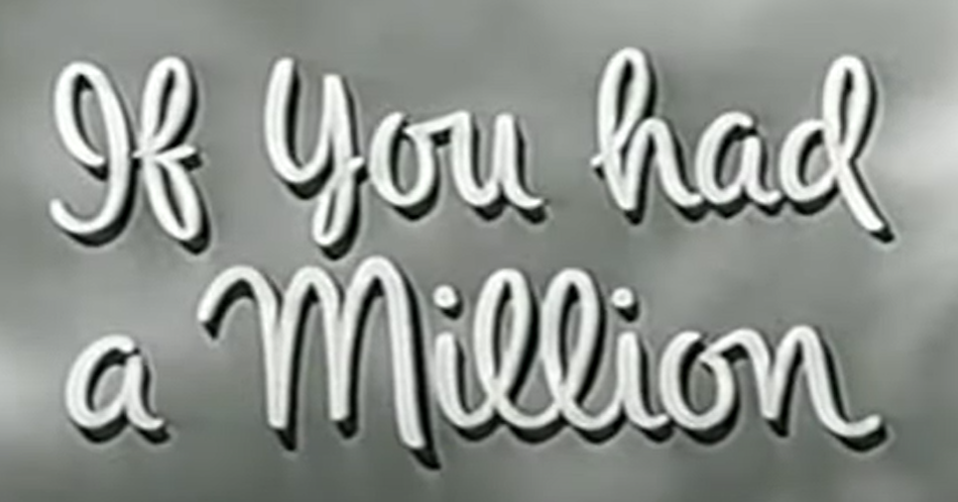
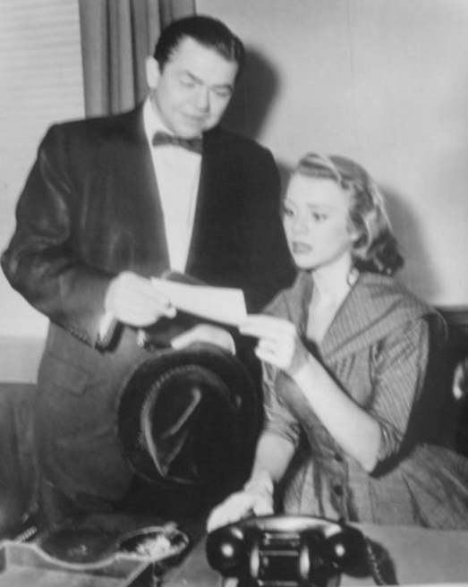
You have that million dollars in Messiah’s love.
Notes:
https://upload.wikimedia.org/wikipedia/commons/5/58/Millionaire_1956.JPG
The Millionaire is an American anthology series that aired on CBS from 1955 to 1960. It told the stories of people who were given one million dollars ($10.9 million in 2022 dollars) from a benefactor who insisted they must never know his identity.

Slide 11
The person next to you is also your $10 million treasure!!
Notes:
Today: Deeper into the history of true spiritual life.

Slide 12
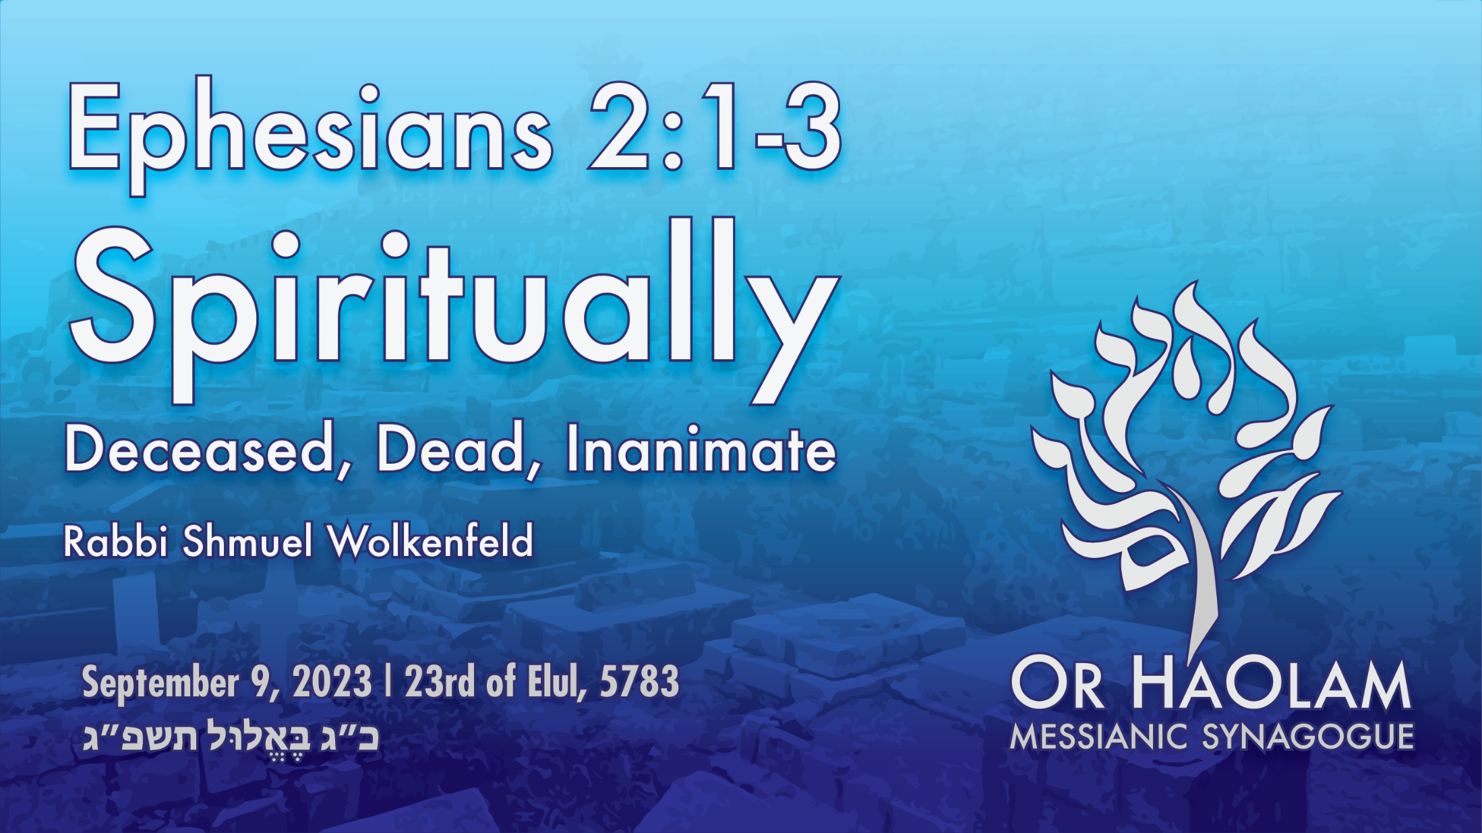

Slide 13
^{Ephesians 2.1-3} You were dead in your trespasses and sins. At that time, you walked in the way of this world, in conformity to the ruler of the domain of the air—the ruler of the spirit who is now operating in the sons of disobedience.
Notes:
Not me! Never dead, just needed a bit of help.

Slide 14
^{Ephesians 2.1-3} We too all lived among them in the cravings of our flesh, indulging the desires of the flesh and the mind. By nature we were children of wrath, just like the others.

Slide 15
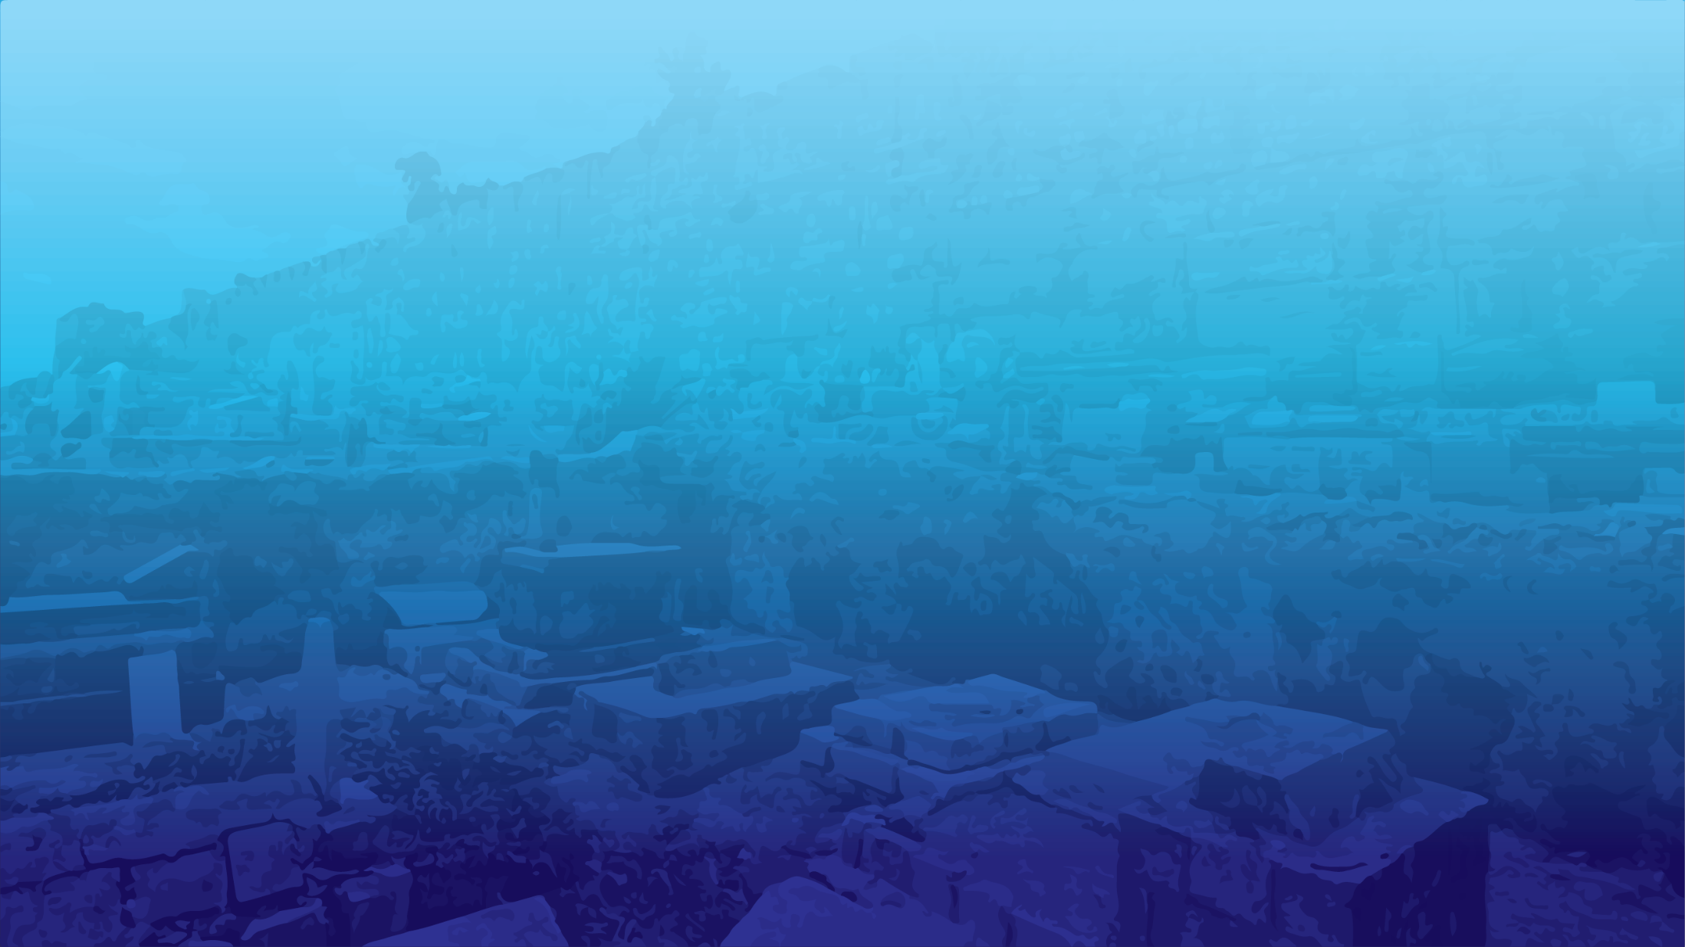
Spiritually Deceased, Dead,
Inanimate
We were dead
We were ruled by ha-satan
Includes Jewish people
Repentance of believers
Bringing life to the dead

Slide 16
Spiritually Deceased, Dead,
Inanimate
We were dead
We were ruled by ha-satan
Includes Jewish people
Repentance of believers
Bringing life to the dead

Slide 17
You were dead in your trespasses and sins.
Notes:
Not great way to flatter people and get on their good side. Win Friends and Influence People.
Key to spiritual understanding!
Not the typical Rabbinic view…

Slide 18
^{Ber /Gen 2.7} Then Adoni Elohim formed the man
וַיִּיצֶר יְיָ אֱלֹהִים אֶת-הָאָדָם
Va-yeetser Adoni Elohim
et ha-adam
וַיִּיצֶר

Slide 19
^{Ber /Gen 2.7} Then Adoni Elohim formed the man
וַיִּיצֶר יְיָ אֱלֹהִים אֶת-הָאָדָם
Va-yeetser Adoni Elohim
et ha-adam
וַיִּיצֶר
Notes:
Rabbinic Jewish theology sees in that extra yud the double formation of mankind: two natures
Yester hatov, good nature,
Yester ha ra, evil nature, and man has to chose.
Mankind choses to repair the world.
תכון עולם Tikun Olam.
But that is not the scriptural view. Some of us here?

Slide 20
^{Ber/Gen 2.17} But of the Tree of the Knowledge of Good and Evil you must not eat. For when you eat from it, you most assuredly will die!
כִּי, בְּיוֹם אֲכָלְךָ מִמֶּנּוּ--מוֹת תָּמוּת.

Slide 21
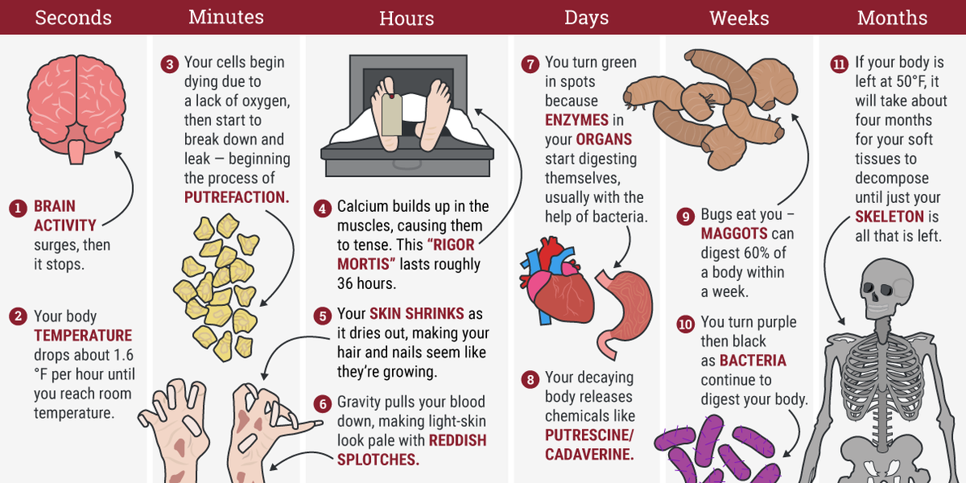
You were dead in your trespasses and sins.
Notes:
Brain activity surges, then stops praise
Temperature drops 1.6 deg/hr till room temp.love
Calcium builds up in muscles → rigor mortis rigid
Skin shrinks so hair and nails appear to grow
Gravity pulls blood down to reddish splotches
Enzymes in organs start to self digest
Chemicals putrescine, caderine
autolysis, or self-digestion. Soon after the heart stops beating, cells become deprived of oxygen, and their acidity increases as the toxic by-products of chemical reactions begin to accumulate inside them. Enzymes start to digest cell membranes and then leak out as the cells break down. This usually begins in the liver, which is rich in enzymes, and in the brain, which has high water content. Eventually, though, all other tissues and organs begin to break down in this way. Damaged blood cells begin to spill out of broken vessels and, aided by gravity, settle in the capillaries and small veins, discolouring the skin.

Slide 22
notes
Notes:
Most internal organs are devoid of microbes when we are alive. Soon after death, however, the immune system stops working, leaving them to spread throughout the body freely. This usually begins in the gut, at the junction between the small and large intestines. Left unchecked, our gut bacteria begin to digest the intestines – and then the surrounding tissues – from the inside out, using the chemical cocktail that leaks out of damaged cells as a food source. Then they invade the capillaries of the digestive system and lymph nodes, spreading first to the liver and spleen, then into the heart and brain.
All that was reversed on the third day!

Slide 23
You were dead in your trespasses and sins.
dead as to understanding, will, and affections, with respect to spiritual things,
and as to capacity to do any thing that is spiritually good;
Notes:
You might say, “I don’t like this idea. It’s hurting my pride. [Just the point] I’ve been a mighty believer for 50 years.”
If you never saw yourself as previously spiritually dead, and in fact without Yeshua’s continual help, hopelessly deceased, then your whole foundation is wrong, false, erroneous.
Like an airplane kept aloft by the aerodynamic lift on the wings. Spiritual lift is receiving moment by moment LIFE FROM THE DEAD!

Slide 24
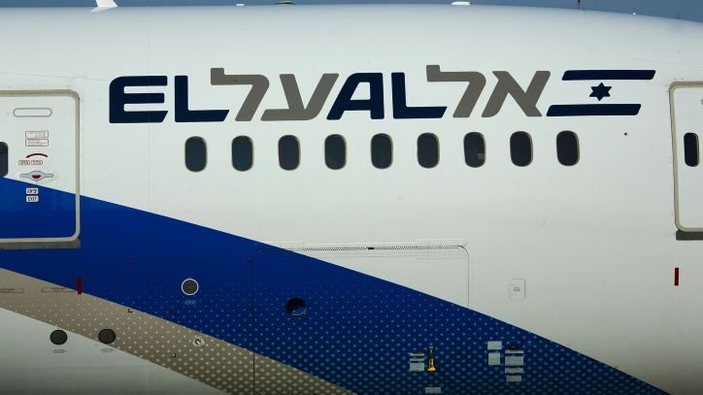
Notes:
https://www.israeltoday.co.il/read/el-als-spiritual-message/?mc_cid=45b4c88924&mc_eid=9f06d9f262

Slide 25
^{Hoshea 11.7} My people are hanging in suspense about returning to me; and though they call them upwards, nobody makes a move.
וְאֶל-עַל יִקְרָאֻהוּ
We MUST continually have Ruakh lift, or we sink back to death.
Notes:
https://www.israeltoday.co.il/read/el-als-spiritual-message/?mc_cid=45b4c88924&mc_eid=9f06d9f262

Slide 26
Notes:
https://www.israeltoday.co.il/read/el-als-spiritual-message/?mc_cid=45b4c88924&mc_eid=9f06d9f262
Important to see ourselves as helpless without Him to do anything really righteous

Slide 27
What about babies, and small children?
What about people without the new birth, can they do any good?

Slide 28
^{Mtt 19.13-14} Then little children were brought to Yeshua so that He might lay hands upon them and pray. Then the disciples rebuked those who brought them. But Yeshua said, “Let the little children come to Me and do not hinder them, for the kingdom of heaven belongs to such as these.”

Slide 29
^{Mt 18.10} “See that you do not despise one of these little ones, for I tell you that their angels in heaven continually see the face of My Father in heaven.

Slide 30
^{Mt 18.10} “See that you do not despise one of these little ones, for I tell you that their angels in heaven continually see the face of My Father in heaven.
Little children are intrinsically innocent and saved. How long, till what age?

Slide 31
^{Ro 7.9-10} I was once alive outside the framework of Torah. But when the commandment really encountered me, sin sprang to life, and I died.
Notes:
We all die spiritually when we come against a commandment, and sin. Maybe commandment from our parents, teachers. Pretty early.
How do kids figure out that they can lie, say something that is not true?
One wonderful family, the kids LOVE war and shoot ‘em up! Where learn that? Not necessarily sinful. I support the military. But there is a sadistic shoot ‘em up.

Slide 32

Notes:
They can do good works, but it’s still not LIFE.
Not bad people good, rather dead people alive.
Sadly, really born again believers, with this new life, don’t always live up to it!

Slide 33
Can people without the Spirit do anything good?
Some are nicer by nature than others are by grace.
^{Eph 4.31-32} Get rid of all bitterness and rage and anger and quarreling and slander, along with all malice. Instead, be kind to one another, compassionate, forgiving each other just as God in Messiah also forgave you.
Notes:
Talking to believers. I am desperately interested that everyone under the sound of my voice, both in this room and on the livestream, and those viewing us afterward, from Peguis Indian Reserve in Manitoba, to Sri Lanka, receive the L-rd, and be born again. Life from the dead
However, that is only the beginning. John Wesley talked about the repentance of believers. Can believers, born again, have bitterness, rage…

Slide 35
Spiritually Deceased, Dead,
Inanimate
We were dead
We were ruled by ha-satan
Includes Jewish people
Repentance of believers
Bringing life to the dead

Slide 36
^{Ephesians 2.1-3} You were dead in your trespasses and sins. At that time, you walked in the way of this world, in conformity to the ruler of the domain of the air—the ruler of the spirit who is now operating in the sons of disobedience.
Notes:
Some say Satan is a Christian invention, not a historic Jewish concept…

Slide 37
^{Iyov/Job 1.6-7} One day the sons of God came to present themselves before Adoni, and the satan [ha-satan הַשָּׂטָן ] also came with them. Adoni said to the satan, “Where have you come from?” The satan responded to Adoni and said, “From roaming the earth and from walking on it.

Slide 38
^{Zekh 3.1} The satan, standing at his right hand to accuse him.
וְהַשָּׂטָן עֹמֵד עַל-יְמִינוֹ לְשִׂטְנוֹ.
V’hasatan omed al y’mino l’sitno
Notes:
Noun and verb from the same root.

Slide 39
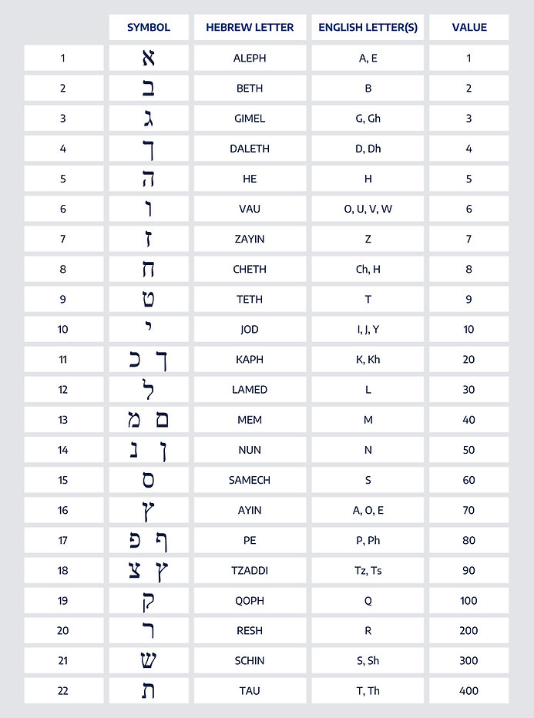
[not authoritative]
Gematria = numerology
The satan,הַשָּׂטָן
5+300+9+50=364
HaSatan can afflict us 364 days. Not Yom Kippur
Notes:
Principal antidote for HaSatan is study of Scripture, Torah.
Yeshua overcame Hasatan with quotes from D’varim, Dt.
Do you have scripture memorized at the ready?

Slide 40
^{Ephesians 2.1-3} You were dead in your trespasses and sins. At that time, you walked in the way of this world, in conformity to the ruler of the domain of the air—the ruler of the spirit who is now operating in the sons of disobedience.
^{Eph 4.27} Do not let the sun go down while you are still angry, and do not give the devil a foothold.
Notes:
Satan’s control:
habits you can’t break
Forgiveness, bitterness you just can’t release.
Desires just beyond reason, fashion, praise, pleasure, food, intoxicants, sex.

Slide 42
Spiritually Deceased, Dead,
Inanimate
We were dead
We were ruled by ha-satan
Includes Jewish people
Repentance of believers
Bringing life to the dead

Slide 43
^{Ephesians 2.1-3} We too all lived among them in the cravings of our flesh, indulging the desires of the flesh and the mind. By nature we were children of wrath, just like the others.
Notes:
Jewish people, Shaul Paul himself, [prototype of all religiously intense people] who lived fervently religious, are not exempt from this. Continuing from previously, if you have been a believer for decades, but no sense of needing Yeshua’s life from the dead every moment, then you are like others.
Paramount example is Paul/Shaul

Slide 44
^{Acts 22.3} “I am a Jew, born in Tarsus of Cilicia, but brought up in this city and trained at the feet of Gamli’el in every detail of the Torah of our forefathers. I was a zealot for God, as all of you are today.
Notes:
Sounds pretty good and holy.

Slide 45
^{Acts 23.1} Sha’ul looked straight at the Sanhedrin and said, “Brothers, I have been discharging my obligations to God with a perfectly clear conscience, right up until today.”
Notes:
But then, inner confession…

Slide 46
^{Ro 7.7-8} The function of the Torah was that without it, I would not have known what sin is. For example, I would not have become conscious of what greed is if the Torah had not said, “Thou shalt not covet.” But sin, seizing the opportunity afforded by the commandment, worked in me all kinds of evil desires.
Notes:
Examine your inner life according to the Sermon on the Mount/Midrash on the Mountain: anger, greed, selfishness, raging inner lustfulness, resentment, pride, stubbornness

Slide 48
Spiritually Deceased, Dead,
Inanimate
We were dead
We were ruled by ha-satan
Includes Jewish people
Repentance of believers
Bringing life to the dead

Slide 49
This is why the Torah has set up this time of year as a season of repentance, self examination, inner searching, getting right with others, seeking MORE Messiah-likeness: love, joy, shalom, Presence!!
Now till Yom Kippur…

Slide 50
^{1 Tim 1.15-16} So here is a statement you can trust, one that fully deserves to be accepted: the Messiah came into the world to save sinners, and I am the number one sinner! But this is precisely why I received mercy —

Slide 51
^{1 Tim 1.15-16} so that in me, as the number one sinner, Yeshua the Messiah might demonstrate how very patient he is, as an example to those who would later come to trust in him and thereby have eternal life.

Slide 52
Today is Shabbat Slikhot, forgiveness, actually tonight.

Slide 53
Selikhot סְלִיחוֹת singular: סליחה selikhah are Jewish penitential poems and prayers, especially those said in the period leading up to the High Holidays, and on fast days. The Thirteen Attributes of Mercy are a central theme throughout these prayers.
Notes:
https://en.wikipedia.org/wiki/Selichot

Slide 54
anger, greed, selfishness, raging inner lustfulness, resentment, pride, stubbornness, evil shame, suspicion, jealousy,
Notes:
Wesley p 132

Slide 55
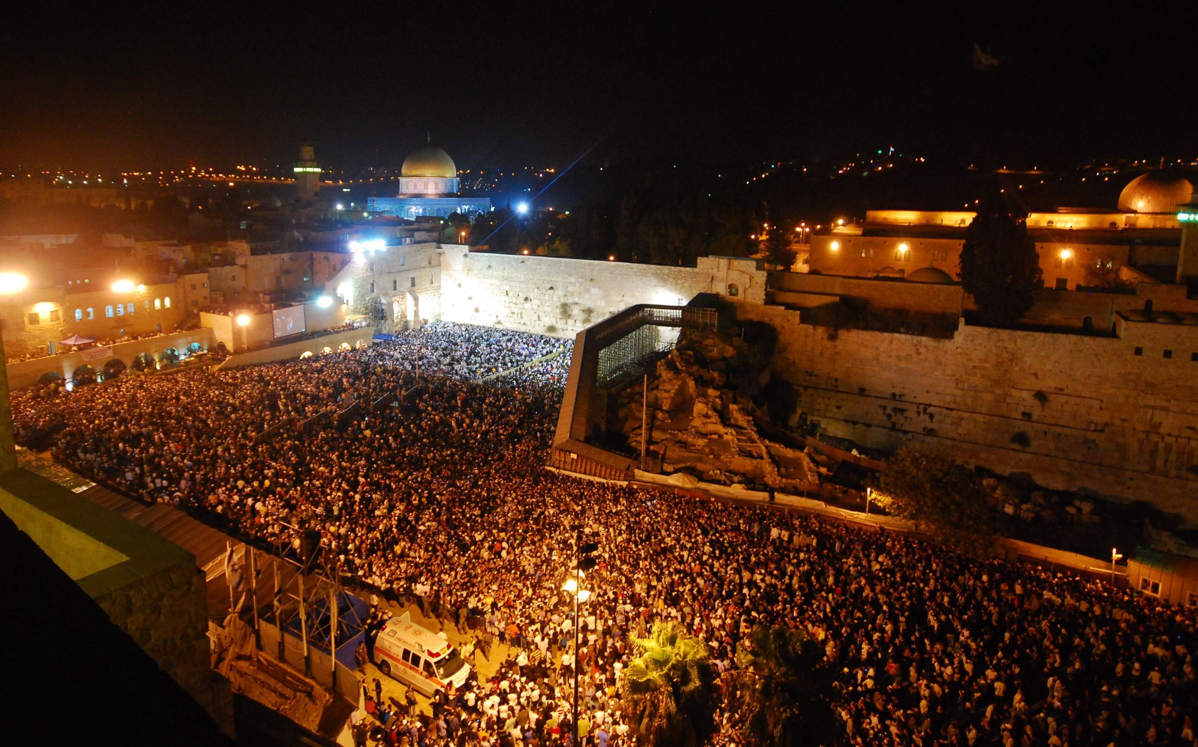
Crowd performing Slikhot
at the Western Wall in Jerusalem.
Notes:
https://en.wikipedia.org/wiki/Selichot#/media/File:Slichot22.JPG

Slide 56
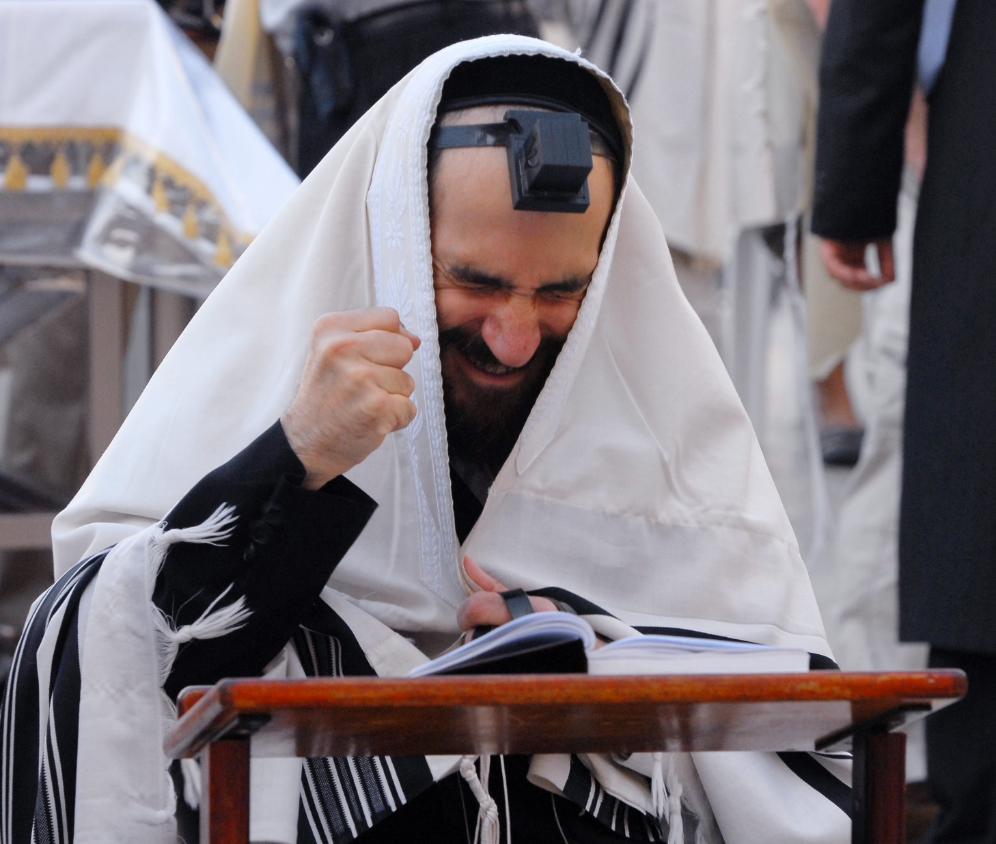
Man reciting Slikhot prayers at the Western Wall, 2008
Notes:
By Mark Neyman / Government Press Office, CC BY-SA 3.0, https://commons.wikimedia.org/w/index.php?curid=22806688

Slide 57
Why soooo much repentance, self examination?

Slide 58
^{Ber 33.1-3} Then Yaakov glanced up and saw, behold, there was Esav coming—and 400 men with him… He himself passed on ahead of [his family], and bowed to the ground seven times until he came near to his brother.
Notes:
Was that a show? Or real change.

Slide 59
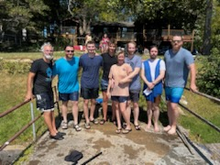
Immer-sion
Sept 3, 2023

Slide 60
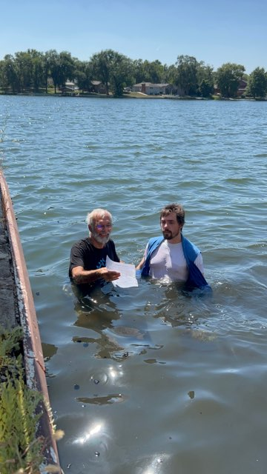
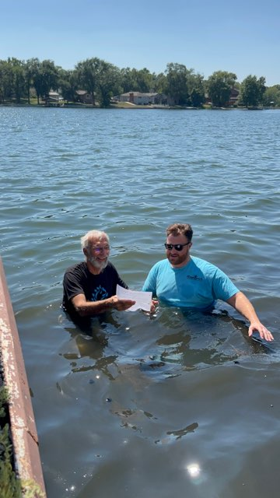
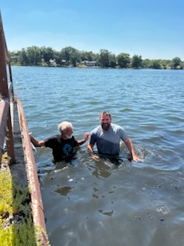

Slide 61

Days of Awe September 15-24
https://www.10days.net/register
Notes:
Dawn and I have fasted from RH to YK for a number of years. Invite you to do the same.

Slide 63
Spiritually Deceased, Dead,
Inanimate
We were dead
We were ruled by ha-satan
Includes Jewish people
Repentance of believers
Bringing life to the dead

Slide 64
Instead of joining with the Jewish Community at Beth Torah for Slikhot, we are doing an Ingathering/ Outreach at Pioneer Park. Bring life from the dead!!

Slide 65
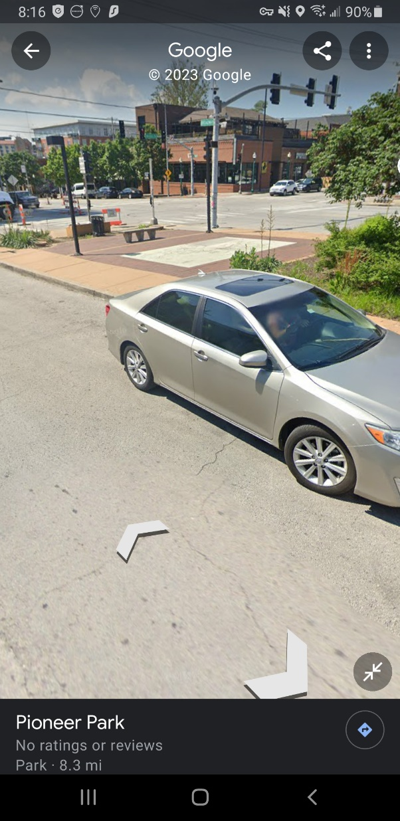
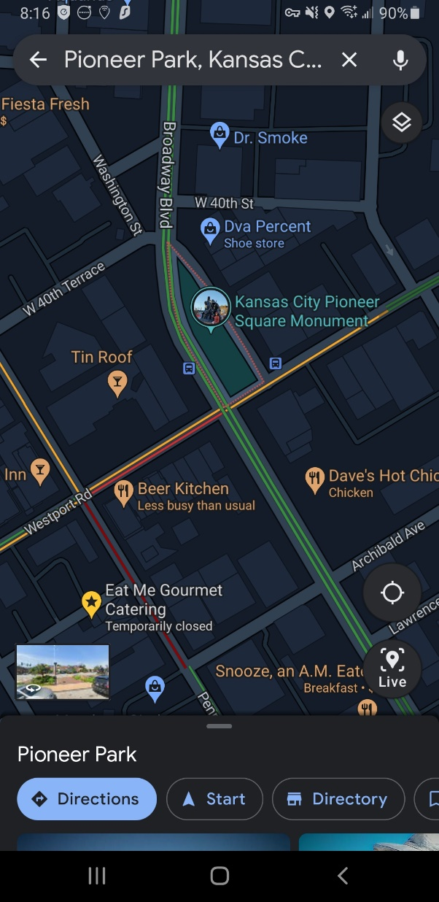
Pioneer Park, Ingathering / Outreach
Sept. 9, 2023
Elul 24, 5783

Slide 66
Why, to share life from the dead with the pedestrians, revelers, bar hoppers, in Westport.
Notes:
We are not just going to spread our beliefs, impose ourselves on them, but we need to view the unsaved as dead in sin…

Slide 67
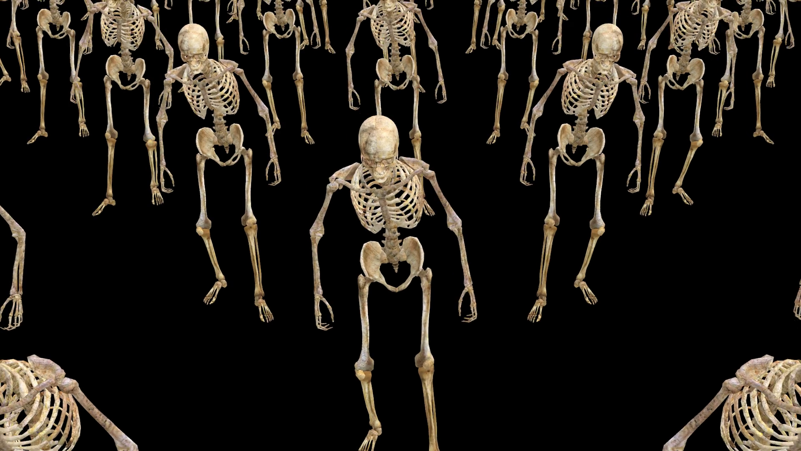
Notes:
https://external-content.duckduckgo.com/iu/?u=https%3A%2F%2Fdm0qx8t0i9gc9.cloudfront.net%2Fthumbnails%2Fvideo%2FCWsBQHy%2Fvideoblocks-a-crowd-of-skeletons-are-walking_scmdoaimz_thumbnail-1080_01.png&f=1&nofb=1&ipt=e06524f2c6bdf93d6ba4c182f8d4a41ea1e9e4fca95f164ae73a332b876ab293&ipo=images

Slide 68
^{Acts 26.17-18} I am sending you, to open their eyes—so they may turn from darkness to light and from the power of satan to God, that they may receive release from sins as well as a place among those who are made holy through trusting in Me.’

Slide 69
^{Eph 2.4-5} But God was rich in mercy, because of His great love with which He loved us. Even when we were dead in our trespasses, He made us alive together with Messiah. (By grace you have been saved!)

Slide 70
^{1 Yn 3.1} See how glorious a love the Father has given us, that we should be called God’s children—and so we are! The reason the world does not know us is that it did not know Him.
Notes:
Friend at JCC on rowfit machine “How is you cong doing.” “Most synagogues are shrinking.”
“Secret ingredient.” Presence. Drew a blank.
JB Bernstein asked his rabbi, “Is G-d here?”

Slide 71
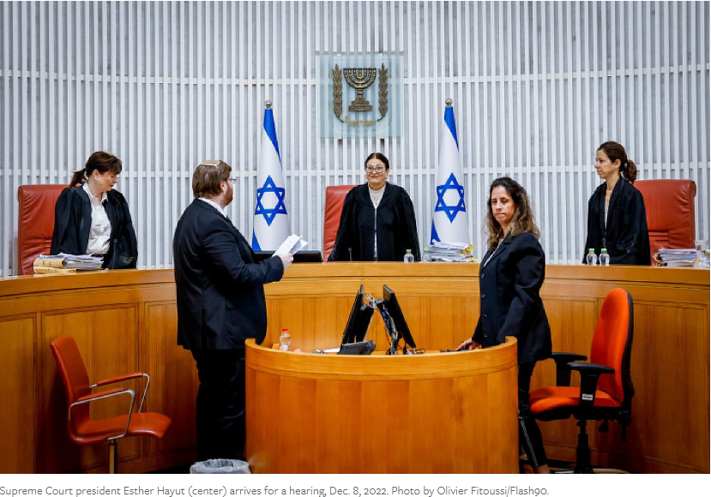
Notes:
https://www.jns.org/israel-news/judicial-reform/23/7/31/306605/

Slide 72
(July 31, 2023 / JNS)
All 15 justices of Israel’s Supreme Court will hear the petitions asking them to cancel the “reasonableness law” that the Knesset passed last week, Supreme Court President Esther Hayut announced on Monday.
Notes:
https://www.jns.org/israel-news/judicial-reform/23/7/31/306605/

Slide 73
The hearing is scheduled for 10 a.m. on Sept. 12, three days before the start of the High Holidays. The government will have to file its response to the petitions 10 days earlier.
It will be the first time in the court’s 75-year history that a panel of 15 justices will preside over a case.
Notes:
https://www.jns.org/israel-news/judicial-reform/23/7/31/306605/

Slide 75
Spiritually Deceased, Dead,
Inanimate
We were dead
We were ruled by ha-satan
Includes Jewish people
Repentance of believers
Bringing life to the dead

Slide 76
Do you KNOW Yeshua and experiencing LIFE from the dead?
Are you hearing daily from His Word?
How are you applying what you heard?
Are you offering that water of life to anyone?

