Slide 1
e-handout
To have these notes
without taking notes
Go to OrHaOlam.com
Click on Messages tab,
2024 Messages

Slide 2
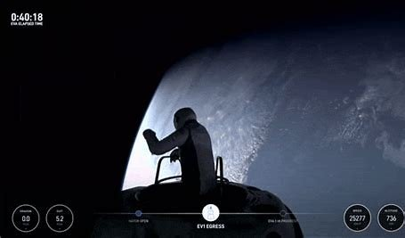
Notes:
https://www.umjc.org/commentary/2024/9/30/rosh-hashanah-a-much-needed-renewal-of-awe? This year on September 12, the entrepreneur Jared Isaacman became the first private citizen to walk in space.

Slide 3
“It’s gorgeous,” he said, in awe of what he could see, as he eased out of the spacecraft into the vacuum of space, hundreds of miles from Earth. “Back at home, we all have a lot of work to do.

Slide 4
But from here, it sure looks like a perfect world,” Isaacman said as the capsule soared above the South Pacific. Cameras on board caught his silhouette, waist high at the hatch, with the blue Earth beneath. (Sky News, news.sky.com)

Slide 5
Isaacman reportedly spent hundreds of millions to gain this vision of awe. The call of the Shofar this week draws us all back to awe in more direct fashion, back to realizing we are in the presence of something—someone—far greater than ourselves.

Slide 6
Notes:
https://www.umjc.org/commentary/2024/9/30/rosh-hashanah-a-much-needed-renewal-of-awe?
This year on September 12, the entrepreneur Jared Isaacman became the first private citizen to walk in space.

Slide 7
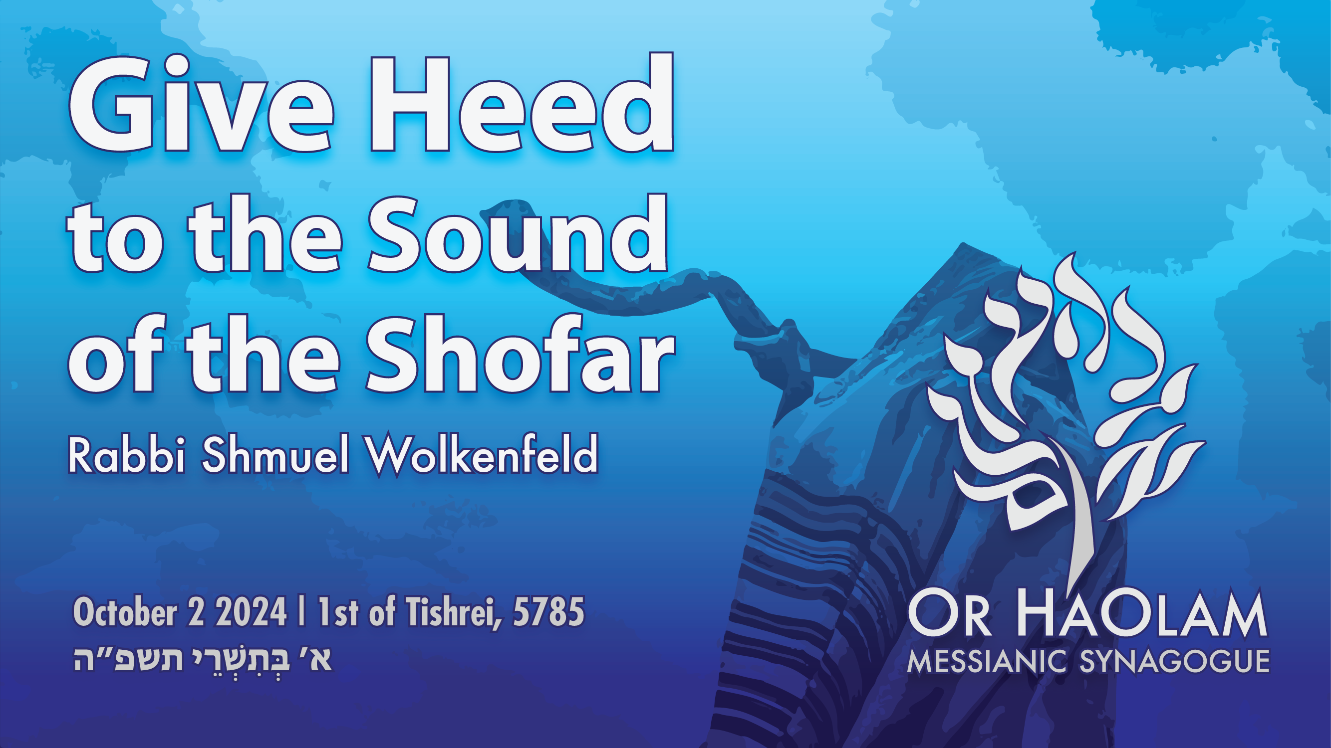

Slide 8
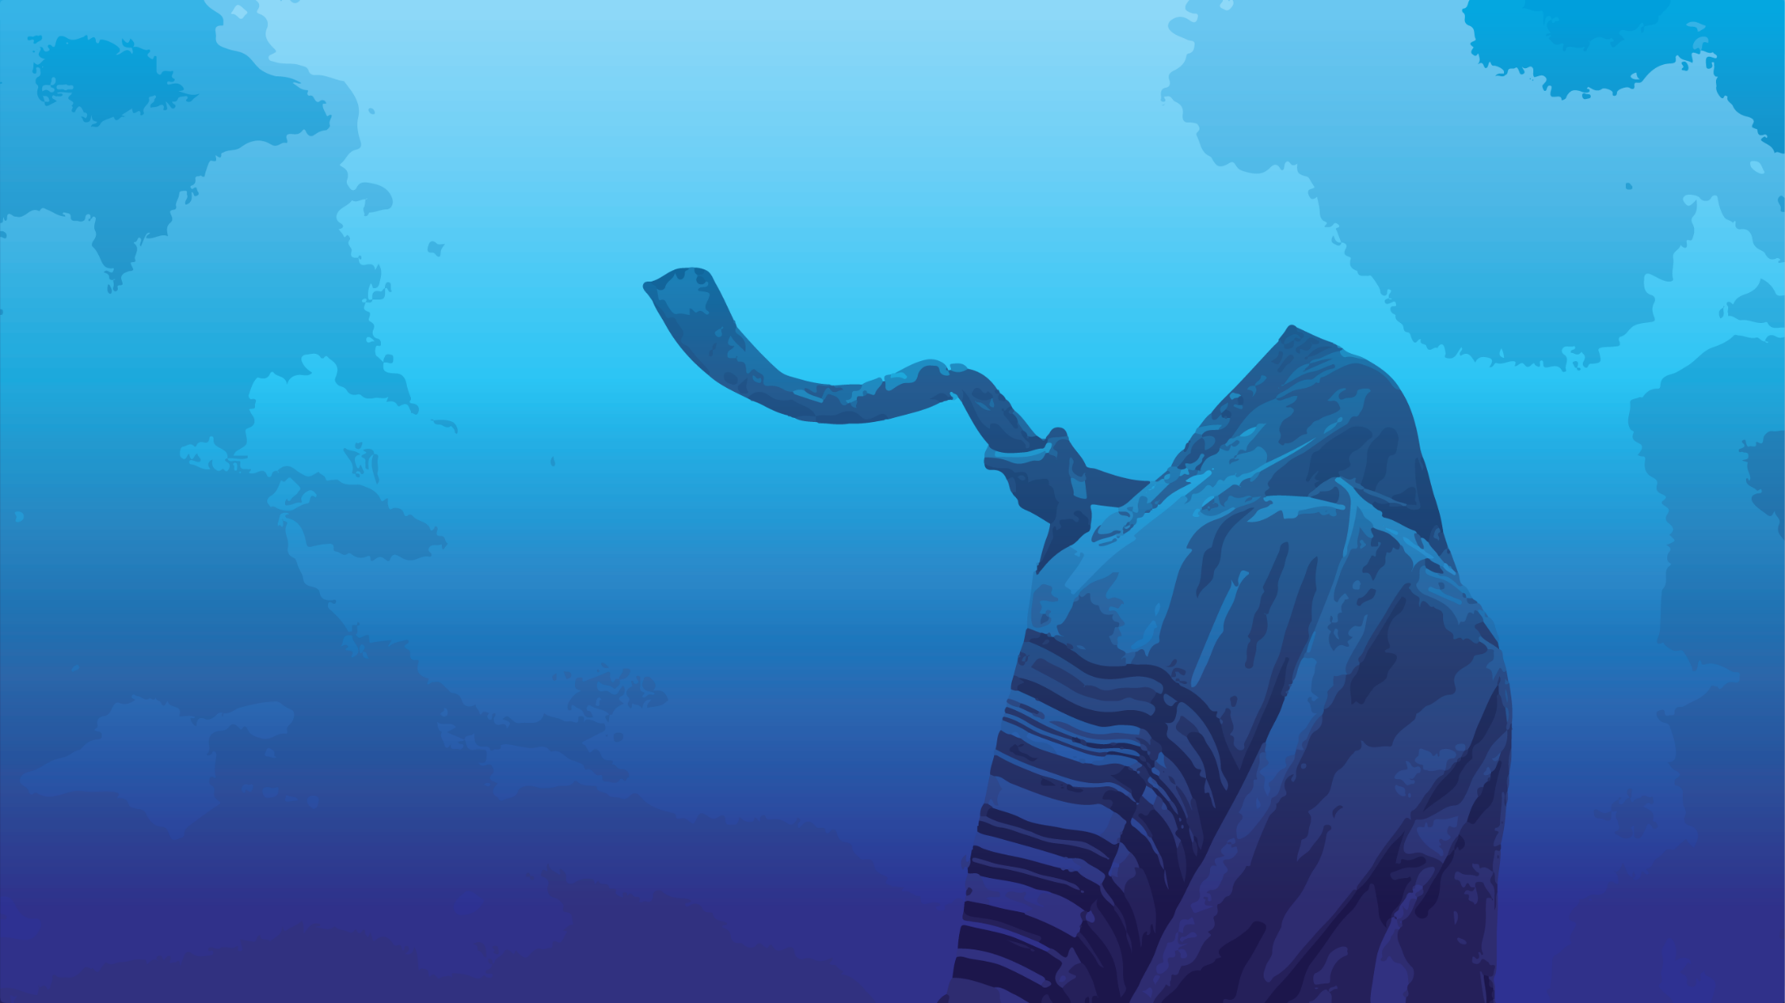
Give Heed to the sound of the Shofar
RH greeting and history
Why the Shofar
Meaning of the sound
Total repentance

Slide 9
Give Heed to the sound of the Shofar
RH greeting and history
Why the Shofar
Meaning of the sound
Total repentance

Slide 10
Review: Rosh Hashanna greetings
Shana Tovah שָׁנָה טוֹבָה
[Have a] Good Year
שָׁנָה טוֹבָה וּמְתוּקָה
Shana Tova oo-m’tukah
[Have a] Good and sweet year

Slide 11
Yom Kippur greeting:
צוֹם קַל tsom kal
Easy fast

Slide 12
Rosh Hashanah רֹאשׁ הַשָּׁנָה‎‎, literally "head [of] the year"
Why that name?

Slide 13
The historian Josephus, and the ancient Aramaic translation of the Bible, the Targum Jonathan, identify Rosh HaShanah as the New Year observed by the people of Israel before the holiday of Passover was instituted.
Notes:
Encyclopaedia Judaica

Slide 14
The traditional Jewish concept is that the world, Adam and Khava/Eve, were created on Rosh HaShanah, so this day is indeed the beginning of the year chronologically.
Notes:
https://en.wikipedia.org/wiki/Rosh_Hashanah

Slide 15
The Babylonian name Tishri seems to derive from the root Ugaritic or Akkadian seru, which means "to begin." The ancient Semitic peoples thought of the year as beginning in the autumn, at the time of the late harvest. This was the beginning of the economic year, when crops began to be sold.
Notes:
School year too, probably based on agricultural cycle.

Slide 16
G-d made a spiritual cycle to start on Pesakh, but the chronological year didn't change. So, Jews have two [actually more] new years, a chronological one, and a spiritual one. Passover is described in these terms.

Slide 17
^{Shmot/Ex. 12:1-2} Now Adoni said
to Moses and Aaron in the land of Egypt, "This month shall be the beginning of months for you; it is to be the first month of the year to you." NASU
So, it’s scripturally OK to call this holiday Rosh HaShanah!
Notes:
With that established, what is this holiday really about?

Slide 19
Give Heed to the sound of the Shofar
RH greeting and history
Why the Shofar
Meaning of the sound
Total repentance

Slide 20
^{Viyikra/Lev 23.23-25} ADONI spoke to Moses saying: “Speak to Bnei-Yisrael, saying: In the seventh month, on the first day of the month, you are to have a Shabbat rest, a memorial of blowing, a holy convocation.
Notes:
Key phrase, unique to this holiday. Memorial, blowing.

Slide 21
^{Viyikra/Lev 23.23-25} You are to do no regular work, and you are to present an offering made by fire to ADONI.”
Notes:
Day off, Don’t go shopping. Like Shabbat. Jewish Community Center is closed.
Temple sacrifices, common to all the holidays.
Unpack key words

Slide 22
a memorial of blowing
זִכְרוֹן memory ; (computing) memory chip
תְּרוּעָה, shout, cry; soundblast
announcement, declaration
Notes:
It doesn’t say “Shofar” but determined from the context. What context?

Slide 23
Memorial of what?
Notes:
What is the prime memory, the formative memory of the Jewish people?

Slide 24
^{Shmot/Ex 19.16-19} On the morning of the third day, there was thunder, lightning and a thick cloud on the mountain. Then a shofar blast sounded so loudly that all the people in the camp trembled. Moshe brought the people out of the camp to meet God; they stood near the base of the mountain.

Slide 25
^{Shmot/Ex 19.16-19} Mount Sinai was enveloped in smoke, because Adoni descended onto it in fire — its smoke went up like the smoke from a furnace, and the whole mountain shook violently. As the sound of the shofar grew louder and louder, Moshe spoke; and God answered him with a voice. [Then later…]

Slide 26
^{Shmot/Ex 20.15-18} All the people experienced the thunder, the lightning, the sound of the shofar, and the mountain smoking. When the people saw it, they trembled. Standing at a distance, they said to Moshe, “You, speak with us; and we will listen.

Slide 27
^{Shmot/Ex 20.15-18} But don’t let God speak with us, or we will die.” Moshe answered the people, “Don’t be afraid, because God has come only to test you and make you fear him, so that you won’t commit sins.” So the people stood at a distance, but Moshe approached the thick darkness where God was.

Slide 28
^{Mes.Jews/Heb 12.18-20} For you have not come to a tangible mountain, to an ignited fire, to darkness, to murk, to a whirlwind, to the sound of a shofar, and to a voice whose words made the hearers beg that no further message be given to them — for they couldn’t bear what was being commanded them.
Notes:
Some Jewish poets and commentators observed…

Slide 30
Give Heed to the sound of the Shofar
RH greeting and history
Why the Shofar
Meaning of the sound
Total repentance

Slide 31
“The shofar speaks in a language that does not have words, is beyond words. ... More powerful than speech in its emotional intensity and impact, it is a mode of communication that bypasses the mind
Notes:
Dr. Rachel Anisfeld, “Listening to the Shofar Inside” & “A Shofar Meditation in Three Parts”
https://www.sefaria.org/sheets/506081.194?lang=bi&with=all&lang2=en

Slide 32
and enters straight into our hearts so that we feel its call viscerally with a different kind of knowing that we cannot explain or articulate.”
Notes:
Dr. Rachel Anisfeld, “Listening to the Shofar Inside” & “A Shofar Meditation in Three Parts”
https://www.sefaria.org/sheets/506081.194?lang=bi&with=all&lang2=en

Slide 33
“Suddenly you are awakened by a strange noise, a noise that fills the full field of your consciousness and then splits into several jagged strands, shattering that field, shaking you awake. The ram's horn, the shofar,
Notes:
https://www.sefaria.org/sheets/506081.204?lang=bi&with=all&lang2=en
R. Alan Lew, This Is Real and Your Are Completely Unprepared: The Days of Awe as a Journey of Transformation, pp.64-65

Slide 34
“the same sound that filled the world when the Torah was spoken into being on Mount Sinai, is being blown to call you to wakefulness. ... lest we forget and slip back, lest we surrender to the entropic pull of mindlessness.”
Notes:
https://www.sefaria.org/sheets/506081.204?lang=bi&with=all&lang2=en
R. Alan Lew, This Is Real and Your Are Completely Unprepared: The Days of Awe as a Journey of Transformation, pp.64-65

Slide 35

Three sounds: meaning
תְּקִיעָה straight, tkiah
תְּרוּעָה t’ruah tremulous like the sigh of a broken heart
שברים 3 broken short, shevarim

Slide 37
Give Heed to the sound of the Shofar
RH greeting and history
Why the Shofar
Meaning of the sound
Total repentance

Slide 38
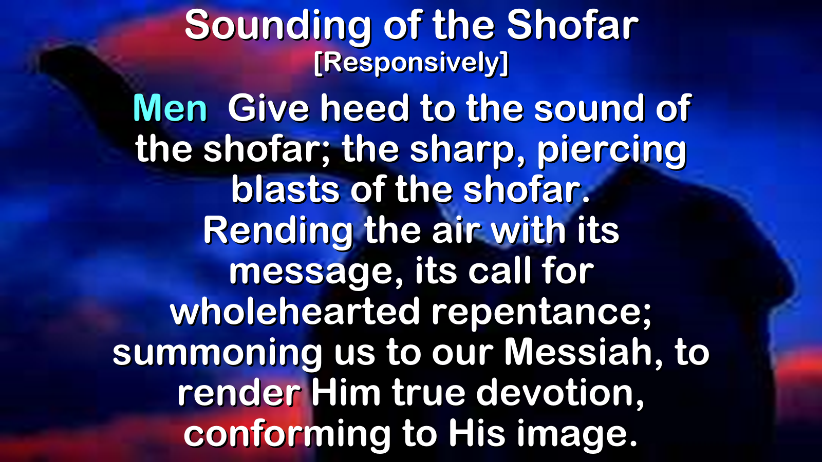

Slide 39
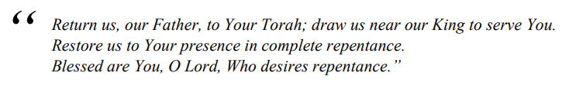
Shmoneh Esray [18 Blessings]
#5
Notes:
https://hebrew4christians.com/Prayers/Daily_Prayers/Shemoneh_Esrei/H4C-weekday-amidah.pdf

Slide 40
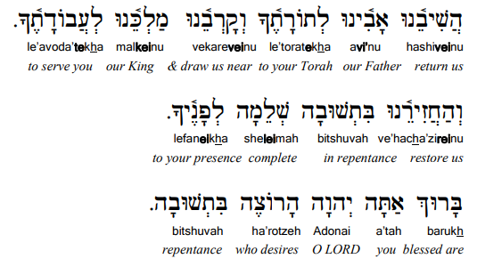
Notes:
https://hebrew4christians.com/Prayers/Daily_Prayers/Shemoneh_Esrei/H4C-weekday-amidah.pdf

Slide 41
^{Mark 1.14-15} After Yokhanan had been arrested, Yeshua came into the Galil proclaiming the Good News from God: “The time has come, God’s Kingdom is near! Repent and believe the Good News!”

Slide 42
^{Mt.4.17} From then on, Yeshua began to proclaim, “Repent [turn from your sins to God], for the kingdom of heaven is near.”
Notes:
You might say, “Why do I need to repent still?” I received Messiah. My life was radically changed.

Slide 43
^{Yn 15.1-9} “I am the real vine, and my Father is the gardener. Every branch which is part of me but fails to bear fruit, he cuts off; and every branch that does bear fruit, he prunes, so that it may bear more fruit.

Slide 44
^{Yn 15.1-9} Right now, because of the word which I have spoken to you, you are pruned. Stay united with me, as I will with you — for just as the branch can’t put forth fruit by itself apart from the vine, so you can’t bear fruit apart from me.

Slide 45
^{Yn 15.1-9} “I am the vine and you are the branches. Those who stay united with me, and I with them, are the ones who bear much fruit; because apart from me you can’t do a thing. 6 Unless a person remains united with me, he is thrown away like a branch and dries up. Such branches are gathered and thrown into the fire, where they are burned up.

Slide 46
^{Yn 15.1-9} “If you remain united with me, and my words with you, then ask whatever you want, and it will happen for you. This is how my Father is glorified — in your bearing much fruit; this is how you will prove to be my talmidim.

Slide 47
^{Yn 15.1-11} “Just as my Father has loved me, I too have loved you; so stay in my love. If you keep my commands, you will stay in my love — just as I have kept my Father’s commands and stay in his love. I have said this to you so that my joy may be in you, and your joy be complete.

Slide 48
^{Mt 5.3-4} How blessed are the poor in spirit! for the Kingdom of Heaven is theirs.
“How blessed are those who mourn! for they will be comforted.

Slide 49
Yeshua’s letters to the congregations

Slide 50
^{Rev 2.4-5} Yet I hold this against you: You have forsaken the love you had at first. Consider how far you have fallen! Repent and do the things you did at first. If you do not repent, I will come to you and remove your lampstand from its place.
Notes:
Ephesians

Slide 51
^{Rev 2.15-16} Likewise, you also have those who hold to the teaching of the Nicolaitans. Repent therefore!
Notes:
Pergamum

Slide 52
^{Rev 2.22-23} Unless they unless they repent of her ways and association with what she does; and I will strike her children dead! Then all the Messianic communities will know that I am the one who searches minds and hearts, and that I will give to each of you what your deeds deserve.
Notes:
Thyatira

Slide 53
^{Rev 3.3} Remember, therefore, what you have received and heard; hold it fast, and repent. But if you do not wake up, I will come like a thief, and you will not know at what time I will come to you.
Notes:
Sardis

Slide 54
^{Rev 3.18-19} I counsel you to buy from me gold refined in the fire, so you can become rich; and white clothes to wear, so you can cover your shameful nakedness; and salve to put on your eyes, so you can see. Those whom I love I rebuke and discipline. So be earnest and repent.
Notes:
Laodicea

Slide 55
Self examination and repentance
are a lifelong pursuit.
Especially if some one offended someone
David’s protype prayer…

Slide 56
^{T’hillim/Ps 51.19.1-15} A psalm of David, when Natan the prophet came to him after his affair with Bat-Sheva: God, in your grace, have mercy on me; in your great compassion, blot out my crimes. Wash me completely from my guilt, and cleanse me from my sin.

Slide 57
^{T’hillim/Ps 51.19.1-15} For I know my crimes, my sin confronts me all the time. Against you, you only, have I sinned and done what is evil from your perspective; so that you are right in accusing me and justified in passing sentence. True, I was born guilty, was a sinner from the moment my mother conceived me. Still, you want truth in the inner person

Slide 58
^{T’hillim/Ps 51.19.1-15} so make me know wisdom in my inmost heart. Sprinkle me with hyssop, and I will be clean; wash me, and I will be whiter than snow. Let me hear the sound of joy and gladness, so that the bones you crushed can rejoice. Turn away your face from my sins, and blot out all my crimes.

Slide 59
^{T’hillim/Ps 51.19.1-15} Create in me a clean heart, God; renew in me a resolute spirit. Don’t thrust me away from your presence, don’t take your Ruach Kodesh away from me. Restore my joy in your salvation, and let a willing spirit uphold me. Then I will teach the wicked your ways, and sinners will return to you.

Slide 60
^{T’hillim/Ps 51.19} My sacrifice to God is a broken spirit; God, you won’t spurn a broken, chastened heart.

Slide 61
תְּשׁוּבָה t’shuvah
Return, repentance, answer, reply, solution, response, rejoinder, retort
Notes:
If I find myself in a mental rut, sinful rut, I find that saying the word “Repentance” or better yet “Tshuvah תְּשׁוּבָה" has a stronghold breaking effect.

Slide 62
My letter to Mike Bickle

Slide 63
Dear Mike,
This is Shmuel Wolkenfeld. You have always been kind and honoring to me. One time you said, in jest, that I was the Rabbi of IHOP. I received it as a loving expression of your gracious heart.

Slide 64
Mike, I would like to BRIEFLY suggest a quick and sure way to restore the honor of G-d, and your legacy in the Kingdom. It will be costly.
If you would just confess, EVERYTHING there is to confess. And maybe it’s all contrived and you’re really innocent? Then stand in that.

Slide 65
But if not, just write the most sordid Fifty Shades of Grey confession, but with a repentant spirit. Right now, there are accusations and investigations that are causing arguments and getting nowhere substantial.

Slide 66
You could end all that chaos and rebuild the kingdom and the wonderful legacy of IHOPKC and bring SHALOM!
This advice is likely legally self-defeating. You may be assessed fines or do jail time. I’m asking you to consider the words of Paul:

Slide 67
Acts 20.23-24 "The Holy Spirit keeps warning me that imprisonment and persecution await me. But I consider my own life of no importance to me whatsoever, as long as I can finish the course ahead of me, the task I received from the Lord Yeshua/Jesus "

Slide 68
But does that really matter if you can undo the damage to the Name of Yeshua the Messiah the King of the Jews and the Savior of all humanity? In eternity, who will care?
Blessings and love my friend,
Shmuel Wolkenfeld
OrHaOlam.com
Notes:
Some of you may be aware that the Messianic organization, Tikkun, has taken on oversight of this Shonda. I forwarded this to them and they responded with total agreement.

Slide 69
Coming of a King

Slide 70
^{1 Kings 1.38-40} So Tzadok the cohen, Natan the prophet, B’nayah the son of Y’hoyada and the K’reti and P’leti went down, had Shlomo ride on King David’s mule and brought him to Gichon. Tzadok the cohen took the horn of olive oil out of the tent and anointed Shlomo.

Slide 71
^{1 Kings 1.38-40} They sounded the shofar, and all the people shouted, “Long live King Shlomo!” All the people escorted him back, playing flutes and rejoicing greatly, so that the earth shook with the sound.

Slide 72
^{Isaiah 27.13} On that day a great shofar will sound. Those lost in the land of Ashur will come, also those scattered through the land of Egypt; and they will worship Adonai on the holy mountain in Yerushalayim.

Slide 73
^{1 Thes 4.15-18} We who remain alive when the Lord comes will certainly not take precedence over those who have died. For the Lord himself will come down from heaven with a rousing cry, with a call from one of the ruling angels, and with God’s shofar;

Slide 74
^{1 Thes 4.15-18} those who died united with the Messiah will be the first to rise; then we who are left still alive will be caught up with them in the clouds to meet the Lord in the air; and thus we will always be with the Lord. So encourage each other with these words.

Slide 76
Give Heed to the sound of the Shofar
RH greeting and history
Why the Shofar
Meaning of the sound
Total repentance

