Slide 1
e-handout
To have these notes
without taking notes
Go to OrHaOlam.com
Click on Messages tab,
2024 Messages

Slide 2
Finally — a great alternative to body scanners at airports.
The Israelis are developing an airport security device that will eliminate the privacy concerns that come with full-body scanners at the airports.

Slide 3
It’s a booth you can step into that will not X-ray you, but will detonate any explosive device you may have on you.

Slide 4
They see this as a win-win for everyone, with none of this difficulty about racial profiling. It also would eliminate the costs of a long and expensive trial. Justice would be swift. Case closed.
Notes:
Anybody play Monopoly? New card.

Slide 5
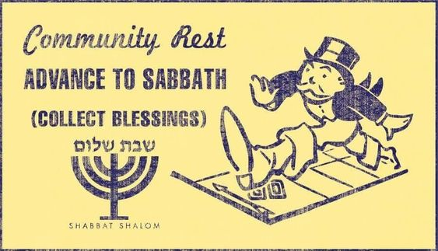
Notes:
from Katia and Vagner Pereira

Slide 6
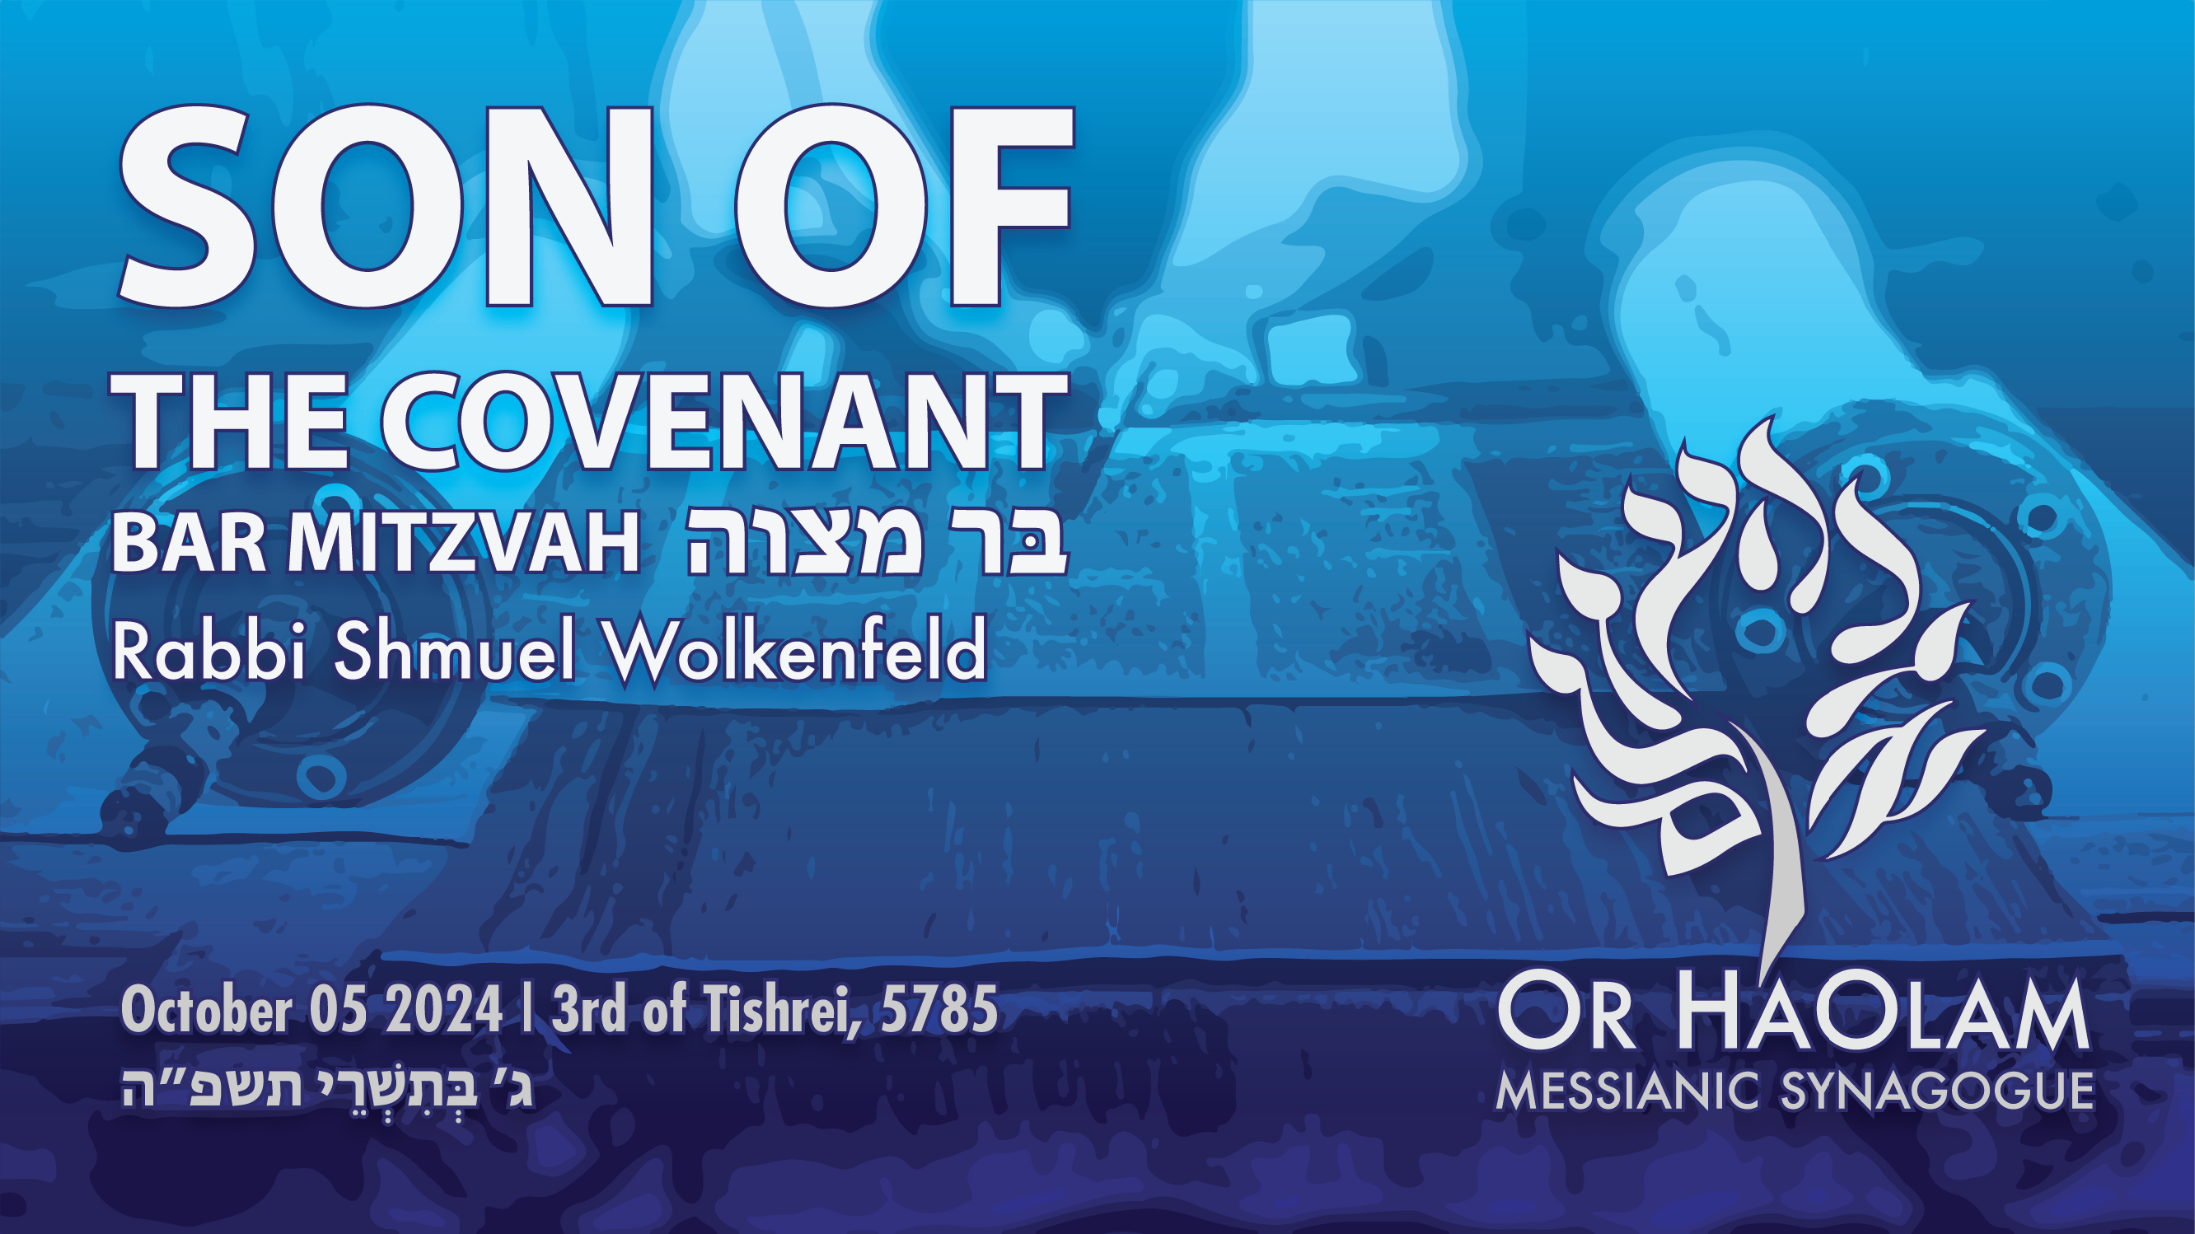
Notes:
This will start as the same message as last week, but take an entirely different direction.

Slide 7
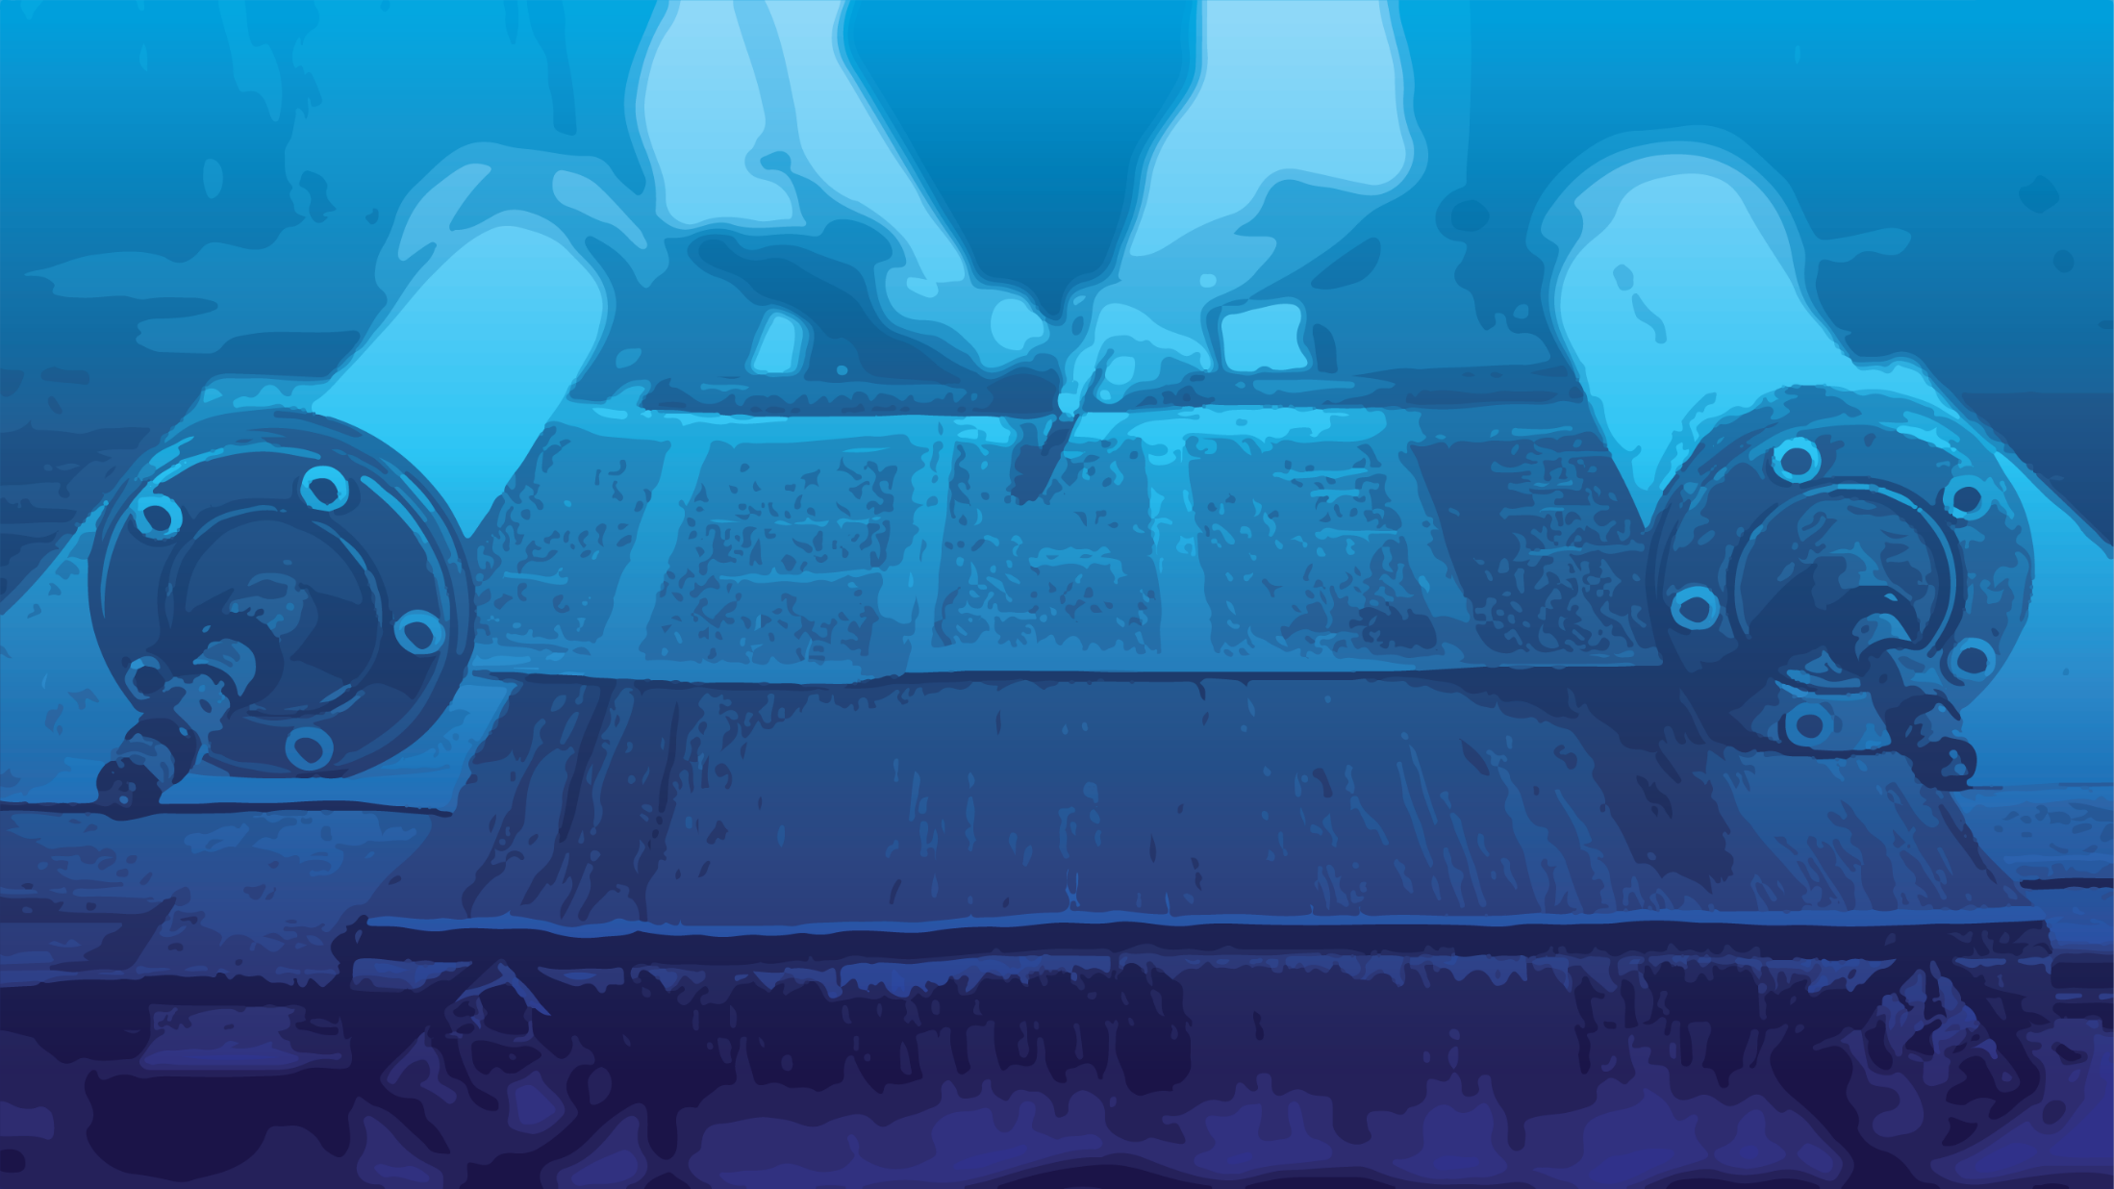
Bar Mitzvah: Son of the Covenant
Entering Covenantal Identity
Aspects of Covenantal Identity
in Romans 3
3. Aspects of Covenantal Identity
In Romans 9
Notes:
Jewish identity from the Mes. Scriptures, from Paul!
Best message I’ve ever given on Replacement theology and Hebrew roots.
Replacement theology says the church and practices replace Israel.
Hebrew roots says that they are the new Israel, doing a better job than Jews at being Jewish.

Slide 8
Bar Mitzvah: Son of the Covenant
Entering Covenantal Identity
Aspects of Covenantal Identity
in Romans 3
3. Aspects of Covenantal Identity
In Romans 9

Slide 9
What is a Bar Mitzvah?
בַּר מִצְוָה
בַּר son
מִצְוָה (religion) commandment, precept; decree, edict; good deed, act of kindness
Notes:
Son and commandment seem opposite.
Son is the epitome of beloved and precious.
Commandment sound legal, military.
It’s being engaged, involved, enamored with the TRUTH of the Word. The sonship dimension is because the Word is a love letter of family identity. Covenantal family identity. Covenant is the key word.
Shortly Jaden’s parents, Jarrod & Jacque, will recite the following over him. Naomi’s parents said last week.

Slide 10
בָּרוּךְ שֶׁפְּטָרַנִי מֵעָנְשׁוֹ שֶׁלָזֶה.
Ba-rukh sheh-p'ta-ra-nee
may-an-sho sheh-lah-zeh.
Blessed is He Who has released
me from full responsibility
for the character and deeds of
my son.
Notes:
He will bear the full responsibility of his own actions, words, thoughts. Somewhat.
So lets explore the tie between Son of the Commandments, and the covenant.

Slide 11
^{Yermiyahu 31.31-33} “Listen! the days are coming,” says Adoni, “when I will make a new covenant with the house of Isra’el and with the house of Y’hudah…“For this is the covenant I will make with the house of Isra’el after those days,” says Adoni: “I will put my Torah within them and write it on their hearts;

Slide 12
^{Yermiyahu 31.31-33} I will be their God, and they will be my people. No longer will any of them teach his fellow community member or his brother, ‘Know Adoni’; for all will know me, from the least of them to the greatest; because I will forgive their wickednesses and remember their sins no more.”

Slide 13
The covenant is expressed in the Torah teachings and commandments.
Son of the Commandments =
[Bar Mitzvah]
Son of the Covenant

Slide 14
Last Shabbat, some particular commandments of adulthood.
Handling conflicts in love.
Handling opposition and hate.
Listening, learning, and leading.
This week, what IS the covenant identity?

Slide 15
Last Shabbat, some things a Bar/Bat Mitzvah person does.
This Shabbat, what a Bar/Bat Mitzvah person IS.

Slide 16
So, it’s a big step, entering into covenantal identity.

Slide 17
God meets us at transition points, so we have ceremonies.
Birth: Brit Milah/circumcision
Puberty: Bar Mitzvah
Marriage: Ceremony
Death: Funeral
Notes:
Celebrate transitions. Honor the budding manhood of Jaden Townsend.

Slide 18
בָּרוּךְ אַתָּה בְּבֹאֶךָ; וּבָרוּךְ אַתָּה בְּצֵאתֶךָ
Barukh atah b'voekha, barukh atah btseitkha
^{Dt. 28.6} “A blessing on you when you go out, and a blessing on you when you come in.”

Slide 19
Notes:
.

Slide 20
Bar Mitzvah: Son of the Covenant
Entering Covenantal Identity
Aspects of Covenantal Identity
in Romans 3
3. Aspects of Covenantal Identity
In Romans 9

Slide 21
^{Ro 3.1-2} Then what advantage has the Jew? What is the value of being circumcised? Much in every way! In the first place, the Jews were entrusted with the very words of God.
Circumcision = covantal identity

Slide 22
Shaul/ Paul is NOT saying, ”What is the value of the surgical procedure of circumcision?”
Shaul/ Paul IS saying, ”What is the central value of covenantal identity.”
“^{Ro 3.2} The Jews were entrusted with the very words of God.”
Notes:
My son Baruch was taking a course at the JCCC in culture and religion, and a Palestinian student was in the class. They got to talking about faith, and Baruch recommended, “You should talk to my Dad.” So the young man came to my study and asked about us, and why all Jews are rich.
Firstly, NOT all Jews are rich.
The reason why it appears this way somewhat is this verse.

Slide 23
Greek culture centered on science and sports.
Roman culture…conquest
Assyrian…cruelty.
Phoenician…trade
Egyptian…afterlife

Slide 24
^{“Ro. 3.2} The Jews were entrusted with the very words of God.”
Jewish culture was centered on literacy. Learning to read and write scripture was our MOST important national task and value.
Notes:
The Palestinian young man responded, “Literacy is NOT important to us. Education is not our big deal.”

Slide 25
So, Jewish = Israelite people preeminently taught their sons and daughters literacy.
Two main advantages.
Literacy was in the Hebrew scriptures, so in the knowledge and wisdom of G-d

Slide 26
Literacy in scripture made a later practice of literacy in other fields easier: law, medicine, science.

Slide 27
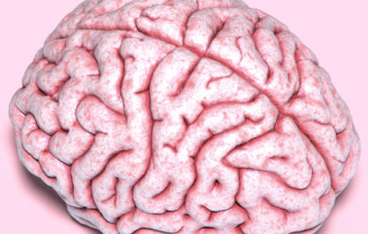
It is thought that neural function happens on the surface of the brain.
Notes:
So if you have more neural activity and connections, you need more brain surface. The skull has limited size, but you can increase your brain surface by more and deeper wrinkles. So, as you learn and study, you wrinkle your brain. https://www.sciencealert.com/some-peoples-brains-are-wrinklier-than-others-and-now-we-know-why
Brain wrinkles naturally develop as the brain gets larger in order to lend more surface area and help white matter fibers [axons] avoid long stretches. https://www.smithsonianmag.com/smart-news/why-are-our-brains-wrinkly-29271143/
That was my stated goal when I was a HS science teacher. “I’m here to wrinkle your brain.”
You can sort of feel it.

Slide 28
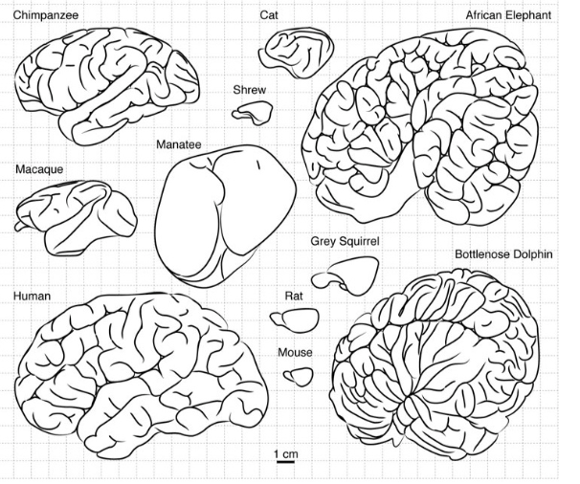
Notes:
So, elephants never forget, they say.

Slide 29
Epigenetics help offspring of studious, brain wrinkled people; tend to be also studious and learned.
THAT is why Jews appear to be rich, and win so many Nobel prizes.

Slide 30
Nobel statistics: 22 per cent of winners have been Jewish, despite our people comprising less than 0.2 per cent of the world’s population.
100x disproportionate.
Notes:
https://www.thejc.com/lets-talk/why-are-there-so-many-jewish-nobel-winners-ctycke48

Slide 31
Education has been put on a pedestal for Jews for millennia, dating back to the Torah — which means “teaching”. God chose Avraham to teach his children the ways of the Chosen People;
Notes:
https://www.thejc.com/lets-talk/why-are-there-so-many-jewish-nobel-winners-ctycke48

Slide 32
Moshe Rabbeinu, “our teacher”, did the same, and following the destruction of the Temple in 70CE, the Romans granted permission to establish an academy.
Notes:
https://www.thejc.com/lets-talk/why-are-there-so-many-jewish-nobel-winners-ctycke48

Slide 33
According to the late Rabbi Lord Sacks, the Jews knew that “to defend a country, you need an army, but to defend an identity, you need a school”.
Notes:
https://www.thejc.com/lets-talk/why-are-there-so-many-jewish-nobel-winners-ctycke48

Slide 34
Covenantal duty of literacy.
Notes:
So all youth who are Jewish or affiliating with Jews, get an appetite for study.
That’s why we throw candy at Bar Mitzvah kids. Candy for children listening to Torah drash.
Part of the reason why the Jew hatred at Harvard and Columbia was so painful. Love to learn.
Do you love to learn? Memorize scripture. In Hebrew.

Slide 37
Bar Mitzvah: Son of the Covenant
Entering Covenantal Identity
Aspects of Covenantal Identity
in Romans 3
3. Aspects of Covenantal Identity
in Romans 9

Slide 38
^{Ro 9.4-5} The people of Isra’el! ₁They were made God’s children, ₂the Sh’khinah has been with them, ₃the covenants are theirs, ₄likewise the giving of the Torah, ₅the Temple service and the promises;

Slide 39
^{Ro 9.4-5} ₆the Patriarchs are theirs; and ₇from them, as far as his physical descent is concerned, came the Messiah, who is over all. Praised be Adoni for ever! Amen.
Notes:
Seven reasons from Paul/Shaul that Hebrew roots and replacement theology are wrong.

Slide 40
₁They were made God’s children
^{Shmot/Ex 4.22-23} Then you are to tell Pharaoh: ‘Adoni says, “Isra’el is my firstborn son. I have told you to let my son go in order to worship me, but you have refused to let him go. Well, then, I will kill your firstborn son!”’
Notes:
Jewish people [and those identifying with us and joining our destiny] have a national sonship besides being born again. A sort of call, destiny. Joseph served all nations, but he was passionate about his own family.
After Avshalom’s rebellion, the tribe of Yehuda wanted to be the first to bring David back.

Slide 41
Covenantal identity #1
Love Messiah the King. He’s the Savior, Redeemer, and a relative.

Slide 42
₂the Sh’khinah has been with them
A passion for the Presence.
^{T’hillim/Ps 27.4} One thing have I asked of Adoni, that will I seek: to dwell in the House of Adoni all the days of my life, to behold the beauty of Adoni, and to meditate in His Temple.
Notes:
The Sh’khinah, cloud of glory. Holy of Holies. Liquid love.

Slide 43
^{Shmot/Ex 34.18-19} But Moshe said, “I beg you to show me your glory!” He replied, “I will cause all my goodness to pass before you, and in your presence I will pronounce the name of Adoni.

Slide 44
^{T’hillim / Ps 90.16-17} Show your deeds to your servants and your glory to their children. May the favor of Adoni our God be on us.
Notes:
One accessible way to enter into the Glory…

Slide 45
^{1Chron 25.1-3} David and the army commanders selected some of the descendants of Asaf, of Heman and of Y’dutun to prophesy with lyres, lutes and cymbals…the descendants of Y’dutun…six, with their father Y’dutun, who, accompanied by the lyre, prophesied thanks and praise to Adoni.
Notes:
Prophesy with music??
Something about anointed music engages the spirit takes us in to the holy of holies.

Slide 46
Music seems to be a relatively accessible way to experience the Presence.
Of all King David’s accomplishments, he his remembered supremely in modern Jerusalem as a worshipper.

Slide 47
The Chords Bridgeגשר המיתרים Gesher HaMeitarim also called the Bridge of Strings or Jerusalem Light Rail Bridge, is a side-spar cable-stayed bridge in Jerusalem’s Western entrance to the city.

Slide 48
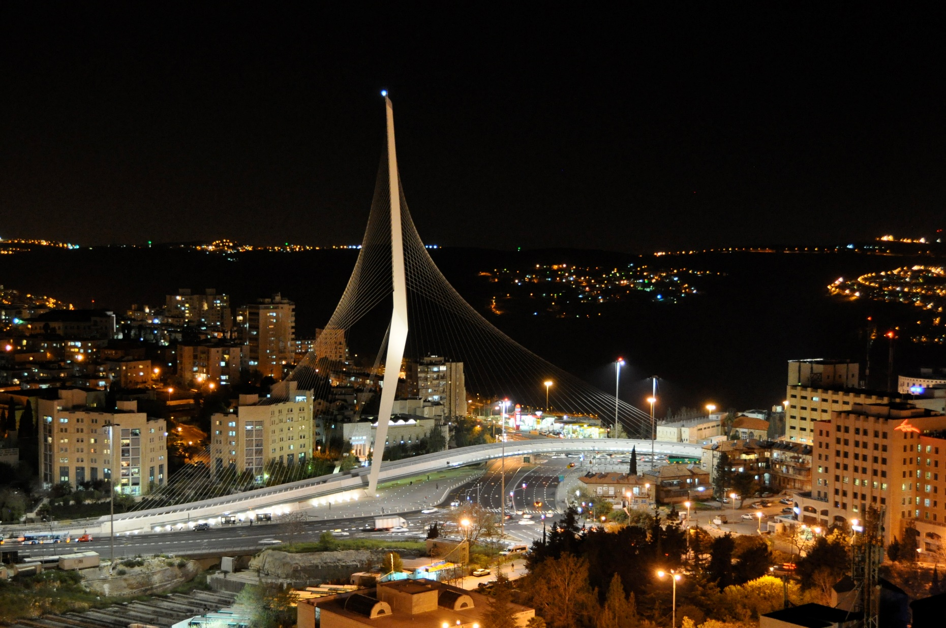

Slide 49
The form of the bridge resembles a tent in the desert or a harp, with the cables as the strings, symbolising King David's harp.
Notes:
https://en.wikipedia.org/wiki/Chords_Bridge

Slide 50
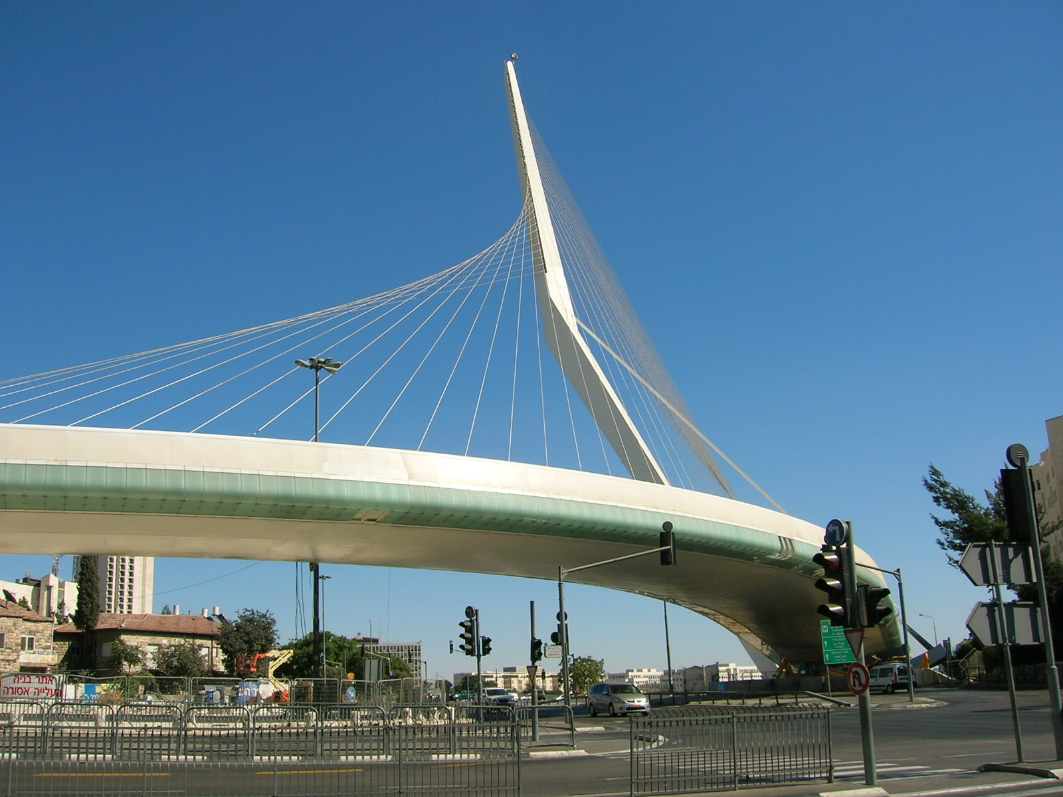

Slide 51
So King David’s music is his prime legacy. Music has become an absolute expression of Jewish covenantal identity.

Slide 52
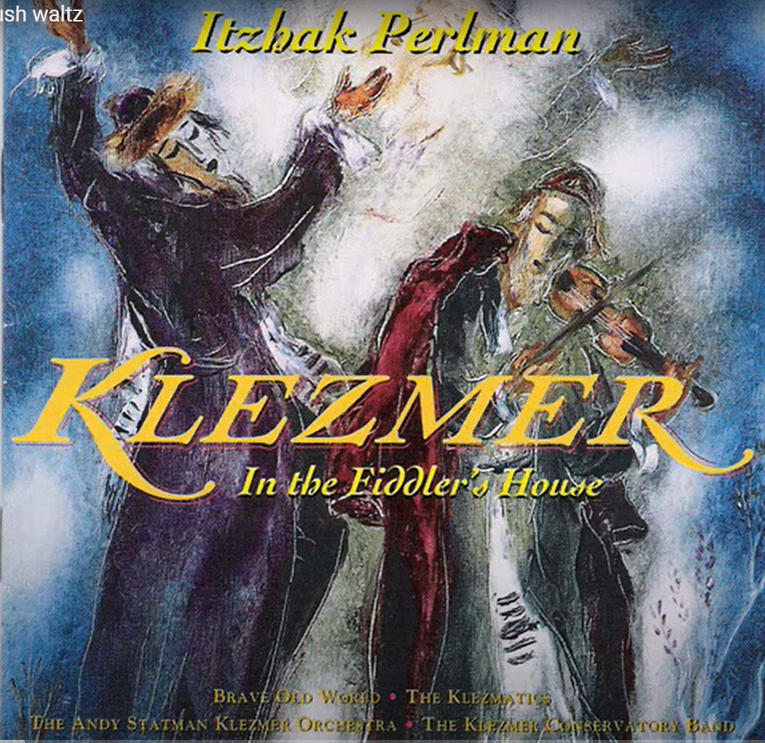
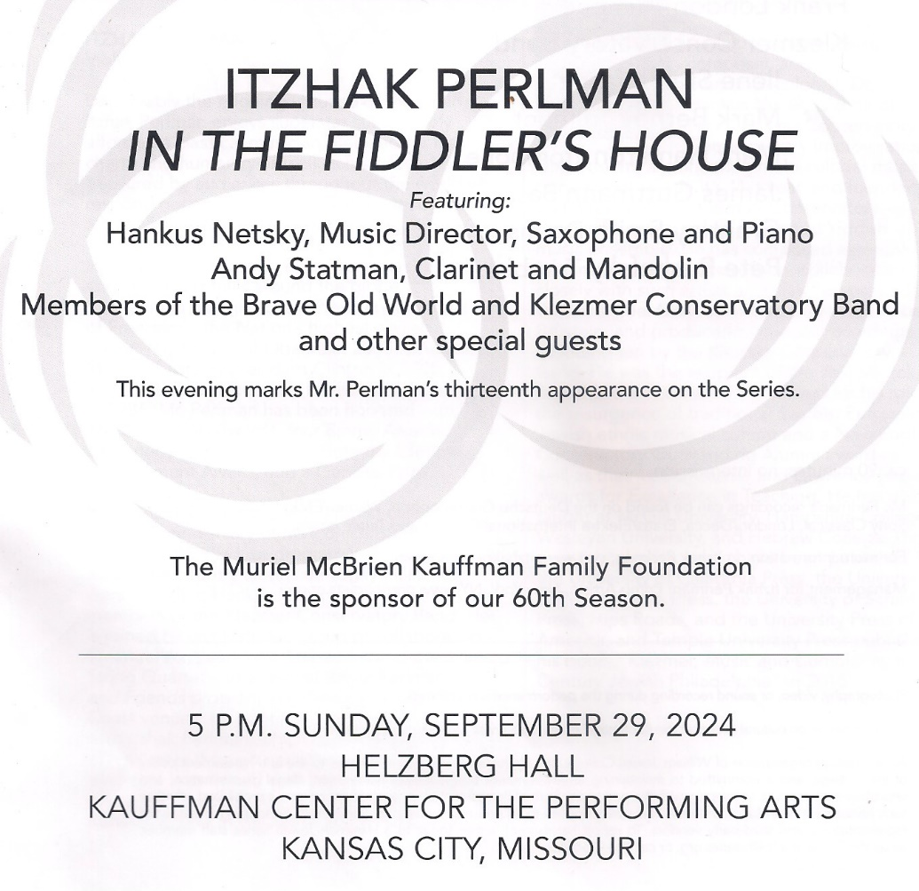
Notes:
Sunday, Sept. 29, Dawn and I went to hear Itzhak Perlman, Andy Statman and others play a Klezmer concert at wonderful Helzberg Hall.

Slide 53
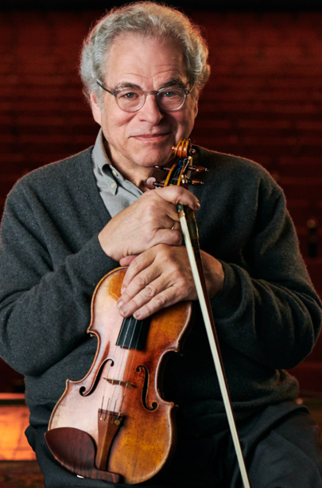
Itzhak Perlman יִצְחָק פרלמן
born 1945
is an Israeli-American violinist.
Notes:
https://itzhakperlman.com/
Maybe the world’s premiere violist.

Slide 54
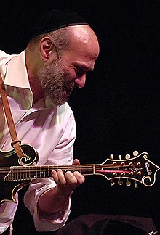
Andrew Edward Statman (born 1950) is a noted American klezmer clarinetist and bluegrass/newgrass mandolinist.
Notes:
https://en.wikipedia.org/wiki/Andy_Statman

Slide 55
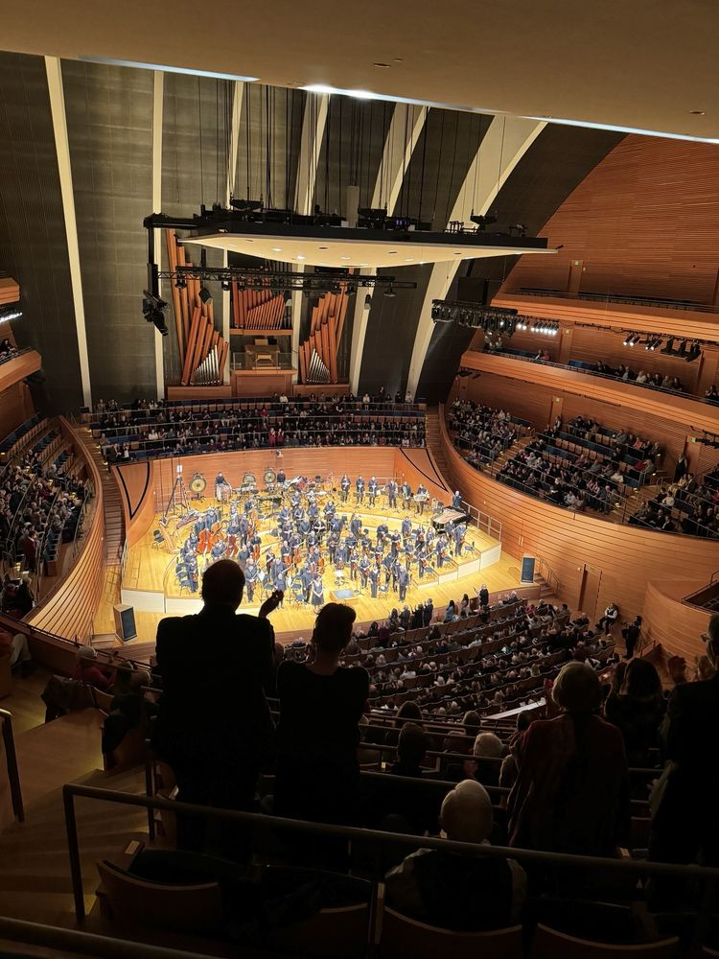
Notes:
As Dawn and I were sitting there in that magnificent Helzberg concert hall listening the rich Klezmer sounds of the instruments and vocals, I thought I should pray for unsaved Jewry. But as I tried to lift my spirit, I had the most surprising sense. Yeshua, the King of Israel, did not want intercessory prayer offered. He was enjoying the music and the spirit of joy and beauty which remained from the glory days of the Temple. This has been one major means of preserving Jewish identity. These people would come to Him in time, but right now just celebrate with them.
That is why we do a lot of folksy Israeli music. Yismikhu HaShamayim and Rad Halila today.
There is an expression of covenantal Jewish joy!!
Messiah is preserving His people, and loves them!!

Slide 56
Covenantal identity #2: enjoy His presence, in music, in Jewish music too.

Slide 57
₃the covenants are theirs
G-d made eight covenants with humanity. In Eden, with Adam, Noah, Abraham, Moshe 2x, David,
Renewed. Five of the covenants were with all humanity, but through the Jewish people.
Notes:
Hebrew roots left out here.

Slide 58
₄likewise the giving of the Torah
We discussed that above in the heritage of literacy, study. But another dimension of that is the beauty of the restored Hebrew language.

Slide 59
^{Zeph 3.9} For then I will restore to the people pure speech, so that all of them may call upon the Name of Adoni.
Something in your kiskas [guts] may resonate with the Hebrew.
Notes:
Really? New alphabet. Two of them: print and cursive. New sounds. Right to left. Despite all that!

Slide 60
Covenantal identity #4
Continue Hebrew study. Maybe five minutes daily? Music? Joshua Aaron, etc.

Slide 61
₅the Temple service and the promises
There is a deep longing for the Land where we had that Temple worship.
Every year, at Passover, we pray and affirm, “Next year in Jerusalem.”

Slide 62
^{T’hillim/ Ps 137.5-6} If I forget you, Yerushalayim, may my right hand wither away! May my tongue stick to the roof of my mouth if I fail to remember you, if I fail to count Yerushalayim the greatest of all my joys.

Slide 63
A custom came out of this that at every wedding, otherwise the pinnacle of joy, a cup would be smashed, acknowledging that our joy is NOT perfect. The Temple Mount is still in enemy hands. We are still fighting enemies!

Slide 64


Slide 65

Notes:
https://external-content.duckduckgo.com/iu/?u=http%3A%2F%2Fwww.bridalguide.com%2Fsites%2Fdefault%2Ffiles%2Fblog-images%2Fbridal-buzz%2Fmodern-jewish-wedding-traditions%2Fjewish-wedding-breaking-the-glass.jpg&f=1&nofb=1&ipt=7008c5085c096ef56e61ea2df664277a0d7ac975f9db5fac34881afd9779c719&ipo=images

Slide 66

Notes:
https://www.smashingtheglass.com/wp-content/uploads/2016/05/breaking-the-glass-jewish-wedding.jpg

Slide 67
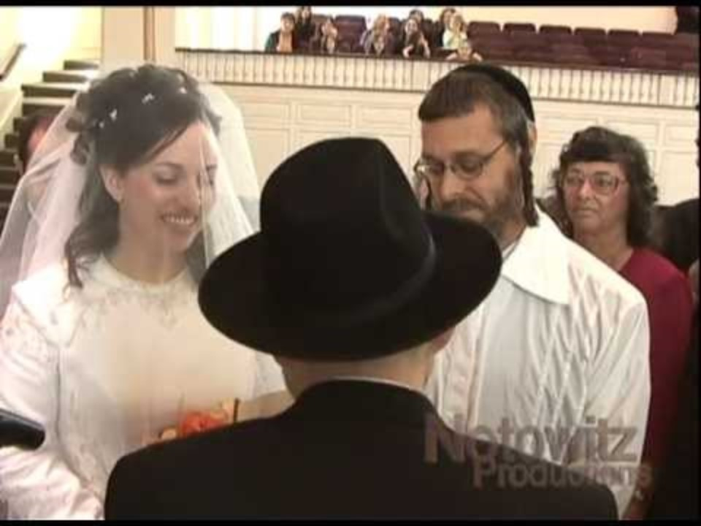
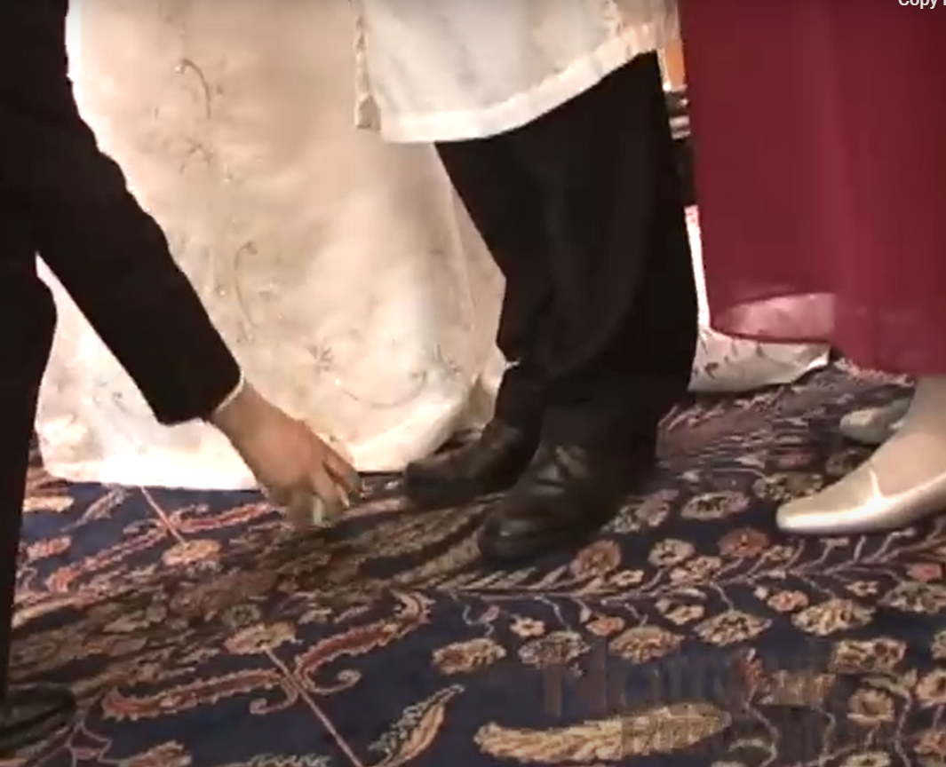
Notes:
https://youtu.be/_c-ZHyqk6sQ?t=282

Slide 68
And that Land, that little sliver on the east edge of the Mediterranean, as big as Metro KC, is our HOME, despite what the world, the UN, the Arabs say.

Slide 69
^{Yermiyahu/Jer 31.34-36} This is what Adoni says, who gives the sun as light for the day, who ordained the laws for the moon and stars to provide light for the night, who stirs up the sea until its waves roar — Adoni-Tzva’ot is his name: “If these laws leave my presence,” says Adoni,

Slide 70
^{Yermiyahu/Jer 31.34-36} “then the offspring of Isra’el will stop being a nation in my presence forever.” This is what Adoni says: “If the sky above can be measured and the foundations of the earth be fathomed, [explore verb חָקַר]

Slide 71
^{Yermiyahu/Jer 31.34-36} then I will reject all the offspring of Isra’el for all that they have done,” says Adoni.

Slide 72
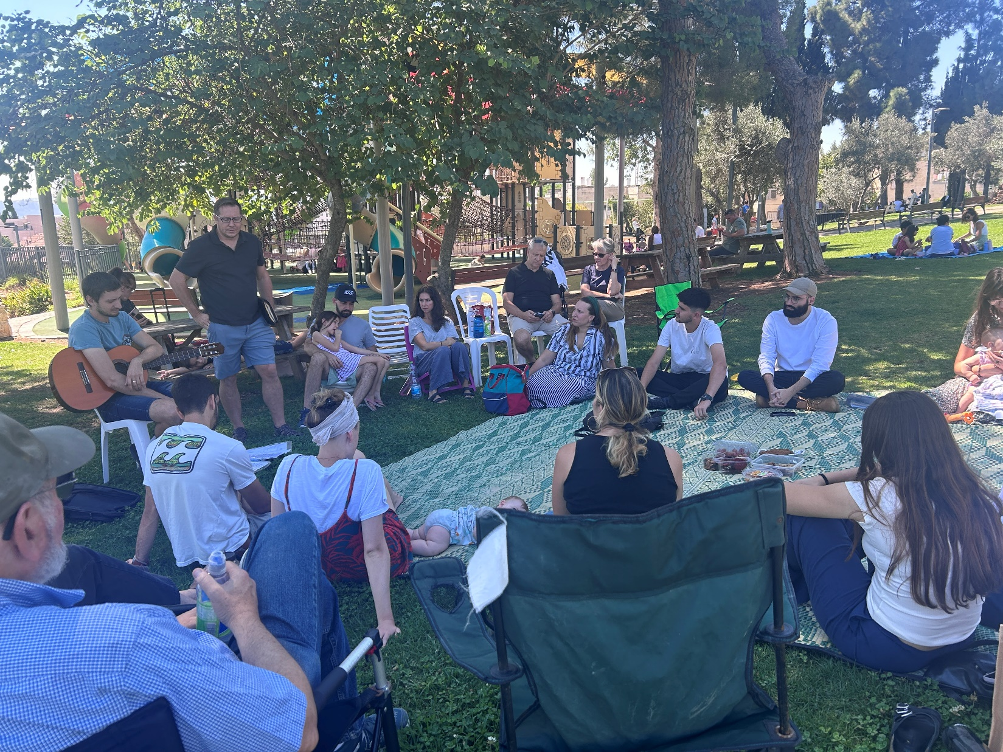
From Jackie Santoro in Tel Aviv

Slide 73
From Jackie Santoro in Tel Aviv
This Saturday, we met, as we do once a month, as a smaller group in a local park. It was a beautiful day and everyone enjoyed the relaxed atmosphere. As we gathered, we heard a "boom" and above us, high in the sky was a burst of smoke- an interception of a rocket. It hardly attracted any attention. Life in Israel.
Notes:
Jews need to be resilience to attack, to what could be trauma.

Slide 74
The whole ceasefire agreement was a ploy to encourage Hezbollah to let down their guard. And more incredible, because of the "beeper" attacks which took the world and Hezbollah by surprise and wonder, it forced Nasrallah to go in person to his meeting in the bunker

Slide 75
Because their communication system was devastated and what remained intact was suspect. The stage was set and God's hand of favor rested upon the Air Force as 8 planes executed a perfect and highly complex maneuver, dropping 82 tons of explosives on the gathering from hell.

Slide 76
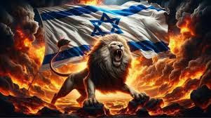
The Lion of Judah is roaring.

Slide 77
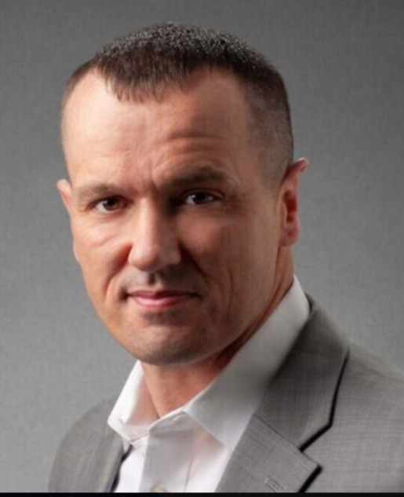
Maj. John Spencer has a long combat career in the US Army, including two tours in Iraq soldier and commander. He emerged as one of the world’s foremost experts in urban warfare.
Notes:
https://www.israeltoday.co.il/read/urban-warfare-expert-hezbollah-suffered-catastrophic-damage/?mc_cid=86ab8bf53f&mc_eid=9f06d9f262

Slide 78
Maj. Spencer made a statement that should resonate globally. “Everything that the world has heard about Gaza has actually been counterfactual. It has been wrong. What Israel has done to protect civilians, and despite what Hamas has wanted, has been an amazing achievement that I didn’t even, personally as an urban warfare scholar, think was possible.”
Notes:
https://www.israeltoday.co.il/read/urban-warfare-expert-hezbollah-suffered-catastrophic-damage/?mc_cid=86ab8bf53f&mc_eid=9f06d9f262

Slide 79
Daniel Cohen, the news director at Real Life Network , who lives in Israel, said the people of the not-so-religious city of Tel Aviv believe the unfolding events and the “way God is protecting Israel is biblical.”
Notes:
https://washingtonstand.com/news/the-church-must-stand-with-israel-pray-vote-stand-summit-panel-urges

Slide 80
Israel is "involved in the near combat in Lebanon, they're still cleaning up Gaza, and now they have a law enforcement action in [Judea and Samaria], and they still have Houthis firing rockets at them from Yemen," Rep. Keith Self (R-Texas) on "Washington Watch"
Notes:
https://washingtonstand.com/commentary/israel-sustains-multifront-war-while-mulling-iran-counterstrike

Slide 81
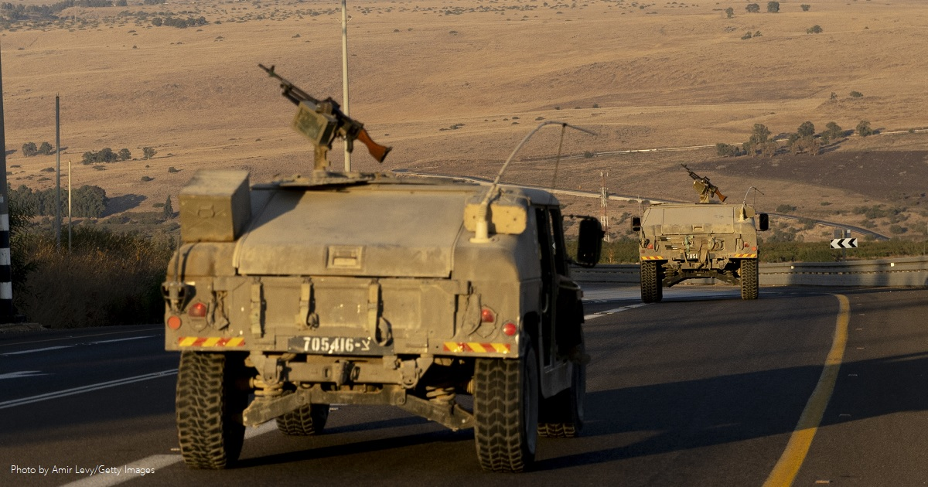
Notes:
https://washingtonstand.com/commentary/israel-sustains-multifront-war-while-mulling-iran-counterstrike

Slide 82
Nevertheless,
Ain Erets akheret אין ארץ אחרת
There is no other land.
No where else to go.

Slide 83
Land of prophetic destiny
Rabbi Judah Ben Samuel wrote the following prophecy in AD 1217: “When the Ottomans conquer Jerusalem they will rule over Jerusalem for eight jubilees.” 400 yrs. Ottoman conquest 1517
1517 + 400 = 1917
Notes:
Exactly what happened.
https://z3news.com/w/800yearold-prophecy-claims-israel-lose-control-jerusalem/

Slide 84
Afterwards Jerusalem will become no-man’s land for one jubilee, and then in the ninth jubilee [1967] it will once again come back into the possession of the Jewish nation – which would signify the beginning of the Messianic end time.”
Notes:
https://z3news.com/w/800yearold-prophecy-claims-israel-lose-control-jerusalem/

Slide 85
Summarize 1917
British government changed to favor Israel and Balfour Declaration made.
General Allenby conquered Jerusalem so British could follow their policy.

Slide 86
1967 Six day war Jerusalem Soviet Union sent bogus word to Egypt and Syria that Israel about to attack. So Arabs mobilized. General Mota Gur Har HaBiyit b’yadenu. Lions Gate. Yeshua coming back as Lion. Prophecy G restoring Israel as Lion.

Slide 87
2017 Jerusalem got legal right and recognition of restoration.

Slide 88
Also 1867
Mark Twain recognized desolations according to parasha of the week Dt 29.22
Charles Warren rediscovered ancient Jerusalem Zech 2.5-8
Ottoman Turks change land law
Notes:
Oracle 52-53
Moreover, 7 x 50 previous was the beginning of Ottoman rule.
Twain and Herzl became friends in 1894 at the Dreyfus trial, where Dreyfus had the insignia torn from his uniform and his sword broken and was paraded before a crowd that shouted, “Death to Judas, death to the Jew.”
https://www.history.com/news/what-was-the-dreyfus-affair

Slide 89
Covenantal identity #6
Love the Land of Israel, and consider going there.
Birthright free tour
HaYovel service project
SarEl service project
Aliyah: 13 Or HaOlamniks

Slide 90
₇From them, as far as his physical descent is concerned, came the Messiah, who is over all. Praised be Adoni for ever! Amen.
Yeshua is the Jewish Messiah.*
Little by little, and big time soon enough, Israel will see:
Notes:
*As mentioned above, He is a relative, besides everything else.

Slide 91
^{Yeshayahy 25.7-9} On this mountain he will destroy the veil which covers the face of all peoples, the veil enshrouding all the nations. He will swallow up death forever.* Adoni Elohim will wipe away the tears from every face, and he will remove from all the earth
Notes:
* The resurrected Messiah will reveal Himself to our people. Is He real to you by repentance of sin and faith in His atoning death and resurrection?

Slide 92
^{Yeshayahy 25.7-9} the disgrace his people suffer. For Adoni has spoken. On that day they will say, “See! This is our God! We waited for him to save us. This is Adoni ; we put our hope in him. We are full of joy, so glad he saved us!” For on this mountain the hand of Adoni will rest.

Slide 94
Bar Mitzvah: Son of the Covenant
Entering Covenantal Identity
Aspects of Covenantal Identity
in Romans 3
3. Aspects of Covenantal Identity
in Romans 9

