Slide 1
e-handout
To have these notes
without taking notes
Go to OrHaOlam.com
Click on Messages tab,
2024 Messages

Slide 2
This is Thanksgiving season. Holiday soon.
I would like to express great praise in my heart…
Notes:
Three numbers to memorize…

Slide 3

Five million

Slide 4
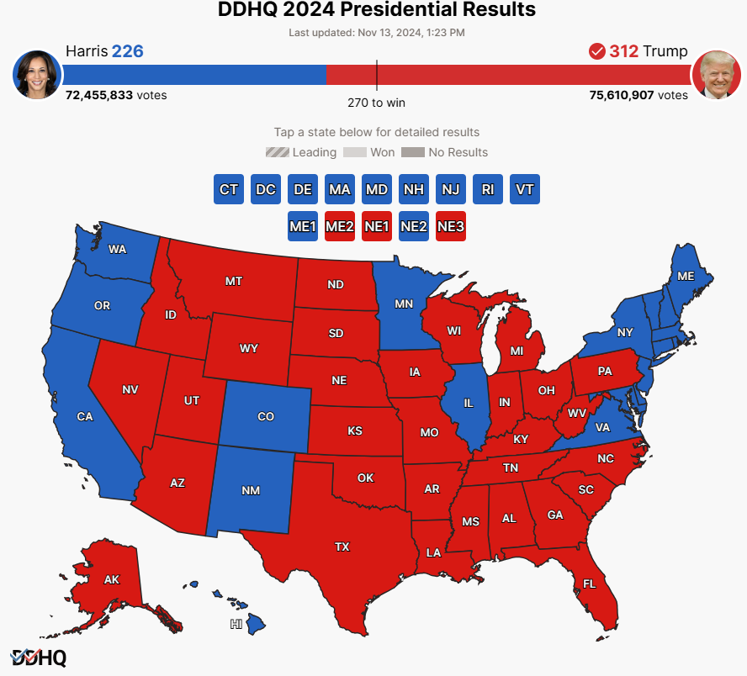
Notes:
https://election.dailywire.com/?_gl=1*exe0q9*_gcl_au*NDg5MTMwNzI1LjE3Mjk4OTY0MTg.*_ga*NzQxMjY0MjMwLjE3Mjk4OTY0MTc.*_ga_CZKR9ZYKJP*MTczMTUyMjE4OS4zMC4xLjE3MzE1MjIxOTEuNTguMC4w

Slide 5
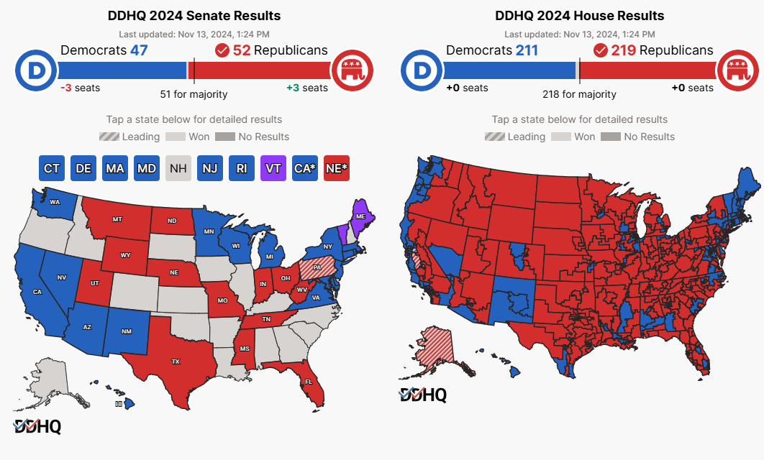
Notes:
https://election.dailywire.com/?_gl=1*exe0q9*_gcl_au*NDg5MTMwNzI1LjE3Mjk4OTY0MTg.*_ga*NzQxMjY0MjMwLjE3Mjk4OTY0MTc.*_ga_CZKR9ZYKJP*MTczMTUyMjE4OS4zMC4xLjE3MzE1MjIxOTEuNTguMC4w

Slide 6
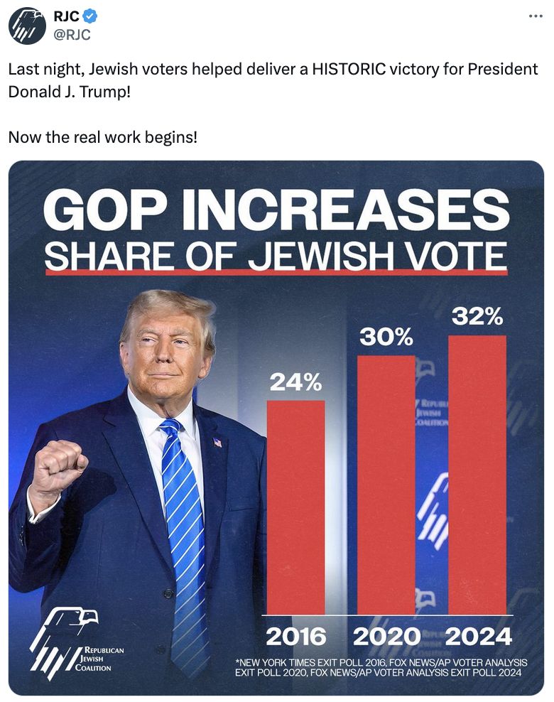
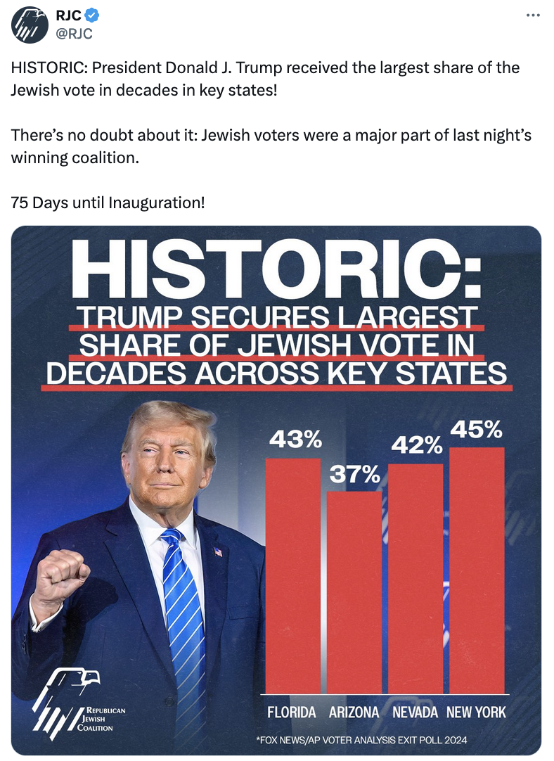
Notes:
https://www.rjchq.org/r?u=elU6hzbBMToeUYFu_p9Q9eX1WIuFvh9gEfvYSjMMP-sux2JwgBlY4E6P1xhpiLam&e=ee1f07d0ff55e705ff44ed1f5124576f&utm_source=rjchq&utm_medium=email&utm_campaign=trump_results_enews_blast&n=1

Slide 7
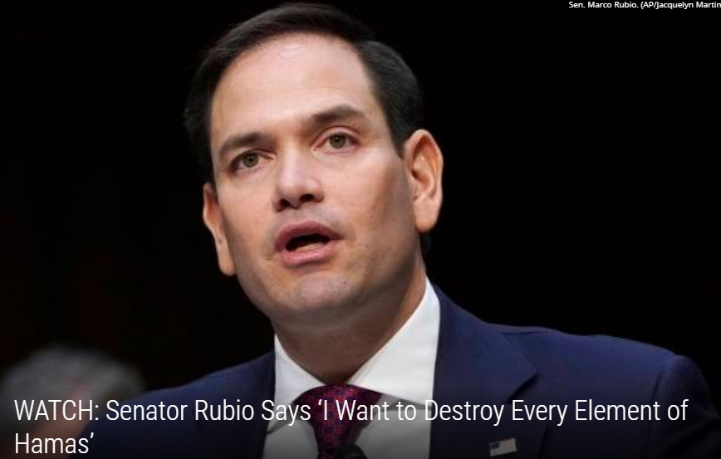
Sec. of
State
nominee

Slide 8
So, I am thankful.

Slide 9
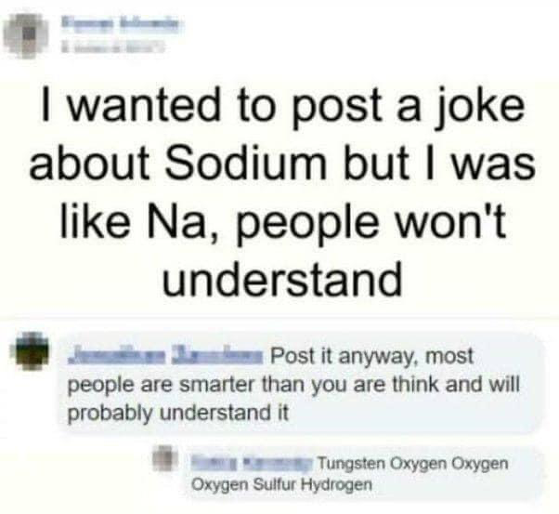
Salty humor
I have some chemistry with this
Notes:
Brian Kaufman

Slide 10
Notes:
Brian Kaufman

Slide 11
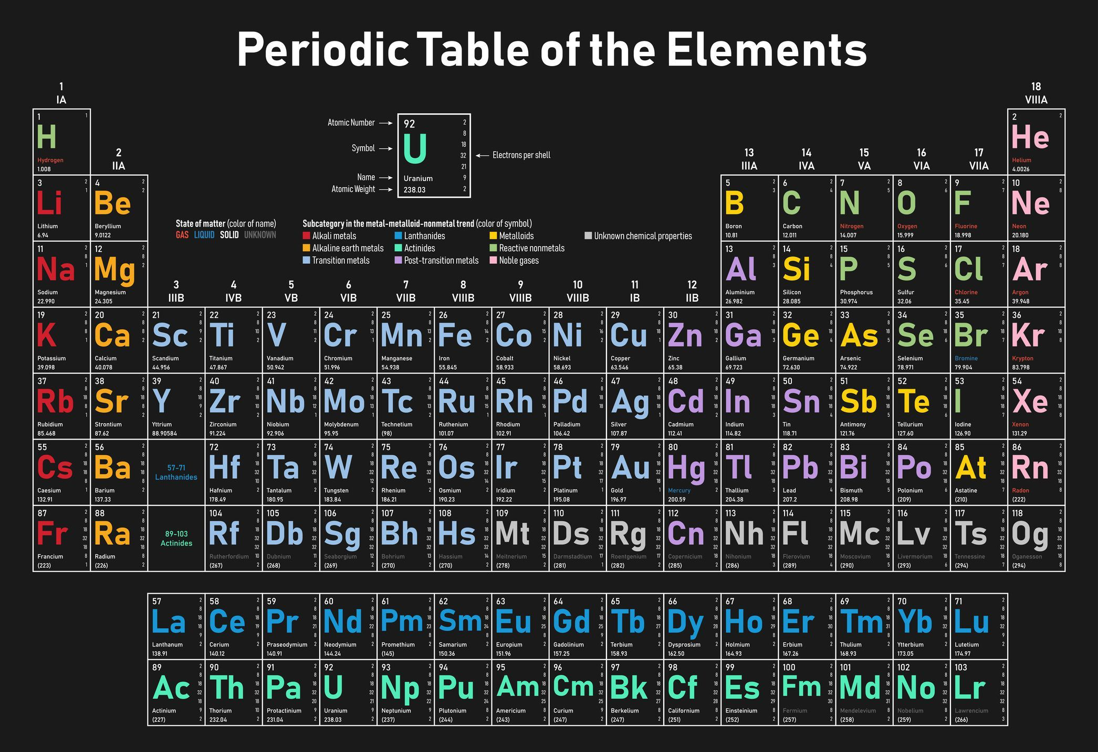
sodium
Notes:
Brian Kaufman
https://i.pinimg.com/originals/c0/bf/7a/c0bf7a24ee49e1edaff224a596507b94.jpg

Slide 12
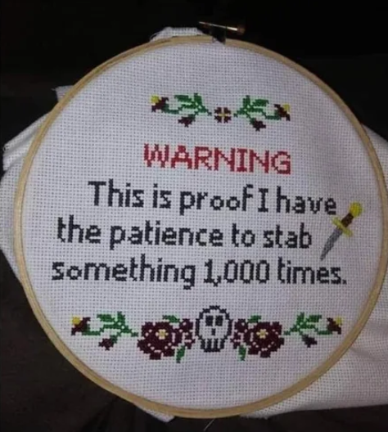
Notes:
https://9gag.com/gag/aXbv9W2
Cross stitch

Slide 13
A major subject of disagreement, misunderstanding, hurt feelings among Messianics…

Slide 14
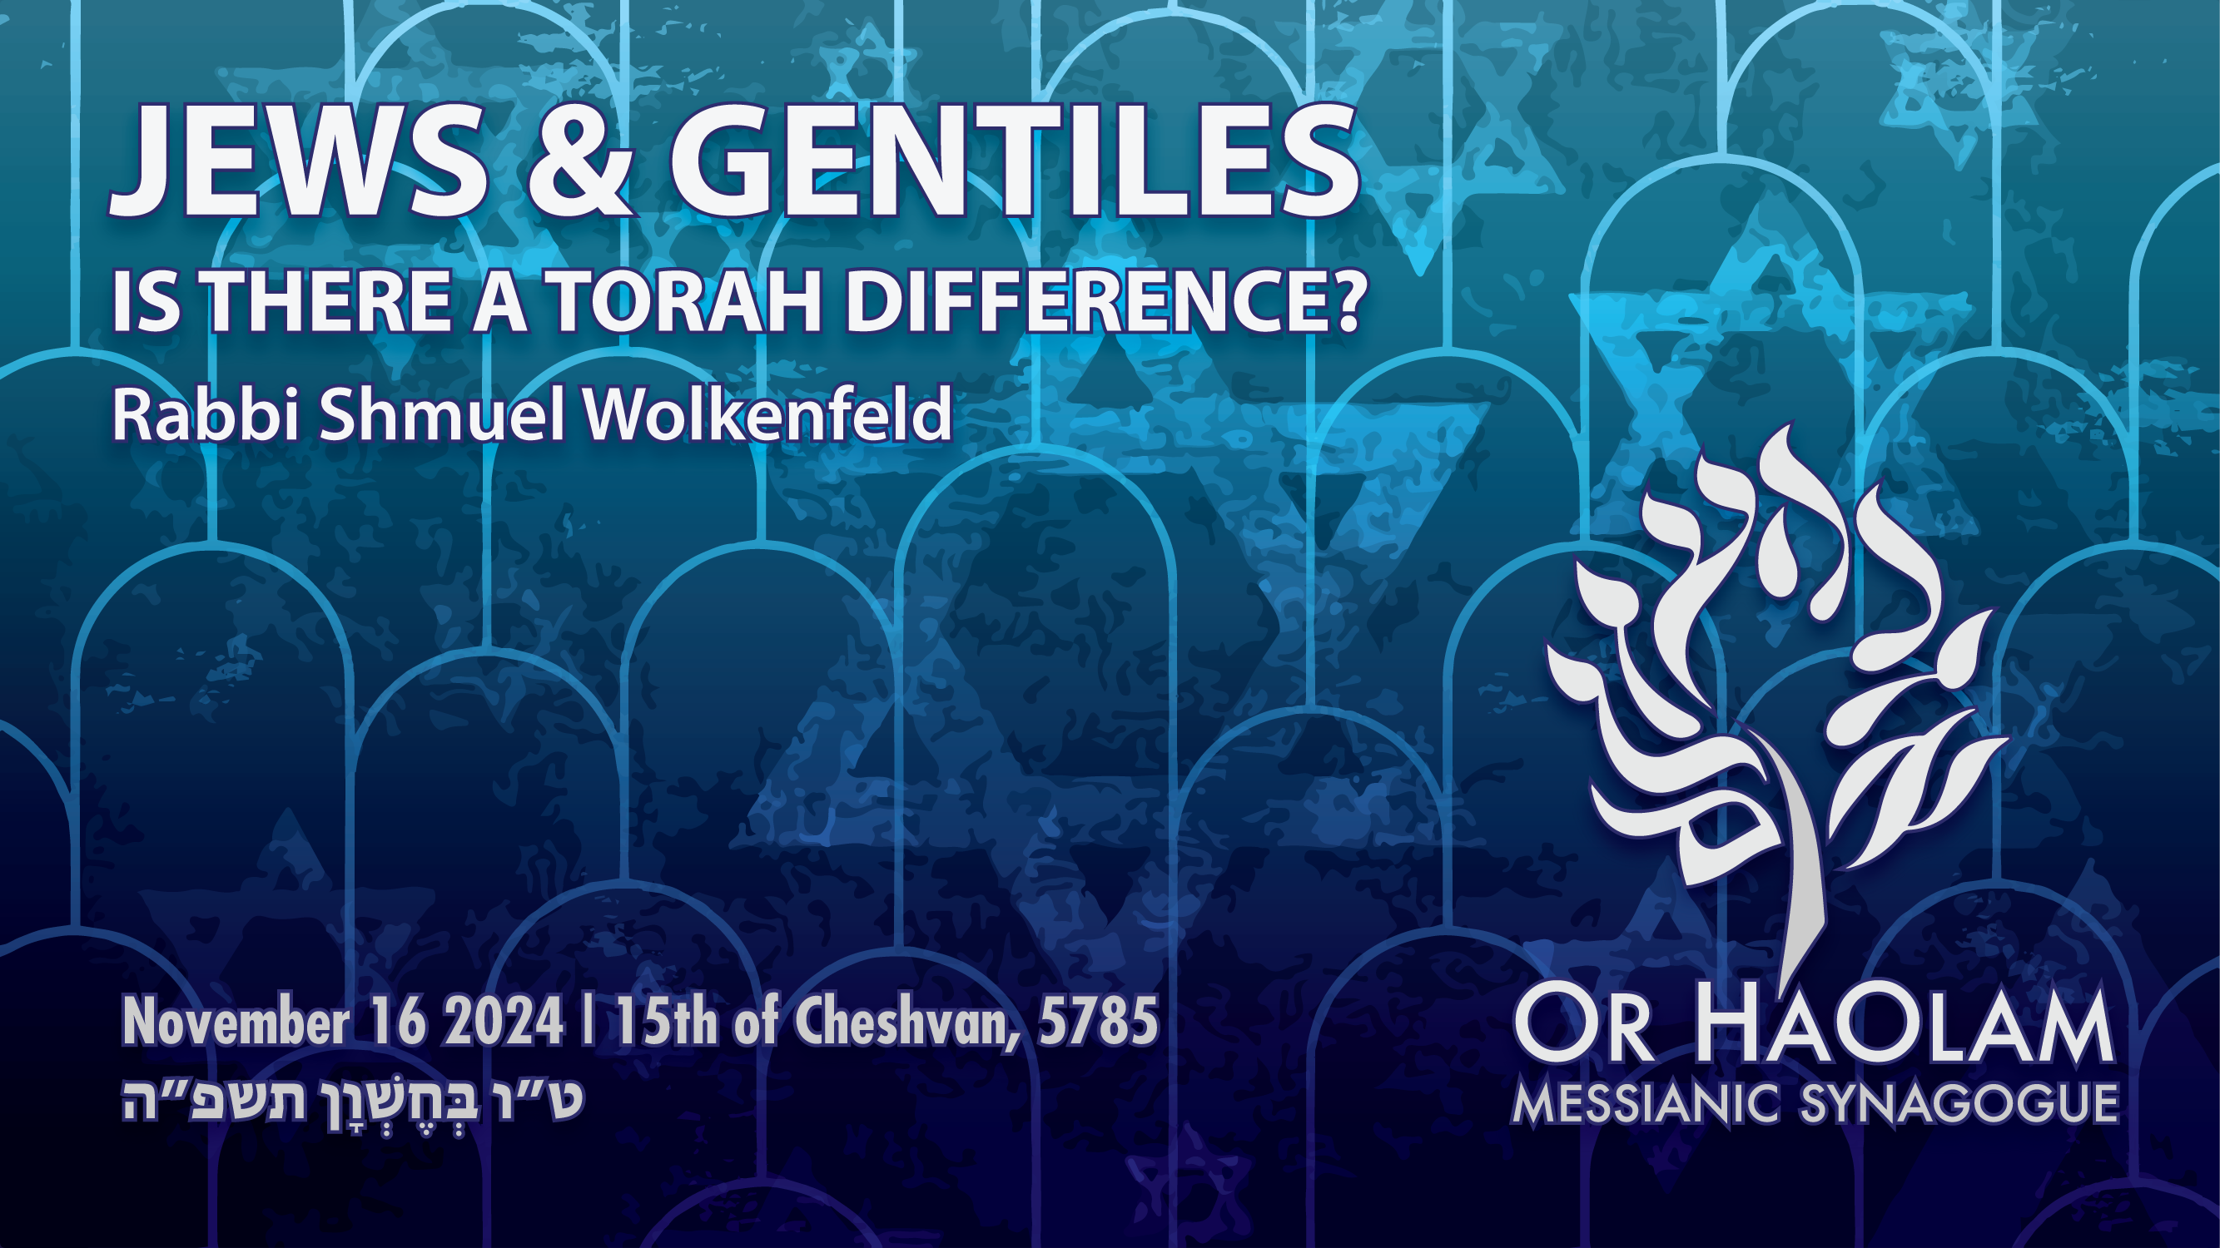

Slide 15

Jews and Gentiles:
is there a Torah Difference?
Uncertainty in scripture
Certainty and power for Jews
Certainty and effect for Gentiles.
My vision for Or HaOlam

Slide 16
Jews and Gentiles:
is there a Torah Difference?
Uncertainty in scripture
Certainty and power for Jews
Certainty and effect for Gentiles.
My vision for Or HaOlam

Slide 17
^{Yn 8.31-32} So Yeshua said to the Judeans who had trusted him,
“… You will know the truth, and the truth will set you free.”

Slide 18
There are at least 7 scriptures stating the differing Torah requirements between Jews and Gentiles in the Messianic Scriptures/New Testament.

Slide 19
^{Acts 15.1-2} But some men came down from Y’hudah to Antioch and began teaching the brothers, “You can’t be saved unless you undergo b’rit-milah / circumcision in the manner prescribed by Moshe.” This brought them into no small measure of discord and dispute with Sha’ul and Bar-Nabba.
Notes:
This has been an argument for a looooong time.

Slide 20
^{Acts 15.5} But some belonging to the party of the P’rushim / Pharisees who had believed stood up, saying, “It is necessary to circumcise them and to command them to keep the Torah of Moshe.”

Slide 21
Ebionites Evyonim אביונים Gentiles keep all the Torah
Nazarenes Natsratimנצרתים נוֹצְרִי more nuanced approach
Minority and majority,
Minority comes back, Hebrew roots.
Notes:
#2 has a learning curve.

Slide 22
[First] Jerusalem Council
^{Acts 15.6-7} The emissaries and the elders met to look into this matter. After lengthy debate, Kefa got up and said to them…

Slide 23
^{Acts 15.10-11} Why then do you put God to the test by putting a yoke on the neck of the disciples—which neither our fathers nor we have been able to bear? But instead, we believe that we are saved through the love and kindness of the Lord Yeshua, in the same way as they are.”
Notes:
The yoke is what will not be put upon the new Gentile believers, that the Jews bear.

Slide 24
What is exactly is the yoke?
Notes:
My thesis, main point of this message: The yoke was never precisely defined.

Slide 25
^{Acts 15.19-21} “Therefore, my opinion is that we should not put obstacles in the way of the Goyim who are turning to God. Instead, we should write them a letter telling them to abstain from things polluted by idols, from fornication,

Slide 26
^{Acts 15.19-21} from what is strangled and from blood. For from the earliest times, Moshe has had in every city those who proclaim him, with his words being read in the synagogues every Shabbat.
Notes:
These words have been the subject of debate.

Slide 27
What exactly are the obstacles?

Slide 28
Two interpretations of these verses:
Moshe has been read and little effect on Gentiles. Fugetaboutit!
Moshe has been read. Now, in Messiah, they’ll get it and embrace Torah. But, timeline to do so?
Notes:
These are the alternative views of the Natsratim/Nazarenes. Evyonim / Ebionites demanded instant TOTAL adherence to Torah. This view was rejected at the Acts 15 Jerusalem Council .

Slide 29
^{Acts 15.24} We have heard that some people went out from among us without our authorization, and that they have upset you with their talk, unsettling your minds [TLV some mss. add saying, “You must be circumcised and keep the law,”].
Notes:
Conclusion of the Jerusalem Council Acts 15

Slide 30
What talk,
“unsettling your minds.” ?

Slide 31
^{Acts 15.27-29} We therefore have sent to you Judah and Silas, who themselves will report to you the same things by word of mouth. It seemed good to the Ruakh ha-Kodesh and to us not to place on you any greater burden than these essentials:
Notes:
Burden?

Slide 32
^{Acts 15.27-29} that you abstain from things offered to idols, from blood, from things strangled, and from sexual immorality. By keeping away from these things, you will do well.
Notes:
Later “Don’t ask / don’t tell about idol offered meat.”
This can’t be complete. No reference to truth telling, murder, generosity. Just a hint.

Slide 33
^{Acts 21.25} “As for Gentiles who have believed, however, we have written by letter what we decided—for them to abstain from what is offered to idols, and from blood, and from what is strangled, and from immorality.”
Notes:
Tanakh, Hebrew scriptures background on the reference to blood…

Slide 34
^{Vayikra/Lev 17. 13-14} “When someone from the community of Isra’el or one of the foreigners living with you hunts and catches game, whether animal or bird that may be eaten, he is to pour out its blood and cover it with earth.
Notes:
Not for outsiders

Slide 35
^{Vayikra/Lev 17. 13-14} For the life of every creature — its blood is its life. Therefore I said to the people of Isra’el, ‘You are not to eat the blood of any creature, because the life of every creature is its blood. Whoever eats it will be cut off.’

Slide 36
^{Gal. 2.7} On the contrary, they saw that I had been entrusted with the Good News for the uncircumcised just as Peter was for the circumcised.
Notes:
Pause, let’s examine that wording

Slide 37
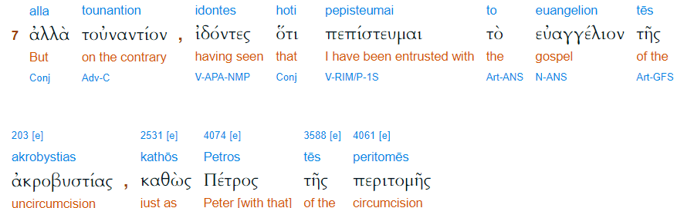

Slide 38
Dr. Willitts' states that there are two different gospels, not two different messages. Sounds confusing, however it’s clear when it is acknowledged that the Gentile's relationship to Torah is
Notes:
Brett Clear’s notes on the Yeshiva class called "Paul's Letter to the Galatians." The teacher's name is Dr. Joel Willitts

Slide 39
completely different than the Jew's. With the covenantal identity that exists for the Jew within Torah also comes a covenantal responsibility to Torah. Whereas the Gentile is not obligated to Torah like the Jew is.
Notes:
Brett Clear’s notes on the Yeshiva class called "Paul's Letter to the Galatians." The teacher's name is Dr. Joel Willitts

Slide 40
^{Gal. 2.14} But when I saw that they were not walking in line with the truth of the Good News, I said to Peter in front of everyone, “If you—being a Jew—live like the Gentiles and not like the Jews, how can you force the Gentiles to live like Jews?”

Slide 41
All the terms for what the Gentiles in the congregations are NOT obligated to do…the yoke, the obstacles, the unsettling issues, the greater burden mean SOMETHING, but are never definitively clarified.

Slide 42
Two interpretations of these verses:
Moshe has been read and little effect on Gentiles. Fugetaboutit!
Moshe has been read, and now they’ll get it and assimilate into Torah. But, timeline to do so?

Slide 43
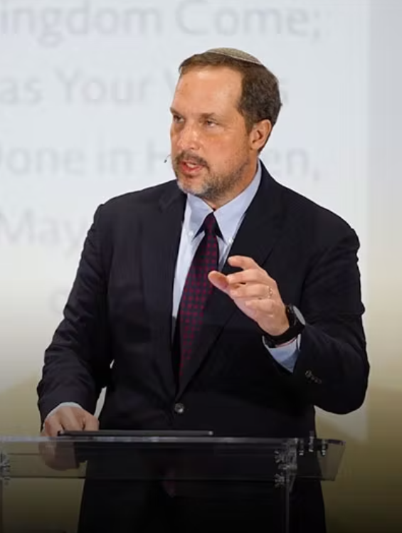
Boaz Michael, founder of First Fruits of Zion, an educational Messianic organization.
“We believe that the Torah of Moses (Genesis­ -Deut.)
Notes:
https://torahclub.ffoz.org/malchut/then-the-end-will-come.html#.YqfaLQLm_zE.gmail

Slide 44
is God’s initial revelation and self-disclosure not only to Israel, but to all of humanity.”
Notes:
https://torahclub.ffoz.org/malchut/then-the-end-will-come.html#.YqfaLQLm_zE.gmail

Slide 45
FFOZ varying interpretations:
divine permission 1990’s,
One Law 2000, [uninvited from the Messiah Conf.]
divine invitation 2009,
distinction theology

Slide 46
Covenant: ^{1 Kefa/Peter 2.9} But you are a chosen people, a royal priesthood, a holy nation, a people for God’s own possession, so that you may proclaim the praises of the One who called you out of darkness into His marvelous light.
Notes:
But who is this addressed to?

Slide 47
Undefined terms for the difference in Torah observance:
The Yoke
The obstacles
The burden
Unsettling the minds

Slide 48
Jews and Gentiles:
is there a Torah Difference?
Uncertainty in scripture
Certainty and power for Jews
Certainty and effect for Gentiles.
My vision for Or HaOlam

Slide 49
Real distinction ^{Ro 11.12-15} Now if their transgression leads to riches for the world, and their loss riches for the Gentiles, then how much more their fullness!.... For if their rejection leads to the reconciliation of the world, what will their acceptance be but life from the dead?
Notes:
Focus: much more riches, life from the dead!!
This applies if and when Jewish people come to Messiah in repentance and faith for salvation, and then life as Jews in Yeshua.

Slide 50
That is, when a Jew comes to Messiah, and lives Jewishly, in Torah, community, there is a cosmic multiplying effect.
When a Jew comes to faith and assimilates into the church, in a sense, Israel is not saved.
Notes:
There are many Jews in the churches who’ve forgotten, or dismissed who they are. Holidays, food, prayers, culture.

Slide 51
^{Zekh 8.23} Thus says Adoni-Tzva’ot, “In those days it will come to pass that ten men from every language of the nations will grasp the corner of the garment of a Jew saying, ‘Let us go with you, for we have heard that God is with you.’”
Notes:
Ten to one is the experience of Yehudim for Yeshua…when one Jewish person comes to repentance and faith, there is an overflow in the Ruakh/Spirit, and ten Gentiles come to faith in Messiah.

Slide 52
That is, when a Jew comes to Messiah, and lives Jewishly, in Torah, community, there is a cosmic multiplying effect.
When a Gentile is saved and keeps Torah, they have great blessings, but no such multiplier.
Notes:
much more riches, life from the dead!!
Collision of Black Holes, radiation of power >> James E. Webb telescope can handle!

Slide 53
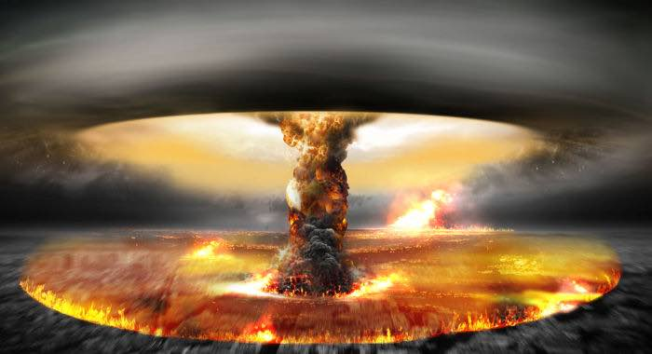
Notes:
much more riches, life from the dead!!
https://youtu.be/c6W2suGacjQ
much more riches, life from the dead!!
So we are here not just for the Jews. If the Jews get restored, the Gentiles profit IMMENSELY!!

Slide 54
Dr. Michael Brown’s comment:
50 Jews in a Messianic Syn has more impact on the Jewish community than 500 Jews in the churches. That’s why we seek the Jew first. Not better, not more important, but a covenantal responsibility.
Notes:
Jews in the churches: “they just chickened out of being Jewish. Maintaining our people.”

Slide 55
So, what is the difference between Jews and Gentiles in Torah observance?
Nothing, in practice, except circumcision.

Slide 56
^{1 Cor.7.18} Was anyone called when he already had been circumcised? Let him not make himself uncircumcised. Has anyone been called while uncircumcised? Let him not allow himself to be circumcised.
Notes:
Cosmetic surgery so men appeared uncircumcised, since nudity and exposure was part of Greek culture. No spandex then so sports, Olympics, done nude.
Babies can be circumcised, for identity with Israel, and health. But we can’t and shouldn’t think we can make them Jewish.

Slide 57
So, what is the difference between Jews and Gentiles in Torah observance?
Nothing, in practice, except circumcision.

Slide 58
So, what is the difference between Jews and Gentiles in Torah observance?
Everything, in spiritual, cosmic, multiplying, world shaking effect.

Slide 59
There is GREAT power for Jewish people to serve the Messiah Jewishly.
^{Ro 11.11} Deliverance has come to the Gentiles, in order to provoke them to jealousy.
Notes:
One of our people: “I’m not Jewish, but I practice Judaism.”
A great way to bless Israel, and yourself.
Shabbat commerce, restaurants, Biblically kosher foods, prayer, Hebrew, Israel.
So having a Messianic Jewish congregation
For Jews: greater riches and life from the dead to the Gentiles
For Gentiles, bless Israel and be blessed

Slide 60
Definitive scripture that the Gentiles can keep Torah, but a gradual and individualized learning curve is expected.

Slide 61
^{Ro 14.1-5} The one who eats anything must not look down on the one who abstains; and the abstainer must not pass judgment on the one who eats anything, because God has accepted him — who are you to pass judgment on someone else’s servant?

Slide 62
^{Ro 14.1-5} It is before his own master that he will stand or fall; and the fact is that he will stand, because the Lord is able to make him stand. One person considers some days more holy than others, while someone else regards them as being all alike.

Slide 63
^{Ro 14.1-5} Now as for a person whose trust is weak, welcome him — but not to get into arguments over opinions. One person has the trust that will allow him to eat anything, while another whose trust is weak eats only vegetables.

Slide 65
Jews and Gentiles:
is there a Torah Difference?
Uncertainty in scripture
Certainty and power for Jews
Certainty and effect for Gentiles.
My vision for Or HaOlam

Slide 66
This huge world impact from Jews behaving Jewishly, Toraically, is reflected in two major ministries in the world of believers.

Slide 67
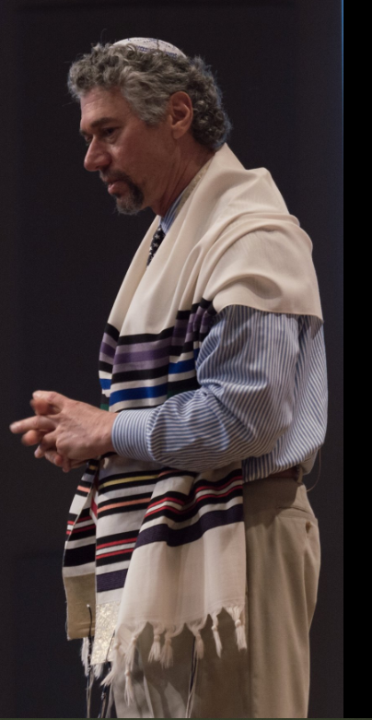
Rabbi Marty Waldman, Baruch HaShem Cong., Dallas, TX

Slide 68
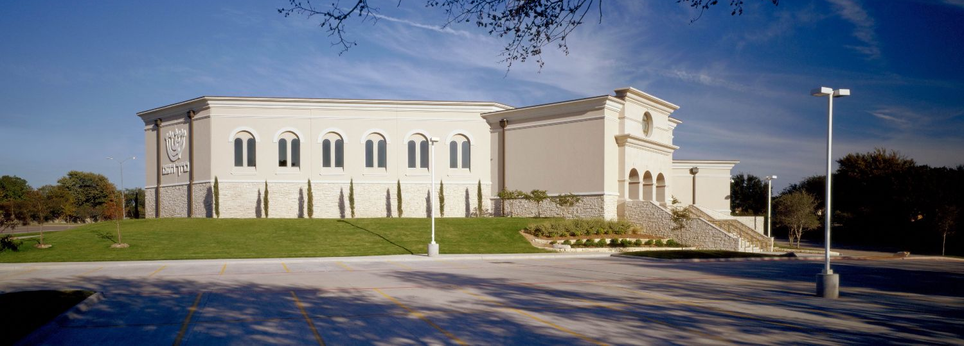
Baruch HaShem Messianic Cong., Dallas, TX

Slide 69
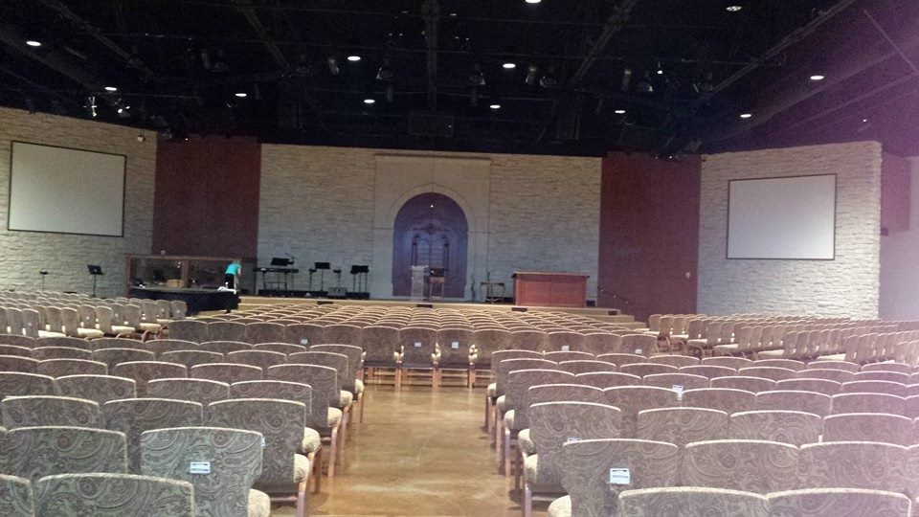
Baruch HaShem Messianic
Cong., Dallas, TX

Slide 70
In about 2005 Marty Waldman had the idea of calling a second Jerusalem council.

Slide 71
Whereas the first Council was made up of Jewish believers in Yeshua who decided not to impose on the Gentiles the requirements of the Jewish law,
Notes:
https://www.peterhocken.org/en/tjcii

Slide 72
so the second Council would be made up of Gentile church leaders, who would recognize and welcome the Jewish believers in Yeshua without requiring them to abandon their Jewish identity and practice.
Notes:
https://www.peterhocken.org/en/tjcii

Slide 73

Notes:
https://www.tjcii.org

Slide 74
TJCII is led by an International Leadership Council (ILC) of fourteen leaders, seven Jewish and seven Gentile leaders, who are broadly representative of the different international movements and churches, historic and modern that confess Yeshua as Lord and Savior.
Notes:
https://www.tjcii.org

Slide 75
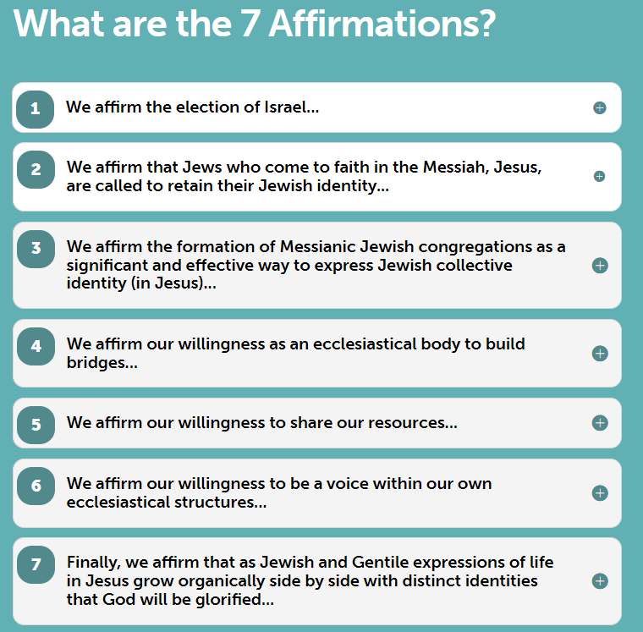
Notes:
https://www.tjcii.org/7-affirmations/

Slide 76
Notes:
https://www.tjcii.org/7-affirmations/

Slide 77
Toward Jerus Council II
From Dan Juster: This month [Nov., 2024] I traveled to Vienna (Heinberg) for an important training meeting for...Toward Jerusalem Council II. This is our effort to see all Church bodies come into alignment
Notes:
http://www.tikkuninternational.org/rfz/nov24.htm

Slide 78
with Israel / the Jewish people and the Messianic Jewish Community. Our younger leaders came from Europe, Brazil, the United States, Japan, Korea, and Africa.
Notes:
http://www.tikkuninternational.org/rfz/nov24.htm

Slide 79
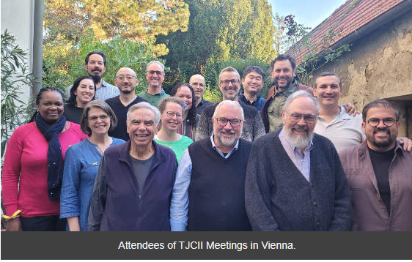
Notes:
https://www.tjcii.org
https://mysteriumchristi.org/

Slide 80

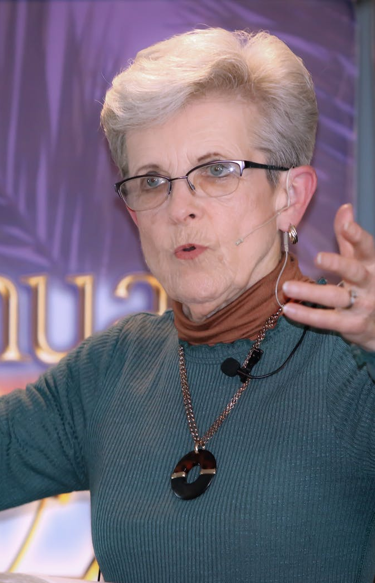
Marilyn Griffin, a
spiritual matriarch
in Kansas City.
Notes:
https://mnewlife.org/about

Slide 81
1987 started the City Wide Prayer movement.
Midwest Minister’s Fellowship
Renunciation of the dedication of Kansas City to Pallas Athena 9/29/1886 -- 9/29/2000
Notes:
I often attend a monthly prayer meeting which came out of this.

Slide 82
A new Kansas City tradition emerged on October 13, 1887 with the first Priests of Pallas parade. President Grover Cleveland and his new bride, Frances, were on hand to witness the spectacle that would begin after nightfall.
Notes:
https://kchistory.org/week-kansas-city-history/we-play-pallas

Slide 83
A crowd waited at the gates of the "Priests' Den," a warehouse where all of the horse-drawn floats were staged. As the doors swung open, fireworks lit the path of mounted and armored guards, the robed Priests of Pallas, and a float bearing the queen Athena, or rather, an elaborately-costumed performer.
Notes:
https://kchistory.org/week-kansas-city-history/we-play-pallas
Marilyn led a city wide renunciation of this dedication of KC to the Greek god Pallas.
Marilyn’s greatest insight…

Slide 84
^{Rev 2.1- 5} To the angel of Messiah’s community in Ephesus write: “Thus says the One who holds the seven stars in His right hand, the One who walks in the midst of the seven golden menorot: I know all about your deeds and your toil and your patient endurance, and that you cannot bear those who are evil…You have not grown weary.

Slide 85
^{Rev 2.1- 5} “But this I have against you, that you have forsaken your first love. Remember then from where you have fallen. Repent and do the deeds you did at first. If not, I will come to you and remove your menorah from its place—unless you repent.
Notes:
f

Slide 86
First love?
Not truth of scripture.
Not deity of Messiah.
Not longsuffering: martyrs then
??
Love of Torah mitzvot!!

Slide 87
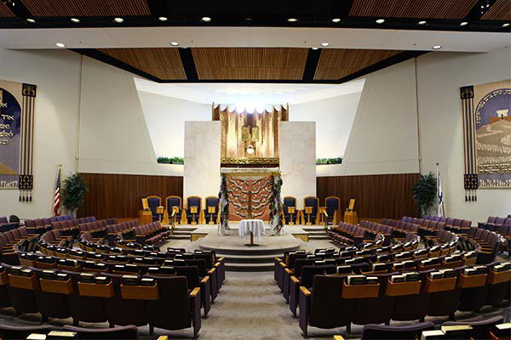
Kehilath Israel Synagogue
Notes:
https://external-content.duckduckgo.com/iu/?u=https%3A%2F%2Fkisyn.org%2Fsites%2Fdefault%2Ffiles%2Fstyles%2Fmikvah_slideshow__600x400_%2Fpublic%2FWWA_HistoryofKI_Slideshow_ALL-16.png%3Fitok%3DEe5NivCo&f=1&nofb=1

Slide 88
2008, May 13 Marilyn orchestrated a public repentance service at Kehilath Israel Synagogue.
  The mayor of Leawood apologized to the Jewish community for deed restrictions barring Jews.

Slide 89
  The president of the St. Lukes Hospital System apologized for a hiring prohibition of Jewish doctors at St. Lukes.

Slide 91
Jews and Gentiles:
is there a Torah Difference?
Uncertainty in scripture
Certainty and power for Jews
Certainty and effect for Gentiles.
My vision for Or HaOlam

Slide 92
That is, when a Jew comes to Messiah, and lives Jewishly, in Torah, community, there is a cosmic multiplying effect.

Slide 93
My vision of what Or HaOlam should communicate to Jews and the Nations [since 1969]

Slide 94
^{Yeshayahu/Is 6 1-3} In the year of King Uzziah’s death, I saw Adoni sitting on a throne, high and lifted up, and the train of His robe filled the Temple. Seraphim were standing above Him.

Slide 95
^{Yeshayahu/Is 6 1-3} Each had six wings: with two he covered his face and with two he covered his feet, and with two he flew. One called out to another, and said: “Holy, holy, holy, is Adoni -Tzva’ot! The whole earth is full of His glory.”
Notes:
^{Yn 12.41} Yesha‘yahu / Is said these things because he saw the Sh’khinah of Yeshua and spoke about him.)

Slide 96
^{Yeshayahu/Is 60.1} Arise, shine [Yerushalayim], for your light has come, the glory of Adoni has risen over you.

Slide 97
Jews and Gentile walking in harmony and love in forgiveness through the atoning Blood, working out Torah obedience in the joyful, supernatural power of the Ruakh/Spirit.

Slide 98
That is, when a Jew comes to Messiah, and lives Jewishly, in Torah, community, there is a cosmic multiplying effect.
When a Gentile is saved and keeps Torah, they have great blessings, but no such multiplier.

Slide 99
Do you KNOW Yeshua and the assurance of sins forgiven?
Are you hearing daily from His Word?
How are you applying what you heard?
Are you asking this of another?
Notes:
Who are you discipling, building up?4

Slide 100
Off camera:
Notes:
About to open Zoom room for hour of prayer.

Slide 101
We are hosting a Bring n Share Thanksgiving dinner for Or HaOlamniks who have no family available to be with that day. Singles, empty nesters, families with no extended family. It's not an invitation to the whole city, but so that none of our people should be alone that day.

Slide 102
Prayer points:
Israeli wars external and now internal: seeing G-d’s hand!
Transition and implementation of new administration’s policies.
Revival is individuals, Reformation is the culture.

Slide 103
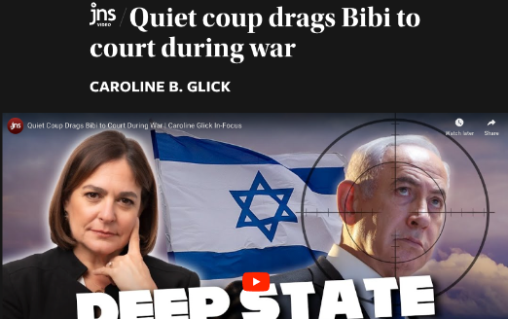
Notes:
https://www.jns.org/quiet-coup-drags-bibi-to-court-during-war/

Slide 104
(Worthy Insights) – Establishment powers in Israel have decided to join the seven-front war against the Jewish state by targeting Prime Minister Benjamin Netanyahu.
Notes:
https://www.jns.org/quiet-coup-drags-bibi-to-court-during-war/

Slide 105
In addition to managing the war, the premier will be held in court for seven hours a day in a courthouse unprotected from rocket fire and drone attacks.
Notes:
https://www.jns.org/quiet-coup-drags-bibi-to-court-during-war/

Slide 106
Sounds crazy? It is. Worst of all, the deep state is attacking Netanyahu and the right-wing government on other fronts as well
Notes:
https://www.jns.org/quiet-coup-drags-bibi-to-court-during-war/

Slide 107
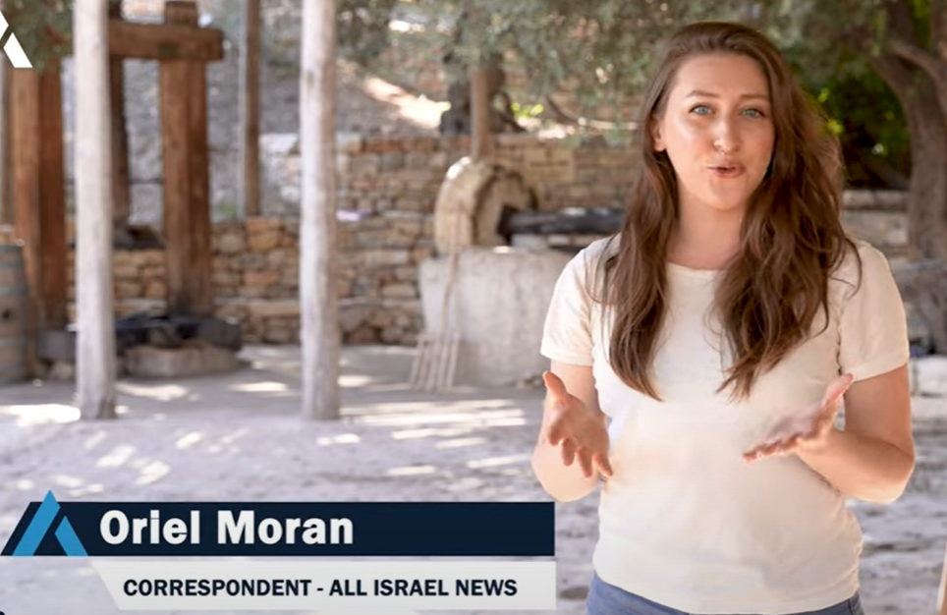


Slide 108
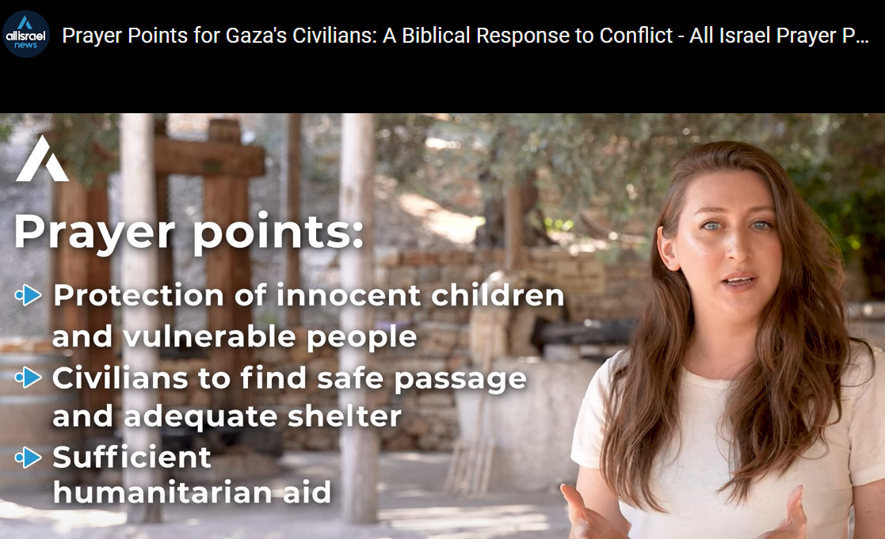
Notes:
https://allisrael.com/videos/prayer-points-for-gaza-s-civilians-a-biblical-response-to-conflict-all-israel-prayer-points?utm_source=convertkit&utm_medium=email&utm_campaign=IDF%20troops%20push%20deeper%20into%20Lebanon%20as%20US%20sends%20ceasefire%20proposal%20to%20Hezbollah%20%20-%2015653437

Slide 109

Notes:
https://allisrael.com/videos/prayer-points-for-gaza-s-civilians-a-biblical-response-to-conflict-all-israel-prayer-points?utm_source=convertkit&utm_medium=email&utm_campaign=IDF%20troops%20push%20deeper%20into%20Lebanon%20as%20US%20sends%20ceasefire%20proposal%20to%20Hezbollah%20%20-%2015653437

Slide 110
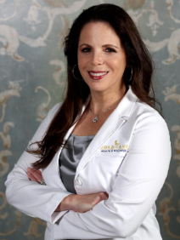
Dr. Simone Gold, MD, JD, an emergency physician and attorney, is the visionary who led the pivotal press conference event that broke the spell of the coronavirus panic in 2020.
Notes:
https://www.thegoldreport.com/news/pentagon-holding-secret-meetings-to-discuss-going-rogue-under-trump

Slide 111
Pentagon holding secret meetings to discuss going rogue under Trump?
Notes:
https://www.thegoldreport.com/news/pentagon-holding-secret-meetings-to-discuss-going-rogue-under-trump

Slide 112

Dr. Simone Gold
Notes:
https://www.thegoldreport.com/news/pentagon-holding-secret-meetings-to-discuss-going-rogue-under-trump
Dr. Simone Gold, MD, JD, an emergency physician and attorney, is the visionary who led the pivotal press conference event that broke the spell of the coronavirus panic in 2020.

Slide 113
Senior officials at the Department of Defense (DoD) have been holding secret meetings to discuss how to thwart President-Elect Donald Trump’s orders, according to a CNN report last week.
Notes:
https://www.thegoldreport.com/news/pentagon-holding-secret-meetings-to-discuss-going-rogue-under-trump

Slide 114
Pentagon leadership are war-gaming a scenario in which Trump orders the military to assist in the mass deportations of millions of illegal immigrants who flooded in under the Biden-Harris administration.
Notes:
https://www.thegoldreport.com/news/pentagon-holding-secret-meetings-to-discuss-going-rogue-under-trump

Slide 115
They are also preparing a response if Trump fires large swathes of federal employees, which he likely will. The incoming president is designing a major overhaul of the federal government and recently announced plans to dismantle the Department of Education.
Notes:
https://www.thegoldreport.com/news/pentagon-holding-secret-meetings-to-discuss-going-rogue-under-trump

